Slide 1
The ‘Bad’ Anthropocene
Anthropocene as dystopia
Humans are an overshoot species, our numbers exceed the Earth’s carrying capacity
There are planetary tipping points that once exceeded cannot return to the conditions of the past.
Technology is also suspect

Slide 2
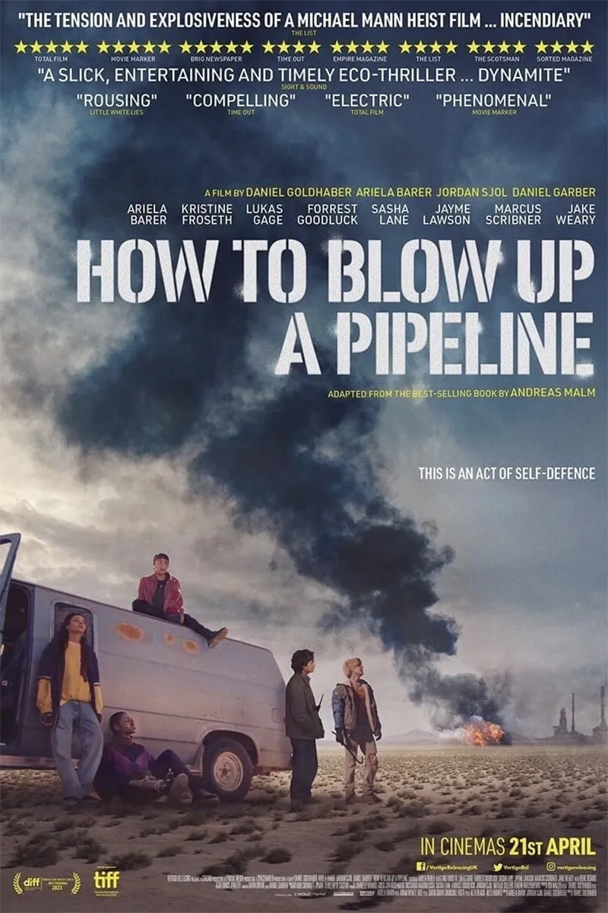
Is the Anthropocene bad? Is it good? Both?
How you think about the Anthropocene shapes what kinds of policies should be prioritized
But how do you come to think what you think about the Anthropocene and environmental issues?
You do so through discourses.

Slide 3
What are discourses?
They are the knowledge claims and positions on issues we have as a result of the kinds of evidence we encounter, the experiences we have, and the stories we tell or are told
Discourses affect our views on all things; it is not possible to avoid discourse.
What we know about recycling, electric vehicles, local food, and other environmental issues are discourses – our ideas about them are social constructed and contextual

Slide 4
Notes:
Example: Santa Claus is a discourse. This discourse consists of all the stories, television shows, images, songs, traditions that keep certain conceptions of Santa as actually existing from a child’s point of view
However, discourse shape not just views on fictitious things like Santa Claus. Even very real things have discourses around them.

Slide 5
Notes:
Manufacturers can print the logo on just about any product. That’s because its main purpose isn’t to say whether it’s recyclable, but to identify the type of plastic it’s made from.

Slide 6
Notes:
https://www.nytimes.com/2019/12/09/opinion/recycling-myths.html

Slide 7
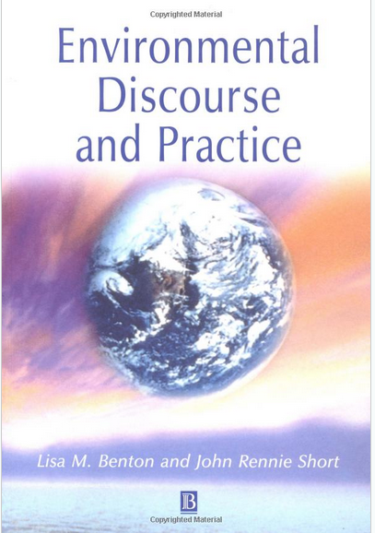
Discourse analysis
Investigates how meaning and knowledge claims are created
Certain discourses get promoted over others, often as a result of who has the power or means to do so
Discourses can be mobilized as a form of persuasion or even propaganda
Understanding discourses is key to being able to look at environmental issues critically
Notes:
Address the discourse, not the person holding an opinion. Discourse analysis illuminates how people hold opinions. Discourse analysis help us work around situations where environmental issues boil down to opposing sides shouting their opinions to each other without deeper understanding of how those opinions came to be. Throughout this semester we look at environmental discourses and we perform discourse analysis – we look at the different knowledge claims about global environmental issues and how to address them

Slide 8
Environmentalist discourse: Local food is always more carbon efficient.
Analysis: Most carbon emissions involving food don’t come from transportation — they come from production
Raising cattle and sheep causes warming that is an order of magnitude more than that from raising fish and chicken
Advanced greenhouse technologies can yield large harvests that are far more carbon neutral and inexpensive even when transported and sold at a distance.
Notes:
https://www.nytimes.com/interactive/2015/12/03/upshot/what-you-can-do-about-climate-change.html https://pubs.acs.org/doi/full/10.1021/es702969f
A typical household that replaces 30% of its calories from red meat and dairy with a combination of chicken, fish and eggs will save more carbon than a household that ate entirely local food for a full year.
Red meat and dairy in cattle result in large amounts of methane production? But can they engineer a cow not to make methane?

Slide 9
The ‘Bad’ Anthropocene

Slide 10
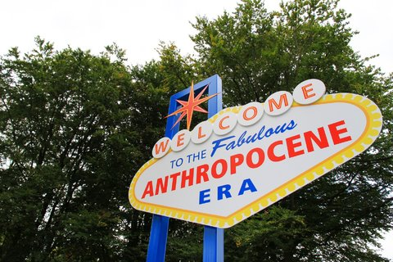
The ‘Good’ Anthropocene
Notes:
Science is going to help us live better. Humans a benevolent caretaker, replanting and restoring the Earth. We’ve been successful thus far, with science we are becoming smart enough to effect change and manage our impacts. More people, but more people to address problems that arise. More people more brains to solve problems

Slide 11
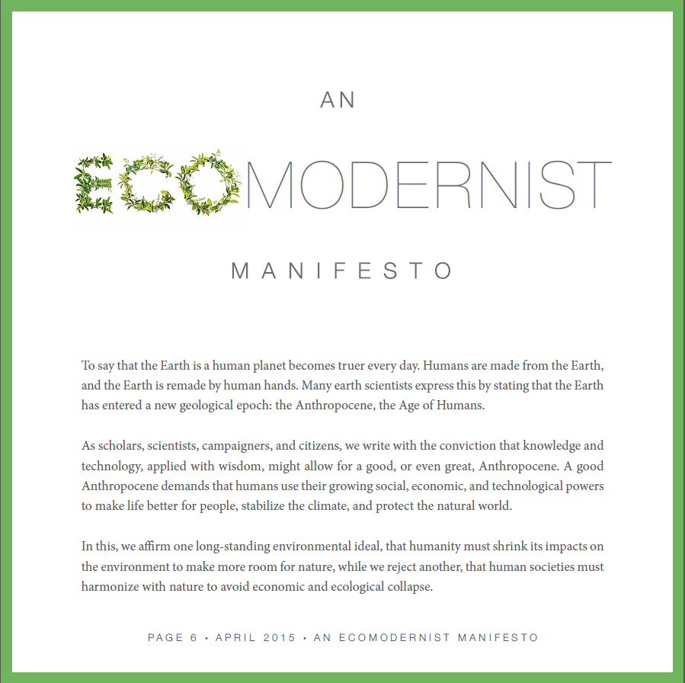
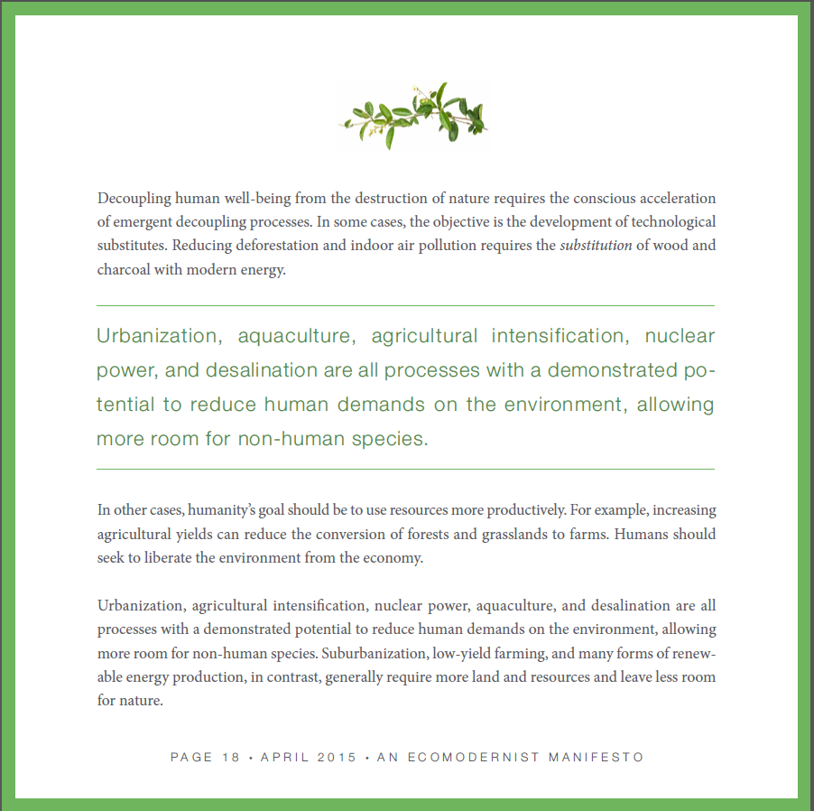
The position of ecomodernists: the Anthropocene is ‘good’
Notes:
Pro-technology

Slide 12
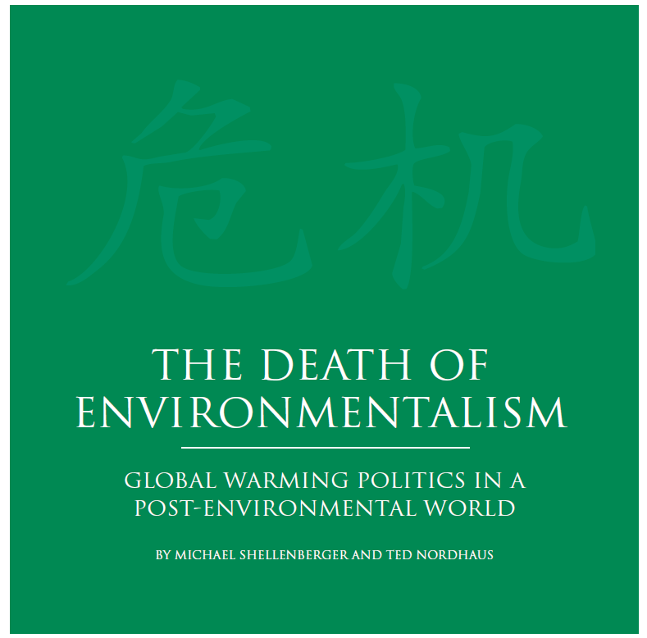
Ecomodernists proclaim that environmentalism is dead
For ecomodernists, the choice that humanity faces is not whether to constrain our growth and development or die.
It is whether we will continue to innovate and accelerate technological progress in order to solve our environmental problems and thrive.
Protecting the environment through traditional conservation practices has not been successful in their opinion.
Notes:
To an older generation of environmentalists, ecomodernist perspective seem antithetical to everything environmentalism stands for.
http://www.ecomodernism.org/ https://thebreakthrough.org/issues/energy/the-long-death-of-environmentalism

Slide 13
Notes:
Ecomodernist or environmentalist? https://www.youtube.com/watch/4c5RPk8FlIk

Slide 14
History of the ecomodernist – environmentalist tension
The Population Bomb (1968) exemplified an environmentalist discourse, one that takes a Malthusian view of human population
Malthus (1798) popularized the idea that the human population of Earth will eventually exceed its carrying capacity
Without radical measures to slow the human use of Earth’s resources, population collapse is inevitable
Notes:
Paul Ehrlich (1968) in The Population Bomb carried forward statement made by many others over decades that the human population, through affluence (which translates into consumption) and facilitated by technology, is damaging the natural bases of life on Earth.

Slide 15
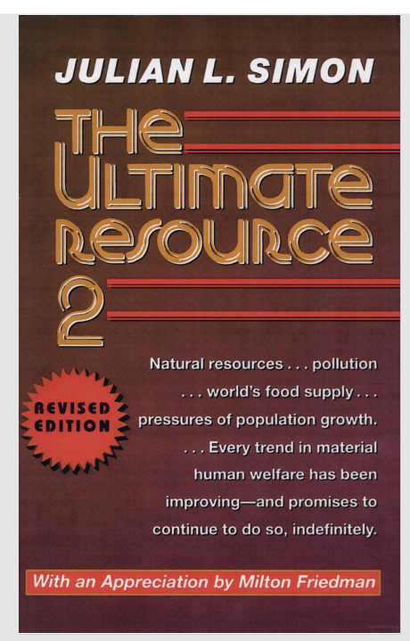
Julian Simon and the Cornucopians (1970-1980s) exemplifies an ecomodernist discourse
More people = more brains to solve environmental problems
Technology will solve problems of resource scarcity and overpopulation while still promoting affluence
Julian Simon predicted 7 billion years of economic growth, interrupted only by the extinction of the sun
Notes:
Julian Simon, a cornucopian “doomslayer” and a contemporary of Ehrlich’s “There is no physical or economic reason why human resourcefulness and enterprise cannot forever continue to respond to impending shortages… and leave us with the bonus of lower costs and less scarcity in the long run. The bonus applies to such desirable resources as better health, more wilderness, cheaper energy, and a cleaner environment.” Elon Musk could be thought of a modern-day equivalent of Julian Simon

Slide 16
Notes:
This is the period table of elements, for example, H is hydrogen, Al is aluminum.

Slide 17
The Simon–Ehrlich bet
Simon had Ehrlich choose five commodity metals: copper, chromium, nickel, tin, and tungsten.
Simon bet that their prices would decrease, while Ehrlich bet they would increase because of overuse and scarcity.
Ehrlich lost the bet; all five commodities declined in price from 1980 through 1990, the wager period: the ecomodernist discourse prevailed
Technological innovation and trade prevented scarcity of these metals
Notes:
This does not mean that Malthusian outcomes are impossible, but neither are they inevitable.

Slide 18
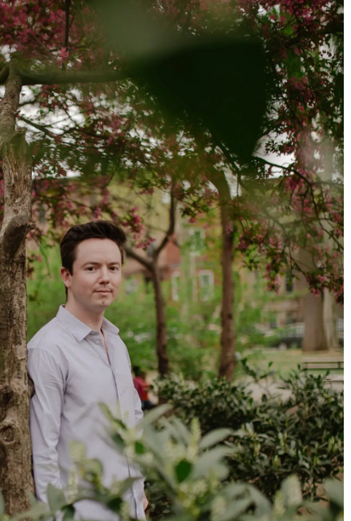
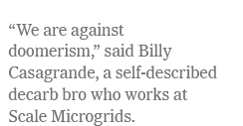
Notes:
Decarb bros - ecomodernist https://www.nytimes.com/2023/04/22/business/decarb-bros-climate-change.html

Slide 19
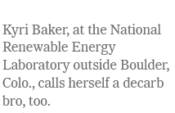

Slide 20
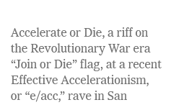
Effective Accelerationism (e/acc)
Notes:
e/acc is a loosely organized movement devoted to the no-holds-barred pursuit of technological progress, especially AI
Ecomodernist

Slide 21
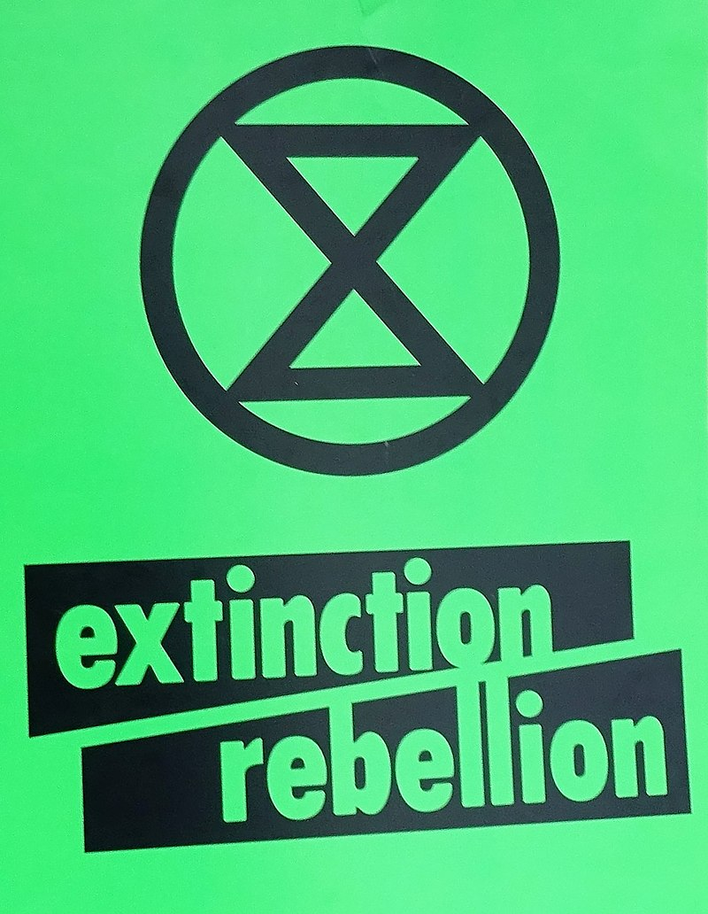
Extinction Rebellion
Notes:
https://rebellion.global/ https://www.youtube.com/watch/9ooe_XqDicA Non-violent organization promoting an environmentalist discourse

Slide 22
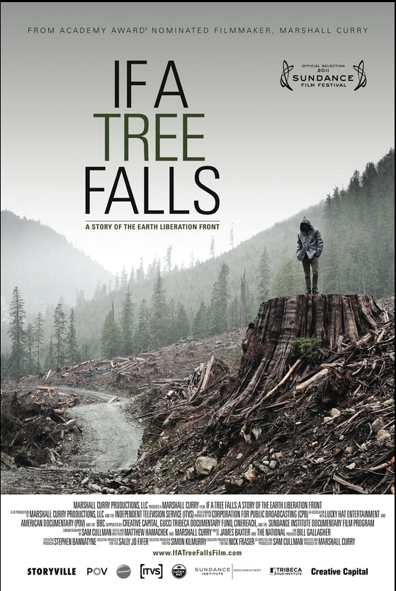
Earth Liberation Front (ELF) and other ecological guerilla groups
Notes:
Environmentalist discourses underlie the growing number of eco-terrorist activities. While the ELF is no longer as active, other groups have arisen in its place, such as this one in France. These groups do not adhere to non-violent protest
https://dgrnewsservice.org/resistance/direct-action/property-destruction/resistance-profile-earth-liberation-front/https://www.nytimes.com/2022/05/26/magazine/earth-liberation-front-joseph-mahmoud-dibee.html
https://newrepublic.com/article/171560/how-to-blow-up-a-pipeline-young-activists

Slide 23
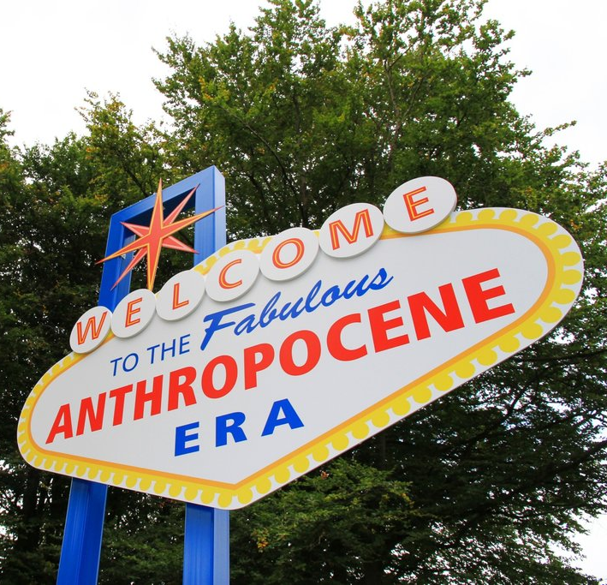
Tempering the ecomodernist zeal: control theory
Affirming belief in scientific progress reduces environmentally friendly behavior
Portraying science as rapidly progressing may reduce environmentally friendly behavior
Communication that questions scientific progress may lead to increases in environmentally friendly behavior.
Notes:
Meijers, M. H., & Rutjens, B. T. (2014). Affirming belief in scientific progress reduces environmentally friendly behaviour. European Journal of Social Psychology, 44(5), 487-495. These findings show that when the aim is to promote environmentally friendly attitudes and behavior, it helps to not overstate scientific progress.

Slide 24
Tempering the ecomodernist zeal: EROI
Human technology and ingenuity have repeatedly confounded Malthusian predictions
The question is: will technology continue to outpace environmental constraints and prevent collapse of the human population and globalized economy?
A useful policy tool is the notion of energy return on investment (EROI)
EROI proposes that a green technology cannot be more energy intensive or polluting to make than what it was intended to replace.
Notes:
A more recent (2018) model of how technological innovation shapes future scenarios of sustainability https://thebreakthrough.org/issues/energy/the-long-death-of-environmentalism

Slide 25
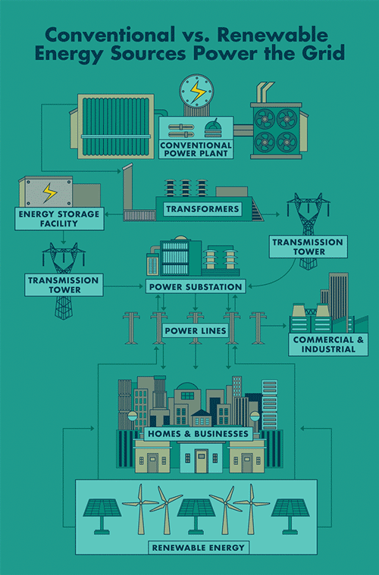
An ecomodernist discourse: Buying an EV is the best way to slow down climate change.
Analysis: It can be a good way to lessen climate change only if you consider the EROI
If EVs draw from power grid with more renewable power plants and less coal-fired power generation, they become much greener than conventional cars.
Notes:
How they are charged – from electricity produced by coal or natural gas or by renewables determines how ‘green’ they are
Most countries are now pushing to clean up their electric grids. In the United States, utilities have retired hundreds of coal plants over the last decade and shifted to a mix of lower-emissions natural gas, wind and solar power.
Even though electric vehicles are more emissions-intensive to make because of batteries, their electric motors are more efficient than traditional internal combustion engines that burn fossil fuels.
https://www.nytimes.com/2021/03/02/climate/electric-vehicles-environment.html
https://www.theguardian.com/business/2023/dec/23/do-electric-cars-really-produce-fewer-carbon-emissions-than-petrol-or-diesel-vehicles
https://www.nytimes.com/interactive/2021/01/15/climate/electric-car-cost.html

Slide 26
Notes:
https://www.theguardian.com/business/2023/dec/23/do-electric-cars-really-produce-fewer-carbon-emissions-than-petrol-or-diesel-vehicles

Slide 27
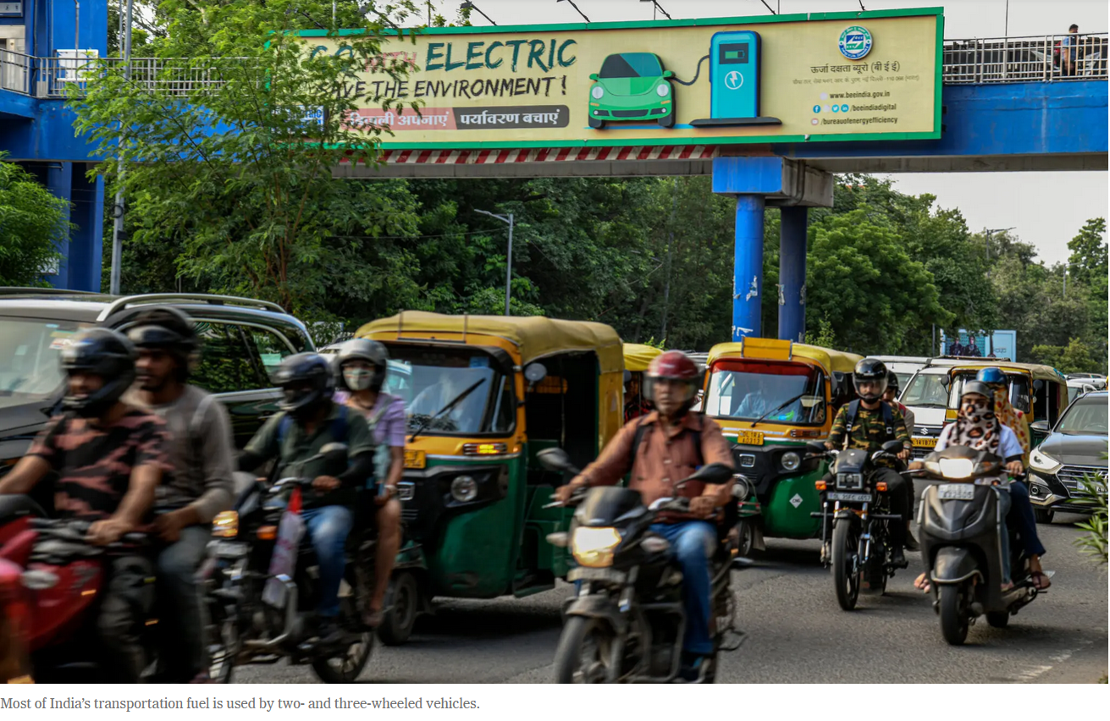
EROI can be substantial depending upon what type of EV vehicle under consideration.
Small, three and two wheeled EV transportation offer a far more greener alternative than the traditional four-wheeled family car.
Notes:
https://www.nytimes.com/2022/09/04/business/energy-environment/india-electric-vehicles-moped-rickshaw.html Countries like India, where if everyone bought a US-sized automobile, the impacts on climate (and air pollution) would be immensely negative. Small, EV vehicles there could have a much greater impact on global climate change in a country like India, with these types of vehicles, than in the US

Slide 28
EROI can also depend on who drives EV vehicles.
Do you drive on average 110 miles per day? Then you are a super driver
The extent to which EVs will have an impact will also involve, at least here in the US, who buys them.
If you drive a lot, then the gains to be made in reduced emissions will be greater if you buy an EV, more so than someone who drives far less
Many of America’s biggest drivers are tradespeople and low- or middle-income Americans who have been pushed out of cities by rising housing prices and face long commutes.
Notes:
https://www.nytimes.com/2024/01/17/climate/electric-vehicles-high-mileage-drivers.html While the average American driver travels about 13,400 miles per year, people who buy electric vehicles today tend to drive them less than that, limiting the climate benefits of switching to a cleaner car. Super drivers are more likely to live in rural areas and small towns,

Slide 29
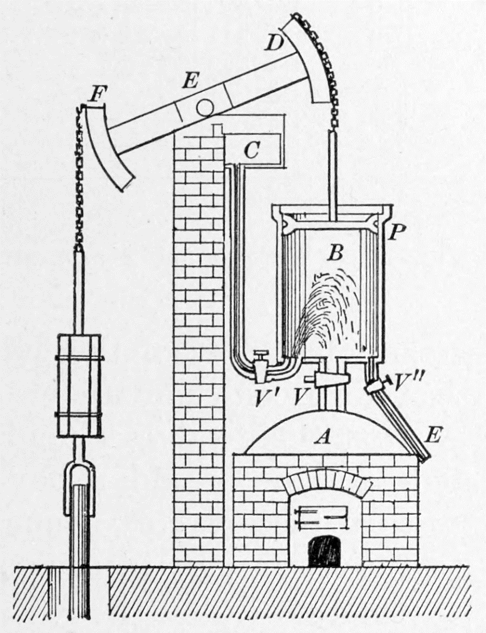
Tempering the ecomodernist zeal: Jevon’s Paradox
Jevon’s paradox suggests that there is not some final technological solution, but a continual set of problems that arrive and need solving
The Coal Question (1865) – William S Jevons.
Predicted that if coal-burning efficiency increased, less coal would be burned.
However, coal burning actually increased with improvement in the efficiency of steam engines:
Greater efficiency decreased cost of coal
This spurred expanded economic uses for steam and coal
More coal burned in response to economic expansion

Slide 30
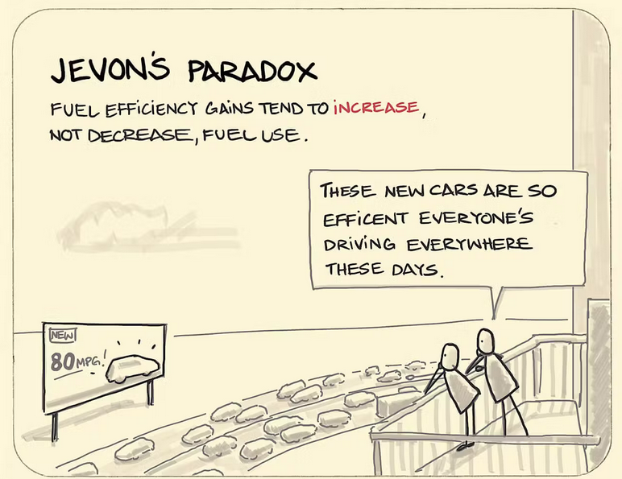
Jevon’s Paradox
Gains in efficiency do not always conserve resource use
However, efficiency is often a much easier policy to sell to the public
Technological solutions can have benefits but may result in outcomes that are undesired
Referred to as the ‘curse of efficiency’
Notes:
Congestion and slow travel times was the initial catalyst for the US Interstate system. However, this led to sprawl, dependency upon cars and gasoline, more cars and eventually the return of congestion. This in turn leads to more road building. Also, neighborhoods were demolished to make room for the interstates, destroying some of their livability
https://interactive.wttw.com/ten/modern-marvels/interstate-highway-system

Slide 31
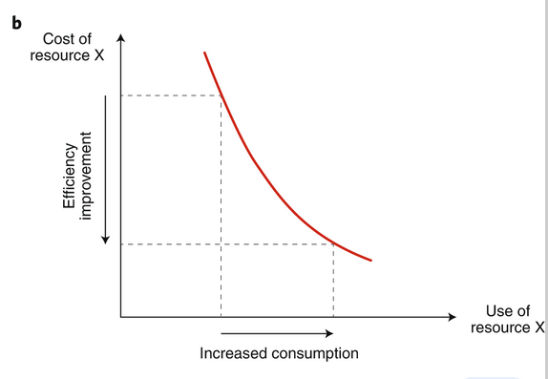
We are often encouraged to adopt a positive, uncritical, unsophisticated view of efficiency
If we just make things efficient we will reduce resource use, waste, and emissions, solve our problems, and pave the way for “green growth” and “sustainability”
Jevon’s Paradox argues that things are more complex and efficiency does not automatically result in conservation or savings

Slide 32
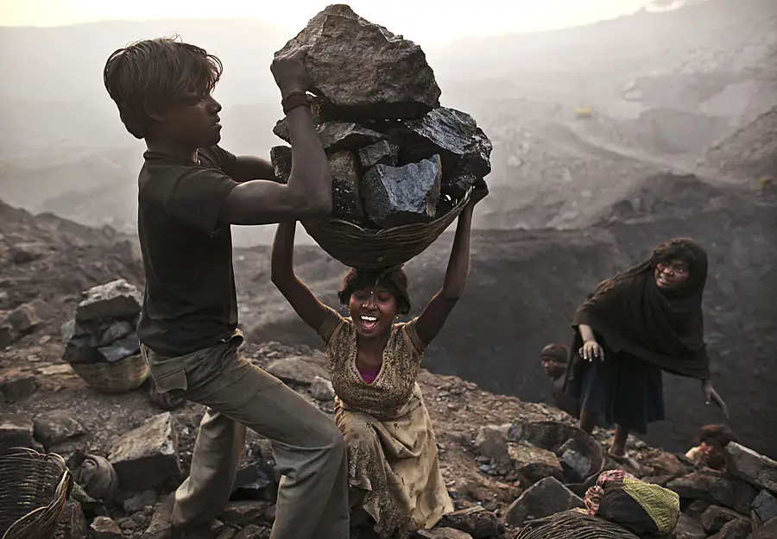
Environmentalist discourse: if we want to stop global warming and protect the environment we must ban fossil fuels.
Analysis: This may disproportionately affect communities that lack access to alternative energy sources.
A sudden shift away from fossil fuels could result in more forest clearing or illegal mining in some countries
Notes:
Without many of the fertilizers and pesticides used in agriculture – and most are derived directly and indirectly from fossil fuels – crop productivity would decline and more land would be needed to make up the difference.

Slide 33
Notes:
https://www.nature.com/articles/d41586-021-01020-z

Slide 34
Notes:
The bottleneck and breakthrough policy approach to the Anthropocene sees urbanization as part of a strategy to conserve nature.
The surprise is that although modern populations continue to expand, the rate of population growth has been falling since the 1960s There is broad agreement among that the world population, while continuing to grow in the interval, will stabilize around or shortly after 2100 around 8 to 10 billion

Slide 35
A bottleneck and breakthrough policy for the Anthropocene
This is a compromise between environmentalist and ecomodernist perspectives:
Urbanization, rural-to-urban migration, and technological innovation will provide ‘breakthrough’ solutions to Anthropocene problems.
If society focuses only on economic development and technological innovation as a mechanism to pass through the bottleneck as fast as possible, then what remains of nature could well be sacrificed.
If society were to focus only on limiting economic growth to protect nature, then terrible poverty and population growth could overwhelm what remains.
Either extreme risks narrowing the bottleneck and preventing the breakthrough
Notes:
Proposed ways we will have a good Anthropocene

