Slide 1
Engineering food
Encompasses foragers to modern global agricultural processes
Foraging comprised 95% of human history until these events initiated transitions
Neolithic Revolution
Columbian Exchange
Green Revolution
Notes:
Table shows food insecurity among developed nations

Slide 2
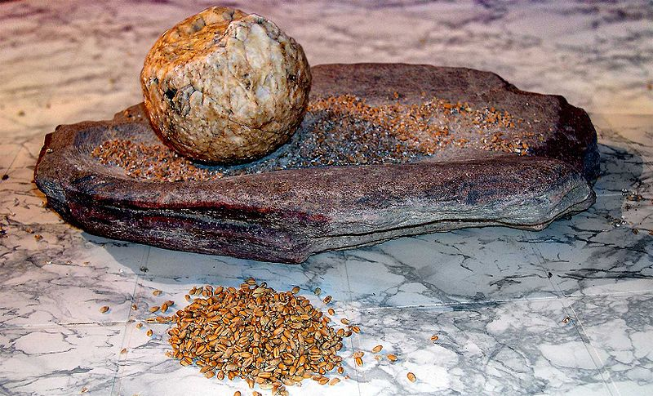
Neolithic Revolution (10,000 ya)
Domestication of plants
Emergence and diffusion of agriculture
Human population expansion
Reorganization of human-environment interactions and socio-cultural life
Notes:
Grindstone for processing grain used during the Neolithic Revolution.
This transition, which represents one of the most important cultural and technological revolutions in our history, affected many aspects of lifestyle (diet, technologies, social organization) and led to the sedentarization of many populations that is widely assumed by archeologists and paleoanthropologists to have driven recent human population expansion.

Slide 3
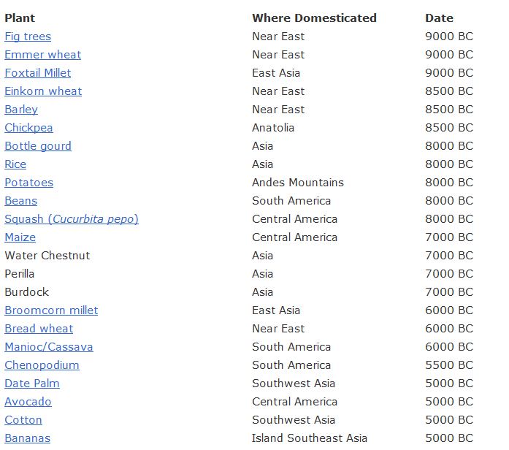
Notes:
Most domesticated plants and animals we use today were established in first few thousand years of plant domestication.

Slide 4
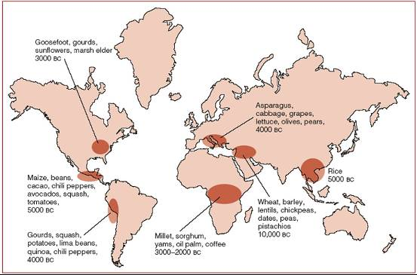
Notes:
The domestication of plants occurred in several locations around the world http://archaeobotanist.blogspot.com/2011/12/de-centering-fertile-crescent.html

Slide 5
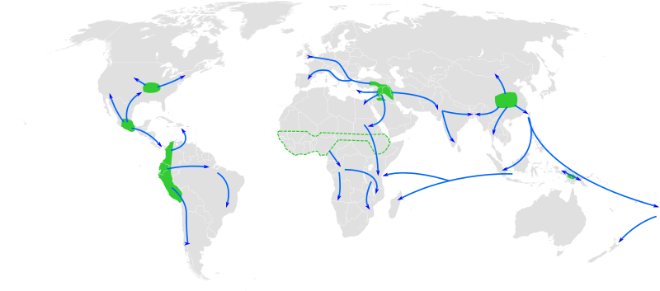
Decentering the Fertile Crescent
Agriculture did not begin in only the Fertile Crescent from which is spread around the world. There were multiple ‘hearths’ where crops domesticated and from which agricultural practices spread.
Many cultures experimenting simultaneously with agriculture
Notes:
http://archaeobotanist.blogspot.com/2011/12/de-centering-fertile-crescent.html Farming began approximately 10,000 years ago as the Neolithic Revolution in many locations (shown below)

Slide 6
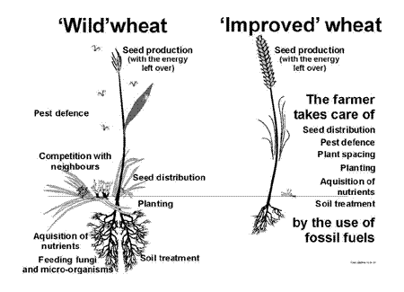
Notes:
Domestication is defined as when a plant becomes dependent upon humans for its occurrence. Without humans, the crop cannot continue to reproduce in the landscape

Slide 7
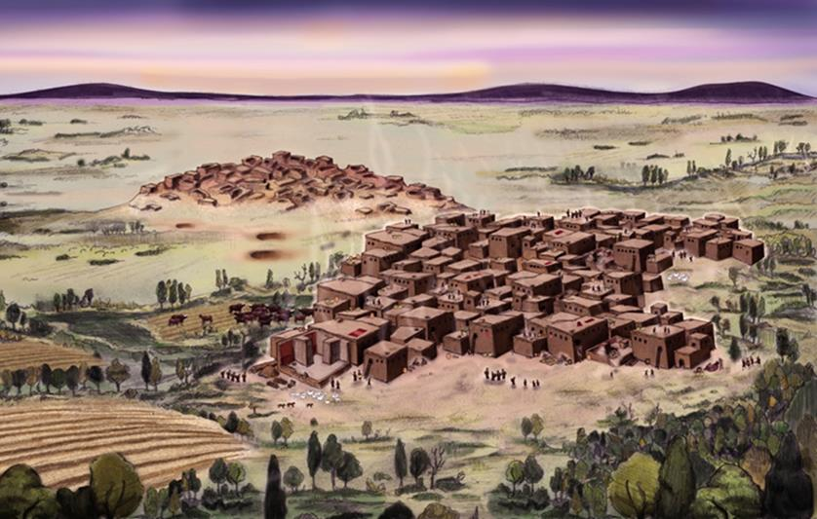
Notes:
Artist's reconstruction of the east and west mounds at Çatalhöyük. In the foreground, you can see the newer west mound, with the older east mound decaying in the background. https://arstechnica.com/science/2016/09/amazing-intact-statue-of-a-woman-unearthed-at-the-neolithic-city-of-catalhoyuk-in-turkey/ Çatalhöyük is the first known city in the world – the first place where surrounding villages came together and formed a central location and began the sort of urban civilization that dominates the modern world.

Slide 8
Early agriculture’s impact on humans
Some scholars have hypothesized that agriculture was worse for humans than foraging because:
More calories were available from agriculture but this required much more strenuous labor demands on human bodies
More people packed together in settlement increased the risk of diseases
Increased contact with domesticated animals, their fecal matter, and parasites also increased disease
Diets became more monotonous. narrowing of range of foods and nutrients
Harvests could vary because of weather, enhancing potential for famine
Variation in land quality and labor availability led to social inequities among groups of humans and conflict
Notes:
Milner, G. R. (2019). Early agriculture’s toll on human health. Proceedings of the National Academy of Sciences, 116(28), 13721-13723.
In 1960s, studies of societies that pursued foraging ways of life postulated they were not just staying one step ahead of starvation. They were considered the original affluent societies because of the plentiful food and leisure time. That was not the case with the domestication of agriculture and the changes that came with it.

Slide 9
These negative factors do not agree with the overall increase in human population following crop domestication.
How did population increase?
Health impacts varied from place to place – some cultures thrived better with agriculture than others.
Overall increase in human global population was slow
Agriculture brought division of labor in society. Agriculture was an impetus for planning, governance, and written language – factors that aided human success
Notes:
Milner, G. R. (2019). Early agriculture’s toll on human health. Proceedings of the National Academy of Sciences, 116(28), 13721-13723.

Slide 10
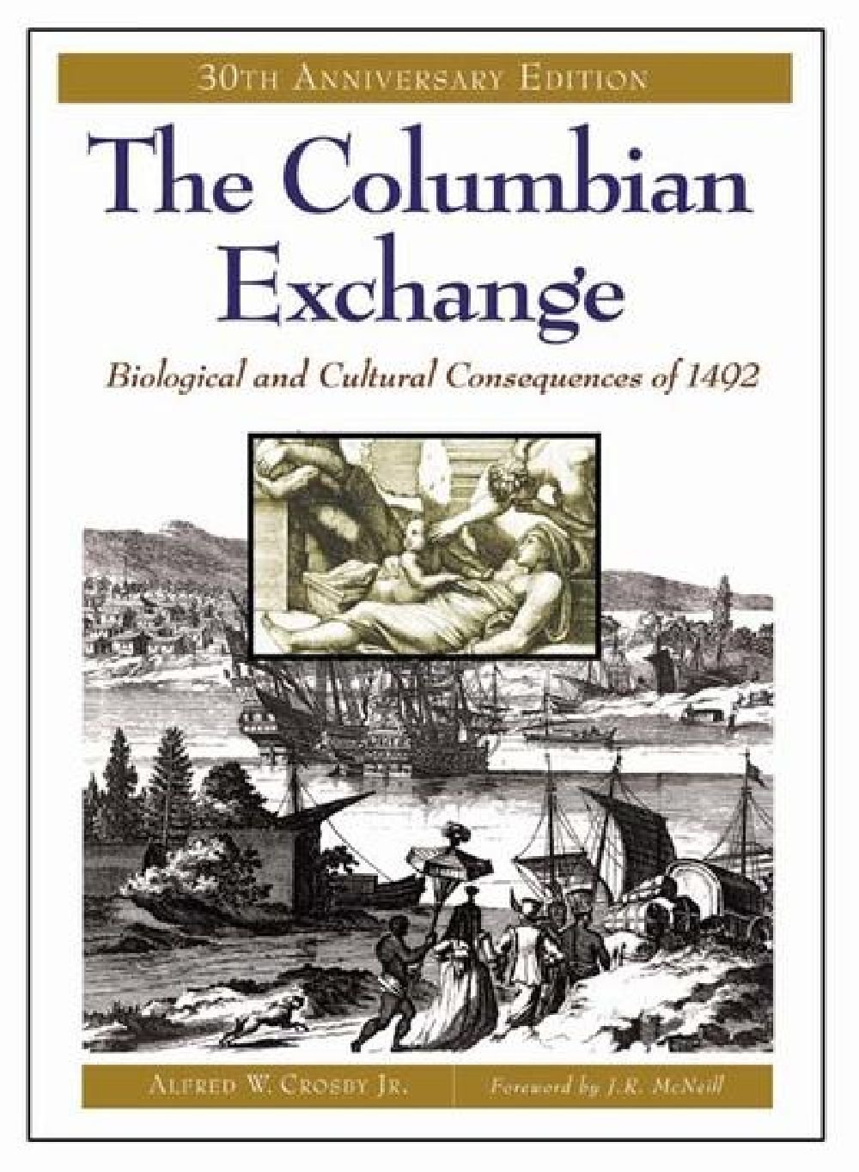
The Columbian Exchange
Occurred with global expansion of European power and colonization
Led to global diffusion of domesticated crops and animals.
Advantage: new types of foods spread around the world
Disadvantages: two-way exchange of disease-causing microbes, invasive species, and replacement of former foods with new ones

Slide 11
Notes:
Domestic pigs from Europe became feral in many parts of the world and led to decreases in plant diversity where their numbers have increased rapidly

Slide 12
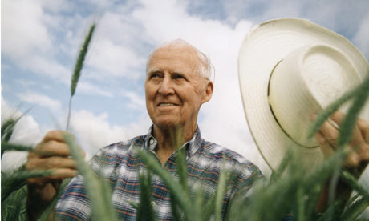
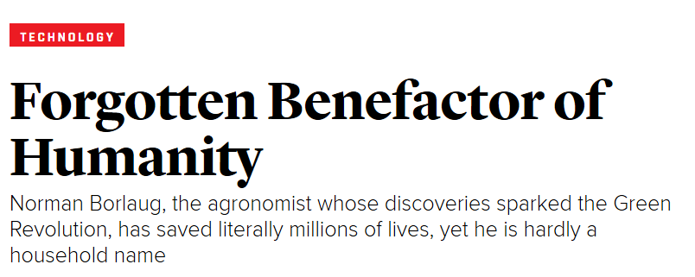
The Green Revolution
Norman Borlaug
In 1940s, plant geneticists began using traditional cross-breeding to create plants with desirable traits (semi-dwarfism, disease and pest resistance, tolerance to drought and increased planting densities)
Norman Borlaug bred new wheat varieties in response to famine in Mexico in 1940s but collective interest shifted to the need to bolster global food supply given the rapidly increasing global human population in 1950s and 1960s
Notes:
High yield varieties were bred at: The International Center for Wheat and Maize Improvement in Mexico and the International Rice Research Institute in the Philippines
Norman Borlaug developed wheat varieties that could better resist disease and gave higher yields. In doing so, he saved an estimated one billion people from starvation.

Slide 13
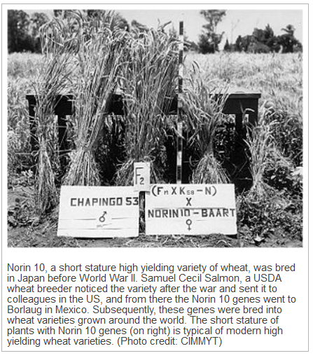
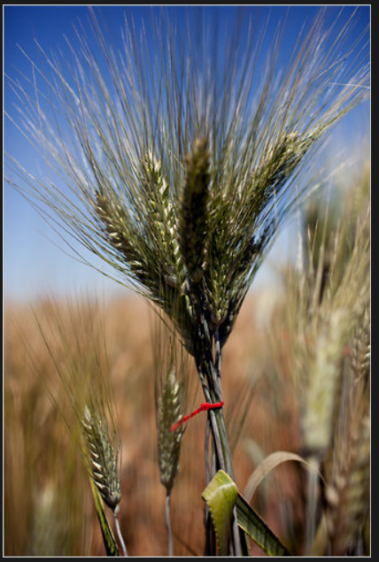
Notes:
Some of the initial plants for breeding a new type of wheat obtained from Japan after World War 2 Semi-dwarfism was one of the desired plant traits of these new Green Revolution crops. Semi-dwarfishm denotes a plant that has shorter thicker stem and fewer leaves which allowed more growth to be directed to seed (the part of wheat we eat). The shorter stem would stay upright even with heavier loads of seed
http://5e.plantphys.net/article.php?id=355
http://www.eoearth.org/view/article/153125/

Slide 14
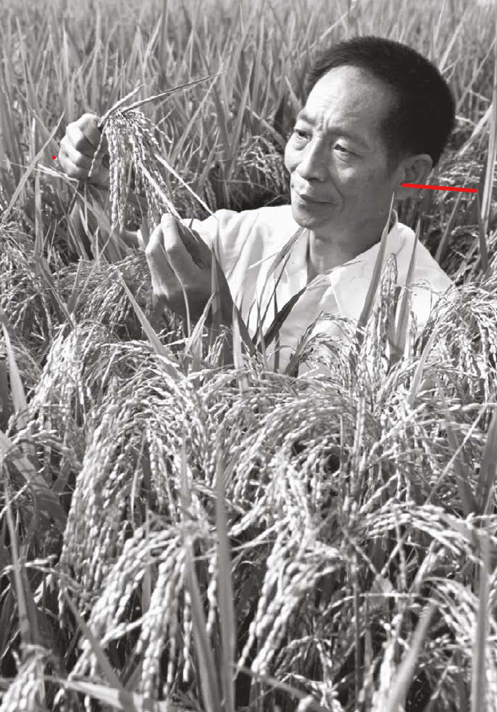
Green Revolution focused chiefly on improving wheat, corn, and rice yields
Yuan Longping did for rice what Norman Borlaug did for wheat
In 1999, it was estimated that the production increases brought about by hybrid rice developed by Longping fed an additional 100 million Chinese people each year
His greatest contribution was the discovery of male-sterile rice plants. Rice is self-pollinating. Rice with sterile male organs facilitated cross-breeding and production of hybrid rice seed with desired traits
Notes:
https://thericejournal.springeropen.com/articles/10.1186/s12284-021-00542-4 The work of Yuan Longping was far more difficult because of the way rice reproduces. Rice plants are self-pollinating. An individual rice plant has flowers with male and female parts and can fertilize itself. It does not outcross with other varieties. However, by discovering a male-sterile rice plant in the field, it could be crossed with the pollen from other rice varieties to combine desired rice plant traits and create hybrid seed.

Slide 15
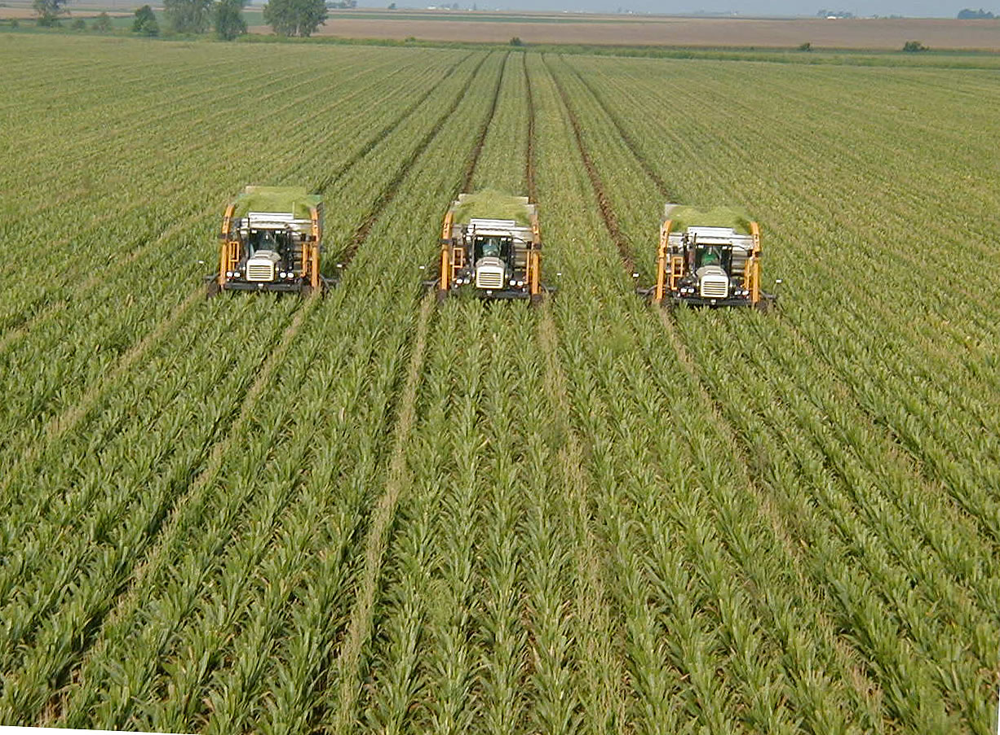
Successes of the first Green Revolution
More and cheaper rice, wheat, and corn thru greater planting densities and higher yields per field.
These new crop varieties tolerated stresses associated with increased planting density
Food shortages were averted and population growth continued its rapid climb

Slide 16
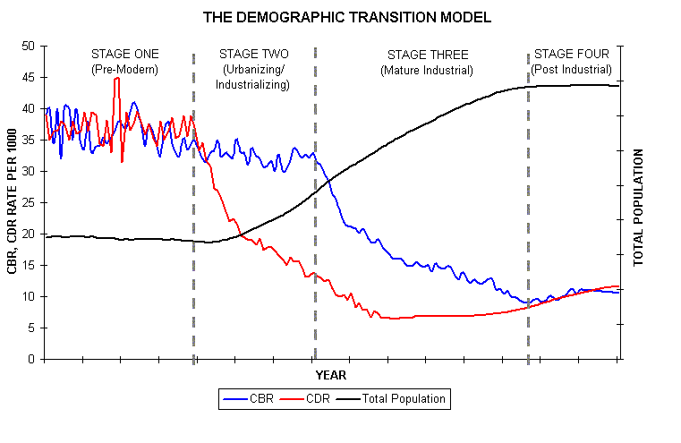

Slide 17
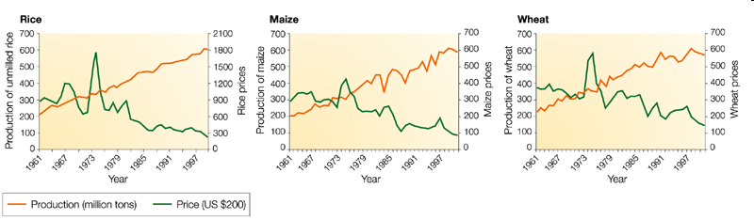
In the 1960's, 70's and 80's, crop yields soared in India, China and Latin America. One billion deaths from starvation averted
Lower food prices occurred globally
If food remained scarce in these countries, it was the result of politics and food distribution

Slide 19
Problems set in motion by the Green Revolution
Dependency upon fossil fuels: high yields were produced from high density crop monocultures requiring tractors, chemical inputs, fertilizer
Increased water and pesticide and herbicide use
Uneven development, food insecurity and dependency arising from global export-import markets
Displacement of small farmers and loss of livelihoods due to expansion of industrial agriculture
Changes in crop diversity and plant nutritional content
Rise of the standard American diet (high in meats and processed foods)

Slide 20
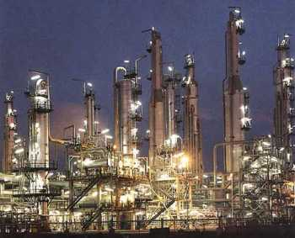
Greater dependency on fossil fuels for:
Fertilizer production requires fossil fuels as part of the Haber process of synthesizing fertilizer
Pesticides and herbicides are also made from petroleum products
Operation of tractors and farm equipment requires fuel, as well as their assembly and delivery
Notes:
Haber process of fertilizer production requires fossil fuel

Slide 21
Food costs tied to the cost of oil
Notes:
Price of food tied to price of fuel

Slide 22
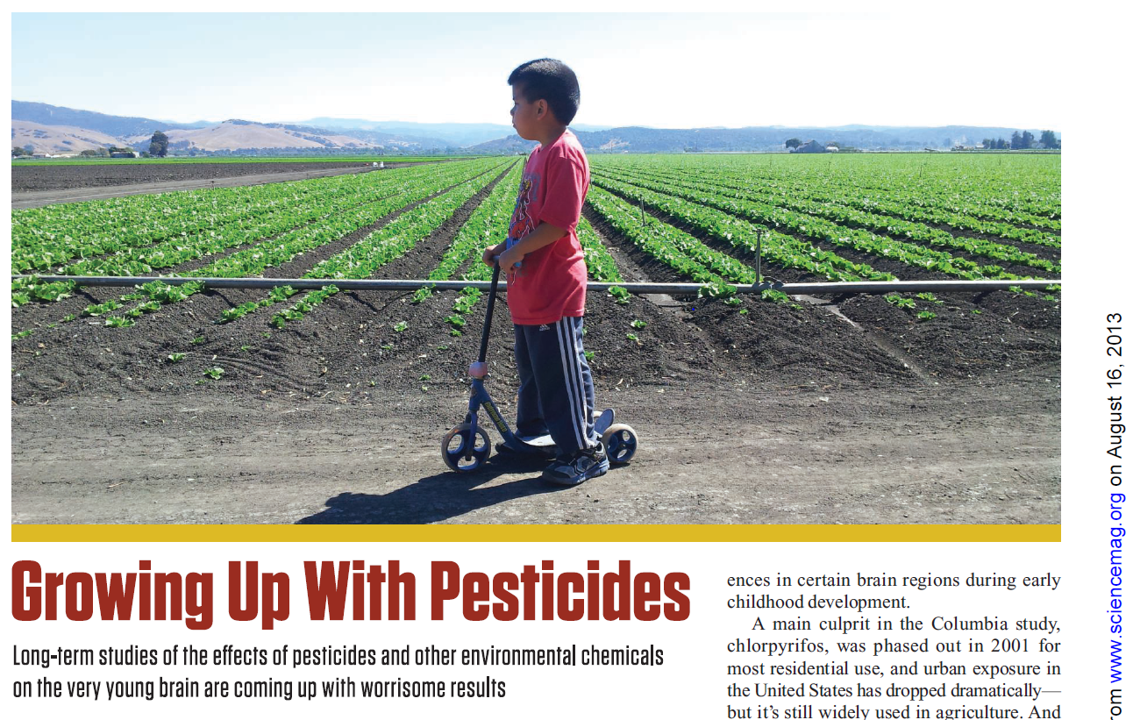
Increased pesticide use began after the Green Revolution
Notes:
Density of plants increased during Green Revolution

Slide 23
Increased water use with the Green Revolution
Notes:
For irrigation water supplies. The unsustainable use of groundwater resources in all three aquifer systems intensified from 2000 to 2008

Slide 24
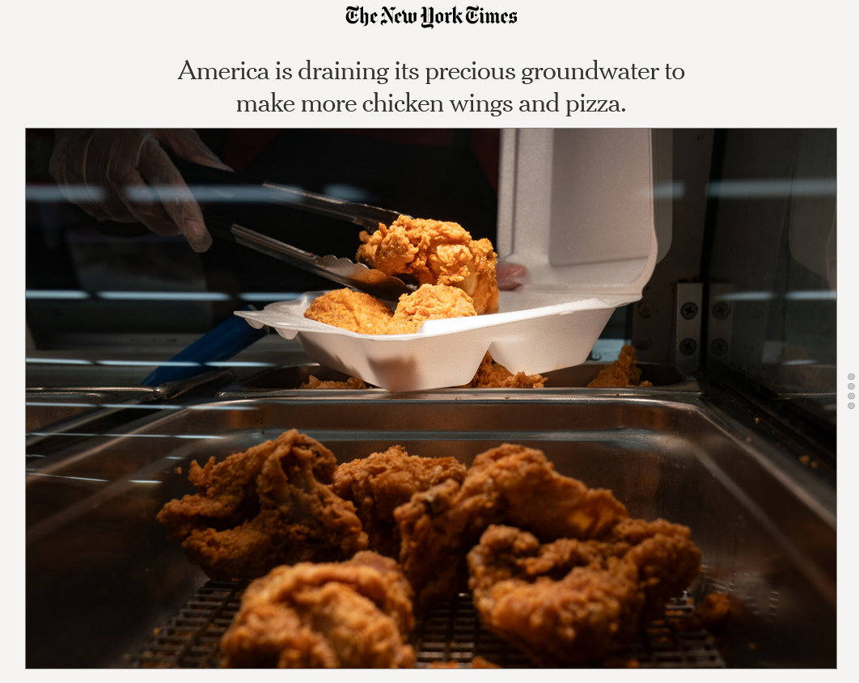
Notes:
https://www.nytimes.com/interactive/2023/12/24/climate/groundwater-crisis-chicken-cheese.html

Slide 25
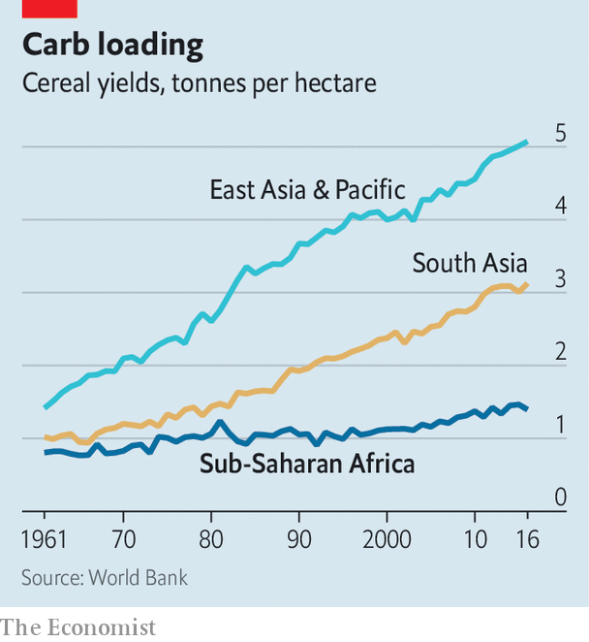
The Green Revolution in Africa
Didn’t happen because
Wide range of crops grown across Africa – wheat and corn were not staples
Lack of experimental crop programs and development of laboratory-refined seeds and plants to initiate breeding programs.
Political instability due to independence movements in African countries
Notes:
Asking African farmers to invest in Green Revolution meant asking them to invest in unsuitable plants

Slide 26
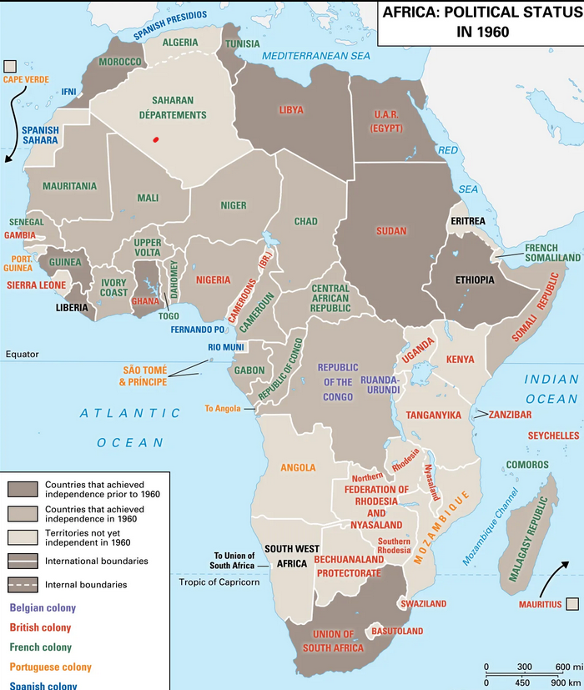
Notes:
African colonial independence (late 1950s through the 1970s)

Slide 27
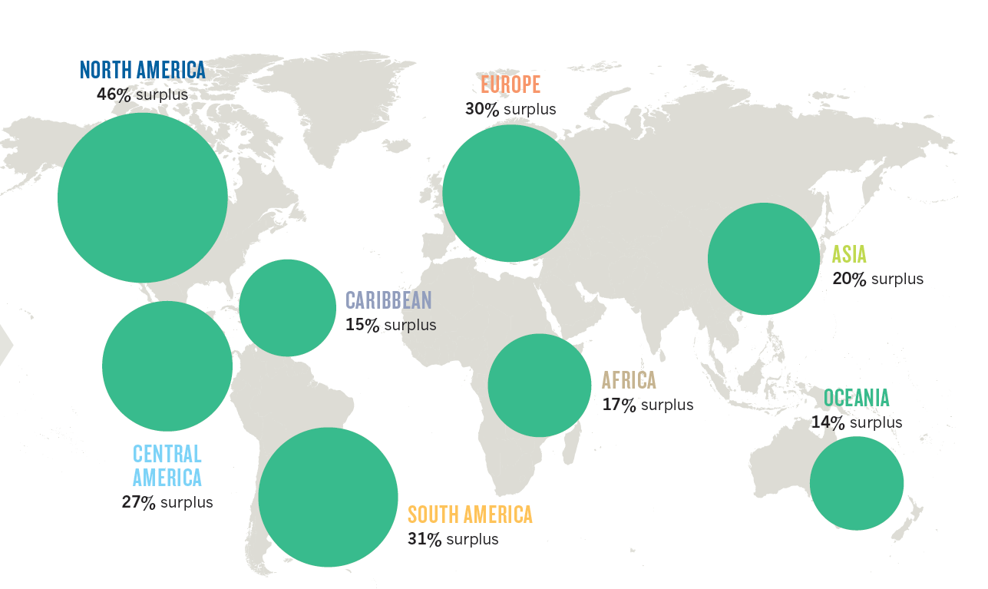
Uneven development
With the Green Revolution, calories available for humans increased
Supply was higher than needed for total population
However, regional deficits exist within this global surplus
This has created a global network of import and export markets for grain commodities like rice, wheat, and corn
This sets up the potential for food insecurity in parts of the world
.

Slide 28
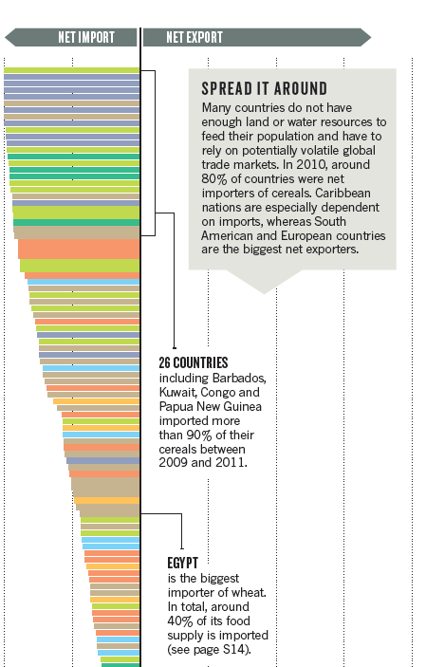

Slide 29
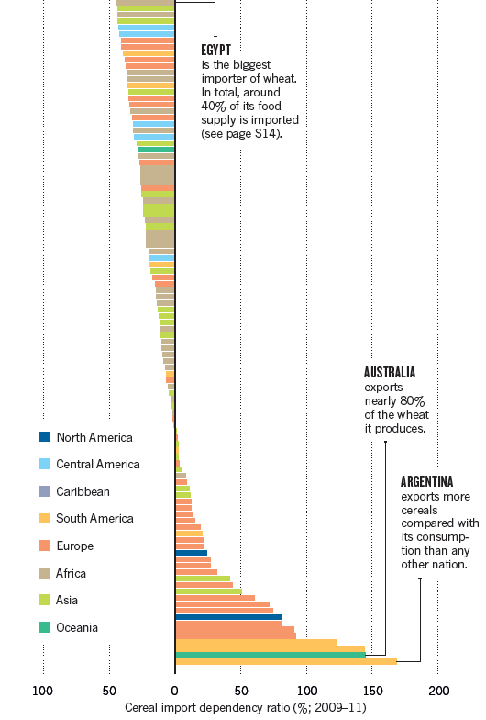

Slide 30
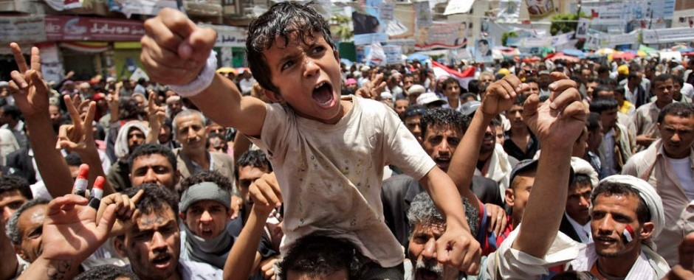
Notes:
Wheat prices rose because of political instability in the wheat belt of Ukraine, along with climate that was not conducive to producing large yields

Slide 31
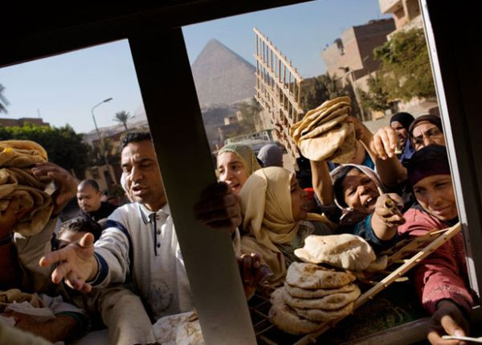
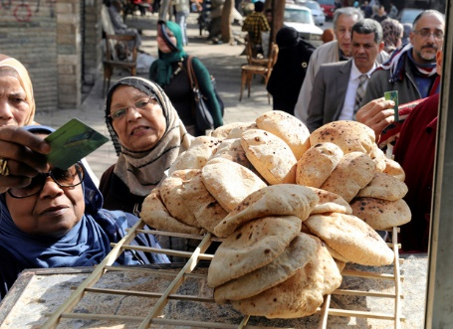
Arab Spring Uprising (2008)
Unfavorable weather in wheat producing nations
Disruption of global wheat networks due to politics
High bread prices led to protests in Middle East
Many other factors at play (legacy of colonialism, autocratic rulers, and religious and social unrest), but underlying causes for the uprising were put in place by industrial agriculture fostered by the Green Revolution
Notes:
Photos reflect protest and instability in Egypt aggravated by rapid rise in bread prices in 2008.
In 2008 more than 60 food riots occurred around the world in 30 different countries. Even higher prices from the end of 2010 coincided with additional food riots (in Mauritania and Uganda, as well as the larger protests and government changes in North Africa and the Middle East known as the "Arab Spring"

Slide 32
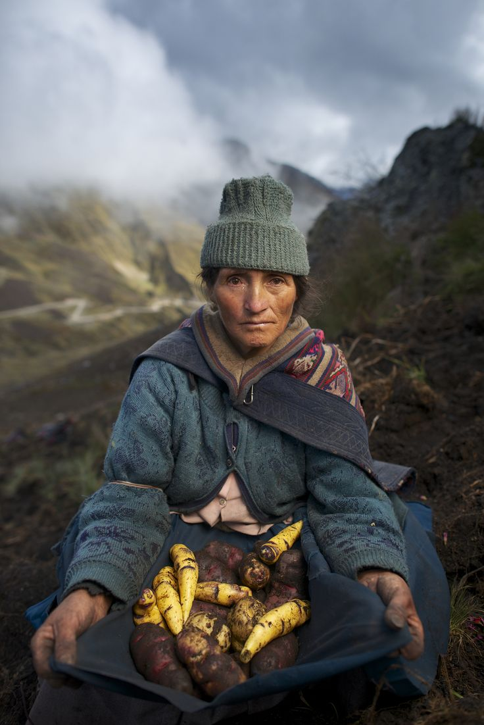
Displacement of small farmers
With Green Revolution, shift was to monoculture export crops grown on large industrial farms
Cash crops for export replaced local, traditional agriculture and food
Land became concentrated with large landholders who could afford cost of inputs to run large industrial-scale farm
Subsequent neoliberal economics and free trade forced small farmers to participate in global markets often to their detriment.
Notes:
Critics of the Green Revolution argued that owners of large farms were the main adopters of the new technologies because of their better access to irrigation water, fertilizers, seeds, and credit. Small farmers were harmed because the Green Revolution resulted in lower product prices, higher input prices, and efforts by landlords to increase rents or force tenants off the land.

Slide 33
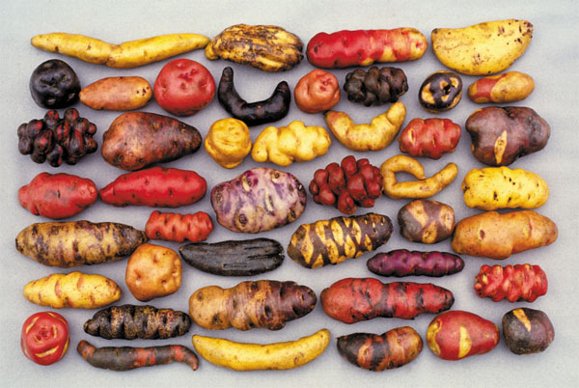
Notes:
Land races of potato

Slide 34
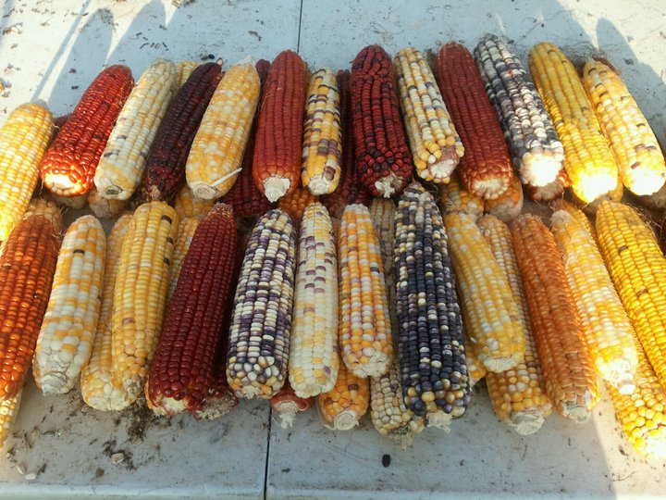
Landraces
Local variety of a domesticated animal or plant species which is adapted to the specific natural and cultural environment in which it lives
More genetically and phenotypically diverse than formal crop breeds.
Maintained through informal exchange and selection by farmers within a particular region.

Slide 36
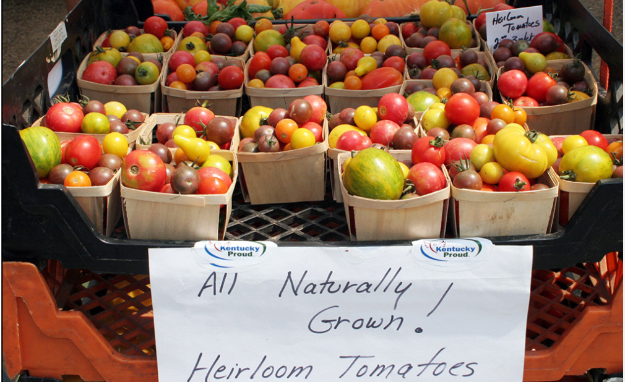
Heirloom varieties
Passed down through families or communities for many generations.
Do not often exhibit the same level of local adaptation as landraces
Have historical significance and cultural heritage.
Also valued for their unique characteristics and flavors which may have been lost in modern commercial varieties bred for uniformity and shelf-life
Notes:
https://www.uky.edu/ccd/sites/www.uky.edu.ccd/files/heirloom_tomatoes.pdf

Slide 37
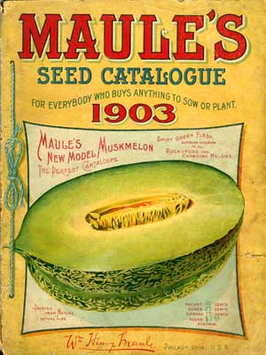
Loss of crop genetic diversity
On average, across all crops grown in the US, over 90% of the varieties grown 100 years ago are no longer in commercial production or maintained in major seed storage facilities.
Four multinational agrochemical firms — Corteva, ChemChina, Bayer and BASF — now control around half of global seed sales.
Uniformity in genetic makeup increases susceptibility to disease
Notes:
Image of citrus greening

Slide 38
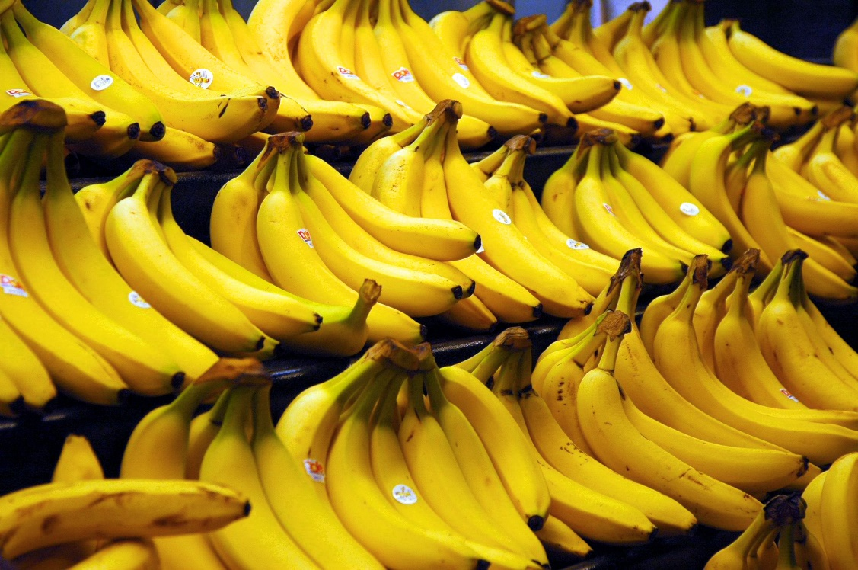
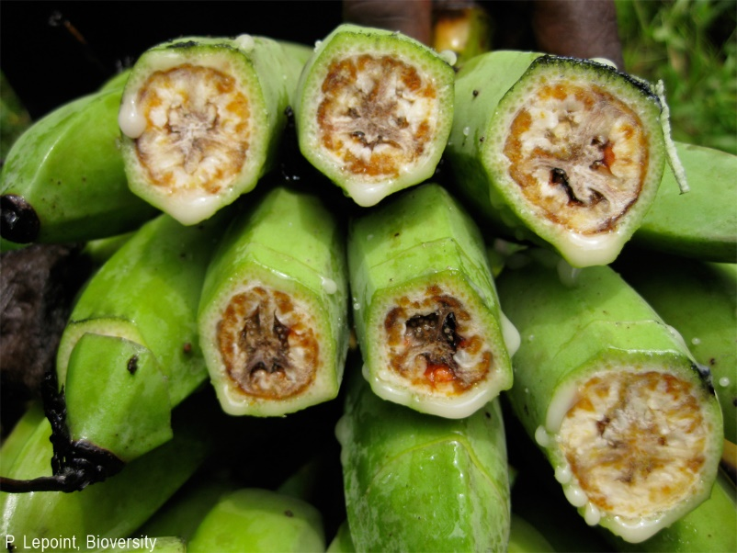
Notes:
Cavendish banana susceptible to a fungal pathogen, fusiform wilt
http://www.nytimes.com/2014/05/04/us/for-florida-grapefruit-one-blow-after-another.html?ref=science https://www.theguardian.com/australia-news/2023/may/12/banana-appeal-australias-first-genetically-modified-fruit-sent-for-approval

Slide 40
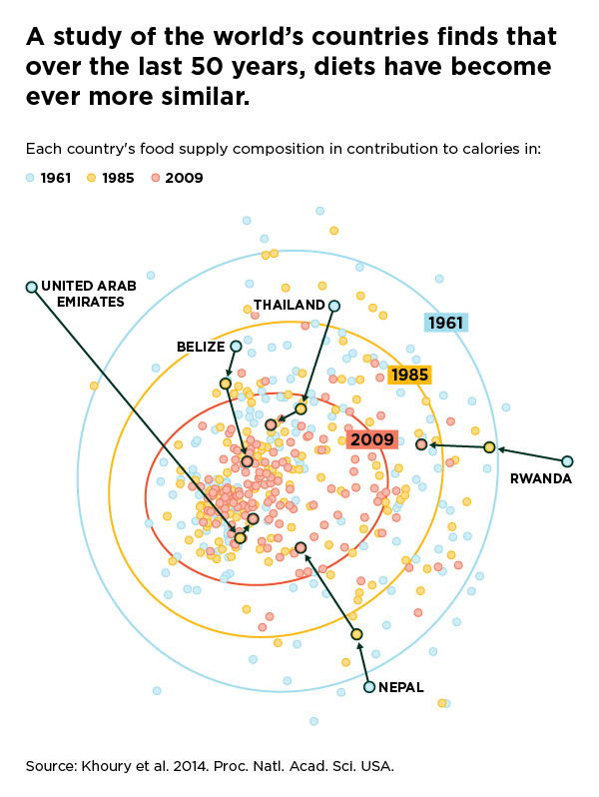
Increasing global homogeneity in food consumption
More people today increasingly rely on a short list of major food crops, like wheat, corn, and rice
Notes:
More people today increasingly rely on a short list of major food crops, like wheat, corn, and rice https://www.mdpi.com/2073-4395/13/1/162 http://www.pnas.org/content/111/11/4001.full Eliazer Nelson, A.R.L., Ravichandran, K. & Antony, U. The impact of the Green Revolution on indigenous crops of India. J. Ethn. Food 6, 8 (2019). https://doi.org/10.1186/s42779-019-0011-9

Slide 41
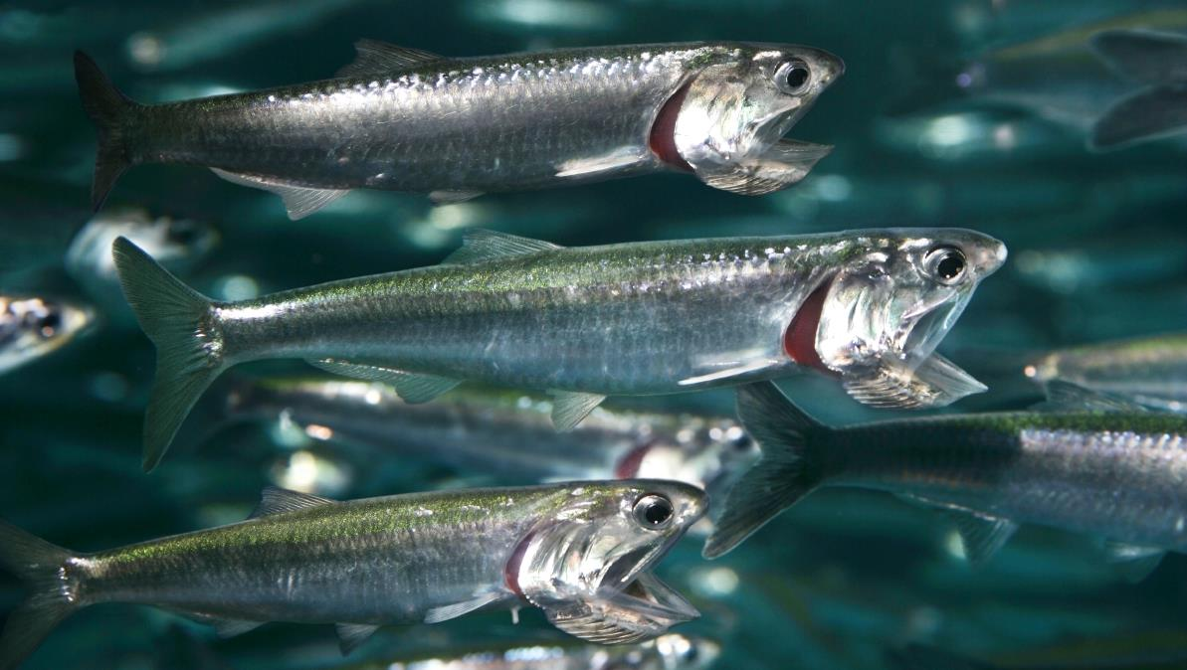
Notes:
Anchovies eat small fish and phytoplankton

Slide 42
Notes:
Pigs eat plants as well as small animals. We, and they, are omnivorous

Slide 43
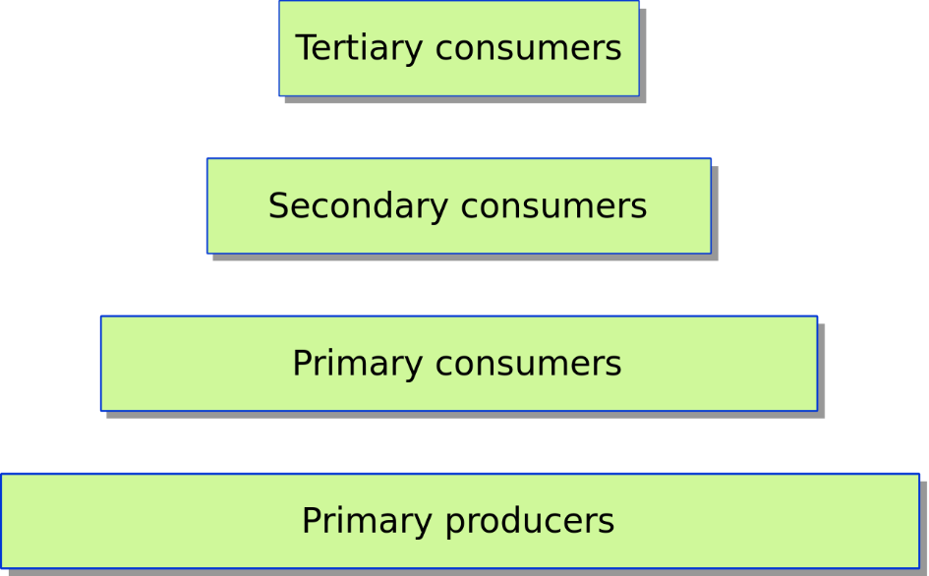
Human global trophic levels: how does the planet eat
Humans have a similar trophic level as pigs and anchovies
We are chiefly primary and secondary consumers - we eat plants and we eat animals that eat plants
But countries and individuals can vary in their trophic level
Notes:
We eat other animals that eat plants – that makes us secondary consumers. We eat plants directly – that makes us primary consumers.
We are less often tertiary consumers – animals that eat animals that eat other animals, although when we consume big ocean fish like tuna we are.
Other animals subsist on more levels in the trophic food web than us – we eat a sizeable amount of plants. For example, a hawk would be higher on the trophic pyramid than us because they do not eat plants.

Slide 44
Regional differences in human trophic levels
Notes:
Groups of similar diets – five categories
The y axis is trophic level - higher values of y indicate greater meat consumption

Slide 46
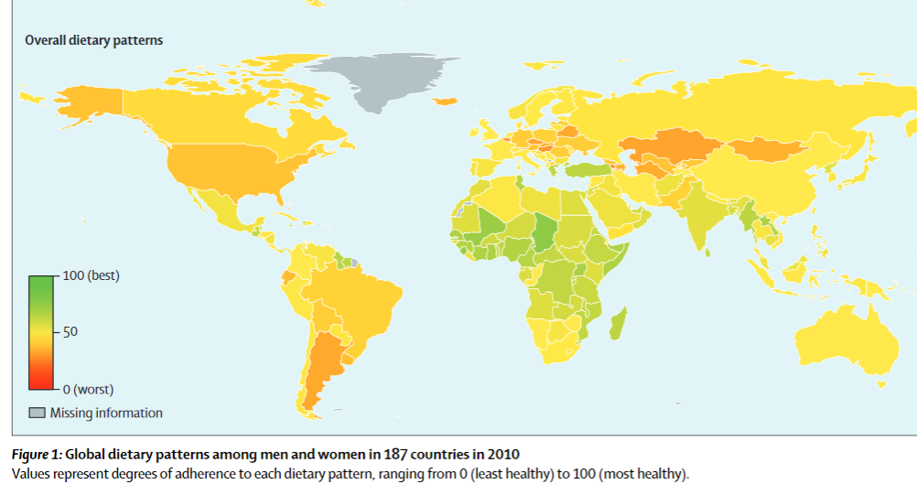
Notes:
People in some poor and middle-income countries have healthier diets than those in rich ones.
https://www.thelancet.com/pdfs/journals/langlo/PIIS2214-109X(14)70381-X.pdf

Slide 47
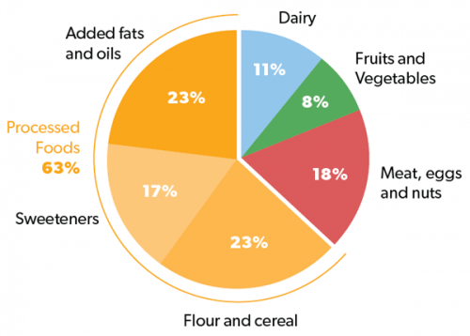
The standard American diet (SAD)
Worldwide obesity has nearly tripled since 1975.
Most of the world's population now live in countries where overweight and obesity kill more people than underweight.
Notes:
Artificially low price maintained for ingredients for processed foods through subsidies provided to corporate farms.

Slide 48
Notes:
http://world.time.com/2013/09/20/hungry-planet-what-the-world-eats/photo/ger_130614_331_x/

Slide 49
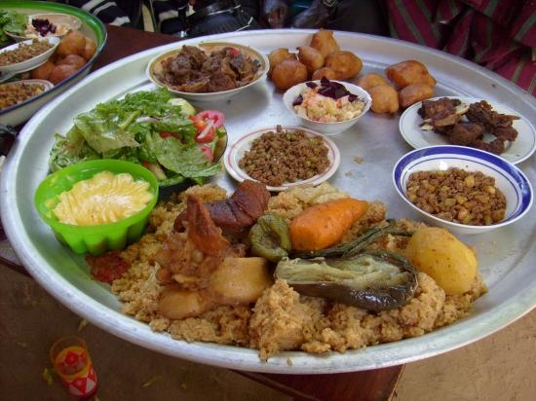
Notes:
Malian cuisine, lots of whole grains and vegetables

Slide 50
Notes:
But traditional diets are changing in Mali as they are many places in the world, even in Africa. In Egypt. Egypt now has some of the highest rates of obesity in the world: 35% of the adult population.
https://www.theguardian.com/world/2016/oct/07/egypt-obesity-battle-calories-overweight https://www.thelancet.com/journals/lancet/article/PIIS0140-6736(19)30041-8/fulltext

Slide 51
Notes:
Clark, M. A., Springmann, M., Hill, J., & Tilman, D. (2019). Multiple health and environmental impacts of foods. Proceedings of the National Academy of Sciences, 116(46), 23357-23362.
https://www.pnas.org/content/116/46/23357.short

Slide 52
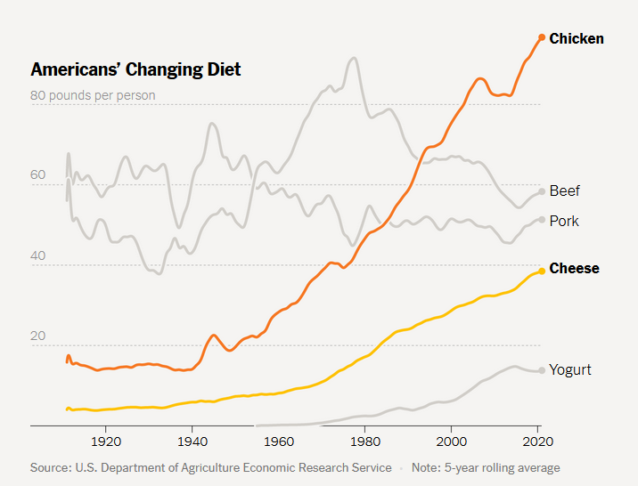
Notes:
https://www.nytimes.com/interactive/2023/12/24/climate/groundwater-crisis-chicken-cheese.html

Slide 54
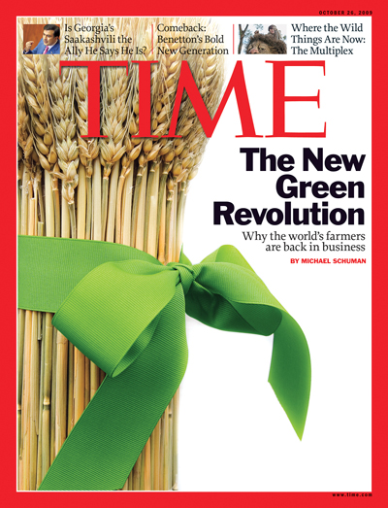
How to feed an estimated 9 to 11 billion people by 2050?
Over the past half-century, human population has doubled but food production has kept pace
Fraction of people with insufficient food has declined dramatically but food production will have to continue to increase
Critics of this position contend that enough food is available, only it goes to those with more power

Slide 55
A second Green Revolution? One that could:
Address inequities in power that shape food access
Be capable of increasing food production to the extent it is necessary
Respond to needs of small-scale farmers and poor agricultural workers
Reduce agriculture’s carbon footprint and dependence upon fossil fuels
Lessen negative environmental and health impacts of SAD
Address inequities in access and control of remaining farmland
Balance agriculture with wildlife conservation
Produce more food under a scenario of rapid climate change

Slide 56
Ecomodernist and environmentalist strategies for a second Green Revolution:
Fair trade and alternative commodity chains
Innovations in the production of farm inputs
Closing yield gaps
Adopting ‘third plate’ practices
Food 2.0 innovations
Use of underutilized and neglected crops
Acceptance of GMOs
Sustainable intensification to balance development and conservation
Notes:
Of course, the reality that unfolds will likely be some combination of the two

Slide 57
Meeting the needs of small-scale food producers
Cambodian rice was long considered poor quality rice unsuitable for global markets
Through national organizing of the agricultural sector, Cambodian farmers began adopting modern milling systems
This helped elevate Cambodian rice to the international market.
In 2022, Cambodia was eighth largest rice exporter in the world
Market for high-quality rice geared toward socially and environmentally aware consumers exported to France, Italy, and Czechia
Much of the rice is being grown by small landowners, not large corporate farms
Notes:
Last year, Cambodia was the world’s fifth-largest exporter of rice and the second-biggest exporter of premium jasmine rice. Sales of milled rice abroad reached 378,856 tons. Modern milling systems adopted in the last few years have helped elevate Cambodian rice to the international market. Most of these farmers work on small farms This has created a niche market for other producers focused on high-quality rice and geared toward socially and environmentally aware consumers in the West.

Slide 58
Meeting the needs of small-scale food producers
Farmers all over the world were encouraged to grow coffee for the global market during the coffee boom of the 1980s and 1990s
A glut of coffee developed and low prices became the norm for farmers in Latin America, Africa and Asia
Four multinational companies - Kraft, Sara Lee, Procter & Gamble and Nestlé - now buy nearly half the world's coffee and sell it at a low price because of the size and power of their companies

Slide 59
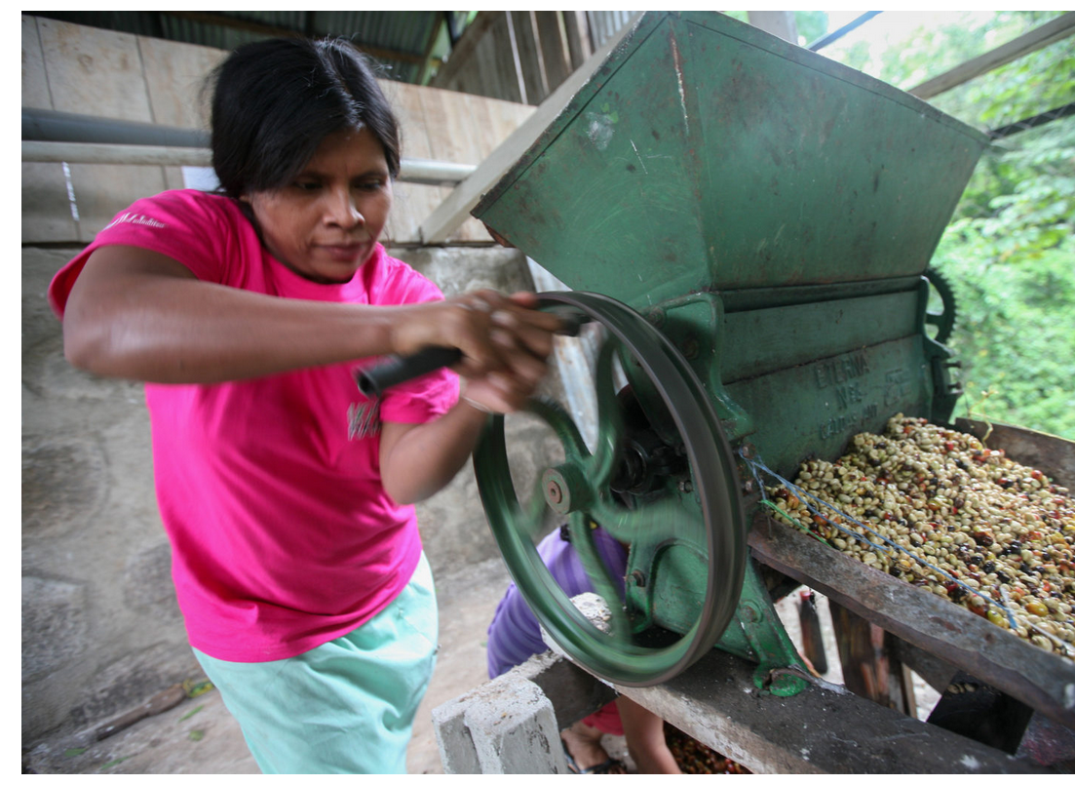
Small coffee farmers in places like Mexico, Nicaragua and Guatemala make little money while multinationals grow wealthy
Notes:
https://rootcapital.org/the-farmer-who-grew-your-coffee-is-losing-money-on-every-cup/

Slide 61
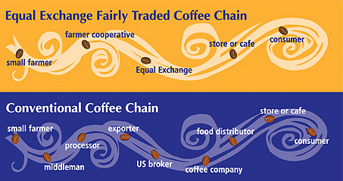
Fair trade certification and other alternative commodity chains are market mechanisms to help small producers
These help insure that fair and equitable financial and ecological advantages return to small farmers and workers when they participate in distant markets

Slide 62
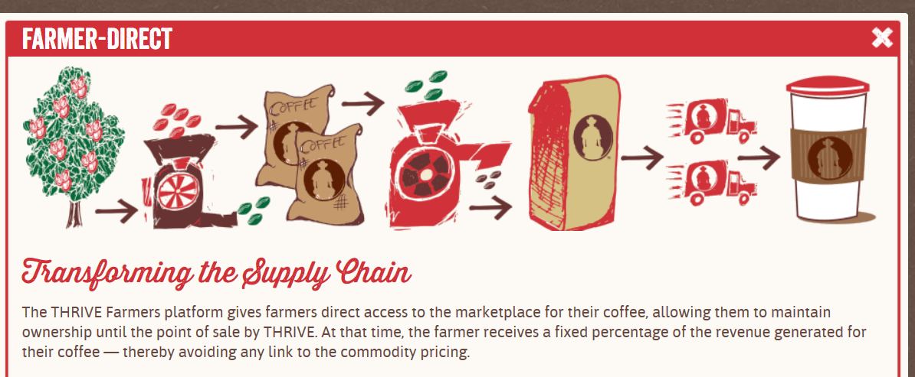

Slide 63
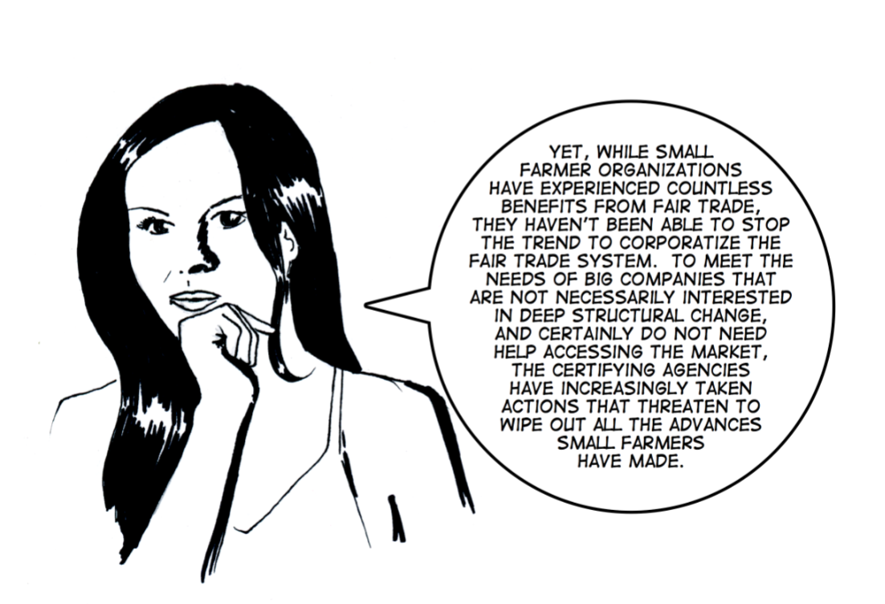
Notes:
However, a negative of fair trade is that it can become commodified and acts as an exclusionary mechanism. Not all farmers benefit, only those that get chosen for fair trade mechanisms.

Slide 64
“Free the seeds” to help the small producer (and promote tastier more diverse food crops too)
Notes:
https://www.nytimes.com/interactive/2019/06/07/opinion/sunday/dan-barber-seed-companies.html
Just 50 years ago, some 1,000 small and family-owned seed companies were producing and distributing seeds in the United States; by 2009, there were fewer than 100. Thanks to a series of mergers and acquisitions over the last few years, only a small number of big multinational agrochemical firms control over around half of global seed sales.

Slide 65
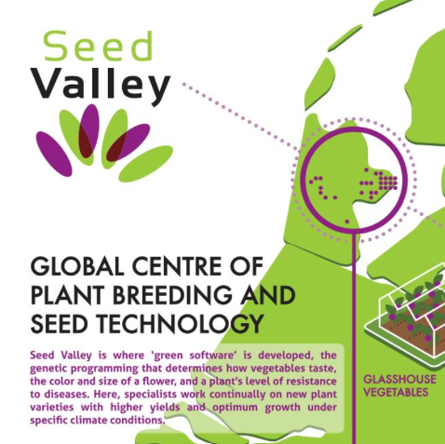
About half of the world’s seed supply is associated with research and production in small region of the Netherlands
A small number of big multinational companies control around half of global seed sales.
Farmers have to buy their patented seeds each year
This provides a return on investment for the companies, but imposes a uniformity on crops at a time when local innovation in plants and farming are needed to develop new varieties
Notes:
Control over seeds is, in many ways, control over the food supply. The question of who produces new plant varieties is absolutely critical for the future of all of us. Loosening up rules about seed patents and introducing more diversity in seeds and seed production will allow more genetic diversity to flourish and potentially improve the overall resilience of crops and the food supply https://www.dw.com/en/agriculture-seeds-seed-laws-agribusinesses-climate-change-food-security-seed-sovereignty-bayer/a-57118595

Slide 67
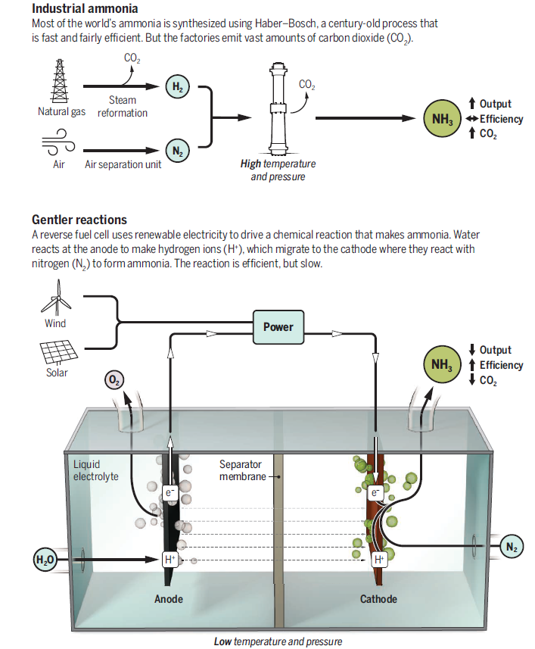
Reducing the carbon footprint
Alternative methods are needed to produce fertilizer that are less fossil fuel intensive than the current Haber process
One such process that was recently invented is shown at right.
Food production results in the production of greenhouse gases, so reduce food waste lessen the need to make more
Estimates for the US suggest up to 40% of all food produced doesn’t get eaten
Notes:
Chen, Jingguang G., Richard M. Crooks, Lance C. Seefeldt, Kara L. Bren, R. Morris Bullock, Marcetta Y. Darensbourg, Patrick L. Holland et al. "Beyond fossil fuel–driven nitrogen transformations." Science 360, no. 6391 (2018): eaar6611.
Globally, between a fifth and a third of total greenhouse-gas emissions have been attributed to agriculture, as has three-quarters of all deforestation.

Slide 68
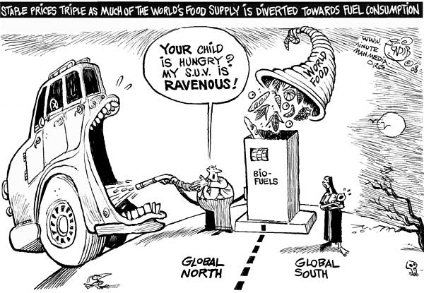
Food or fuel?
Notes:
Some countries want to use food as fuel.
Food versus fuel is the dilemma regarding the risk of diverting farmland or crops for biofuels production to the detriment of the food supply. The benefit of biofuels is that it is more renewable than fossil fuels. However, there are tradeoffs involved with diverting crops that may have been destined for food or livestock feed to fuels.
https://www.youtube.com/watch?v=JhXOeCcvyII

Slide 69
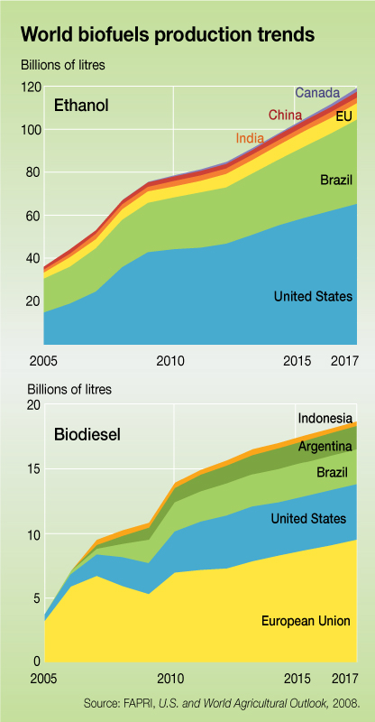
Biofuels are useful only when they do not replace food crops
Lower greenhouse gas emissions come from biofuels (ethanol, biodiesel) made from grains
But possible only when food crops are not replaced.
In that case, lower emissions would mean less food: more land would have to be cleared to replace the food lost
But more crop planting would mean more fuel use
Notes:
Using ethanol as a vehicle fuel has measurable greenhouse gas emissions benefits compared with using gasoline. CO₂ released when ethanol is used in vehicles is offset by the CO2 captured when crops used to make the ethanol are grown. Vehicles running on ethanol produce less net CO2 than conventional vehicles per mile traveled.
Recent studies have shown the importance of incorporating assumptions about future crop production rates and land use into life cycle analyses. These factors can substantially affect net GHG emission calculations. If biofuels are diverted to food, then the response to offset potential declines in availability of food will be increased agricultural production elsewhere with more inputs of fuel – thereby reducing the overall benefits of the original biofuels.
http://www.afdc.energy.gov/vehicles/flexible_fuel_emissions.html

Slide 70
Notes:
https://doi.org/10.1073/pnas.1713820115 Opportunity food loss: the food loss associated with consuming resource-intensive animal-based items instead of plant-based alternatives which are nutritionally comparable in terms of protein content.

Slide 71
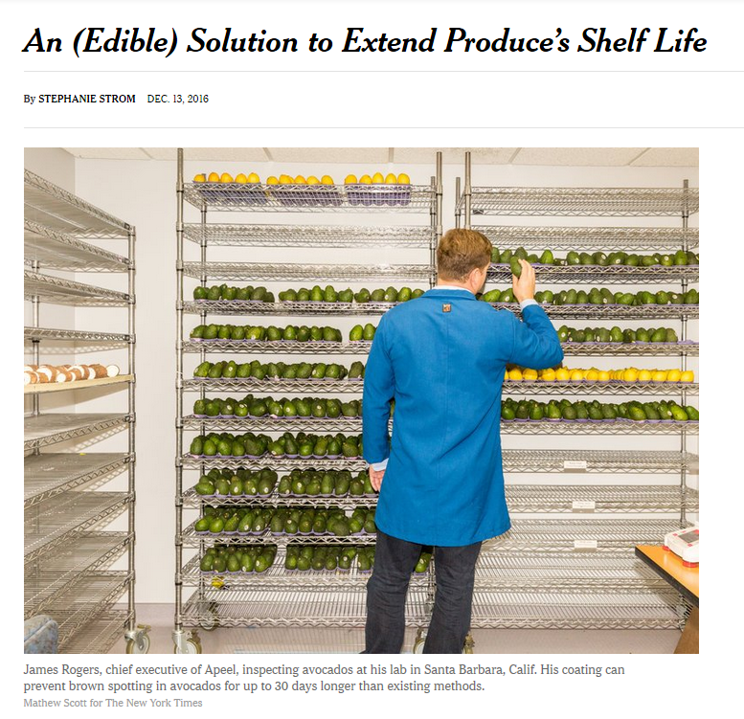
Notes:
The answer to feeding the growing world population isn’t just to grow more food, it’s to preserve more of what we already grow and make optimal use of the resources we already have.
A company has developed a method for creating imperceptible, edible barriers that the company says can extend the life of produce like green beans and berries by as much as five times.

Slide 72
Notes:
https://www.nature.com/articles/nature11420

Slide 73
Closing existing yield gaps
Yield gaps: when productivity of farmland is below potentially attainable yield
Due to variability between years, fields and crops due in:
Weather, pests, and disease
Soils and topography
Management practices
Methods to increase yield
Agricultural extension
Precision farming

Slide 74
Closing yield gaps: agricultural extension
Notes:
This is the more traditional approach of working with farmers to identify best management practices – farming is a highly contextual practice and developing skills to increase yields requires the development and dissemination of this knowledge. It can involve technology in the form of measuring of crop conditions and yields, but the main way it works is through better integration of research and farmer knowledge. Understanding local markets and the way farmers rationalize their decisions about farming helps figure out ways to increase yields while still serving the needs and situations of the local farmer

Slide 75
Closing yield gaps: precision agriculture

Slide 76
Notes:
http://www.buzzfeed.com/mattortile/23-unexpected-cultural-delicacies-from-asia#45whh36 Clotted chicken blood cubes from the Philippines

Slide 77
The Third Plate: making more food available by using and improving upon what is already there
Notes:
First plate: Green Revolution agriculture and eating (meat and potatoes) Second plate: Farm to table movement; organic and local foods Third plate: Making more food available by improving upon what is already there

Slide 78
The Third Plate: integration of commodity chains
Aquaculture pioneered by Chinese (3500 BC)
Cultivation of fish can be integrated with field agriculture
Vegetation clippings used to feed fish
Fish waste used to fertilize plants
Practiced inside as aquaponics

Slide 79
Aquaponics

Slide 80
Smithtown Seafood and FoodChain, Lexington KY

Slide 82
Food 2.0
New foods and ways of making or raising foods
Food 2.0 companies use computer algorithms to analyze thousands of plant species to find out what compounds can be derived from them and then recombined to create new and sustainable sources of food.

Slide 83
Notes:
Meat is environmentally costly and has a negative health impact on humans – this fuels the search and marketization of alternative proteins.

Slide 84
Food 2.0: Alternative proteins
Meat production requires large volume of corn and other grains – it diverts food humans can consume
Meat has a large environmental footprint and is correlated with health problems
Food 2.0 seeks to develop new alternative proteins (cell-based meat, insect-based foods, fungi, plant-based proteins)
Notes:
https://www.smithsonianmag.com/arts-culture/seitan-the-other-fake-meat-97622092/
See next slide for a photo of seitan prepared in Chinese cuisine

Slide 85
Meat substitutes are not new
Longstandings tradition of meat substitutes in some cuisines of the world
Seitan is flavored wheat gluten, the protein portion of wheat that gives bread dough its elastic quality.
It has been used as a meat substitute for centuries in China and Japan, where it was developed by vegetarian Buddhist monks.

Slide 86
Neglected and underutilized crops
Notes:
These are crops that may be eaten in some parts of the world as a staple but ignored elsewhere. This may be because they are not available elsewhere, but it also may be a bias against new and unfamiliar foods even when they have qualities that are desirable, like taste, nutritional content, or their contribution to overall diversity of foods available.

Slide 87
Breadfruit
Tropical perennial tree domesticated in Polynesia
Produces more food in dry weight per area than corn, rice, or wheat.
Rich in iron, potassium, and vitamin A precursors.
Certain varieties ground into flour pack more protein than rice.

Slide 89
Greenhouse agriculture
Notes:
These greenhouses, with less fertilizer and water, can grow in a single acre what would take 10 acres of traditional dirt farming to achieve. Dutch farms use only a half-gallon of water to grow about a pound of tomatoes, while the global average is more than 28 gallons. However, some greenhouse systems can be very fossil fuel intensive. The devil is in the details, the context of greenhouse agriculture. How they are powered, where they are built, what crops they grow, the technology used in them – these things will all matter in determining their role in future agricultural production. A black and white perspective as good or bad is simplistic.

Slide 90
Genetically-modified organisms (GMOs)
Future improvements in crop health and increases in yields will depend upon the use and public acceptance of GMO crops.
Drought and pest resistance are two properties that can be engineered into food crops
GMO crops are proven safe to eat; the controversy over them is in how large corporate interests patent GMO crops and control farmers and food
You already eat GMO foods regularly, including corn and soy, and there will be more to come

Slide 91
Sustainable intensification (SI)
Aims to avoid the cultivation of more land, and thus prevent the loss of unfarmed habitats, but also aims to increase overall farm performance without net environmental cost
SI seeks to optimize where to separate nature, to ‘spare’ it, and where to ‘share’ it by integrating humans, farmland, and nature

Slide 92
Notes:
These are ways of reducing the environmental impact of farming while also increasing yields Pretty, J. (2018). Intensification for redesigned and sustainable agricultural systems. Science, 362(6417), eaav0294.

Slide 93
Bumping up against barriers: constrains on a second Green Revolution
Notes:
https://www.scientificamerican.com/article/can-we-feed-the-world/ At first blush, the way to feed more people would seem clear: grow more food, by expanding farmland and improving yield—the amount of crops harvested per hectare. Unfortunately, the world is running into significant barriers on both counts. Society already farms roughly 38 percent of the earth’s land surface, not counting Greenland or Antarctica. Agriculture is by far the biggest human use of land on the planet; nothing else comes close. And most of that 38 percent covers the best farmland. Much of the remainder is covered by deserts, mountains, tundra, ice, cities, parks and other unsuitable growing areas. The few remaining frontiers are mainly in tropical forests and savannas, which are vital to the stability of the globe, especially as stores of carbon and biodiversity. Expanding into those areas is not a good idea, yet over the past 20 years five million to 10 million hectares of cropland a year have been created, with a significant portion of that amount in the tropics. These additions enlarged the net area of cultivated land by only 3 percent, however, because of farmland losses caused by urban development and other forces, particularly in temperate zones.

Slide 94
Decreasing amount of suitable farmland for a second GR

Slide 96
The tropical time bomb
Most remaining suitable farmland is found in tropics especially in Sub-Saharan Africa and South America.
This is where some of the last large tracts of tropical forest remain
Need for farmland may result in clearing of tropical forests
The ‘bomb’ is the intensification of the conflict between food production and nature conservation.
Notes:
http://www.washingtonpost.com/blogs/wonkblog/wp/2013/01/26/chinese-firms-and-gulf-sheiks-are-grabbing-farmland-worldwide-why/

Slide 97
Land grabbing
Notes:
Farmland in one country is being bought by private investors in other countries because they expect that they can turn a profit when demand for farmland and food rises higher.

Slide 98
Notes:
This map shows where governments and agribusinesses are buying and leasing land in foreign countries. Countries that are more engaged in buying land internationally are shown in grey or shades of yellow, while countries that sell more land are shown in red. The bigger the circle, the more trading partners a country has.
https://iopscience.iop.org/article/10.1088/1748-9326/9/11/114006/pdf

Slide 99
Notes:
Why buy farmland As an investment. Investors are anticipating the shortage of farmland and food with a growing number of humans on the planet. This graphic shows the top 20 countries in the global land trade network, ordered by the largest number of trading partners. The gray bars indicate “imports” – where the country listed is buying another country’s land – while the red bars indicate “exports,” or countries that are selling their land. https://iopscience.iop.org/article/10.1088/1748-9326/9/11/114006/pdf

Slide 100
Notes:
https://www.thedailyscoop.com/news/retail-industry/which-foreign-country-owns-most-farmland-us-hint-its-not-china
China doesn’t own the most farmland in the U.S., according to a new USDA report. It’s actually Canada, followed by the Netherlands, Italy, the United Kingdom, and Germany All told, 43.4 million acres of forest and farmland in the U.S., or 3.4% of all ag land, is foreign owned as of Dec. 31, 2022. USDA says the two biggest Chinese-owned companies with land holdings in the U.S. are Brazos Highland and Murphy Brown LLC, which owns Smithfield Foods.

Slide 101
A second Green Revolution will take place in a rapidly changing climate
Notes:
https://www.nytimes.com/2023/09/25/dining/climate-change-fruits-vegetables.html

Slide 102
Notes:
Crop yield response to warming in California’s Central Valley based on higher emission scenario (A2) and lower emission scenario (B1) .
www.pnas.org/cgi/doi/10.1073/pnas.1701762114

Slide 103
Simplism: the unambiguous ascription of single causes and remedies for multifactored phenomena
Notes:
In their 1970 classic The Politics of Unreason, the sociologists Seymour Lipset and Earl Raab coined a word for this black-and-white thinking: “simplism.” They defined it as “the unambiguous ascription of single causes and remedies for multifactored phenomena.” Reality was irrelevant to its advocates and strength of will was more important than attention to practicalities. For the simplist, “just saying the right thing, believing the right thing, is the substance of victory and remedy.” https://www.persuasion.community/p/the-simpleton-manifesto

Slide 104
Simplistic perspectives about sustainability and the next Green Revolution
The diversity of food systems, the range of cultures and peoples involved, the integration of places through trade, and variability in climate and soils makes a forward-looking, proactive, and comprehensive food policy a major challenge
Solutions should be viewed as context-dependent, temporary and likely to lead to new problems
Ongoing experimentation is necessary to continue to meet global food demands, address current problems, and prepare for future ones

Slide 105
A realistic complexity versus an idealized and ineffective simplicity
How do we change existing food systems to address inequities in food access and prepare for a future where food demand could rise? (There are multiple issues to address not just one)
What are the limits of sustainable livestock production in the US? (The question should not be how do we eliminate meat. Meat-eating is not likely to ever go away, and it is a problem in that only wealthier countries consume high volumes of meat)
How do we find the middle ground between large, industrial scale farming and farming done by small producers? (Neither extreme is likely to be a universal solution and both can potentially complement each other)
Notes:
Rail against the harms of agricultural industry, but what are you going to do without it? We are in a precarious position – returning to some romanticized version of an all-organic world is not possible, nor is it possible for agriculture to continue as it is doing now.

