Slide 1
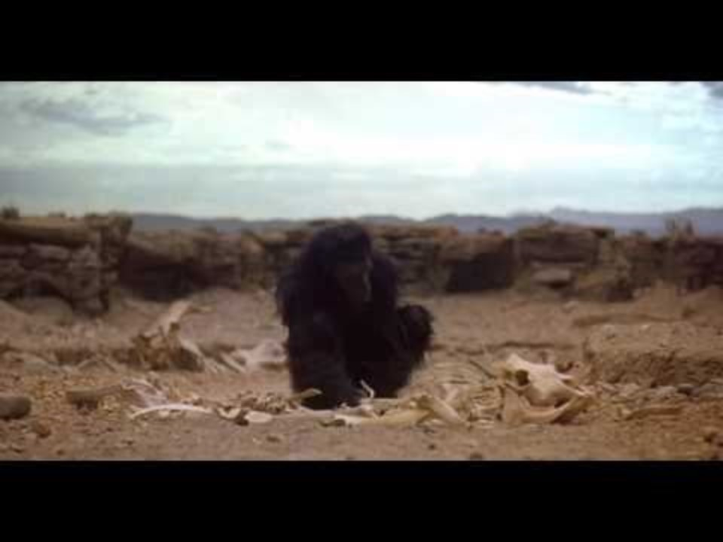
Notes:
5:22
Are humans good? Bad? A question not to be answered. But we have caused extinctions.

Slide 2
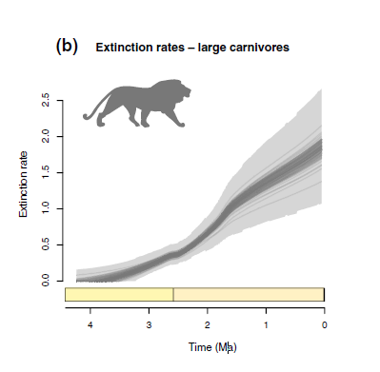
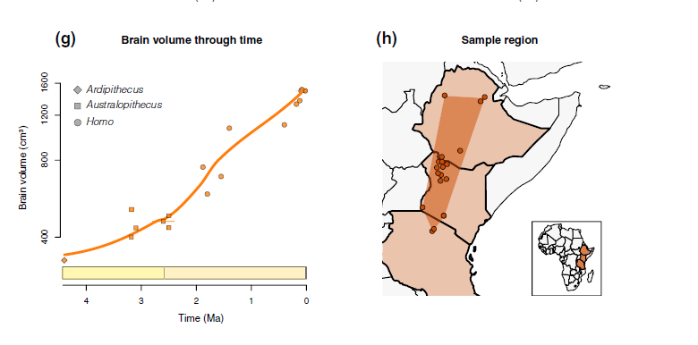
Plio-Pliestocene carnivore decline in Africa (5 mya)

Slide 3
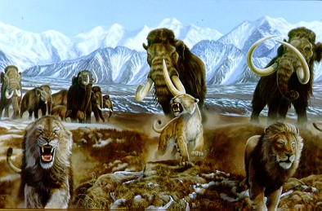
Pleistocene megafaunal extinctions in North America (10,000 to 12,000 ya)

Slide 4
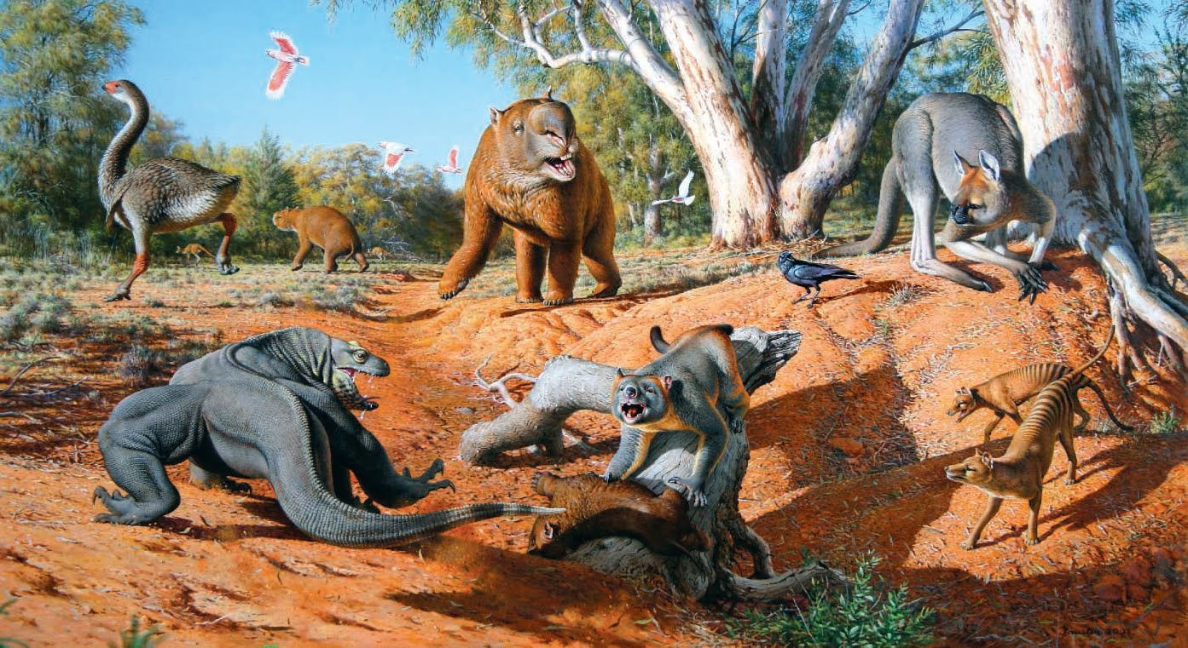
Pleistocene megafaunal extinctions in Australia (40,000 ya)

Slide 5
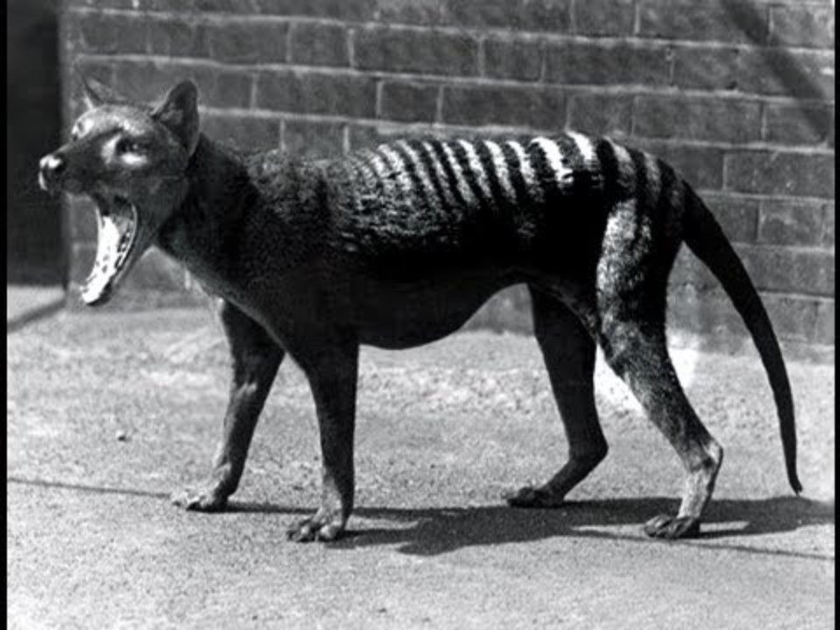

Slide 6
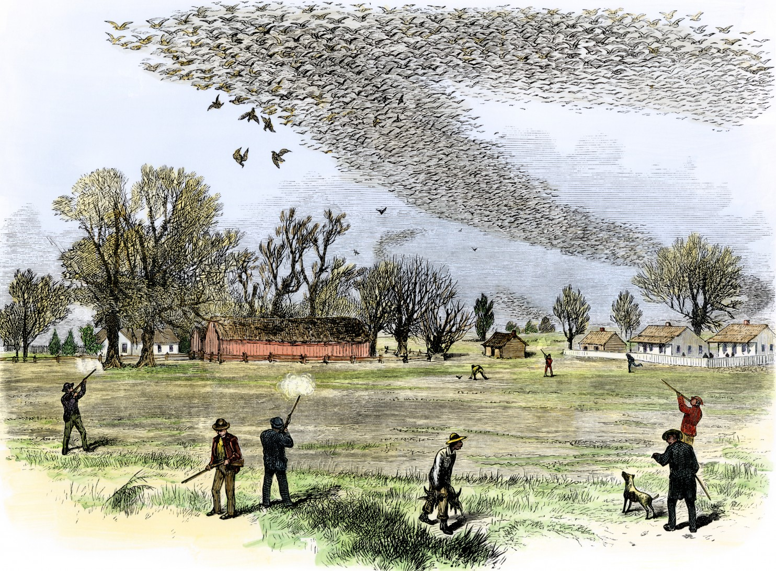
Notes:
Passenger pigeon shoot, 1875, Northern Louisiana
Passenger pigeons provided cheap meat. Commercial hunting lead to their extinction in 1914 despite efforts by zoos to maintain them. There were no existing rules and regulations to protect them, and they were an easy and bountiful protein source. If this hunting were to go on today, it would likely be similarly labeled as bushmeat by outsiders that prioritize conservation of biodiversity.
The passenger pigeon was once the most common bird in North America. It is estimated that there were as many as five billion passenger pigeons in the United States at the time Europeans arrived in North America. They lived in enormous flocks, and during migration, one could see flocks of them a mile wide and 300 miles long, taking several days to pass and probably containing two billion birds. Over the 19th century, the species went from being one of the most abundant birds in the world to extinction.
Some decimation in numbers occurred as a result of loss of habitat, when the Europeans started settling further inland. However, the primary factor emerged when pigeon meat was commercialized as a cheap food for slaves and the poor in the 1800s, resulting in hunting on a massive scale. There was a slow decline in their numbers between about 1800 and 1870, followed by a catastrophic decline between 1870 and 1890, at the end of which they were rare and beyond the point of recovery.
'Martha', thought to be the world's last passenger pigeon, died on 1 September 1914.

Slide 7
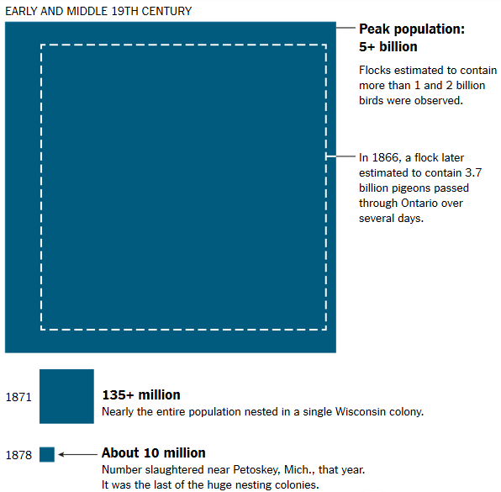
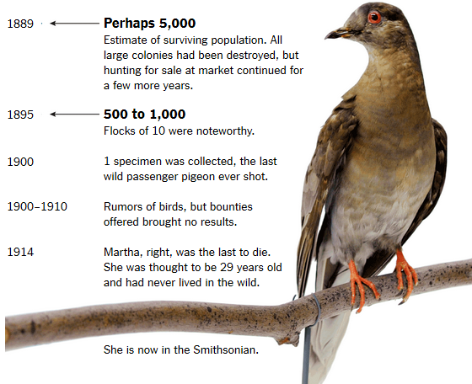

Slide 8
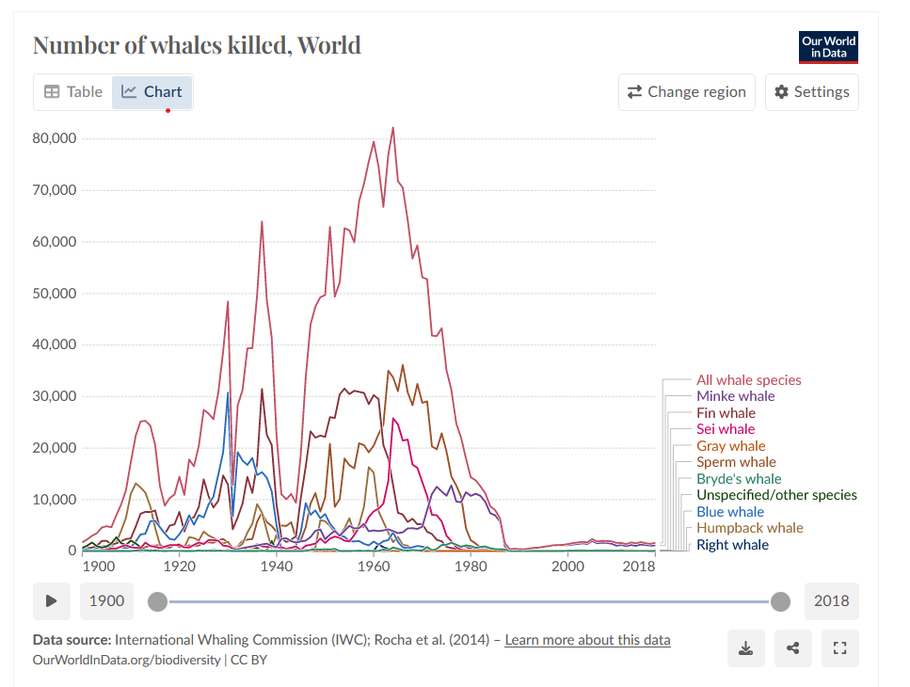
Notes:
https://ourworldindata.org/whaling
https://open.library.ubc.ca/soa/cIRcle/collections/facultyresearchandpublications/52383/items/1.0074757

Slide 9
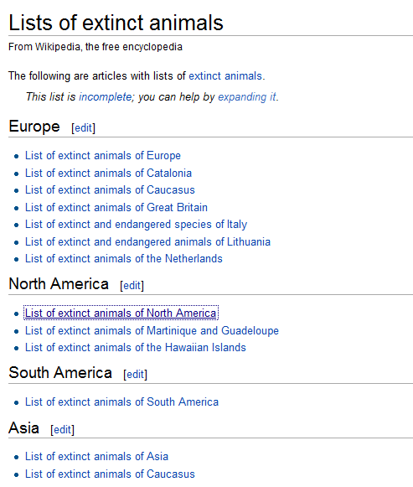
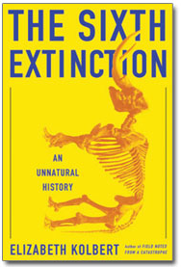
Notes:
We lose between 1-5% of species per year. Current rates of extinction are 100 to 1,000 times natural background levels. Extinctions have accelerated in the last few centuries

Slide 10
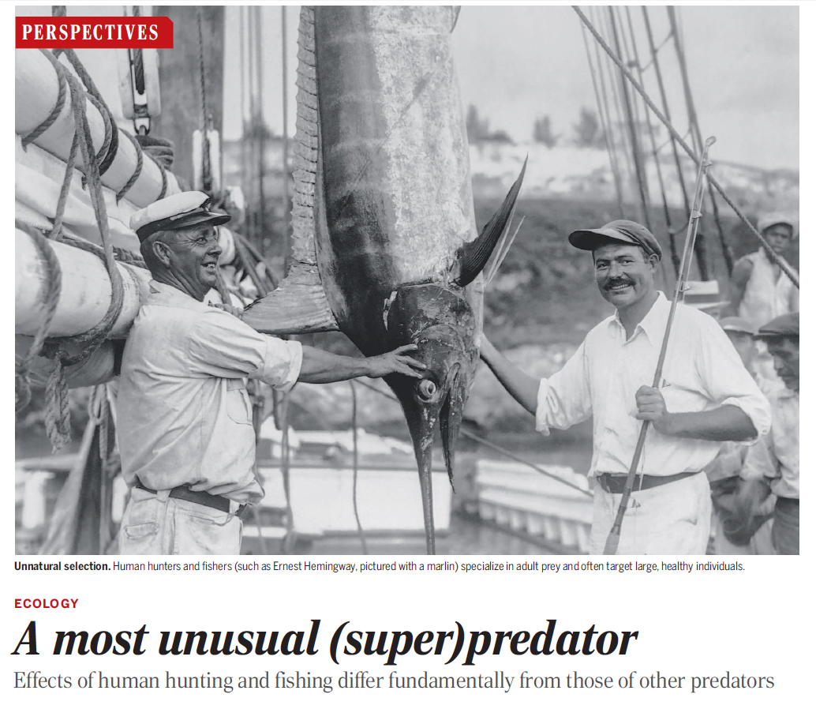
Notes:
Human beings focus heavily on taking down adult prey. This is quite different from the rest of the animal kingdom, for which the juveniles of a species tend to be the most exploited. Humans are using up the reproductive capital of these adults – their ability to reproduce and augment population numbers
http://www.bbc.com/news/science-environment-34011026

Slide 11
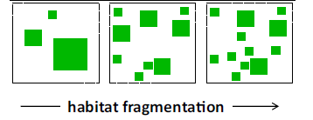
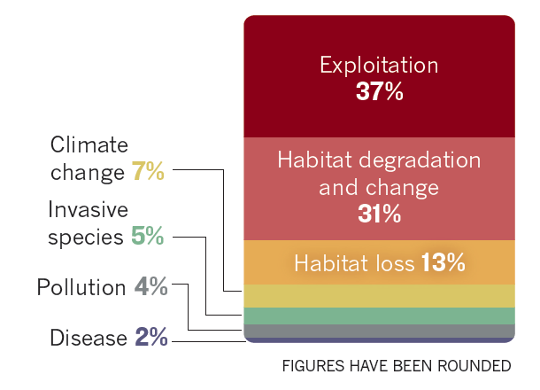

Slide 12
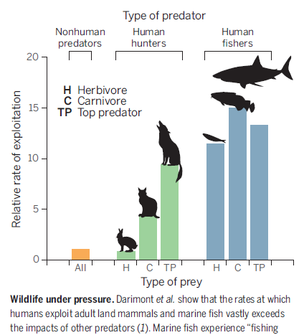

Slide 13
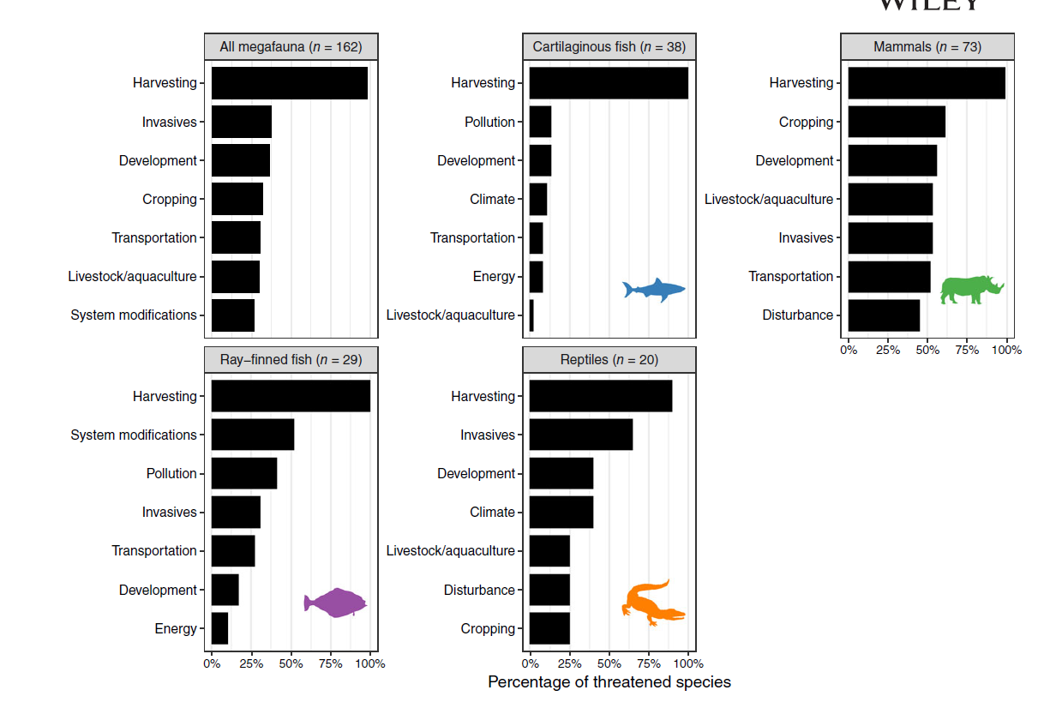
Notes:
Ripple, W. J., Wolf, C., Newsome, T. M., Betts, M. G., Ceballos, G., Courchamp, F., ... & Worm, B. (2019). Are we eating the world's megafauna to extinction?. Conservation Letters, 12(3), e12627.

Slide 14
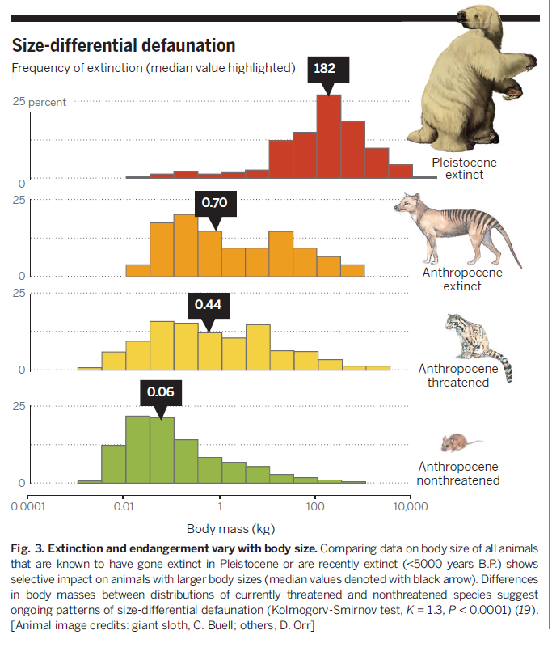
Notes:
Overexploitation has a size and taxon-specific bias. Selective impact on large-bodied mammals and birds. Large-bodied animals have gone extinct disproportionately earlier, leaving behind a smaller-bodied set of animals
The average size has gone from 182 kilograms, or 400 lbs to 0.70-0.44 kg (1.5-1 lbs), and 0.06 kilograms, or a couple of ounces.

Slide 15
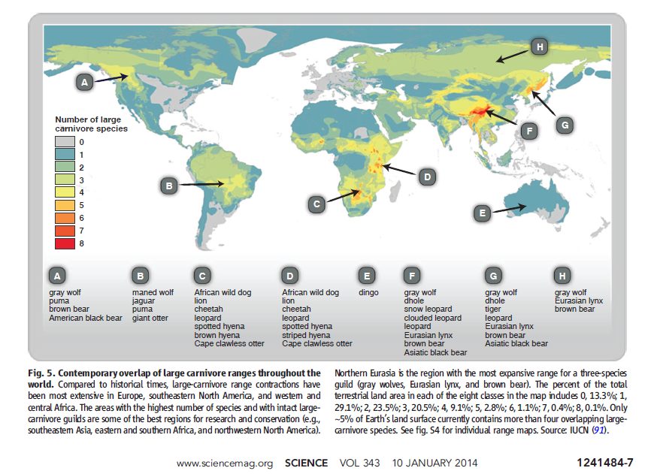
Notes:
Trophic downgrading of Earth
Large carnivore ranges have contracted globally, leaving only a few places with more than one or two large predators.
Until recently, large apex consumers were ubiquitous across the globe and had been for millions of years. The loss of these animals may be humankind’s most pervasive influence on nature. Although such losses are widely viewed as an ethical and aesthetic problem, recent research reveals extensive cascading effects of their disappearance in marine, terrestrial, and freshwater ecosystems worldwide. This empirical work supports long-standing theory about the role of top-down forcing in ecosystems but also highlights the unanticipated impacts of trophic cascades on processes as diverse as the dynamics of disease, wildfire, carbon sequestration, invasive species, and biogeochemical cycles. These findings emphasize the urgent need for interdisciplinary research to forecast the effects of trophic downgrading on process, function, and resilience in global ecosystems.
https://science.sciencemag.org/content/333/6040/301

Slide 16
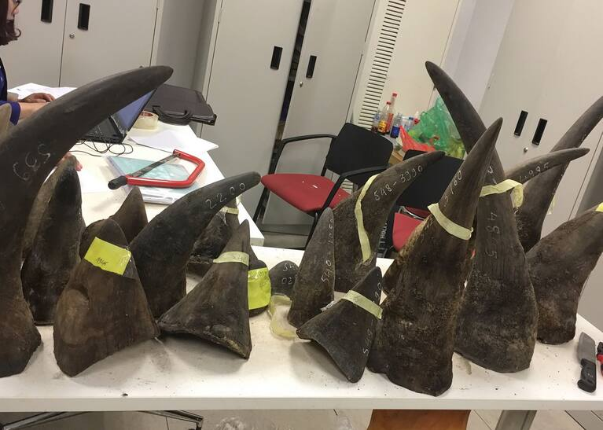
Notes:
https://www.washingtonpost.com/national-security/kenyan-national-faces-indictment-in-new-york-on-charges-of-peddling-elephant-tusks-and-rhino-horns-harming-more-than-100-endangered-animals/2021/01/25/bed4cd18-5f58-11eb-afbe-9a11a127d146_story.html

Slide 17
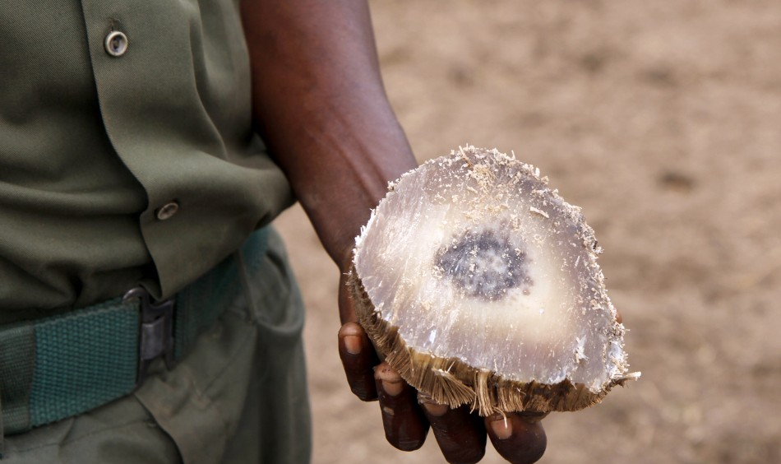

Slide 18
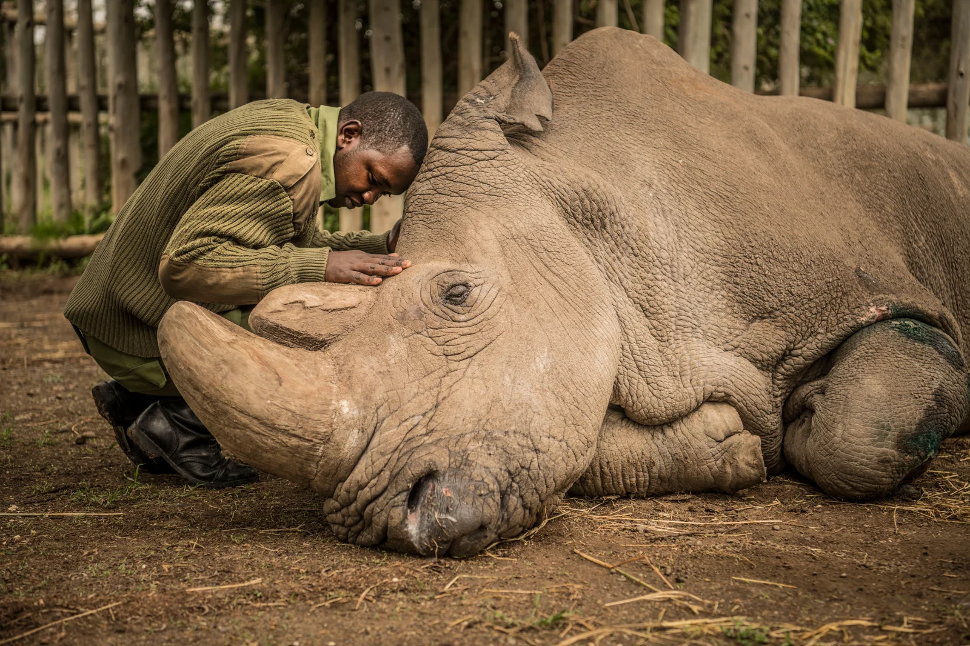
Notes:
Sudan, the world's last male northern white rhino, died in 2018. In his final years, he became a global celebrity and conservation icon, helping raise awareness about the brutality of poaching. Since then, there are only two known rhinos of this subspecies left, both of which are female; barring the existence of unknown or misclassified male northern white rhinos elsewhere in Africa, this makes the subspecies functionally extinct.

Slide 19
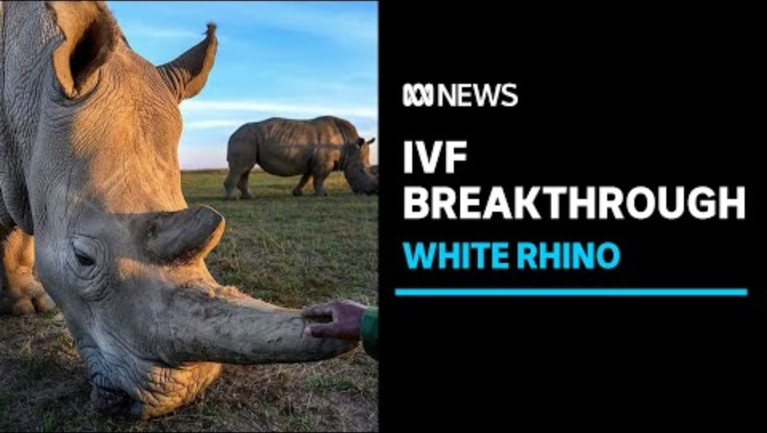

Slide 20
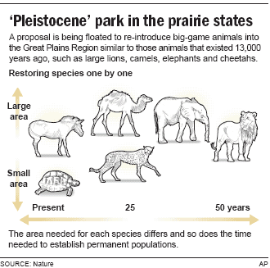
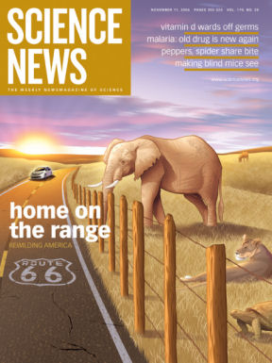

Slide 21
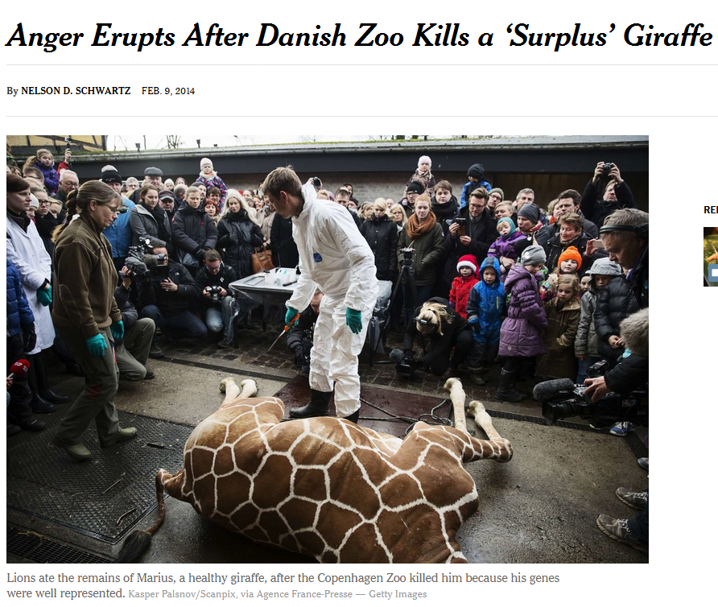
Notes:
https://www.nytimes.com/2014/02/10/world/europe/anger-erupts-over-danish-zoos-decision-to-put-down-a-giraffe.html

Slide 22
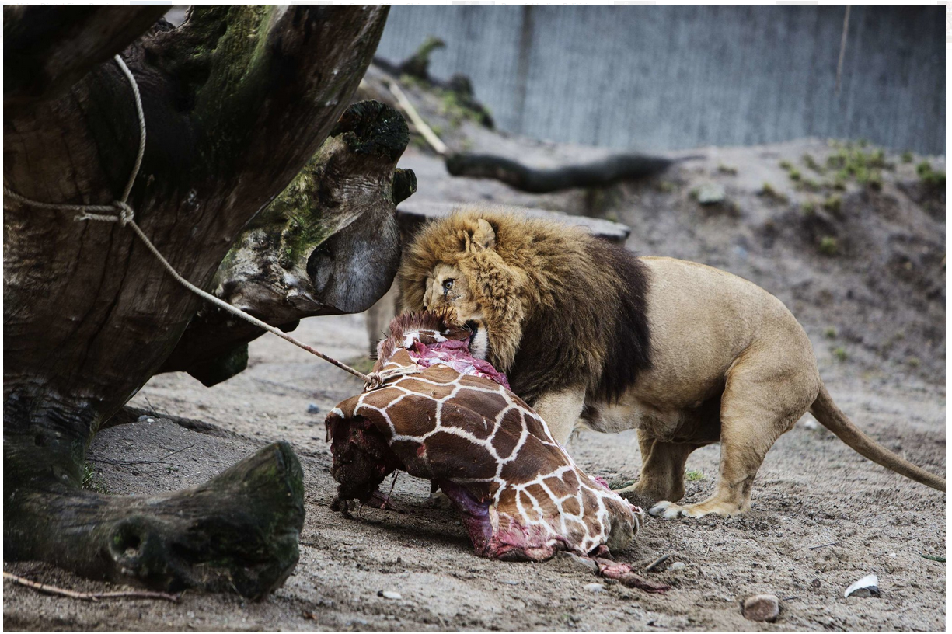
Notes:
Marius the reticulated giraffe died at the Copenhagen Zoo on Sunday. He was 2 years old. The cause of death was a shotgun blast, and after a public autopsy, the animal, who was 11 feet 6 inches, was fed to the zoo’s lions and other big cats. Administrators said they had decided to kill Marius, who was in good health, because his genes were well represented among the captive giraffe population in European zoos. But that explanation did not satisfy animal rights activists who had mounted a furious last-minute campaign to save him. Besides nearly 30,000 online signatures from those who did not want Marius killed, Copenhagen Zoo officials received death threats after they turned down adoption offers from other zoos, as well as a bid of 500,000 euros, or $682,000, from an individual who was willing to take Marius in. One group, Animal Rights Sweden, urged people to stop visiting zoos as a protest, The Associated Press reported. “It is no secret that animals are killed when there is no longer space, or if the animals don’t have genes that are interesting enough,” the organization said in a statement.
Marius was born in captivity at the Copenhagen Zoo, where there are seven reticulated giraffes, a species native to Africa. The species is not endangered, but it faces threats from habitat loss and hunting. Mr. Holst said he had decided against sending Marius to another zoo because doing so would have opened the door to inbreeding and potentially removed a place for a giraffe whose genetic makeup was more valuable in terms of future offspring in captive breeding programs. He seemed caught off guard by the public protest, calling it “totally out of proportion.” “People said, ‘If you kill the giraffe, I’ll kill you,’ ” he said. “It’s insane.” “We don’t do it to be cruel; we do it to ensure a healthy population,” Mr. Holst added. “You have to breed them to make sure the population is renewed.” As for individual offers, he said giraffes were social animals and could not be kept in isolation. Giraffes are allowed to breed in captivity because it is part of their natural behavior in the wild, Mr. Holst said, even though breeding can produce what he called “a surplus animal.” “As long as they are with us,” he said, “we want them to have a good life, with as much natural behavior as possible.” Marius was not fully grown, Mr. Holst said: He could have grown another three feet or so. Officials used a shotgun rather than an injection to kill the giraffe so that his meat would be safe for the zoo’s predator animals to eat. After an autopsy that was open to visitors as an educational opportunity, parts of Marius’s remains were fed to the zoo’s lions — and there is some left over. “We still have meat for lions, tigers and leopards,” Mr. Holst said. “It’s just meat that can be fed to every animal.”

Slide 23
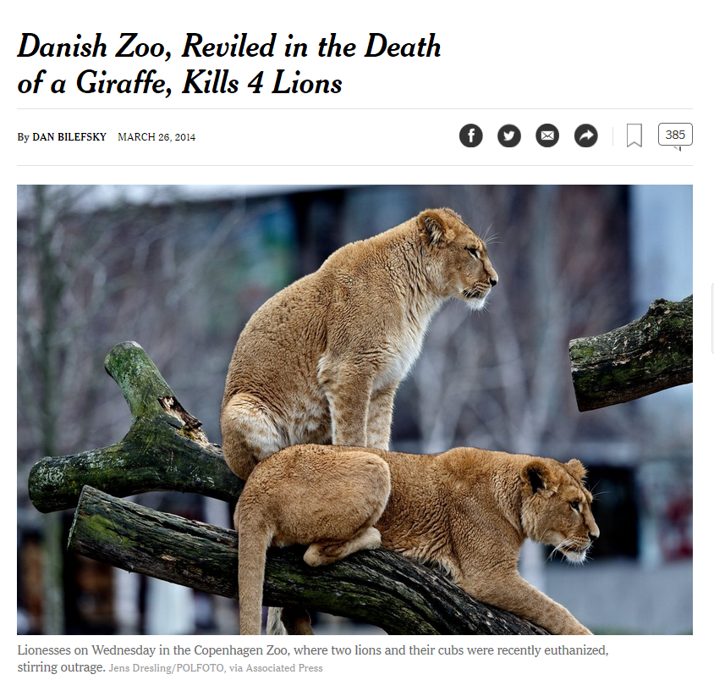
Notes:
https://www.nytimes.com/2014/03/27/world/europe/lion-killing-at-danish-zoo-provokes-fresh-outrage.html

Slide 24
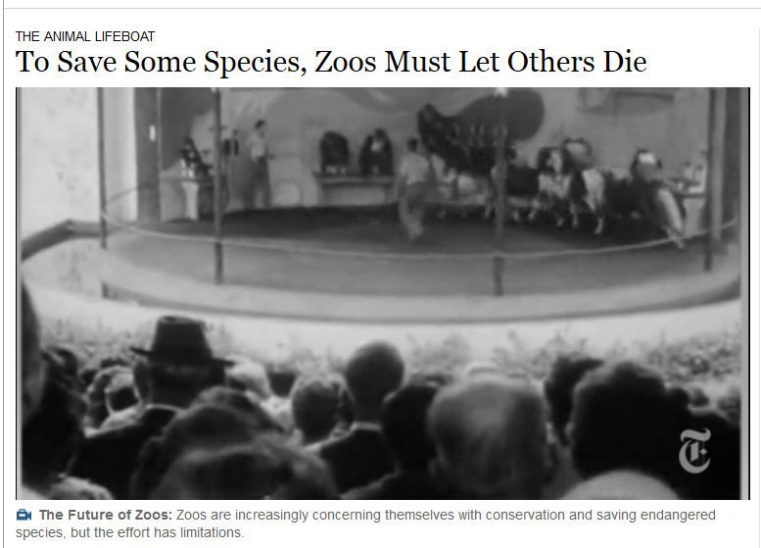
Notes:
https://www.nytimes.com/2012/05/28/science/zoos-bitter-choice-to-save-some-species-letting-others-die.html?emc=eta1

Slide 25
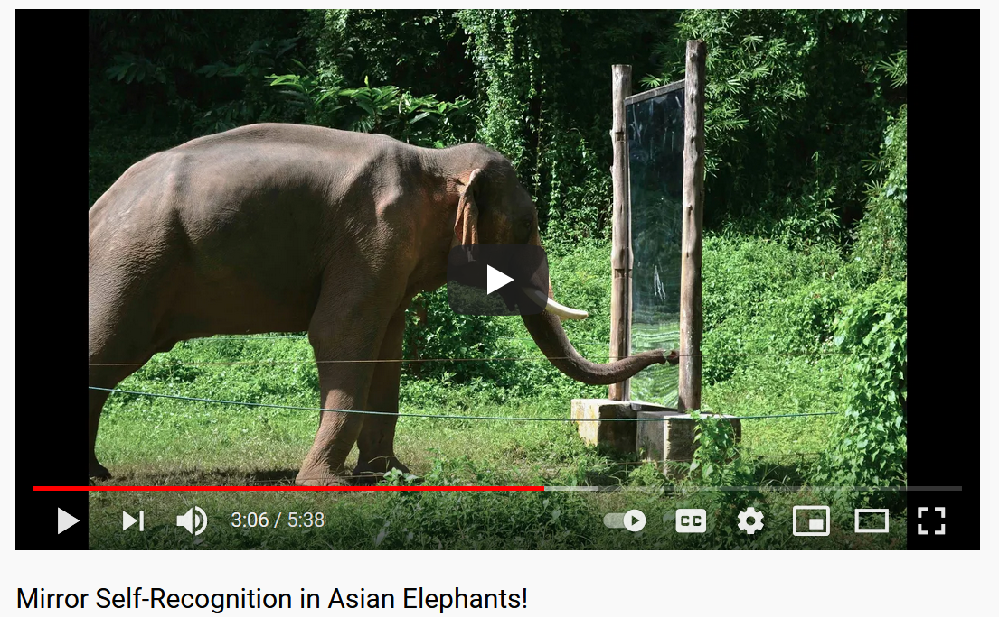

Slide 26
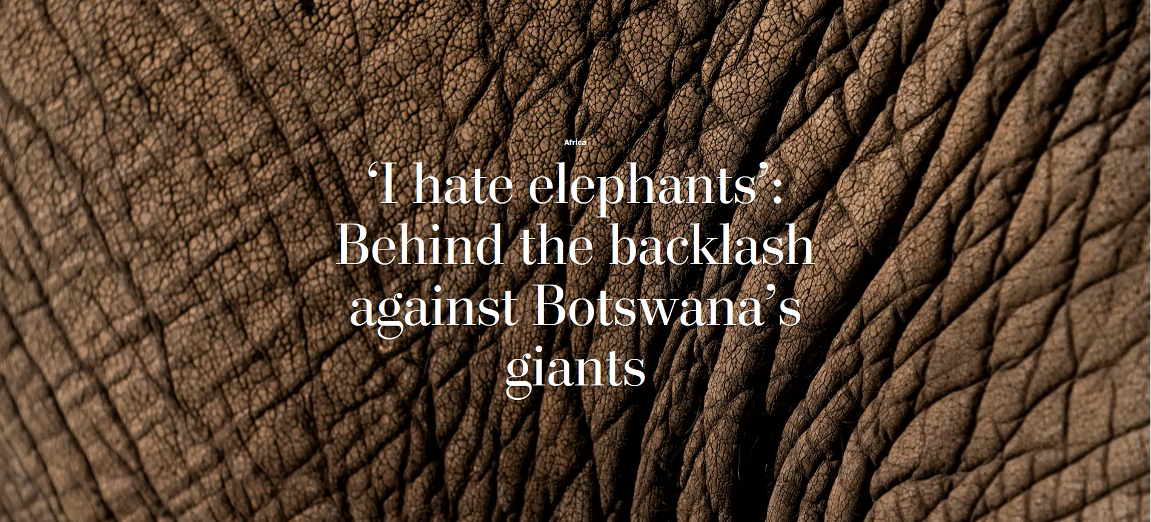
Notes:
https://www.washingtonpost.com/world/2019/06/07/i-hate-elephants-behind-backlash-against-botswanas-giants

Slide 27

Notes:
Lumba Nderiki, a farmer in her 80s, stands for a portrait in her field in Chobe Enclave, Botswana, on May 25, 2019. Her husband of 65 years was killed by an elephant in 2014. She says her fields have been trampled and eaten by elephants for years, and she cannot afford to keep fixing the fencing.
https://www.washingtonpost.com/world/2019/06/07/i-hate-elephants-behind-backlash-against-botswanas-giants/?arc404=true

Slide 28
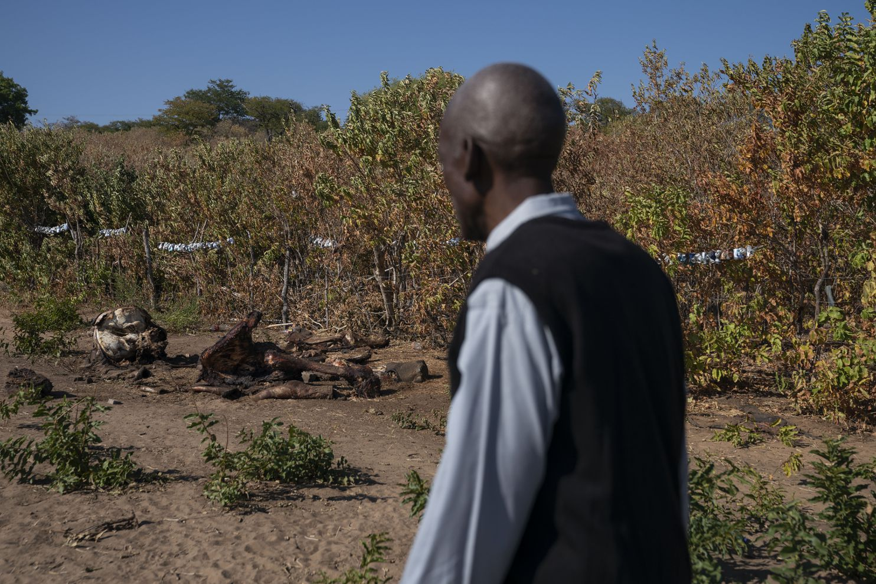
Notes:
Ephraim Simasiku, 71, looks at the carcass of an elephant he killed when he could not scare it off of his watermelon field in Chobe Enclave, Botswana. He uses a fence with tin cans and patrols with a flashlight and a drum to scare the elephants away, but on the night of May 14, after his other methods failed, he shot an elephant with a rifle. After he killed it, community members came to gather the meat. He said that elephants ate 400 of the 1,000 watermelon plants he planted this season.
https://www.washingtonpost.com/world/2019/06/07/i-hate-elephants-behind-backlash-against-botswanas-giants/?arc404=true

Slide 29
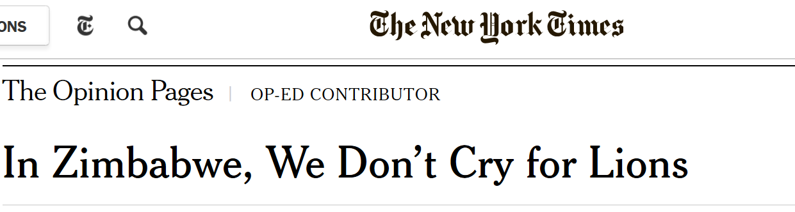
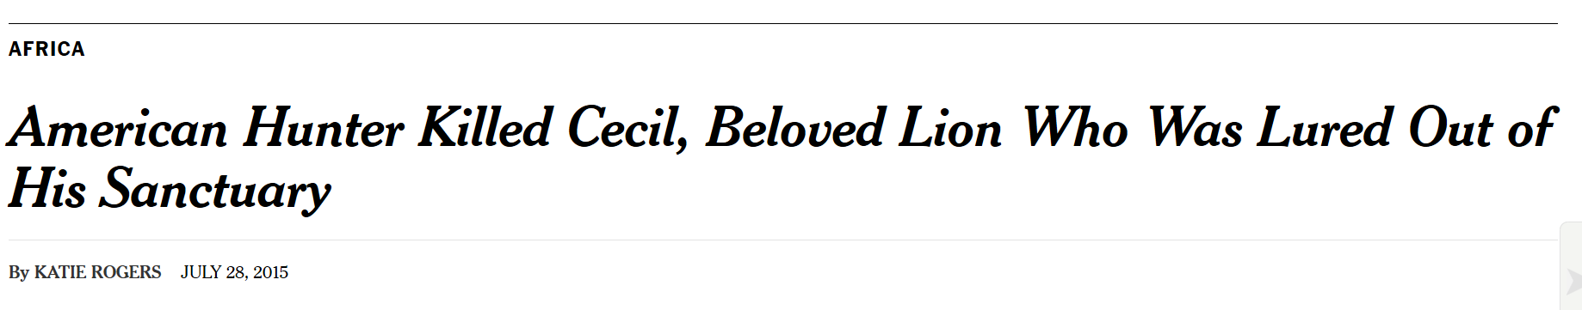
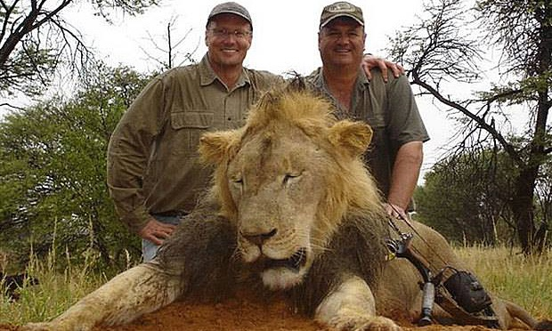

Slide 30
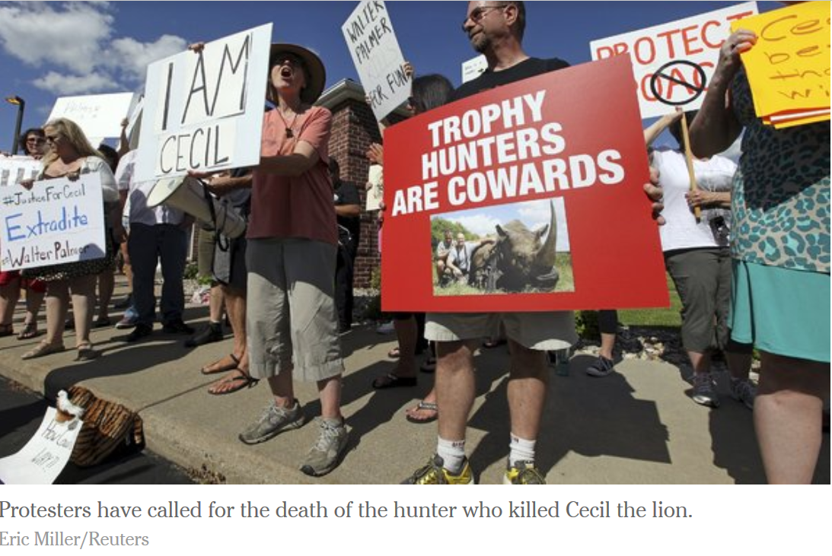
Notes:
The death of Cecil the lion and the protests over it illustrate some of the overlooked tensions around the conservation of large predators.

Slide 31

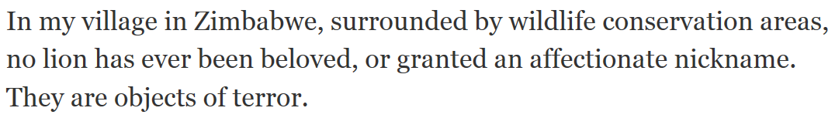
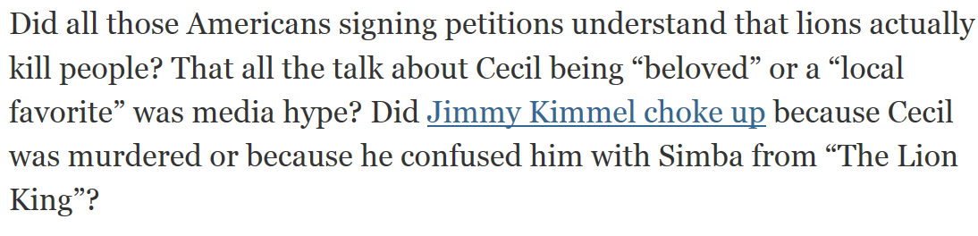
Notes:
http://www.nytimes.com/2015/08/05/opinion/in-zimbabwe-we-dont-cry-for-lions.html
Costs of living with large predators and other megafauna may not be uniformly shared, and impact the poor more.

Slide 32
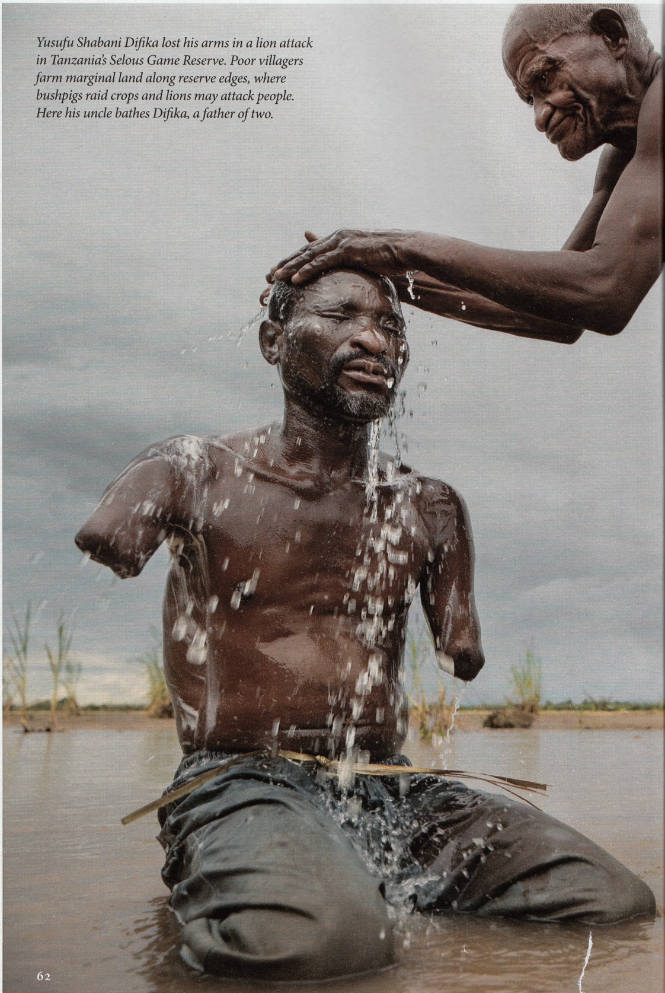
Notes:
We in developed countries are stuck with the contradiction of simultaneously wanting to protect megafauna, recognizing its ecological importance, and calling for policies to protect it. But we don’t have to live with predatory megafauna directly. The goal of today’s lecture is to examine some of the complex tensions around megafauna conservation policies

Slide 33
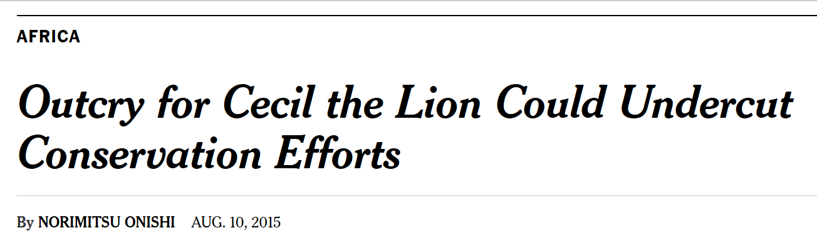
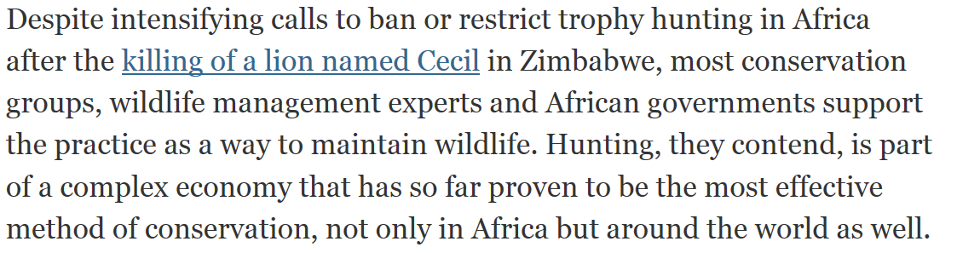
Notes:
http://www.nytimes.com/2015/08/11/world/africa/outcry-for-cecil-the-lion-could-undercut-conservation-efforts.html

Slide 34
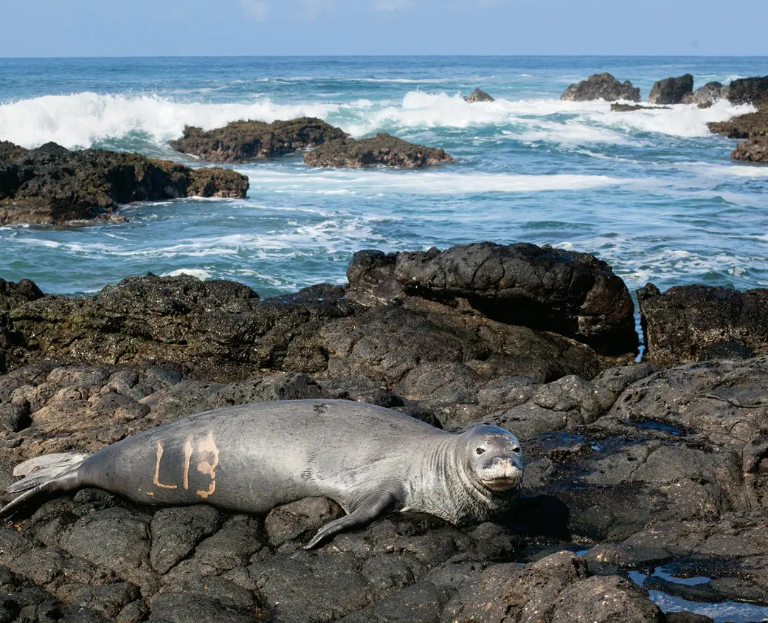


Notes:
Popular discourses that are challenged in this reading: 1) Indigenous cultures are pro-conservation and protective of flora and fauna; 2) Conservative politics are anti-environmental, 3) Large megafauna cannot live in proximity to humans

Slide 35
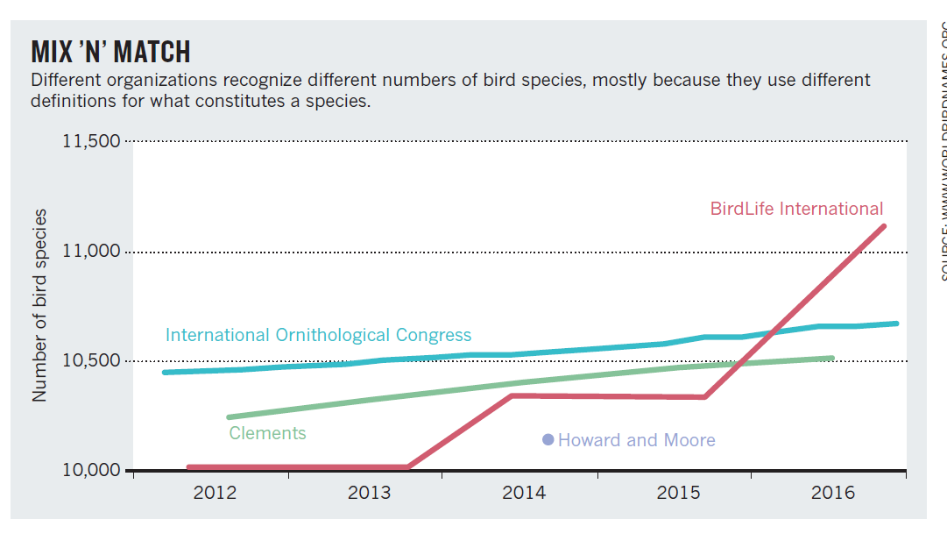
Notes:
BirdLife international uses more

Slide 36
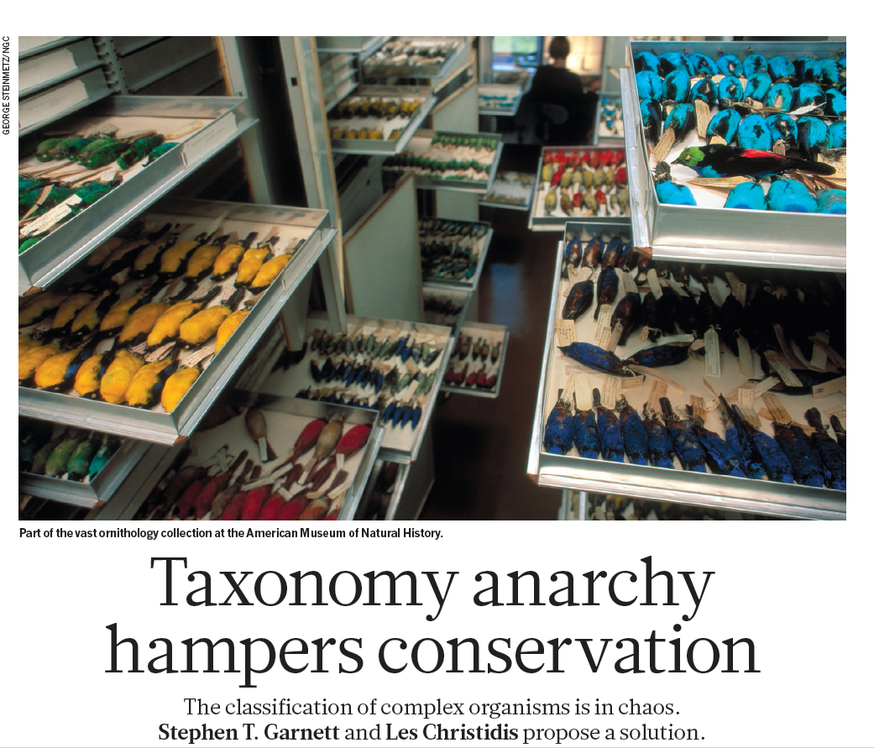
Notes:
There are important consequences for how we define species

Slide 37
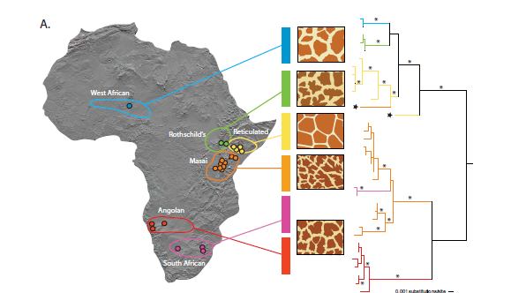
Notes:
All extant giraffes (Giraffa camelopardalis) were considered to represent a single species classified into multiple subspecies. However, there are at least six genealogically distinct lineages of giraffe in Africa, whereas there has been no overall consensus in the past. Even within well known and highly mobile species, subdivisions can exist and their lack of recognition could lead to further endangerment or even extinction. There is little evidence of interbreeding between these six populations. Some of these lineages appear to be maintained in the absence of contemporary barriers to gene flow, possibly by differences in reproductive timing or assortative mating,

Slide 38
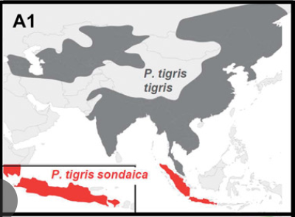
Notes:
Wilting, A., Courtiol, A., Christiansen, P., Niedballa, J., Scharf, A. K., Orlando, L., ... & Kitchener, A. C. (2015). Planning tiger recovery: understanding intraspecific variation for effective conservation. Science advances, 1(5), e1400175.
Although significantly more money is spent on the conservation of tigers than on any other threatened species, today only 3200 to 3600 tigers roam the forests of Asia, occupying only 7% of their historical range. Despite the global significance of and interest in tiger conservation, global approaches to plan tiger recovery are partly impeded by the lack of a consensus on the number of tiger subspecies or management units, because a comprehensive analysis of tiger variation is lacking. We analyzed variation among all nine putative tiger subspecies, using extensive data sets of several traits [morphological (craniodental and pelage), ecological, molecular]. Our analyses revealed little variation and large overlaps in each trait among putative subspecies, and molecular data showed extremely low diversity because of a severe Late Pleistocene population decline. Our results support recognition of only two subspecies: the Sunda tiger, Panthera tigris sondaica, and the continental tiger, Panthera tigris spondaic, which consists of two (northern and southern) management units. Conservation management programs, such as captive breeding, reintroduction initiatives, or trans-boundary projects, rely on a durable, consistent characterization of subspecies as taxonomic units, defined by robust multiple lines of scientific evidence rather than single traits or ad hoc descriptions of one or few specimens. Our multiple-trait data set supports a fundamental rethinking of the conventional tiger taxonomy paradigm, which will have profound implications for the management of in situ and ex situ tiger populations and boost conservation efforts by facilitating a pragmatic approach to tiger conservation management worldwide.

Slide 39
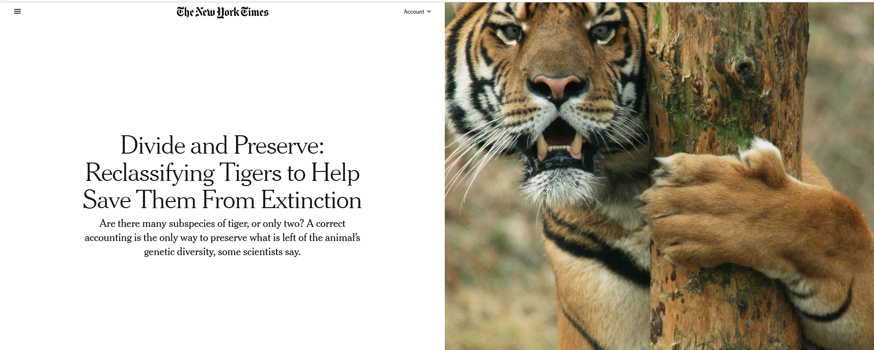

Slide 40
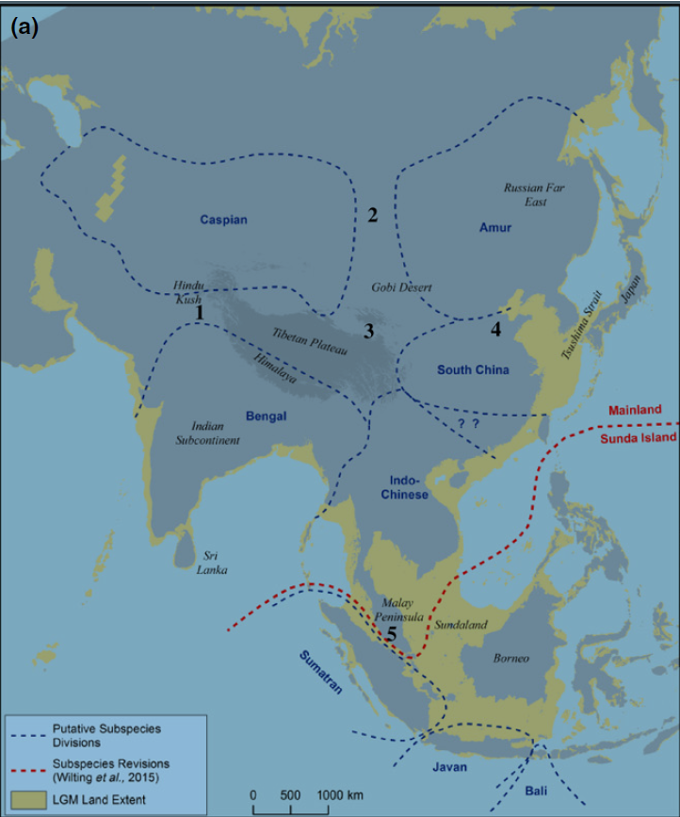
Six extant tiger subspecies
Extinct subspecies
  Bali tiger (1940)
  Caspian tiger (1970s)
  Javan tiger (1980s)
Extinct in the wild subspecies
  South China tiger (1990s)
Critically endangered
  Sumatran tiger
Endangered
  Amur (Siberian) tiger
  Indian (Bengal) tiger
  Indochinese tiger
  Malayan tiger (designated a subspecies in 2004)
Notes:
Liu, Y. C., Sun, X., Driscoll, C., Miquelle, D. G., Xu, X., Martelli, P., ... & Luo, S. J. (2018). Genome-wide evolutionary analysis of natural history and adaptation in the world’s tigers. Current Biology, 28(23), 3840-3849.
The lack of consensus over the number of tiger subspecies has partially hindered the global effort to recover the species from the brink of extinction, as both captive breeding and landscape intervention of wild populations increasingly require an explicit delineation of the conservation management units. The recent coalescence to a late Pleistocene bottleneck (circa 110,000 years ago poses challenges for detecting tiger subspecific morphological traits, suggesting that elucidating intraspecific evolution in the tiger requires analyses at the genomic scale. Here, we present whole-genome sequencing analyses from 32 voucher specimens that resolve six statistically robust monophyletic clades corresponding to extant subspecies, including the recently recognized Malayan tiger (P. tigris jacksoni). The intersubspecies gene flow is very low, corroborating the recognized phylogeographic units. We identified multiple genomic regions that are candidates for identifying the adaptive divergence of subspecies. The body-size-related gene ADH7 appears to have been strongly selected in the Sumatran tiger, perhaps in association with adaptation to the tropical Sunda Islands. The identified genomic signatures provide a solid basis for recognizing appropriate conservation management units in the tiger and can benefit global conservation strategic planning for this charismatic megafauna icon.

Slide 41
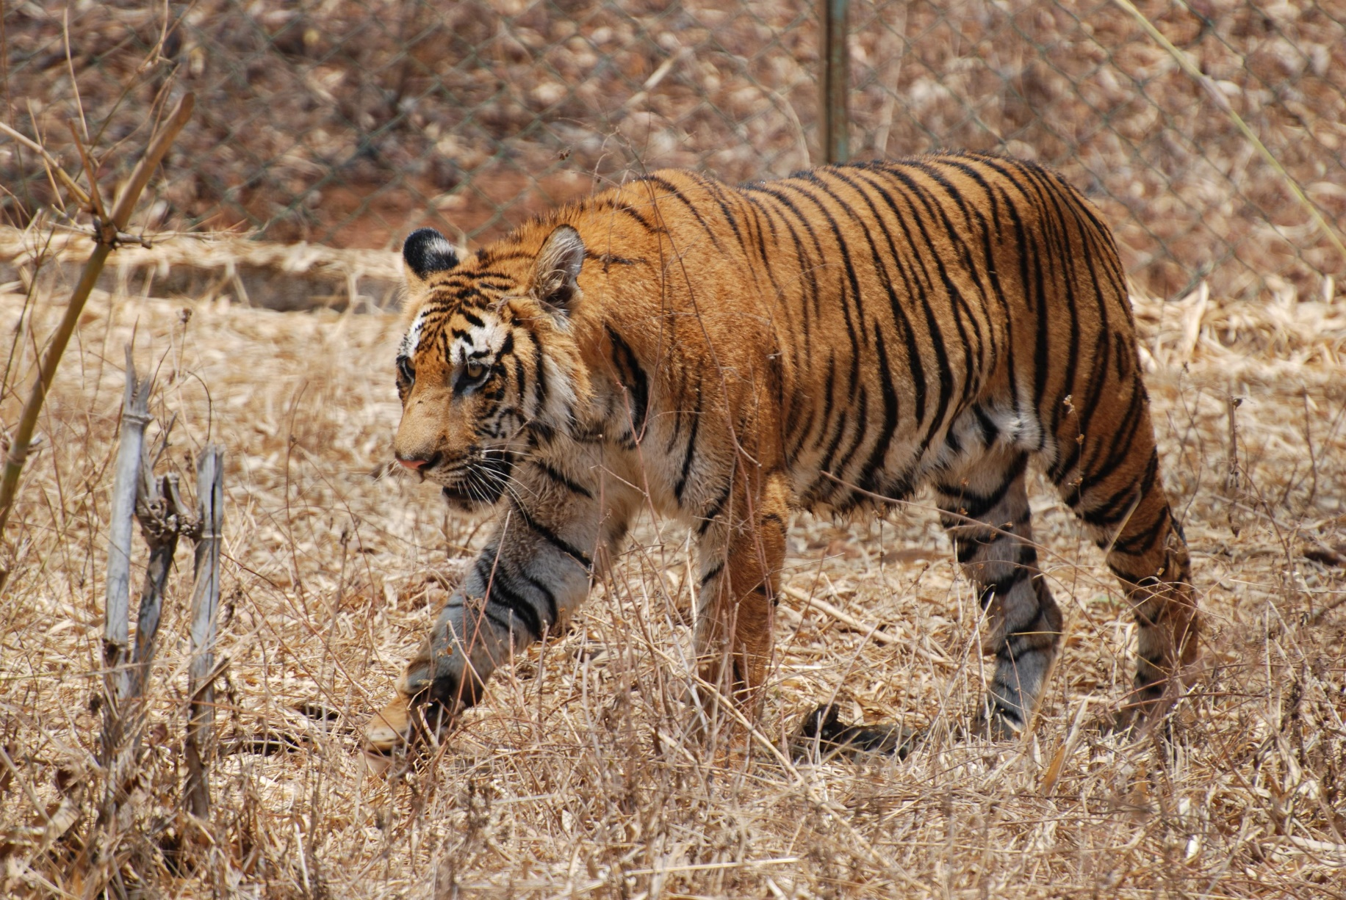
Notes:
Above, the Indian or Bengal tiger. Found in India with smaller populations in Bangladesh, Nepal, Bhutan, China and Myanmar.
Most numerous of all tiger subspecies. Classified as endangered by the IUCN Red List. India plays a vital role in the conservation of tigers since nearly 60% of all wild tigers are currently found here.
In China, all the farmed tigers and remaining tigers in the wild are Amur tigers, also known as Siberian tigers.

Slide 42
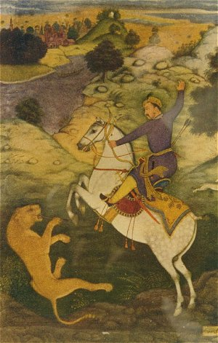

.
Notes:
Emperor Babur Hunting a Tiger
Large scale hunting of Bengal tigers by Mughal rulers of India beginning 500 years ago. The British conducted tiger hunts during colonial era from 1850’s until 1947, the year India gained independence from Britain
http://voices.nationalgeographic.com/2014/03/10/a-concise-history-of-tiger-hunting-in-india/

Slide 43

Notes:
http://vimeo.com/7586728

Slide 44


Notes:
States in India compete for being the “Tiger State” and having the most tigers.
If you convert the kilometers to miles, you would see that many of these reserves are quite small. At the largest, 3568 km, this is approximately a 60 x 60 km area. Given that a couple of kilometers define a mile, then the largest reserve would only span an area of 25 x 25 miles. For the very smallest reserve 257 square kilometers, this would be an area of 15 x 15 km, or roughly a 7 x 7 mile area.

Slide 45

Notes:
The animals are increasingly becoming isolated in small reserves. If the cats leave the parks, the risks are rising that they will encounter humans and infrastructure, with tragic results for both the animals and people.

Slide 46

Notes:
https://www-nature-com/articles/d41586-019-03267-z
A motion-activated camera trap shows a tiger using the same path as people and livestock

Slide 47

Notes:
https://www-nature-com/articles/d41586-019-03267-z
A tiger was killed trying to cross a train track near Jaldapara National Park, India

Slide 48




Slide 49

Notes:
Tigers are far from maneaters, and go out of their way to avoid humans
However, there is a high density of people surrounding reserves. As conservation areas increase tiger populations, likelihood of attacks on livestock and humans increase. Therefore, recovery goals may bring about more conflict.
85 people per year die in India each year from tiger attacks

Slide 50


Slide 51


Notes:
Pro-tiger sentiments strong in rich countries
In some cases, it has been shown that the numbers were so exaggerated as to be biologically. Not a single tiger survived in Sariska Tiger Reserve, despite government claims that 18 tigers lived there. When three men were later arrested, they described how easy it was to kill them.
In paper parks there may be only a partial enforcement of bans on use of the park for resources so as to lessen local political conflicts.
Tiger conservation in India has long depended upon funds from international conservation organizations. These can exert considerable influence on Indian politics
This power that more powerful economic actors exert on the environmental policies can be a form of green neocolonialism. Numbers of tigers may be exaggerated because
of political pressure from outside as well as inside India

Slide 52


Notes:
But the burden of living with tigers and lions is often born by rural poor
A successful Royal Bengal tiger breeding program has increased their numbers but decreased the number of husbands. There are now an estimated 3,000 widows in the villages where their husbands, have been killed by tigers
http://www.thenational.ae/news/world/south-asia/the-tiger-widows-of-the-sundarbans

Slide 53


Notes:
In the Sundarbans region of undersubscribes India and Bangladesh, breeding programs have increased tiger numbers, but at the cost of human fatalities
Tiger fatalities are often revenge killings

Slide 54

Notes:
https://youtu.be/A7TG4SIy3dg?si=sEot-CiabUEDF2F7
Killings are not purely retaliatory in nature (i.e. driven by a desire for retribution following livestock depredation or attacks on humans by tigers), and that previous negative experience of tigers is not the sole determinant of villagers’ acceptance of killing behaviour. Inter-related socio-psychological factors (risk perceptions, beliefs about tigers and the people that kill tigers, general attitude towards tigers), perceived failings on the part of local authorities whom villagers believe should resolve village tiger incidents, perceived personal rewards (financial rewards, enhanced social status, medicinal or protective value of tiger body parts), and contextual factors (the severity and location of tiger incidents) motivate people to kill tigers when they enter villages and foster the widespread acceptance of this behaviour. The complexity of these factors highlights the need for conservation practitioners to explore and understand people’s motivations for killing endangered carnivore species, in order to address better the community-led killing of these animals. Knowledge of these motivational factors can be used to develop conservation actions suitable for developing both communities’ capacity and, crucially, desire to co-exist with tigers and to respond with non-lethal action to village tiger incidents.

Slide 55

Notes:
Potential solutions: 1) Address crowd formation behavior (tiger attacks can be a defensive behavior in response to being surrounded by people); 2) Tiger proof houses and livestock pens; 3) Address development issues and enhance social capital; 4) Provision of solar electricity grids (nighttime lighting may thwart tigers and enhance their detection); 5) Build village capacity to respond to tigers through non-lethal means; 6) Empower villagers to organize and respond on their own rather depending solely upon officials

Slide 56

Global conservation initiatives
Notes:
CITES - Convention on International Trade in Endangered Species. CITES is an international treaty, not a formal set of laws. Countries pledge their support for this international agreement to ensure that international trade in specimens of wild animals and plants does not threaten their survival.
IUCN Red List - International Union for Conservation of Nature. This is a comprehensive, global database detailing the conservation status of plant and animal species. It plays a role in guiding conservation activities of governments, NGOs and scientific institutions.
ESA – Endangered Species Act. The Endangered Species Act of 1973 is the primary law in the United States for protecting and conserving imperiled species. It has served as the model for the conservation of species globally

Slide 57

Notes:
Species toward the top of these charts (Spix’s macaw, Socorro dove, Hawaiian crow…) are those that human have successfully brought back from extinction because of conservation efforts. The probability that human factors made this possible is very high with little uncertainty. However, many of these species toward the top are still low in number and remain conservation reliant.
Species toward the bottom (Townsend’s shearwater, Chinese crested tern, Chatham’s parakeet, Niceforo’s wren) are those in which it is less likely that human efforts were will be able to keep these species from going extinct. There is also considerably more uncertainty as to whether our efforts will work for these species toward the bottom.
This graph shows that there are some undeniable successes. However, there are many more species in which the range of variability in the likelihood that human conservation efforts can prevent extinction is large. In other words, our efforts have a large degree of uncertainty as to their outcomes.

Slide 58


Slide 59


Slide 60


Slide 61

How are northern white rhinos different from the atmosphere? What does such a question suggest about addressing extinctions?

Slide 62


Slide 63

Notes:
https://www.youtube.com/watch?v=zNtr0RahRqM

