Slide 1
Alternative proteins and underutilized and neglected crops
Growing recognition of the need to reduce the impact of meat consumption
This has led to searches for alternative proteins
In addition, a small number of food crops feed the majority of people
Incorporating underutilized and neglected crops into diets increases food security
Addressing economic inequities governing food surpluses and deficits at present levels of food production is also needed
But diet evolves – humans have not eaten the same throughout their evolution
Relationships among food, population, and environment have always co=evolved

Slide 2
Alternative proteins

Slide 3
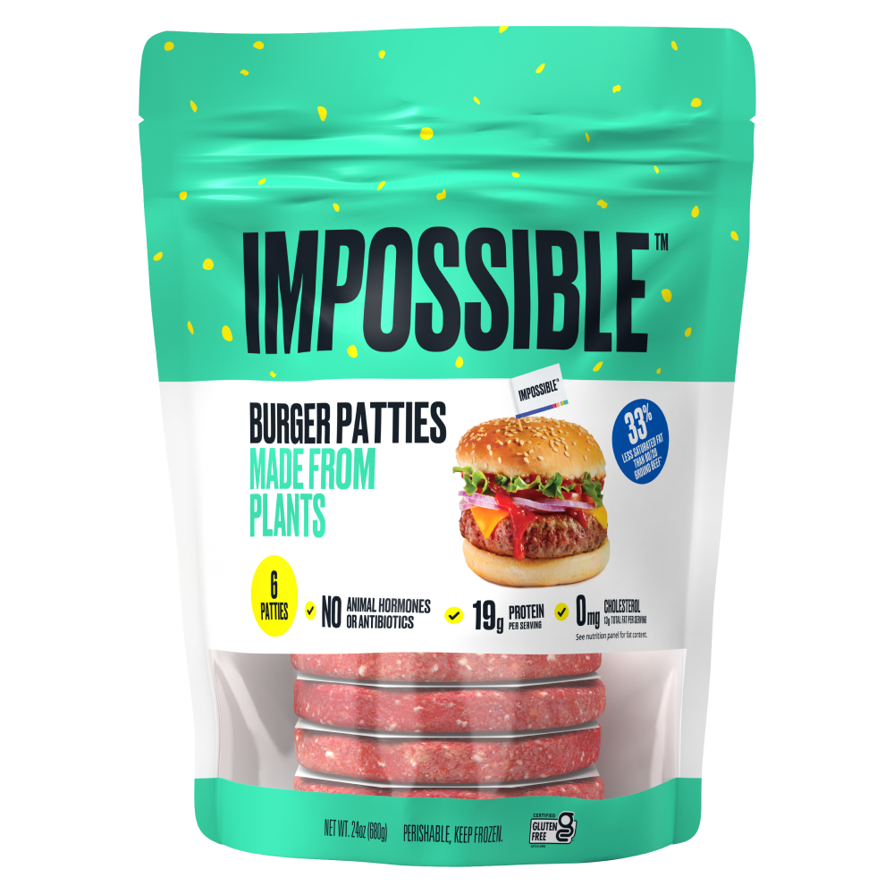
Impossible Burger
Plant-based ingredients: wheat and potato proteins, coconut oil, and heme
Heme is the iron-containing component of hemoglobin that gives meat its taste and texture.
Heme is found in both plants and animals
Yeast were genetically engineered to produce heme made by a soybean gene
Compared to beef, requires 96% less land, 87% less fresh water, generates 89% less greenhouse gas emissions and 92% less pollution to fresh water ecosystems.
Notes:
https://impossiblefoods.com/ca/products/burger https://unfccc.int/climate-action/momentum-for-change/planetary-health/impossible-foods

Slide 4
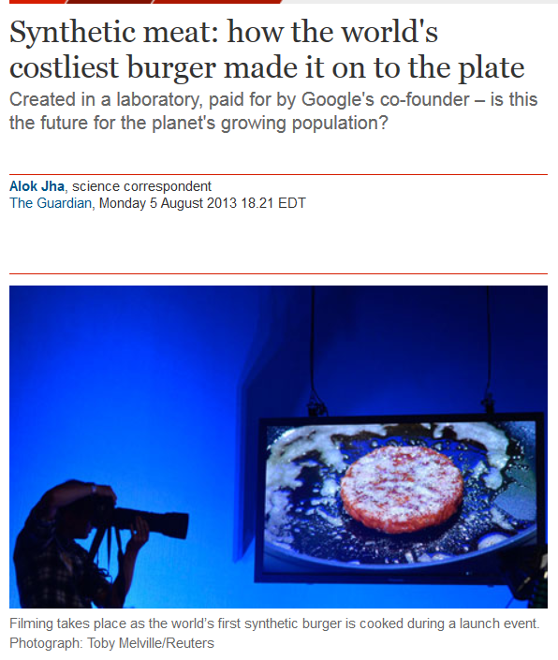
Notes:
http://www.theguardian.com/science/2013/aug/05/world-first-synthetic-hamburger-mouth-feel
https://www.technologyreview.com/2023/05/25/1073590/lab-grown-burger-taste-cultured-meat/

Slide 5
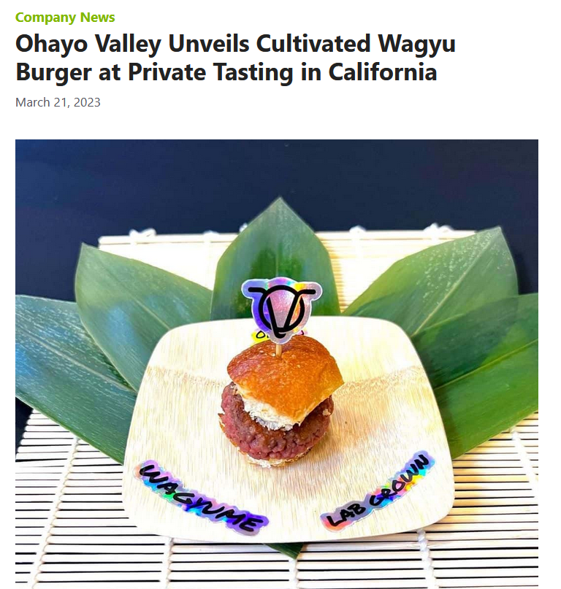
Lab burger: cultured meat cells
Muscle cells initially harvested from cow (or other animal)
Cells are fed nutrient-rich broth so they divide and grow (tissue cultures like this are routinely used in medicine and science)
Not necessary to keep butchering cows for cells
First burger in 2013 cost $330,000 to produce
Not anywhere near as successful as plant-based proteins
Notes:
https://vegconomist.com/company-news/ohayo-valley-cultivated-wagyu-burger-private-tasting/ https://www.technologyreview.com/2023/05/25/1073590/lab-grown-burger-taste-cultured-meat/

Slide 6
Notes:
In fact, cell-based meat and much of Silicon Valley’s interest in creating lab-grown meat an other foods was a bubble. Investments were made, but no innovations have become anywhere nearly as successful as hyped. https://www.nytimes.com/2024/02/09/opinion/eat-just-upside-foods-cultivated-meat.html Yet despite nearly a decade of work and a great many messianic pronouncements, it is increasingly clear that a broader cultivated meat revolution was never a real prospect, and definitely not within the few years we have left to avert climate catastrophe. Interviews with almost 60 industry investors and insiders, including many who have been employed by or been part of the leadership teams of these companies, reveal a litany of squandered resources, broken promises and unproven science. Founders, hemmed in by their own unrealistic proclamations, cut corners, such as using ingredients derived from slaughtered animals. Investors, swept up in the excitement of the moment, wrote check after check despite significant technological obstacles. Costs refused to enter the realm of plausible as launch targets came and went. All the while, nobody could achieve anything close to meaningful scale. And yet companies rushed to build expensive facilities and pushed scientists to exceed what was possible, creating the illusion of a thrilling race to market.

Slide 7
Notes:
https://youtu.be/qwGeio0wJ-w?si=Y5kqXqLRBEOoWjOb One place in the world where cell-based meat is sold publically – Singapore. And it is chicken.

Slide 8
Notes:
https://youtu.be/_oTmv1nYHAY?si=zAwHw6EongrpBptj
But cell culture-based food is not done yet. Coffee can be produced in the laboratory without coffee plants. But would it put small coffee farmers out of business? All of them? Some of them?

Slide 9
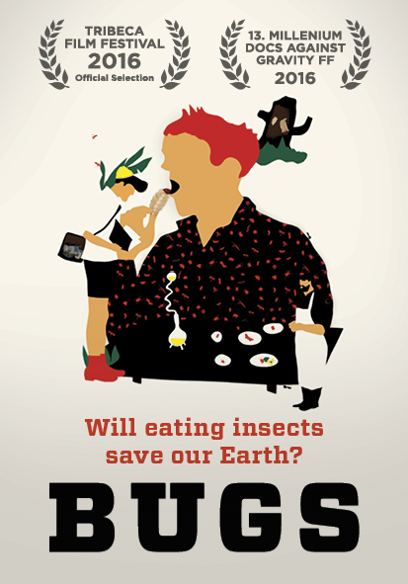
Industrial insect food production
Insects produce body mass at a high rate because as cold-blooded animals they don’t need to expend energy on regulating their body temperature.
Most insects can be eaten whole. Only about half of a chicken or a pig is edible; for a cow the fraction is even less
Notes:
In Southern Africa, 9.5 billion mopane caterpillars— named for their favorite tree—are harvested every year for human consumption, and in Uganda, a kilogram of grasshoppers is more expensive than a kilogram of beef. Insects produce body mass at an astonishing rate, in part because as cold-blooded animals they don’t need to expend energy on regulating their body temperature. Most insects can be eaten whole. Only about half of a chicken or a pig is edible; for a cow the fraction is even less

Slide 10
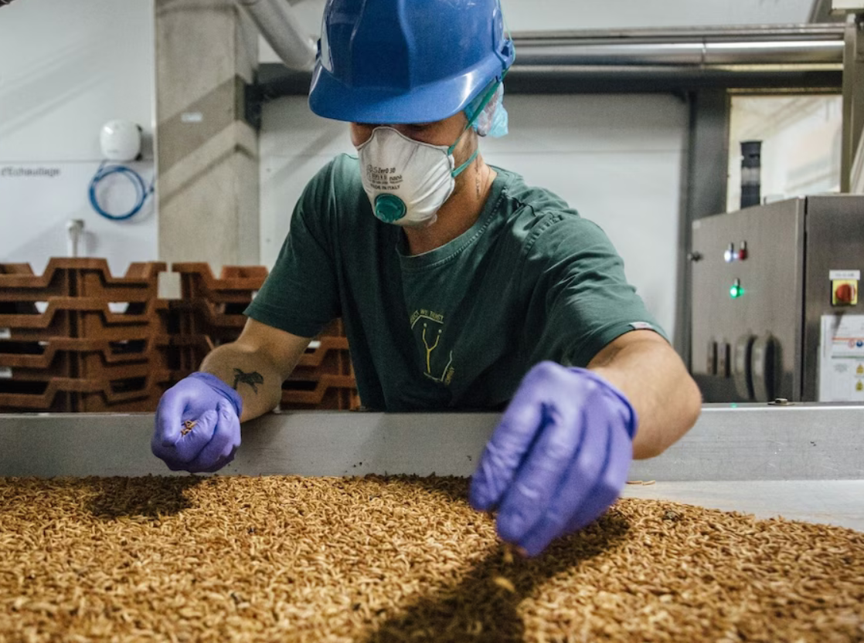
Notes:
https://www.washingtonpost.com/climate-solutions/2023/11/12/biggest-insect-farm-record/

Slide 11
Notes:
https://www.ynsect.com/

Slide 12
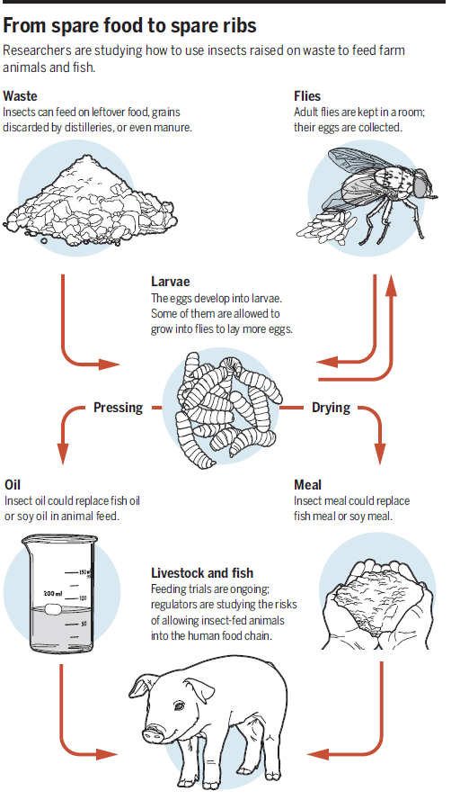
Notes:
You ever been to a farm? Are there insects there? Flies? Why not put them to work?
Many insect species like maggots can feed on manure or other types of organic waste, such as leftover food, offal, and grains discarded by breweries. Once dried, these insects can be used to feed cattle.

Slide 15
Notes:
Quinoa http://www.fao.org/quinoa-2013/press-room/news/detail/en/

Slide 16
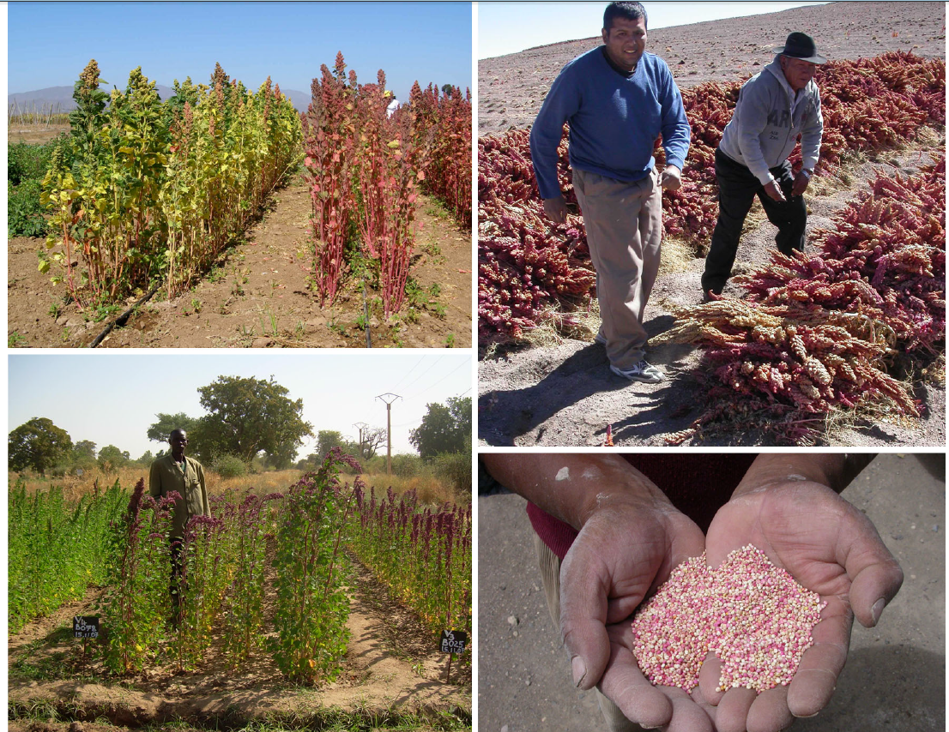
Quinoa
Grows in poor quality soils in dry climates
Domesticated in the Andes
Quinoa seeds are high in protein, have all essential amino acids, a lack of gluten, and high content of several minerals
Notes:
Archaeological evidence indicates that quinoa was domesticated some 7,000 years ago in the high plateau around Lake Titicaca in the Andes, becoming a major food crop for Andean civilizations that preceded the Inca. Quinoa was prized for its nutritional qualities and adaptability to diverse environments, growing at an exceptional range of altitudes (from sea level to 14,000 ft, temperatures (can withstand persistent freezing temperatures as well as hot and humid weather) and soil conditions. By the mid-twentieth century, quinoa had fallen out of fashion, being cultivated mainly by isolated native communities in the Andean highlands. It wasn’t until the 1970s that that the plant’s nutritional and commercial potential began to be more widely appreciated, but increased scientific input into breeding programs will be needed if the full potential of this crop is to be realized. At the same time, the cultures that have grown quinoa should benefit from the use of their culture for the development of improved varieties. A growing concern with underutilized crops is that they may be put into commercial use without due recognition of those who have been their caretakers, and worse, the success of these crops used to disenfranchise these peoples from the lands and agricultural traditions they may wish to continue practicing. Could quinoa become a seed crop controlled by large agricultural interests like corn?

Slide 17
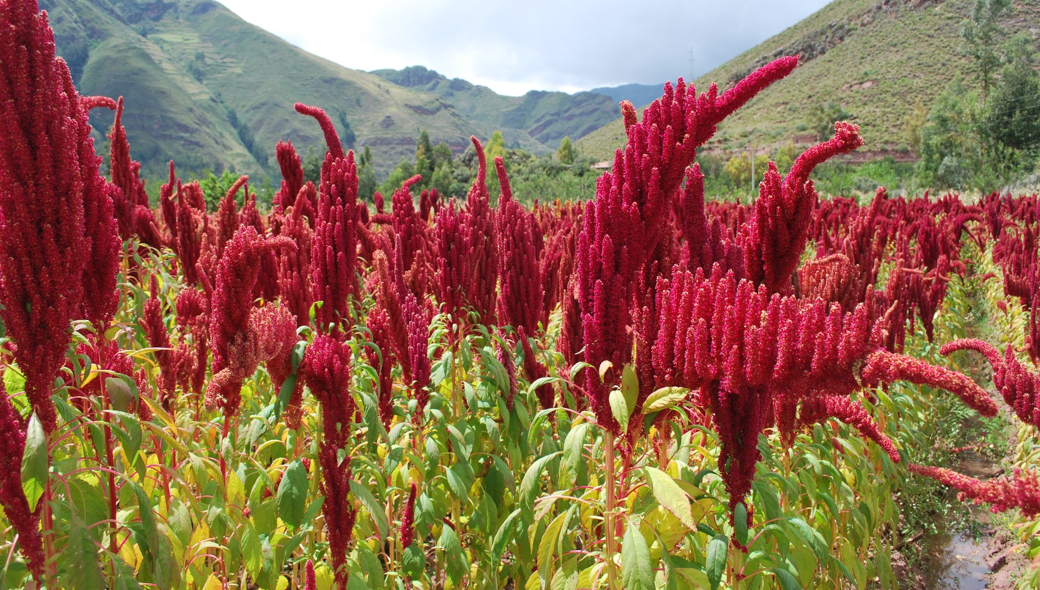
Amaranth
Notes:
An important but underused African crop is amaranth. Amaranth is native to South and Central America. It was a staple in the Aztec However, its use as a staple diminished considerably when Spanish colonizers considered it heathen food and banned its use. This did not prevent Amaranth from spreading throughout the world. The grain can be consumed in various forms, turned into flour or even popped as popcorn. The grain is richer in protein, iron and vitamin C than wheat, maize and brown rice. Amaranth flour can be blended with maize flour to make ugali — a staple dish in many African countries. Amaranth is one of a host of plants used by indigenous communities around the world that researchers are turning their attention to. The appeal of these traditional crops lies in their pre-adapted condition. Unlike a new line of rice or wheat that requires careful testing before it can be used commercially, and may not be suited to every environment, these underused crops have been growing locally for centuries. They are well adapted to their environment, and often resistant to a region’s pests and diseases.

Slide 18
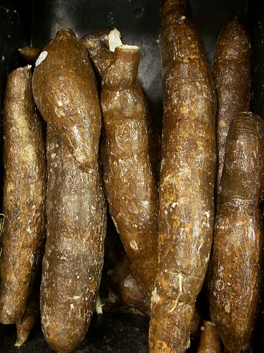
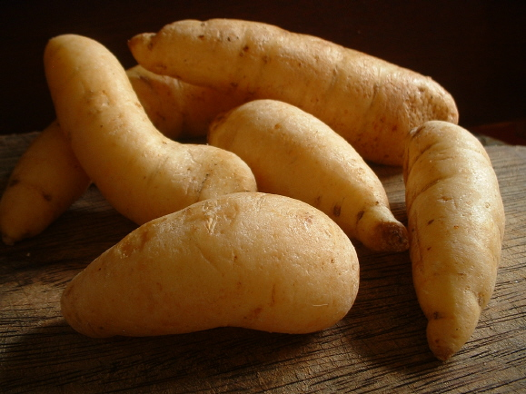
Yuca
Arracacia
Notes:
Arracacia xanthorrhiza is a root vegetable originally from the Andes, somewhat intermediate between the carrot and celery. Its starchy taproot is a popular food item in South America where it is a major commercial crop. Yucca is an ornamental plant.

Slide 20
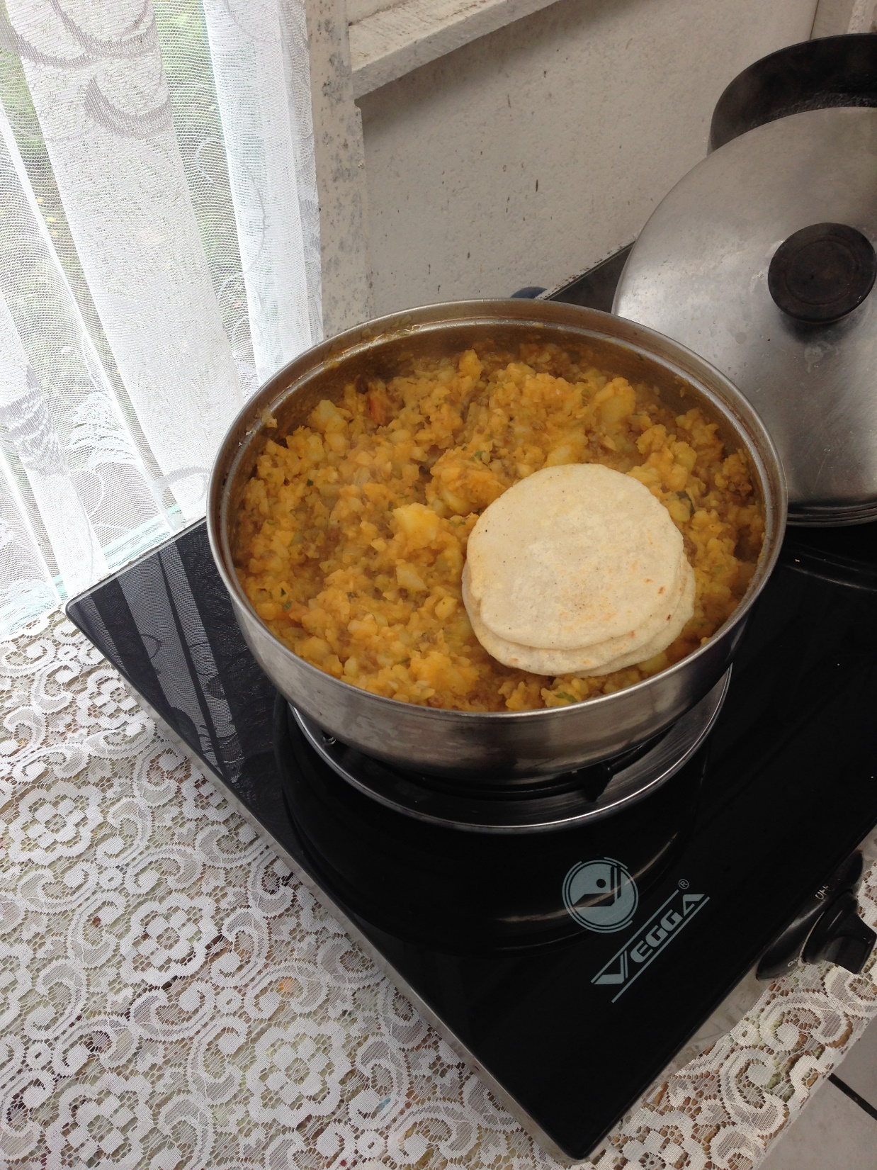
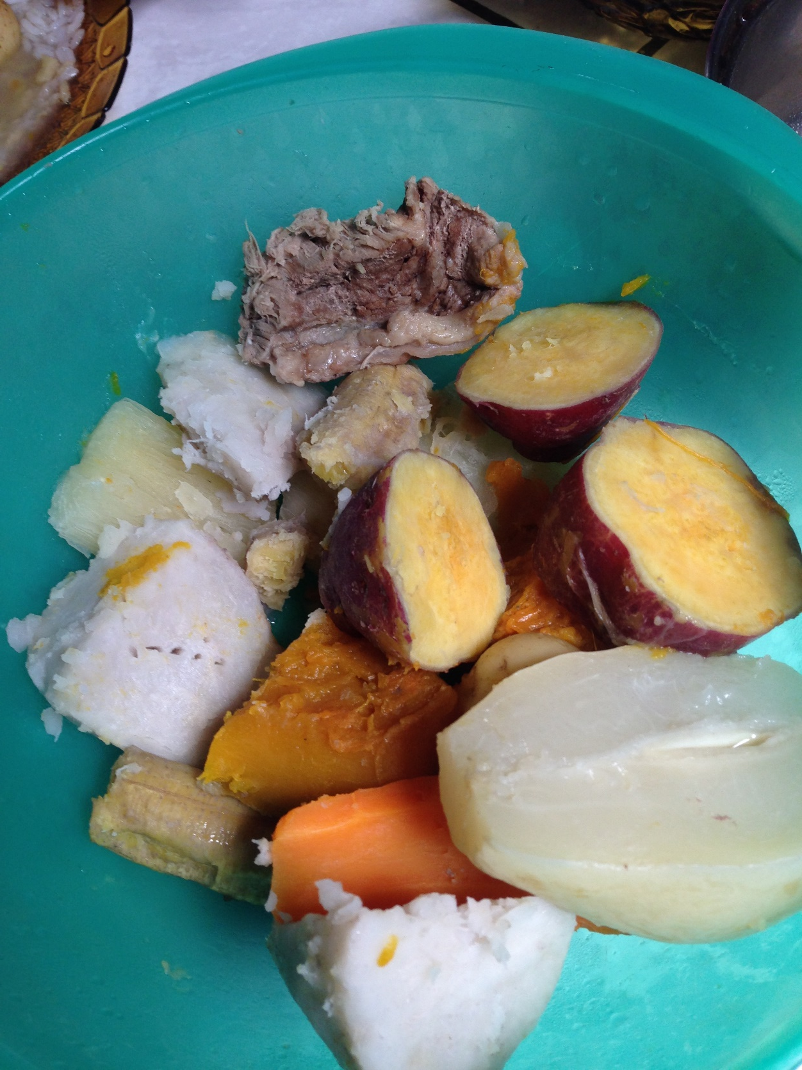
Notes:
Arracacia xanthorrhiza is a root vegetable originally from the Andes, somewhat intermediate between the carrot and celery. Its starchy taproot is a popular food item in South America where it is a major commercial crop.

Slide 21
Underutilized and neglected crops
Developing countries were encouraged to plant Green Revolution varieties of wheat, corn, rice that were to be grown in an industrial manner
This decreased production of local food crops and in some cases increased reliance on imports of these staple foods
Industrial agriculture displaced local small producers
Diets shifted with less consumption to traditional crops which were often well suited to local soils and climate
Notes:
https://www.nytimes.com/2024/01/22/climate/agriculture-africa-traditional-crops.html In the 1960s and ’70s, the U.S.-led green revolution focused on producing more food — specifically more maize, wheat, and rice — using fertilizers, pesticides and hybrid seeds. Maize yields, for instance, soared, thanks to investments in plant breeding. In much of southern and eastern Africa, maize became the major food grain, while, in some places, cash crops for export, like cotton and tobacco, were prevalent. A handful of countries came to dominate the production of cereals, while a handful of cereals — wheat, rice and maize — came to dominate the world’s diet. While the green revolution is credited with offering up more calories, it did little to ensure a varied, nutritious diet.

Slide 22
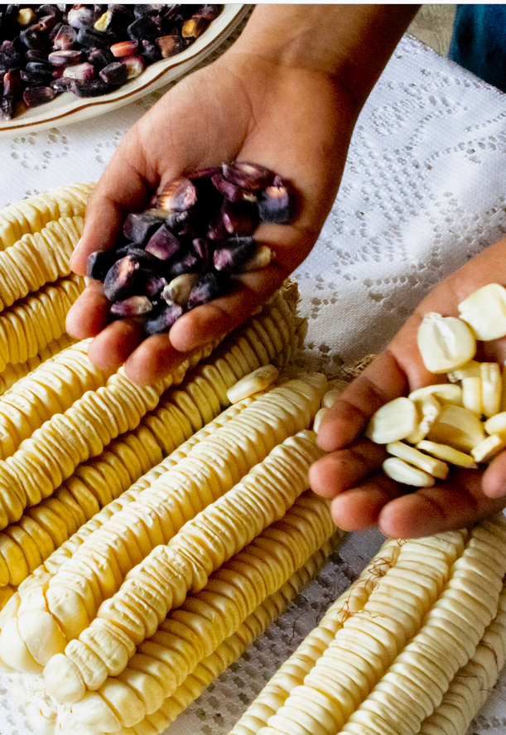
Emphasis is now on
Expanding consumption of traditional crops for local production and consumption
Developing new varieties of these traditional crops
Introducing them to a larger market to diversify diets globally
Exploring how these traditional crops may be well-suited for new climates arising from human-caused climate change
Notes:
Climate change affects crop production, further exacerbating the gap between inadequate food supplies and growing human populations. New varieties of crops with both increased yield and improved adaptation to diverse environments are urgently needed². Maize (Zea mays) is widely grown worldwide, but has lost abundant genetic diversity for adaptation owing to population bottlenecks (certain events that can strongly reduce the size of a population) during domestication and breeding³. Teosintes (wild congeners of maize) are adapted to a diverse range of environments, from hot, humid, subtropical regions to cold, dry and high elevations. They exhibit biotic and abiotic adaptations (such as resistance to extreme environments and disease) that are absent in modern maize, and provide a wealth of genetic diversity that could be used in modern breeding Adaptive variation in wild relatives of modern maize has potential use in breeding. Nature Genetics1589–1590 (2022). https://doi.org/10.1038/s41588-022-01186-w
https://www.cimmyt.org/news/tracing-maize-landraces-50-years-later/

Slide 23
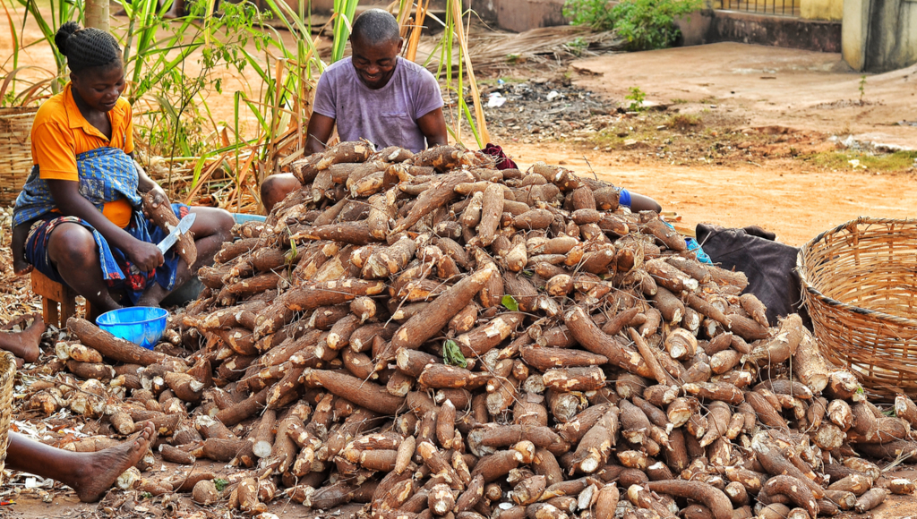
Cassava
Notes:
Cassava is a major staple food in the developing world, providing a basic diet for over half a billion people. Cassava is a nutty-flavored, starchy vegetable in the root and tuber family. Other vegetables in this group include potatoes, sweet potatoes, taro, and yams.

Slide 24
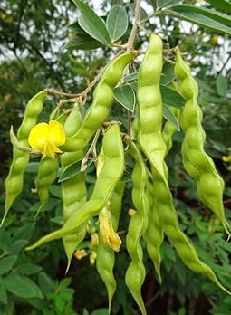
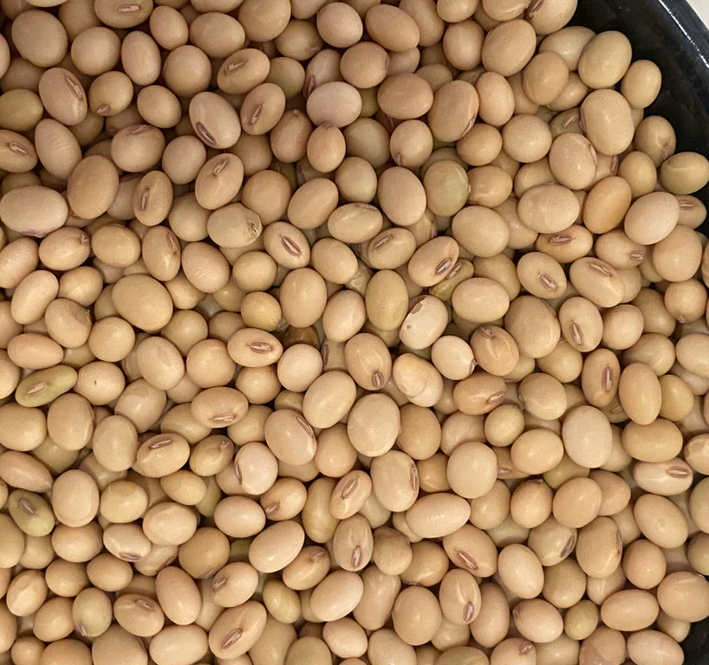
Pigeon pea
Notes:
Pigeon pea (Cajanus cajan) plays an important role in preserving poor smallholders' major source of income in the tropics and subtropics by improving food and feed security, particularly protein intake. In the meantime, protein deficiency is frequent in tropical and subtropical regions due to rapidly increasing human populations and the high cost of animal-origin proteins. As a result, pulse crops should be their primary source of protein. Among these, PP is the most important pulse crop utilized as a food component in rain-fed agricultural conditions with the lowest costs, and it is the best source of protein supplements in typical cereal-based diets to fill the nutritional deficit. Despite this, it is the world's least-used pulse crop. https://www.ncbi.nlm.nih.gov/pmc/articles/PMC8803422/

Slide 25
Dioscorea, the tropical yams
Notes:
Yams are a staple food in West Africa, which produces over 90% of the world's yams each year. Yams play a key role in the food security, economic income, and traditional culture for the region.
While they are commonly assumed to be the same as sweet potatoes in the U.S., yams are a completely different plant. The yam tubers are much starchier and drier compared to sweet potatoes. Yams are native to Africa and Asia, and most Americans have never had a true yam. https://www.croptrust.org/pgrfa-hub/crops-countries-and-genebanks/crops/yam/

Slide 26
Sorghum
Notes:
Sorghum, a grass

Slide 27
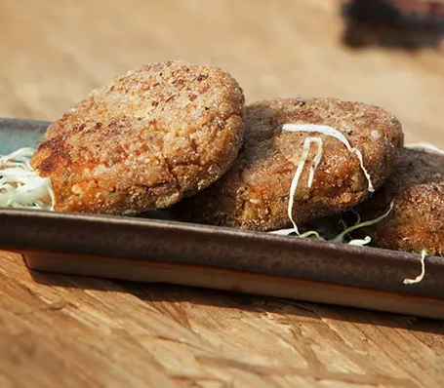
Millet
Notes:
Millet is a versatile grain that grows in harsh environments where many other crops would fail. It thrives in well-draining soils and can tolerate soil acidity and lower fertility. Millet patties

Slide 28
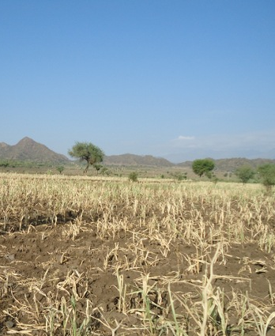
Grass pea
Notes:
https://www.theguardian.com/science/2023/jul/08/uk-scientists-could-make-poisonous-grass-pea-a-valuable-food-crop https://en.wikipedia.org/wiki/Neurolathyrism Grass pea is a particularly important crop in areas that are prone to drought and famine, and is thought of as an 'insurance crop' as it produces reliable yields when all other crops fail. The seeds contain a neurotoxin that causes lathyrism, a neurodegenerative disease, if eaten as a primary protein source for a prolonged period.

Slide 29
Notes:
https://youtu.be/Y8w3HxeCw9I?si=Vvrc_IrP1UBzVc9A

Slide 30
Notes:
https://youtu.be/aCBPWNI4jR0?si=Yi7xZZIFNepLYn_a

