Slide 1
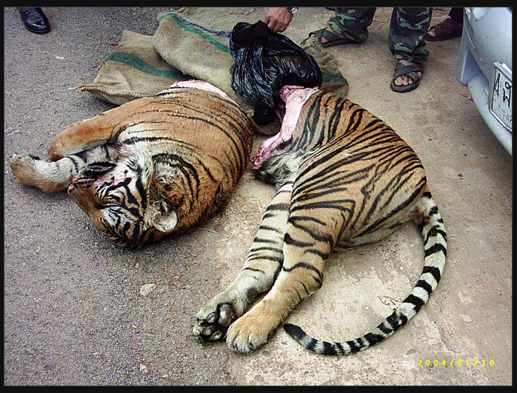
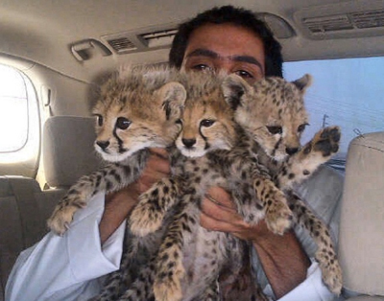
The trade in wildlife
Trade in bushmeat, folk medicines (like tiger parts, rhino horn, bear bile, pangolin scales) and in pets
Aspects of this trade can be deemed legal, as for example the trade in some pets versus trade in endangered species
Illegal trade in wildlife is a major global criminal enterprise that generates profits that are surpassed only by drugs and weapons and arms sales.
Can involve corrupt governments and organized crime syndicates
Notes:
The sawed halves of a farmed tiger, found in the possession of smugglers by the Thai highway police. Pet cheetahs.

Slide 2
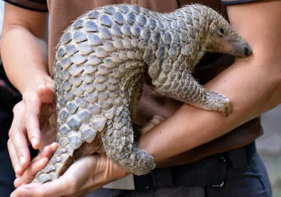
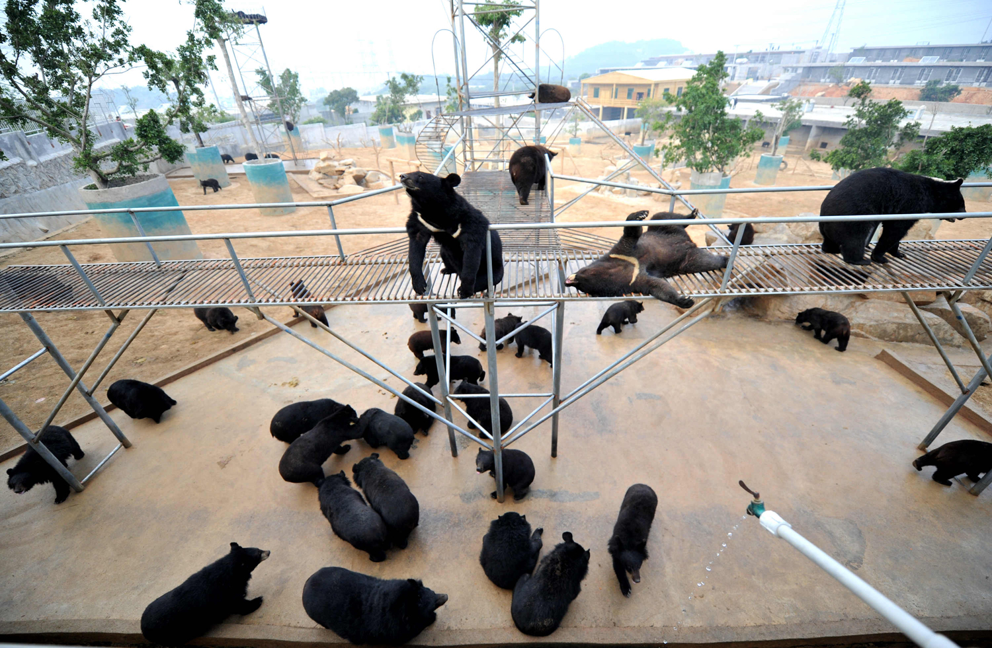
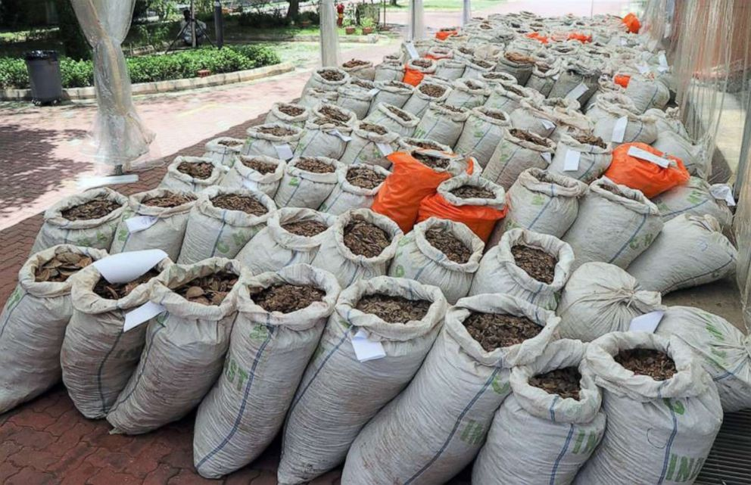
Notes:
Pangolin scales are made of keratin, the same material that makes up fingernails, hair, and horn. Pangolin scales, like rhino horn, have no proven medicinal value, yet they are used in traditional Chinese medicine to help with ailments ranging from lactation difficulties to arthritis.

Slide 3
Exotic pet trade
Illegal and legal trade in pets can be global in scope
Involves more than just demand and supply, but also differences in economic conditions and stability in governance and law enforcement from one country versus another

Slide 4
Typical flow of animals is from poorer countries to wealthier one
Status of legality in the exotic pet trade often centers around whether animals being sold are wild-caught (depletes population) or captive bred (considered sustainable, but not necessarily humane)
Trade regulated by CITES at a global level
Birds are the most species-rich and abundant class reported in pet trade; reptiles were second most abundant.
Mammalian and reptilian species traded as pets are more likely to be threatened.

Slide 5
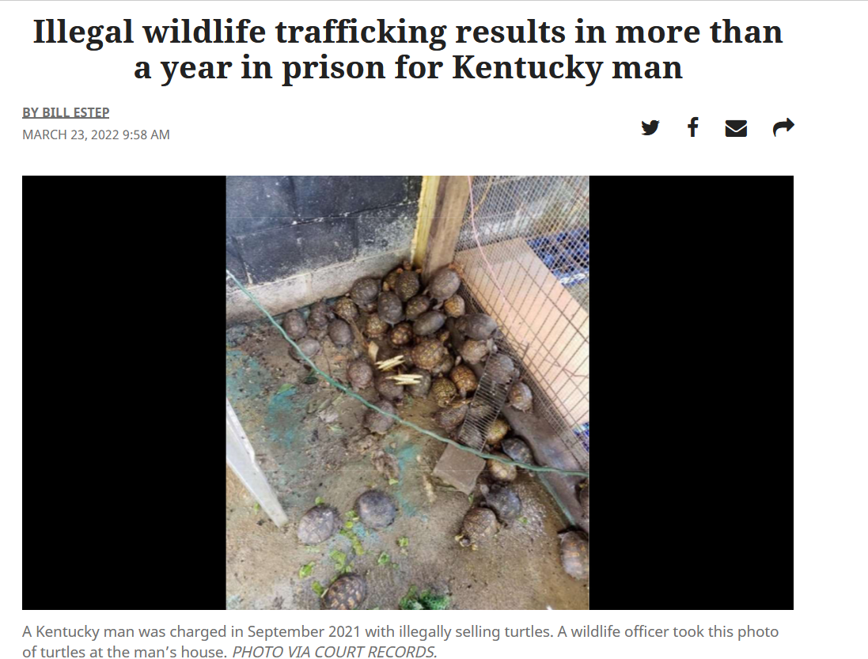
Notes:
https://www.kentucky.com/article259681120.html

Slide 7
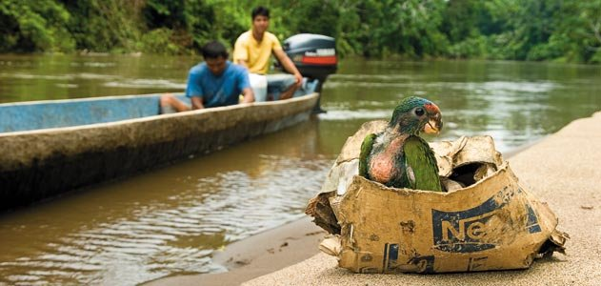
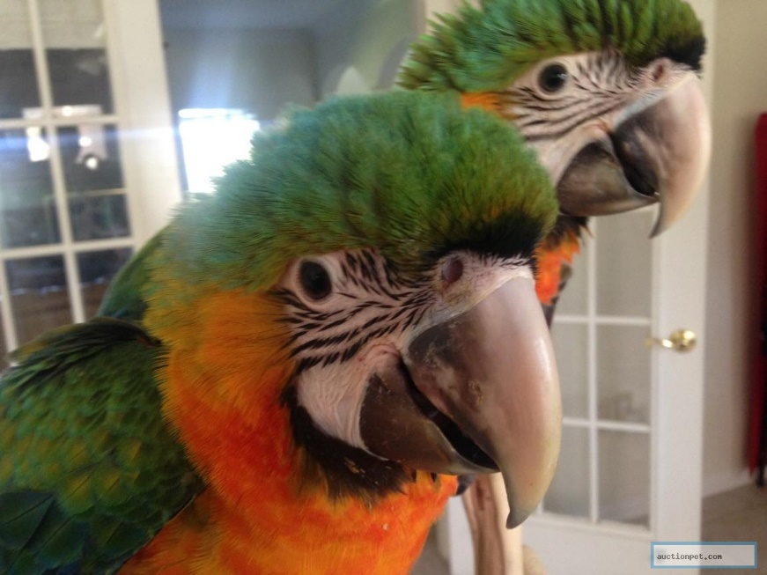
Drivers of exotic pet trade
Demand for pets by individuals in developed economies
Need for incomes and livelihoods where wildlife originates
Allee effects – increase in selling price as rarity increases
Uneven legal geographies

Slide 8
Legal reptile pet trade import countries

Slide 9
Legal reptile pet trade export countries

Slide 10
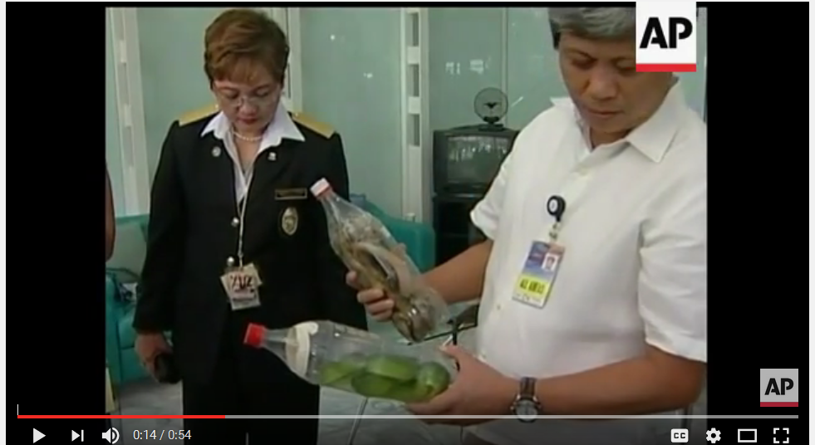
Notes:
Several key findings of the UN World Wildlife Crime Report implicate the use of legal trade loopholes.

Slide 11
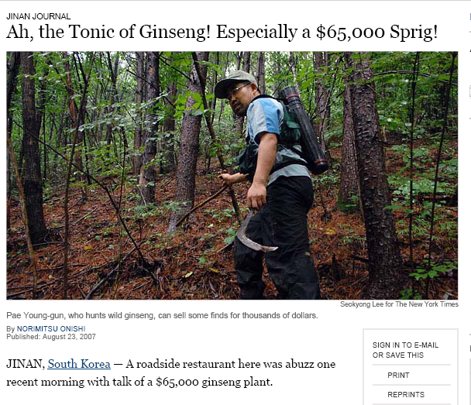
Notes:
Pet trade dealers consult scientific literature to find the next rare species. After a study defined the Roti Island snake-necked turtle and Chinese leopard gecko as rare, their prices boomed. Both species are now nearly extinct in the wild.

Slide 12
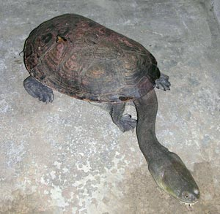
Notes:
Pet trade dealers consult scientific literature to find the next rare species. After a study defined the Roti Island snake-necked turtle as rare, their prices boomed. This species is likely extinct in the wild

Slide 13
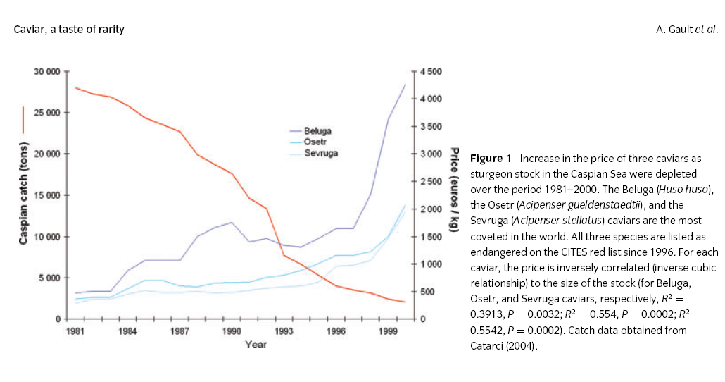
Allee effects

Slide 14
Notes:
Zanesville, OH

Slide 15
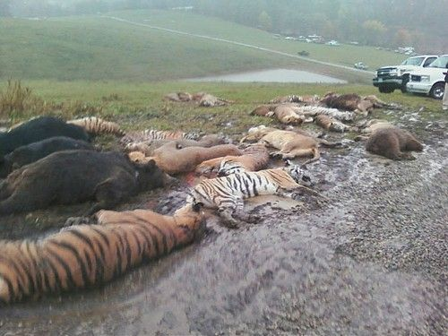
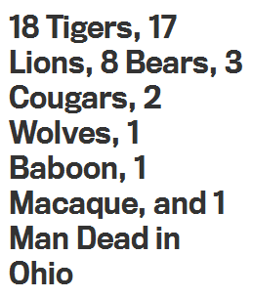
Notes:
Zanesville, OH

Slide 16
Uneven legal geographies
Countries differ in their level of enforcement of wildlife laws
Traffickers look for weak link countries to pass their wildlife through, often poor countries with destabilized or corrupt government
US states also differ in the laws governing the ownership and sale of exotic animals – some states are more lenient than others

Slide 17
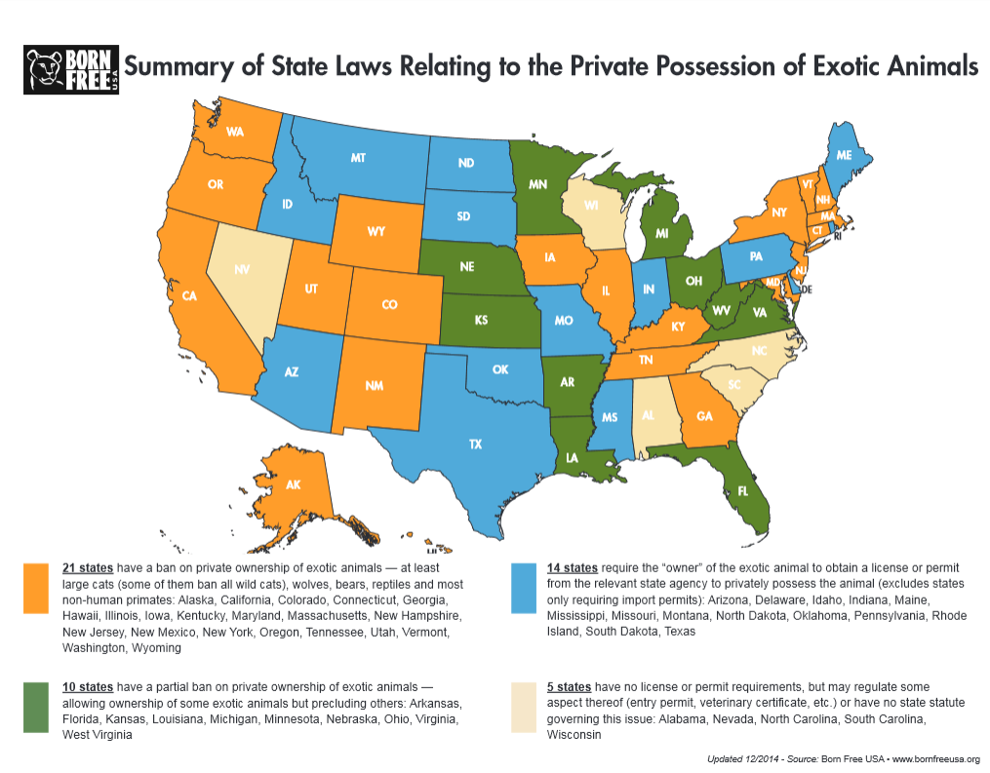
Notes:
Geographic differences in the legal standing of possessing exotic animals in the US. States with weaker laws typically have more collectors and breeders and more legal as well as illegal activity.

Slide 18
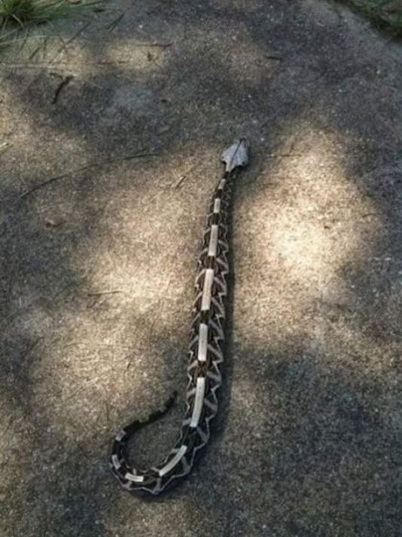
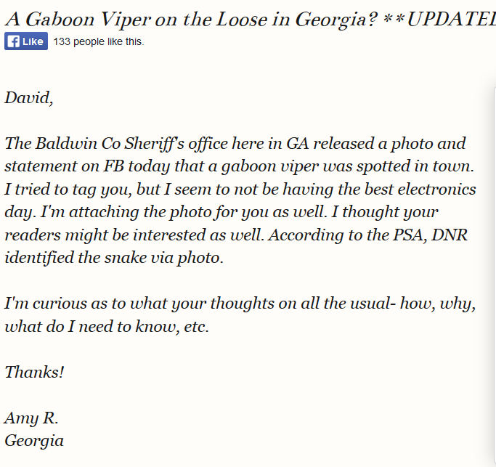
Notes:
The Gaboon viper is native to west and central Africa It has large fangs and can deliver a large amount of venom. This siting occurred in 2015.

Slide 19
Notes:
https://www.youtube.com/watch?v=YnhT7ZjX4HA https://www.fox5atlanta.com/news/operation-viper-catches-nearly-200-highly-illegal-potentially-deadly-snakes-in-georgia

