Slide 1
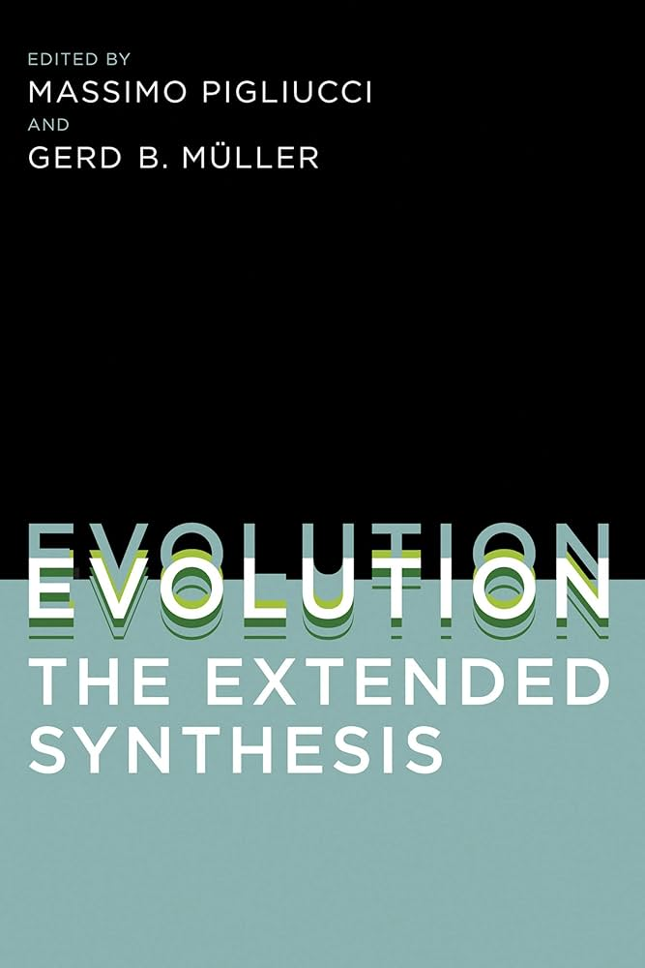
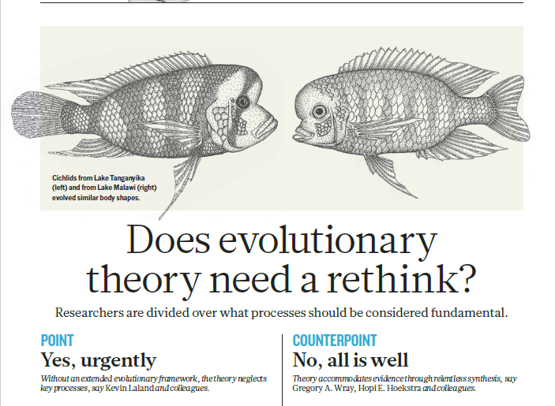

Slide 2
What does selection act upon?
After the concepts of genes and DNA became accepted, genotype was considered the focus of selection. Natural selection occurred because of the traits of better adapted genotypes
But it is more complicated now. The same genotype can have different phenotypes.
Phenotype is the outward form of an organism, its biochemistry, and behavior - all of its observable characteristics — which are influenced both by its genotype and by the environment.
No simple tit-for-tat relationship between a gene and a phenotype

Slide 3
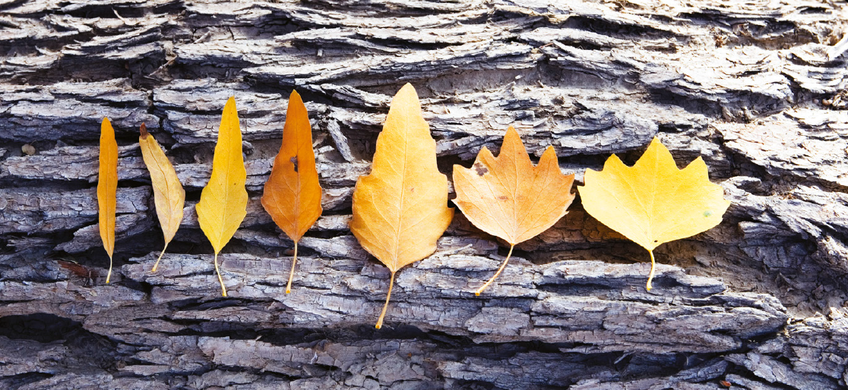
Phenotypic plasticity

Slide 4
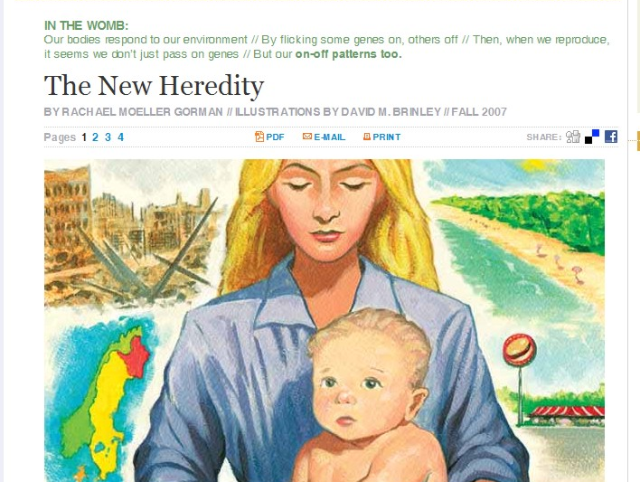
Epigenetics
Our bodies respond to our environment // By flicking some genes on, others off // Then, when we reproduce, it seems we don’t just pass on genes // But our on-off patterns too.
Notes:
Non-DNA biochemicals can interact with the surfaces of DNA to facilitate novel modes of gene expression.
Epigenetic signals can be passed on from one generation to the next

Slide 5
The epigenome
For decades, change in an organism’s DNA sequence has been considered the primary mode of evolutionary change.
However, environmental contexts around DNA can alter what genes are turned on and off.
The same DNA sequence can produce different phenotypes through epigenetic modifications
Epigenetic modifications can even be passed on to offspring
The epigenome: the biochemical markers that modify the products of the genome

Slide 6
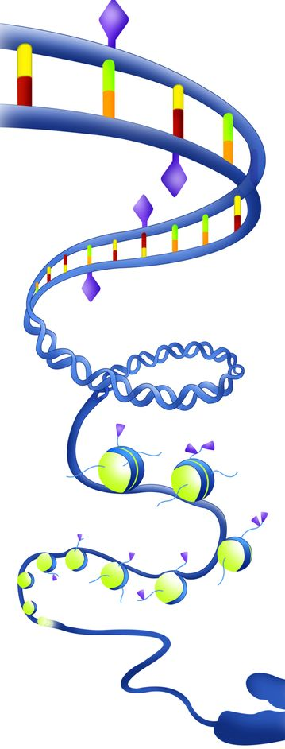
These biochemicals markers can bind to DNA and change its function without modifying DNA sequence
Methylation and histone modifications are two types of epigenetic mechanisms that can turn genes on and off
They develop from environmental exposures (stress, chemicals, environmental change).
Notes:
The addition of a methyl-group to the cytosine base: methylation. Cytosine methylation indicates gene silencing: methylated genes are not transcribed.
Histone modifications also play an important role in epigenetic regulation. Histones are proteins that act as spools around which DNA winds

Slide 7
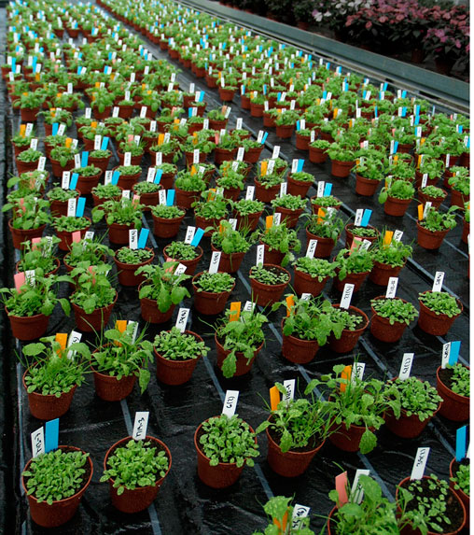
Epigenetics and natural selection
Researchers created Arabidopsis plants with distinct patterns of low and high methylation sites in their genomes
DNA methylation patterns were associated with heritable variation in flowering time and root length
Methylation patterns were stable over the eight generations
Showed that methylation has an impact on phenotypic variation that selection can act upon
Notes:
Same plant genome
Different epigenetic modification
Stably inherited and expressed phenotypes over multiple generations

Slide 8
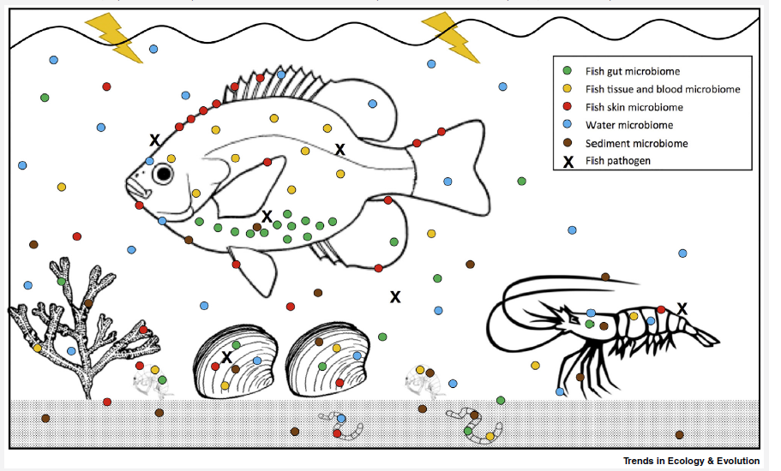
Microbiomes
Animals and plants are associated with a diverse array of resident microbiota.
Metagenome: the genome of an organism inclusive of the bacteria, viruses and other microbiota living within and on it
Besides producing their own biochemicals, organisms in the microbiome can alter host gene expression and its products in their host
Horizontal gene transfer can take place among the constituent microbiota of an organism
Holobiont: the view of an organism as a collection of organism
Notes:
Bacterial cells outnumber our cells 10 to 1.
Even bacteria contain viruses and plasmids – they too have a microbiome.
There are no sterile animals in nature. Most microbes are beneficial to their animal hosts.

Slide 9
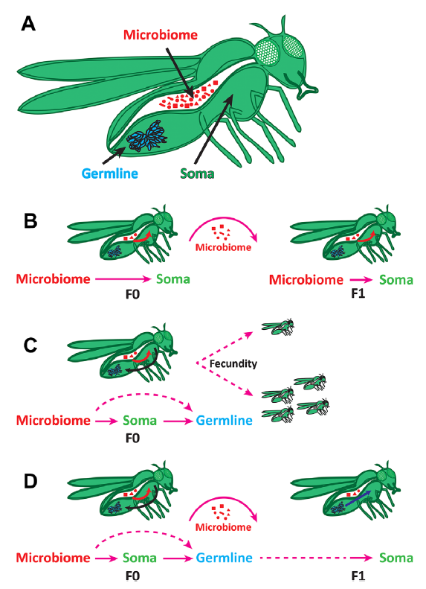
The microbiome and natural selection
The influence of the microbiome on the host soma (body cells) and germline (sex cells, i.e., eggs and sperm) can potentially give rise to novel phenotypes that natural selection can then act upon
  The microbiome can be shared and inherited (B). Changes in its composition can alter fitness.
  The microbiome can alter gene expression in germline cells and create conditions that influence traits (C)
  The microbiome can alter germline cells through epigenetic mechanisms that can be inherited in subsequent generations. (D)
Notes:
Soma – diploid cells, body cells
Germline – haploid cells, sex cells, gametes.
https://www.youtube.com/watch?v=R42KqyxuFF0&ab_channel=CarisLifeSciences

Slide 10
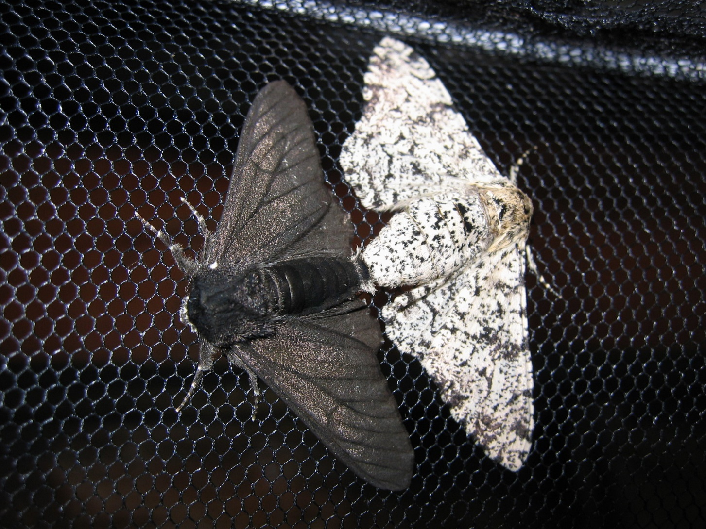
Notes:
Researchers have pinpointed the precise genetic mutation that led to the darker moth and determined just when this mutation occurred. The mutation is on a “jumping gene,” or a transposable element, which can hop between locations on the genome. It was not entirely the traditional narrative that the white butterflies were eaten when the trees darkened. What caused the darkening to begin with? A jumping gene initiated this color change, and then selection took place

Slide 11
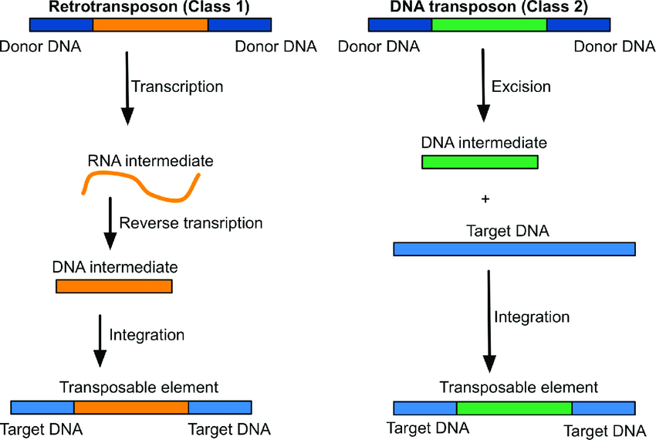
The mobilome
The mobilome is all mobile genetic elements in a genome.
Transposons, or jumping genes, can move about on the genome and are major constituents of the mobilome in multi-celled animals.
Horizontal gene transfer among bacteria is another component of the mobilome
They may speed up evolution and introduce novel phenotypes upon which natural selection can occur

