Slide 1
Biotic interactions
Interactions categorized along a spectrum spanning negative (benefits are to one species of the interaction) to positive interactions (benefits are spread more evenly among the interacting species)
Notes:
Relationships as metaphor, their effects on geographic pattern

Slide 2
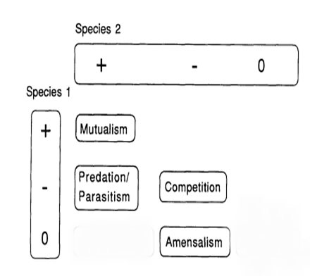
Old view of biotic interactions
Notes:
Valid, but not very nuanced. Time and space are not considered, or are at least assumed to be static. The Red King hypothesis and the Red Queen hypothesis convey that biotic interactions have a spatiotemporal component. In other words context matters. While the above chart is useful, it doesn’t capture the dynamism and variability of biotic interactions.

Slide 3
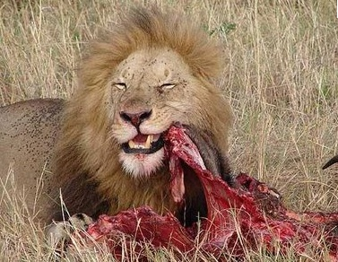
Negative interactions
Predation
Competition
Parasitism
Amensalism
Notes:
Googling food webs

Slide 4
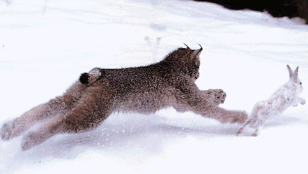
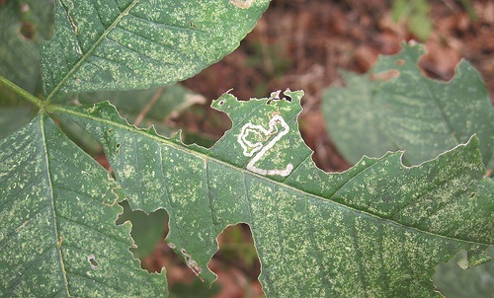
Predation
Interactions in which one organism consumes all or part of another.
  Predator-prey
  Herbivore-plant
These relationships shape biogeographic distributions in time and space

Slide 5
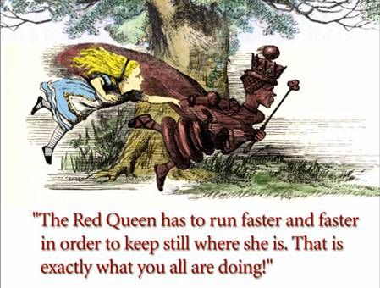
Red Queen Hypothesis (Van Valen, 1973)
Never-ending evolutionary interactions between predators and prey, herbivores and plants
Notes:
"[I]t takes all the running you can do, to keep in the same place.“
As species that live at each other's expense coevolve, they are engaged in a constant evolutionary struggle for a survival advantage. They need "all the running they can do" because the landscape around them is constantly changing.

Slide 6
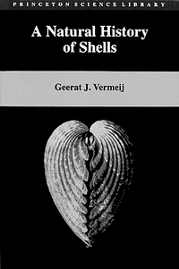
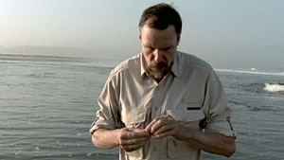
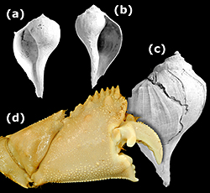
Selective predation - snail evolution and crab predation
Notes:
The predation upon snails by crabs reflects a Red Queen interaction. The thickness of shells and the size and musculature of crab claws have grown over time.
This example also illustrates selective predation – crabs prefer right-handed snails to munch on.
Being a leftie promotes survival from attacks, at least in the world of snails and crabs. While rare in nature, many organisms including humans have some, but few, members that are lefties. Left coiling snails have a competitive advantage as long as they remain rare. This parallels some social interactions in human cultures, such as sporting competitions in which left-handed players enjoy an advantage over their right-handed opponents.
The overwhelming majority of snail species are right-handed — their shells coil clockwise. Some predatory crabs are “righties” — and have a specialized tooth on their right claw that acts like a can opener to crack and peel the snail shells. The ‘sinistral advantage,’ or advantage to being left-handed, is that it would be like using a can opener backwards for the crab to crack and peel the snail shell. Based on measures of the frequency of unsuccessful crab predation left as repair scars on the snail’s shell in specimens from the fossil record, ten out of the eleven species pairs studies showed more scars on the right-handed shells, suggesting that crabs are attacking them in preference to their left-handed counterparts. These traces of failed predation indicated to the researchers that left-handed coiling enhances survival from attacks by right-handed crabs. A right-handed crab often abandons a left-handed snail before it breaks the shell. In the balance of selection processes, the survival advantage of sinistrality may be as important a selection pressure as mate selection.
Which snails, right or left coiling, would you expect to have thicker shells?

Slide 7
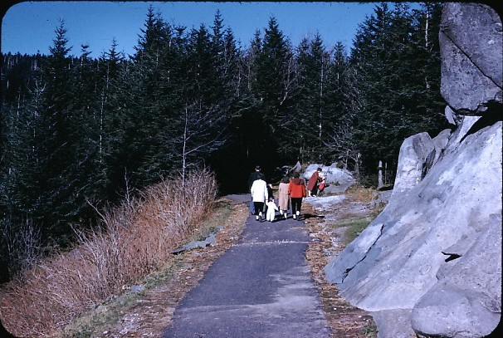
Selective predation – herbivory: Fraser fir and balsam wooly adelgid
Notes:
Highly selective predation: the balsalm wooly adelgid feeds exclusively on Fraser fir, red spruce, another high elevation conifer of the Smoky Mountains is not preyed upon. In this example, note how this selective predation has cascading effects upon the structure of the entire high elevation forest of the Appalachian Mountains.
1956

Slide 8
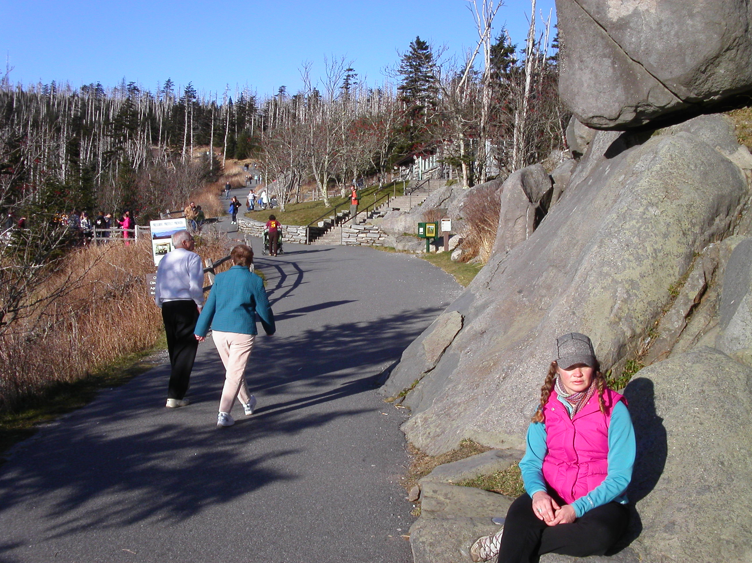
Notes:
2008

Slide 9
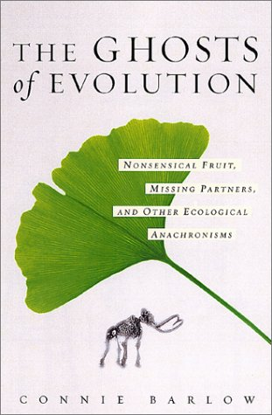
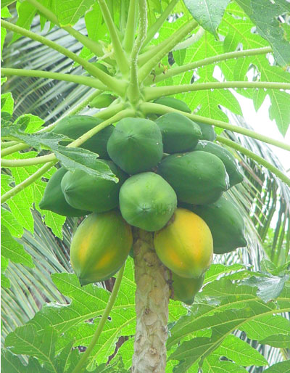
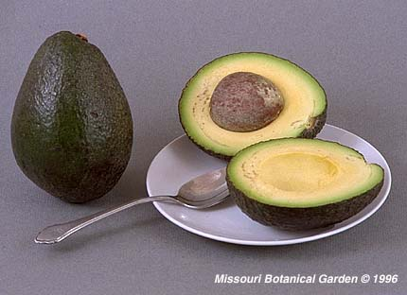
Herbivory in the past shapes biogeography today
Notes:
Also an example of selective predation
Trees who fruit is eaten to increase the likelihood of seed dispersal.
Fortunately, the papaya (top right) and the avocado (bottom right) are widely propagated by humans and other animals today. However, they evolved in the presence of much larger herbivores, and developed traits to attract them (fruity flesh) so as to disperse their seeds.
So when these megafauna when extinct, humans became in many cases their dispersal agent.

Slide 10
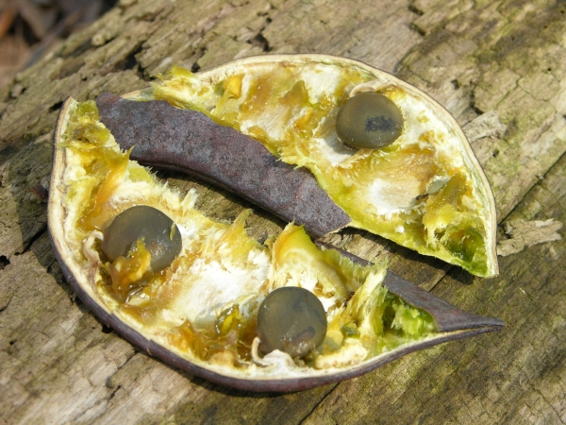
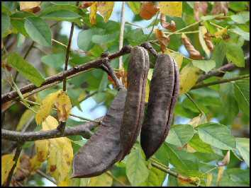
Kentucky coffee tree
(Gymnocladus dioicus)
An anachronistic fruit – it’s original herbivore dispersers are extinct
No recognized non-human dispersal agent other than water if near stream
Large seeds with carbohydrate pulp
Seeds set (sprout) best after scarification and exposure to low ph environments during animal digestion
Increasingly rare tree
Notes:
Keeler, Harriet L. (1900). Our Native Trees and How to Identify Them. New York: Charles Scriber's Sons, pp. 109–112.
When Kentucky was first settled by Anglo-pioneers from the Atlantic states who commenced their career in the primeval wilderness, almost without the necessaries of life, except as they produced them from the fertile soil, they fancied that they had discovered a substitute for coffee in the seeds of this tree; and accordingly the name of Coffee-tree was bestowed upon it. But when communication was established with the sea-ports, they gladly relinquished their Kentucky beverage for the more grateful flavor of the Indian berry; and no use is at present made of it in that manner.”

Slide 11
Predation and the concept of top-down control
Keystone species
  Exert strong top-down control on community composition
  Sea stars are keystone species in rocky marine intertidal habitats
  Robert Paine coined the term keystone species
Notes:
Robert Paine, who coined the term keystone species

Slide 12
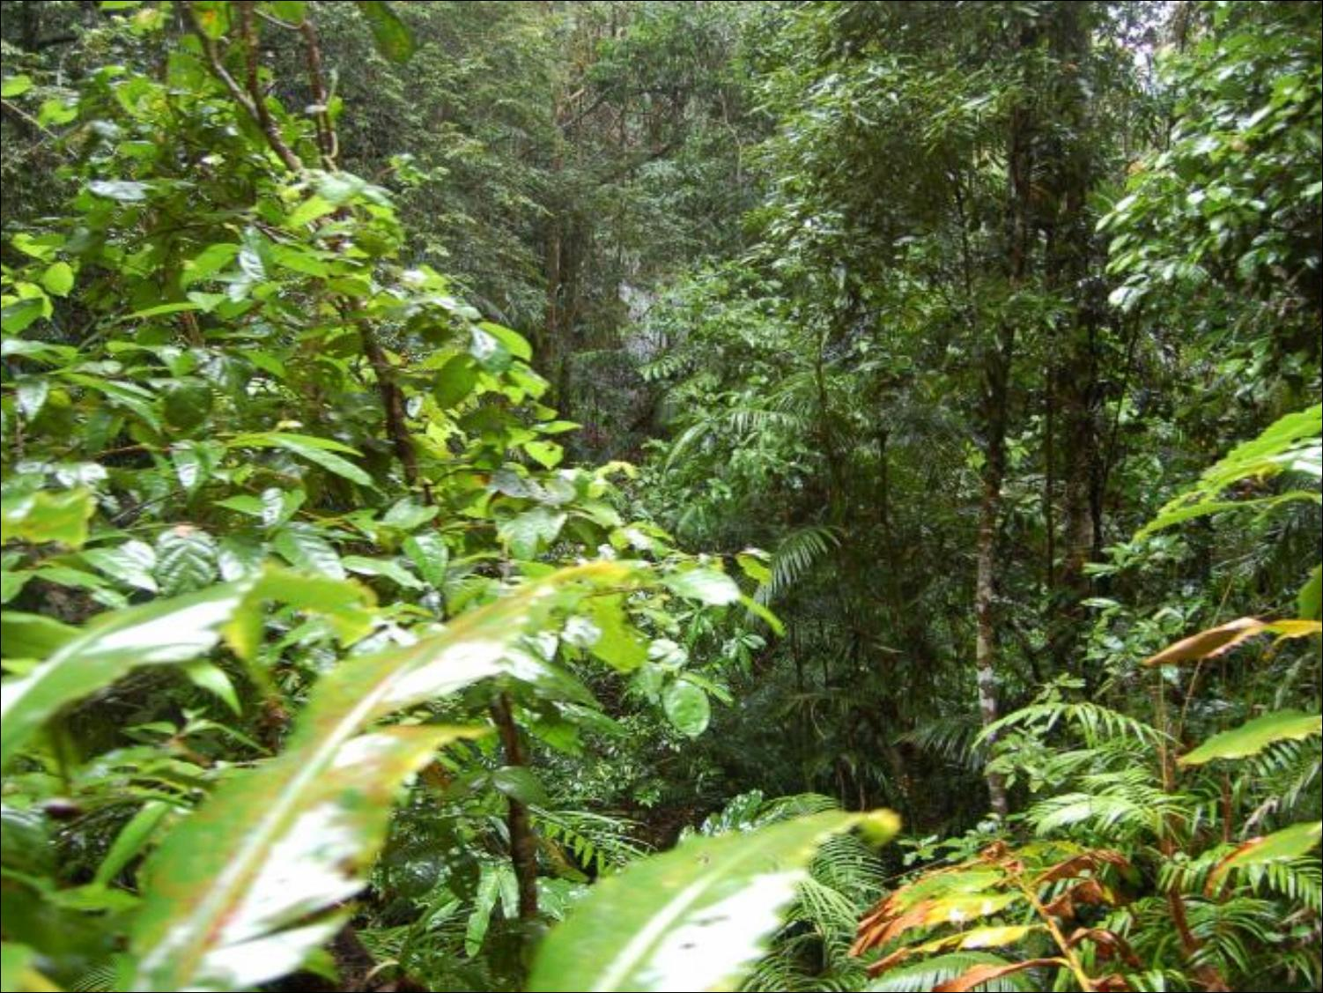
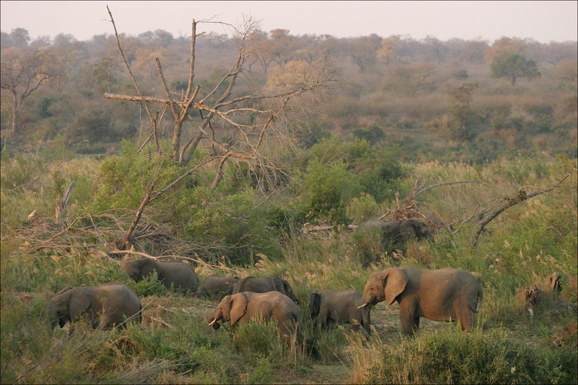
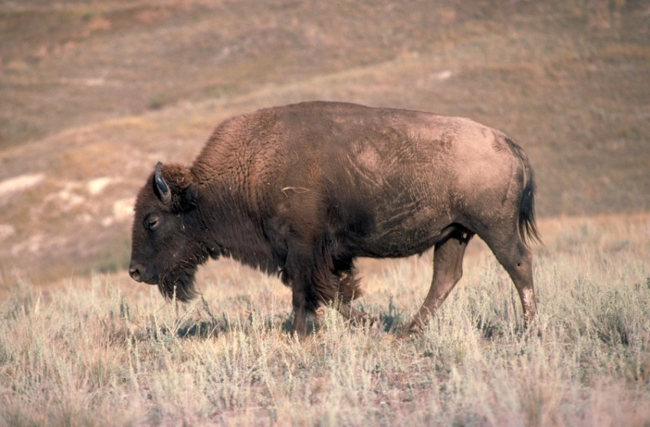
Green World Hypothesis
The world is green because predators keep the herbivores in check.
Without predators, herbivores would defoliate the planet
Notes:
The green world hypothesis was proposed in 1960 by the scientists Nelson Hairston, Frederick Smith and Lawrence Slobodkin.

Slide 13
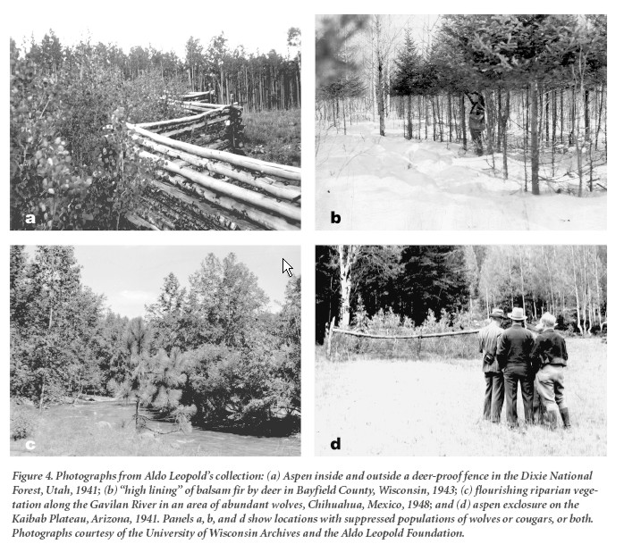
Notes:
Deer browsing examples from the collection of Aldo Leopold

Slide 14
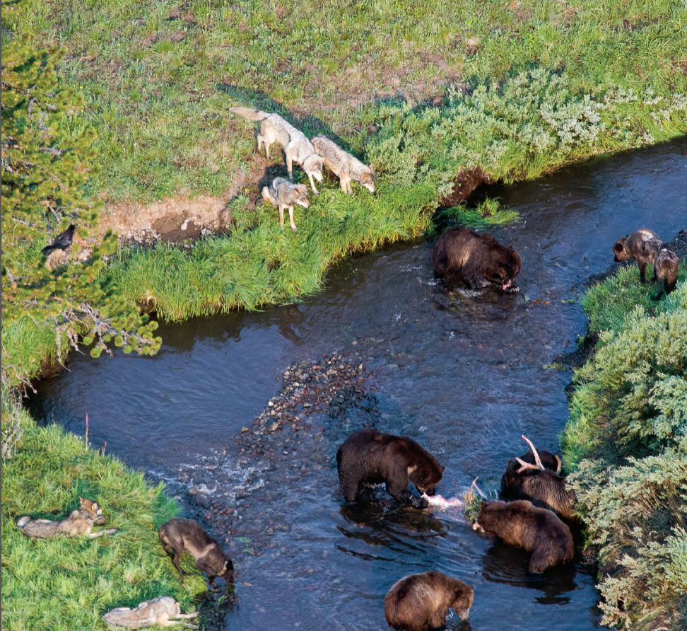
Trophic cascades
These are the changes in an ecosystem that develop in response to alteration of abundances of predators.
Emphasis is on top down control of ecosystems by the presence or absence of predators
Trophic cascade controls likely exert an immense influence on present-day landscapes

Slide 15
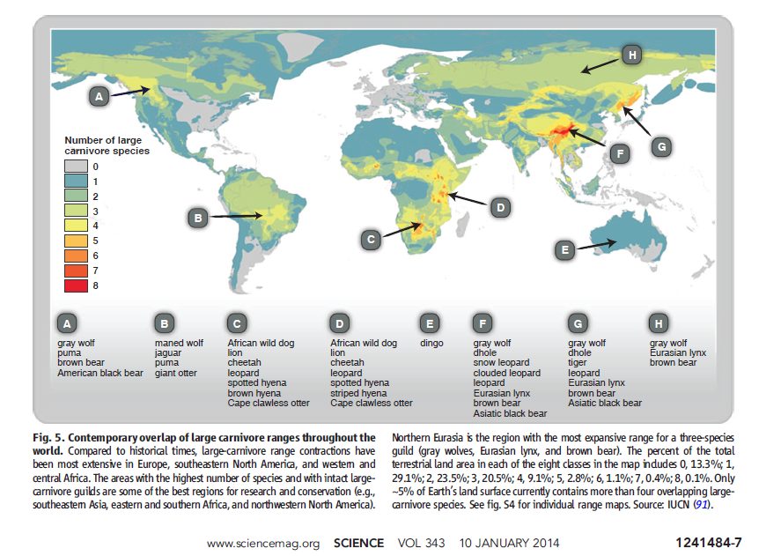
Notes:
Trophic downgrading of Earth
Large carnivore ranges have contracted globally, leaving only a few places with more than one or two large predators.
Until recently, large apex consumers were ubiquitous across the globe and had been for millions of years. The loss of these animals may be humankind’s most pervasive influence on nature. Although such losses are widely viewed as an ethical and aesthetic problem, recent research reveals extensive cascading effects of their disappearance in marine, terrestrial, and freshwater ecosystems worldwide. This empirical work supports long-standing theory about the role of top-down forcing in ecosystems but also highlights the unanticipated impacts of trophic cascades on processes as diverse as the dynamics of disease, wildfire, carbon sequestration, invasive species, and biogeochemical cycles. These findings emphasize the urgent need for interdisciplinary research to forecast the effects of trophic downgrading on process, function, and resilience in global ecosystems.
https://science.sciencemag.org/content/333/6040/301

Slide 16
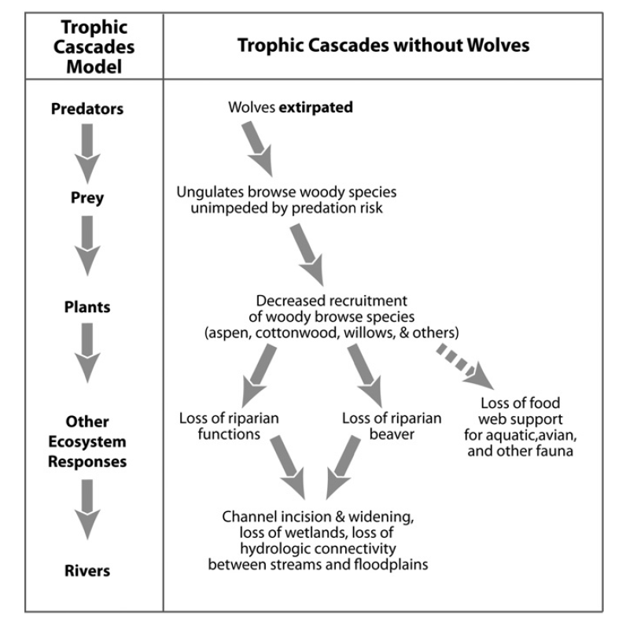
Yellowstone National Park, WY

Slide 17
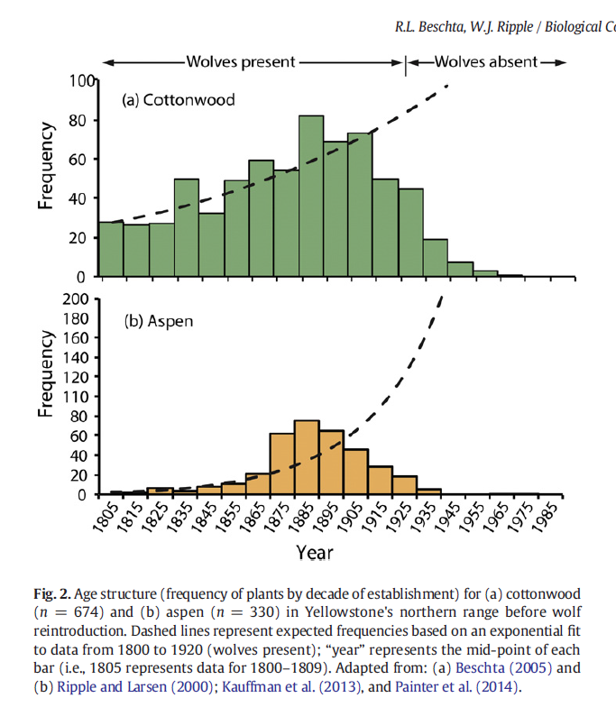
Notes:
Ev

Slide 18
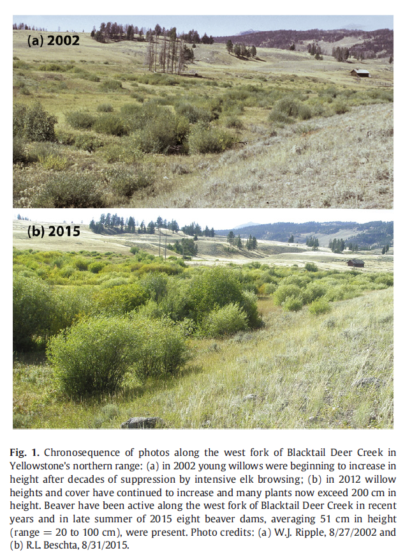

Slide 19
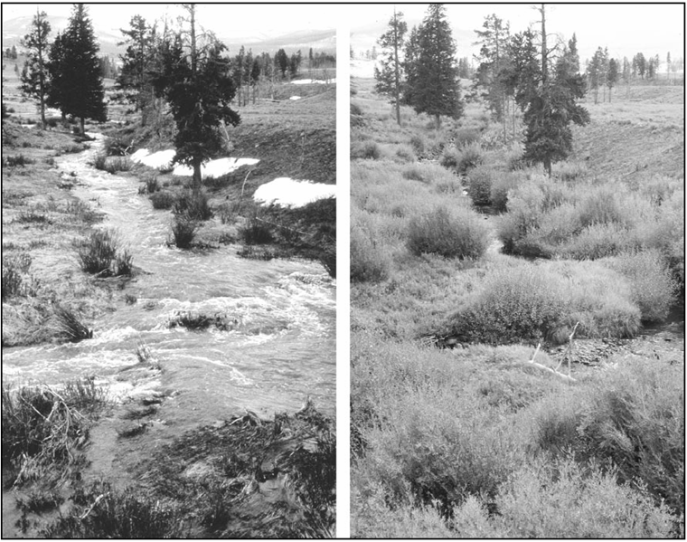
Notes:
Which side is with wolves present and which is without wolves in the park?

Slide 20
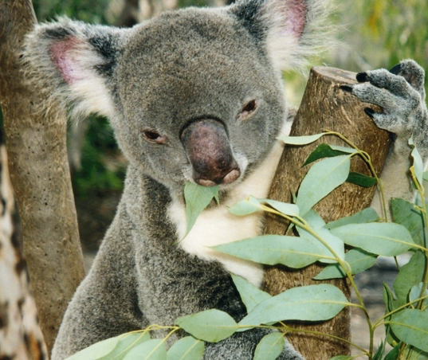
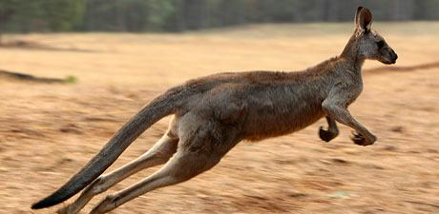
Mesopredator release
Elimination of apex predators can lead to the counterintuitive decline of native prey populations through the ecological release of smaller predator species
Notes:
During the last 150 years, Australia has suffered the world's highest rate of mammal decline and extinction, and most evidence points to introduced mid-sized predators (the red fox and the feral cat) as the cause. Dingoes were persecuted from the beginning of European settlement in Australia and have been eliminated or made rare over large parts of the continent. There is a strong positive relationship between the survival of marsupials and the geographical overlap with high-density dingo populations. The rarity of dingoes was a critical factor which allowed smaller predators to overwhelm marsupial prey, triggering extinction over much of the continent. This is evidence of a crucial role of top predators in maintaining prey biodiversity at large scales in terrestrial ecosystems and suggests that many remaining Australian mammals would benefit from the positive management of dingoes.

Slide 21
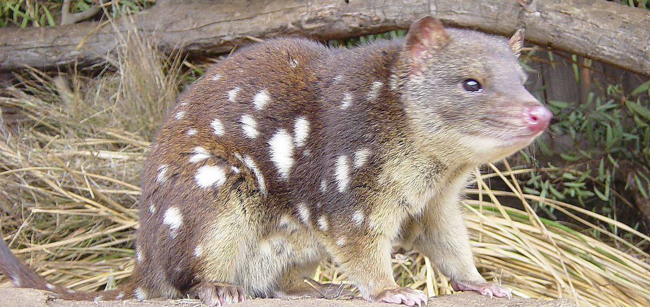
Quolls
Notes:
Over the past 2 decades, scientists have documented sharp declines in marsupials in Australia. The European influx beginning 2 centuries ago turned the island continent into a crucible of extinction. Since then, 29 land animal species have gone extinct, including, most famously, the thylacine, or Tasmanian tiger, which winked out early last century. Other vanished fauna include species of bettongs, bandicoots, potoroos, bilbies, and wallabies. Australia’s losses represent about a third of the world’s mammal extinctions over the past 500 years. Many disappeared before 1950, after getting squeezed out of habitats and falling prey to invaders including cats and European red foxes. Another invader, the cane toad, has been a bane to northern quolls, which eat the toads and succumb to poison they secrete. The quoll is a carnivorous marsupial native to mainland Australia, New Guinea, and Tasmania. It is primarily nocturnal and spends most of the day in its den. Of the six species of quoll, four are found in Australia and two in New Guinea. They are largely solitary, but come together for a few social interactions such as mating which occurs during the winter season. The quoll eats small mammals such as rabbits, small birds, lizards, and insects.

Slide 22
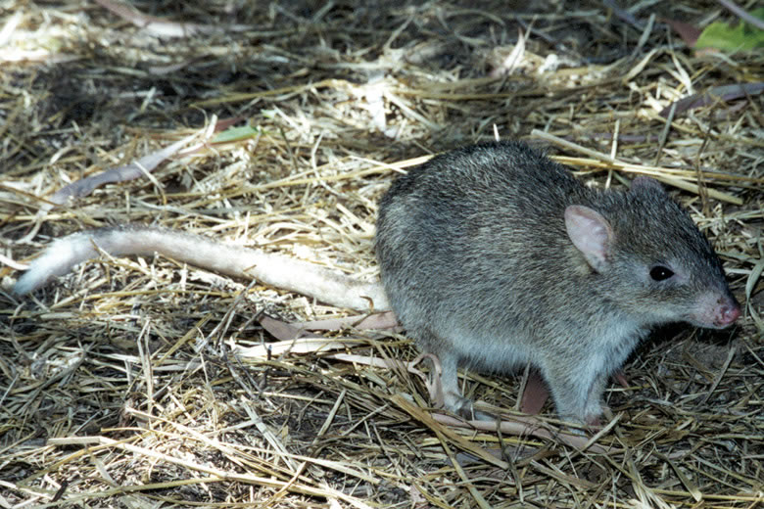
Bettongs
Prefer arid climates
Nocturnal to avoid moisture loss
Four species
Endangered northern bettong
Only small isolated populations in Northern Queensland

Slide 23
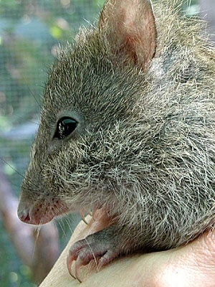
Potoroo
The broad-faced potoroo of southwestern Australia has been missing since 1875
Gilberts’s potoroo, after being missing for over 120 years was just rediscovered in southwest Australia
Two other extant species, the long-nosed and the long-footed potoroo
Long-nosed potoroo
Notes:
Gilbert’s potoroo is Australia's most endangered animal. The species was discovered in 1840 by a naturalist called John Gilbert. It was then thought to have become extinct until being rediscovered in Western Australia. Conservation efforts have grown an initial wild population of 30-40 to over 100

Slide 24
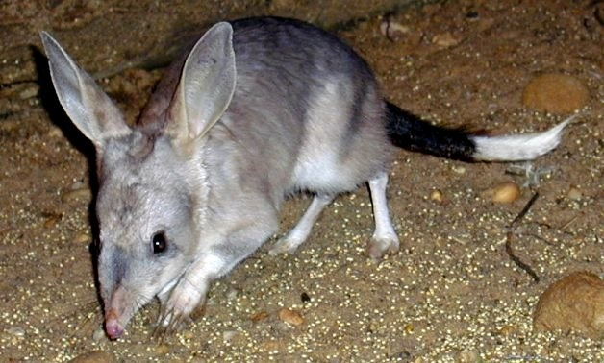
Bilbys
Burrowing marsupial
Only three locations of isolated bilbies exist today
Notes:
Easter bilby

Slide 25
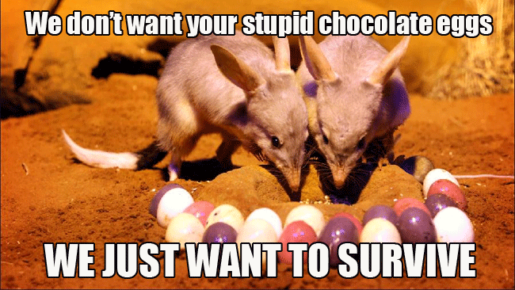

Slide 26
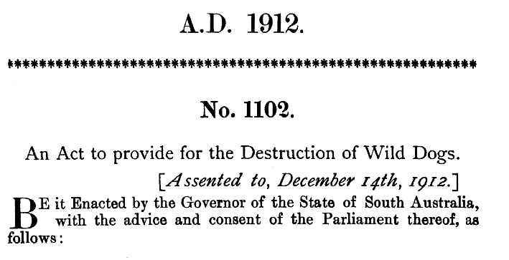
Wild Dog Act called for the culling of Canis lupus dingo
Notes:
The dingo was introduced to Australia by people at least 3500 years ago and has an ambiguous status owing to its brief history on the continent

Slide 27
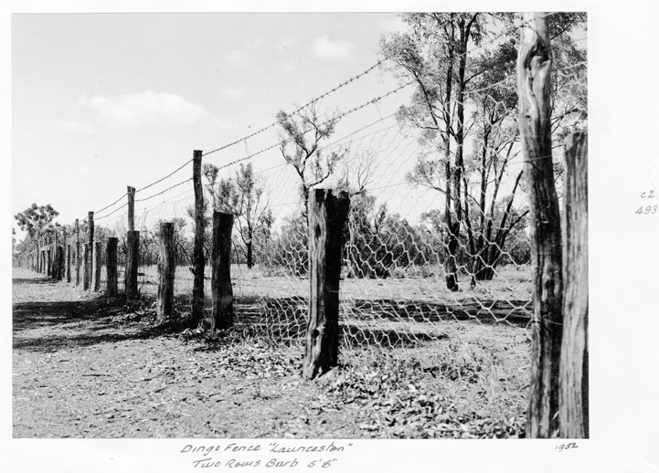
Notes:
Dingo fence built un 1880s to keep dingos out of southeastern corner of Australia

Slide 28
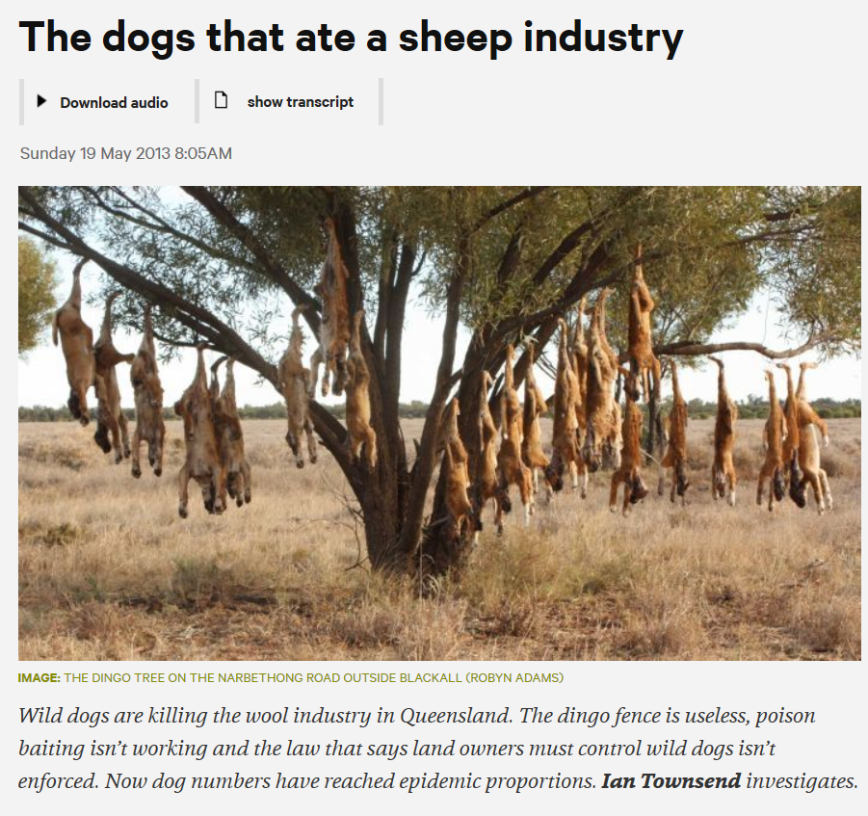

Slide 29
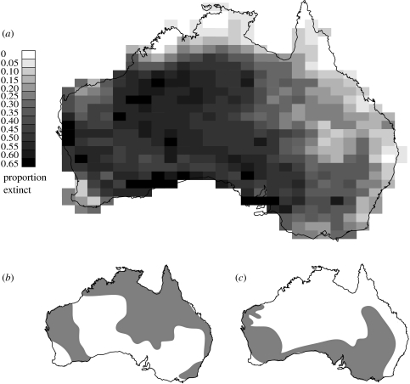
(A) Distribution of proportion of marsupial extinctions.
(B) Remaining high density distribution of dingoes

Slide 30
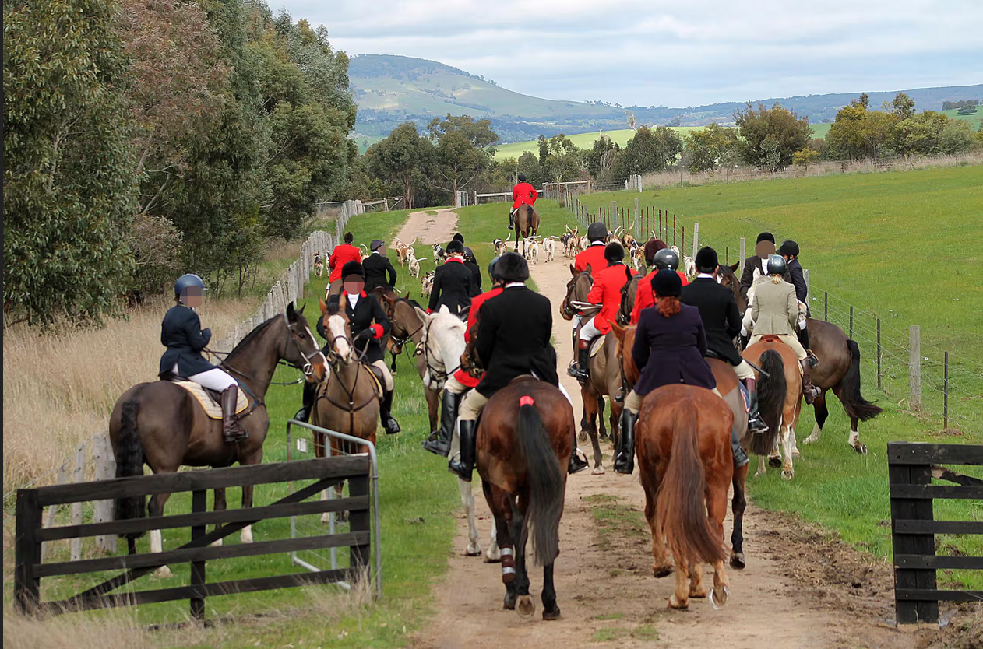
Notes:
https://www.theguardian.com/australia-news/2023/may/06/the-hunt-the-little-known-war-being-waged-over-horse-and-hound-foxhunting-in-australia

Slide 31
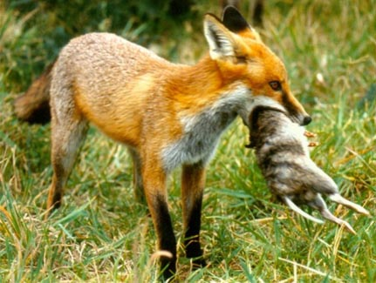

Slide 32
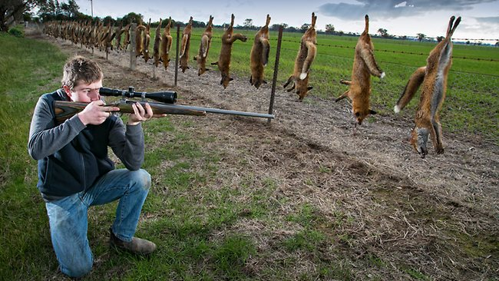
Notes:
Fox hunting

Slide 33
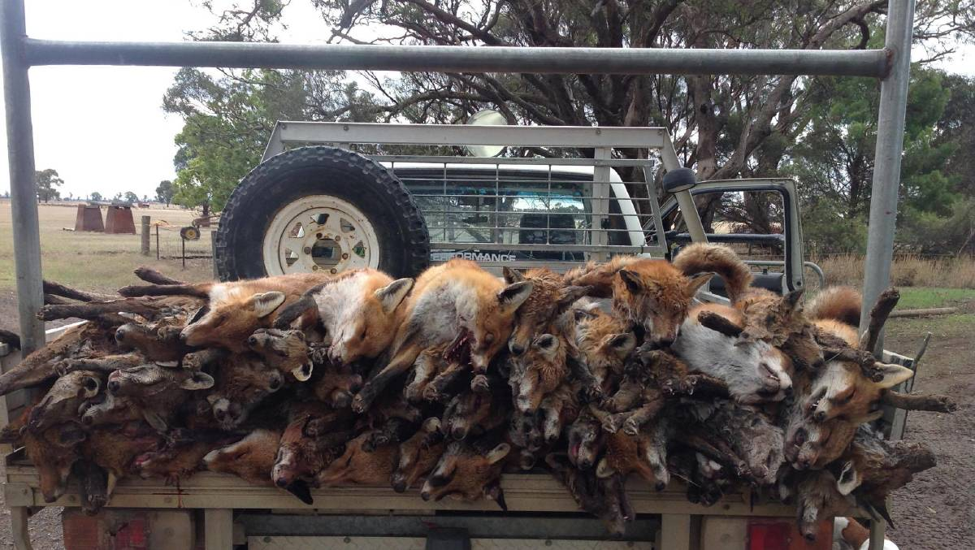
Notes:
https://www.northqueenslandregister.com.au/story/4955055/foxes-on-the-run/

Slide 34
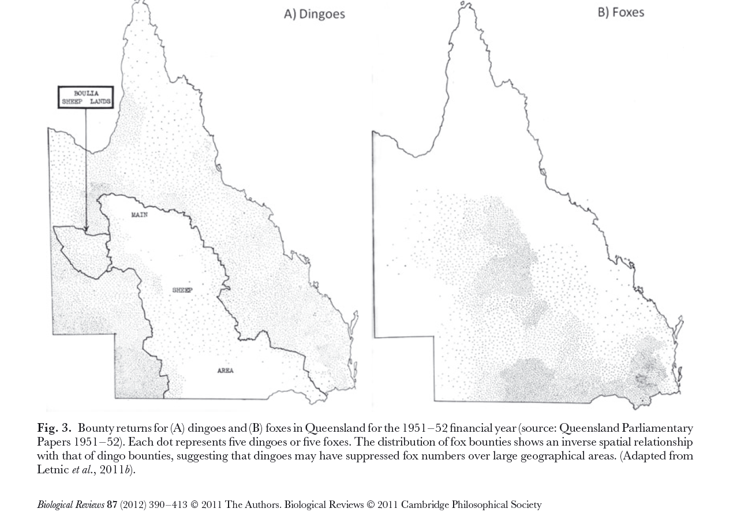

Slide 35
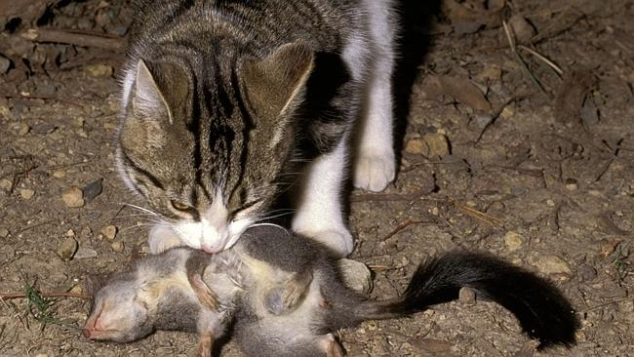
Notes:
One of Australia’s 15 million feral cats eats a phascogale
http://www.theaustralian.com.au/national-affairs/greg-hunt-calls-for-eradication-of-feral-cats-that-kill-75m-animals-a-night/story-fn59niix-1226939644027?nk=f4331cf1254aa801b5fc47db3e314ab1

Slide 36
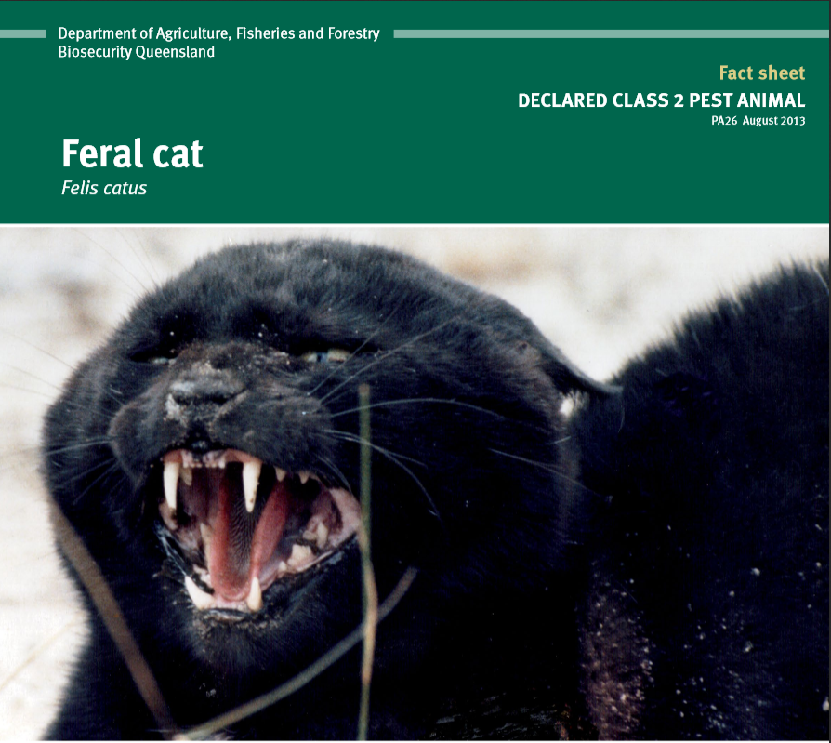
Notes:
http://www.daff.qld.gov.au/__data/assets/pdf_file/0004/61987/IPA-Feral-Cat-Ecology-PA26.pdf

Slide 37
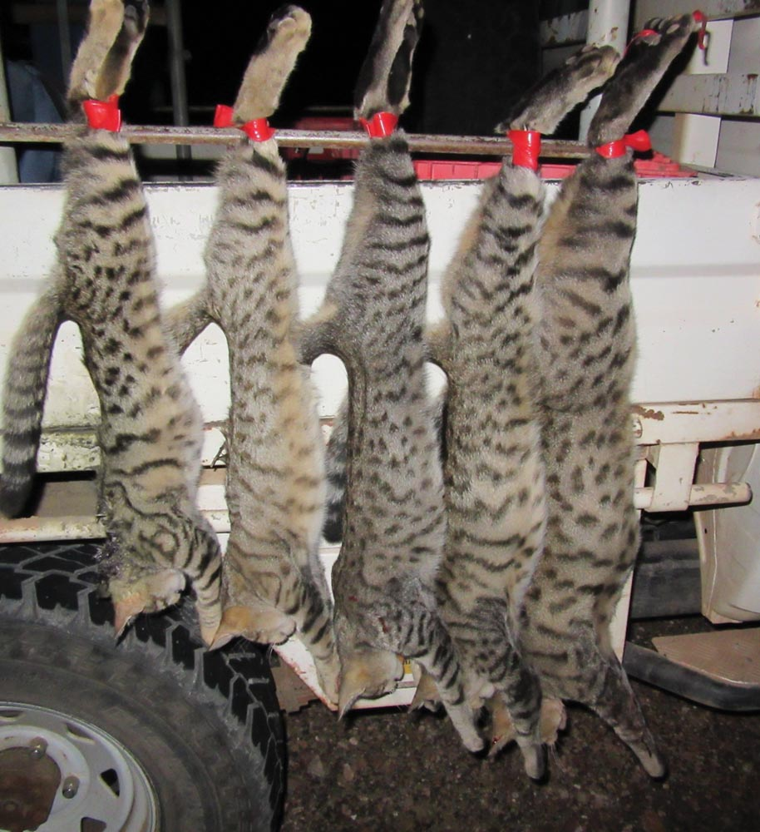
Notes:
Feral cat hunting

Slide 38
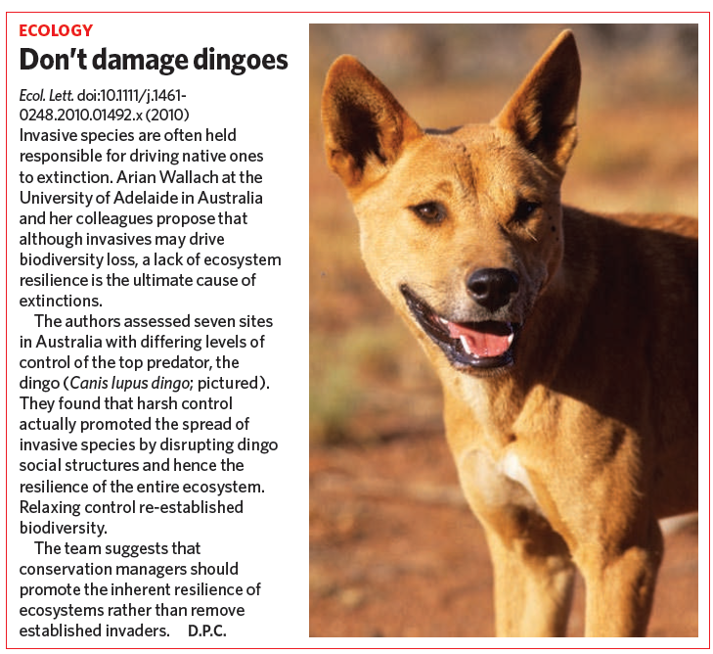
Notes:
Invasive species are regarded as one of the top five drivers of the global extinction crisis. In response, extreme measures have been applied in an attempt to control or eradicate invasives, with little success overall. We tested the idea that state shifts to invasive dominance are symptomatic of losses in ecosystem resilience, due to the suppression of apex predators. This concept was investigated in Australia where the high rate of mammalian extinctions is largely attributed to the destructive influence of invasive species. Intensive pest control is widely applied across the continent, simultaneously eliminating Australia’s apex predator, the dingo (Canis lupus dingo). We show that predator management accounts for shifts between two main ecosystem states. Lethal control fractures dingo social structure and leads to bottom-up driven increases in invasive mesopredators and herbivores. Where control is relaxed, dingoes re-establish top–down regulation of ecosystems, allowing for the recovery of biodiversity and productivity.

Slide 39
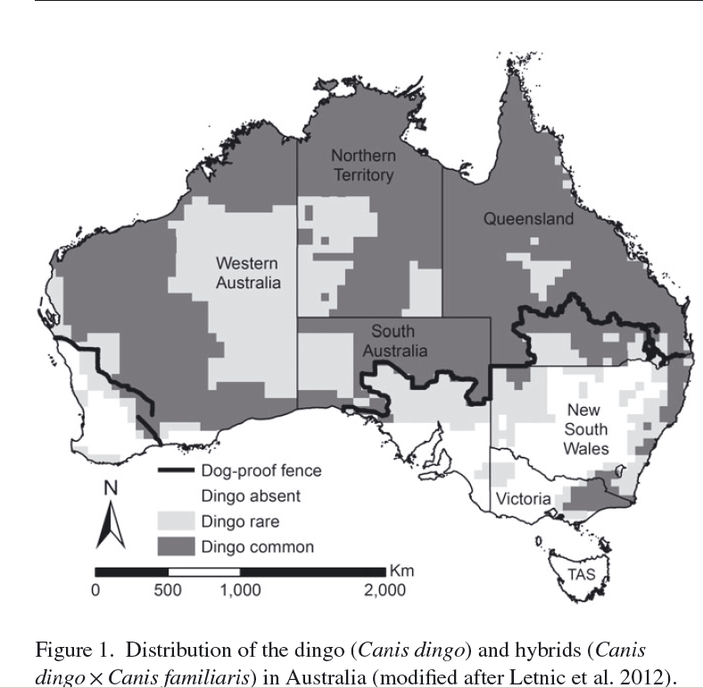
Notes:
Can dingoes can help restore Australia’s rangeland biodiversity, and potentially provide proof-of-concept for apex predator reintroductions globally? This question follows from the precedents set by studies in Yellowstone. But how are things different here in Australia? Will it work?

Slide 40
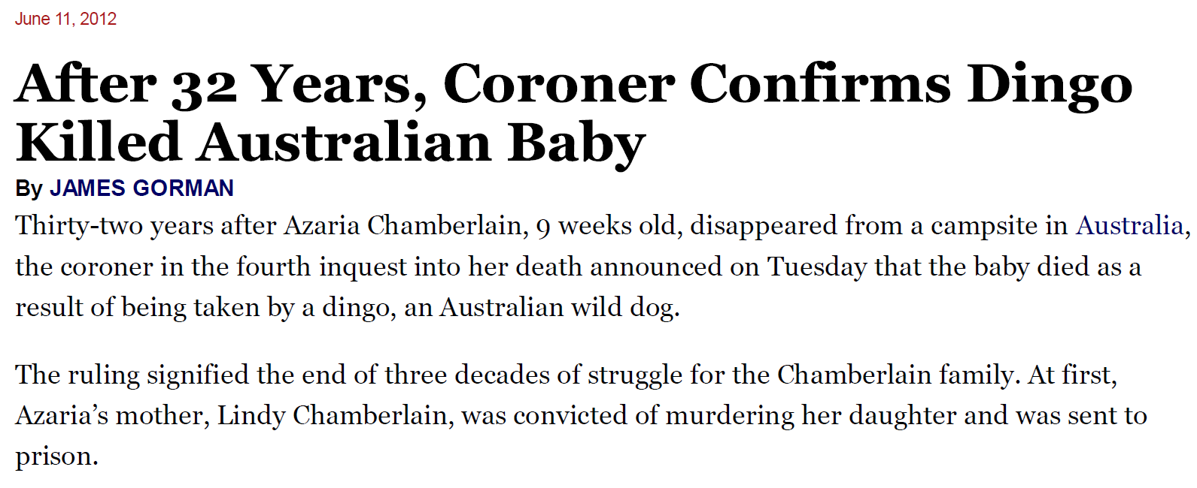

Slide 41

Notes:
Dingo, now that they have been given an ecological justification for keeping them around, have also been implicated in attacks on humans.

Slide 42
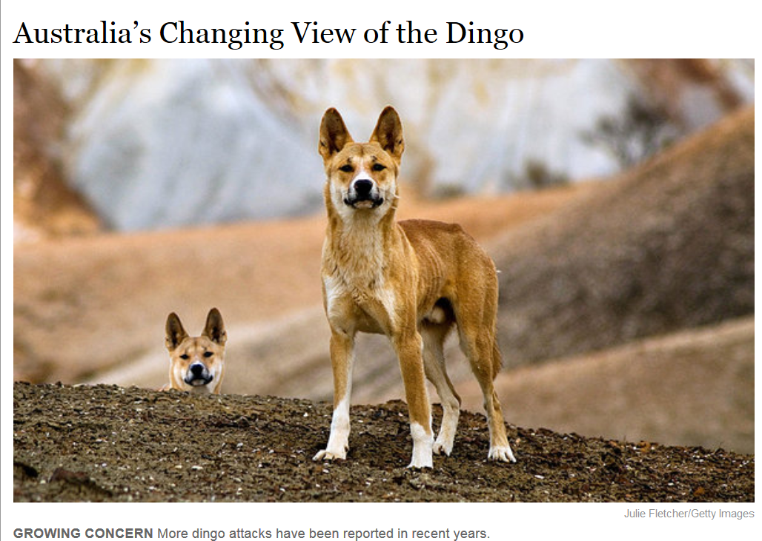
Notes:
http://www.nytimes.com/2012/03/06/science/australias-view-of-the-dingo-evolves.html?pagewanted=all

Slide 43
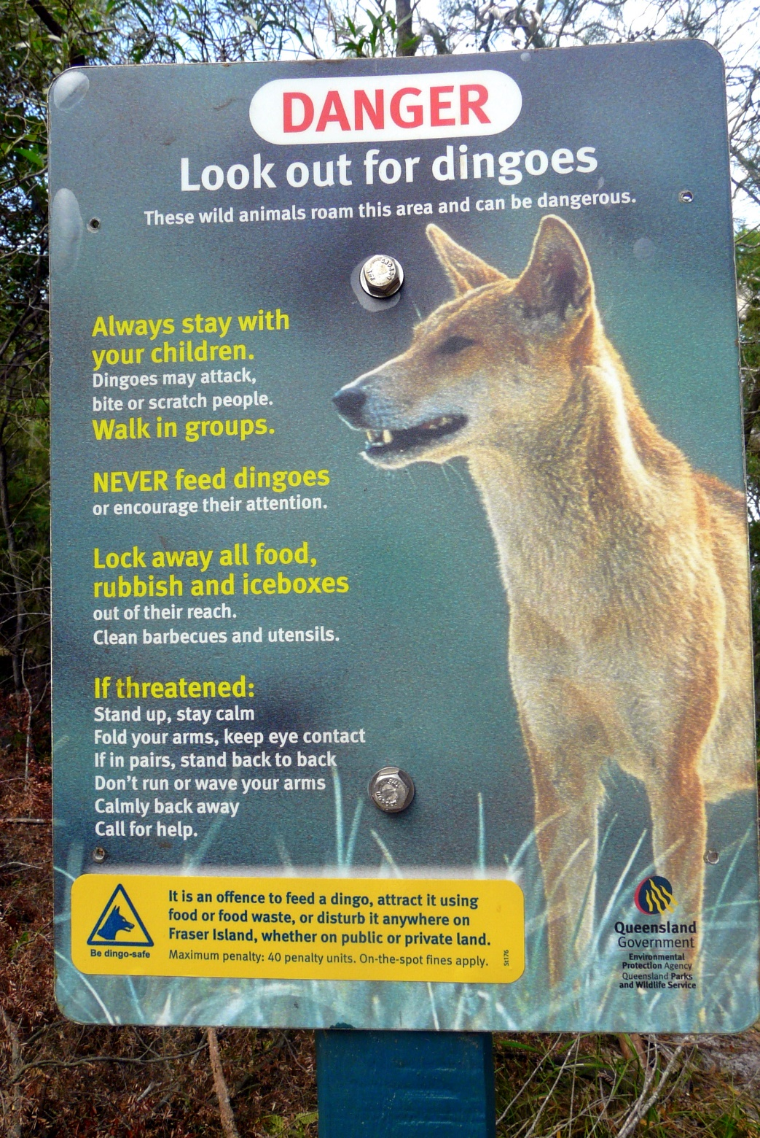

Slide 44
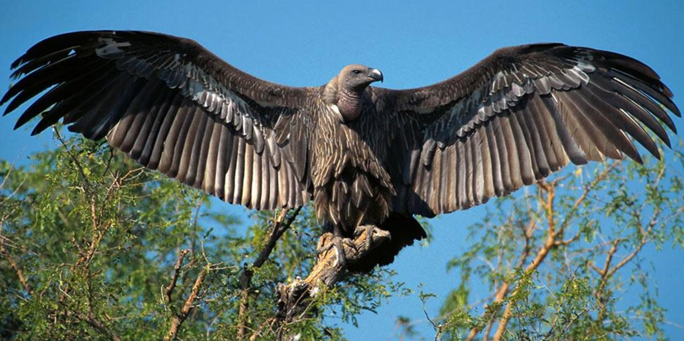
Thinking more critically about trophic cascades

Slide 45


Trophic cascades are not just for predators
Decline of vultures
  Avian obligate scavengers
  Poisoned by the cattle drug diclofenac in south Asia, particularly India
  Veterinary drug administered to livestock
  Vultures fed on livestock carcasses
Notes:
Vultures, which are the only obligate vertebrate scavengers, have experienced the most rapid decline in conservation status of any group of birds over the past decade and comprise the most threatened avian functional guild in the world. Of the 22 vulture species, nine are critically endangered, three are endangered, four are near threatened, and six are least concern
In India, Pakistan, Nepal, vulture populations declined by as much as 99.9% from 1992 to 2007. Vultures were exposed to diclofenac when they consumed carcasses of livestock that died within a few days of drug treatment.
And in other parts of the world: in Central and South America, 60–95% of carcasses are located and consumed by vultures. Most carcasses were located within 12 h by turkey vultures. Due to their competitive advantage in finding and consuming carrion, vultures likely consume more meat in Central and South America than all mammalian predators combined. Similarly, before their recent decline, vultures in the Serengeti of East Africa were estimated to consume about the same amount of meat as all the mammal predators.
Dietary toxins are causing vulture populations in Africa to crash, as well. The deliberate poisoning of mammalian carnivores, such as jackals, hyenas and lions, to avenge the loss of livestock is common in Africa and has led to widespread unintentional poisoning of vultures. With the recent escalation of rhino and elephant poaching across the continent, poachers are also now intentionally poisoning vultures, whose circling over carcasses can quickly lead authorities to the crime site Carbofuran, a widespread and cheap insecticide that is highly toxic is a primary culprit for such poisonings. However, numerous types of poisons have been used throughout Africa, including strychnine and synthetic organic pesticides. These poisons are incredibly effective at killing wildlife. For example, in 2013, a single poisoned elephant carcass in Namibia killed as many as 600 vultures

Slide 46

Vulture decline and mesopredator release
  Increase in numbers of facultative scavengers: gulls, ravens, crows
  Increases in these birds have resulted in increases in nest predation on other birds
  Feral dogs increased in India due to uneaten carcasses, leading to uptick in rabies in humans – which was already a problem before vulture decline
Notes:
With the decline of vultures in India, feral dog numbers increased by 7 million, despite widespread sterilization programs. This increase in dogs resulted in 39 million dog bites from 1992 to 2003, causing an estimated 48,000 human rabies mortalities in India.
https://www.youtube.com/watch?v=RMTOiALikK0

Slide 47

Trophic cascades: criticisms
Trophic cascades are difficult to document because prior conditions not always known

Slide 48

Trophic cascades: criticisms
Trophic cascade may overemphasize the importance of top-down controls over bottom-up or other types of controls.
Notes:
Elton saw the world through a bottom up view: the base of the pyramid exerted more control on the abundance of organisms. And indeed it does. However, both bottom up and top down controls are operative in the world.

Slide 49

Trophic cascades: criticisms
Changes in predator abundance can have different outcomes depending upon context.
  Hunting and culling of older male cougars brought in more males

Slide 50

Trophic cascades: criticisms
Many interacting factors in space and time: loss of predators rarely occurs in the absence of other changes
Aboriginal fire stick farming has declined as fewer individuals practice it. Fewer fires, led to greater build up of fuel and leaf litter and consequently larger, higher temperature fires occurred. This left understory more open and made predation on marsupials by cats and foxes easier. These changes accompanied the decline of the dingo.
Notes:
Aboriginals were thought to be hunter gatherers but actually use fire to shape the land for resources. They often set small fires in parts of the country and among particular peoples to create landscape heterogeneity or patchiness, thus increasing biodiversity and the number of monitor lizards, an important food source.

Slide 51


Slide 52

Revisiting the Yellowstone trophic cascade
Cascading effects of predator absence would have less relevance outside of Yellowstone because of pervasive anthropogenic influences there
In lower 48 only Yellowstone has entire assemblage of large carnivores and ungulates present at end of Pleistocene (and even then, there have been significant human-modification of wildlife abundance in Yellowstone)
Despite this, conservation decisions made in Yellowstone are often weighed heavily when considering conservation strategies in other areas.

Slide 53

Elk numbers also impacted by other grizzlies and cougar
Since widespread fire in 1988, drought, human harvest of elk, increased grizzly bear numbers
Elk, particularly young or sick, are predated upon by grizzly bears, which never went extinct from the park
Cougar were hunted out of existence in park in 1926 but returned in 1972
Notes:
Ferreting out the role of each of these factors in the YNP elk decline is a complex task Certainly under some conditions wolves can seriously reduce prey herds. However, such a wolf effect occurs primarily when other conditions, usually adverse weather, is also affecting the prey or when populations are small and isolated. There have been worse winter conditions, drought, human harvest of elk, increased grizzly bear numbers and long-term reduction in moose numbers since widespread fire in 1988.
A major elk herd that migrates between Yellowstone National Park and central Montana has dropped in size to fewer than 4,000 animals. Montana wildlife authorities say the herd now stands at around 3,900. That’s compared to more than 20,000 elk in 1992, only a few years before Canadian gray wolves were introduced into Yellowstone. Officials say more hunters and other predators such as mountain lions and bears have also taken their toll on the herd.
http://www.sciencedirect.com/science/article/pii/S0006320712001462
A decade after the park was established in 1872, most of the wolves, cougars, and many smaller predators were largely gone from Yellowstone—a drastic culling whose consequences are still playing out. Grizzlies managed to stay on, largely because of their popularity at dumps and sites where they were intentionally fed to entertain the tourists. In the 1930s, one hotel built an outdoor arena with bleachers so 1500 people could view the 50 or more bears snuffling among the garbage every night.

Slide 54


Slide 55


Slide 56


Slide 57

Longer growing season
The growing season in Yellowstone has increased 27 days since the elimination of wolves from Yellowstone
Notes:
The average length of the growing season in the contiguous 48 states has increased by nearly two weeks since the beginning of the 20th century. A particularly large and steady increase occurred over the last 30 years.
The length of the growing season has increased more rapidly in the West than in the East. In the West, the length of the growing season has increased at an average rate of about 22 days per century since 1895, compared with a rate of about eight days per century in the East.
http://www.epa.gov/climatechange/science/indicators/health-society/growing-season.html

Slide 58
Competition
Costs incurred due to common pursuit of resources (sunlight, water, nutrients, mates)
  Intraspecific competition (within the same species)
    Tree seedlings that sprout underneath their parent tree
    Siblings competing for resources provided by the parent
  Interspecific competition (between different species)
Many different competition-related concepts

Slide 59




Competitive exclusion
Notes:
Competitive exclusion can lead to extinction, but it does not often play out that way. Why: resource partitioning, habitat shift, and character displacement

Slide 60

Character displacement
Character displacement, along with resource partitioning and habitat shift are solutions to coexistence that circumvent competive exclusion and local extinction
Notes:
Character displacement can be taken as competition

Slide 61


Habitat shift and resource partitioning
Cliff chipmunk, Neotamias dorsalis
Uinta chipmunk, Neotamias umbrinus
Notes:
SW US
Cliff chimpmunk, Neotamias dorsalis, is a more aggressive defender of food than Neotamias umbrinus, which is “mellower” and less likely aggressively defend food sources.

Slide 62

Notes:
Habitat shift in response to competition. Habitat shift is a solution to the potential for competitive exclusion.
Food is more abundant at higher elevations, acorns, pine combs. Climate is denser, cooler and supports more vegetation. Lower elevations are drier and more open in terms of vegetation.
Experimental results confirmed that N. dorsalis is able to exclude N. umbrinus from open woodlands by aggressively defending patchy food resources on the ground, where chipmunks do most of their traveling.
However, in denser forests at higher elevations, food is abundant and harder to defend. N umbrinus wins out because it does not waste excessive time and energy on fruitless defenses.
N. quadrivittatus is like N. dorsalis in that it is a more aggressive defender of food caches

Slide 63

Ghost of competition past
Term coined to stress that interspecific competition, acting as an evolutionary force in the past, has often left its mark on the distribution of species, even when there is no present-day competition between them.
Notes:
This make it difficult to detect the level at which competition in the past shapes the present; what we see today is a ghost (as expressed as differences in resource partitioning, habitat shift, and character displacement) of the competition that occurred earlier

Slide 64

Treeline advance reflects not just warming temps but also competition
Where vegetation cover is sparse, upward change in elevation is greater because there is less competition among plants as they disperse and establish.
Biotic interactions and external conditions are intertwined – just as external and internal controls
Notes:
Competition, as well as other external controls, can impact the dispersal of trees on mountain slopes. In mountains and in the tundra climatic warming tends to promote an upward or northward shift of alpine treelines at local and regional scales. However, migration rates to cooler temperatures can be controlled by interspecific interactions like competition. Thicker, heavier cover of vegetation promotes more interspecific competitive interactions and thus slows the rate of upward movement.

Slide 65


Slide 66

Notes:
Beaver dam in Tierra del Fuego

Slide 67
Positive interactions
Facilitation - species positively affects another species by making the environment more favorable for the second species, without any direct harm or benefit to itself.
Mutualism - interaction in which two different species interact in a way that benefits both of them.
Both facilitation and mutualism are important biotic interactions that contribute to the coexistence of different species

Slide 68
Positive interactions
Facilitation and mutualism were topics of interest early in the development of ecology at the start of the 20th century
However, competition and antagonistic interactions became to be seen as main structuring agent by early ecologists
Turn back in the last three decades to positive interactions and the coexistence of both positive and negative interactions
Notes:
Organism, Hitler, and WWII

Slide 69


Obligate pollination mutualism
For some plants and pollinators
  Yucca and yucca moth
  Senita cactus and senita moth
Indicative of strong co-evolutionary development
Notes:
Senita moth and senita cactus

Slide 70
Red King Effect
Red Queen effect arises in negative biotic interactions – constant change and selection
Is rapid evolution useful in a co-evolutionary mutualistic relationship?
Not always: slower evolution may be favored with mutualisms. This is the Red King effect
Biotic interactions have an evolutionary component – time, space, in other words context shape them.
Notes:
Evolution matters in the sense of defining a biotic interaction. What would happen if a specialist moth underwent a phenotypic change that altered the efficiency of the pollination services they provide?

Slide 71
Facilitative engineering
Modification of availability of abiotic or biotic conditions or resources through habitat construction or habitat amelioration (reduction of abiotic or biotic stress)
Terms range widely to describe these facilitator taxa, such as ‘ecosystem engineer’ or a ‘driver’ species. Keystone species can be facilitator, but this term is typically applied to species that influence abundances of other species through predation

Slide 72

Notes:
Bears transport salmon out of the stream to eat, leaving behind nutrients. More tree cover along salmon streams
Redds – excavations made by female salmon during breeding

Slide 73


Slide 74

Notes:
Bears transport salmon out of the stream to eat, leaving behind nutrients. More tree cover along salmon streams

Slide 75
Salmonids as ecosystem engineers
Direct effects in response to mass spawning of salmonids
  Changes to streambed topography
  Changes in volumes of sediment moving through the river
  Changes in the river channel morphology
Indirect effects through carcasses
  Contributes nutrients to the riparian zone, which may influence the vegetation and bank stability

Slide 76

Notes:
Whales and their food may help in retaining limiting nutrients (N, P, and Fe) in the surface layer and releasing these nutrients slowly into the water
https://www.ncbi.nlm.nih.gov/pmc/articles/PMC4743783/pdf/pnas.201502549.pdf

Slide 77
Effects of highly mobile engineer species
Shape ecosystems of entire continents
Whales, sea birds, salmon, and bison in North America formed interlinked system moving nutrients from deep ocean to continental interiors
  Large marine mammal populations helped maintain nutrients in surface waters
  Seabirds and anadromous fish like salmon moved nutrients from the ocean to coast
  Large terrestrial animals (bears, bison, antelope, caribou) moved nutrients away from hotspots and dispersed them across continental interior.

Slide 78


Notes:
Migratory caribou (right) would transport these nutrients far inland away from rivers and into the continental interior. This ocean-continent nutrient pump illustrates facultative engineering and how animal and plant taxa modify their environment and facilitate coexistence of other species.

Slide 79

Global capacity of animals to move nutrients from concentrated patches in the ocean has decreased to 8% of former terrestrial levels and 5% of its marine levels
Notes:
Some of the greatest concentrations of primary productivity are in the ocean, where large quantities of biomass and nutrients originate in phytoplankton blooms.
Whales and their food may help in retaining limiting nutrients (N, P, and Fe) in the surface layer and releasing these nutrients slowly into the water – the whale pump
https://www.ncbi.nlm.nih.gov/pmc/articles/PMC4743783/pdf/pnas.201502549.pdf

Slide 80
Old view of biotic interactions
Notes:
Valid, but not very nuanced. Time and space are not considered, or are at least assumed to be static. The Red King hypothesis and the Red Queen hypothesis convey that biotic interactions have a temporal component. They are also. In other words context matters. While the above chart is useful, it doesn’t capture the dynamism and variability of biotic interactions.

Slide 81

New view of biotic interactions
  Biotic interactions are indirect as well as direct. They cannot be examined in isolation of other organisms and their biotic influences

Slide 82
New view of biotic interactions
  Biotic interactions change through time and across space - they depend upon context.
    Nurse trees: facilitation and then competition
    Mistletoe: parasitism, mutualism, and facilitation
    Lianas: competition and facilitation

Slide 83
New view of biotic interactions
  Biotic interactions change through time and across space - they depend upon context.
    Nurse trees: facilitation and then competition
    Mistletoe: parasitism, mutualism, and facilitation
    Lianas: competition and facilitation

Slide 84


Notes:
Nurse plants can impact seedling emergence, but once saguaro matures, it may begin to compete with the creosote bush for water.
Saguaro germinating under woody shrub. Facilitation may lead to competition later----biotic processes are not necessarily fixed throughout an organism’s life span.
Paloverde, creosote bush
Hydraulic lift: uptake of water by other plants makes water more available for adjacent plants. Creosote bush has a deeper taproot and brings water up from the subsurface and makes soil moisture higher, conditions that help a germinating saguaro. However, as the saguaro matures, its shallow spreading roots near the surface may intercept rainfall and limit its downward movement and ultimately its availability for the creosote bush.

Slide 85

Notes:
Biotic interactions change over lifespan of organism

Slide 86



Mistletoe as parasite…
,
Phoradendron serotinum, a generalist hemiparasitic mistletoe of woody trees. This species requires a degree of parasitism, but can also photosynthesize.
Notes:
Mistletoe (Phoradendron spp.) is found in hardwoods.
Damage more commonly only results in growth reduction. Phoradendron is a hemi-parasite They bear evergreen leaves that carry out some photosynthesis of their own, relying on the host mainly for mineral nutrients from the ground obtained through the host’s xylem, water tissue.
They are obligate stem parasites whose dependency ranges from holoparasitic to hemiparasitic, and they are characterized by the development of a haustorium, an absorptive organ that serves as a sort of root, attaching to the host and penetrating its conductive tissues in order to pass nutrients to the parasite.
Phoradendron serotinum is used in North America as Christmas decoration, substituting for the European mistletoe Viscum album.
Many species of mistletoe, more than 1,300 in all. Despite the associations with winter, many of them grow in the tropics. There are even mistletoes that grow on mangrove trees. All mistletoes are parasites, and grow on other plants, stealing water, minerals and other nutrients from their hosts. Some mistletoes even grow on other mistletoes. To a botanist, “mistletoe” refers to a way of life rather than to one particular family of plants. It’s a habit that’s evolved independently several times.
Most mistletoes are “hemiparasites.” This means they don’t rely on their hosts for all their needs: Instead, they harvest the sun’s energy to make some sugars for themselves. Heavy mistletoe infestation in a tree can lead to water stress, and increased susceptibility to insects or disease or even death. Mistletoes are an important resource. Some birds collect the leaves to make a lining for their nests. Others nest in mistletoe clumps. And plenty of animals drink mistletoe nectar, or eat the leaves or the berries.
In Europe and North America, mistletoes make berries in winter. They thus provide food for birds when most other plants don’t. And presumably, those berries explain why mistletoe became a traditional decoration at this time of year, and how it came to be used in a kissing ritual.
The flesh is sticky, and forms a viscous goop. The stickiness means that, after eating the berries, birds often regurgitate the seeds and then wipe their bills on twigs — leading to the seeds’ getting glued to the tree, where they can germinate and begin the cycle anew. The stickiness persists through the gut, making it hard to defecate mistletoe seeds. To deal with this, birds like the silky flycatcher, Phainopepla nitens, that are mistletoe specialists, have evolved a “waggle dance” — also known as butt-wiping behavior — where they clean up by rubbing themselves against twigs. Indeed, the association with bird droppings may even be the origin of the word: Some evidence suggests that “mistletoe” comes from Anglo-Saxon for “dung on a twig.”

Slide 87

…as mutualistic partner
Notes:
Specialist bird dispersers

Slide 88

…as faciltative engineer
Notes:
This image reflects more than just a parasite living off a tree.
Parasites can have positive effects on other species within communities, despite the negative impacts on their hosts.
http://www.nytimes.com/2012/12/18/science/beyond-the-kiss-mistletoe-helps-feed-forests-study-suggests.html?ref=science
Not only bird diversity, but also soil nutrients are higher where mistletoe is present. It drops leaves more often than host trees and its dropped leaves have more nutrients, creating a unique soil trophic web

Slide 89

Notes:
Schematic illustration of mistletoe effects driving long‐term vegetation change in an individual host tree. (a) A tree lacking mistletoe receives sporadic visitations of frugivorous birds. (b) Once the tree is parasitized by mistletoe, it has greater chances to be re‐infected due to the greater activity of avian seed dispersers. In addition to mistletoe seeds, frugivores disperse seeds of co‐fruiting plants under the host canopy. With time, intense parasitic loads coupled to greater frugivore activity not only enhance seed deposition, but also organic matter inputs beneath the host canopy, giving rise to local soil enrichment that favors seedling establishment and subsequent plant growth. Moreover, heavily parasitized trees produce less biomass, which permits greater amounts of light to penetrate the forest canopy, having a positive effect on growth of understory woody plants already established beneath the host. (c) This positive loop would intensify as the system matures, ending with the death of the host, which would finally be replaced by zoochorous understory vegetation
onlinelibrary.wiley.com/doi/10.1111/1365-2435.12907/full

Slide 90


Tropical regions have high rates of cloud to ground lightning but surprisingly little lightning damage to trees.

Slide 91



Lianas as parasite and facilitator
While lianas are a structural parasite that can bring down a tree, they also facilitate a tree’s survival from a lightning strike. This illustrates how biotic interactions are contextual and can be positive or negative depending upon context.
Notes:
Researchers have mapped the location of lightning strikes in tropical forests and documented the patterns of mortality and recovery.

Slide 92
New view of biotic interactions
They are more plastic and changeable in terms of behavior.
Individual personality, learned behavior, animal cultures and social transmission make biotic interactions less fixed

Slide 93

Individual personality
Animal personalities can be stable and quantifiable
There are consistent differences between individuals that persist across circumstances
Personality can impact survival, adaptation, distribution, and selection
What personality is favored when food is scarce in European great tit communities?
Notes:
Scarce resources favor meek birds. Highly competitive birds expend large amount of energy defending food stores. This causes more physiological stress, which can impact biological health and survival.
When bird populations are dense, competition for territories, mates, and food sharpens, and one might expect aggressive individuals to win out. But when birds have to compete for scarce resources, the aggressive ones often get into fights, which take a physical toll. Aggressive birds also strain to keep all their young fed, further taxing their health. Thus, compared with more docile individuals, these birds are more likely to wear themselves out and fail to survive to the next breeding year. Only when densities are low do these high strung birds outcompete gentler ones and thrive

Slide 94

Learned behaviors
Notes:
https://www.youtube.com/watch?v=6zHUNAx7q1M
Urban adaptor

Slide 95



Slide 96

Notes:
Yet when researchers at Germany’s Max Plank Institute for Ornithology tracked stork paths using a GPS logger in 2016, they found that some had skipped the grueling migration across the Sahara Desert. That year, the birds stopped, instead, in cities like Madrid, Spain, and Rabat, Morocco. Apparently, they had developed a taste for junk food, in particular the stuff that piles up in landfills along the migration route
https://www.citylab.com/life/2017/09/where-the-animals-go-book-urban-development-animal-migration/540174/?utm_source=nl__link6_092117&silverid=MzEwMTkyMjY4Njg4S0
Less energy would be expended in foraging in a dump versus their natural habitat. Migration route is also a source of mortality – the dump may be safer.
If open dumps closed, what might happen?
https://www.nytimes.com/2016/03/17/science/seduced-by-junk-food-storks-are-opting-not-to-migrate.html

Slide 97

Animal culture and social transmission
Notes:
Diversity in cultural species and behavioral domains. (A) After filial imprinting on the costumed human pilot of a microlight aircraft, young cranes followed the flight path of this surrogate parent, adopting it as a traditional migratory route. (B) Female fruit flies (left) that witness a male marked with one of two colors mating (top right) later prefer to mate with similarly colored males. This behavior is further copied by others, initiating a tradition. (C) Bighorn sheep translocated to unfamiliar locations were initially sedentary, but spring migration and skill in reaching higher-altitude grazing grounds expanded over decades, implicating intergenerational cultural transmission. (D) Groups of vervet monkeys were trained to avoid bitter-tasting
corn of one color and to prefer the other. Later, when offered these options with no distasteful additive, both naïve infants and immigrating adult males adopted the experimentally created local group preference. (E) Young meerkats learn scorpion predation because adults initially supply live prey with stingers removed and later provide unmodified prey as the young meerkats mature. (F) A humpback whale innovation of slapping the sea surface to refine predation, known as “lobtail feeding,” spread over two decades to create a new tradition in hundreds of other humpbacks.

Slide 98

Social transmission
Many invertebrates, plants, and some vertebrates have evolved a strategy called aposematism to protect themselves from being eaten.
This strategy works because it is a warning signal: species display bright conspicuous colors or patterns to alert educated predators that they are not good to eat. Prey are left unmolested.
How do easily-detectable prey survive until every predator learns?
Notes:
https://nicheconstruction.com/is-social-transmission-a-forgotten-force-in-coevolution/

Slide 99

Humans as major influence on all biotic interactions
Negative: avoidance of humans create pervasive changes in species distribution in time and space
Positive: humans are also intentional and unintentional facultative engineers. Synanthropic adaptations allow some animals and plants to live closer to humans and thrive.
Notes:
https://www.uky.edu/env/stormwater/protecting-our-streams

Slide 100

Nocturnality as mammal response to humans
Notes:
Peregrines may be changing in response to city life. Researchers in the United Kingdom have found urban falcon nests lined with bat remains. This suggests that the falcons are moving, at least in part, from diurnal to nocturnal hunting

Slide 101

Landscapes of fear
The potential or perceived threat of a negative biotic interactions can be enough to have an impact on an organism
Notes:
The potential or perceived threat of a negative biotic interactions may have costs .
The fear of predation can, by itself, strongly affect the number of offspring produced over an annual cycle by song sparrows.
The ‘‘landscape of fear’’ model has been proposed as a unifying concept in ecology, describing, in part, how animals behave and move about in their environment. The basic model predicts that as an animal’s landscape changes from low to high risk of predation, prey species will alter their behavior to risk avoidance.

Slide 102

Notes:
http://calgaryherald.com/news/local-news/elk-calving-season-leads-to-warnings-in-Banff
Do we have a more positive relationship with elk through their learned behavior, and our responses to it?

Slide 103





Notes:
Humans construct as well as destroy habitats
Our habitat construction can be incidental, as in the way in which cities have had an unintended effect of increasing the number of niches and microclimates for other organisms to exploit.
Our habitat construction is also intentional, as with the construction of artificial reef.

