Slide 1
Defining biodiversity
“The biological variety bequeathed to us by evolutionary processes over millennia’’
Does this mean all of biology? How do you work with a definition this encompassing?
“Biodiversity is what is being conserved by the practice of conservation biology.”
Then does ‘biodiversity’ merely stands in for whatever measure of value is best for a particular place?

Slide 2
Notes:
In short: if it is encompasses everything, then it explains nothing. And also: if all the types of biodiversity are correlated with each other, but not tightly, perhaps we should be more cautious about lumping them all together. Another reason to do away with biodiversity: it overshadows other types of value, like functional roles.

Slide 4
How is biodiversity defined?
We are going to use the multidimensional concept of biodiversity, which postulates that there are many different kinds of biodiversity that are correlated
We are going to take the position that biodiversity plays an important explanatory rule in ecology even if we don’t comprehend the relationships among all the different kinds of biodiversity
Notes:
Biodiversity thus understood is important from a scientific perspective, because it plays important explanatory roles within contemporary ecology. Moreover, although it does not encompass all valuable features of the natural world, this does not show that we should abandon it as a target of conservation. Instead, biodiversity should be conceived as one of many grounds of value associated with ecosystems. This is consistent with concluding that a central aim of conservationists should be to protect biodiversity.

Slide 5
Defining biodiversity
As a process of identification
As a balance between extinction and speciation
As evenness and richness
As taxonomic diversity
As alpha, beta, and gamma diversity
As genetic diversity
As phylogenetic diversity
As functional diversity
As interaction diversity
As cryptic diversity
As dark diversity
As landscape diversity

Slide 6
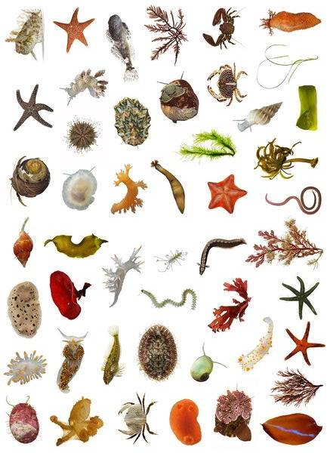
How many species?
5 - 9 million non-bacterial species estimated
Some estimates have ranged up to 100 million because of potential insect diversity
1.5 million cataloged, but many are only descriptions or a museum specimen

Slide 7
The challenges of counting
Species extinctions have increased because of humans
Taxonomic biases toward certain animals and plants
Taxonomic skills are necessary to find and identify new species
New species are routinely discovered in museums not just in their habitats
Speciation is occurring in some taxa
Extinctions need to be verified
Extinction debt
Ongoing conservation efforts, some that have been highly successful, while others are still pending
Scale and sampling effects complicate the derivation of trends

Slide 8
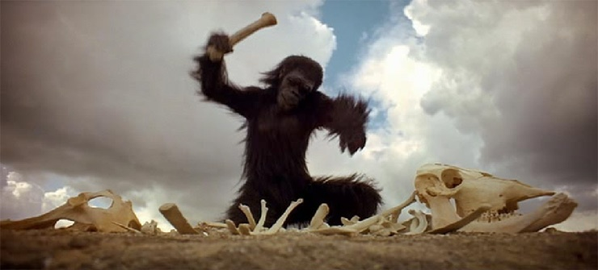
Notes:
5:22 in

Slide 9
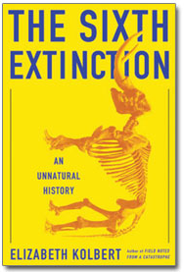
Human-caused extinctions: counting a moving target
Lose between 1-5% of species per year
Current rates of extinction are 100 to 1,000 times natural background levels

Slide 10
Taxonomic biases

Slide 11
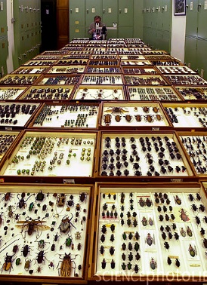

Slide 12
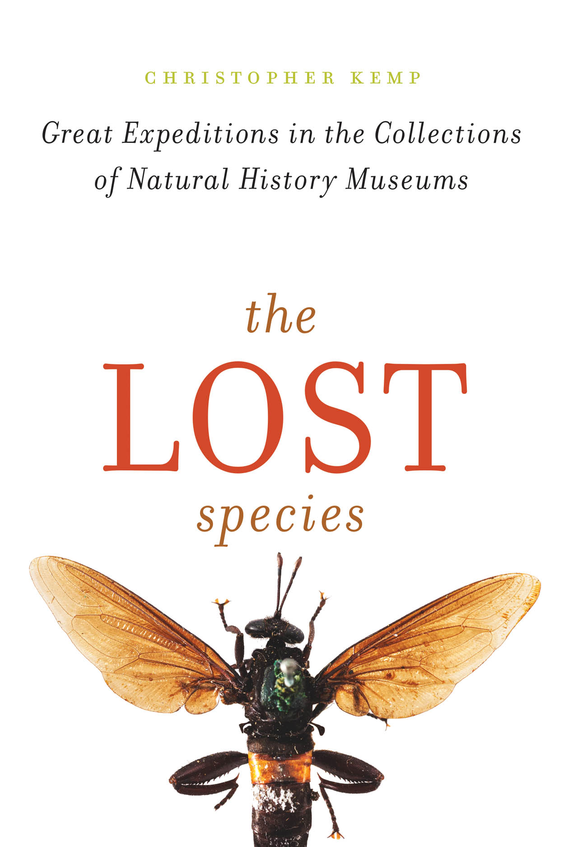
The lost species
Specialists who use their expertise to recognize new species are in short supply
Many uncatalogued and misidentified specimens in natural history museums
The raccoon-like olinguito discovered in the Chicago Field Museum’s mammal collections
Many museum collections were assembled by natural historians and explorers, sometimes centuries ago often based on outdated or incomplete information
Notes:
The olinguito was discovered in a drawer at Chicago’s Field Museum in 2003. It was originally filed with the museum’s olingos—small, raccoon-like mammals that live in South America. But researcher Kristofer Helgen said when he opened the drawer, he knew he was looking at something related, but different, that no one had yet described or named.

Slide 13
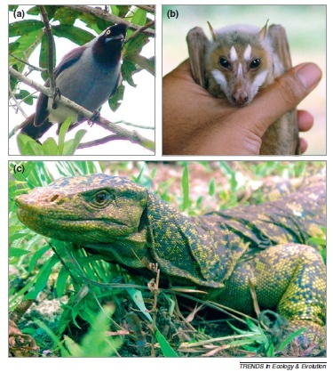
New species identified in the field
30,000 to 40,000 taxonomists worldwide
16,000 new species identified per year
However, there are fewer species being described per taxonomist, suggesting that it may already be harder to discover new species
Relatively large, conspicuous species are still being discovered in remote or poorly studied areas. Shown are (a) an undescribed jay species from the Amazon basin, (b) a recently discovered fruit bat and (c) a new monitor lizard species from the Philippines

Slide 14
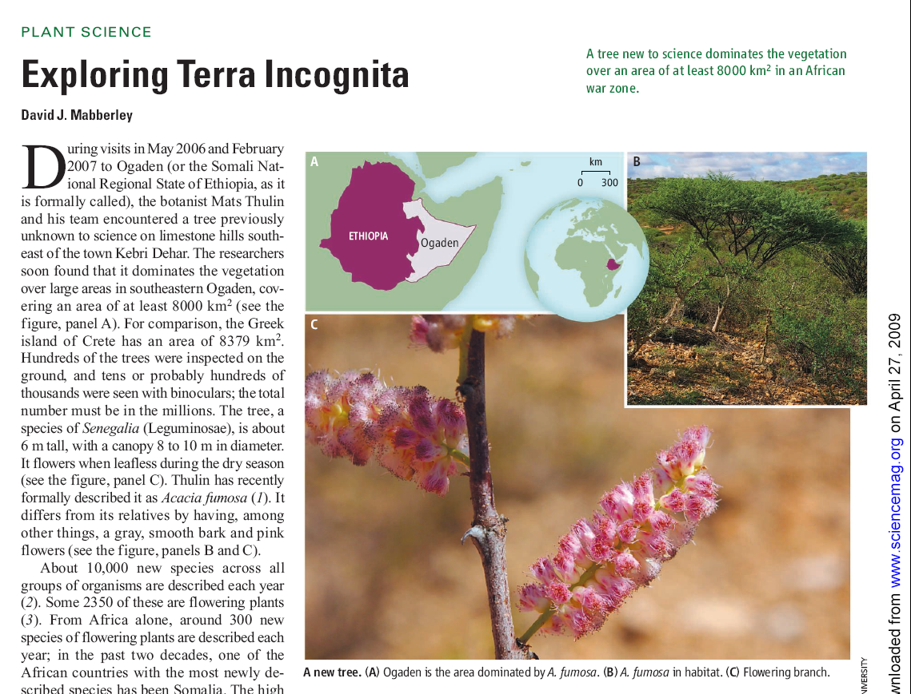

Slide 15
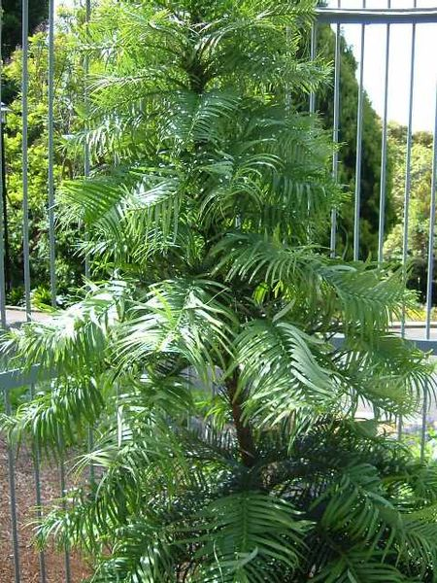
Notes:
Oldest fossils date back to 200 mya
Rediscovered in 1994
The Wollemi Pine was discovered as a small grove of seedlings and mature trees only 200 kilometres west of Sydney (Australia) in the Wollemi National Park. Since then, two other small groves have been discovered.

Slide 16
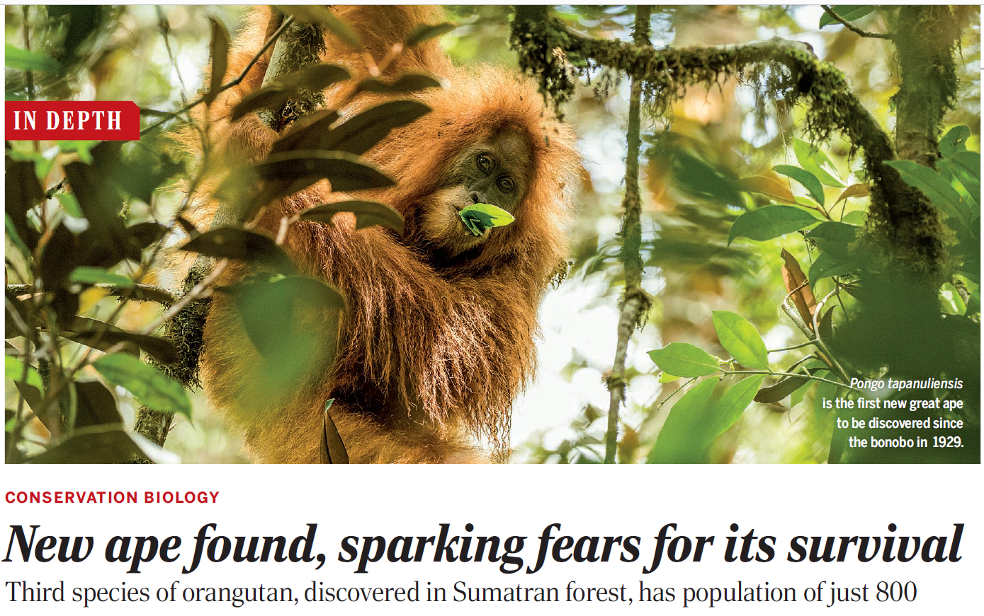

Slide 17
Notes:
https://www.cnn.com/videos/world/2022/11/19/black-naped-pheasant-pigeon-discovery-cprog-orig-aw-jc.cnn

Slide 18
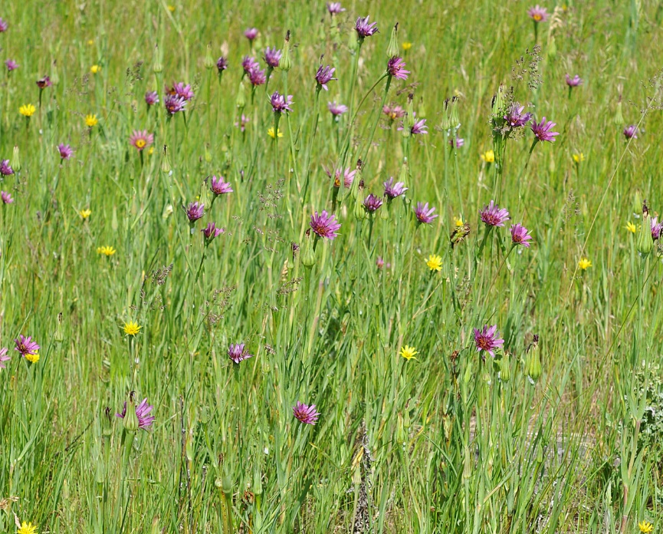
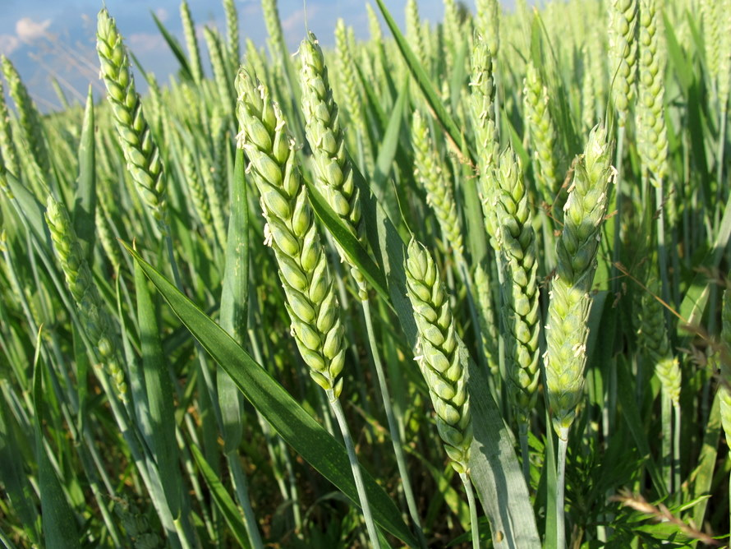
Speciation is occurring in some taxa…
Plant hybridization has contributed many new species
More new plant species have come into existence in Europe over past three centuries than documented as becoming extinct
Many new hybrid-origin plant species likely to remain undetected.
Notes:
Speciation: the evolutionary process by which new species arise.
Top In Washington and Idaho states in the USA, new species of Tragopogon. Tragopogon mirus is a hybrid formed in naturalised populations of the introduced European Tragopogon dubius and Tragopogon porrifolius. The purple flowers in the photo are T mirus interspersed among T dubius and T porrifolius.
Bottom Humans are responsible for the formation and maintenance of new hybrid crops, such as the new hybrid wheat species Triticum aestivum

Slide 19
…while other taxa are going extinct or moving ever closer to extinction
Notes:
Since March 19, 2018, there are only two known rhinos of this subspecies left, both of which are female; barring the existence of unknown or misclassified male northern white rhinos elsewhere in Africa, this makes the subspecies functionally extinct.

Slide 20
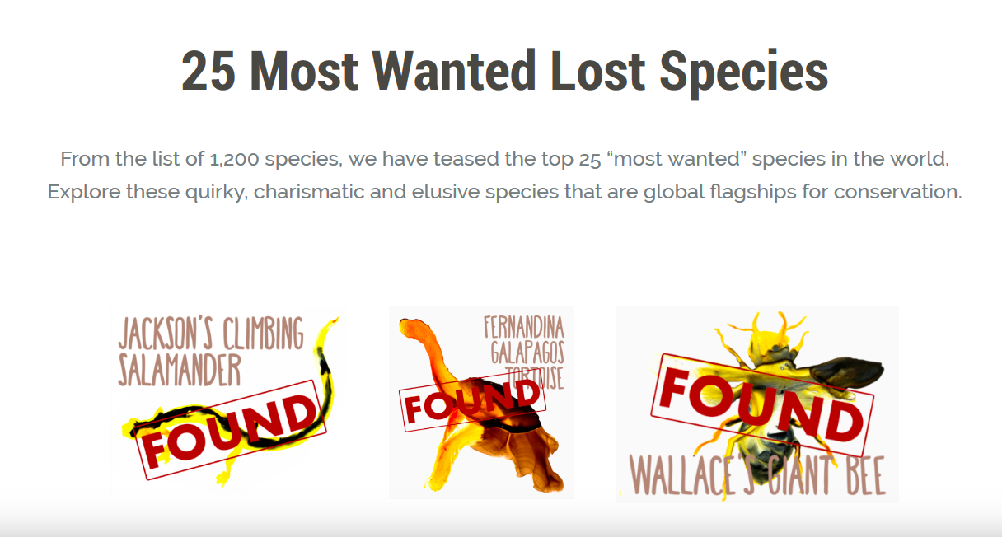
When do you conclude a species is extinct?
Of all the mammalian species thought to have become extinct since the year 1500, about one-third have at some stage been rediscovered.
How long should you continue to look?
Notes:
Numbers of species

Slide 21
Notes:
Became endangered species because of predation by the small Asian mongoose, which was introduced in colonial times to hunt snakes and rats, as well as by feral cats and dogs. The Cuban Solenodon was thought to have been extinct until a live specimen was found in 2003. The Hispaniolan solenodon, was also once thought to be extinct, probably more because of its secretive and elusive behavior than to low population numbers. Recent studies have proven that the species is widely distributed through the island of Hispaniola, but that does not tolerate habitat degradation. https://www.youtube.com/watch?v=cWOPC2kt_IA&ab_channel=ZSL-ZoologicalSocietyofLondon

Slide 23
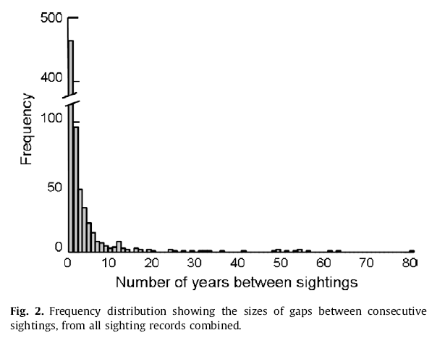
Extinction is not necessarily easy to conclude. Sometimes species thought to be extinct are still present in small isolated populations

Slide 24
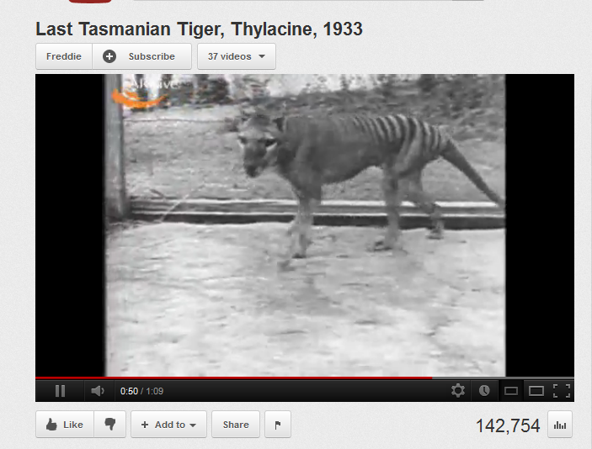

Slide 25
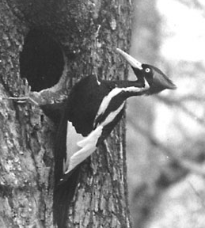
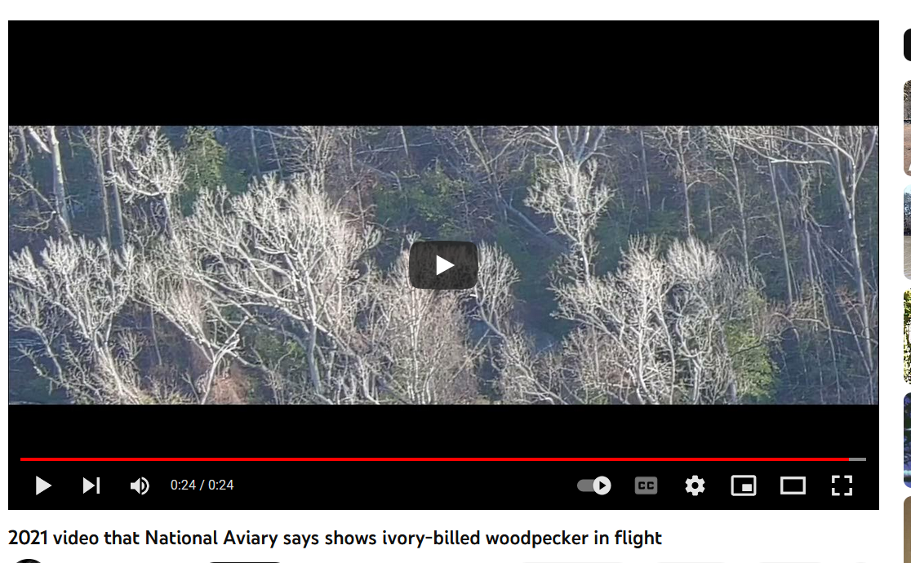
Notes:
Singer Tract Forest, Louisiana 1935 in photo of ivory-billed woodpecker at right. Supposedly the species went extinct in 1924, but last seen in Louisiana in 1944
A population of ivory bills may have held on in Cuba until the 1980’s
http://www.birds.cornell.edu/ivory/ https://www.youtube.com/watch?v=Hzg6y0TtUYA&t=295s

Slide 26
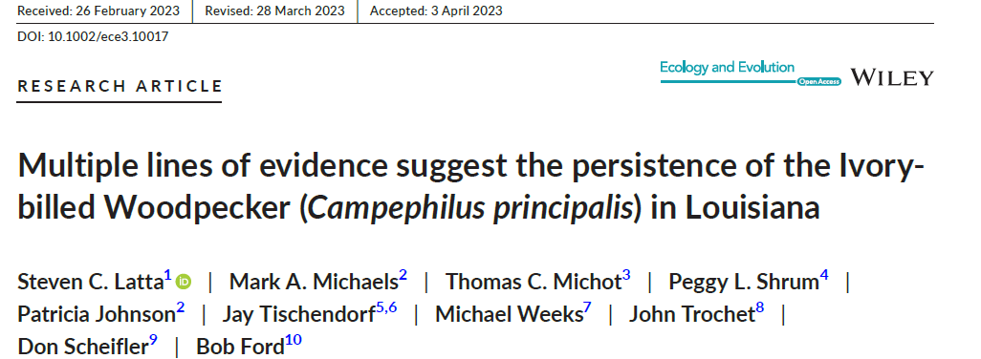
Notes:
https://www.washingtonpost.com/climate-environment/2022/12/19/ivory-billed-woodpecker-extinct/
Latta, S. C., Michaels, M. A., Michot, T. C., Shrum, P. L., Johnson, P., Tischendorf, J., ... & Ford, B. (2023). Multiple lines of evidence suggest the persistence of the Ivory‐billed Woodpecker (Campephilus principalis) in Louisiana. Ecology and Evolution, 13(5), e10017.

Slide 27
How many species will not be described because they went extinct?
It depends upon rates of extinction, which are challenging to estimate. It also depends upon having taxonomists who can identify species, and of course, how these experts define a species
At current rate of identification, if there are 5 million species, then most will have been described by the year 2220
If extinction rates are as high as 5% per decade, then regardless of how many species exist on Earth, more than half will be extinct within 150 years, 2164 – we won’t get to describe them.
At the rates considered more realistic (i.e., <1% per decade) the rate of species description greatly outpaces extinction rates whether there are 2 or 10 million species on Earth.

Slide 28
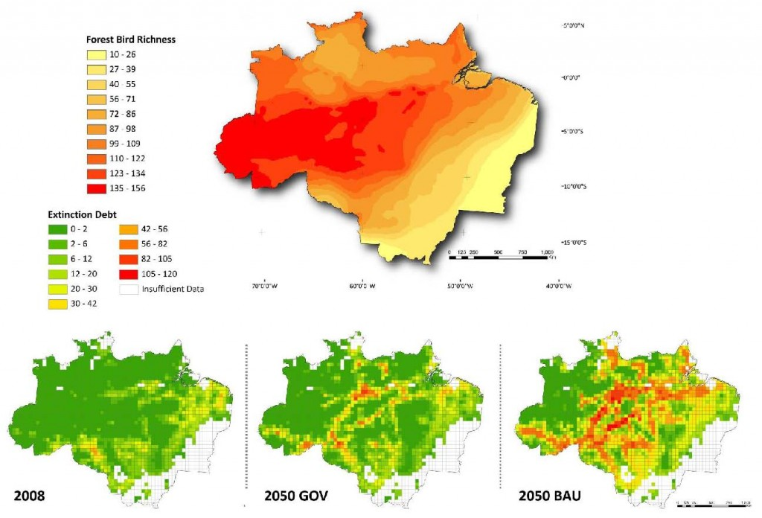
Extinction debt
Challenges counting of species
Defined as the lock in of future extinction of species due to human impacts that occurred at some earlier point in time.
Time delay between human impact and extinction
Notes:
http://www.australianscience.com.au/news/the-extinction-that-is-yet-to-come/

Slide 29
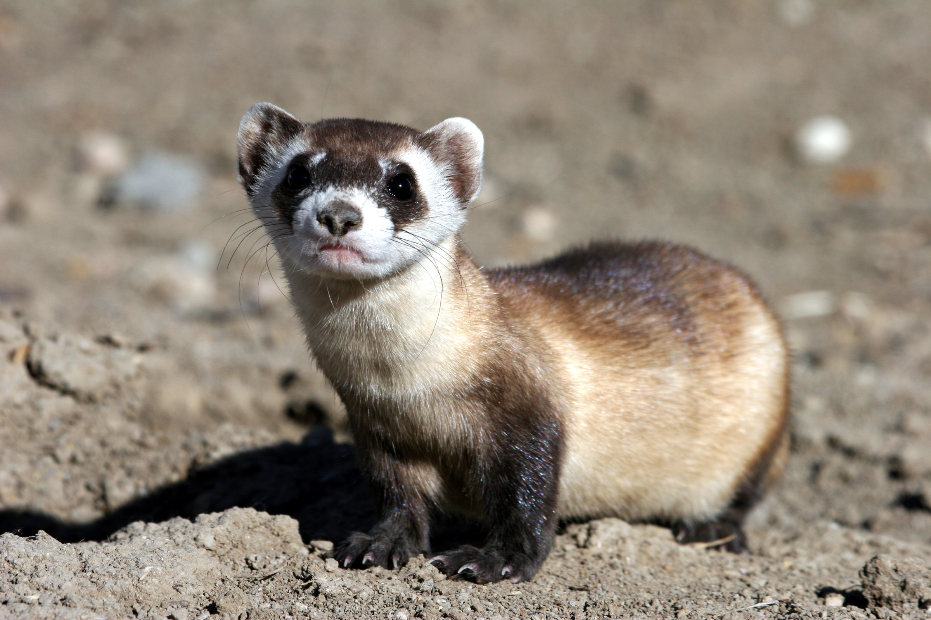
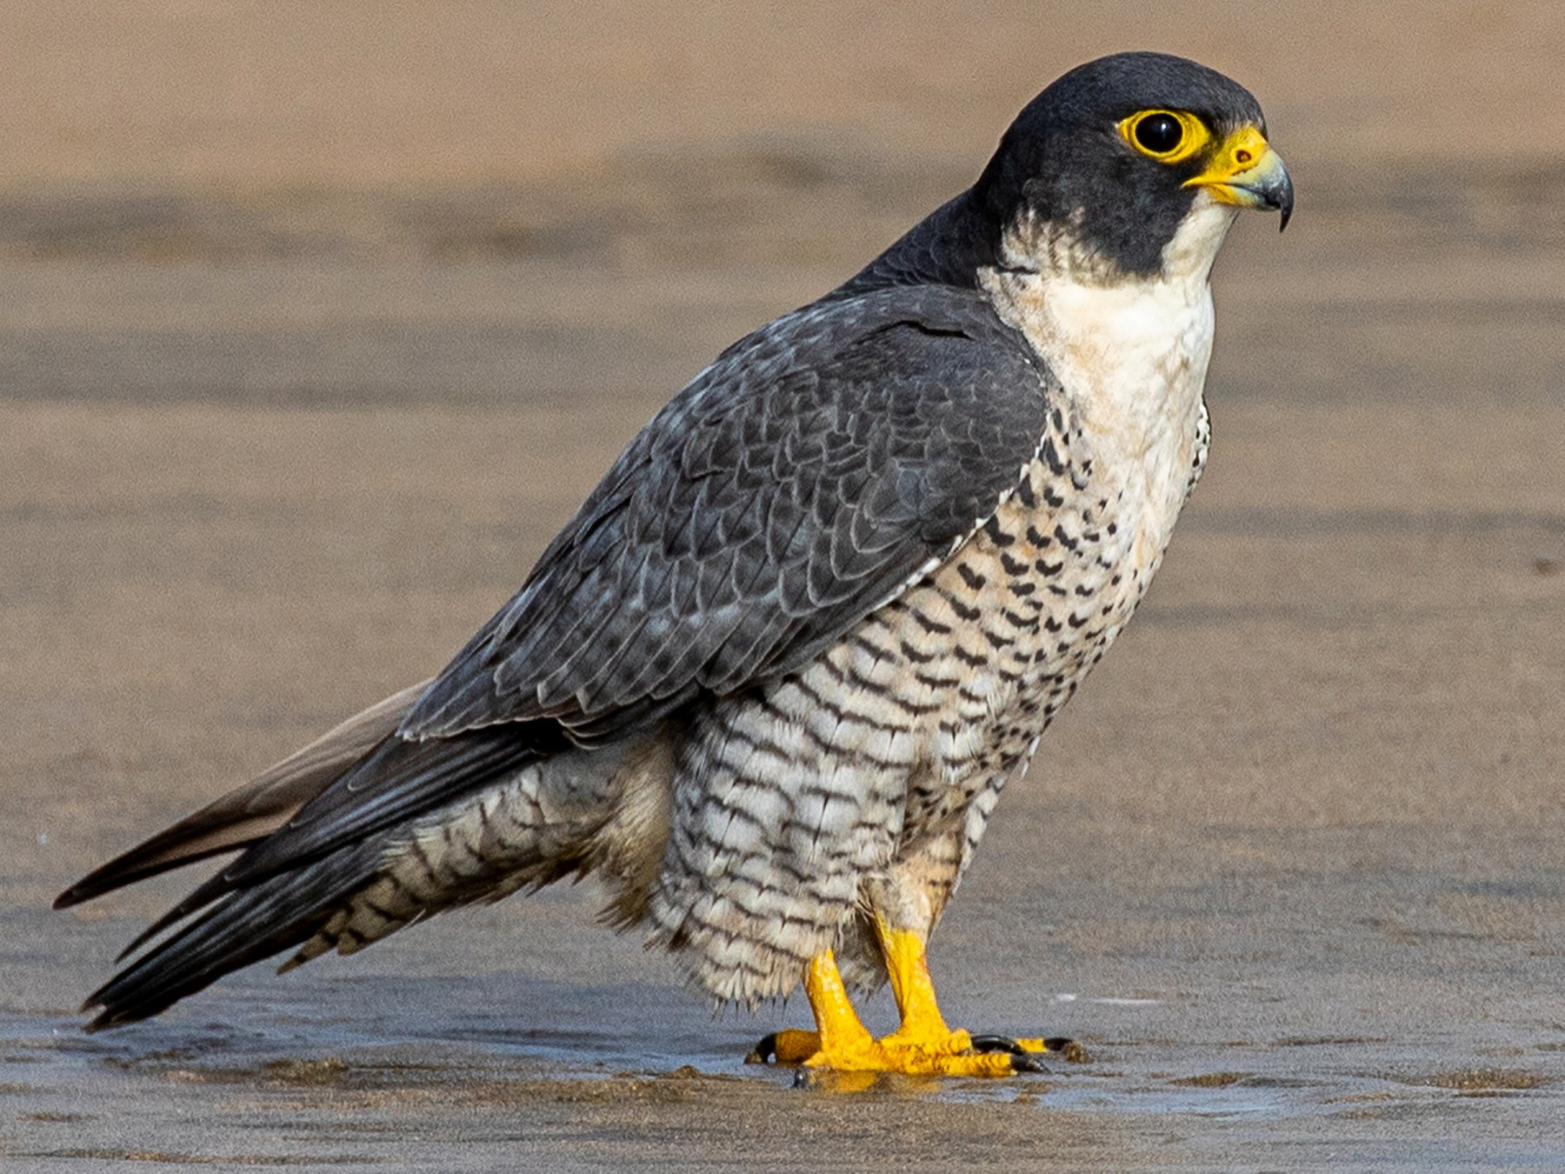
Contemporary extinction
There is evidence that contemporary extinctions, while very high, have not been as high as some had predicted, for several reasons:
Effective conservation efforts
Species persisting in secondary habitats and anthropogenic land covers
Notes:
Peregrine falcon Black-footed ferret

Slide 30
Anthropocene mechanisms that can contribute to exinction
What are the top two contributors to extinction?
Invasive species
Habitat fragmentation
Overexploitation
Pollution
Climate change
Disease

Slide 31
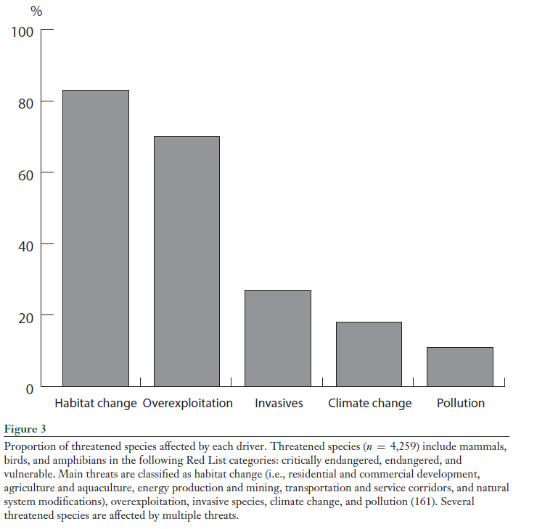

Slide 32
Fragmentation and human access, often through roads, leads to
habitat degradation and loss
Notes:
“To fragment” means “to break apart”; it does not mean “to shrink”.

Slide 33
Notes:
Forest surrounding a church in Ethiopia

Slide 34
Habitat fragmentation
Notes:
Island concept emphasizes decreasing size as the dominant facet of fragmentation Large patches are implied as better for species richness

Slide 35
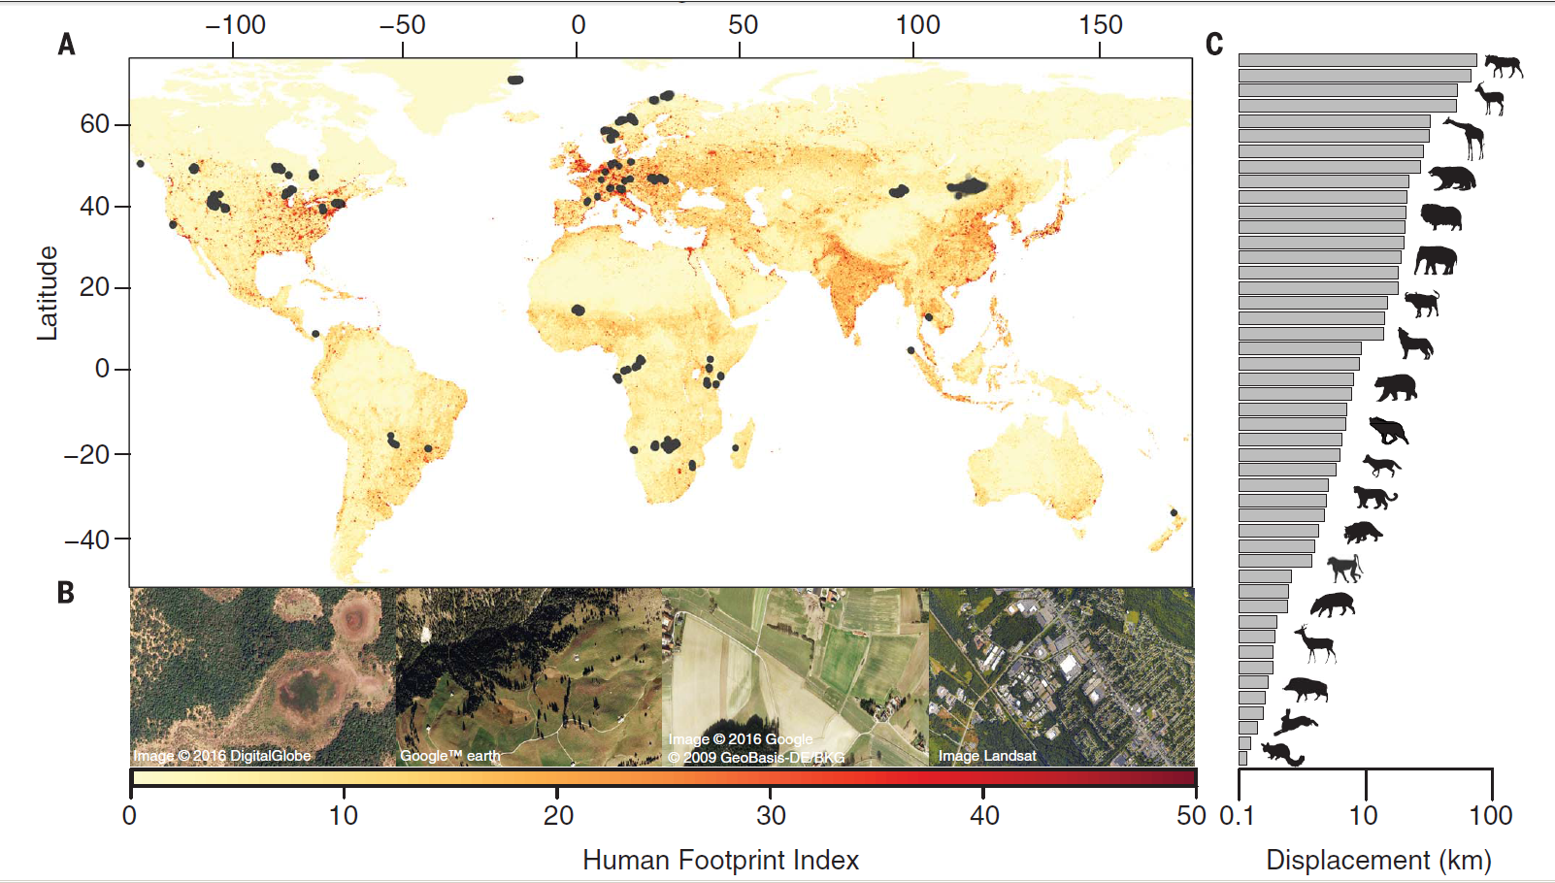
Habitat fragmentation results in island systems
Notes:
Locations from the GPS tracking database and the Human Footprint Index. (A) GPS relocations of 803 individuals across 57 species plotted on the global map of the Human Footprint Index (HFI) spanning from 0 (low; yellow) to 50 (high; red). Animal movement is fundamental for ecosystem functioning and species survival, yet the effects of the anthropogenic footprint on animal movements have not been estimated across species. Using a unique GPS-tracking database of 803 individuals across 57 species, we found that movements of mammals in areas with a comparatively high human footprint were on average one-half to one-third the extent of their movements in areas with a low human footprint. We attribute this reduction to behavioral changes of individual animals and to the exclusion of species with long-range movements from areas with higher human impact. Global loss of vagility alters a key ecological trait of animals that affects not only population persistence but also ecosystem processes such as predator-prey interactions, nutrient cycling, and disease transmission.
Tucker, M. A., Böhning-Gaese, K., Fagan, W. F., Fryxell, J. M., Van Moorter, B., Alberts, S. C., ... & Bartlam-Brooks, H. (2018). Moving in the Anthropocene: Global reductions in terrestrial mammalian movements. Science, 359(6374), 466-469.

Slide 36
Overexploitation
Overexpoitation has a size and taxon-specific bias
Selective impact on large-bodied mammals and birds
Large-bodied animals have gone extinct disproportionately earlier, leaving behind a smaller-bodied set of animals
Notes:
The mean has gone from 182 kilograms, or 400 lbs to 0.70-0.44 kg (1.5-1 lbs), and 0.06 kilograms, or a couple of ounces.

Slide 37
Defining biodiversity
As a process of identification
As a balance between extinction and speciation
As evenness and richness
As taxonomic diversity
As alpha, beta, and gamma diversity
As genetic diversity
As phylogenetic diversity
As functional diversity
As interaction diversity
As cryptic diversity
As dark diversity
As landscape diversity

Slide 38
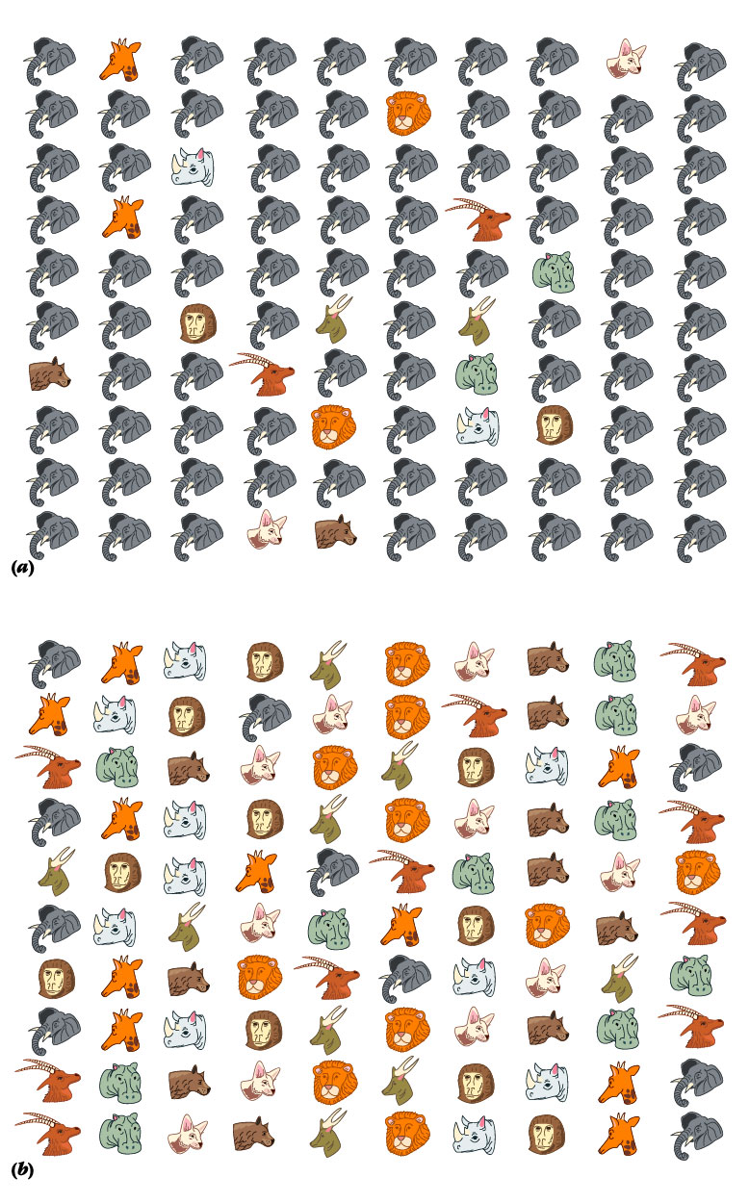
As evenness and richness
Low evenness: elephants dominant (Lower diversity)
Equal richness-same number of species (10)
High evenness (Higher diversity)

Slide 39
As taxonomic diversity
Species diversity is only one example of taxonomic diversity, there are other taxonomic hierarchies – we can also talk about genus diversity, family diversity, order diversity:
Kingdom
Phylum
Class
Order
Family
Genus
Species

Slide 40
As alpha, beta, and gamma diversity
Alpha (or local) diversity expresses the number of species within a given habitat. It is the most common way that diversity is employed
Beta (or turnover) diversity expresses the difference, or turnover, in species from one habitat to another.
Gamma (or regional) diversity-total number of species observed in all habitats within a geographic area

Slide 41
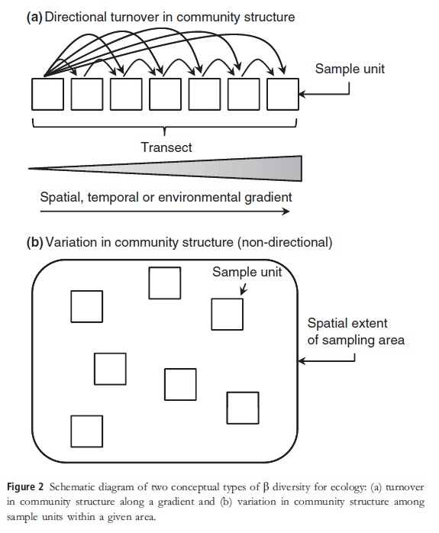

Slide 42
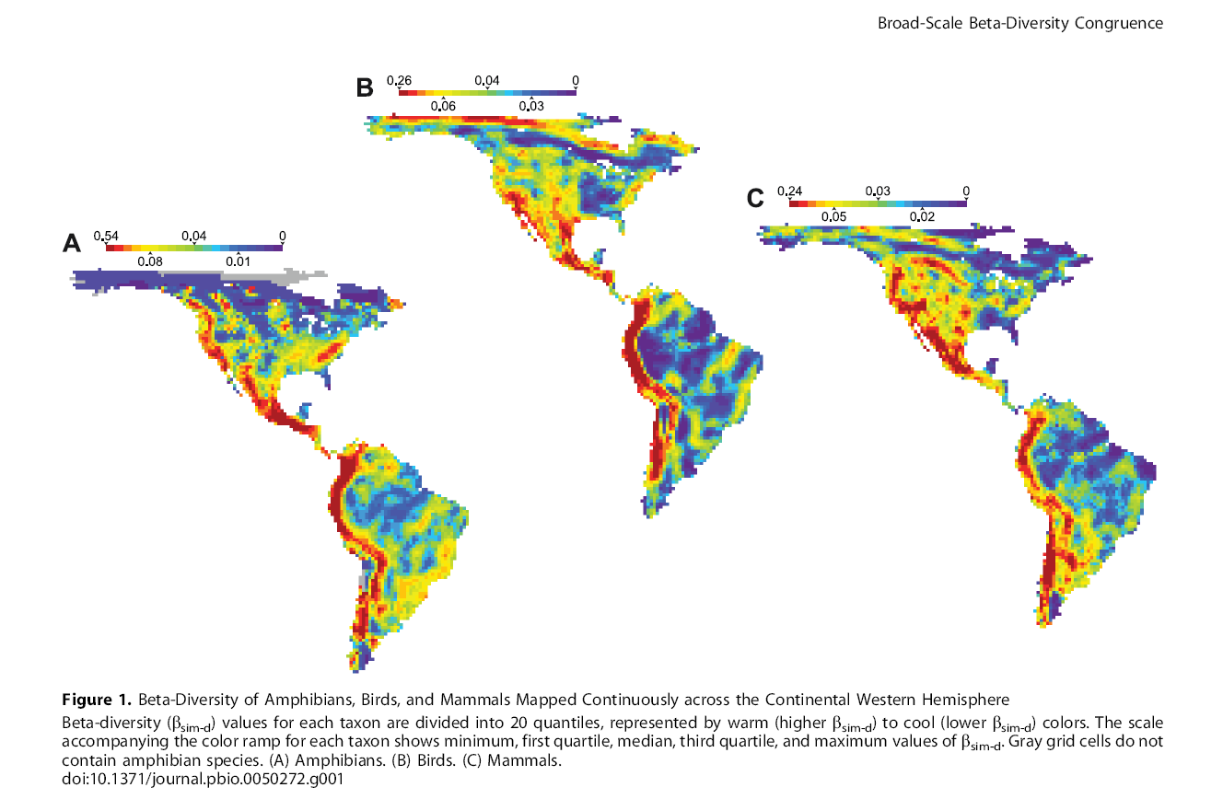

Slide 43
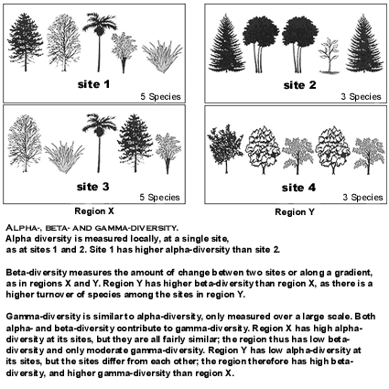

Slide 44
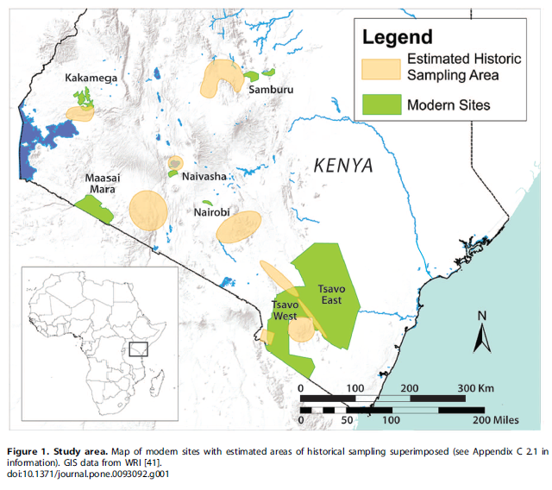
Notes:
A Century of Change in Kenya’s Mammal Communities: Increased Richness and Decreased Uniqueness in Six Protected Areas
The potential for large-scale biodiversity losses as a result of climate change and human impact presents major challenges for ecology and conservation science. Governments around the world have established national parks and wildlife reserves to help protect biodiversity, but there are few studies on the long-term consequences of this strategy. We use Kenya as a case study to investigate species richness and other attributes of mammal communities in 6 protected areas over the past century. Museum records from African expeditions that comprehensively sampled mammals from these same areas in the early 1900’s provide a baseline for evaluating changes in species richness and community structure over time. We compare species lists assembled from archived specimens (1896–1950) to those of corresponding modern protected areas (1950– 2013). Species richness in Kenya was stable or increased at 5 out of 6 sites from historical to modern times. Beta-diversity, in contrast, decreased across all sites. Potential biases such as variable historical vs. modern collection effort and detection of small-bodied, rare, and low-visibility species do not account for the observed results. We attribute the pattern of decreased beta diversity primarily to increased site occupancy by common species across all body size classes.
http://www.nature.com/news/the-anthropocene-could-raise-biological-diversity-1.13863

Slide 45
Comparison of species richness among wildlife parks. Color code: yellow = 1896–1950, green = 1950–2013. Species richness (the number of species) higher today.

Slide 46
Stable or increasing alpha diversity in time
Increasing beta diversity through time
Decreasing beta diversity through space (among parks)
Decreasing gamma diversity over space

Slide 47
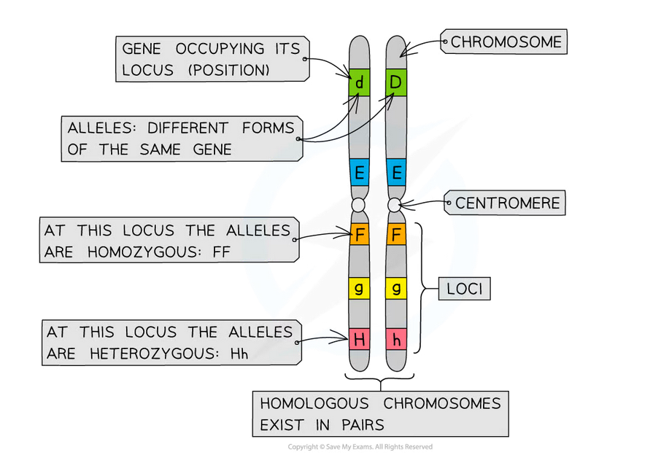
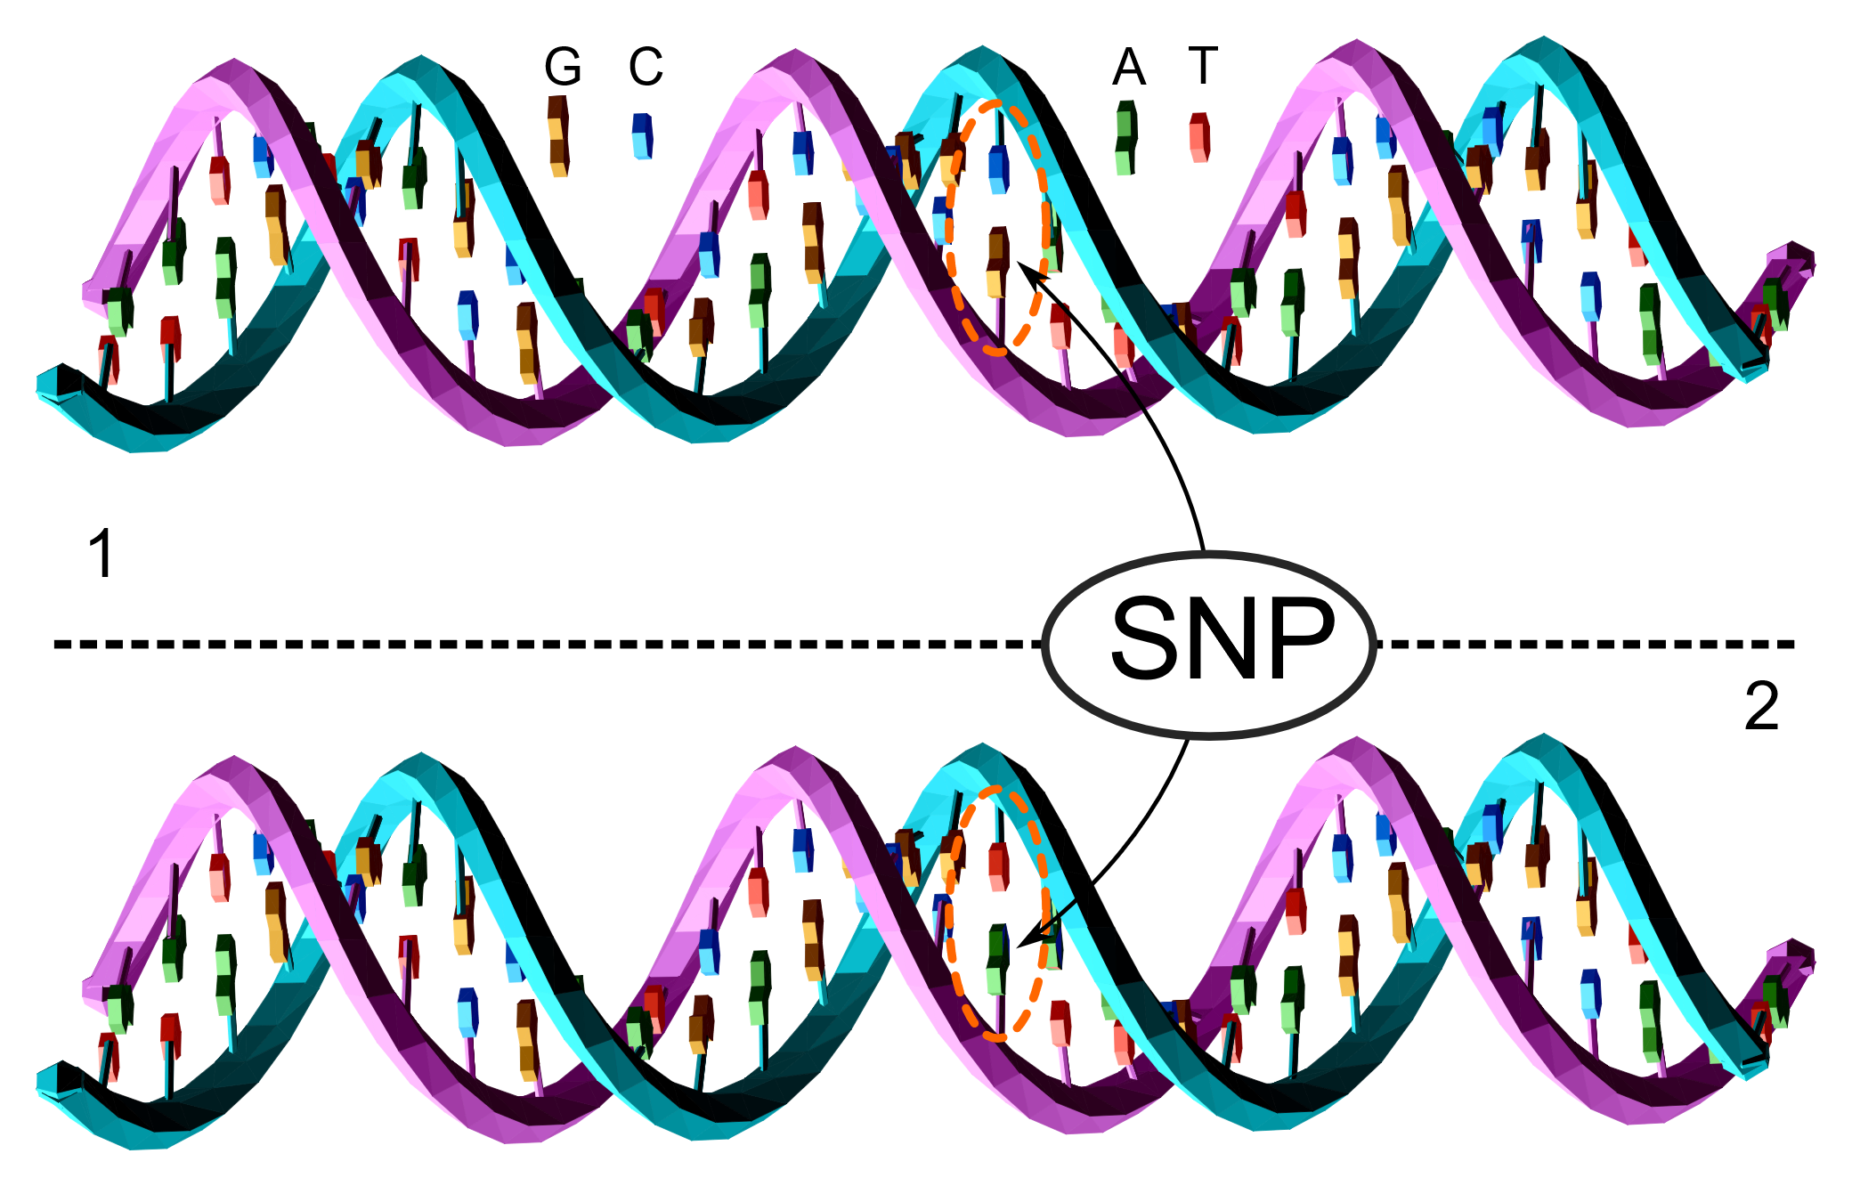
As genetic diversity
Notes:
Many different ways to measure genetic diversity. It is common to examine genetic diversity as:
Variability in genes and alleles
Variability in nucleotide sequence (C, T, A, G) as polymorphisms
Gene is defined as a section of DNA that encodes for a certain trait. An allele is defined as a variant form of a gene.
Alleles can come in different extremes of size. At the lowest possible end one can be the single base choice of an SNP (single nucleotide polymorphism) At the higher end, it can be the sequence variations for the regions of the genome that code for the same protein which can be up to several thousand base pairs long

Slide 48
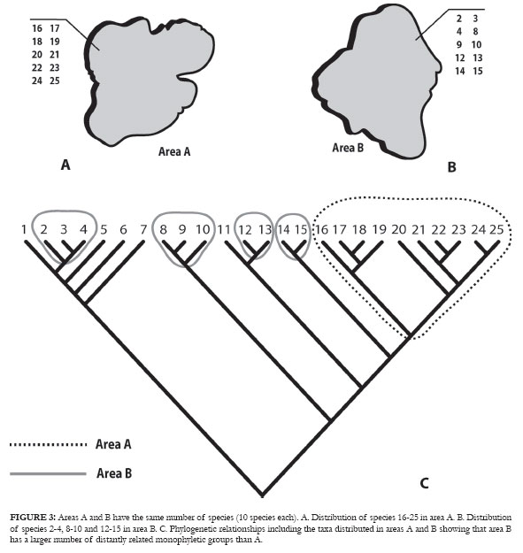
As phylogenetic diversity
Diversity arising from differences in species lineages based on their evolution

Slide 49
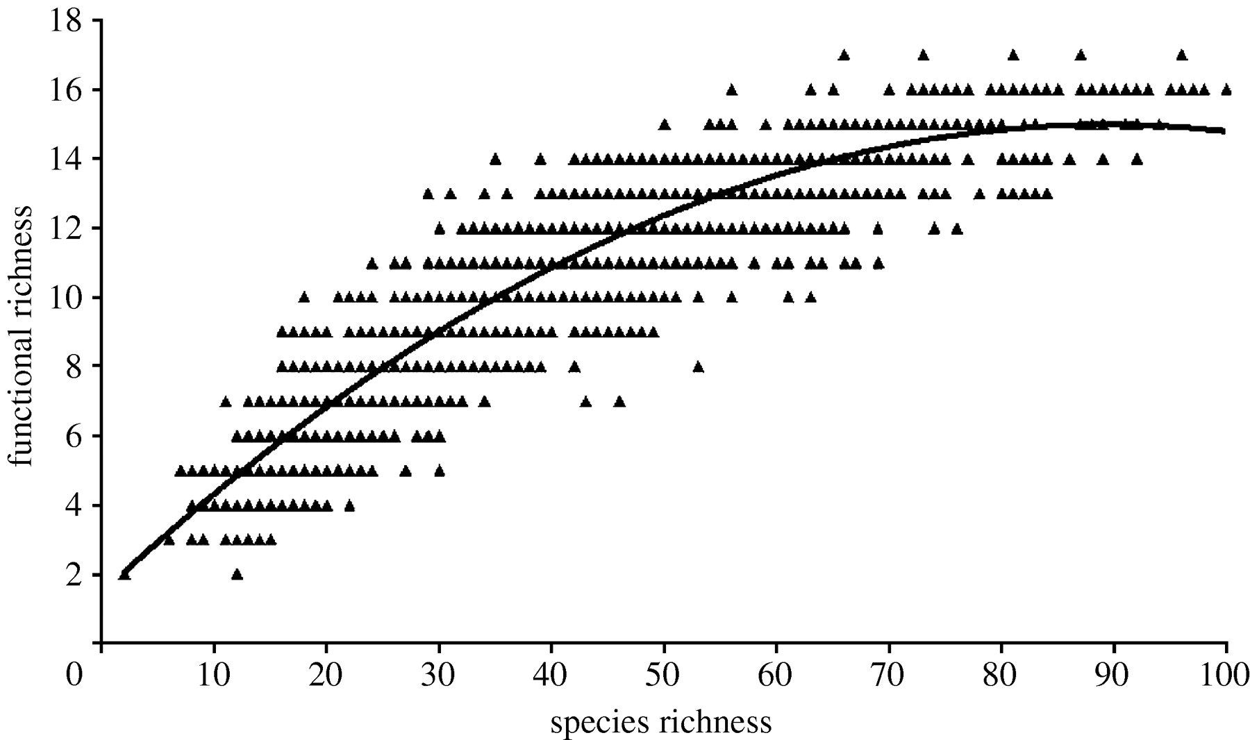
As functional diversity
Notes:
Function is often highly correlated with phenotype and the traits of an individual organism

Slide 50
As interaction diversity
Measure of the number and kinds of biotic interactions. The two plots below differ in the number of predatory interactions among trophic levels.
Notes:
Interaction diversity can also be measured in terms of other biotic interactions, like competition, cooperation, mutualism, or parasitism

Slide 51
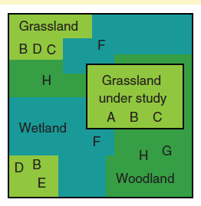
Dark diversity
All species in the region that can potentially inhabit a defined set of local ecological conditions but may not be noted as present .
The dark diversity for the grassland under study would include species D and E as they occur in the same habitat nearby.

Slide 52
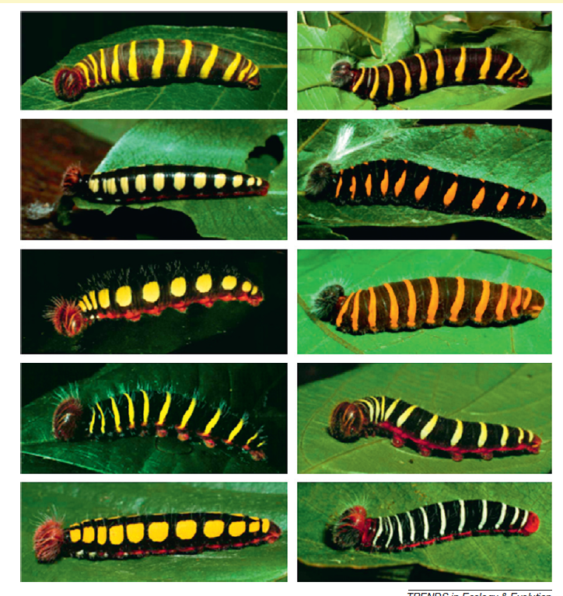
Notes:
Ten species of cryptic caterpillars in the Astraptes fulgerator complex from the Guanacaste Conservation Area in Costa Rica. Think of them as subspecies. Whether or not you include subspecies as a taxonomic category or not would greatly influence the levels of diversity you derive.

Slide 53
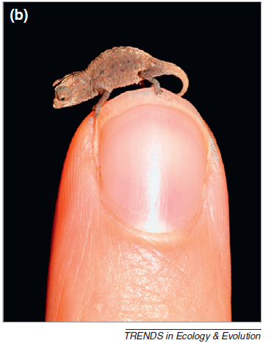
As cryptic diversity
Undetected or unnoticed biodiversity: organisms are too small, reclusive, isolated, or similar in appearance to get counted
Human visual perception cannot adequately recognize extent of biodiversity
Identification aided by molecular genetics
Notes:
A newly discovered chameleon (Brookesia micra) from Madagascar that is the smallest lizard in the world

Slide 54
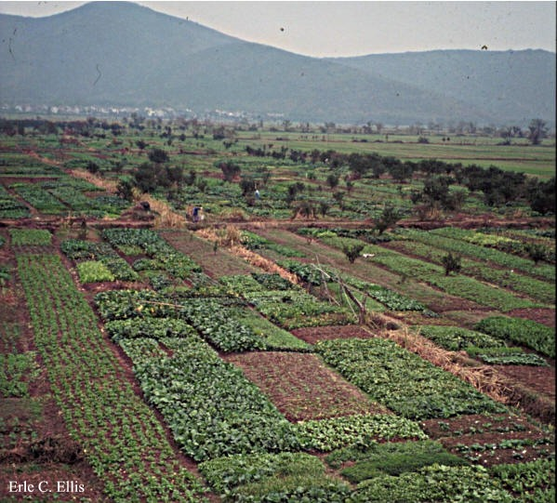
As landscape diversity
Number and size of different habitat patch types within a landscape

Slide 55
Detecting accurate global biodiversity trends using local richness is limited with current approaches.
Notes:
In this study, the researchers modeled different scenarios for monitoring local species richness. They used different baselines to compare changes to, used different intervals of time to measure species richness, and varied the spatial grain, sampling bias, and sampling error. They used different number of monitoring sites too. The results of these modelled trends were compared with a distribution of the likelihood of trends derived from running the models over and over. An analogy would be taking your grades over time and the trends they exhibited. How few years could you sample and still capture the trend? If you assumed that there are errors and bias in grading – in other words there was a margin or error around any one grade – how would that impact your grade? What if you only included grades from 10 randomly chosen classes?

Slide 56
A monitoring network with hundreds of sites could detect global change in species richness over a 30-year period,
However, the number of sites needed for accurately detecting trends doubles for a ten-year period, increases 10-fold for three years change detection, and annual trends are undetectable.
Where you sampled can also reduce the ability to detect negative global biodiversity trends and can even yield positive trends.
Global scales may not be useful for pinpointing species numbers and changes through time except over multi-decadal scales.

Slide 57
So how do you measure biodiversity? The multidimensional approach
Notes:
Because of its complexity, the relationships
among different types of biodiversity are
examined rather than choosing only one

Slide 58
Notes:
These plots convey how the same present day diversity can be comprised of very different phylogenetic diversity

