Slide 1
Disturbance
Disturbance is ubiquitous in nature. It constantly interrupts succession and prevents climax from developing.
Occurs naturally and from the direct and indirect activity of humans
Longleaf pine forests of the southeastern
Gulf-Atlantic coastal plain

Slide 2
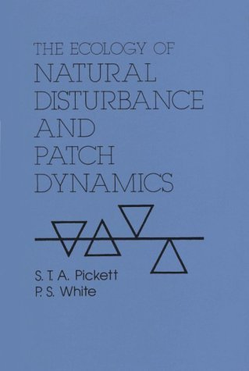
Formalization of disturbance ecology
.
Publication of “The Ecology of Disturbance and Patch Dynamics” in 1985
Impact was to heighten a non-equilibrium view of ecology.
New vocabulary introduced
Disturbance regime
Disturbance patch dynamics
Disturbance residuals
Demographic, community, and ecosystem disturbance
Endogenous and exogenous disturbance

Slide 3
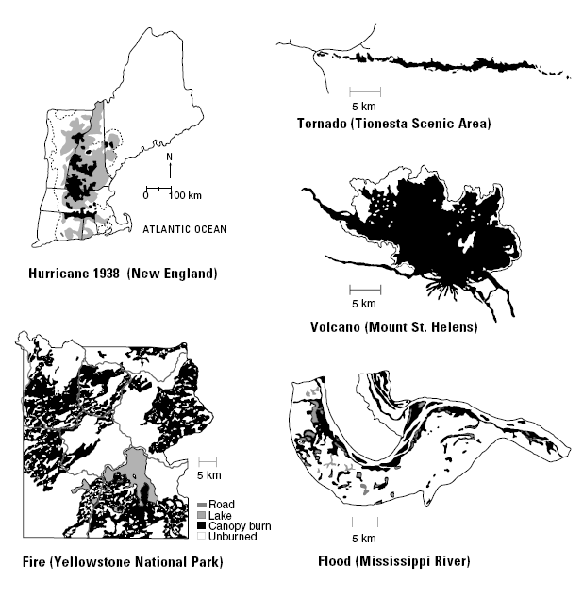
Disturbance regime
Disturbances are characterized by their disturbance regime: the frequency, intensity, extent or size, and severity of the disturbance

Slide 4
Properties of a disturbance regime

Slide 5
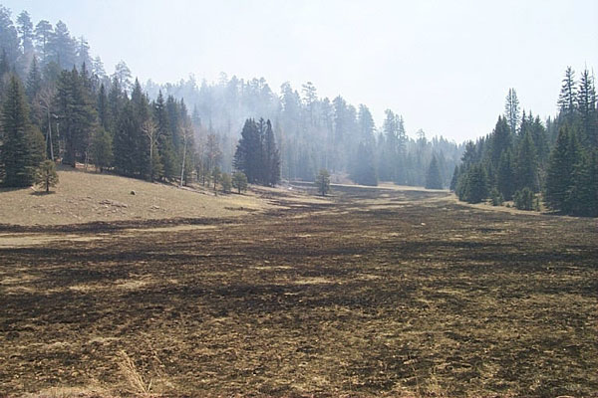
Disturbance patch dynamics

Slide 6
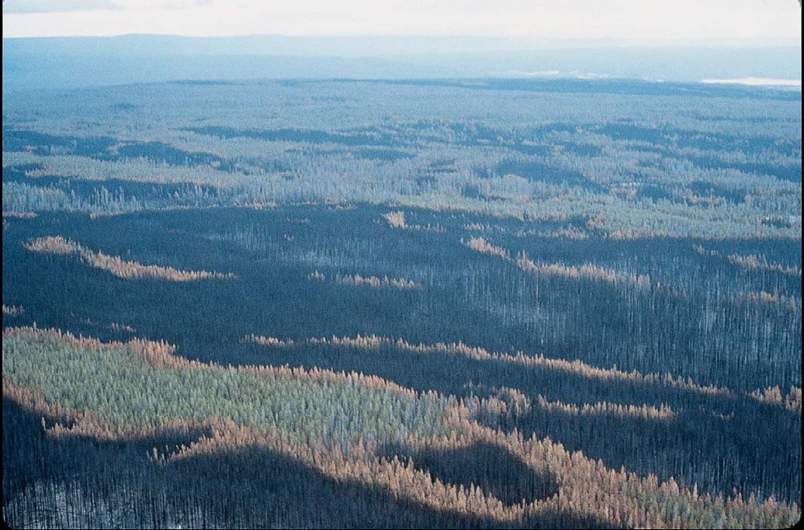
Notes:
1988 fires in Yellowstone

Slide 7
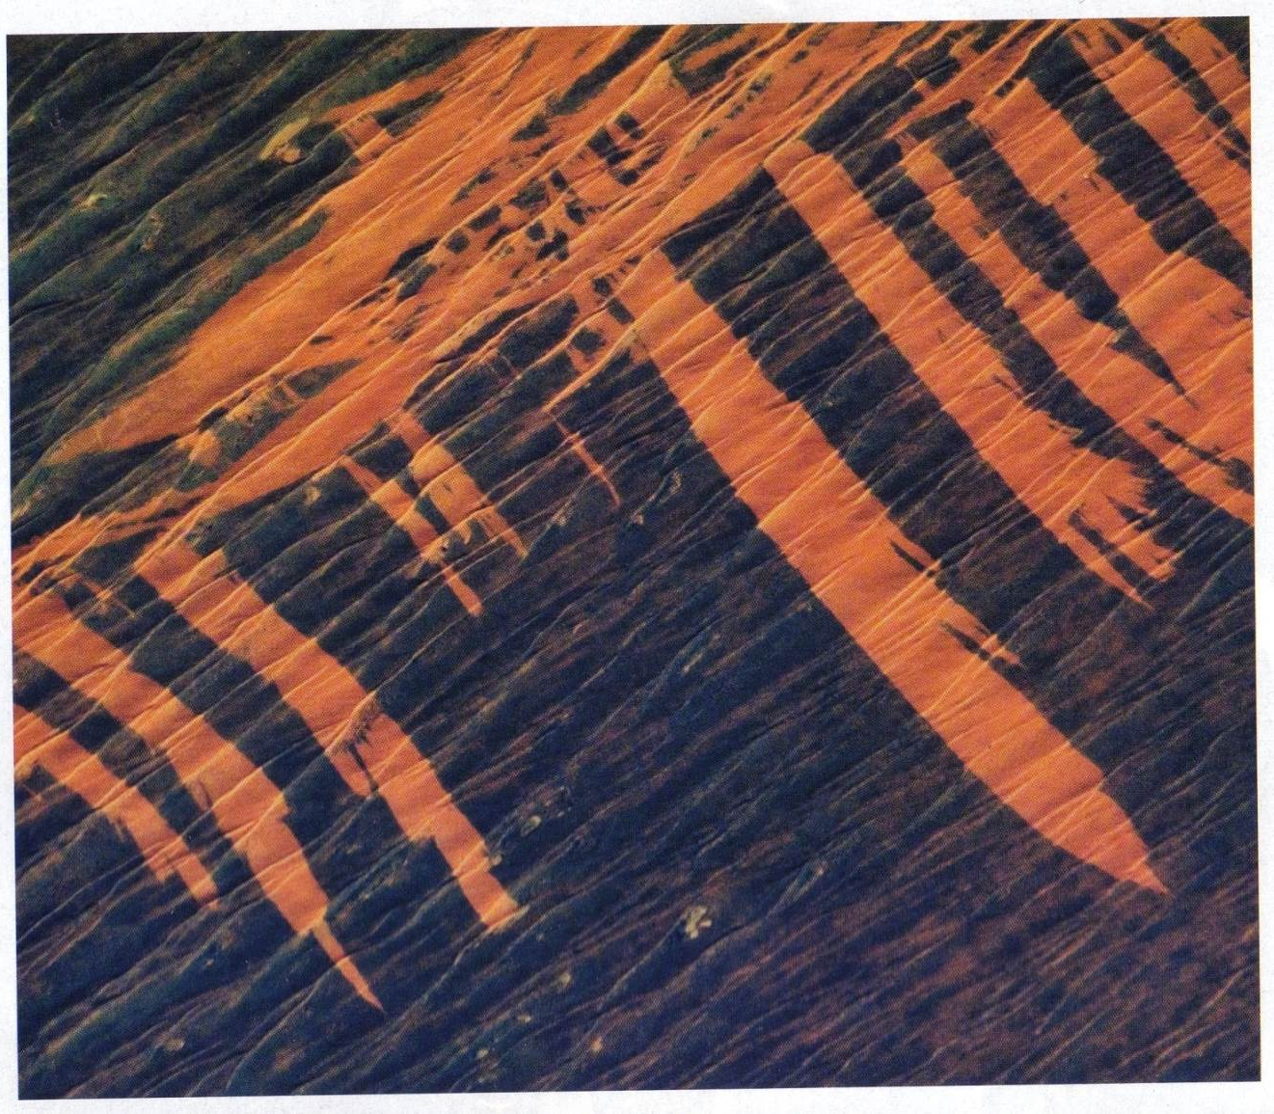

Slide 8
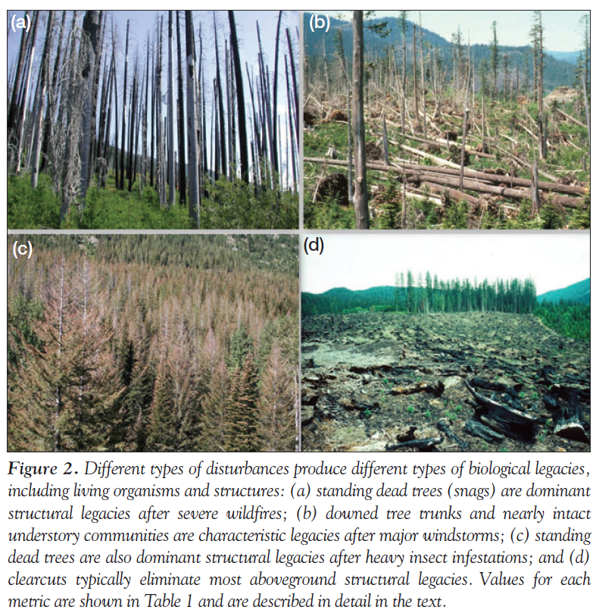
Disturbance residuals
Notes:
Disturbance residuals, as biological legacies, may be missing in human disturbances like logging that attempt to mimic natural disturbance.

Slide 9
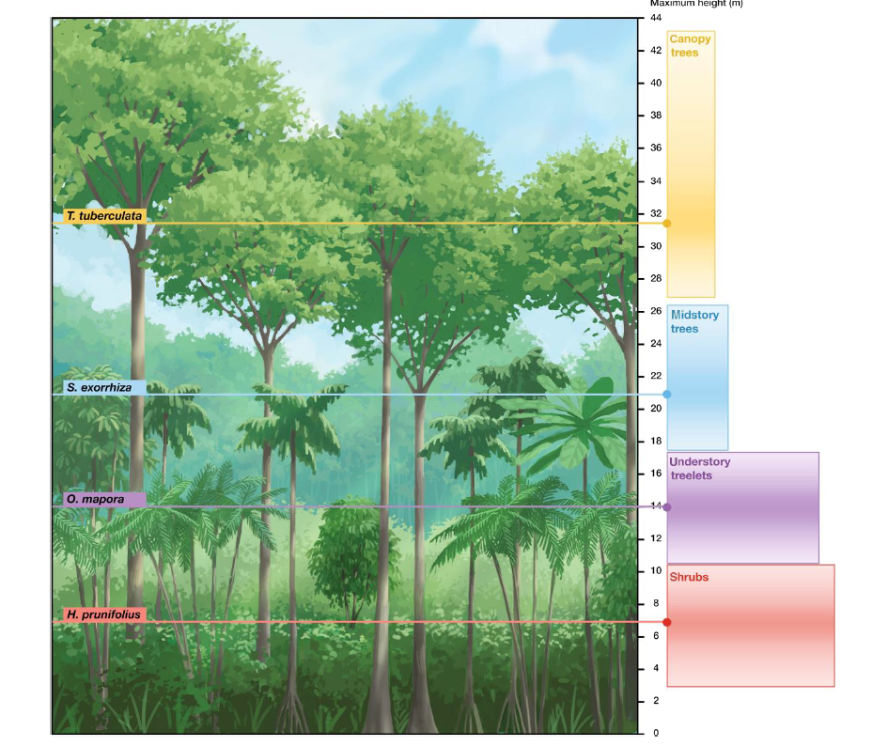
Disturbance definitions
Demographic: event that results in the death of one or more dominant individuals
Ecosystem: event that releases a previously unused resource
Community: event that results in the alteration of the composition or structure of the biota
Notes:
By structure, we are referring to the understory, overstory, and midstory.

Slide 10
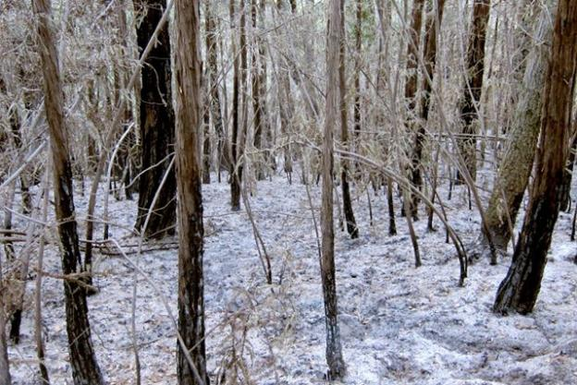
Forest receive a pulse of nutrients from ash and sunlight following a stand-clearing fire. This is ash, not snow, following a fire in the redwood forests of Big Sur California
Notes:
Ecosystem definition

Slide 11
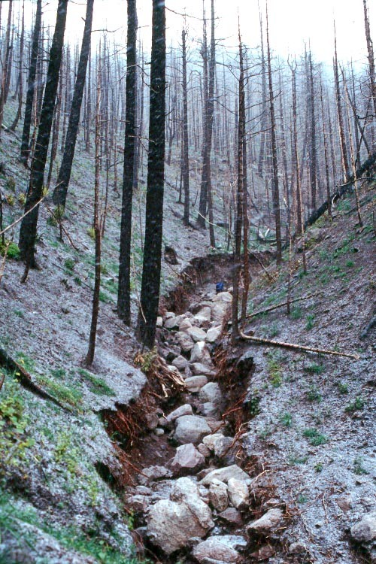
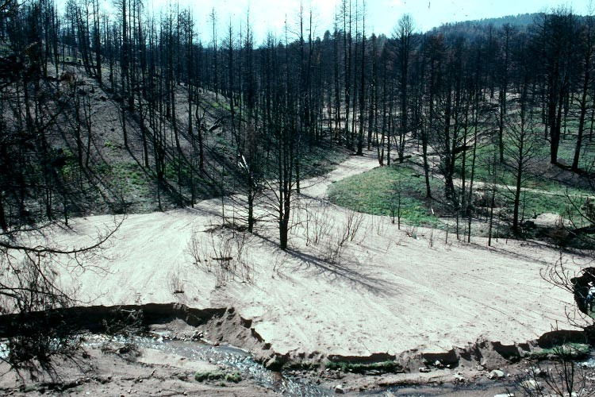
Notes:
http://wwwbrr.cr.usgs.gov/projects/Burned_Watersheds Fire modifies the flow of water, sediments and shapes topography. With the removal of vegetation, erosion can occur.
Most chemicals liberated by fire are same elements released during microbial decomposition. Chemical changes requiring years of microbial activity occur within seconds
Fire breaks down plant/animal tissues into nutrients that can be recycled into new living tissues. Temps may volatilize some elements which are lost as gases

Slide 12
Downed woody debris in a natural stream course (top), with it removed (bottom)
Notes:
Downed woody debris in a natural stream course

Slide 14
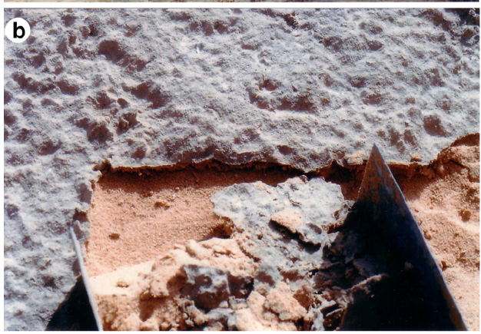
Effects of disturbance are scaled to the organism. Footsteps can be a disturbance for these organisms
Notes:
Demographic definition of disturbance

Slide 15
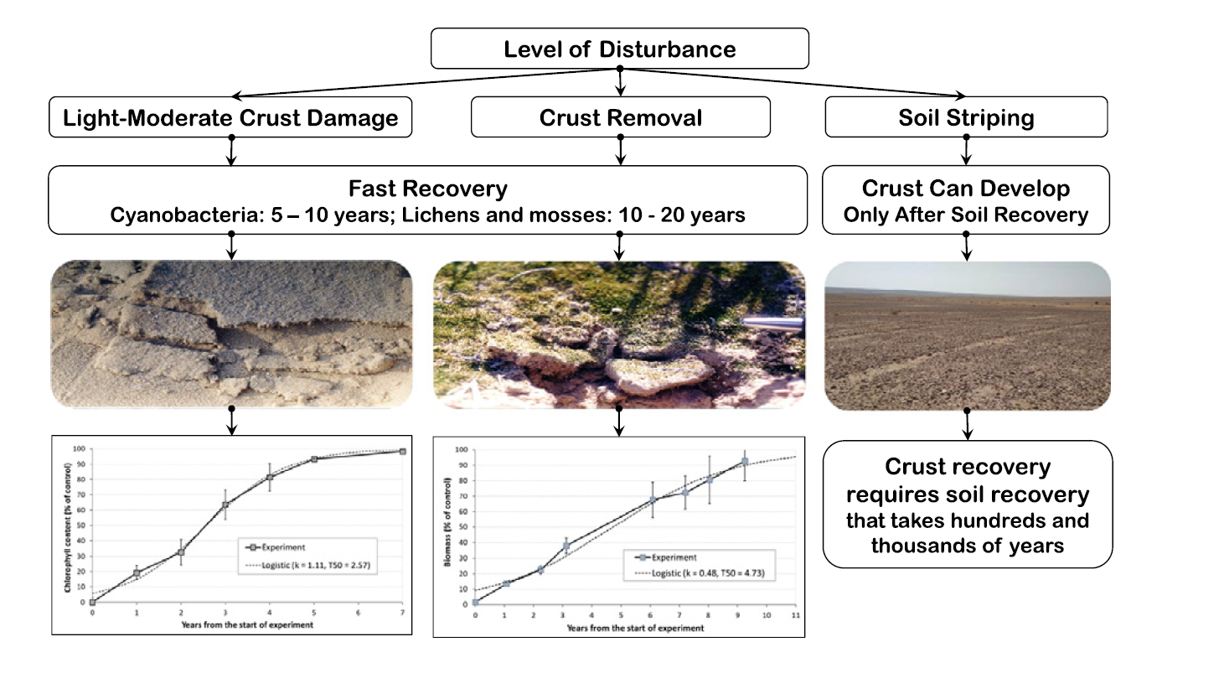
Notes:
Kidron, G. J., Xiao, B., & Benenson, I. (2020). Data variability or paradigm shift? Slow versus fast recovery of biological soil crusts-a review. Science of The Total Environment, 721, 137683.

Slide 16
Structure and composition of a forest can help infer past disturbance history
Notes:
Community definition of disturbance
Age and size of trees can reflect disturbance history and can be used to reconstruct past conditions. What can you discern about the size of the last disturbance event in each of the three scenarios? What kind of a disturbance event was it? How long ago?

Slide 17
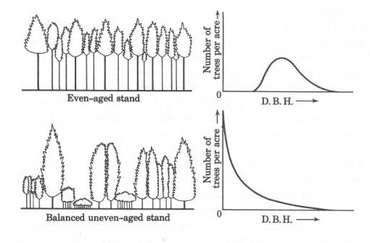
Notes:
DBH – diameter at breast height of trees

Slide 18
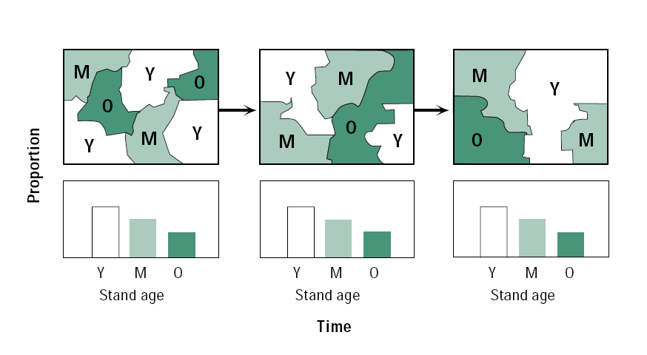
Endogenous disturbance

Slide 19
Exogenous disturbance
Notes:
Mt St Helens

Slide 20
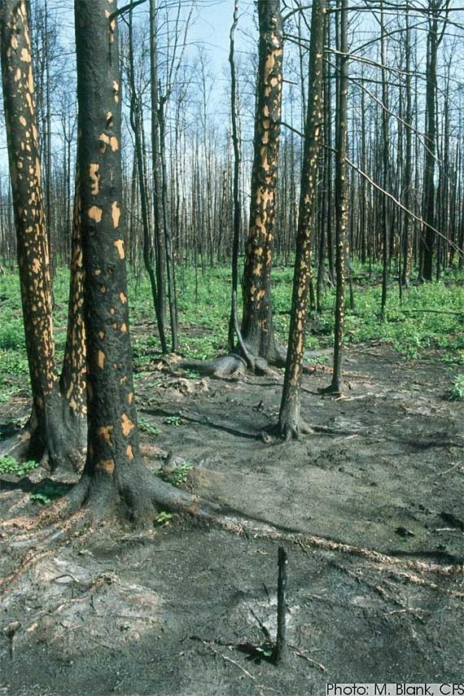
Fire disturbance
Fires release nutrients stored in biomass.
Light is made available to the understory after fire
Alters the age distribution and structure of forest trees.
Tree species killed depends upon the intensity of the fire

Slide 21
Types of fires
Ground (soil) fire
Canopy (or crown) fire
Surface fire
Ground fires in Okeefenokee Swamp
Burns organic soils
No evident flame front
Destroys seed bed

Slide 22
Tallgrass prairie, Kansas
Surface fires
Grasses regenerate because growth tissues are underground
Seedlings and saplings killed; adult trees spared
Lower temperature than canopy fires
Notes:
Burns litter to promote decomposition; release of nutrients stored in biomass
Maintains community boundaries: prairie and forest

Slide 23
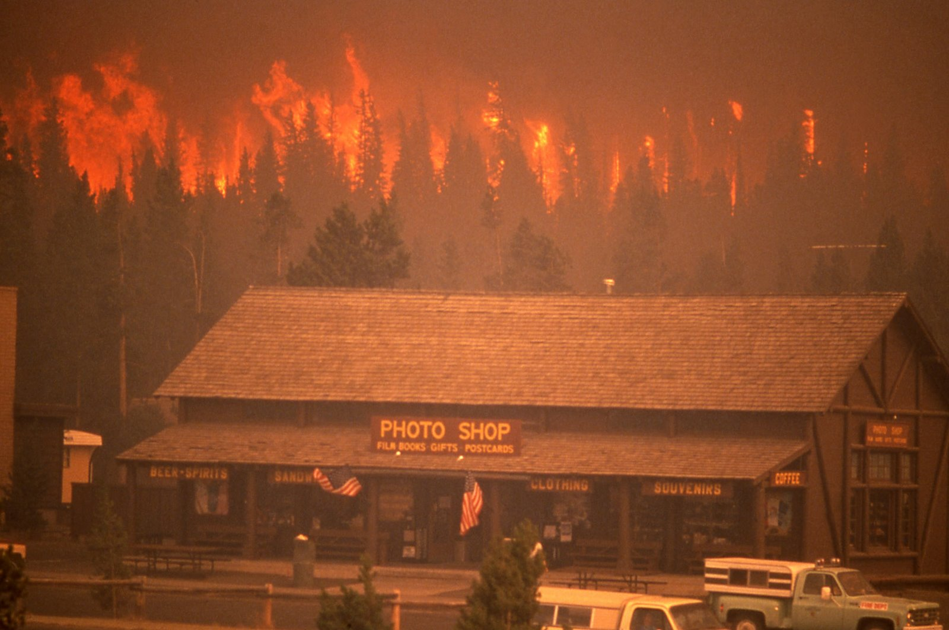
Canopy/crown fire
Hot (300-400 F)
Widespread mortality of mature
canopy trees.
Strongly linked to fire weather
Potentially large spatial extent
Yellowstone National Park,
1988

Slide 24
Flood disturbance

Slide 25
Flood disturbance
Floodwaters results in:
Mortality for some species
Opening up of the canopy
Provides soil nutrients
Transports seeds
Timing of floods and dry periods determines the establishment and persistence many riparian tree species.
This flood regime shapes the availability of ‘regeneration’ niches
Stand structure reflect flood regime

Slide 26
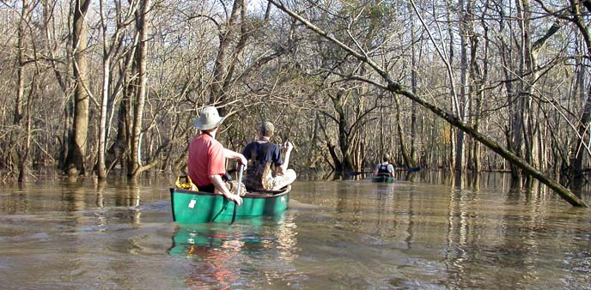
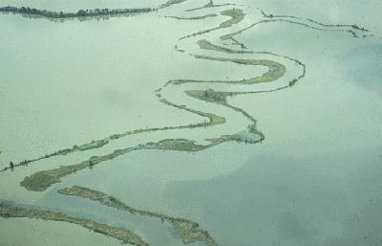
Periodicity to flooding: once or twice a year a river will reach bankfull discharge and water will crest over the levee and spill into the surrounding floodplain.

Slide 27
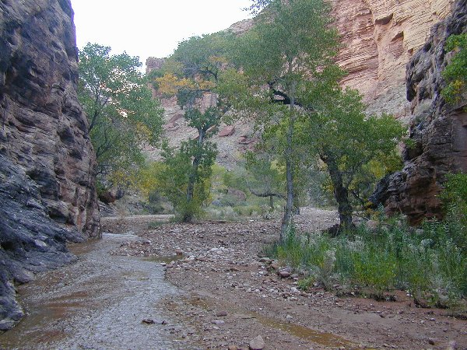
Notes:
Flash flooding
What evidence is there in the existing structure of vegetation to indicate flood disturbance history?

Slide 28
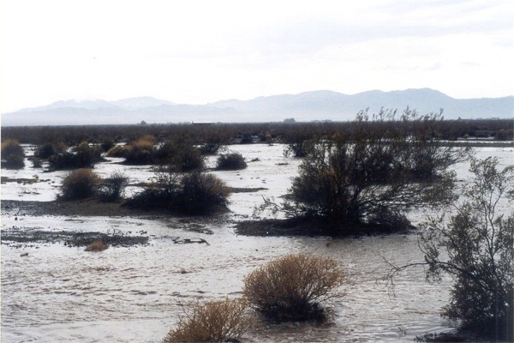

Slide 29
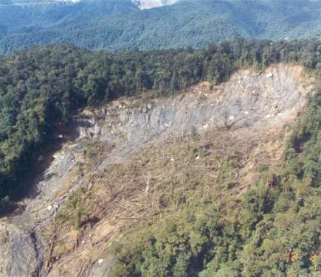
Geomorphic disturbances
Slope failure

Slide 30
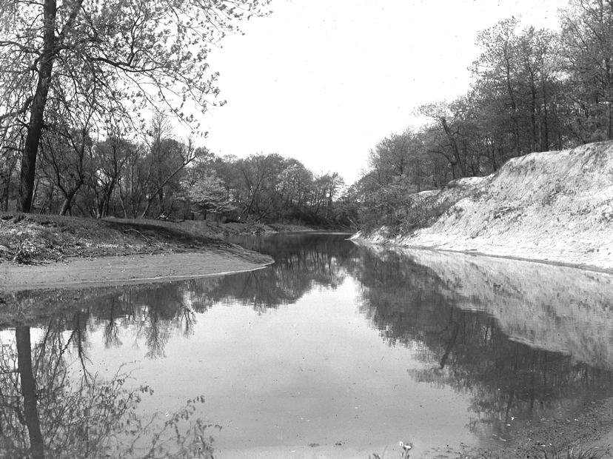
Meandering of a river creates geomorphic disturbance

Slide 31
Point bar-deposition and availability
of substrates for germination
Meandering of a river is also a disturbance agent

Slide 32
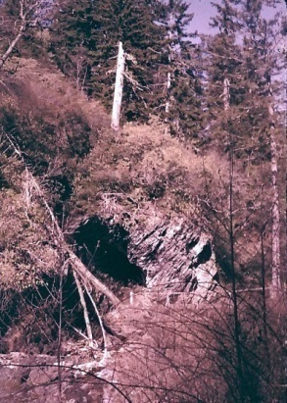
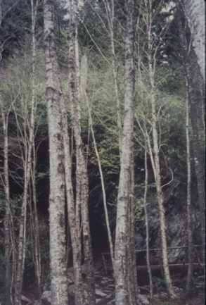
1959
1995
Notes:
What can you infer about the disturbance history of the riparian forest in these repeat photos from 1959 and 1995 in the Great Smoky Mountains National Park?

Slide 33
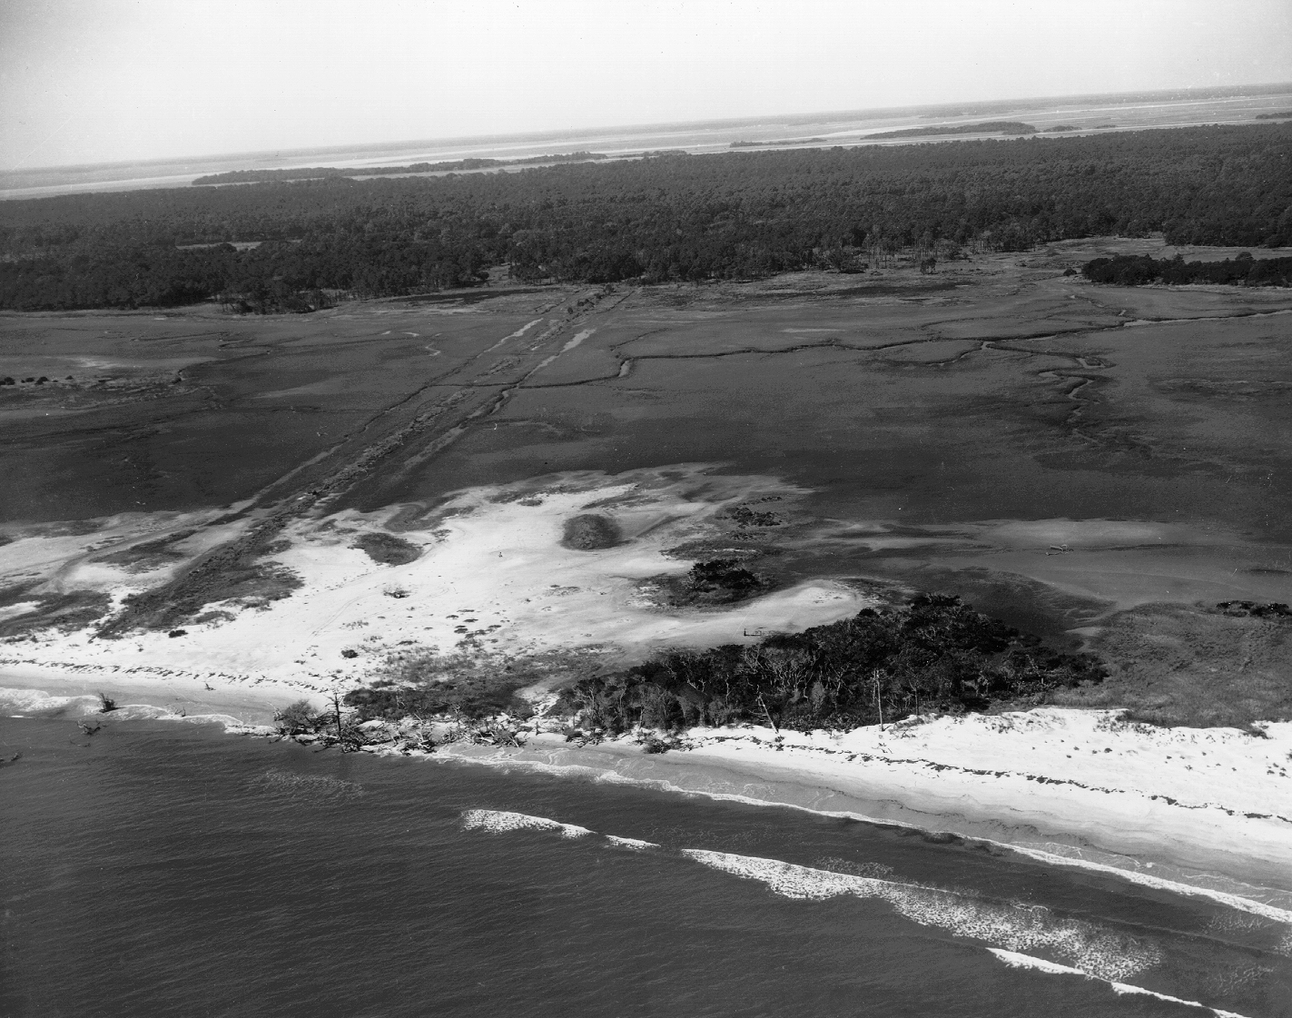
Overwash disturbance

Slide 34
Overwash disturbance

Slide 35
Overwash disturbance
Notes:
Some species are adapted to burial and can regrow through deposits

Slide 36
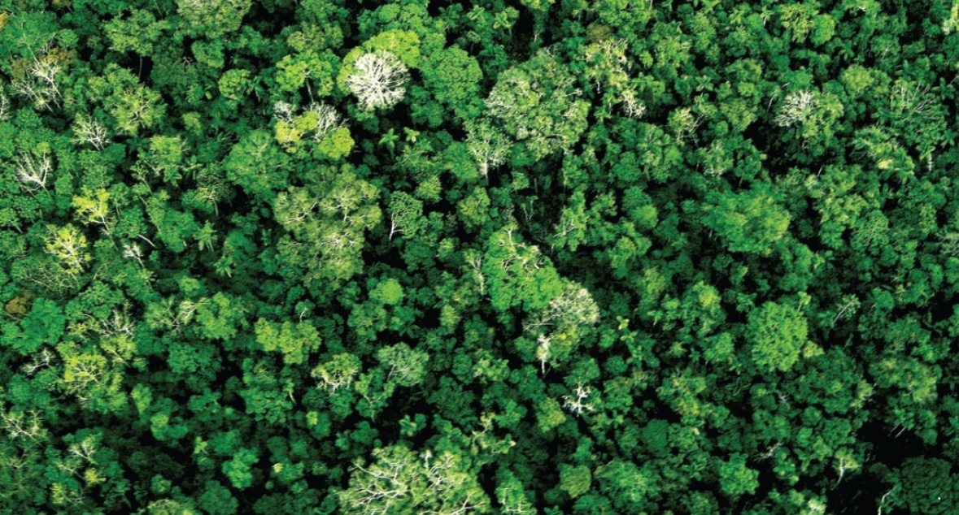

Slide 37
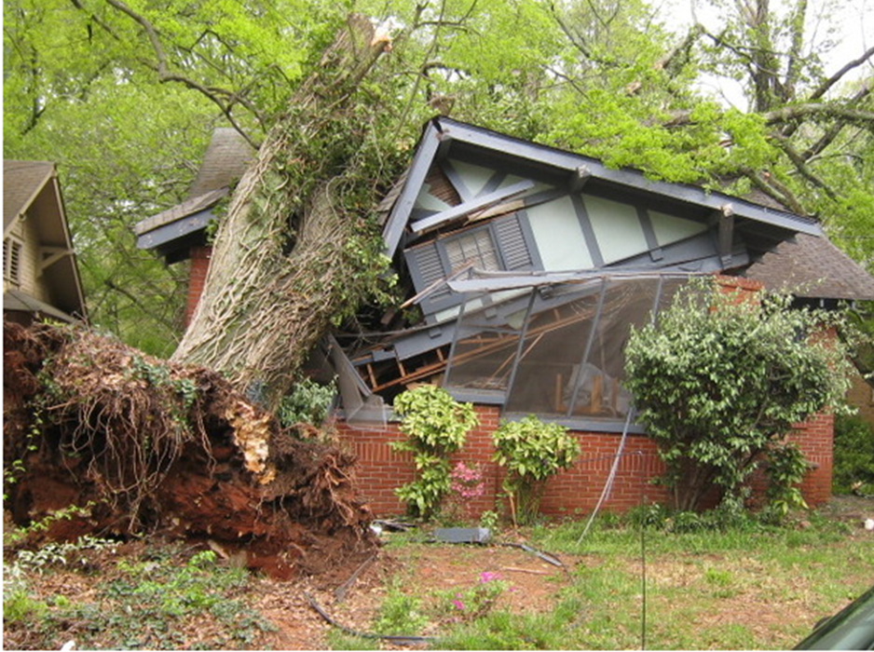
Treefall disturbance
Notes:
As tree ages more metabolic demands are placed on photosynthesis (in leaves) at the expense of woody support tissue (in trunk). Center of gravity shifts upward through time, leading to treefall.

Slide 38
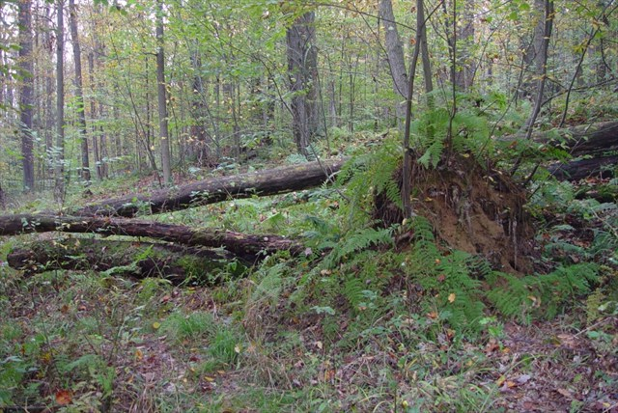
Endogenous (related to senescence, i.e. old age) to exogenous treefall (from high wind events)
Light is made available to the understory, decaying vegetation provides release of nutrients

Slide 39
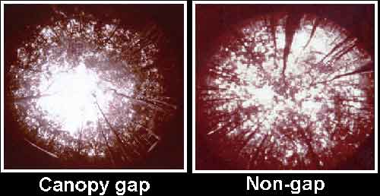
Light gaps

Slide 40
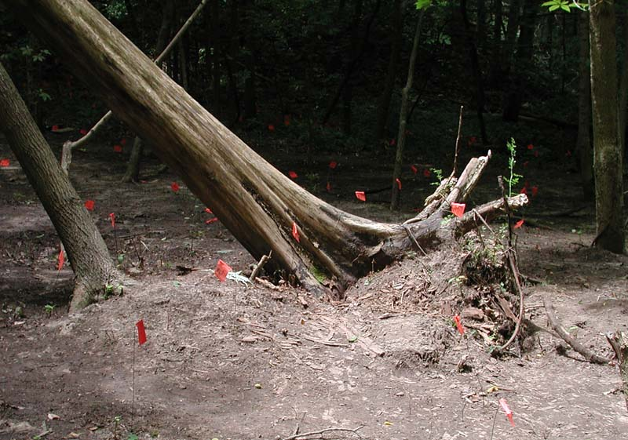
Pit and mound topography with individual treefall

Slide 41
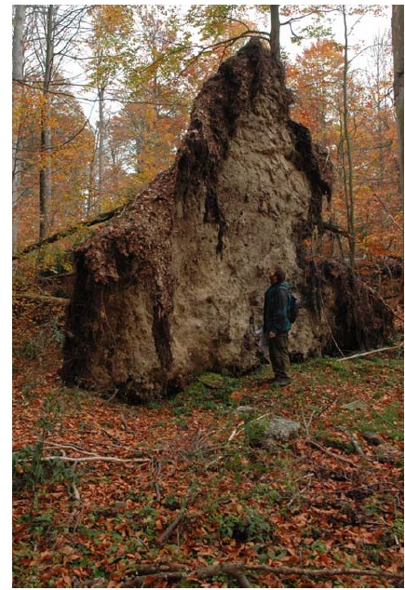

Slide 42
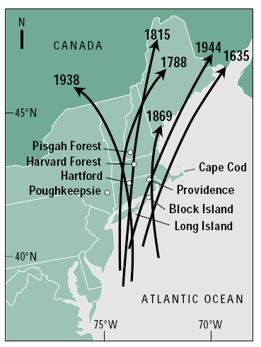
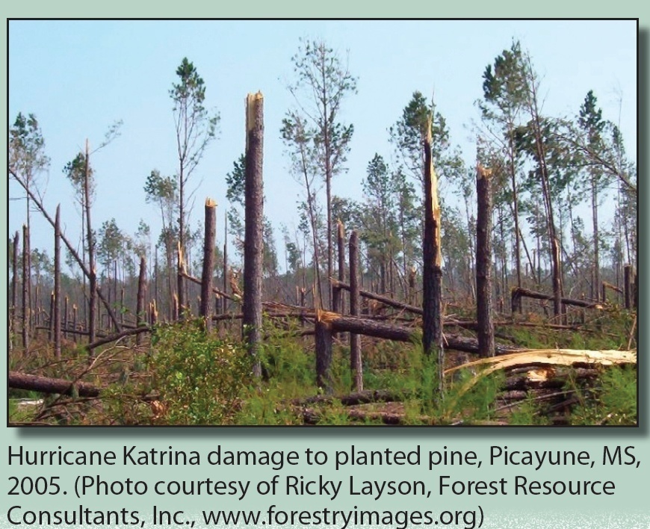
Hurricane Andrew (top) and Hurricane Katrina (bottom)
Hurricane windthrow
Notes:
Hurricane windthrow has been known to impact forests in New England and southern Canada.

Slide 43
Tornado windthrow, Sapelo Island, GA

Slide 44
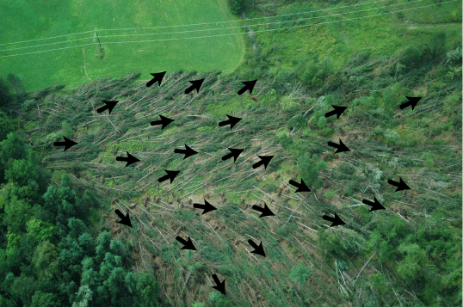
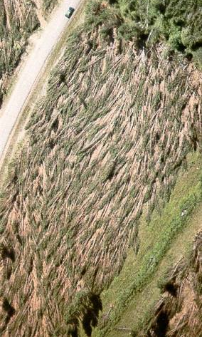
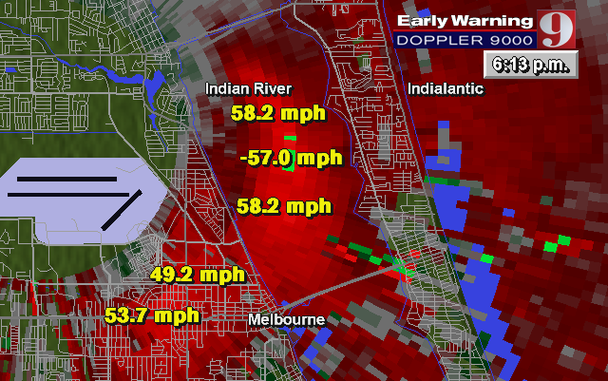
Thunderstorm downburst

Slide 45
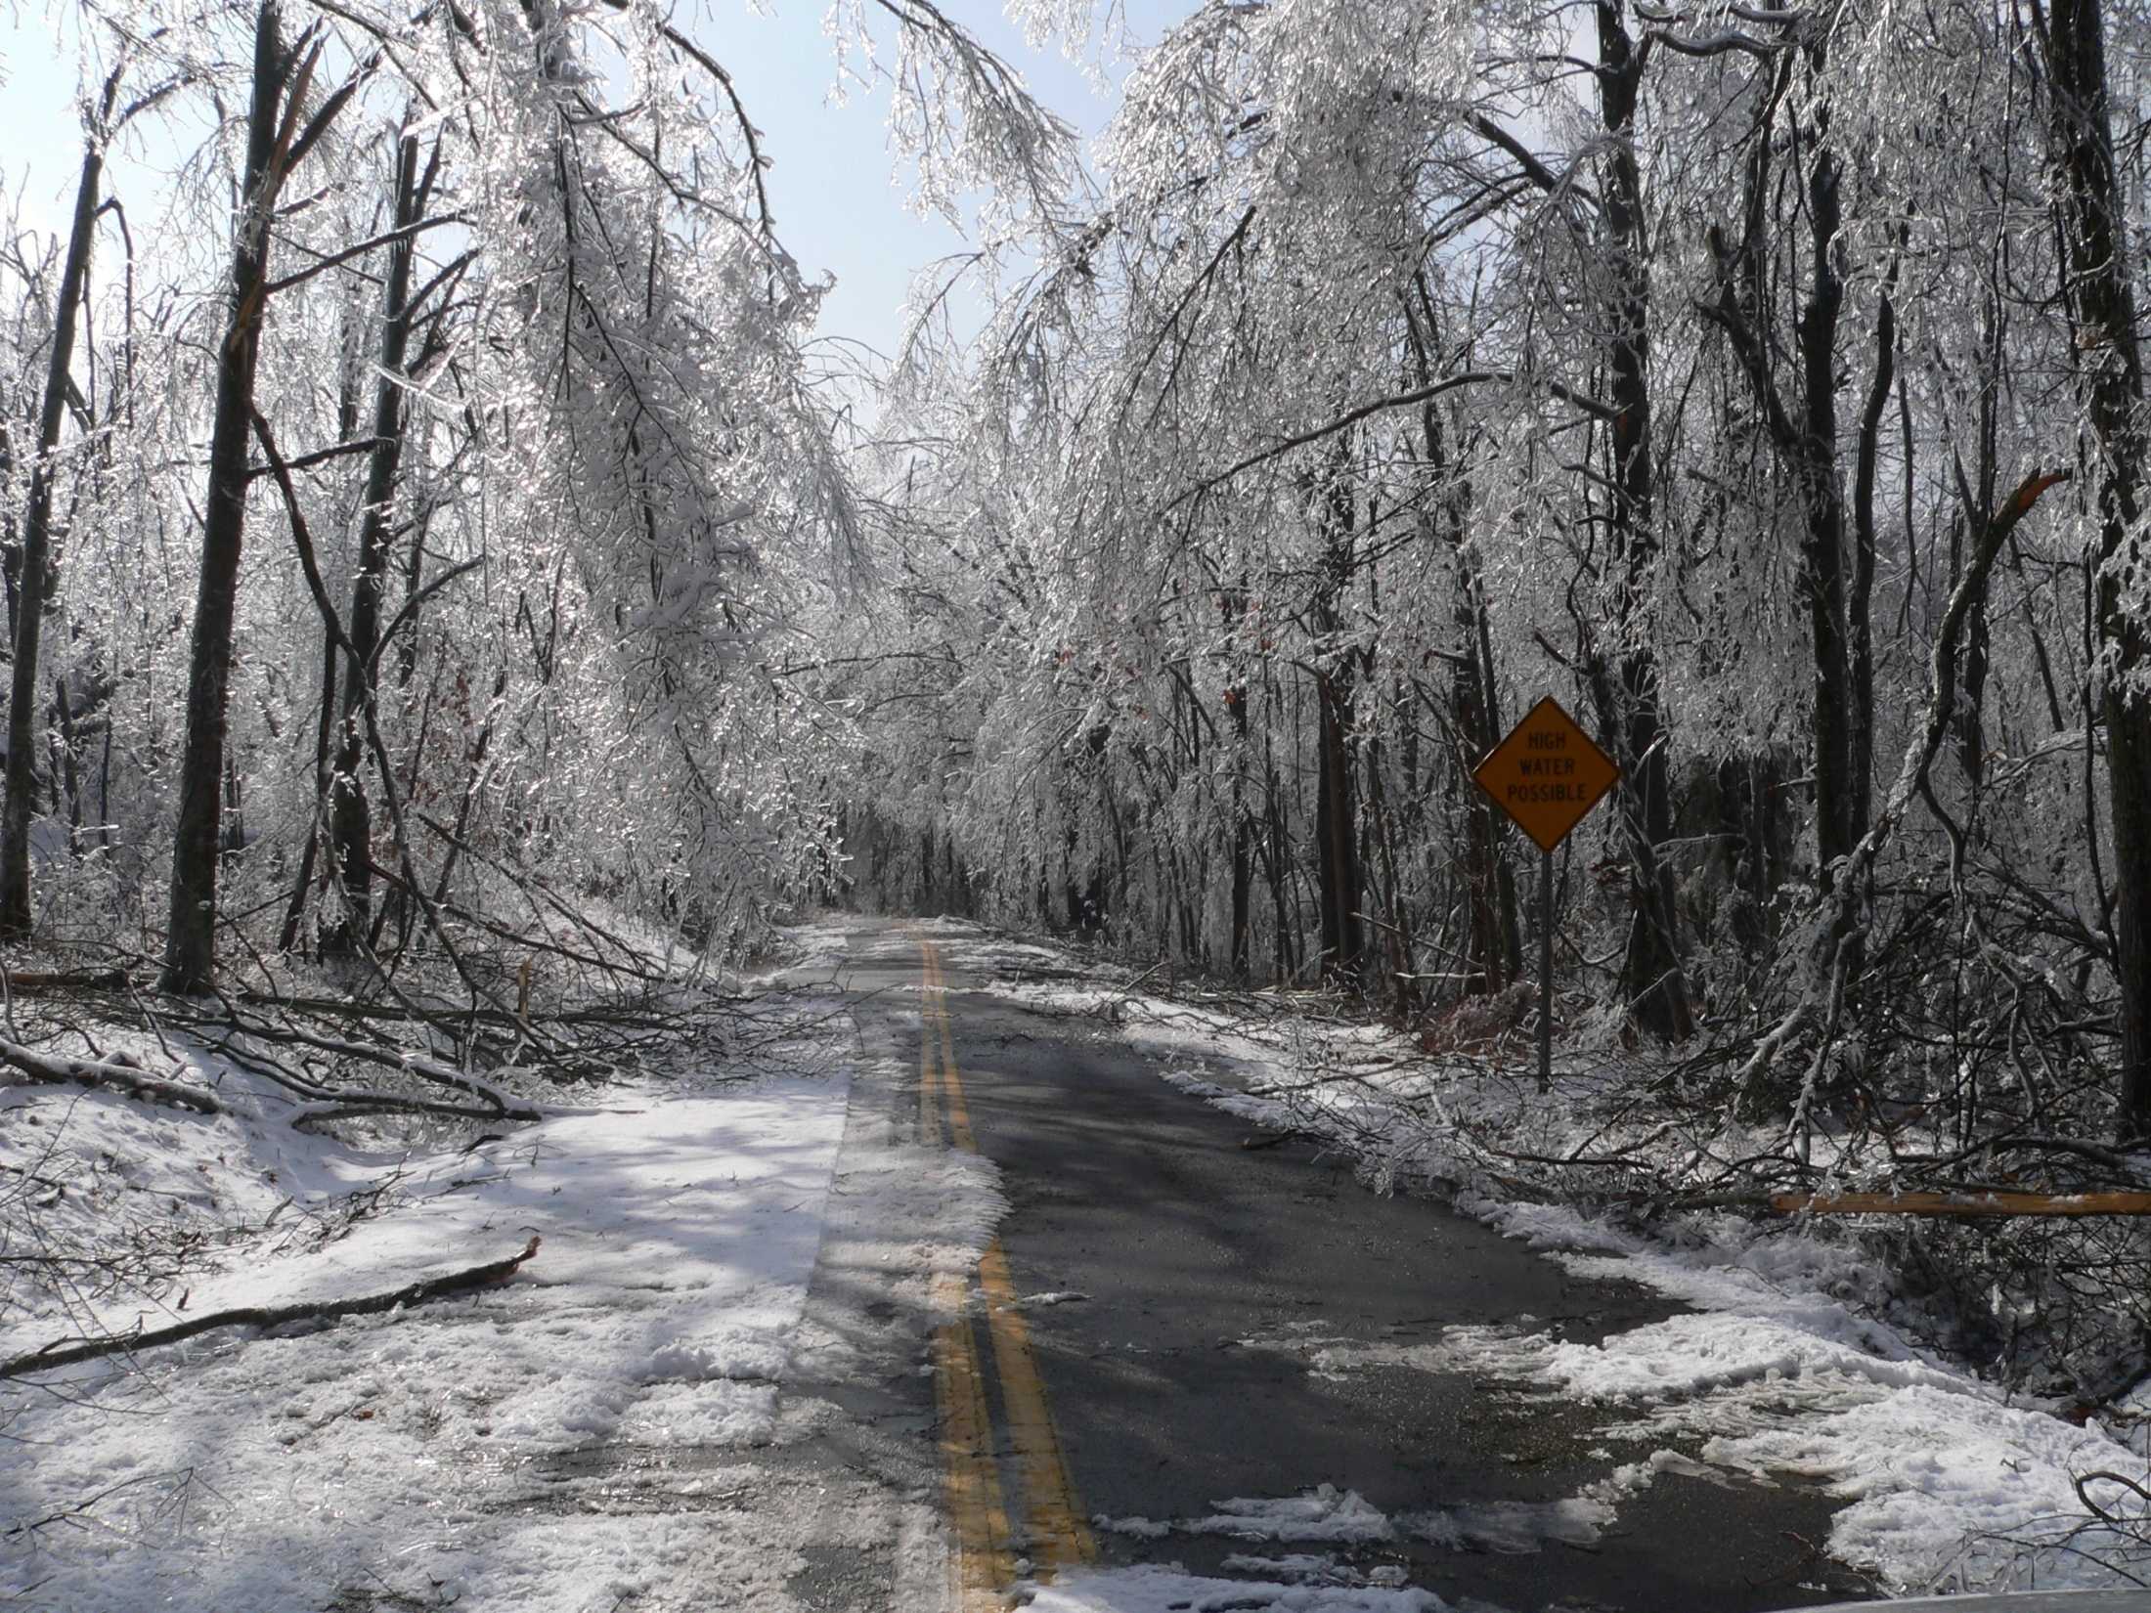
Ice damage

Slide 46
Notes:
Forest pests

Slide 47
Disease and pest infestation
Effects are often strongly species-specific
Composition and structure can be impacted over an extremely large area over a short period of time
Often intertwined with other factors (climate change, logging, pollution)
Fungal: chestnut blight
Insect: basalm wooly adelgid (Fraser fir), mountain pine bark beetle, southern pine bark beetle

Slide 48
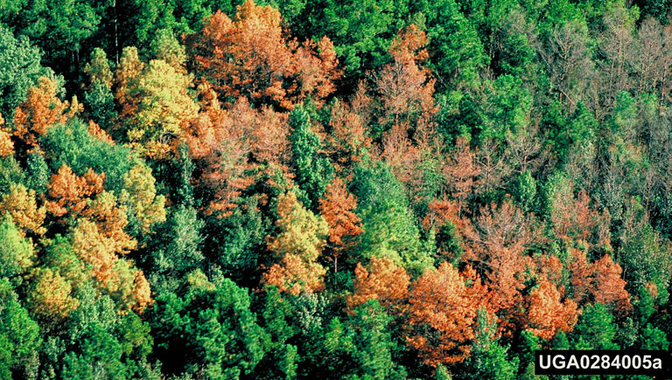
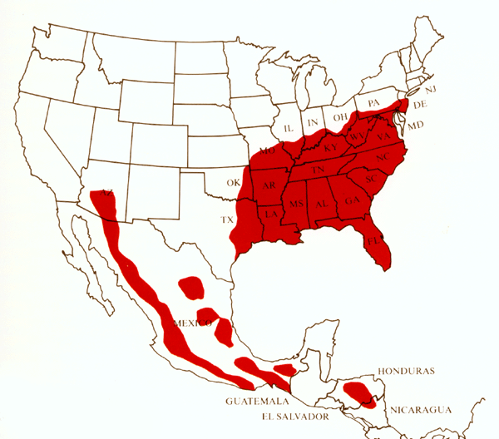
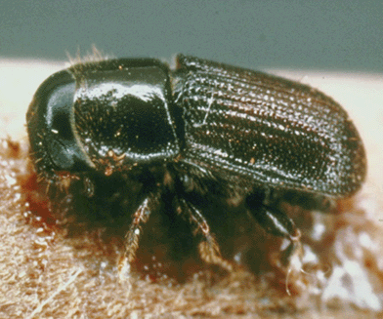
Southern pine bark beetle in southeastern US.
Notes:
Southern pine beetles attack mainly densely stocked, slow growing pine stands with a high percentage of over-mature pines. Some pine tree species are more susceptible than others. Trees damaged by lightning and other natural events or by humans are more likely to be infested. Injured trees decline rapidly during summer months

Slide 49
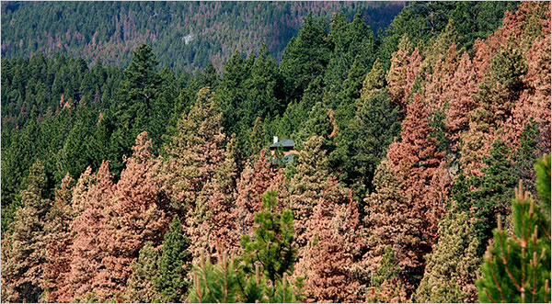
Mountain pine bark beetle in western North America
Notes:
Western US

Slide 50
Notes:
Pine bark beetle damage in British Columbia

Slide 51
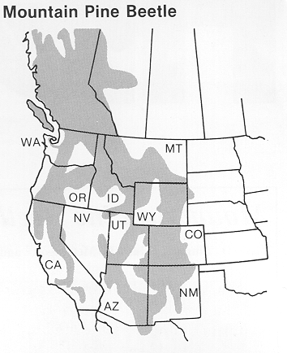
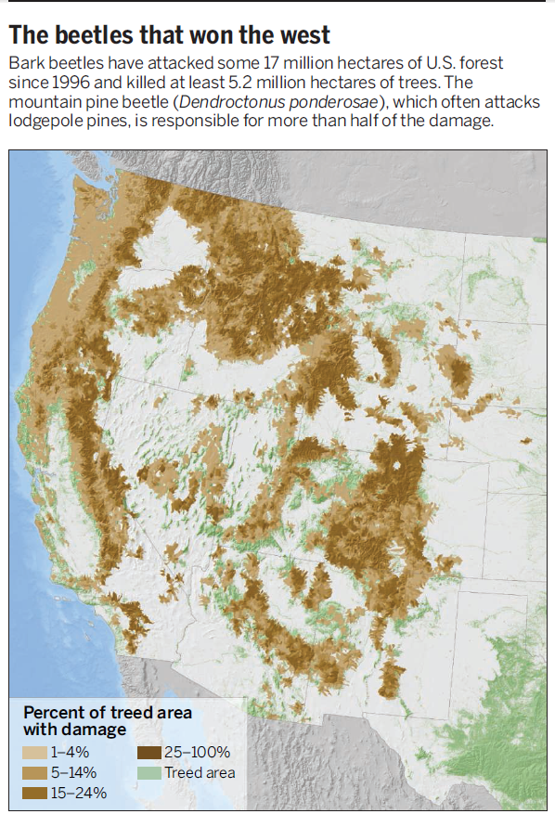

Slide 52
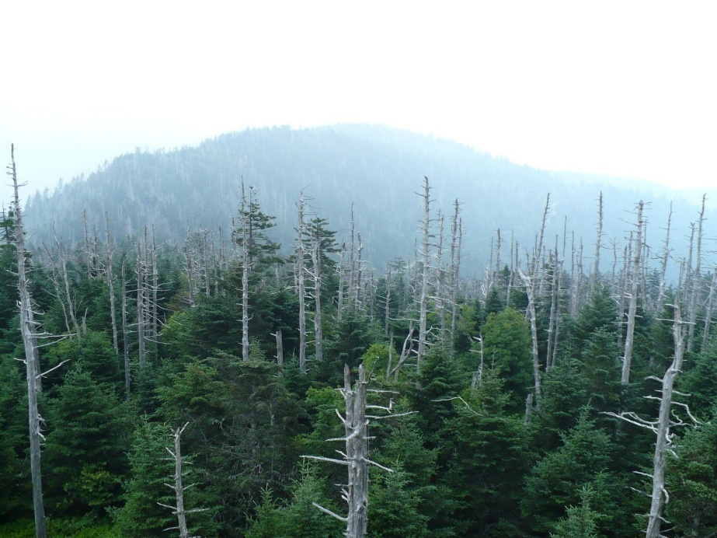
Notes:
Fraser fir and balsam wooly adelgid disturbance in the Great Smoky Mountains

Slide 53
Fraser fir in Appalachians. Dense stand at left is emblematic of forests before the invasion of the balsam wooly adelgid.
Notes:
Fraser fir in upper elevations of the Smoky Mountains

Slide 54
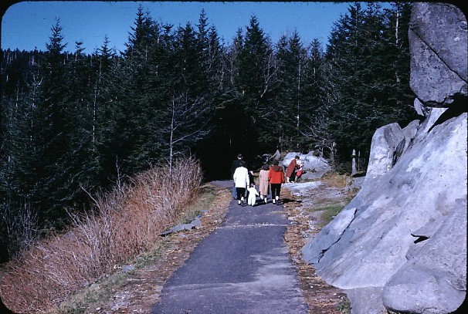
Fraser fir and balsam wooly adelgid
Notes:
1959

Slide 55
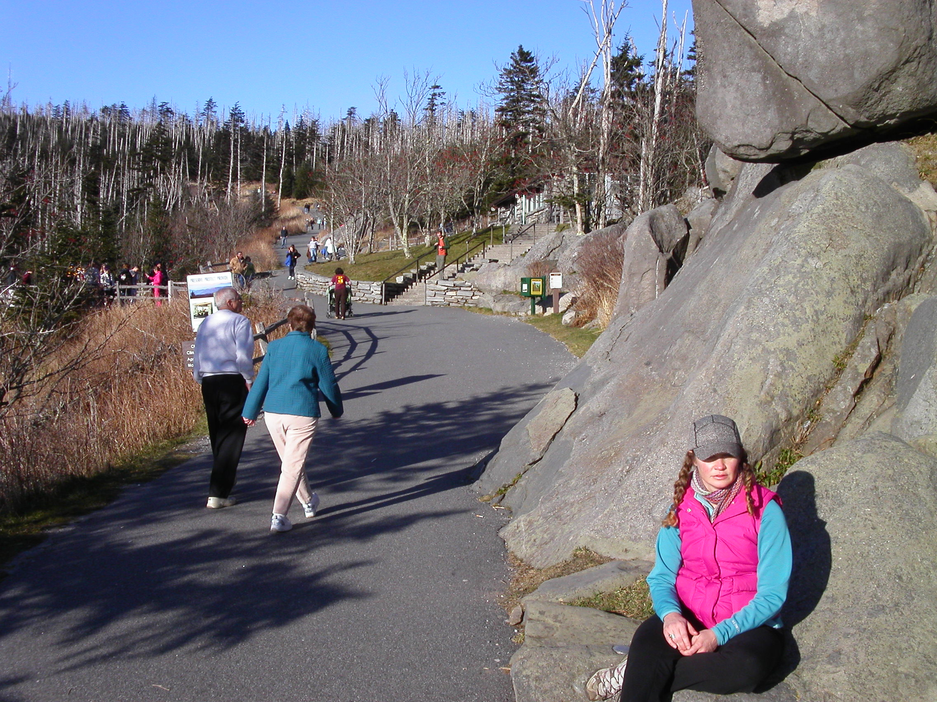
Notes:
2008

Slide 56
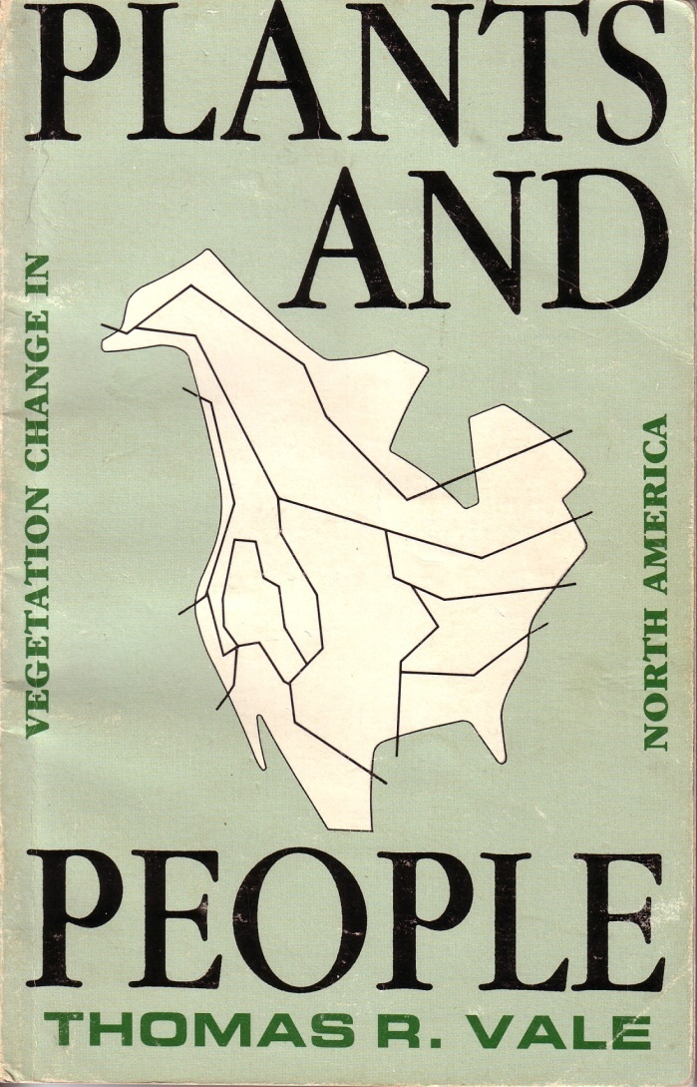
Anthropogenic disturbance
Direct impacts on vegetation from grazing, agriculture, roads, burning, vehicles, and trampling
Indirect effects due to disruption of natural disturbance regime
Notes:
Name human disturbances

Slide 57
Human-initiated fires

Slide 58
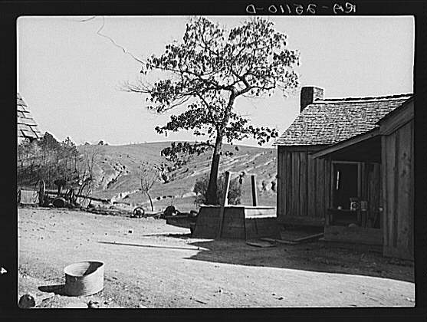
Agriculture and logging impacts

Slide 59
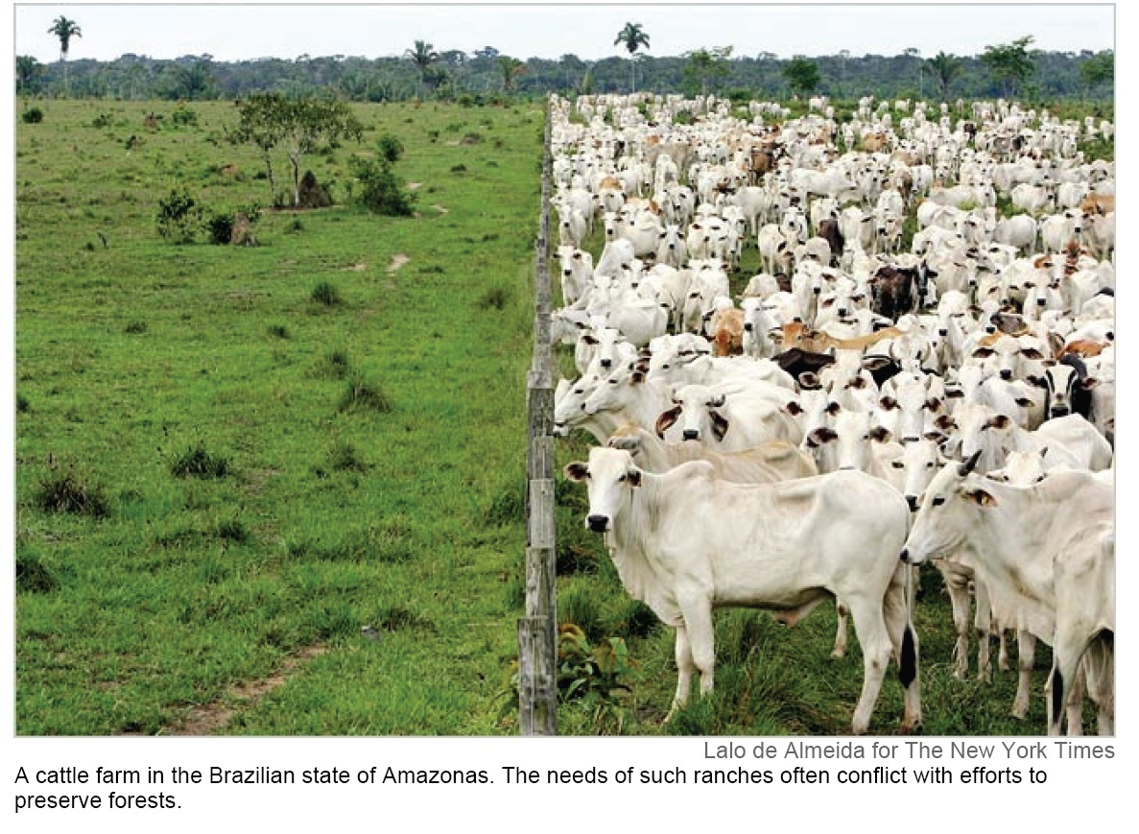
Grazing

Slide 60
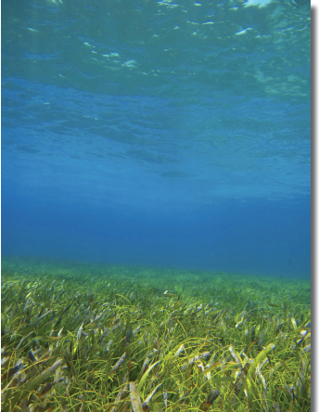
Roads and vehicles

Slide 61
Edge effects
Notes:
Disturbed, fragmented forests create change in conditions around perimeter of patches

Slide 62
Notes:
Disturbed, fragmented forests create change in conditions around perimeter of patches

Slide 63
Notes:
Disturbed, fragmented forests create change in conditions around perimeter of patches

Slide 64
Hyperdynamism
Hyperdynamism encompasses the large fluctuations in environmental conditions and populations along
edges in fragmented habitat.
Notes:
Hyperdynamism is defined as an increase in the frequency and/or amplitude of population, community, and landscape dynamics in fragmented habitats. Examples of parameters that could be altered in habitat fragments include disturbance regimes, mortality and recruitment rates, the population fluctuations of individual species, species extinction and turnover rates, and the pace of biogeochemical cycling. Not all environmental processes will accelerate – some may remain stable or even decline – but the majority of ecological processes in fragmented landscapes will be hyperdynamic.

Slide 65
Principles for applying disturbance in management and policy
Disturbance is common in nature and may even be necessary for some species to flourish
Fire scars in longleaf pine growth rings indicating regular, natural fire interval. Longleaf is a fire-dependent species. In the absence of fire, this species declines in abundance. There are many fire-dependent pine species across North American forests.

Slide 66
Former extent of longleaf pine forests. This forest
type is now greatly reduced across this range
because of logging and fire suppression

Slide 67
Notes:
Flash density map Vegetation was adapted to frequent fires

Slide 68
Gulf-Atlantic coastal plain
Notes:
Presettlement fire regime

Slide 71
Adaptations to fire in longleaf pine
Grassy stage
Cone serotiny
Punctuated growth
Notes:
Fire-resistant morphology (left) and punctuated growth in longleaf pine (right): adaptations to frequent surface fire
Remains 10 years in grass stage at left before shooting above flame front. Stores photosynthate in root for burst of growth. In fire-resistant morphology, growth tissue protected by needles. Rapid growth over 3-4 years extends growth tissue above fire front
Cone serotiny: seeds will not be released from cone until heated above a threshold temperature

Slide 72
Fire suppressed longleaf pine forest in Florida
Oaks and less fire dependent pines increases in abundance in the absence of fire. Understory is not as flammable. Longleaf does not regenerate without frequent fire. Ecosystem is locked into a fire suppressed composition and forest structure and cannot revert back to natural fire regime. Prescribed fire, mechanical removal of oak, and planting of fire-adapted and fire-promoting understory grasses may be required to revert back to a natural, frequently burned longleaf pine forest
Notes:
72

Slide 73
Distribution of shortleaf pine, a fire-dependent pine found in Kentucky that has also decreased in abundance because of fire suppression. Oaks and less fire dependent pines have taken its place

Slide 74
Principles for applying disturbance in management and policy
Disturbance and diversity are intertwined. Disturbance can promote coexistence. Abundance of some organisms dependent upon disturbance

Slide 75
Notes:
Spring wildflowers in the San Felipe Hills grow out of an old forest fire.
Uplands of Mojave Desert

Slide 76
Notes:
Disturbance from mountain pine bark beetle and from fire

Slide 77
Notes:
Eastern Oystercatcher eggs in nest

Slide 78
Principles
Removal of natural disturbances can have a negative impacts. Disturbance in this sense becomes the absence of the historic disturbance regime.
Fire in southern California in chaparral vegetation (right)
Notes:
Aspen trees amid pine in Rocky Mountain National Park, Colorado

Slide 80
Floodwaters result in mortality, open the canopy, provide nutrients for plants on floodplains, transport seeds, and remove understory vegetation.
Timing of floods and dry periods determines the establishment and persistence many riparian tree species

Slide 81
Notes:
A dam has changed the flow regime of the Apalachicola River. The floodplain no longer floods as regularly due to alteration of the river channel induced by the dam. Drought in the southeastern US has also limited the amount of water that enters the river.

Slide 82
Notes:
What happens to a forest if you build a dam upstream? How might the absence of regular flooding disturbance alter the composition and structure of the forest?

Slide 85
Notes:
Not entirely fire suppression: increases in fire weather and drying climate, human fire starters, controlled burns that get out of control.

Slide 86
Principles
Some parts of the landscape are more vulnerable to disturbance event than others.
Notes:
Insert image of aspect

Slide 87
Notes:
Where are disturbance impacts greatest? Where do you think macroinvertebrates have evolved adaptations for disturbance?

Slide 88
Notes:
Where is wildfire going to be the most intense? Where do you think tree species are better adapted to frequent fire and will have a species composition that reflects this?

Slide 89
Principles
5. The extent to which a disturbance has been historically prevalent for an area determines species responses, abundance, and evolution.
Volcanic eruptions
Natural fire regime

Slide 90
Seasonal inundation in the Pantanal
Notes:
The Pantanal, the lowland region of SW Mato Grosso state, Brazil, bordering the Paraguay River and extending to the western edge of the Brazilian Plateau. Parts of the pantanal extend into Bolivia and Paraguay. It is the world's largest wetland area, c.77,000 sq mi (200,000 sq km). It is subject to annual flooding, it is not a marshland; the water is not stagnant but flowing across a very wide area. The pantanal completely dries out at the end of the six-month rainy season.

Slide 92
Principles
Natural disturbance is not necessarily a disaster
Notes:
Yellowstone Fires of 1988

Slide 93
Principles
Resource extraction practices can mimic natural disturbances to lessen impacts. Selective logging and limiting the size of clear cuts are an attempt to mimic natural disturbances

Slide 94
Principles
Disturbances rarely act alone. They often act in synergism with each other

Slide 96
Coupled fire-geomorphic disturbance in chaparral vegetation
Chaparral vegetation is fire-adapted
Fuels accumulate and result in fire
Some water-repellant oils translocate to subsurface of soil
This layer acts like wax-paper; water will not infiltrate soil
Runoff and erosion increases in a positive feedback
Mudflows more extensive in El Nino years that follow an active wildfire season.

Slide 97
Principles
Because disturbance is common, unrealistic to manage land with the intent of keeping it the same. It is not possible to preserve wilderness if by definition it must change.
Notes:
YNP

Slide 98
Lake Mead, Nevada
Notes:
http://www.azcentral.com/story/news/arizona/investigations/2015/02/27/southwest-water-crisis-part-one/24011053/
http://www.azcentral.com/story/news/arizona/investigations/2015/02/27/southwest-water-crisis-urban-rural-battle/24060879/

Slide 99
Lake Tahoe, Nevada
Notes:
Lake Tahoe, a high elevation lake in northern California near the Nevada border. This pine tree is evidence that this lake was not always here – it is evidence of former megadroughts.

Slide 100
Notes:
These pines have been found in the lake as well, and their tree rings provide records of the former drought period in which they grew

