Slide 1
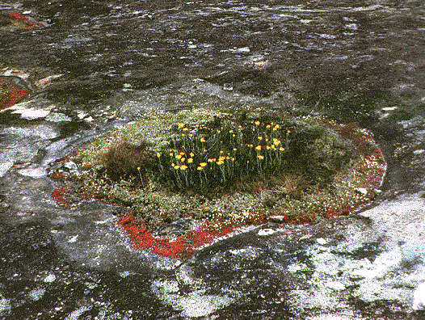

Slide 2
Notes:
Glacier Bay, Alaska. This study now represents the longest-running primary succession plot network in the world. Permanent plots are useful for their ability to follow mechanistic change through time without assumptions inherent in space-for-time (chronosequence) designs.
Buma, B., Bisbing, S., Krapek, J., & Wright, G. (2017). A foundation of ecology rediscovered: 100 years of succession on the William S. Cooper plots in Glacier Bay, Alaska. Ecology, 98(6), 1513-1523.

Slide 4
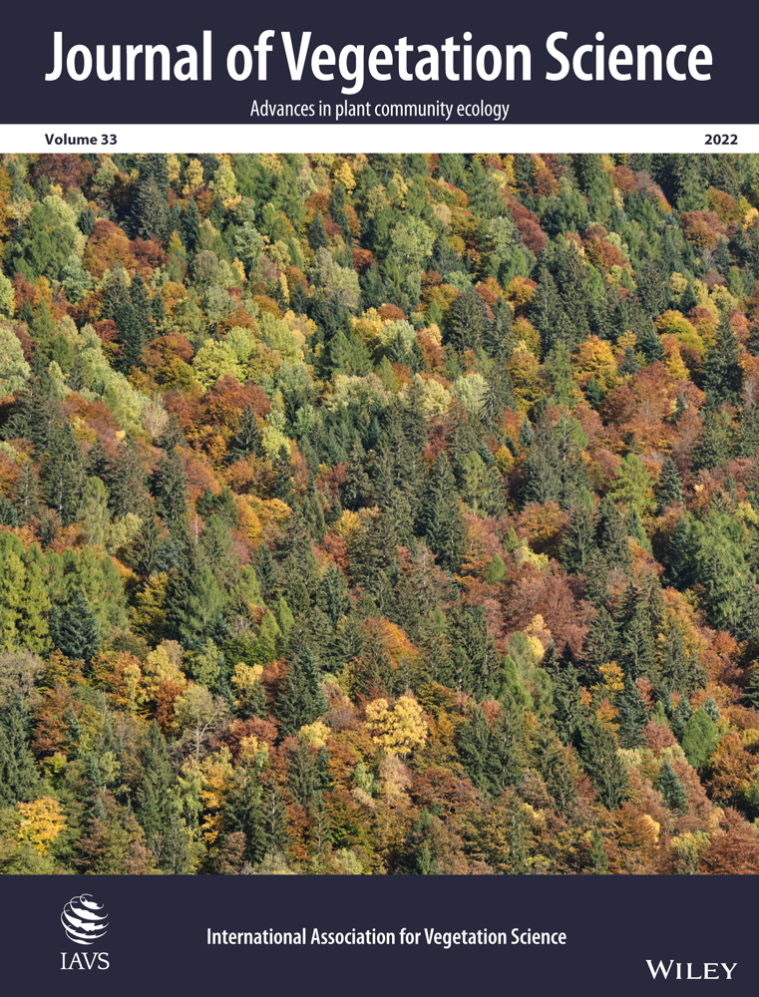
Vegetation dynamics
Also known as plant succession
Sequence of compositional and structural vegetation changes through time
Why study plant succession?
Pragmatic reasons: an understanding of succession can help inform ecological policies and management

Slide 5
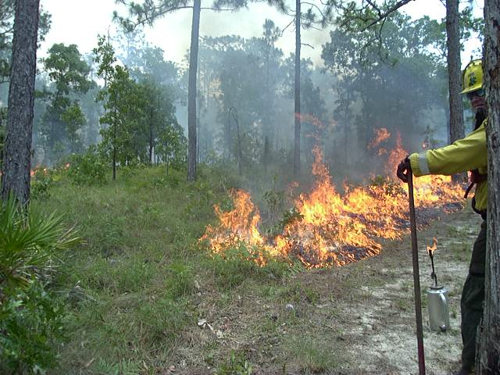
Notes:
Burning of a longleaf pine forest in Florida panhandle. Succession informs forest management

Slide 6
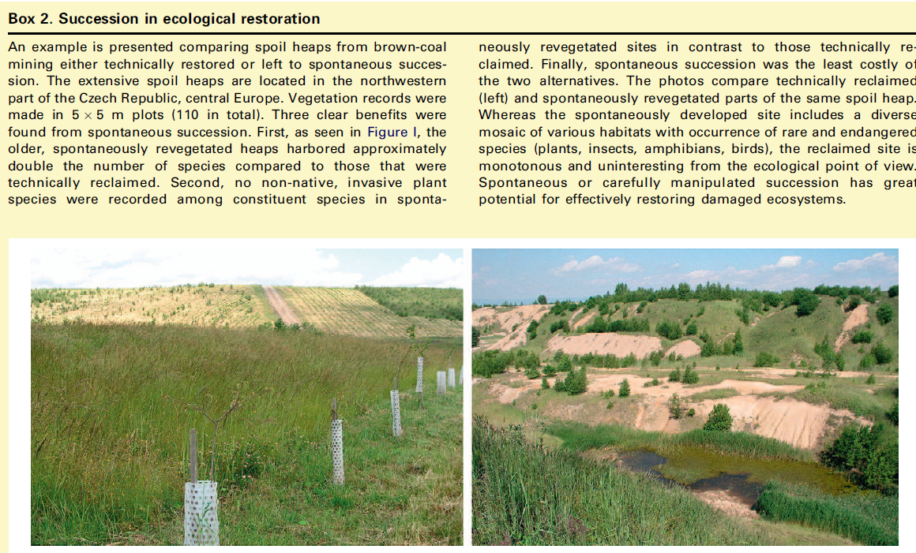
Succession initiated by technical reclamation
Succession initiated spontaneously
Notes:
Succession informs ecological restoration

Slide 7
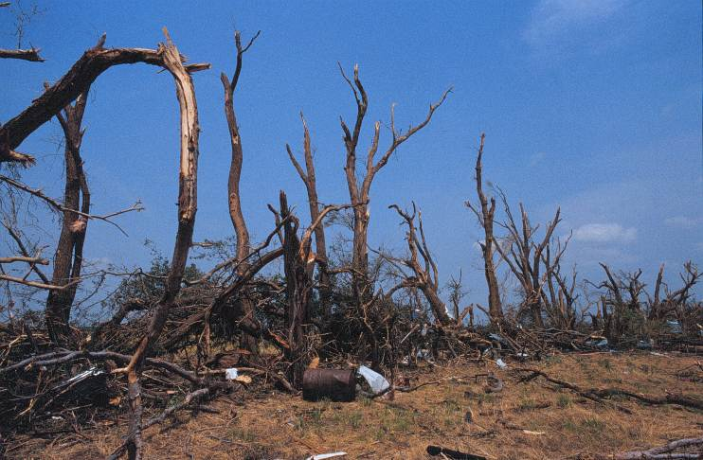
Succession as taught in most high school and college intro biology classes posits two types of succession: primary and secondary
Notes:
Rock outcrop, primary succession
Tornado disturbance, secondary succession
Which is slower? Which has to accumulate a soil and plant propagules? Which is ecologically driven? Which is climatically driven?

Slide 8
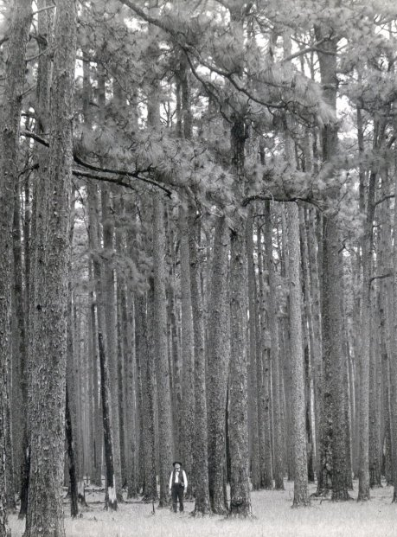
Theoretical questions raised in successional studies
How is nature organized?
Are communities highly integrated or are they more individualistic?
Do they return to their original state?
Is there balance or equilibrium in nature or is it a non-equilibrium system?
Environmental policies take positions on these questions

Slide 9
Teleology
The concept that there is an outside guiding force to development of a system
In teleological views of nature, there is telos, a guiding hand to change
Early ecologists and scientists often espoused a teleological view of nature that was religious

Slide 10
Religious teleologies of nature
Pervasive order
Nature is seen as the handiwork of a deity
Change is to admit imperfection
Nature as a cathedral, holy and timeless, without change
Succession and evolution would run counter to religious doctrine
Notes:
This is largely a non-scientific view of ecological change

Slide 11
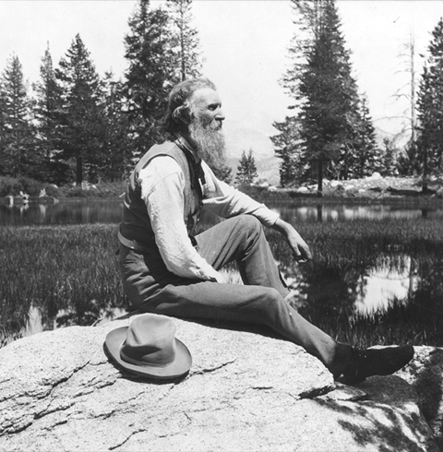
John Muir
Founder of the Sierra Club, one of the first environmental organizations
Saw nature as a cathedral, holy and timeless, without change, a reflection of religious handiwork
Notes:
He also had what we would consider a science-based observational understanding of the Sierra Nevada forests of California. John Muir has a deeply religious view toward nature. Whether he had a sophisticated understanding of succession is not clear, but he saw any human interference in the forests of the Sierra Nevada of California as a sin.

Slide 12
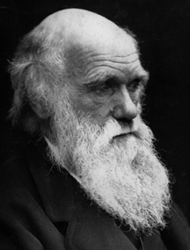
Charles Darwin
No religious telos
No external, god-like entity organizing nature
Competition in nature contradicted the perfection of holy design
Telos was evolutionary theory

Slide 13
Outline: Vegetation dynamics
Organismal views (Clements)
Individualistic views (Gleason, Whittaker, Watt, Egler)
Ecosystem ecology and resurgence of organismal views (Odum)
Next sets of slides will cover more recent ideas in disturbance ecology
And finally we will get to complex adaptive systems theory and resilience theory

Slide 14
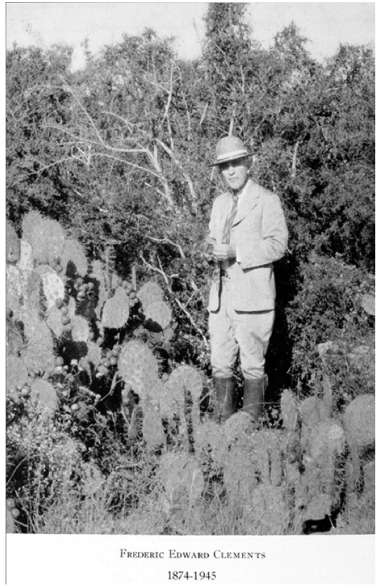

Slide 15
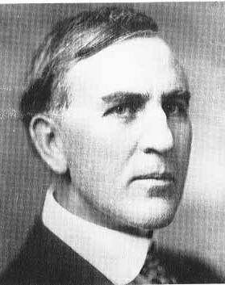
Frederic Clements
(1874-1945)
Key terms associated with his
facilitation model of succession:
immutable
deterministic
equilibrial
organismal
holistic
superorganismal
orderly
integrated

Slide 16
Notes:
Applies best to primary succession

Slide 17
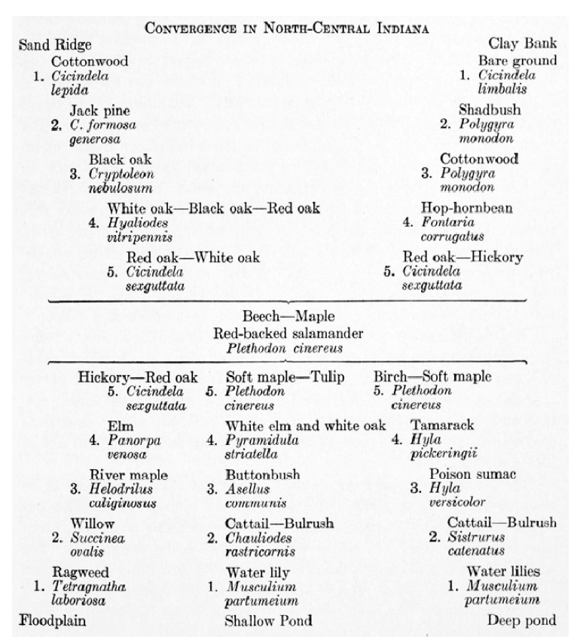
Notes:
Downplayed the role of disturbance, may not ever get to beech-maple climax if disturbances are frequent
Other ideas at that time in history were taking a similar organismal, developmental, equilibrial view: WM Davis and fluvial landscape evolutionary stages – the fluvial landscape climax Ratzel and organic state theory – countries grow, expand, as part of its development, leading to climax of cities and agriculture Jenny’s ideas about soil formation –climax soil stages
Clement introduced the idea that evolution may work at biological levels higher than the species—in Clement’s theories, communities were subject to evolutionary forces that shaped their assembly

Slide 18
Contributions of Clements
Defined primary and secondary succession
Introduced idea that evolution works at higher levels than the individual
Popularized a misleading concept: nature will always grow back to its climax state as a kind of superorganism
This immutability of the pioneer-to-climax sequence brought out critics who saw natural disturbance as overlooked phenomena
His superorganismal concept is no longer used
However, he had a much more nuanced conception of a climax than critics give credit for
Notes:
Not just climax according to Clements, but also disclimax, subclimax, proclimax, serclimax

Slide 20
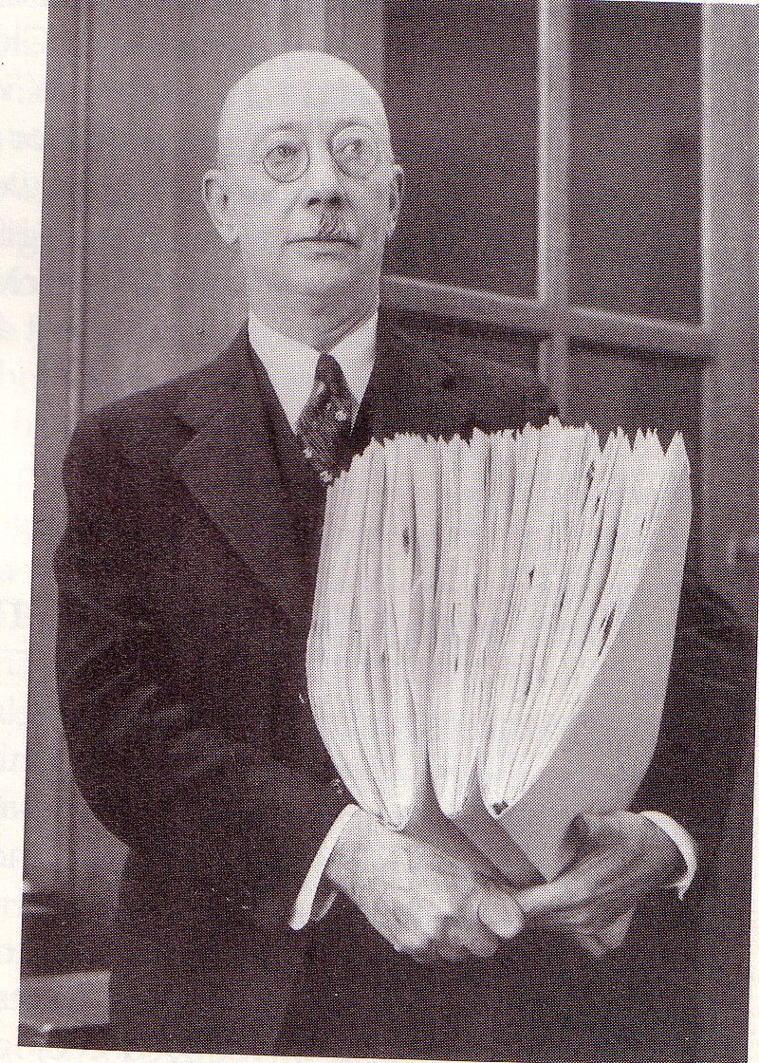
Henry Allen Gleason
(1882-1975)
Key terms associated with his
continuum concept:
individualistic
reductionist
random
contingent
non-equilibrial
disorganized

Slide 21
Notes:
Much more individualistic – communities were only loosely defined

Slide 23
Contributions of Gleason
Major works published in mid 1920’s, but not acknowledged for 30 years because of the shadow of Clements
Gleason was the only major dissenter of Clementsian succession until late 1940s and 1950s
Contributed to development of non-equilibrium ecology
His work allowed for a much richer possibility of new and novel plant communities
Idea of loosely organized plant communities has been abused: if nature is unorganized, then why worry about human impacts, right?
Notes:
Between 1917 and 1945 only one major ecologist in the whole of America dissented from the general consensus of Clementsian vegetation-units—Henry Allen Gleason

Slide 24
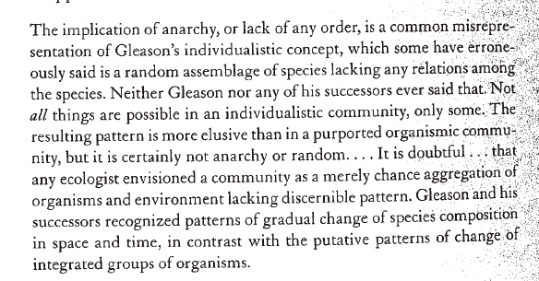
Notes:
Gleason was also misread, in that he did not imply that nature was in anarchy or random
McIntosh, 1998

Slide 25
Events that weakened the dominant Clementsian view of succession
Dust Bowl (1930’s)
The Dust Bowl introduced ecological changes on the short grass prairie that illustrated how succession is not orderly – it is often interrupted by disturbance. These disturbances may lead to a new state rather than a climax
Chestnut blight (1950’s)
This blight illustrated how plant communities were much more individualistically organized. Species replace each other rather than entire plant communities through succession

Slide 26
Notes:
http://intersector.com/case/shortgrass_colorado/ Shortgrass prairie

Slide 27
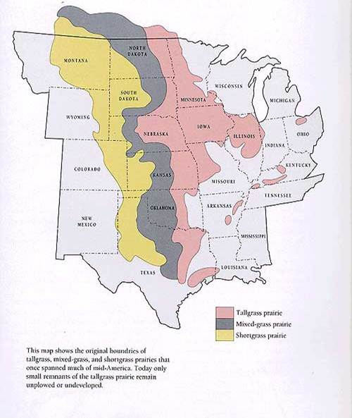
Notes:
Rainfall decreases across these grasslands from east to west

Slide 28
Notes:
Dryland farming and dust mulch
Market dynamics made it logical to plant more wheat to try to recover losses due to rapid declines in wheat prices. Many farmers had borrowed heavily to invest in new tractors and machinery for farming.
“Rain follows the plow”

Slide 29
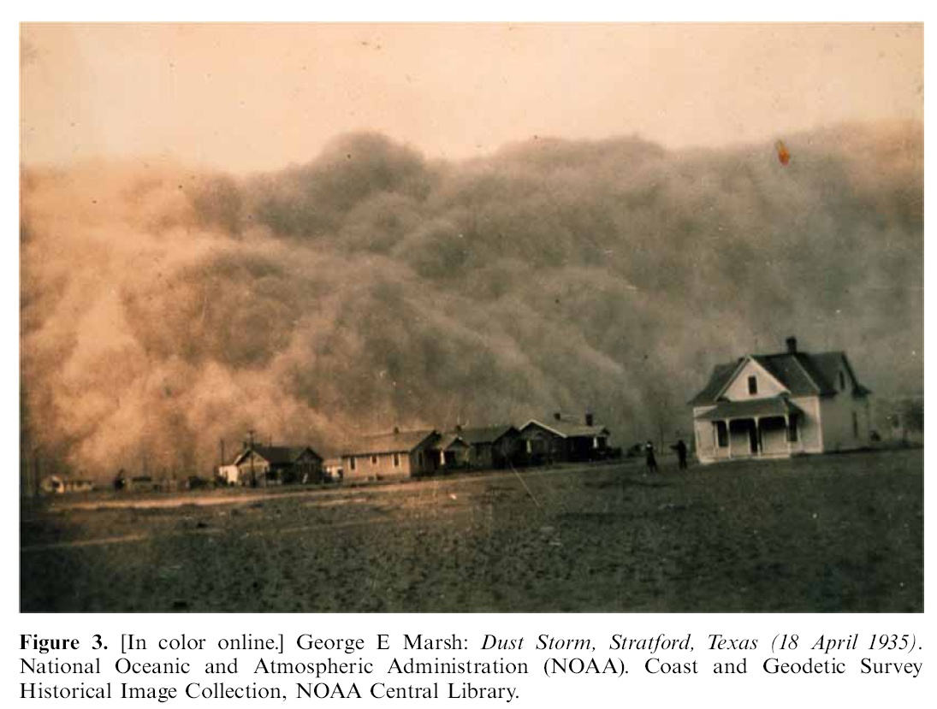

Slide 31
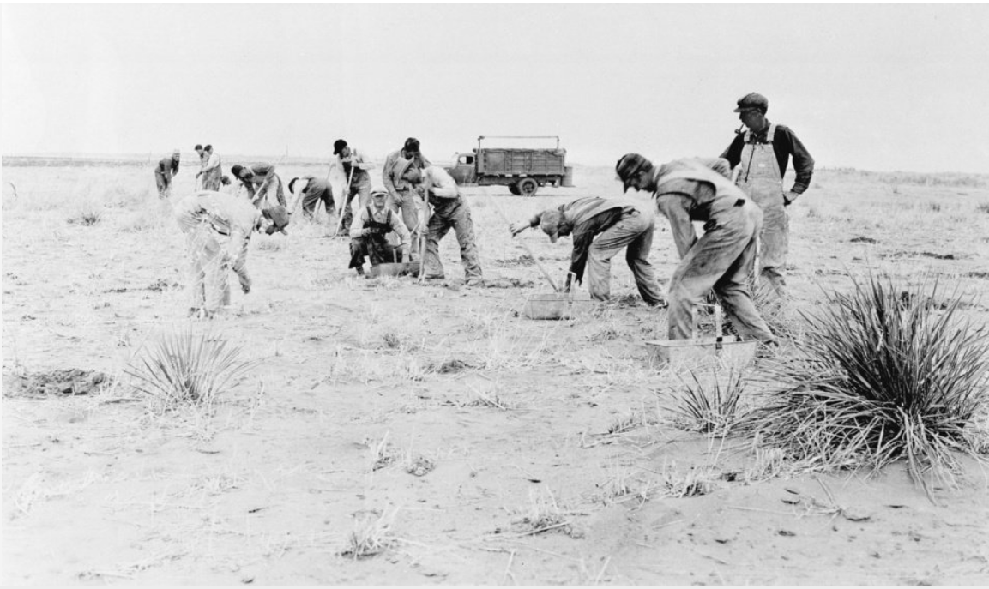
The shortgrass prairie did not recover where erosion was severe – it was a permanent change . This illustrated how the Clementsian model of succession was simplistic and did not account for the possibility of disturbance and multiple endpoints to succession – the climax shortgrass prairie did not return
Notes:
In this 1935 file photo, workers plant a shelterbelt strip of trees during the reclamation of a farm.

Slide 32
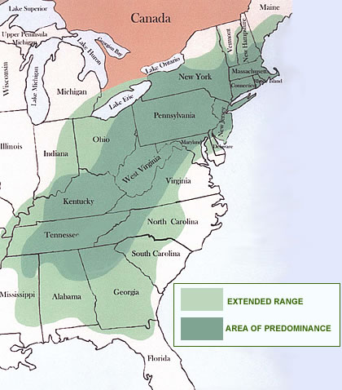
American chestnut
(Castanea dentata)

Slide 33
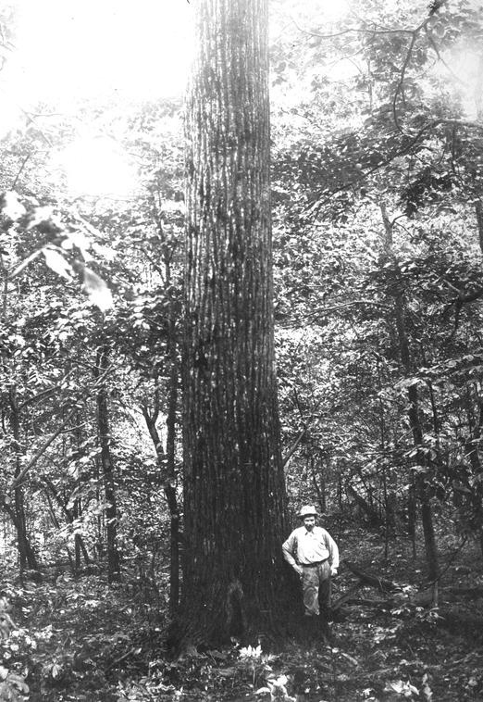
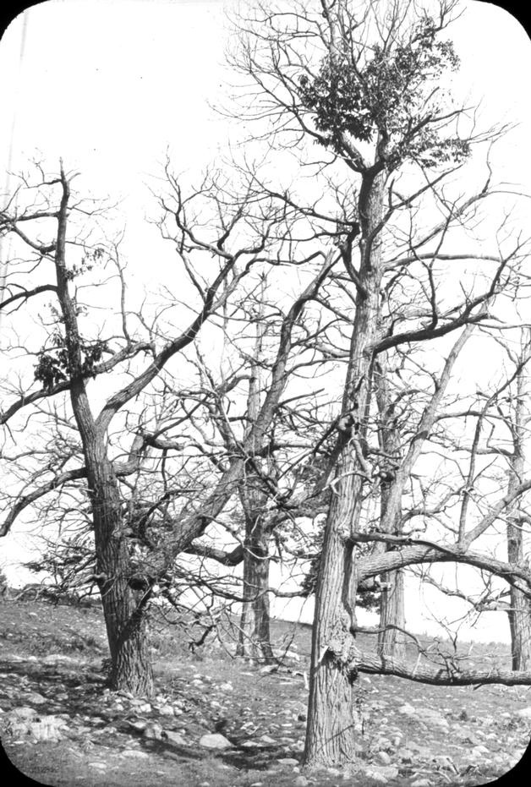

Slide 34
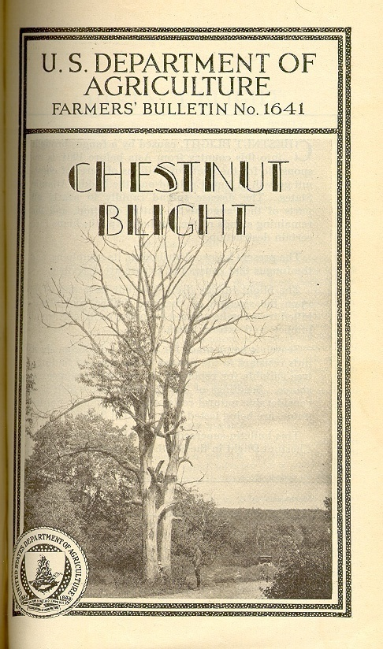
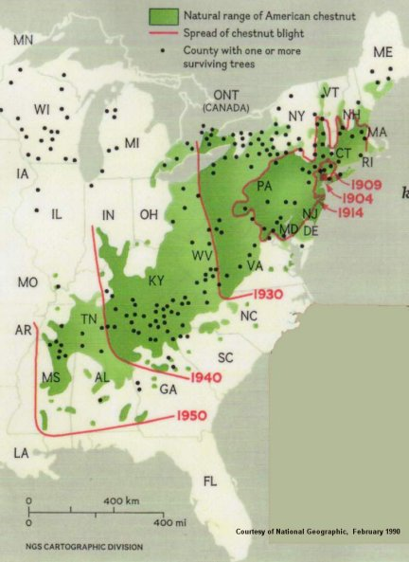
Notes:
First discovered in 1904 in New York City, the blight - an Asian fungus to which our native chestnuts had very little resistance - spread quickly from its origins in contaminated nursery stock. It spread quickly via wind-dispersed fungal spores, an example of passive dispersal. In its wake it left only dead and dying stems. By 1950, except for the shrubby root sprouts the species continually produces (and which also quickly become infected), the keystone species on some nine million acres of eastern forests had disappeared

Slide 35
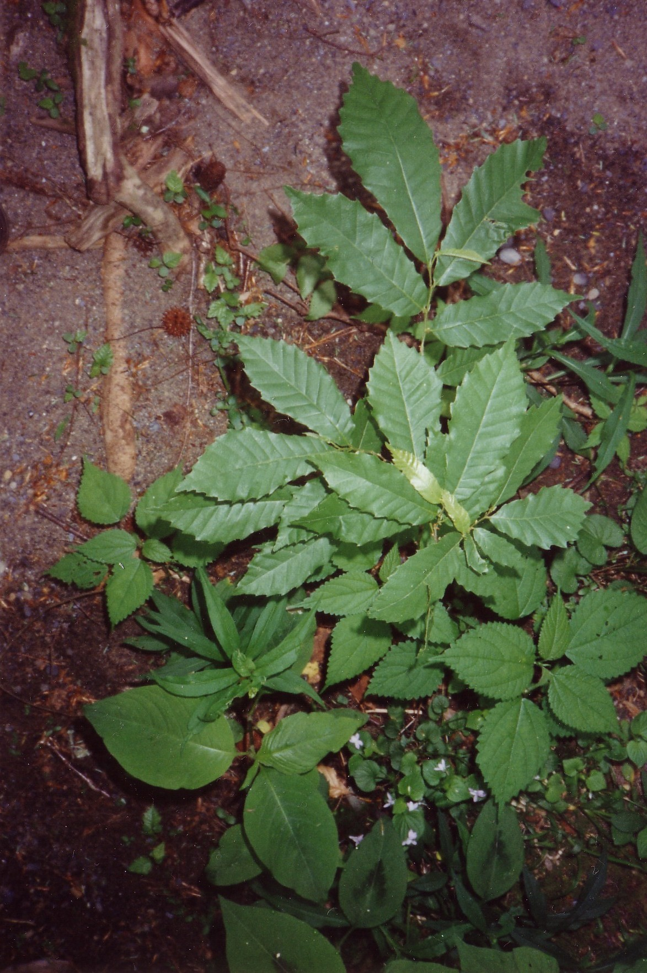

Slide 36
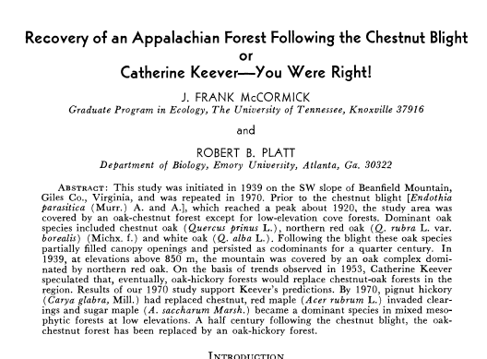
Hickories and maples replaced chestnut. The forest was not so tightly integrated a community as a Clementsian model would predict. It was more individualistic as Gleason had hypothesized.

Slide 37
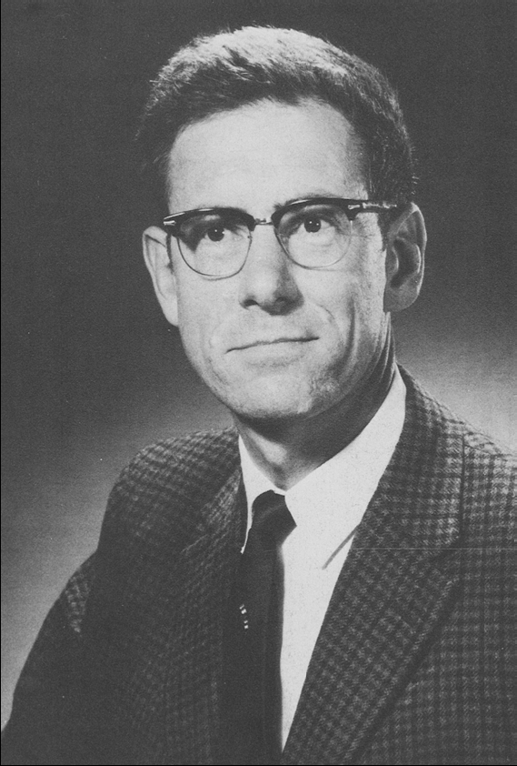
R.H. Whittaker (1920–1980)
Individualistic Gleasonian
Mathematical
Gradient analysis Smoky Mountains

Slide 38
Individual species, not entire populations, replace each other during succession and across environmental gradients
Whittaker was a Gleasonian and he backed up his ideas with lots of data and field description
Whittaker showed that in the absence of disturbance or a sudden change in soil type or topography, boundaries between plant communities are not sharp.
Notes:
Gradient analysis, a technique refined by Whittaker

Slide 39
A.S. Watt (1947)
Put disturbance into succession
He viewed disturbance as a normal endogenous component of succession – Clements and Gleason were certainly aware of disturbance but did not formalize incorporate it in their theories
Watt contributed the idea that stability is achieved through constant change (dynamic equilibrium) and these other concepts:
Gap phase dynamics
Chronosequence
Space for time substitution

Slide 40
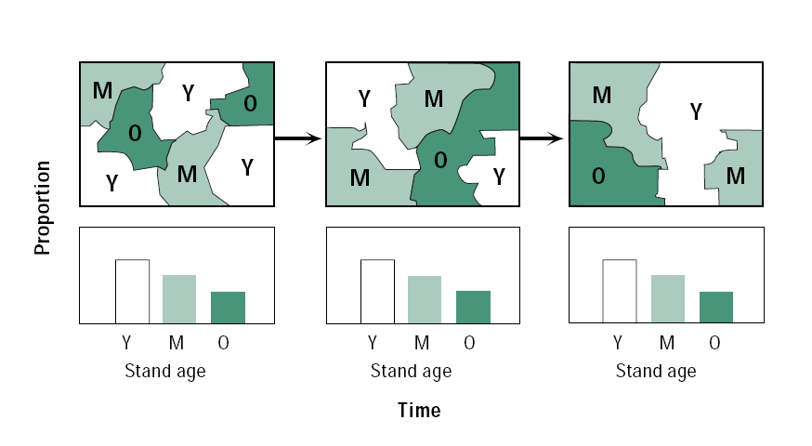
Gap phase dynamics and dynamic equilibrium

Slide 41
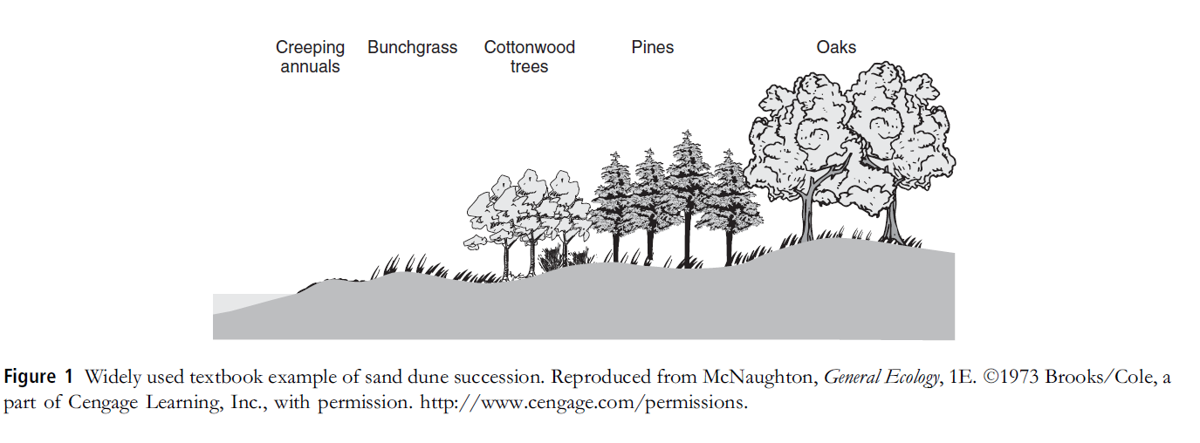
Chronosequences and space-for-time substitution

Slide 42
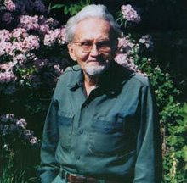
F. Egler’s (1954) Initial relay floristics model of succession
Gleasonian
Egler put a greater emphasis on change and contingency in succession
The conditions and factors of where succession takes place and what kinds of vegetation are present or nearby shape the direction of succession
Climax is useless term
Emphasize the role of life history traits

Slide 43
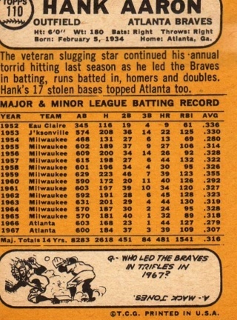
Life history traits

Slide 45
Initial relay floristics (Egler)
Grasses and forbs (A)
Weeds or ruderal vegetation
r-selected, efficient long-distance dispersal, fast-growing, shade intolerant
Pines (B)
Shade intolerant, intermediate growth rate
Oaks (C)
k-selected, more local dispersal, slow growing, shade tolerant
Life history traits

Slide 46
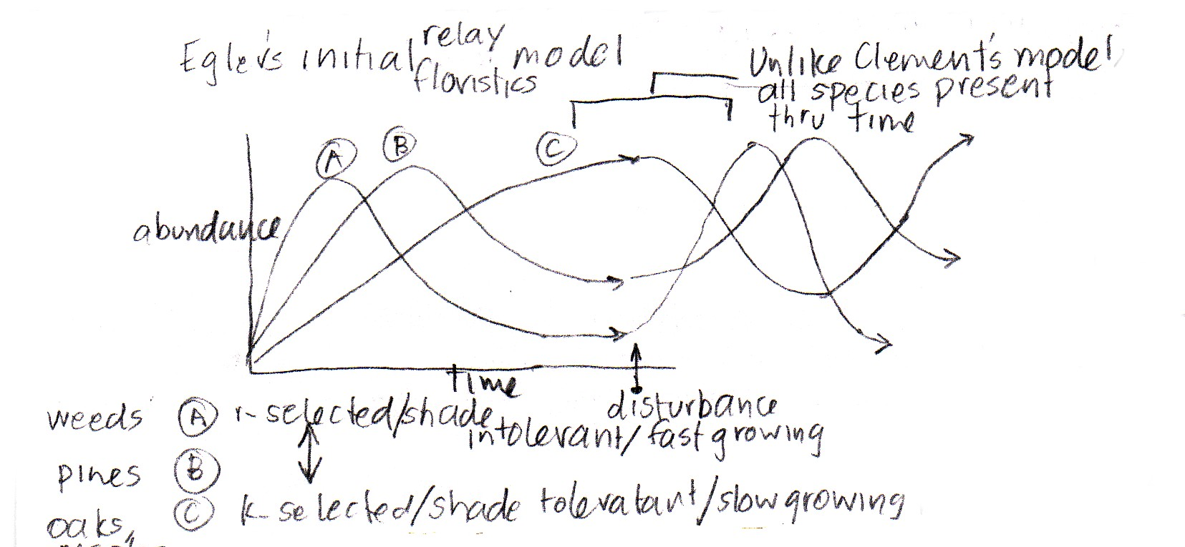

Slide 47
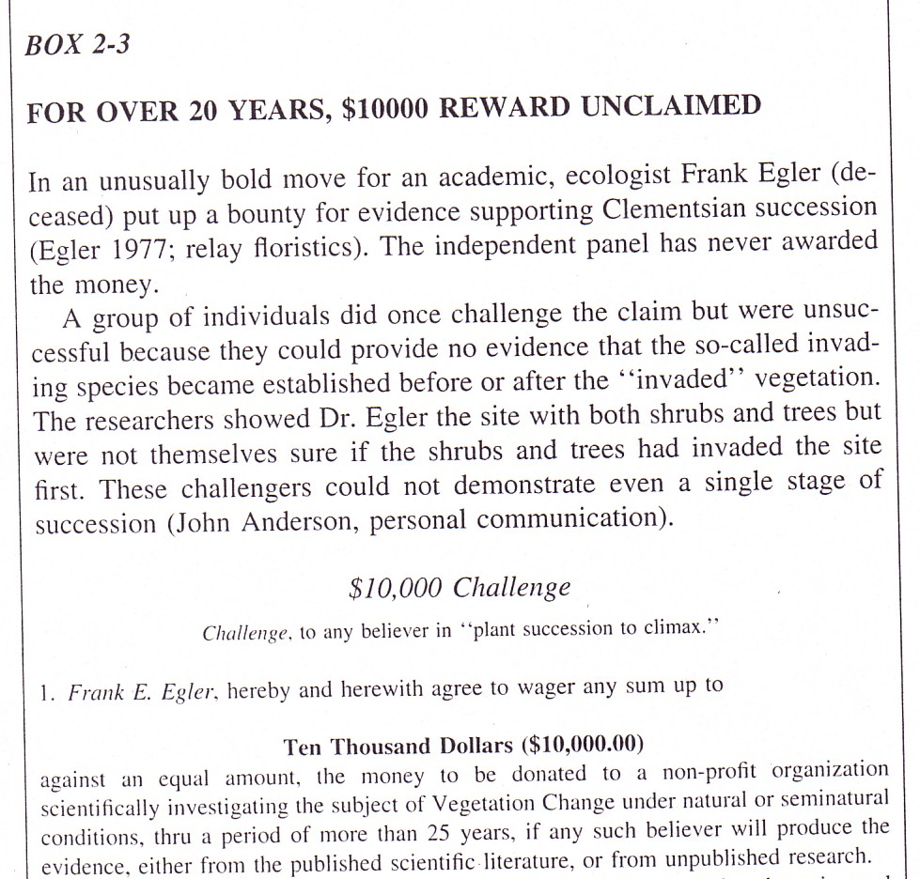

Slide 48
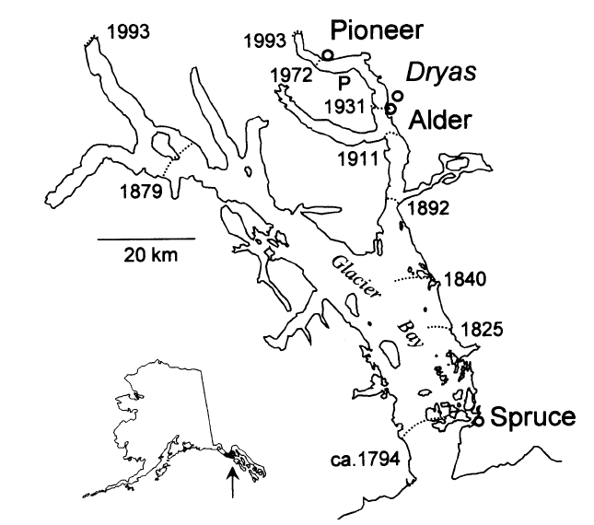
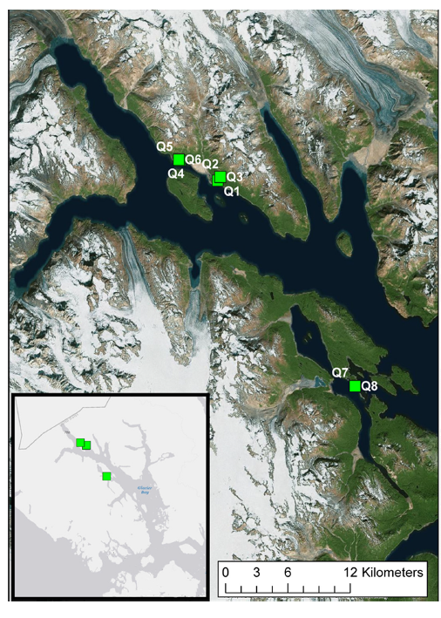
What kind of vegetation patterns would you expect to find with the retreat of a glacier according to Clements? Egler?
Notes:
Mechanisms of primary succession following deglaciation at Glacier Bay, Alaska (1994)
There has been almost a complete community composition replacement over the century and general species richness increase, but the effective number of species has declined significantly due to dominance of Salix species which established 100-yr prior (the only remaining species from the original cohort). Where Salix dominates, there is no establishment of “later” successional species like Picea. Plots nearer the entrance to Glacier Bay, and thus closer to potential seed sources after the most recent glaciation, have had consistently higher species richness for 100 yr.

Slide 49
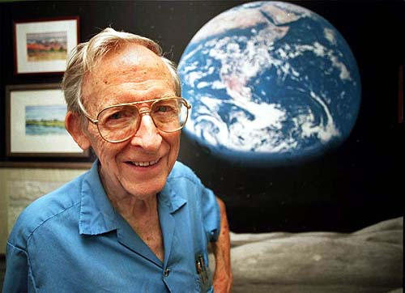
Eugene Odum
(1913-2002)
Clementsian Ecosystems
Holistic
Community controlled
Equilibrium
Biomass
Notes:
Dates

Slide 51
Odum: the Strategy of Ecosystem Development (1969)
Succession is orderly, directional, and predictable
Succession is community-controlled – driven by the biota and their interactions, though physical environment often sets limits
Culminates in a stabilized ecosystem in which a maximum in biomass is maintained for the available energy flow.
Strategy of succession is increased control of the physical environment to achieve maximum protection from its perturbations.

