Slide 1
Historical controls of biogeographic pattern
How did you get here? What happened in the past to get you where you are now? How much importance do you assign to the deep past to explain your present whereabouts? How does the past influence where you will be in the future?
Notes:
Registered for this class versus my mom and dad meeting
Requirements for graduation versus evolution of humans in Africa

Slide 2
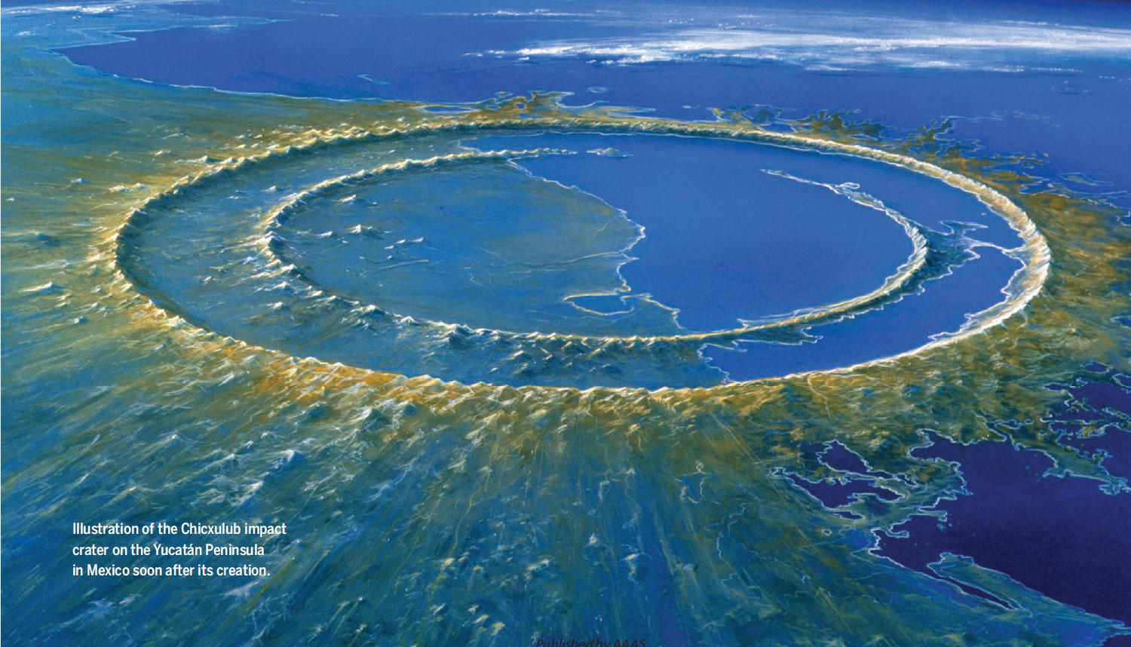
Proximate versus ultimate causality
A proximate cause is an event or explanation which is closest, or immediately responsible, for causing some observed outcome or pattern
This exists in contrast to a higher-level ultimate cause which is usually thought of as the "real" reason for something occurring or being present.
Notes:
Registered for this class versus my mom and dad meeting
Requirements for graduation versus evolution of humans in Africa

Slide 3
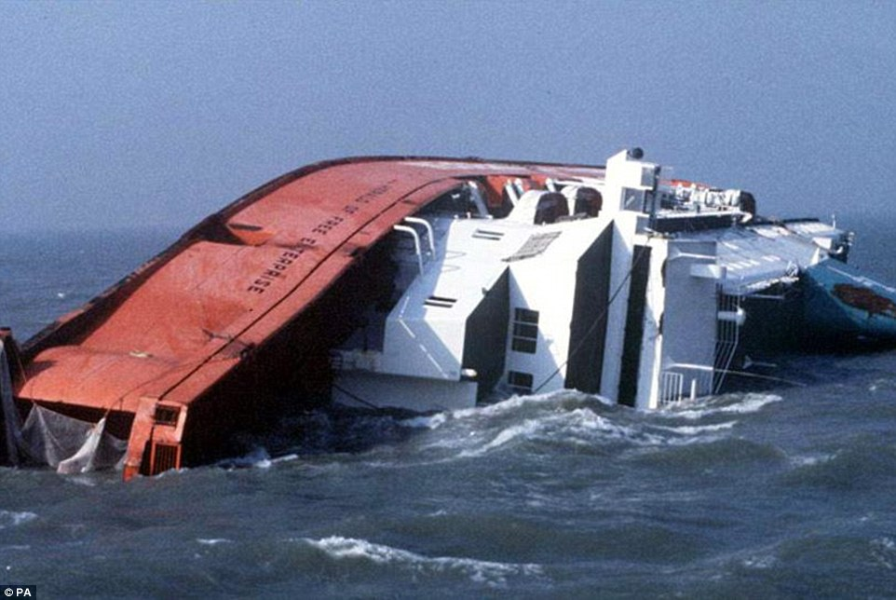
Why did the ship hit the rock?
Proximate cause: Because the ship failed to change course to avoid it.
Ultimate cause: Because the ship was under autopilot and the autopilot received bad data from the GPS.
Separating proximate from ultimate causations frequently leads to better understandings of the events and systems their relationships.
Notes:
So, not useful to always say we have the same history. Nor is it useful to think of only the most recent cause. We have to disregard some patterns and choose others to look at. We have to draw spatial and temporal extents.

Slide 4
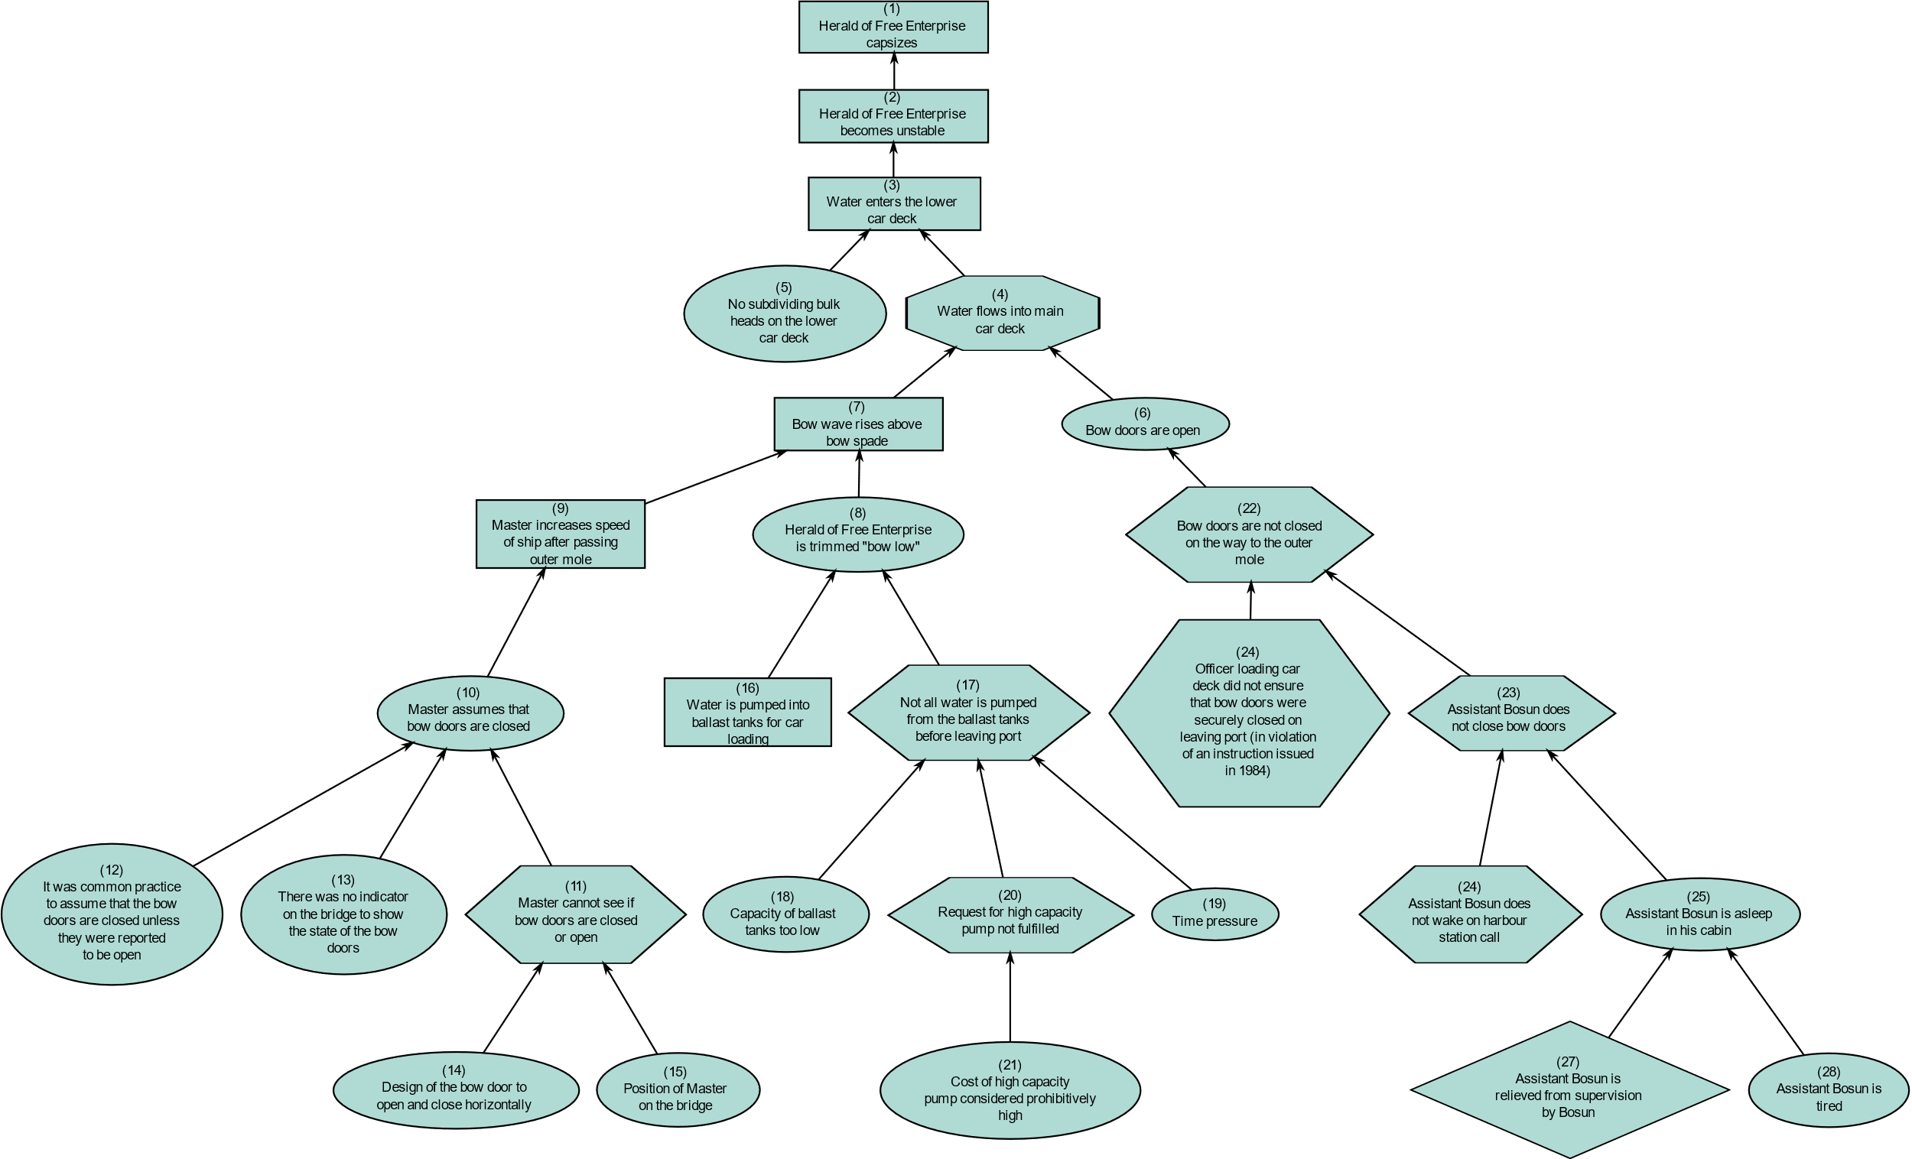
Notes:
So, not useful to always say we have the same history. Nor is it useful to think of only the most recent cause. We have to disregard some patterns and choose others to look at. We have to draw spatial and temporal extents.

Slide 5
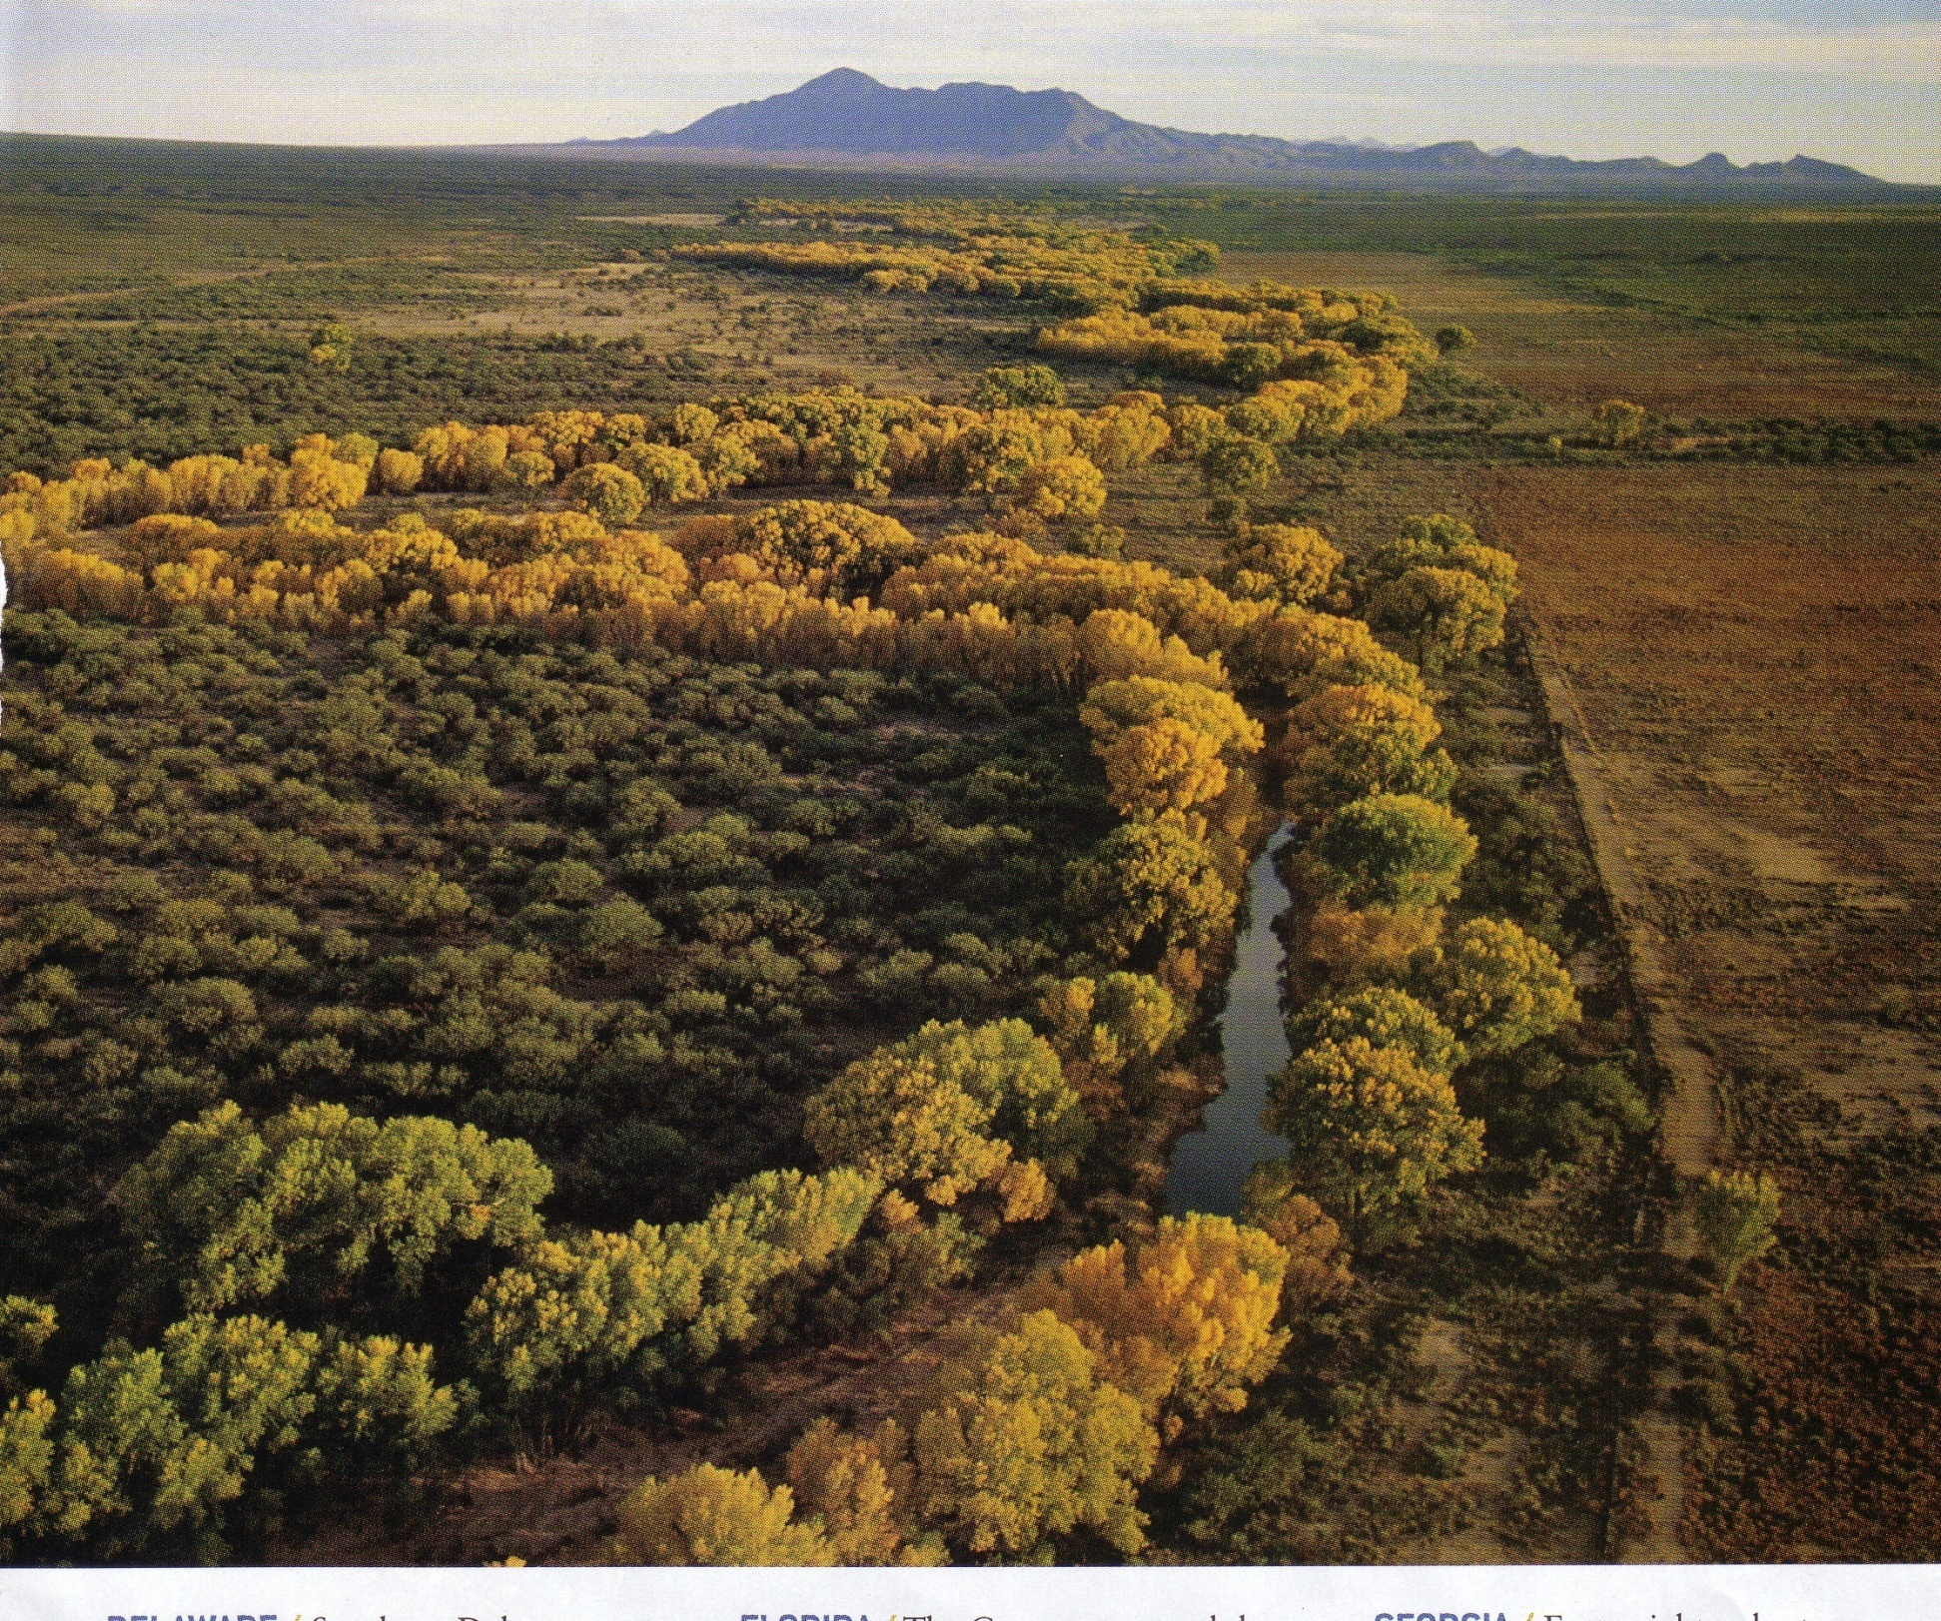
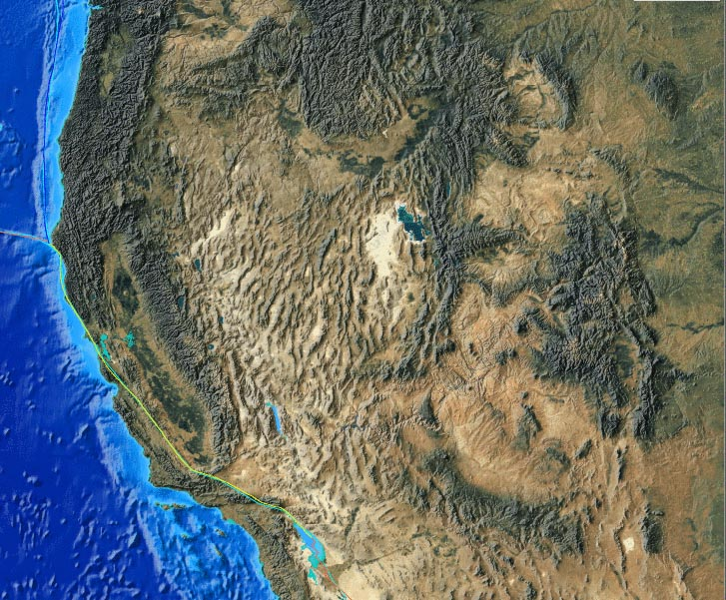
Notes:
5
What are the proximate controls of vegetation pattern? What are the ultimate controls of vegetation pattern?
Proximate: rainfall, soil nutrients
Ultimate: plate tectonics that created the arid regions of North America. T

Slide 6
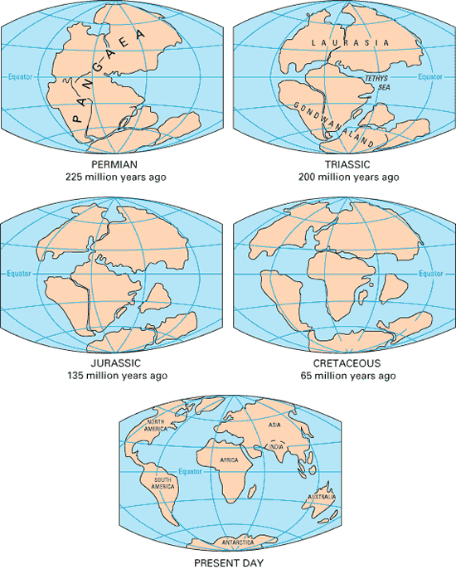
Historic processes
They are often more ultimate causes but visibility of their influence may not be readily apparent.
  Plate tectonics
  Dispersal and vicariance
  Evolution
  Biotic exchanges
  Climate change
  Historic disturbance
  Historic human impacts
Notes:
Plate tectonic emerged as a predominant paradigm in the 1950s through the 1970s.

Slide 7
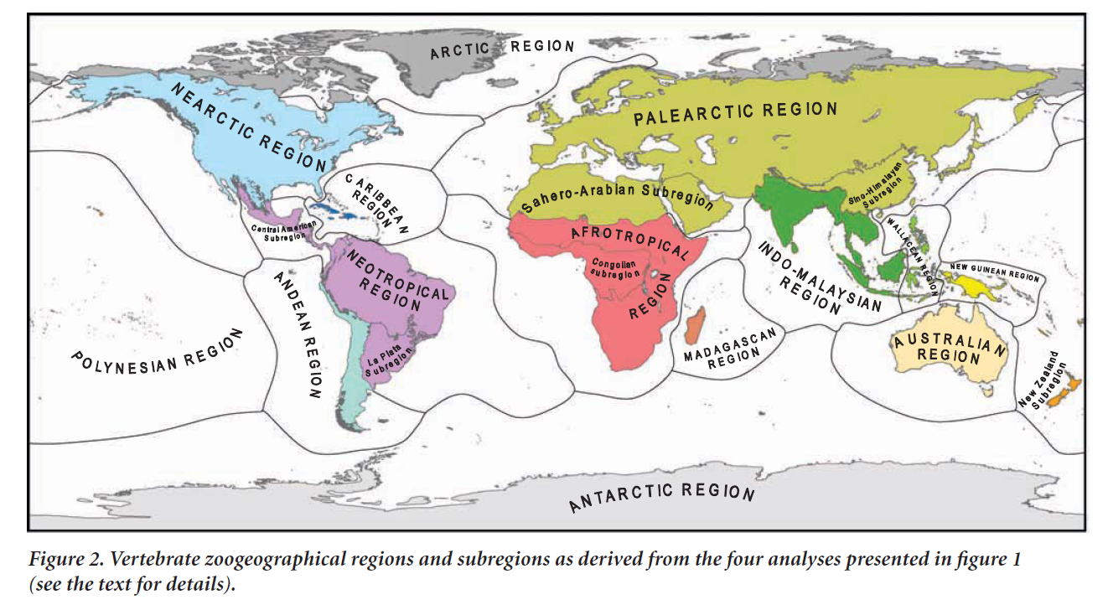
What causes the biogeographic patterns in biogeographic realms?
Proximate cause: patterns of temperature and rainfall
Ultimate cause: tectonic and geothermal forces that moved continents into current latitudinal positions and created topography
Notes:
Based on the taxonomic or phylogenetic relationships of animals

Slide 8
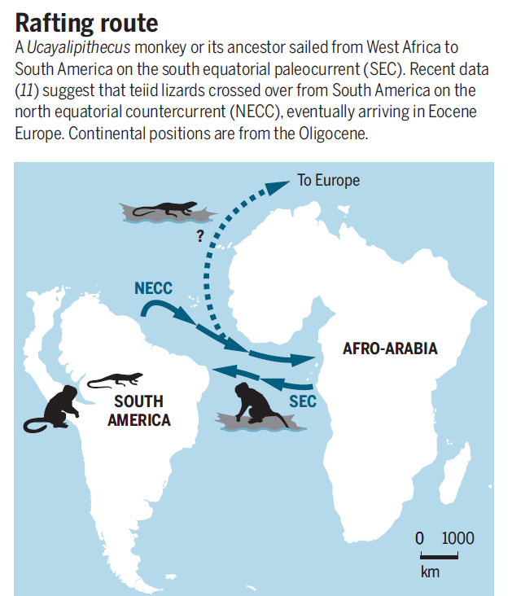
Vicariance versus dispersal
Vicariance - term used to describe how organisms are carried to different locations because of movement of underlying tectonic plate
Vicariance as a cause of a distribution of an animal or plant may be difficult to distinguish from active or passive dispersal.
Notes:
Both vicariance and dispersal shape biogeographic patterns
Plate tectonic emerged as predominant paradigm in the 1960s and1970s
Land bridges and rafting were the only explanation for plant/animal that occurred on separated continents before plate tectonics was accepted

Slide 9
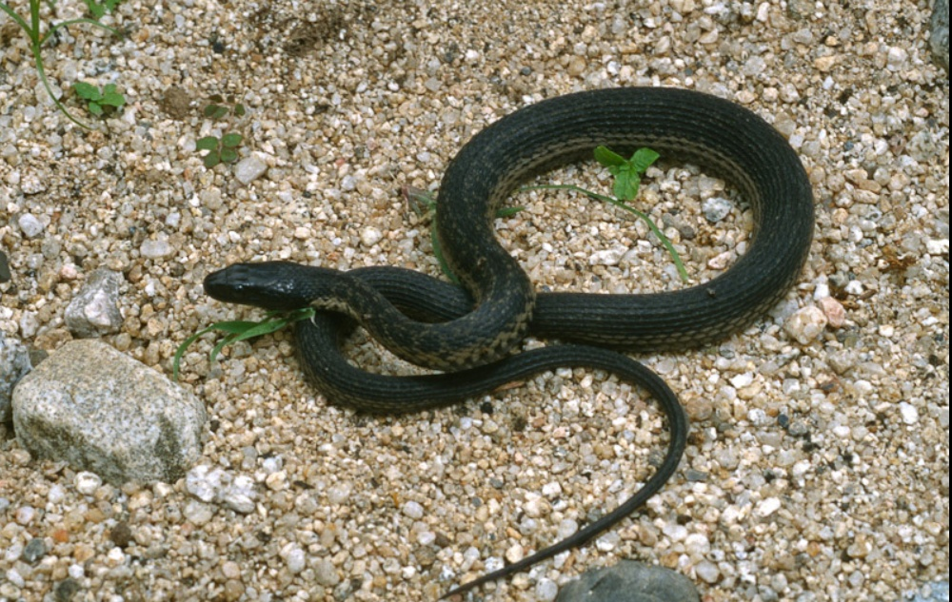
Thamnophis validus (Mexican Pacific lowlands garter snake): plate tectonics (vicariance) or dispersal?

Slide 10
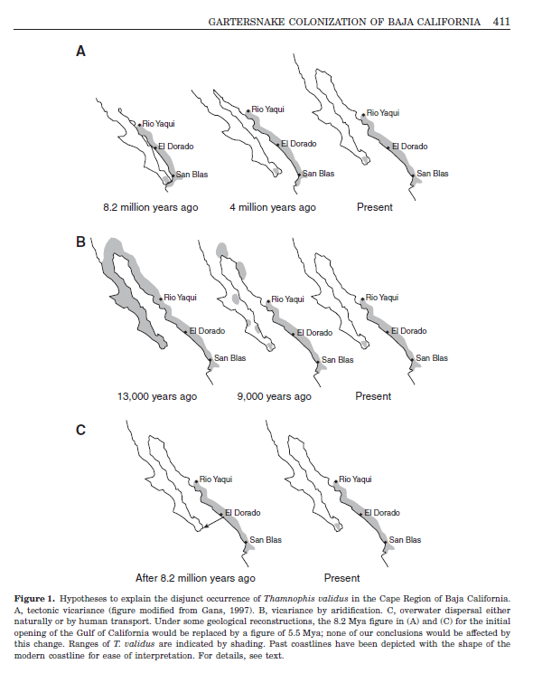

Slide 11
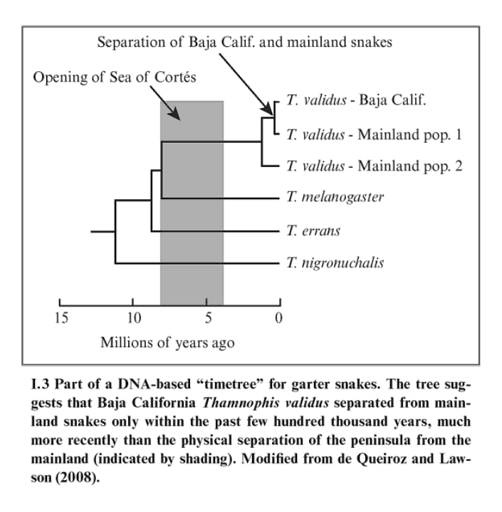

Slide 12
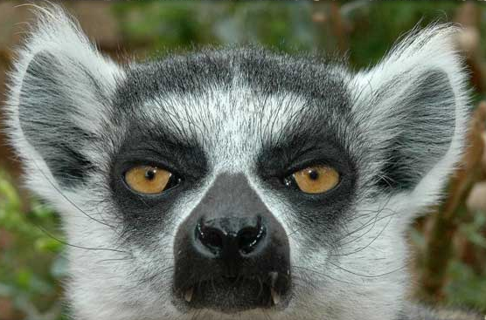
Where is it easy to see the role of history?
Islands are natural experiments where the influence of plate tectonics, dispersal, and evolution are readily visible
  Madagascar rifted apart from the African continent during Late Cretaceous period (65 million ya).
  Although close to Africa, many groups of birds and mammals did not persist after rifting or failed to cross the growing gap.
  Of those that did, they contributed to novel adaptive radiations, including the emergence and diversification of lemurs, which only occur on Madagascar
Notes:
Madagascar rifted away from the continent of Africa via plate tectonic mechanism. Even in these smaller islands, plate tectonics and volcanism (in the creation of new islands) are important drivers
Islands are often created by plate tectonics, especially larger islands. A single dispersal event can have a disproportionate influence on the types and diversity of species to come. The outcomes of evolution can also be more readily seen on islands, as isolation allows evolution to occur in conditions that are in a sense more controlled, or at least more variable.

Slide 13
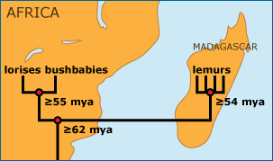
Madagascar’s lemurs are thought to be descended from a small number of primates — possibly a single pregnant female — that rafted to the island from mainland Africa about 60 million years ago.
Notes:
Madagascar’s lemurs are thought to be descended from a small number of primates — possibly a single pregnant female — that rafted to the island from mainland Africa during a tropical storm about 60 million years ago.

Slide 14
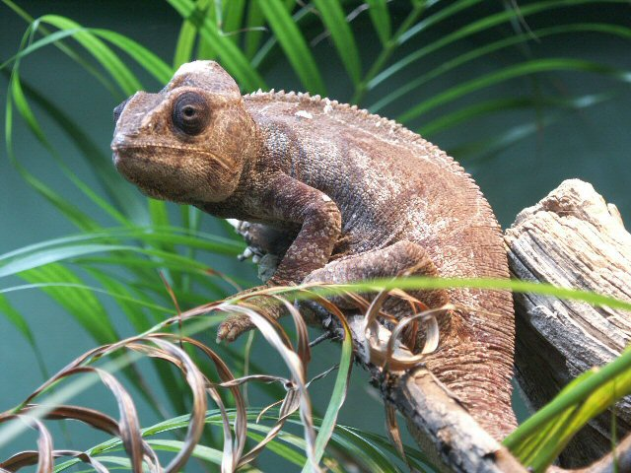
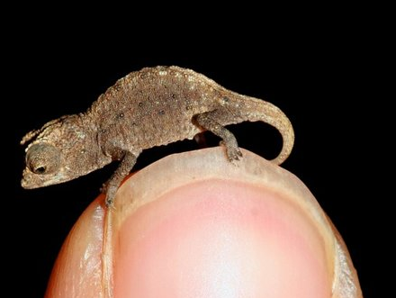

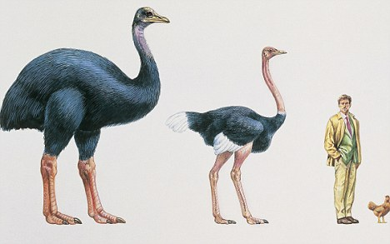
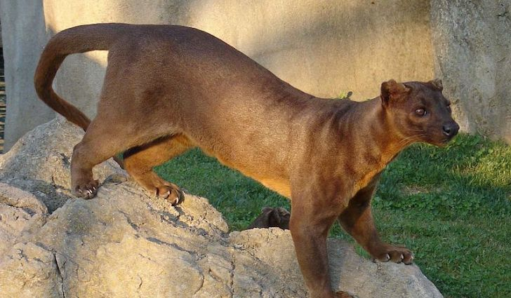
Notes:
The extinct elephant bird of Madagascar. Madagascar has 59 species of chameleon, half of all in the world. The fossa, a carnivore that fills the niche of a mongoose in Madagascar.

Slide 15
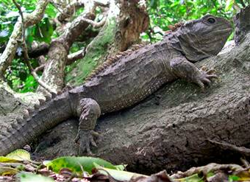
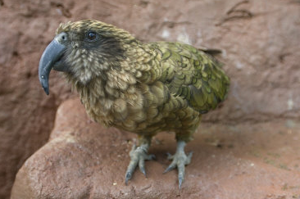
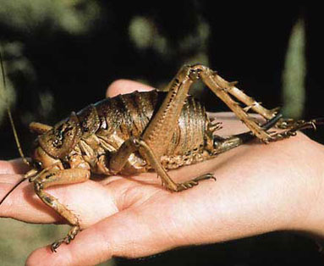
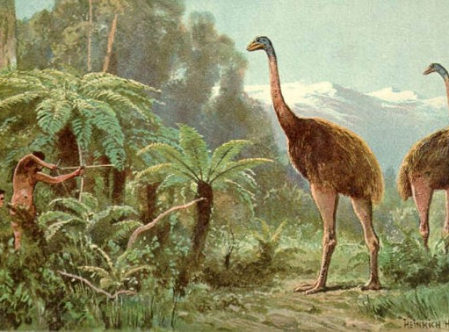
Notes:
Evolutionary diversification on the islands of New Zealand, which has occurred in the almost complete absence of mammals,. As a result, the fauna of pre-human New Zealand was unlike that of anywhere else and included a radiation of moas (flightless browsing birds up to 3 m in height); a carrion-eating parrot (kea); giant orthopterans, a weta, and a unique reptile called a tuataras

Slide 16
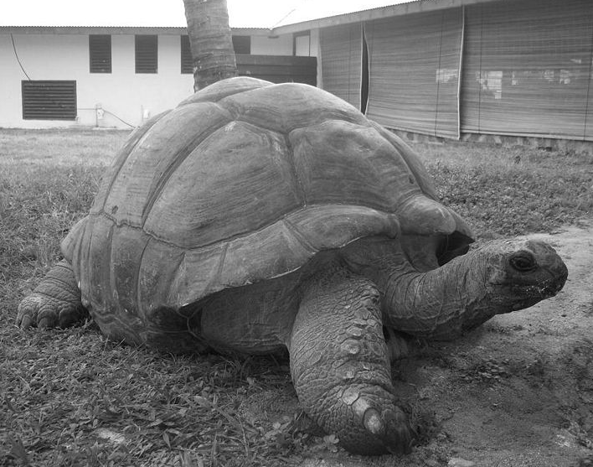
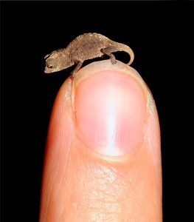
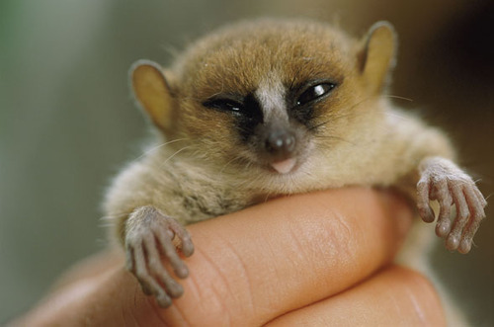
Similar evolutionary outcomes on isolated islands
Loss of defenses (large predators are uncommon on small islands)
Larger body sizes
Dwarfism
Notes:
Large tortoises are among the longest-lived animals on the planet. Some individual Aldabra Giant Tortoises are thought to be over 200 years of age, but this is difficult to verify because they tend to outlive their human observers. Adwaita was reputedly one of four brought by British seamen from the Seychelles Islands that eventually came to reside in the Calcutta Zoo in 1875. At its death in March 2006 at the Kolkata (formerly Calcutta) Zoo in India, Adwaita is reputed to have reached the longest ever measured life-span of 255 years (birth year 1750). The age of Adwaita was determined by carbon dating his shell, making his age to be around 255 in 2006. Prior to human colonisation of the Western Indian Ocean giant tortoises occurred on almost all islands in the region. Shortly after colonisation most of these populations were driven to extinction by over-exploitation.
http://www.pbs.org/wgbh/nova/evolution/gigantism-and-dwarfism-islands.html

Slide 17
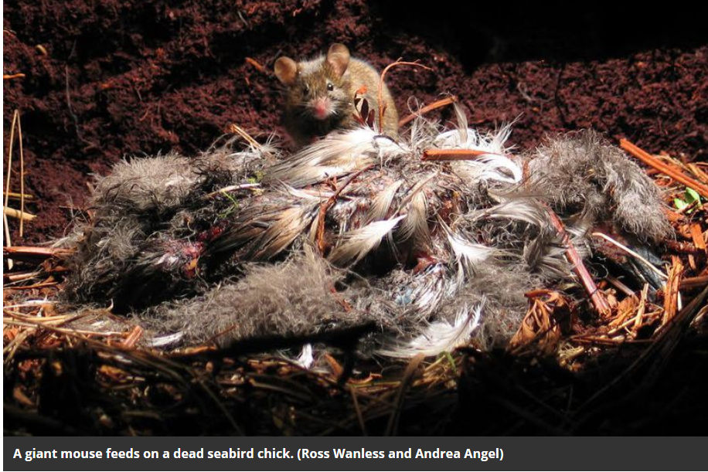
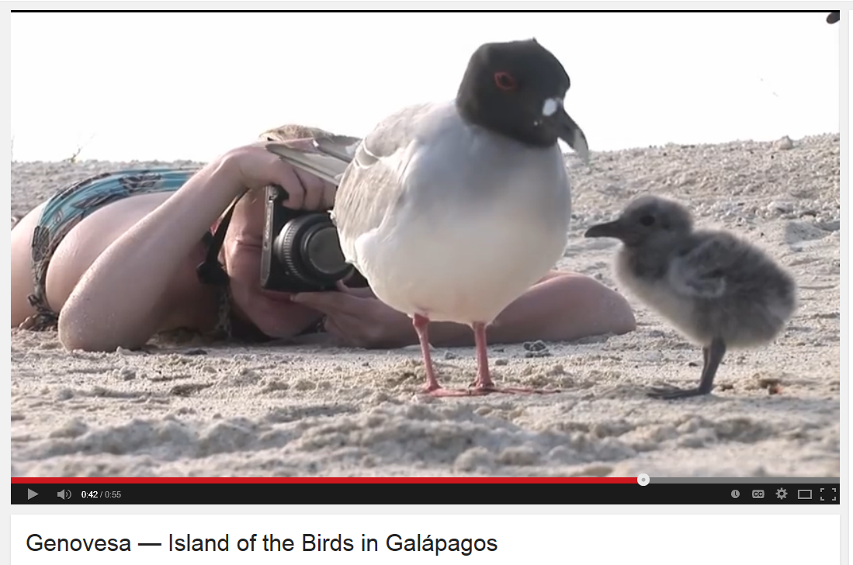
Island biota are very extinction-prone
Differential dispersal – islands do not represent a balanced subset of the species on mainlands.
Arrival of new biota can have strong influence on island organisms
Naïve behaviors of animals on islands make them easy prey
Rats and cats have been responsible for many island extinctions
Arrival of humans to the Pacific islands caused massive die-off of nearly 1,000 flightless bird species
Notes:
When isolated from predators, costly and no longer functional anti-predator behavior should be selected against. Predator naiveté is often pronounced on islands, where species are found with few or no predators.
Some animals on islands have only recently been exposed to humans. The remote islands of the eastern Pacific were the last habitable region on Earth to be colonized by humans. People had moved east into the Pacific as far as the islands of Samoa and Tonga (including settlement of the islands of Vanuatu, New Caledonia, Fiji, and the Marianas) by ~3,500 y ago and then colonized the more remote islands, including Hawaii, New Zealand, and Rapa Nui, only 900 -700 y ago during a phase of rapid expansion.
http://articles.latimes.com/1988-10-09/news/mn-5403_1_galapagos-islands
http://rspb.royalsocietypublishing.org/content/272/1573/1663
http://www.pnas.org/content/110/16/6436.full.pdf+html

Slide 18
Biotic exchanges
Set up and controlled by plate tectonics and climate change
These are major dispersal events that reshape continental fauna
They altered evolutionary trajectories and shape the biodiversity we see today
  Great American Biotic Interchange
  Trans-Beringian Biotic Interchange
However, humans have also contributed to a massive global biotic exchanges. The Columbian Exchange (plate tectonics involved only in that it constrained where Europeans travelled to first

Slide 19
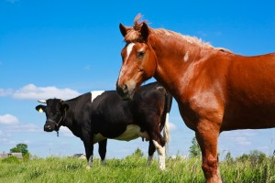
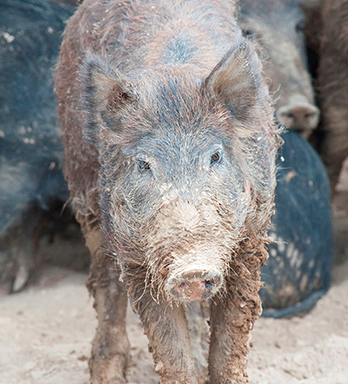
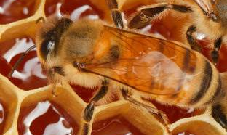
Columbian Exchange
Horses and cattle were introduced in NA by Europeans
Pigs introduced during Columbian Exchange have become feral and destructive in many locations, including North America
European honey bee introduced to North America when bees arrived from England in Virginia in 1622. They were known as “white man’s flies” by Native Americans
Notes:
Global dispersal of plants and animal via humans commencing with European global exploration
Domestic pigs from Europe became feral in many parts of the world and led to decreases in plant diversity where their numbers have increased rapidly. Horses and cattle have had a similarly strong impact on biogeography through their grazing and trampling effects.

Slide 20
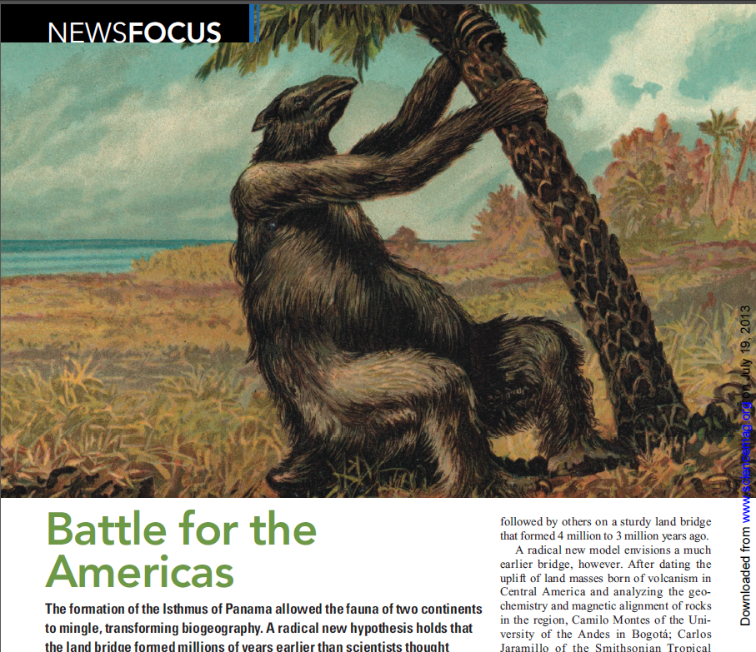
Great American Biotic Interchange
2.5 – 3.7 million years ago a land bridge connecting North America and South America along the spine of Central America formed through plate tectonics. Continents were separated for 30 million years prior
Often referred to as the Panamanian land bridge or the Mesoamerican Biological Corridor

Slide 21
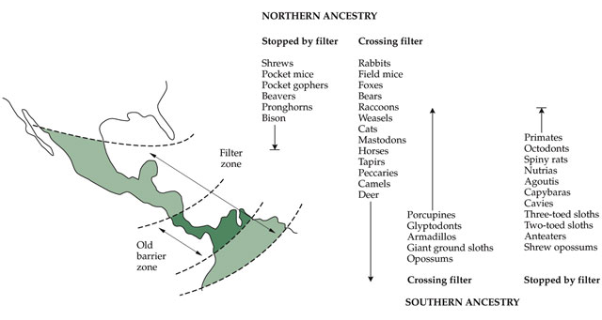

Slide 22
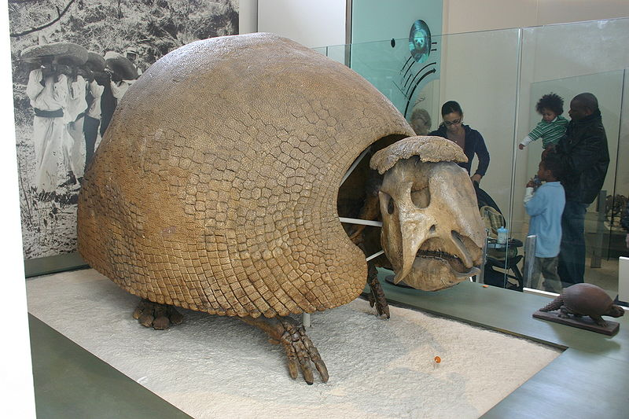
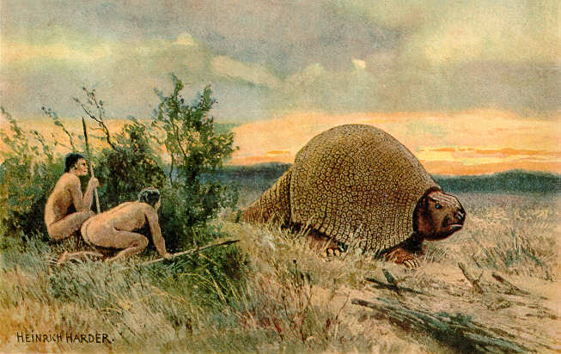
Notes:
A Glyptodon, one of the successful immigrants from South America. It went extinct shortly after the arrival of humans into North America during the last glaciation.

Slide 23
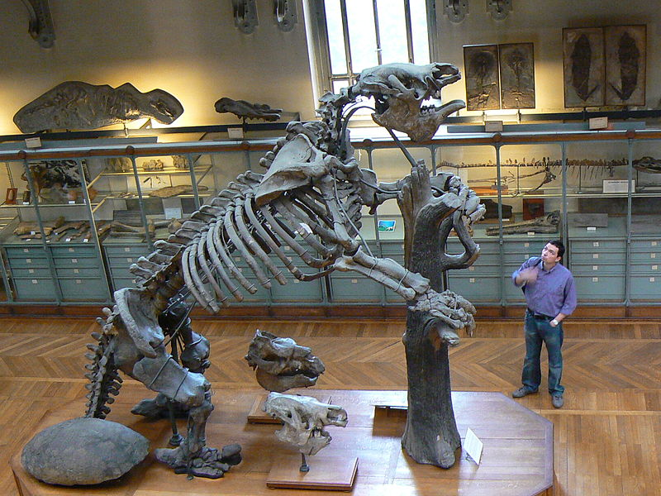
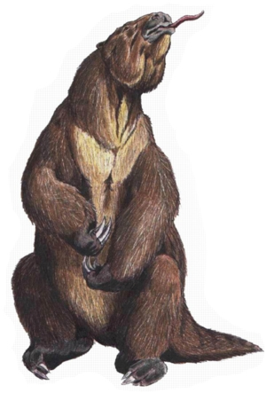
Notes:
Megatherium, a giant sloth, another successful immigrant from South America. It too eventually went extinct from human hunting in the Pleistocene

Slide 24
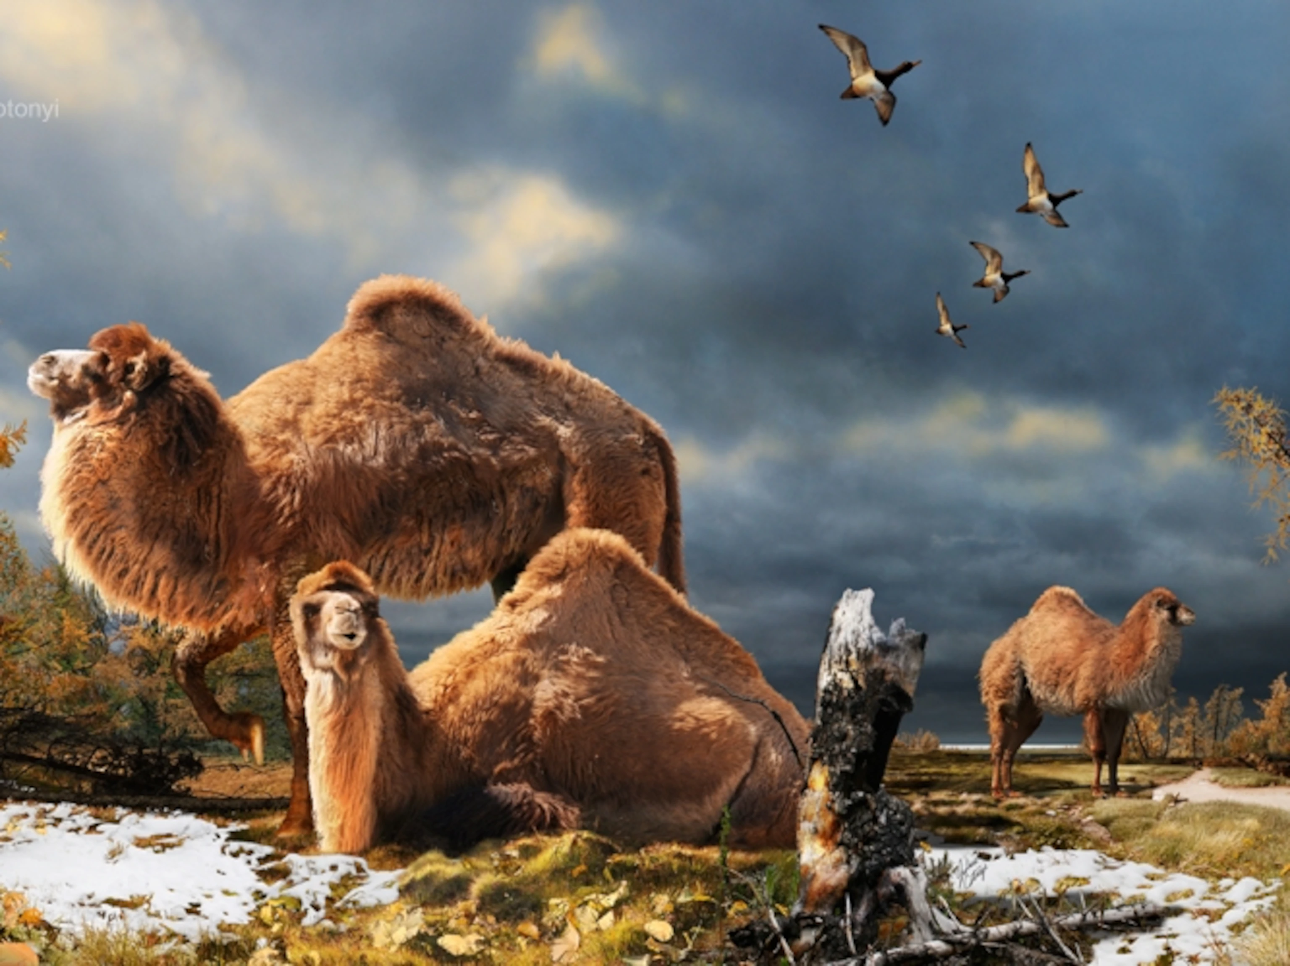
Asymmetries of GABI
NA invasion of SA was overall more successful.
South America had more extinctions due to influx of North American species
But many of these arriving North American genera underwent adaptive radiations in SA
Half of living South American genera today are descendants of northern immigrants.
Little diversification of SA immigrants that entered North America
Notes:
The North American camel ranged all the way up into the arctic.

Slide 25
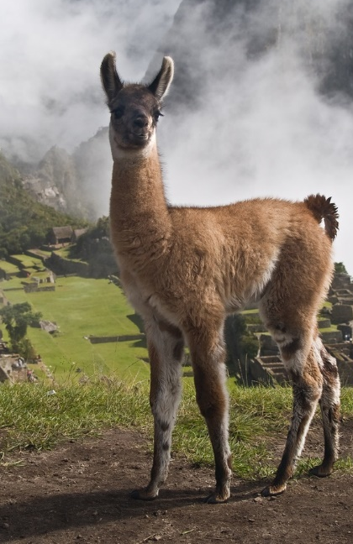
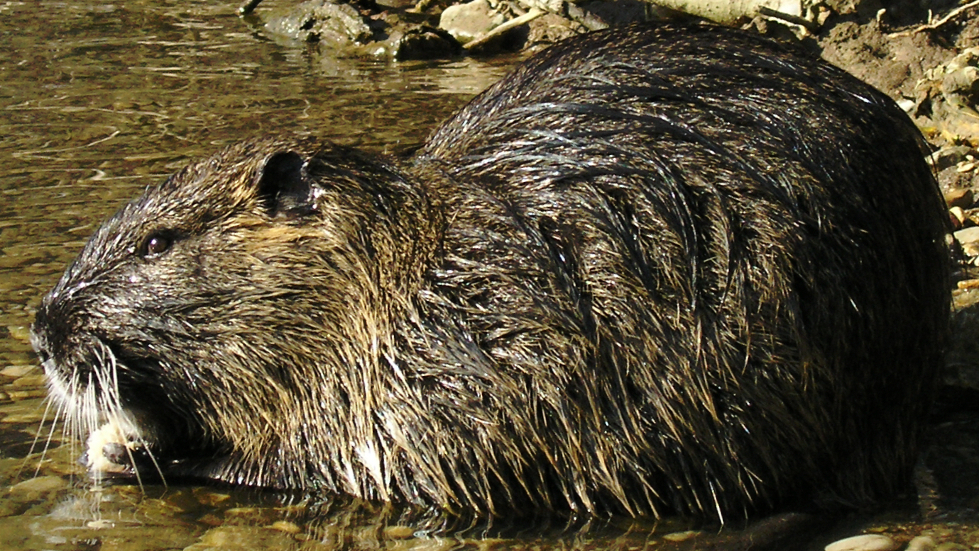
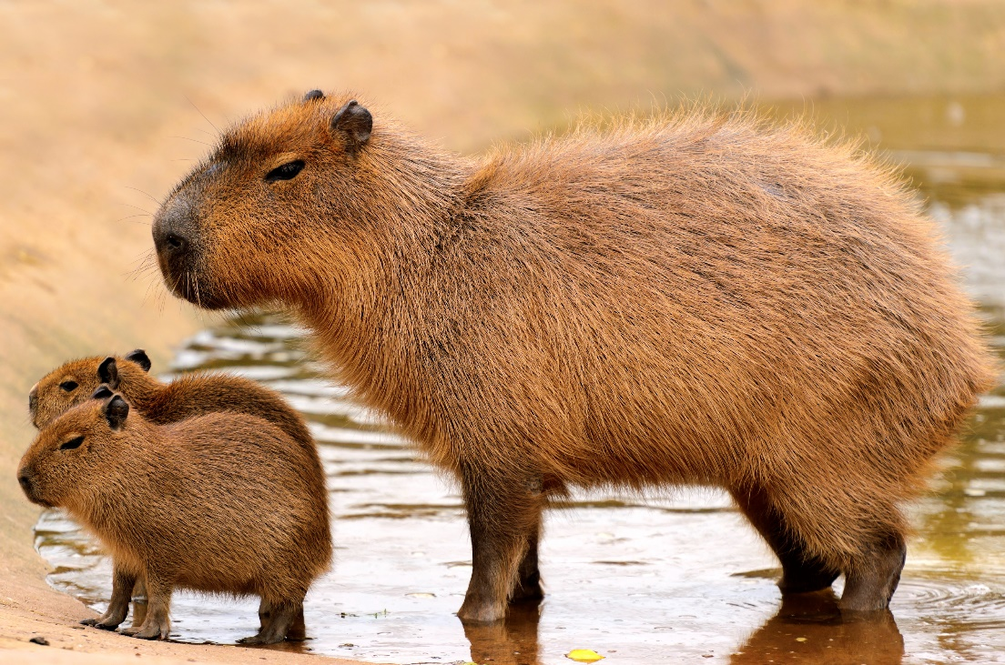
SA adaptive radiations of immigrants from NA
Camels from NA radiated to became vicunas, guanacos, alpacas and llamas
Muridae, a family of rodents from North America evolved explosively in South America, to become the capybara, the agouti, the coypu (nutria), the cavy (guinea pig) and the chinchilla
Notes:
http://www.pbs.org/wnet/nature/andes-the-dragons-back-land-bridge/1790/
Capybaras have escaped into Florida and may become invasive. Nutria are semi-aquatic rodents native to southern parts of South America. In the 1930s, they were sold throughout North America to fur farmers and as a means of controlling unwanted aquatic vegetation but have since escaped and become invasive

Slide 26
The World Continent Hypothesis as explanation for extinctions in SA
Many North American land mammals that immigrated to SA had evolved from forms that dispersed from Eurasia through the Trans-Beringian biotic exchange.
These cosmopolitan taxa were in more frequent competition with other species, that results in ‘arms races’ between predator and prey
South America was more of an island continent compared to NA
SA had fewer predators and there was a loss of defense

Slide 27
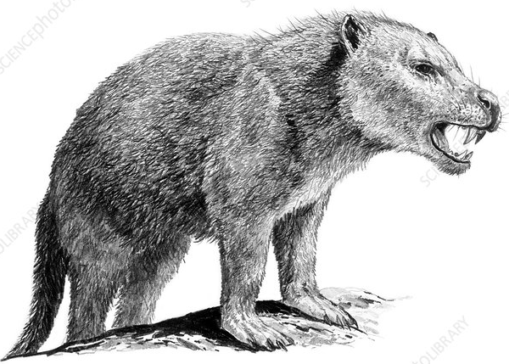
Only carnivores were the borhyaenoids of SA, a group of carnivorous marsupials (now extinct)
This led to more extinctions in SA
But this also set the stage for the successful adaptive radiation of NA immigrants in SA
Example: 6 species of wild cats in NA, 12 in SA.

Slide 28
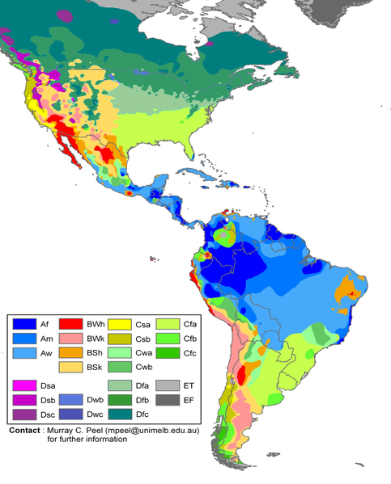
Xeric climate barrier in North America
North moving immigrants from SA met with deserts in northern Mexico
These limited immigration into NA
While in the reverse direction, NA mammals encountered wetter conditions

Slide 29
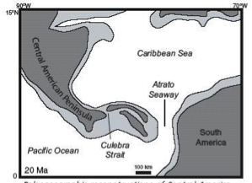
The GABI was not a simple drop of the drawbridge
Several distinct migrational pulses between Americas going back to 23-20 million years ago
Nature of interchange depends not only on the separation between habitats, but on dispersal properties of plants and animals.

Slide 30
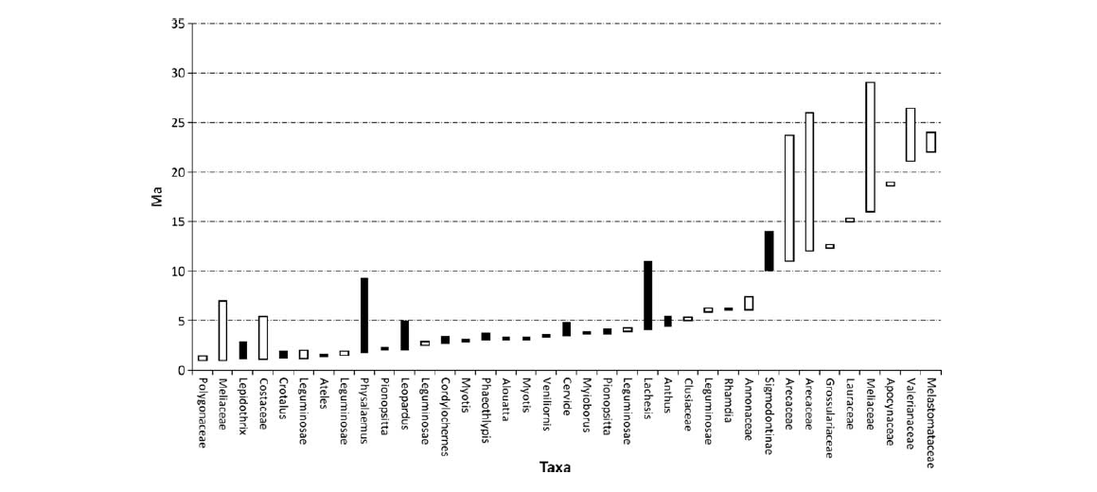
Wider range of arrival times of immigrants going from SA to NA
Arrival time of plants and animals into North America from South America. Note the
earlier time for some plants, those that were able to disperse across the ocean before
the isthmus became completely above sea level. A few animal families arrived early too because of their dispersal abilities
Notes:
Arrival of plant and animal families in North America during Great Interchange
Based on geological evidence, the land bridge may have been largely formed as early as 15 million years ago, with the last deep-water connection between the oceans closing at most 5 million years later.
Polygonaceae – weedy plants
Meliaceae – trees and shrubs, mahogonies
Lepidoptherix – birds
Costaceae – plants (bananas)
Lachesis is a genus of venomous pit vipers found in forested areas of Central and South America

Slide 31
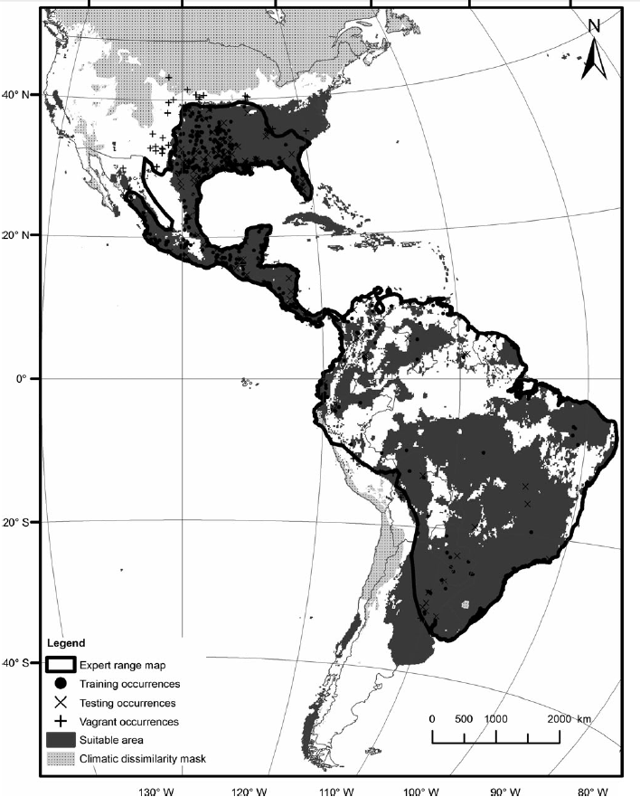
Notes:
This is the distribution for what successful SA invader of NA?

Slide 32
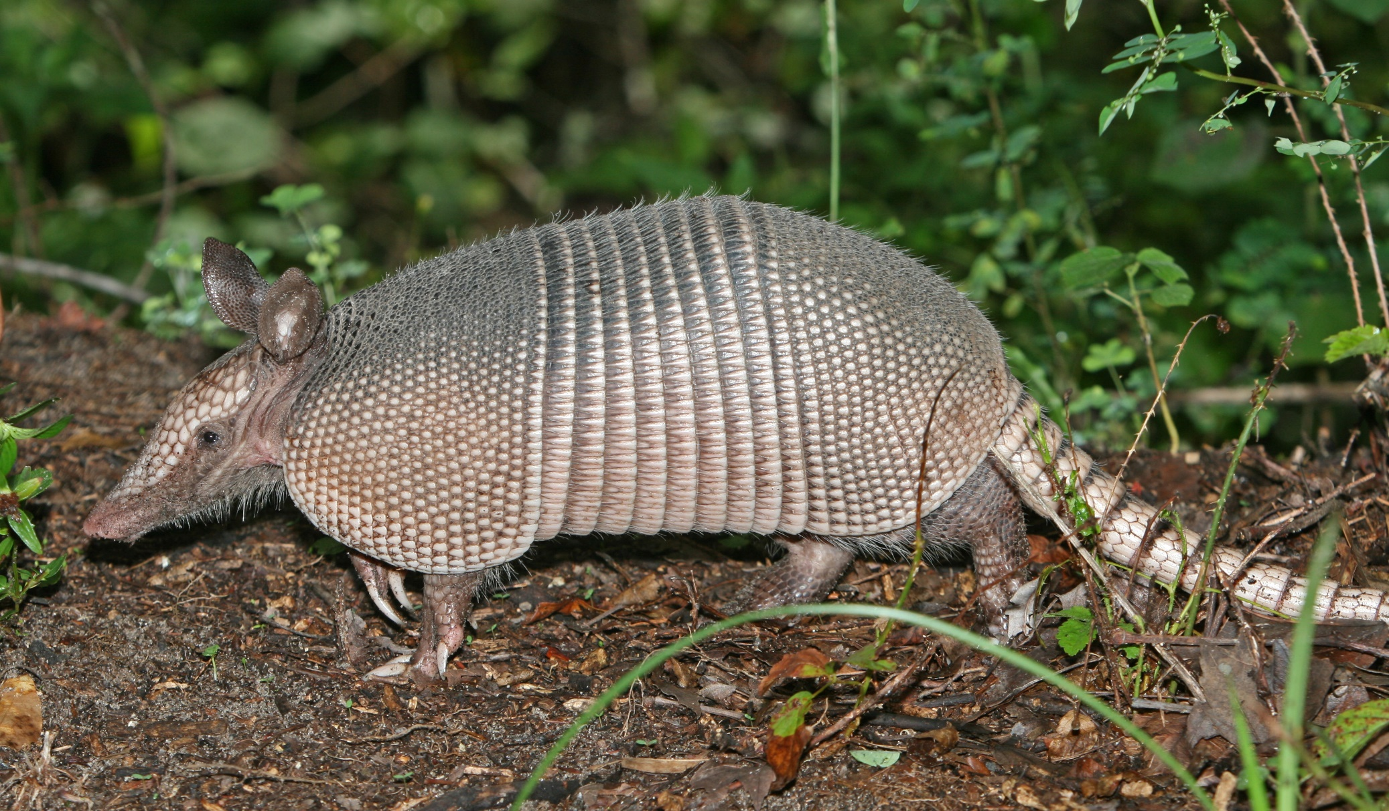
The armadillo is SA in origin and eventually became established in both North and South America. It has been slowly migrating northward.
Notes:
Nine-banded armadillo

Slide 33
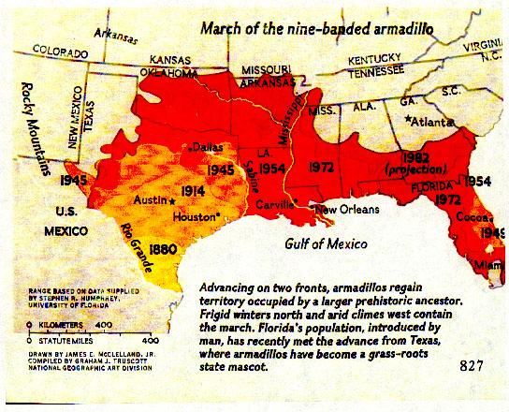
Notes:
The armadillo has been moving northward since it arrived in Texas in the 1880s and Florida in the 1920s

Slide 34
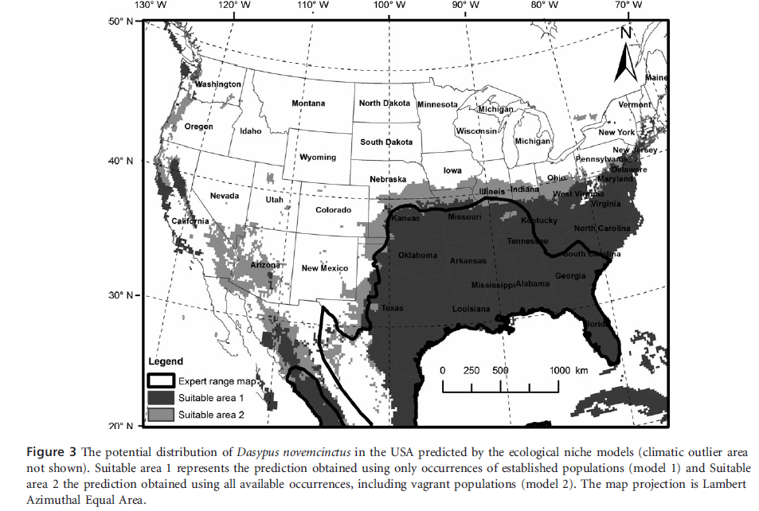

Slide 35
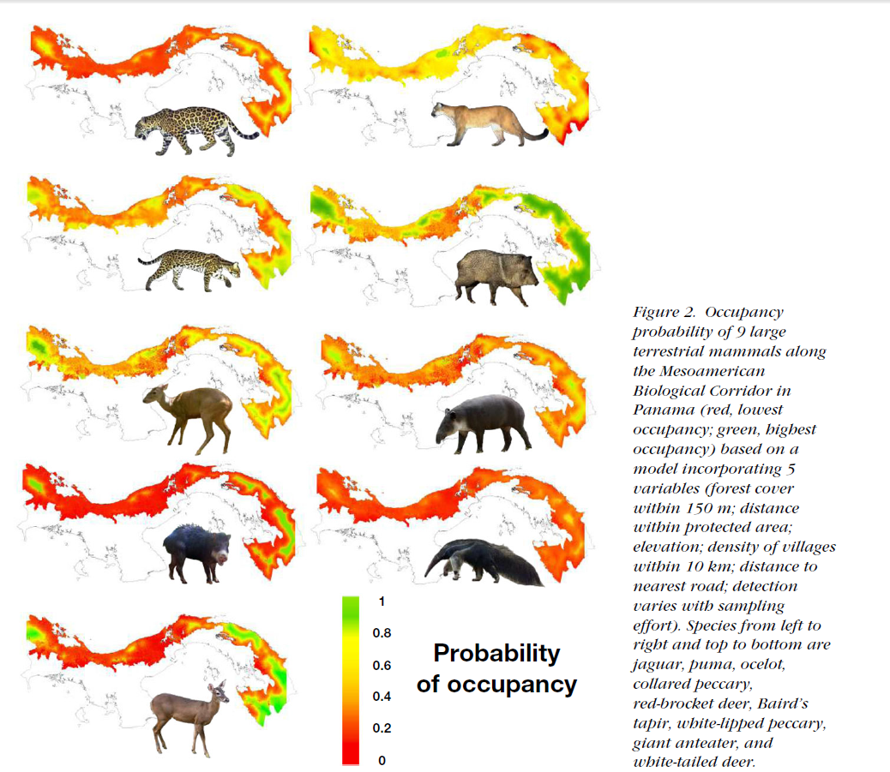
Notes:
Mesoamerican Biological Corridor is no longer an efficient land bridge
Puma (Puma concolor), red brocket deer (Mazama temama), ocelot (Leopardus pardalis), and collared peccary (Pecari tajacu), which are more adaptable, had higher occupancy, even in areas with low forest cover near infrastructure. However, the majority of species were subject to gaps that was larger than their known dispersal distances, suggesting poor connectivity along the Mesoamerican Biological Corridor in Panama. Based on our results, forests in Darien, Donoso–Santa Fe, and La Amistad International Park are critical for survival of large terrestrial mammals in Panama.
Fragmentation of habitat no longer allows as many mammals to move between locations north and south of Panama.

Slide 36
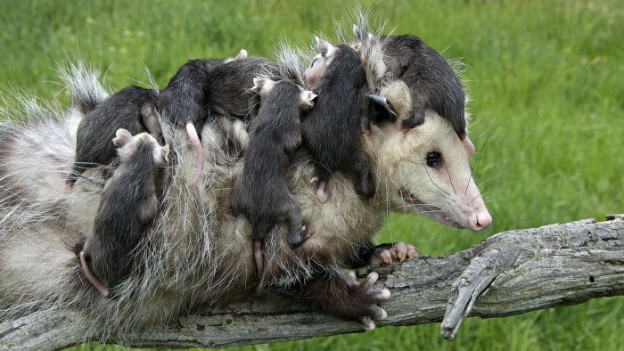
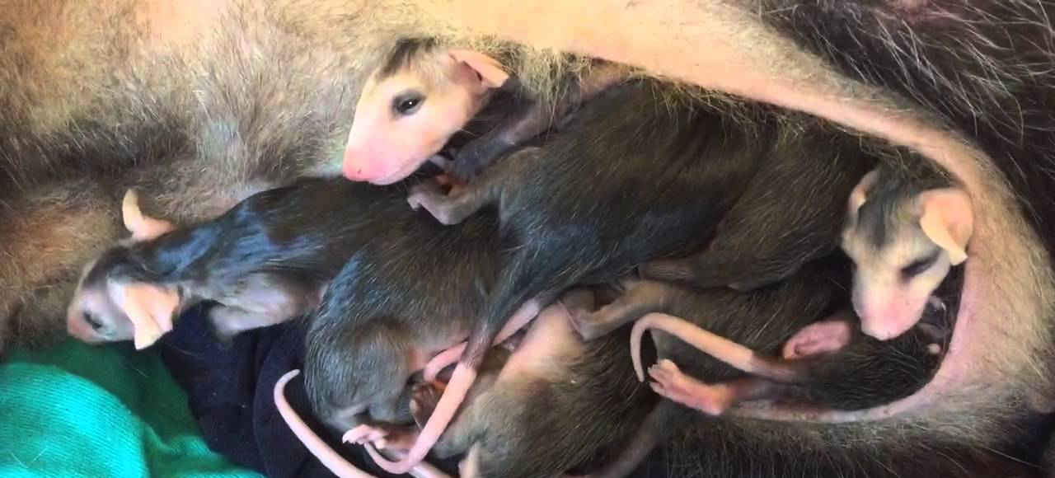

Placental vs marsupial mammals
Marsupials first evolved in North America during Cretaceous (100 mya)
Europe, Asia, North Africa colonized (but eventually went extinct)
Dispersed through the landmass comprising S America, Australia, Antarctica
Marsupials underwent adaptive radiation in Australia as it became isolated due to plate tectonics

Slide 37


Placentals outcompeted and replace all marsupials in NA
Many SA marsupials outcompeted by NA placentals during GABI
Three way tie:
  Placentals won in NA,
  Marsupials and placentals tied in SA
  Marsupials won in Australia
335 marsupial species today
70% in Australia-New Guinea, the remaining species are in Central and South America, but only one in North America, north of Mexico.
Opossum dispersed back into N. America during GABI

Slide 38


Didelphis absent from N America until the late Pleistocene approx 1 mya.
Didelphis was the last mammalian genus to arrive in North America, and is only one of three genera (along with armadillo, Dasypus and porcupine, Erethizon) that arrived from SA during GABI still found in NA
First records of Didelphis virginiana come from central-southeastern fauna in Florida, approximately 600,000 years ago.
Didelphis virginiana evolved from Central American species earlier in the Pleistocene and dispersed to temperate North America due to their ability to live in colder climates
Notes:
Didelphis marsupialis

Slide 39



Slide 40

Trans-Beringian Exchange

Slide 41


Bison
Red indicates the species is extinct, green extant, alive today
Parabos (9 mya, Europe)
Proleptobos (4 mya, China) – ancestor of Bos (cattle) and Bison
Bos (cattle) and Bison split (2 mya)
The Old World genus Bison disperses throughout Asia and Europe
Old World Bison population splits into two species, Bison schoetensacki (woodland bison) and Bison priscus (steppe bison)
European bison, Bison bonansus evolves from Bison priscus
Bison priscus
Woodland bison (Bison bonansus) in the Białowieża Forest, Poland 1955
Notes:
Red indicates extinct, green extant, alive today

Slide 42

Notes:
Bison priscus remains uncovered in 1979 by a miner in Alaska, discolored blue by copper deposits and named Blue Babe, now in a museum in Fairbanks. The miner ate part of his discovery.

Slide 43

Bison priscus disperses into Beringia, Alaska and Canada; ice prevents it from dispersing further south (380,000 - 200,000 ya)
Ice corridor opens during this interval and two waves of Bison priscus dispersal deeper into North America. Bison priscus evolves into Bison latifrons and Bison bison
These bison disperse back into Asia and interbreed with Bison priscus
Bison latrifons goes extinct either due to competition from Bison bison or through genetic swamping

Slide 44

Beringia ice free corridor closes (20,000 ya)
Two subspecies evolved from Bison bison: Bison bison antiquus and Bison bison occidentalis
The Plains bison, Bison bison bison and the wood bison, Bison bison athabascae (4,000 - 5,000) evolved from Bison bison antiquus

Slide 45

Pleistocene and Holocene glacial-interglacial oscillations
Notes:
45

Slide 46
Pleistocene glacial-interglacial climate change
Shaped the Trans-Beringian Exchange
Helped shape refugia that could colonize formerly ice-covered habitats
Created phylogeographic discontinuities visible today
Modified species richness through extinction when species could not adapt to changing climate
Notes:
During the Quaternary period (roughly 1.8 million years ago to the present), glacial-interglacial climatic variations occurred as a result of changes in controlling factors such as Earth’s orbital parameters, continental ice sheets, sea-surface temperature, and atmospheric CO2 concentration. Abrupt climatic events at much shorter time scales have also occurred, some of which have pronounced magnitudes and rates (e.g., temperature shifts of up to ~10°C within a few decades during the last glacial-interglacial transition in some areas). Networks of fossil pollen and plant macrofossils show that in response to these climatic fluctuations, the biosphere has experienced dramatic changes, with large-scale species’ range shifts, population contractions and extinctions, as well as aggregation and disassociation of forest communities.

Slide 47

Refugia
A location of an isolated or relict population of a once more widespread species often due to climate oscillations
These refugia can repopulate adjacent habitats when they become hospitable

Slide 48

Refugia
Notes:
Peripheral glacial refugia are organisms contained with unglaciated patches that are still above the lowland arms of the glacier.

Slide 49

Current distribution of North American mountain goats (Oreamnos americanus)
Notes:
Map of sample localities for North American mountain goats (Oreamnos americanus) across their native range. Mountain ranges are delimitated by polygons

Slide 50

Refugia based on genetically distinct clusters
Notes:
Locations of 17 genetic clusters of mountain goats Two major groups, Southern (triangles) and northern (circles),

Slide 51

Phylogeographic discontinuities
Coastal refugia dispersed northward after glaciation in North America and became separated by geographic barriers that resulted in allopatry and natural selection

Slide 52

Freshwater fish species
Notes:
Depauparate in fish species from glaciations in North America, Asia, and Europe.
The taxonomic richness of seed plants at different taxonomic levels was compared between temperate East Asia and North America at both continental and semi-continental scales. In each comparison, land area and latitude range were adjusted to a comparable level between the two continental regions. East Asia is significantly more diverse than North America. In general, differences in taxonomic diversity arise at and below the genus level. At the continental scale, East Asia has 1.3 and 1.5 times as many genera and species, respectively, as North America.

Slide 53

Depauperate North American flora and fauna due to glaciation

Slide 54

Notes:
Canadian Shield, Eastern Canada
Because of the repeated Pleistocene glaciations, the vegetation and present flora of the Canadian provinces, like that of the Arctic Province, are very recent, composed largely of immigrant elements from unglaciated territories to the south and west and from such ice-free refugia that might have offered asylum. Thus these formerly glaciated areas have low biodiversity, particularly when compared to Asia, where Pleistocene glaciation was not as extensive

Slide 55

Impact of Pleistocene glaciation on plant biodiversity

Slide 56

Notes:
The numbers at the bottom are types of plants.
1 Gymnosperms,
2 Magnoliids,
3 Alismatids
4 Liliidae
5 Arecidae
6 Commelinidae
7 Ranunculids
8 Caryophyllidae,
9 5 Rosaceae
10 Lamiidae
11 Euasterids

Slide 57

Notes:
www.pnas.org/cgi/doi/10.1073/pnas.1703985114
Numbers for colors and on the Y axis represent depth of time over which evolutionary processes have played out. East Asia has a deeper evolutionary history given the less pervasive impacts of Pleistocene glaciation on climate.

Slide 58

Effect of Pleistocene glacial and interglacial oscillations on biodiversity of US Gulf-Coastal Plain
Notes:
Climate relicts can increase local species richness.

Slide 59


Notes:
Ravines of north Florida along the Apalachicola River

Slide 60


Torreya taxifolia, a paleoendemic species
Notes:
Florida torreya (Torreya taxifolia) is a paleoendemic species. It was once widespread during cooler glacial climates but is now restricted in distribution to the cool ravines along the Apalachicola River in Florida. It is effectively isolated in these ravines, with little chance of dispersing north on its won. Climate relicts like Torreya taxifolia have limited opportunities for migrating to alternative favorable sites as climate warms.

Slide 61


Slide 62




Notes:
Center of origin for Florida neoendemics

Slide 63


Neoendemics of the Lake Wales Ridge, Florida
Florida scrub jay
Isolation of plant species on higher ground in Florida during > 2 million years of climate oscillations
Speciation events have led to unique flora and fauna
Florida scrub hickory
Notes:
The Florida scrub jay is only one of 15 birds endemic to the US mainland, and the only one endemic to Florida

Slide 64
Classification of dispersal
Categories of dispersal
  Long range (“sweepstakes” or “waif”) dispersal
  Active – via own mode of locomotion
  Passive – requires outside force; wind, water, or another organisms
  Diffusion – continuous distribution during dispersal
  Step or jump dispersal
  Conservation dispersals

Slide 65



  Long range (“sweepstakes” or “waif”) dispersal
Notes:
How did it get there? A single dispersal by a bird from northwestern North America to southernmost South America, taking place in the Mid-Pleistocene, is sufficient to explain the disjunction in crowberries.

Slide 66

Active dispersal
Notes:
Much of dispersal today involves humans indirectly or directly

Slide 67

Otis, the coyote in Central Park in 1999.

Slide 68

Coyote on public train in Portland, Oregon 2002
Notes:
http://www.kptv.com/story/27895419/coyotes-ride-on-max-train-re-created-in-new-modest-mouse-music-video
https://www.youtube.com/watch?v=vI1o39Oxh-w

Slide 69

The capture of Hal the coyote in 2006 in Central Park

Slide 70

Feb 2010 Central Park, NYC

Slide 71


2015, NYC

Slide 72

Passive dispersal
Notes:
When the magnitude 9 Tohoku earthquake and subsequent tsunami struck the east coast of Japan in March 2011, vast numbers of objects, from docks and fishing vessels to plastic fragments, were swept out to sea. 300 different species from 16 phyla were carried out to sea on human-made objects, rafting from the coast of Japan across the Pacific to the west coast of North America. Rafting, or the transport of organisms across water on natural debris such as trees or kelp, is thought to have contributed to the colonization of islands and the exchange of life between continents. More recently, rafting on human artifacts, such as large plastic items, has been growing in importance; these items survive longer at sea than their natural counterparts and can therefore carry their cargo further. The scale and spatial extent of the rafting event associated with the 2011 tsunami are, however, unprecedented. Numerous species not previously been recorded on the shores of western North America arrived in large numbers in just a few years. The combination of a natural pulse perturbation—the earthquake and tsunami—with dense human coastal infrastructure resulted in the largest known rafting event in Earth’s history.

Slide 73

Conservation dispersals
Notes:
https://www.youtube.com/watch?v=wJnjCgEFzTQ&ab_channel=ghostsofevolution
https://www.youtube.com/watch?v=3YYHoCYewao&ab_channel=ghostsofevolution

Slide 74

Disturbance
Historic frequency and severity of fires, floods, hurricanes, ice storms, hard freezes shape biogeographic distributions of plants and animals in the present.

Slide 75

Historic human impacts
Can exert an influence on biogeographic patterns long after the human activity has ceased or altered.
Logging in the Smoky Mountains
Notes:
Logging in the Smoky Mountains

Slide 76

Notes:
Sawmill on Bush Creek, Breathitt County, 1920s

Slide 77

Notes:
Log raft on the shore of the Middle Fork of the Kentucky River at Buckhorn, KY, 1920s

Slide 78

Land use change in NE US
Notes:
This graph from the 2005 Harvard Forest "Wildlands and Woodlands" report shows New England population steadily increasing, while forest cover in all six states fell to a low point in the second half of the nineteenth century. After recovering for about a century, most states have entered a fresh stage of forest decline in recent decades.
As noted by Thoreau 1854, no deer had been seen for 80 years in central Massachusetts.

Slide 79


Slide 80


Slide 81


Slide 82

Pleistocene megafaunal extinctions in North America (10,000 to 12,000 ya)
Rapid extinctions coinciding with migration of humans into North America
Naïve fauna, keystone herbivores overhunted
Dire wolf, American lion lost in extinction cascade after their large herbivorous prey hunted out
70% of megafauna became extinct in North America. Far fewer extinctions in Africa
Notes:
The large-bodied mammal extinctions occurred between 10-12,000 years ago in North and South America, with 73 and 80%, respectively, of megafauna becoming extinct.
Africa, on the other hand, which is the site of human evolution and dispersal, experienced only a 14% extinction of megafauna within the last 100,000 years.
This sequence of extinction follows the spread of people from Africa into Australia, Eurasia, and North and South America.
Extinctions were fewer in Africa because megafauna evolved in tandem with the evolution of humans. There were no humans in other parts of the world, and when humans migrated there, megafauna were naïve – they had no experience or wariness associated with humans and were easily hunted to extinction.

Slide 83


Slide 84

Giant sloth dung

Slide 85




Notes:
Evidence for Pleistocene extinctions
Sporormiella – fungus, its spores are common in the feces of large mammals. One can examine the amount of Sporormiella in sediment deposits to infer the relative biomass of large mammals.
No-analog mixed woodlands – new combinations of plants brought on by the increased burning of the landscape by the Pre-Clovis and Clovis peoples. The loss of the large herbivorous animals also changed the vegetation

Slide 86

80% of megafauna went extinct with arrival of humans in Central and South America.
Notes:
Extinct giant sloth

Slide 87
Questioning North American overkill scenarios
Dearth of direct archaeological evidence of Clovis-period humans killing or scavenging extinct genera.
For what evidence there is, only five genera (mammoth, mastodon, gomphothere, horse, and camel) were prey out of the 38 that went extinct.
Humans arrived earlier than Clovis period. Despite longer overlap between people and megafauna, there are no pre-Clovis age kill−scavenging sites
There are abundant kill−scavenging sites for extant large herbivores (bison, elk, moose, and deer): where we have abundant archaeological evidence of large mammal hunting in the Late Pleistocene, it is of genera that survived
Transition from glacial to interglacial climate and vegetation change may have been more of a factor.

Slide 88

Notes:
Bison were hunted starting in Clovis times, and, among the many hundreds of bison kill sites known from the subsequent ∼12,000 y, are sites where hundreds, and, in some sites, thousands , of these animals were slain. That long record of Indigenous hunting was capped by the slaughter of millions of
bison by late 19th century Euro-American commercial hide hunters. Yet, bison survive today, even after millennia of intensive human predation.

Slide 89

Pleistocene megafaunal extinctions in Australia (40,000 years ago)
Human hunting implicated: timed with arrival of Aboriginals
Notes:
Occurred much earlier here, as humans arrived here 50,000 – 60,000 years ago

Slide 90


Protemnodon, an extinct kangaroo, 2 meters tall and 300 lbs
Thylacoleo, an extinct Pleistocene marsupial lion
Notes:
Protemnodon survived in Tasmania until the arrival of humans. The other kangaroo is also a species of Protemnodon. It formerly lived in the mountains of New Guinea, the island just north of Australia

Slide 91


Notes:
Miller, G. H., Fogel, M. L., Magee, J. W., Gagan, M. K., Clarke, S. J., & Johnson, B. J. (2005). Ecosystem collapse in Pleistocene Australia and a human role in megafaunal extinction. science, 309(5732), 287-290.

Slide 92


Plio-Pliestocene megaherbivore decline in Africa (5 mya)
Notes:
Faith, J. T., Rowan, J., Du, A., & Koch, P. L. (2018). Plio-Pleistocene decline of African megaherbivores: No evidence for ancient hominin impacts. Science, 362(6417), 938-941.
The difference between browsing (C3) versus grazing (C4)
Some megaherbivores, like elephants, prefer or rely on C3 vegetation, especially trees and shrubs, for their diet.
C3 plants: Generally, they are more digestible for herbivores due to their lower fiber content. C4 plants: They tend to have higher fiber content, which can make them less digestible for some herbivores.
C3 plants more nutritious
Seasonal migrations were likely altered by the appearance of extensive grasslands.

Slide 93

Notes:
Expansion of C4 grasses was also tied to the evolution of modern humans. With the decline of dense forest and C3 vegetation, our ape-like ancestors were forced to descend from the trees. The new challenges presented by these wide open spaces forced our ancestors to develop new flexible diets, large brains and complex social structures.

Slide 94

Notes:
There was a steady, long-term decline of megaherbivores beginning ~4.6 million years ago, long before the appearance of hominin species capable of exerting top-down control of large mammal communities and predating evidence for hominin interactions with megaherbivore prey. Expansion of C4 grasslands can account for the loss of megaherbivore diversity.
There is a perception that Africa’s exceptional large herbivore diversity is due to the continent being spared the extinctions that occurred elsewhere as modern humans (Homo sapiens) dispersed across the world in the past 100,000 years. This anomaly has been thought to reflect coevolution of hominin hunters and their prey or perhaps a long history of extinctions precipitated by pre-modern hominins in Africa. Indeed, for decades it has been suggested that hominins drove extinctions and shifts in the functional structure of large mammal communities throughout the Pleistocene. Many of these hypotheses posit that top-down control of mammal communities by tool-bearing, meat-eating hominins contributed to the demise of large-bodied herbivores long before the emergence of Homo sapiens
Decline in fossil assemblages is likely related to the Plio-Pleistocene expansion of C4 grasslands due to larger scale climate change, which reduced the reduced the availability of C3 forage (trees, shrubs, herbs) on the landscape.
The antiquity of the megaherbivore decline effectively eliminates top-down hominin impacts as a plausible mechanism for setting it in motion, as it would have had to involve smallbodied
australopiths or pre-australopiths (e.g., Australopithecus, Ardipithecus), which were functionally equivalent to bipedal apes. Like extant chimpanzees, these hominin taxa may have
preyed upon vertebrate species smaller than themselves, but they almost certainly did not hunt megaherbivore prey

Slide 95


Plio-Pliestocene carnivore decline in Africa (5 mya)
Notes:
More evidence suggests that carnivores may have decline more in tandem with brain capacity evolution in humans, along with reductions in forest cover as grasslands expanded.
Faurby, S., Silvestro, D., Werdelin, L., & Antonelli, A. (2020). Brain expansion in early hominins predicts carnivore extinctions in East Africa. Ecology Letters, 23(3), 537-544.

