Slide 1

Internal controls of biogeographic patterns
Photosynthetic pathways
Natural selection
Phenotypic plasticity
Genotype x phenotype x environment interactions
Epigenome
Microbiome
Mobilome
Modes of speciation
Adaptive radiation
Notes:
What is inside and what is outside? Mechanisms like photosynthesis, natural selection, speciation have an internal mechanistic basis, but they are strongly coupled to the external environment. New insights, like epigenetics and the microbiome expand and revise some of the longstanding ideas about how genetic processes are coupled to the external environment.

Slide 2
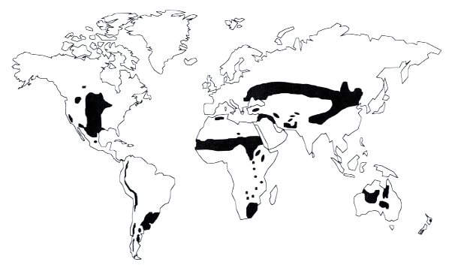
Photosynthetic pathways
Different photosynthetic pathways have evolved that differ in the efficiency by which CO₂ is procured and evapotranspirative water loss is minimized
Photosynthetic pathways:
  C3 (woody vegetation)
  C4 (grasses)
  CAM (cacti)
Notes:
Photosynthetic pathways are intertwined with the presence, absence, and distribution of plants

Slide 3
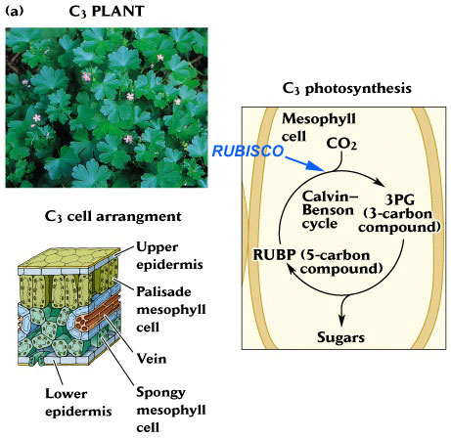
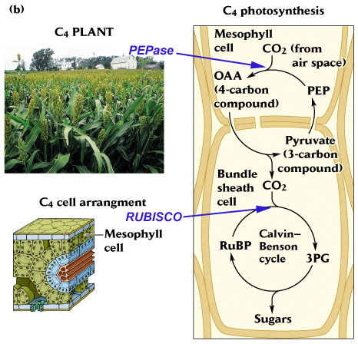
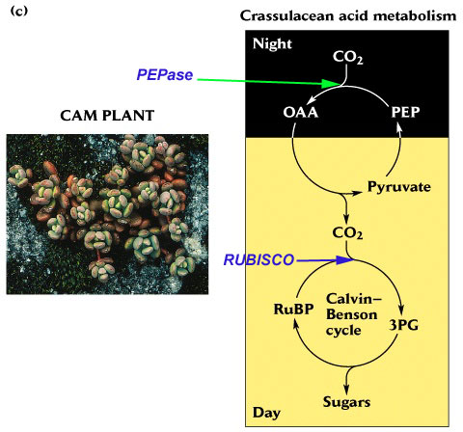
C4: More efficient biochemical
mechanism for binding CO2 and maximizing net PSN - less potential evapotransporative water loss.
C3: Less efficient biochemical
mechanisms for binding CO2 and maximizing net PSN when stomates are open – more potential evapotransporative water loss.
CAM: Stomates open at night to limit evapotranspirative
water loss
Notes:
You do not need to know the molecular details of each photosynthetic pathway.
Efficiency by which carbon dioxide is taken in through the stomates and used to produce carbohydrates determines the potential amount of water loss through evapotranspiration.
Crassulacean acid metabolism: CAM
C4 plants evolved during hotter drier conditions

Slide 4
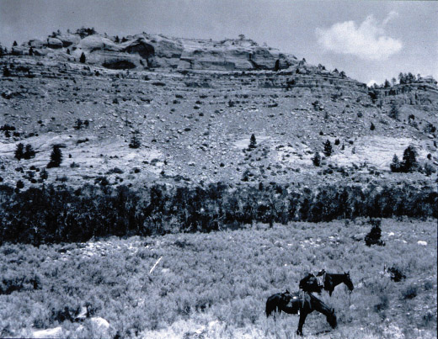
1904
Notes:
Historical Photography of Twentieth Century Vegetation Change in Wyoming and Montana

Slide 5
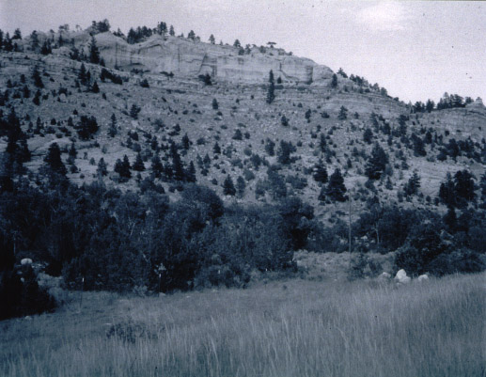
1998

Slide 6
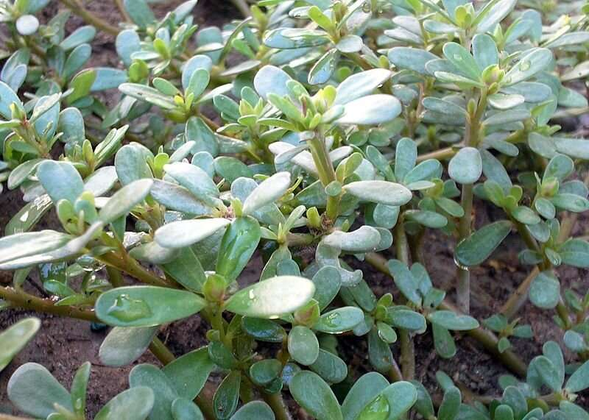
CAM plants are highly water-efficient but may have lower overall rates of photosynthesis compared to C4 plants
Purslane possesses C4 and CAM photosynthetic pathways which allows it to be both highly productive and also very drought tolerant
C4 and CAM activity operate in the same cells, with products of CAM reactions being processed by the C4 pathway.
Notes:
https://www.science.org/doi/10.1126/sciadv.abn2349
https://phys.org/news/2022-08-common-weed-super-key-drought-resistant.html

Slide 7
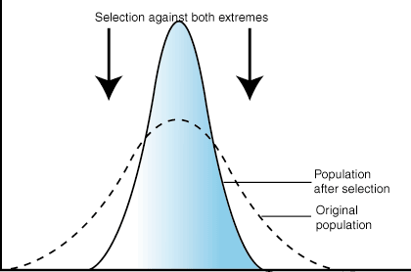
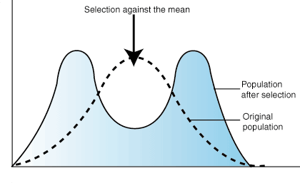
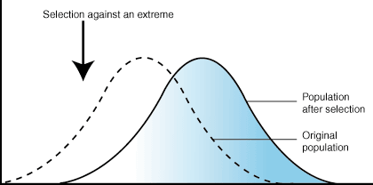
Natural selection
Natural selection is the non-random process thru which biological traits become more or less common in a population as a result of differential reproduction
Natural selection can cause genotypes to vary but not result in a new species (speciation)
Natural selection is not necessarily the emergence of new species, but it can be.
The traditional view is that a genotype produces a trait. Natural selection works on genotypes by selecting the more adaptive trait.
Notes:
X axis represents a trait. However, goes the trait have a genetic basis or is it only phenotypic?
Disruptive selection: selection that favours extreme phenotypes over intermediate phenotypes within a population.

Slide 8
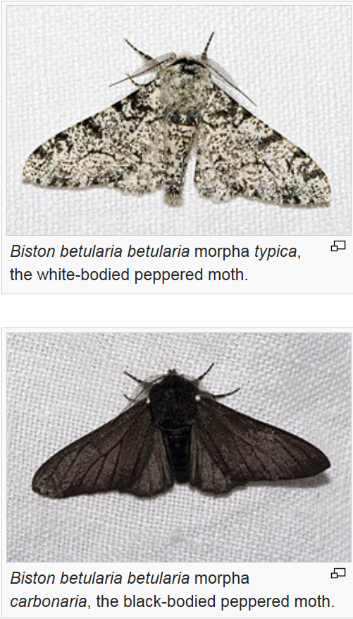
The peppered moth and industrial melanism
Is this natural selection? Yes
Change in genotype? Yes
Change in phenotype? Yes
Is this a speciation? No
Notes:
Natural selection is not speciation

Slide 9
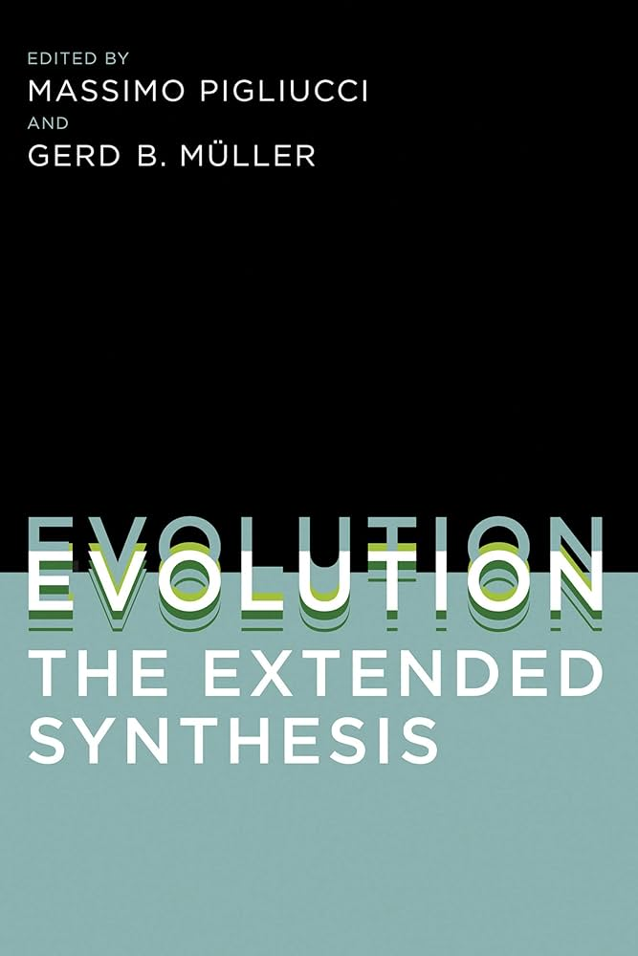
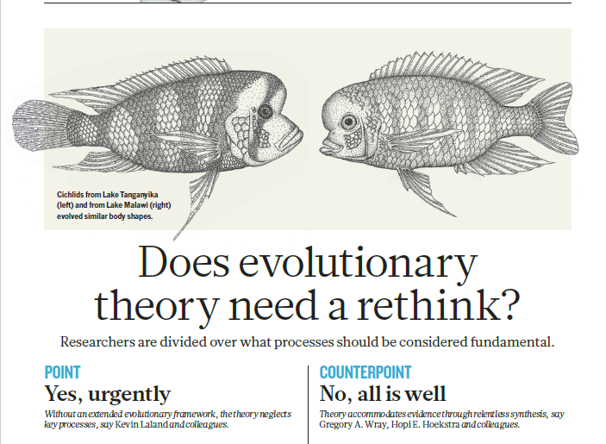

Slide 10
What does selection act upon?
After the concepts of genes and DNA became accepted, genotype was considered the focus of selection. Natural selection occurred because of the traits of better adapted genotypes
But it is more complicated now. The same genotype can have different phenotypes.
Phenotype is the outward form of an organism, its biochemistry, and behavior - all of its observable characteristics — which are influenced both by its genotype and by the environment.
No simple tit-for-tat relationship between a gene and a phenotype

Slide 11
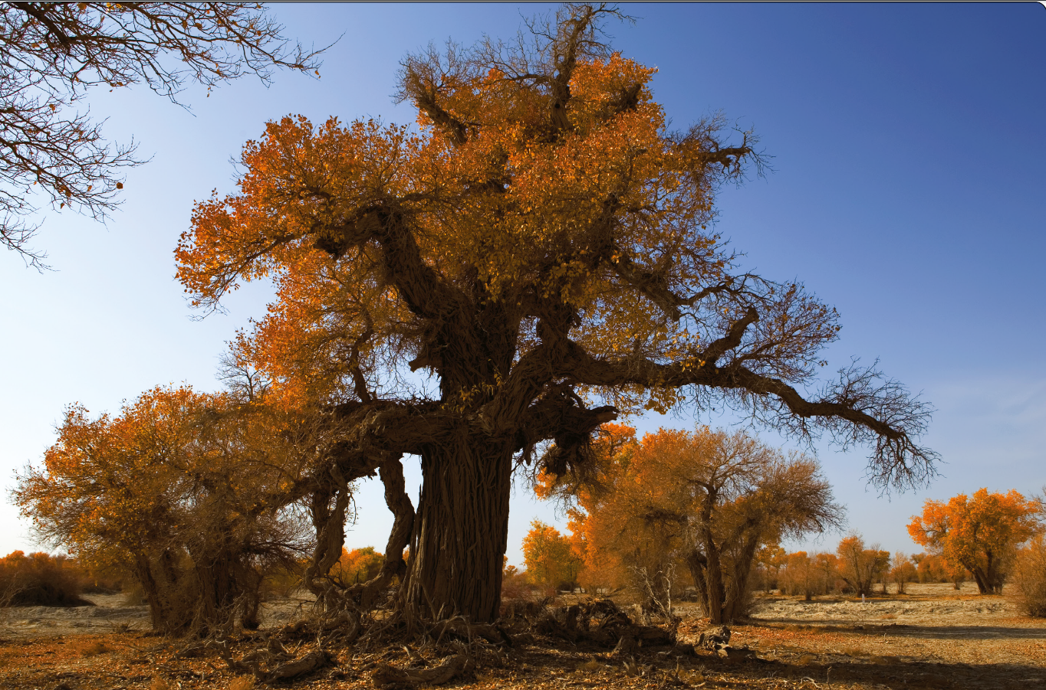
Notes:
The desert poplar (Populus euphratica) is an ancient and protected species, and forms riparian forests in the deserts of mid-and west Asia, northern Africa, and southern Europe. This tree, photographed in November 2013, is the oldest recorded living desert poplar. The innermost ring dates back to 1709 or earlier.
Its leaves vary widely in shape; some smooth-edged, others serrated, some narrow, others broad, some shaped like lance heads while others are oval. Drought is a dominant stressor in this hyperarid environment, with highly variable temperatures and soil salinity. Leaf shape may relate to trade-offs among water conservation, thermoregulation, and growth rate. Are these large variations in leaf shape on a single tree an adaptation to wide environmental fluctuations? Or is a neutral and therefore non-adaptive consequence of variable gene expressions?

Slide 12
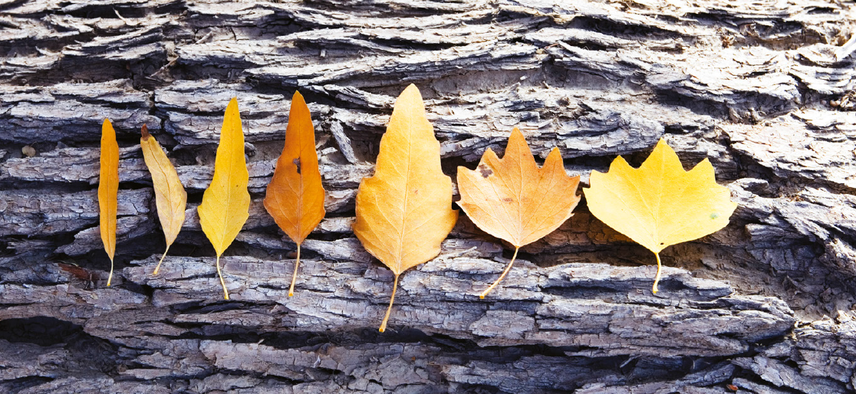
Phenotypic plasticity

Slide 13
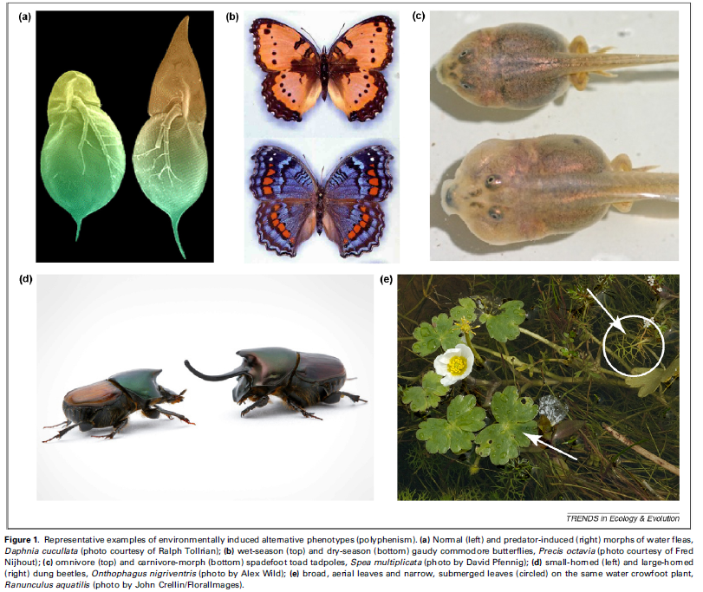

Slide 14
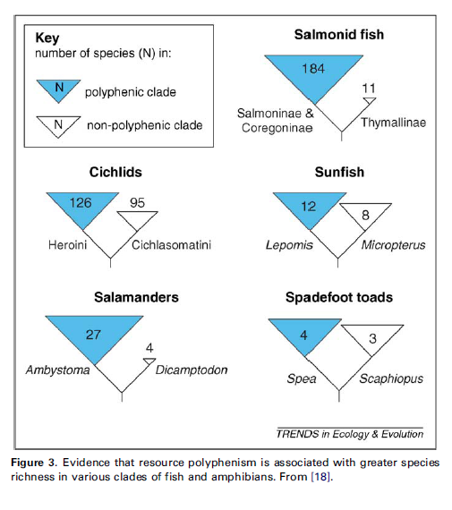
Phenotypic plasticity
Phenotypic change is not natural selection, although it can initiate it
Taxa with high phenotypic plasticity are more likely to undergo speciation
Notes:
Polyphenic – having a lot of phenotypic plasticity

Slide 15
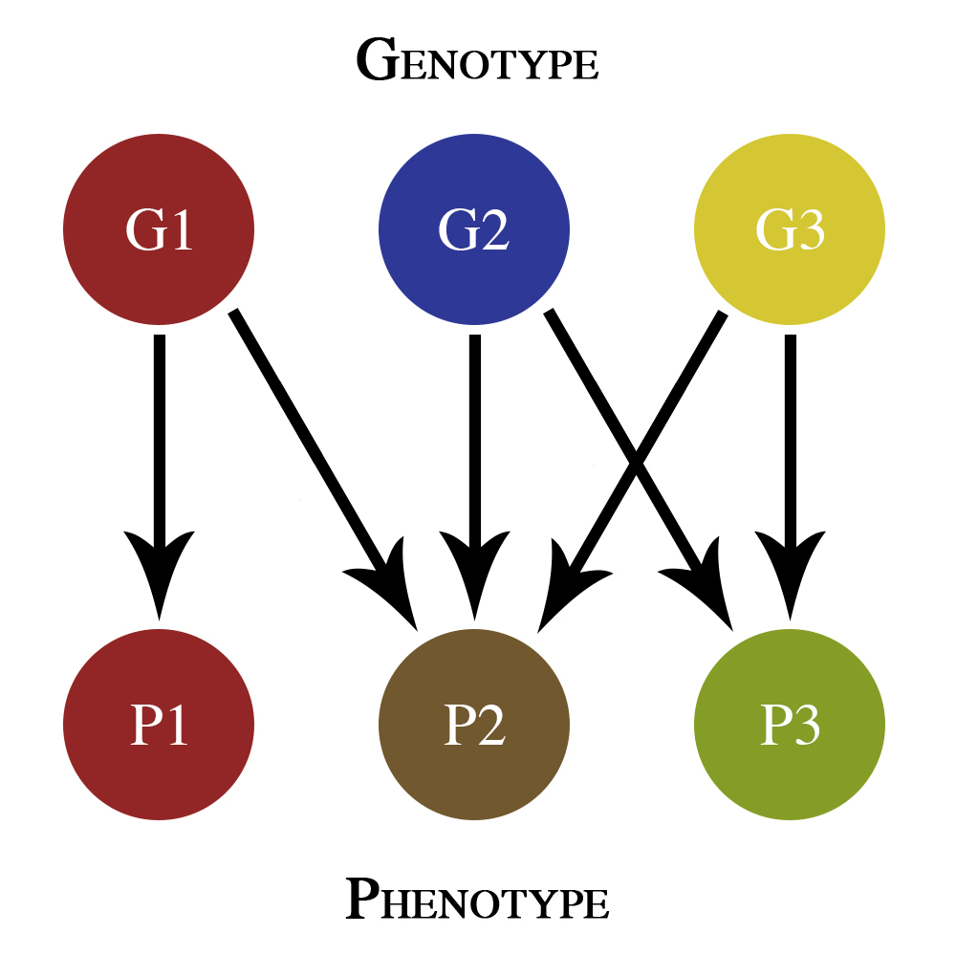
Mapping the phenome
The phenome is the sum of all the expressed phenotypic outputs of genomic sequence.
We now ‘map’ phenomes like we mapped genomes.

Slide 16
Genotype x phenotype x environment interactions
Integrating G x P x E is necessary to understand natural selection and speciation.
G x P x E accounts for a much wider range of permutations in the relationships between genotype, phenotype, and environment.
  The same genotype can have different phenotypes.
  Different phenotypes can have the same genotype.
  Different environments can cause the same genotype to have different phenotypes.
  The same environment can produce the same phenotypes from different genotypes.

Slide 17
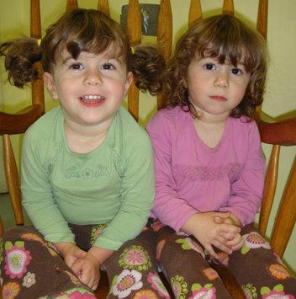

Slide 18
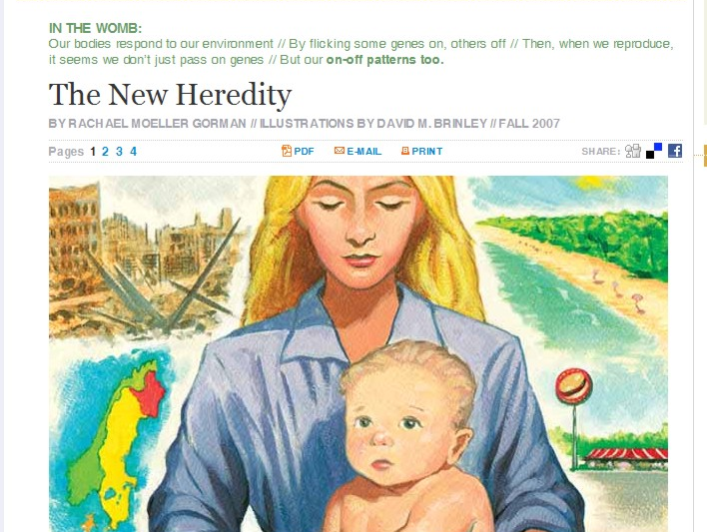
Epigenetics
Our bodies respond to our environment // By flicking some genes on, others off // Then, when we reproduce, it seems we don’t just pass on genes // But our on-off patterns too.
Notes:
Non-DNA biochemicals can interact with the surfaces of DNA to facilitate novel modes of gene expression.
Epigenetic signals can be passed on from one generation to the next

Slide 19
The epigenome
For decades, change in an organism’s DNA sequence has been considered the primary mode of evolutionary change.
However, environmental contexts around DNA can alter what genes are turned on and off.
The same DNA sequence can produce different phenotypes through epigenetic modifications
Epigenetic modifications can even be passed on to offspring
The epigenome: the biochemical markers that modify the products of the genome

Slide 20
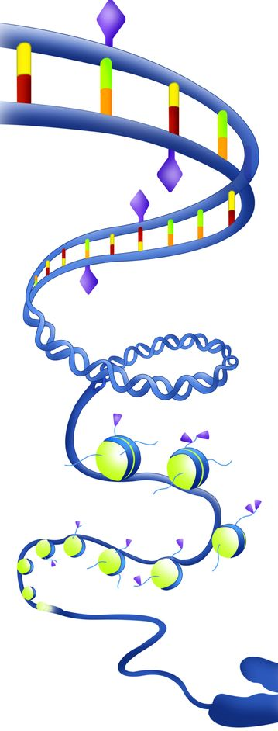
These biochemicals markers can bind to DNA and change its function without modifying DNA sequence
Methylation and histone modifications are two types of epigenetic mechanisms that can turn genes on and off
They develop from environmental exposures (stress, chemicals, environmental change).
Notes:
The addition of a methyl-group to the cytosine base: methylation. Cytosine methylation indicates gene silencing: methylated genes are not transcribed.
Histone modifications also play an important role in epigenetic regulation. Histones are proteins that act as spools around which DNA winds

Slide 21
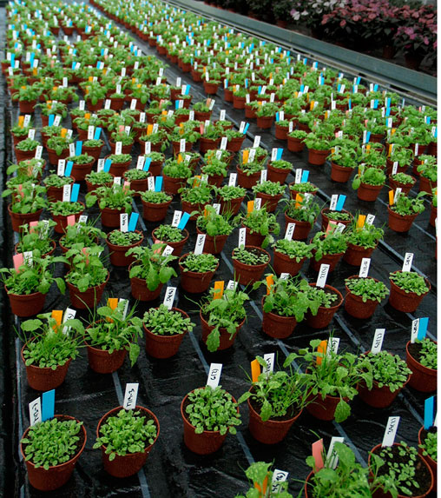
Epigenetics and natural selection
Researchers created Arabidopsis plants with distinct patterns of low and high methylation sites in their genomes
DNA methylation patterns were associated with heritable variation in flowering time and root length
Methylation patterns were stable over the eight generations
Showed that methylation has an impact on phenotypic variation that selection can act upon
Notes:
Same plant genome
Different epigenetic modification
Stably inherited and expressed phenotypes over multiple generations

Slide 22
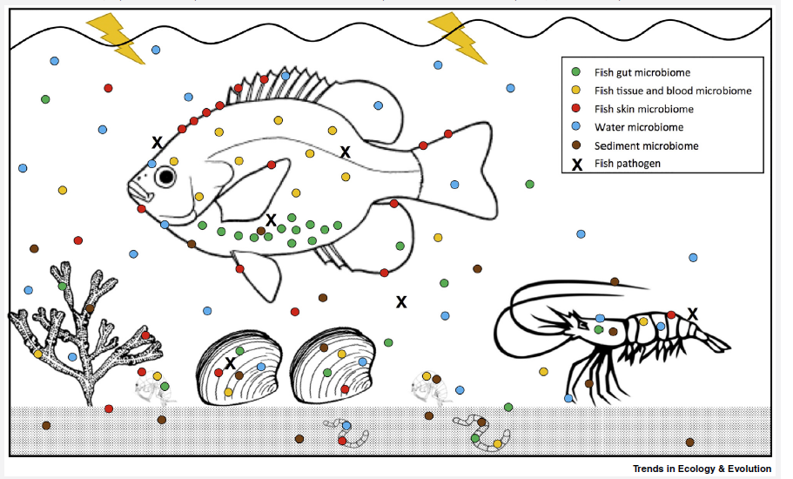
Microbiomes
Animals and plants are associated with a diverse array of resident microbiota.
Metagenome: the genome of an organism inclusive of the bacteria, viruses and other microbiota living within and on it
Besides producing their own biochemicals, organisms in the microbiome can alter host gene expression and its products in their host
Horizontal gene transfer can take place among the constituent microbiota of an organism
Holobiont: the view of an organism as a collection of organism
Notes:
Bacterial cells outnumber our cells 10 to 1.
Even bacteria contain viruses and plasmids – they too have a microbiome.
There are no sterile animals in nature. Most microbes are beneficial to their animal hosts.

Slide 23
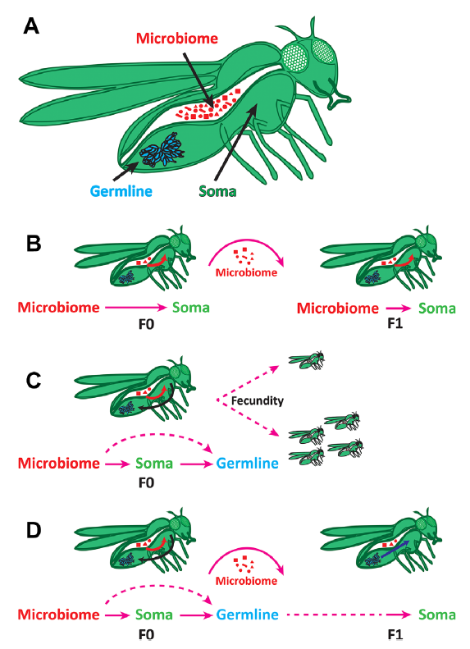
The microbiome and natural selection
The influence of the microbiome on the host soma (body cells) and germline (sex cells, i.e., eggs and sperm) can potentially give rise to novel phenotypes that natural selection can then act upon
  The microbiome can be shared and inherited (B). Changes in its composition can alter fitness.
  The microbiome can alter gene expression in germline cells and create conditions that influence traits (C)
  The microbiome can alter germline cells through epigenetic mechanisms that can be inherited in subsequent generations. (D)
Notes:
Soma – diploid cells, body cells
Germline – haploid cells, sex cells, gametes.
https://www.youtube.com/watch?v=R42KqyxuFF0&ab_channel=CarisLifeSciences

Slide 24
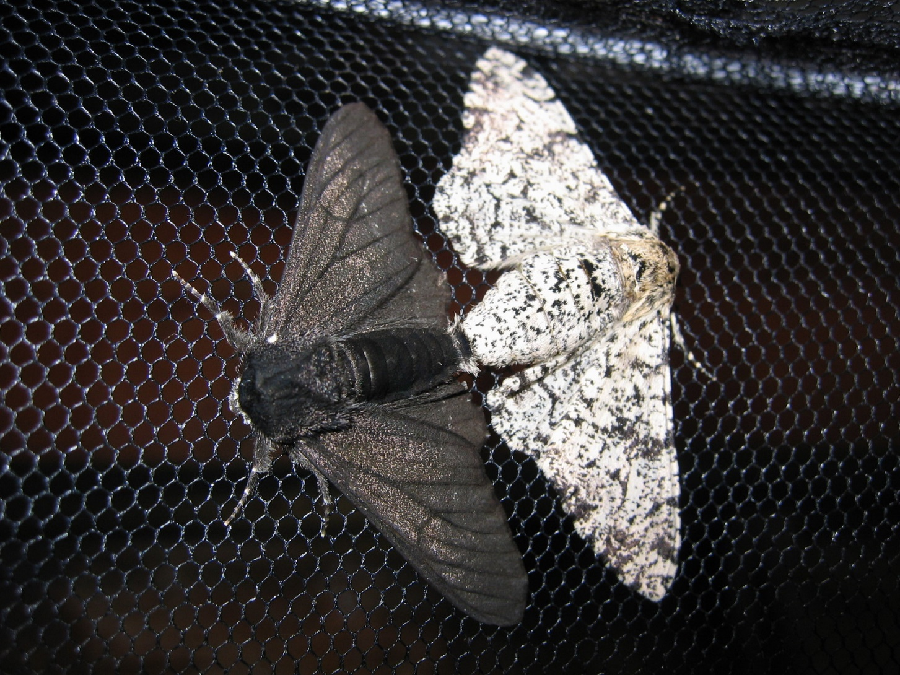
Notes:
Researchers have pinpointed the precise genetic mutation that led to the darker moth and determined just when this mutation occurred. The mutation is on a “jumping gene,” or a transposable element, which can hop between locations on the genome. It was not entirely the traditional narrative that the white butterflies were eaten when the trees darkened. What caused the darkening to begin with? A jumping gene initiated this color change, and then selection took place

Slide 25
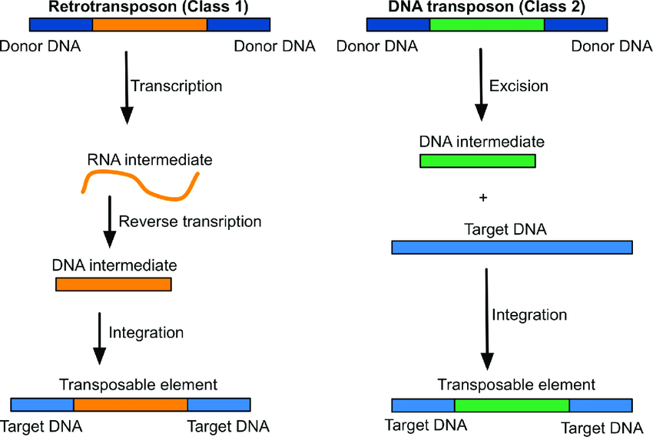
The mobilome
The mobilome is all mobile genetic elements in a genome.
Transposons, or jumping genes, can move about on the genome and are major constituents of the mobilome in multi-celled animals.
Horizontal gene transfer among bacteria is another component of the mobilome
They may speed up evolution and introduce novel phenotypes upon which natural selection can occur

Slide 26
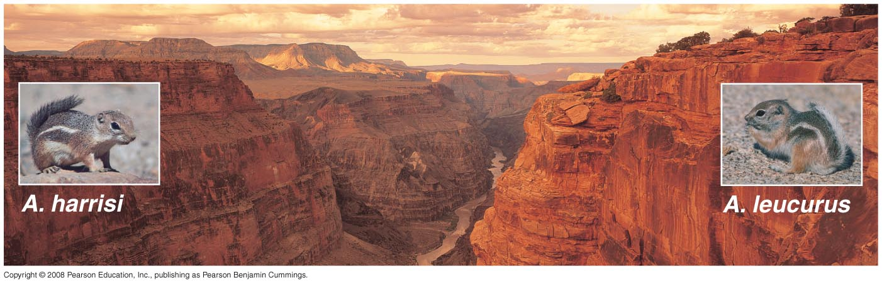
Modes of speciation
Allopatric speciation, the prevailing conception of speciation until the last two decades.
Harris’s antelope squirrel (Grand Canyon south rim)
White-tailed antelope squirrel (Grand Canyon north rim)
Notes:
About 80% of the canyon has been carved in the last 6 million years. Original animal populations became isolated, although in some cases it may not have been six million years ago as some animals were able to continue to share genes. For some animals, like birds, the canyon was less of a barrier.
Ammospermophilus (antelope squirrels)
A. leucurus possess large feet which allow them to quickly evade and escape predators. They remain cool during the hot desert days by retreating to their burrows and limiting the majority of activity to the early morning and late evening hours.
A. harrisii are the only antelope squirrels who dig their own burrows instead of re-purposing burrows of other animals. They cool down by salivation and holding their tails above their heads to provide shade. During times of cold, they survive off the seeds they cached

Slide 27
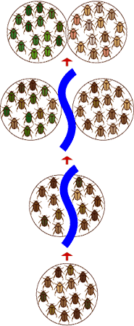
Allopatric speciation
Requires geographic isolation of population
Physical barrier, such as a mountain range or a long distance dispersal event
Natural selection and/or neutral processes promote genetic separation,
Pre- or post-zygotic reproductive isolation from original population occurs
Separated populations considered different species

Slide 28
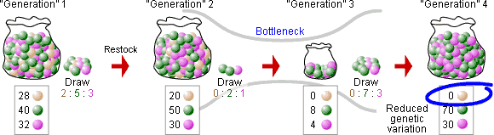
Founder effects
Allopatric speciation is sensitive to founder effects

Slide 29
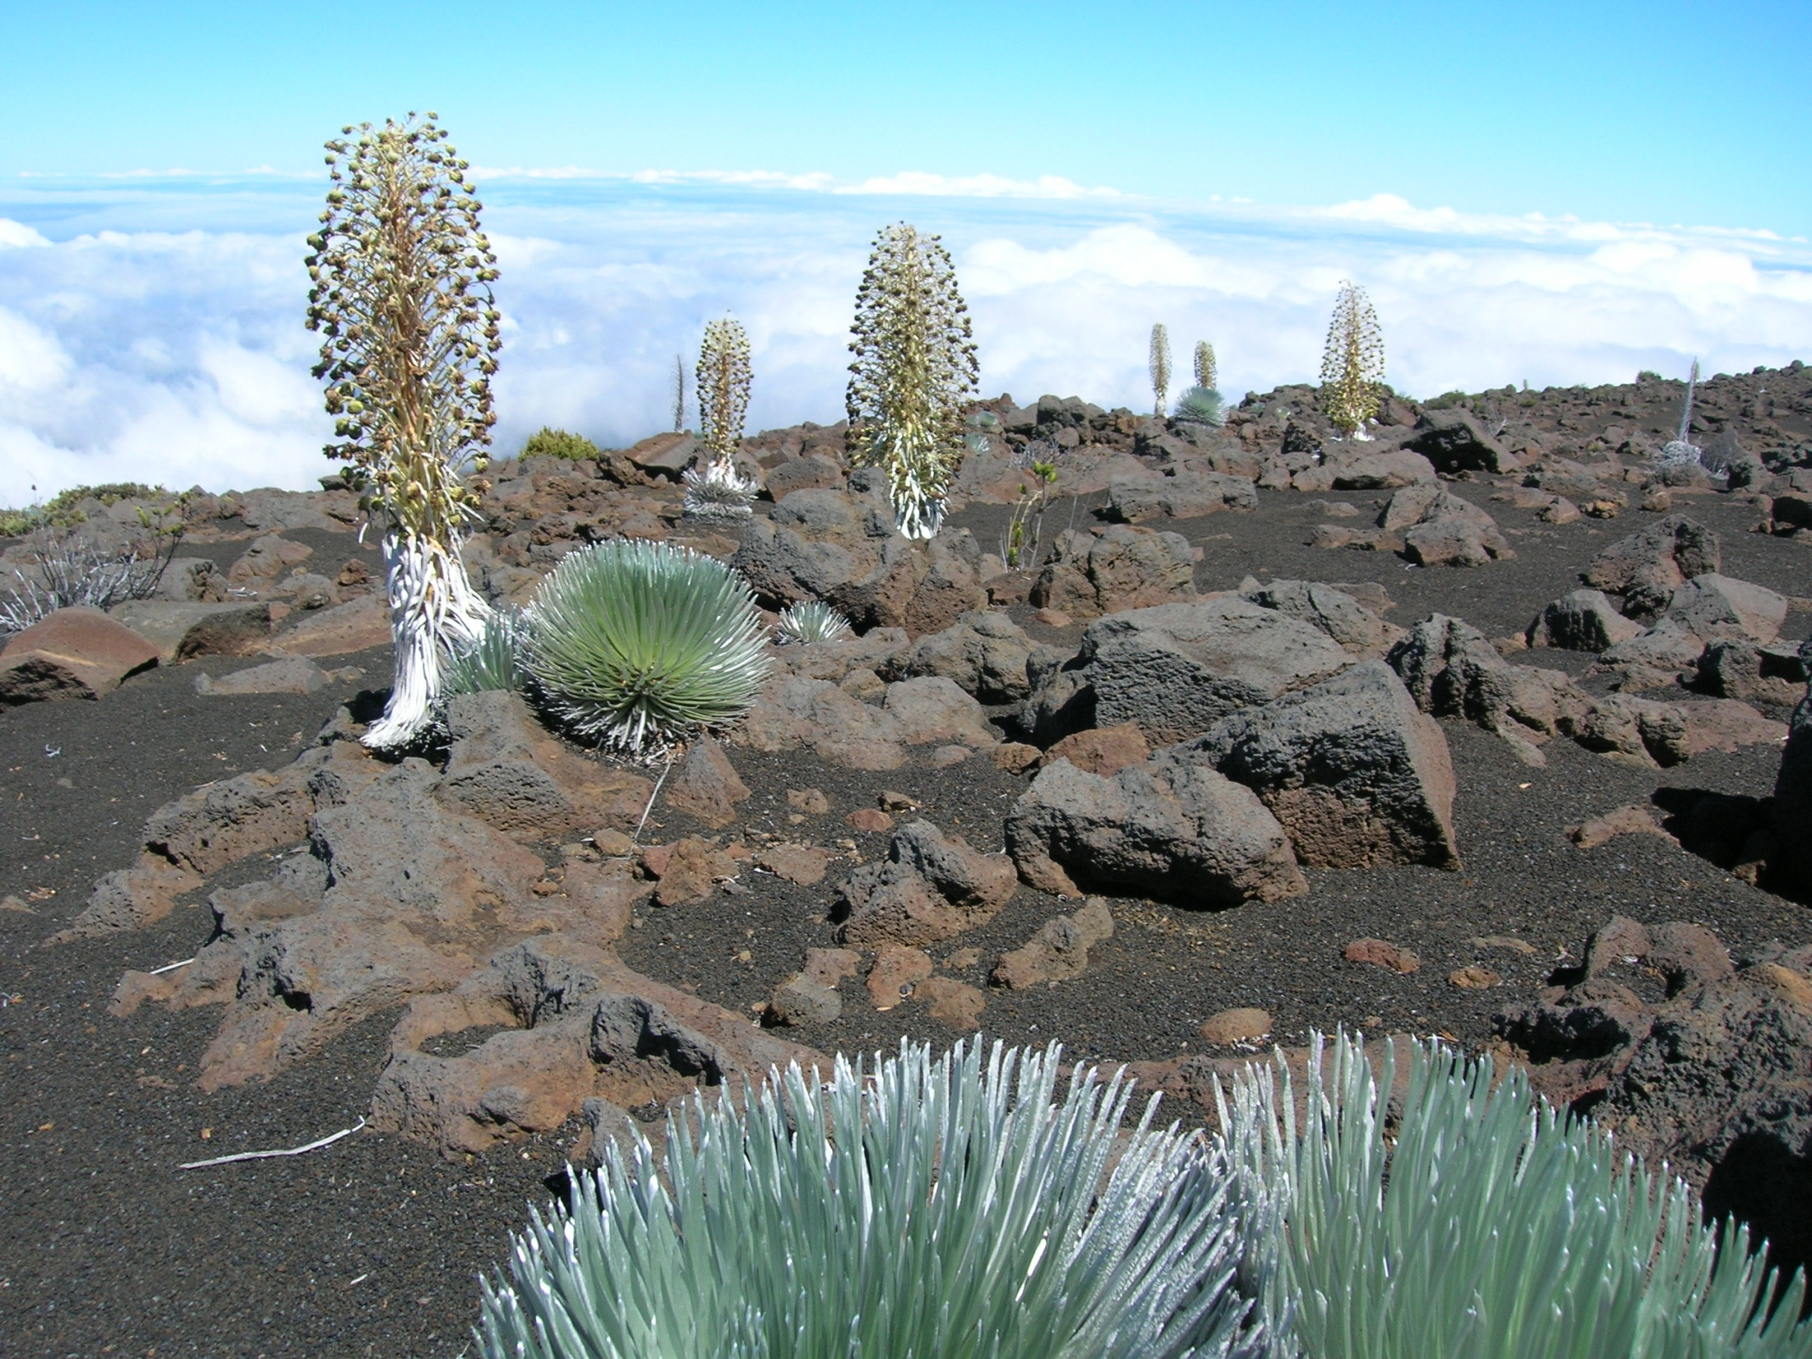
Allopatric speciation
Hawaiian silversword alliance
Notes:
The 30-odd species of silver sword plant (Asteraceae) that occupy almost all terrestrial habitats in the Hawaiian islands and exhibit a vast range of morphologies, including trees, erect and compact shrubs, lianas, and branched and unbranched rosettes. These phenotypes are not seen in their mainland ancestor. The diversity of environmental conditions on the mountainous topography of Hawaii have led to this diversification. Some have grown tall to compete for light. Others are tall as a means to intercept water in passing fog, particular on the drier aspects of volcanic slopes.
Three genera of silverswords (Argyoxiphium, Dubautia, Wilkesia) have evolved from one colonization event by Madia elegans (tarweed) from the mainland USA

Slide 30
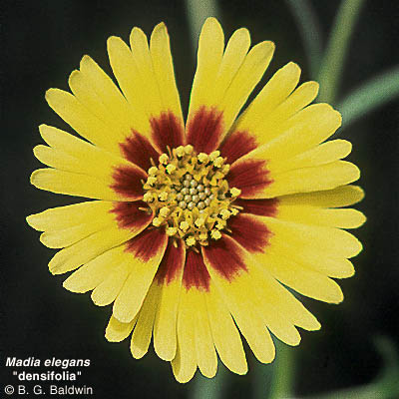
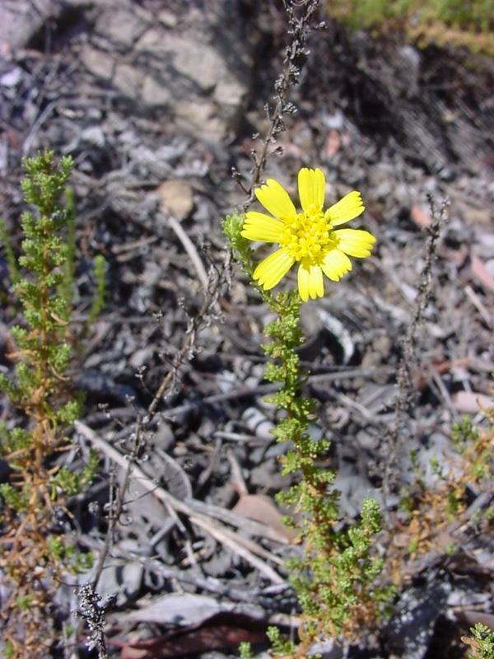
Ancestor of silversword alliance
Tarweed
  Found in California and Mexico floristic province
  Shrubby, sprawling plant
  Similar in floral morphology and anatomy to silverswords
  Sticky substance on flowers and fruits
  Arrived in Hawaii on bird feathers (most likely) roughly 5 mya

Slide 31
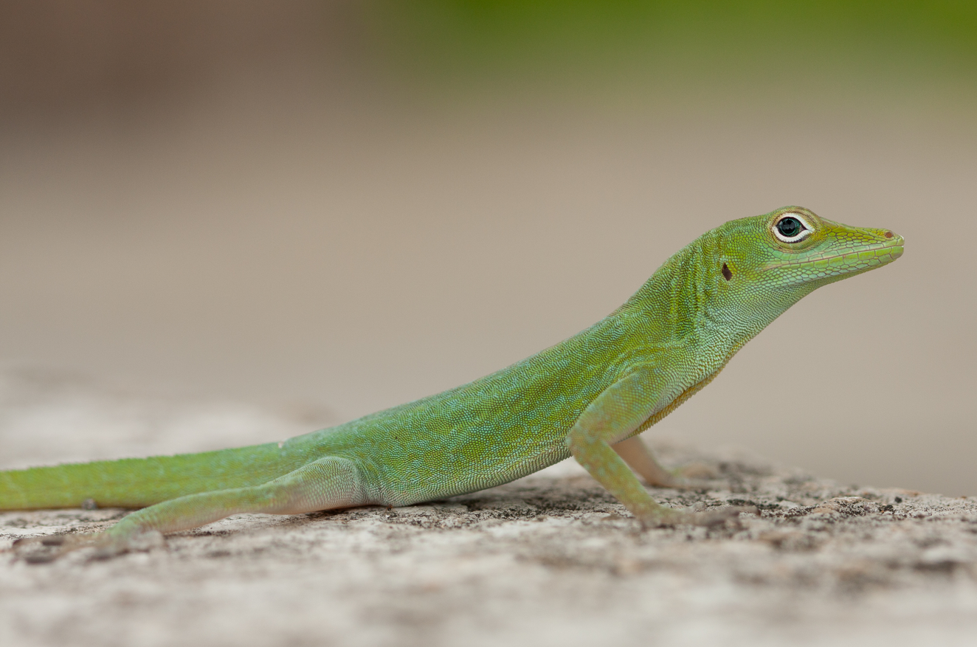
Allopatric speciation of Caribbean Anolis lizards

Slide 32
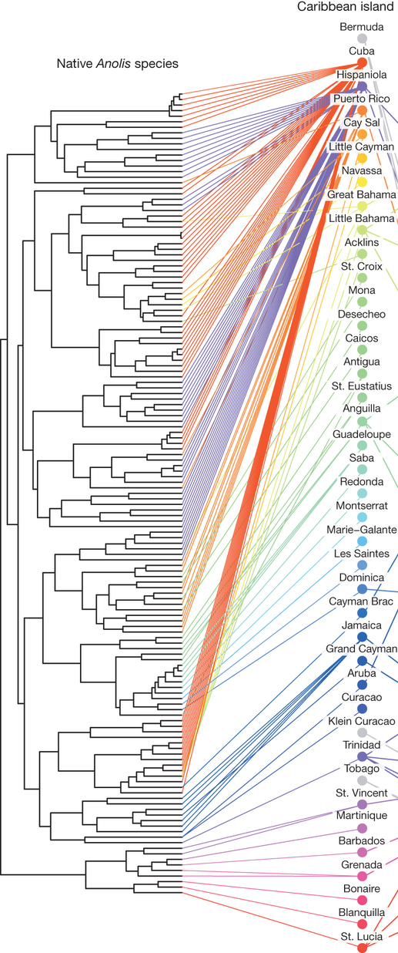
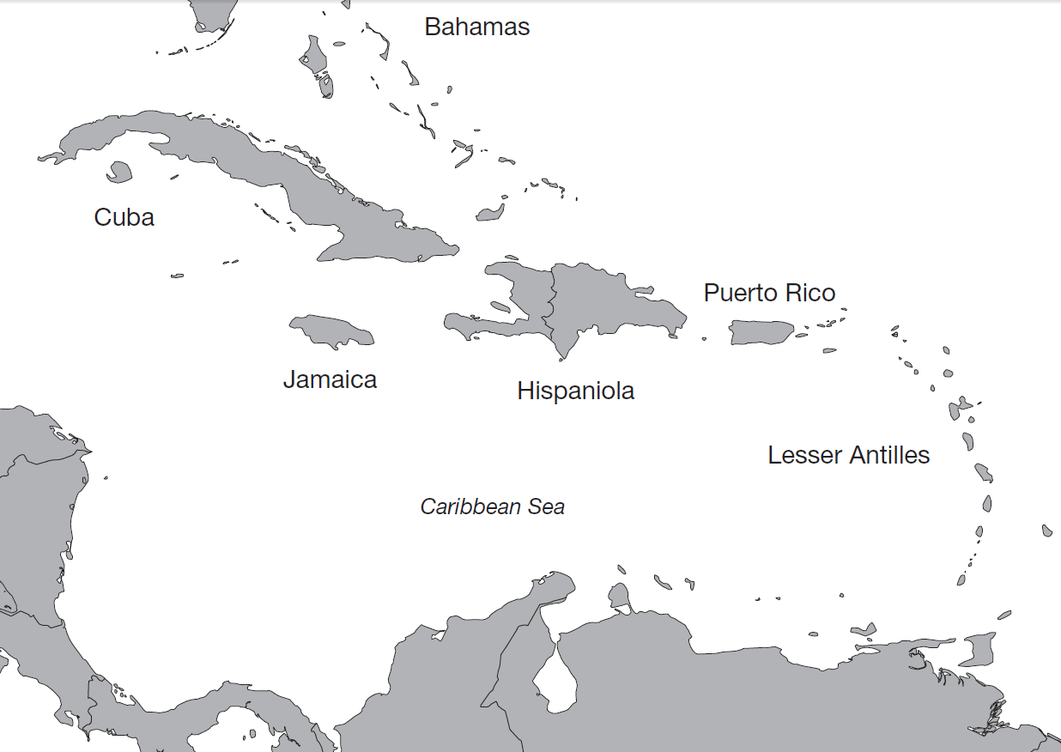
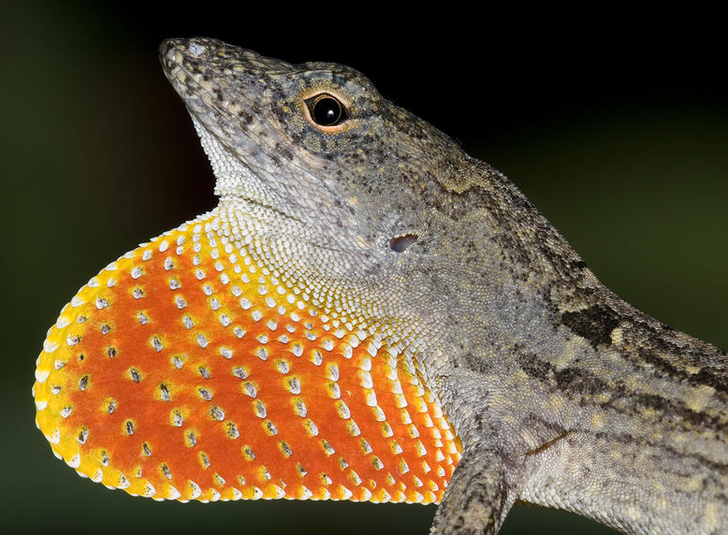
Anoles, the most diverse vertebrate in the Caribbean (140 species)
Notes:
Until recently, each Caribbean island housed endemic (native) clades of anoles. This high endemicity of native Caribbean anoles resulted because over-water dispersal is naturally perilous for anoles, making natural long-distance colonization rare and allopatric speciation common even among neighboring islands.
http://www.nature.com/nature/journal/v513/n7519/full/nature13739.html

Slide 33
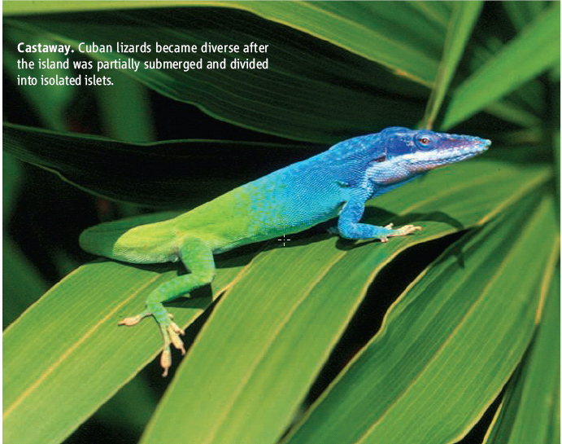
Cuban anole

Slide 34
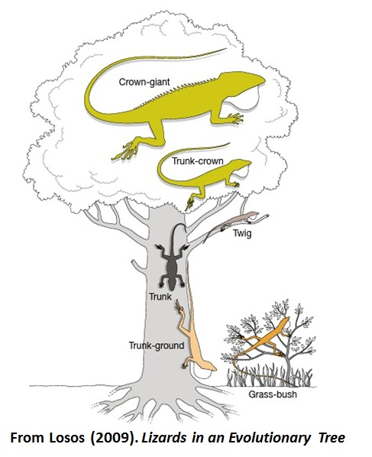
Sympatric speciation
Cuba has 57 species of Anole
More than can be accounted for via isolation events and allopatric speciation
Speciation also driven by interspecific competition, an ecological interaction
This process is an example of sympatric speciation, or sympatry

Slide 35
Sympatric speciation
Does not require geographic isolation
Reproductive isolation originates from an originally contiguous population
Populations evolve to become separate species
But in almost all cases of sympatry documents, some subtle form of spatial segregation was observed
What can make formerly contiguous interbreeding species separate in space without a physical barrier or dispersal event occurring?

Slide 36
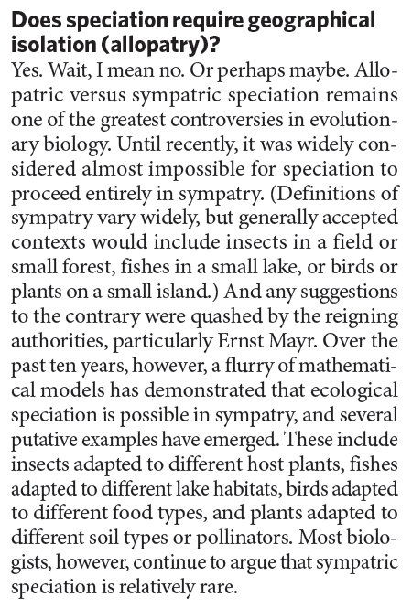
Sympatric speciation
Mechanisms of isolation
  Ecological speciation
  Assortive mating
  Genomic islands
Notes:
Sympatric speciation – separation driven from within a population. Argument is over the impetus for separation, imposed by geological or climatic forces or selected from within

Slide 37
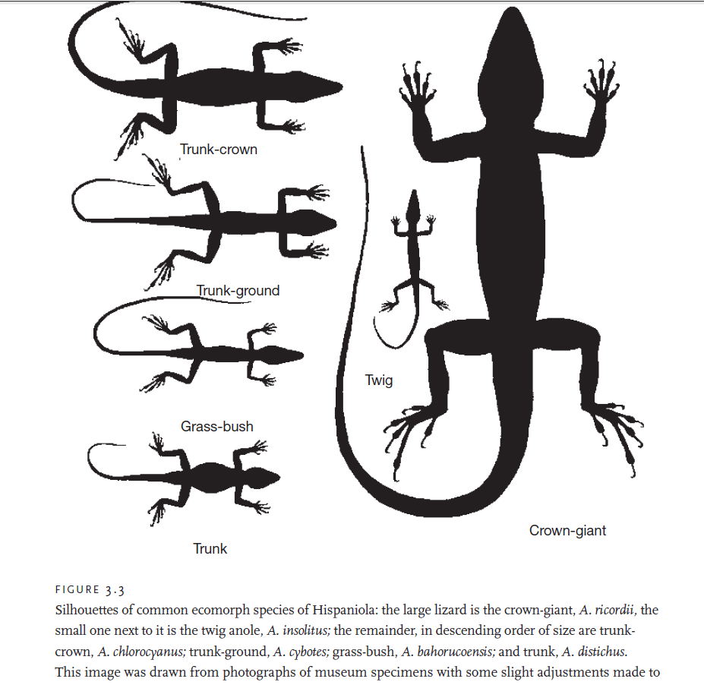
Sympatry: ecological speciation
The evolution of reproductive isolation between populations as a result of ecologically-based divergent natural selection.

Slide 38
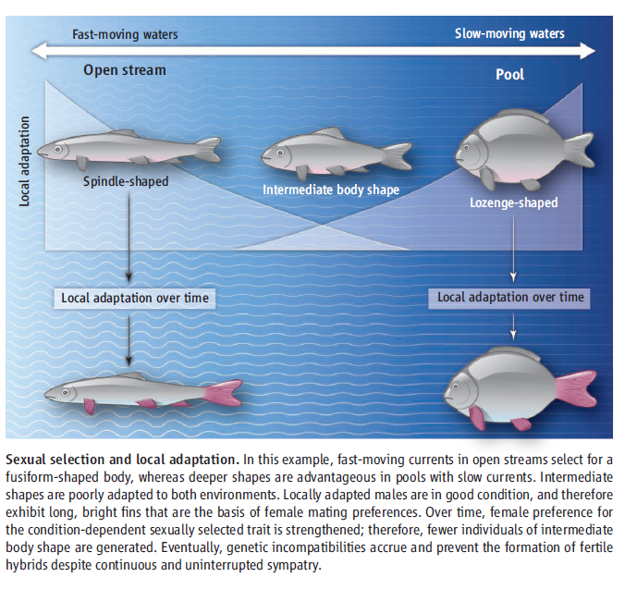
Sympatry: assortive mating
Sensory-determined preferences for particular individuals of the group, displaying specific distinctive phenotypic trait

Slide 39
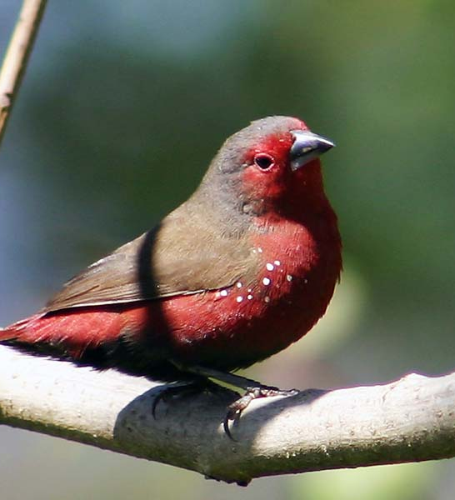
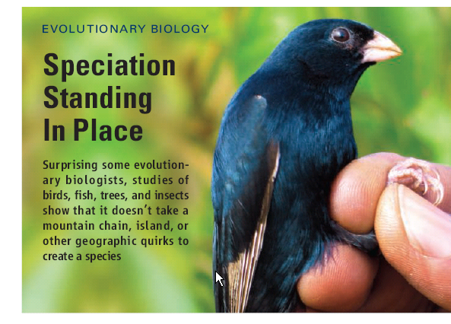
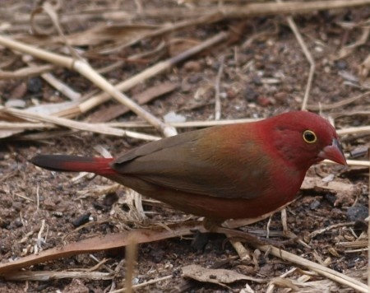
Sympatry: assortive mating
African firefinch
Black bellied firefinch
Blue indigo bird of Cameroon
Notes:
Again, we are finding that evolution may take place over relative small time scales.
A blue indigobirds in Cameroon, Africa. These opportunistic birds lay their eggs in the nests of different species of finches. The newborn indigo birds then look and act as if they belong there, and as adults, incorporate the twills and whistles of their foster parents into their own mating calls. Researchers observed in this study that indigo birds learned the songs of their respective finches and now seem to have developed into two “races.” Although all the blue indigo birds can still mate with one another—which means the races are not yet distinct species—females prefer suitors who know the same finch song they do. And they pass their preferences on: female indigo birds that grow up in an African firefinch nest, for example, tend to lay eggs in the same kind of nest rather than in one belonging to a black-bellied firefinch.
There is separation in space, but it is driven by assortive mating

Slide 40
Criticisms of sympatric speciation
The biological realism and relevance of the classification of the mode of speciation into the discrete geographic categories such as sympatric and allopatric is questioned.
Almost all candidate case studies of sympatric speciation have some degree of spatial differentiation between sister taxa
Parapatric speciation refers to the isolation of a small, more connected population
But there is the problem of how divergence occurs given the potential for gene flow to exist

Slide 41
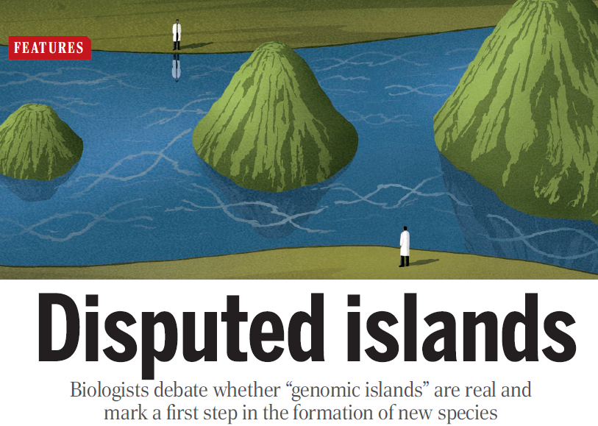
Genomic islands
Some parts of DNA genome diverge, even with gene flow
These genomic ‘islands’ expand until reproductive isolation is locked in and a species has split into two.
Notes:
Islands extend beyond beneficial mutation because DNA right next to the advantageous DNA tends to be transmitted as a unit, due to reduced recombination in this region.

Slide 42
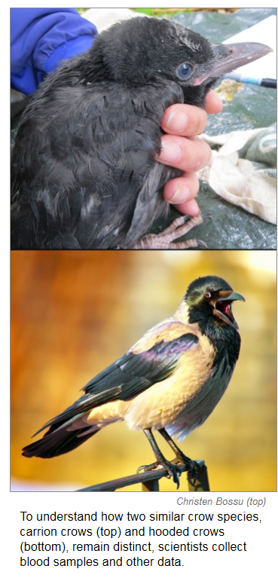
Sympatry: genomic islands
These two species can interbreed in some locations in Europe, but appear to be diverging into two distinct species
  Only an 82 DNA base pair differences between carrion crow and hooded crow out of a possible 8.4 million
  Almost all differences in one ‘island’ that contains genes related to feather color and to visual perception
  Genes causes black crows to prefer black mates and hooded crows to prefer their kind.
Notes:
http://m.sciencemag.org/content/345/6197/611.full

Slide 43
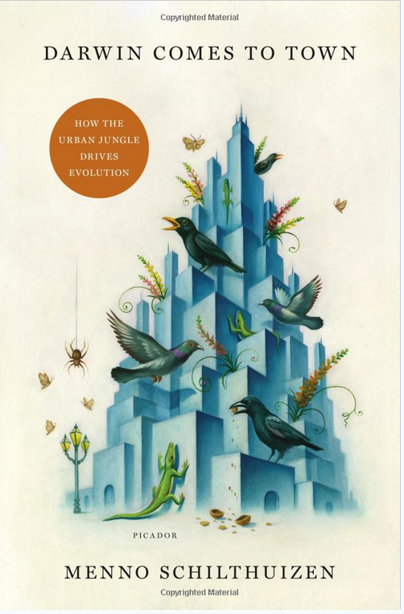
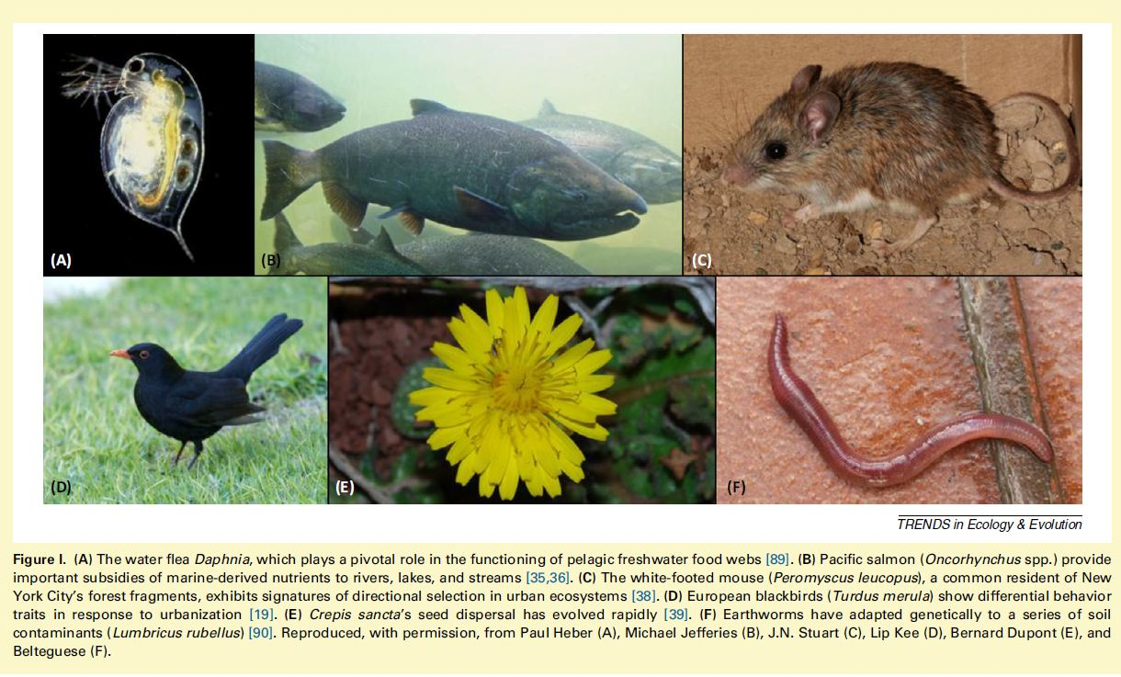
Anthropogenically-imposed selection
Notes:
https://www.pnas.org/doi/10.1073/pnas.0708446105

Slide 44
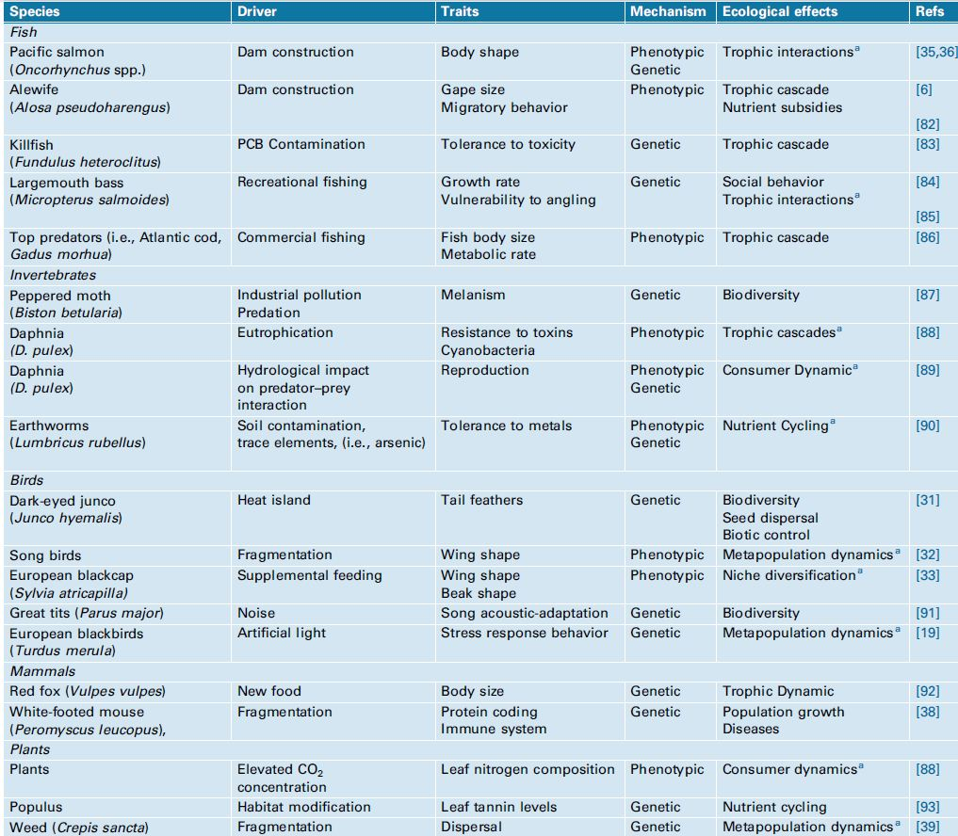

Slide 45
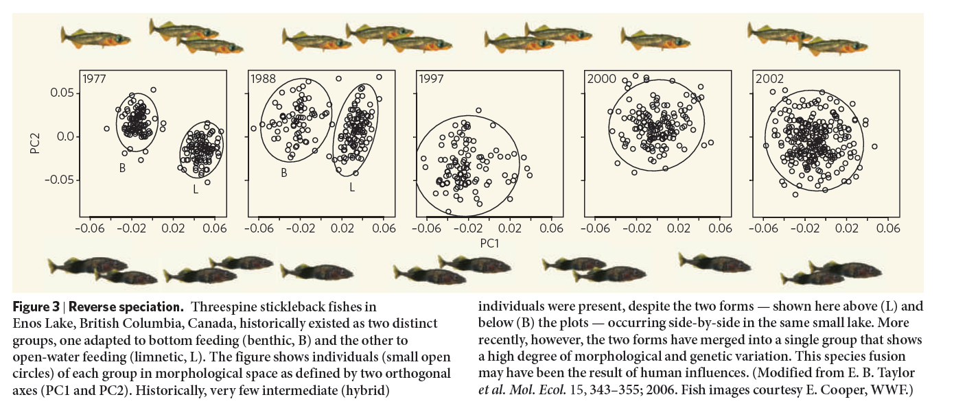
Reverse speciation
Notes:
Changes in water chemistry drove reverse speciation – an erosion of biodiversity

Slide 46

Evolutionary rescue
Adaptation that occurs quickly enough to prevent extinction due to maladaptation to a new environment is termed evolutionary rescue
Notes:
Armor developed in response to the introduction of a predatory pike

Slide 47

Adaptive radiation
Evolutionary divergence of members of a single phylogenetic lineage into a variety of different adaptive forms
Notes:
Hawaiian honeycreepers

Slide 48

Canonical examples of adaptive radiation
Darwin’s finches
Hawaiian honeycreepers
Cichlids of Africa
Marsupials of Australia
Anoles of the Caribbean islands

Slide 49

Adaptive radiation exemplifies divergent evolution
Adaptive radiation is a form of divergent evolution.
  Cladogenesis – derivation of multiple species from a single ancestor
  Anagenesis - the derivation of a single species from a single ancestor.

Slide 50

Cladogenesis increases richness (the number of taxa, like species richness)
Anagenesis does not increase richness
Notes:
.

Slide 51
Adaptive radiation
Adaptive radiation arise because of ecological opportunity
  Appearance of new resources
  Extinction of species previously using resources
  Colonization of area where resources not used
  Evolution of a new trait that permits use of new resource

Slide 52


Adaptive radiation of cichlid fish of the Rift Valley Lakes of East Africa
Notes:
Lake Victoria, the world’s second-largest freshwater lake in the world
Cichlids are thought to have diversified from a handful of species in as few as 15,000 years — essentially a new species every 30 years.
Illustrates allopatry and sympatry

Slide 53


Slide 54


Notes:
Allopatric speciation – drier climate, cool, 18,000 years ago; warmer, wetter, 10,000 years ago at start of Holocene. This resulted in isolation and local adaptation, selection, as well as founder effects

Slide 55

Notes:
But there is also sympatric speciation within lakes.

Slide 56


Notes:
Assortive mating, the preference for a mate of a particular color, drives speciation.
Cichlids in Lake Victoria prefer males of different colors, which apparently led to separate species of blue and red cichlids. Researchers say the phenomenon provides evidence that differences in sensory perception--not just geography—can spark speciation. It's a diverse environment with water tending to be bluish near the surface and reddish deeper down. That disparity is reflected in cichlids in some regions of the lake; males in shallow water tend to be blue during the mating season, whereas males in deep water typically take on a reddish cast. Females of both species are yellowish, but they prefer to mate with either blue or red males. How did this happen? Over time, cichlid eyes adapted to either the bluish or the reddish ambient light, depending on where they lived. And indeed, after analysis of the fishes' retinas, its been found that retinal pigments in shallow-water cichlids were more sensitive to blue wavelengths than those of their deep-water counterparts, which were tuned to red. As a result, females in shallow water would have an easier time noticing blue males, and deep-water females would have favored red males.

Slide 57



Three different outcomes of adaptive radiations

Slide 58

Convergent evolution
Produces similar phenotypes (S) but distantly related genetically (A and T)
Notes:
The development of similar morphological or physiological traits in unrelated living species in considered evolutionary convergence. An example of evolutionary convergence is the radiation of marsupials in Australia to fill many of the same functional niches as the placental mammals.

Slide 59

Notes:
Echolocation: an example of a convergent evolution. Similar phenotypes (echolocation organs) very distant genetically

Slide 60

Notes:
Convergence of chaparral vegetation

Slide 61



Fynbos, southwest South Africa coast
Chaparral, California USA
Mattoral, coastal Chile
Notes:
Chaparral
Sclerophyllous (waxy, resiny leaves that resist drying out)
Shrub growth form, no large trees
Pyrogenic, this biome has fire as part of its natural disturbance regime
S. Europe, Chile, S. Africa, Australia

Slide 62
Parallel evolution
A degree of genetic relatedness at (A) that leads to similar phenotypes (S)
Notes:
‘

Slide 63
Divergent evolution
Produces different phenotypes (S and T), and originally closely related genetically when opportunity for radiation occurred (A)

