Slide 1
1. Introduction
Biogeography is the study of the temporal and spatial patterns of past and present organisms and the derivation and comprehension of processes that generated these patterns.
Notes:
Expansive definition; several types of biogeography

Slide 2
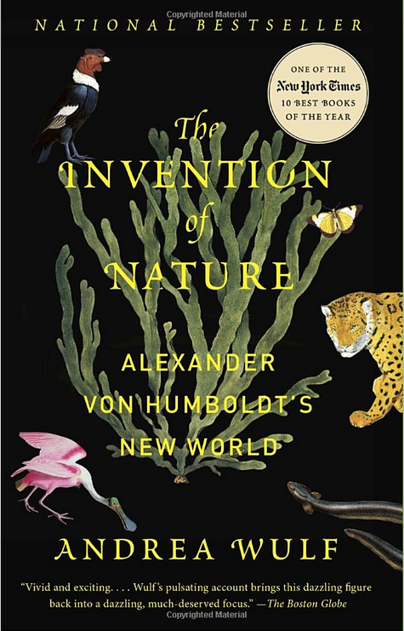
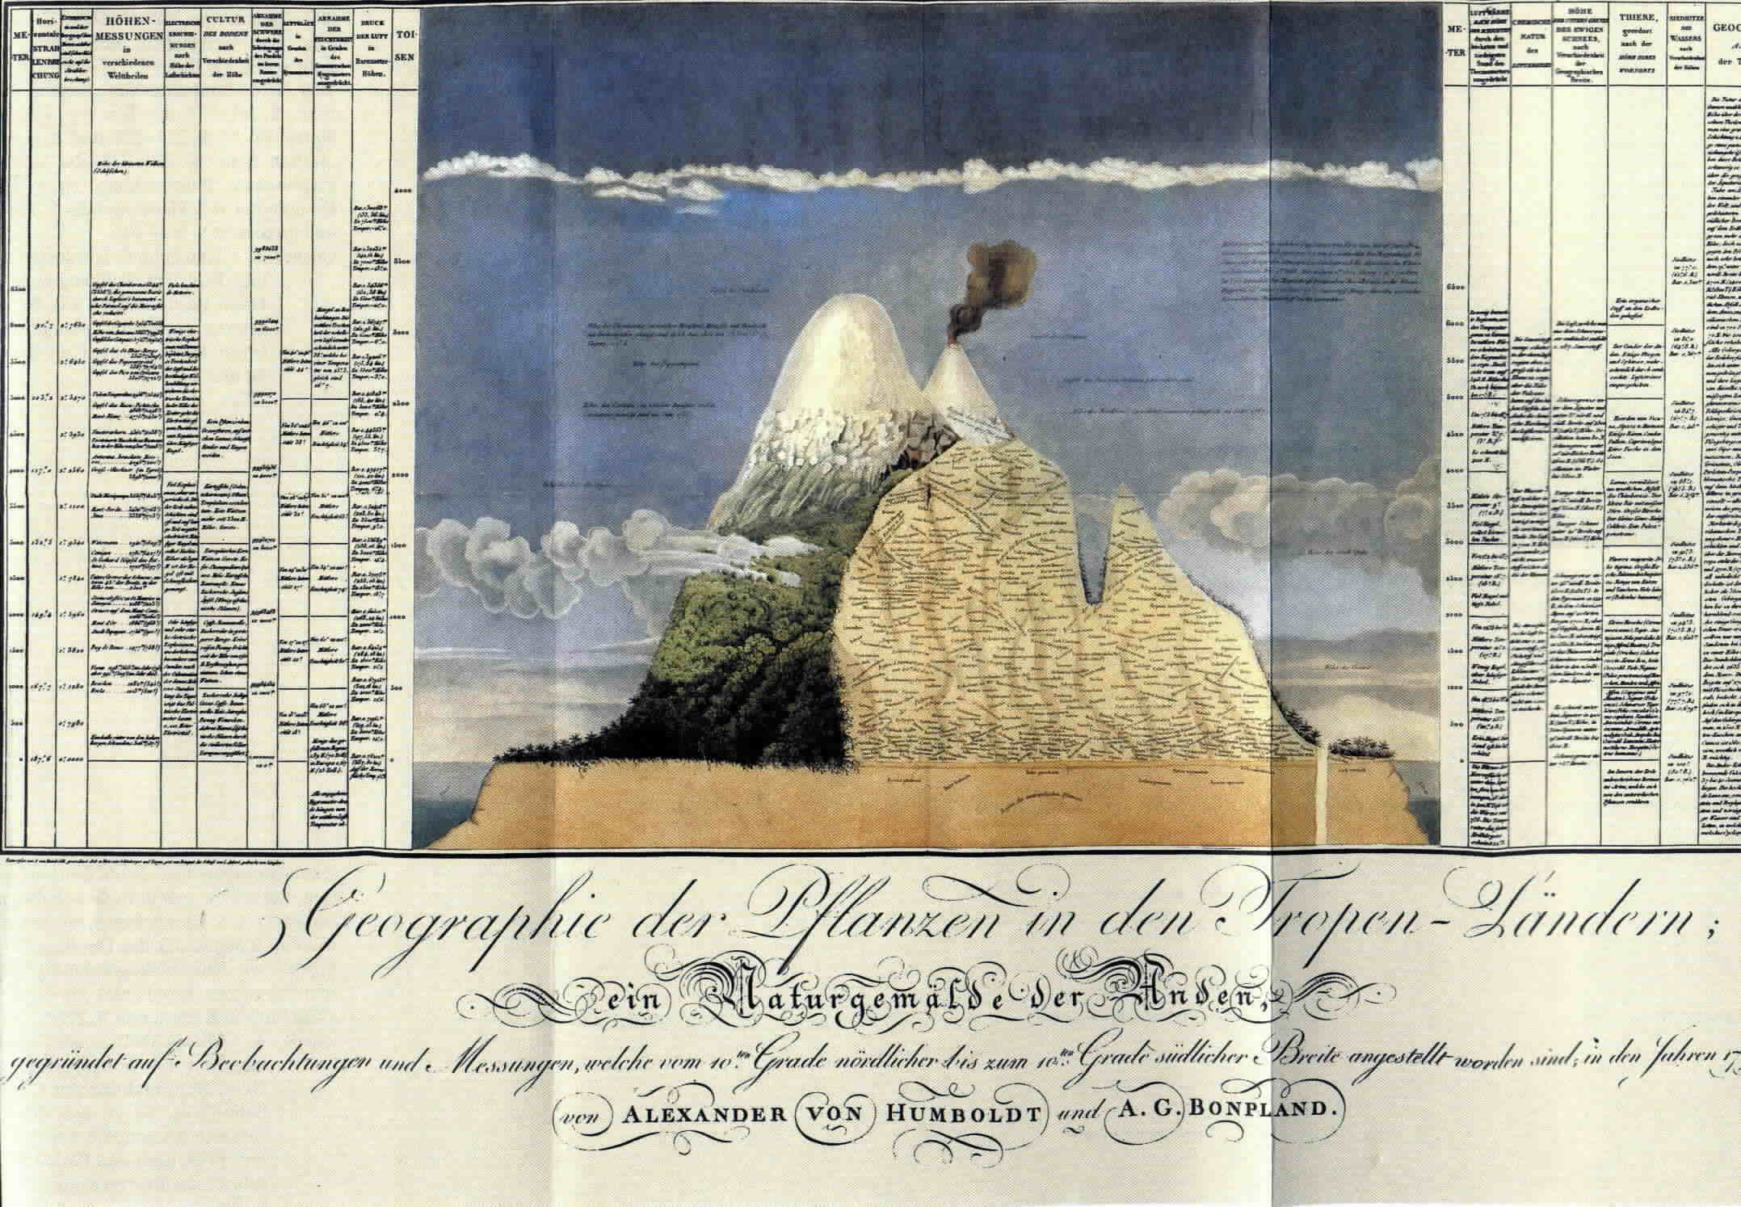
Origins of biogeography: Alexander von Humbolt
Essay on the Geography of Plants (1807)
Notes:
Alexander von Humboldt’s contributions, in particular the narrative account of his explorations to the New World tropics (1852) and his classic, comprehensive Essay on the Geography of Plants (1807), not only inspired Darwin and Wallace and generations of others to become naturalists, but also served as exemplars of holistic approaches to exploring the geography of nature. The Essay on the Geography of Plants included his Tableau Physique (above) which, in addition to detailing the distributions of plants and animals along the slopes of Mount Chimborazo (6268 m), describes elevational variation in air temperature, light intensity, the limits of perpetual snow, and geological phenomena.

Slide 3
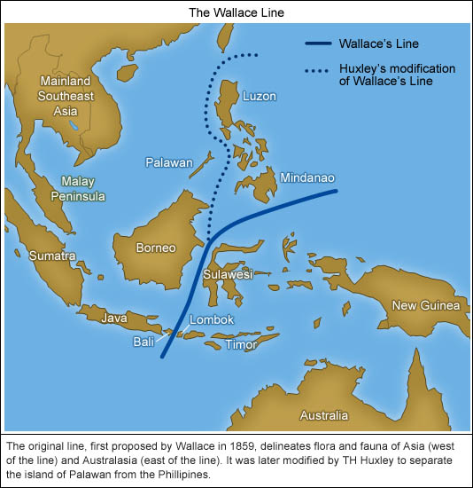
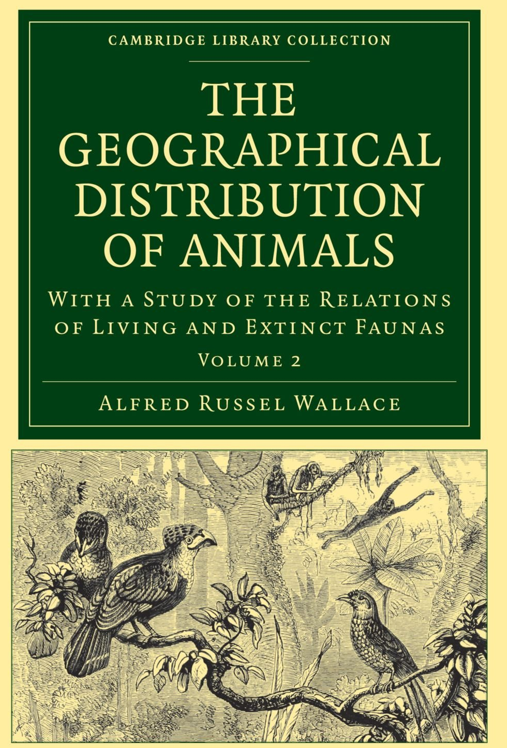
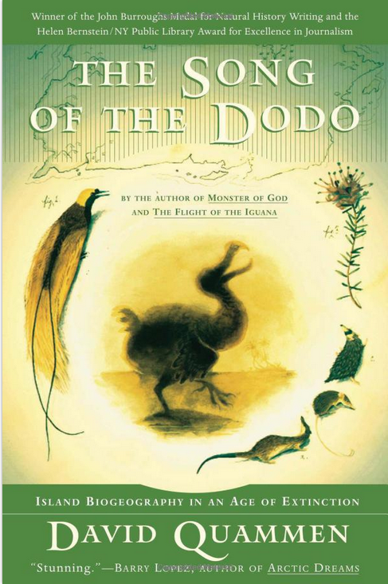
Origins of biogeography: Alfred Russel Wallace
Notes:
Wallace’s Line proposed in 1859
His two volume “Geographical Distribution of Animals” was published in 1876,

Slide 4
Types of biogeography
Historical biogeography
  Spans deeper history where evolutionary change over time is more visible
  The processes that make patterns are indirectly inferred through proxy measures
  We look at historical biogeography in this introductory lecture, although the rest of the semester is more focused on ecological biogeography.
Ecological biogeography
  Less dependent upon proxy measures
  Present-day and recent history over the past few centuries
  Often incorporates human impacts
  Evolution is relevant but depends upon the life span of organism
  Processes shaping biogeographic patterns more directly measurable
Notes:
Of note though, evolutionary processes are increasingly recognized as operating over faster time scales than previously thought. As I note later in the slides, the division between these two type of biogeography depend upon technological innovation and the accumulation of knowledge

Slide 5
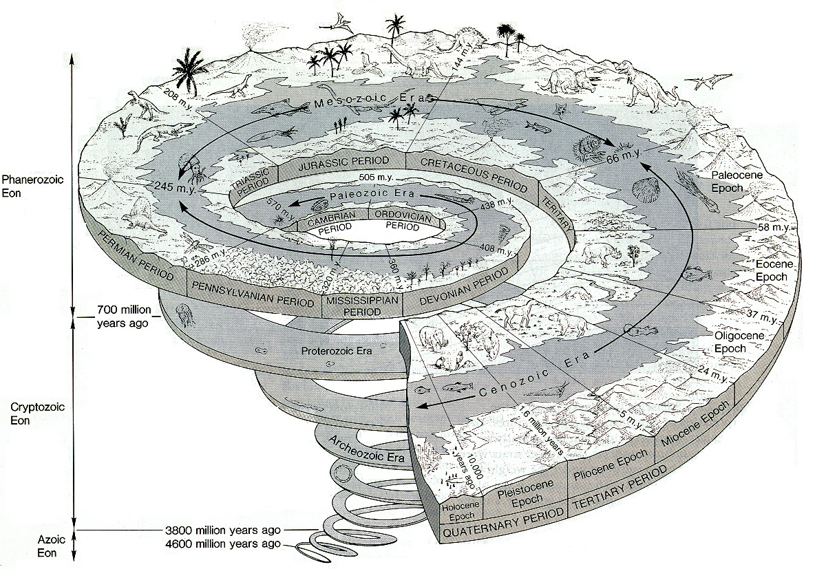
The geologic time scale
Our class focus is on ecological biogeography, which we will designate as from the Pleistocene to the present
Holocene – 10,000 yrs ago
Pleistocene – approx. 2 mya
Notes:
In this class, which focuses more on ecological biogeography, we concentrate on the Pleistocene forward.
Holocene – 10,000 yrs ago
Pleistocene – 2 mya
The Pleistocene was not an “Ice Age”, but a two million year period of oscillating warm and cold climates.

Slide 6
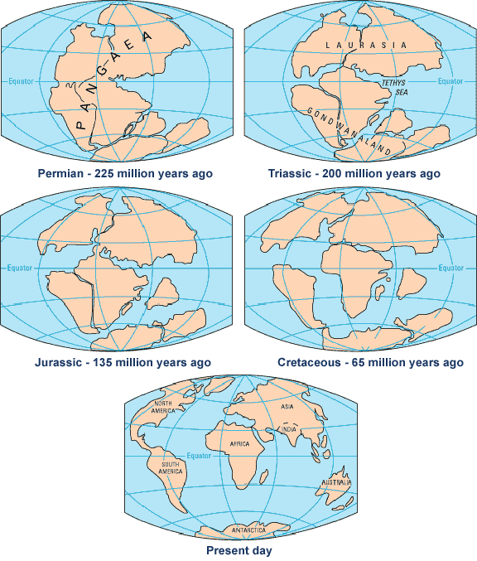
Process controls of patterns seen in historical biogeography
Plate tectonics
  Creates mountain ranges and ocean basins
  This shapes dispersal patterns of plants and animals
  Moves organisms around as continents aggregate and break apart
Long-term variations in Earth-Sun geometry
  Shapes climate and sea level, both can be barriers to dispersal
Evolutionary processes
Ecological interactions relevant but more challenging to decipher when deep in history
Notes:
Climate can be a barrier just like a mountain range

Slide 7
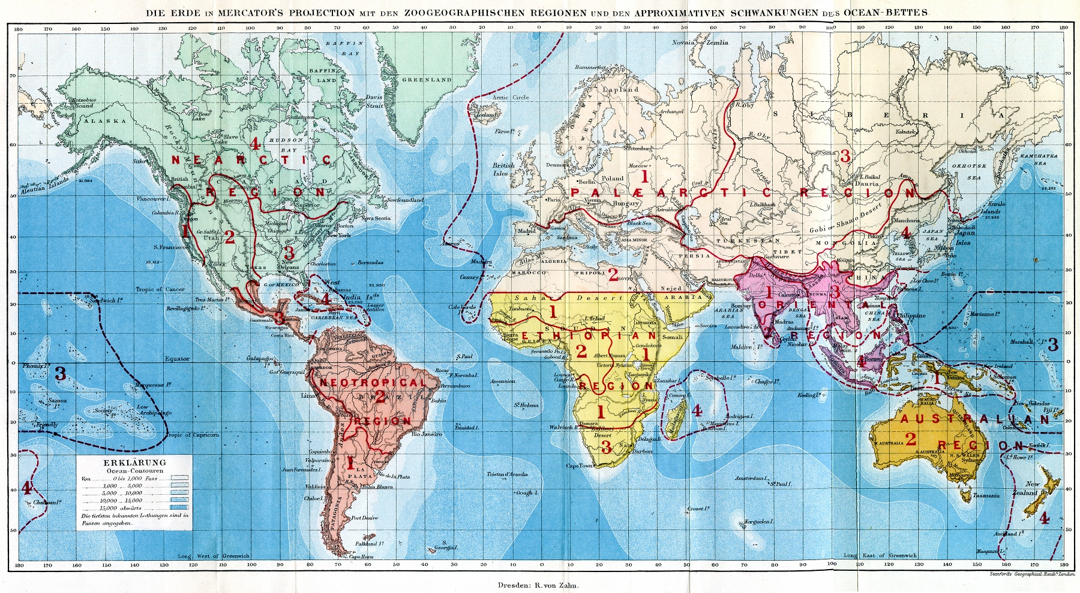
Notes:
In an 1858 paper for the Proceedings of the Linnean Society, British zoologist Philip Sclater first identified six terrestrial zoogeographic realms of the world. Alfred Wallace adopted Sclater's scheme for his book The Geographical Distribution of Animals (shown in this image). This is the same scheme that persists today, with relatively minor revisions,
Before plate tectonics was known, the main process believed to alter biogeographic distributions was dispersal. Taxonomic groups were thought to originate in one confined area, called the center of origin, and then descendant populations dispersed away from it.

Slide 8
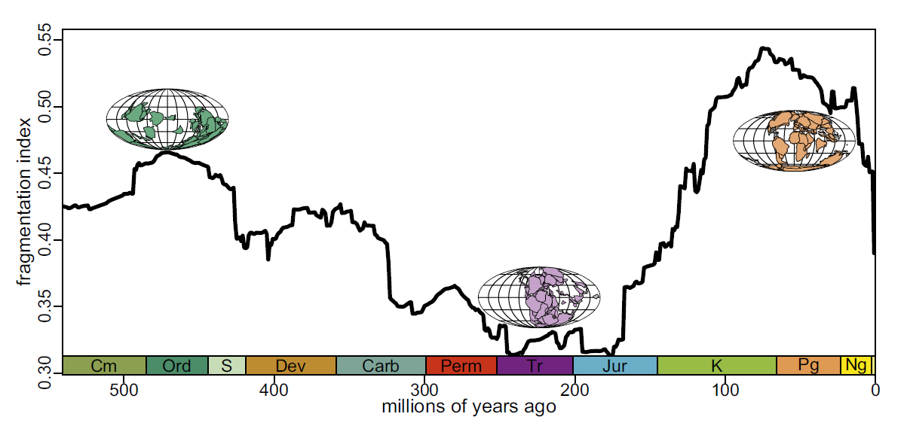
Plate tectonic regulation of global marine animal diversity
Notes:
An exercise in global historical biogeography – for ocean biota.
Zaffos, A., Finnegan, S., & Peters, S. E. (2017). Plate tectonic regulation of global marine animal diversity. Proceedings of the National Academy of Sciences, 114(22), 5653-5658.

Slide 9
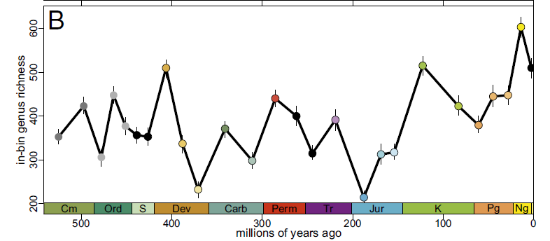
Notes:
Why is there more genus richness when the fragmentation index is higher?

Slide 10
Long-term variations in Earth-Sun geometry
Contribute to alternating climates that shape the distribution of organisms over longer time scales:
  Interglacial (warm)
  Glacial (cold)
Have profound effects on sea level and active dispersal of organisms around planet
The Pleistocene was not an “Ice Age”, but a two million year period of oscillating warm and cold climates.

Slide 11
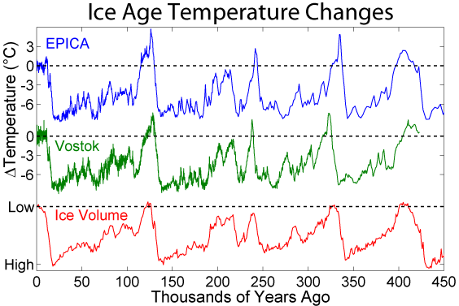
Interglacial and glacial periods
Notes:
The Pleistocene was a period of alternating glacial and interglacial periods.
Ice cores have been recovered that go back 5 million years, recording an almost annual record of temperatures.
https://www.nature.com/articles/d41586-022-02129-5
11

Slide 12
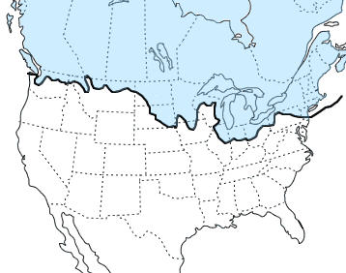
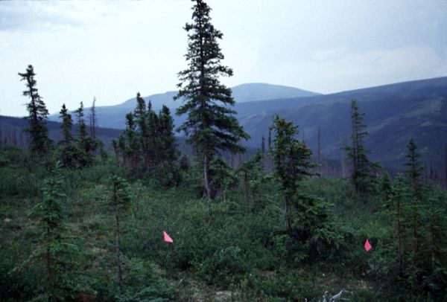
Wisconsian LGM (20,000 ybp)
LGM- Last Glacial Maximum
Blue shading on map shows the maximum extent of glaciation during the last glacial period 20,000 years ago.
Boreal forests extended as far south as Atlanta and Birmingham, Alabama.
Notes:
Boreal forest in Alaska shown at bottom. These were common in the southeastern US during the Wisconsian LGM

Slide 13
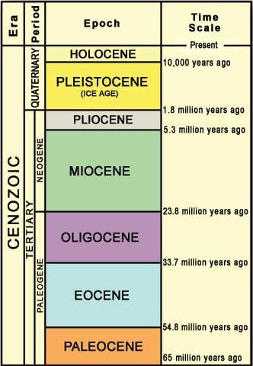
Start of Holocene interglacial (10,000 ybp)
Rapid interglacial warming at this time marks the start of the Holocene.
11,700 ybp is more exact figure
Notes:
13

Slide 14
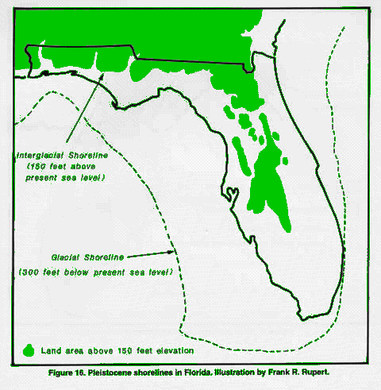
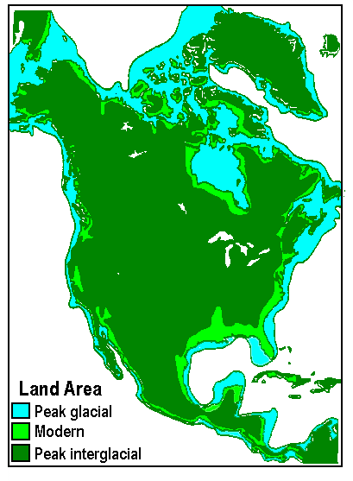
Notes:
Glacial period: lots of water trapped in ice: less evaporation because of cooler temps: sea levels drop
Interglacial (warm) period: melting: higher sea levels

Slide 15
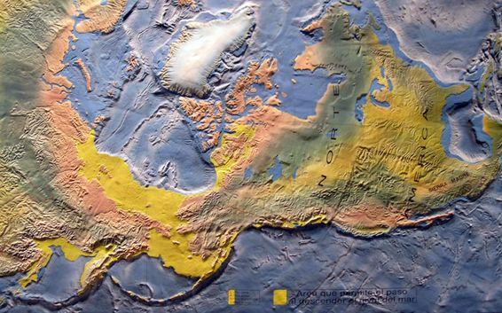
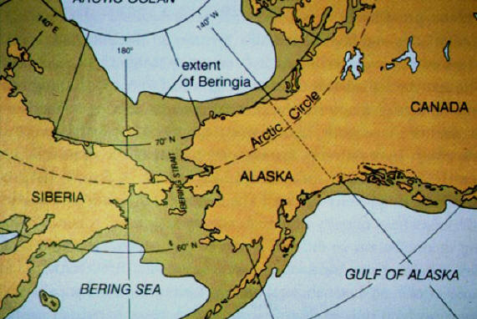
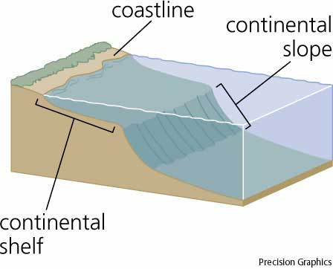
Beringia
Beringian land mass allowed humans and many other organisms to disperse from Siberia to North America. During a glacial period, there was no ocean to block their passage.
Notes:
Beringia allowed humans and many other organisms to disperse from Siberia to North America. During a glacial period, there was no ocean to block their passage.

Slide 16
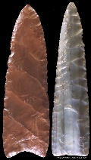
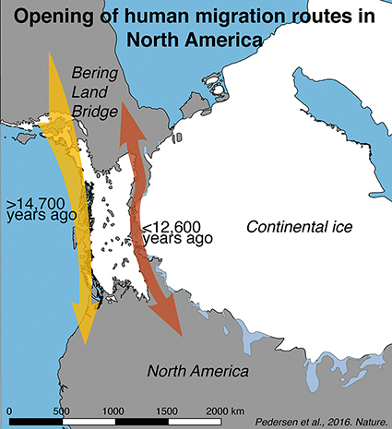
Notes:
Clovis points (right) associated with the movement of humans starting 12,600 years ago along an ice-free corridor into North America
We now know that the date of arrival of humans into North America is older

Slide 17
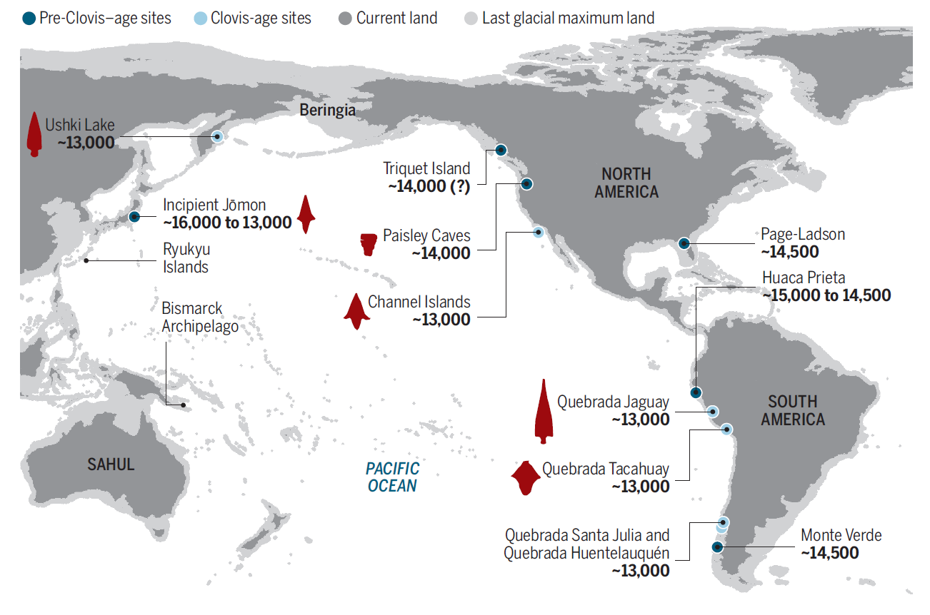
The Kelp highway
Notes:
Up until the 1990s the standing theory of how the Americas were populated was via an overland route that crossed Beringia and followed a long and narrow, mostly ice-free corridor to the vast plains of central North America. There, Clovis people and their descendants hunted large game and spread rapidly through the New World. Twentieth-century discoveries of distinctive Clovis artifacts throughout North America, some associated with mammoth or mastodon kill sites, supported this “Clovis-first” model. North America’s coastlines and their rich marine, estuarine, riverine, and terrestrial ecosystems were peripheral to the story of how and when the Americas were first settled by humans. Recent work along the Pacific coastlines of North and South America has revealed that these environments were settled early and continuously provided a rich diversity of subsistence options and technological resources for New World hunter-gatherers.
Clovis cultures were associated with dates around 11,000 ybp

Slide 18
The division between historical and ecological biogeography is subjective
Depends upon advances in tools and methods to reconstruct past environmental influences and the presence/absence of flora and fauna
What was once deep history may be ecological biogeography because of paleoenvironmental and paleoecological reconstructions
  Dendrochronology
  Palynology
  Limnology
  Ancient environmental DNA
Notes:
Cypress

Slide 19
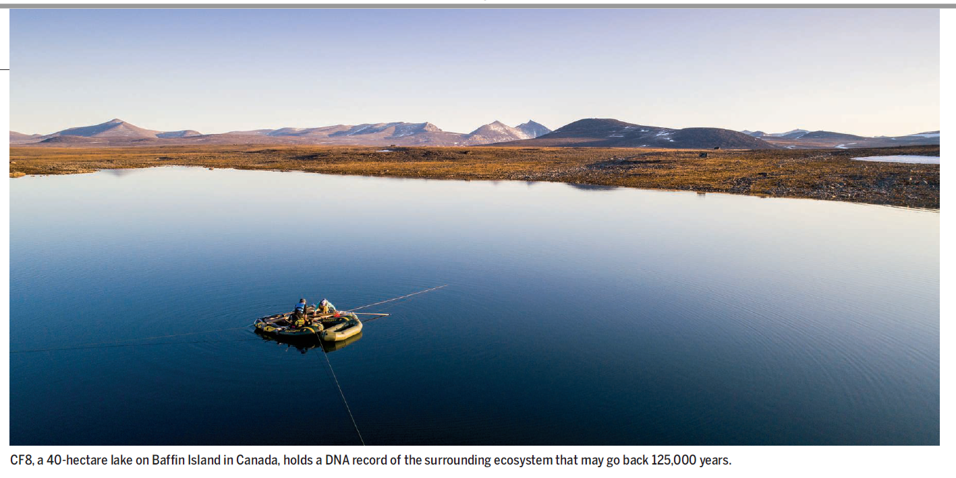
Limnology

Slide 20
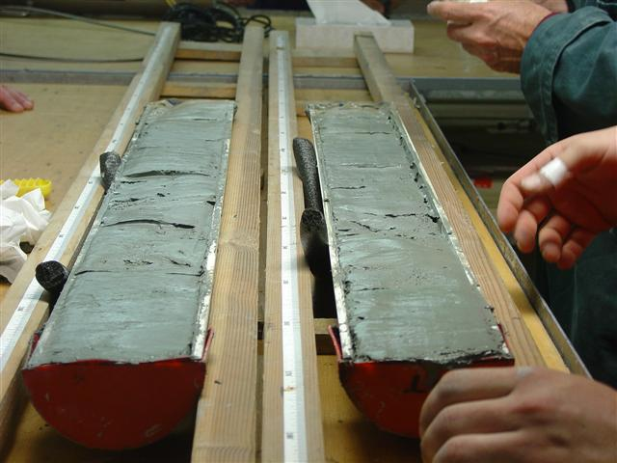
Notes:
Paleolimnology – macrofossils, pollen, carbon dating of debris found in mud and sediments of lakes and other water bodies

Slide 21
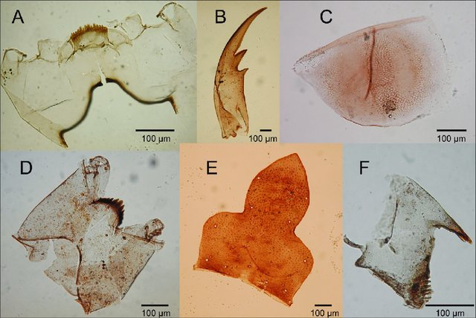
Notes:
Figure 1: Examples of chitinous fossils produced in lakes and preserved in lake sediments: Head capsules of chironomid larvae (A and D), mandibles of larvae of other aquatic insects (B and F), a resting egg of a water flea (C), and a head capsule part of a caddisfly larva (E).

Slide 22
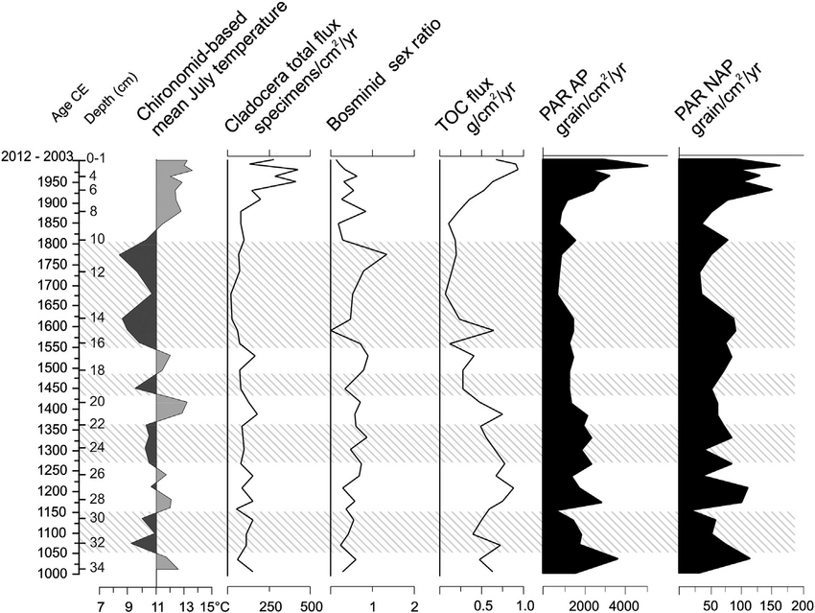
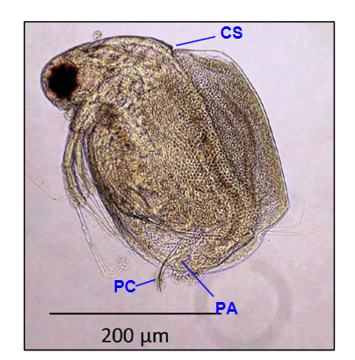
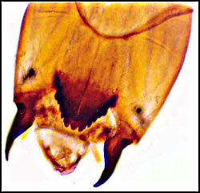
Notes:
An example of limnology as a tool to interpret past climate and floral and faunal abundances. This particular plot communicates climate variability and lake ecosystem responses in western Scandinavia (Norway) over the last 1000 years
Chironomids are flies in their aquatic larval state. Bosmids and Cladocera are water fleas, like Daphnia. Total organic carbon flux (TOC), pollen accumulation rates for arborum (tree) (PAR AP) and non-arborum (grasses) pollen flux (PAR NAP). Highlighted areas correspond to periods of climate cooling.

Slide 23
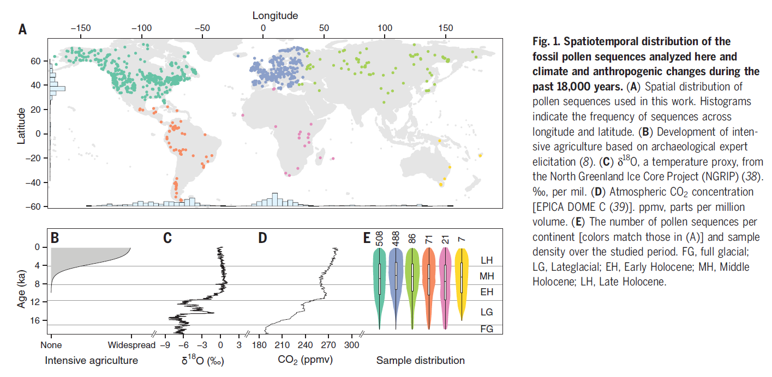
Rates of change (RoC) of paleoecological time series of pollen data
Notes:
Mottl, O., Flantua, S. G., Bhatta, K. P., Felde, V. A., Giesecke, T., Goring, S., ... & Williams, J. W. (2021). Global acceleration in rates of vegetation change over the past 18,000 years. Science, 372(6544), 860-864.
Global vegetation over the past 18,000 years has been transformed first by the climate changes that accompanied the last deglaciation and again by increasing human pressures; however, the magnitude and patterns of rates of vegetation change are poorly understood globally. Using a compilation of 1181 fossil pollen sequences and newly developed statistical methods, we detect a worldwide acceleration in the rates of vegetation compositional change beginning between 4.6 and 2.9 thousand years ago that is globally unprecedented over the past 18,000 years in both magnitude and extent. Late Holocene rates of change equal or exceed the deglacial rates for all continents, which suggests that the scale of human effects on terrestrial ecosystems exceeds even the climate-driven transformations of the last deglaciation. The acceleration of biodiversity change demonstrated in ecological datasets from the past century began millennia ago.

Slide 24
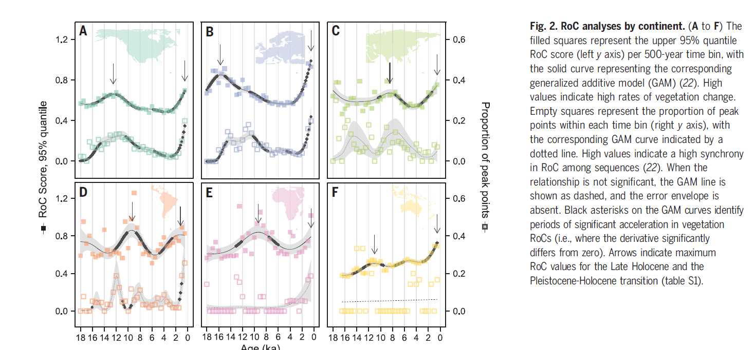
Notes:
Mottl, O., Flantua, S. G., Bhatta, K. P., Felde, V. A., Giesecke, T., Goring, S., ... & Williams, J. W. (2021). Global acceleration in rates of vegetation change over the past 18,000 years. Science, 372(6544), 860-864.

Slide 25
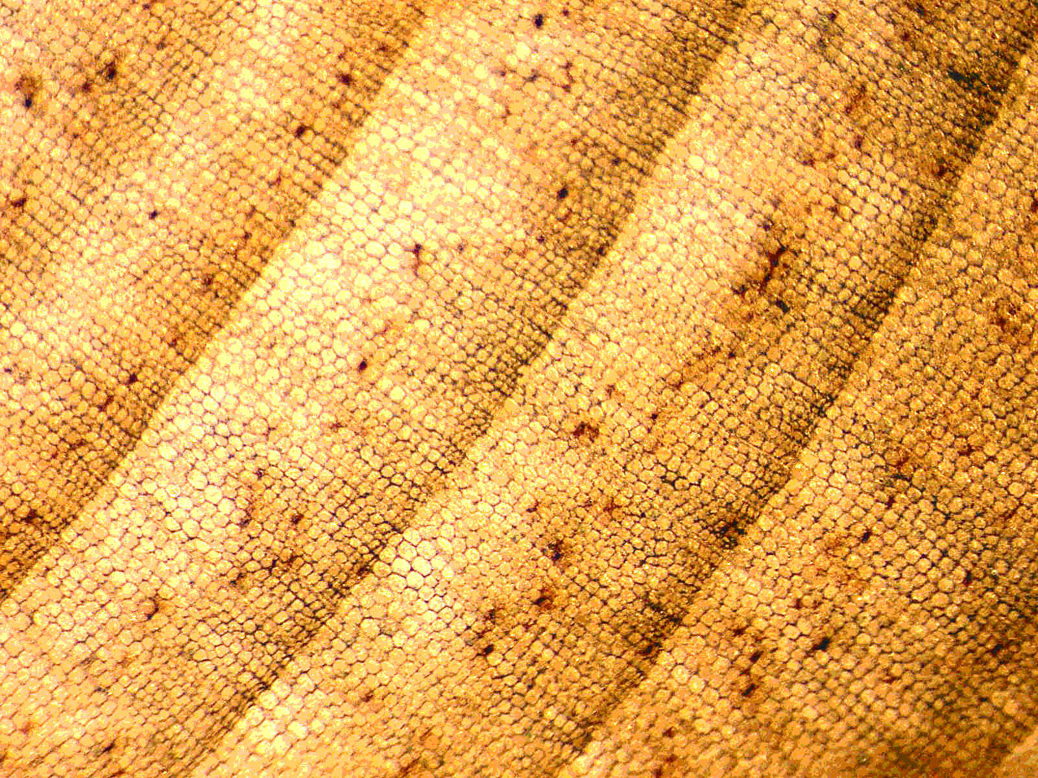
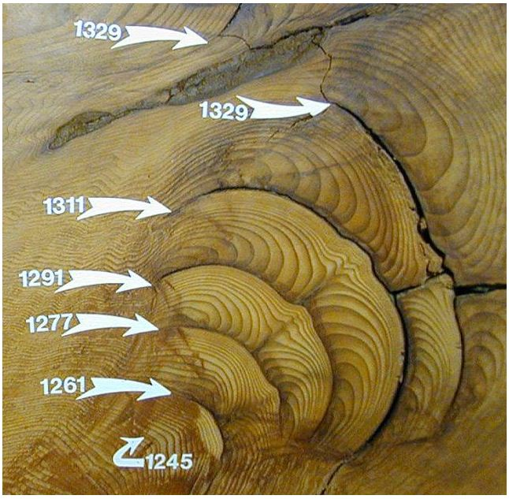
Dendrochronology
Notes:
Early wood and late wood in an annual ring (left)
Fire scars (right)
Dendroclimatology
Dendropaleotempestology
Dendroisotopes

Slide 26
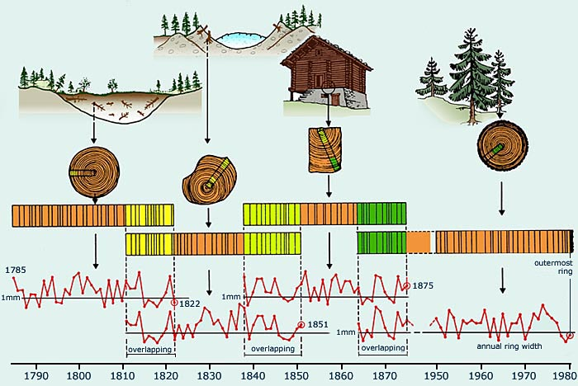
The principle of cross-dating
Notes:
The chronology at the bottom is the master chronology
Typically can go back years, decades, and centuries. Older trees and preserved trees in the environment or in archaeological sites have been used to develop chronologies back 14,000 years.

Slide 27
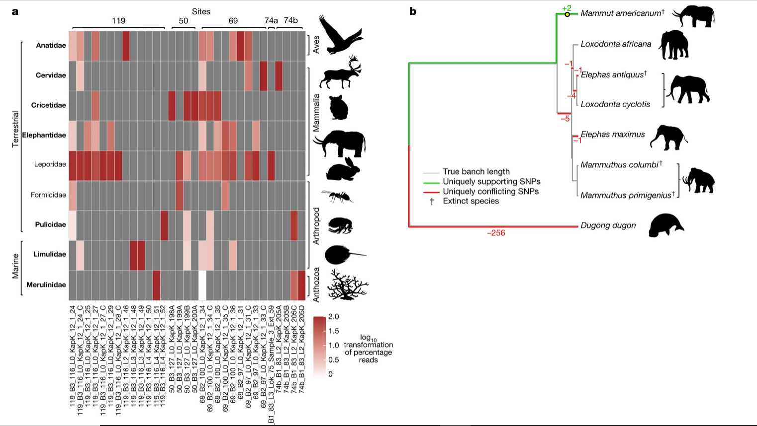
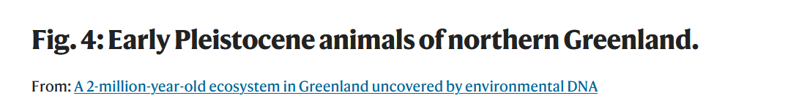
Ancient environmental DNA
Notes:
Kjær, K.H., Winther Pedersen, M., De Sanctis, B. et al. A 2-million-year-old ecosystem in Greenland uncovered by environmental DNA. Nature 612, 283–291 (2022). https://doi.org/10.1038/s41586-022-05453-y

Slide 28
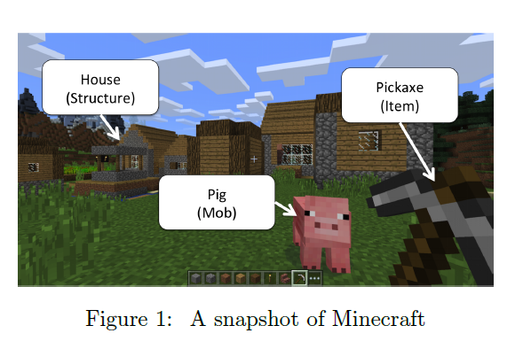
Ontology
An ontology is a scheme for organizing and labeling entities and processes
An ontology is a specification of a conceptualization.
How we ‘label’ things influences how we respond to and work with them
Notes:
Ontology can be fixed and almost below the level of thought, or it can be flexible and accommodating

Slide 29
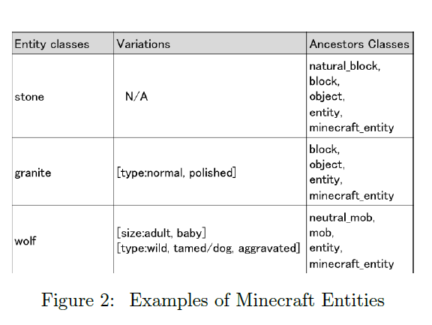
Notes:
This is an ontology of Minecraft – it defines the objects in the program and their relationships to one another, as well as their relationships to other classes of objects. Very logical right? Do you think such rigidity of names and objects and their classes works as smoothly in biological systems (instead of video games)?

Slide 30
Fixed categories (being) versus processural accounts (becoming) of nature
What is a species?
Being and becoming is a philosophical, ontological tension that manifests in biology.
Ontologies in biological systems need to have some fixity to allow humans to understand them, but nature does not rigorously adhere to these categories and this fixity
The concept of ‘‘species’’ itself has multiple definitions. In fact, some scholars argue there is no such thing as a species.
Pfisteria

Slide 31
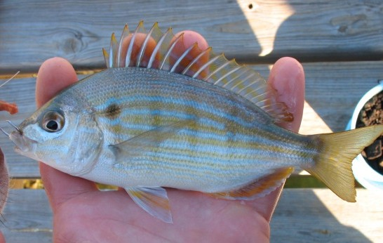
Not only do organisms change, but so do the ways in which humans label and categorize them
Scientific taxonomy versus common names (folk classifications)
  Lagodon rhomboides
  “Chopa espina” (Mexico and Cuba)
  “Chofer” (old timers in Florida panhandle)
  “Pinfish” (wealthier newcomers in Florida panhandle)
Notes:
Baitfish debates
Ontology here is more than just a name, it is a process, one that reflects positions of power and identity, as in what you call (or enact) as the name of this fish reflects a distinctive context, and positionality. Having an agreed upon scientific names enables conversations about the fish and its biology, while common names, although informative about culture, can be confusing in a scientific context.

Slide 32
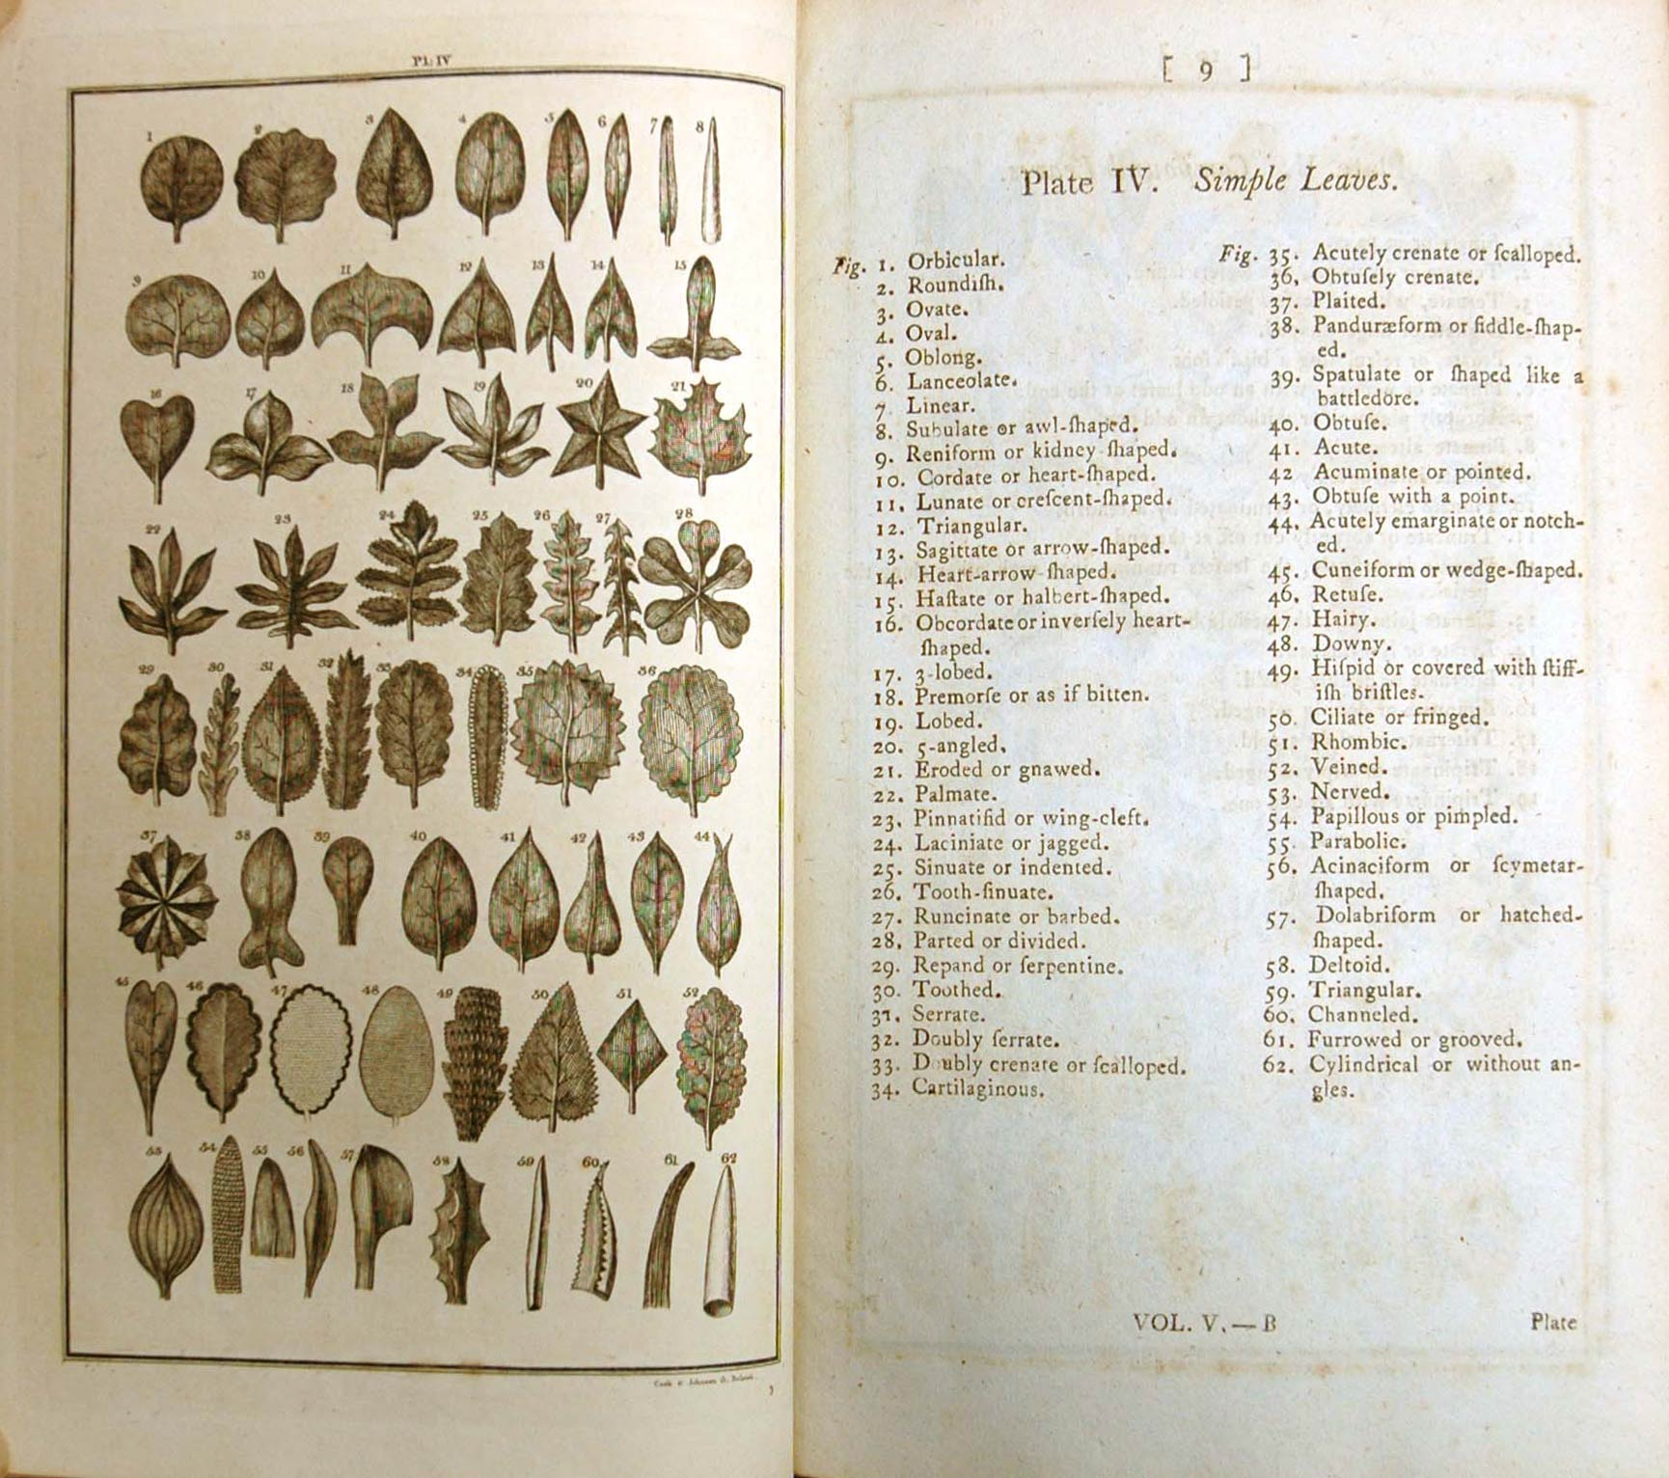
Taxonomic hierarchies (an ontology)
Kingdom
Phylum
Class
Order
Family
Genus
Species
Subspecies
Notes:
Carolus Linnaeus
This ontology has proven very useful, but it does have some weaknesses. For example, how we define these groupings, particularly species and subspecies, has a degree of arbitrariness and impermanence.

Slide 33
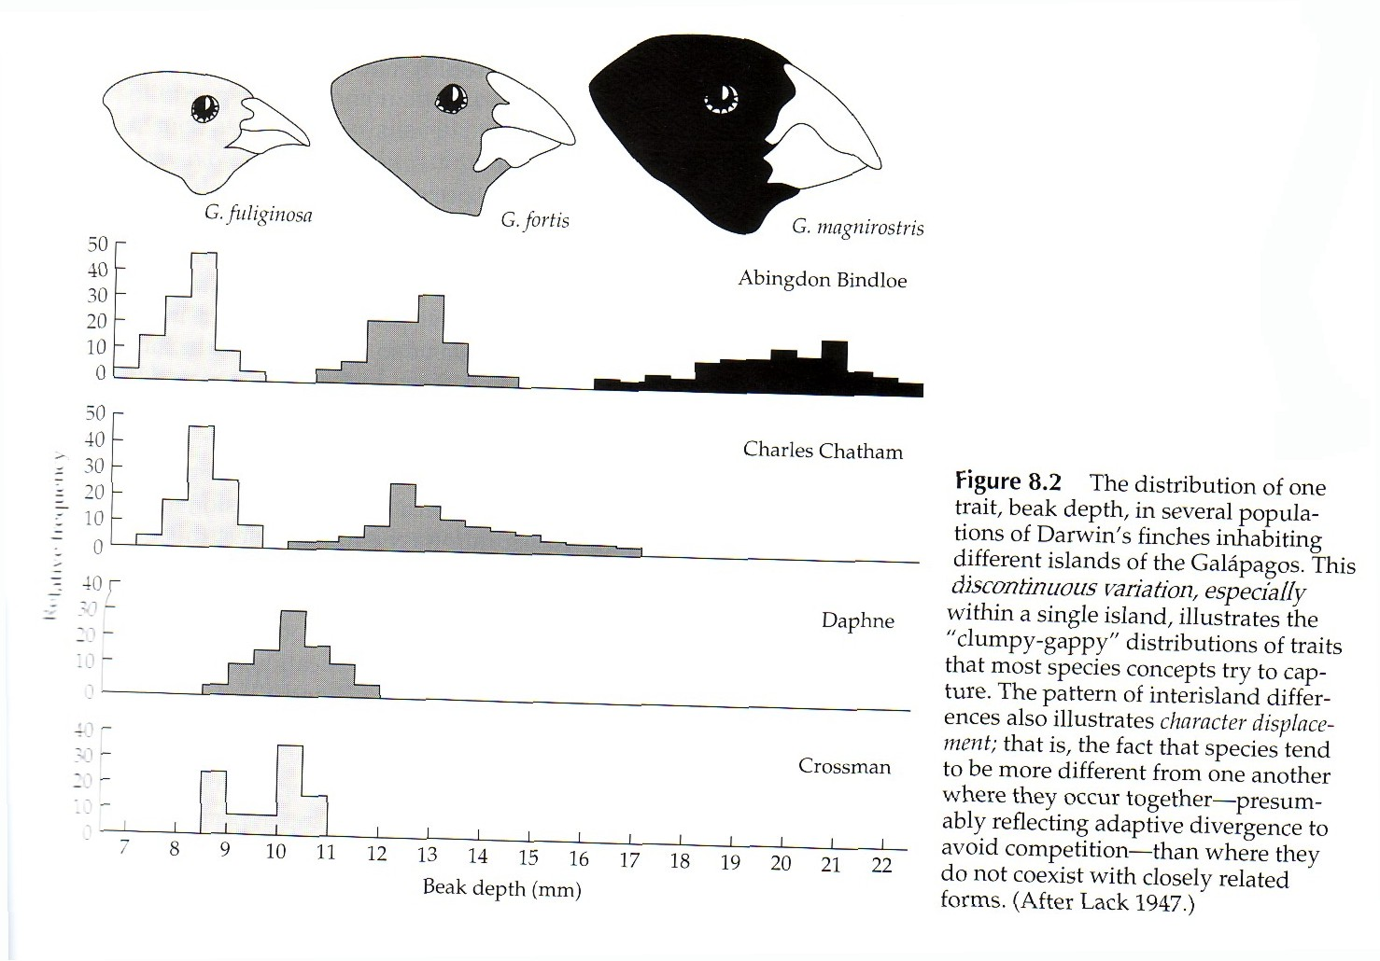
What is a species?
The morphological species concept
Notes:
Ontologies are imprecise and pluralistic in biology. There are actually several different ways to define a species and none of them are perfect.

Slide 34
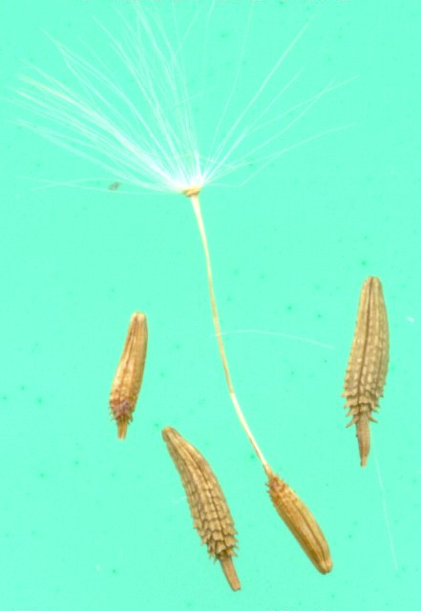
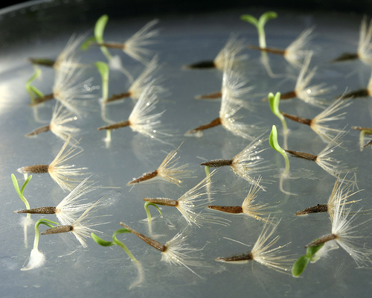
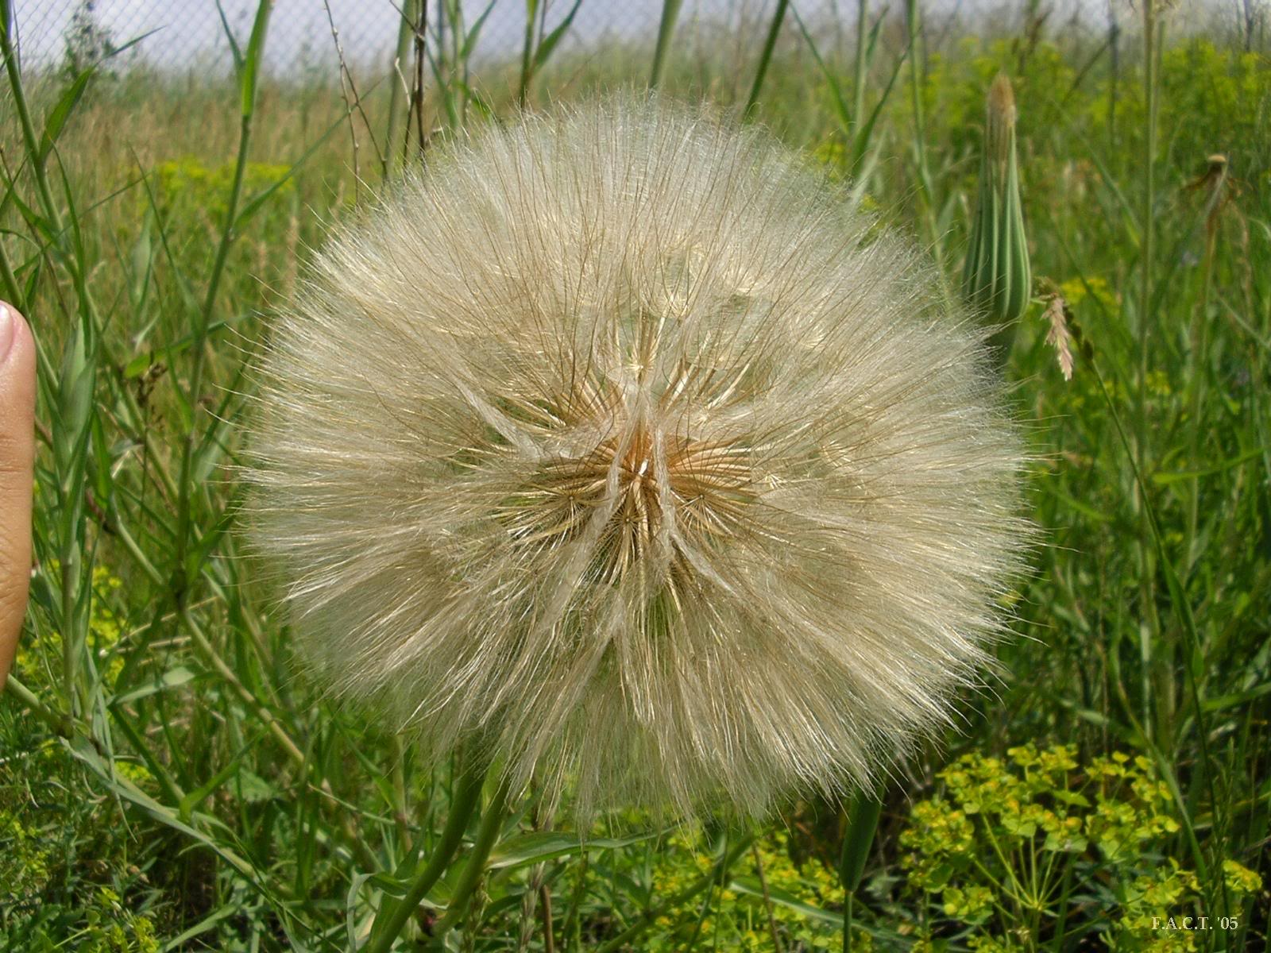
Notes:
Achene – the thicker darker seed, the pappus, the white whispy structures

Slide 35
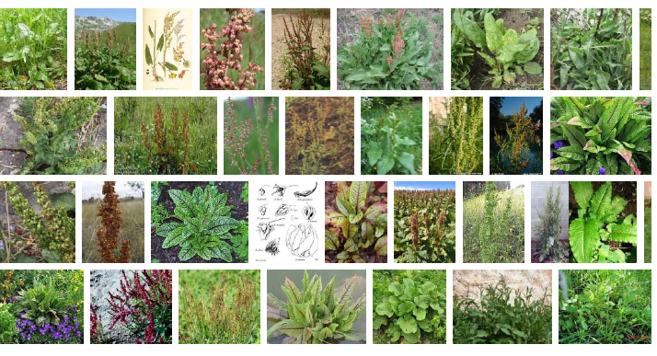
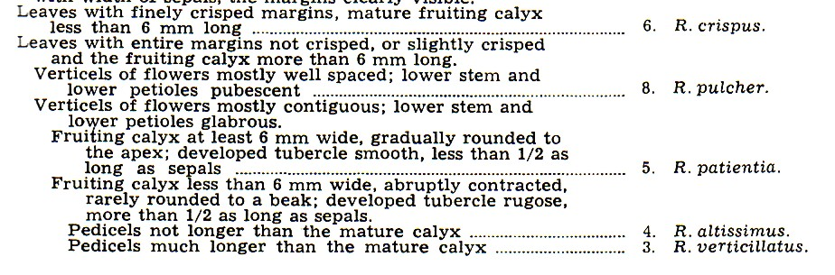
Notes:
Morphological species concept for Rumex, buckwheats

Slide 36
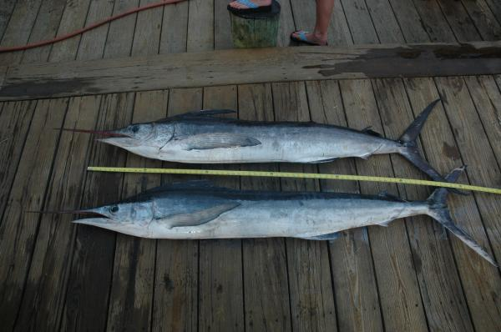

Slide 37
A white marlin (top) and roundscale spearfish (bottom) showing their very similar appearance, or phenotype.
Notes:
White Marlin: Abundance of a Look-Alike Species Clouds Population Status of a Million Dollar Fish
The prized white marlin, sought by anglers in million dollar prize tournaments and captured incidentally in commercial fisheries, is among the most overfished marine species under international management and the subject of contentious debate on how to best achieve its recovery. A study (2009) published in the journal Endangered Species Research casts uncertainty on the accuracy of current knowledge of white marlin biology and previous population assessments, which form the basis of management and conservation policy.
The study reports that the white marlin look-alike species, the enigmatic roundscale spearfish -- whose very existence was only confirmed three years ago -- makes up almost a third (approximately 27%) of the fish historically identified as white marlin. This previously unrealized, relatively high abundance of roundscale spearfish and their misidentification might have impacted past assessments of white marlin population sizes and concomitant management efforts.
Given considerable concern about its declining populations, petitions to list the white marlin under the U.S. Endangered Species Act were considered in 2002 and 2007. Listing the fish would have undoubtedly put an end to white marlin fishing tournaments, which infuse millions of dollars into the recreational fishing industry as well as local economies.
This proportion of roundscale spearfish along with its longstanding misidentification as white marlin for decades compromises the accuracy of current biological knowledge on white marlin.

Slide 38
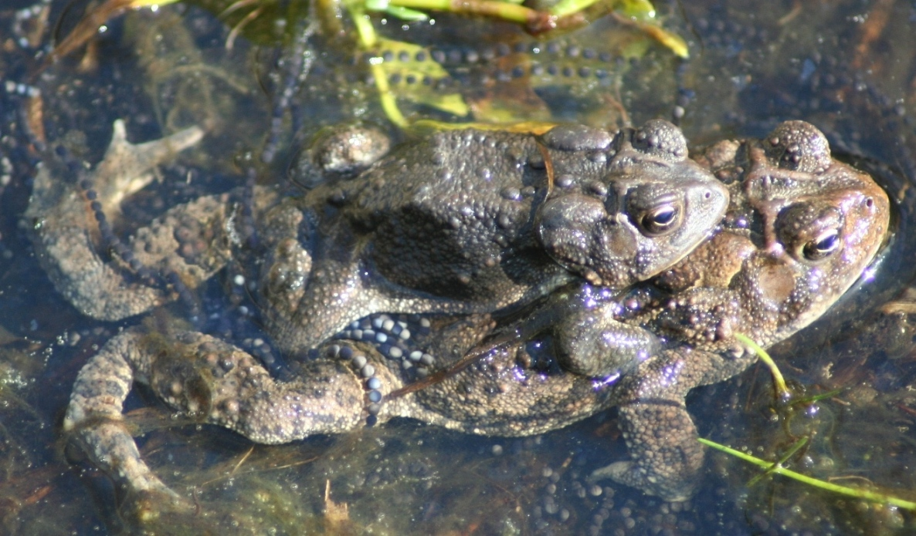
What is a species?
The biological species concept: species can interbreed freely to produce viable offspring under natural conditions
Notes:
This definition assumes sexual reproduction

Slide 39
Hybridization
Defined broadly as reproduction between members of genetically distinct populations
Interspecific (between species) hybridization has often been seen as an exception rather than the rule
However, a large number of species hybridize regularly, even though only a small fraction of a population may be involved
Hybridization may be much more common than earlier scholars thought.

Slide 40
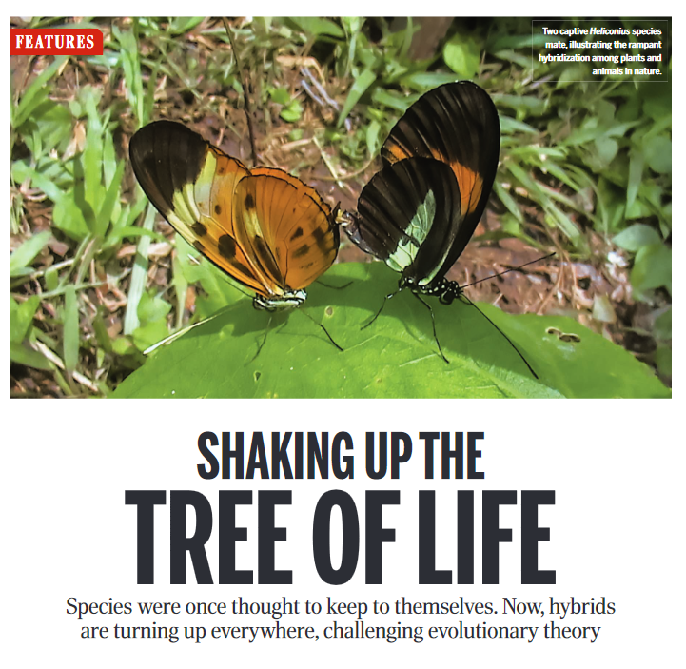
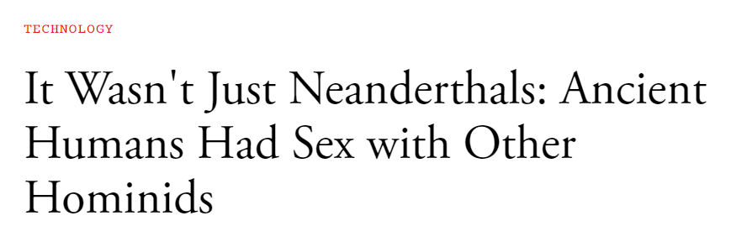
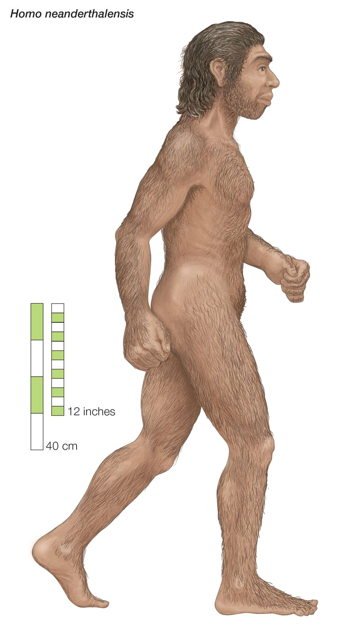
Notes:
Almost every genome study where people use sensitive techniques for detecting hybridization, it is found.
Same with humans –Homo neanderthalensis and Home sapiens are one of the hybridization events in our biogeographic history

Slide 41

Grizzly-polar bear hybrids are emerging due to climate change, as polar bears that live and hunt on the ever-shrinking Arctic sea ice are forced on land during mating season in spring and summer.
At the same time, male grizzly bears are expanding their habitats, roaming into polar bear territories, and emerging from hibernation earlier in the year
Although the current drivers for interbreeding are novel, polar bears and grizzly bears have cross-mated before.
Polar bears and grizzly bears first diverged as a species between 479,000 and 343,000 years ago. Since then, the two species have met and interbred several times, and today, grizzly bears still retain some of this ancient polar bear DNA, and vice-versa.
Ursus maritimus – polar bears
Ursus arctos horribilis –grizzly bears
Notes:
Polar bears and grizzly bears don’t think in terms of species
Ursus maritimus – polar bears
Ursus arctos horribilis – mainland grizzly bears in North America
Their offspring are fully fertile
Grolar or pizzly bear
Climate change is in part responsible for the emergence of these grolar hybrids, as polar bears that live and hunt on the ever-shrinking Arctic sea ice are forced on land during mating season in spring and summer. At the same time, male grizzly bears are expanding their habitats, roaming into polar bear territories, and emerging from hibernation earlier in the year. Inuit hunters have spotted grizzly bears in the Arctic for decades, but numbers are believed to have increased recently, as males disperse further to find mates.
Although the current drivers for interbreeding are novel, polar bears and grizzly bears have cross-mated before. Polar bears and grizzly bears first diverged as a species between 479,000 and 343,000 years ago. Since then, the two species have met and interbred several times, and today, grizzly bears still retain some of this ancient polar bear DNA, and vice-versa.

Slide 42

Cichlids: ancestral hybridizations
Lake Victoria produced 500 species of cichlid in 15,000 years from only a few ancestor species: “Darwin’s Dreampond”
Allopatric and sympatric speciation have been the main narrative to explain this adaptive radiation
However, hybridization before this adaptive radiation of species provided the genetic variability for it to occur so rapidly
Notes:
https://www.quantamagazine.org/new-hybrid-species-remix-old-genes-creatively-20190910/

Slide 43

The eastern coyote and hybridization events
Hybridization of western coyote with wolf populations in western US and north of the Great Lakes with eastern wolves took place as these coyotes began dispersing back into eastern US
Coyotes once had distribution across N. America, but hunted to extinction almost everywhere except for locations in western US.
Coyotes also hybridizing with domestic dogs
Eastern coyote can be 40% larger than western coyote and more of a pack hunter
Notes:
The eastern coyote is actually a four-in-one hybrid of coyotes, eastern wolves, western gray wolves, and dogs.
Coyotes in the Northeast are mostly (60%-84%) coyote, with lesser amounts of wolf (8%-25%) and dog (8%-11%). Start moving south or east and this mixture slowly changes. Virginia animals average more dog than wolf (85%:2%:13% coyote:wolf:dog) while coyotes from the Deep South had just a dash of wolf and dog genes mixed in (91%:4%:5% coyote:wolf:dog). Tests show that there are no animals that are just coyote and wolf (that is, a coywolf), and some eastern coyotes that have almost no wolf at all.
All eastern coyotes show some evidence of past hybridization, but there is no sign that they are still actively mating with dogs or wolves. The coyote, wolf and dog are three separate species that would very much prefer not to breed with each other. However, biologically speaking, they are similar enough that interbreeding is possible.
Nowadays, eastern coyotes have no problem finding a coyote mate. Their populations continue to grow throughout their new forested range, and they seem more likely to kill a dog than breed with it. Wolf populations in the Great Lakes have also recovered, and the wolf is once again the worst enemy of the coyote, rather than its last-chance prom date.
https://theconversation.com/yes-eastern-coyotes-are-hybrids-but-the-coywolf-is-not-a-thing-50368

Slide 44

Facultative parthenogenesis

Slide 45


Facultative parthenogenesis is asexual reproduction by a sexually reproducing species
Documented in four diverse taxonomic groups, sharks, birds, lizards, and snakes.
A polar body fuses with the nucleus of the mature ovum, restoring diploidy and triggering cell division.
Notes:
When a polar body fuses with the mature ovum, diploidy is restored

Slide 46


Parthenogenic vs hermaphroditic
Helix aspersa is a hermaphrodite, producing both male and female gametes. Reproduction is usually sexual, although self-fertilization can occur.
The asexual, all-female whiptail species Cnemidophorus neomexicanus (center), which reproduces via parthenogenesis, is shown flanked by two sexual species, C. inornatus (left) and C. tigris (right), which hybridize naturally to form the C. neomexicanus species.

Slide 47

Clonal or vegetative reproduction
Successive development of tissues (fungi) or accessory stems and roots (flowering plants) from original organism. Genetically similar through time and can result in extremely long-lived and large organisms
Notes:
Clonal growth is advantageous as it serves as means of vegetative reproduction, secures colonization of unoccupied ground, increases competitive power of the species within the community, increases survival rate of the stressed/disturbed genet in marginal habitats, forms replacement for ageing or damaged organs, and enables reiteration of the genet's entire architectural model.
“Pando” is a clonal colony of a single male quaking aspen (Populus tremuloides) located in the U.S. state of Utah, all determined to be part of a single living organism by identical genetic markers and one massive underground root system, although whether it is a single tree is disputed, as it depends on one's definition of an individual tree. The root system of Pando is claimed by some to be among the oldest known living organisms in existence at 80,000 years of age.

Slide 48

What is a species?
The phylogenetic species concept
Notes:
Phylogenetic species: relatedness is determined by a shared common ancestor. Typically, relatedness is defined by genes, DNA, or morphological characteristics that allow its phylogeny to be mapped.
The concept of a phylogenetic species is a group whose members are descended from a common ancestor and who all possess a combination of certain defining, or derived, traits Hence, this concept defines a species as a group having a shared and unique evolutionary history.
What is a species? It is not a simple question and it does not have a simple answer. But we do need the idea of a species, correct? Something we can frame protection around, an entity that we can define and work with and have a degree of certainty?

Slide 49

Ancestral relatedness can be different when defined by morphological versus genetic criteria.
Morphological phylogeny
Molecular phylogeny (based on DNA)
Notes:
Squamates – chiefly lizards and snakes
Tuataras – lizard-like organism native to New Zealand
Turtles are more similar to crocodilians evolutionarily as based on DNA. Although a strictly morphological treatment of relatedness over time (say the appearance of a shell) would put them at a distance from each other.
Criticism of phylogenetic approaches is that relatedness is subjective, choice of DNA or morphological trait to use can vary from researcher to researcher

Slide 50


Phylogenetic criteria
Can be morphologic or genetic
Genetic criteria rely on DNA ‘clocks’ to construct phylogenies
  Nuclear DNA, mitochondrial DNA, choroplast DNA
Notes:
Proteacea - family of plants native to Australia
What organisms is being studied, and how far back in time you wish to reconstruct a phylogeny will determine which clock to use.

Slide 51

Phylogeography
Study of the historical processes that may be responsible for the contemporary geographic distributions of individuals
DNA clocks are used to reproduce evolution in time as well as in space
Area cladograms summarize these patterns in time and space.

Slide 52

Killer whales (Orcinus orca)
Originally thought to be one species
Full mitochondrial genome analysis suggest multiple species and subspecies
Notes:
http://www.nmfs.noaa.gov/pr/species/mammals/cetaceans/killerwhale.htm
Scientific studies have revealed many different populations--or even potentially different species or subspecies--of killer whales worldwide. These different populations of killer whales may exhibit different dietary needs, behavior patterns, social structures, and habitat preferences. Therefore, interbreeding is not expected to occur between different populations, in spite of the overlap between home ranges.

Slide 53

Notes:
This plot shows the phylogenetic concept of species applied to killer whales. Species identity is related to evolutionary history and ancestry.

Slide 54

Three populations of killer whales in the Antarctic belong in their own individual species (as based on the phylogenetic species concept): a form that feeds mostly on dolphins and whales (Type A, bottom left), a pack ice killer whale that hunts seals by knocking them off ice floes (Type B, top left) and the Ross Sea killer whale, which pursues fish under the ice (Type C, top right).
Transient killer whales that live in the northeastern Pacific near Alaska are the most genetically distinct of the killer whales. This group diverged from other killer whales as a separate species about 700,000 years ago
Notes:
Differences in their mitochondrial DNA is as large as what is seen in other species.
In this case, the differences in mitochondrial DNA were also associated with very different social behaviors, in particular, how they hunt. There are phenotypic differences in the eye patch and color pattern, but they are perhaps not as striking as the differences in social behavior

Slide 55

Criticisms of phylogenetic approaches that use genetic information
Sensitive to choice of genetic clock
Phylogenetic trees produced from microRNA produced results different from DNA – and were called into question as valid
Notes:
microRNA phylogenies have been called into question. They may be valid for some types of organisms more than others:
https://www.pnas.org/content/111/35/E3659
MiRNAs are short post-transcriptional gene regulators

Slide 56
Subspecies
Nomenclature includes three Latin names (genus, species, subspecies)
Subspecies designation based on one or more of the following:
  Morphologic differences
  Genetic differences
  Geographic distribution
  Niche
Subspecies can interbreed with other subspecies to produce viable offspring, but there is the potential for species divergence

Slide 57

Terrapene carolina carolina
Notes:
Eastern box turtle

Slide 58

Terrapene carolina bauri
Notes:
Florida box turtle

Slide 59


Slide 60

Eastern box turtle
Order: Chelonia
Family: Emydidae
Genus/species: Terrapene carolina
Subspecies:
Terrapene carolina bauri (Florida box turtle)
Terrapene carolina major (Gulf Coast box turtle)
Terrapene carolina triunguis (three-toed box turtle)
Terrapene Carolina carolina (eastern box turtle)
Notes:
60

Slide 61


Slide 62

88 species of rat snakes with global distribution

Slide 63

Previously, most North American rat snakes were assigned to the genus Elaphe. Analyses of mitochondrial DNA has led to revision of this classification.

Slide 64

Pantherophis obsoletus
Herpetologists produced phylogenetic evidence in 2002 for my snake to be placed in its own separate genus Pantherophis.
Notes:
Utiger et al. 2002

Slide 65

Notes:
This phylogenetic tree from a study in 2017 confirms the distinctiveness of Pantherophis from Elaphe.
Pantherophis evolved later and is considered a New World species. Elaphe as a genus is confined to the Old World. Break between Old and New World represents outcome of dispersal of rat snakes into North America.

Slide 66

Pantherophis obsoletus spiloides (Schmidt and Kunz 2005)
Notes:
Unique coloration due to adaptation on white sands and pine needled ground of Florida panhandle.
Taxonomic arguments to its subspecies status go back to 1854 based on morphology.
Other studies suggest that the subspecies delineation is not supported by mitochondrial DNA.

Slide 67


Notes:
Delineating subspecies is a challenge, but subspecies do exist, and their separation in appearance behavior and genetics may underlie ongoing adaptation, selection, and eventual speciation.
However, this designation of my rat snake is not entirely accepted. Some taxonomic authorities adopted the classification shown above, others have not.

Slide 68

Scotophis spiloides (Collins and Taggart 2008)
Notes:
Based on morphology, this study argues that Pantherophis obsoletus spiloides should be in another genus entirely.

Slide 69

Notes:
Morphological and genetic evidence used to delineate and define the new genus Scotophis (red is genetic evidence, the rest of the evidence is morphological)
You have to wonder at this point how much of this detail is relevant to the snake’s conservation…

Slide 70
So what is a species?
Good question, but no always right answer. There have even been calls to do away with the species concept.
Species are recognized as open and fluid in theory, but in practice there is a need for more stability
A compromise is to apply a combination of concepts: morphological, biological, evolutionary, genetic, location and niche.

Slide 71

Notes:
71
Repurcussions for conservation?

Slide 72

Notes:
Aesthetics, neat divisions, when their may be none.
Will our ontology of organisms be the same in 100 years? No, its subjective.

Slide 73

Name-users: rely on relatively fixed classifications contained in a formally agreed upon taxonomy (Criticisms: too much lumping, they do not acknowledge the dynamics of process)
Phylogenians: genetic and biochemical differences yield to constant realignments of groupings (Criticism is too much splitting, instability)
Notes:
Is there a right or wrong? Or is context more important? In other words whether you are a name-user of a phylogenian depends upon the context

Slide 74

Notes:
Spartina alterniflora on the coast of Georgia

Slide 75



Notes:
An argument for not changing the name (a lumper is talking here, a name-user):
Spartina species have contributed substantially (and continue contributing) to our knowledge in multiple disciplines, including ecology, evolutionary biology, molecular biology, biogeography, experimental ecology, biological invasions, environmental management, restoration ecology, history, economics, and sociology. There is no rationale so compelling to subsume the name Spartina as a subgenus that could rival the striking, global iconic history and use of the name Spartina for over 200 years.

Slide 76

Notes:
There are important consequences for how we define species and apply our ontologies in ecology and biogeography

Slide 77


Slide 78

Notes:
https://www.nytimes.com/2018/10/25/science/six-tiger-subspecies.html
Previously, just one complete tiger genome had been sequenced. In the new study, the researchers undertook whole-genome sequence analysis of 32 preserved wild tiger specimens from around the world. A statistical analysis of 1.8 million DNA variants across the specimen tigers’ genomes finalized the breakdown into six distinct subspecies.
Fewer than 4,000 tigers remain in the wild. New research aims to give conservationists an improved understanding of their genetics in order to help save them. After years of debate, scientists report in the journal Current Biology that tigers comprise six unique subspecies. One of those subspecies, the South China tiger, survives only in captivity. “The results presented in this paper are important because they contradict the currently accepted international conservation classifications for tigers,” said Uma Ramakrishnan, a molecular ecologist at the National Center for Biological Sciences in Bangalore, India, who was not involved in the study. A system recently proposed by some scientists that would classify the world’s tigers into two subspecies would harm the world’s remaining tigers rather than benefit them, said Shu-Jin Luo, a geneticist at Peking University who led the study. Preserving what is left of tigers’ genetic diversity will require ensuring that all remaining subspecies are taken into account, she and her co-authors argue.“If you think that all tigers are genetically homogeneous, you might say if you lose the Amur tiger, you still have the Bengal tiger — and that’s O.K. because they’re very similar,” Dr. Luo said. “But that’s not O.K., because now we know that tigers are not all alike.”

Slide 79

Ecological hierarchies relevant to biogeography (another example of an ontology)
Individual organisms
Population
Metapopulation
Community
Metacommunity
Ecosystem
Landscape
Biome
Biogeographic realm
Wolf 527F
Notes:
Keep in mind, these ontologies are not perfect, there are weaknesses, and like the species concept, some scientists question their worth and propose alternatives. The ontology of biogeography today will not be the ontology of the biogeography of tomorrow.
These can also be thought of as the observational units of biogeography.
In Oct 2009 a few weeks after Montana opened its first legal wolf-hunting season in decades, a hunter killed a female wolf in the Absaroka-Beartooth Wilderness, less than a mile from the border of Yellowstone National Park. She wasn't the first Northern Rocky Mountain gray wolf to be legally hunted since wolves were removed from the federal endangered species list last May. But she was the alpha female of Yellowstone Park's Cottonwood Pack and wore a large radio collar identifying her as wolf 527F. Her behavior, travels, life history, and genealogy had been studied in detail by scientists for 5 of her 7 years.

Slide 80


Notes:
The ants assess the quality of a new nest site’s interior size and shape by keeping track of how often they cross their own trails.
Radio-frequency identification tags (RFID) used to track their movements
Colonies are between 40-400 individuals and are kept in what resemble cd cases so they can be easily viewed under a microscope. In some colonies individuals have been painted to they can be distinguished, allowing a view of the individual ant in a colony. This study has shown how individual ants learn.

Slide 81

Individual animal personalities matter
Active deer mice (Peromyscus maniculatus) were more likely to consume a seed than to cache it
Docile red-backed voles (Myodes gapperi) often cached seeds in optimal germination sites, while bold voles dispersed seeds farther afield than timid ones.
More docile mice consumed more preferred seeds and cached less preferred seeds, and increasing boldness affected the number of seeds potentially cached.
Notes:
Hunter Jr, M. L., Boone, S. R., Brehm, A. M., & Mortelliti, A. (2022). Modulation of ecosystem services by animal personalities. Frontiers in Ecology and the Environment, 20(1), 58-63.
Darwin noted that some earthworms appeared “timid” whereas others were “brave”, and that some were “neat and tidy” but others were “slovenly”. Even individual earthworms differ in their ability to learn and solve problems. This suggest that individuals may vary in their ability to perform tasks effectively, such as creating burrows and burying organic material. As such, the daily activity patterns of earthworms, and whether they are “tidy” or “slovenly”, likely impact soil characteristics. If even lowly worms have personalities, what about the thousands of arthropod species that inhabit soils, shredding litter and breaking down material while consuming its surficial bacteria and fungi? Indeed, diverse studies have shown that arthropods exhibit numerous personality traits, including timidness/ boldness, activity level, aggression, and even sociality

Slide 82

Populations and metapopulations
A population is a set of interbreeding individuals of a species, a metapopulation is a set of potentially interbreeding individuals of a species.
Notes:
Florida black bear
Population is a set of interbreeding species, a metapopulation is a set of potentially interbreeding species

Slide 83

Communities
Populations of organisms and their interactions within a given area.
Appalachian mixed mesophytic forest community
Notes:
Appalachian mixed mesophytic forest community

Slide 84

Ash-oak savanna of the Bluegrass, a presettlement plant community. Griffith Woods is considered the best remnant of old-growth savannah in the Bluegrass region of Kentucky.
Notes:
Griffith Woods, KY
http://naturepreserves.ky.gov/pubs/Pages/reports.aspx
Ash-oak savanna of the Bluegrass, a presettlement plant community. Griffith Woods is considered the best remnant of old-growth savannah in the Bluegrass region of Kentucky.

Slide 85

Notes:
Dolomite glade communities of Kentucky. Dolomite glades occur only within a small area of Kentucky, essentially southeastern Bullitt County (just south of Louisville).

Slide 86

Metacommunities

Slide 87



Metacommunity
A set of interacting communities that are spatially disjunct but still have close enough for interactions, often dispersal, to occur
Notes:
The metapopulation concept addresses how dispersal connecting a set of local populations can compensate for local extinction and enable the regional persistence of a species.

Slide 88

Ecosystem
Collection of interacting species and their relationships with the physical environment, particularly the flows or energy and matter, which are often constrained by climate and topography.

Slide 89

Notes:
Ecosystem boundaries are not always sharp and can be designated according to different criteria.

Slide 90
Landscape
The observational element in the discipline of landscape ecology
A landscape encompasses organisms and their interactions with the configuration and composition of landscape elements.
Involves measurement of spatially-explicit characteristics of land cover and how these patterns influence ecosystem, community, and population dynamics.

Slide 91

Landscape ecology

Slide 92

Notes:
Examples of patch metrics for a landscape. You can also measure the landscape properties, such as the diversity of patches, or the degree of clustering of patch types.

Slide 93

Notes:
Yellow-bellied slider.

Slide 94


Notes:
US Highway 27 is a four-lane highway that was built directly across a 3/4-mile portion of northwest Lake Jackson, isolating part of the lake to the west now known as Little Lake Jackson. US Highway 27 is a virtually impassable barrier to turtles and other wildlife because of traffic. The road mortality and attempted crossings, especially of turtles, was higher than has been documented anywhere else in the world. Sixty animal species (not including birds) have been documented navigating across Hwy 27.

Slide 95

Notes:
In February, 2000, a single day produced 90 road-killed turtles.

Slide 96


Notes:
The Lake Jackson Ecopassage
http://www.lakejacksonturtles.org/

Slide 97


Slide 98

Notes:
Landscape processes are important for biogeography.
Sometimes we want connected patches of habitat. Other times connectivity can introduce problems.
This example of landscape ecology shows that connectivity is not always good. It depends upon context. Connectivity can promote access to additional resources and mates for organisms, but in this figure it conveys how connectivity increases the abundance of antagonistic species, enhanced edge effects and invasion, as well as promoting the spread of disturbance.

Slide 99

Biome
A distinctive assemblage of plants that forms a regional biogeographical unit in response to climate
Notes:
Quantified by different climatologists and ecologists in different ways

Slide 100


Slide 101

Biogeographic realms
Notes:
Realms reflect deep historical biogeographic influences

Slide 102

4 (non-exclusive) processes and conditions underlie biogeographic patterns

Slide 103

Notes:
103
What are the patterns? What are the controlling processes?
Water
Seed dispersal along river
Dispersal to region/continent in past
Topography/elevation
Natural selection
Physiology
Flood disturbance
Humans as disturbance agent
Land-use
Fluvial (river) dynamics
Soil nutrients
Competition
Facilitation
Landscape evolution
Plate tectonics – control on elevation, erosion, dispersal and climate

Slide 104

Processes/conditions in the physical environment

Slide 105

Processes internal to the organism

Slide 106

Biotic interactions

Slide 107

History

Slide 108

Notes:
From A Short History of America, 1979 by Robert Crumb

Slide 109

Notes:
Epilogue, R. Crumb

Slide 110

History inclusive of human impacts
Colors indicate distance to nearest road in meters

Slide 111

Methods to investigate pattern and process in ecological biogeography
Experimental approaches
  Field manipulation experiments
  Controlled plots
  Microcosms
  Mesocosms
  Simulations
  Modeling

Slide 112

Controlled plots
Notes:
Species are removed to test hypotheses about a specific mechanism. Often the experiment is paired with a control and replicates to insure the results are reliable

Slide 113





Microcosms

Slide 114

Mesocosms
Notes:
Insert image of Ecotron

Slide 115

Simulation

Slide 116

Species distribution modeling
Notes:
Species distributions and environmental conditions measured in the field. Based on these values, statistics are used to predict the distribution over a wider area. By comparing actual with the predicted distribution, one can learn more about the process controls of pattern

Slide 117

Criticisms of experimental approaches
Although they can reveal mechanistic detail, experiments, simulations and modeling are simplifications
  Results are limited to small spatial and temporal scalar extents.
  Species included in experiments do not assemble into more natural groupings incorporating dispersal history and biotic sorting
  Does not include real world heterogeneity

Slide 118

Descriptive, non-experimental methods to investigate biogeographic pattern and process
Notes:
Alexander Humbolt, Charles Darwin, and Alfred Wallace were all descriptive scientists

Slide 119



Notes:
Alexander Humbolt, Charles Darwin, and Alfred Russel Wallace, all observationists.

Slide 120

Descriptive, non-experimental methods
Do not necessarily try to isolate and verify singular causal mechanisms, but may nonetheless inform them
Examples:
  Natural “experiments” like floods, fires as well as human impacts present an opportunity to study pattern and process
  Artificial islands created by the filling of Lake Guri in Venezuela as part of a dam project provided a ‘natural experiments’
  Allowed for different sized islands with different kinds and number of species to be tracked through time
  Aided in our understanding of how fragmentation impacts biodiversity

Slide 121


Exploratory data analysis
Large amounts of data are available today from satellite photos, data loggers, and sensors that are constantly recording and archiving data
Observations from other studies can be combined
These data can be ‘explored’ through statistics and artificial intelligence programs to examine patterns in the data and develop as well as test hypothesis with this data
Notes:
https://esajournals.onlinelibrary.wiley.com/doi/abs/10.1890/120103

Slide 122

Criticisms of non-experimental, descriptive approaches
Cannot isolate causal mechanisms with descriptive studies – correlation is not causation
However, correlation is an indication of causal relations that merit more investigation
Experimental approaches can refine the ideas obtained from descriptive studies.
Non-experimental descriptive research is a fundamental process of knowledge creation.
A compromise position: both experimental and descriptive approaches are necessary

Slide 123


