Slide 1
Paradox of the plankton (1961)
How can scarce resources sustain the multitude of species that exists on Earth?
Theory predicted that the number of species had to be equal to the number of resource types available in the environment, a conclusion that fails the test of reality. The contrast between the theoretical prediction and the experimental observation is so glaring that it has been called paradoxical.
This paradox is elegantly illustrated by the properties of plankton ecosystems. In open sea water, there are fewer than 10 growth-sustaining resources such as light, nitrogen, carbon, phosphorus, and iron. Yet even there, hundreds of species of plankton are able to stably coexist without driving each other extinct.
Notes:
G. E. Hutchinson (1903–1991) coined the famous term 'paradox of the plankton,' which asks why well-mixed pelagic environments of lakes or oceans maintain a large number of phytoplankton species (tens or hundreds), even though the component species largely require the same resources.

Slide 2
Explanations for the paradox of the plankton:
Resource partitioning: Different species of plankton have evolved to use resources in slightly different ways
Temporal and spatial heterogeneity: The environment is not uniform over time and space.
Predation and grazing: Zooplankton and fish limit abundance of particular plankton species and prevent any one species from becoming dominant, promoting diversity.
Adaptation to disturbance: Some species may be adapted to thrive under specific disturbance regimes, such as fluctuations in nutrient levels or physical disturbances.
Evolutionary processes: Diversification of traits among plankton species reduces direct competition and over time contributes to the maintenance of species diversity.

Slide 3
Correlates of biodiversity
Area
Disturbance
Habitat heterogeneity
Isolation
Latitude

Slide 4
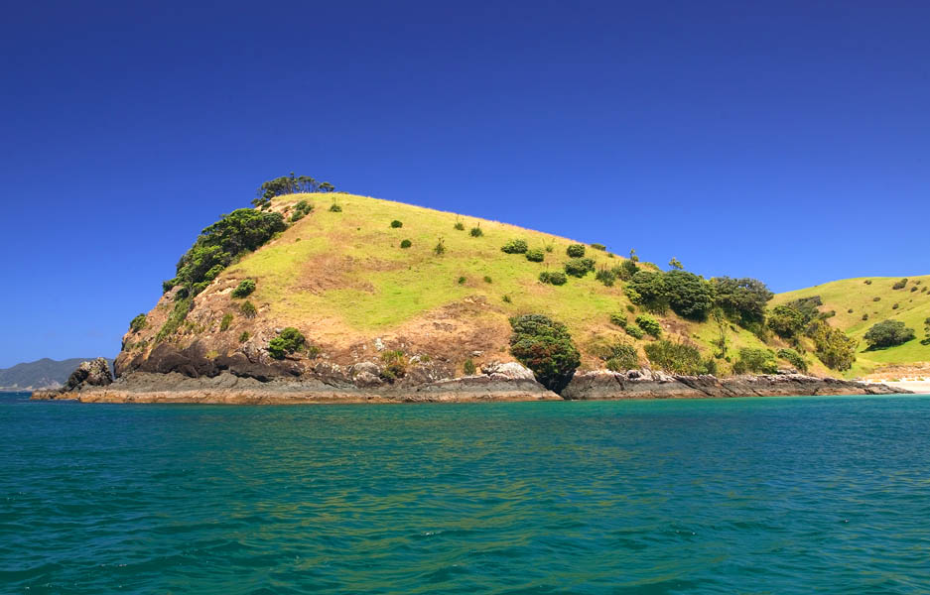
Area
As area increases, so does the number of species. Originally applied to
the study of oceanic islands but is applicable to terrestrial islands as well.

Slide 5
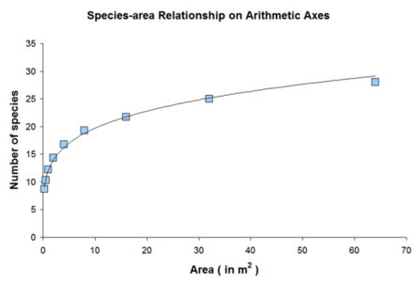
The species-area relationship
Species-area relationships are often graphed for islands (or habitats that are otherwise isolated from one another, such as woodlots in an agricultural landscape) of different sizes

Slide 6
Disturbance
The Intermediate Disturbance Hypothesis predicts that diversity in will peak at intermediate disturbance frequencies. IDH is a very general model to explain diversity, and holds true in some but not all situations.

Slide 7
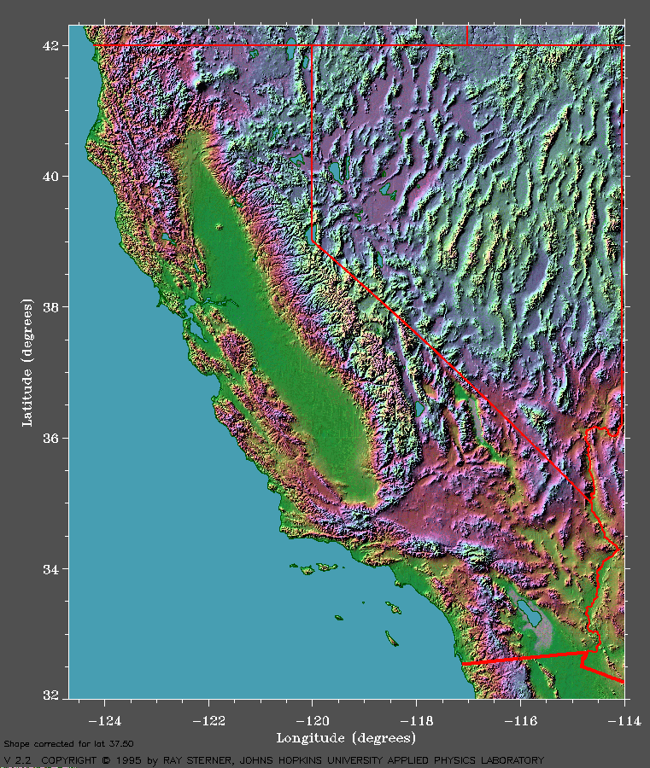
Habitat heterogeneity
Greater heterogeneity in habitat can contribute to high biodiversity. For example, the most biodiverse states are those that have a large number of habitats, such as California.

Slide 8
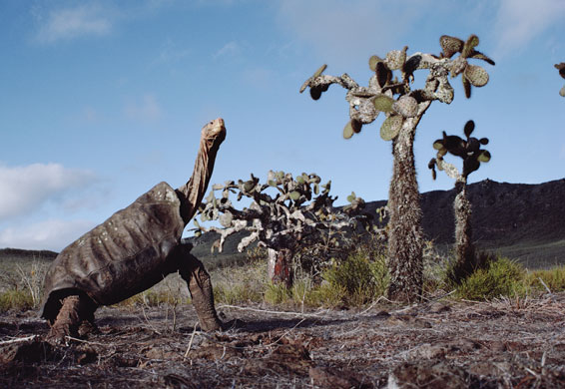
Isolation
Isolation facilitates speciation, as evidenced in the unique flora and fauna of isolated islands like Hawaii, the Galapagos, New Zealand

Slide 9
Latitude
Plant species richness peaks in the tropical latitudes, as do many animal taxonomic groups. This map shows the latitudinal diversity gradient of plants

Slide 10
Theories and conceptual frameworks to explain general diversity patterns
Niche models
Island biogeography theory
Mosaic models
Neutral models
Metacommunity models

Slide 11
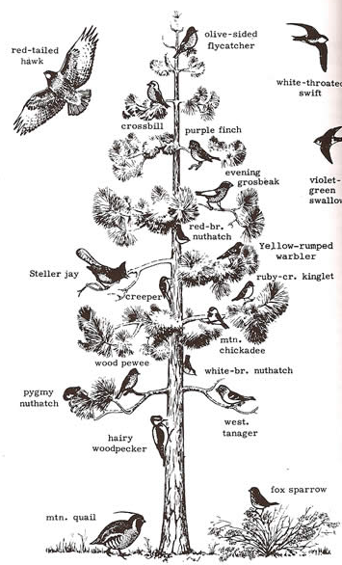
Niche-based models of diversity
Niches provide a means for species to accumulate
Assumption is that each species has a niche
More niches = more species

Slide 12
Island Biogeography Theory
In 1967 Robert H. MacArthur and Edward O. Wilson published The Equilibrium Theory of Island Biogeography (ETIB). It marked a turn toward quantification in ecology.
The theory aims to explain the processes that control the number of species present
Notes:
MacArthur and Wilson published a general mathematical theory to explain the regulation of species richness on islands. Their theory was based on the argument that island biotas eventually reach a
dynamic equilibrium between processes that add species, particularly by immigration counterbalanced by processes that cause local extinction of species
Specifically, the model at the core of their theory predicts that the rates of these two key processes are determined by geographical context, represented in the first instance by island area and isolation

Slide 15
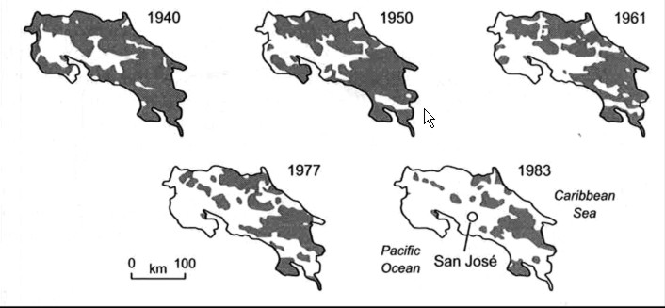
Contributions of island biogeography theory: island dynamics applied to conservation
Diversity of fragmented islands of forest in Costa Rica can be framed in terms of ‘island’ size and separating distances among islands

Slide 16
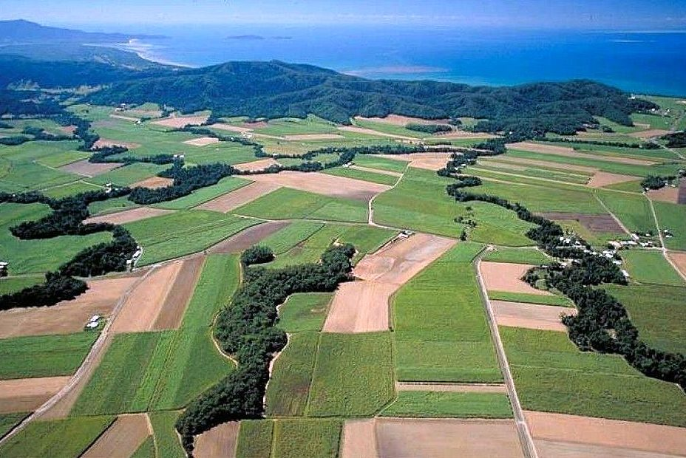
As island size (i.e. fragmentation) decreases:
Extinction rate increases
Resources become limited
Distances between island increases
Organisms cannot come in contact with a mate
it is useful to avoid fragmentation because fragmentation is almost always linked with habitat loss

Slide 17
The SLOSS (Single large versus several small) debate
Insights about the design and management of conservation areas came out of island biogeographic theory.
The SLOSS debate is the conversation over the best strategy for designing reserve areas – single large or several small.
One side of this debate is presented in the figure at right – it holds that single large is better and that more edge is a negative.

Slide 18
SLOSS implications for conservation
Small patches may be assumed to have no conservation value.
Forestry policy may recommend cutting patterns that “defragment” the remaining forest by removing small patches
Landowners and communities may be paid to preserve forest, but only at some threshold size of patches
In places where natural habitats are already scarce, these small patches are where the remaining habitat most needs protection

Slide 19
Mosaic theory of biodiversity
Holds that several small reserves may not necessarily be detrimental to biodiversity
Recognizes that fragmentation should not be automatically equated with negative effects of reduction in size or extent of habitat
Low levels of fragmentation can increase species richness for some taxa
Having large intact habitats may not always increase species richness
Notes:
The mislabelling of patch size effects as fragmentation effects has caused a critical error in the transfer of science to policy. To “fragment” means “to break apart”; it does not mean “to shrink”.
The assumption that small bits of habitat have little value for conservation does a disservice to conservation, especially in the places where natural habitats are already scarce.

Slide 21
Mosaic theory upgrades SLOSS debate
Notes:
Riva, F., & Fahrig, L. (2023). Landscape‐scale habitat fragmentation is positively related to biodiversity, despite patch‐scale ecosystem decay. Ecology Letters, 26(2), 268-277. Riva, F., & Fahrig, L. (2022). The disproportionately high value of small patches for biodiversity conservation. Conserv. Lett. 12881, e12881. Small habitat patches have been historically neglected in conservation, primarily because extinction risk is higher in small patches. Nevertheless, sets of small patches usually harbor more species than one or a few larger patches of equal total area. Resolving this inconsistency is key to policy and practice in biodiversity conservation. Our analysis of 32 datasets (603 patches and 2290 taxa) provides
two novel lines of evidence confirming that small patches have disproportionately high value for biodiversity. First, sets of small patches harbor more species than large patches even when considering only species of conservation concern. Second, sets of small patches harbor more species than large patches even when the small patches are very small compared to the large patches. Therefore, higher extinction risk in small than large patches does not decrease the cumulative value of small patches for biodiversity. We contend that acknowledging the conservation value of small patches, even very small patches, will be a necessary step for stemming biodiversity loss in the Anthropocene.

Slide 22
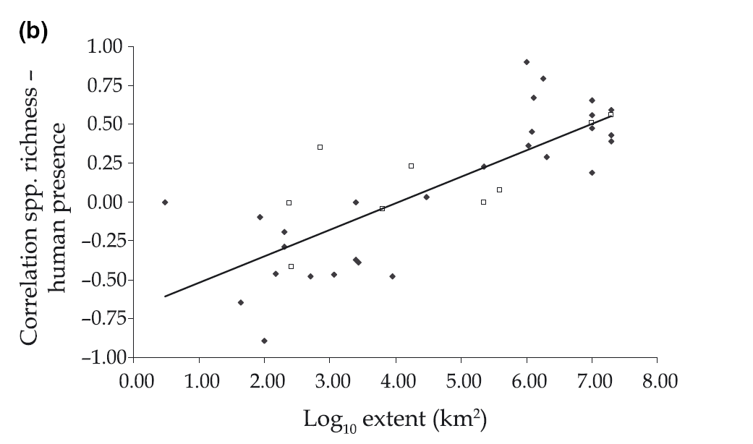
Processes that occur at local patch scales—the scale of the vast majority of fragmentation studies—may not be the dominant processes that affect biodiversity at larger landscape scales.
Notes:
8.00 - 10,000 km x 10,000 km
1.00 – 10 km x 10 km
Scale dependence of the correlation between human population presence and vertebrate and plant species richness
Human presence is generally negatively related to species richness locally, but the relationship is positive at coarse scales. The correlation turns from positive to negative below a study grain of approx.1 km and below a study extent of approx. 10 000 sq km. The broad-scale positive correlation between human presence and species richness suggests that people have preferentially settled and generally flourished in areas of high biodiversity and/or have contributed to it with species introductions and habitat diversification. The scale dependency of the correlation between people and biodiversity's presence emphasizes the importance of the preservation of green areas in densely populated regions.
Fahrig (2017) recently argued that the evidence base for these beliefs, recommendations, and actions is not as strong as many think, largely due to the confounding effects of scale, habitat amount, and fragmentation. In a separate essay, Fahrig (2018) described the history of research that led to the current understanding (or misunderstanding) regarding the effects of fragmentation on biodiversity. Processes that occur at local patch scales—the scale of the vast majority of fragmentation studies—may not be the dominant processes that affect biodiversity
at larger landscape scales. Moreover, in practice, landscapes with more fragmentation tend to also have less habitat, making it difficult to separate the effects of fragmentation and habitat loss.
Fahrig (2017) uses “positive” to refer to statistical relationships
between fragmentation and a variety of response variables.
However, it is not always clear whether that positive relationship is
“good” for conservation goals. For example, positive relationships between
fragmentation and species richness may reflect increasing occurrences
of species that are undesirable from a conservation perspective
(e.g. nonnative or invasive species) and mask declines in species of
conservation concern. F

Slide 23
Critiques of the idea that fragmentation is not bad
Fragmentation may increase abundance of disturbance-adapted and invasive species
Some people might use findings of positive effects of fragmentation to justify development, logging, or road building
We cannot assume that the initial rates of biodiversity change observed at different levels of fragmentation will remain over longer time periods.
Extinction debts may accumulate following fragmentation

Slide 24
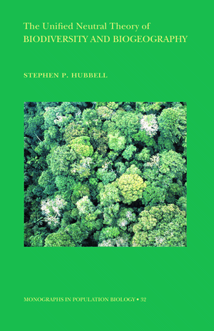
Neutral-based models of diversity
No niche specialization
All individuals of a species considered equivalent
Many species can occupy the same niche
Diversity is a function of who occupies a niche first
Dispersal and basic demographics (birth, death) are key variables

Slide 25
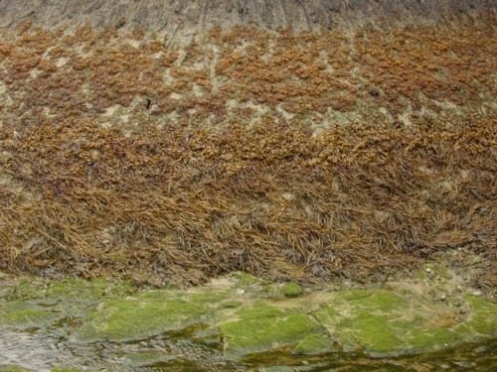
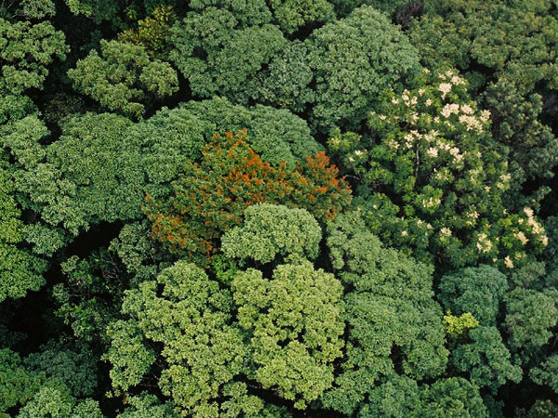
Niche-based models - species diversity arises based on match between species life history traits and availability of its niche
Neutral models – biodiversity arises through the random shuffling of species – dispersal and colonization shapes biodiversity
Pure niche-assembly models
Pure neutral-assembly models

Slide 26
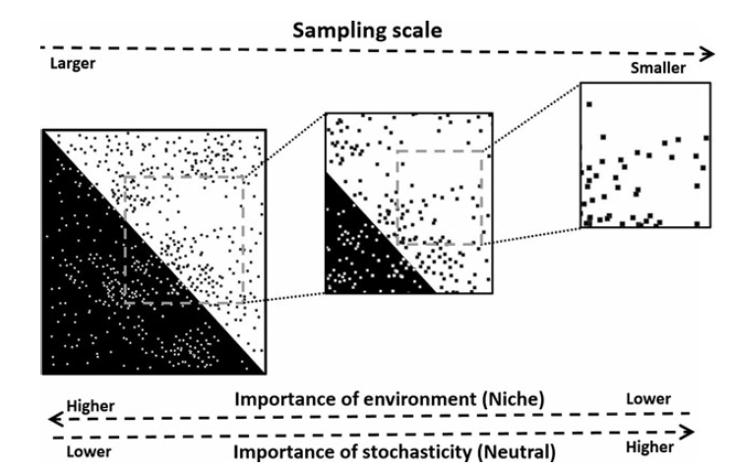
Niche versus neutrality: scale matters (it always does)
Their explanatory value also varies depending upon scale extent and resolution

Slide 27
Metacommunity models of diversity
Metacommunity – many communities linked by dispersal of potentially interacting species.
Diversity measured locally within a community (alpha), as turnover between communities (beta) or regionally across all communities (gamma).

Slide 28
Diversity in metacommunity models is determined by:
Local community environmental heterogeneities which favor abundance of certain species through niche processes over others
Source sink dynamics: net flow of individuals among communities constrains outcomes of species interactions and their abundances
Competition - colonization tradeoffs: abundance in a local community is a trade-off between being a better competitor or having adaptations that favor colonization
Rescue effects: local community extinction of a poor competitor can be prevented by immigration.
Neutrality: species abundances are due in part to random processes and dispersal limitation

Slide 30
Complexity definitions of biodiversity
Biodiversity is a cause and a result of complex adaptive systems interactions
Biodiversity arises out of cross-scale interactions
Biodiversity is coupled to systems properties like resilience and stability

Slide 31
What are the relationships between diversity and stability?
A very complex question that is very simplified in this lecture
Stability can defined in many ways.
One way is to define it as the persistence of a function, like overall production of biomass, an ecosystem definition of stability.
A population definition considers whether or not the population numbers differ through time.
Here are some of the views of this relationship between diversity and stability

Slide 32
High diversity promotes stability in ecosystem function
Notes:
Many of the early ecologists saw high diversity as stable, not just Ehrlich and Ehrlich. Elton, Odum, and MacArthur also link high diversity to overall stability in ecosystem function.

Slide 33
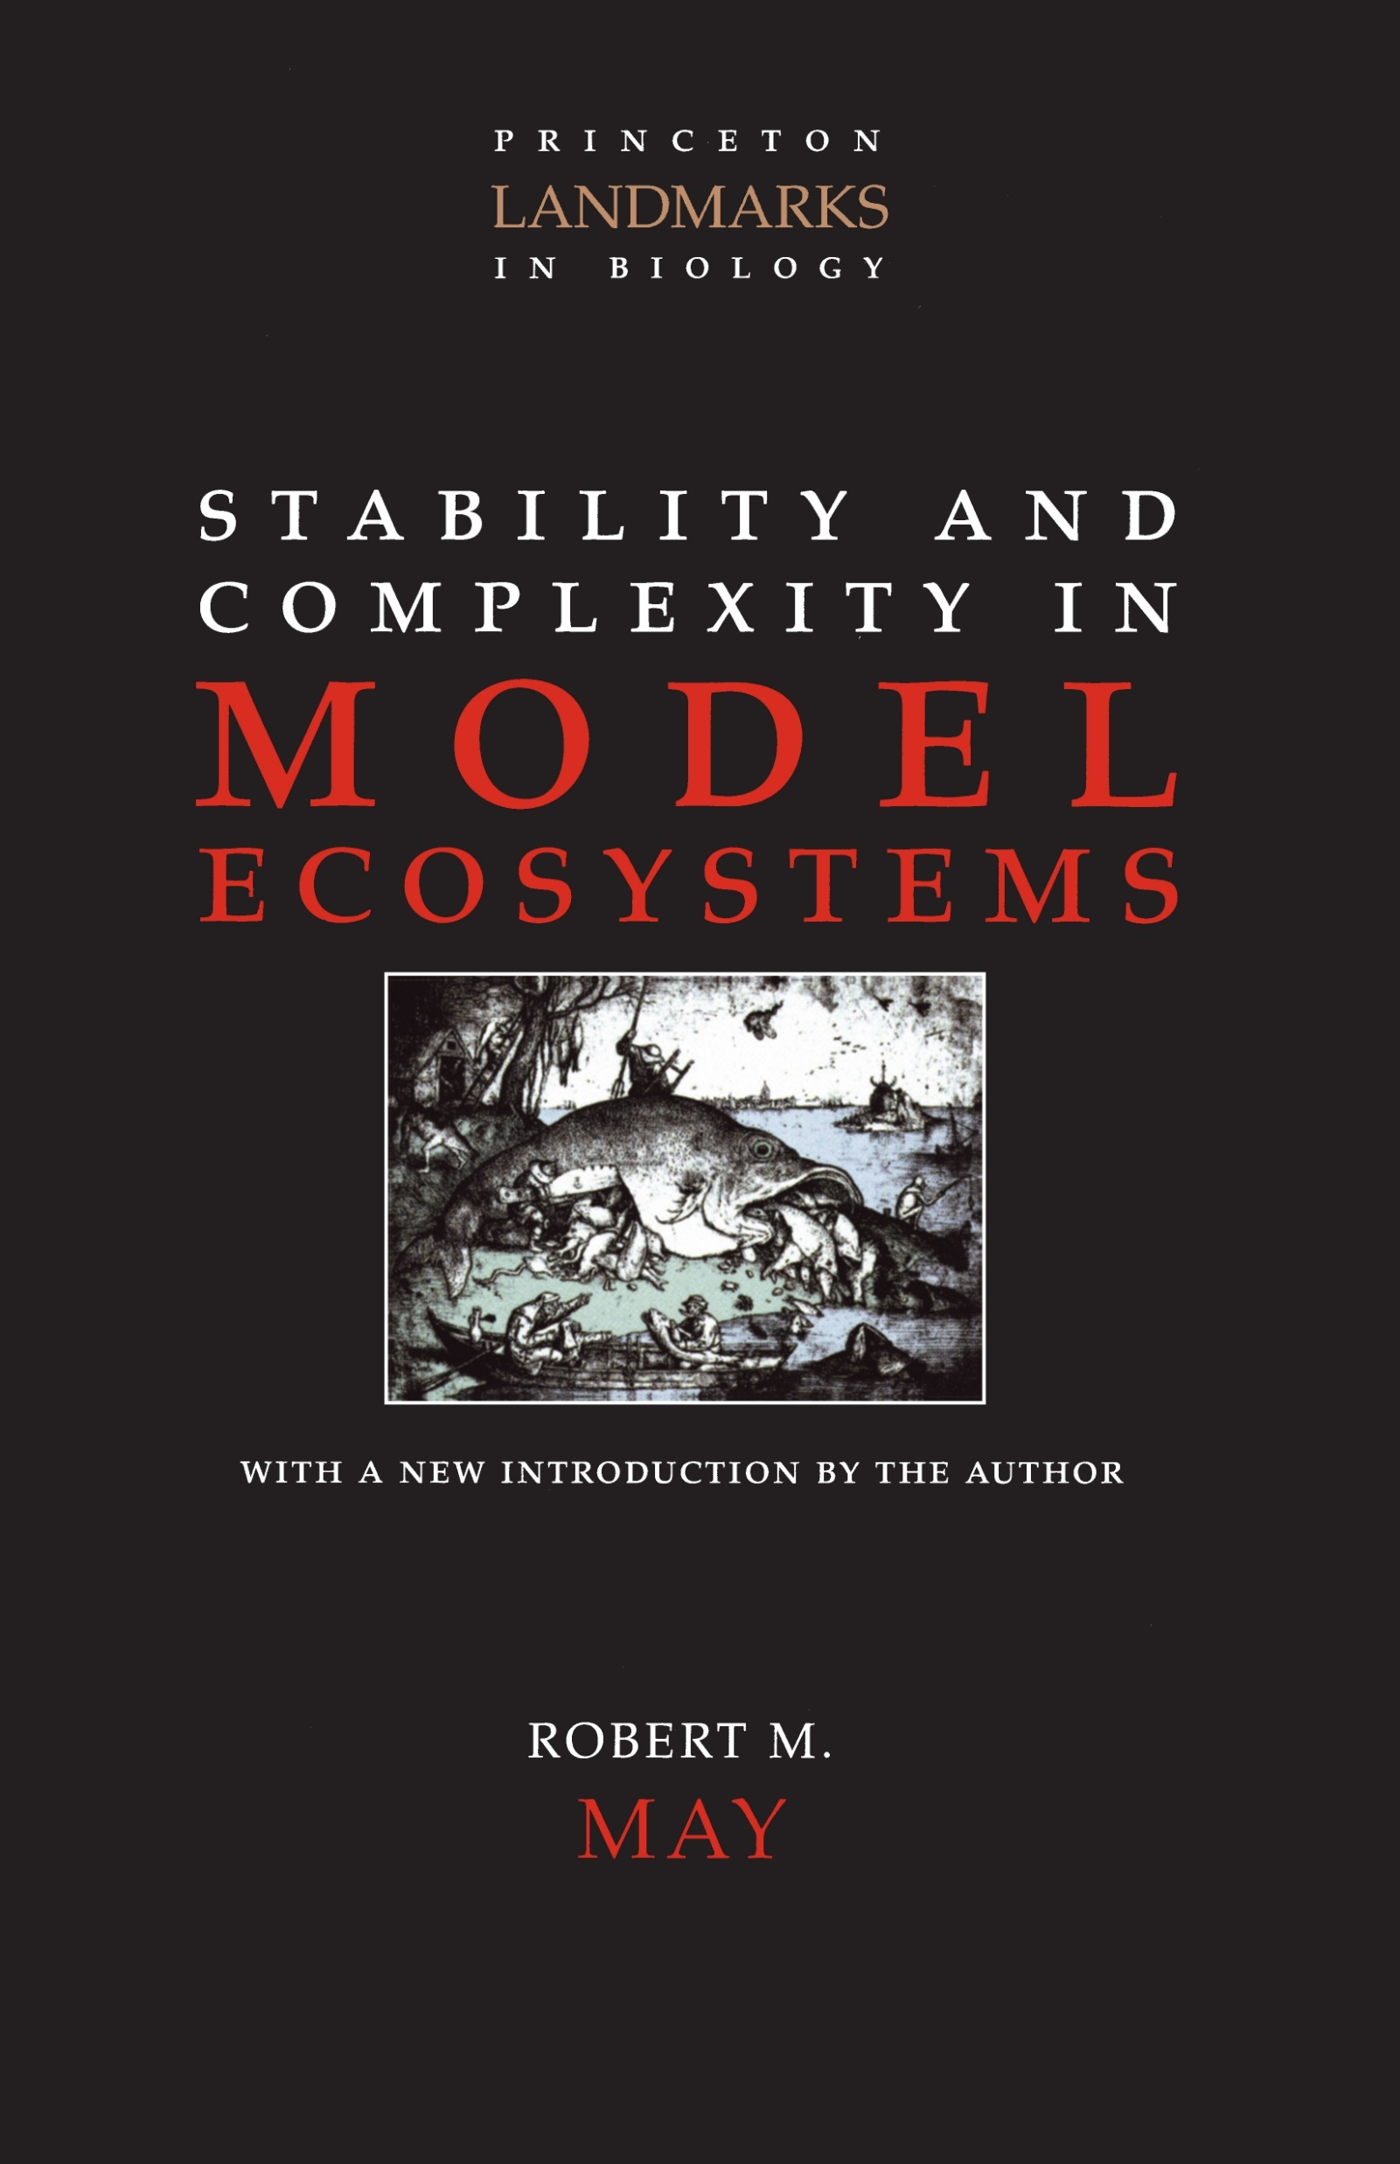
High diversity can be associated with population instability
Populations in diverse ecosystems are not more stable than populations in simple ecosystems (May, 1973)

Slide 34
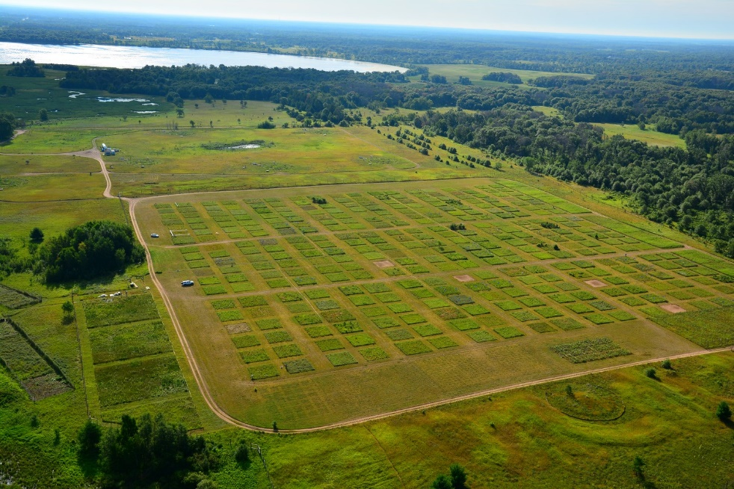
High diversity promotes aggregate ecosystem stability but low population stability (Tilman et al 1996)
Having many different kinds of species results in more ways to achieve recovery from disturbance or environmental fluctuation (the portfolio effect)
Large number of species results in aggregate stability – the capacity to retain ecosystem function
But population of species fluctuate in abundance when ecosystem stability is high
Notes:
Cedar Creek, MN

Slide 35
Notes:
Tilman (1996): Biodiversity stabilizes community and ecosystem processes, but not population processes.

Slide 36
High diversity is not directly necessary for stability in ecosystem function (sensu Allen and Holling 2010)
High diversities and fluctuations in the abundances of populations are mechanisms to evolve ecosystem stability
Ecosystem stability may not require high diversity, but is derived from it.
Some lower diversity systems may actually be very stable
Example: salt marsh (monotypic grass species maintain stable ecosystem functions)
Notes:
High diversity is a way of solving problems, a way of providing avenues for a particular configuration of environment and species to come up with an organization and set of feedbacks that will confer engineering and ecological resilience. Discontinuity theory predicts regions or boundaries between spatial and temporal assemblages of organisms that are high in novelty. These regions are where solutions are generated. They may begin with high or even idiosyncratic diversity, but subsequent autocatalytic processes may reduce the number of species apparent. High population turnover can lead to ecosystem stability, but one established, population turnover may decrease. Savage et al 2000 also look at this discontinuity from the perspective of intermediate frequencies of disturbance.

Slide 37
Notes:
Salt marsh

Slide 39
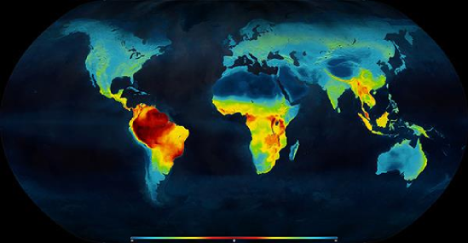
The latitudinal species diversity gradient
Notes:
Tropics as cradle or museum? Destination?

Slide 40
Why do the tropics have so many species? Mechanisms to explain the latitudinal diversity gradient:
Climate stability hypothesis
Geographical area hypothesis
Species-energy hypothesis
Historical perturbation hypothesis
Evolutionary rate hypothesis
Tropical refugia hypothesis
Middle domain effect
Competition-based hypothesis
Tropical conservativism hypothesis

