Slide 1
Human-caused extinctions:
Lose between 1-5% of species per year
Current rates of extinction are much higher than natural background levels
Extinctions have accelerated in the last few centuries
But this is not a lecture on how extinctions happen, it is about how we think about biodiversity and how that shapes biodiversity policy

Slide 5
Notes:
In short: if it is encompasses everything, then it explains nothing. And also: if all the types of biodiversity are correlated with each other, but not tightly, perhaps we should be more cautious about lumping them all together. Another reason to do away with biodiversity: it overshadows other types of value, like functional roles.

Slide 7
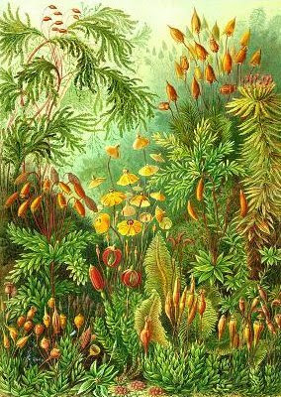
The fuzzy concept of biodiversity:
“The biological variety bequeathed to us by evolutionary processes over millennia’’
Does this mean all of biology?
Save all life? Same some life forms but not others?
How do you work with a definition this encompassing?

Slide 8
Rethinking biodiversity
Since there are epistemic limits on measuring biodiversity directly, biologists must choose a stand-in, or surrogate for all biodiversity
Biodiversity is meant to serve as a reliable indicator of biological value, but given the vast variety of ways in which we value the biosphere, it is challenging to identify what kinds of diversity should be conserved and where

Slide 9
Notes:
https://www.nytimes.com/2018/03/13/magazine/should-some-species-be-allowed-to-die-out.html

Slide 11
Rethinking biodiversity
What arguments do we use to decide what to save?
What kinds or categories of biodiversity should we prioritize?
How do we identify and measure biodiversity?
Do the choices we make about conserving biodiversity have equitable impacts among humans in the many places and cultures they occupy?

Slide 12
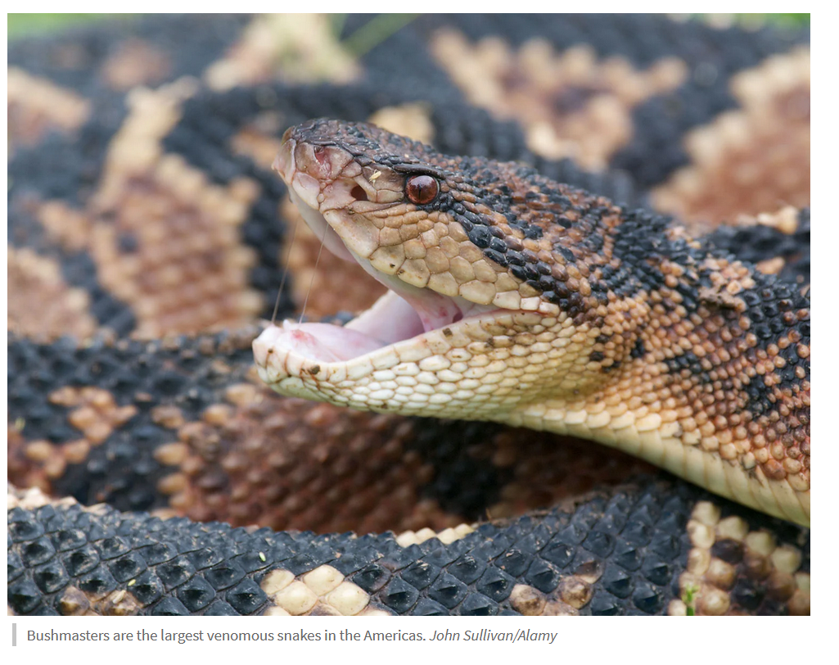
Instrumental versus intrinsic arguments for conserving biodiversity
Intrinsic value is the value that an entity has in itself, for what it is
Instrumental value is the value that something has as a means to a desired or valued end
Notes:
The snake in the image is a bushmaster (Lachesis species). Bushmasters are the largest venomous snakes in the Americas and belong to the viper family (Viperidae). Bushmasters (Lachesis spp.) have a reputation for being elusive and reclusive rather than aggressive. They are known for their distinctive pattern, large size, and potent venom. They are found in tropical forests of Central and South America.
Snake venoms can be considered as mini-drug libraries in which each drug is pharmacologically active. However, less than 0.01% of these toxins have been identified and characterized.
Mohamed Abd El-Aziz, T., Soares, A. G., & Stockand, J. D. (2019). Snake venoms in drug discovery: valuable therapeutic tools for life saving. Toxins, 11(10), 564.
Instrumental value is always derivative on the value of something else, and it is always conditional.
Valuing biological diversity on the basis of an instrumental value system is problematic because measurement is often difficult; instrumental value changes thru time and across space; instrumental value varies across human cultures and societies and with such factors as socioeconomic conditions, individual experiences, and educational backgrounds.
Valuing biological diversity on the basis of an intrinsic value system also poses challenges because intrinsic value can be seen as a disguised form of human instrumental value; intrinsic value is initially ambiguous as to which objects or characteristics of biological diversity are to being valued; all aspects of biological diversity (e.g., species and ecosystems) are transitory; species and ecosystems are not static concrete entities; and intrinsic value of one species is often in conflict with the intrinsic value of other species. Instrumental and intrinsic value systems share a common origin, such that instrumental values are always derived from intrinsic value and life mutely expresses both intrinsic and instrumental values—these are derived from and are products of biological evolution. White, P. S. (2013). Derivation of the extrinsic values of biological diversity from its intrinsic value and of both from the first principles of evolution. Conservation Biology, 27(6), 1279-1285.

Slide 13
Instrumental arguments
natural resources argument
pharmacopoeia argument
life support argument
resilience argument
storage silo argument
ontogeny argument
cathedral argument
cultural diversity argument
future generations argument
Notes:
Intrinsic value arguments - biodiversity should be preserved because they have inherent value. The organism does not have to be useful in an instrumental sense for it to have value.
Instrumental value arguments - biodiversity should be preserved because its existence benefits humans materially The natural resources argument - - biodiversity should be preserved because it is a vast repository of natural resources for use as commodities
The pharmacopoeia argument - - biodiversity should be preserved as a safeguard for human health
The life support argument - biodiversity should be preserved in order to provide ecosystem services and the functions that support humans and their quality of life
The resilience argument - biodiversity provides resilience or stability in the provisioning of ecosystem services and functions
The cathedral argument - biodiversity should be preserved because in its fullest and complete form it is a celebration of creation, an essentially religious activity
The storage silo argument - biodiversity holds the world’s accumulated evolutionary and ecological wisdom Destroying biodiversity is like burning unread books, stories about how nature works The loss of biodiversity takes away unprecedented unique information from which to understand how nature works
The ontogeny argument - humans evolved within nature By preserving biodiversity we insure our ancestral context, the source of our physiological and psychological evolution
The cultural diversity argument - the rich diversity of the world’s cultures reflects a corresponding diversity in the wilds that gave them birth Preserving biodiversity preserves cultural diversity
The future generations argument - argues that it is a moral obligation to preserve biodiversity for future generations, we should pass the world on as we inherit it We do not inherit the earth from our ancestors, we borrow it from our children
.

Slide 14
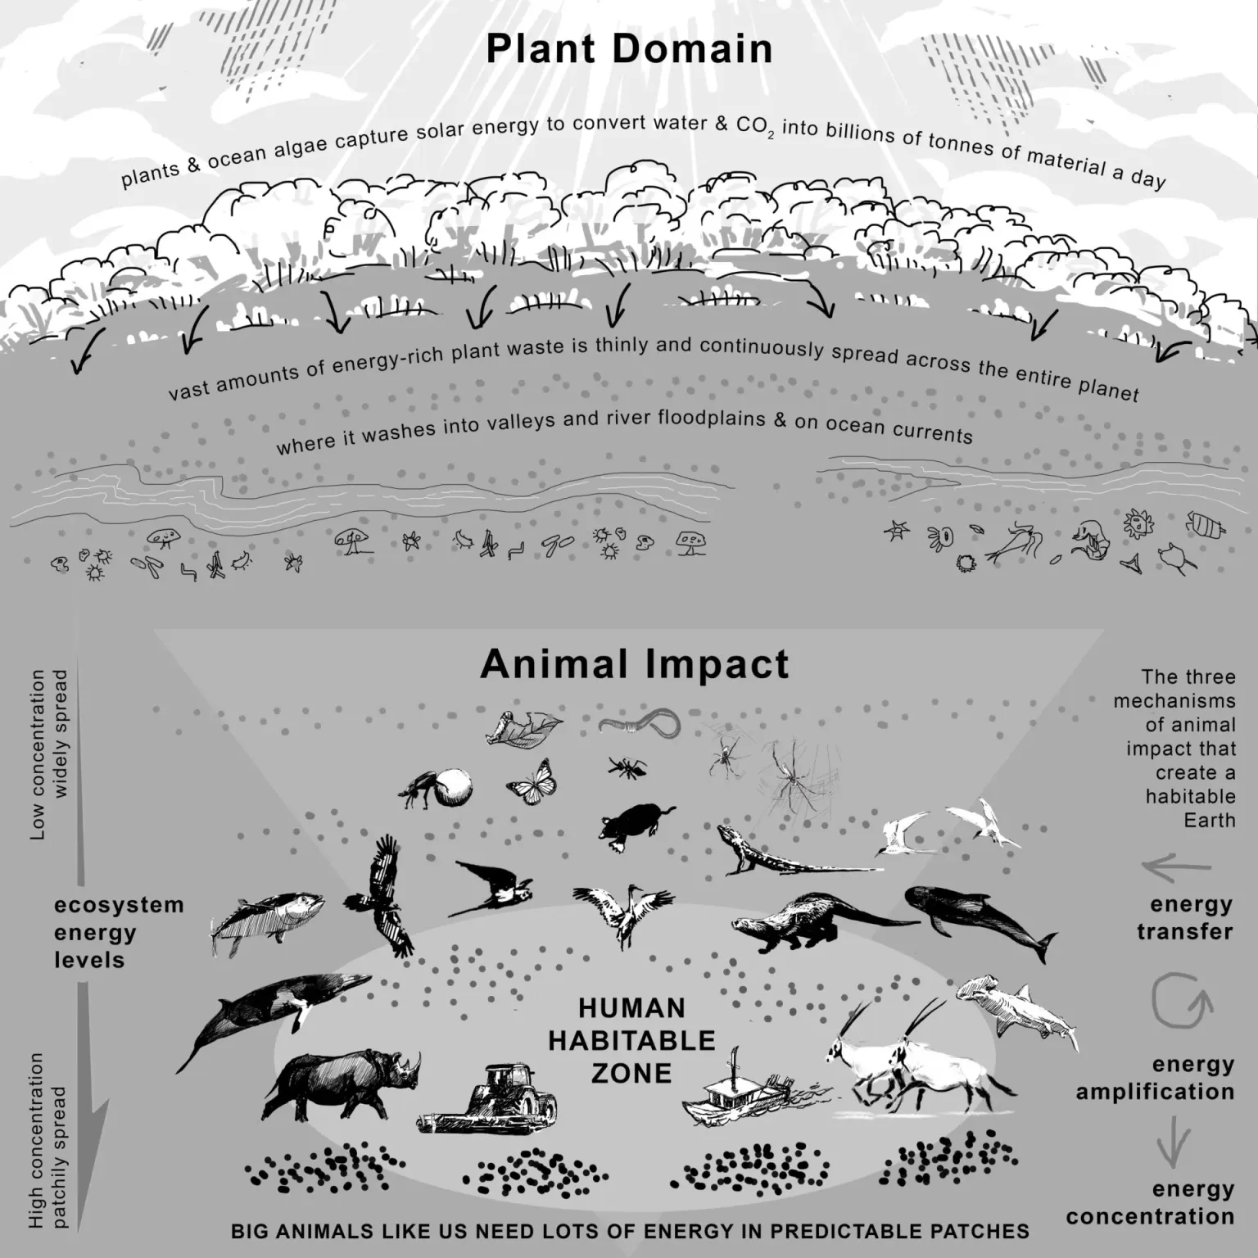
However, in each of these instrumental arguments there rests a paradox – that humans are protecting or conserving what they also must use, and have used throughout out our evolution
Ultimately, the habitability of Earth depends upon our relationships to non-human life – it has in the past and it will continue to be so in the future.

Slide 15
But what organisms will continue is in part in the hands of humans
What kinds or categories of biodiversity should we prioritize?
How do we identify and measure biodiversity?

Slide 16
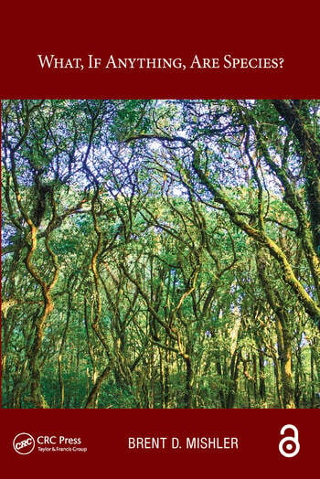
What kinds of biodiversity should we prioritize?
Taxonomic diversity
Most recognized by the public as species diversity but only one of many kinds of biodiversity
Defining a species is not as clear cut as popular usage of the term applies.
Species can be defined morphologically, biologically and phylogenetically (and several other ways)

Slide 17
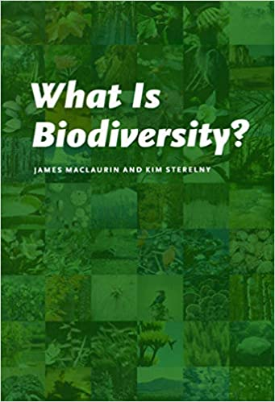
What kinds of biodiversity should we prioritize?
Biodiversity is an ambiguous and context-dependent concept, often used without clear philosophical justification. There are actually many different types of biodiversity, including:
Taxonomic diversity
Functional diversity
Interaction diversity
Landscape diversity

Slide 18
Taxonomic diversity
Typically, this is the kind of biodiversity we speak of when we reference ‘biodiversity’. Often assumed to refer to species-level biodiversity.
However, you can measure biodiversity at any taxonomic level: Kingdom, Phylum, Class, Order, Family, Genus, or Species
Which is more biodiverse? 10 families consisting of 200 species vs 20 families containing 100 species?
Taxonomic identity can be defined in several different ways. We will examine three ways of identifying species
Notes:
There is also functional diversity, another important type of diversity.

Slide 19
The morphological species concept: the physical appearance (phenotype) of an organism determines its taxonomic identity
Notes:
Morphological species concept for Rumex, the buckwheats

Slide 20
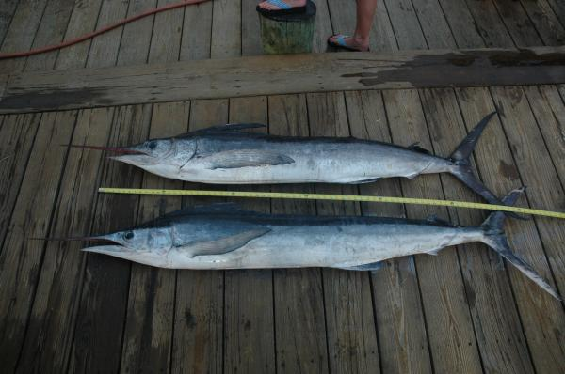

Slide 21
A white marlin (top) and roundscale spearfish (bottom) showing their very similar appearance, or phenotype.
Notes:
White Marlin: Abundance of a Look-Alike Species Clouds Population Status of a Million Dollar Fish
The prized white marlin, sought by anglers in million dollar prize tournaments and captured incidentally in commercial fisheries, is among the most overfished marine species under international management and the subject of contentious debate on how to best achieve its recovery. Now a new study published in the journal Endangered Species Research casts uncertainty on the accuracy of current knowledge of white marlin biology and previous population assessments, which form the basis of management and conservation policy.
The study reports that the white marlin look-alike species, the enigmatic roundscale spearfish makes up almost a third (approximately 27%) of the fish historically identified as white marlin. This previously unrealized, relatively high abundance of roundscale spearfish and their misidentification might have impacted past assessments of white marlin population sizes and concomitant management efforts.
Given considerable concern about its declining populations, petitions to list the white marlin under the U.S. Endangered Species Act were considered in 2002 and 2007. Listing the fish would have undoubtedly put an end to white marlin fishing tournaments, which infuse millions of dollars into the recreational fishing industry as well as local economies.
This proportion of roundscale spearfish along with its longstanding misidentification as white marlin for decades compromises the accuracy of current biological knowledge on white marlin.

Slide 22
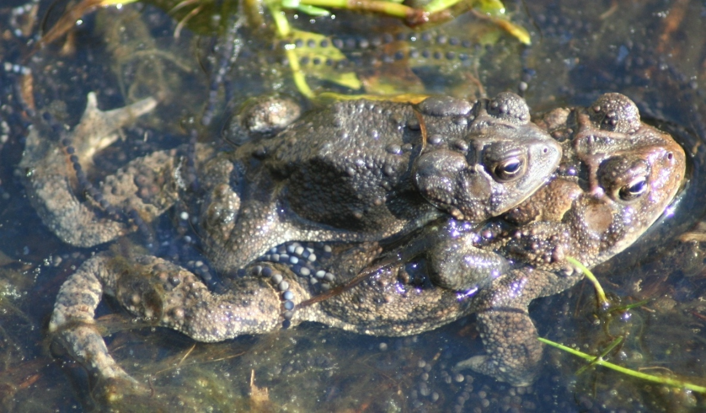
The biological species concept: species can interbreed freely to produce viable offspring under natural conditions

Slide 23
Hybridization
Defined as reproduction between members of genetically distinct populations
Interspecific (between species) hybridization has often been seen as an exception rather than the rule
However, a large number of species hybridize regularly, even though only a small fraction of a population may be involved

Slide 24
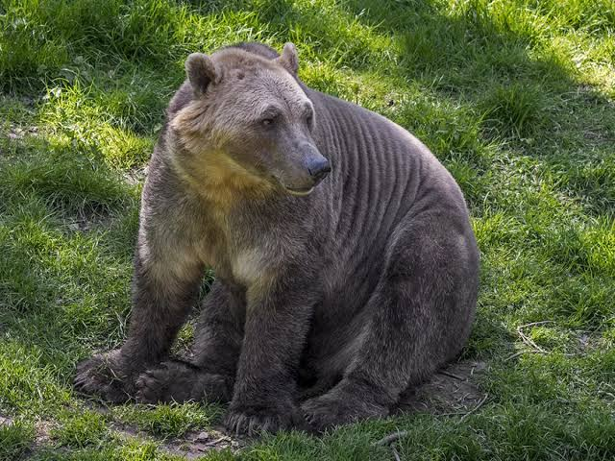
Grizzly-polar bear hybrids are emerging due to climate change, as polar bears that live and hunt on the shrinking Arctic sea ice are forced on land during mating season.
Male grizzlies are expanding their habitats, roaming into polar bear territories, and emerging from hibernation earlier
Although current drivers for interbreeding are novel, polar bears and grizzlies have cross-mated before.
Ursus maritimus – polar bears
Ursus arctos horribilis –grizzly bears
Notes:
http://sciencenordic.com/grizzly-polar-bear-hybrids-spotted-canadian-arctic
Polar bears and grizzly bears first diverged as a species between 479,000 and 343,000 years ago. Since then, the two species have met and interbred several times, and today, grizzly bears still retain some of this ancient polar bear DNA, and vice-versa.
Polar bears and grizzly bears don’t think in terms of species Ursus maritimus – polar bears
Ursus arctos horribilis – mainland grizzly bears in North America
Their offspring are fully fertile
Grolar or pizzly bear
Climate change is in part responsible for the emergence of these grolar hybrids, as polar bears that live and hunt on the ever-shrinking Arctic sea ice are forced on land during mating season in spring and summer. At the same time, male grizzly bears are expanding their habitats, roaming into polar bear territories, and emerging from hibernation earlier in the year. Inuit hunters have spotted grizzly bears in the Arctic for decades, but numbers are believed to have increased recently, as males disperse further to find mates.
Although the current drivers for interbreeding are novel, polar bears and grizzly bears have cross-mated before. Polar bears and grizzly bears first diverged as a species between 479,000 and 343,000 years ago. Since then, the two species have met and interbred several times, and today, grizzly bears still retain some of this ancient polar bear DNA, and vice-versa.

Slide 25
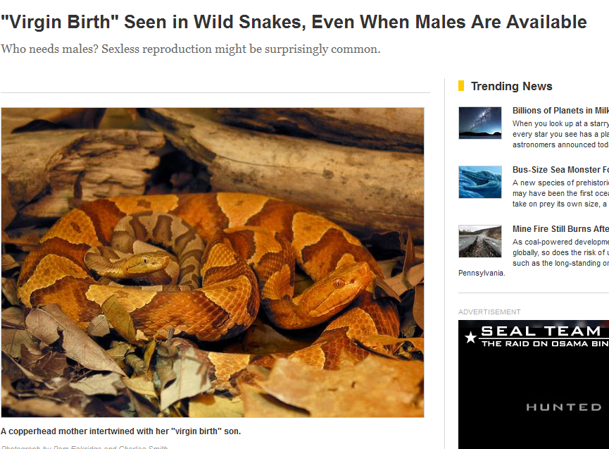
Facultative parthenogenesis
Facultative parthenogenesis is asexual reproduction by a sexually reproducing species
Documented in four diverse taxonomic groups, sharks, birds, lizards, and snakes.
A polar body fuses with the nucleus of the mature ovum, restoring diploidy and triggering cell division.
Notes:
When a polar body fuses with the mature ovum, diploidy is restored
An obligate parthenogenic species produce only female offspring because they inherit their mother's genetic material without recombination. However, in rare cases, male offspring have been reported in some parthenogenetic species due to spontaneous genetic anomalies or environmental factors. In facultative parthenogenesis, reproduction can be both sexual and asexually However, most fully parthenogenetic species are obligate parthenogens, meaning they do not engage in sexual reproduction at all.If a facultative parthenogenetic lizard species encounters a male, it may reproduce sexually, potentially leading to male offspring.

Slide 26
The phylogenetic species concept: relatedness and identity is determined by a shared common ancestor. Relatedness is defined by changes in DNA and/or phenotype
Notes:
All extant giraffes (Giraffa camelopardalis) were considered to represent a single species classified into multiple subspecies. However, there are at least six genealogically distinct lineages of giraffe in Africa, whereas there has been no overall consensus in the past. Even within well known and highly mobile species, subdivisions can exist and their lack of recognition could lead to further endangerment or even extinction. There is little evidence of interbreeding between these six populations. Some of these lineages appear to be maintained in the absence of contemporary barriers to gene flow, possibly by differences in reproductive timing or assortative mating,

Slide 27
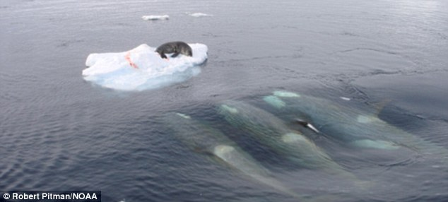
Killer whales (Orcinus orca)
Originally thought to be one species
Full mitochondrial genome analysis suggest multiple species and subspecies
Notes:
http://www.nmfs.noaa.gov/pr/species/mammals/cetaceans/killerwhale.htm
Scientific studies have revealed many different populations--or even potentially different species or subspecies--of killer whales worldwide. These different populations of killer whales may exhibit different dietary needs, behavior patterns, social structures, and habitat preferences. Therefore, interbreeding is not expected to occur between different populations, in spite of the overlap between home ranges.

Slide 28
Notes:
This plot shows the phylogenetic concept of species applied to killer whales. Species identity is related to evolutionary history and ancestry.

Slide 29
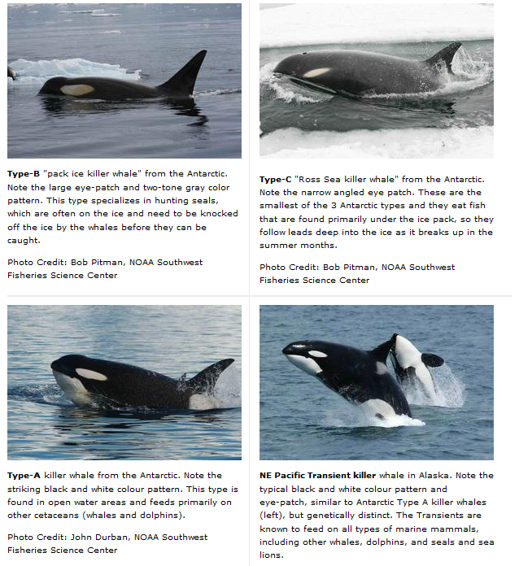
Three populations of killer whales in the Antarctic belong in their own individual species: a form that feeds mostly on dolphins and whales (Type A, bottom left), a pack ice killer whale that hunts seals by knocking them off ice floes (Type B, top left) and the Ross Sea killer whale, which pursues fish under the ice (Type C, top right).
Transient killer whales that live in the northeastern Pacific near Alaska are the most genetically distinct of the killer whales. This group diverged from other killer whales as a separate species about 700,000 years ago
Notes:
Differences in their mitochondrial DNA is as large as what is seen in other species. In this case, the differences in mitochondrial DNA were also associated with very different social behaviors, in particular, how they hunt. There are phenotypic differences in the eye patch and color pattern, but they are perhaps not as striking as the differences in social behavior

Slide 30
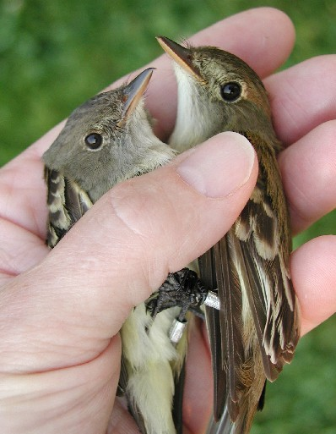
Lumpers versus splitters
These ways of identifying taxonomic species (biological, morphological, and phylogenetic) create subjectivity in how they are lumped into a large group versus split into finer groups.
What defines a species is not fixed, and this has relevance for policy

Slide 31
Notes:
There are important consequences for how we define species

Slide 33
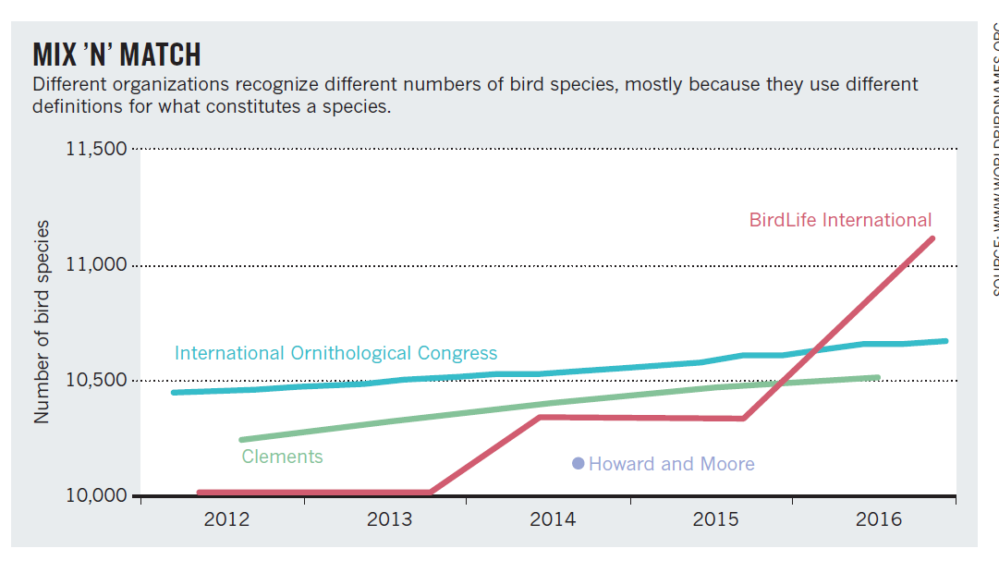
Notes:
BirdLife international uses more

Slide 34
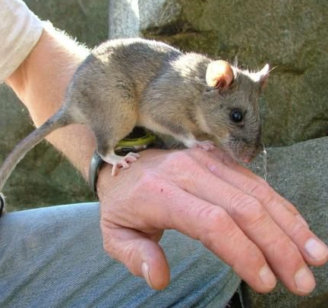
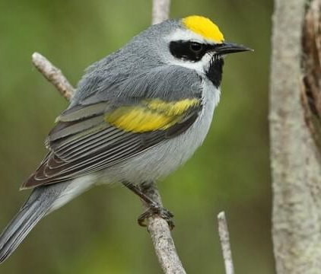
Conservation funding impacted by how species defined
Many mammalian taxonomists use the phylogenetic species concept.
Many bird taxonomists favor the more conservative morphological and biological species concept
This impacts amount of money received for individual species conservation
Assume that roughly the same amount of conservation spending is dedicated to birds and mammals
But if mammals are more finely split than birds, that means more money is being directed towards the protection of mammalian genetic diversity overall.
Notes:
For a discipline aiming to impose order taxonomy is remarkably anarchic.
Top, Allegheny woodrat, an endangered mammal of Kentucky. It is almost indistinguishable visually from the Eastern Woodrat.
Bottom, Golden-winged warbler, an endangered bird of Kentucky. https://en.wikipedia.org/wiki/Allegheny_woodrat

Slide 35
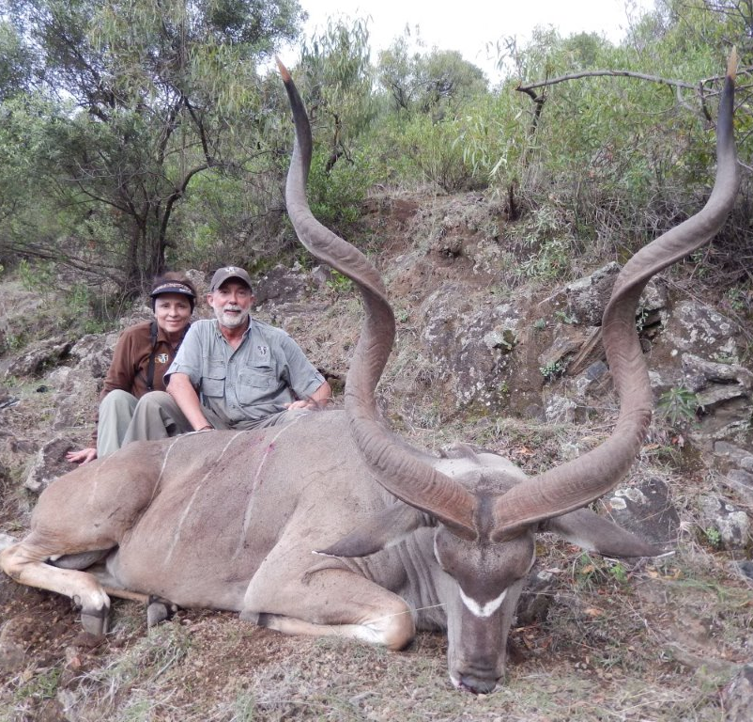
Hunting is used in some parts of the world to generate conservation funds
Safari hunters currently achieve the ‘spiral horned grand slam’ by killing nine types of antelope.
Recent developments in phylogenetics suggest there may be up to 25 kinds of antelope.
Differences in DNA and in their appearance suggest different evolutionary histories and hence different species
Hunters could chose to target more than nine.

Slide 36
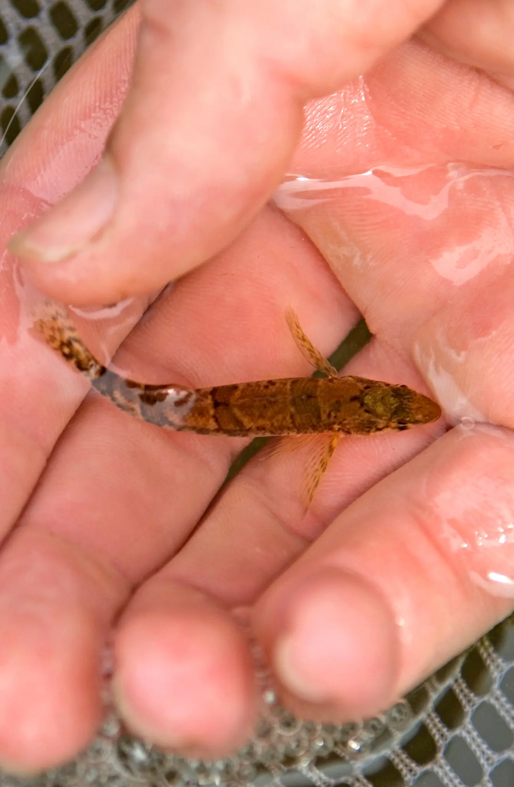
Debates over species or subspecies status can become the basis of lawsuits and delays in implementing conservation or development
The endangered snail darter was the basis of a 1978 Supreme Court case to decide its fate and the fate of the construction of a new federal dam in Tennessee.
The snail darter won, then lost the case and the Tellico dam was built.
Populations of the snail darter were relocated to other adjacent rivers before construction
Notes:
https://www.nytimes.com/2025/01/03/science/snail-darter-fish-tellico-dam.html

Slide 37
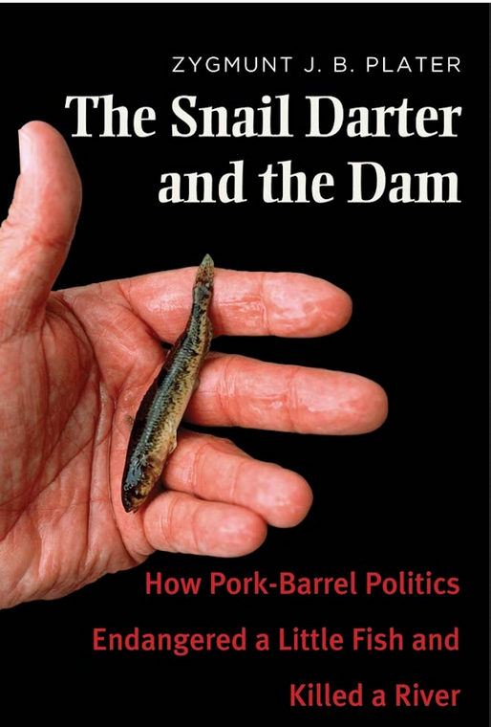
The snail darter recovered and was taken off the endangered species list in 2022
In 2025 it was determined that the snail darter, Percina tanasi, is neither a distinct species nor a subspecies.
Rather, it is an eastern population of Percina uranidea, known also as the stargazing darter, which has not ever been considered endangered.
These kinds of debates can lead to charges of scientists and conservationists ‘making up species’
Notes:
https://www.nytimes.com/2025/01/03/science/snail-darter-fish-tellico-dam.html

Slide 38
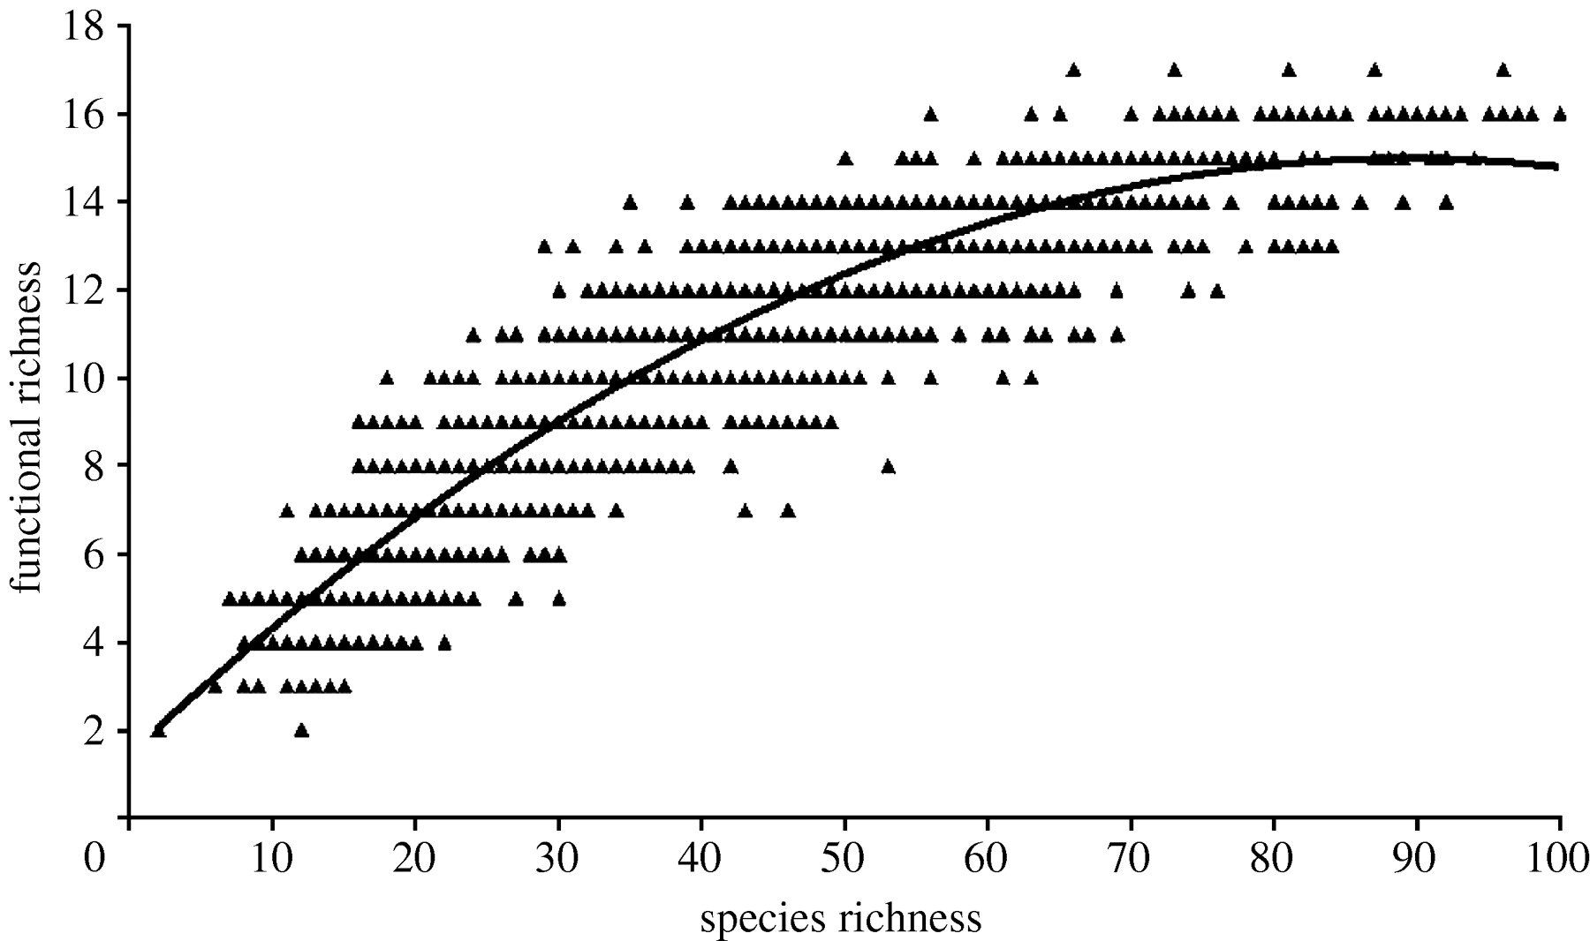
Functional diversity
Notes:
Function is often highly correlated with phenotype and the traits of an individual organism

Slide 39
Interaction diversity
Measure of the number and kinds of biotic interactions. The two plots below differ in the number of predatory interactions among trophic levels.
Notes:
Interaction diversity can also be measured in terms of other biotic interactions, like competition, cooperation, mutualism, or parasitism

Slide 40
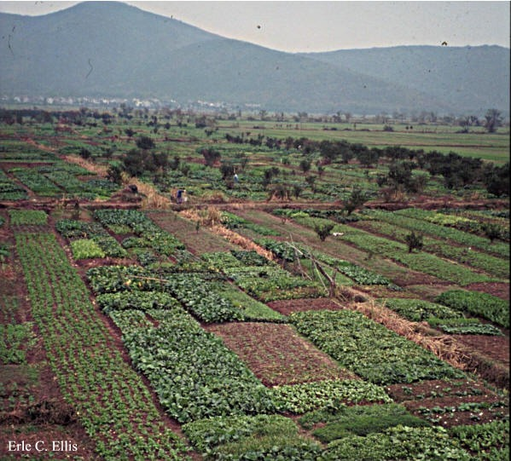
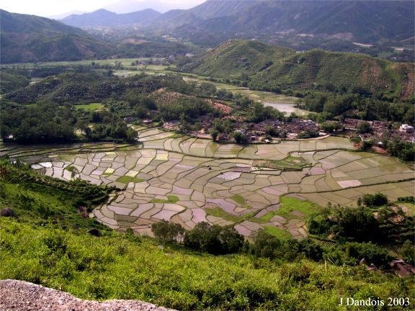
Landscape diversity
Number and size of different habitat patch types within a landscape

Slide 41
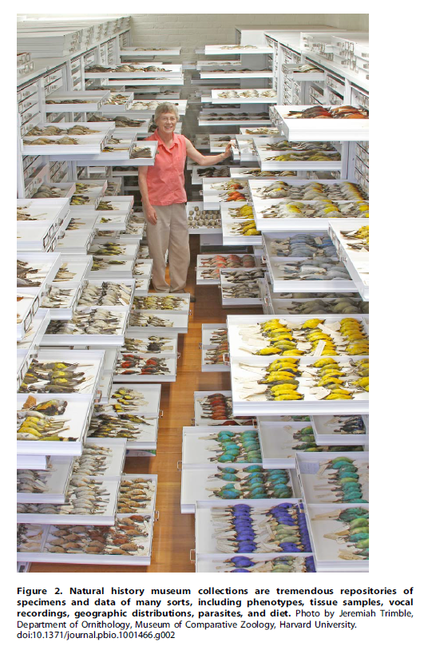
How do you identify and measure biodiversity?
The majority of species on Earth has not yet been described – the world is immense, with fine grain
We cannot protect species we are not aware of, and we cannot define policies if we do not know have details about the species itself
Many of the species known today exist only as a written description and/or a specimen in a museum
Notes:
For many species, even common ones, there is a scarcity of data on their distribution, evolutionary history, population abundance and dynamics, ecological traits and function, environmental tolerances, and ecological interactions of many species. Incomplete data strongly impact all aspects of biodiversity conservation research, policy, and management.
1.5 million cataloged, but many are only descriptions or a museum specimen

Slide 42
The challenges of counting
Species extinctions have increased because of humans
Taxonomic biases toward encountering and identifying certain organisms
Taxonomic skills are necessary to find and identify new species
New species are routinely discovered (in their habitats and in museums)
Speciation is occurring in some taxa
Extinctions need to be verified
Extinction debt
Ongoing conservation efforts, some that have been highly successful, while others are still pending
Scale and sampling effects complicate the derivation of trends

Slide 43
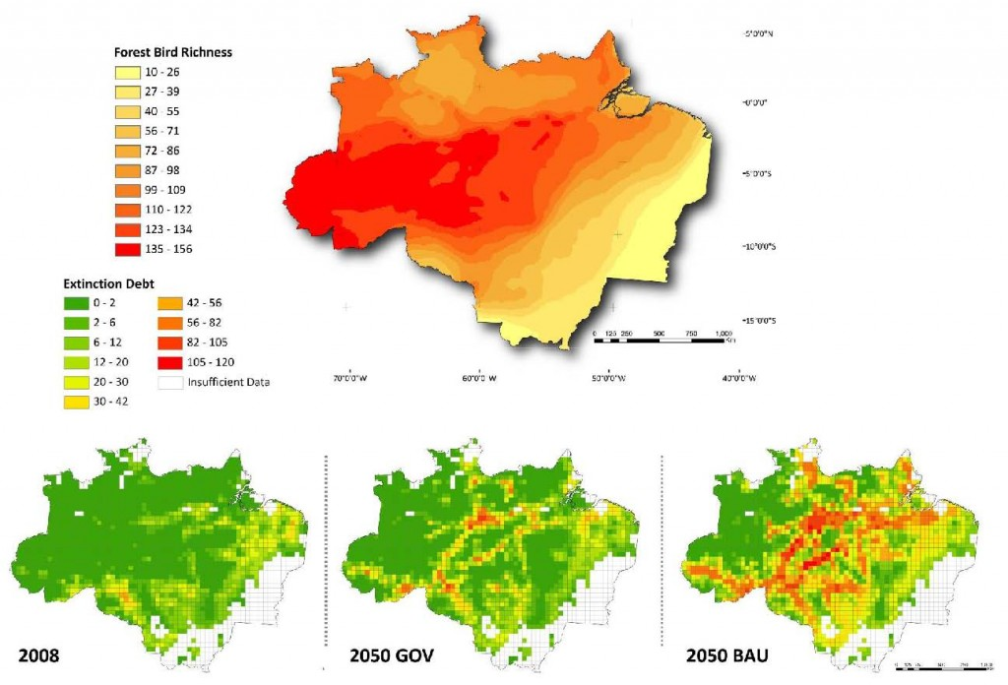
Extinction debt
Defined as the lock in of future extinction of species due to human impacts that occurred at some earlier point in time.
Time delay between human impact and extinction
Notes:
http://www.australianscience.com.au/news/the-extinction-that-is-yet-to-come/

Slide 44
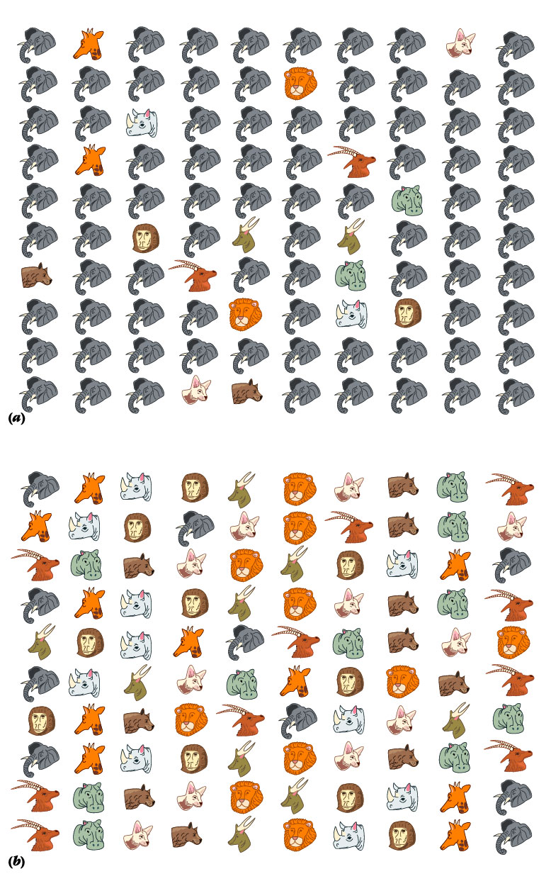
Richness and evenness
Low evenness: elephants dominant (Lower diversity)
Deriving quantitative characteristics of biodiversity can be done different ways
Diversity can be measured in terms of evenness and richness
Which location, top or bottom, should be targeted for conservation?
Equal richness-same number of species (10)
High evenness (Higher diversity)
Notes:
Understandably, nearly all discussions of how to define and measure biodiversity fall back at least some extent on richness at a taxonomic level

Slide 45
Alpha (or local) diversity
Expresses the number and abundance of species within a given habitat
It is sometimes referred to as local diversity
This area at right has a higher alpha diversity

Slide 46
Beta diversity
Expresses the difference, or turnover, in species from one habitat to another
It is often referred to as turnover diversity
For example, there is no change in the number and abundance of species from Site 1 to Site 2 in this region. Beta diversity would be considered low.
Site 1
Site 2

Slide 47
Site 1
Site 3
Site 2
Site 4

Slide 48
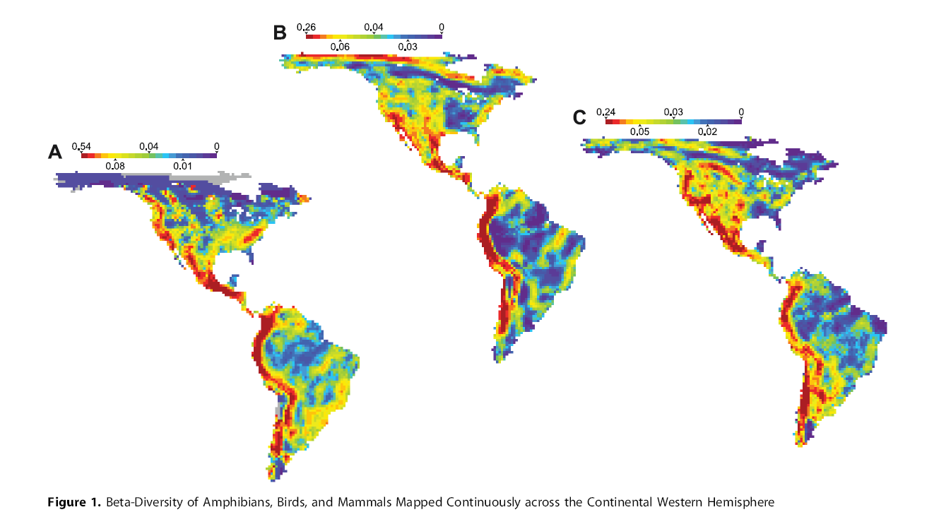
Notes:
A) Amphibians B) Birds C) Mammals Note that while beta diversity may be lower in the heart of the Amazon rainforest of the Congo of Africa, alpha diversity would be high

Slide 49
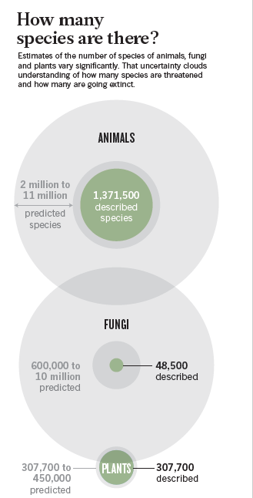
Gamma diversity
Total number of species observed in all habitats within a geographic area
Studies that try to tally the number of species of animals, plants and fungi alive right on Earth now produce estimates that swing from less than 2 million to more than 50 million
Some estimates have ranged up to 100 million because of potential insect diversity
Notes:
But is a habitat easily defined? Do some species use multiple habitats? Species migrate as well.

Slide 51
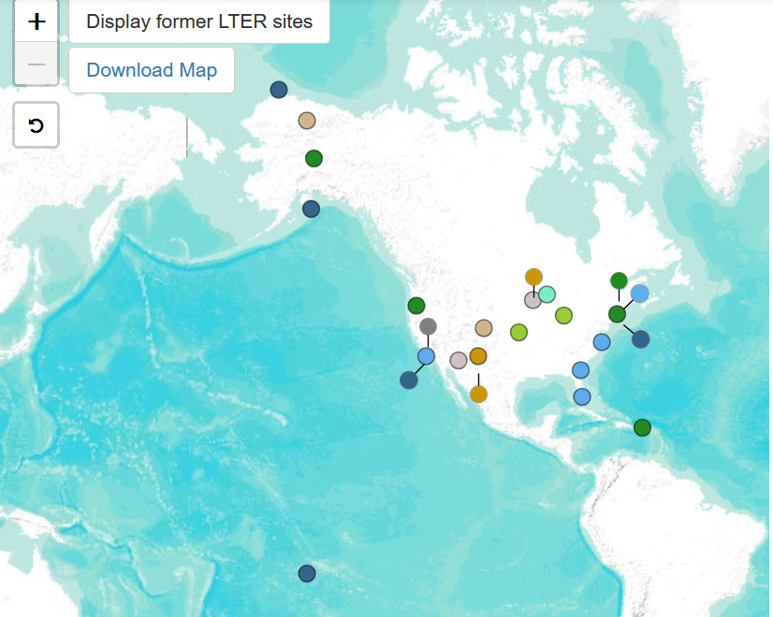
Undetectability of annual global trends in local species richness
A monitoring network with 500 randomly selected sites is needed to detect global change in local species richness over a 30-year period,
The number of sites needed for detecting trends is 1000 for a ten-year period, increases to 5000 for three years change detection and annual trends are undetectable.
Global scales may not be useful for tracking local changes in species richness except over multi-decadal scales.
Notes:
These are all the long-term ecological study sites in North America – there are not enough sites, nowhere near the number needed to accurately and consistently identify local species richness trends. https://lternet.edu/site/

Slide 53
Notes:
https://www.washingtonpost.com/world/2019/06/07/i-hate-elephants-behind-backlash-against-botswanas-giants

Slide 54
Rethinking biodiversity
Do the choices we make about conserving biodiversity have equitable impacts among humans in the many places and cultures they occupy?
Notes:
My job is to complicate your world and keep you from making generalizations and talking in greenspeak. Many of you use the term ‘biodiversity’ in conversation. Most of the time, having some ambiguity about its meaning is not a problem. But if you want to make conservation policy, more detail in language is required, especially if we have to make decisions about what to protect and what to let die. Moreover, any choice to delineate a discrete quality of biodiversity is going to be a simplification of it’s inherent complexity. Choice is also an act that is contextual and related to one’s cultural and social identity.

Slide 55
Notes:
Lumba Nderiki, a farmer in her 80s, stands for a portrait in her field in Chobe Enclave, Botswana, on May 25, 2019. Her husband of 65 years was killed by an elephant in 2014. She says her fields have been trampled and eaten by elephants for years, and she cannot afford to keep fixing the fencing. https://www.washingtonpost.com/world/2019/06/07/i-hate-elephants-behind-backlash-against-botswanas-giants/?arc404=true

Slide 56
Notes:
Ephraim Simasiku, 71, looks at the carcass of an elephant he killed when he could not scare it off of his watermelon field in Chobe Enclave, Botswana. He uses a fence with tin cans and patrols with a flashlight and a drum to scare the elephants away, but on the night of May 14, after his other methods failed, he shot an elephant with a rifle. After he killed it, community members came to gather the meat. He said that elephants ate 400 of the 1,000 watermelon plants he planted this season. https://www.washingtonpost.com/world/2019/06/07/i-hate-elephants-behind-backlash-against-botswanas-giants/?arc404=true

Slide 57
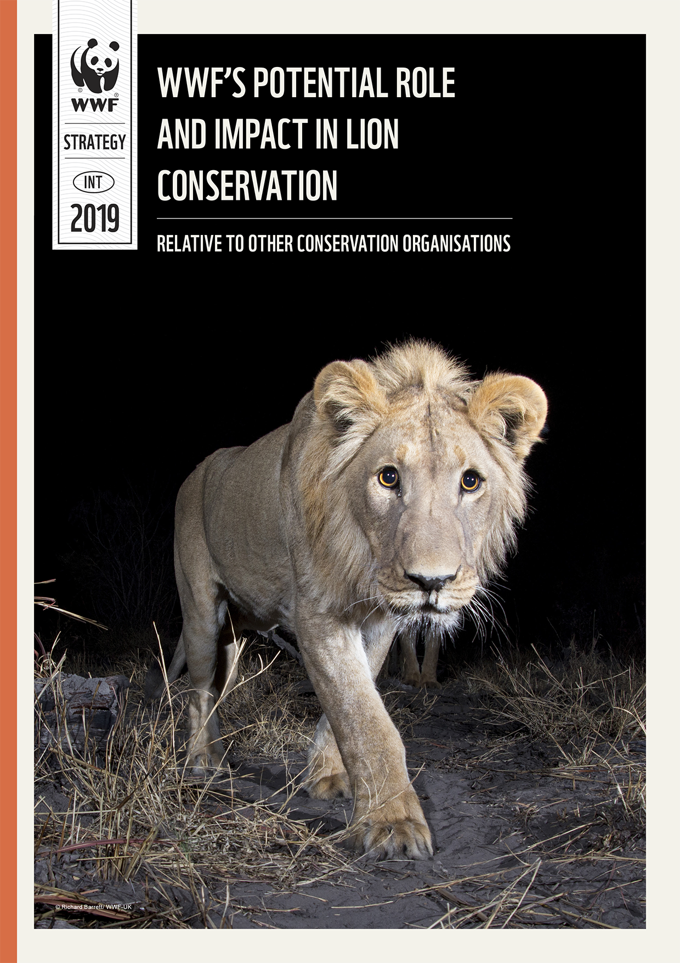
Notes:
Western view of lion conservation

Slide 58
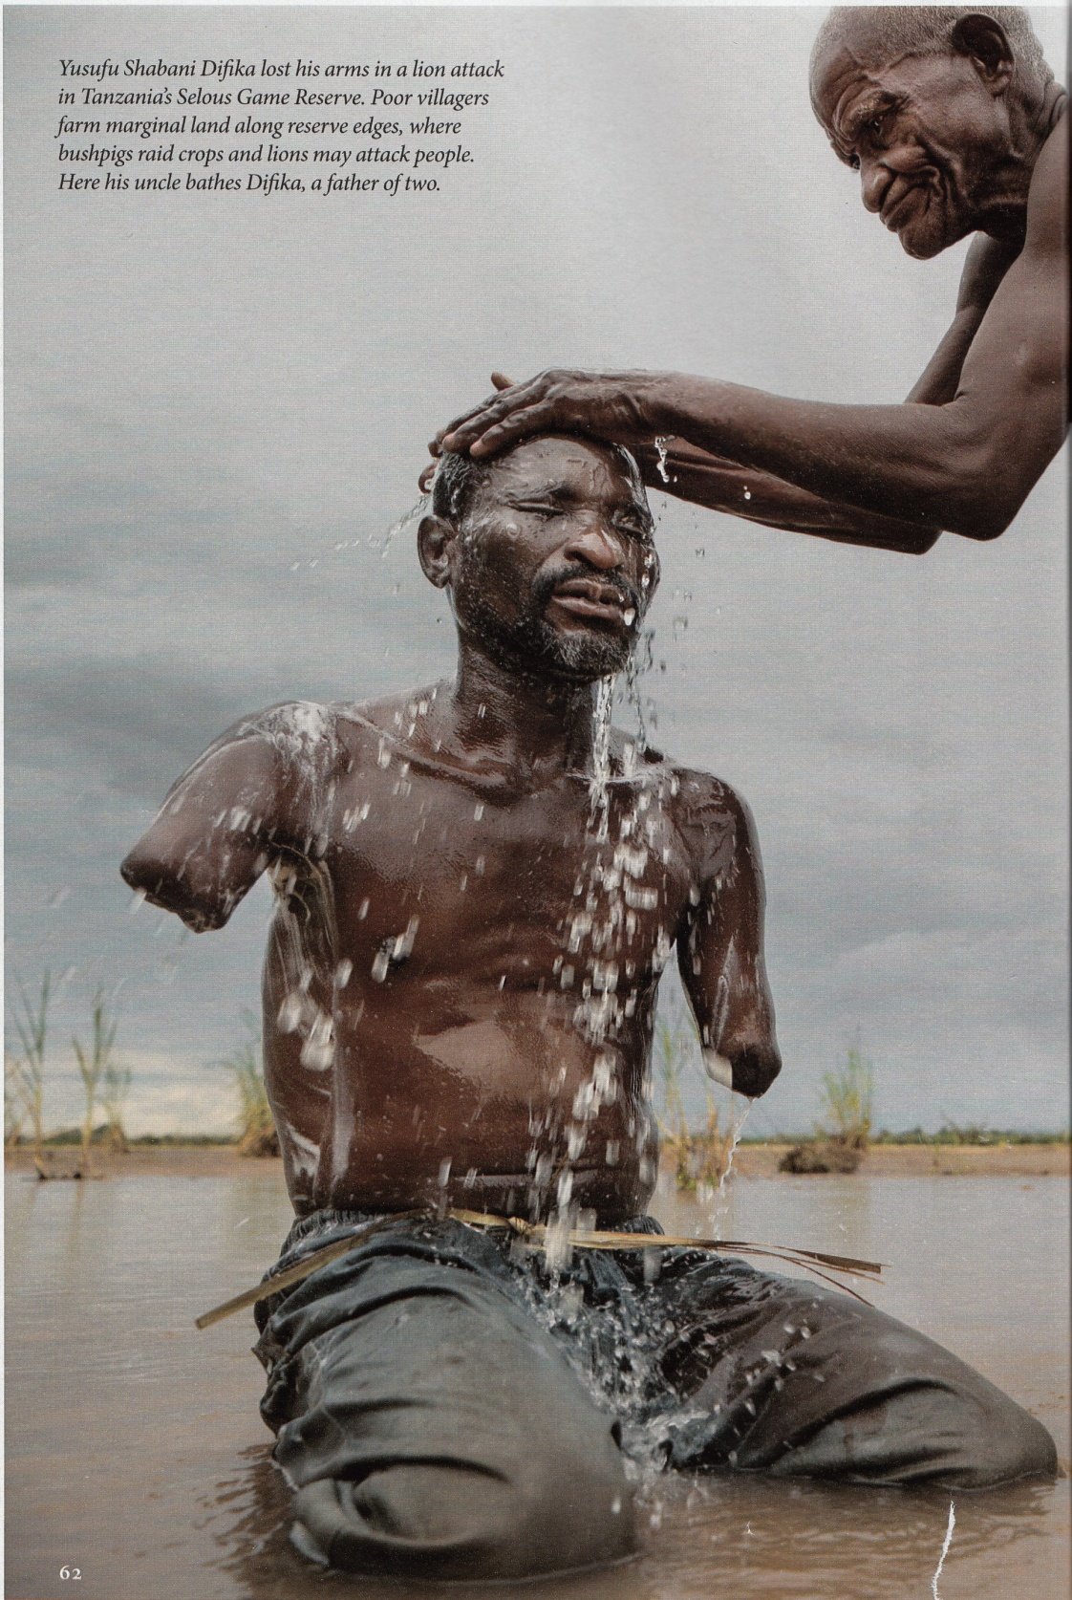
Developed countries are stuck with the contradiction of simultaneously wanting to protect biodiversity, recognize its ecological importance, and call for policies to protect it, but from a distance – other people may shoulder the responsibility of living with and/or protecting biodiversity
Middle ground positions that try to balance interests of differing parties can also be difficult to develop and maintain

Slide 59
Notes:
https://www.bbc.com/news/av/world-africa-37305603

Slide 61
Notes:
The death of Cecil the lion and the protests over it illustrate some of the overlooked tensions around the conservation of large predators.

Slide 62
Notes:
http://www.nytimes.com/2015/08/05/opinion/in-zimbabwe-we-dont-cry-for-lions.html
Costs of living with large predators and other megafauna may not be uniformly shared, and impact the poor more.

Slide 63
Notes:
http://www.nytimes.com/2015/08/11/world/africa/outcry-for-cecil-the-lion-could-undercut-conservation-efforts.html

Slide 64
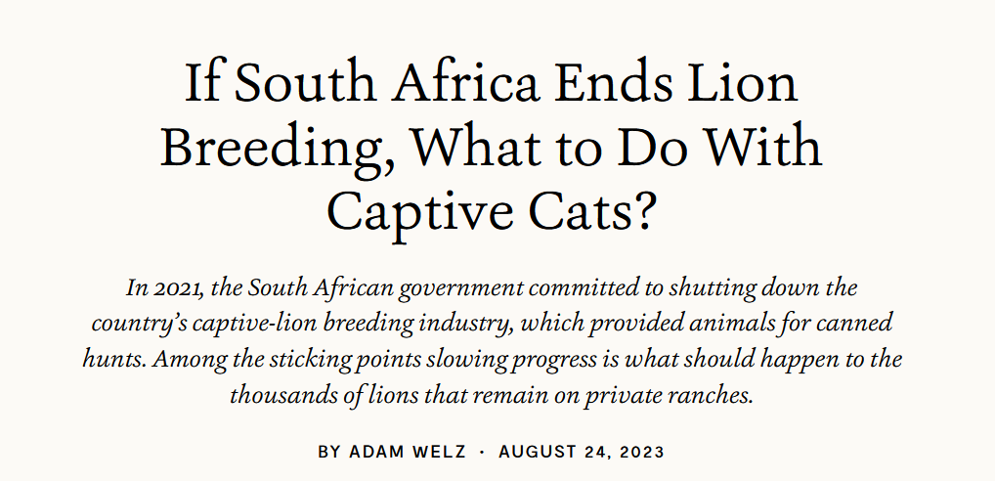
Notes:
https://e360.yale.edu/features/south-africa-captive-lions

Slide 65
Biodiversity leakage
Reducing biodiversity loss in one location may cause an increase in biodiversity loss in another location
Conservation of habitat has impacts on agriculture and economics that can ripple out across the globe.

Slide 66
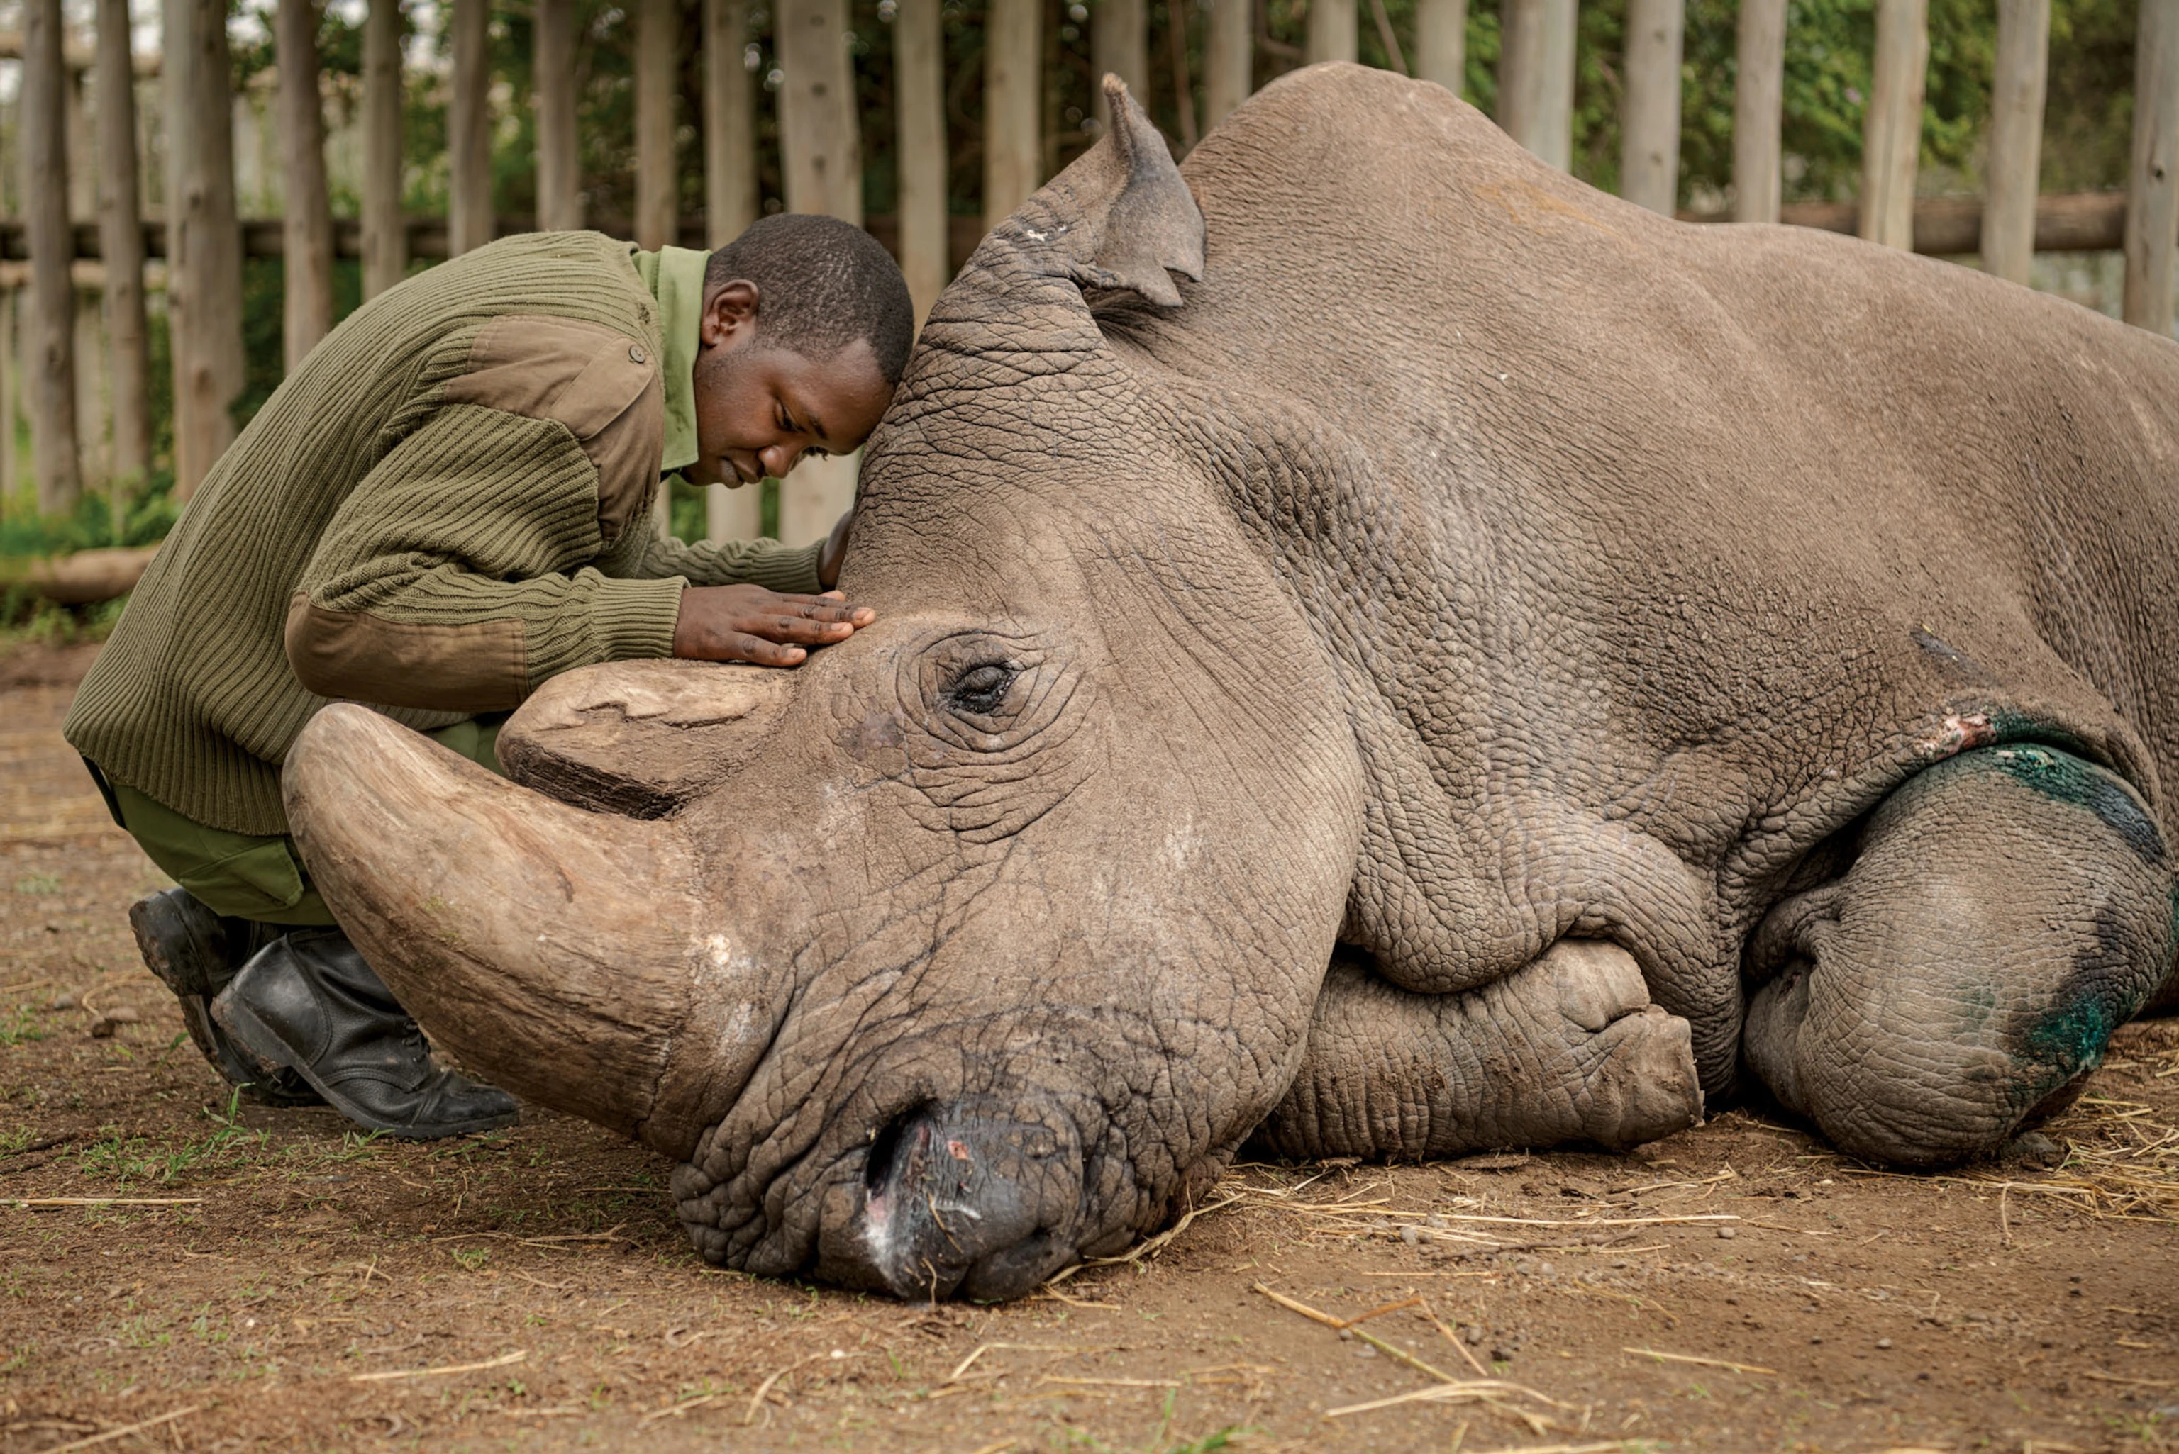
Closing
Biodiversity is not uniformly distributed across the planet like the atmosphere
Challenging to coordinate any pervasive global protection policy of biodiversity through joint cooperation
Biodiversity often becomes the direct responsibility of nations, zoos, or even individuals
Notes:
How are northern white rhinos different from the atmosphere?
Why should China be interested in conserving India’s Bengal tiger, or why should India be interested in the Chinese panda? UN Biodiversity Conference (COP 15) held in 2022 https://www.savetherhino.org/rhino-info/population-figures/

Slide 67
Statements like “Save Biodiversity” are good in intent and outlook, but do not capture the paradoxes and challenges of actually undertaking a specific conservation policy for a life form
Humans have the responsibility to decide what to prioritize and value, and with this includes attentiveness to how we define and measure biodiversity. This will have implications for the protected organisms, but also for the people who live near them
Biodiversity may be more difficult than global climate change to develop policy

