Slide 1
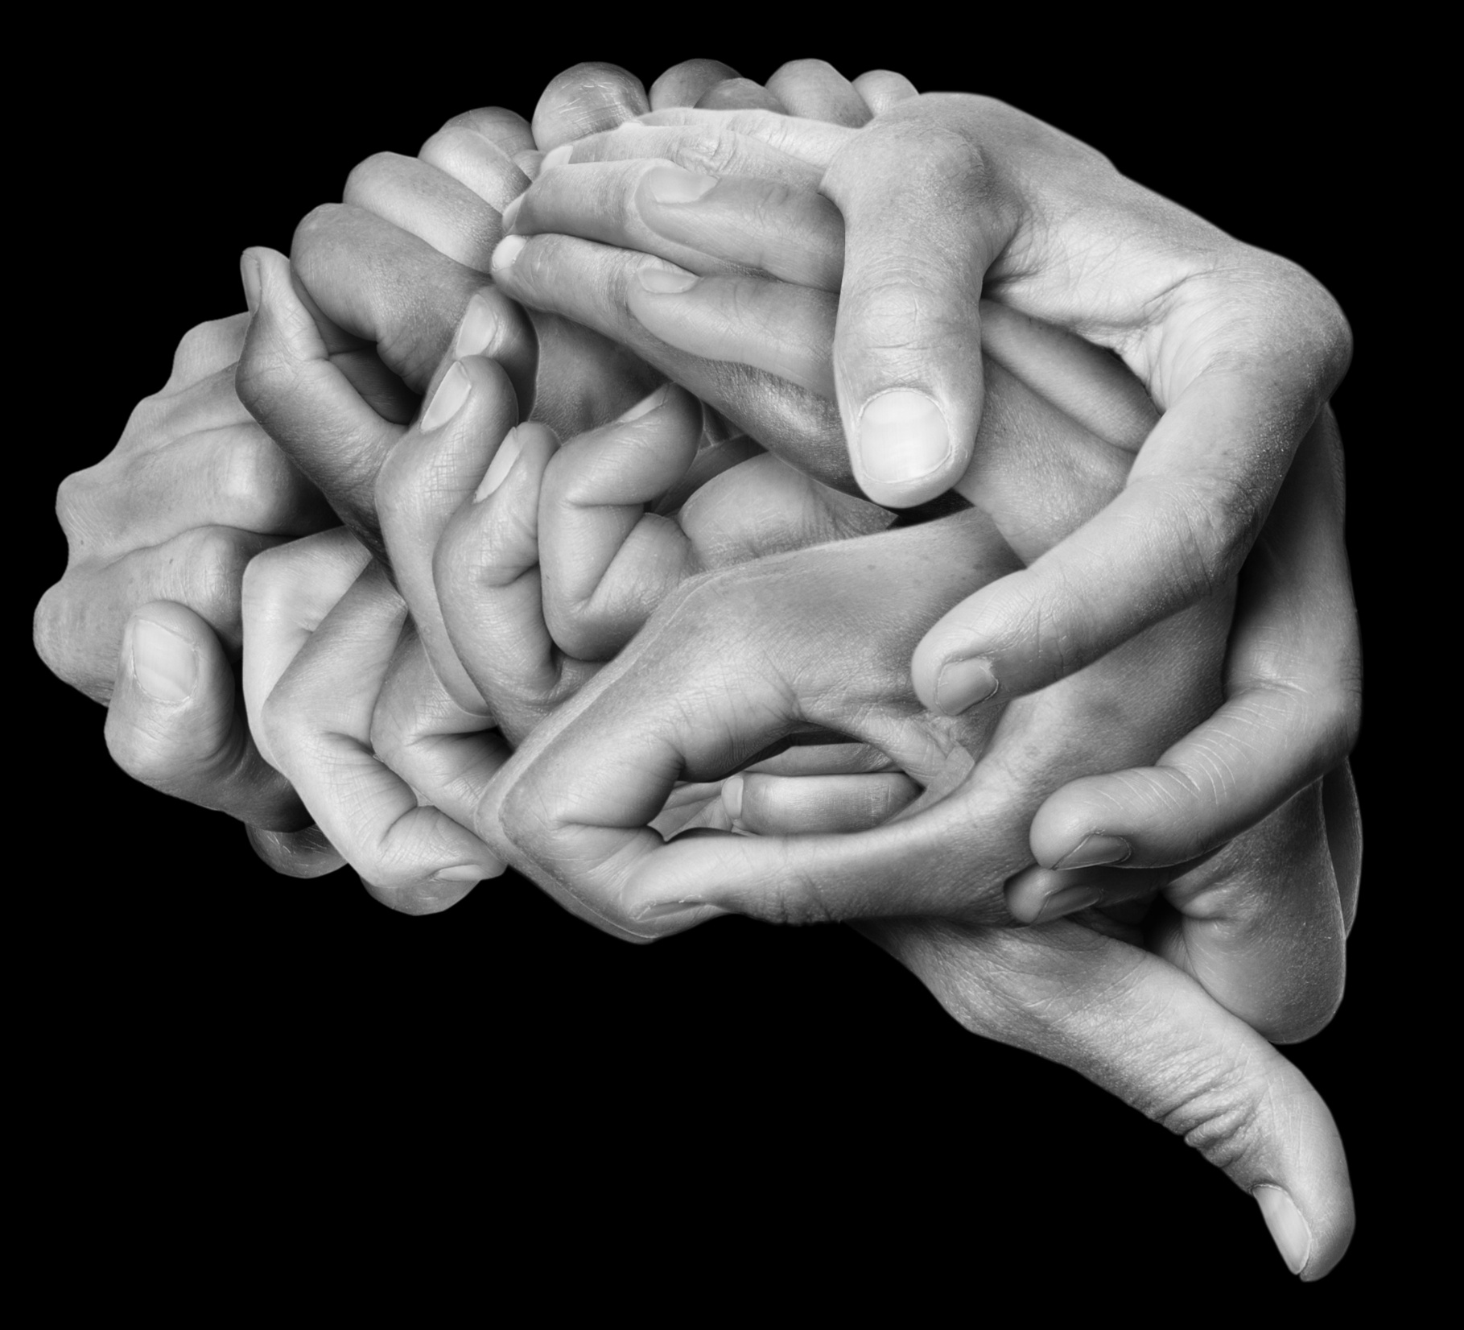
In this lecture, we will discuss:
Cognitive biases
Nudging
Behavioral contagion
We examine these topics in order to explore how people make decisions
Understanding how people make decisions helps in the design of effective environmental and sustainability policy.
Notes:
Cognitive biases are not simply the idea of unconscious biases that we here about a lot of late, and how we have unconscious biases toward people not like us.

Slide 2
Notes:
The thylacine is also known as the Tasmanian tiger.

Slide 3
Notes:
But it is not so easy in the real world, when we're dealing with people and situations rather than lines. We would all like to have a warning bell that rings loudly whenever we are about to make a serious error, but no such bell is available. These kinds of cognitive biases are difficult to overcome. It may be possible to overcome the pitfalls of optical illusion, but extremely difficult with real-world cognitive biases.

Slide 4
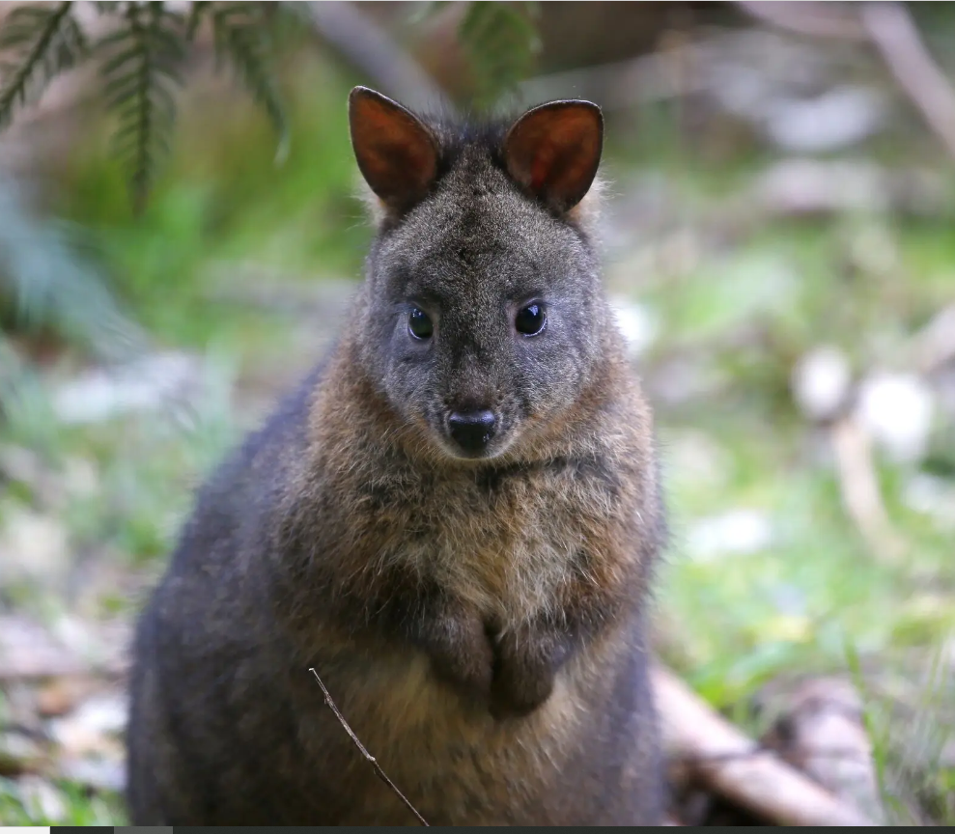
Why do we keep seeing thylacines?
Processing every individual sensory detail is impossible, so our brain actively reconstructs our visual world based on the complex but ambiguous input received by our eyes.
Research has shown that unclear sensory data — such as a blurry picture — causes the brain to rely more heavily on preconceived patterns to make sense of it.
Our beliefs and prior experience can influence what we see, or more accurately, what we think we see.
Notes:
Many people who go looking for thylacines have an emotional investment in identifying them, and are already convinced the creatures are already out there. That pre-existing belief makes it easier to begin seeing thylacines in every shadow and rustle of brush, or in photographs that don’t offer a clear look at the animal in question. In their desire to see the thylacine, people genuinely miss details that might contradict their preferred hypothesis. A Tasmanian pademelon, which is likely what is being seen in the video of purported evidence of thylacines https://www.nytimes.com/2021/03/10/science/thylacines-tasmanian-tigers-sightings.html

Slide 5
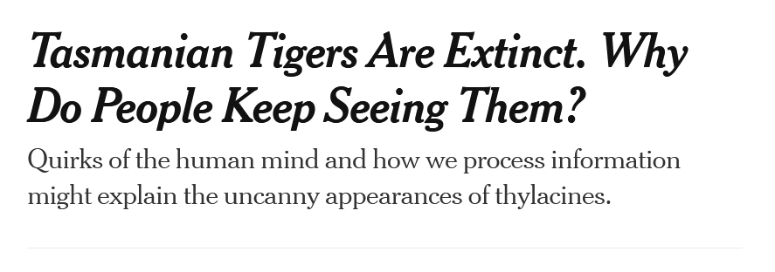
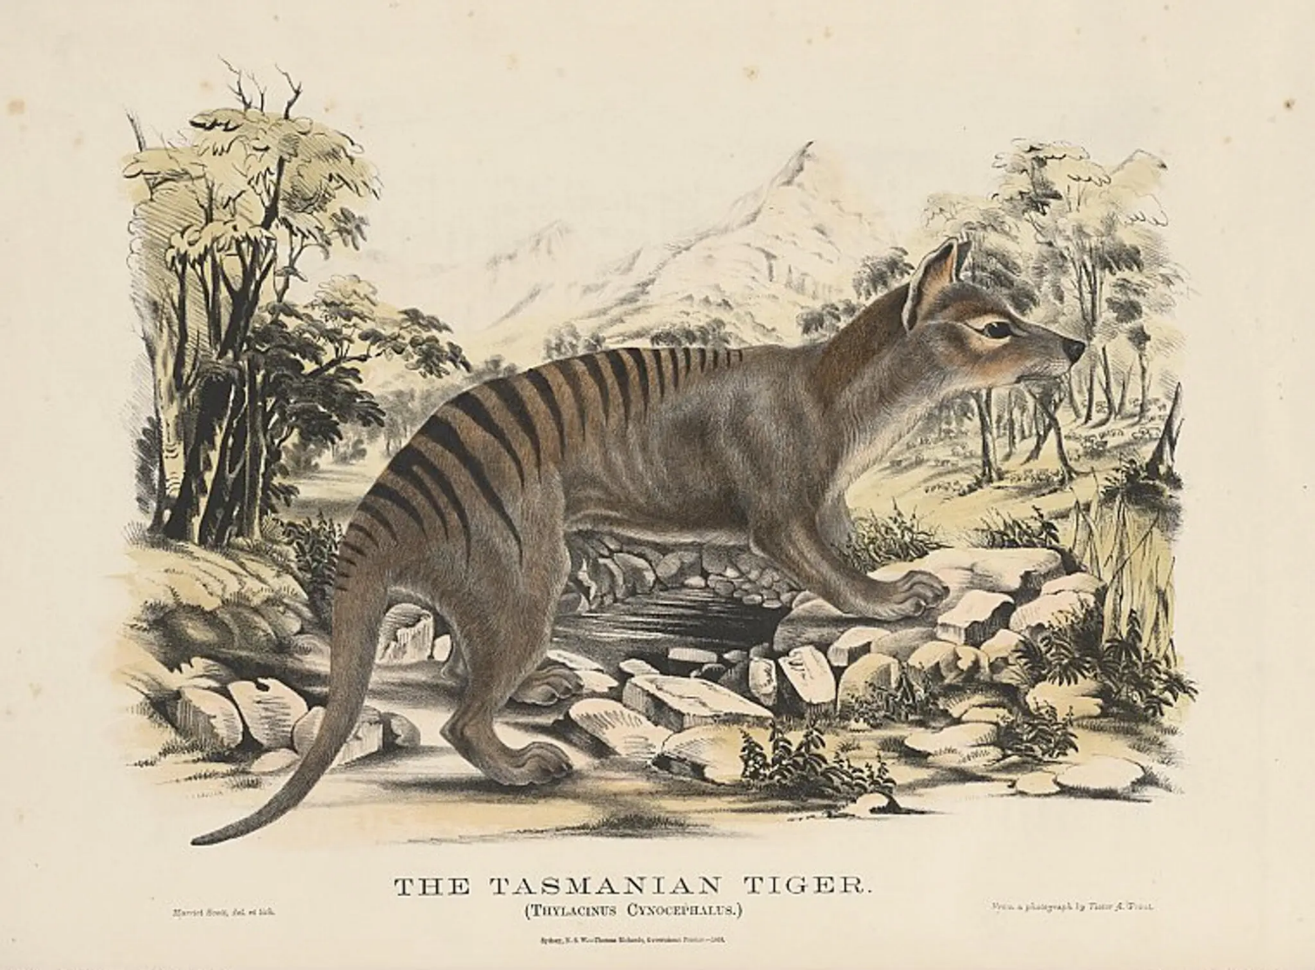
In other words, some of us keep seeing them because of cognitive biases.
For example, confirmation bias is a cognitive bias in which the tendency is to interpret new evidence as confirmation of one’s pe-existing existing beliefs or theories and rejecting any evidence that contradicts them.

Slide 6
Notes:
2007

Slide 7
Notes:
Early 1980s

Slide 8
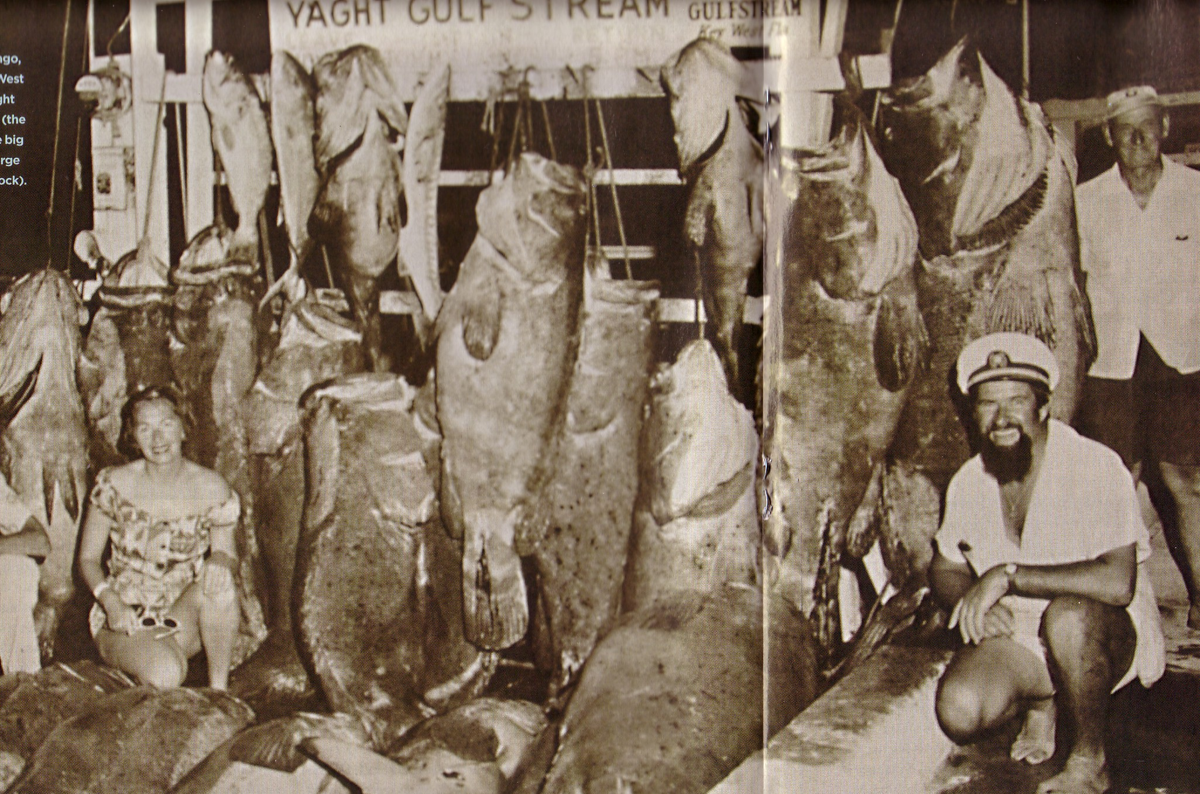
Notes:
An example of shifting baselines
Photo was taken in Key West in 1957

Slide 9
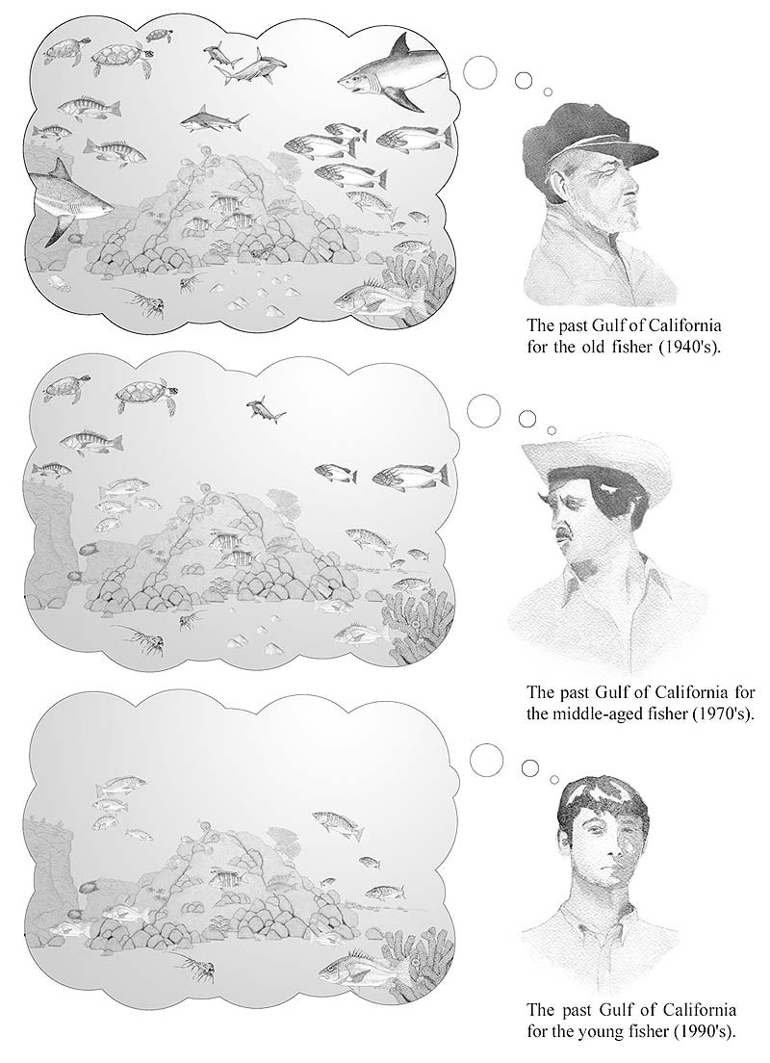
Because of a cognitive bias known as generational bias, later generations have a different baseline of what is normal.
In ecology they call this phenomena the shifting baseline syndrome.
A similar cognitive bias is the memory illusion: a single event in the past, like an extremely good fishing season, can bias the perception a fisher has of the present
Notes:
Shifting baselines, the young fisher at the bottom has no experience of the fishery from the time of his grandfather. What is normal to this young person would be very different from what would be normal to the grandfather. The baseline has changed.

Slide 10
Linda is 31 years old, single, outspoken, and very bright. She majored in philosophy. As a student, she was deeply concerned with issues of discrimination and social justice, and also participated in anti-nuclear demonstrations.
Which is more probable?
Linda is a bank teller.
Linda is a bank teller and is active in the feminist movement.
Notes:
This is an example of the conjunction fallacy.

Slide 11
Cognitive biases
Cognitive biases are systematic patterns of deviation from rationality in judgment.
An individual's construction of reality, not the objective input, dictate behavior and decision-making.
This can sometimes lead to perceptual distortion, inaccurate judgment, illogical interpretations
However, biases can help humans find shortcuts to assist in the navigation of common situations in life.
Some are presumably adaptive - they enable faster decisions which can be desirable when speed is more valuable than accuracy
Cognitive biases are not universal, they can vary as a function of culture and identity. They are propensities to think in certain ways that has a degree of generality among humans.

Slide 12
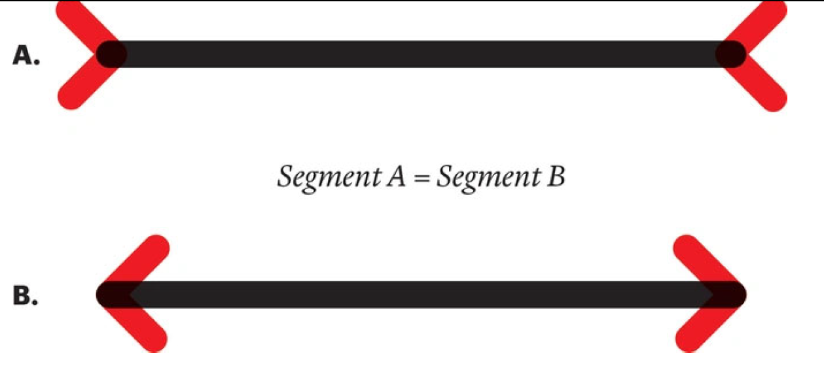
We all have cognitive biases
Not always easy to overcome – some are, like:

Slide 13
The status quo bias: People prefer to stick with the first choice they make. They would rather make errors through inaction (errors of omission) as opposed to action (errors of commission).
Notes:
The Monty Python problem from the game show, Let’s Make a Deal The status quo bias in which people prefer to stick with the choice of door they have already made. The errors of omission vs. errors of commission effect, in which, all other things being equal, people prefer to make errors through inaction (Stay) as opposed to action (Switch). https://en.wikipedia.org/wiki/Monty_Hall_problem
Suppose you're on a game show, and you're given the choice of three doors: Behind one door is a car; behind the others, goats. You pick a door, say No. 1, and the host, who knows what's behind the doors, opens another door, say No. 3, which has a goat. He then says to you, "Do you want to pick door No. 2?" Is it to your advantage to switch your choice?

Slide 14
Notes:
Intuition is at odds with probability. The probabilities here arise from a series of events that relate and shape one another. Bayesian statistics allows probabilities to be derived from these kinds of related events. You have a significantly better chance of winning by switching to the other door because the probability of winning by staying is 1/3 versus winning by switching which is 2/3. https://medium.com/i-math/the-monty-hall-game-show-problem-ef68c8581845

Slide 15
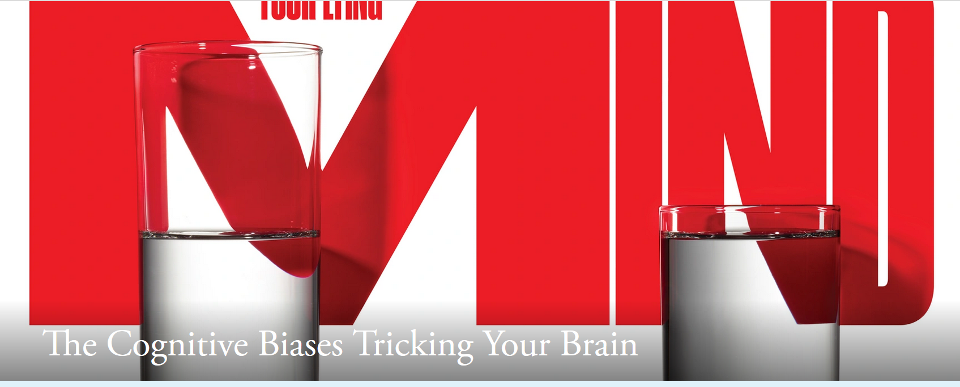
Cognitive biases
anchoring effect
availability bias
base-rate neglect
confirmation bias
conjunction fallacy
endowment effect
gambler’s fallacy
generational bias
future discounting/present bias
memory illusion
representativeness heuristic
scope neglect
status quo bias
sunk cost fallacy
Dunning-Kruger effect
better-than-average effect
deficit of knowledge fallacy
For the next test, you will need to know what all of these cognitive biases are and provide an example related to an environmental issues or sustainability practice. The reading above goes through many of the these cognitive biases others are mentioned in these slides.
Notes:
Fallacies are incomplete or faulty modes of reasoning
Click on the image to access descriptions for some of these cognitive biases. Some are listed below.
The gambler’s fallacy makes us absolutely certain that, if a coin has landed heads up five times in a row, it’s more likely to land tails up the sixth time. In fact, the odds are still 50-50.
Optimism bias leads us to consistently underestimate the costs and the duration of basically every project we undertake.
The anchoring effect is our tendency to rely too heavily on the first piece of information offered, particularly if that information is presented in numeric form, when making decisions, estimates, or predictions. This is the reason negotiators start with a number that is deliberately too low or too high: They know that number will “anchor” the subsequent dealings.
The base-rate neglect bias is the disinclination to believe statistical and other general evidence, basing their judgments instead on individual examples and vivid anecdotes.
Confirmation bias is the effect that leads us to look for evidence confirming what we already think or suspect, to view facts and ideas we encounter as further confirmation, and to discount or ignore any piece of evidence that seems to support an alternate view

Slide 16
The illusion of moral decline
For decades, when people around the world compare morals of the present with the past, they overwhelmingly report that morals are deteriorating.
84% of Americans said morality had declined when they looked back over time. Responses in 59 other countries were similar.
However, when asked periodically over a timespan of years whether morality was at that time declining, their responses were stable. This conflicts with the idea that morality is in a downward spiral.
Notes:
That isn’t meant to undermine the very real crises society faces. To say that things haven’t gotten worse is not to say that things are good.
It always feels like the problems of today are uniquely bad.

Slide 17
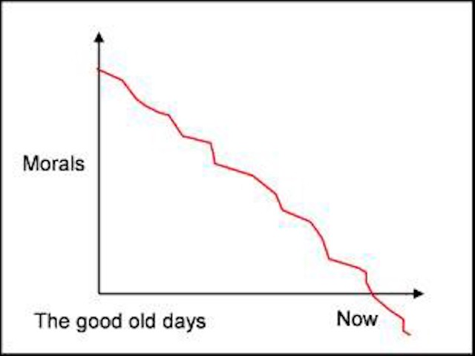
Feeling like you know that morals have declined is not good evidence that you do know.
The reason we have this illusion is that negative events fade more easily in memory, giving the past a rosiness that the present lacks
This is the cognitive bias known as the positivity effect of memory
Notes:
That isn’t meant to undermine the very real crises society faces. To say that things haven’t gotten worse is not to say that things are good.
It always feels like the problems of today are uniquely bad.

Slide 18
Why do we find it difficult to empathize with the problems of people in the future?
Notes:
This is a cognitive bias known as future discounting or present bias

Slide 19
Why do the wealthy consistently underestimate their environmental impact?
Notes:
Scope neglect: individuals struggle to grasp large numerical disparities, such as what might develop between the rich and the less wealthy. It can lead them to underestimate, in this example, the true extent of their carbon footprint.

Slide 20
Getting around cognitive biases
Slow-thinking organizations
The most effective check against cognitive biases is from the outside
Others can perceive our errors more readily than we can.
Slow-thinking organizations can institute policies that include the monitoring of individual decisions and predictions.
Pre-mortems
Slow-thinking institutions can also require procedures such as checklists and ‘premortems’
A premortem attempts to counter optimism bias by requiring team members to imagine that a project has gone very bad and to identify how it happened.
Conducting this exercise helps people think ahead and around cognitive biases.

Slide 21
Training
Training to overcome cognitive biases can have limited success
Difficult to eliminate biases from our thinking thru education because aspects of our information processing is hard-wired
Nudges
Ways of prompting behaviors that do not rely solely on logical reasoning and use contextual strategies
Notes:
https://www.coursera.org/learn/mindware

Slide 22
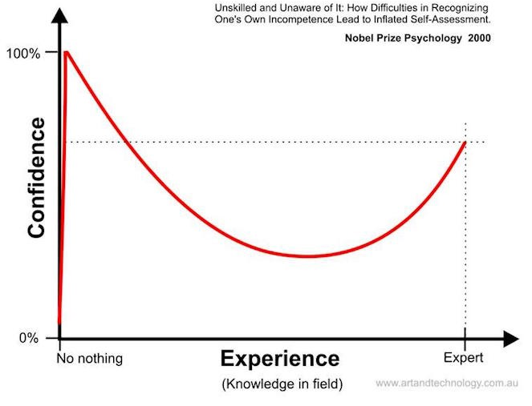
Dunning-Kruger effect
Named for the two psychologists who wrote an academic paper entitled “Unskilled and Unaware of It.”
People who hold the strongest views are often the least objectively informed
They reach erroneous conclusions and make certain choices because their incompetence robs them of the ability to realize their own incompetence
In sum: too ignorant to know one’s ignorance.
Notes:
Kruger, Justin, and David Dunning. "Unskilled and unaware of it: how difficulties in recognizing one's own incompetence lead to inflated self-assessments." Journal of Personality and Social Psychology 77.6 (1999): 1121.

Slide 23
Refinements of Dunning-Kruger effect
The effect is not universal and depends on context, task difficulty, and availability of feedback
In some cultures and with some tasks, the least skilled individuals actually recognize their lack of skill better than others.
Other cognitive biases like the better-than-average effect may be a better explanation:
People tend to overestimate their own abilities, qualities, or performance compared to others.
Most individuals believe they are above average in various positive attributes, even when statistically that is unlikely.

Slide 24
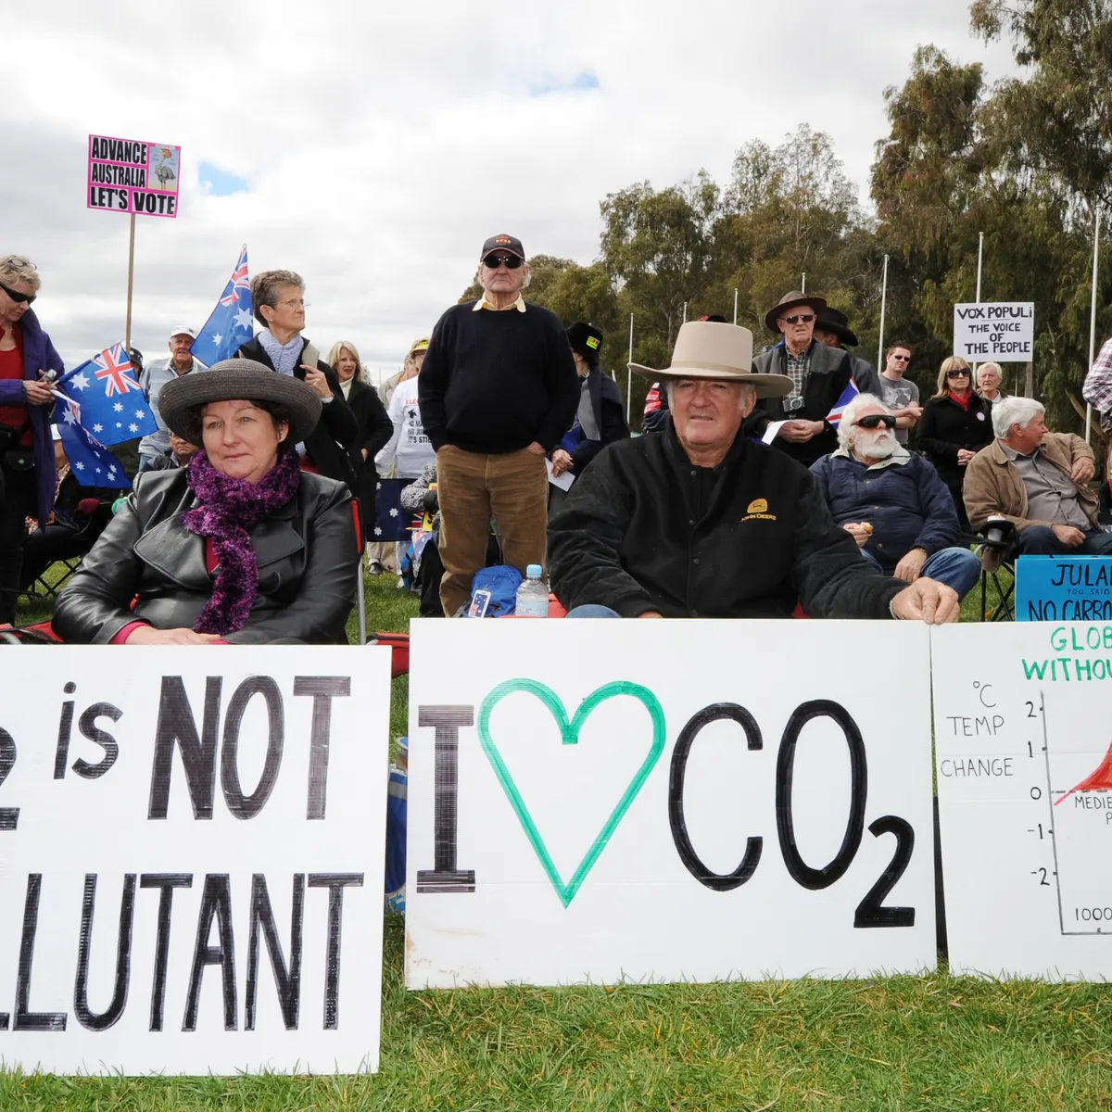
The deficit of knowledge fallacy
Unfamiliarity with the basic ‘facts’ is assumed to be the sole cause of the failure of an individual or group to converge on the desired behavior. “If they had only known the facts, then…”.
However, facts are not necessarily persuasive in and of themselves.
In fact, providing ‘facts’ may have an effect opposite than intended, as, for examples, when anti-vaxxers or anti-maskers or climate change-deniers are presented with the science to try and change their minds
Notes:
“If they just understood the facts and scientific evidence, then they would understand”. This is a simplification of how people acquire and respond to knowledge. To be ‘heard’, other strategies may need to be employed, such as trying to understand the context for why there is resistance to objective reasoning. Making an emotional connection may also provide a way for the message to be understood. Committing this fallacy may promote stereotyping of individuals as simply dumb while overlooking that social context – where they are, who they are, who their friends and family are – shapes their views.

Slide 25
If information is given in a way that assumes that just the presentation of the facts will result in changed behavior – we have committed the DOK fallacy
In a ‘rational actor’ world, this would be all that would be required. For example, giving someone generic facts about food waste would be enough to change their behavior.
However, humans may require their information to be more contextual in order to change their behavior
Notes:
metric tonnes: a unit of weight equal to 1,000 kilograms (2,205 lb).

Slide 26
Salience nudge
Salience is defined as the quality of being particularly noticeable or important; having prominence
In a salience nudge, certain choices made more prominent than others. But the message is framed in a way that it is not strictly an informational appeal to a rational actor
Notes:
The “Food Waste Buffett” was an exhibit in the dining hall at Portland State University – and an example of a salience nudge
https://www.asumag.com/green/sustainability-initiatives/article/20852955/program-shows-portland-state-students-how-much-food-they-waste

Slide 27
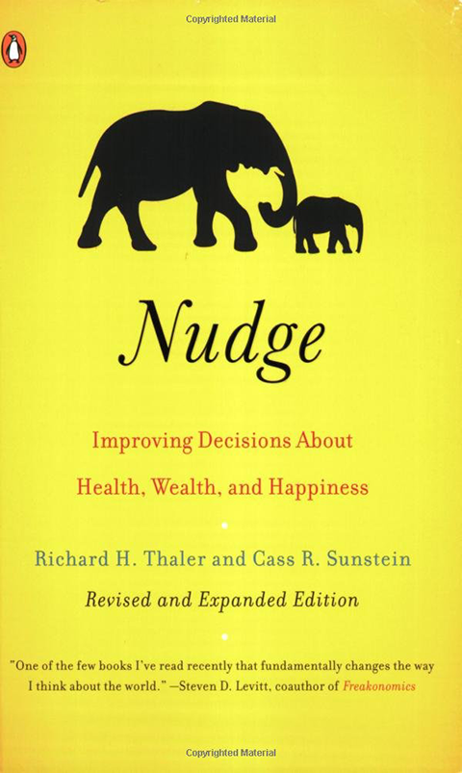
Nudging
Nudges are policies and programs designed to influence decision making that have historically been shaped by the economic model of the ‘rational actor’, someone who is completely self interested
Decisions and are not always made from a strictly self-interested, rational point of view. Where and when decisions are made also play a role
Intentionally altering the context within which decisions are made – giving a nudge – can encourage socially desirable behaviors and discourage socially undesirable ones

Slide 28
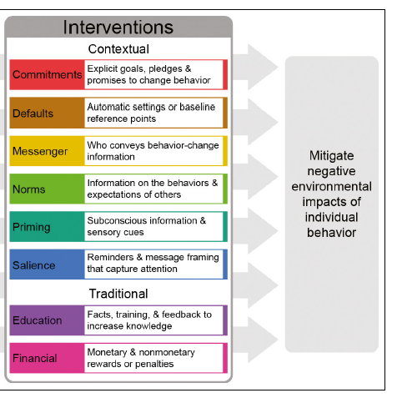
Nudges versus traditional interventions
Traditional interventions appeal to the self-interested rational actor model
Providing the facts (DOK fallacy), or training or financial incentives are perceived to work because we typically want to be informed, to earn money and to do a good job
However, these traditional interventions don’t always work and more contextual approaches are needed

Slide 29
Notes:
https://www.zerowastescotland.org.uk/litter-flytipping/nudge-study This is an example of a priming nudge

Slide 30
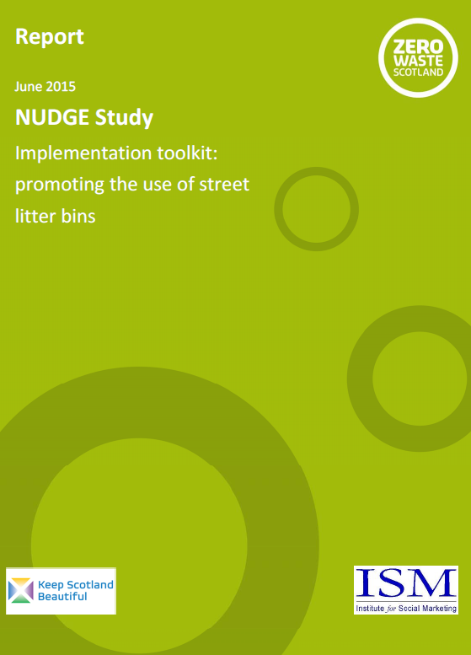
Nudges offer gentle, non-coercive and often cost effective ways to guide people toward better choices
Insights into human behavior offer new options for influencing people’s choices in ways that will affect the environment
Notes:
https://www.zerowastescotland.org.uk/litter-flytipping/nudge-study

Slide 31
Notes:
Many government departments and international agencies have established “nudge units”. Goal is to redesign government programs to take into account behavioral insights.

Slide 32
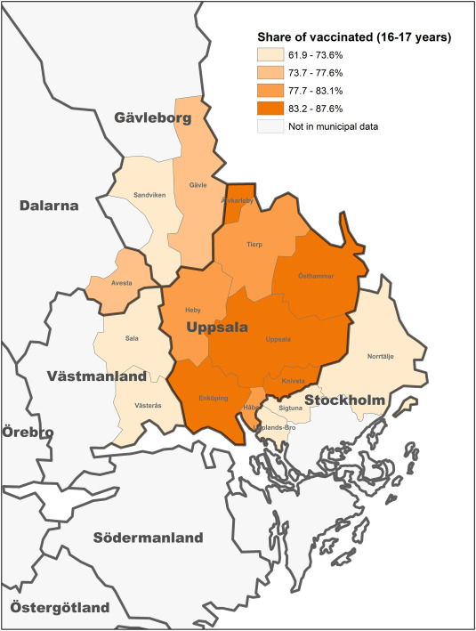
Default nudges to increase vaccination rates
During the COVID- 19 vaccine rollout, the Swedish region of Uppsala sent letters with pre-booked appointments to inhabitants aged 16–17 instead of opening up manual appointment booking.
Higher vaccine uptake, particularly among younger people
Pre-booked appointments are a default nudge strategy for increasing vaccination rates in populations with low perceived risk.
Notes:
Bonander, C., Ekman, M., & Jakobsson, N. (2022). Vaccination nudges: A study of pre-booked COVID-19 vaccinations in Sweden. Social Science & Medicine, 309, 115248.

Slide 33
Notes:
This is a norm nudge.

Slide 34
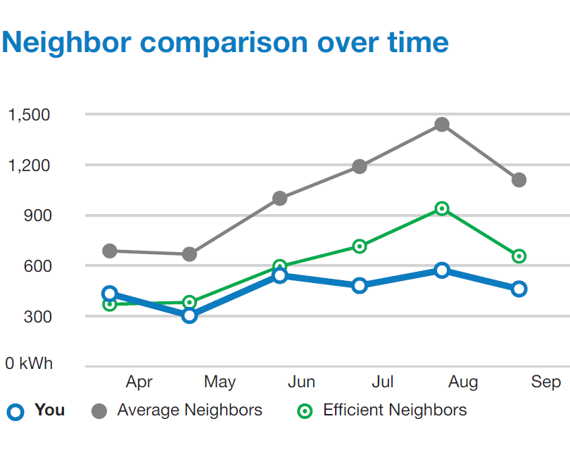
Norm nudge
Providing homeowners info about electric consumption compared to neighbors:
Makes heavy users cut power use 5%
However, may increase consumption by those who used less than average
Including a smiley face on the electricity notice to praise and encourage continued thriftiness did not increase consumption

Slide 35
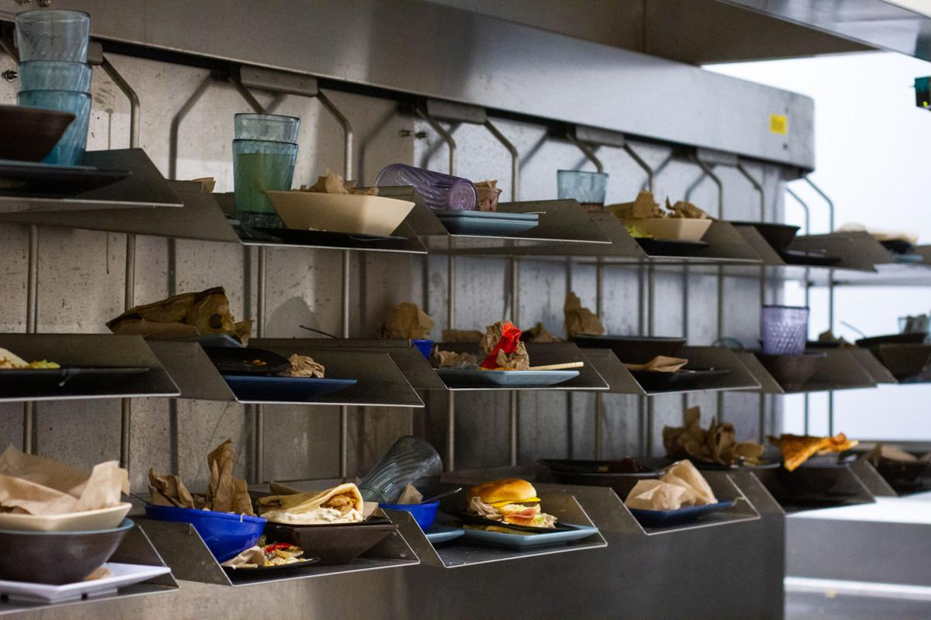

Slide 36
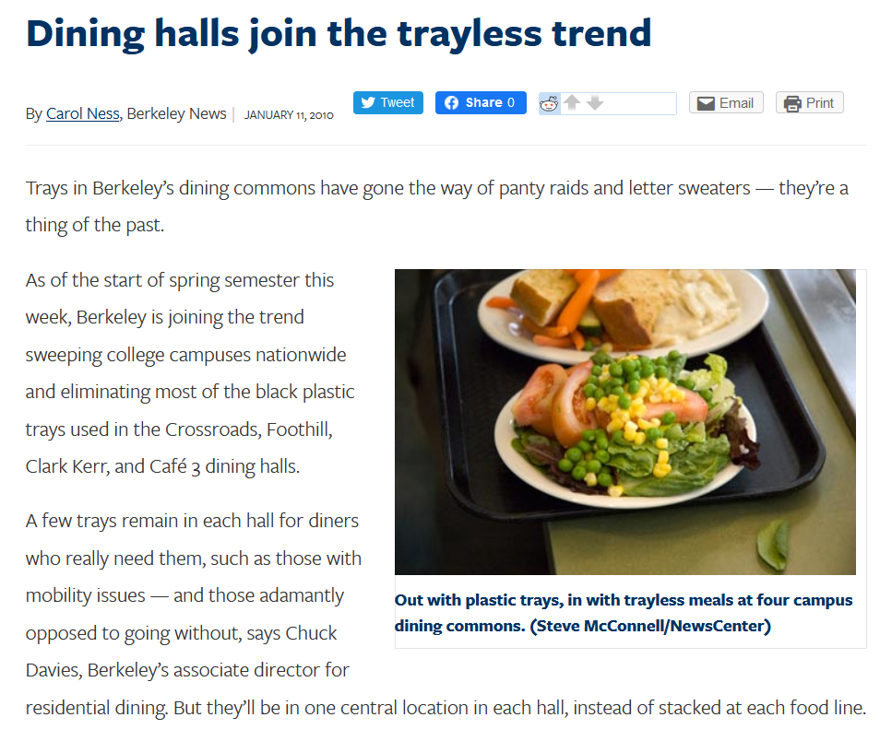
Default nudge
Taking away trays from the dining hall so students cannot stack plates of food on them

Slide 37
Nudging
Commitment nudges
Default nudges
Messenger nudges
Norm nudges
Priming nudges
Salience nudges
For the next test, you will need to know what nudges are, how they work, and provide an example related to an environmental/sustainability issue

Slide 38
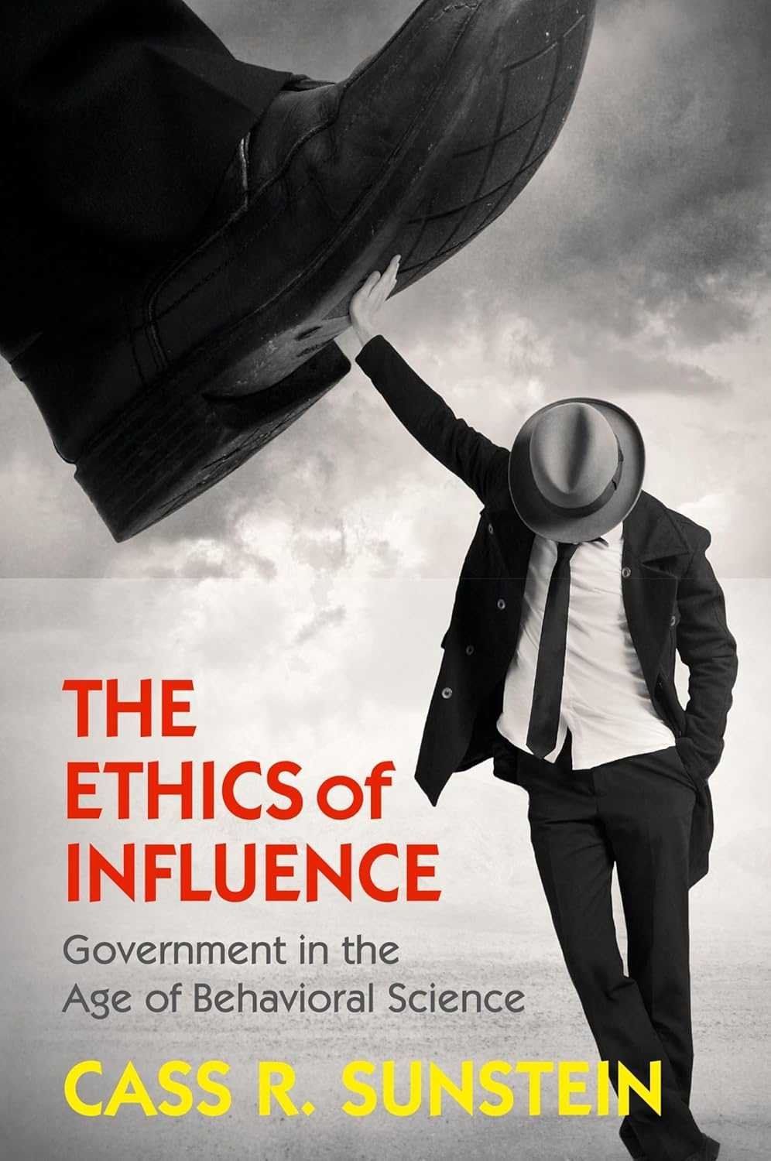
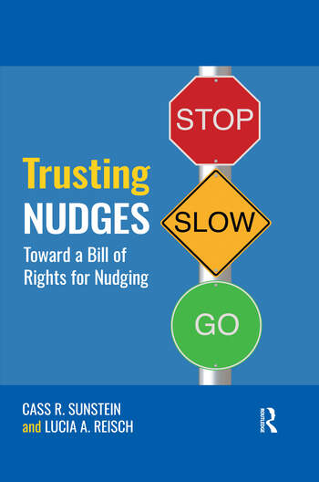

Slide 39
Criticisms of nudges
They can be coercive, a form of control and potentially unethical in some situations
They distract from a closer inspection of the reasons why they are needed.
Unintended consequences:
Advertisements about composting in dining halls may tend to increase food waste because the students are not as concerned if the food is going to be put to another use
Providing homeowners info about electric consumption compared to neighbors may increase consumption by those who used less than average

Slide 40
A default nudge: automatic enrollment in retirement saving plan upon initial employment
These do increase enrollment in retirement savings plans, but the underlying problem is people don’t make enough money to save adequately in the first place.
Many people who have retirement accounts contribute little more than the ‘match’, the amount to match what the employer contributes to the employee’s retirement

Slide 41
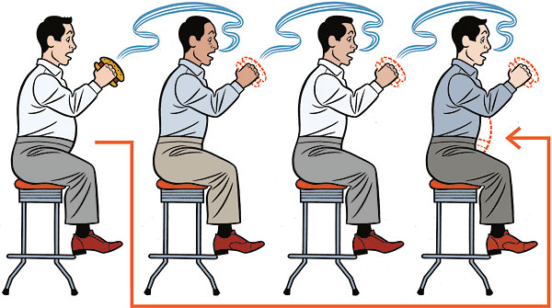
Behavioral contagion
Social networks play a role in behaviors and decision making
These networks can be virtual or physical
Ideas and behaviors spread from person to person
Human behavior tends to clusters in both space and time. For example, environmental practices, health habits, whether positive or negative, can be reinforced through social networks.
Notes:
People often eat meat because they grew up with, and continue to live among, people for whom substantial meat consumption is the norm. The same can be said for other practices that govern the kinds of choices we make that impact the environment.

Slide 42
Notes:
Norm nudging works through behavioral nudging

Slide 43
Notes:
A social network map of 2,200 people, the largest group of connected individuals in the Framingham Heart Study, in the year 2000. Each circle represents one person, and the size of each circle is proportional to that person's body-mass index (BMI). Yellow circles indicate people who are considered medically obese and green circles indicate people who are not obese. Lines indicate family and friendship ties. Obese people tend to form clusters indicating similar patterns of behavior and environment that they share. It suggests that what makes obesity is not all choice and availability, but who we surround ourselves around and their particular health habits. https://www.framinghamheartstudy.org/ Started in 1948

Slide 44
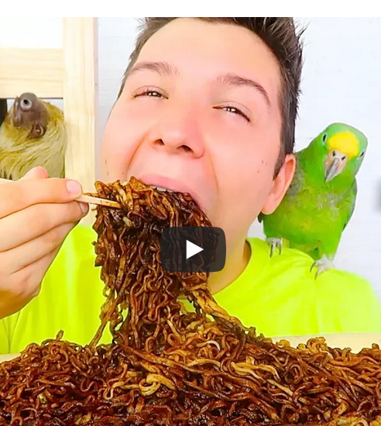
Notes:
https://www.nytimes.com/2023/09/07/us/paqui-one-chip-challenge-removed.html

Slide 45
Notes:
https://www.nytimes.com/2019/03/23/style/super-bloom-california-instagram-influencer.html https://www.facebook.com/ABCWorldNewsNow/videos/poppy-apocalypse-abc-news/390074361806369/

