Slide 1
Biodiversity conservation policy strategies: advantages, disadvantages and implications
What are the top two mechanisms that make biodiversity conservation policies necessary?
  Invasive species
  Habitat fragmentation
  Overexploitation
  Pollution
  Climate change
  Disease
Notes:
5:21

Slide 2

Notes:
Forest surrounding a church in Ethiopia

Slide 3
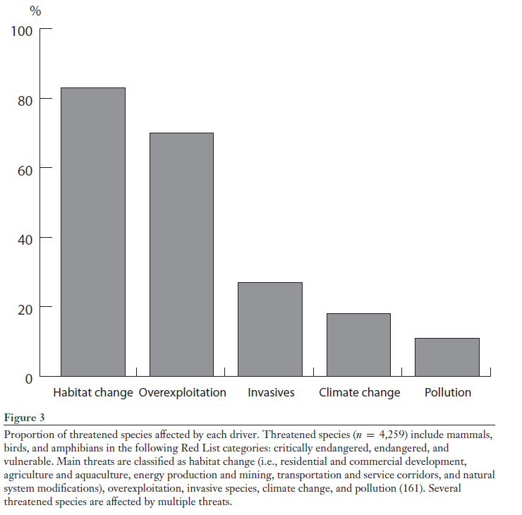

Slide 4
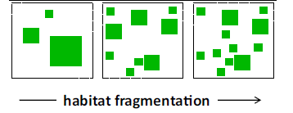
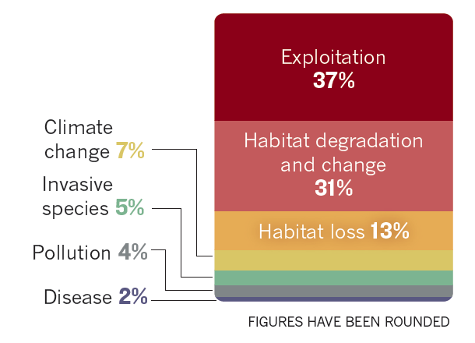
Notes:
“To fragment” means “to break apart”; it does not mean “to shrink”.

Slide 5
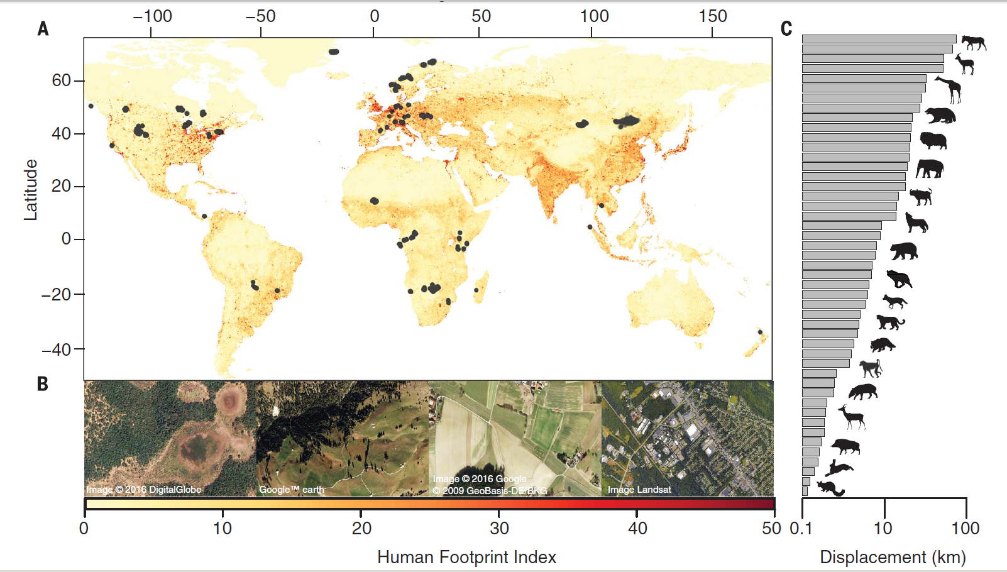
Habitat fragmentation results in island systems
Notes:
Locations from the GPS tracking database and the Human Footprint Index. (A) GPS relocations of 803 individuals across 57 species plotted on the global map of the Human Footprint Index (HFI) spanning from 0 (low; yellow) to 50 (high; red).
Animal movement is fundamental for ecosystem functioning and species survival, yet the effects of the anthropogenic footprint on animal movements have not been estimated across species. Using a unique GPS-tracking database of 803 individuals across 57 species, we found that movements of mammals in areas with a comparatively high human footprint were on average one-half to one-third the extent of their movements in areas with a low human footprint. We attribute this reduction to behavioral changes of individual animals and to the exclusion of species with long-range movements from areas with higher human impact. Global loss of vagility alters a key ecological trait of animals that affects not only population persistence but also ecosystem processes such as predator-prey interactions, nutrient cycling, and disease transmission.
Tucker, M. A., Böhning-Gaese, K., Fagan, W. F., Fryxell, J. M., Van Moorter, B., Alberts, S. C., ... & Bartlam-Brooks, H. (2018). Moving in the Anthropocene: Global reductions in terrestrial mammalian movements. Science, 359(6374), 466-469.

Slide 6
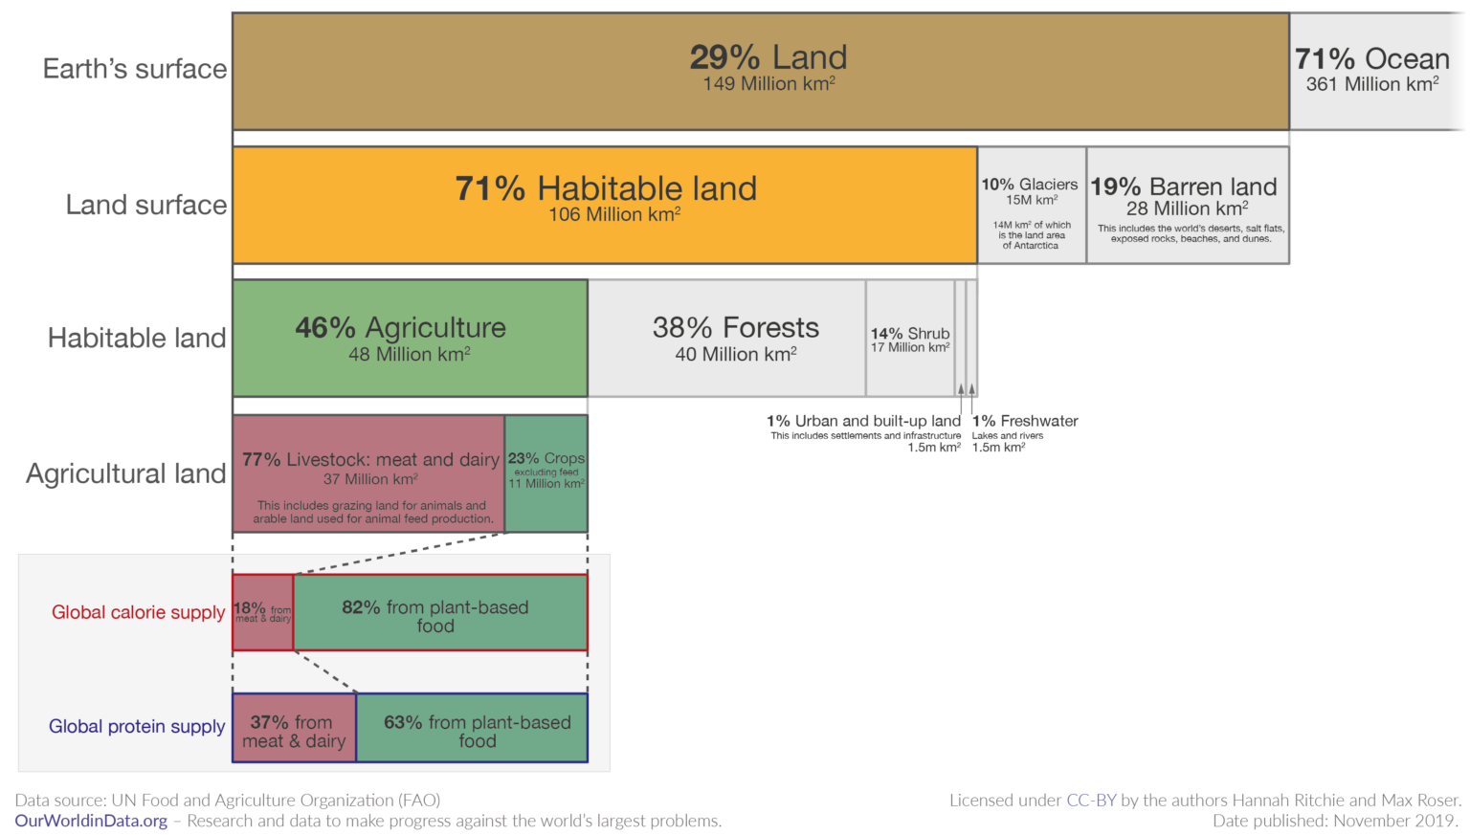
Notes:
https://www.nytimes.com/2022/12/15/opinion/food-diets-meat-biodiverstiy-cop15.html
https://ourworldindata.org/global-land-for-agriculture
Meat and dairy production uses a disproportionate amount of agricultural land
Half of Earth’s habitable land has been converted into agricultural land. Human food production drives habitat loss and fragmentation

Slide 7
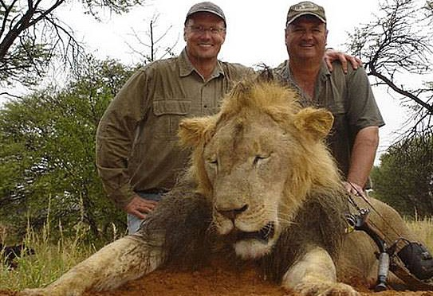
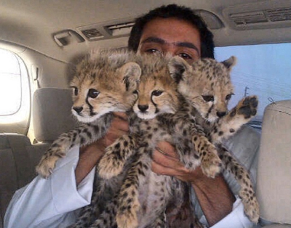
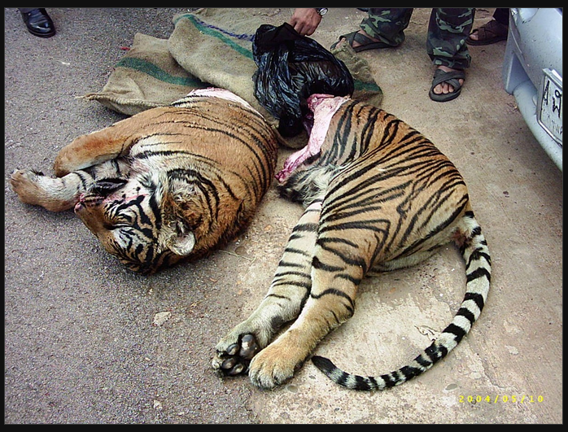
Types of overexploitation
Hunting for sport or culling of undesired species
Material resources (whale oil; hides, skins and feathers for clothing)
Bushmeat, the illegal, unsustainable trade in wildlife for income or meat
Traditional medicines and folk remedies
Exotic pet trade
Notes:
Bushmeat (left)
Cheetah cubs (middle)
The sawed halves of a farmed tiger, found in the possession of smugglers by the Thai highway police in May of 2004 (right)

Slide 8
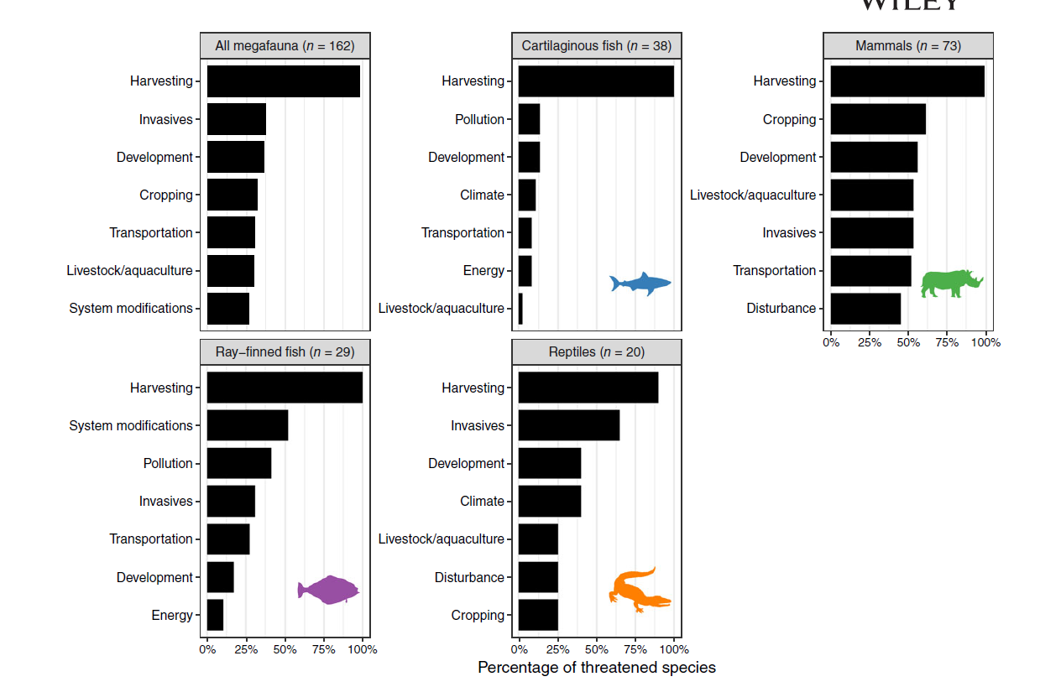
Notes:
Ripple, W. J., Wolf, C., Newsome, T. M., Betts, M. G., Ceballos, G., Courchamp, F., ... & Worm, B. (2019). Are we eating the world's megafauna to extinction?. Conservation Letters, 12(3), e12627.

Slide 9
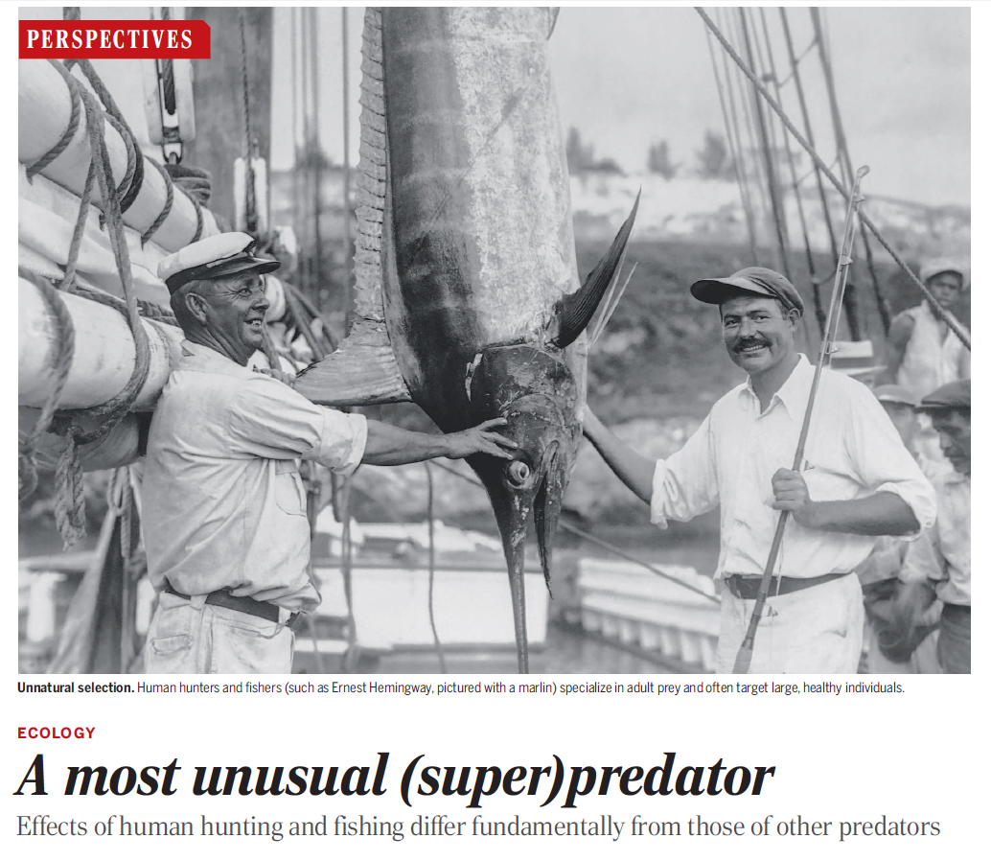
Notes:
Human beings focus heavily on taking down adult prey. This is quite different from the rest of the animal kingdom, for which the juveniles of a species tend to be the most exploited. Humans are using up the reproductive capital of these adults – their ability to reproduce and augment population numbers
http://www.bbc.com/news/science-environment-34011026

Slide 10
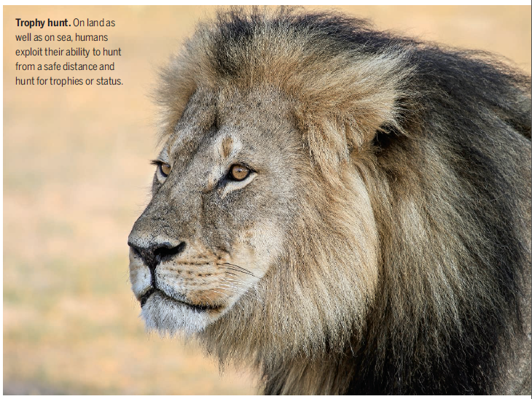
Notes:
Our hunting is fundamentally different in another way: we are not often in real danger.

Slide 11
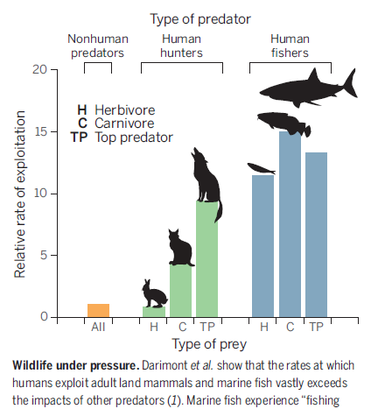
Humans exploit prey far more than any other predator
More than 90% of the mammals and birds that have gone extinct recently (within the past 500 years) were hunted by humans
Many species can sustain human hunting (for example, whitetail deer), but others cannot without management and/or regulations

Slide 12
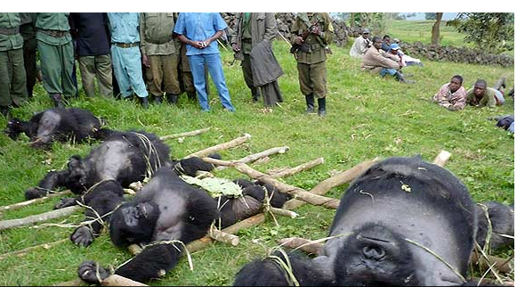
Notes:
Our hunting is also motivated by reasons to kills that are uniquely human – these gorillas were killed solely as a gesture of revenge amongst rival militant groups in the Democratic Republic of Congo.
But can we hunt for conservation?.
http://www.usnews.com/news/world/articles/2008/02/06/the-story-behind-the-killings-of-congos-rare-mountain-gorillas
Civil war in the Democratic Republic of Congo

Slide 13
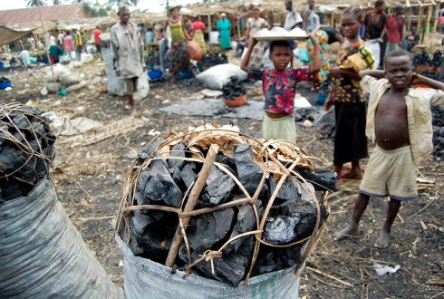
Notes:
The gorilla victims were part of Congo’s resource wars, reportedly killed by a corrupt park official who was trying to spite a warden for cracking down on the illegal charcoal trade. Local people go into the forest to collect wood to make charcoal, an efficient fuel source (raw wood is smokier and burns unevenly. Partially burned wood, as charcoal, is easier to work with.

Slide 14
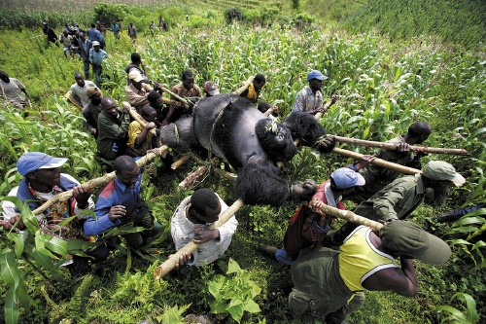
Notes:
Our hunting is fundamentally different. We have little reason to be concerned over own safety. Prefer large big often healthy animals with disproportionate influence on reproduction in a population. Predation by non-humans tends to favor the diseased, the weak, the very young or the very old.
In our last lecture we looked at home attitudes toward megafauna can lead to their protection or their harm when encounters occur. These encounters are often about livelihoods. From an elephant trampling the crops of a subsistence farmer to a Bangladeshi mauled by an Indian tiger in a poor fishing village, it is difficult to divorce economics from wildlife. Our attitudes toward charismatic wildlife like lions and tigers lead us to donate money to conservation organizations. These discourses that motivate us to save megafauna elsewhere are often incomplete, as we saw with the example of the Indian tiger and the complexities surrounding what will happen with future populations of these tigers in one of the most populous countries in the world.
Today we want to continue to look at overexploitation, but from a slightly different perspective: we look at the consumptive use of animals, their use as food, folk medicines (that rarely have any true medical value), their collection and captivity as pets, and as animals for hunting in canned trophy hunts
Since the late 1990s, approximately 6 million people have died in a civil war raging sporadically in the Democratic Republic of the Congo, although the exact number is hard to determine.
The country is also home to the largest remaining population of mountain gorillas

Slide 15
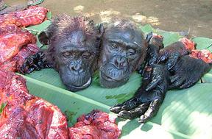
Notes:
Bushmeat

Slide 16
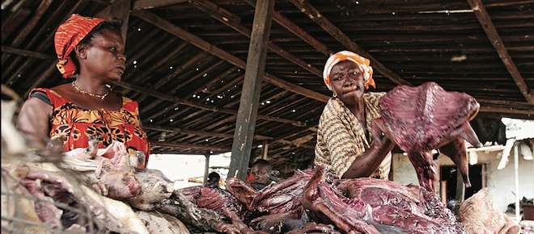
Notes:
Bushmeat is the illegal, unsustainable trade in wildlife for income or meat
Ghana

Slide 17
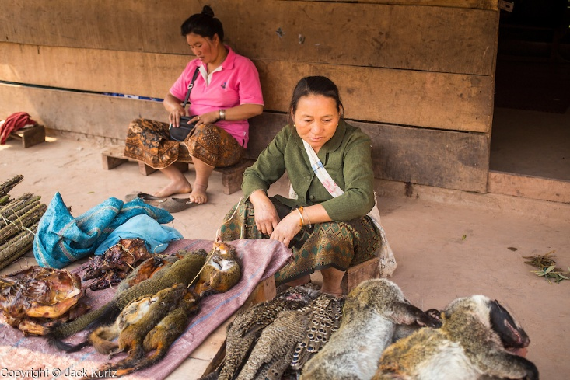

Slide 18
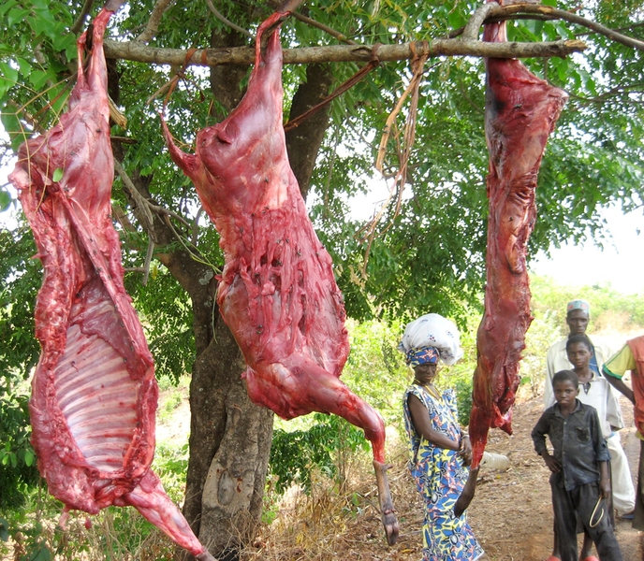
Drivers of the bushmeat trade
Provides protein where other sources lacking
Overall instability in food supply
Poverty and the need for an income from hunting and selling bushmeat
Cultural, ceremonial uses of animals
Where and what animals are hunted determines legality
Notes:
Bushmeat provides food, but also a livelihood and a role in society

Slide 19
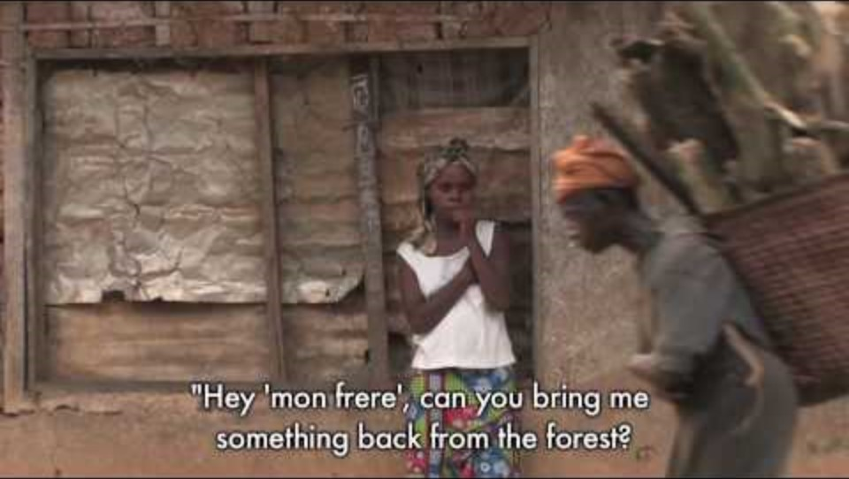

Slide 20
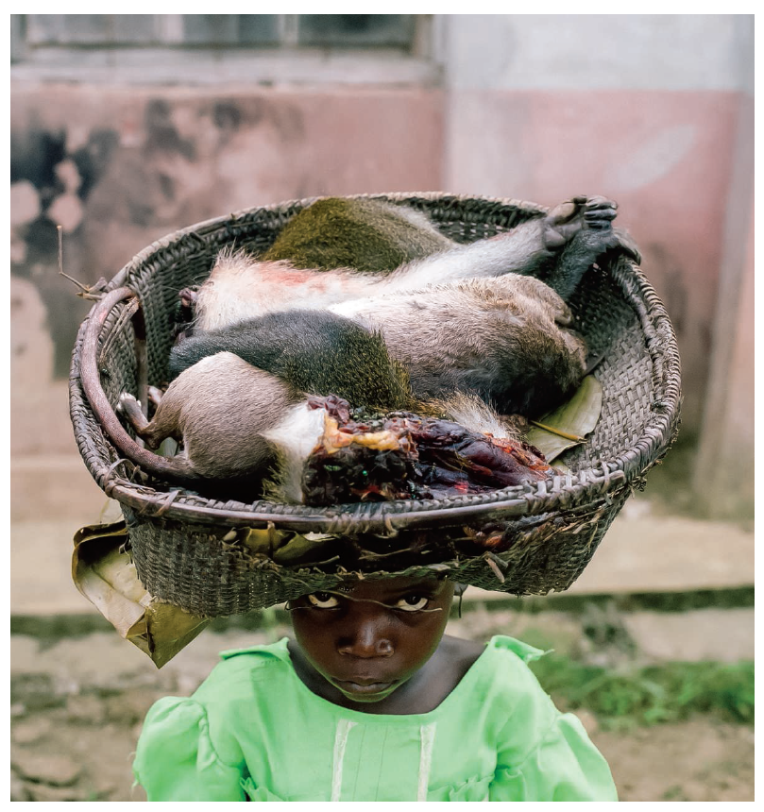
Bushmeat needs to be understood in its historical, social, political context
Bushmeat unfairly targets one type of overexploitation specific to a group of people (rural) and a location (the developing world)
However many cultures have or have had practices that converge upon the bushmeat category
Notes:
A child carries a basket containing a Gambian rat and a monkey in Lomela, Democratic Republic of the Congo.

Slide 21
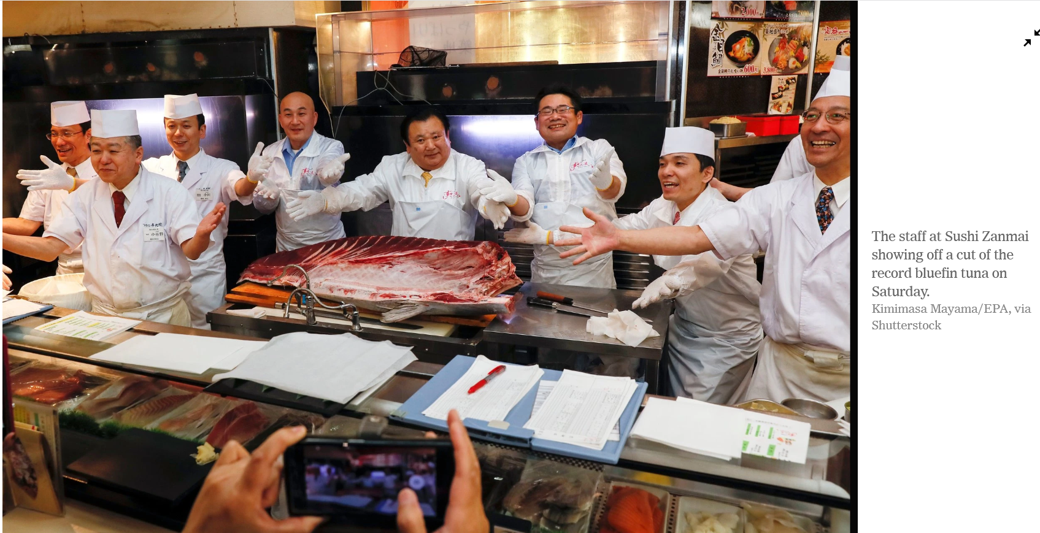
Notes:
https://www.nytimes.com/2019/01/05/world/asia/record-tuna-price-japan.html

Slide 22
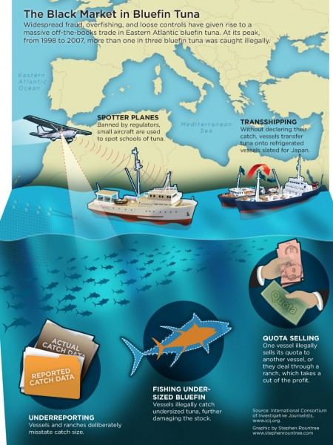
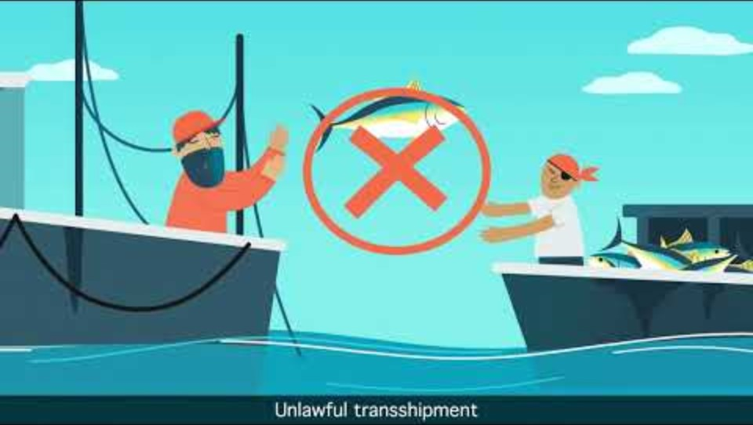
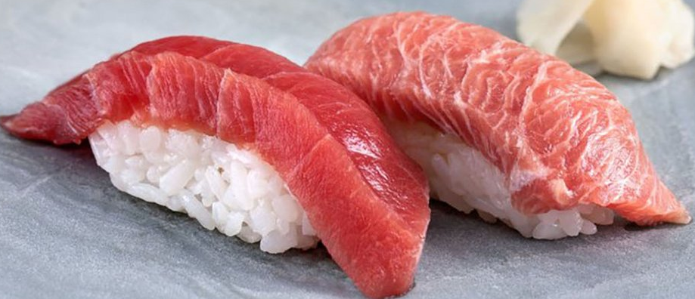
Notes:
Bushmeat, as a larger practice of unregulated or illegal consumption of wildlife, is common across economic circumstances
Bluefin tuna is considered wildlife and it is being taken illegally such that it is in danger of being fished out of existence.

Slide 23
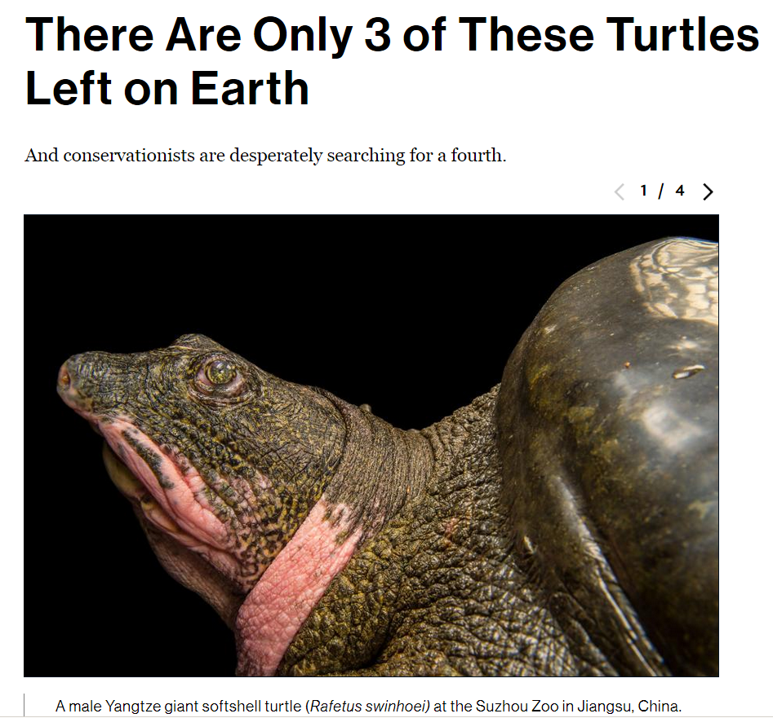
Notes:
One individual is known to be in captivity at the Suzhou Zoo in China. One or two individuals are believed to be in the wild in Dong Mo Lake in Vietnam. There is a possibility of another individual in the Xuan Khanh Lake in Vietnam.

Slide 24
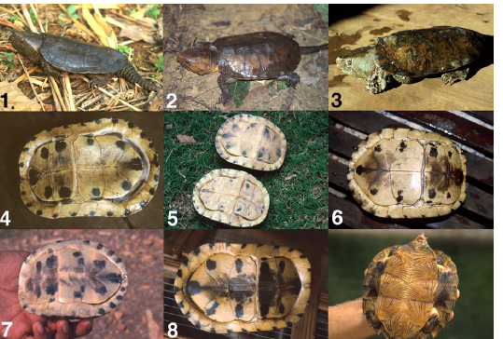
Notes:
Although Southeast Asia has long been regarded as a hotspot of turtle diversity, the fauna of Laos, Cambodia, and Vietnam (formerly known as French Indochina) remains poorly known. Biological investigation was limited prior to World War II, and since then decades of civil unrest, political instability, and military conflict have largely prevented fieldwork. Exploitation of turtles for food and medicinal markets is widespread in Laos, Cambodia and Vietnam. Hunters in rural villages capture turtles and tortoises for local consumption or to sell to traders who periodically visit villages to purchase wildlife. Although turtles and tortoises are locally consumed and domestically traded in Laos, Cambodia, and Vietnam, most are exported to markets in southern China. Turtles from Laos and Cambodia are usually transported to Vietnam, where they join with Vietnamese turtles on northward routes to China

Slide 25
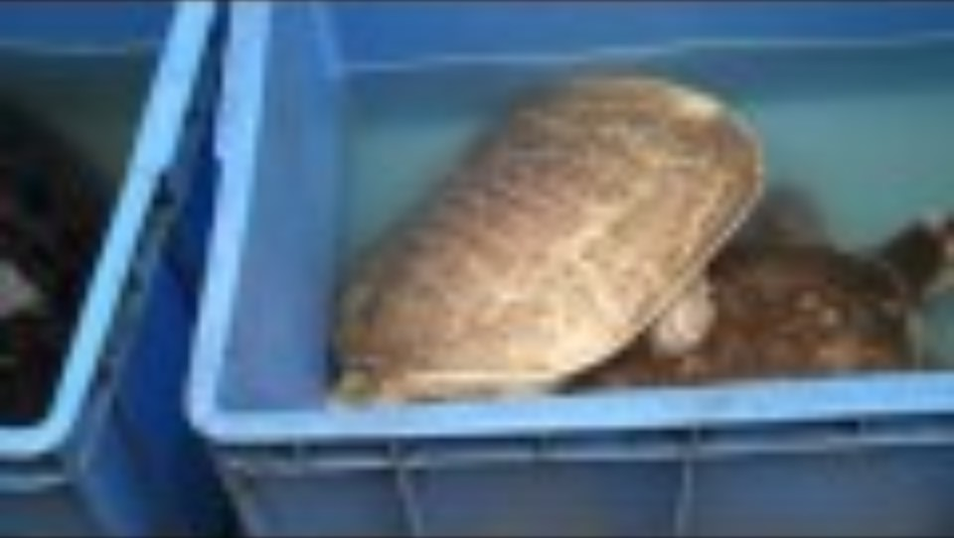
Notes:
Markets are places to see rare turtles bound for consumption. Some of these turtles have been bought in markets and taken into captivity by herpetologists to become, in some cases, some of the only known specimens.

Slide 26
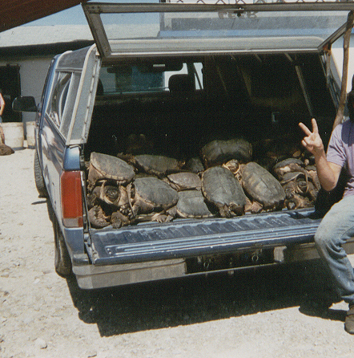
Notes:
Demand for turtle meat in Asia has increased illegal and legal hunting pressure on turtles in the US. Turtles are caught here but sold and exported mainly to China where household incomes have risen over the last several decades. Many states are now strengthening legislation to more tightly control turtle hunting. Turtle hunting has been legal in many states, but the hunting regulations (length of season, number of turtles taken) need to be reassessed in light of increasing pressure

Slide 27
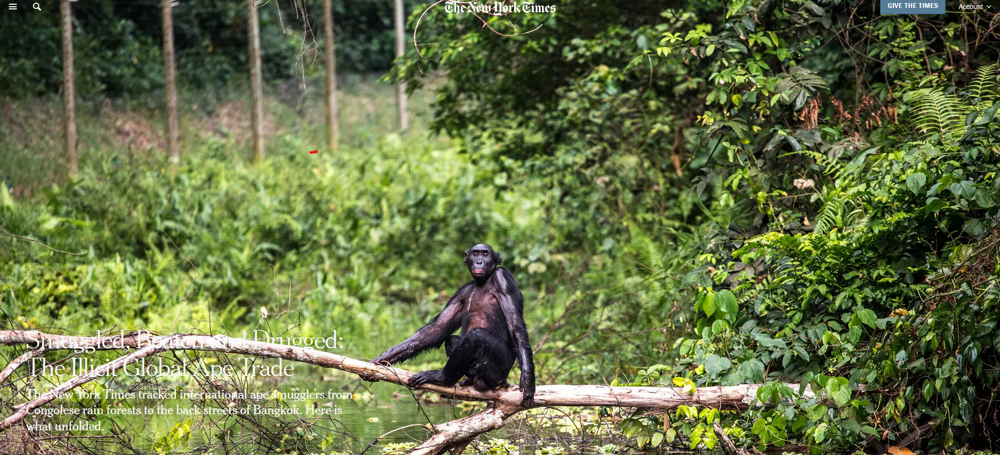
Exotic pet trade
Notes:
https://www.nytimes.com/2017/11/04/world/africa/ape-trafficking-bonobos-orangutans.html

Slide 28
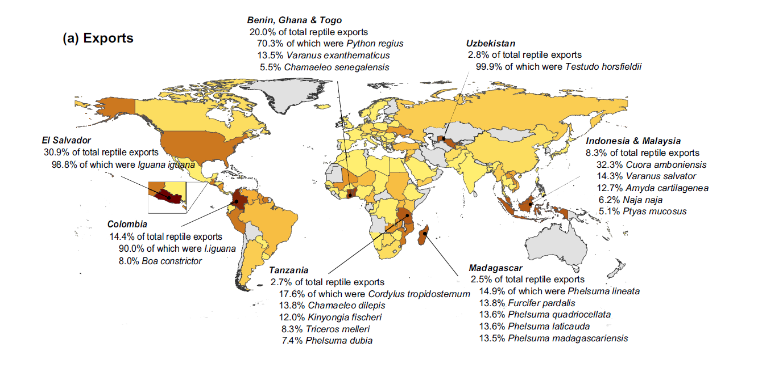
Reptile pet trade export countries
Notes:
Reptile pet trade export countries

Slide 29
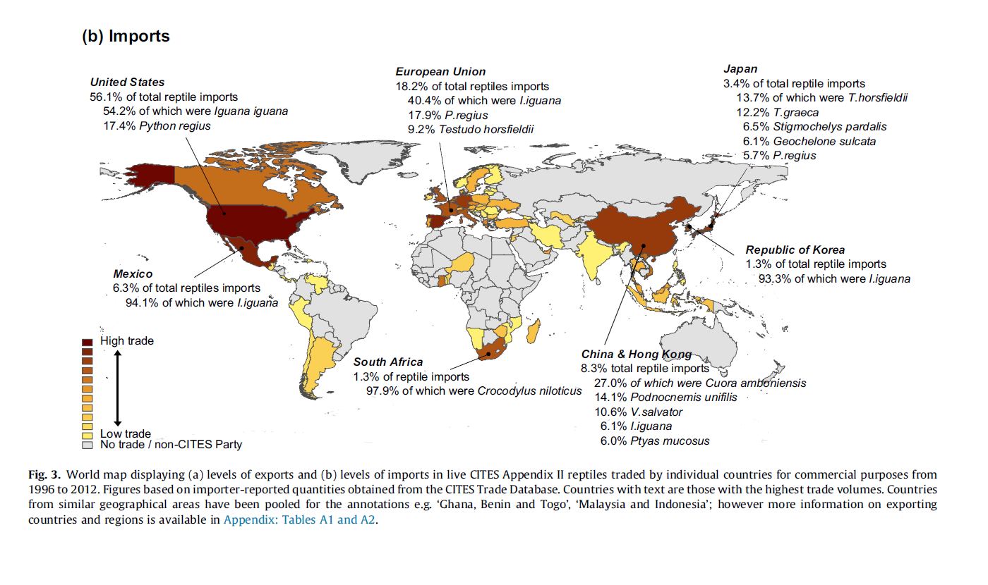
Reptile pet trade import countries

Slide 30
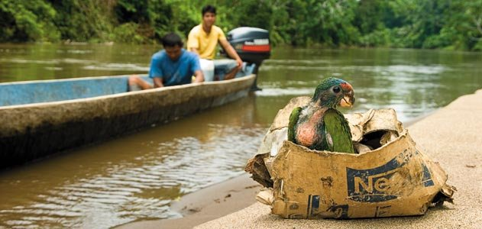
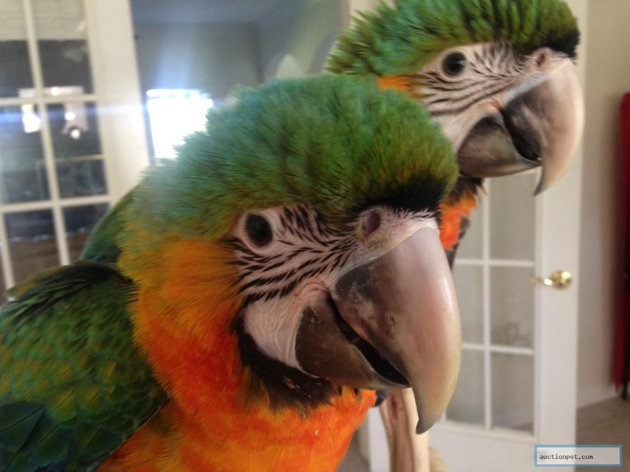
Drivers of exotic pet trade
Demand for pets and specimens wanted by collectors in developed economies
Need for incomes and livelihoods where wildlife originates
Variable laws and enforcement among countries
Legal aspects of the trade difficult to separate from illegal aspects
Notes:
http://ngm.nationalgeographic.com/print/2010/01/asian-wildlife/christy-text

Slide 31
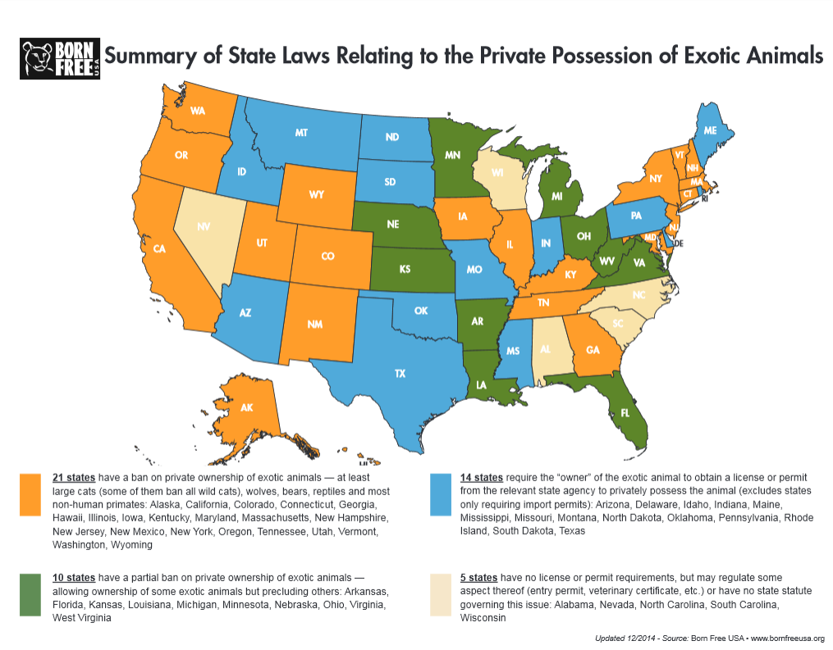
Notes:
Geographic differences in the legal standing of possessing exotic animals even in the US.

Slide 32
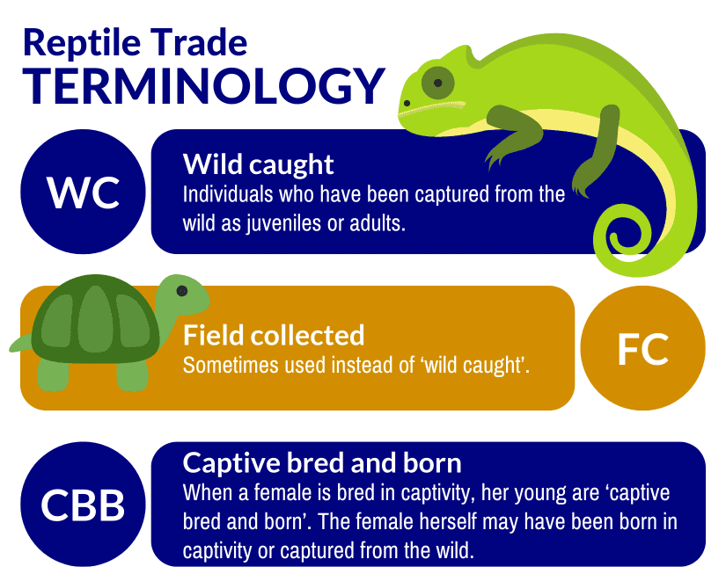
Captive bred and born versus field collected
Wild caught animals sought as pets deplete populations in their habitat.
Arguments are made that collecting wild caught animals can help re-establish their numbers through captive breeding
It can be difficult to know the origins of an animal, particularly for some species

Slide 33
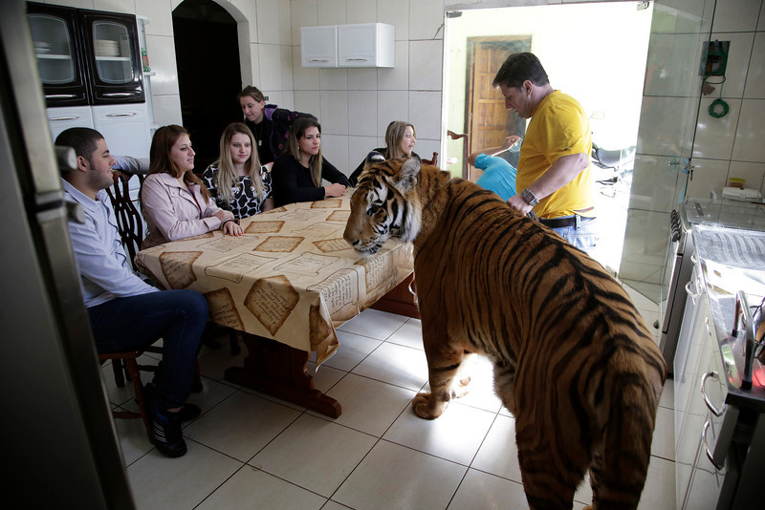

Slide 34
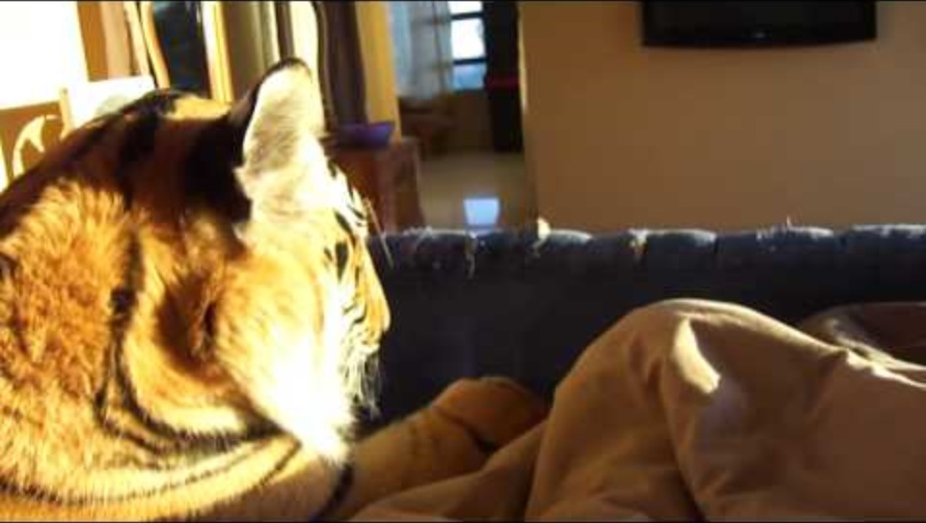

Slide 35
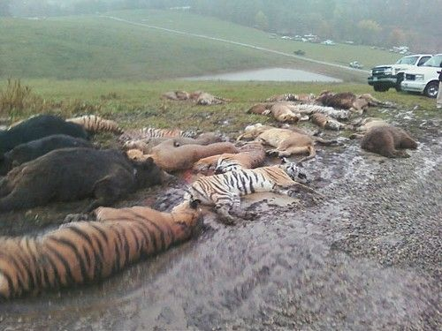
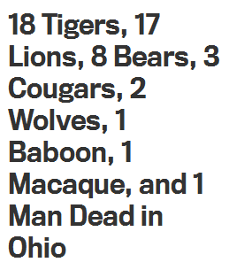
Notes:
Zanesville, OH

Slide 36
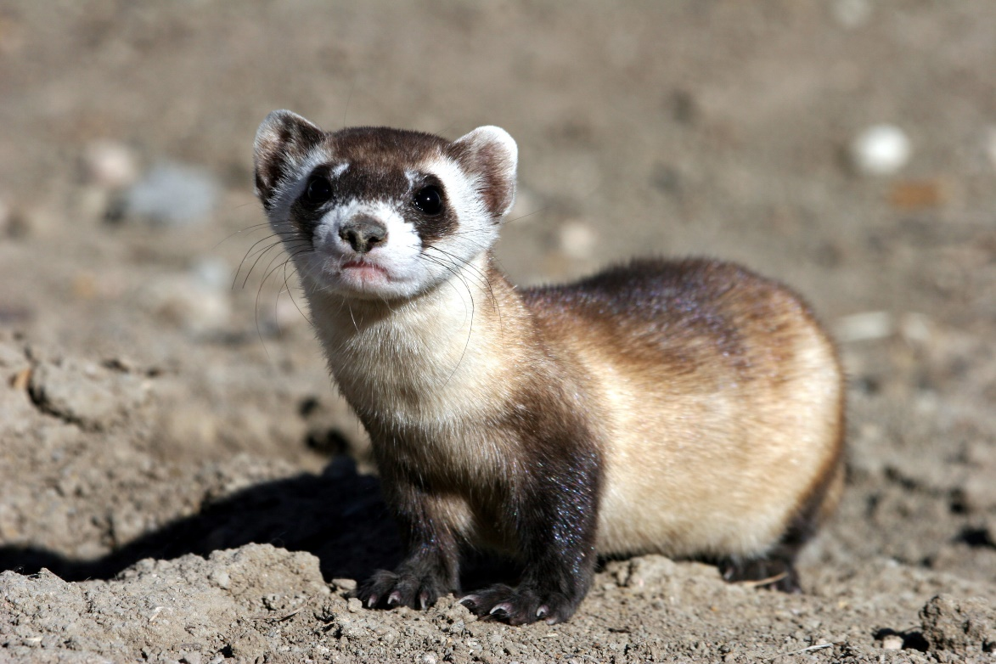
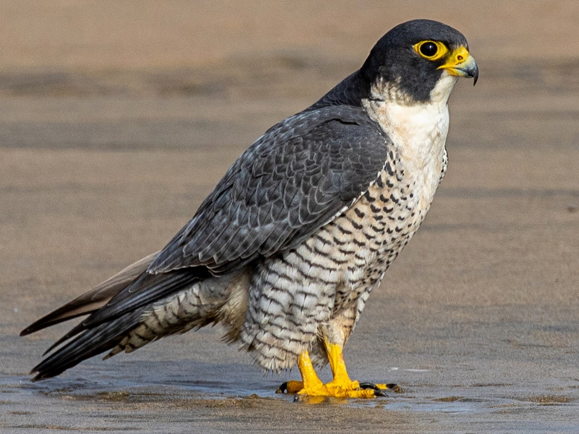
Contemporary extinction
There is evidence that contemporary extinctions, while very high, have not been as high as some had predicted, for several reasons:
  Effective conservation efforts
  Species persisting in secondary habitats and anthropogenic land covers
Notes:
Peregrine falcon
Black-footed ferret

Slide 37
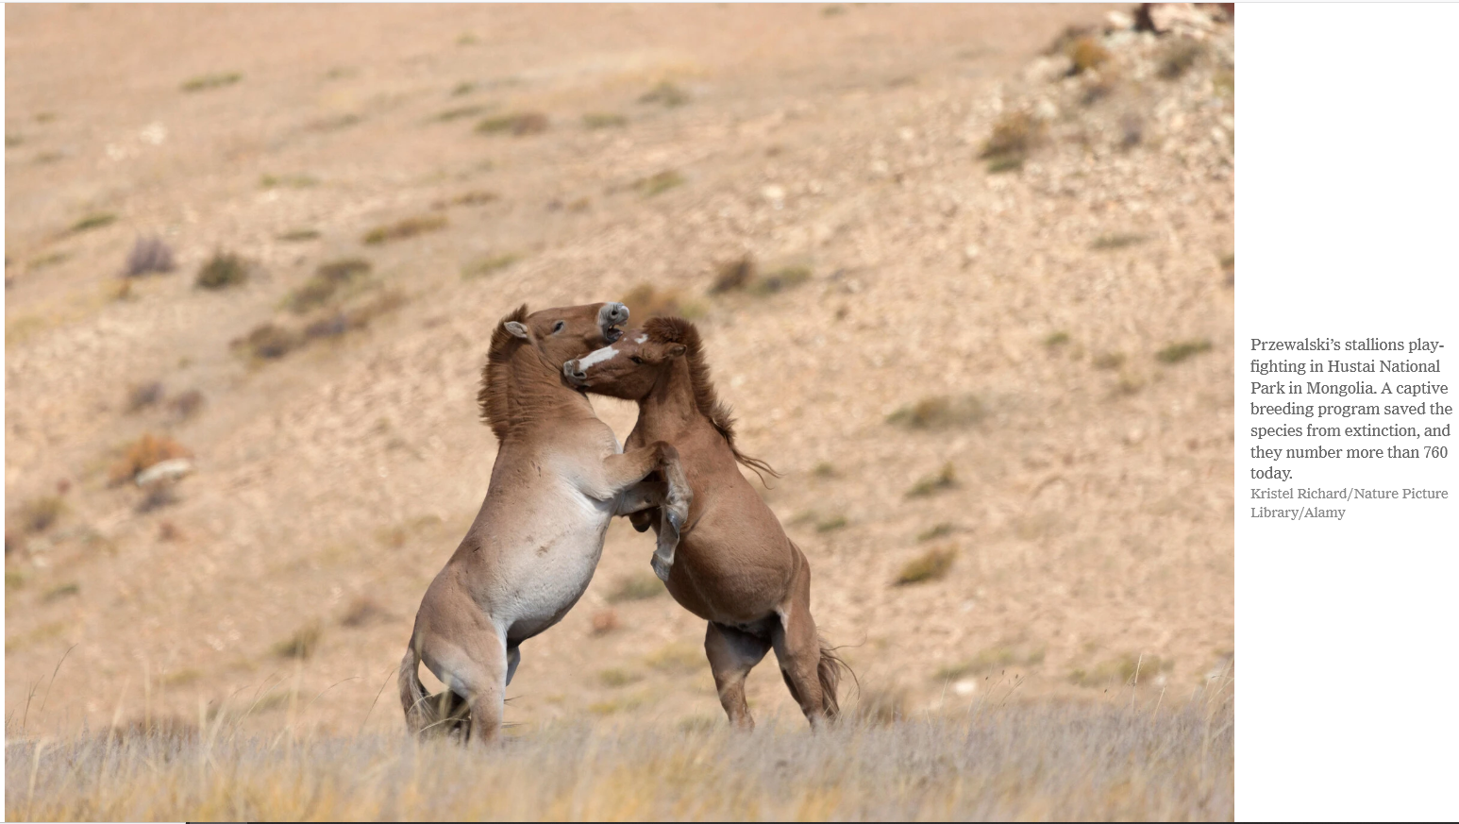
Notes:
For example, the Endangered Species Act was passed by Congress in 1973 and signed by President Richard Nixon. The act has been credited with the resurgence of the American alligator, which had been hunted to near extinction for the use of its skin in purses and other goods; the gray whale, depleted by commercial fishing in parts of the Pacific Ocean; and the bald eagle, which is flourishing again after nearly disappearing from much of the United States.
https://www.nytimes.com/2020/09/12/science/extinction-species-conservation.html
https://animals.sandiegozoo.org/animals/przewalskis-horse

Slide 38
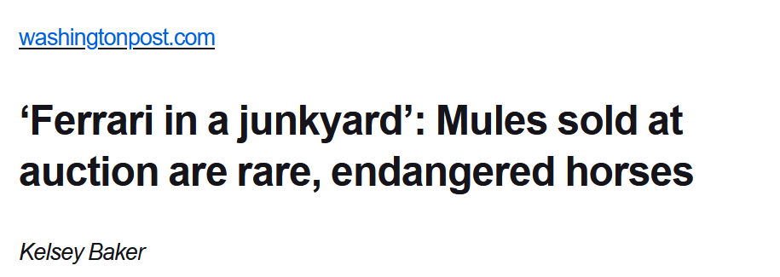
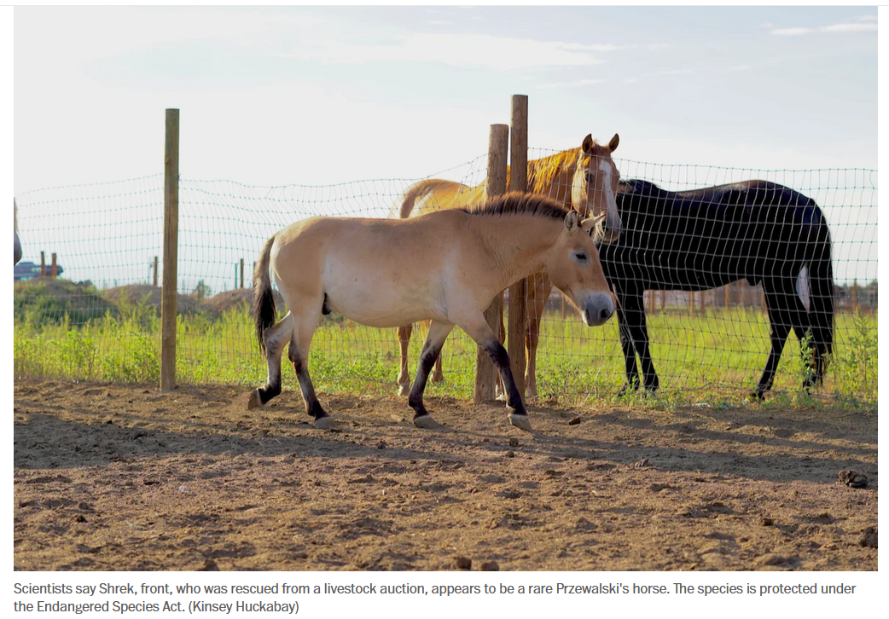
Once extinct in the wild, around 2,500 Przewalski’s horses remained worldwide as of 2022. They’re native to Mongolia and seven were reintroduced to nearby Kazakhstan as part of an effort to return them to their natural habitats. They are the only truly wild horse remaining (mustangs are feral horses).

Slide 39
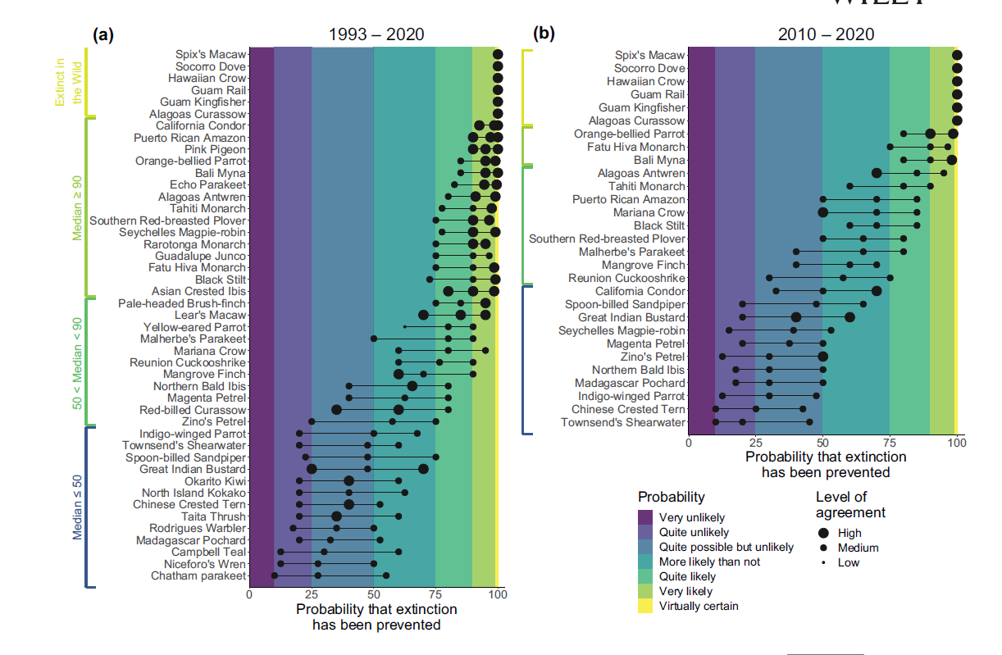
Notes:
Species toward the top of these charts (Spix’s macaw, Socorro dove, Hawaiian crow…) are those that human have successfully brought back from extinction because of conservation efforts. The probability that human factors made this possible is very high with little uncertainty. However, many of these species toward the top are still low in number and remain conservation reliant.
Species toward the bottom (Townsend’s shearwater, Chinese crested tern, Chatham’s parakeet, Niceforo’s wren) are those in which it is less likely that human efforts were will be able to keep these species from going extinct. There is also considerably more uncertainty as to whether our efforts will work for these species toward the bottom.
This graph shows that there are some undeniable successes. However, there are many more species in which the range of variability in the likelihood that human conservation efforts can prevent extinction is large. In other words, our efforts have a large degree of uncertainty as to their outcomes.

Slide 40
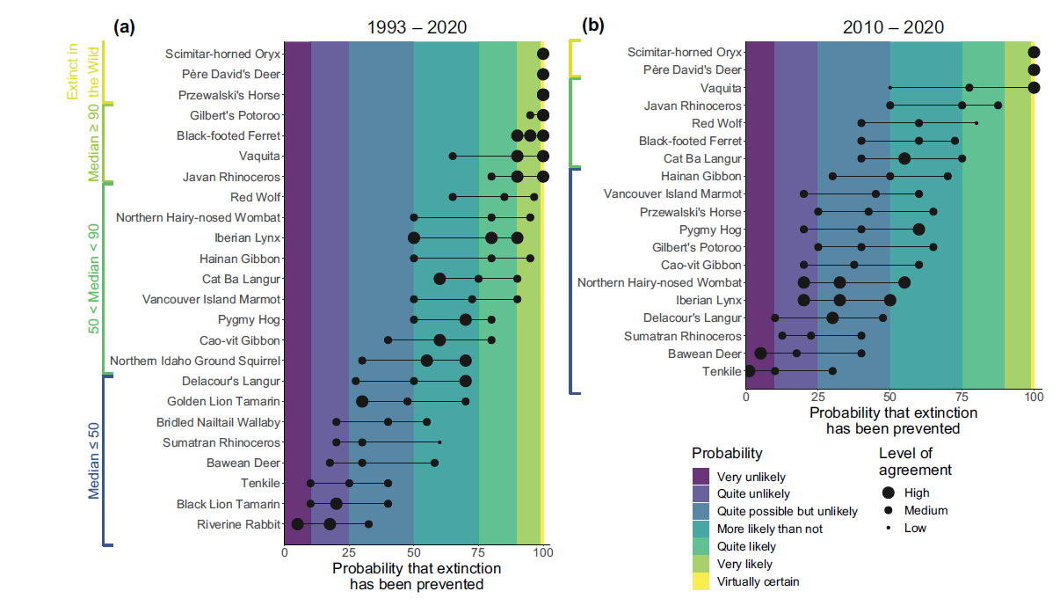

Slide 41
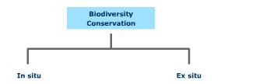
How have some extinctions been prevented or slowed?
Species-based conservation policies
  Ex situ approaches - preservation of species in zoos and botanical gardens, as well as assurance colonies
  In-situ approaches - conservation of species in their habitat
  Each has their advantages and disadvantages
  Sometimes both are required for the recovery of an animal or plant

Slide 42
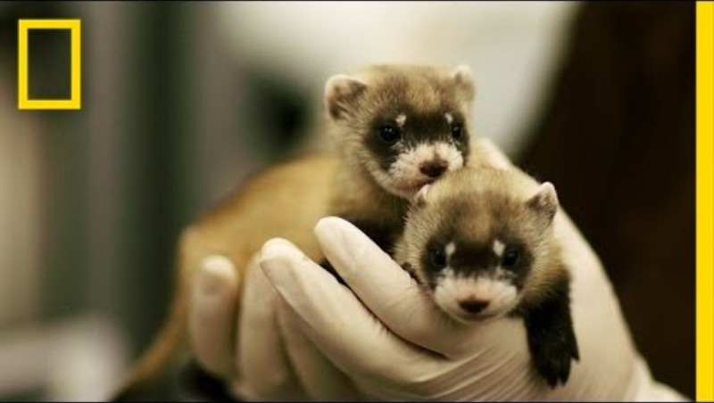
Ex situ species based conservation policies
Black footed ferret recovery
Louisville Zoo is one of the six organizations contributing to the recovery of this species.
Notes:
Declared extinct in 1979
Their numbers, once estimated at 500,000, had been decimated due to habitat destruction and the poisoning of prairie dogs, their primary prey.
Fortunately, in 1981, a remnant population of ferrets was discovered in Meeteetse, Wyoming.
However, this group of ferrets faced almost insurmountable odds when in 1985, there were outbreaks of canine distemper virus and sylvatic plague. With the population critically at risk, the last 18 black-footed ferrets were gathered and placed in a managed breeding program, that includes the Louisville Zoom.
In 2021, a black-footed ferret was cloned from a member of its species that had died and been frozen since 1998. It is the first North American endangered animal to be successfully cloned. The clone will reintroduce genetic variability to the current population.

Slide 43
Ex-situ policies
Large zoos often have a conservation mission. However:
  Zoos often have to generate their own budget, thus tourism and conservation roles can conflict
  Zoos tend to specialize in one or only a few kinds of animals.
  Focused on large-bodied, charismatic mammals
  Zoos are full – number of individuals per conserved population is high
  Birth control, sterilization, and euthanasia practiced in zoos

Slide 44
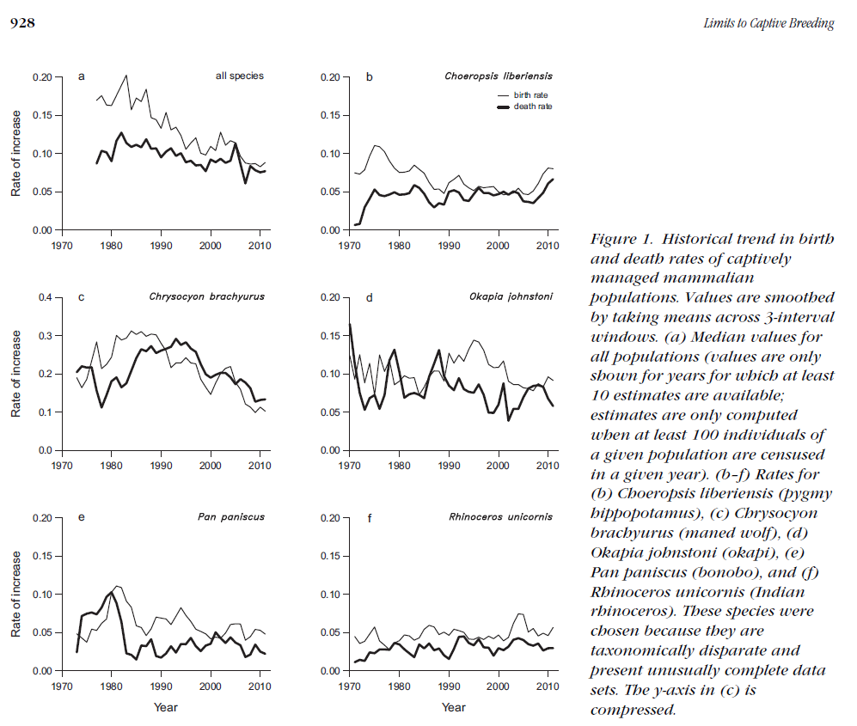
How are zoos doing?
Notes:
Graph above is for mammals in zoos
Alroy, J. (2015). Limits to captive breeding of mammals in zoos. Conservation Biology, 29(3), 926-931.

Slide 45

Notes:
https://www.nytimes.com/2014/02/10/world/europe/anger-erupts-over-danish-zoos-decision-to-put-down-a-giraffe.html

Slide 46

Notes:
Marius the reticulated giraffe died at the Copenhagen Zoo on Sunday. He was 2 years old. The cause of death was a shotgun blast, and after a public autopsy, the animal, who was 11 feet 6 inches, was fed to the zoo’s lions and other big cats. Administrators said they had decided to kill Marius, who was in good health, because his genes were well represented among the captive giraffe population in European zoos. But that explanation did not satisfy animal rights activists who had mounted a furious last-minute campaign to save him. Besides nearly 30,000 online signatures from those who did not want Marius killed, Copenhagen Zoo officials received death threats after they turned down adoption offers from other zoos, as well as a bid of 500,000 euros, or $682,000, from an individual who was willing to take Marius in. One group, Animal Rights Sweden, urged people to stop visiting zoos as a protest, The Associated Press reported. “It is no secret that animals are killed when there is no longer space, or if the animals don’t have genes that are interesting enough,” the organization said in a statement.
Marius was born in captivity at the Copenhagen Zoo, where there are seven reticulated giraffes, a species native to Africa. The species is not endangered, but it faces threats from habitat loss and hunting. Mr. Holst said he had decided against sending Marius to another zoo because doing so would have opened the door to inbreeding and potentially removed a place for a giraffe whose genetic makeup was more valuable in terms of future offspring in captive breeding programs. He seemed caught off guard by the public protest, calling it “totally out of proportion.” “People said, ‘If you kill the giraffe, I’ll kill you,’ ” he said. “It’s insane.” “We don’t do it to be cruel; we do it to ensure a healthy population,” Mr. Holst added. “You have to breed them to make sure the population is renewed.” As for individual offers, he said giraffes were social animals and could not be kept in isolation. Giraffes are allowed to breed in captivity because it is part of their natural behavior in the wild, Mr. Holst said, even though breeding can produce what he called “a surplus animal.” “As long as they are with us,” he said, “we want them to have a good life, with as much natural behavior as possible.” Marius was not fully grown, Mr. Holst said: He could have grown another three feet or so. Officials used a shotgun rather than an injection to kill the giraffe so that his meat would be safe for the zoo’s predator animals to eat. After an autopsy that was open to visitors as an educational opportunity, parts of Marius’s remains were fed to the zoo’s lions — and there is some left over. “We still have meat for lions, tigers and leopards,” Mr. Holst said. “It’s just meat that can be fed to every animal.”

Slide 47

American zoos prefer to use contraception to prevent overpopulation or inbreeding
European zoos often favor allowing animals to breed and express their natural behavior, including sexual reproduction.
In Europe, there is a strict attempt to maintain genetically pure animals and not waste space in a zoo for genetically similar specimens
Notes:
https://www.nytimes.com/2014/03/27/world/europe/lion-killing-at-danish-zoo-provokes-fresh-outrage.html

Slide 48

How are zoos doing?
In a dataset spanning 2000-2017 and encompassing more than 400 ex situ vertebrate populations:
  Instead of the general declines expected for small and often closed populations like those in zoos and aquariums, no change in the demographic and genetic characteristics of the majority of these populations.
  While some zoo and aquarium populations are currently unsustainable, zoos are helping slow or prevent declines in the health of many ex situ populations.
Notes:
Summary of demographic and genetic trends over time (2000–2017) in American Zoo Association animal populations for (a) all populations studied and (b) only those with data that spanned at least two generations.
Che‐Castaldo, J., Gray, S. M., Rodriguez‐Clark, K. M., Schad Eebes, K., & Faust, L. J. (2021). Expected demographic and genetic declines not found in most zoo and aquarium populations. Frontiers in Ecology and the Environment, 19(8), 435-442.
Since the 1980s, animals in accredited zoos and aquariums have been managed as populations through cooperative breeding, with a goal of maintaining ex situ populations that are as demographically viable and genetically diverse as possible. Here, we provide what we believe to be the first large-scale assessment of whether cooperative breeding programs are achieving this goal over time. Using a comprehensive dataset spanning nearly 20 years and encompassing more than 400 ex situ vertebrate populations, we applied Bayesian hierarchical modeling to quantify changes in seven population metrics over time. Instead of the general declines expected for small and often closed populations like those in zoos and aquariums, we found no change in the demographic and genetic characteristics of the majority of these populations. Our results indicate that while some zoo and aquarium populations are
currently unsustainable, cooperative management is helping to slow or prevent declines in the health of many ex situ populations.

Slide 49

Notes:
https://www.nytimes.com/2012/05/28/science/zoos-bitter-choice-to-save-some-species-letting-others-die.html?emc=eta1

Slide 50

Assurance colonies
A response to the operational limits of zoos
Assurance colonies are collections held by public entities, citizens, and professional collectors for the intent of releasing them as some future date
Do not function as places of entertainment, although some zoos may maintain or support them indirectly

Slide 51

Assurance colonies
Advantages
  Citizen science aspect allows more people to engage in conservation
  Knowledge gathered about husbandry of rare or understudied species can aid formal scientific conservation
Disadvantages
  Collections or organisms still vulnerable

Slide 52
Disadvantages of ex-situ policies
Economically impossible to preserve large numbers of species.
Species-by-species approaches are expensive and time-consuming
Reproduction in captivity is difficult to achieve for some organisms.
Does not address the larger biodiversity in which the endangered species are embedded.

Slide 53

In-situ species conservation policies
Conserving and restoring biological diversity in the places where it has occurred
The Endangered Species Act is an example of a chiefly in-situ conservation policy
In-situ conservation may also involve ex-situ approaches
Notes:
Louisiana black bear, a subspecies of the North American black bear, and the Florida black bear have recovered their population numbers thru in situ conservation and have been delisted as threatened according to the policies of the ESA
https://www.nwf.org/Our-Work/Wildlife-Conservation/Success-Stories

Slide 54

In-situ conservation
Advantages
  Animals have opportunity to evolve
  Assessments of health and viability are more realistic given they are measured in their context
  Restores interactions among species
Notes:
Gray wolves in Yellowstone are an example of in-situ conservation

Slide 55
Disadvantages of in-situ conservation
Requires sizeable public investment and private intent to set aside land and address human-wildlife encounters
Politics can change in areas where species occur and support for their maintenance may fluctuate
Monitoring is less continuous and there is more potential for surprises (disease, hunting) that could threaten population
Labor and costs for monitoring populations of endangered species high but necessary to prevent poaching
Climate change and other facets of environmental variability can cause numbers to fluctuate
Genetic drift can occur if populations are small in the wild. At least while in captivity, targeting breeding can be done

Slide 56



Slide 57


Slide 58

Restoration, translocation, rewilding

Slide 59

Notes:
Corlett, R. T. (2016). Restoration, reintroduction, and rewilding in a changing world. Trends in Ecology & Evolution, 31(6), 453-462.

Slide 60


The predicament: the emergence of conservation-reliant animals and plants
Many conservationists now operate in a state of constant maintenance: endlessly working to prop up species that have fallen into decline.
At worst, an endangered animal becomes a literal ward of the state: preserved only in breeding facilities or in tiny, meticulously maintained “wild” habitats.
The official term for such species is “conservation-reliant.”
84% of species on the United States Endangered Species List are currently conservation-reliant.

Slide 61



Notes:
Financing conservation through farming wildlife and hunting

Slide 62

“If it pays it stays”

Slide 63


