Slide 1
Policies for the Anthropocene: environmentalist and/or ecomodernist?

Slide 2
When did the Anthropocene begin?
How you define the start and causes of the Anthropocene shapes what policy approaches you prioritize.
Notes:
The dispersal of Homo sapiens around the world? The domestication of crops – the Neolithic Revolution? Establishment of the first cities? European exploration of the world? The Industrial Revolution? The Great Acceleration?

Slide 3
When did the Anthropocene begin?
How you define the start and causes of the Anthropocene shapes what policy approaches you prioritize.

Slide 4
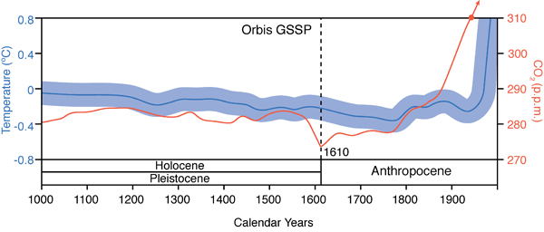
European exploration as signal of the start of the Anthropocene: the Orbis spike
Notes:
http://www.scientificamerican.com/article/mass-deaths-in-americas-start-new-co2-epoch/
European contact began in late 1400s – Columbus Balboa and De Soto in early 1500s Jamestown, Virginia – 1607
What could make this sharp drop in the CO2 in the atmosphere?

Slide 5
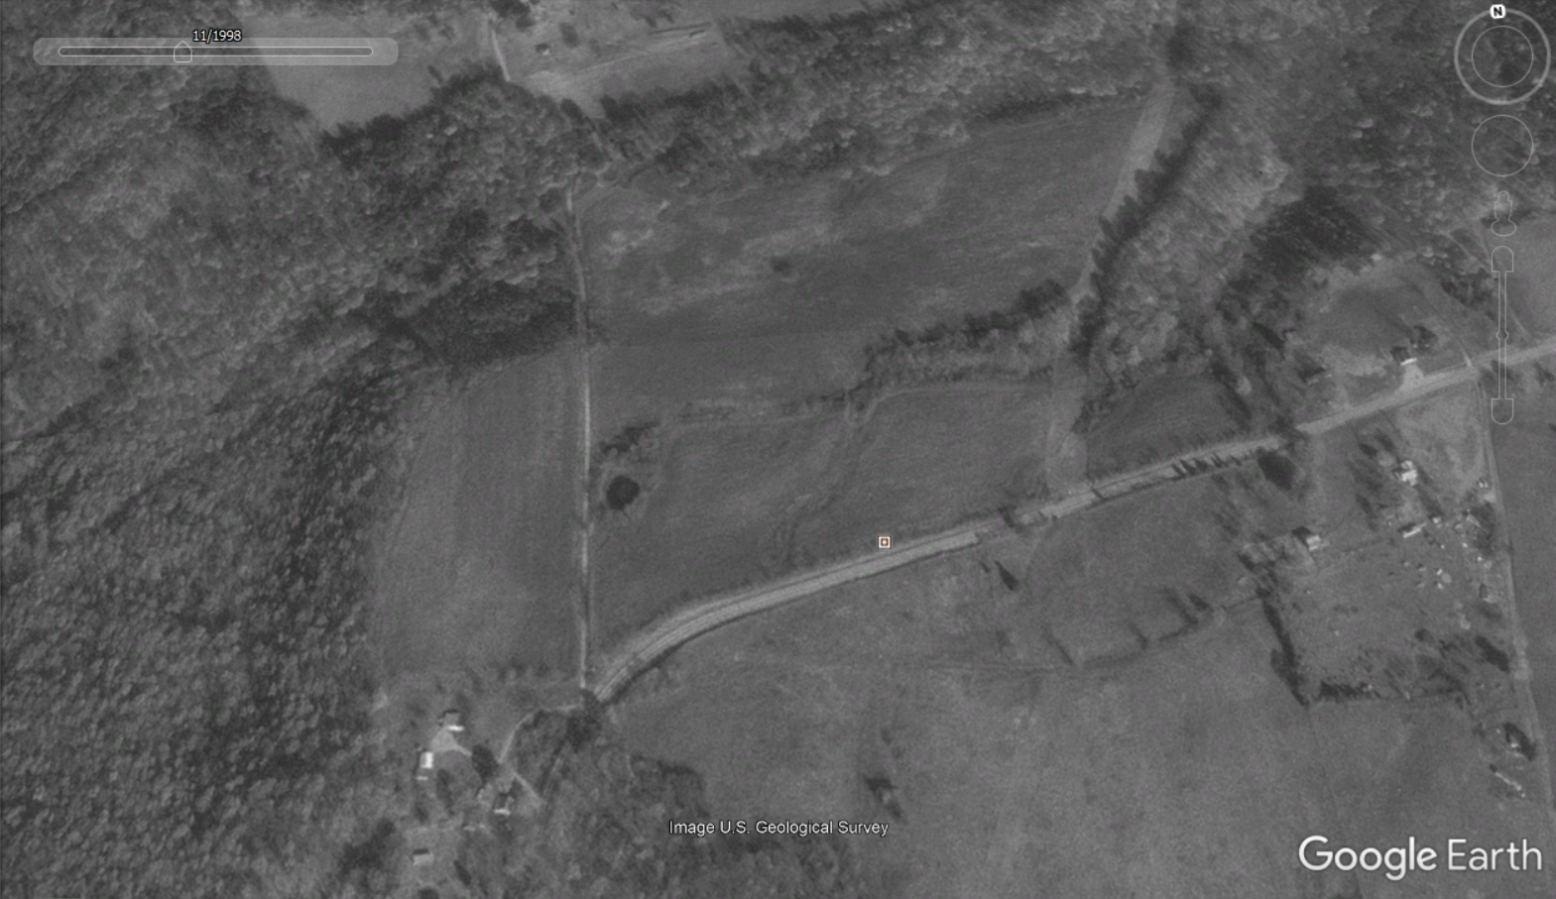
1998, the family farm near Princeton Kentucky on Highway 62
Notes:
1998

Slide 6
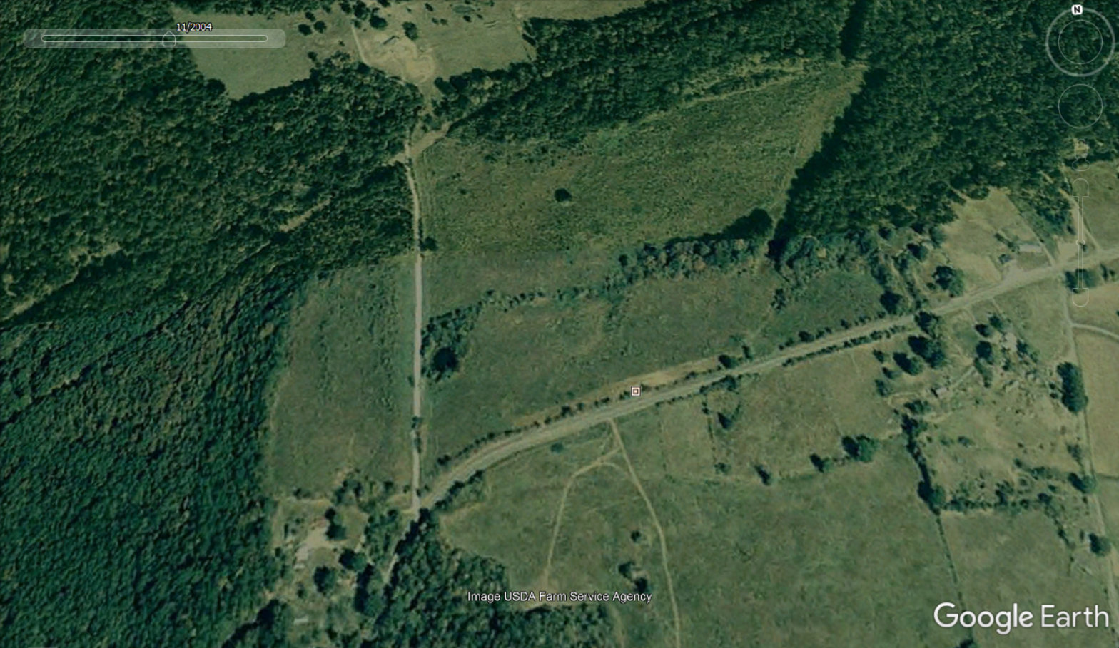
2004, the family farm near Princeton Kentucky on Highway 62
Notes:
2013

Slide 7
2019, the family farm near Princeton Kentucky on Highway 62

Slide 8
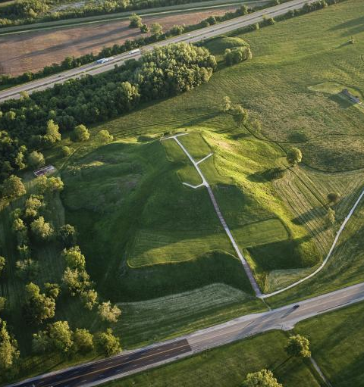
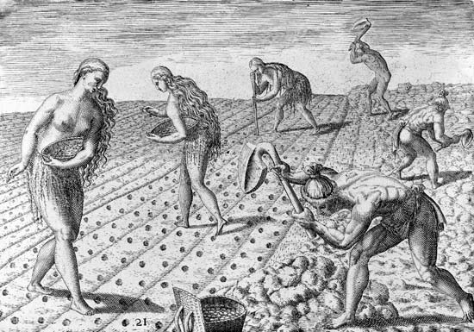
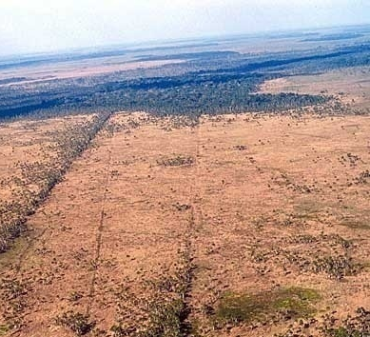
Prior to European arrival, North and South American landscapes had been highly modified by large numbers of native Americans.
Grasslands kept open thru the use of fire
Earthworks, roads, fields common
Forest cover was reduced by human activity
Cahokia Mounds (southern Illinois)
Relict fields in S. America
Notes:
Regional population estimates sum to a total of 54 million people in the Americas in 1492, with recent population modelling estimates of 61 million people.
Numbers rapidly declined to a minimum of about 6 million people by 1650 via exposure to diseases carried by Europeans, plus war, enslavement and famine. Timucua native Americans planting in large cleared fields, early 1500’s, in Florida. http://emedicine.medscape.com/article/237229-overview

Slide 9
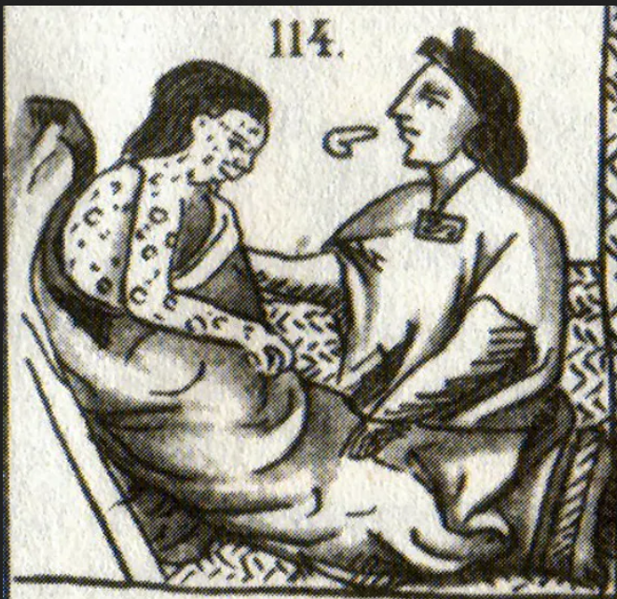
Pre-European contact Americas may have held as many people as in Europe at that time
Estimates range up to 50-90 million
After arrival of smallpox and influenza (flu), population greatly reduced (90-95%)
Depopulation left fields fallow
Forests recovered because of the drastically reduced numbers of native Americans
Notes:
Numbers rapidly declined to a minimum of about 6 million people by 1650 via exposure to diseases carried by Europeans, plus war, enslavement and famine. The Great Dying

Slide 10
The Orbis spike is a result of reforestation. Regrowth of forests took up carbon dioxide. This drop in carbon dioxide levels was large enough to leave a signal recorded in ice cores in Antarctica
Notes:
With reforestation, plants took in CO2, causing its concentration to drop globally.
The accompanying near-cessation of farming and reduction in fire use resulted in the regeneration of over 50 million hectares of forest, woody savanna and grassland with a carbon dioxide uptake by vegetation and soils. The approximate magnitude and timing of carbon sequestration suggest that this event significantly contributed to the observed decline in atmospheric CO2 of 7–10 p.p.m. between 1570 and 1620 documented in two high-resolution Antarctic ice core records. There is evidence that some of the forest regrowth had begun earlier, before the Great Dying of American peoples. This is hypothesized for regions of Amazonia, where social strife and environmental change may have led to reduction of cropland and subsequent reforestation. On the other hand, one might argue that perhaps Europeans arrived earlier and brought the diseases sooner. Either way, it is likely that the Orbis signal varies regionally depending upon the context of timing of the arrival of humans with the events and circumstances endogenous to the Americas.
Bush, M. B., Nascimento, M. N., Åkesson, C. M., Cárdenes-Sandí, G. M., Maezumi, S. Y., Behling, H., ... & McMichael, C. N. H. (2021). Widespread reforestation before European influence on Amazonia. Science, 372(6541), 484-487.

Slide 11
Choosing the Orbis spike as start of Anthropocene has implications for what kind of policies are sought to address the environmental issues of the Anthropocene
The Orbis spike implicates European exploration - colonialism and imperialism, unequal power relationships between different groups of people, as a cause of the Anthropocene
From this angle, policies should seek to address issues related to governance and power, racism, and colonialism as drivers of environmental change
Notes:
The accompanying near-cessation of farming and reduction in fire use resulted in the regeneration of over 50 million hectares of forest, woody savanna and grassland with a carbon dioxide uptake by vegetation and soils. The approximate magnitude and timing of carbon sequestration suggest that this event significantly contributed to the observed decline in atmospheric CO2 of 7–10 p.p.m. between 1570 and 1620 documented in two high-resolution Antarctic ice core records.

Slide 12
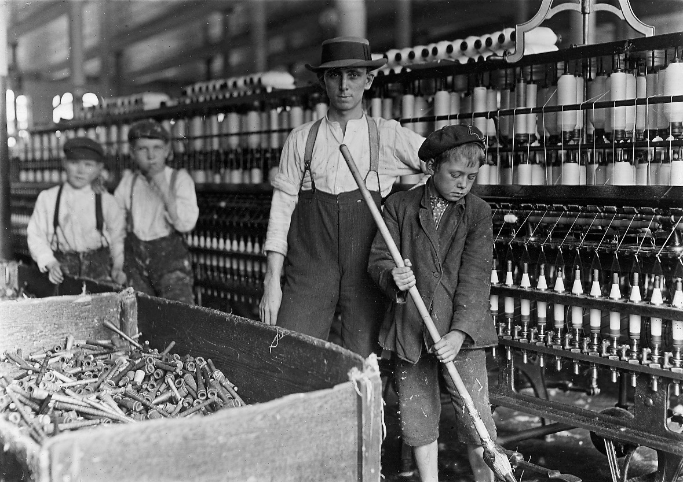
The Industrial Revolution (1780 to 1945) as signal of the start of the Anthropocene
Invention of the steam engine catalyzed radical social, economic, political and environmental change
Implicates fossil fuels and industries it supports as drivers of the Anthropocene
Industrialization and technological change are at root of the Anthropocene and global environmental change
Notes:
Carbon dioxide levels recorded in ice cores begin to increase at this time
The Industrial Revolution was a period in which fundamental changes occurred in agriculture, textile and metal manufacture, transportation, economic policies and the social structure Coal was being used in China 800 years earlier

Slide 15
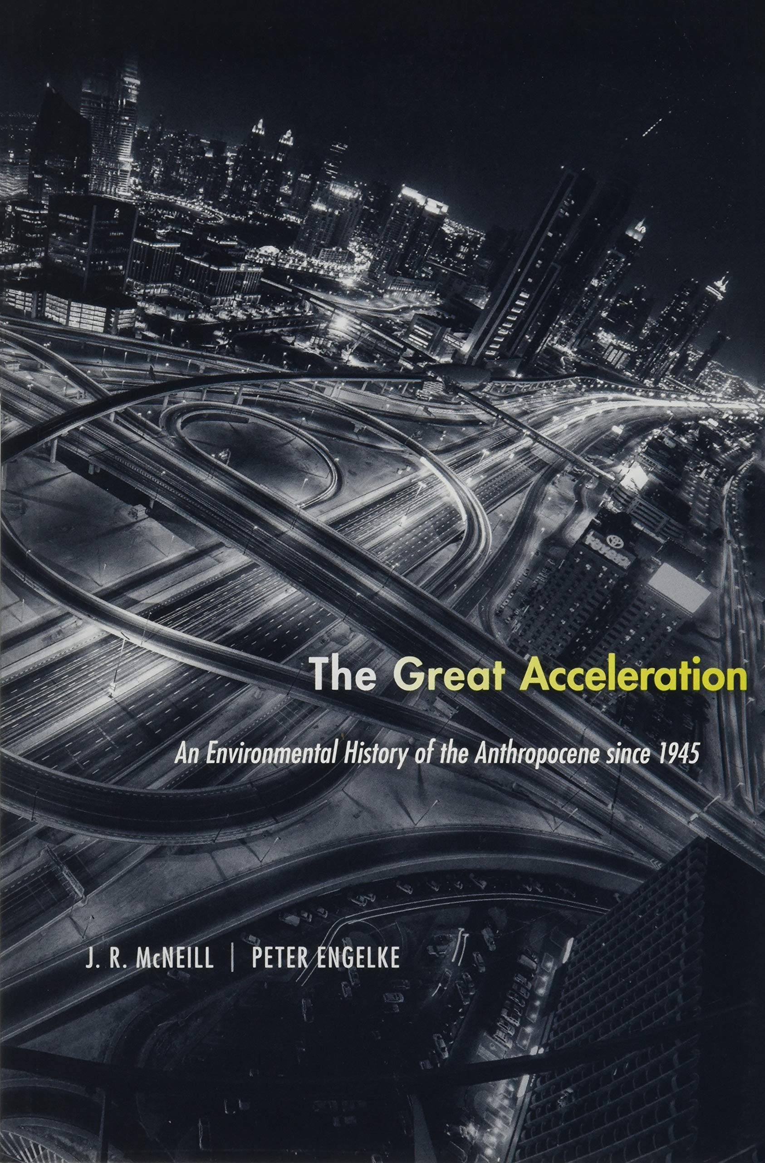
The Great Acceleration as start of the Anthropocene
Began with economic expansion after World War II
Implicates globalization
Unlike the Industrial Revolution, the Great Acceleration is considered post-industrial. Manufacturing was not the sole economic activity
Trade, financial services, data networks generated economic activity as well as manufacturing
Notes:
1950 has been designated as the official start of the Anthropocene. In 2016, the Anthropocene Working Group agreed that the Anthropocene is different from the Holocene, which began 10,000 years ago. The Anthropocene, in their decision, began in the year 1950 when the Great Acceleration, a dramatic increase in human activity affecting the planet, took off

Slide 16
Notes:
Post World War 2 economic policies and globalization mark the start of the Anthropocene based on the Great Acceleration
Steffen, W., Broadgate, W., Deutsch, L., Gaffney, O., & Ludwig, C. (2015). The trajectory of the Anthropocene: the great acceleration. The Anthropocene Review, 2(1), 81-98.

Slide 17
The distinctly American origins of the Great Acceleration
The federal Materials Policy Commission, more commonly known as the Paley Commission published a report in 1952 that initiated the Great Acceleration.
The report “Resources for Freedom: Foundations for Growth and Security” was crucial to the development of a globe spanning US-led 'growth paradigm’
The report proposed a novel redefinition of the way that resource scarcity was measured: from the absolute scarcity of previous assessments to a relative, price-based definition of scarcity.
If demand was high and price was up for a resource, the policy view of Paley Commission was that that would fund expansion to acquire new resources or to innovate and find replacements – so there was no actual scarcity as defined from this point of view
Notes:
Lane, R. (2019). The American anthropocene: Economic scarcity and growth during the great acceleration. Geoforum, 99, 11-21.

Slide 18
“Resources for Freedom” reconceptualized material resource reserves from one that was exhaustible, to one of a replenishable working inventory.
Advocated for the expansion of overseas resource extraction and importation instead of domestic self-sufficiency and conservation of resources.
The economy was understood as free to continue a trajectory of continuous growth
In this view, American economic policies were the cause of the Anthropocene
Revising economic concepts and practices is the way to address environmental problems
Notes:
Lane, R. (2019). The American anthropocene: Economic scarcity and growth during the great acceleration. Geoforum, 99, 11-21.

Slide 19
Unique attributes of the Anthropocene
Humans now recognize their ability to shape the evolution of the Earth and how our policy choices can influence the trajectory of the Anthropocene. Below is one prominent discourse about our policy choices – a good versus a bad Anthropocene.
Notes:
We have the technology to detect the details of our impact, and we have the potential to modify our impacts on the earth, to an extent.

Slide 20
The ‘Bad’ Anthropocene
Anthropocene as dystopia
Humans are seen an overshoot species
There are planetary tipping points
Technology is viewed as a cause for this state of scarcity and collapse
Notes:
Dystopian , humans are an overshoot species. There are planetary tipping points that once exceeded cannot return to the conditions of the past. Our science and technology have allowed us to use up the resources of the Earth. Technology is suspect, or at least fallible and not necessarily able to solve all of our problems related to our dependency on the environment

Slide 21
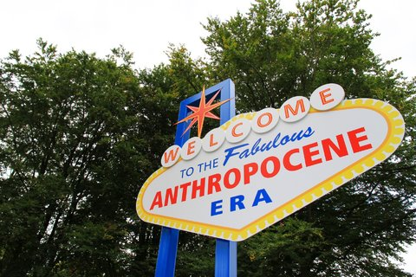
The ‘Good’ Anthropocene
Science and technology will continue to solve problems of humans
Our tools and knowledge can now be turned toward repairing and reinventing to alter our current trajectory for the better
Rejection of the despair of the ‘bad’ Anthropocene
Notes:
Science is going to help us live better. Humans a benevolent caretaker, replanting and restoring the Earth. We’ve been successful thus far, with science we are becoming smart enough to effect change and manage our impacts. More people, but more people to address problems that arise. More people more brains to solve problems

Slide 22
Environmentalism, a world view that prioritizes:
Living within the Earth’s biophysical boundaries – environmental limits cannot be exceeded or collapse will result
The protection and conservation of nature over its rapid modification
The intrinsic value of nature and ethical cohabitation with non-human life
A skepticism toward technology to solve environmental problems
Sustainability through degrowth, localism, and cultural, political, and behavioral transformation

Slide 23
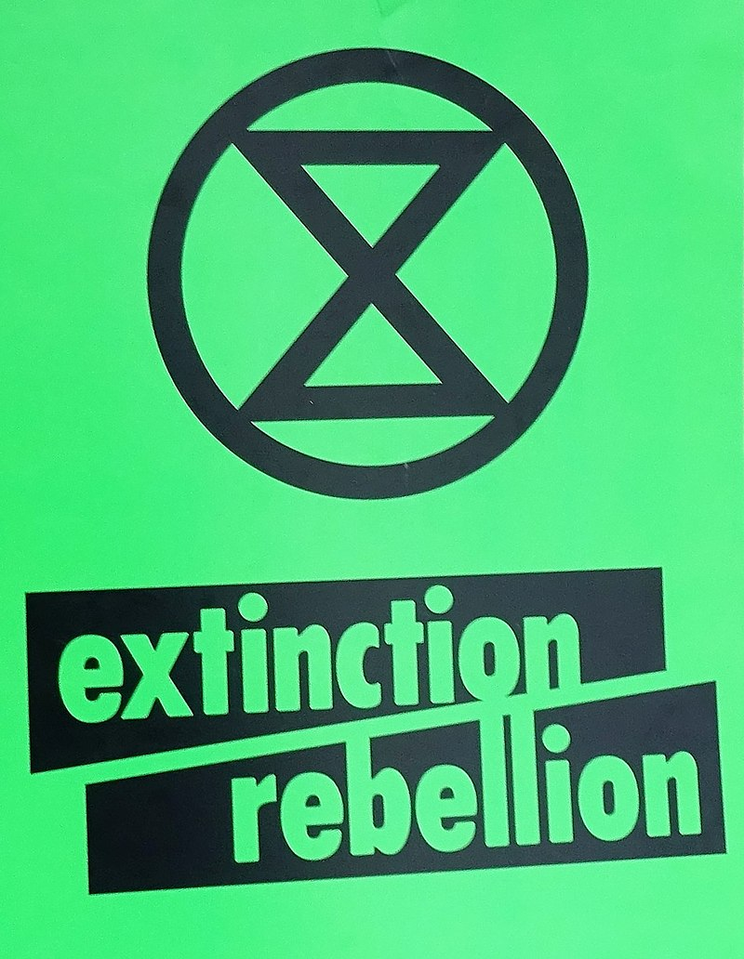
Extinction Rebellion
Notes:
https://rebellion.global/ https://www.youtube.com/watch/9ooe_XqDicA Non-violent organization promoting an environmentalist discourse

Slide 26
Successes of environmentalism
Creation of environmental laws and regulations
Emergence of governance structure for environmental management
Practice of conservation science
Establishment of protected areas
Environmental justice movement
Concepts and practice of sustainability

Slide 27
Notes:
Organic agriculture

Slide 28
Notes:
Highly efficient greenhouses in the Netherlands. For some crops, these greenhouse technologies can produce more food with less inputs that traditional farming.

Slide 29
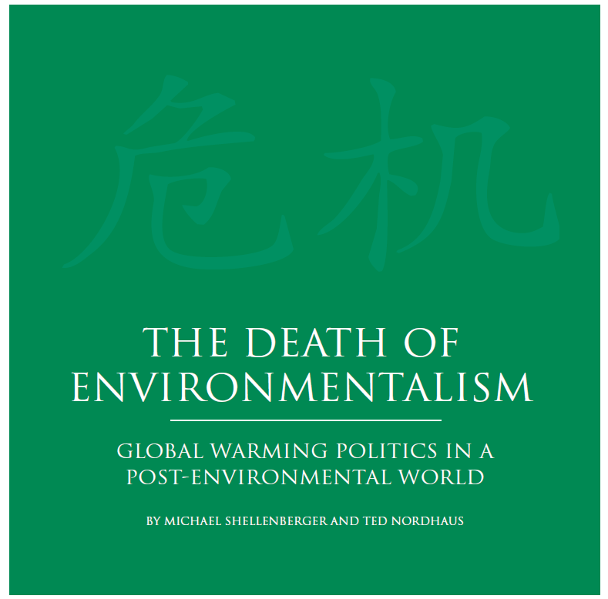
Ecomodernists: proclaim that environmentalism has failed
They believe that the choice humanity faces in the Anthropocene is not whether to constrain our growth and development or face collapse
It is whether we will continue to innovate and accelerate technological progress in order to thrive.
Prioritizes resource use, capitalism and market mechanisms to spur innovation
Notes:
https://grist.org/article/doe-reprint/
http://www.ecomodernism.org/ https://thebreakthrough.org/issues/energy/the-long-death-of-environmentalism

Slide 30
The position of ecomodernists: the technologies of the Anthropocene are ‘good’
Notes:
Good or bad Anthropocene?

Slide 31
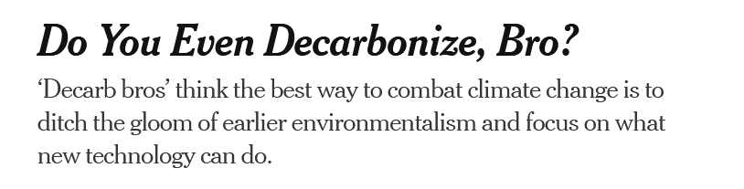
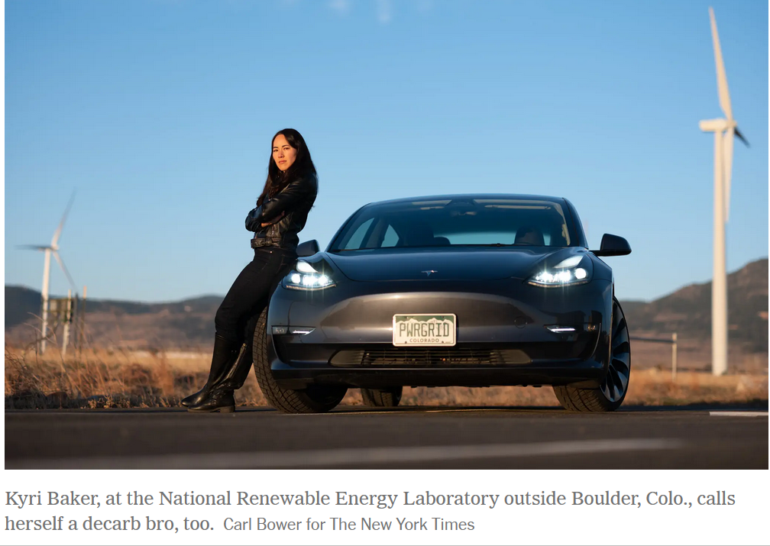
Notes:
https://www.nytimes.com/2023/04/22/business/decarb-bros-climate-change.html

Slide 32
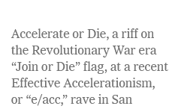
Effective Accelerationism (e/acc)
Notes:
e/acc is a loosely organized movement devoted to the no-holds-barred pursuit of technological progress, especially AI
Ecomodernist

Slide 33
Notes:
https://www.nytimes.com/2024/03/31/climate/climate-change-carbon-capture-ccs.html

Slide 34
The Population Bomb (1968)
Book published by Paul Ehrlich, this book popularized an environmentalist view on growth thru a neo-Malthusian view of humans
Malthus (1798) popularized the idea that the human population of Earth will eventually exceed its carrying capacity
Without radical measures to slow the human use of Earth’s resources, collapse is imminent
Environmental impact is the product of population, affluence, and technology (I=P*A*T).
Notes:
Paul Ehrlich (1968) in The Population Bomb carried forward statement made by many others over decades that the human population, through affluence (which translates into consumption) and facilitated by technology, is damaging the natural bases of life on Earth. Ehrlich and Holdren (1972) formulated the IPAT model which states that environmental impact is the product of population, affluence, and technology (I=P*A*T).

Slide 35
Julian Simon and the Cornucopians (1970-1980s)
Exemplifies the ecomodernist perspective
More people = more brains to solve problems
Technology will solve problem of resource scarcity and overpopulation while still promoting affluence
Julian Simon predicted 7 billion years of economic growth, interrupted only by the extinction of the sun
Notes:
Julian Simon, a cornucopian “doomslayer” and a contemporary of Ehrlich’s “There is no physical or economic reason why human resourcefulness and enterprise cannot forever continue to respond to impending shortages… and leave us with the bonus of lower costs and less scarcity in the long run. The bonus applies to such desirable resources as better health, more wilderness, cheaper energy, and a cleaner environment.”

Slide 36
The Simon–Ehrlich wager
Simon had Ehrlich choose five commodity metals: copper, chromium, nickel, tin, and tungsten.
Simon bet that their prices would decrease, while Ehrlich bet they would increase.
Ehrlich lost the bet; all five commodities declined in price from 1980 through 1990, the wager period
Substitutes were found, technology changed to require less of a metal or to use different metals; mining efficiencies improved
Notes:
This does not mean that Malthusian outcomes are impossible, but neither are they inevitable.

Slide 37
Notes:
This is the period table of elements, for example, H is hydrogen, Al is aluminum.

Slide 38
Tempering the ecomodernist zeal: EROI
Will technology continue to outpace environmental constraints and prevent collapse of the human population and globalized economy?
A useful frame of reference to examine this question is concept of energy return on energy investment (EROI),
This is the ratio of usable energy derived from a resource to the amount of energy used to obtain it.
A green technology cannot be more energy intensive or polluting to make than what it was intended to replace.

Slide 39
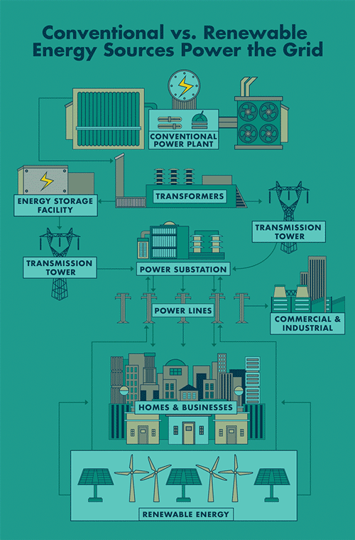
An ecomodernist discourse: Buying an EV is the best way to slow down climate change.
EROI has to be taken into account to quality this statement
Even though electric vehicles are more emissions-intensive to make because of batteries, their electric motors are more efficient than traditional internal combustion engines that burn fossil fuels.
If EVs draw from power grid with more renewable power plants and less fossil fuel-fired power generation, then yes, this can be an effective way to reduce carbon dioxide emissions .
Notes:
How they are charged – from electricity produced by coal or natural gas or by renewables determines how ‘green’ they are
Most countries are now pushing to clean up their electric grids. In the United States, utilities have retired hundreds of coal plants over the last decade and shifted to a mix of lower-emissions natural gas, wind and solar power.
Even though electric vehicles are more emissions-intensive to make because of batteries, their electric motors are more efficient than traditional internal combustion engines that burn fossil fuels.
https://www.nytimes.com/2021/03/02/climate/electric-vehicles-environment.html
https://www.theguardian.com/business/2023/dec/23/do-electric-cars-really-produce-fewer-carbon-emissions-than-petrol-or-diesel-vehicles
https://www.nytimes.com/interactive/2021/01/15/climate/electric-car-cost.html

Slide 40
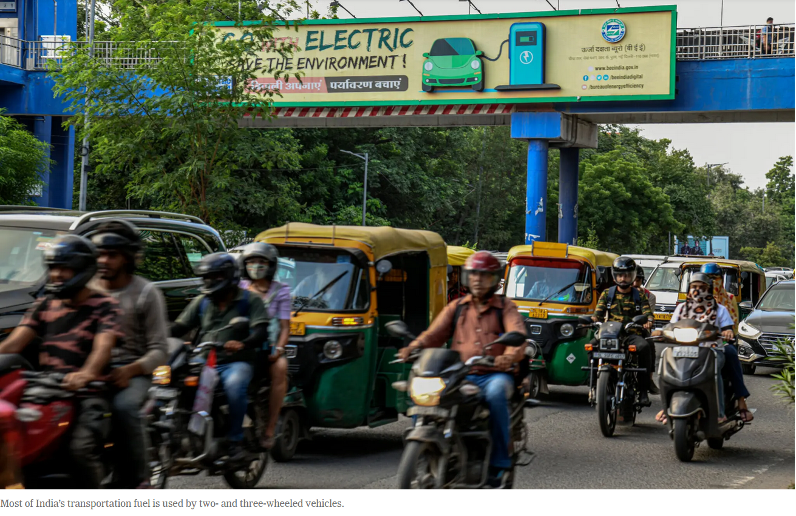
EROI can be vary significantly depending upon what type of EV vehicle under consideration.
Small, three and two wheeled EV transportation offer a far more greener alternative than the traditional four-wheeled family car.
Notes:
https://www.nytimes.com/2022/09/04/business/energy-environment/india-electric-vehicles-moped-rickshaw.html Countries like India, where if everyone bought a US-sized automobile, the impacts on climate (and air pollution) would be immensely negative. Small, EV vehicles there could have a much greater impact on global climate change in a country like India, with these types of vehicles, than in the US

Slide 41
EROI can also depend on who drives EV vehicles.
Do you drive on average 110 miles per day in an automobile? Then you are a super driver
If you drive a lot, then there is a greater return on energy investments in EVs if you drive one
Many of America’s biggest drivers are tradespeople and low- or middle-income Americans who have been pushed out of cities by rising housing prices and face long commutes.
Notes:
New technologies don’t matter as much as the context in which they are used
https://www.nytimes.com/2024/01/17/climate/electric-vehicles-high-mileage-drivers.html While the average American driver travels about 13,400 miles per year, people who buy electric vehicles today tend to drive them less than that, limiting the climate benefits of switching to a cleaner car. The extent to which EVs will have an impact will also involve, at least here in the US, who buys them.
Super drivers are more likely to live in rural areas and small towns,

Slide 42
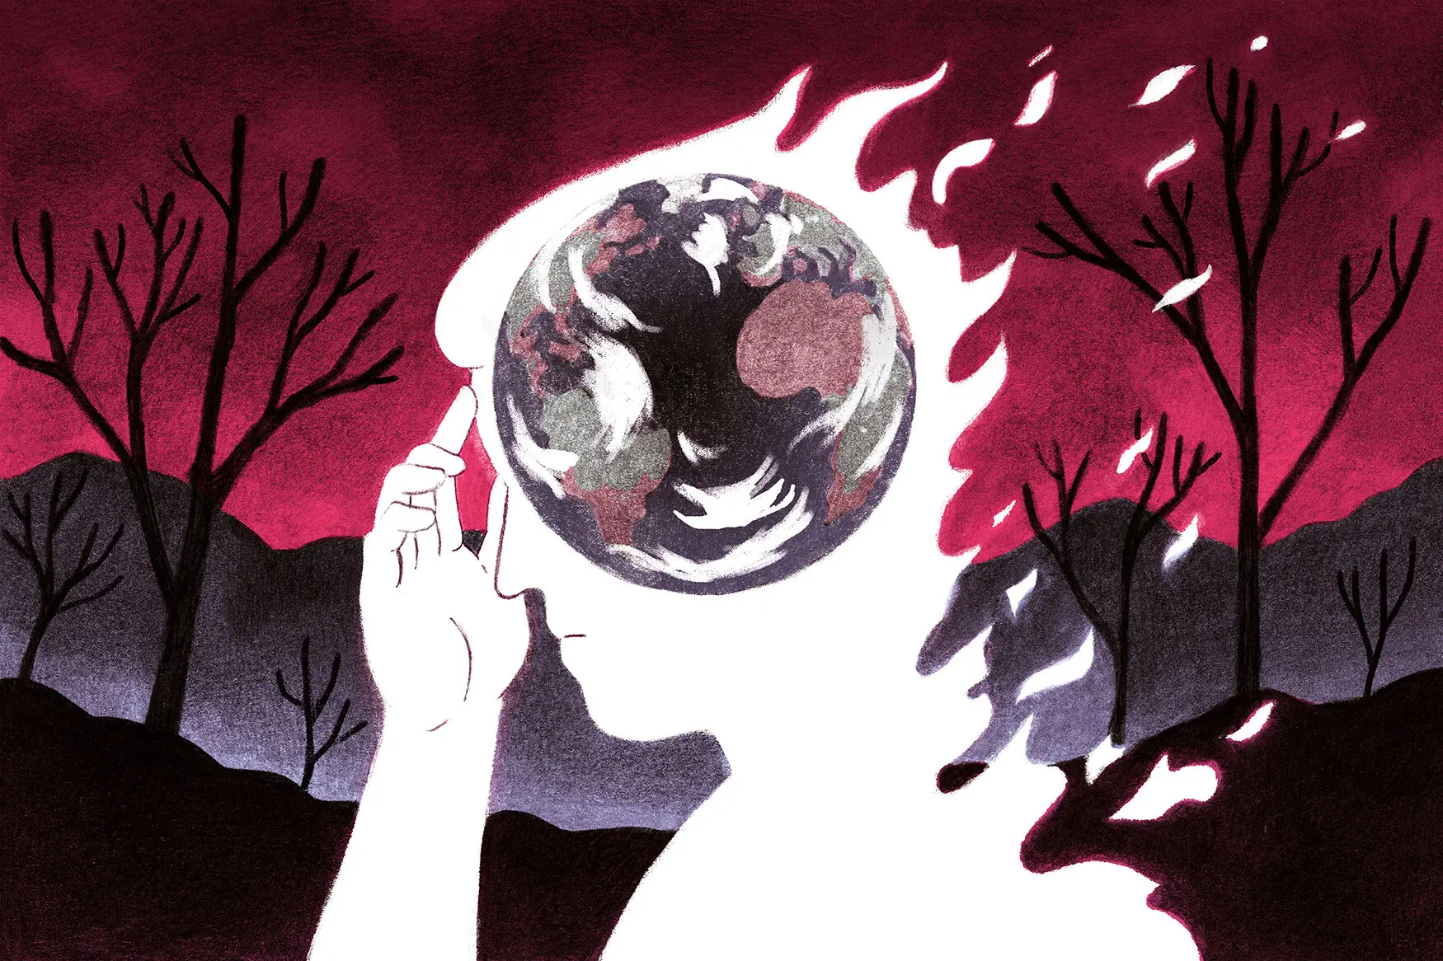
Tempering the ecomodernist zeal: control theory
Technological-based policy approaches can be criticized from a psychological viewpoint
Control theory says that we adjust our perception of personal control in relation to how we perceive external controls

Slide 43
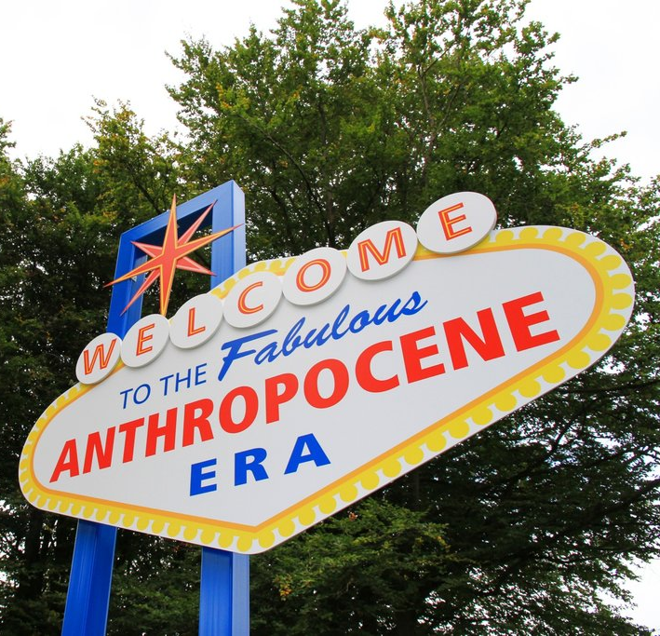
Affirming belief in scientific progress reduces environmentally friendly behavior
Portraying science as rapidly progressing may also reduce environmentally friendly behavior
Communication that questions the inevitability scientific progress and the how EROI matters may lead to increases in environmentally friendly behavior.
Notes:
Meijers, M. H., & Rutjens, B. T. (2014). Affirming belief in scientific progress reduces environmentally friendly behaviour. European Journal of Social Psychology, 44(5), 487-495. These findings show that when the aim is to promote environmentally friendly attitudes and behavior, it helps to not overstate scientific progress.

Slide 44
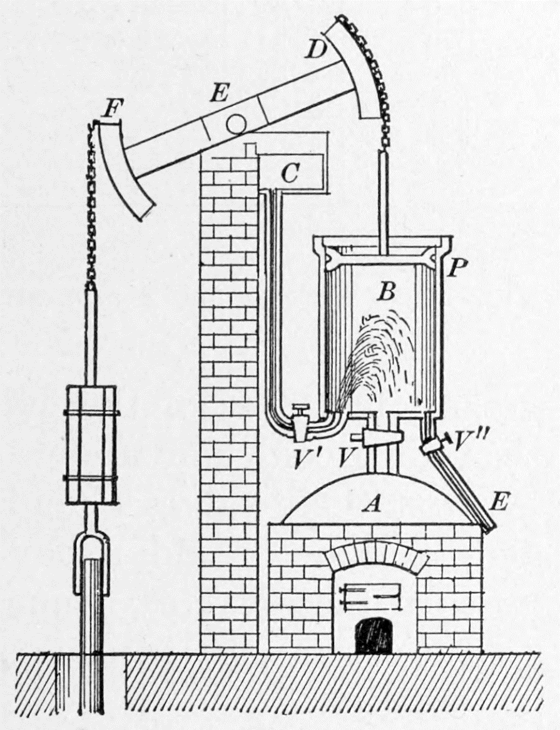
Tempering the ecomodernist zeal: Jevon’s Paradox
States that that there is no final technological solution, but a continual set of problems that arrive and need solving revolving around the ‘curse of efficiency’
The Coal Question (1865) by William S Jevons.
Most people then thought that if coal-burning efficiency increased, less coal would be burned.
However, Jevon predicted correctly that coal burning would increase with improvement in the efficiency of steam engines:
Greater efficiency decreased cost of coal. This spurred expanded economic uses for steam and coal. More coal burned in response to economic expansion

Slide 45
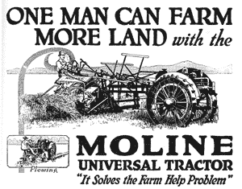
Jevon’s Paradox in the US Dust Bowl (1930s)
Jevon’s paradox holds that gains in efficiency do not always conserve resource use
Technological solutions can have benefits but may result in outcomes that are undesired
What happened when improvements in tractor technology coincided with growing demand for wheat in an arid region of the US?

Slide 46
Tractors improved farming efficiency
Potential for greater efficiency led to increased borrowing by farmers from banks to buy tractors and to purchase more land
This increased amount of soil tilled
With drop in price of wheat, farmers tilled even more to make up for losses needed to pay their loans and make a profit
Arrival of drought in this semi-arid region was tipping point and desertification and land abandonment ensued
Original technological efficiencies in farming – the fuel-powered tractor - created new problems, including fossil fuel dependency and soil erosion (which continues to this day)

Slide 47
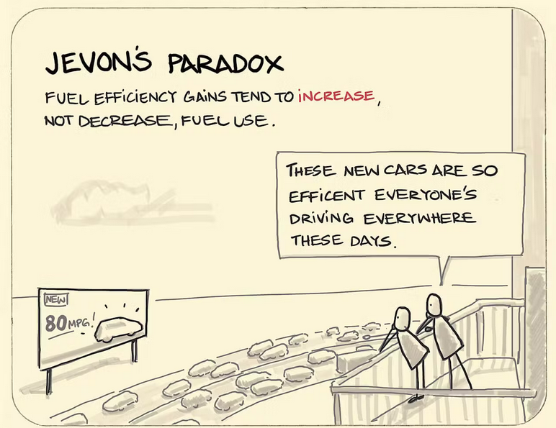
We are often are encouraged to adopt a positive, uncritical, and unsophisticated view of efficiency
We’ll just make things more efficient and that will enable us to reduce resource use, waste, and emissions, to solve our problems, and to pave the way for “green growth” and “sustainable development.”
Jevon’s paradox illustrates that this is not always so easily accomplished
Notes:
Increased auto fuel efficiency and lower operating costs led to more driving and road building

Slide 48
A bottleneck and breakthrough policy for the Anthropocene
This is a compromise between environmentalist and ecomodernist perspectives:
Based on the idea that the mechanisms that are destroying nature are laying the foundation for its long-term recovery
Urbanization, rural-to-urban migration, and technological innovation will provide ‘breakthrough’ solutions to Anthropocene problems.

Slide 49
Notes:
The bottleneck and breakthrough policy approach to the Anthropocene sees urbanization as part of a strategy to conserve nature.
The surprise is that although modern populations continue to expand, the rate of population growth has been falling since the 1960s There is broad agreement among that the world population, while continuing to grow in the interval, will stabilize around or shortly after 2100 around 8 to 10 billion

Slide 50
A bottleneck and breakthrough policy for the Anthropocene
If society focuses only on economic development and technological innovation as a mechanism to pass through the bottleneck as fast as possible, then what remains of nature could well be sacrificed.
If society were to focus only on limiting the economic growth that has improved the living conditions for billions of people on Earth, then poverty and population growth could overwhelm what remains of nature
Either extreme – too much or too little of environmentalism or ecomodernism – risks narrowing the bottleneck and preventing the breakthrough

Slide 52
Notes:
https://www.nature.com/articles/d41586-021-01020-z

Slide 53
Yellow Vest Movement (France)

Slide 54
Farmer–Citizen Movement “BoerBurgerBeweging” (Netherlands)

Slide 56
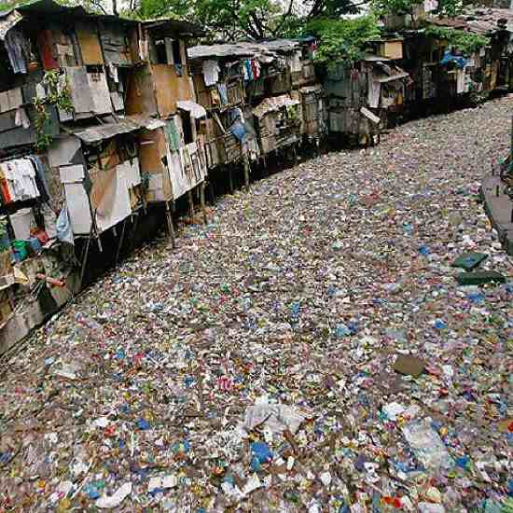
What is an environmentalist versus an ecomodernist viewpoint on the issue of plastics?
How does EROI apply to the plastics problem?
How does control theory apply?
What are some ways in which Jevon’s Paradox can play out in ways that deflect solutions and/or generate new problems?
Describe a successful and an unsuccessful bottleneck and breakthrough policy scenario

Slide 58
Efficiency is often a much easier policy to sell to the public
Whether or not a practice is made more efficient may not be readily determined, leading to ‘greenwashing’ of efficiency claims
Efficiencies can be used to expand production and growth in ways that postpone solutions or generate new problems

