Slide 1
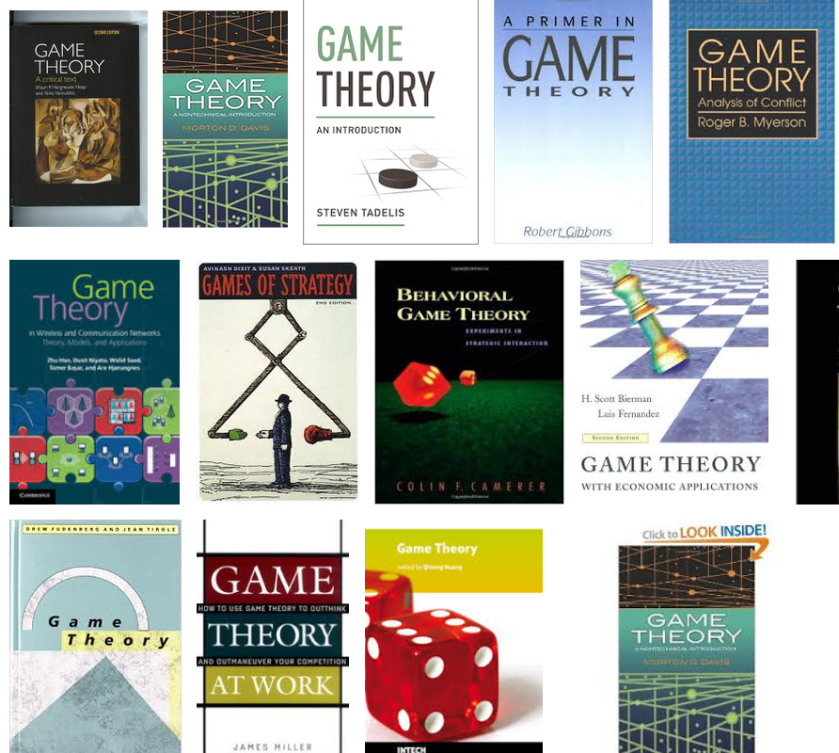
Game theory
Originated with “Theory of Games and Economic Behavior” by von Neumann (1944)
Refined during Cold War (capitalist US versus communist USSR) because of need to anticipate and counter opponent’s actions and propaganda, particularly in regard to nuclear war
Game theory aims to understand:
Why individuals or groups cooperate (or defect, cheat, or punish)
How local interactions among humans play out in their particular contexts and how these interactions change over time and space
Notes:
Game Theory is a formal field of study in mathematics and economics. How are the Cold War nuclear fears and negotiations similar to the tragedy of the commons? Should I take all the fish first before anyone else can? Can I trust my neighbor not to take more than their share of fish if I have agreed not to? Are my neighbors lying to me about their plans?

Slide 2
Types of games
A zero-sum game is a situation in which each participant's gain or loss is exactly balanced by the losses or gains of the other participants. No overlap of interests. An example are sports – gains for one are losses for the other
A non-zero sum game the players interests overlap, what is good or bad for one is good or bad for all. Gains for one can be gains for another, and losses for one can be losses for the other. Game theory works with these types of games.

Slide 3
Prisoner’s dilemma, a non-zero sum game
Notes:
Assuming these criminals do not trust each other (they are criminals), and it is expected that your partner will rat you out, it is better to confess, rather than serve a year in jail. Both criminals have an incentive to confess and get a shorter sentence (three months instead of a year). So how do we steer the outcome from the bottom right (3 months in jail) to the top left (1 month in jail for each)? How does cooperation evolve?

Slide 4
How does cooperation evolve?
Cooperation is considered one of the reasons for the success of humans despite our flaws
We exhibit an innate propensity for prosocial behaviors
Notes:
Darwin postulated individual fitness in a competitive environment as a driver of evolution, but cooperation is a hallmark of many species. Again, we return to the idea of approaching sustainability in terms of co-evolutionary processes
https://www.nytimes.com/2023/01/30/science/dolphins-brazil-fishermen.html https://www.youtube.com/watch?v=lRwWfYLKFw0&t=142s&ab_channel=AnimalPlanet

Slide 5
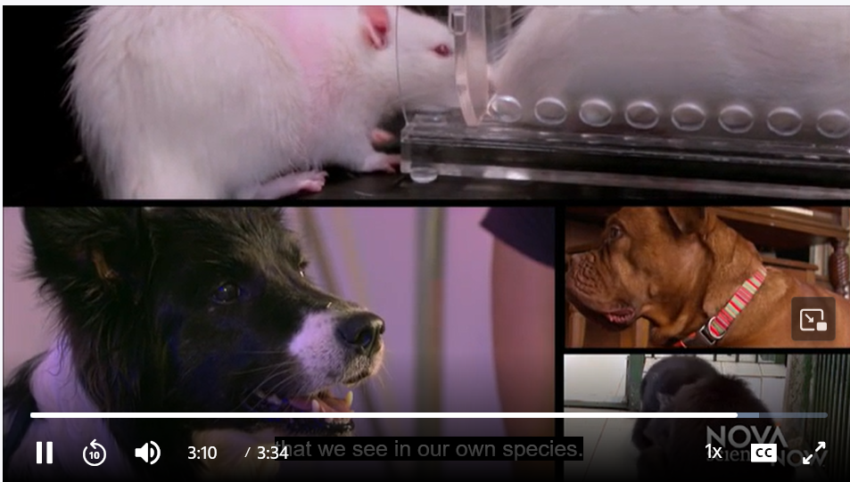
Prosociality refers to behaviors that are intended to benefit others or society as a whole.
These behaviors can include acts of cooperation, helping, sharing, comforting, and altruism
Other species can exhibit prosociality, but not to the potential extent as humans
Chimps, bonobos, gorillas, orangutans are the best studied, but other vertebrates exhibit prosociality too

Slide 6
Human prosociality
1. Evolutionary evidence
Early humans lived in groups and relied on each other for hunting, gathering, protection, and childcare. The need for interdependence favored evolution of prosocial traits like empathy, fairness, and reciprocity.
Humans are uniquely inclined to shared intentionality—the ability to understand and align goals with others, which is fundamental to teamwork and cultural learning.
Helping others, even at a short-term cost, is beneficial in the long run because it fosters trust and future cooperation (reciprocal altruism)

Slide 7
Humans have an innate desire for fairness, which has even been documented in other vertebrate species and between humans and non-human vertebrates
Notes:
Darwin postulated individual fitness in a competitive environment as a driver of evolution, but cooperation is a hallmark of many species. Again, we return to the idea of approaching sustainability in terms of co-evolutionary processes
https://www.nytimes.com/2023/01/30/science/dolphins-brazil-fishermen.html https://www.youtube.com/watch?v=lRwWfYLKFw0&t=142s&ab_channel=AnimalPlanet

Slide 9
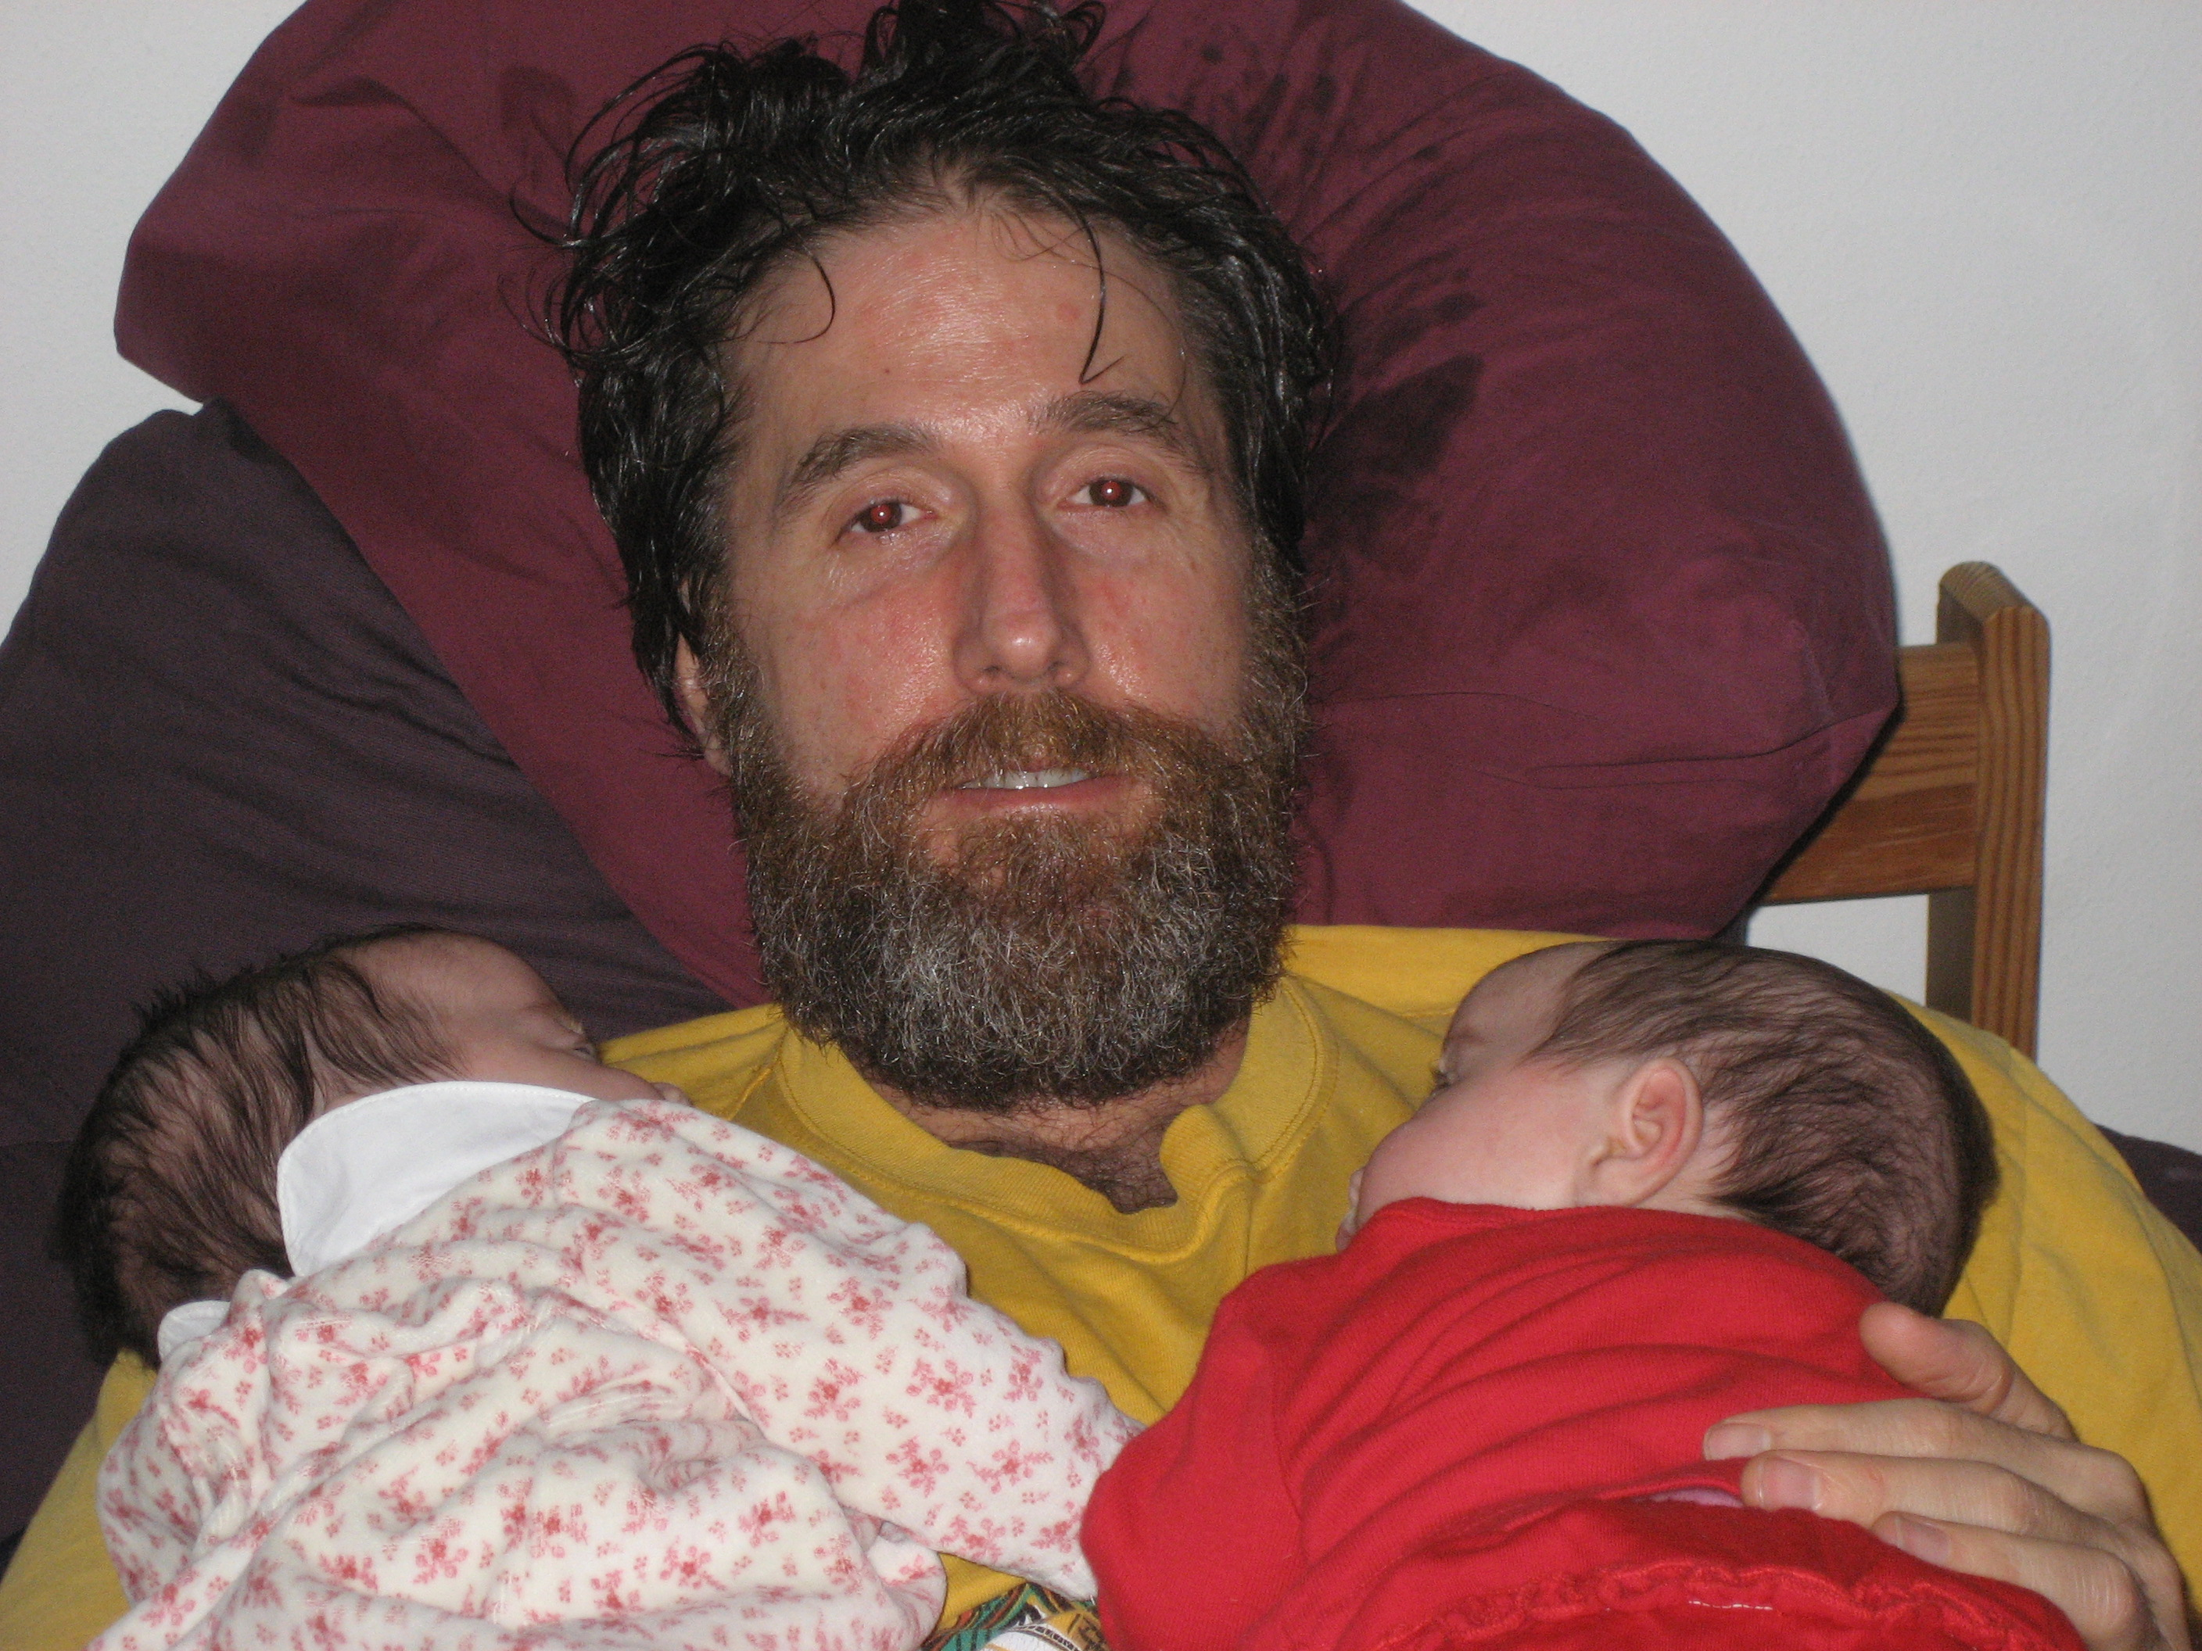
2. Psychological evidence
Acts of kindness and cooperation activate reward centers in the brain, reinforcing prosociality
Mirror neurons in the brain help humans simulate experiences of others, fostering empathy and social bonding.
Oxytocin, the “love hormone,” released during positive social interactions, reinforcing trust and bonding.
Very young children help spontaneously, suggesting that prosociality is not learned but an innate predisposition
Notes:
https://www.sciencedirect.com/science/article/pii/S2666497621000813

Slide 10
Yet despite our cooperative nature and propensity for prosocial behaviors, cooperation (and pro-environmental behaviors) don’t always evolve.
Researchers have identified conditions that promote it:
Repetitive interactions (iterations) over time and across space
A familiarity among players
Consequences or punishments for defectors, those who choose not to play by the rules.
Notes:
Darwin postulated individual fitness in a competitive environment as a driver of evolution, but cooperation is a hallmark of many species. Again, we return to the idea of approaching sustainability in terms of co-evolutionary processes
https://www.nytimes.com/2023/01/30/science/dolphins-brazil-fishermen.html https://www.youtube.com/watch?v=lRwWfYLKFw0&t=142s&ab_channel=AnimalPlanet

Slide 11
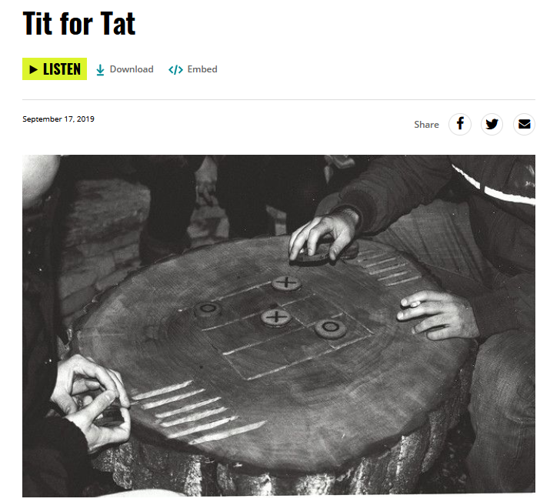
In iterated prisoner's dilemma, a game is played over and over
It is then more likely for both players to devise a strategy that punishes betrayal and rewards cooperation.
Tit-for-tat or copying has proven to be a strategic choice in iterated prisoner’s dilemma
Notes:
Tit-for-tat or copying is a strategic choice – cooperation tends to evolve if that game is played over and over. In the iterated prisoner's dilemma, it is possible for both players to devise a strategy that punishes betrayal and rewards cooperation. The tit-for-tat strategy has been determined to be the optimal way for optimizing a prisoner's dilemma scenario.

Slide 12
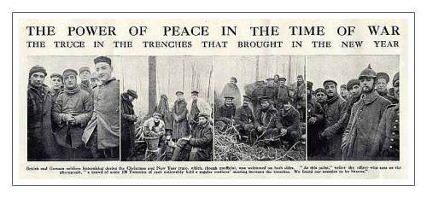

Slide 15
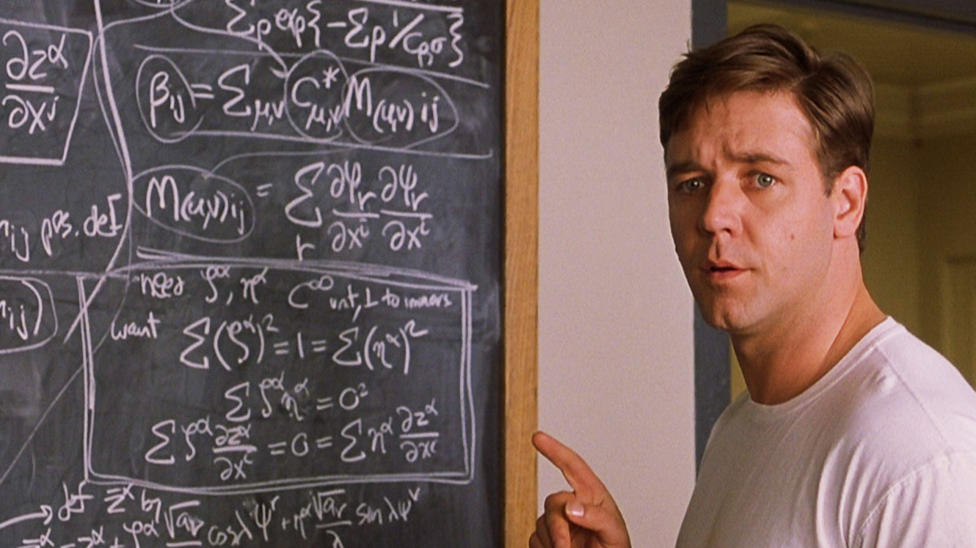
Nash equilibrium
Occurs when the optimal outcome of a game is one where no player has an incentive to deviate from chosen strategy after considering opponent's choice.
In this example from the film biography of John Nash (“A Beautiful Mind”), the ‘players’ in a ‘game’ know the strategy of the others and there is no incentive for them to deviate. This is the Nash equilibrium.
As shown in this video, the Nash equilibrium may be potentially good for an individual to pursue, but if all pursue their strategy, the group as a whole may not benefit.
Notes:
In a Nash equilibrium, no player would want to change the strategy they are employing, given that no other players are going to change their own strategies. For prisoner’s dilemma, the Nash equilibrium is to confess. A very overt example that conveys the concept of a Nash equilibrium is driving on the right side of the road in the US and some other countries. There is no incentive to deviate from this strategy.

Slide 16
Notes:
Three months in jail (confess and betray is the Nash equilibrium, if the assumption is that the criminals don’t trust each other (they are criminals). Confessing and betraying is the best that you can hope to do with this understanding of each other. Steering the Nash equilibrium toward the one-month in jail outcome where both stay silent is a better option for them, but unless they have established some level of trust or put into place some incentives, then they both stand to lose more by choosing to confess and betray.

Slide 17
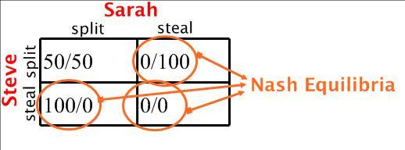
Notes:
https://www.facebook.com/classictvmoments/videos/100000-steal/2294216330611721/
This game show is a good example of a non-zero sum game in which interests can align and win-win, lose-lose scenarios are also possible. What the two contestants are trying to do is understand the motives and behavior of the other person and trying to chose a strategy for themselves based on it.
The Nash equilibrium is to choose to steal. By choosing to steal, the player has a chance at maximizing his own payoff.
Iteration changes the nature of game – playing against the same person over and over allows the potential for cooperation to evolve. However, what if you are always playing someone new?
Once a cooperator has been tricked, that person is loath to be a cooperator again. In this sense, memory plays a role in how games will turn out. The woman in this game, Sarah, had been previously tricked.

Slide 18
Notes:
Green in the figure is the typical Nash equilibrium. It is not optimal. The Nash equilibrium needs to be negotiated through interaction among the player toward something more beneficial for all. Usually, the strategy is to agree to split (and hope the other player keeps their word). However, in this video, a new strategy is put into play. By saying he is going to steal and then split, in the future, Nick forces the other player to split. He is steering the player toward a particular outcome in which none of them can do no better based on the relationship they have established.
By the end of the negotiation, Nick has convinced Ibraham 100% that he is going to steal the money. Ibraham may only have had a confidence level of 50% that Nick was honest about splitting the money with him after the show, but with a 50% confidence level, Ibrahim’s possible payoffs are:
Choose steal and go home with nothing.
Choose split and have a 50/50 chance of going home with half the jackpot (based on his level of confidence in Nick’s promise to split the money after the show).
Nick realigns the Nash equilibrium toward a more desired outcome.

Slide 19
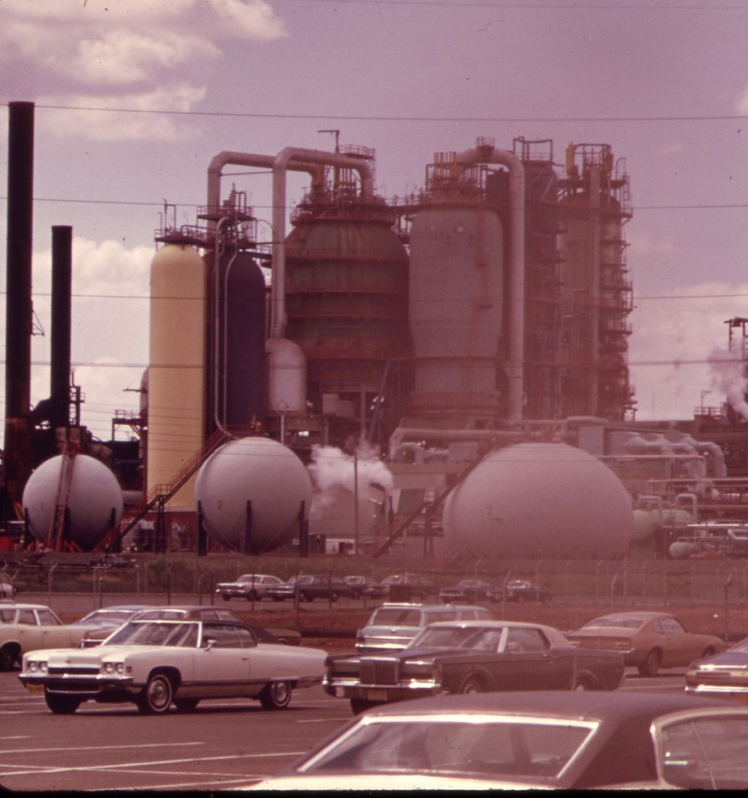
Nash equilibrium
The Nash equilibrium may not the be the best option for society.
The incentive is to steer games from their Nash equilibrium toward outcomes that are more socially optimal.
For example, the Nash equilibrium is for a country’s industrial sector to ignore pollution control measures if they think no other country is adhering to them and making more of a profit.
A mechanism or incentive is needed to steer away from this Nash equilibrium
Notes:
Whenever a government considers a new environmental regulation, one of the first questions it needs to ask is whether obeying the rule and achieving its aims is a Nash equilibrium – one that is optimal and no player has an incentive to deviate from his/her chosen strategy after considering an opponent's choice. If it isn’t a Nash equilibrium, the new policy measure is likely to prove a failure, because those affected will seek a way around it.
Assuming that the policy of each state is set independently, there is no incentive for a single state to unilaterally cap emissions. The effect of one country doing so would be small, while the cost in that country would be high. Hence, inaction on air pollution was a Nash Equilibrium. It is only through the development of a system that changes the strategies of many actors that a low-carbon outcome can be achieved.

Slide 20
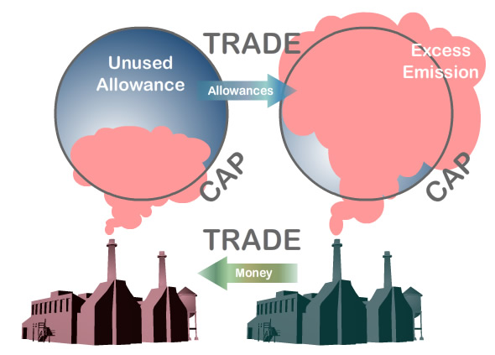
Cap and trade emissions trading provides an incentive to shift away from an undesired Nash equilibrium
If given the capacity to sell pollution allowances (also known as credits), this creates an incentive to follow emissions rules without being at a disadvantage
Companies have to buy allowances to pollute or get punished with a fine. There is an incentive to reduce air pollution

Slide 22
Notes:
This diagram categorizes goods based on two criteria: subtractability and exclusion. Here's how to interpret it:
A. Subtractability (or rivalry):
Refers to whether one person's use of a good diminishes the availability of that good for others.
Low subtractability: Using the good does not significantly reduce its availability for others.
High subtractability: Using the good diminishes its availability for others.
B. Exclusion:
Refers to whether it is easy or difficult to exclude people from accessing the good.
Difficult exclusion: It is hard or costly to prevent people from accessing the good.
Easy exclusion: It is straightforward or inexpensive to prevent access.
Four Types of Goods: A. Public Goods (low subtractability, difficult exclusion):
Examples: National defense, clean air, public parks.
Characteristics: Everyone can use them without reducing availability for others, and it’s hard to exclude anyone from using them.
B. Common-Pool Resources (high subtractability, difficult exclusion):
Examples: Fisheries, groundwater, forests.
Characteristics: Use by one person reduces availability for others (high subtractability), and it’s hard to stop people from accessing them.
C. Toll or Club Goods (low subtractability, easy exclusion):
Examples: Movie theaters, private parks, subscription services.
Characteristics: Use by one person doesn’t reduce availability for others (low subtractability), but it’s easy to restrict access (like charging a fee).
D. Private Goods (high subtractability, easy exclusion):
Examples: Food, clothing, personal devices.
Characteristics: Use by one person reduces availability for others, and it’s easy to prevent others from using them.
Key Insights:
Public and common-pool goods often require collective management because they are prone to overuse (e.g., the "tragedy of the commons" in common-pool resources)
Toll/club and private goods are easier to regulate since exclusion is straightforward and they tend to operate in markets.

Slide 23
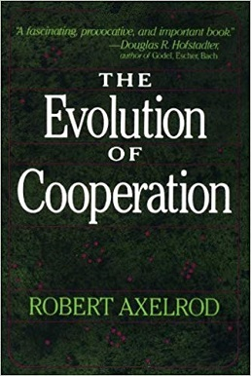
Complexity and the common pool resources
Common pool resource management systems evolve over time
Local interactions and norms can be established that maintain a resource’s availability for all
The management system operates as a complex adaptive system – it self-organizes over time.
Certain conditions make the evolution of successful commons management systems more likely
Notes:
We will review the conditions that make it more likely that successful commons management systems will evolve in a later lecture on game theory.

Slide 24
Guidelines for managing common pool resources
Behaviors should be guided by culturally-transmitted beliefs about what is collectively right and wrong
Norm violaters should suffer and those who adhere do better so adherence to rules is self-interested
Graduated sanctions should be used: punishments start small and then increase over time in severity
The cost and benefits for collective action should be perceived as fair by all
The group must be willing to enforce the limits on resource use set by rules
Issues should be combined and packaged together so as to make the possibility for solutions greater
The idea that one does not want to look selfish should be promoted
Notes:
Countries, cultures, and groups of people have developed cooperative adaptive management strategies to avoid the tragedy of the commons.
These guidelines require deliberation, decision-making, and influencing others to change their behaviors.

Slide 25
Examples: common pool resource management
Subak irrigation systems (Bali, Indonesia)
A centuries-old, cooperative irrigation network managed by local farmer organizations
Based on shared water temples and community cooperation to ensure equitable water distribution and sustainable rice farming
Farmers adhere to traditional rules and schedules to prevent overuse.

Slide 27
Lobster fisheries (Maine, USA)
Lobster fishers in Maine self-regulate through territorial use rights and a system where local fishers enforce sustainable harvesting practices, including size limits, trap restrictions, and protection of breeding females.
The success of this system has helped prevent overfishing and maintain stable lobster populations.

Slide 28
Grazing systems (Mongolia)
Mongolian herders traditionally manage pastureland through communal agreements that prevent overgrazing.
Seasonal rotation and informal rules about grazing areas ensure that land remains productive while preventing the "tragedy of the commons."
Community forest management (Nepal)
Nepal’s Community Forestry Program allows local user groups to manage forest resources, balancing conservation with livelihoods.
Groups regulate logging, enforce reforestation efforts, and distribute resources fairly, leading to significant forest regeneration and improved livelihoods.

Slide 29
Water governance (Netherlands)
Dates back to medieval times,
Covers water levels, flood and storm surge protection, and dike maintenance.
Residents pay water taxes, participate in decision-making, and ensure that water resources are managed equitably and effectively.

Slide 30
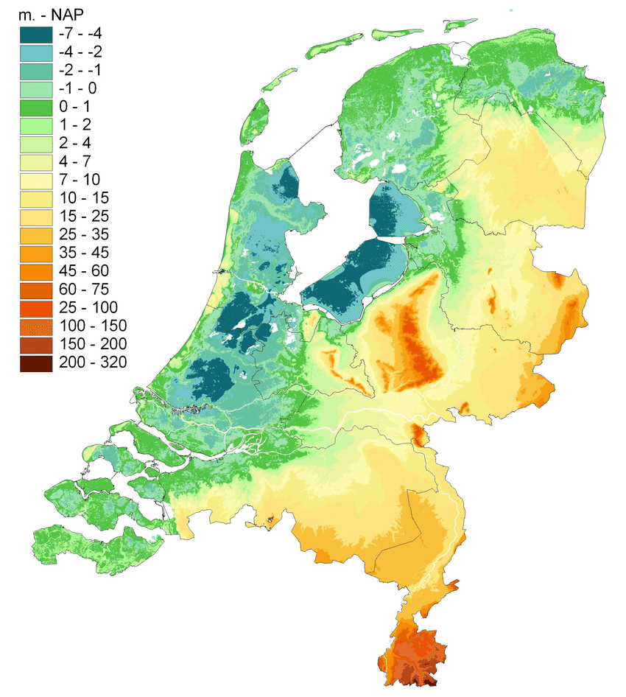
The Netherlands
Neder is the Dutch word for ‘low’
Nederland means low land
The region of northern Belgium and Netherlands is often referred to as the the Low Countries because of their low elevations.
Notes:
Elevation of the Netherlands shown in meters

Slide 31
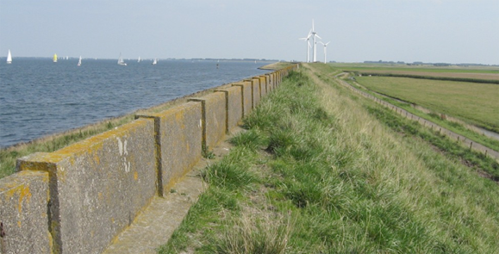

Slide 32
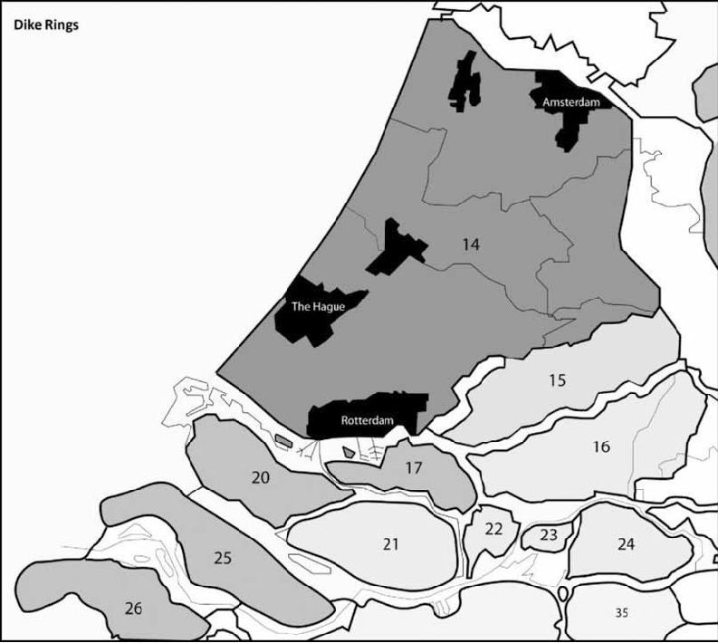
Dike rings
These structures enclose large areas to prevent flooding within them.
Notes:
Abegail

Slide 33
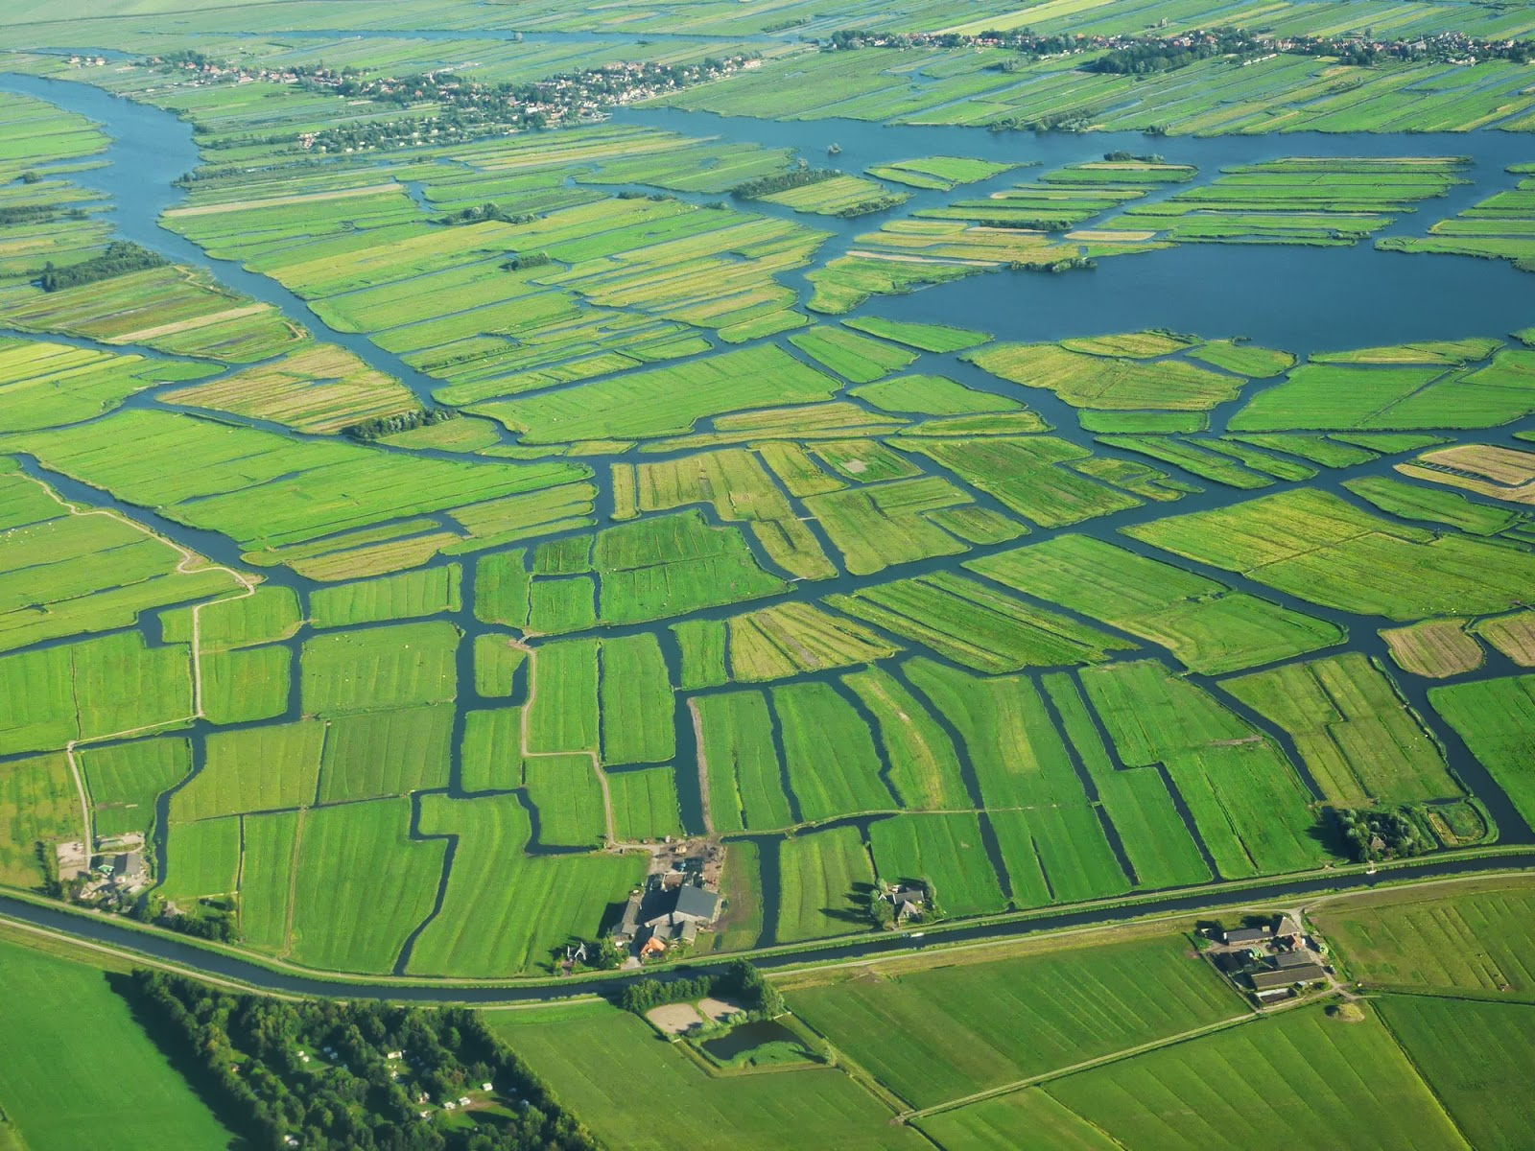
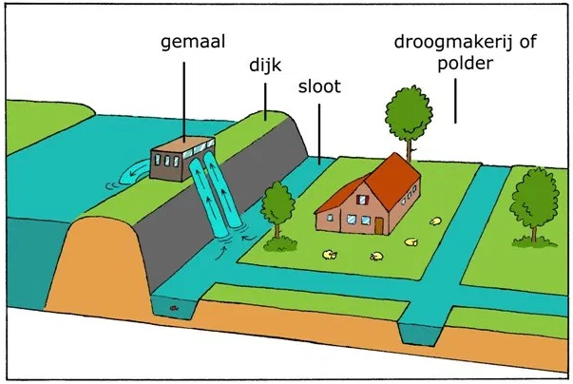
Polder
A tract of lowland reclaimed from a body of water by the construction of dikes, followed by drainage of the area between the dikes
The Dutch have a long history of reclamation of land through poldering
Notes:
Laura

Slide 34
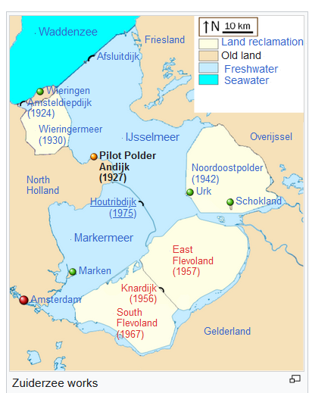
Zuiderzee Works
Dammed the Zuiderzee, a large, shallow sea in order to:
Protect inland areas from storm surge
Store freshwater, and to convert former ocean bottm to dry land.
Flevoland is an entirely reclaimed land area that was once underwater.
Notes:
Emma

Slide 35
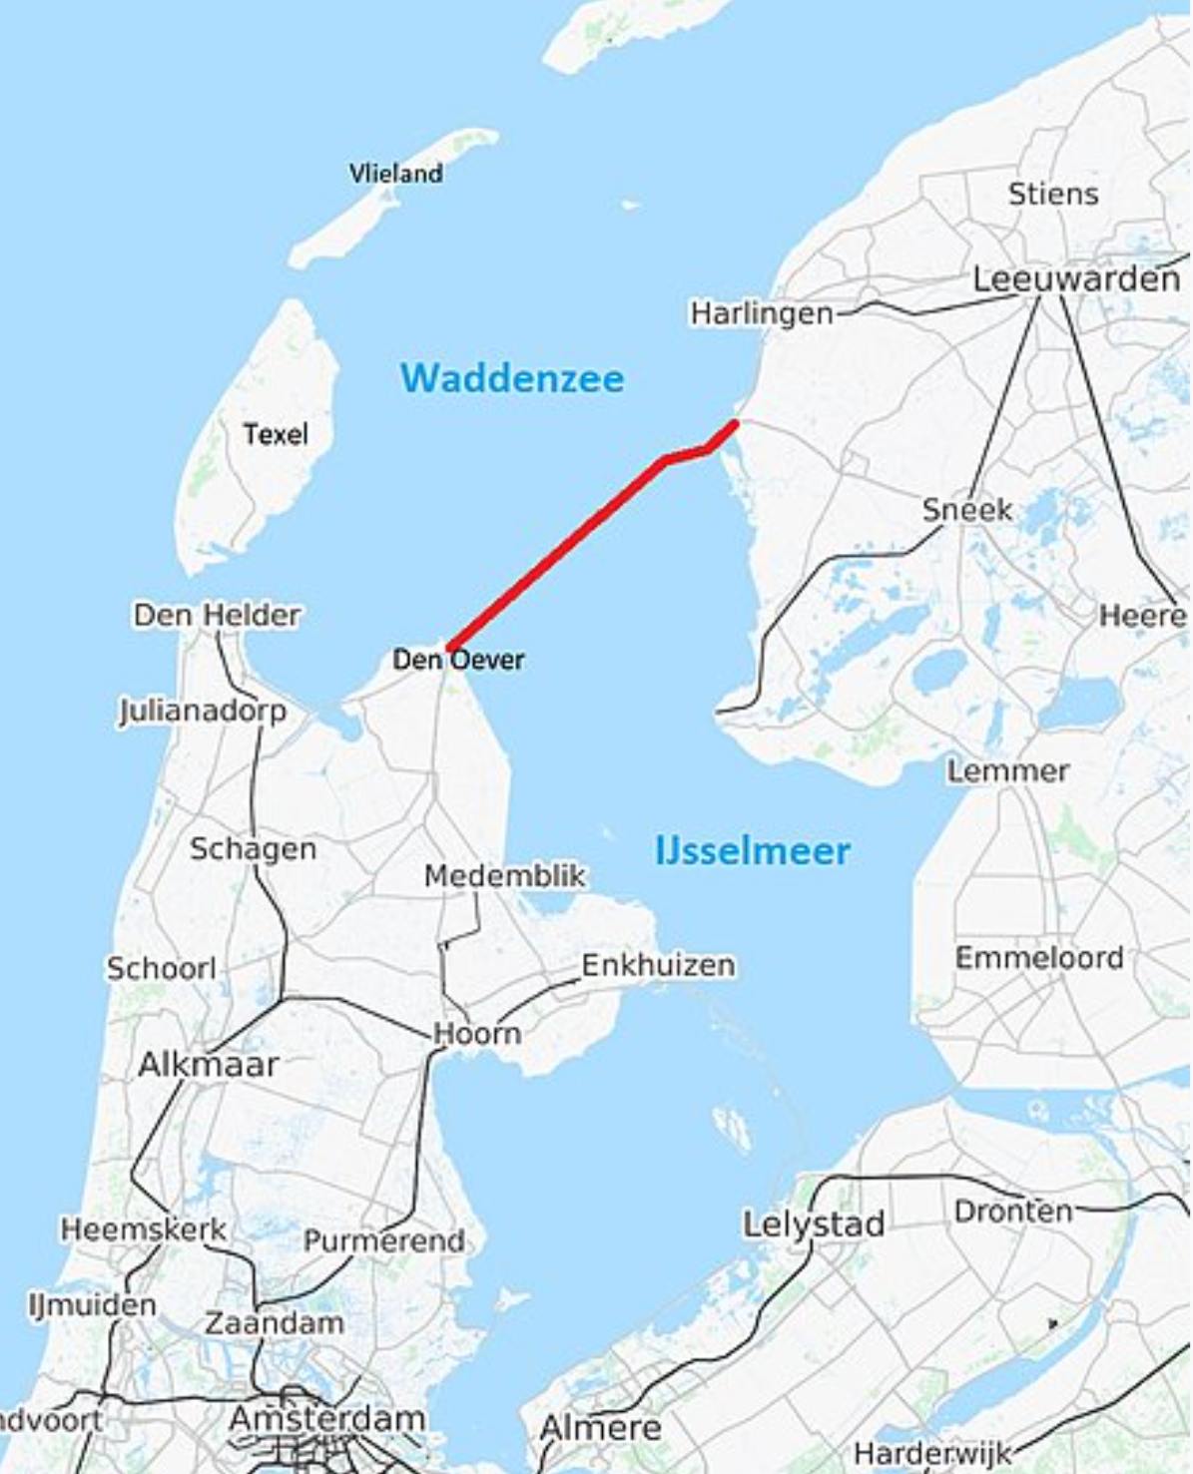
Afsluitdijk
Dike constructed between 1927 and 1932 that shut out the North Sea
Buffers storm surge and also create fresh water behind it
Notes:
Chloe Type directly into the slide and insert your images directly into the slide rather than cutting and pasting an image of the slides you are working on. Take a look at my text. Aim for his kind of detail and length. Find another photo of this dike and insert into the slide. Resize the image so that it fits. Crop it if needed.

Slide 36
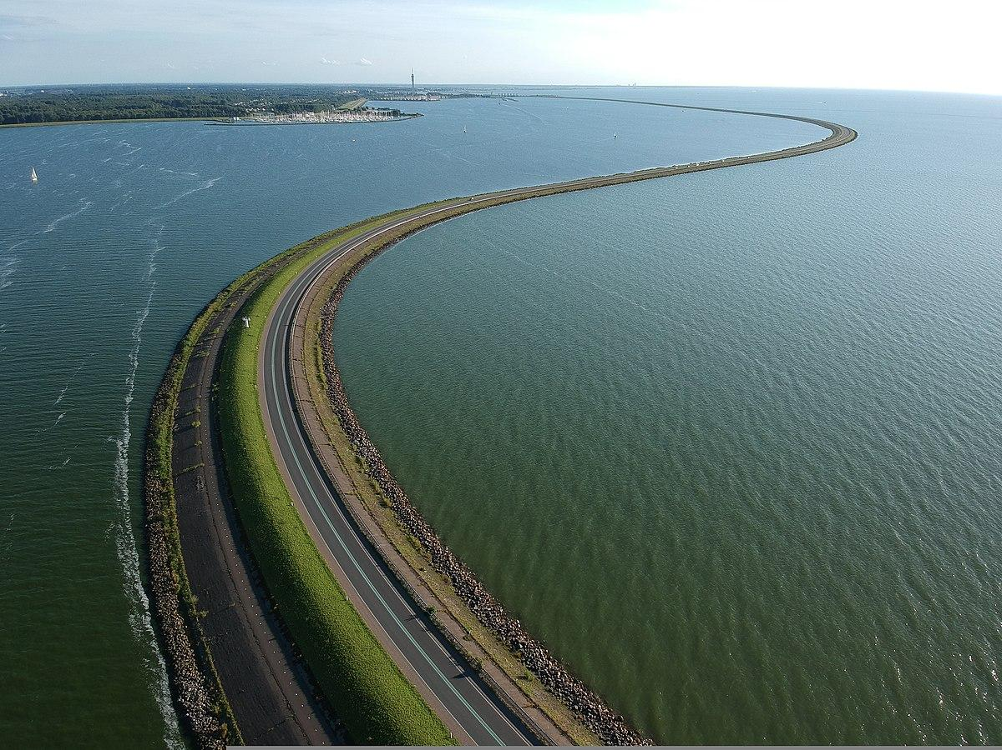
Houtribdijk
A dike built between 1963 and 1975 as part of the Zuiderzee Works.
It to impounds fresh water and serves as a buffer for high water events
Notes:
Rachel

Slide 37
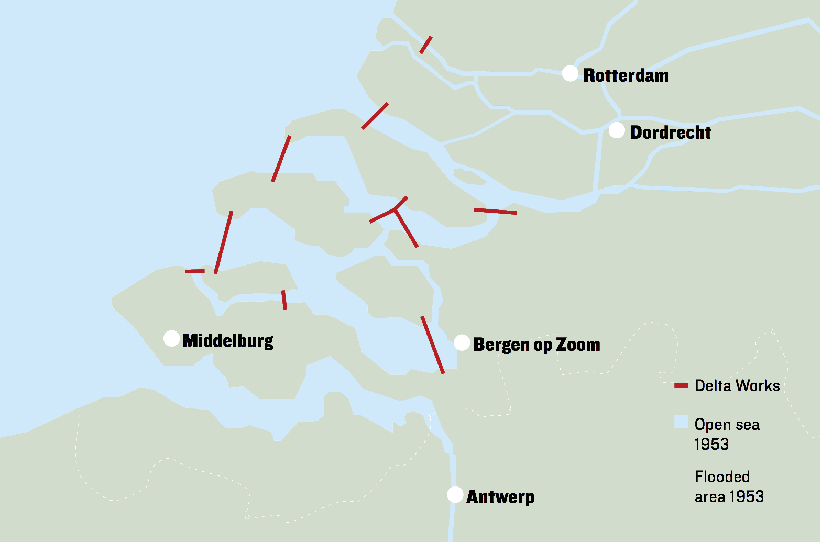
The Delta Works
Largest flood defense system of the Netherlands,
Made up of locks, dams, and storm surge barriers.
The dams also benefit agriculture by impounding fresh water
Notes:
Abegail

Slide 38
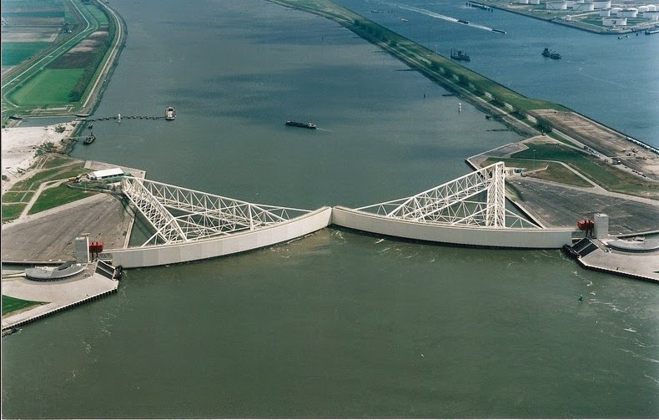
Maeslant Barrier
The largest movable flood barrier in the world,
Protects Rotterdam from storm surge and flooding during storms
Notes:
Cale

Slide 39
Oosterscheldekering Barrier
Protects Zeeland in the south of the Netherlands from the North Sea
Notes:
Georgia

Slide 40
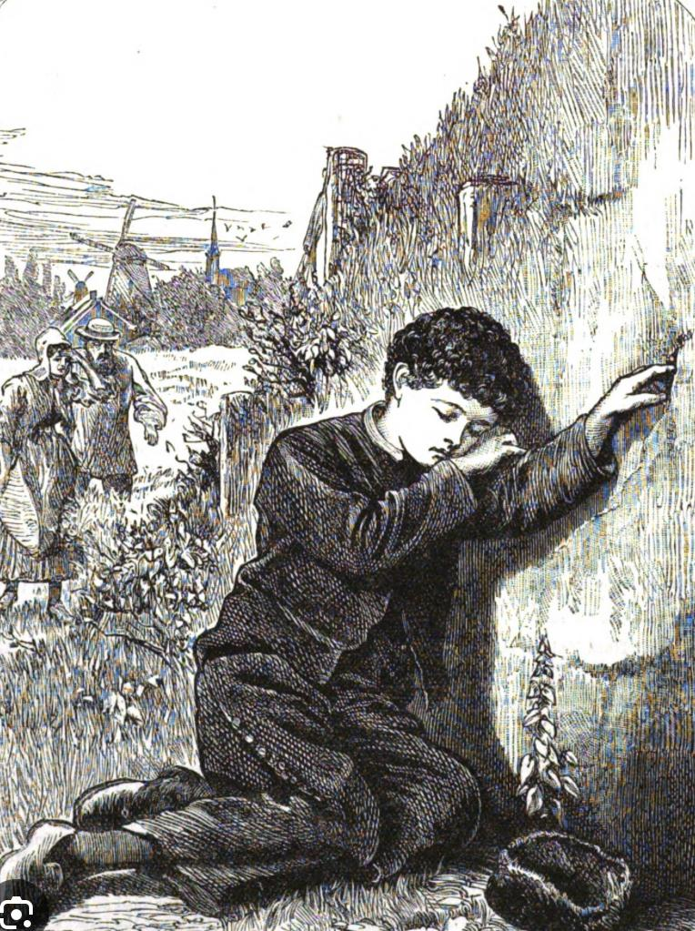
Hans Brinker and the
Silver Skates
A children’s story published in 1865 by an American author.
Tells the story of a young Dutch boy who finds a small crack in a dam. Instead of leaving the crack to grow bigger over time and eventually break the dam, he put his finger in it through the cold night to stop the leak.
The story of the boy is untrue – in fact, a much more collective response would have happened
Notes:
Carelynn

Slide 41
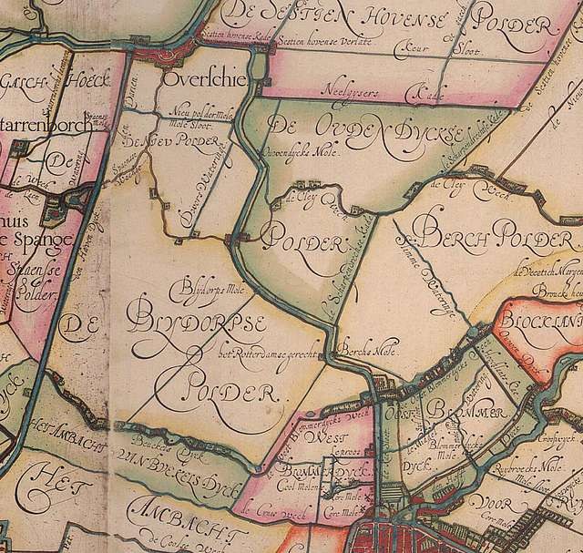
Dutch Water Boards (Waterschappen) and management of the Dutch water commons
The Netherlands has a long tradition of collective water management, dating back to the Middle Ages.
Regional water boards (21 at present) are democratically governed institutions where stakeholders (farmers, industries, municipalities, and residents) manage water levels, flood protection, and water quality.
Notes:
Polder map from 1611

Slide 42
Water boards operate independently (increasingly less so) of national politics, ensuring long-term sustainability over short-term political interests.
Water system is funded by local water taxes, creating financial independence and accountability.

