Slide 1
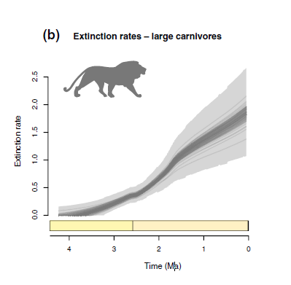
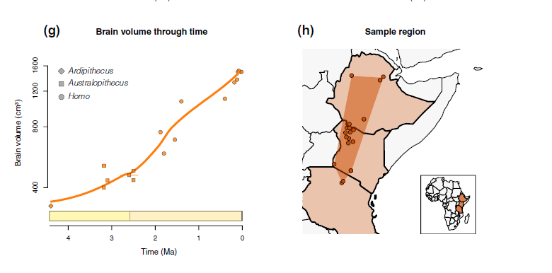
Plio-Pliestocene carnivore decline in Africa (5 mya)
Notes:
Carnivore’s declined not because they were hunted out but because humans were scavenging many of their kills

Slide 2
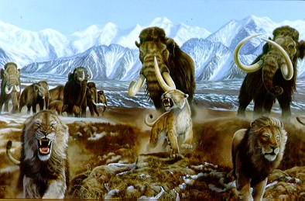
Pleistocene megafaunal extinctions in North America (10,000 to 12,000 ya)

Slide 3
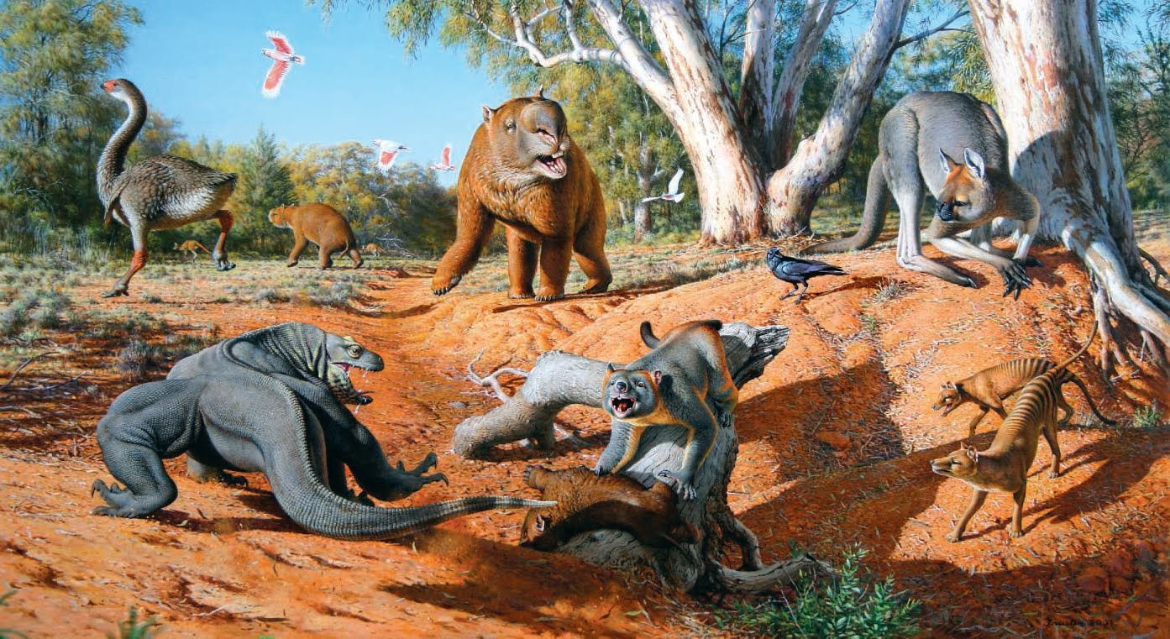
Pleistocene megafaunal extinctions in Australia (40,000 ya)

Slide 4
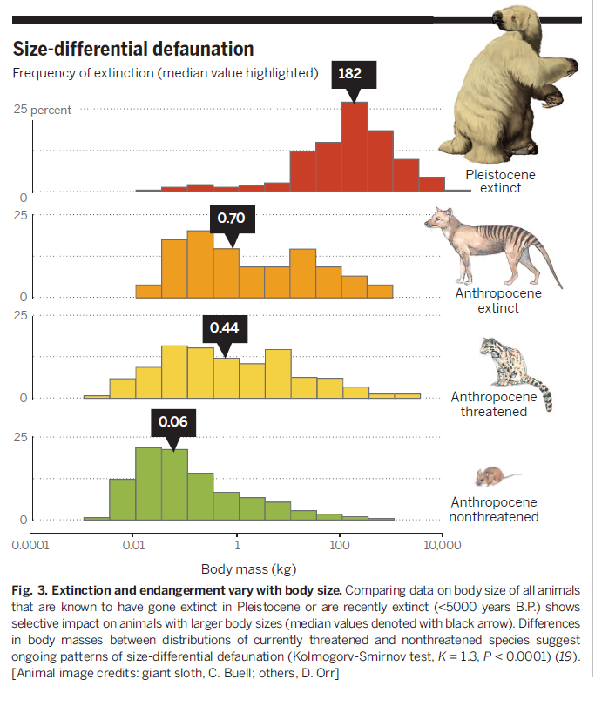
Notes:
Overexploitation has a size and taxon-specific bias. Selective impact on large-bodied mammals and birds. Large-bodied animals have gone extinct disproportionately earlier, leaving behind a smaller-bodied set of animals
The average size has gone from 182 kilograms, or 400 lbs to 0.70-0.44 kg (1.5-1 lbs), and 0.06 kilograms, or a couple of ounces.

Slide 5
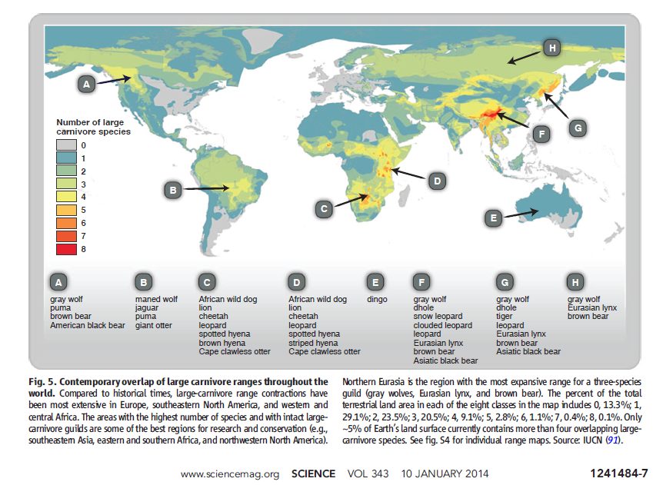
Notes:
Trophic downgrading of Earth
Large carnivore ranges have contracted globally, leaving only a few places with more than one or two large predators.
Until recently, large apex consumers were ubiquitous across the globe and had been for millions of years. The loss of these animals may be humankind’s most pervasive influence on nature. Although such losses are widely viewed as an ethical and aesthetic problem, recent research reveals extensive cascading effects of their disappearance in marine, terrestrial, and freshwater ecosystems worldwide. This empirical work supports long-standing theory about the role of top-down forcing in ecosystems but also highlights the unanticipated impacts of trophic cascades on processes as diverse as the dynamics of disease, wildfire, carbon sequestration, invasive species, and biogeochemical cycles. These findings emphasize the urgent need for interdisciplinary research to forecast the effects of trophic downgrading on process, function, and resilience in global ecosystems.
https://science.sciencemag.org/content/333/6040/301

Slide 6
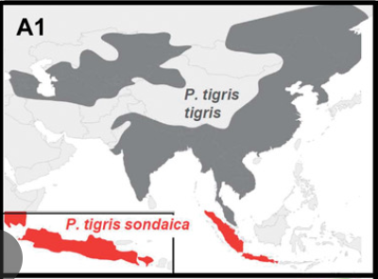
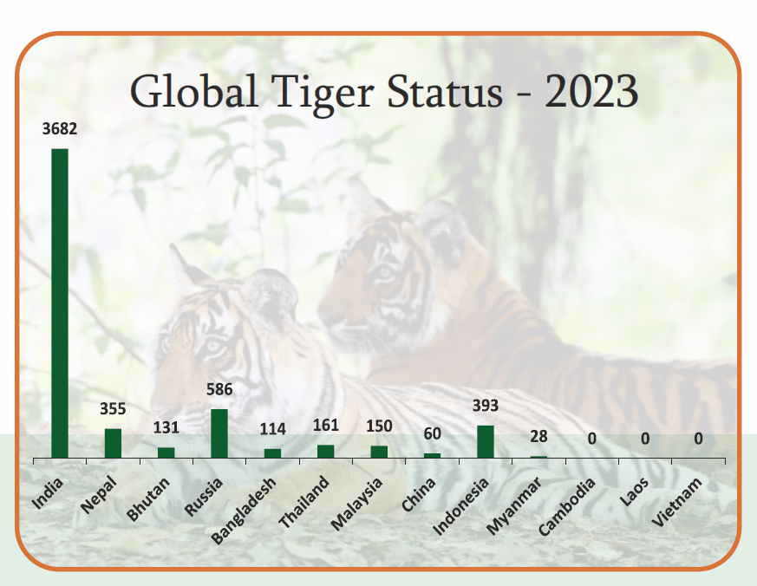
Over 100,000 tigers once roamed widely throughout Asia as recently as the early 1900s. That number is now 5600 up form a low of 3200 in 2010. Most remaining tigers are in India.
Notes:
Wilting, A., Courtiol, A., Christiansen, P., Niedballa, J., Scharf, A. K., Orlando, L., ... & Kitchener, A. C. (2015). Planning tiger recovery: understanding intraspecific variation for effective conservation. Science advances, 1(5), e1400175.

Slide 7
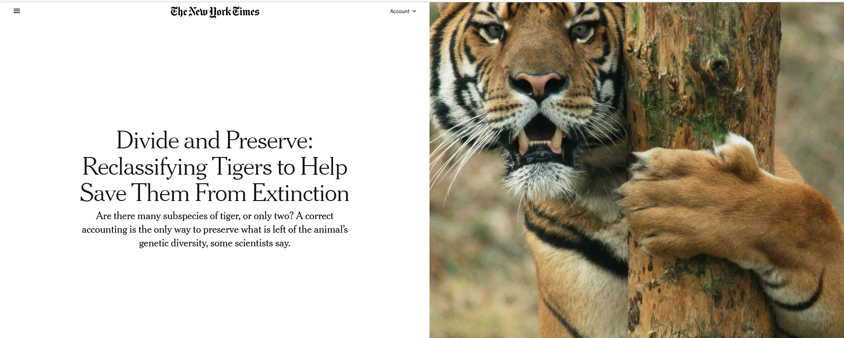
Notes:
Wilting, A., Courtiol, A., Christiansen, P., Niedballa, J., Scharf, A. K., Orlando, L., ... & Kitchener, A. C. (2015). Planning tiger recovery: understanding intraspecific variation for effective conservation. Science advances, 1(5), e1400175.
Although significantly more money is spent on the conservation of tigers than on any other threatened species, today only 3200 to 3600 tigers roam the forests of Asia, occupying only 7% of their historical range. Despite the global significance of and interest in tiger conservation, global approaches to plan tiger recovery are partly impeded by the lack of a consensus on the number of tiger subspecies or management units, because a comprehensive analysis of tiger variation is lacking. We analyzed variation among all nine putative tiger subspecies, using extensive data sets of several traits [morphological (craniodental and pelage), ecological, molecular]. Our analyses revealed little variation and large overlaps in each trait among putative subspecies, and molecular data showed extremely low diversity because of a severe Late Pleistocene population decline. Our results support recognition of only two subspecies: the Sunda tiger, Panthera tigris sondaica, and the continental tiger, Panthera tigris tigris, which consists of two (northern and southern) management units. Conservation management programs, such as captive breeding, reintroduction initiatives, or trans-boundary projects, rely on a durable, consistent characterization of subspecies as taxonomic units, defined by robust multiple lines of scientific evidence rather than single traits or ad hoc descriptions of one or few specimens. Our multiple-trait data set supports a fundamental rethinking of the conventional tiger taxonomy paradigm, which will have profound implications for the management of in situ and ex situ tiger populations and boost conservation efforts by facilitating a pragmatic approach to tiger conservation management worldwide.

Slide 8
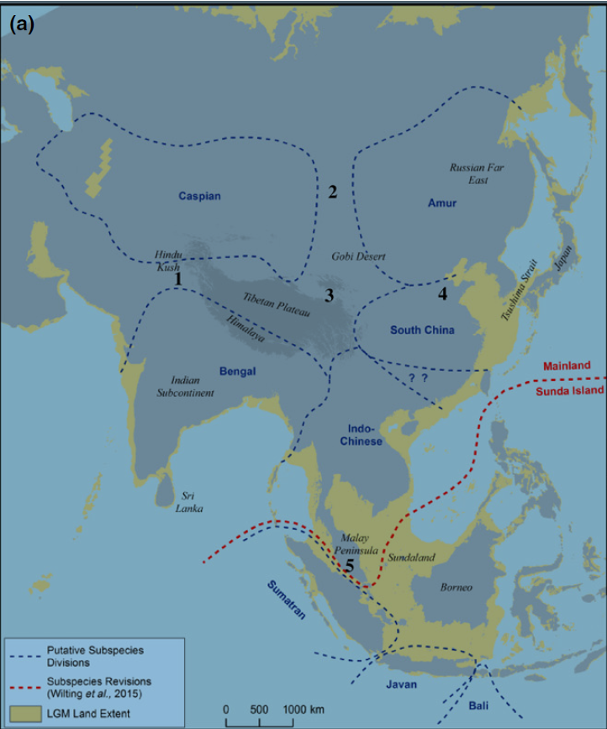
Six extant tiger subspecies
Extinct subspecies
  Bali tiger (1940)
  Caspian tiger (1970s)
  Javan tiger (1980s)
Extinct in the wild subspecies
  South China tiger (1990s)
Critically endangered
  Sumatran tiger
Endangered
  Amur (Siberian) tiger
  Indian (Bengal) tiger
  Indochinese tiger
  Malayan tiger (designated a subspecies in 2004)
Notes:
Liu, Y. C., Sun, X., Driscoll, C., Miquelle, D. G., Xu, X., Martelli, P., ... & Luo, S. J. (2018). Genome-wide evolutionary analysis of natural history and adaptation in the world’s tigers. Current Biology, 28(23), 3840-3849.
The lack of consensus over the number of tiger subspecies has partially hindered the global effort to recover the species from the brink of extinction, as both captive breeding and landscape intervention of wild populations increasingly require an explicit delineation of the conservation management units. The recent coalescence to a late Pleistocene bottleneck (circa 110,000 years ago poses challenges for detecting tiger subspecific morphological traits, suggesting that elucidating intraspecific evolution in the tiger requires analyses at the genomic scale. Here, we present whole-genome sequencing analyses from 32 voucher specimens that resolve six statistically robust monophyletic clades corresponding to extant subspecies, including the recently recognized Malayan tiger (P. tigris jacksoni). The intersubspecies gene flow is very low, corroborating the recognized phylogeographic units. We identified multiple genomic regions that are candidates for identifying the adaptive divergence of subspecies. The body-size-related gene ADH7 appears to have been strongly selected in the Sumatran tiger, perhaps in association with adaptation to the tropical Sunda Islands. The identified genomic signatures provide a solid basis for recognizing appropriate conservation management units in the tiger and can benefit global conservation strategic planning for this charismatic megafauna icon.

Slide 9
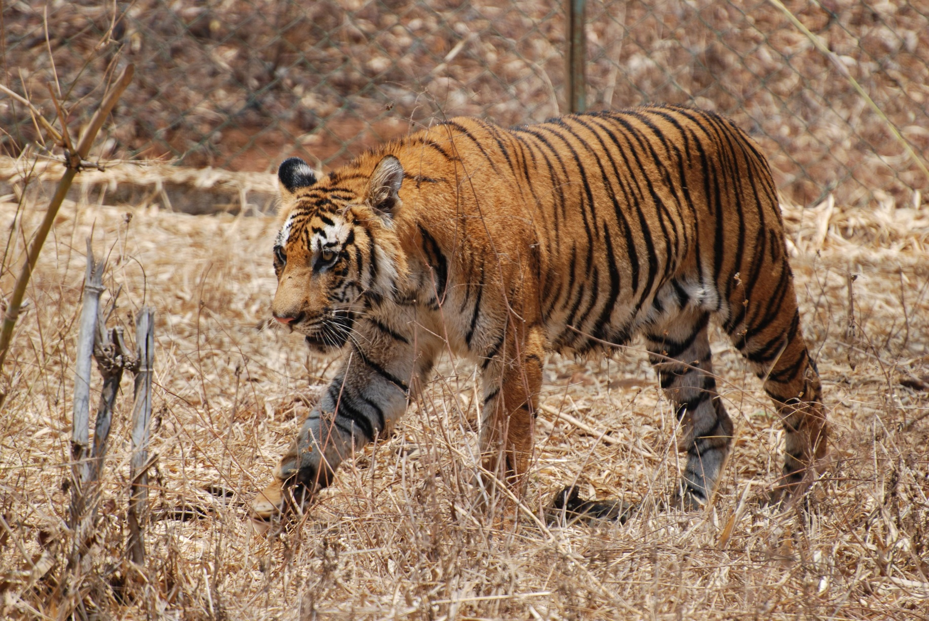
Notes:
Above, the Indian or Bengal tiger. Found in India with smaller populations in Bangladesh, Nepal, Bhutan, China and Myanmar.
Most numerous of all tiger subspecies. Classified as endangered by the IUCN Red List. India plays a vital role in the conservation of tigers since nearly 60% of all wild tigers are currently found here.
In China, all the farmed tigers and remaining tigers in the wild are Amur tigers, also known as Siberian tigers.

Slide 10
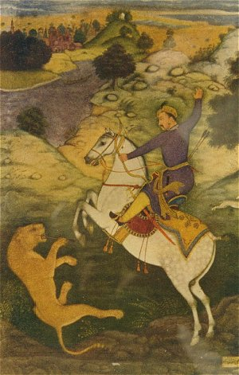
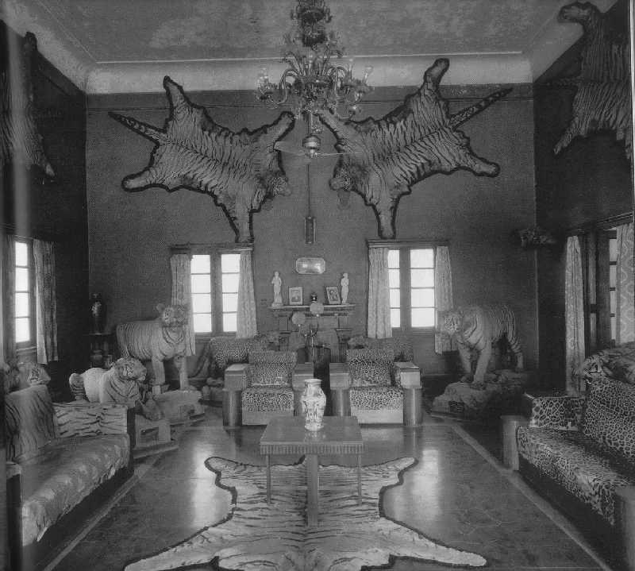
.
Notes:
Large scale hunting of Bengal tigers by Mughal rulers of India beginning 500 years ago. The British conducted tiger hunts during colonial era from 1850’s until 1947, the year India gained independence from Britain
http://voices.nationalgeographic.com/2014/03/10/a-concise-history-of-tiger-hunting-in-india/

Slide 11
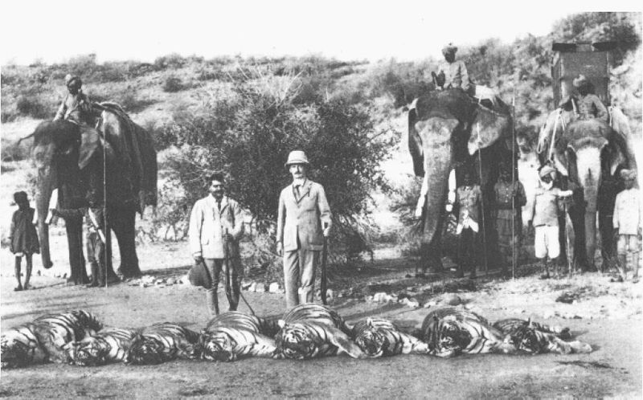
Notes:
http://vimeo.com/7586728

Slide 12
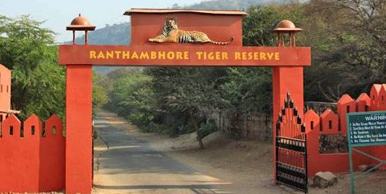
Notes:
The animals are increasingly becoming isolated in small reserves. If the cats leave the parks, the risks are rising that they will encounter humans and infrastructure, with tragic results for both the animals and people.

Slide 13
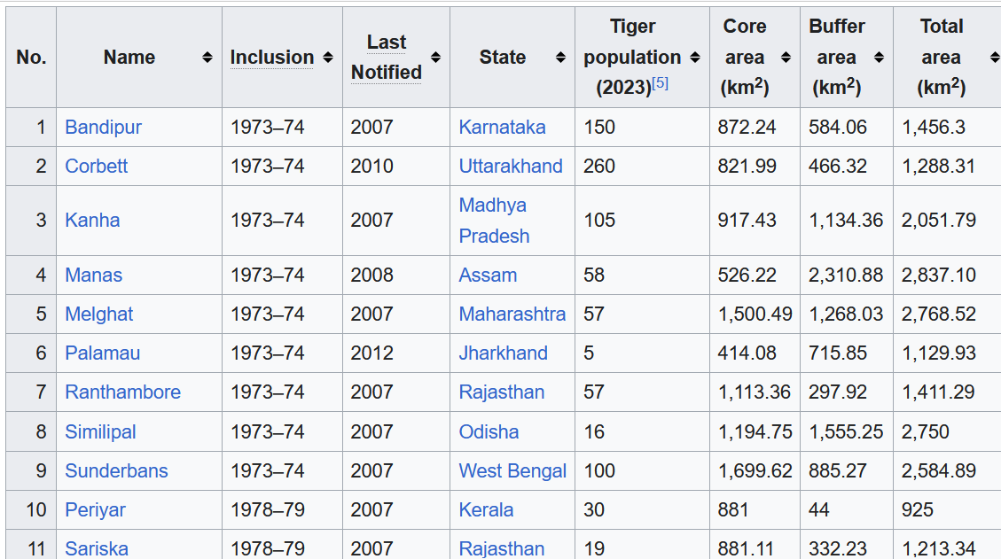
Tiger reserves of India
Set up as a part of Project Tiger initiated in 1973
As of March 2025, there are 58 protected areas that have been designated as tiger reserves.
As of 2023, there were 3,682 wild tigers in India, which is almost 75% of the world's wild tiger population.
Low of 1411 in 2006
Notes:
States in India compete for being the “Tiger State” and having the most tigers.
If you convert the kilometers to miles, you would see that many of these reserves are quite small. At the largest, 3568 km, this is approximately a 60 x 60 km area. Given that a couple of kilometers define a mile, then the largest reserve would only span an area of 25 x 25 miles. For the very smallest reserve 257 square kilometers, this would be an area of 15 x 15 km, or roughly a 7 x 7 mile area.

Slide 14
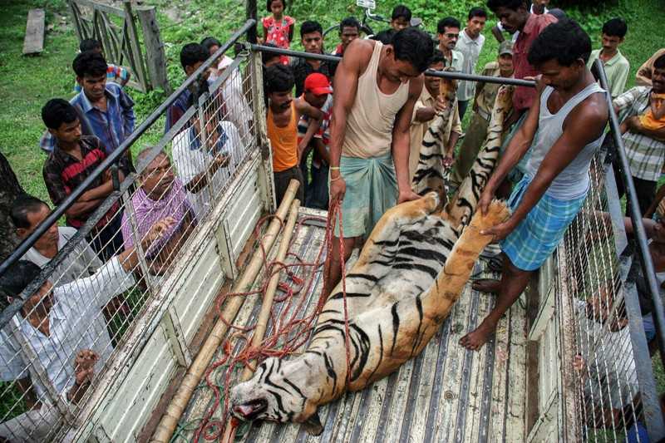
Notes:
https://www-nature-com/articles/d41586-019-03267-z
A tiger was killed trying to cross a train track near Jaldapara National Park, India

Slide 15
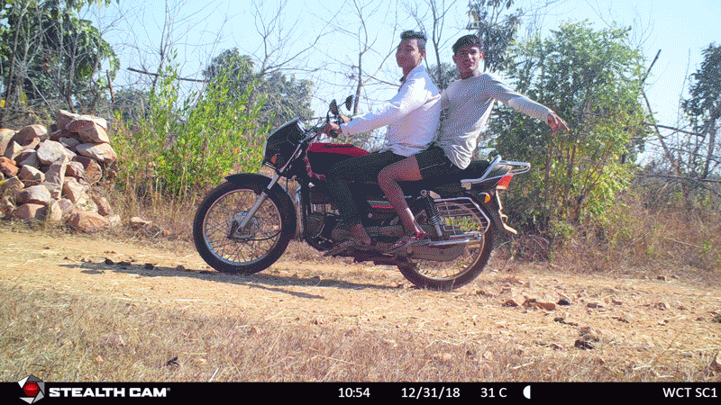
Notes:
https://www-nature-com/articles/d41586-019-03267-z
A motion-activated camera trap shows a tiger using the same path as people and livestock

Slide 16

Notes:
Tigers are far from maneaters, and go out of their way to avoid humans
However, there is a high density of people surrounding reserves. As conservation areas increase tiger populations, likelihood of attacks on livestock and humans increase. Therefore, recovery goals may bring about more conflict.
85 people per year die in India each year from tiger attacks

Slide 17
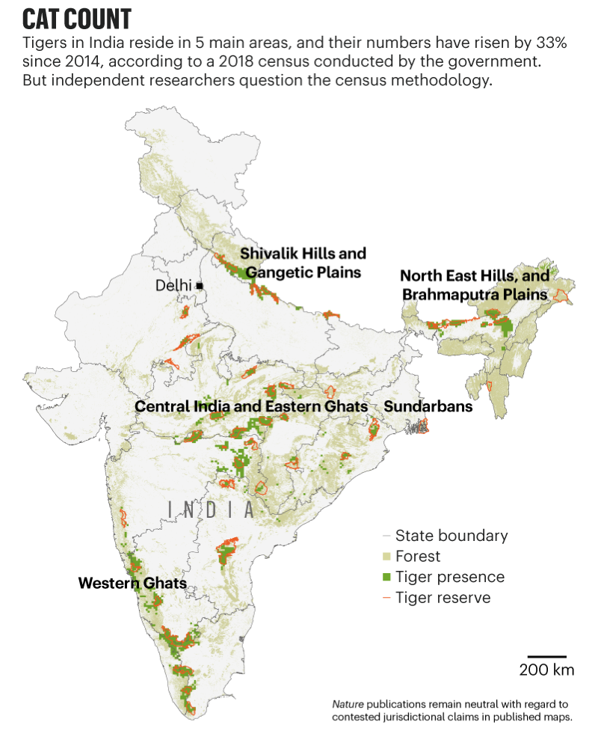

Tigers are confined to reserves that are often surrounded by a high density of people, and some may even have villages or temples inside of their boundaries
With recovering tiger populations, more risk from human-tiger encounters
Notes:
The animals are increasingly becoming isolated in small reserves that prioritize tourism. If the cats leave the parks, the risks are rising that they will encounter humans and infrastructure, with tragic results for both the animals and people.

Slide 18


Notes:
Pro-tiger sentiments strong in rich countries
In some cases, it has been shown that the numbers were so exaggerated as to be biologically. Not a single tiger survived in Sariska Tiger Reserve, despite government claims that 18 tigers lived there. When three men were later arrested, they described how easy it was to kill them.
In paper parks there may be only a partial enforcement of bans on use of the park for resources so as to lessen local political conflicts.
Tiger conservation in India has long depended upon funds from international conservation organizations. These can exert considerable influence on Indian politics
This power that more powerful economic actors exert on the environmental policies can be a form of green neocolonialism. Numbers of tigers may be exaggerated because
of political pressure from outside as well as inside India

Slide 19
Paper parks
  Tiger conservation in India has long depended upon funds from international conservation organizations
  These can exert considerable influence on Indian politics
  This power that more powerful economic actors exert on the environmental policies can be a form of green neocolonialism
  Numbers of tigers may be exaggerated because of political pressure from outside as well as inside India
Notes:
In some cases, it has been shown that the numbers were so exaggerated as to be biologically. Not a single tiger survived in Sariska Tiger Reserve, despite government claims that 18 tigers lived there. When three men were later arrested, they described how easy it was to kill them.
In paper parks there may be only a partial enforcement of bans on use of the park for resources so as to lessen local political conflicts.

Slide 20


In the Sundarbans region of of India and Bangladesh, breeding programs have increased tiger numbers, but at the cost of human fatalities
Tiger fatalities are often revenge killings
Notes:
A successful Royal Bengal tiger breeding program has increased their numbers but decreased the number of husbands. There are now an estimated 3,000 widows in the villages where their husbands, have been killed by tigers

Slide 21

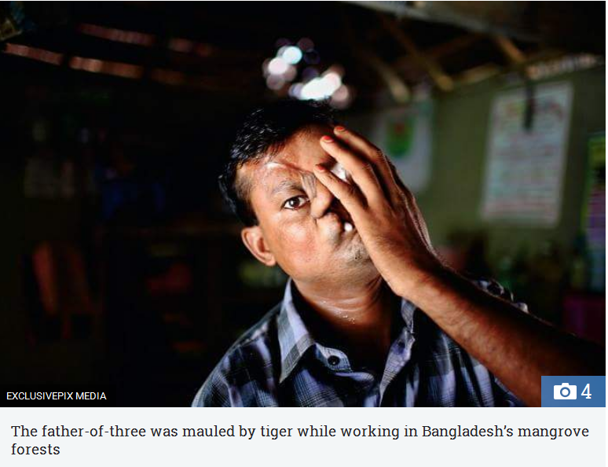
Notes:
Approximately 85 people are killed or injured - accidentally or otherwise - in a year by tigers in India. The burden of living with tigers and lions is often born by rural poor
http://www.thenational.ae/news/world/south-asia/the-tiger-widows-of-the-sundarbans

Slide 22
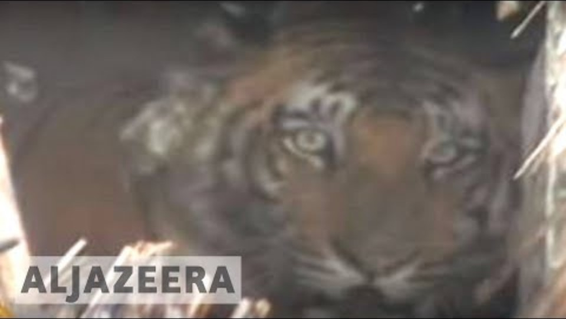
Notes:
https://youtu.be/A7TG4SIy3dg?si=sEot-CiabUEDF2F7
Killings are not purely retaliatory in nature (i.e. driven by a desire for retribution following livestock depredation or attacks on humans by tigers), and that previous negative experience of tigers is not the sole determinant of villagers’ acceptance of killing behaviour. Inter-related socio-psychological factors (risk perceptions, beliefs about tigers and the people that kill tigers, general attitude towards tigers), perceived failings on the part of local authorities whom villagers believe should resolve village tiger incidents, perceived personal rewards (financial rewards, enhanced social status, medicinal or protective value of tiger body parts), and contextual factors (the severity and location of tiger incidents) motivate people to kill tigers when they enter villages and foster the widespread acceptance of this behaviour. The complexity of these factors highlights the need for conservation practitioners to explore and understand people’s motivations for killing endangered carnivore species, in order to address better the community-led killing of these animals. Knowledge of these motivational factors can be used to develop conservation actions suitable for developing both communities’ capacity and, crucially, desire to co-exist with tigers and to respond with non-lethal action to village tiger incidents.

Slide 23
Solutions promoted in the Sundarbans
Address crowd formation behavior (tiger attacks can be a defensive behavior in response to being surrounded by people)
Tiger proof houses and livestock pens
Address development issues and enhance social capital
Provision of solar electricity grids (nighttime lighting may thwart tigers and enhance their detection)
Build village capacity to respond to tigers through non-lethal means
Empower villagers to organize and respond on their own rather depending solely upon officials

Slide 24
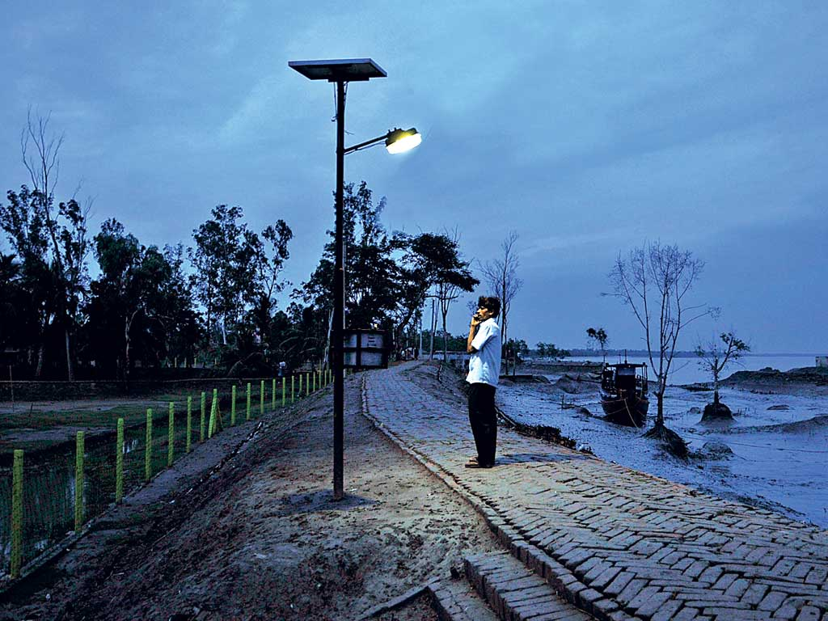

Slide 25

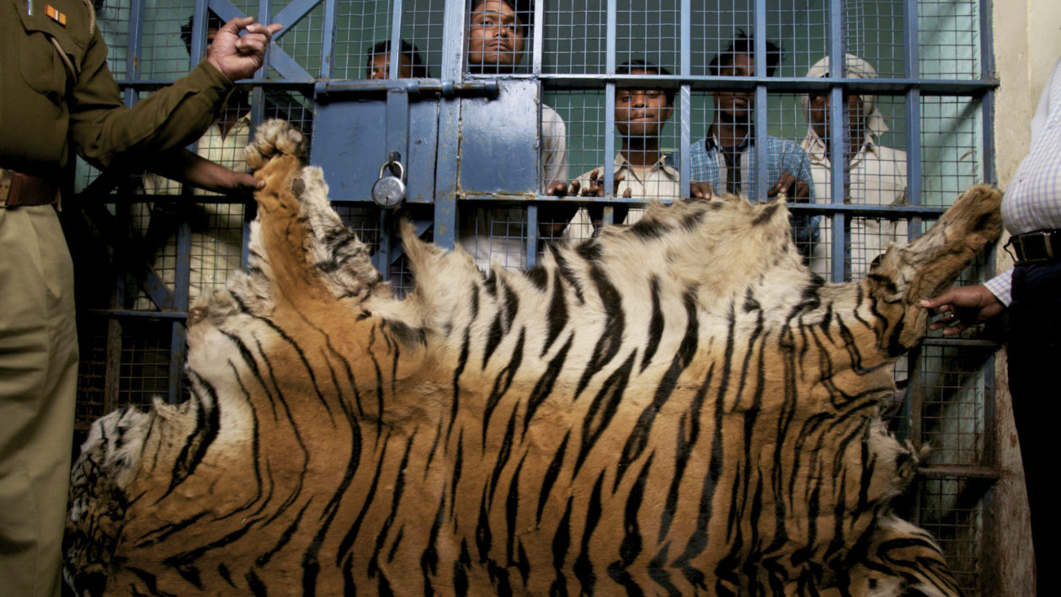
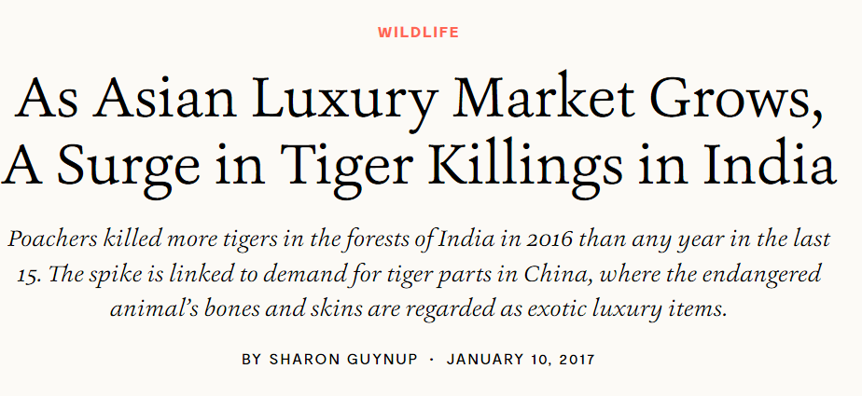

Slide 26
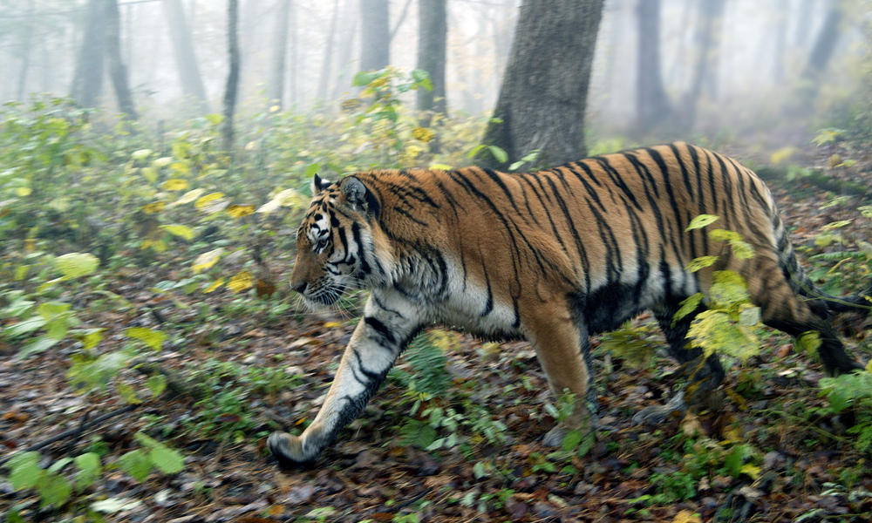
Amur or Siberian tiger
Notes:
The largest tiger subspecies, up to 660 pounds and 10 feet in length.
Amur tigers were once found throughout the Russian Far East, northern China, and the Korean peninsula. By the 1940s, hunting had driven the Amur tiger to the brink of extinction—with no more than 40 individuals remaining in the wild. By the 1980s, the Amur tiger population had increased to around 500. Although poaching increased after the collapse of the Soviet Union, continued conservation and antipoaching efforts by many partners—including World Wildlife Fund—have helped keep the population stable at several hundred individuals. The Amur tiger’s habitat is now restricted to the Russian Far East, and to small pockets in the border areas of China and possibly North Korea.
Amur tigers represent the largest unfragmented tiger population in the world, but there are fewer of them than Indian tigers.

Slide 27
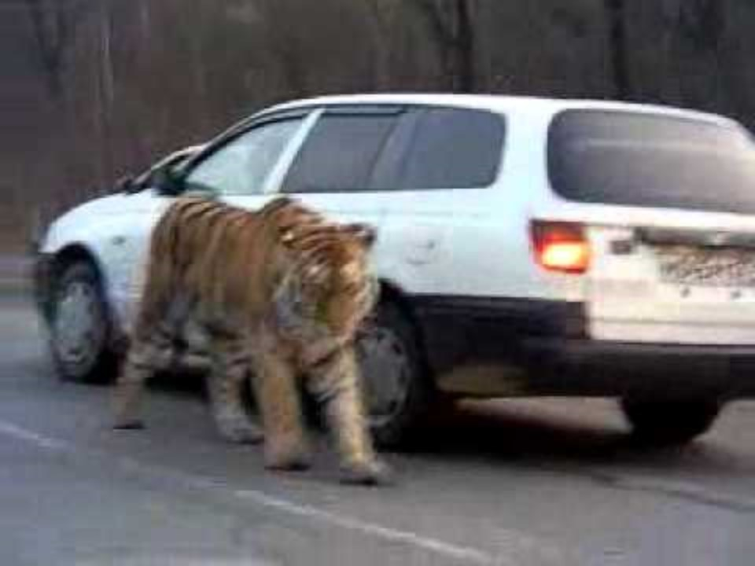
Notes:
Pressure from poaching and habitat fragmentation have diminished the population of Amur tigers (also called Siberian tigers) to fewer than 500. In the study, a team of scientists from the US and Russia show that canine distemper virus infected and caused fatal neurological disease in members of this critically endangered species. They estimate that the virus has killed at least 1% of Amur tigers since 2009. Normally a reclusive species, tigers have been seen entering villages and wandering onto roads in the Russian Far East, stumbling, emaciated, and unafraid of humans.
http://blogs.scientificamerican.com/extinction-countdown/2014/11/06/canine-distemper-siberian-tigers/
http://journals.plos.org/plosone/article?id=10.1371/journal.pone.0110811

Slide 28
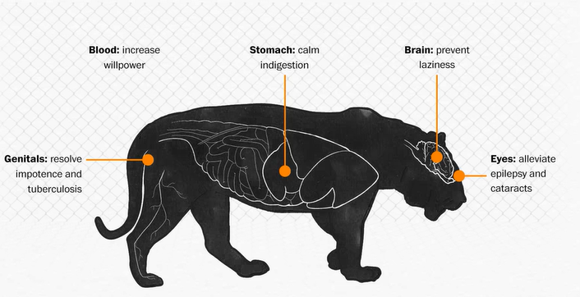

Slide 29
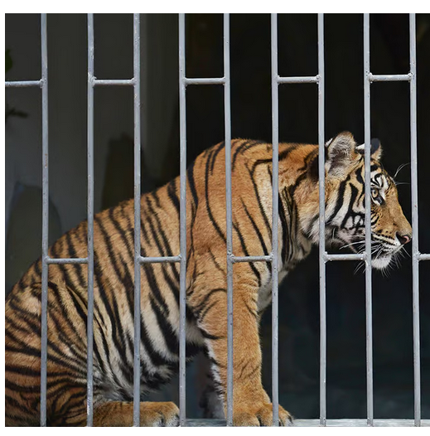
In 2022 estimated 300 – 500 Amur tigers in Russian Far East with small number ranging into China and possibly North Korea.
China has 6000 captive tigers in over 36 facilities, many are tiger farms that use their body parts in folk medicines and other products.
Trade and consumption of tiger parts is illegal, but tiger farming continues to operate grey legal zone

Slide 30
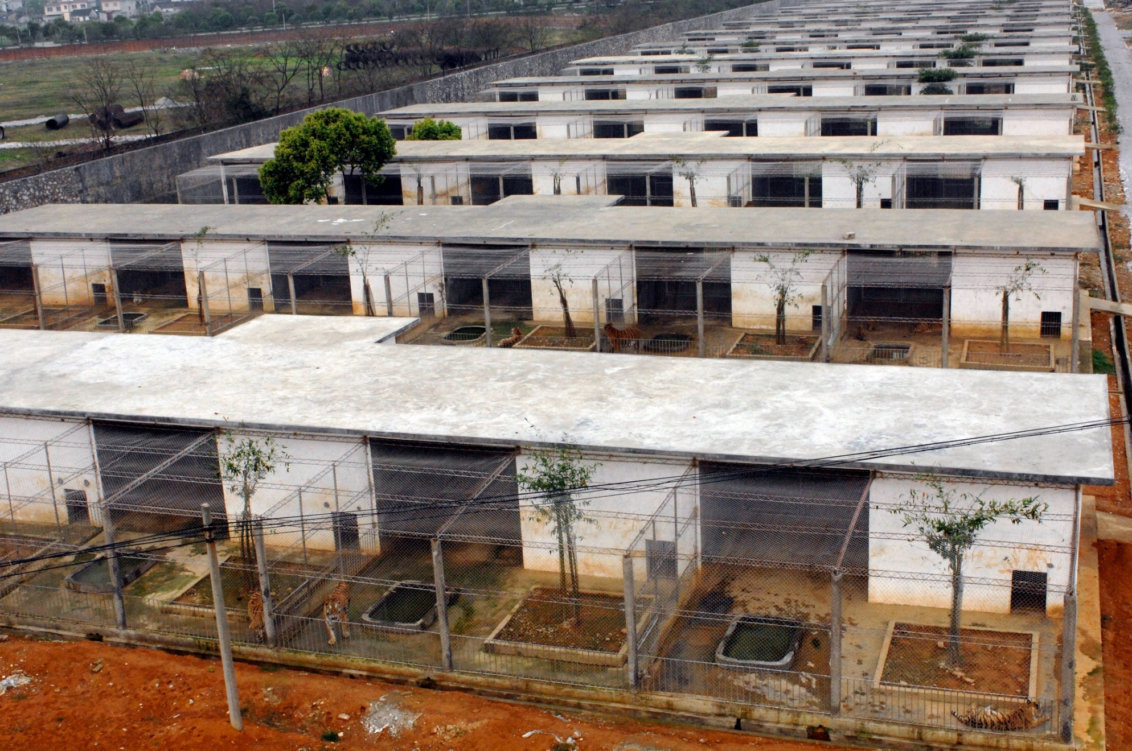
Notes:
Response by Chinese: farm the animals, breed them in captivity for release into the wild or to harvest for the market to take pressure of wild populations, as with this Chinese tiger farm shown above. Farm tourism can be used to raise money for habitat conservation. Farmed animals can be released and hunted on sanctioned hunts.

Slide 31
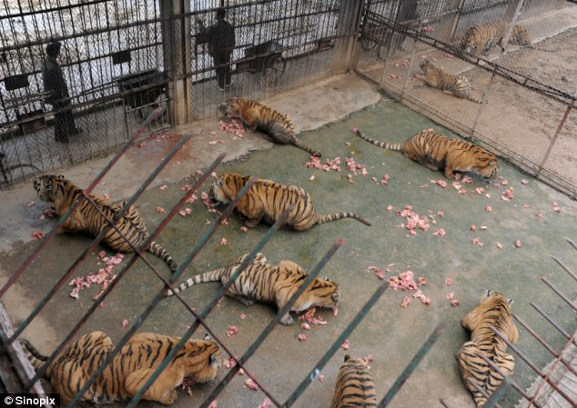
Notes:
10 – 25 pounds of food per day, dollar a pound, $25/day, $250 a day for the 10 tigers in this scene
Chinese state media reported that dozens of endangered tigers and other animals died from malnutrition at the Northern Forest Zoo in the city of Harbin. Disenfranchised workers leaked the story to the media, revealing a mass gravesite for tigers, lions and leopards. Workers had buried them in a 10-foot deep pit order to avoid getting caught by authorities. In March another report had surfaced of 11 rare Siberian tigers starving to death at the Shenyang Forest Wild Animal Zoo in northeast China.

Slide 32
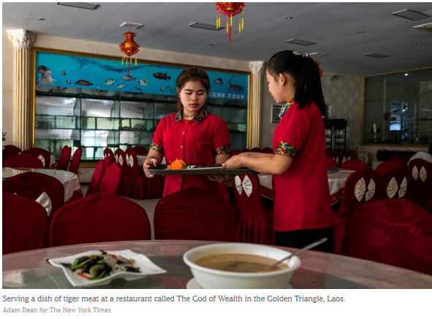

Slide 33
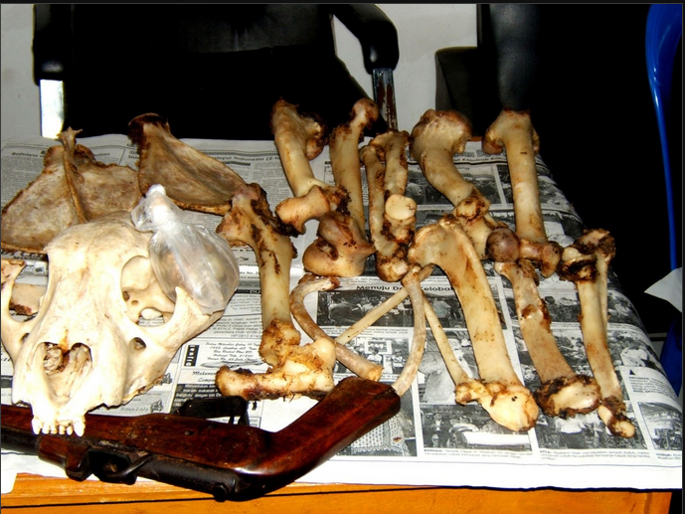
Notes:
Set of tiger bones worth as much as $7,000

Slide 34
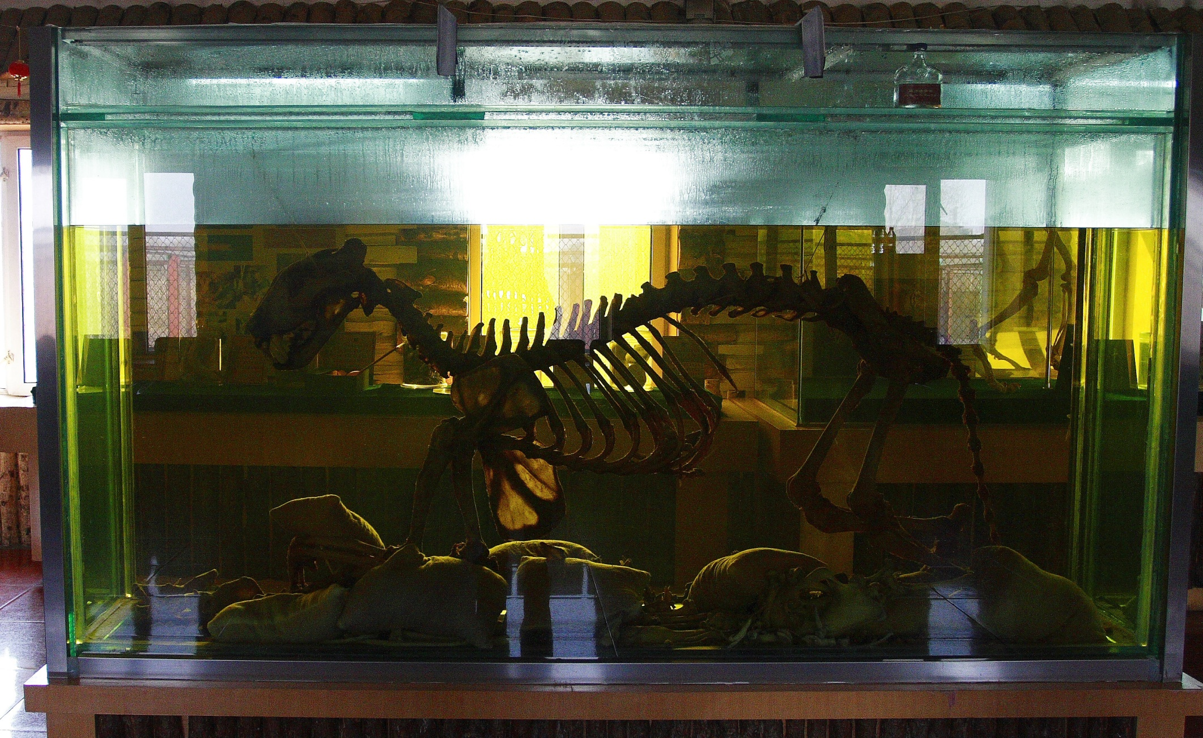
Notes:
Tiger bone wine, made by steeping tiger bones in huge vats of potent 38 per cent-proof rice wine

Slide 35

Traditional Chinese medicine
  Has historically used tiger parts but sparingly
  No medical evidence found for the curative powers of tiger parts
  Trade in tiger parts illegal today but tolerated in China
  What accounts for growing demand for tiger parts in China?
Photo of traditional Chinese medicine store. These are common in China and in Chinese communities and neighborhoods throughout the world
Notes:
Photo of traditional Chinese medicine store
http://www.jcm.co.uk/endangered-species-campaign/tiger/use-in-traditional-medicine/

Slide 36



Slide 37
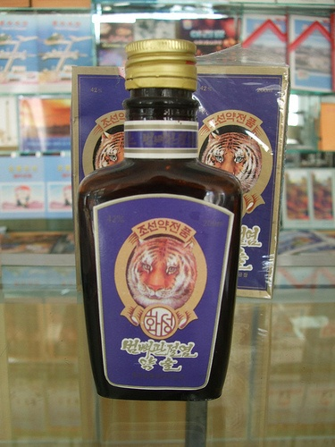
Economic globalization and conspicuous consumption
Due to China’s recent economic ascendance over the past several decades, the newly affluent have extra income to spend
New medicinal uses of tiger parts (tiger wine, shampoo, and soup) socially constructed as traditional Chinese medicine

Slide 38
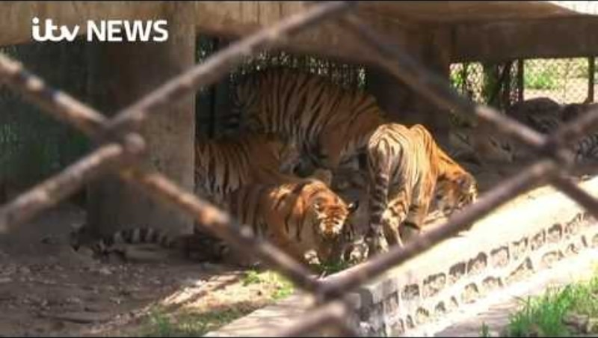

Slide 39
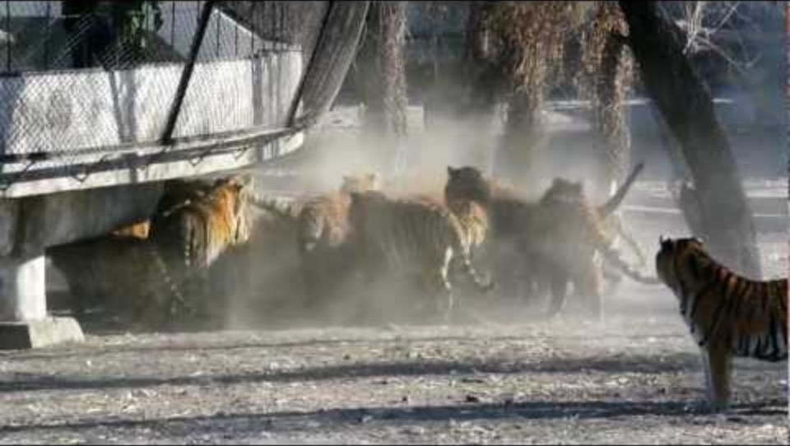
Notes:
http://www.youtube.com/watch?v=uHmcsJ0DaOk
Zoos are used more as a profit-making enterprise, and the revenues are not widely used to enhance conservation.

Slide 40
Arguments for (pro) and against (con) Chinese tiger farming
Pro: takes pressure of wild populations
Con: farming may maintain or even enhance demand
Con: if demand grows, hunting of wild tigers may increase, as it still cheaper to hunt a wild tiger
  $15-20 to pay poachers to kill a wild tiger versus much higher farm costs
Con: wild animals may be preferred over captive animals for medicine - thought to be more potent
Notes:
A simple cost analysis of wild versus farmed tiger parts indicates that it would cost at least US$4000 to raise a tiger to adulthood in captivity and as little as $15–$20 to poach a wild tiger. Even allowing for the costs of transporting wild tiger products to end markets and occasional losses to enforcement action along the way, the cost of producing farmed tiger parts would clearly be far higher, perhaps even by a factor of 10. This gross discrepancy would offer substantial economic incentives for poachers and smugglers to undercut farmers in any legal market, despite the risks associated with being caught and penalized. Furthermore, consumers of traditional Chinese medicine (TCM) prefer products made from wild individuals, believing they are more potent than farm-raised ones. These, therefore, can command a significantly higher price—as demonstrated in the bear-bile market
You could argue that these breeding farms will take the pressure off wild animals. This is the argument for crocodile farms, which produce meat and skin. But the reality is that farms maintain demand for the animal parts, yet cannot cope with any surge in demand. If this happens, the temptation will be to satisfy it by hunting — putting pressure on wild populations. There are millions of crocodiles in the world, but only a few thousand tigers. So farming tigers not only encourages the capture of wild animals for breeding but also stimulates demand for the products. With so few tigers left in the wild, it would only take a small increase in demand to push them over the edge into extinction.

Slide 41
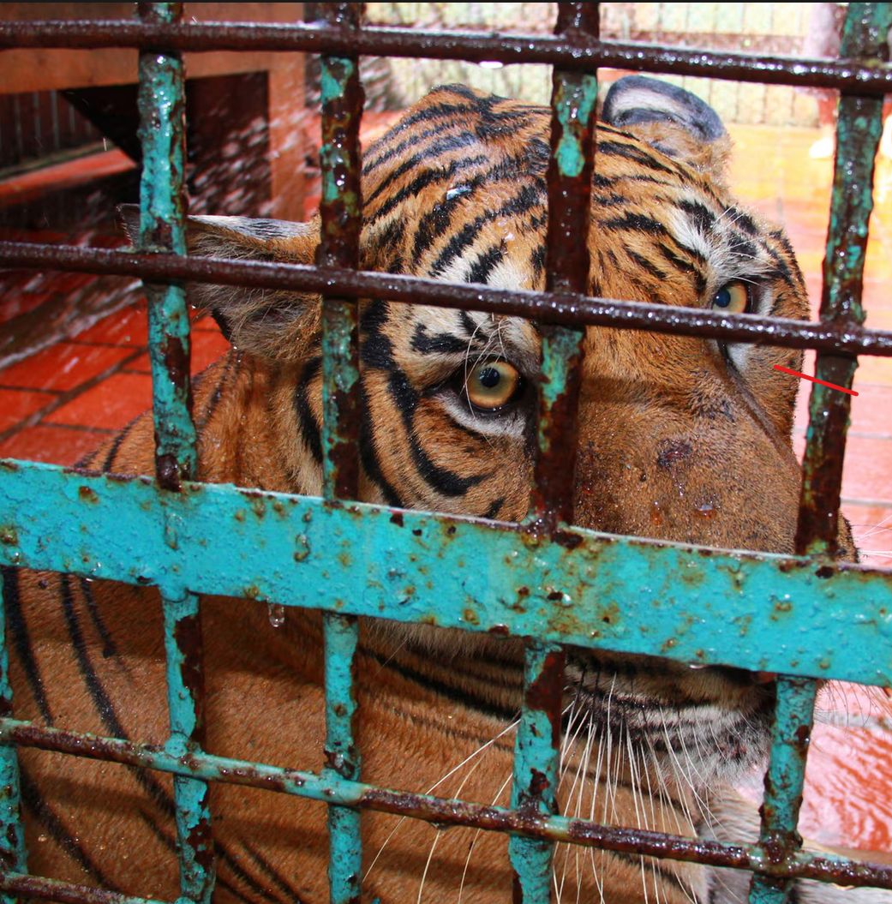
Other criticisms of tiger farming
Suffering of animals
Has not met conservation goals or introduced tigers in the wild.
Tigers mate freely on farms. Breeding facilities are not member of the international stud book for Siberian tigers, which includes almost all US and European zoos.
Promotes investing in extinction
Notes:
There is a need to manage the genetics of these populations

Slide 42
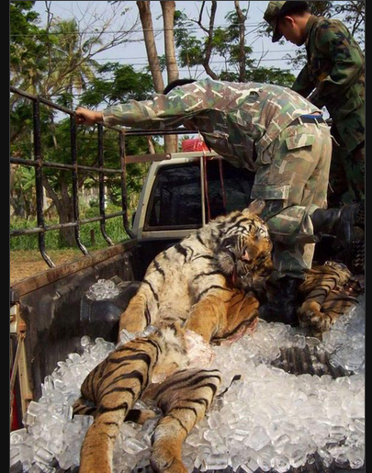
Investing in extinction
  Farms and investors may be buying up and stockpiling tiger parts
  They are anticipating rarity and the potential to profit from it
  Stockpiling may encourage further poaching as others want to invest

Slide 43
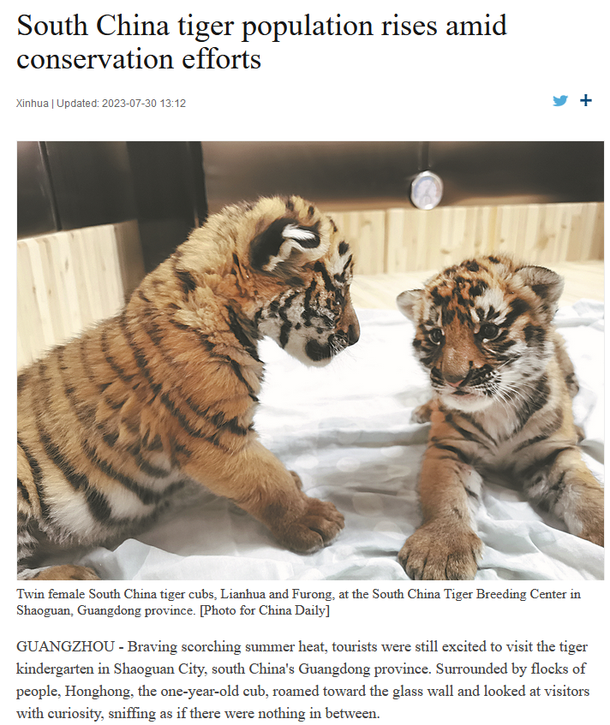
Changes in the tiger trade
Tiger farms now outsourced to neighboring countries like Laos
Conservation-oriented attitudes toward tiger in China now coexist with the economic, utilitarian ones associated with tiger farming
Recent declines seen in the consumption of wildlife in urban populations in China
Notes:
Zhang, L., & Yin, F. (2014). Wildlife consumption and conservation awareness in China: a long way to go. Biodiversity and Conservation, 23, 2371-2381.
An attitudinal survey on wildlife consumption and conservation awareness was conducted in Beijing, Shanghai, Guangzhou, Kunming and Nanning of China recently. Comparison with the results from a similar survey we did in 2004, after 8 years, the proportion of respondents who had consumed wildlife was dropped slightly from 31.3 % down to 29.6 %. It showed that the rates of wildlife consumed as food and as ingredients for traditional medicines in Guangzhou and Nanning ranked in the top. The consumptions in these two cities were mostly driven by utilitarian motivation, and mainly for food. Meanwhile, the rate of consumers taking wildlife as food was declining significantly in Beijing after 8 years. The results also showed that 52.7 % agreed that wildlife should not be consumed, which was significantly increased comparison with the survey result of 42.7 % in 2004. In addition, respondents agreed that wildlife could be used significantly decline from 42.8 to 34.8 %. It’s indicated that wildlife conservation awareness was raised in China in the past years. We also found that consumers with higher income and higher educational background were having higher wildlife consumption rate. It suggested that to strengthen the law enforcement and to promote the public awareness were keys to reduce wildlife consumption in China

Slide 44

Proposed national park for Siberian tigers in China
Notes:
https://e360.yale.edu/features/china-carves-out-a-park-for-the-imperiled-siberian-tiger

