Slide 1
Terms
algorithmic nature
ecological anxiety disorder
shifting baselines
loss of stationarity
sympoeisis
posthumanism
anthropomorphism
anthropocentrism
anthropomorphism
biocentrism
speciesism
intrinsic value
instrumental value
biophilia hypothesis
non-human labor
rewilding
Notes:
Where animals are is not just a matter of biological distribution, but an interaction between animals, individuals, and society as they work out the place of animals. Where we find animals, how we envision our place relative to them is fluid and changes across time and through space.

Slide 2
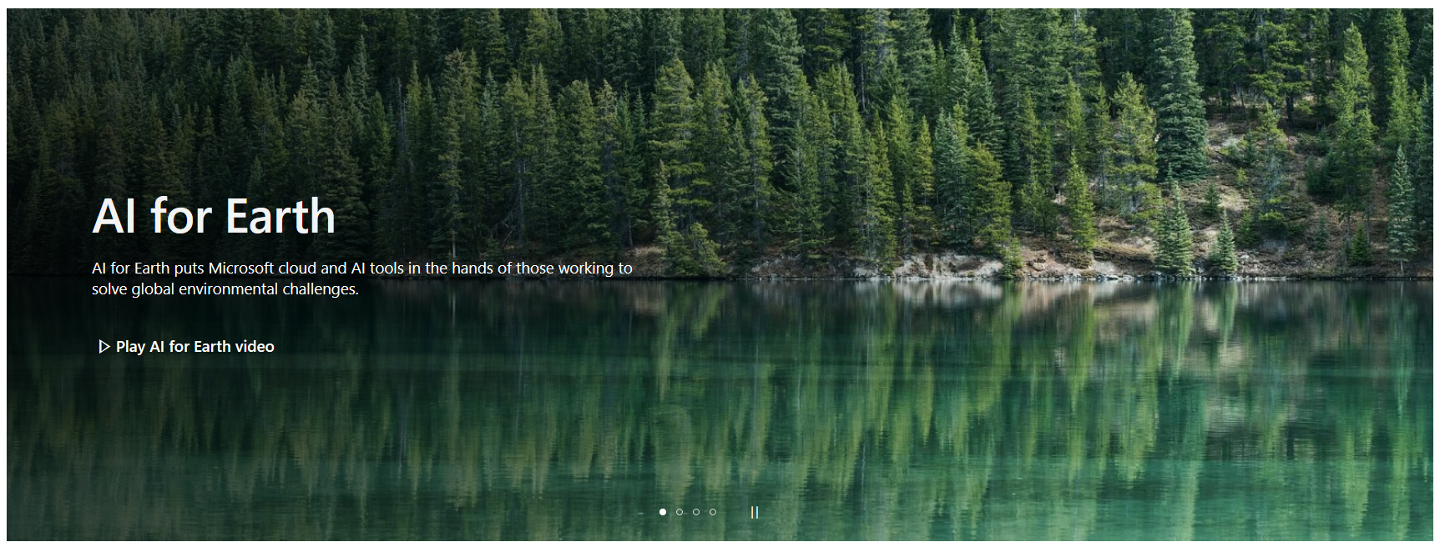
Algorithmic nature
The nature that results through the use of artificial intelligence, modeling, and computer vision to inform ecological and conservation decision making.

Slide 3
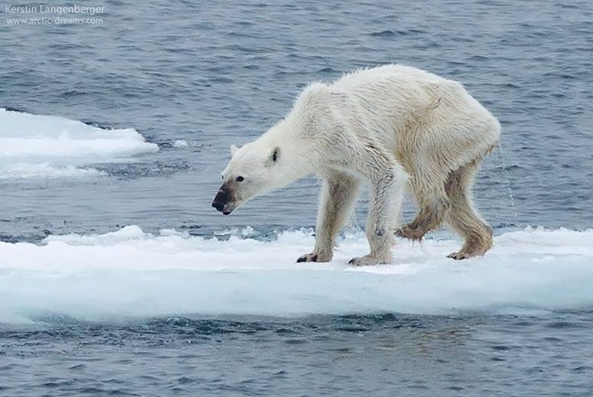
Cognitive externalization
We think and problem solve not just through internal cognition. We use images and representation of the world to help us think, knowingly and sometimes subconsciously
Photos and filmic representations of nature become part of how we conceptualize and problem solve
These are cognitive externalizations, ways of thinking based on what is around us instead of what is just in our brains
Notes:
Humans are prolific users of external props and visual aids

Slide 4
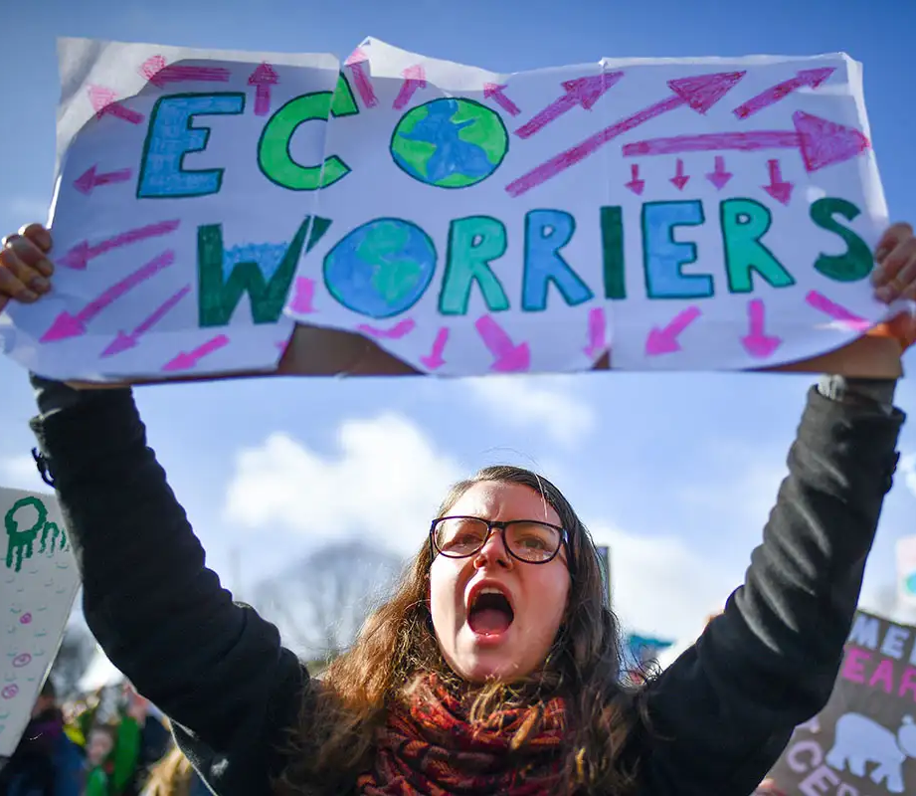
Ecological anxiety disorder
A chronic fear of environmental doom
An anxiety arising due to the recognition of loss and irreversible change in nature, compounded by the growing dominance of far less familiar ecologies of global change
Another example would be climate grief over anthropogenic climate change.
Notes:
Tension is due to a ‘edenic’ conservation mindset that seeks to preserve the past versus with the growing recognition that ecosystems today are increasingly novel and not likely to resemble the past

Slide 5
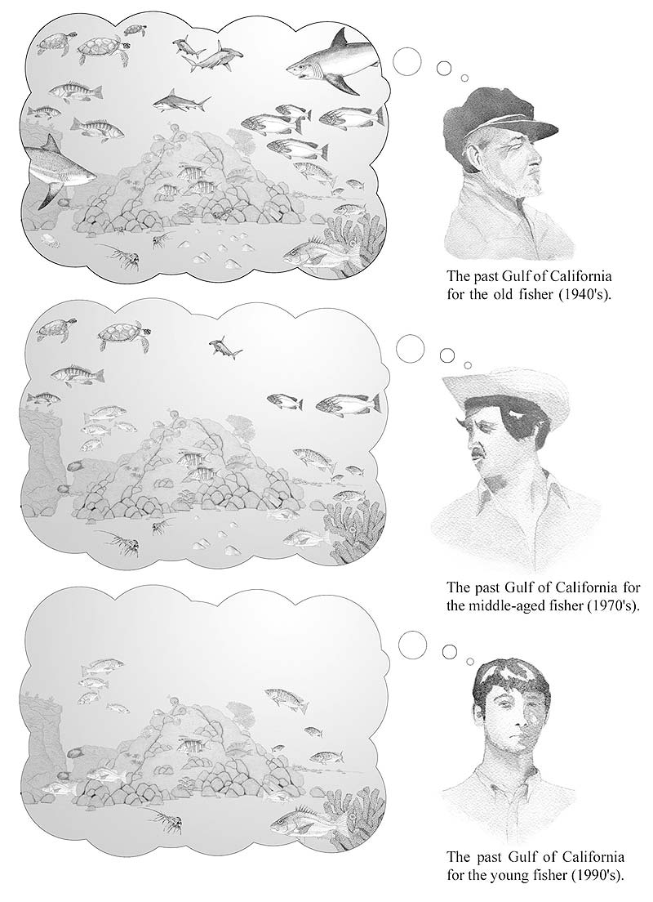
Shifting baselines
The idea that successive generations of humans have a diminished comprehension of what was ‘normal’ or a ‘baseline’ compared to their parents, and their parent’s parents.
Notes:
The young fisher at the bottom has no experience of the fishery from the time of his grandfather. What is normal to this young person would be very different from what would be normal to the grandfather. The baseline has changed.

Slide 6
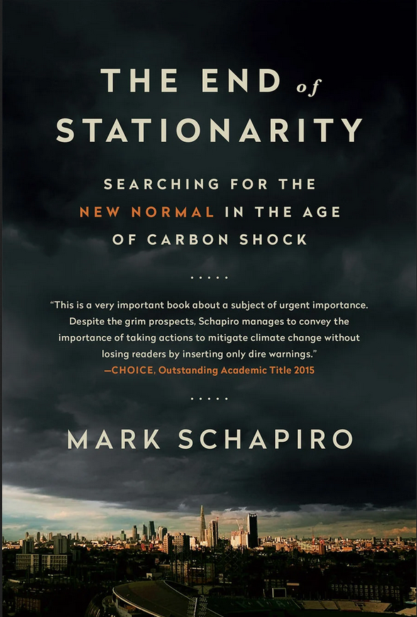
The end of stationarity
The idea that as humans have altered the biosphere, many of the ecological and climatic processes that once had a degree of predictability around an average or mean no longer do
  The past is often used to predict the future in many aspects of society. For example, farming, electrical demand, and oil prices are often anticipated based on climatic averages
  With the lost of stationarity, the past can no longer be as useful of a guide for the future.
Notes:
There has been an ‘expulsion from history’, the loss of the historic range of variability in weather, climate, and ecological processes

Slide 7
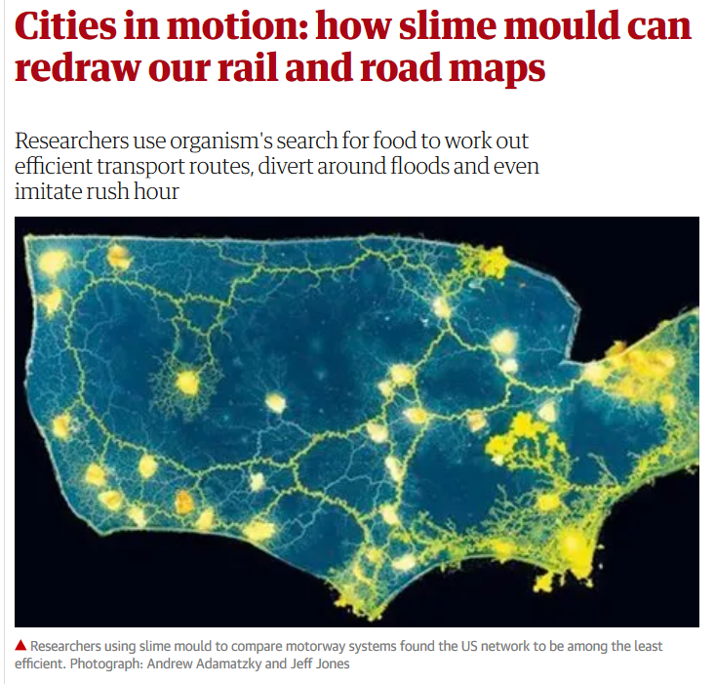
Biomimicry
Encompasses the imitation of the models, systems, and elements of nature for the purpose of solving complex human problems.
Algae, bacteria, trees possess traits and processes that can improve and innovate existing human systems
Notes:
However, some aspects of biomimicry are criticized for furthering the economic forces that destroy nature and threaten us.
https://www.theguardian.com/cities/2014/feb/18/slime-mould-rail-road-transport-routes

Slide 8
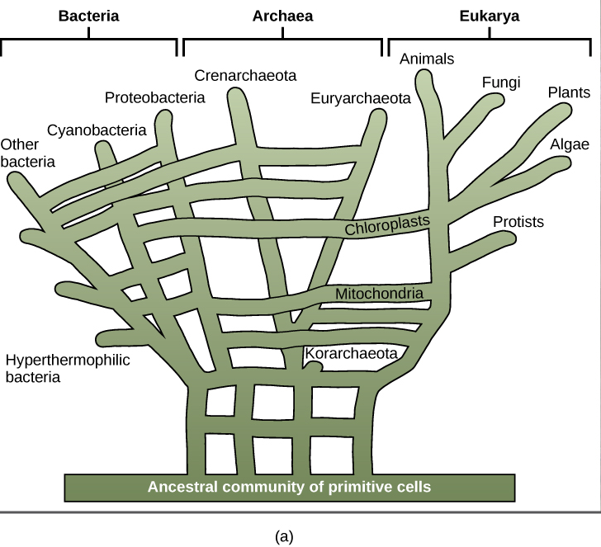
Sympoiesis
The idea that there are no completely distinct and separate biological individuals.
Instead, humans and other organisms, arise and exist as composites of many life-forms living and developing together
All organisms are composed of the bodies and genetic traces left by other organisms in our evolutionary history
For example, 10% of the human genome is made of benign even beneficial bits of virus DNA. Human bodies have 10X more bacterial cells than human cells
Notes:
Instead of a tree of life, we have a web of life

Slide 9
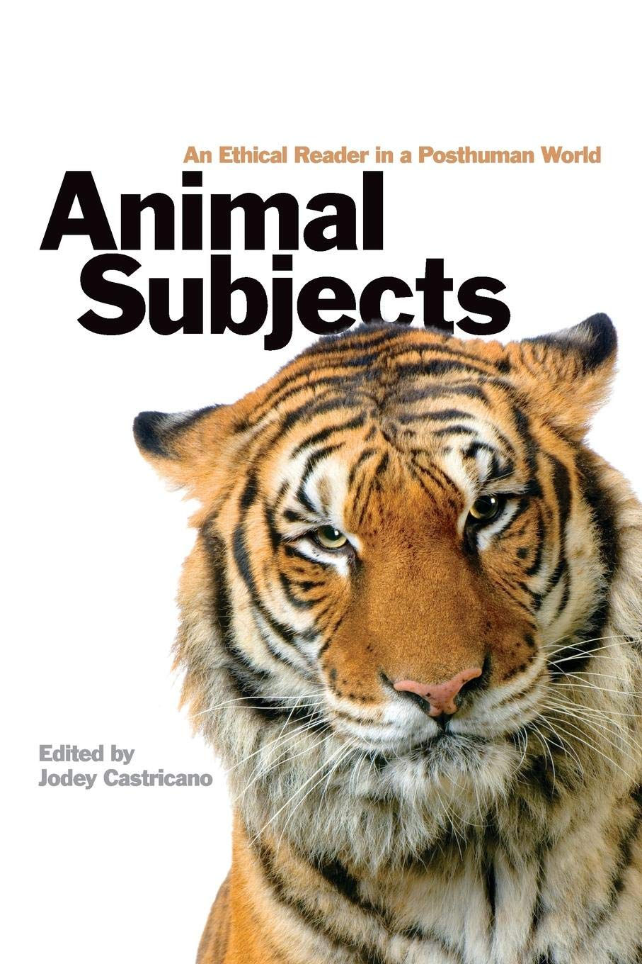
Posthumanism
A humanist perspective frequently assumes that only the human is autonomous, conscious, intentional, and exceptional in acts of change
Posthumanism holds that this view is too anthropocentric, or human-centered.
Posthumanism aims to diminish this human exceptionalism
Non-human organisms participate in an analogous kind of existence and are deserving of recognition and rights that come with it.

Slide 10
Panpsychism
The view that thought is fundamental and ubiquitous in the natural world.
All living organisms, including such brainless ones as plants, slime molds, and bacteria, exhibit at least a certain degree of sentience, cognition, decision making, and will
Implies the independence of all living entities from our comprehension of them
These entities value themselves, and differentially value whatever other entities they may happen to encounter.

Slide 11
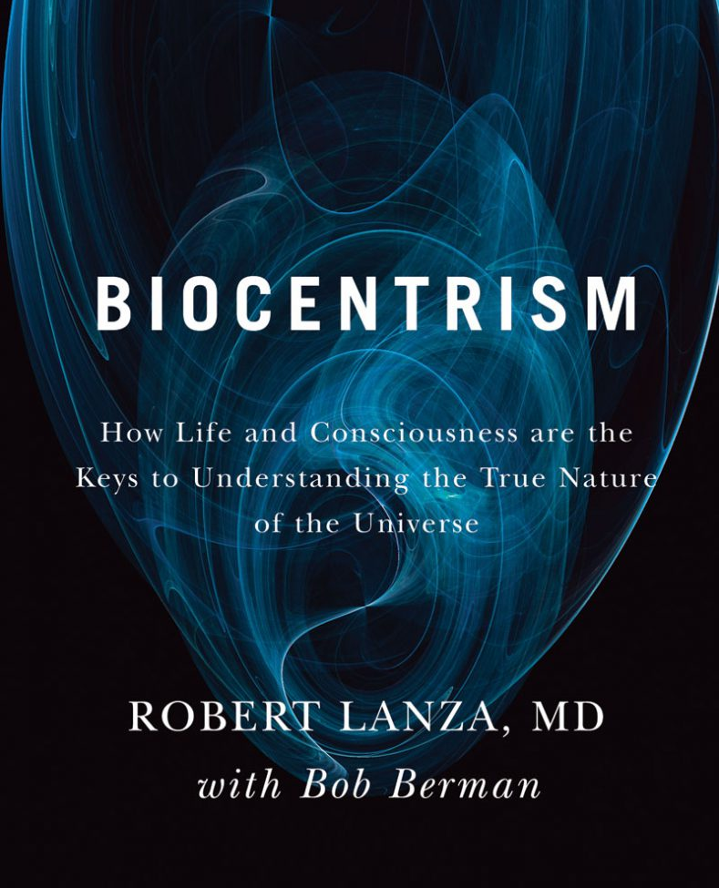
Biocentrism
View of the world in which biology is the origin of perception
  Color, sound, temperature exist only as perceptions in our head, not as absolute essences.
  This strand of biocentrism holds that the universe comes to form by the presence of life and not the other way around.
  Everything perceived by all organisms is actively and repeatedly being reconstructed by their senses and nervous system
Notes:
https://www.discovermagazine.com/the-sciences/the-biocentric-universe-theory-life-creates-time-space-and-the-cosmos-itself

Slide 12
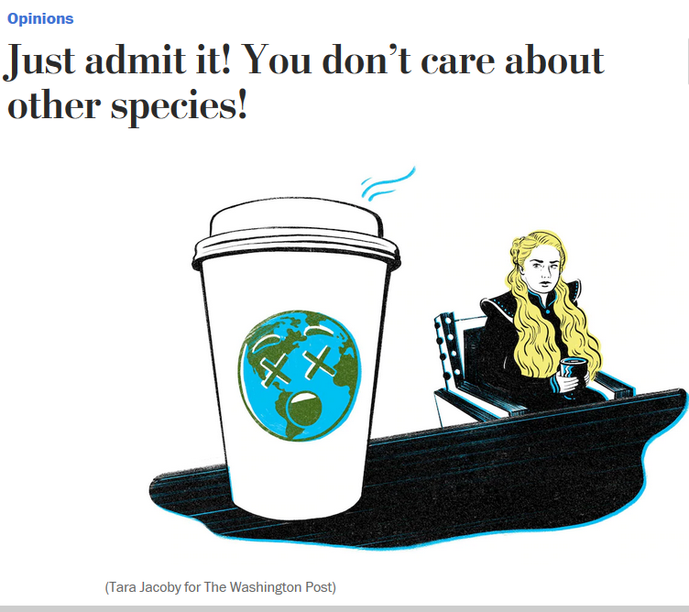
Speciesism
Giving different sentient beings differing moral consideration for unjust reasons.
When any organism is given less moral consideration than others or treated worse for an unjustified reason.
If someone accuses you of being speciesist, it means you are to degrees unresponsive to the situation of non-human organisms on Earth

Slide 13
Anthropomorphism
A form of personification in which human characteristics are ascribed to animals and inanimate objects
On the one hand, this is part of how we form bonds with other organisms. We bring them into our circle by attributing human likenesses to them
However, this can lead to an inaccurate understanding of biological processes in the natural world, such as trying to adopt a wild animal as a pet or misinterpreting the actions of a wild animal.
It can also lead us to see the world only in terms of how it relates to us, thereby diminishing the intrinsic value of other organisms.
Notes:
Inanimate objects such as cars, food products, brand logos can be animated to have likenesses to humans. This causes us to relate to them in a different way – like they were alive and like us. This distracts us from their true ecological costs to make.

Slide 14
Anthropocentrism
Anthropocentrism is the belief that value is human-centered and all other beings are means to human ends.
Anthropocentrism can be beneficial in that it helps distinguish between legitimate and illegitimate human interests. For example, since ecosystems constitute the life-support system for humans, anthropocentrism is a powerful motivation for environmental protection.
However, anthropocentrism can promote human behaviors that ignore the risks they pose to the planet.
Notes:
https://link.springer.com/article/10.1007/s10806-018-9711-1

Slide 15
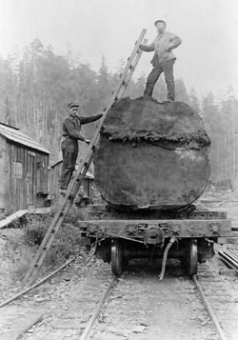
Instrumental value
Value of other life forms is predicated upon how it benefits humans materially
Instrumental value can vary across human cultures and societies
Notes:
https://www.ncbi.nlm.nih.gov/pubmed/24033598

Slide 16
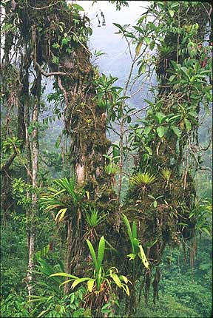
Intrinsic value
Value of other life forms exists on its own, independent of human uses.
Non-human life forms have value even if they do not directly or indirectly materially benefit humans.
Notes:
Valuing biological diversity on the basis of an intrinsic value system also poses challenges because intrinsic value can be seen as a disguised form of human extrinsic value

Slide 17
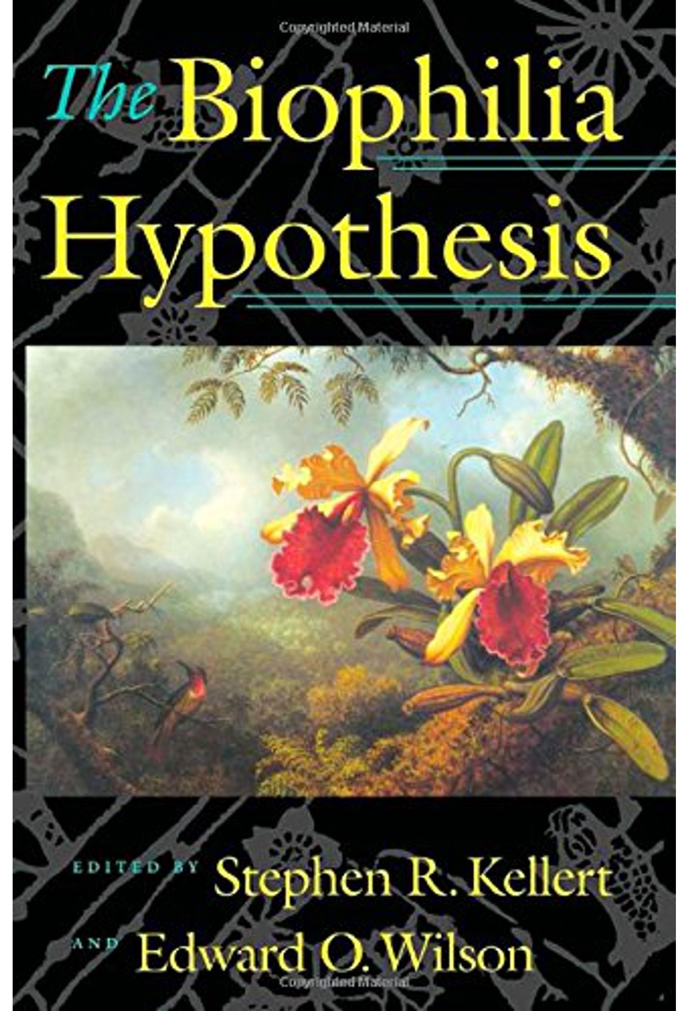
The biophilia hypothesis
Biophilia is the love of life , the deep emotional affiliations humans have with other life forms and nature
The biophilia hypothesis suggests that humans possess an innate tendency to seek connections with nature and other form of life.
It is an urge to affiliate with other forms of life rooted in our biology and evolution
Notes:
Example on how a love of life sustains life: Love of flowers and plants reflects their longstanding significance as sources of food. For our ancestors, it was crucial to spot, detect and remember the plants that would later provide nutrition. This dependence has evolved into a human liking of plants and especially flowers, as this is where fruit develops

Slide 18
Non-human labor
Recognizes how non-human animals promote human well-being through their role in ecosystem services, as companions, as objects used as both raw materials and as processors of raw materials, and directly as labor.
To increase efficiency, those seeking to use organisms as capital have to find a way to reduce the agency of these non-human life forms, whether they are bacteria or livestock
This dominance and power-based relationship hinders recognition that the work of nature is a collective, distributed undertaking of humans and nonhumans acting to reproduce, regenerate, and renew a common world.
Notes:
Animals are treated more like machines or raw materials with predictable characteristics for the production of biological products than as independent organisms with distinct characteristics

Slide 19
Rewilding
Restoration of ecological functions that ceased when the organisms that provided them went extinct
Most typically applied to large mammals, or megafauna.
Rewilding of the central North American grassland plains would involve introducing large herbivores and carnivores to create the ecological functions that existed prior to their extinction approximately 20,000 years ago
Proposals have been made to introduce African wildlife in similar North American habitats to ‘rewild’ North America and make it resemble the past in terms of function

