Slide 1
Terms
glocalization
shock city
economies of scale
spatial fix
game theory
zero sum game
non-zero sum game
hegemony
race to the bottom
Homo economicus
behavioral economics

Slide 2
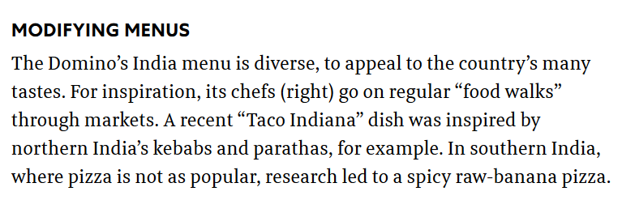
Glocalization
It is a simplification to assume globalization is simply homogenization
Impacts of globalization are often mediated through national and regional policies
Glocalization denotes how the global and the local are intertwined
Example: the glocalization of fast food
Notes:
For example, obesity and diabetes has a common biological basis among all humans. However, we can’t assume that a global one-size-fits-all approach to preventing and treating diabetes works everywhere. Circumstances of diet, access to health care, level of physical activity required at work, population genetics that determine susceptibility will vary from place to place and culture to culture. So the global epidemic of obesity and diabetes is global, but it is also local, or glocalized

Slide 3
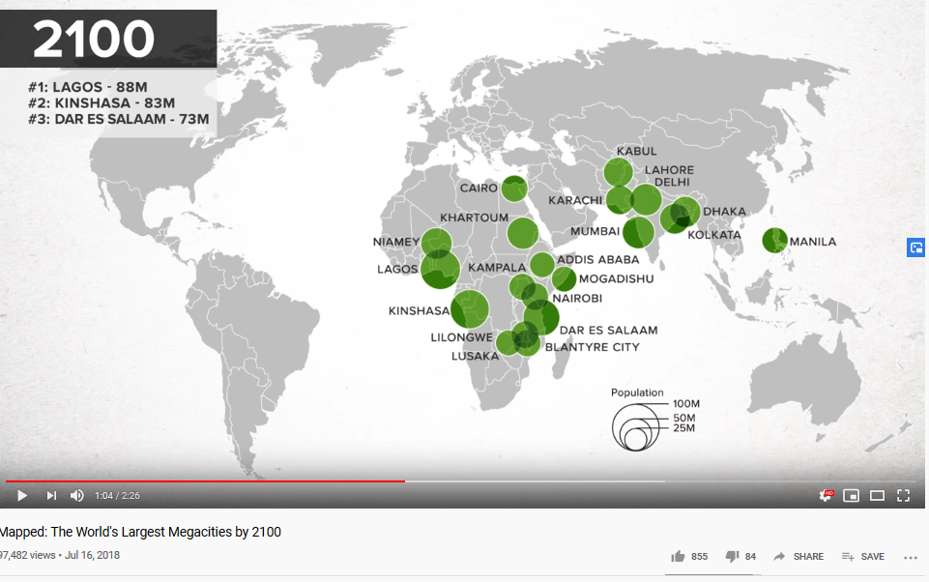
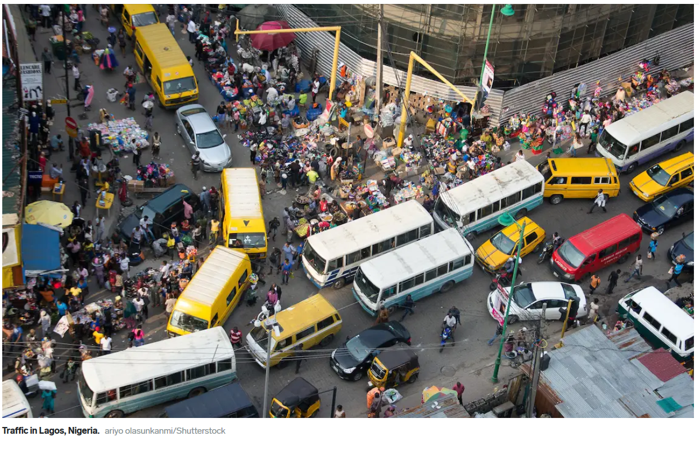
Shock city
A city with significant symbolic meaning as related to spectacular growth and technological advancement, but also newly emerging political, social, and economic problems that have few precedents.
Manchester, England during the Industrial Revolution was a shock city – its growth and new social issues (pollution, economic class differences) were new for that time
By 2100, many of the new shock cities will be in Africa

Slide 4
Economies of scale
Economies of scale are cost reductions that occur when companies increase production. The fixed costs, like administration, are spread over more units of production.
In other words, it is potentially more profitable to produce a large output once the infrastructure and production management is in place
Economies of scale give a competitive advantage to large entities over smaller ones. The larger the business, non-profit, or government, the lower its per-unit costs.
McDonalds and Amazon, for example, can offer low prices because of the large number of items they are able to produce and move from producer to consumer.

Slide 5
Spatial fix
Capitalism often depends upon a place and the proximity of resources around it, while the infrastructure (buildings and equipment) may be relatively fixed.
However, it will alter that space thru pollution, thru the consumption of natural resources, or by the demand for higher wages brought on by increased affluence
Business entities thus have to enact a “spatial fix”, a way ofusing space to renew the accumulation of wealth
Examples: outsourcing production where there is cheap labor and inexpensive natural resources or relocating where environmental laws are less strict or where you can pay workers less.

Slide 6
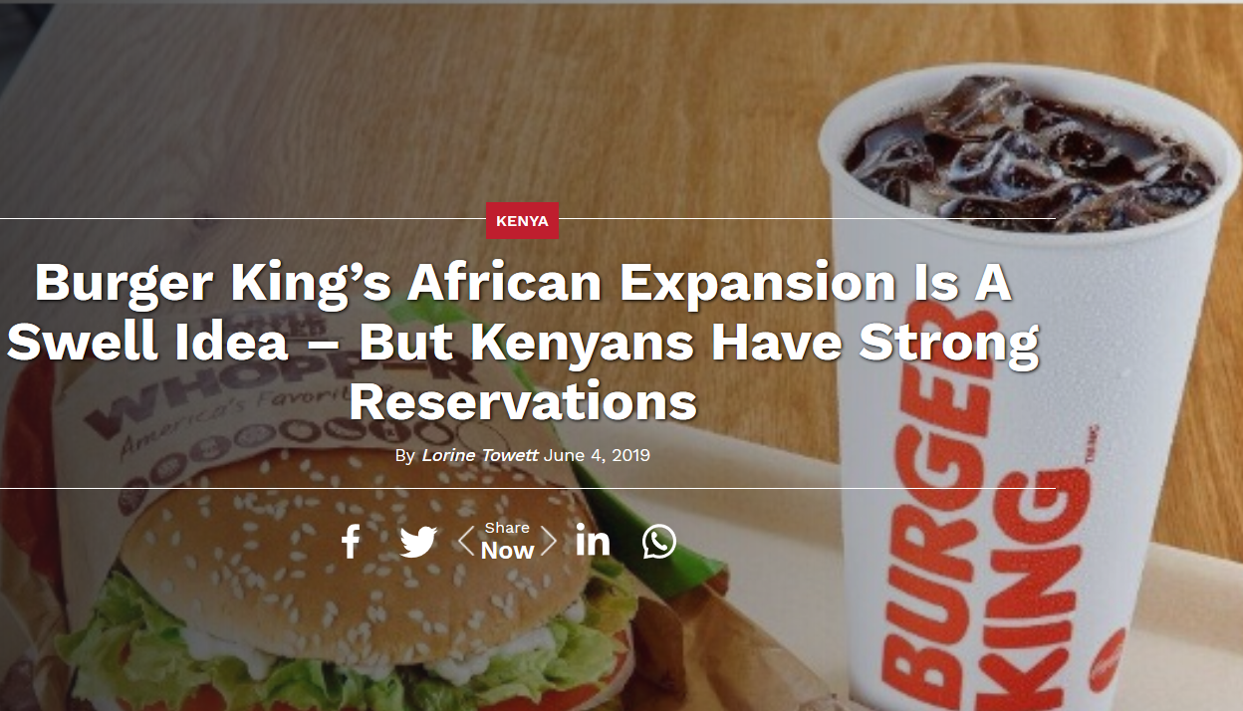
Opening up new markets can also provide this spatial fix.
Capitalism cannot not survive without being geographically expansionary and perpetually seeking out “spatial fixes” for its problems

Slide 7
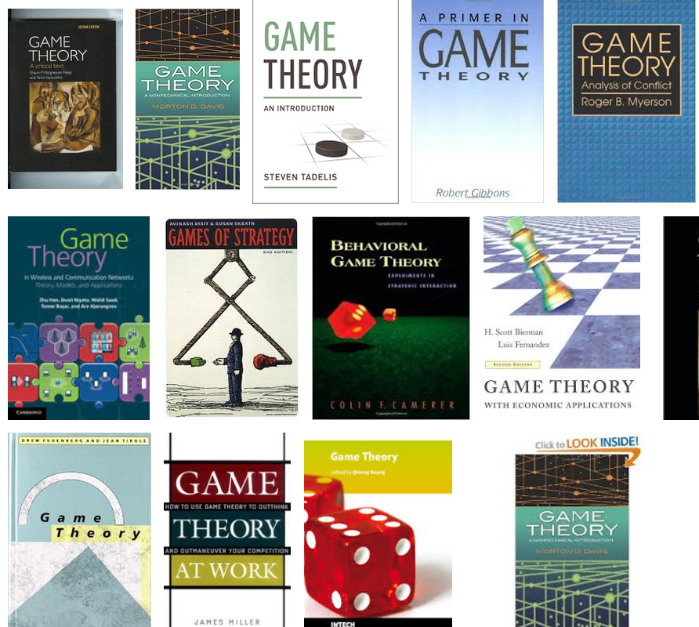
Game theory
Game theory developed out of US-USSR Cold War politics after World War 2
Countries sought to anticipate and counter opponent’s actions and propaganda
Game theory aims to understand and predict why individuals or groups cooperate (or defect, cheat, or punish)
As applied to globalization, it is the way in which companies and individuals try to anticipate their competitor’s strategies

Slide 8
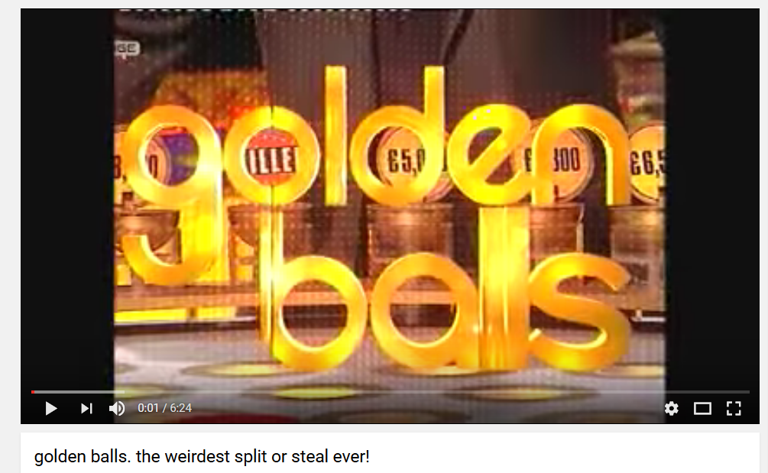
Any kind of game or competition, real or an actual game, invokes the strategies of formal game theory strategies
Golden Balls was a television show from Britain the illustrates how tricky and complex negotiations can be. Whether to trust, defect, cheat, or cooperate was built into the game.
With global economics and politics, similar types of strategizing are undertaken to try to understand what your choices and the choices of those around you will yield.

Slide 9
Two main types of games
A zero-sum game is a situation in which each participant's gain or loss is exactly balanced by the losses or gains of the other participants. No overlap of interests. An example are sports – gains for one are losses for the other
A non-zero sum game the players interests overlap, what is good or bad for one is good or bad for all. Gains for one can be gains for another, and losses for one can be gains for the other.

Slide 10
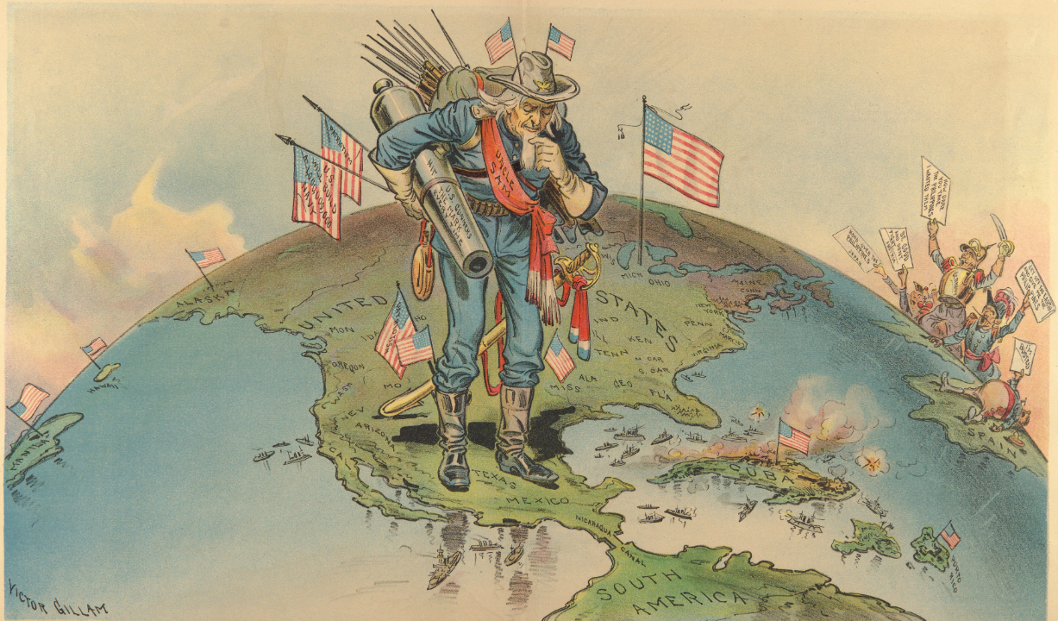
Hegemony
The position of being the strongest and most powerful and therefore able to control others, a term often applied to countries
The US has been in a position of hegemony for much of the last one-hundred years.

Slide 11
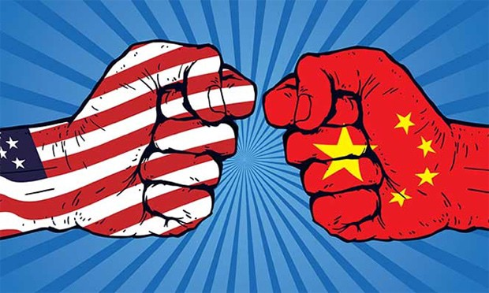
The status of the US as hegemonic global power is now challenged by other countries of the world, including China
Hegemonic is often used in a negative sense. To be hegemonic is to dominate and dictate the terms that shape the lives of others.

Slide 12
Race to the bottom
The race to the bottom refers to a competitive state where a company, state or nation attempts to undercut the competition's prices by sacrificing quality standards or worker safety, defying regulations, or paying low wages.
As each party aims to undercut the competitor, through time this leads to downward trend in prices, but also standards, safety, and wages.
What is good for an individual company is not necessarily good for everyone else
Notes:
https://obeygiant.com/prints/race-to-the-bottom-letterpress/
The problem with a race to the bottom is you might win. Or worse, finish second.

Slide 13
Homo economicus
Construct used by economists and those studying how humans behave in economic systems
It assumes that humans always seeks to maximize profits and minimize costs. We only act "rationally," and rationalism is defined as always seeking to maximize profits and minimize costs. “Profit" is often assumed to mean "monetary profit" measurable only in dollars (or some other currency).
Although useful, this concept downplays the complexity of human decision making and is considered fallible and an insecure foundation to base all economic theories upon.

Slide 14
Behavioral economics
Branch of economics which takes a more realistic psychological view of human economic behavior than the Homo economicus perspective
Humans do not have perfect knowledge – their rationality is bounded.
The economic choices they make reflect emotion and bias.
Why we buy certain cars over others, why some people save money and other spend, why we will pay more certain brands – these are all outside of the purview of the Homo economicus model
Notes:
https://www.youtube.com/watch?v=FHAhaUMmNlU

