Slide 1
Terms
central place theory
cultural hearth
formal, functional and perceptual regions
topophilia
toponym
edge cities
boomburbs
ethnoburbs
landscapes of exclusion
exurbia
sprawl
greenbelt
urban growth boundary
infill
financialization of housing
Great Recession of 2008
slumburbia
Great Migration
White Flight
blockbusting
The Great Inversion

Slide 2
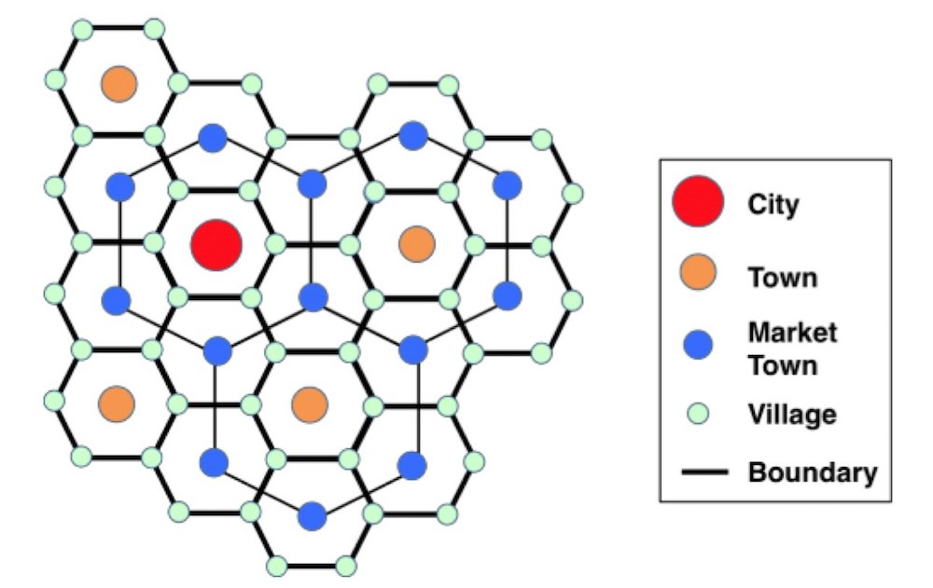
Central place theory
Theory that aimed to explain the reasons behind the spatial arrangement, size, and number of towns and cities
Developed by the German geographer Walter Christaller in 1933.
Assumptions were simplistic, but it was one of the first studies to theorize about the processes of urban geography.
Notes:
Very orderly and rationale in design – it does not incorporate many of the contingent processes that shape where and how cities and towns develop

Slide 3
Cultural hearth
A heartland, source area, or innovation center; a place of origin of a culture or cultural practice
A common example is the domestication of agriculture: there are several cultural hearths around the world where agriculture arose independently
Can be applied to many cultural phenomena, not just ancient ones. One of punk rock’s cultural hearth’s is the Lower East Side of Manhattan. One of rap’s hearths is the Bronx is NYC.

Slide 4
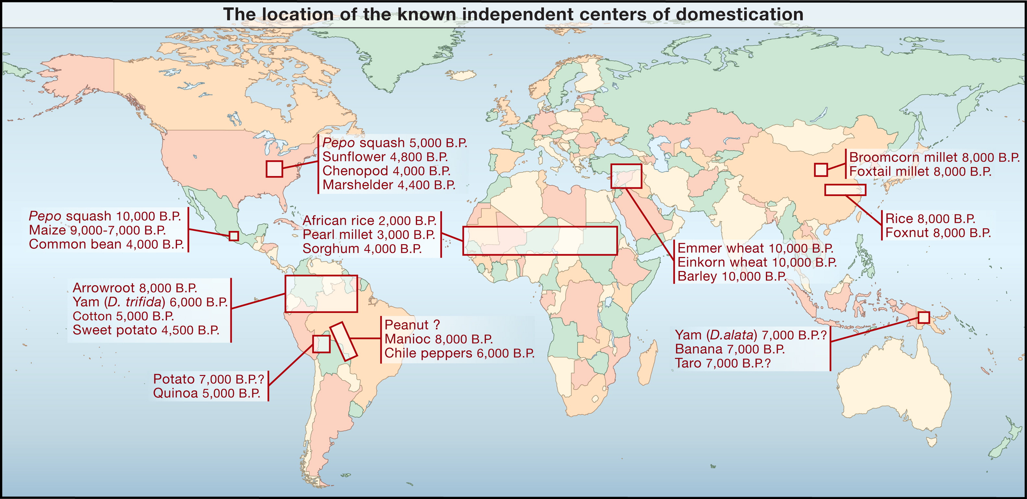
Notes:
The domestication of plants
http://archaeobotanist.blogspot.com/2011/12/de-centering-fertile-crescent.html

Slide 5
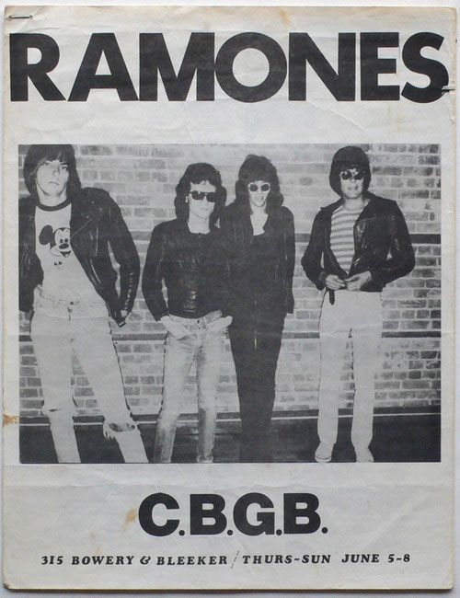
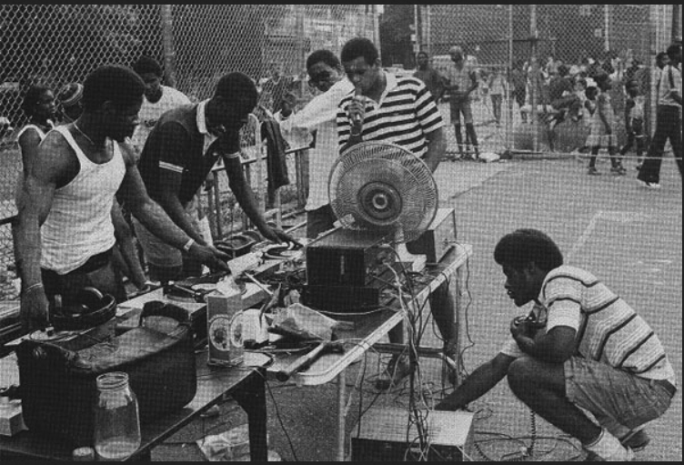

Slide 6
Formal and functional regions
A formal region may be characterized by human-centered properties, such as a common political system (the United States), or by physical properties, such as a particular landform (the southern Appalachians).
A functional region is a defined geographical area centered around a specific feature with a specific function. Trade routes, transportation corridors, or the area served by a shopping mall would be considered functional regions.

Slide 7
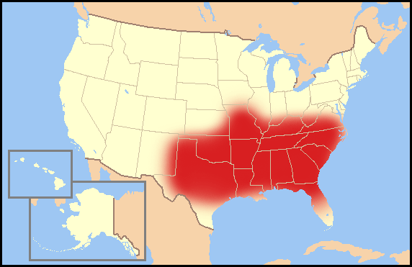
Perceptual regions
A perceptual region is based on the shared feelings and attitudes of the people who live in the area. Perceptual regions reflect the cultural identity of the people in the region.
The Bible Belt of the southeastern US is an example of a perceptual region. The ‘South’ or the ‘North’ of the USA are perceptual regions.
The boundaries of perceptual regions are not always distinct, as they may be perceived differently from person to person. For example, whether one considers Kentucky and specifically Lexington or Louisville to be in the South or the North will vary among individuals.
Notes:
US Bible Belt (right).

Slide 8
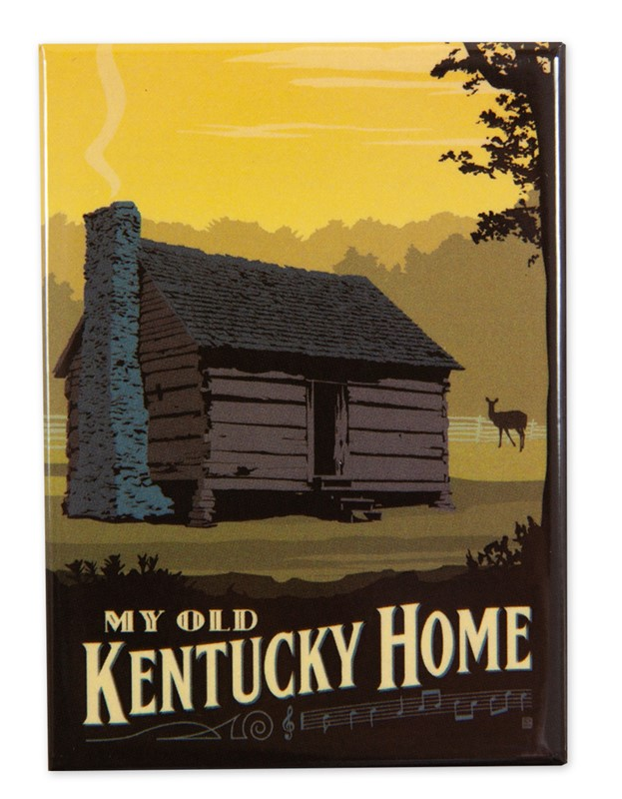
Topophilia
The affective bond between people and place
A strong sense of place, which often becomes mixed with the sense of cultural identity
Topophilia also has a darker side, serving as a motive force behind nationalism and social exclusion, and even extending sometimes to the racist celebrations of homelands

Slide 9
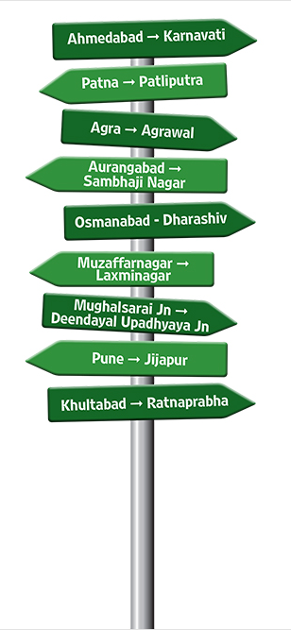
Toponymy
Toponymy is the study of geographic place names
Origins, values and aspirations of residents, recognition of past events, the physical character of a place, as well as literary device can inform the naming of places
Naming expresses ownership; it implies legitimacy of the namer’s historical and cultural legacy
Thus toponymy can be very political and reflect past struggles as well as changes in how history is understood
Notes:
The city that was known as St Petersburg in imperial Russia was renamed Petrograd in 1914 at the start of World War I because authorities thought its original name sounded too German. In 1924, following the formation of the USSR and the death of Lenin, the name of the city was changed once again, this time to Leningrad. The city's name was reverted back to St Petersburg in 1991, following the collapse of the Soviet Union.

Slide 10
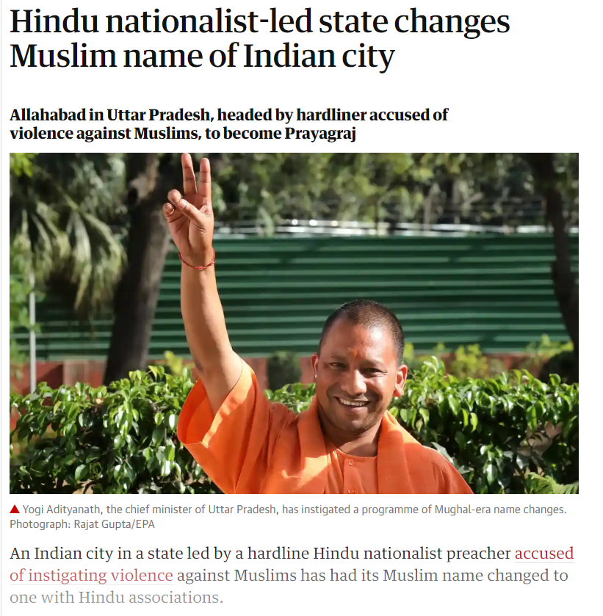
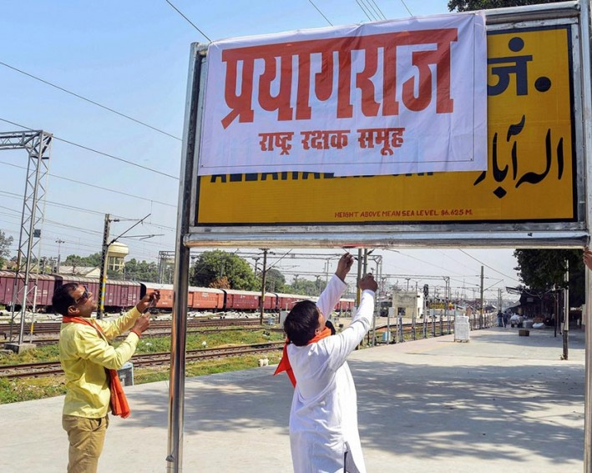
Notes:
https://www.aljazeera.com/indepth/opinion/renaming-india-saffronisation-public-spaces-181012113039066.html
https://www.outlookindia.com/magazine/story/allahabad-to-prayagraj-the-politics-of-name-change/300886

Slide 11
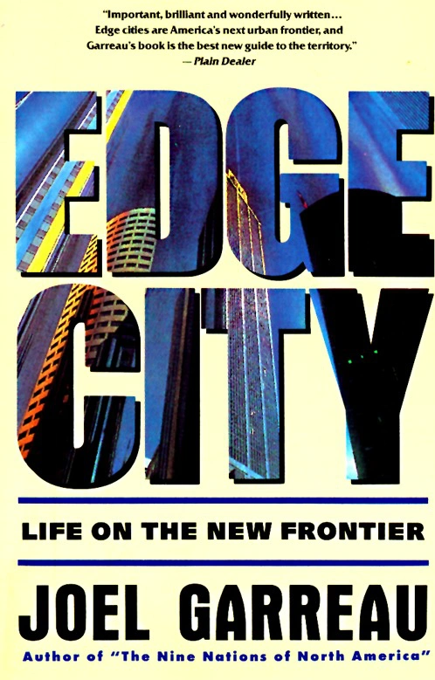
Edge cities
Edge city is a term that originated in the United States for a concentration of urban development outside a traditional downtown or central business district, in what had previously been a suburban residential or rural area.
It was coined in the 1991 book Edge City: Life on the New Frontier
An edge city is not as suburban or ‘horizontal’ as a boomburb.
An edge city will have taller buildings – it is a newer urban core that emerges outside of an older one.
Notes:
https://www.citylab.com/design/2018/04/return-to-edge-city/552362/

Slide 12
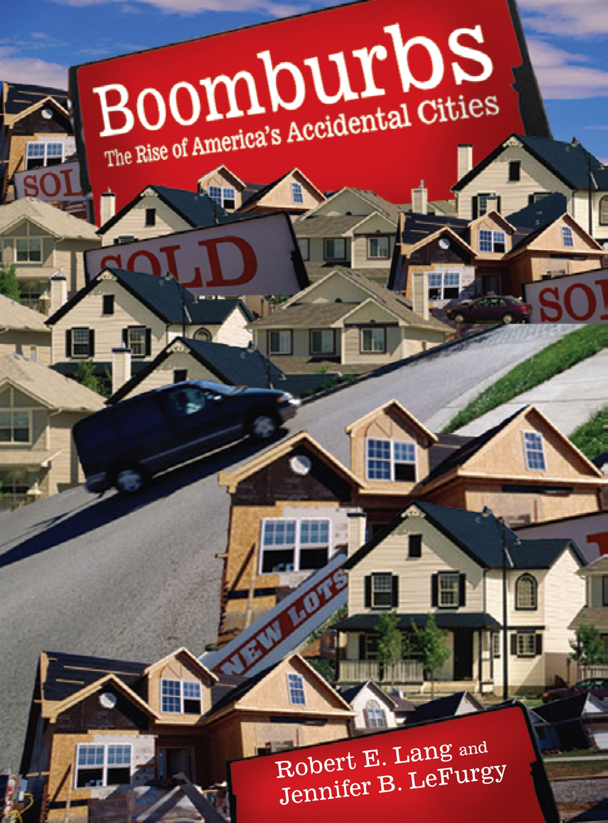
Boomburbs
A large, rapidly growing city in the United States (and now in many other countries) that remains essentially suburban in character, even as it reaches populations more typical of urban core cities.
They are located outside of a larger urban center that remains the biggest city in their region
Often referred to as accidental cities, boomburbs have housing, retailing, and offices, but lack the tall buildings and infrastructural core that resides at the center of older urban areas.

Slide 13
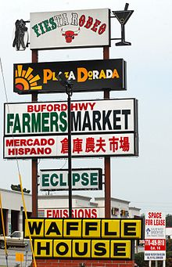
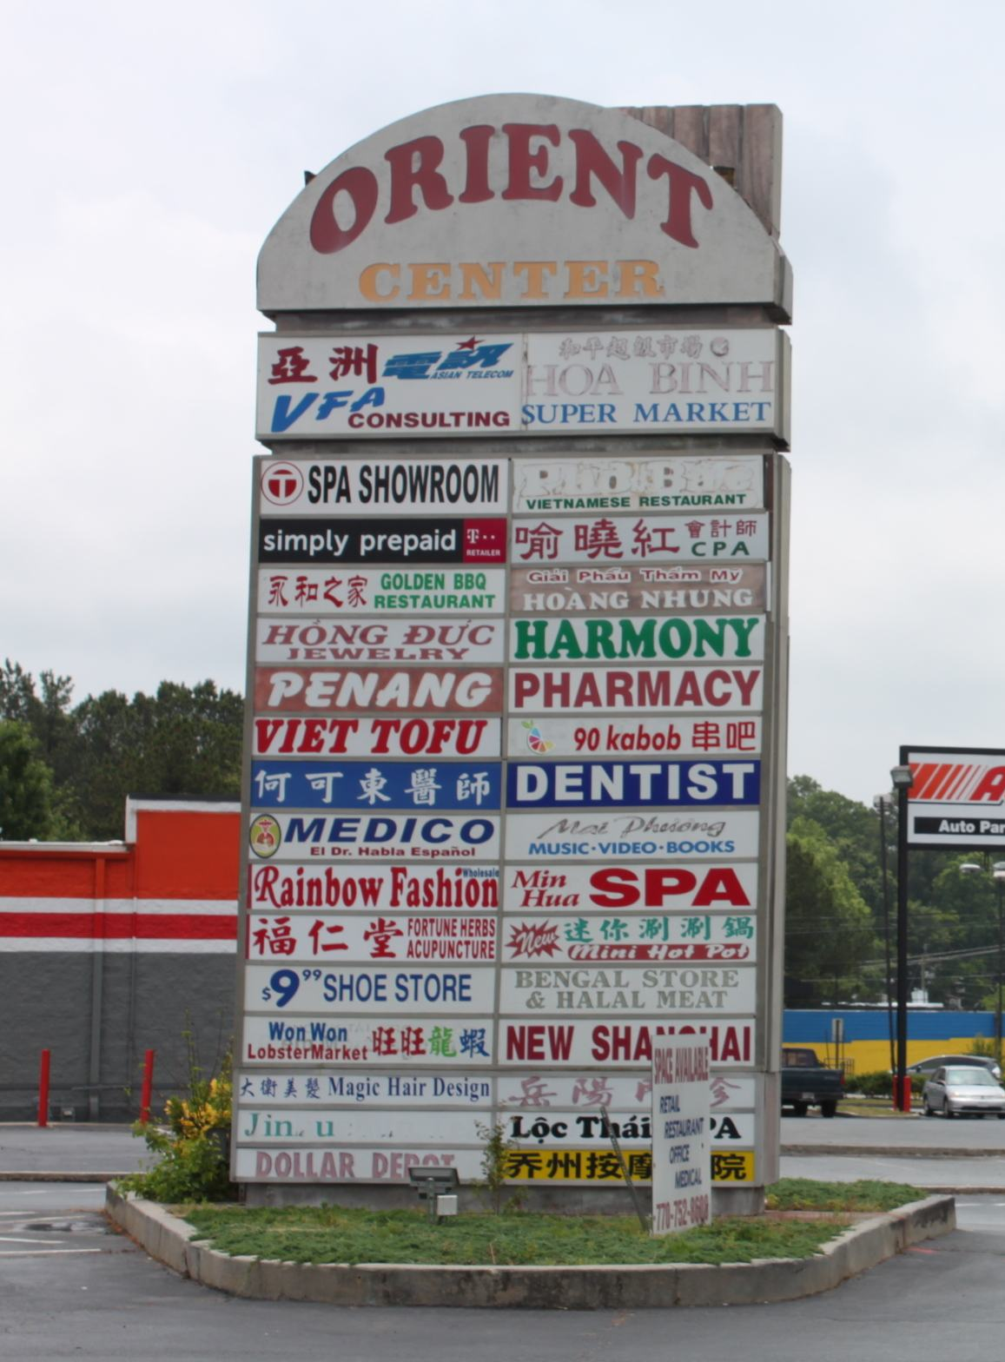
Ethnoburbs
Suburban ethnic clusters comprised of residential areas and business districts that have emerged outside of large cities.
They reflect what is known as the Great Inversion, the movement of ethnic groups from urban centers to outlying suburbs that were formerly dominantly white

Slide 14
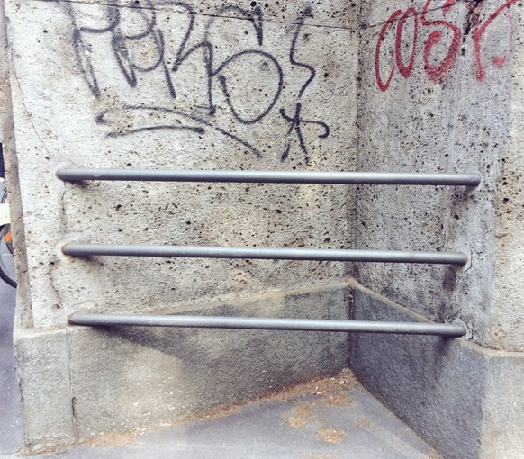
Landscapes of exclusion
Cities exist to bring people together, and their design can reflect this
But cities may also attempt to keep some people apart
Cities deploy arsenals of exclusion and other forms of hostile architecture to manage where people are allowed or where they are excluded
These are tactics used by architects, planners, policy-makers, developers, real estate brokers, and other urban actors to make some people feel they belong while others do not and should be excluded

Slide 15
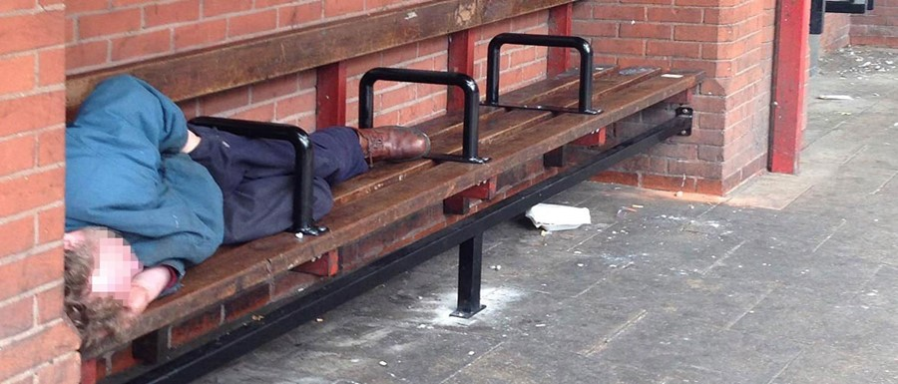

Slide 16
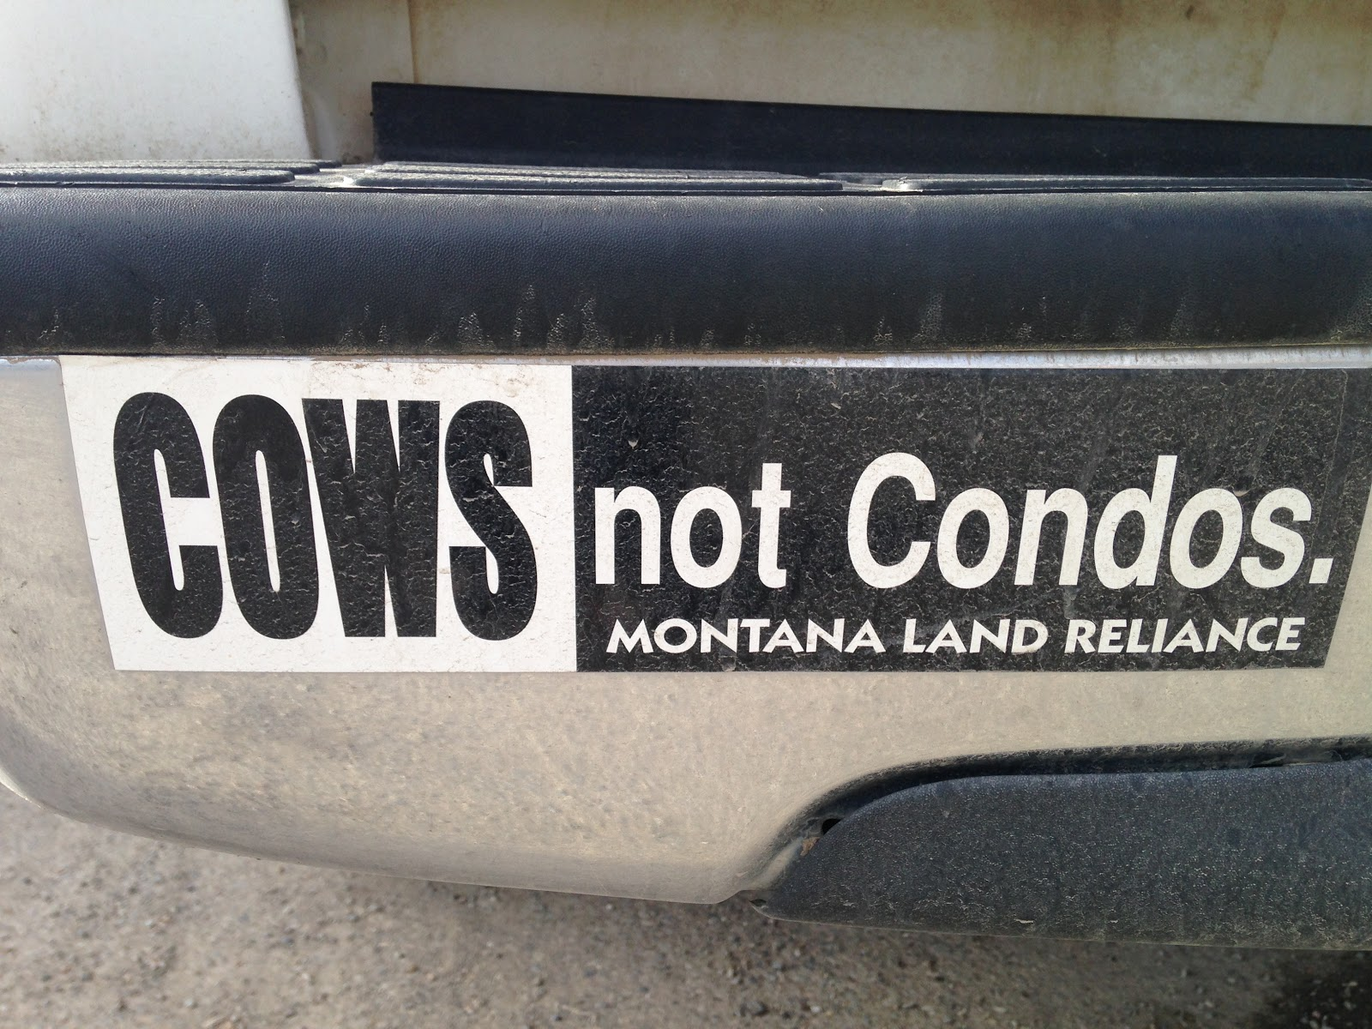
Exurbia
The region beyond the suburbs that is rural
Less densely developed than suburban areas, this is the leading edge of new housing construction. Sewer and water service may not yet be widely established there
Fewer amenities and large commuting times
However, it is here that development poses a direct threat to rural livelihoods
Notes:
https://www.washingtonpost.com/national/expanding-efforts-to-keep-cows-over-condos-are-protecting-land-across-the-west/2020/04/10/96ec2f80-79c6-11ea-9bee-c5bf9d2e3288_story.html

Slide 17

Notes:
Ty Turecek feeds the horses on his family’s Colorado ranch, which includes several thousand acres protected in perpetuity through a conservation easement. (Matthew Staver/For The Washington Post)

Slide 18
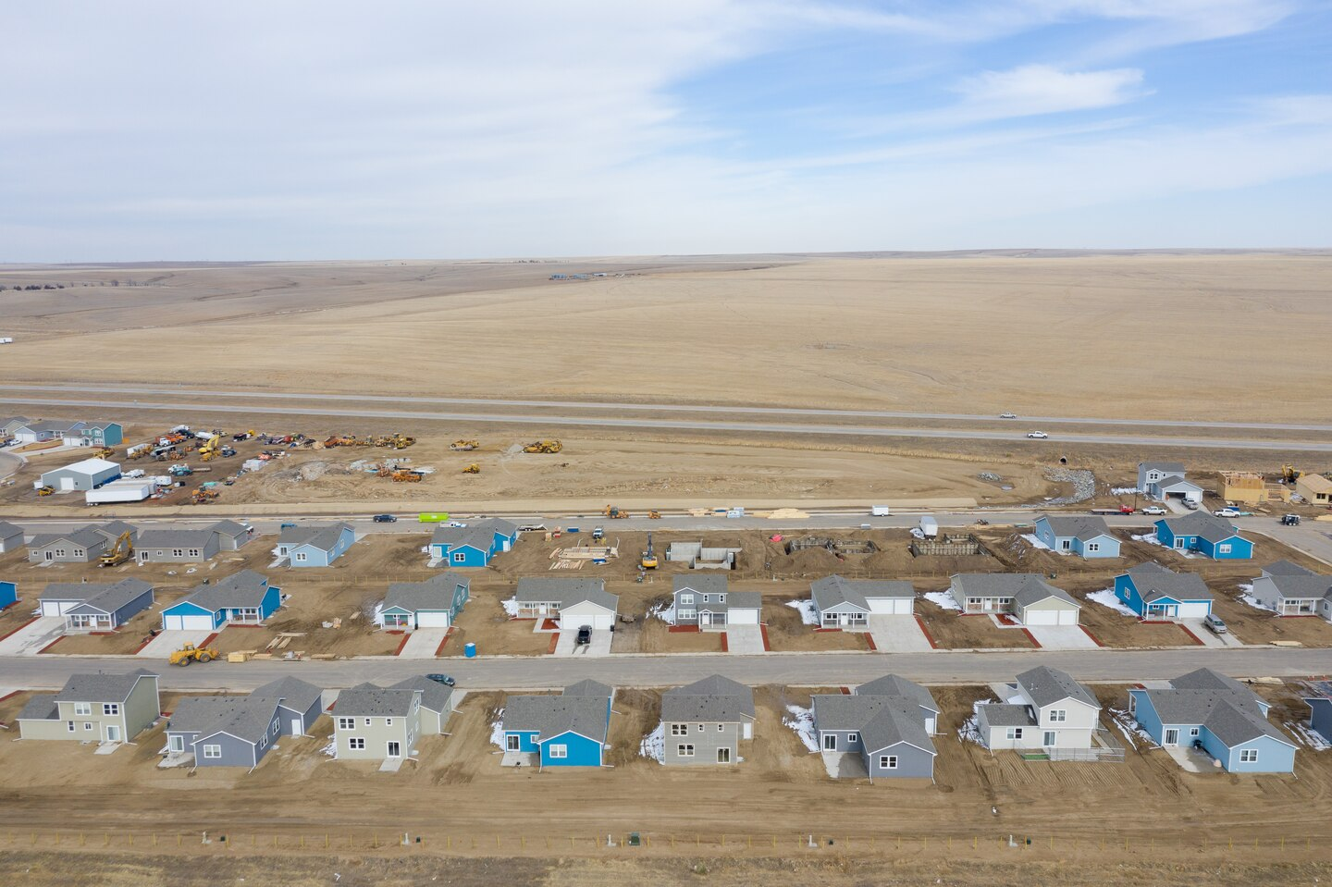
Notes:
This is exurbia.
Only a highway separates the Tureceks’ Stacked Lazy 3 Ranch from a new housing development, Bijou Creek. Downtown Denver is barely an hour to the west. (Matthew Staver/For The Washington Post)

Slide 19
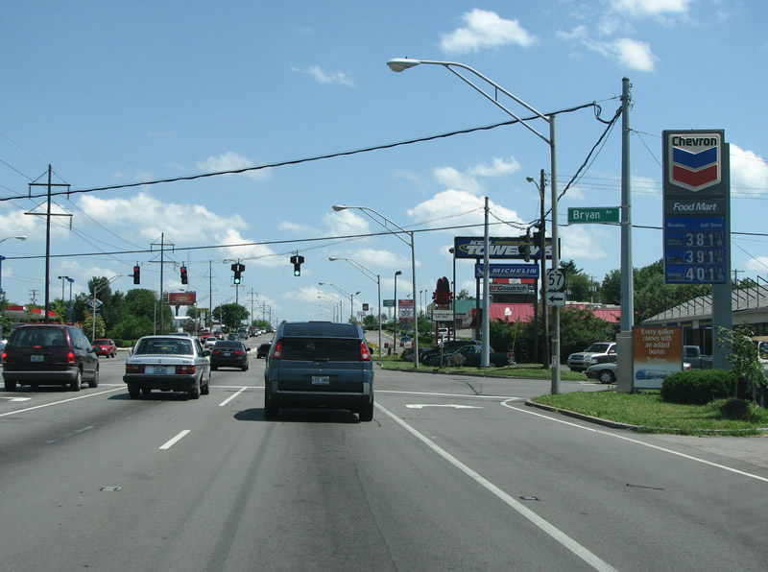
Sprawl
Typically refers to the unrestricted growth in housing, commercial development, and roads over large expanses of land, with little concern for planning
It almost always has negative connotations. It is criticized for causing environmental degradation, auto dependency, urban heat islands, intensifying segregation, and is attacked on aesthetic grounds

Slide 20
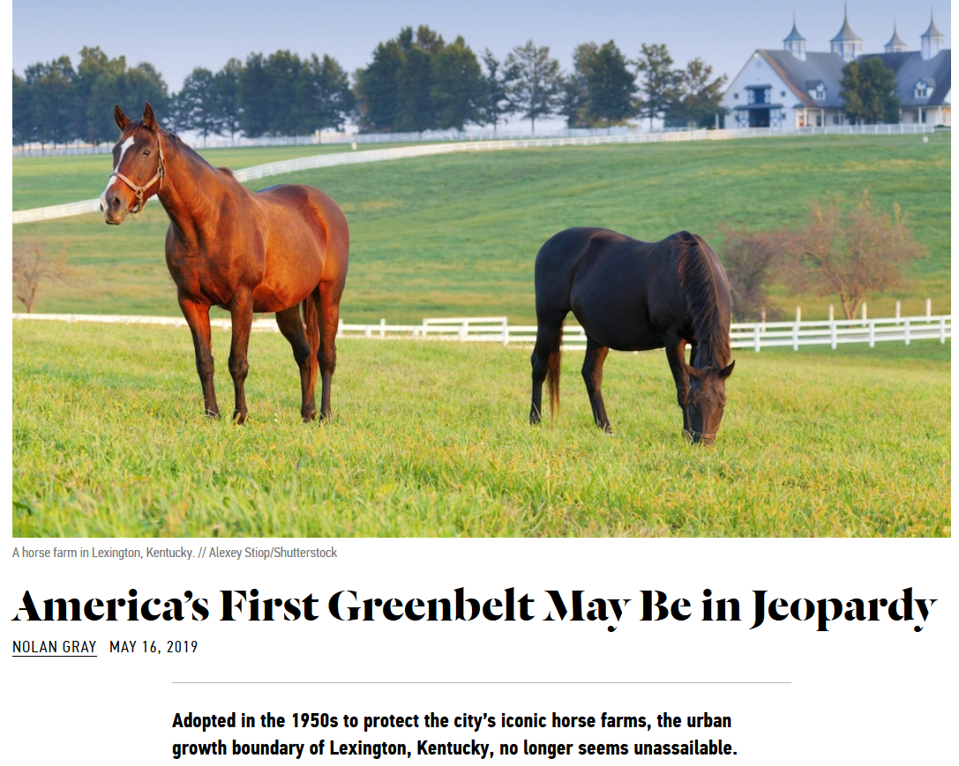
Notes:
https://www.citylab.com/design/2019/05/lexington-kentucky-horse-farms-urban-growth-planning-history/589519/

Slide 21
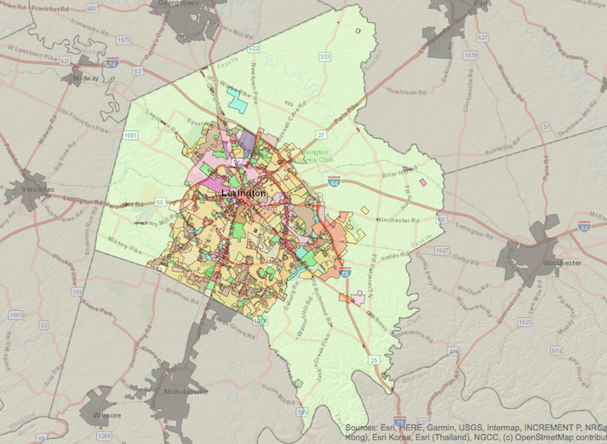
Greenbelts, urban growth boundaries, and infill
A greenbelt is a land use zone designation used in urban planning to retain areas of largely undeveloped, wild, or agricultural land surrounding or neighboring urban areas.
The urban growth boundary demarcates this border between developed and conserved land
Notes:
Oregon often gets the credit for pioneering greenbelts and urban growth boundaries in the U.S., but it was Lexington that adopted the nation’s first in 1958. Its failure to get credit for this might come down to the unusual politics surrounding its greenbelt. Whereas the 1973 Oregon push for a greenbelt tapped into emerging environmental sensibilities, Lexington’s earlier push was mostly focused on protecting the interests of the horse industry.
The greenbelt lies fully within Fayette County, which merged with Lexington in 1974.
Businesspeople and developers argued that a lack of developable land in Lexington is driving businesses away and housing costs up, while defenders of the greenbelt countered that there is still ample land to develop without extending the boundary further. However, this has spurred development inside the growth boundary in the form of infill.

Slide 22
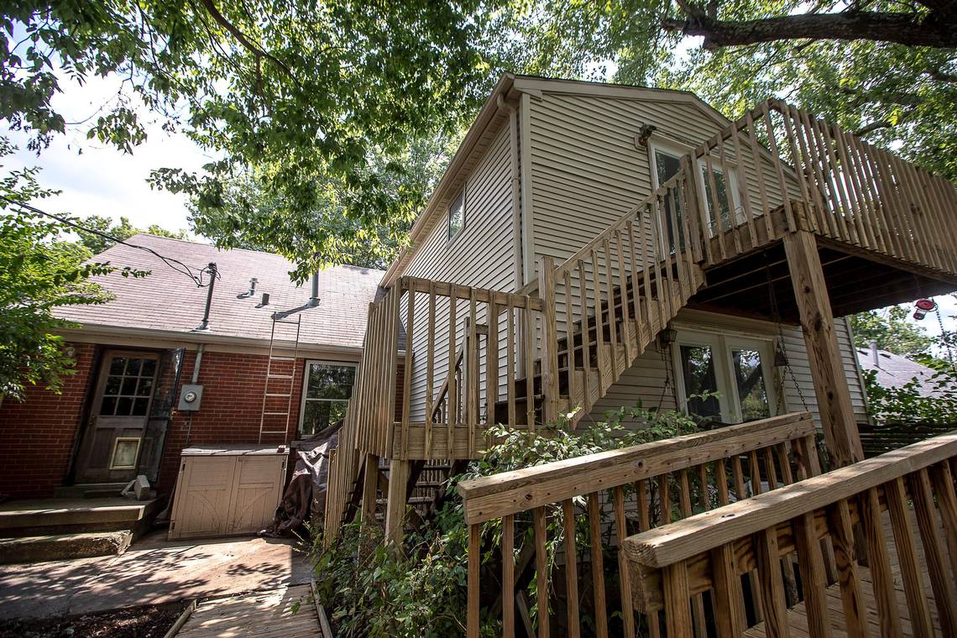
A greenbelt is intended to increase infill, the building of new housing in formerly unused land in the city
This allows the surrounding greenbelt to retain its less developed character.
The apartment built in the backyard of another home is an example of infill.
Notes:
In this photo, a house in Lexington has added an apartment rental in its backyard. This decreases development pressure in the greenbelt, while also increasing the availability of housing closer in to the city.
https://www.kentucky.com/opinion/op-ed/article225311025.html

Slide 23
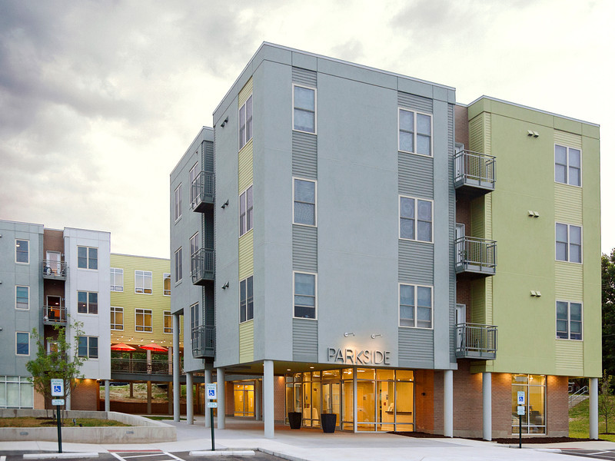
Notes:
Urban infill in Lexington Kentucky. It aims to increase housing and population density in the city so that the greenspace surrounding horse farms can remain less developed.
http://auassociates.com.s157318.gridserver.com/?p=18

Slide 24
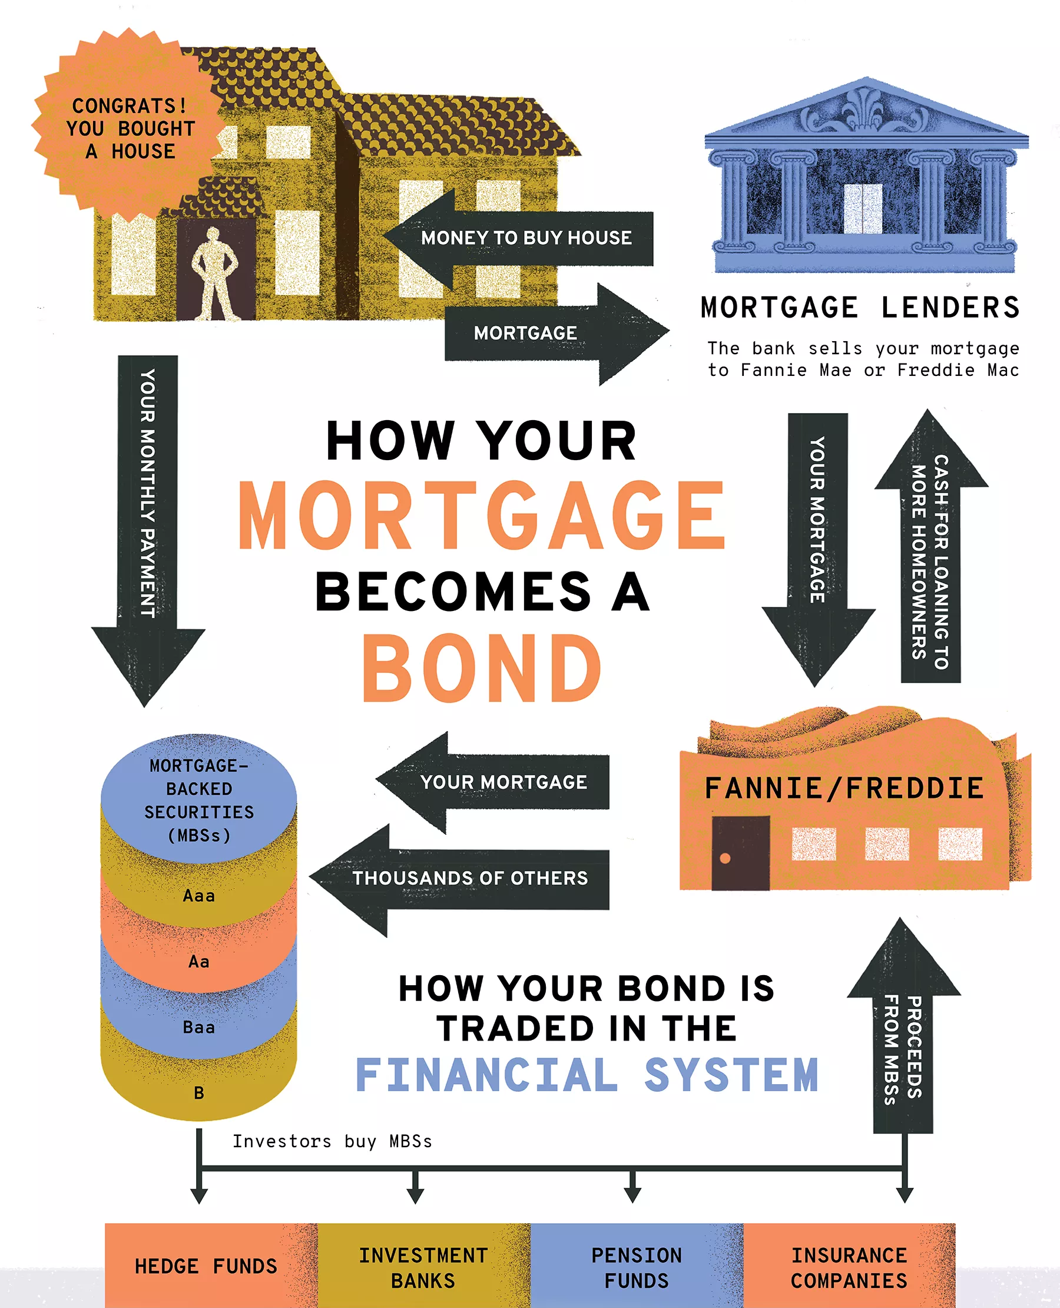
Financialization of housing
Reflects the expanding role of financial markets and corporations in the housing sector
Housing is now treated as a commodity, a means of accumulating wealth for homeowners, but also through financial instruments that are traded and sold on global markets.
A mortgage may be a loan that helps buy a home. But investors see a mortgage as a stream of future cash flows. House mortgages become securitized and incorporated into a secondary mortgage market.

Slide 25
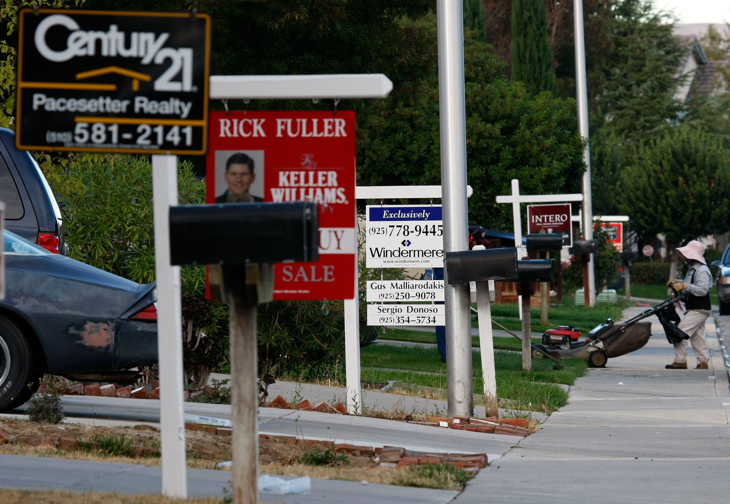
The Great Recession of 2008
Caused by the financialization of housing
Because mortgages were sold and used in financial speculation, the more an investment firm sold and traded them the more profit
As they wanted more mortgage loans to be issued, standards for lending fell.
Those of modest income were often offered a subprime mortgage loan, which is also known as an adjustable rate mortgage. No money was needed up front for the mortgage loan, but interest rates could increase over the life of the loan and make the payments balloon.
When defaults occurred on these mortgages due to a drop in housing value, the financial markets around the world became unstable and started to fail.
Notes:
The Great Recession of 2008 was triggered by a large decline in home prices after the collapse of a housing bubble, leading to mortgage delinquencies, foreclosures, and the devaluation of housing-related securities. The housing bubble preceding the crisis was financed with mortgage-backed securities (MBSes) and collateralized debt obligations (CDOs), which initially offered higher interest rates (i.e. better returns) than government securities, along with attractive risk ratings from rating agencies. While elements of the crisis first became more visible during 2007, several major financial institutions collapsed in September 2008, with significant disruption in the flow of credit to businesses and consumers and the onset of a severe global recession.
There were many causes of the crisis, with commentators assigning different levels of blame to financial institutions, regulators, credit agencies, government housing policies, and consumers, among others. Two proximate causes were the rise in subprime lending and the increase in housing speculation. The percentage of lower-quality subprime mortgages originated during a given year rose from the historical 8% or lower range to approximately 20% from 2004 to 2006, with much higher ratios in some parts of the U.S. A high percentage of these subprime mortgages, over 90% in 2006 for example, were adjustable-rate mortgages. Housing speculation also increased, with the share of mortgage originations to investors (i.e. those owning homes other than primary residences) rising significantly from around 20% in 2000 to around 35% in 2006–2007. Investors, even those with prime credit ratings, were much more likely to default than non-investors when prices fell. These changes were part of a broader trend of lowered lending standards and higher-risk mortgage products, which contributed to U.S. households becoming increasingly indebted.
When U.S. home prices declined steeply after peaking in mid-2006, it became more difficult for borrowers to refinance their loans. As adjustable-rate mortgages began to reset at higher interest rates (causing higher monthly payments), mortgage delinquencies soared. Securities backed with mortgages, including subprime mortgages, widely held by financial firms globally, lost most of their value. Global investors also drastically reduced purchases of mortgage-backed debt and other securities as part of a decline in the capacity and willingness of the private financial system to support lending. Concerns about the soundness of U.S. credit and financial markets led to tightening credit around the world and slowing economic growth in the U.S. and Europe.

Slide 26
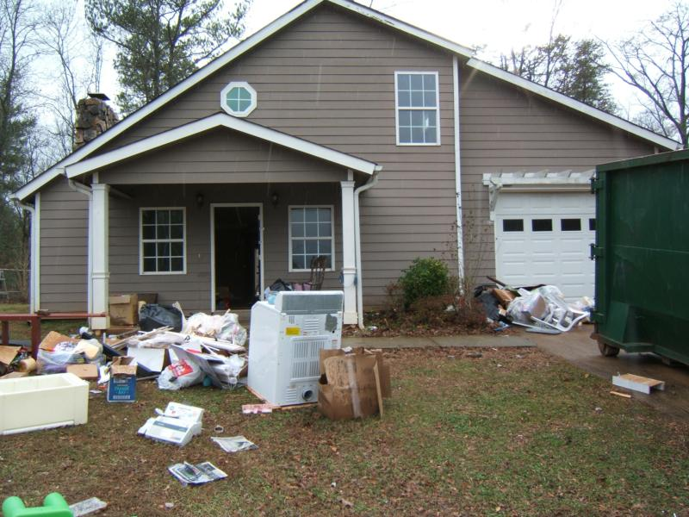
Slumburbia
A term for suburbs that are declining into poverty.
It was a term that became widely used after the Great Recession of 2008 left wide swatch of suburban neighborhoods abandoned because their owners could no longer afford to make payments
These owners were ‘upside down’ and paying for a house that was worth far less than what they bought it for.

Slide 27
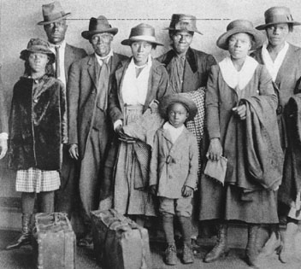
The Great Migration
Between 1917 and 1970, more than seven million African Americans left homes in the South to resettle in northern and western states.
Once a people of the South, Black Americans became increasingly part of the big cities of all regions and in those urban settings steadily gained political and cultural influence.
Notes:
Southern family arriving in Chicago during World War I

Slide 28
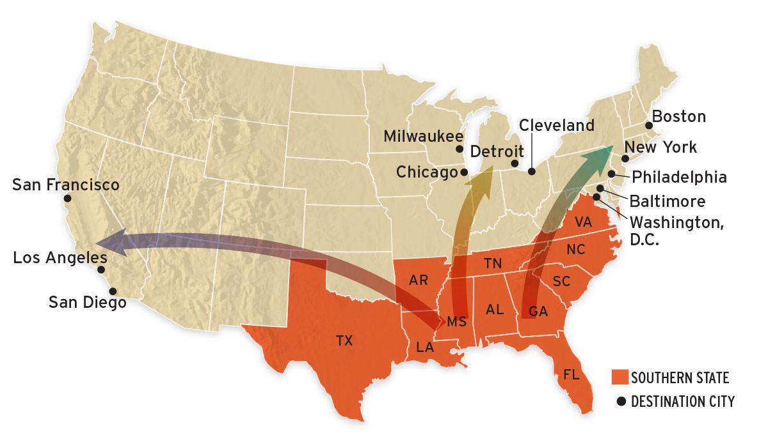
Notes:
The movement of African-Americans during the Great Migration

Slide 29
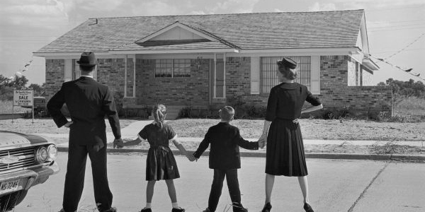
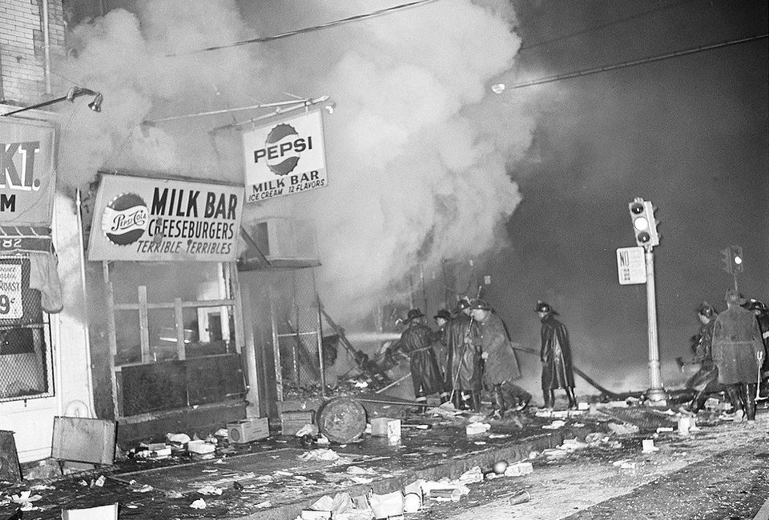
White flight
Large-scale migration of white people from cities and the first suburbs as they became more racially or ethnoculturally diverse
Started in the 1950s and 1960s but has reversed as part of the Great Inversion
Rioting in several large American cities in the 1960s hastened the departure of whites as well as many businesses – these riots, like those in Newark NJ (right) were in response to decades of racism toward African-Americans
Notes:
https://vimeo.com/126309107
https://www.njtvonline.org/news/uncategorized/newark-riots-happen/
https://www.youtube.com/watch?v=pxkDJ4cQvTo
After many African countries gained political independence, the period of post-colonial emigration of whites to areas where they were more of a majority

Slide 30
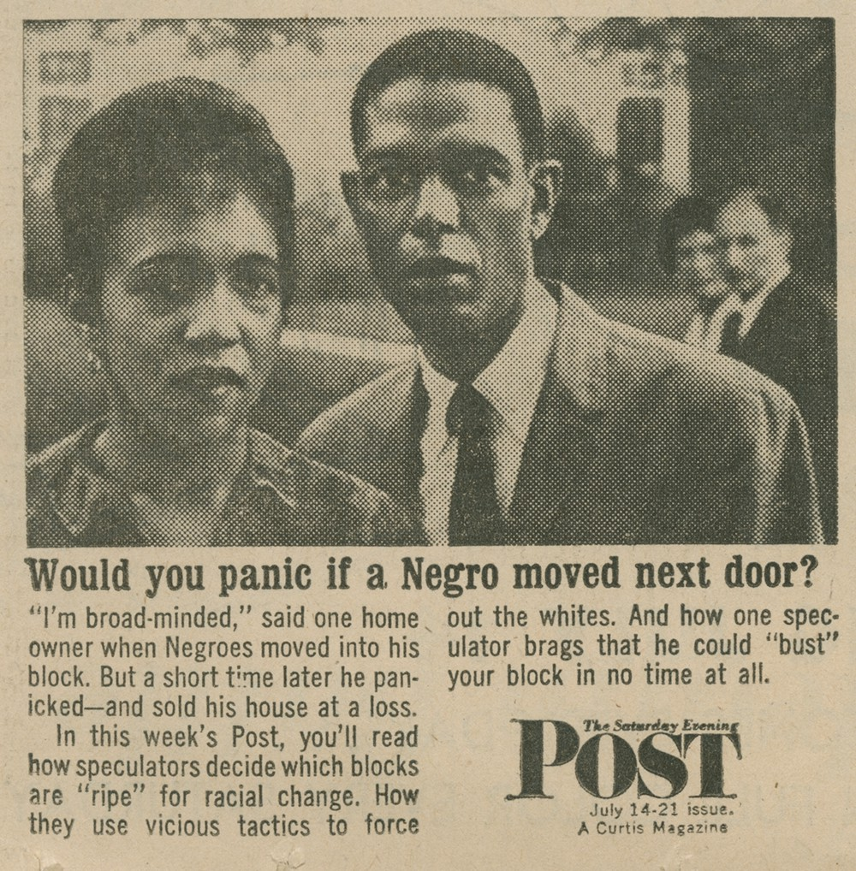
Blockbusting
The practice of persuading owners to sell property cheaply because of the fear of people of another race or class moving into the neighborhood, and thus profiting by reselling at a higher price.
Notes:
1962 newspaper ad for the Saturday Evening Post story

Slide 31
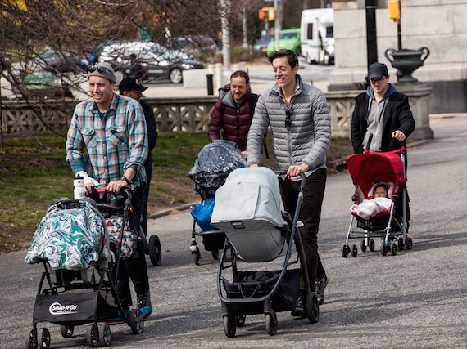
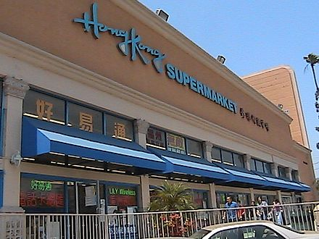
The Great Inversion
The more recent change in American cities in which whites and older Americans have returned to live in urban centers while ethnic groups have moved out of the city into the surrounding suburbs to form ethnoburbs.
Notes:
Top, Park Slope in Brooklyn.
Bottom, Asian supermarket in San Gabriel Valley, CA

