Slide 1
Identities
Our two films were selected because they powerfully reveal the dynamism of the borders and boundaries of identities amongst their lead characters. The films convey the way in which they (and us) perceive, negotiate and find resolution with who they are.
Race, class, gender, are commonly used to ascribe identities. They invoke lines and boundaries in that they shape whether and how someone belongs, participates, and is accepted in multiple ways
However, identity can also be performed by an individual. Identities are made by our everyday actions and choices. Identities can be spontaneous and subconscious, yet they can also be scripted, even forced by our social, political, and economic contexts.

Slide 2
Terms
identity politics
deconstructive identity
poststructuralist identity
sex
gender
gender identity
race
ethnicity
nationality
normative
othering
cultural appropriation
embodiment
performativity
situated knowledge
standpoint theory
code switching
double consciousness
essentialism
Notes:
https://plato.stanford.edu/entries/identity-politics/

Slide 3
Identity politics
Emerged in North American-European social movements that culminated in the 1960s, including the women’s rights movement, the civil rights movement, gay rights struggles, and leftist labor movements.
Their actions created new conceptualizations of the importance of recognizing and valuing previously denigrated or devalued identities.
At the same time, identity politics articulated coalitional strategies for linking social identities to one another in struggles for justice, equity, and rights

Slide 4
Notes:
A quote illustrating the logic underlying poststructuralist interpretations of identity. Identity in the poststructuralist view is decentered and the product of discourses.

Slide 5
Deconstructive identity
Identity is neither something we possess nor something that defines us but is instead a linguistic process of becoming.
Whereas identity politics can insist that a lack of affirmation for some identities is a social insult needing rectification, a deconstructive perspective names identity itself as the problem.
When identities are placed onto individuals and groups by others, and when those identities limit or constrain the personal and social identities one might wish to claim, recognition of our identities no longer seems a mechanism of social justice but rather seems to be the social insult.

Slide 6
Poststructuralist identity
Identity is a product of discourse, the stories and images around us which construct identity, as well as our own performance of an identity
A poststructuralist view recognizes the conditions of possibility for different identities to form, yet at the same time recognizes that there are constraints on what forms of self-making individuals may engage.
Notes:
In this view, there is no real identity—individual or group-based—that is separable from its conditions of possibility. Any political appeal to identity formations must engage with the paradox of acting from the very subject-positions it must also oppose. In other words, any claim to identity must organize itself around a constitutive exclusion

Slide 7
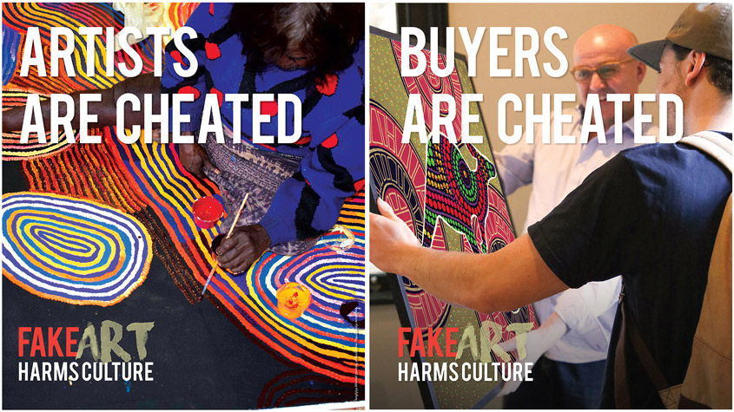
Cultural appropriation
Occurs when a dominant culture takes, uses, or borrows things from another culture that is experiencing oppression.
In this way it differs from cultural exchange (baseball in Japan) and cultural assimilation (sushi in the university dining hall) because these assume a more neutral power relationship.
Cultural appropriation continues the oppression of the non-dominant culture.
Notes:
In Australia, it is against the law to sell Aboriginal art unless it has been created by Aboriginals. This allows them to profit from the works of their culture. It is cultural appropriation to make fake Aboriginal art that looks the part, but is sold to profit those whose cultural forms are being copied. https://www.theatlantic.com/entertainment/archive/2015/10/the-dos-and-donts-of-cultural-appropriation/411292/
https://www.reclaimindigenousarts.com/home

Slide 8
Notes:
Do bodt images like this influence your sense of identity?

Slide 9
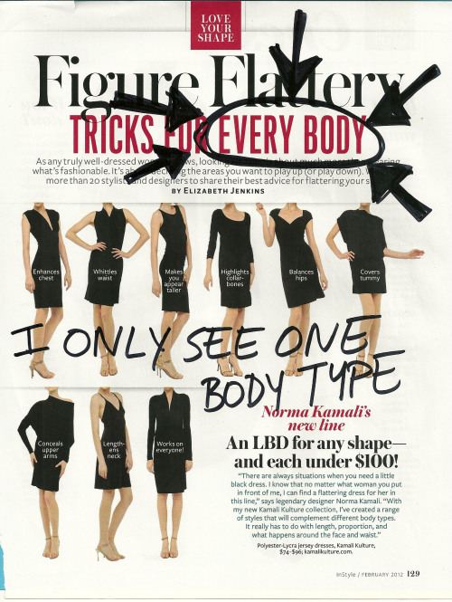
Embodiment
The way in which our bodies play a role in identity
A person can embody an identity, or a particular set of identities, by the way one moves, interacts, communicates and perceives.
Our bodies give us identity as in they are us, the body-as-self
But our bodies shape our identity through the way in which bodies are given larger cultural meaning
Notes:
Embodiment usually refers to how the body and its processes of perception contribute to identity. Identity is grounded in physical experience, through bodily form, gaze, gesture, body posture, facial expression, and movement. A person can also embody an identity, or a particular set of identities, by the way one moves, interacts, communicates and perceives.

Slide 10
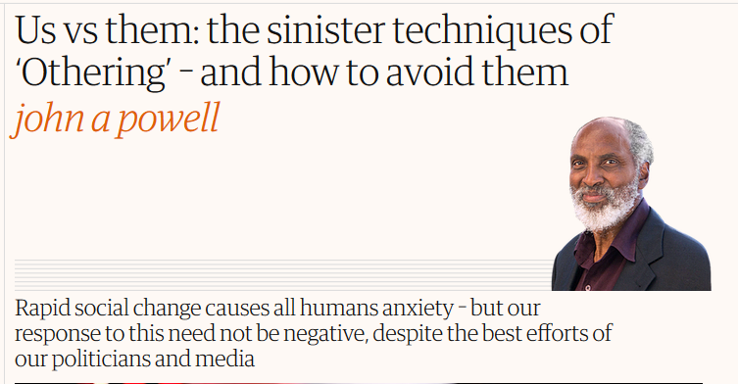
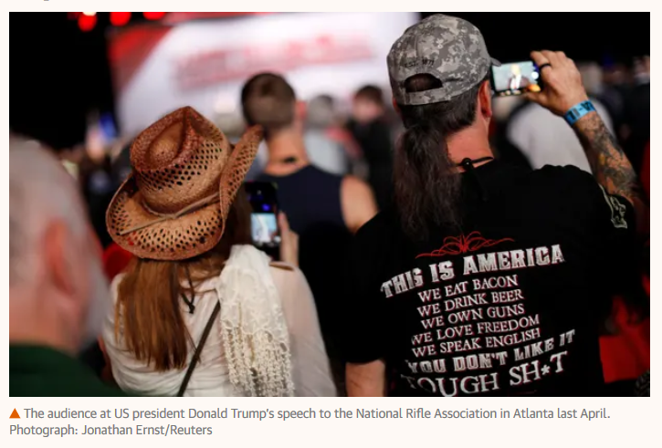
Othering
Used to define someone's own 'normal' identity by distancing oneself from the ‘other’. This ‘other’ means someone else that is ‘not us’, often our opposite.
While categorization of people and things in relation to oneself is necessary as part of communication, these differences can also be the basis for prolonging conflict.
Notes:
http://www.otheringandbelonging.org/subverting-established-views-oppose-othering/

Slide 12
Sex, gender, gender identity, and sexuality
Sex is a label, male or female, that you’re assigned by a doctor at birth based on the genitals you’re born with and the chromosomes you have.
Gender is the social set of expectations from society, about behaviors, characteristics, and thoughts that are ascribed to a gender. Cultures vary in the way that people are expected behave based on their gender.
Gender identity is how you feel inside and how you express your gender through clothing, behavior, and personal appearance.
Sexuality is the way people experience and express themselves sexually. It can involve biological, erotic, physical, emotional, social, or spiritual feelings and behaviors

Slide 13
Race, ethnicity, nationality
Often, “race” is conceived as a biological quality reflecting physical features and “ethnicity” as a cultural phenomenon.
However, genetic differences within any designated racial group are often greater than differences between racial groups.
Ethnicity can reflect race, but it is not bound to it. Ethnicity is more a question of choice regarding shared ancestry, language, or culture, as well as memories of migration or colonization.
Although both can be socially constructed and hierarchical, race has more often been the basis of institutionalized discrimination
Notes:
https://www.pbs.org/race/000_About/002_04-experts-03-02.htm Someone with an Algerian background who lives in France occupies a specific ethnic role that depends completely on the history of occupation and colonization between France and Algeria. In France, the ethnic distinction of “Algerian” carries specific connotations. But that ethnic role disappears once they move to the United States. Once in the U.S., this person would gain a new and/or different ethnicity, since their national context changes when they move. Now, they fit into American racial and ethnic categories. So while this person might be Algerian in France, they may be categorized as Muslim in the United States. While this person would personally continue to have the ethnic and national identity of an Algerian, they would be perceived and treated, by and large, as a Saudi or Iraqi might be treated. They would perhaps even be called “Middle Eastern,” even though they are actually African. https://blog.prepscholar.com/race-vs-ethnicity-vs-nationality

Slide 14
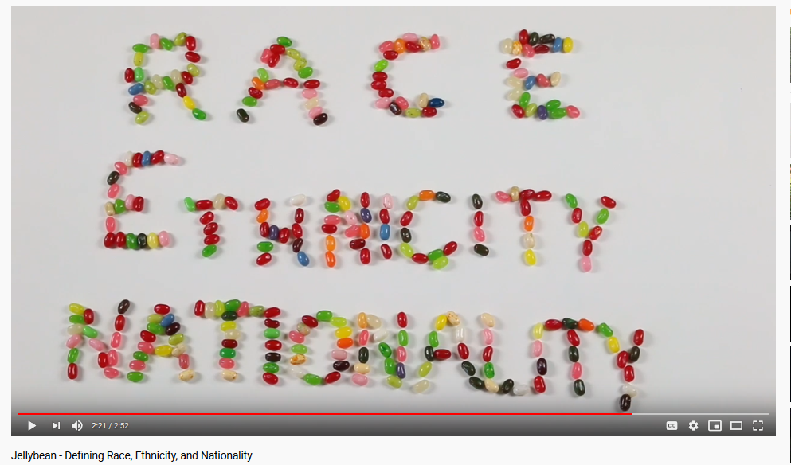
Race is primarily unitary – you are often designated as belonging to one race, while you can more flexibly claim multiple ethnic affiliations.
Nationality is citizenship, your legal ties to a country.
Race and ethnicity exist within the cultural context of a specific national environment. In other words, racial and ethnic categories can differ between countries, and they even differ within countries
Notes:
https://www.pbs.org/race/000_About/002_04-experts-03-02.htm Someone with an Algerian background who lives in France occupies a specific ethnic role that depends completely on the history of occupation and colonization between France and Algeria. In France, the ethnic distinction of “Algerian” carries specific connotations. But that ethnic role disappears once they move to the United States. Once in the U.S., this person would gain a new and/or different ethnicity, since their national context changes when they move. Now, they fit into American racial and ethnic categories. So while this person might be Algerian in France, they may be categorized as Muslim in the United States. While this person would personally continue to have the ethnic and national identity of an Algerian, they would be perceived and treated, by and large, as a Saudi or Iraqi might be treated. They would perhaps even be called “Middle Eastern,” even though they are actually African. https://blog.prepscholar.com/race-vs-ethnicity-vs-nationality

Slide 15
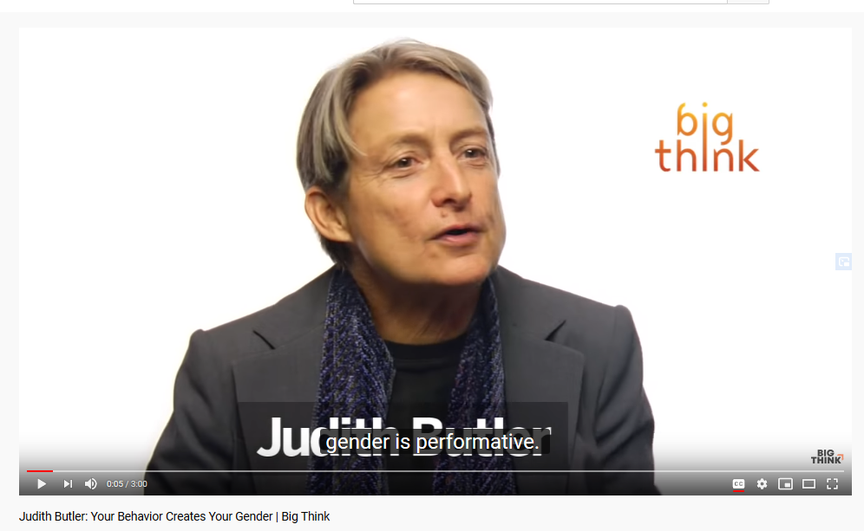
Performativity
To construct identity in terms of an intended or spontaneous performance
Identity arises from performance, and can be performed differently in different areas.
For example, students perform their roles when they come to class, so do I and this becomes part of the border between us.
We are constantly performing identities of gender, race, occupation, and family roles.

Slide 16
Performativity
Performativity reveals that identities are not really “our own” and that we are not really “what we are”
Instead, we are how we identify—a process that is mutable and changeable.
We make our identities in reaction to the signs and practices that signify it
As a practice, performativity can refigure available norms as contingent and open to change.

Slide 17
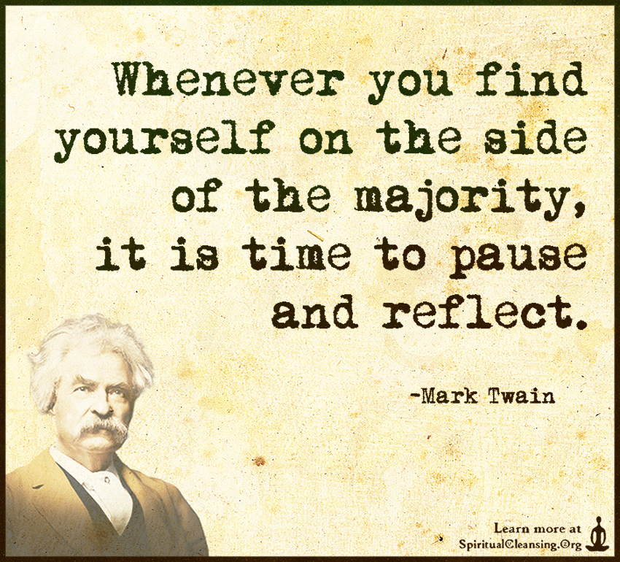
Normative
Normative means of, relating to, or prescribing a norm or standard. If something is normative, it is what is held up as a standard or expectation to follow. Examples:
Heteronormativity is the belief that heterosexuality is the only normal or natural form of sexual and marital relations
In some social circles, aggressive, competitive behavior is taken to be the normative model of masculinity

Slide 18
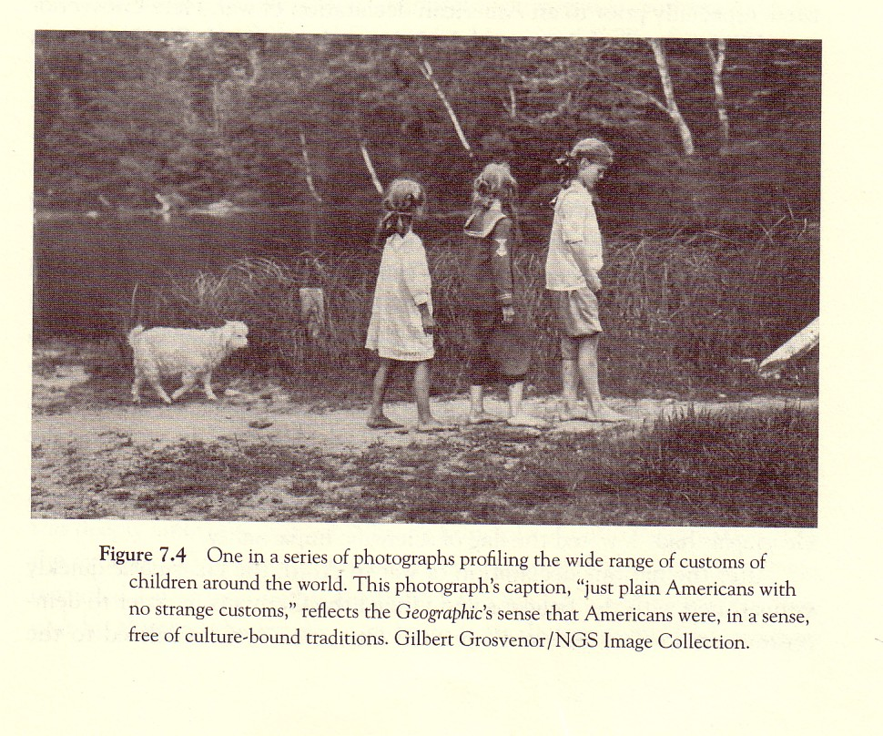

Slide 19
Situated knowledges
This is the understanding that all knowledge comes from positional perspectives. Our positionality inherently determines what it is possible to know about an object of interest.
Situated knowledges asks us to be accountable to learn what we may not necessarily be immediately able to see
Without this accountability, the implicit biases and societal stigmas of one’s own identity can lead us to build assumptions and generalizations that obscure the unique knowledge identities of others

Slide 20
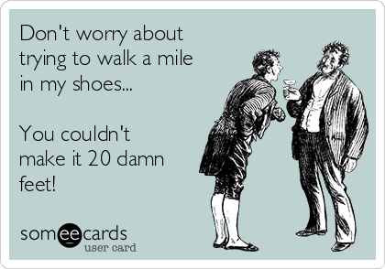
Standpoint theory
This theory posits that one’s social position relative to systemic power confers additional insight or access to knowledge(s) that allows the oppressed to understand both oppression and the society or systems it operates within better than the privileged are able to
We cannot experience the standpoint of another – we can’t comprehend or understand it fully

Slide 21
Code switching
Code-switching is a linguistic phenomenon which a communicatively competent speaker alternates or switches between two languages or more commonly, in the dialects and colloquialisms of a single language
It can also encompass the modes of dress and behavior that accompany these linguistic changes
Notes:
https://www.youtube.com/watch?time_continue=58&v=CJkE_CxUHaI&feature=emb_logo

Slide 22
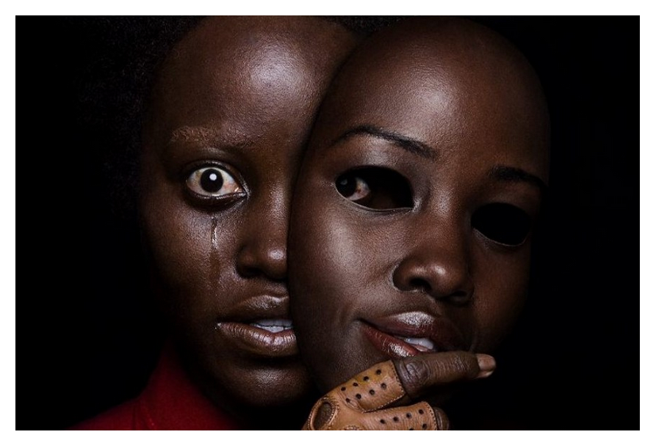
Double consciousness
Coined by the writer-scholar W. E. B. Du Bois
Speaks to this sense that we do not merely negotiate identities but these can be “warring” and at odds with each other
This conflict revolves around keeping “who I am” intact and unrestrained by “who society thinks I should be”

Slide 24
Essentialism
Essentialism is the belief that a person has a certain quality by virtue of what they seem to be
The term is used more to imply, most commonly, an illegitimate generalization about identity
If I am >this<, then in an essentialist point of view, it logically follows that I have these >specific< properties.
Notes:
This self help book title illustrates an essentializing discourse about men, women and their respective behaviors in relationships.

