Slide 1
Introduction: Environment and Film
Geographers theorize the world through concepts like ‘environment’, ‘space’, and ‘place’.
In this course we employ film to describe the processes by which place, space and environment acquire form and meaning.
How are class, economics, identity (gender, race, ethnicity), religion, justice, conservation, and concepts of home illustrated in the following video?

Slide 2
Notes:
https://www.youtube.com/watch?v=2FHi2n9NPPY

Slide 3
Terms
atmosphere
ecological fallacy
environmental determinism
environmental possibilism
epistemology habitus
idiographic individualistic fallacy
MAUP nomothetic
phenomenology
place
space
umwelt

Slide 4
Atmosphere
An atmosphere can refer to anything ranging from a room to a political climate, from a person’s presence to the feel of a city.
To speak of the atmosphere of a room (or city or landscape) is to speak of a dialogue that takes place between the inhabitants and the space itself
Notes:
Name an “atmospheric” film.

Slide 5
Ecological fallacy/individualistic fallacy
Individualistic fallacy: extrapolating to broad extents based on observations made at small, local extents
Ecological fallacy: making local-scale characterizations based on observations at broad extents.
Notes:
Individualistic fallacy – 1941, an early Steven Spielberg comedy in which a siting of a Japanese sub off the coast of LA leads to zaniness in the city
War of the Worlds – ecological fallacy

Slide 6
Environmental determinism
The idea that the environment shapes individuals, groups, societies and states towards particular development trajectories
Notes:
A prominent environmental determinist of the early 20th century was Ellsworth Huntington. “Civilization,” according to him, could thrive only where allowed by climate. The ideal environment was a temperate one: free from extremes of heat or cold, yet blessed with a bracing seasonal contrast between winter and summer. Rainfall should be spread throughout the year, as prolonged dry seasons sapped both human health and mental acuity. Short-term alternations between wet and dry, on the other hand, were regarded as a positive force, refreshing the mind and spirit. Huntington translated these favorable conditions into numbers and then mapped them across the world. As seen in the map reproduced above, he concluded that climatic energy peaked in western Europe and northeastern North America. New Haven, Connecticut, where he made his home, was in the ideal range, making Huntington a lucky man indeed. Huntington next compared the map to one showing the “level of civilization.”
The Matrix, or any movie in which the events and outcomes are pre-ordained or locked in by their environment. Trading Places

Slide 7
Environmental possibilism
The ideas that the environment exerts an influence on us, but the outcomes are more open-ended due to human agency and the availability of choices
Notes:
The underdog overcoming their environment story, movies where the protagonist escapes what seemed to be there destiny

Slide 8
Epistemology
An epistemology is a way of thinking which sets the boundaries of what can and can’t be known or what is possible and what is not within a particular place
Notes:
A person who views the world through a universal logic versus a person who views the world through emotion and individuality – these are two broad categories of epistemology A Jedi versus someone without the Force

Slide 9
Habitus
The mental structures of thought that individuals develop over the course of the varying circumstances of their lifetime
These mental structures guide the way individuals observe, appreciate, and act.
Notes:
The returning war movie veteran who sees the world through the war, or someone who sees the world through a past traumatic event. What might be one place to you will be different to someone else. The Witch

Slide 10
Idiographic
Unique, not the result of general trends or laws.
The opposite of nomothetic.
Notes:
Is place idiographic? Is each individual place unique to the point of exclusivity? What is shared?

Slide 11
MAUP
Modifiable areal unit problem
How boundaries are drawn determines meaning and interpretation
Based originally on the idea of gerrymandering, but applies to any aspects of space and time
Notes:
What was the cause of World War 2?
Where is the border of a city? MAUP is a constraint imposed on us by our senses and technology – we can’t know everything simultaneously. Films about people who cross boundaries and categories

Slide 12
Nomothetic
The result of laws that apply everywhere – they are universal.
Explanation is based on general laws and relationships that always hold true

Slide 13
Place
A portion of geographical space, sometimes called “territories of meaning”
The difference between ‘space’ and ‘place’ can be described as the extent to which human beings have given meaning to a specific area.

Slide 14
Phenomenology
Phenomenology is the study of the ways we experience things and the meanings things have in our experience.
Phenomenology studies conscious experience from the subjective or first-person point of view
Notes:
A film that puts you in the place of someone else – you live their experience

Slide 15
Space
Space can be described as a location which has no social connections for a human being.
It can also be thought of as a container that holds entities, which is a Cartesian form of space.

Slide 16
Structuration theory
Human agency and social structure reinforce one another
We make the world by our choices and actions
Individuals are simultaneously produced by, and producers of, their geography as well as history.
Notes:
Structuration theory holds that social and spatial change occurs through intentional action, but not intentionally: in forming their biographies everyday, people unintentionally reproduce and transform their social worlds. Thus, everyday thought and behavior do not simply mirror the world, they constitute it. Societies and regions are neither reducible to, nor independent of, the everyday lives of their inhabitants. Live by the sword, die by the sword – gangster movies. Going to work so as to reproduce capitalism

Slide 17
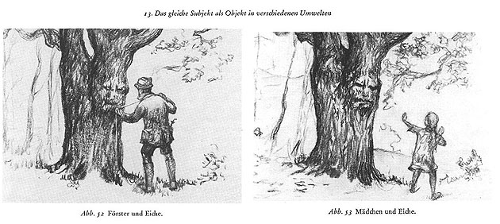
Umwelt
Self-world
A bubble around each organism that represents its own world and how it experiences it
Notes:
Jakob von Uexkell (1934), A Tick’s Umwelt Film in which you are perceiving the world from within their Umwelt – Blair Witch Project.

