Slide 1
Justice
post-truth politics
ecological stereotyping
Dumping in Dixie
gentrification
redlining
sovereign power
disciplinary power
governmentality
biopower
structural violence
slow violence
panopticon
culture of impunity
extrajudicial
spatial inequality
spatial mismatch
Notes:
180ism

Slide 2
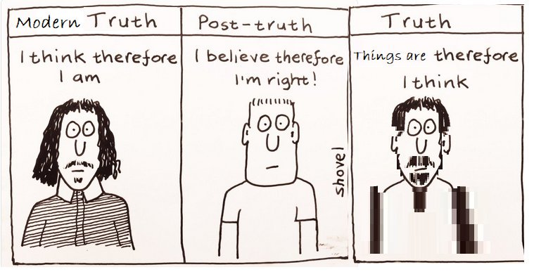
Post-truth politics
Politics in which objective facts are less influential in shaping public opinion than appeals to emotion and personal belief
Reliance on assertions that “feel true” but have no basis in fact
Notes:
https://andrewscampbell.com/2019/09/15/teaching-and-educating-in-a-post-truth-world/

Slide 3
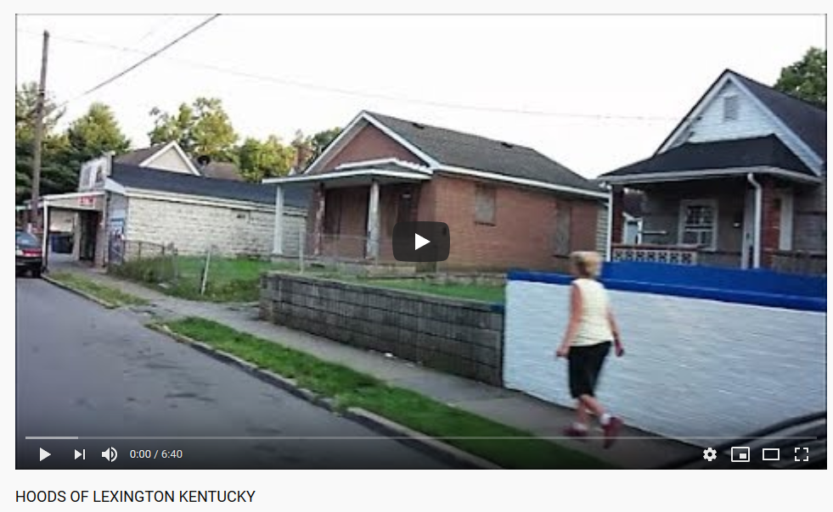
Ecological stereotyping
Generalizing the characteristics of people who live in a particular area based on the appearance of their environment
Notes:
https://www.pnas.org/content/113/2/310 Williams, K. E., Sng, O., & Neuberg, S. L. (2016). Ecology-driven stereotypes override race stereotypes. Proceedings of the National Academy of Sciences, 113(2), 310-315.

Slide 4
Environmental racism
The poor have greater exposures to environmental pollutants.
Dumping in Dixie was the seminal book that drew broad sustained public attention in the U.S. to environmental racism

Slide 5
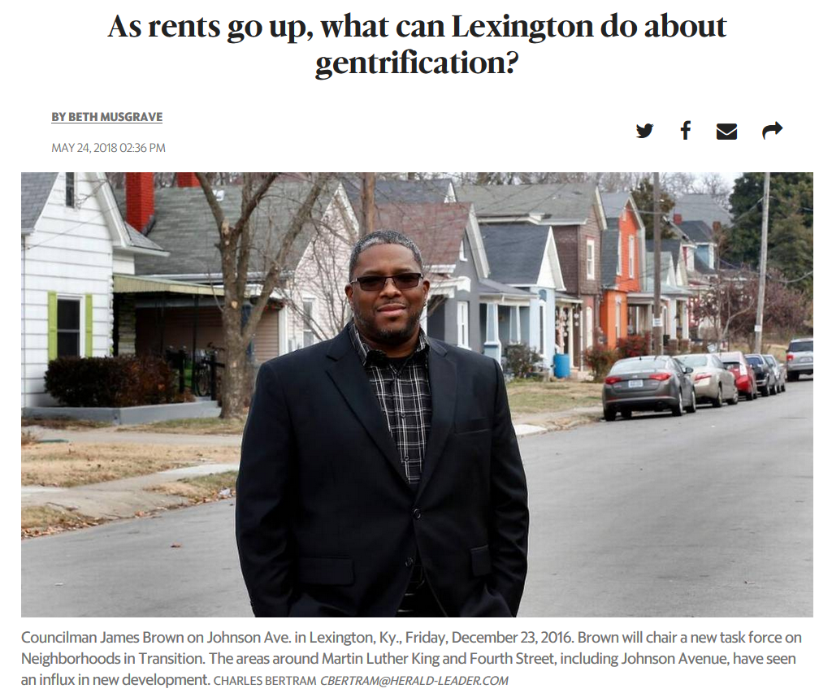
Gentrification
Revitalization of a neighborhood that on one hand may bring more amenities and a middle class quality of life, but on the other hand it may displace residents due to rising prices and changes in the social and cultural fabric
Notes:
Gentrification is sometimes called “social cleansing” by its critics
https://nymag.com/intelligencer/2014/02/spike-lee-amazing-rant-against-gentrification.html
https://www.theatlantic.com/politics/archive/2015/09/this-is-what-happens-after-a-neighborhood-gets-gentrified/432813/ https://www.kentucky.com/news/local/counties/fayette-county/article211819979.html

Slide 7
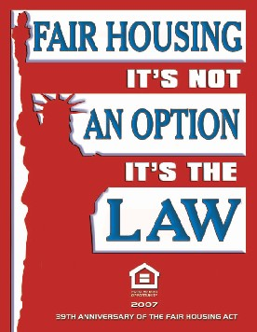
Redlining
A discriminatory practice by which banks or insurance companies refuse or limit loans, mortgages, or insurance within specific geographic areas, especially inner-city neighborhoods.
Redlining can be used as a tool of segregation.
Notes:
A discriminatory practice by which banks, insurance companies, etc., refuse or limit loans, mortgages, insurance, etc., within specific geographic areas, especially inner-city neighborhoods. Redlining can be used as a tool of segregation.

Slide 8
Power
Sovereign power – power that is taken as absolute and cannot be challenged
Disciplinary power – evolved out of sovereign power in which schools, jails, mental institutions discipline citizens to behave according to a body of knowledge shaped by those in power
Governmentality – the government of the self in response to their awareness of this body of knowledge
Notes:
Power is everywhere, not because it embraces everything, but because it comes from everywhere

Slide 9
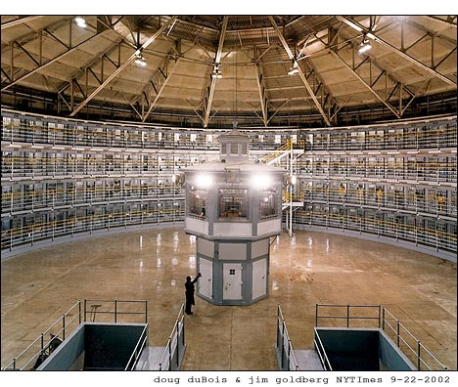
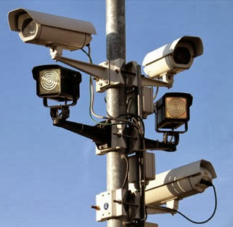
Panopticon
A metaphor for modern disciplinary societies and their inclination to observe, monitor and normalize
Social citizens internalize authority as a form of self-discipline out of a fear of being watched.
This becomes a source of power for prevailing norms and institutions.
Notes:
A driver, for example, might stop at a red light even when there are no other cars or police present. Even though there are not necessarily any repercussions, the police are an internalized authority. They are in effect watching everywhere all the time through this internalized control (as well as through the increasing prevalence of surveillance cameras)
The Panopticon is a type of institutional building designed by the English philosopher and social theorist Jeremy Bentham in the late 18th century. The concept of the design is to allow all inmates of an institution to be observed by a single watchman without the inmates being able to tell whether or not they are being watched. Although it is physically impossible for the single watchman to observe all cells at once, the fact that the inmates cannot know when they are being watched means that all inmates must act as though they are watched at all times, effectively controlling their own behavior constantly.

Slide 10
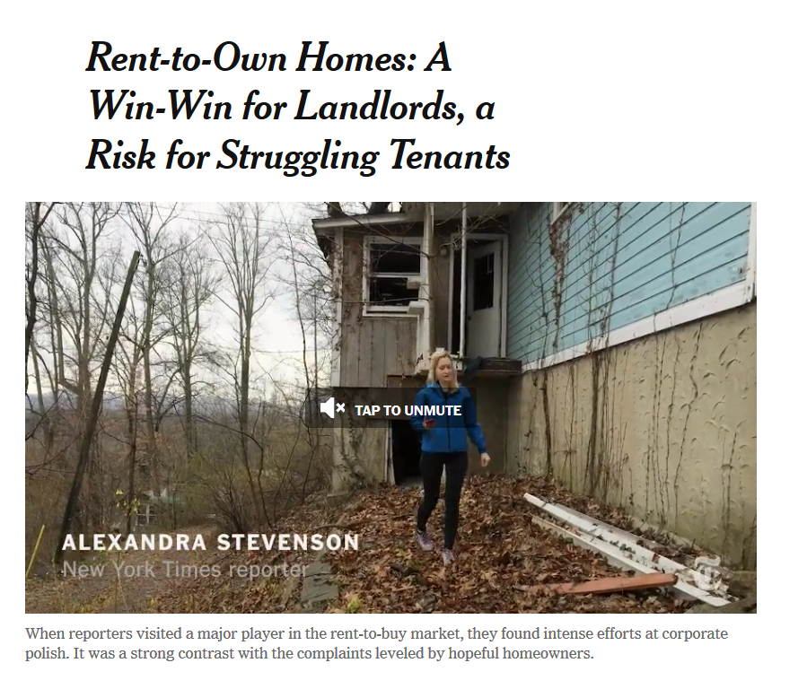
Structural violence
A form of violence wherein social structure or a social institution can bring harm.
It is not direct violence, but the form of violence that can be financial, psychological, or deprivational in a way that causes harm.
Notes:
https://www.nytimes.com/2016/08/22/business/dealbook/rent-to-own-homes-a-win-win-for-landlords-a-risk-for-struggling-tenants.html

Slide 11
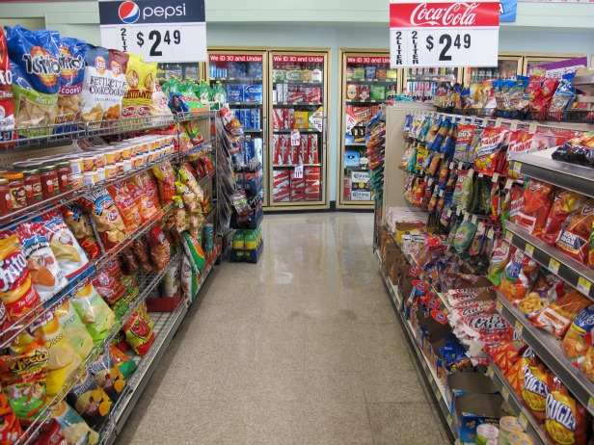
Biopower
The power and control over bodies and populations through legal, economic, and governmental policies
These policies ultimately shape the way in which live at a fundamental level
Our health and well being are tied to policies that shape what we eat, where we live, the access and quality of health care, our environmental exposures, and our safety at work and at home.
Notes:
Nutritional standards, trade practices, medical guidelines, including how diseases are diagnosed and covered by insurance are ways in which biopower operates

Slide 12
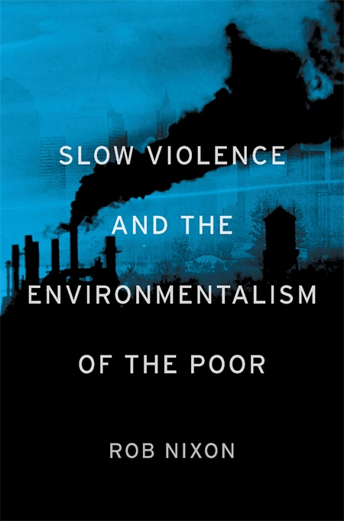
Slow violence
Violence that is invisible or slow
Examples include climate change, deforestation, habitat fragmentation, and accumulation of pollutants
These may occur gradually, at a distance, such that their effects are not immediately known until much of the damage has been done.

Slide 13
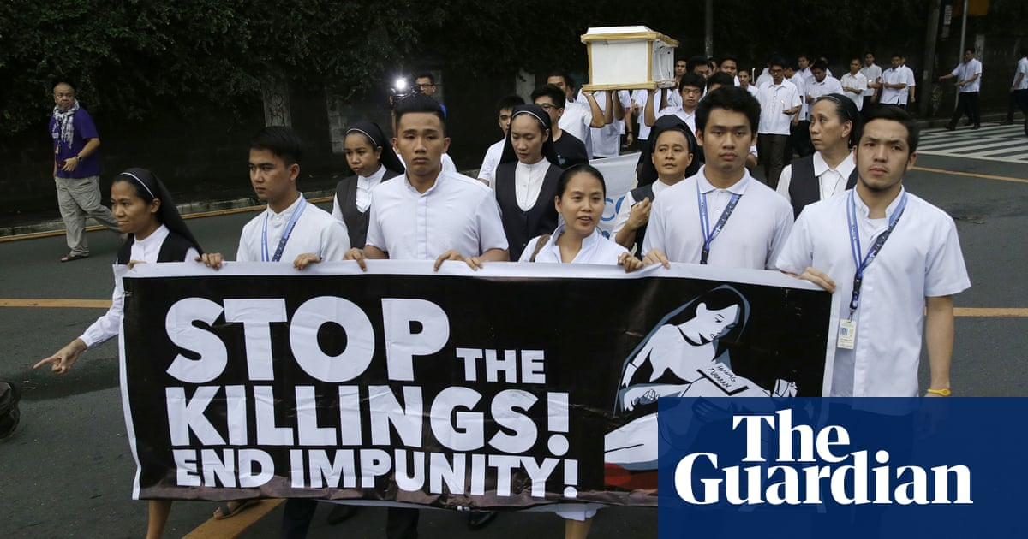
Culture of impunity
The concept that some people are above the law
International human rights and anti-corruption reformers talk about "cultures of impunity" in countries where murder, the looting of economic resources, and other crimes by the powerful regularly go unpunished.
Notes:
https://prospect.org/labor/cultures-impunity/

Slide 14
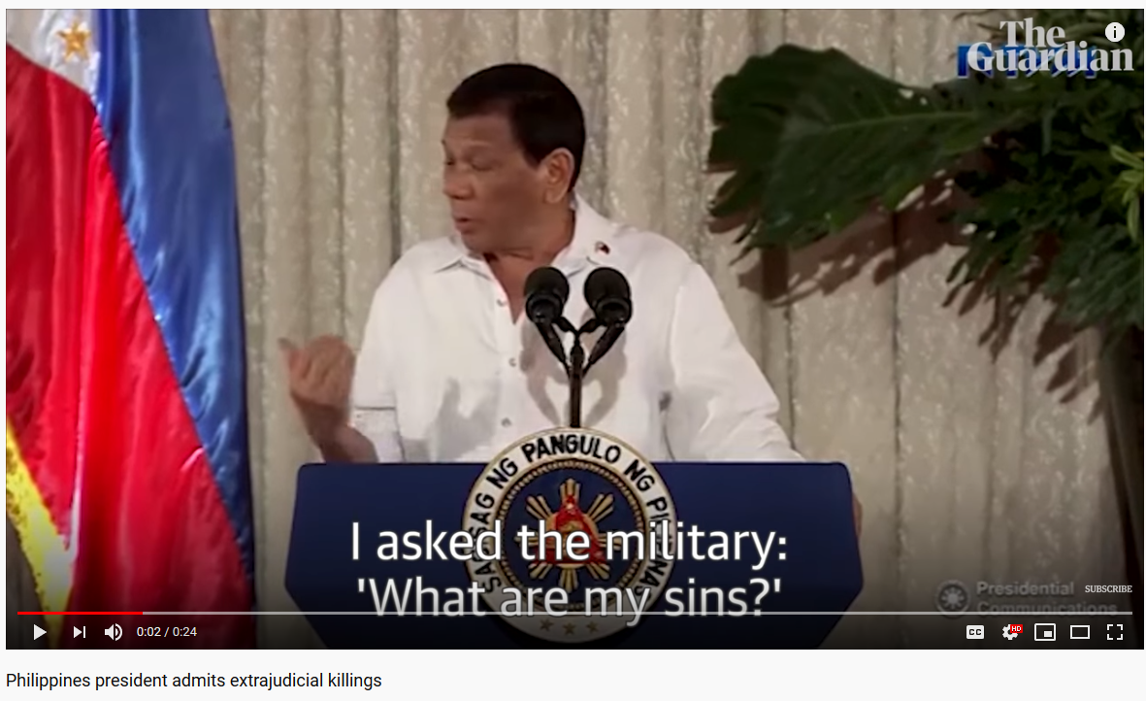
Extrajudicial
Done without the permission of or without using the official legal system
Notes:
Think of how this term is geographical and spatial in the sense of being ‘outside’ the law. There is an environment in which the law works legally and a context where it operates outside of these legalities

Slide 15
Notes:
https://qz.com/india/1396785/drone-photos-capture-the-staggering-inequality-in-mumbai/

Slide 16
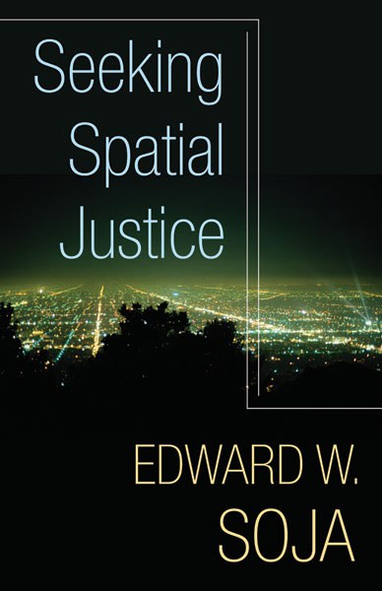
Spatial inequality
Unequal spatial distribution of resources and services
Healthcare, public transportation, household income, and infrastructure are spatially structured
Space is fundamental to inequality, it is implicit in its expression
Notes:
http://www.nytimes.com/projects/2013/invisible-child/index.html#/?chapt=1

Slide 17
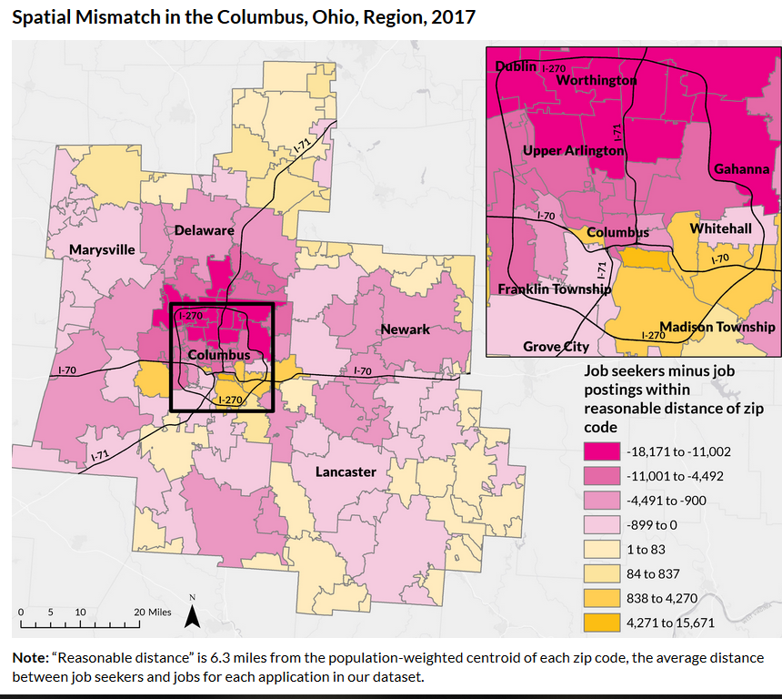
Spatial mismatch
How low-income residents in many cities live far from available jobs, and employers can’t find people to fill open positions.
This mismatch between where jobs are located and where job seekers live can cause higher unemployment rates and lead to longer spells of joblessness.
Notes:
https://www.urban.org/features/too-far-jobs-spatial-mismatch-and-hourly-workers

