Slide 1
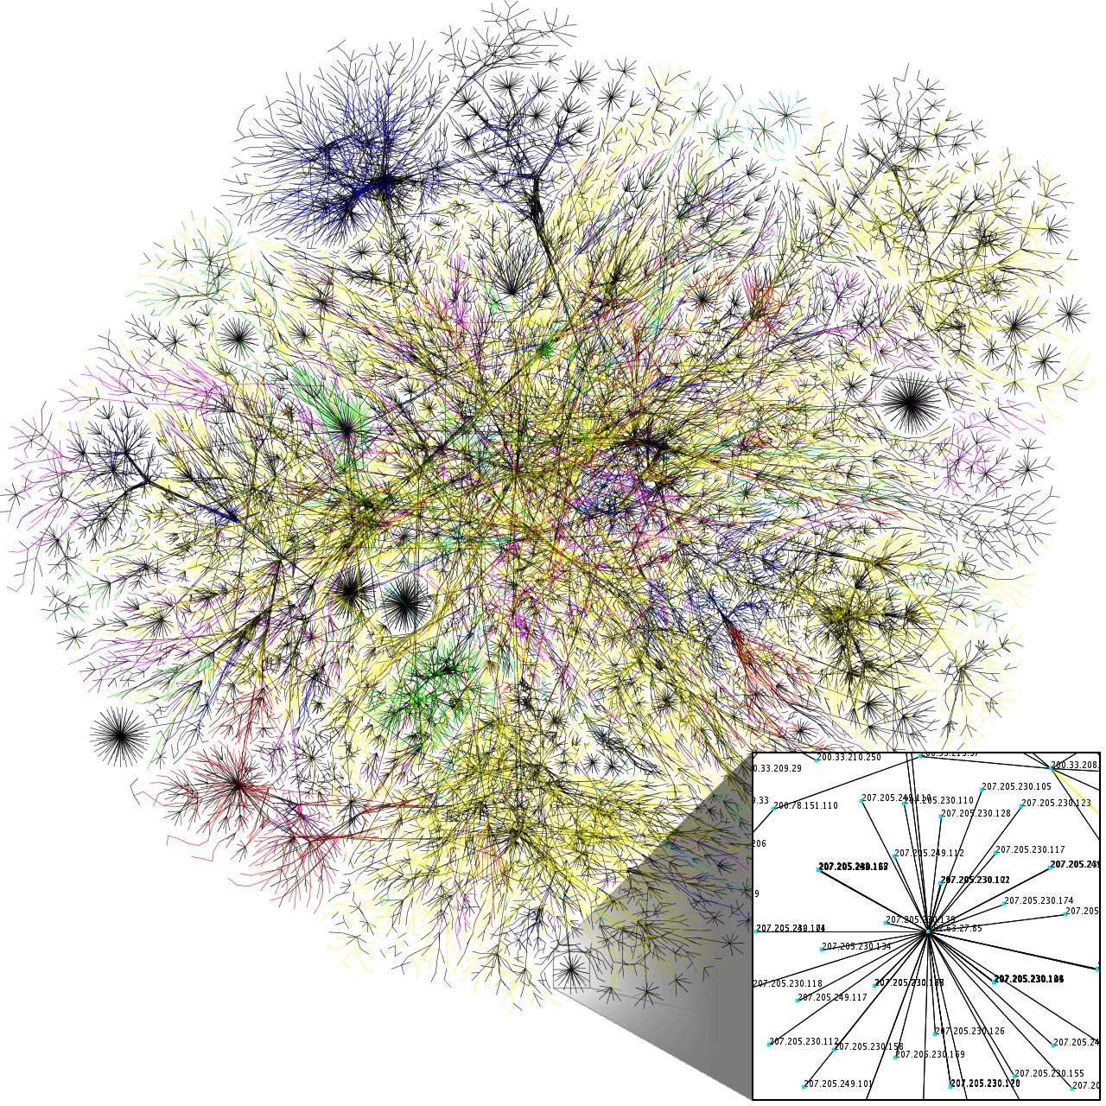
Geographies of media and information
Information is from somewhere; about somewhere; it evolves and is transformed somewhere
Information is mediated by networks, infrastructures, and technologies: all of which exist in physical, material places.
Information – ‘the imparting of knowledge’ – encompasses its transmission and movement of information
Notes:
Until relatively recently, however, much of the world’s geographic information was tethered to particular parts of the world. Some of it passed orally, from person to person. Information, or content (for instance, directions, a description, a story), was stuck to its container (the person who spoke about it, who heard about it. The internet greatly changed that.

Slide 2
Terms
medium is the message
remediation
network society
time-space convergence
convergence culture
filter bubbles
algorithmic society
algorithmic bias
cybertyping
reputation economy
gamification
microwork
data shadows
semantic web
internet of things
dark web
block chain
surveillance capitalism

Slide 3
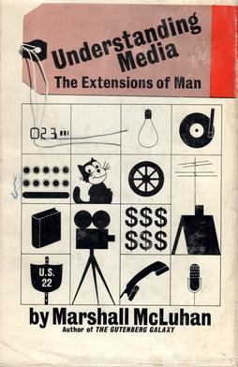
The medium is the message
Phrase coined by Marshall McLuhan in his 1964 book
The ‘message’ is the change of scale or pace or pattern that a new invention or innovation (the ‘medium’) introduces.
The ‘message’ is the change in inter-personal dynamics that the innovation brings with it
Original intent of this expression was meant to apply to many different innovations, not just communications media.
However, it is has lived on most familiarly to imply that how we communicate our information is as important as the message.
Notes:
More broadly, this quote reminds us to look beyond the obvious and seek the non-obvious changes or effects that are enabled, enhanced, accelerated or extended by the new thing. How did Twitter change the world beyond simply the content of its messages?
https://individual.utoronto.ca/markfederman/article_mediumisthemessage.htm

Slide 4
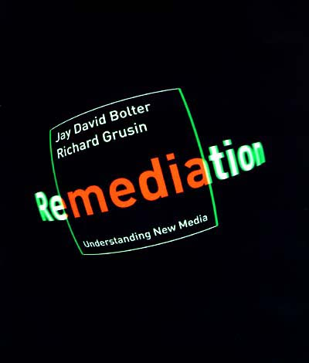
Remediation
How media constantly remediates its predecessors.
New digital media reincorporate aspects of older media forms
Books incorporated oration
Radio is contained within television
The internet subsumes all of these
Notes:
Media are continually commenting on, reproducing, and replacing each other. This process is integral to media. Media constantly interacts with other media by reproducing and replacing and making other changes. New digital media constantly justifies itself by remediating old media. How have the ways in which listening to music changed from first listening to live music to how it can be experienced in diverse ways today?

Slide 5
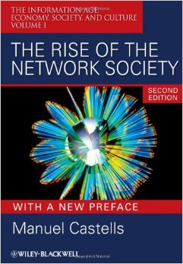
Network society
The expression coined in 1981 related to the social, political, economic and cultural changes caused by the spread of networked, digital information and communications technologies.

Slide 6
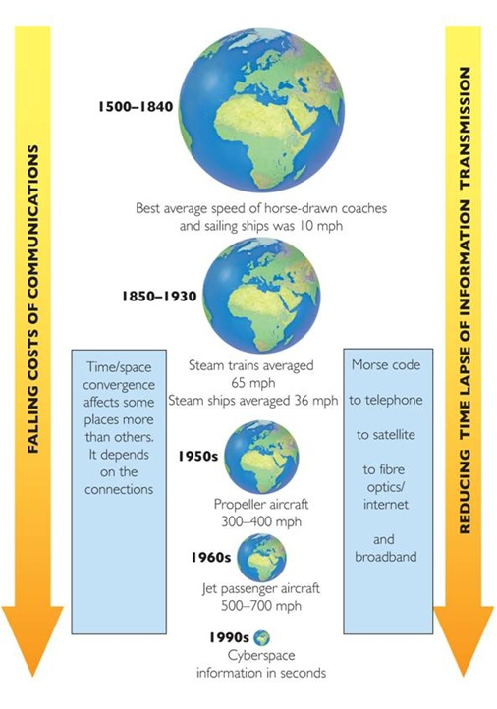
Time-space convergence
With improvements in communication systems (and methods of transport), the barrier of geographic distance is lessening. You can be simultaneously everywhere or anywhere on the internet

Slide 7
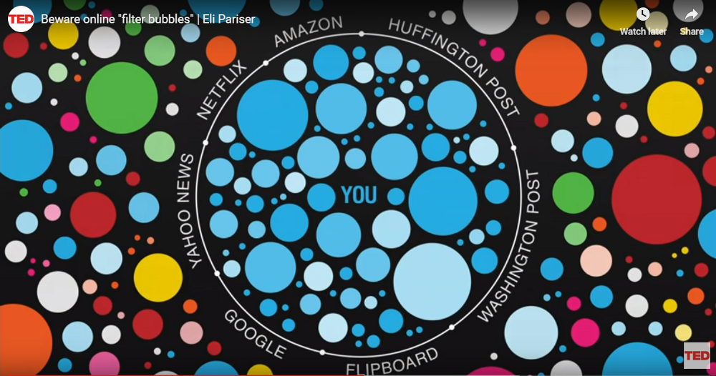
Filter bubbles
How search algorithms use personal information such as location, past click behavior and search history to shape what information it provides users.
As a result users become separated from information that disagrees with their viewpoints, effectively isolating them in their own cultural or ideological bubble.
Notes:
There is considerable evidence that people do not, naturally, seek truth. Rather than a model in which people gather facts and then, based on those facts, form opinions the reverse is true. Instead, people form their opinions and then accept facts that support those opinions and reject those that don’t. Filter bubbles lead people to become increasingly isolated in their own “information bubble” where they never encounter any dissenting information

Slide 8
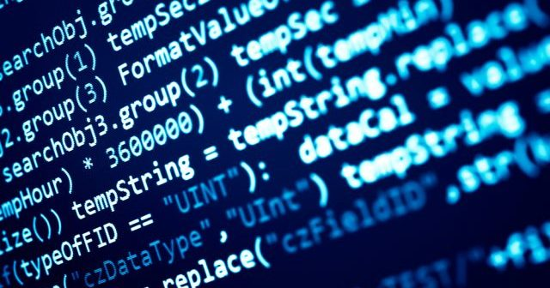
Algorithmic society
How the algorithms of the internet and our computational devices shape how we live collectively and individually
The information we see, the decisions made about finances, public safety, transportation, and health have a basis in software

Slide 9
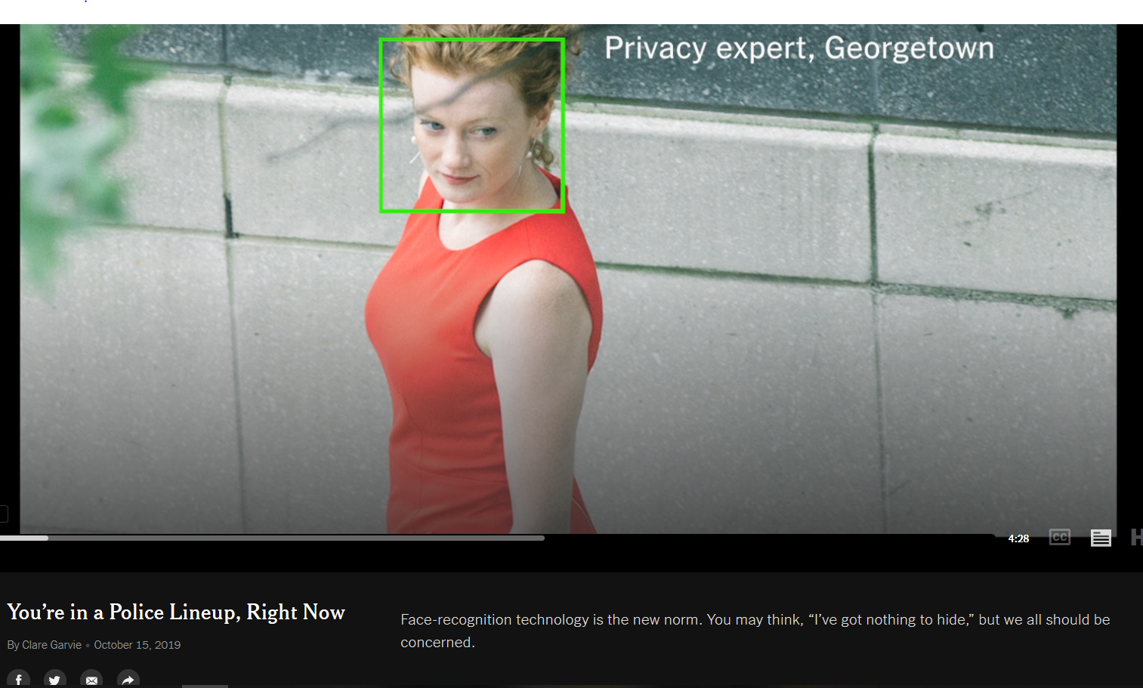
Algorithmic bias
Algorithmic bias encompasses the forms of discrimination that arise when software is used to predict behaviors.
Software is trained on data that contains all kinds of human biases, which can then appear in its own inferences.
Notes:
https://www.nytimes.com/2019/11/15/technology/algorithmic-ai-bias.html https://www.nytimes.com/2016/06/26/opinion/sunday/artificial-intelligences-white-guy-problem.html https://www.youtube.com/watch?v=59bMh59JQDo&t=70s&ab_channel=Google Examples: Women were less likely than men to be shown ads on Google for highly paid jobs. Widely used software to access the risk of recidivism in criminals was twice as likely to mistakenly flag black defendants as being at a higher risk of committing future crimes. It was also twice as likely to incorrectly flag white defendants as low risk.
It is often thought that machines are neutral arbiters: cold objects, calculators that can distinguish patterns which our human minds cannot (or refuse to) distinguish and make an optimal decision. However, algorithmic decisions can also be a way of unintentionally amplifying and extending prejudice and discrimination

Slide 10
Reputation economy
Through social media, digital reputations acquire economic influence
Criticism is that there is not necessarily an equivalence between online reputation and reality
Reviews of products and how we portray ourselves as customers can be readily manipulated

Slide 11
Gamification
The way in which interactive online design plays on people’s competitive instincts and incorporates the use of rewards to drive action— friend counts, retweets, the ability to “level up.”

Slide 12
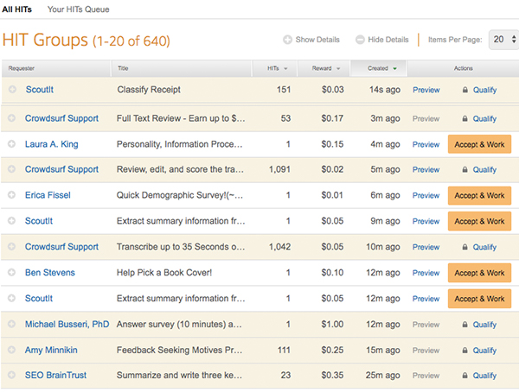
Microwork
Work tasks that are crowdsourced out to individuals over the internet for pay
Typically these tasks are best done by humans, such as moderating content, tagging photos, or cleaning up data
Amazon’s Mechanical Turk is a web site where tasks can be assigned to project, and are completed by many people over the Internet.
Notes:
https://www.youtube.com/watch?v=Pjm1uYbuyk4 https://thehustle.co/making-money-on-amazon-mechanical-turk/

Slide 13
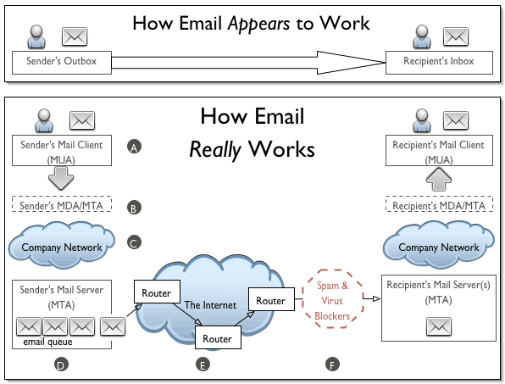
Data shadows
In a network, data cannot travel directly from one device to another – it has to go through many other devices on the network.
All digital activity travels through multiple servers in a network until it reaches its destination.
These third party actors can have access to our digital shadow
Data shadows are this trackable data that a person creates by using digital networks

Slide 14
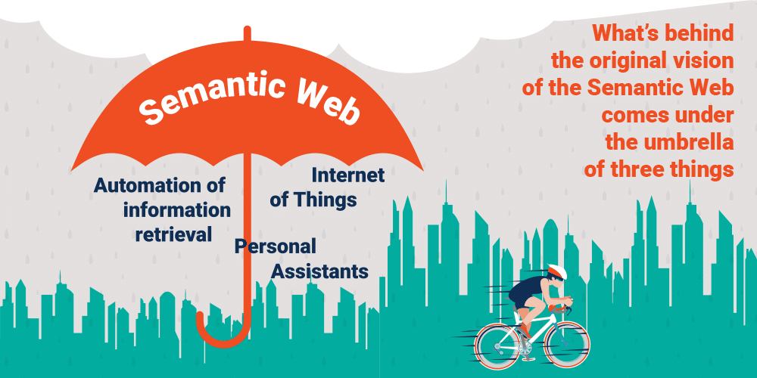
Semantic web
The web of connections between different forms of data that allow our devices to do something they weren’t able to do directly.
Automates the way in which the internet works so that it can in a sense ‘think’ for you and better manipulate information on our behalf.

Slide 15
Internet of things
A system of interrelated computing devices, mechanical and digital machines that are provided with unique identifiers and the ability to exchange and monitor data over a network

Slide 16
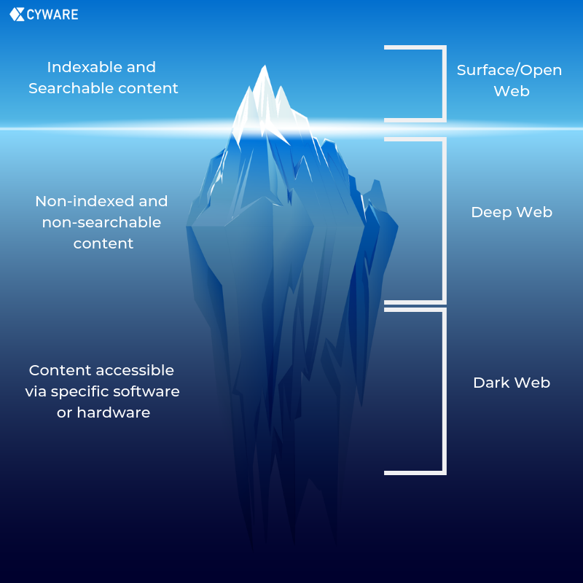
Dark Web
Site of illegal activity – drug sales, trade in stolen data, human trafficking – on the internet
To access it requires special software (like the Tor browser and network)that allows users to remain difficult to trace
Notes:
The secret world of the Darknet is not entered through any gate, but through the TOR: TOR stands for "The Onion Router". The word "onion" refers to the layers that must be penetrated by the data: Unlike normal surfing, the computer does not connect directly to the server where the website is located. Instead, a whole series of servers are involved in the connection in order to create the greatest possible anonymity.

Slide 17
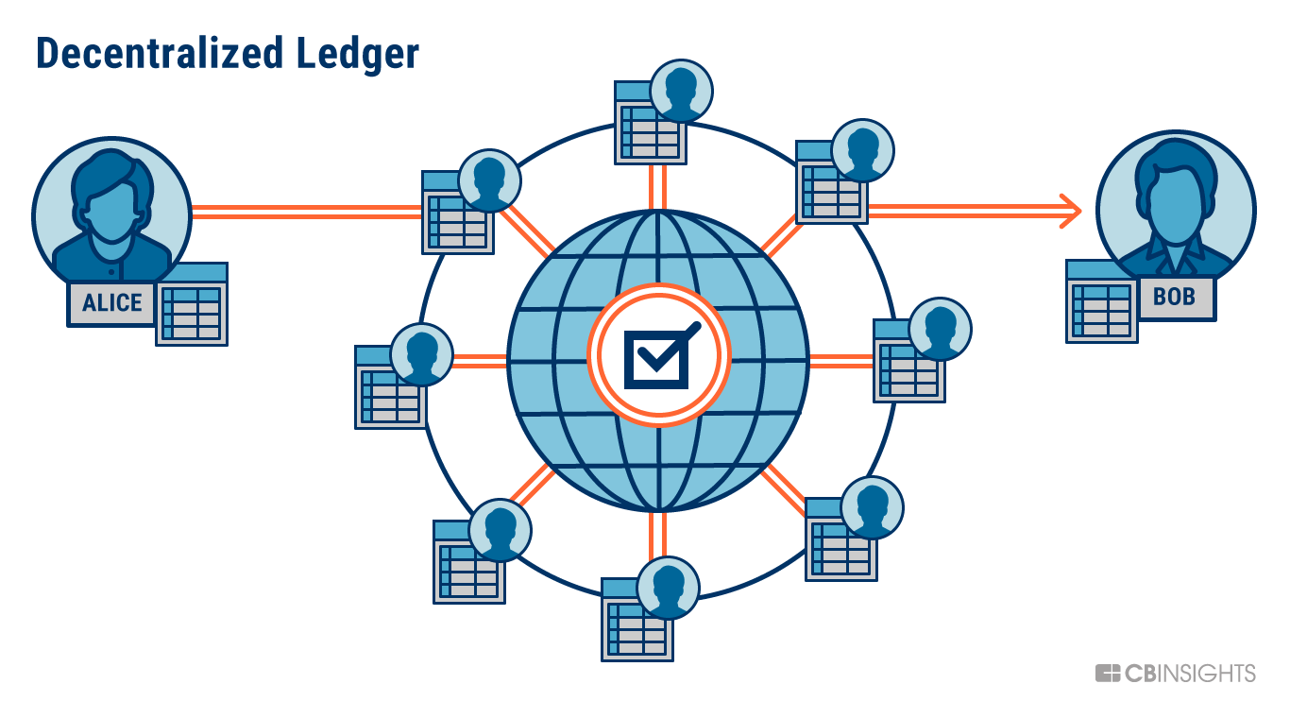
Blockchain
Online method for recordkeeping and validation of identity
Digital records are distributed instead of copied or transferred.
Decentralization allows full real-time access and maintains transparency and integrity of the data.
Notes:
A simple analogy for understanding blockchain technology is a Google Doc. When we create a document and share it with a group of people, the document is distributed instead of copied or transferred. This creates a decentralized distribution chain that gives everyone access to the document at the same time. No one is locked out awaiting changes from another party, while all modifications to the doc are being recorded in real-time, making changes completely transparent.

Slide 18
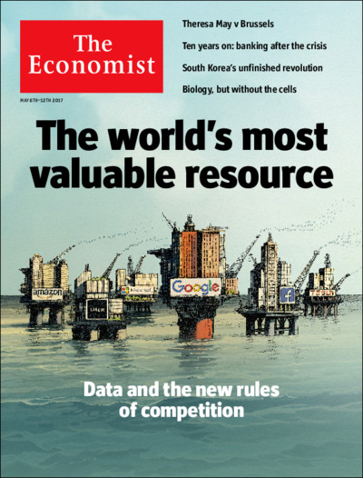
Surveillance capitalism
Instead of simply selling products, online vendors collect details about people to create massive predictive engines
These are meant to anticipate what and how you think in order to direct and control individuals along paths that will benefit the companies and all the other parties they sell data to.

