Slide 1
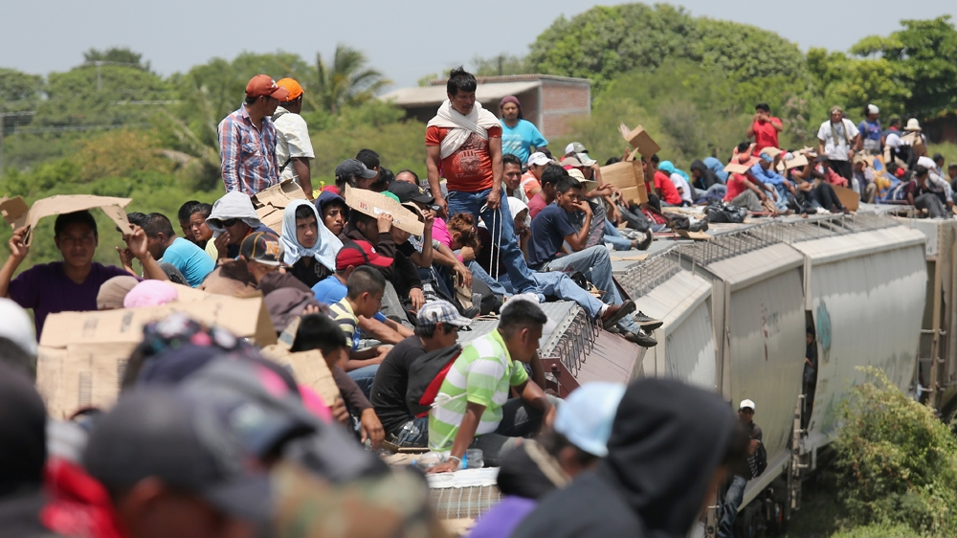
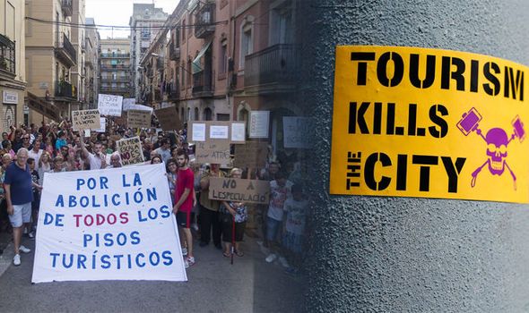
Mobility and environment
Movement of people, objects, and materials shape environments and landscapes.
Places are not static, but in flux, dynamic
Notes:
Guatemalan immigrants riding a train to Mexico, top March against tourist crowds in Barcelona, Spain. Geographers study movement and mobility as they constitute place.

Slide 2
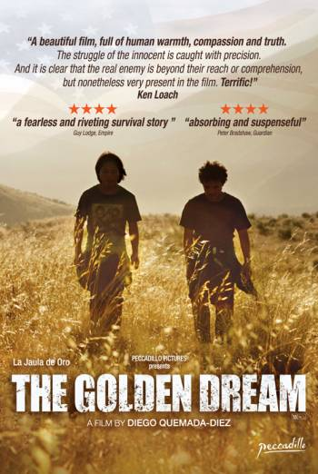
Migration
migrant transnationalism
diaspora
chain migration
step migration
assimilation discourses
transnational citizenship
liminal spaces
biometric border
remittance landscapes
Notes:
Also sometimes titled “The Golden Cage”.

Slide 3
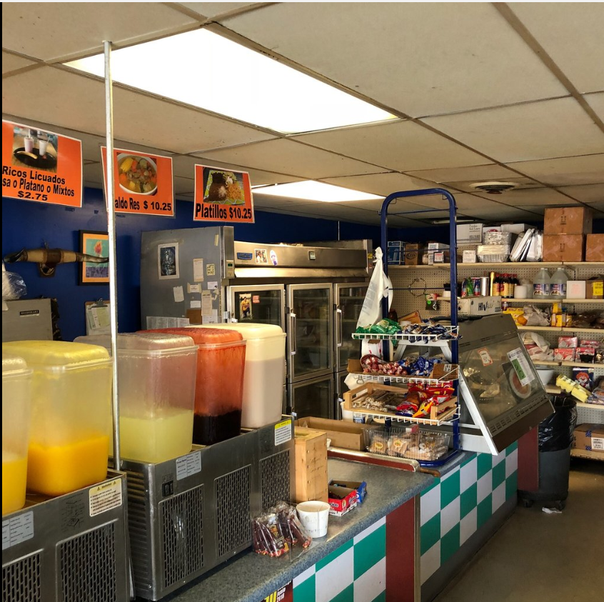
Migrant transnationalism
The process whereby immigrants establish and maintain socio-cultural connections across geopolitical borders.
When migrants arrive in destinations where they craft new, often permanent lives, they do not sever all ties to their culture and home countries
Notes:
When migrants arrive in destinations where they craft new, often permanent lives, they do not sever all ties to their home countries, hometowns, or families. I have highlighted culture (food) here, but there are many other ways transnationalism is expressed. Maintaining aspects of one’s immigrant identity through dress and language is also part of migrant transnationalism.

Slide 4
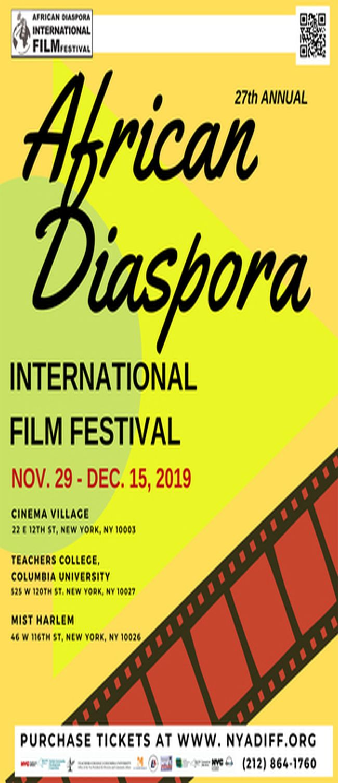
Diaspora
A way of thinking about a group of people dispersed from one place or region to many others – the Jewish diaspora, the African diaspora, the Palestinian diaspora
Can signify a collective longing where one dreams of home while living in exile in many scattered locations
More recent definitions recognize a more heterogeneous notion of diaspora as a result of new identities which develop

Slide 5
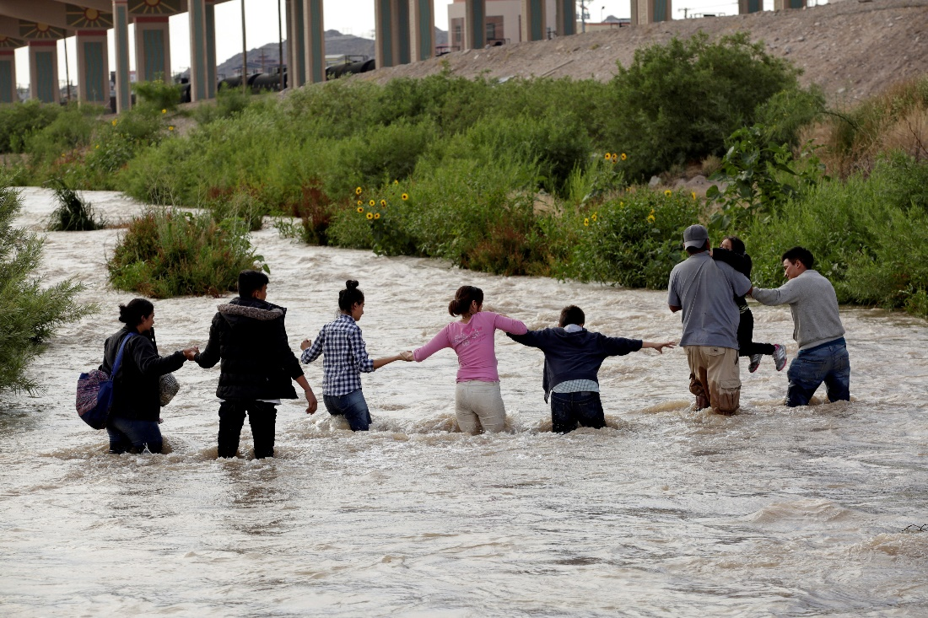
Chain migration
Refers to the social process by which migrants from a particular place follow others from that place to a particular destination.
For example, Georgia’s Mexican immigrants came predominately from three states in Mexico: Guerrero, Michoacán, and Guanajuato.
Social networks play a large role in chain migration
Notes:
In a State of the Union address, President Trump claimed, “Under the current broken system, a single immigrant can bring in virtually unlimited numbers of distant relatives.” In reality, America’s immigration laws strictly limit the types and numbers of family-sponsored immigrants. The laws allow U.S. citizens and legal residents to sponsor only immigrants who are their immediate relatives — spouses, children, siblings and parents — and the spouses and minor children of those immigrants.
https://www.washingtonpost.com/outlook/five-myths/five-myths-about-chain-migration/2018/02/14/42d35276-1009-11e8-8ea1-c1d91fcec3fe_story.html
https://www.washingtonpost.com/politics/2019/06/19/adding-troops-mexicos-border-with-guatemala-wont-block-migrants-coming-us-heres-why/ Guatemalans crossing into Mexico

Slide 6
Step migration
Notes:
Migration is rarely a single move but may consist of several steps, often beginning with movement from rural areas to smaller towns and then to larger cities before crossing national boundaries. Once arrived, step movements continue as immigrants move from initial temporary housing to more fixed and permanent homes.

Slide 7
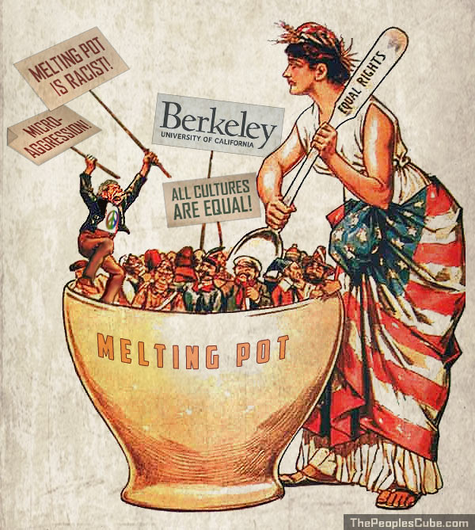
Assimilation discourses
The ways in which politicians, media, as well as native residents formulate expectations for immigrants to adapt to prevailing norms and cultures—and the effects that such discourses have on social relations in immigrant-receiving societies.
Notes:
For example, native residents may feel threatened that immigrants live in clusters of their own culture and commerce and advocate that they do more to assimilate.
However, immigrants may contest this assimilation discourse because these ethnic enclaves offer advantages not seen by outsiders.

Slide 8
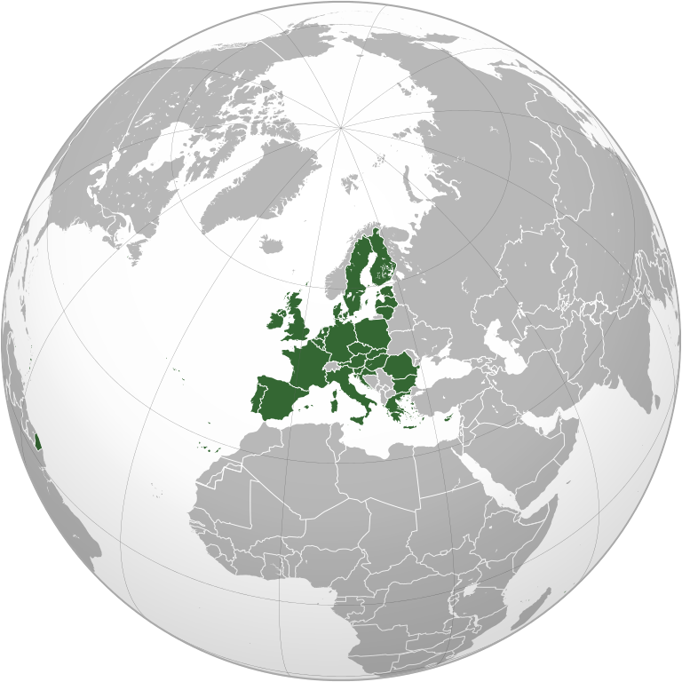
Transnational citizenship
Refers broadly to the enjoyment of rights, political participation, and/or membership in a community that extends beyond the borders of nation-state so that people may move more easily and safely.

Slide 9
Stateless people
Individuals who by migration and/or undocumented birth no longer have legal ties to a country are ‘stateless’
Concepts such as “UN identity card” and “self-sovereign identity” are being considered as a way to create the idea of transnational citizenship for stateless people.
Notes:
Concepts such as “UN identity card” and “self-sovereign identity” are being discussed among experts groups to create the idea of transnational citizenship for stateless people.
https://blogs.worldbank.org/digital-development/world-citizen-transforming-statelessness-global-citizenship

Slide 10
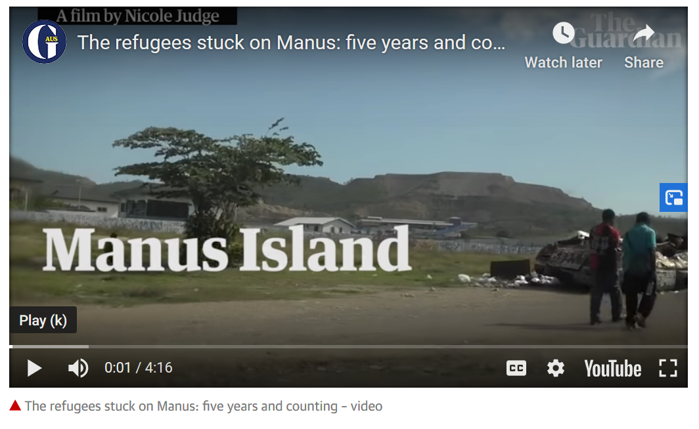
Liminal spaces
Liminal means ‘in between’
Places can emerge that are in between formal nation-states
Administration of justice and provisioning of basic human rights are difficult to define and monitor here
Notes:
Immigrants held in the Manus Island holding facility have been relocated to a major city in New Guinea

Slide 11
Biometric border
Traditionally, identification of travelers at national borders has been done with paper-based documents.
However, now more technologically advanced methods such as facial recognition and iris scans are being leveraged for screening people trying to enter a country.
Algorithms would lessen the role of human decision-making in who can cross borders
Notes:
Fingerprint pattern searches that take much longer, may require filtering, and may return multiple candidate matches. Furthermore, there are additional user variability limitations with fingerprint identification such as skin integrity and age that are not a factor in the performance when using iris recognition.

Slide 13
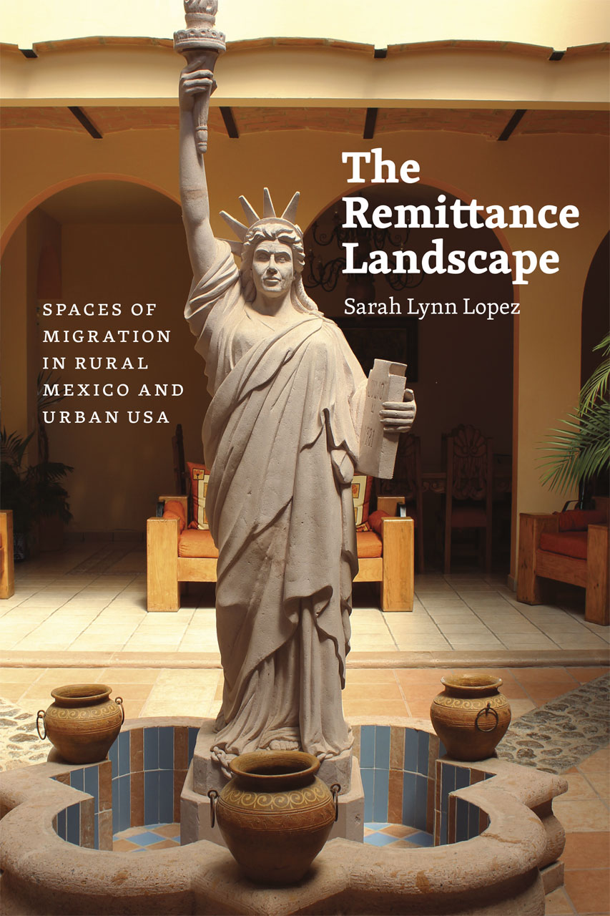
Remittance landscapes
A remittance is the transfer of money, often by a foreign worker, to an individual in their home country.
Families in less developed countries are often supported on income made by migrants working in another
The homes they build and the communities shaped by this money often stand in contrast to what is around them – leading to the concept of the remittance landscape
Notes:
Remittance ‘architecture’ can be seen in countries in which a large amount of money is sent back to build homes and support families.

Slide 14
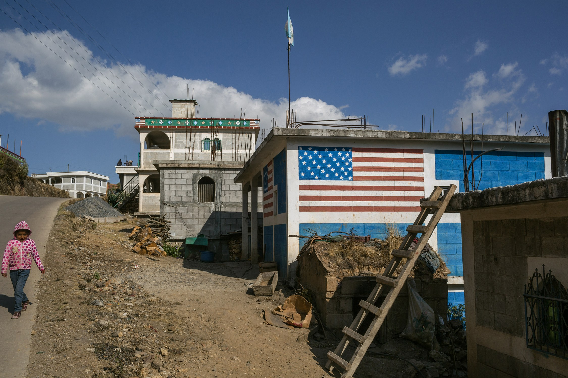
Notes:
https://www.newyorker.com/news/dispatch/the-dream-homes-of-guatemalan-migrants

Slide 15
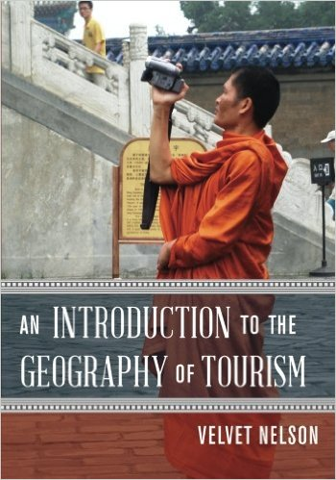
Tourism
types of tourism
gringo trail
neocolonialism
social construction
tourist gaze
commodity fetishism
landscape as representation

Slide 16
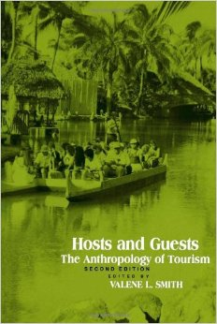
Types of tourism
Tourism encompasses diverse forms and has diverse effects in the places where it takes place
agricultural tourism
rural tourism
ecotourism
medical tourism
service tourism
reality tourism
Notes:
According to the United Nation World Tourism Organization nearly 1 billion people cross international borders each year.

Slide 17
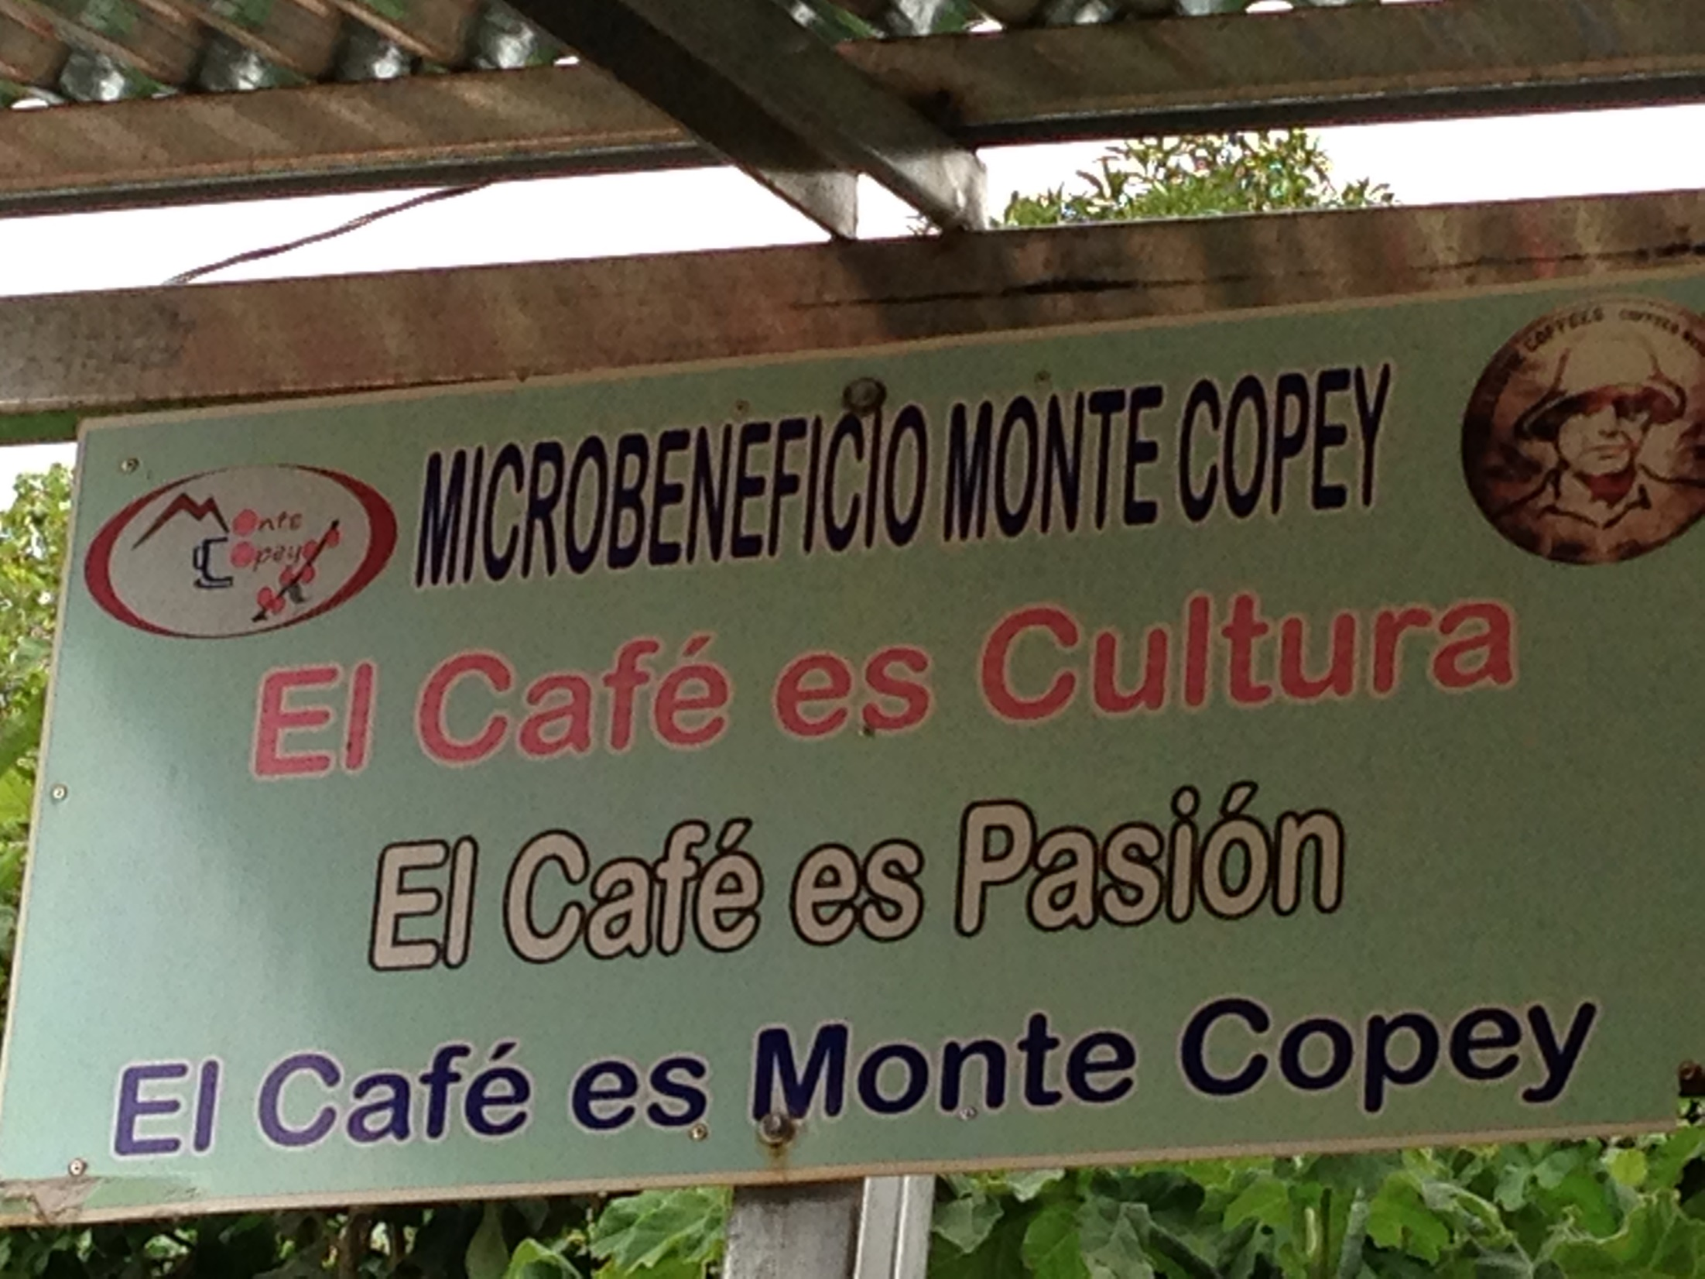

Slide 18
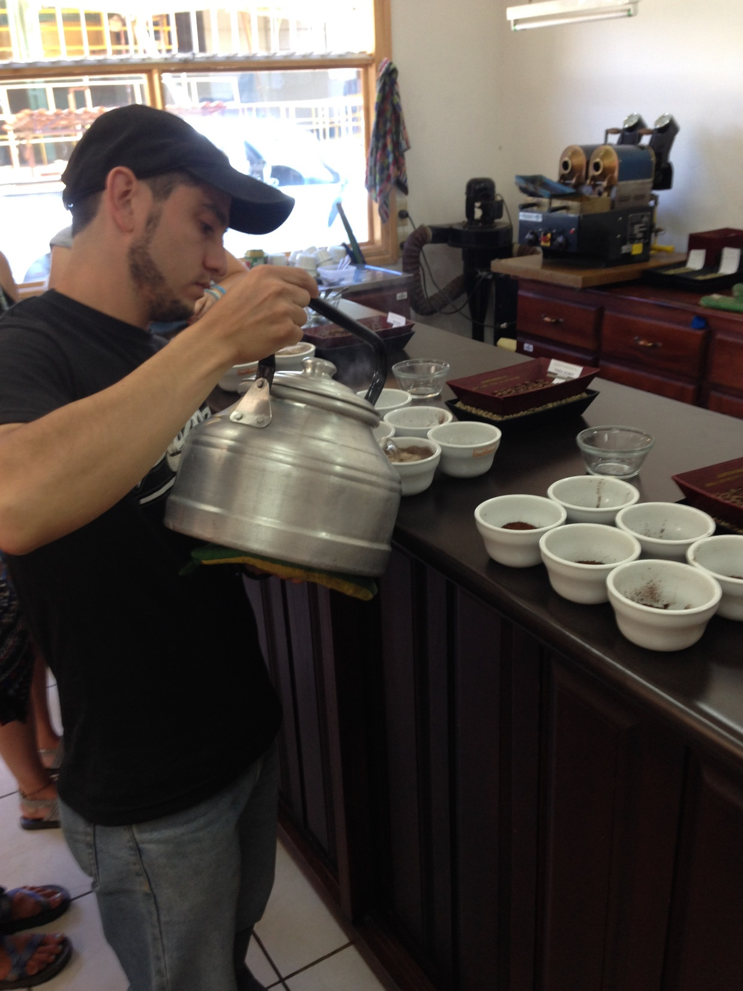

Slide 21
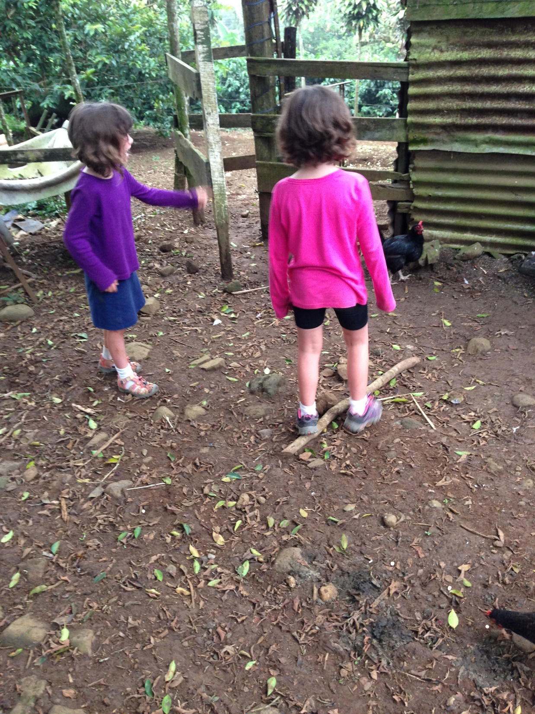

Slide 25
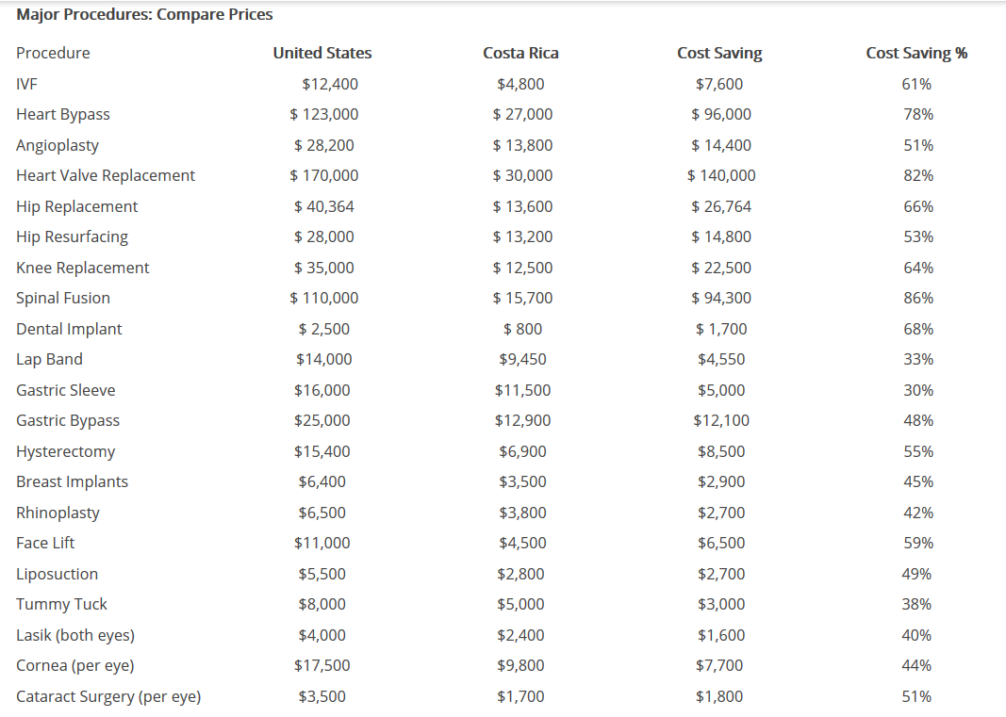

Slide 26
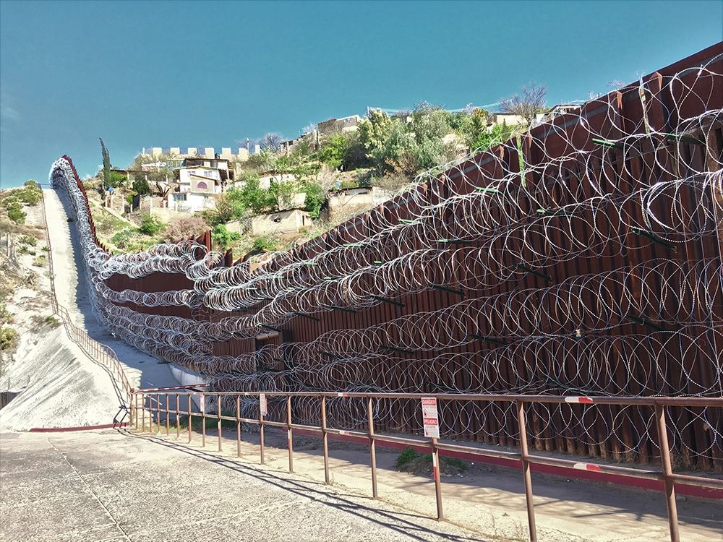
Reality tourism
Tourists are provided a chance to see the reality of hunger, malnutrition, terrorism, position of women in such part of society.

Slide 27
Can have a positive service or volunteer aspect to the travel, or it can be more negative - exploitative and voyeuristic

Slide 28
Gringo trail
Notes:
The Gringo Trail refers to a string of the most frequently visited places by “gringos", US-Americans and other foreigners in Latin America.

Slide 29
Neocolonialism
The control of less-developed countries by developed countries through indirect means
These means can be political, economic, or cultural
Tourism can be neocolonialist in that our visit can be harmful in ways we may be unaware of – tourists indirectly wield power on those places they visit because of the money they spend
Notes:
Colonialism was control of a country by direct means, often through the military
Tourism can control of the worldview of a country and take representations of its culture out of the hands of its people and give it to people of more developed and dominating countries

Slide 30
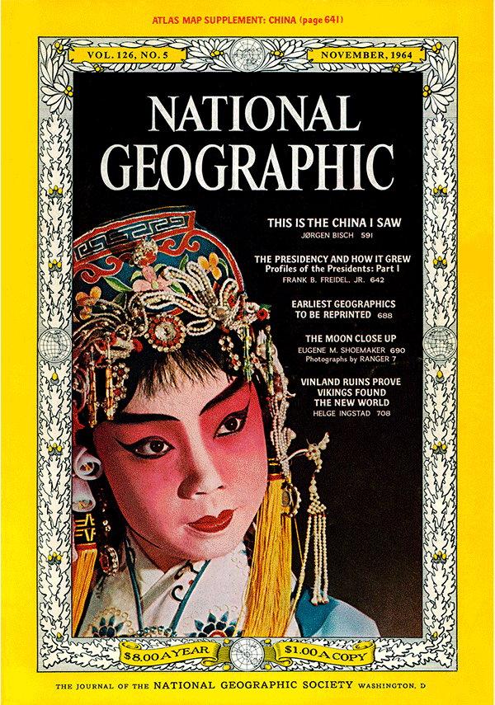
Social construction
How we view a place, an environment, or even people is the result of social processes that take place in historical and cultural context
No such thing as a neutral or objective place

Slide 31
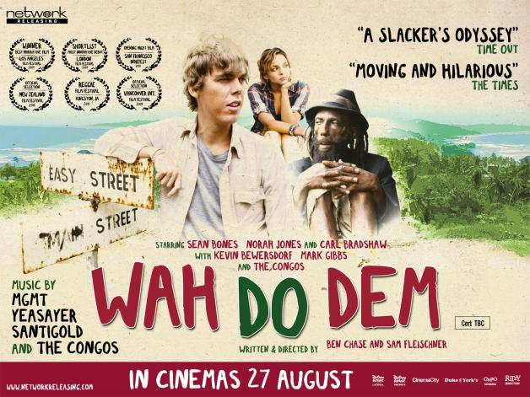
Notes:
How did Max socially construct, or imagine, his trip? What shaped it? How did it differ from what he originally envisioned?
Throughout the film there are motifs of what is real and what is fake – the reality of cruise ships versus how they are advertised to the public, the paintings being auctioned on the boat were mass produced by ‘slaves’. Max was seeking an authentic experience – but is such an experience possible?

Slide 32
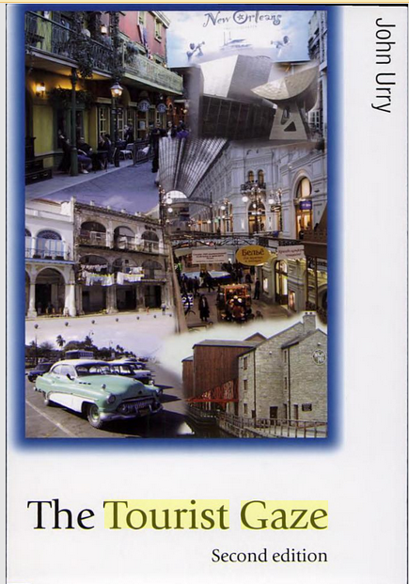
The tourist gaze
The way in which we view a landscape when we travel
The gaze that develops from socially constructing a place before we visit
We tend to see the place through a lens unique to ourselves
However, the tourist gaze can also be scripted and controlled
Notes:
Think about the way the Rasta tries to get Max to “see”, to lose his tourist gaze for a moment…
Even the idea of tourism is in itself a recent invention….

Slide 33
Notes:
The tourist gaze can also be programmed or scripted. People they take photographs of the same monuments and sites in the same way. This applies to tourist sites, public spaces and ordinary buildings. The same gestures and vantage points and compositions are repeated, and the images come out so uncannily similar that it’s as though everyone were subject to the same set of instructions.
We think we are moving through the world, while the whole time the world is pulling us along, telling us where to walk, where to stop, where to take a photo.
Views are arranged through turnstiles, paths, guardrails, signs and walls. A visitor might think she’s simply experiencing a set of archaeological ruins or a natural feature of the landscape, but she is in fact subject to whatever the tourist board, landscape designer or architect has prepared for her. This preparation of the site has a major but often unnoticed influence on the photos she might end up taking at the site.
https://www.nytimes.com/2018/06/27/magazine/take-a-photo-here.html?rref=collection%2Fbyline%2Fteju-cole&action=click&contentCollection=undefined&region=stream&module=stream_unit&version=latest&contentPlacement=1&pgtype=collection

Slide 34
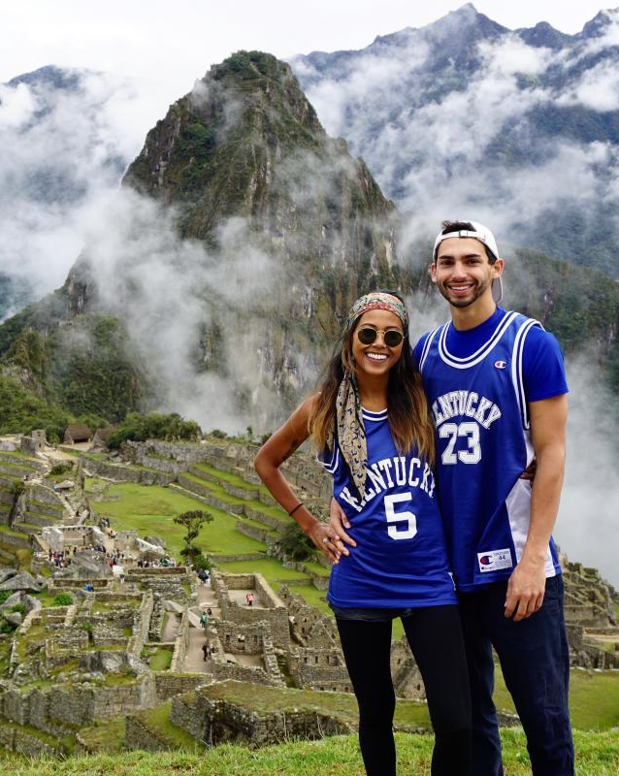
Commodity fetishism
The value of something bought transcends their origins in (often hidden) human labor and resource extraction
An object or a landscape is something to acquire and consume without regard to the social relationships underneath it
Notes:
Max fetishized his experience of the beach – it was just the presence of the people, the clean sand, a Red Stripe, the clear water, and not anything with the underlying social realities of the people who live there.

Slide 35
Notes:
Fetishism in the film – the banquets, the pool, the ‘escape’ of the cruise: they mask the underlying labor and unequal power relations Max fetishized his experience of the beach – it was just the presence of the people, the clean sand, a Red Stripe, the clear water, and not anything with the underlying social realities of the people who live there.

Slide 36
Notes:
https://www.theguardian.com/cities/2018/jun/25/tourists-go-home-refugees-welcome-why-barcelona-chose-migrants-over-visitors

