Slide 1
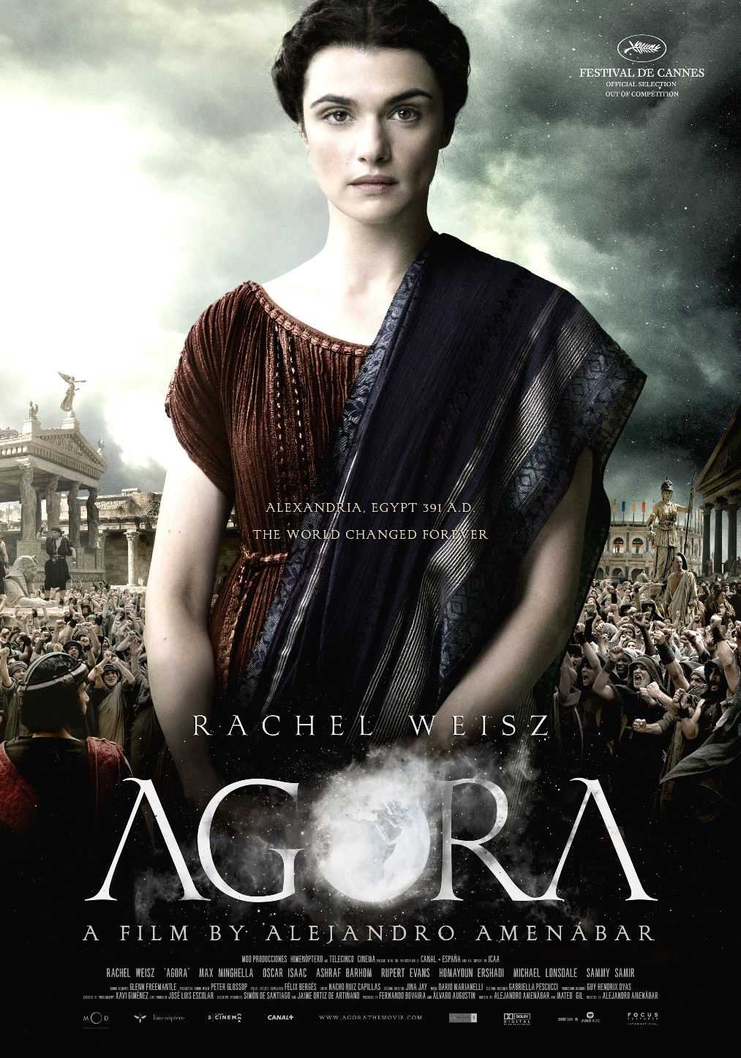
The sacred and the secular
There are places of worship, sacred places, as well as secular common places and private spaces
We perform actions related to our spirituality in some places but not others.
The geography of religion is more than just a cataloging of what religions are practiced where and what those beliefs are. It is about how place and religious practice inform one another.
What we believe and value shapes the way in which arrange and coordinate our spaces of living.
Notes:
Agora illuminates the way in which reason and science conflicted with superstition, fundamentalism and political expediency. It shaped not only the spaces were people lived and worked. It also shaped politics and bounded ideas of nation and state.

Slide 2
The sacred and the secular
animism
polytheism
religious syncretism
monism
civil religion
liberation theology
secularism
secular humanist
cosmology
religious idealism
proselytism
millennialism

Slide 3
Animism
The attribution of a soul to plants, inanimate objects, and natural phenomena.
Notes:
The early Romans believed in a simple animism - that there were spirits/powers, or numina, which surrounded all men. There were no temple/statues. The rites were clean and simple and they were practiced with an exactness believed pleasing to gods.

Slide 4
Polytheism
Worship of or belief in multiple deities, which are usually assembled into a pantheon of gods and goddesses
Notes:
But the Romans did not remain entirely animistic. As the Romans extended their dominance throughout the Mediterranean world, their policy in general was to absorb the deities and cults of other peoples rather than try to eradicate them, since they believed that preserving tradition promoted social stability.

Slide 5
Notes:
Serapis was a Greek-Egyptian god that the Romans deified, often replacing Osiris, the Egyptian god of the afterlife

Slide 6
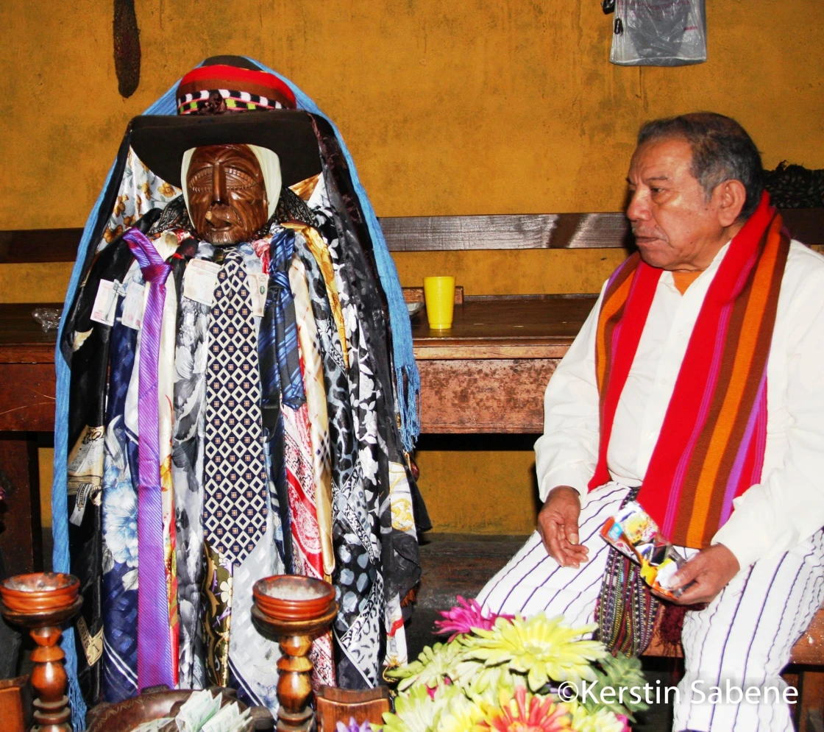
Religious syncretism
Blending of two or more religious belief systems into a new system, or the incorporation into a religious tradition of beliefs from unrelated traditions.
Catholic – Mayan syncretism
Afro-Brazilian religions like Umbanda blend African traditions with Catholicism and animism
Germanic pagan fertility goddess adopted into Christianity as Easter
Notes:
Catholicism in many parts of Central America is syncretic in that it reflects a fusion of traditional Mayan belief with Catholicism. The Easter bunny and its eggs are symbols of reproductive fertility, which has always been celebrated in the Spring—by pagans. Easter is an example of religious syncretism – the blending of different religious. Easter was named after an ancient Germanic pagan fertility goddess. Photo: The statue of the Mayan demi-god Maximon is kept in the home of one of the members of his cofradia—the traditional brotherhood that cares for the Mayan saint—on Holy Week, he is transferred to his chapel near the Catholic Church https://www.nbcnews.com/news/latino/mayan-catholic-easter-tradition-yes-santiago-atitl-n-guatemala-n745176 Religious syncretism is probably the most talked about kind of syncretism, but you can also talk about cultural, political, musical, linguistic, culinary, or other sorts of syncretism. Any time aspects of two different cultural traditions blend and become something new, it’s syncretism. However, syncretism is potentially quite different from polytheism. The ideal of the ‘melting pot’ is syncretic because the things that go into a melting pot lose their original identity and become something new.

Slide 7
Monism and dualism
All existence is universally one thing, in contrast to a dualism
In religious monism all things are derived from a single deity, and we interpret our reality as a single continuous whole emanating from this deity
Dualistic religions imply boundaries and a dynamism of forces to explain the world
Notes:
The ubiquitous yin-yang symbol holds its roots in Taoism/Daoism, a Chinese religion and philosophy. The yin, the dark swirl, is associated with shadows, femininity, and the trough of a wave; the yang, the light swirl, represents brightness, passion and growth

Slide 8
Civil religion
A religious faith often centered around the sacred symbols of a country and its national history. It acts as a cohesive force, a common set of values that foster social and cultural integration.
Notes:
In ancient Rome, religion was state-sponsored. The gods were thought to have a vested interest in the health and success of the Roman state and so religious beliefs and practices were not just suggested but mandated. People were expected to participate in state-sponsored religious rituals and festivals.

Slide 9
Notes:
Bellona was an ancient Roman goddess of war. She was called the sister of Mars. Bellona's main attribute is the military helmet worn on her head, and she often holds a sword, a shield, or other weapons of battle. She symbolizes how religion can meld with government and national identity to become a civil religion.

Slide 10
Notes:
The Imperial cult of ancient Rome identified emperors and some members of their families with the divinely sanctioned authority of the Roman State.
http://www.bbc.co.uk/history/ancient/romans/roman_religion_gallery_06.shtml

Slide 11
Liberation theology
Notes:
Christianity in its initial stages was more revolutionary in that it had the aim to help the oppressed

Slide 12
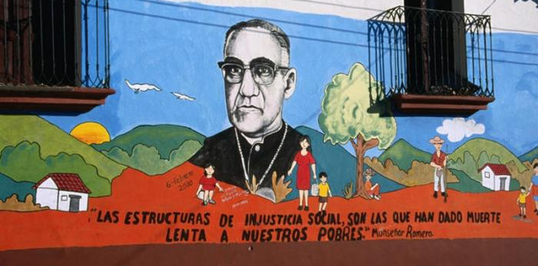
Liberation theology is facet of Catholicism that prioritizes the helping of the poor by actively seeking social change. Many activists and religious leaders who took this position were persecuted by the Vatican and assassinated by the dictatorships of the time. Roots are deeper than this and are not limited to Catholicism
Notes:
As Oscar Romero, the late Bishop of San Salvador, said, “If I give food to the poor they call me a saint. If I ask why the poor have no food, they call me a Communist Dorothy Day was an earlier liberation theologist: https://www.youtube.com/watch?v=RKiLCDaCAOU&t=117s&ab_channel=dorothydaydoc

Slide 13
Secularism
Principle of the separation of government institutions from religious institution and religious dignitaries

Slide 14
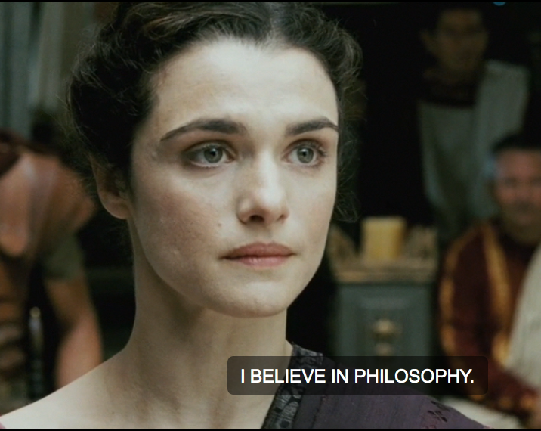
Secular humanism
An outlook or system of thought attaching prime importance to human rather than divine or supernatural matters.
Humanist beliefs stress the potential value and goodness of human beings, emphasize common human needs, and seek solely rational ways of solving human problems.

Slide 18
Notes:
You cannot question what you believe, but (I) Hypatia must…

Slide 19
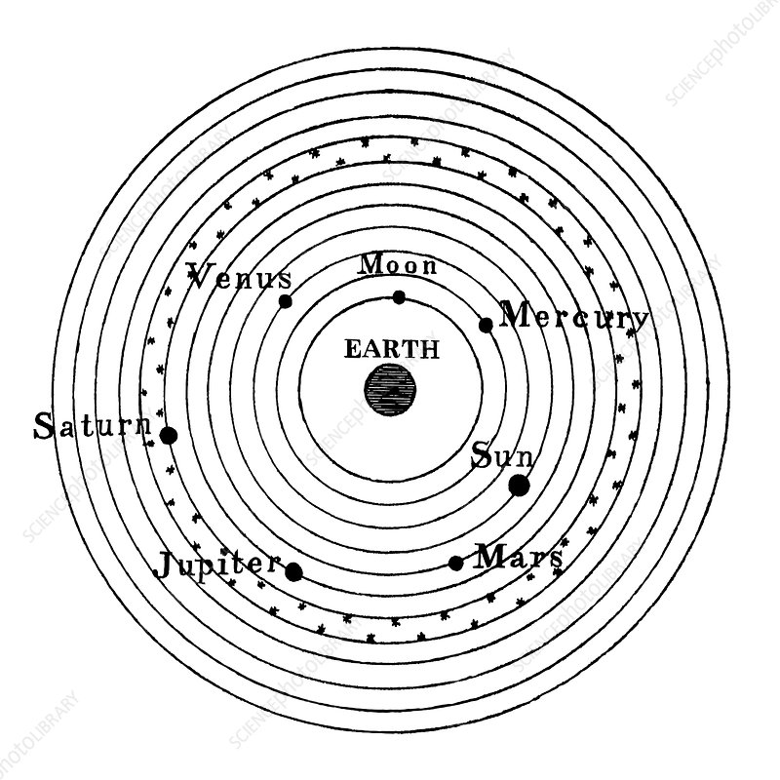
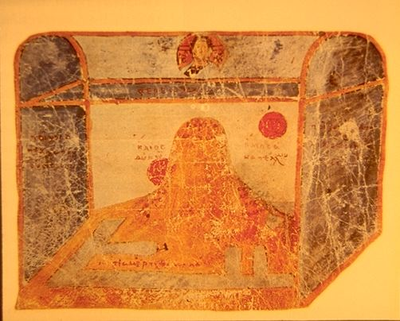
Cosmology
Cosmology deals with the world as the totality of space, time and all phenomena and the human place in it.
One’s cosmology is an explanation for all that exists
Historically, it was founded in religion, but now can encompass the more scientific ideas about the place of humans in the cosmos

Slide 20
Religious idealism
Religious idealism holds that all knowledge is contained within religious teaching and understanding of this knowledge is what guides all manner of living.

Slide 22
Proselytism
Refers to the attempt of any religion or religious individuals to convert people to their beliefs, or any attempt to convert people to a different point of view, religious or not.
Notes:
Proselytism is illegal in some countries. However, the right to convert to another religion and to manifest religion is enshrined in Article 18 of the UN Declaration of Human Rights. The term is generally understood as pejorative (negative) by contrast with evangelism which is viewed as a term of approval

Slide 23
Millennialism
Belief in the spiritual or physical "end of the world," generally brought about in such a way that certain favored people will survive into paradise and the rest of the world will perish.

Slide 24
How do these things shape space and the things and people in it? How do they make boundaries and borders? How do they create the qualities that define our environments? What terms from this unit on the sacred and the secular do they invoke?
Separation of church and state
Texas and the banning of abortions
Thanos and the snap
Ave Maria, a planned Catholic community in Florida
Megachurches
Evangelical drug gangs in Brazil
Hindu versus Muslim in Kashmir
Christian Mingle and other religious dating apps
Taliban and the imposition of Sharia law

