Slide 1
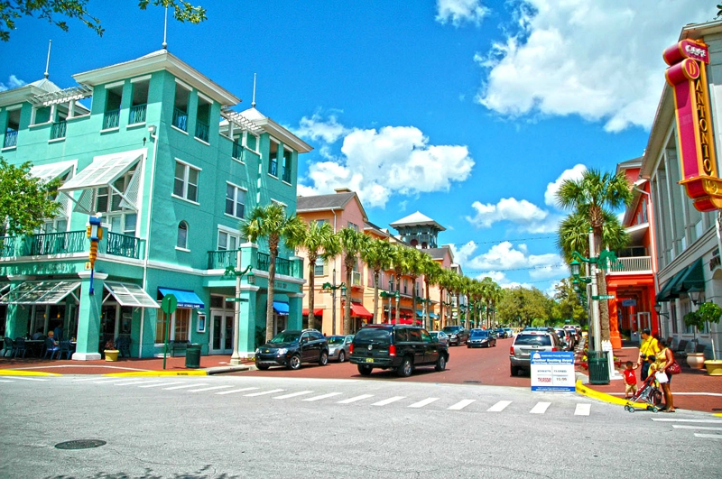
Simulacra and the geographies of postmodernism
Notes:
Today, the virtual is as real as the actual. The idea of authenticity and originality have become slippery and hard to anchor. Environment is not just around us as a physical space. We are responding to it through representations of cities and places derived from movies and the internet. The virtual and the imaginary have become real in a way that supplants the material world.
Minecraft is as much a playground as an actual playground at a city park. One of the world’s biggest pop stars, Hatsune Miku, is a hologram that plays sold out concerts. Celebration, Florida is a town designed and managed to resemble the small town America of the past. How we represent ourselves there, in that place we call online, is a simulation of who we imagine ourselves to be, and how we want others to image us.
Our two films, “La La Land” and “Scott Pilgrim versus the World” examine how what we see is often a reflection of many influences coming together and mixing, borrowing, and creating something original.

Slide 2
Terms
Plato’s cave
modernism
postmodernism
deconstruction
intertextuality
simulacra
hyperreality
meta
metanarratives
discourse
post-structuralism

Slide 3
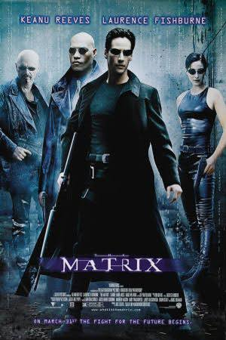
Plato’s cave
Heuristic that says we perceive the world through our senses, and these ‘shadows’ are only what we can see and know of the world without deeper philosophical understanding
Notes:
The allegory of the cave, or Plato's Cave, was presented by the Greek philosopher Plato in his work Republic. It is written as a dialogue between Plato's brother Glaucon and his mentor Socrates, narrated by the latter. Plato has Socrates describe a group of people who have lived chained to the wall of a cave all of their lives, facing a blank wall. The people watch shadows projected on the wall from objects passing in front of a fire behind them and give names to these shadows. The shadows are the prisoners' reality.
Socrates explains how the philosopher is like a prisoner who is freed from the cave and comes to understand that the shadows on the wall are not reality at all, for he can perceive the true form of reality rather than the manufactured reality that is the shadows seen by the prisoners. The inmates of this place do not even desire to leave their prison, for they know no better life. The prisoners manage to break their bonds one day and discover that their reality was not what they thought it was. Plato implies that the human condition is forever bound to the impressions that are received through the senses. Even if these interpretations are an absurd misrepresentation of reality, we cannot easily break free from the bonds of our human condition—we cannot free ourselves from phenomenal.

Slide 5
Modernism
Postmodernism
Reason and science provide an accurate, objective, reliable foundation of knowledge
Reasons transcends and exists independently of our historical, cultural contexts; it is universal and true
A reaction against modernism that views reason and science as more fallible. All judgments of truth exist within a cultural context
Postmodernism is a set of critical practices that destabilize ideas about the certainty of meaning, knowledge, and identity.
Includes the erosion of the older distinction between high culture and pop culture
Notes:
Modernism has many definitions, but in terms of philosophy, it began in the 1700s with Descartes. Postmodernism began in the late 1800’s and early 1900s. A criticism of postmodernism is that it serves mainly to deconstruct rather than to build and assemble.

Slide 7
Deconstruction
The postmodern method of critical analysis that aims to reveal the ambiguities of meaning, knowledge and identity
To deconstruct something is to show that there is not just one dominating mode or signifying meaning over all others .
Deconstructions of The Searchers (right) have shown how the film reflects the cultural and psychological underpinning of racism
Notes:
In many ways a traditional western, The Searchers (1956) is considered by critics as one of the greatest Hollywood films, made by the most influential of western directors. But John Ford’s classic work, in its complexity and ambiguity, was a product of post-World War II American culture and sparked the deconstruction of the western film myth by looking unblinkingly at white racism and violence and suggesting its social and psychological origins. The Searchers tells the story of the kidnapping of the niece of Ethan Edwards (John Wayne) by Comanche Indians, and his long search to find her—ultimately not to rescue her but to kill her, since he finds her racially and sexually violated.

Slide 8
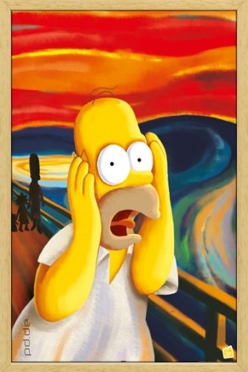
Intertextuality
Referencing multiple texts (books, movies, memes) in order to add layers of meaning based on assumed prior knowledge and understanding
Examples: books or movies that reference other books and movies, social media’s way of mixing many different memes and threads into one
Intertextuality can be seen as a representation of the, pluralistic, information-rich aspects of postmodern society.
Highlights how authenticity and authorship are fluid
Notes:
Easter eggs in movies are a form of intertextuality
https://www.youtube.com/watch?v=AwTpsw-ufDA

Slide 10
Simulacra
Postmodern society is organized around simulacra
Our cultural modes of representation today create reality through video, movies, and the information on the internet
Our reality is mediated through these modes of representation – what we see in the world is refracted through them
Notes:
Some of us are better at recognizing this than others. Some are really good at shaping the world that others see.

Slide 12
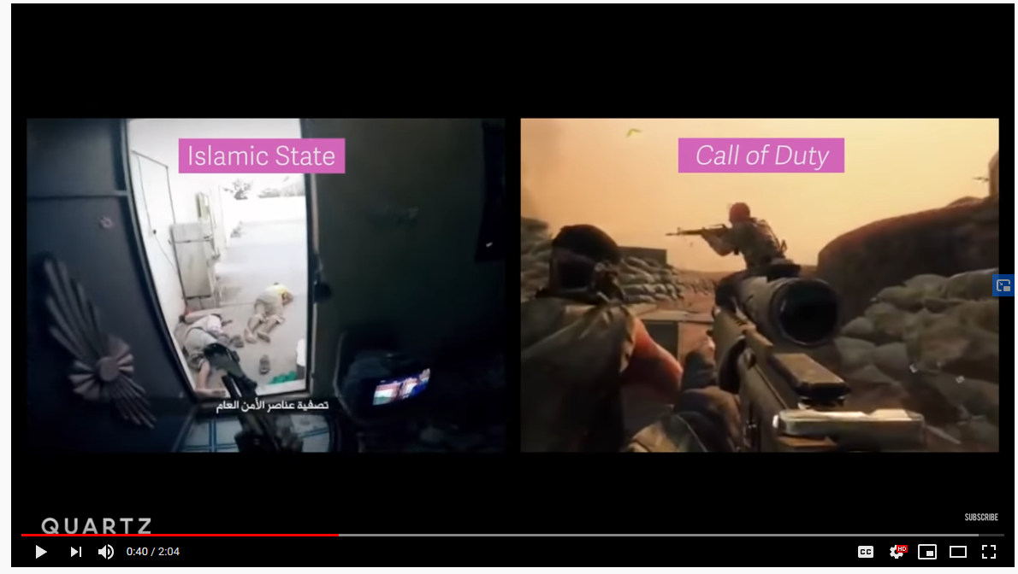
Hyperreality
In postmodernism, the world we experience is hyperreal – it is augmented by signs, symbols, copies and references to images, books, media, and other events.
Notes:
Facebook, as an example of social media, markets itself as a connecting tool; a user posts updates of their life to their friends, who can react and comment as they wish. This platform acts as a digital reproduction of real life, a heightened version or simulacra of real communication between friends, but it does not reflect real life interaction. This is the hyperreal, a digital simulation of reality, where a user ultimately uses Facebook to form an online identity and persona more vivid than ‘the real’ self.

Slide 13
Meta
Postmodern term to denote when something is consciously self referential or recursive
Books about writing a book, plays about being in a play, movies about making movies are ‘meta’
Notes:
https://www.bostonglobe.com/ideas/2012/05/05/dude-this-headline-meta-dude-this-headline-meta/it75G5CSqi82NtoQHIucEP/story.html
When a character in a TV show says to another character "this isn't a movie, this is real life" it's a little meta too, because of course it isn't real life, and by saying this, talking about their situation, they've brought up their own fictionality to you.

Slide 14
Notes:
https://www.youtube.com/watch?v=P8u8md-NiHM&ab_channel=MarvelMusicVEVO

Slide 15
Metanarrative
A story or account that explains multiple phenomena
Marxism, capitalism, religion can be considered metanarratives in that they attempt to explain for a wide range of patterns and processes
Metanarratives not only explain but they also legitimate knowledge and existing power relations
In postmodernism, there is skepticism expressed toward metanarratives, as knowledge, authenticity, and authorship are not fixed

Slide 16
Discourse
Postmodernism aims to reveal underlying discourses
Discourses give form to our knowledge claims and positions on issues
They arise and become entrenched through stories we tell or are told, the images that we see and share.
Discourses affect our views on all things; it is not possible to avoid discourses.

Slide 17
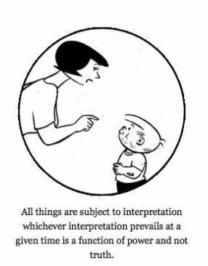
Post-structuralism
An aspect of postmodernism that focuses on way power shapes the discourses that shape our reality
We experience only limited aspects of the world and some of what we experience is based on falsehoods embedded in the discourses we have learned and often reproduce unless we unmask them
Notes:
https://www.mtholyoke.edu/courses/sgabriel/post_structuralism.htm

