Slide 1
Terms for nature and wilderness
social construction of nature
pristine myth
wilderness debates
Earth First
anarchism
monkey wrenching
ecoterrorism
culture jamming
Neo-Malthusian
ecomodernism

Slide 2
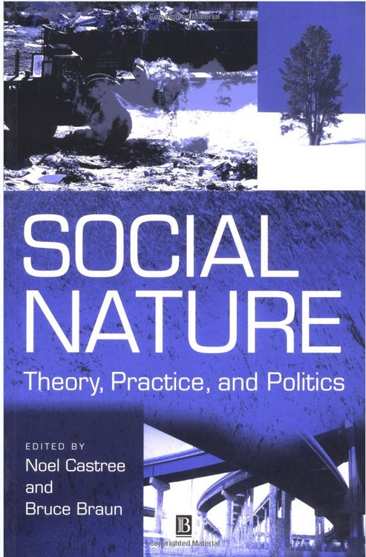
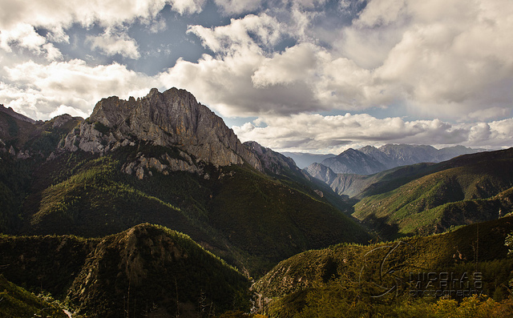
Social construction of nature
How nature or wilderness is valued and/or given identity depends upon the discourses originating out of culture, politics and power
Notes:
Urban park in Louisville, Tibet, rooftop of the world and one of the more remote places in the world

Slide 3
Pristine Myth
The idea that many of the lands encountered by Europeans in their colonization of the world were pristine and devoid of human impacts
Much of the world had already been modified by indigenous humans for millennia.
As applied to North America, that land seemed empty of people and open, even park-like. However, this was an artifact of the early Europeans and the diseases they brought. Rapid depopulation led to cessation of intentional burning and clearing for agriculture

Slide 4
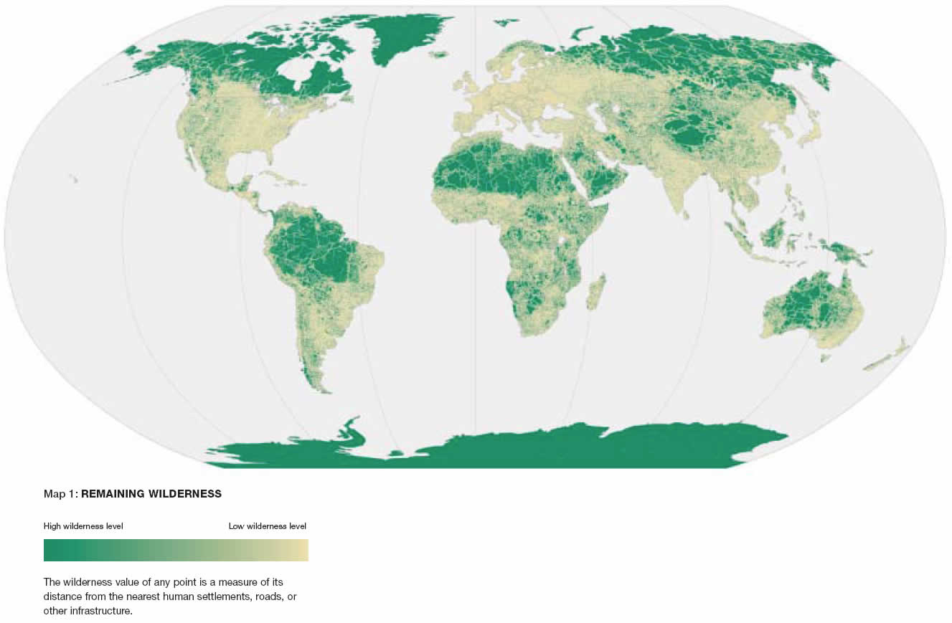
Notes:
What is wilderness? Why does it matter how we define it? Are humans part of wilderness? Or separate from it?

Slide 5
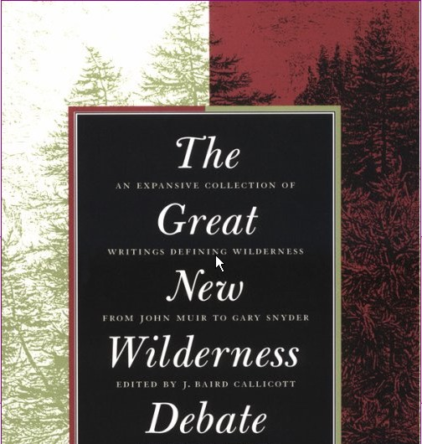
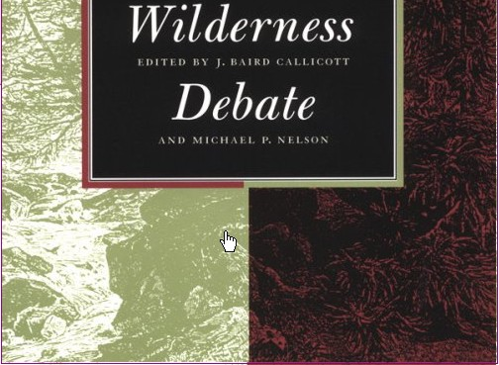
Wilderness debates
Series of debates that began in 1960’s about the meaning of wilderness and continues today.
The debate articulate a tension between the position that humans should be considered as separate from wilderness and the position that humans should be considered part of wilderness

Slide 6
Notes:
Earth First is a Deep Ecology movement.

Slide 7
Anarchism
Belief in the organization of society on a voluntary, cooperative basis without recourse to force or compulsion.
Does not imply that there are no rules, only that the organization of society is much less hierarchical, obligatory and fixed

Slide 8
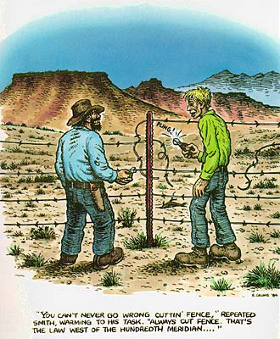
Notes:
Synonyms: Ecotage, ecodefense Practices may include desurveying (pulling up survey flags or markers), tree spiking (putting nails in trees so that sawmill equipment will malfunction), putting sugar in the gas tanks of bulldozers, cutting down fences.

Slide 9
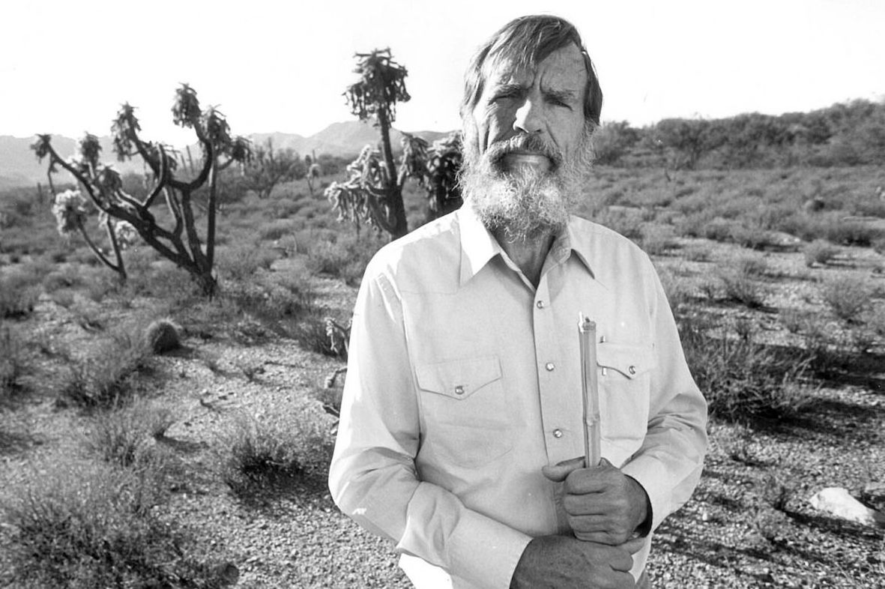
Monkey wrenching
Sabotage undertaken in the interest of nature and wilderness.
Derived from novel by Edward Abbey “The Monkey Wrench Gang”
Also known as ecodefense, ecotage

Slide 11
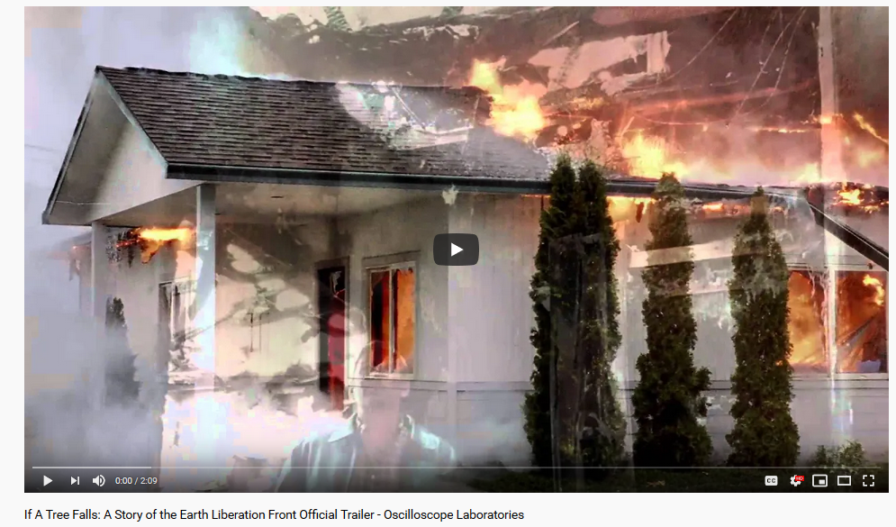
Ecoterrorism
Sabotage intended to hinder activities that are considered damaging to the environment
A form of political terrorism intended to damage an enemy's natural environment

Slide 12
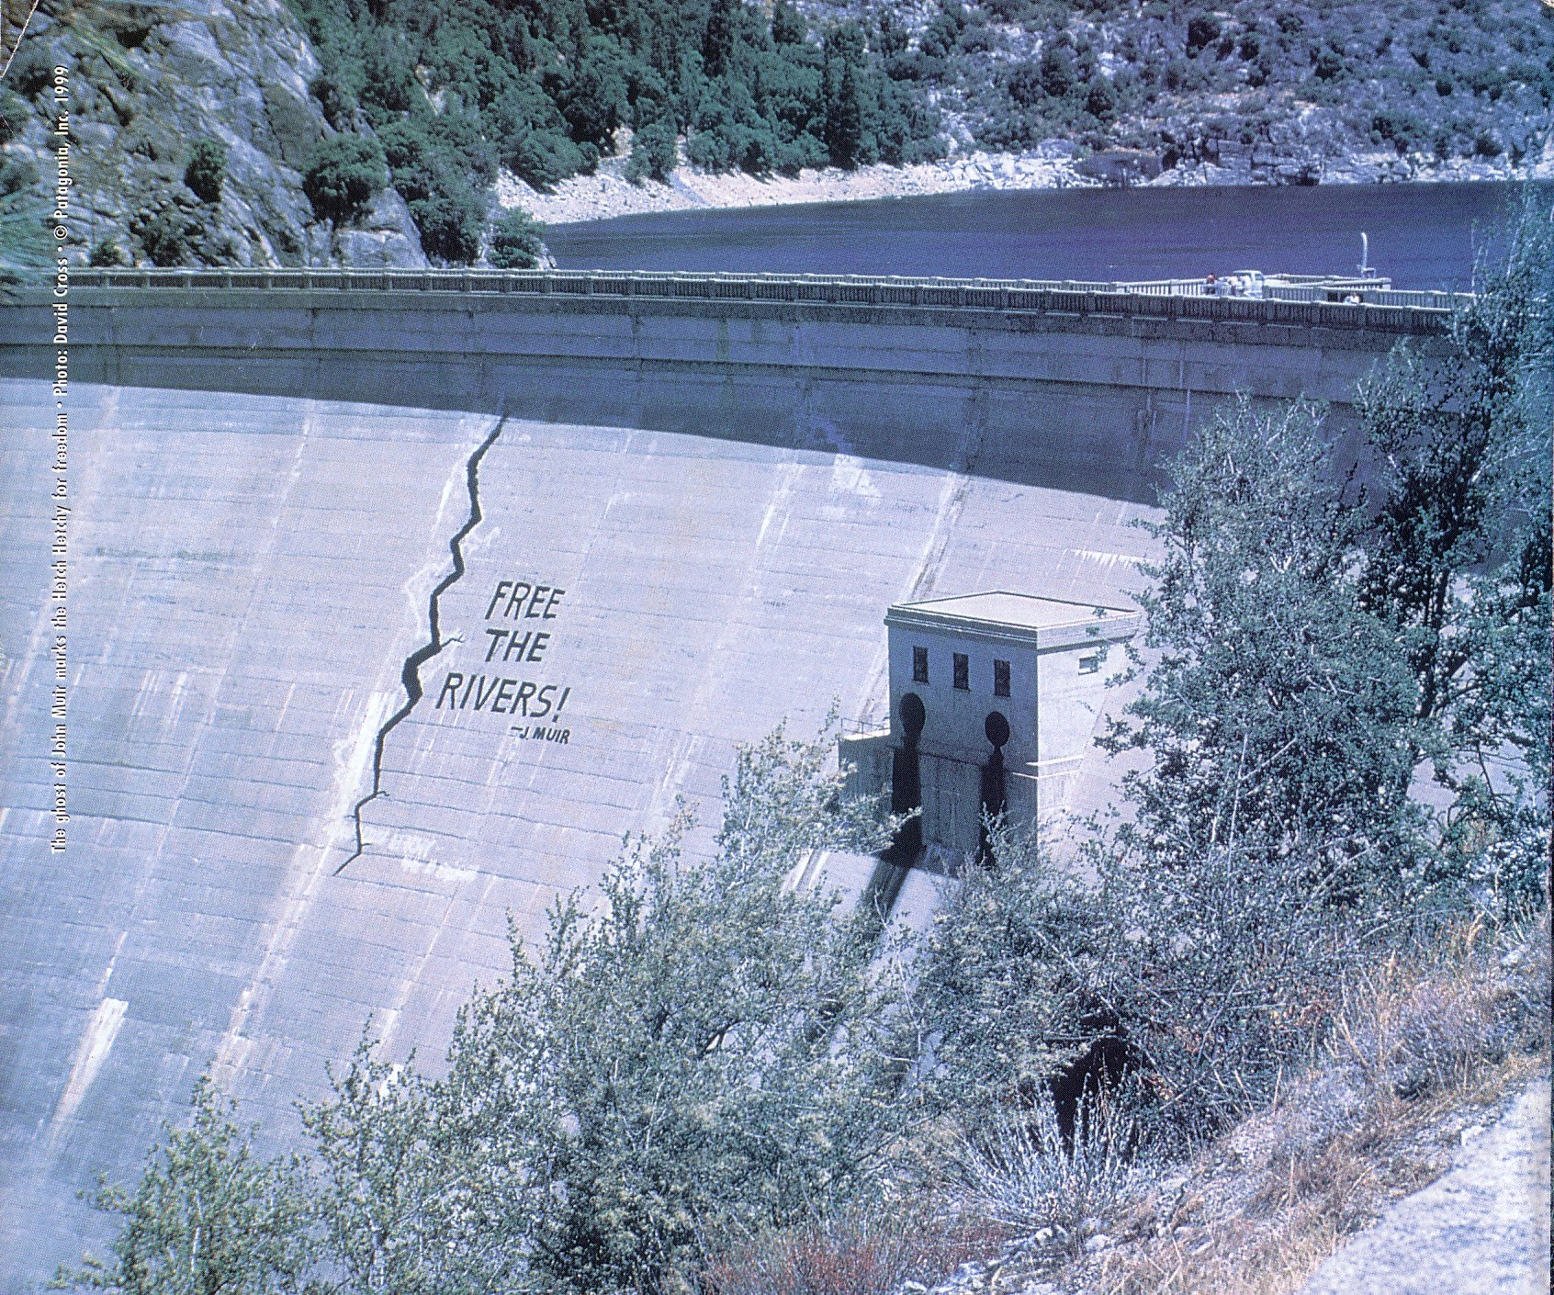
Notes:
Practices may include desurveying (pulling up survey flags or markers), tree spiking (putting nails in trees so that sawmill equipment will malfunction), putting sugar in the gas tanks of bulldozers, supergluing locks, cutting down fences.

Slide 14
Culture jamming
Culture jamming (or guerrilla communication) is a tactic used by anti-consumerist social movements to disrupt or subvert media environments and its mainstream cultural institutions, including (but not limited to) corporate advertising.

Slide 15
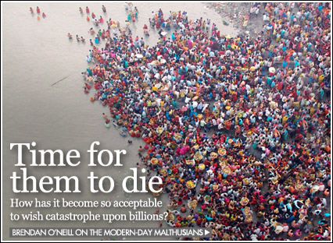
Notes:
“The power of population is so superior to the power of the earth to produce subsistence for man that premature death must in some shape or other visit the human race. “
Thomas Malthus (1798) “Essay on the Principle of Population

Slide 16
Neo-Malthusian
Neo-Malthusian view human population as a key driver of environmental conditions and advocate population control as a means to protect or conserve the environment.
Notes:
An Essay on the Principle of Population (1798) by Thomas Malthus: “…the power of population is so superior to the power of the earth to produce subsistence for man, that premature death must in some shape or other visit the human race.”

Slide 17
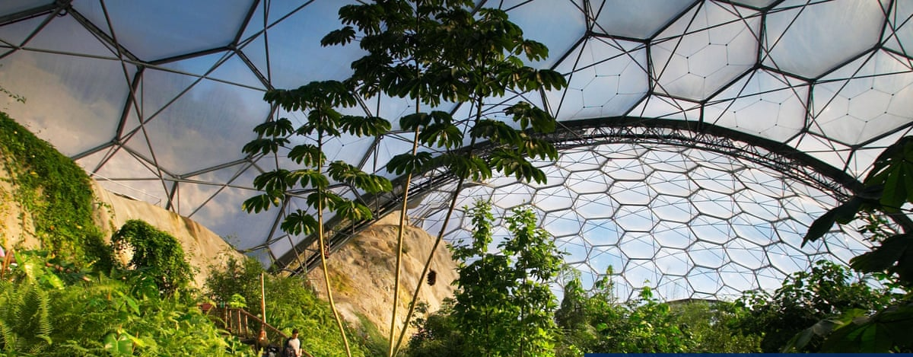
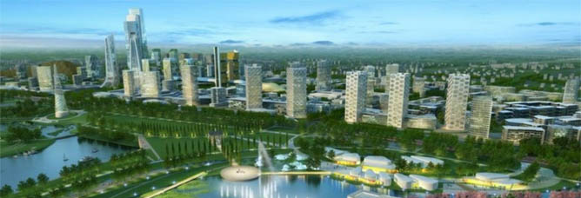
Ecomodernism
The premise of ecomodernism is that through the help of science, technology and development, human impacts on the natural world can be decoupled from economic activity.
People can increase their standard of living while doing less damage to the environment
Ecomodernists tend to dislike policies of “degrowth” and are skeptical of “collapse anxiety.”
Notes:
https://www.theguardian.com/environment/georgemonbiot/2015/sep/24/meet-the-ecomodernists-ignorant-of-history-and-paradoxically-old-fashioned

