Slide 1
Notes:
https://youtu.be/zzKqEZmUGxY?si=wLxoAPOsULYOhNet

Slide 2
Reading/Questions 9
Notes:
https://www.nytimes.com/2020/07/15/sunday-review/coronavirus-history-pandemics.html

Slide 3
Notes:
Commercialization of penicillin Howard Florey (1898–1968), a pharmacologist and pathologist, Ernst Chain (1906–1979), a biochemist, were instrumental in testing penicillin’s effectiveness and pushing penicillin closer to commercial production. Another vital figure in bringing penicillin to market was a biochemist, Dr. Norman Heatley, who used every available container, bottle and bedpan to grow vats of the penicillin mold, suction off the fluid and develop ways to purify the antibiotic. In September 1940, that the Oxford police constable, Albert Alexander, 48, provided the first test of the effectiveness of antibiotics. Alexander nicked his face working in his rose garden. The scratch, infected with streptococci and staphylococci, spread to his eyes and scalp. Although Alexander was admitted to the Radcliffe Infirmary and treated with doses of sulfa drugs, the infection worsened and resulted in smoldering abscesses in the eye, lungs and shoulder. Florey and Chain heard about the horrible case at high table one evening and, immediately, asked the Radcliffe physicians if they could try their ”purified” penicillin. After five days of injections, Alexander began to recover. But Chain and Florey did not have enough pure penicillin to eradicate the infection, and Alexander ultimately died.
In the summer of 1941, shortly before the United States entered World War II, Florey and Heatley flew to the United States, where they worked with American scientists in Peoria, Ill., to develop a means of mass producing what became known as the wonder drug. Aware that the fungus Penicillium notatum would never yield enough penicillin to treat people reliably, Florey and Heatley searched for a more productive species. One hot summer day, a laboratory assistant, Mary Hunt, arrived with a cantaloupe that she had picked up at the market and that was covered with a ”pretty, golden mold.” Serendipitously, the mold turned out to be the fungus Penicillium chrysogeum, and it yielded 200 times the amount of penicillin as the species that Fleming had described. Yet even that species required enhancing with mutation-causing X-rays and filtration, ultimately producing 1,000 times as much penicillin as the first batches from Penicillium notatum.

Slide 4
Discovery of penicillin by Alexander Fleming in 1928 in United Kingdom
Commercialization of penicillin in the mid-1940’s
Golden Era of antibiotic prospecting and commercialization from 1940s to 1960s
During this period antibiotics penicillin and streptomycin were extracted from fungi; tetracycline, erythromycin, vancomycin from bacteria
However, when accepting Nobel Prize in 1945, Fleming gave the first public warning about bacterial resistance
Notes:
In the ‘Golden Age’ of antibiotic discovery, the best source of new agents was from other naturally occurring soil microorganisms. After streptomycin was isolated in 1944 from Streptomyces griseus (a fungal organism found in soil), a worldwide search began. Every effort was made to reach all corners of the globe, but resources were limited. Eli Lilly had the bright idea of asking Christian missionaries to send back a soil sample from every exotic place that they visited. A sample from Borneo sent in 1952 grew Streptomyces orientalis, from which vancomycin was eventually extracted; vancomycin became available for patient use in 1958.
https://www.pbs.org/newshour/health/the-real-story-behind-the-worlds-first-antibiotic

Slide 5
Notes:
https://www.who.int/news/item/15-04-2021-global-shortage-of-innovative-antibiotics-fuels-emergence-and-spread-of-drug-resistance

Slide 6
Notes:
Antibiotic resistant bacteria and bacterial genes that confer resistance now move among humans, domesticated animals, wildlife, and the environment
AMR is a challenge because it is an environmental issue. Antimicrobials are used in agriculture. However, veterinary and human medicine not well integrated

Slide 7
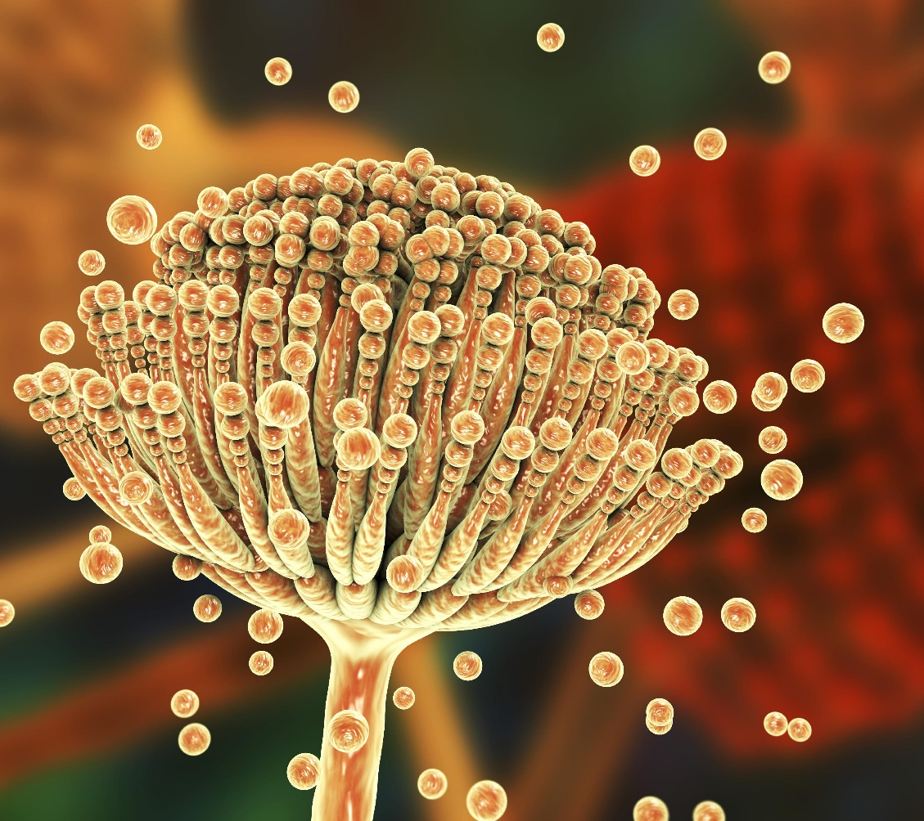
Antifungal resistance
Although antibacterial drug resistance has received more attention, antifungal drug resistance is a growing problem
Antifungals used extensively in human health care, particularly for chemotherapy and transplants
Doctors may prescribe years of antifungal therapy for the immunosuppressed, which significantly increases the likelihood of the evolution of resistance
Notes:
Aspergillus

Slide 8
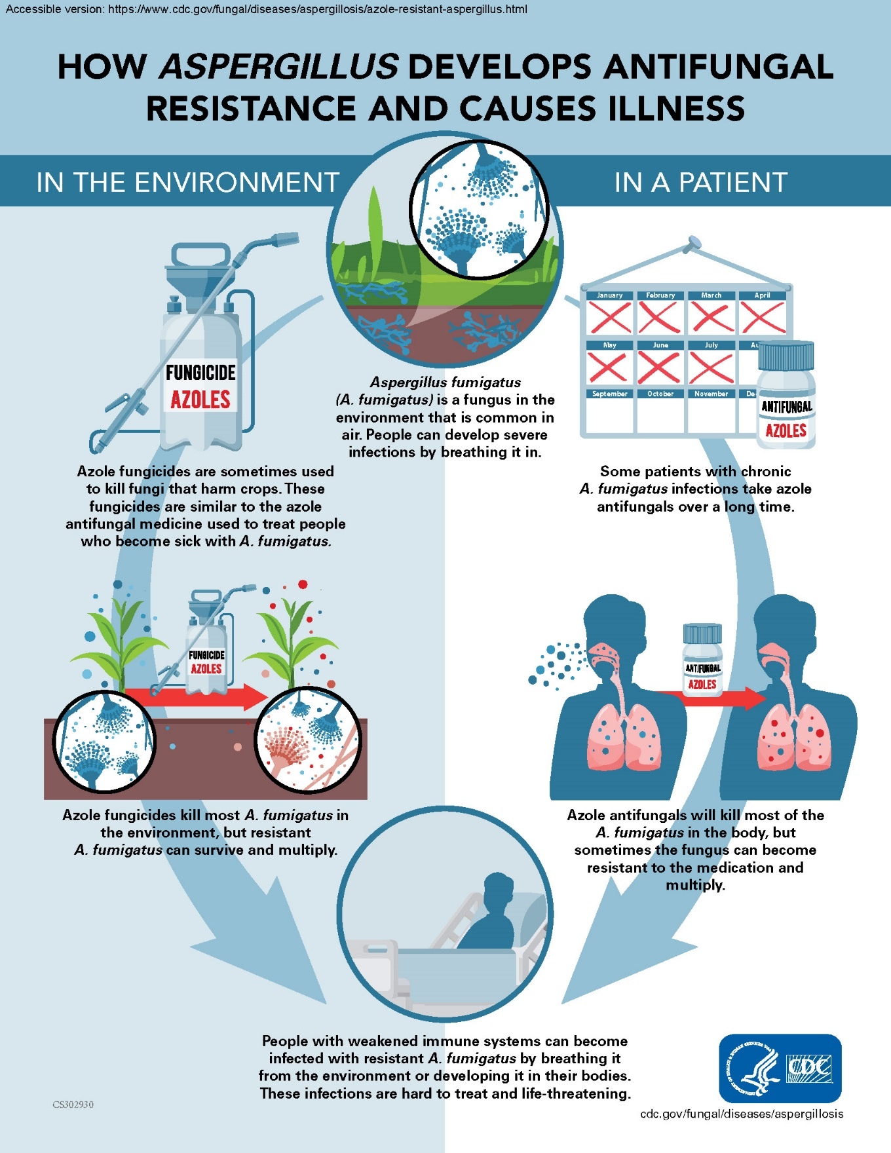
Factors driving rise of fungal infections and antifungal resistance
Extensive use antifungals on crops
Medical treatments that leave patients immunosuppressed as a side effect
A limited number of antifungal drugs

Slide 9
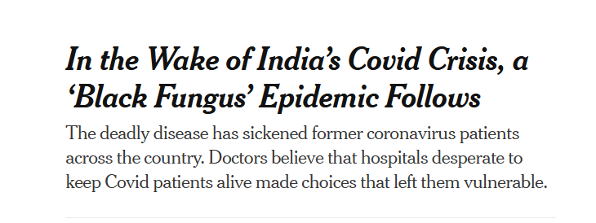
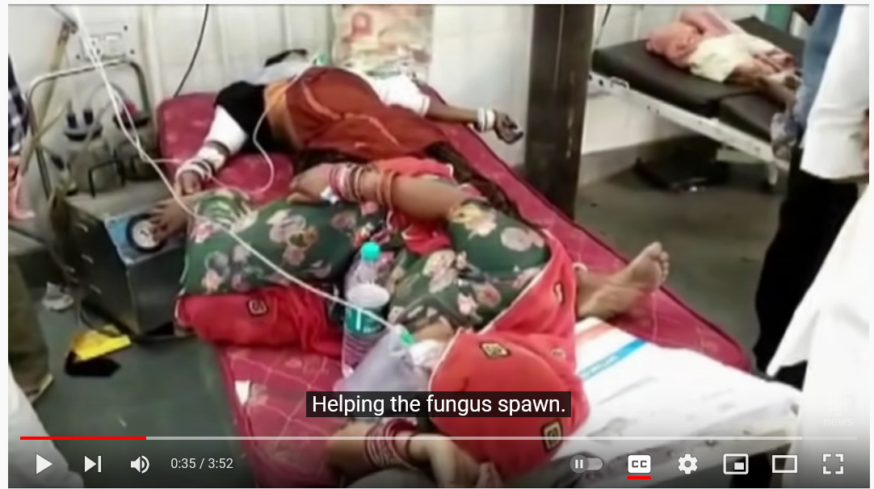
Notes:
Mucormycosisis a serious but usually rare fungal infection caused by a group of molds called mucormycetes. These molds live throughout the environment. Video documents Mucormycosis, a devastating fungal infection. People who have had Covid are susceptible, and especially those that are diabetic or have weakened immune systems. Treatment of mucormycosis is challenging because these fungi are intrinsically resistant to most of the routinely used antifungal agents, such as most of the azoles https://www.nytimes.com/2021/06/20/world/asia/india-covid-black-fungus.html

Slide 10
Why few treatments for fungal infections?
Because fungal cells share some similarities with our own, antifungals often have harmful side effects
Toxicity has been a major hurdle in the development of antifungal agents because mammalian cells, in contrast to bacterial cells, share with fungal cells many structures and metabolic pathways.
For example, the two most common classes of antifungal agents, polyenes and azoles, target the synthesis of the cell membrane, a structure shared by both mammalian and fungal cells, and thus these drugs have inherent toxicity.

Slide 11
Notes:
Three outbreaks of Candida auris, three separate times, producing three different resistant strains, on three continents
This argues for a common origin of resistance

Slide 12
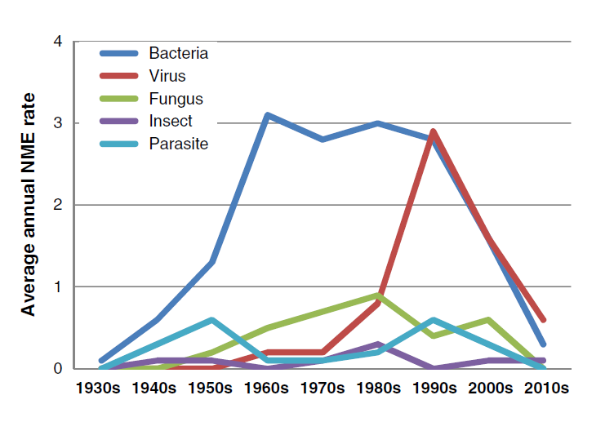
New molecular entities (NME) to make antibiotics
Notes:
Antibacterial new molecular entities (NME)
Kinch, M. S., Patridge, E., Plummer, M., & Hoyer, D. (2014). An analysis of FDA-approved drugs for infectious disease: antibacterial agents. Drug discovery today, 19(9), 1283-1287.

Slide 13
Incentives to develop and sustain antimicrobial drug development
“Push" incentives provide support for early research and development with less emphasis on commercial development and financial return
“Pull" incentives offer a financial reward for a successful launch of a new drug such as a guaranteed purchase.
Subscription models
Profits from new antimicrobial drugs can be achieved by decoupling the revenues derived from these drugs to their use.
A purchasing entity would pay for access to a company's portfolio of antimicrobials for a fee that is independent of the volume of use of any particular drug.
Notes:
https://thehill.com/opinion/healthcare/478488-reframing-the-antimicrobial-resistance-crisis?amp
https://www.bmj.com/content/366/bmj.l5364
Drug company executives, public health experts and advocates for patients — groups often at odds with one another — have been united in urging Washington to enact new policies and programs that would help shore up the finances of ailing antibiotic companies and lure pharmaceutical giants back to the field. Without such incentives, these small innovative companies developing new medicines will struggle to obtain the resources they need to fully develop them and bring these breakthroughs to patients. Despite bipartisan support, legislation aimed at addressing the problem has languished in Congress.
There are two basic strategies: push and pull. Push incentives support research by getting new compounds through trials and up to the point of approval; pull incentives take over afterwards, supporting companies so that they can survive until their earnings start to flow. Push incentives have had some success. The best known example is the non-profit organization CARB-X (Combating Antibiotic-Resistant Bacteria Biopharmaceutical Accelerator), based at Boston University, which has committed US$452 million to early-stage research, contributed by governments and big philanthropic organizations.
Pull incentives, however, have faced political headwinds. Although many options have been debated, only one has launched: a subscription-style arrangement in which drug companies receive grants that constitute advance down payments on future sales. The idea is that by removing the incentive for a company to sell a new drug aggressively, and thereby reducing the use of the drug, it will delay the inevitable arrival of resistance to it.

Slide 14
The PASTEUR Act
The Pioneering Antimicrobial Subscriptions To End Up Surging Resistance Act of 2021
Aim is to reinvigorate the antibiotics pipeline by providing sizable, subscription-based government contracts for access to innovative, high-priority antibiotics.
Although pharmaceutical revenue is typically tied to how much of a drug is sold, these contracts would instead pay for new antibiotics based on their value to public health.
Bill is still under deliberation as of 2024
Notes:
This approach addresses the core issue confronting the antibiotics market: the pressing need for innovative drugs that don’t have high sales potential.

Slide 15
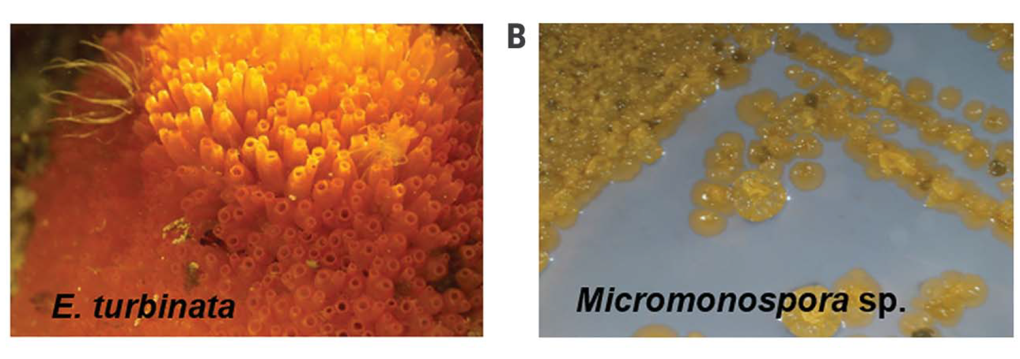
Discovery of antifungal for C. auris
Turbinmycin, a bacteria isolated from the microbiome of a sea squirt
Notes:
Many antifungals can not readily be used because of their toxicity. They are toxic to mammal cells. Topical (skin) applications are not a concern because little of these medicines go beyond the skin surface.
Zhang, F., Zhao, M., Braun, D. R., Ericksen, S. S., Piotrowski, J. S., Nelson, J., ... & Bugni, T. S. (2020). A marine microbiome antifungal targets urgent-threat drug-resistant fungi. Science, 370(6519), 974-978.

Slide 16
Notes:
Resistance genes travel with them. MDR – multidrug resistance

Slide 17
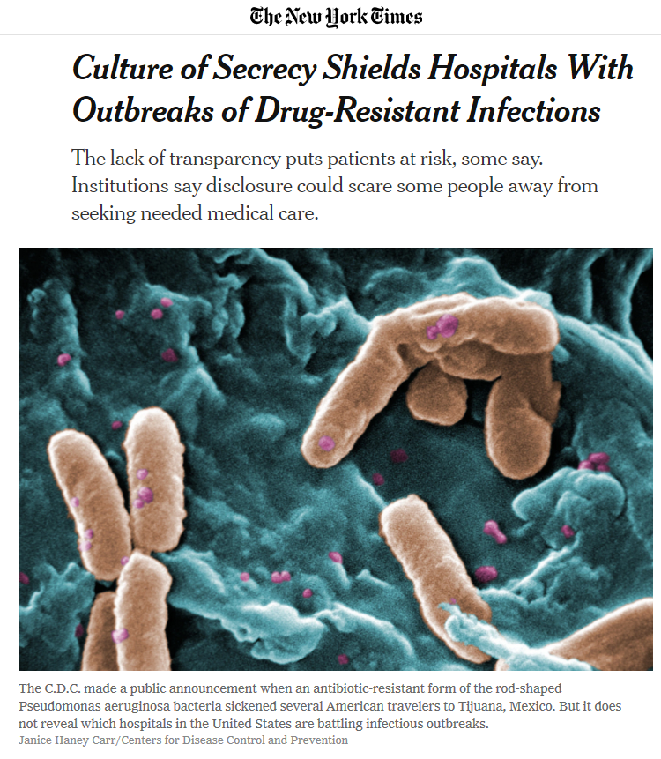
The secrecy problem
CDC says a degree of confidentiality is necessary to encourage the cooperation of hospitals and nursing homes, which might otherwise seek to conceal infectious outbreaks.
Medical institutions want to protect their reputations
If people become wary of hospitals, they may not go, making it more likely they may have other health issues from not seeking care
Notes:
Restaurants and cruise ships also announce outbreaks of bacterial disease immediately – but hospitals do not.

Slide 18
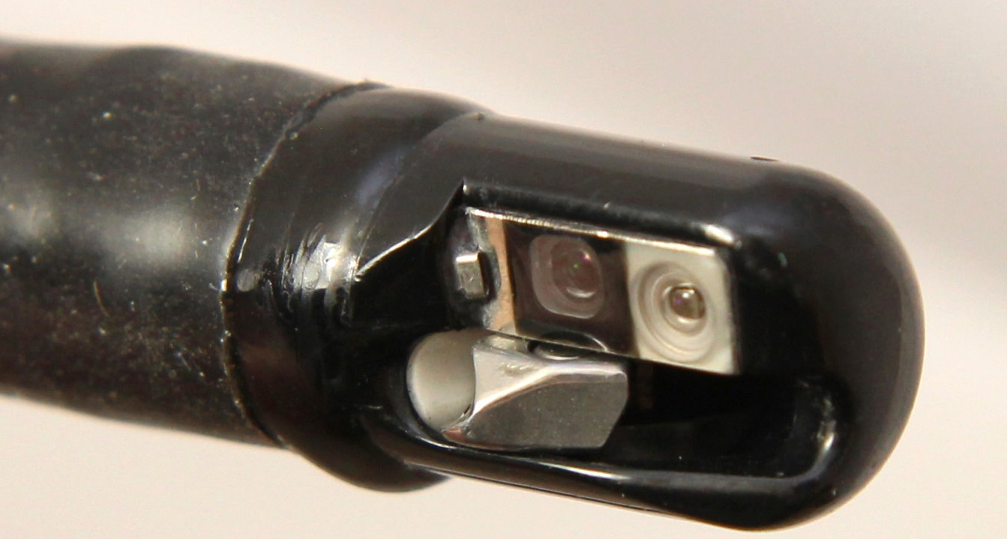
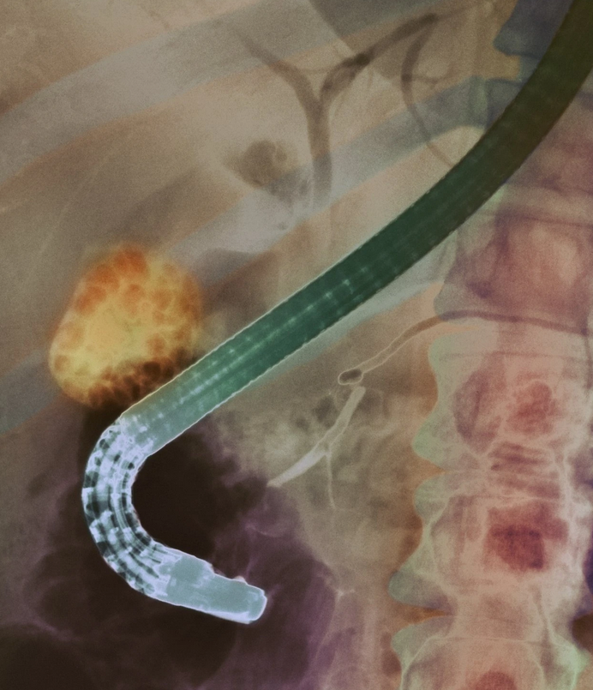
AMR incidents in the US
2016: Carbapenem-resistant Enterobacteriaceae outbreak in rural Kentucky hospital.
C.D.C. issued a report on that outbreak in 2018 and even then, the agency did not name the hospital where it occurred.
In 2012-2014, more than three dozen people at a Seattle hospital were infected with a drug-resistant bacteria from a contaminated medical scope.
Eighteen died, but the hospital did not disclose the outbreak, saying at the time it did not see the need to do so.
Notes:
http://www.cidrap.umn.edu/news-perspective/2018/01/2016-cre-outbreak-kentucky-highlights-need-vigilance
https://www.cdc.gov/mmwr/volumes/66/wr/mm665152a5.htm
https://www.nytimes.com/2019/08/06/health/duodenoscopes-infections-hospitals-antibiotics.html
https://www.help.senate.gov/imo/media/doc/Duodenoscope%20Investigation%20FINAL%20Report.pdf
https://academic.oup.com/cid/article-abstract/68/8/1327/5094756?redirectedFrom=fulltext Also incidents have happened in neonatal wards

Slide 19
AMR incidents abroad
In 2019 the Centers for Disease Control and Prevention sent out an urgent alert about a deadly bacteria, resistant to virtually every known antibiotic, that sickened more than a dozen Americans who had elective weight loss surgery at Grand View Hospital in Tijuana, Mexico.
When outbreaks occur in other countries, however, warning are issued quickly
Video

Slide 20
Global AMR
International reports disproportionately reflect data from resource-rich settings. Much less data from the lower and middle income nations
Only 25% of countries have implemented a national policy to tackle AMR.
Less than 40% of countries have put in place infection prevention and control programs for AMR.
Notes:
https://resistancemap.cddep.org/AntibioticResistance.php

Slide 21
Global AMR
Low-and middle-income countries (LMICs) have highest death rates from AMR for all individuals
However, the lack of antibiotics is still a greater cause of mortality, although the gap is closing as AMR becomes more frequent
Notes:
Murray, C. J., Ikuta, K. S., Sharara, F., Swetschinski, L., Aguilar, G. R., Gray, A., ... & Tasak, N. (2022). Global burden of bacterial antimicrobial resistance in 2019: a systematic analysis. The Lancet, 399(10325), 629-655. At the regional level, we estimated the all-age death rate attributable to resistance to be highest in western sub Saharan Africa, at 27·3 deaths per 100 000 (20·9–35·3), and lowest in Australasia, at 6·5 deaths (4·3–9·4) per 100 000. Lower respiratory infections accounted for more than 1·5 million deaths associated with resistance in 2019, making it the most burdensome infectious syndrome. The six leading pathogens for deaths associated with resistance (Escherichia coli, followed by Staphylococcus aureus, Klebsiella pneumoniae, Streptococcus pneumoniae, Acinetobacter baumannii, and Pseudomonas aeruginosa) were responsible for 929 000 (660 000–1 270 000) deaths attributable to AMR and 3·57 million (2·62–4·78) deaths associated with AMR in 2019.

Slide 22
Notes:
Figure 5: Ten deadliest pathogen–drug combinations, by burden attributable to AMR by region, in 2021. Cells colored by annualized rate of change (1990–2021). Total deaths attributable to AMR in 2021 presented in the bottom right of each cell. AMR=antimicrobial resistance.
Naghavi, M., Vollset, S. E., Ikuta, K. S., Swetschinski, L. R., Gray, A. P., Wool, E. E., ... & Dekker, D. M. (2024). Global burden of bacterial antimicrobial resistance 1990–2021: a systematic analysis with forecasts to 2050. The Lancet, 404(10459), 1199-1226.

Slide 24
Gender disparities in AMR in LMICs
In poor regions, inadequate access to clean water puts women and girls at greater risk of drug-resistant urinary tract infections than men because of menstrual-hygiene needs.
Women and girls are also often responsible for fetching water, preparing food and doing farm work, which increases exposures to pathogens such as antibiotic-resistant E. coli in water and food, and to antibiotics fed to animals.
Women more likely to encounter drug-resistant infections in hospitals and clinics, because globally women make up 70% of health-care workers
Higher rates of sexual violence against women also put them at a greater risk of drug-resistant sexually transmitted infections.
Lack of financial independence and decision-making power can limit women’s access to treatments for infections, makes them more likely to self-diagnose and use inappropriate treatments that allow microbes to evolve drug resistance.
Notes:
https://doi.org/10.1038/d41586-024-01476-9

Slide 25
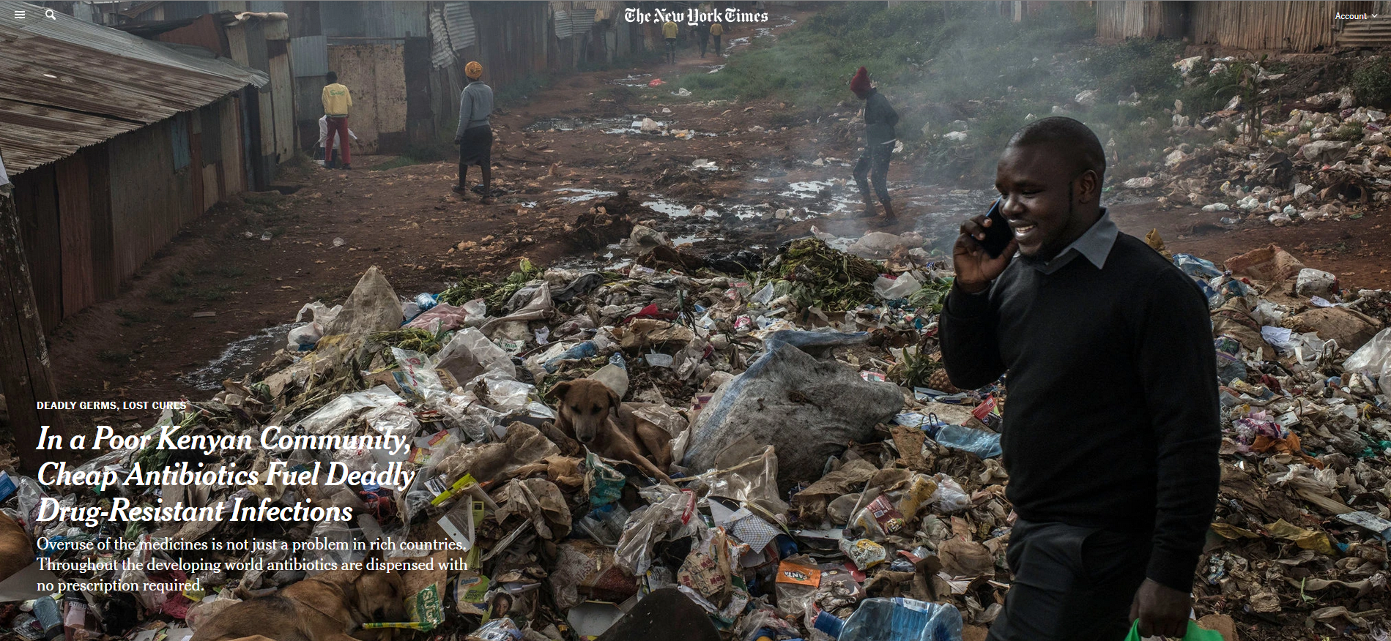
AMR in low and middle income countries (LMICs)
Reading/Questions 9

Slide 26
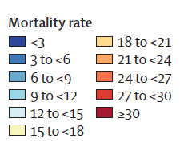
Death rates per 100 000 attributable to AMR, all ages, 2021
Notes:
Death rates per 100 000 attributable to AMR, all ages, 2021. Higher mortality rates than high income countries Naghavi, M., Vollset, S. E., Ikuta, K. S., Swetschinski, L. R., Gray, A. P., Wool, E. E., ... & Dekker, D. M. (2024). Global burden of bacterial antimicrobial resistance 1990–2021: a systematic analysis with forecasts to 2050. The Lancet, 404(10459), 1199-1226.

Slide 27
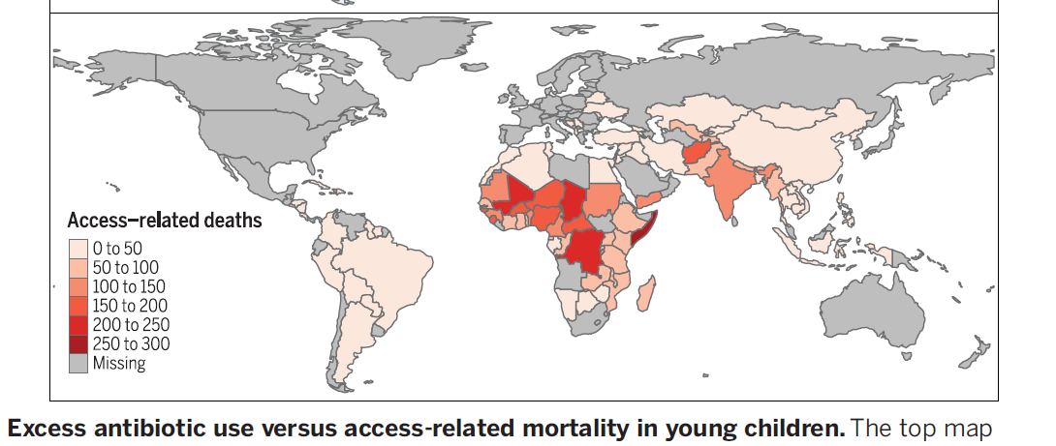
Lack of antibiotics causes more childhood deaths than AMR
In low and middle income countries lack of antibiotics still results in more childhood deaths than antibiotic resistance (but gap is narrowing)
More than 1 million children with untreated pneumonia, diarrhea, and sepsis die annually.
Modeled estimates of annual deaths from community-acquired bacterial
pneumonia, expressed per 100,000 children under the age of 5, which could
be averted with universal access to antibiotics.
Notes:
Universal provision of antibiotics could avert 75% of 590,000 annual deaths from pneumonia in children under the age of 5

Slide 28
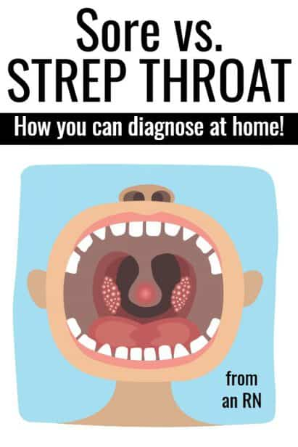
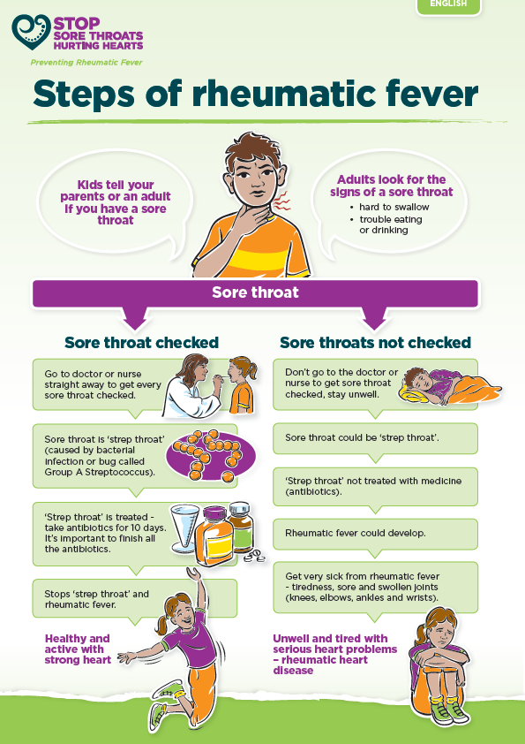
Notes:
Rheumatic fever is an inflammatory disease of the heart, bone, skin or brain that can develop as a complication of streptococcal throat infections like strep throat

Slide 29
Reading/Questions 9
Notes:
But in poor countries, strep throat often goes undiagnosed and can become a long, slow death sentence. Without treatment, it can lead to rheumatic fever and rheumatic heart disease, in which the immune system attacks the heart valves — intricate flaps of tissue that must open and shut properly 100,000 times a day for the heart to work normally. As the valves deteriorate, the heart struggles and gradually wears out. Patients become weak, short of breath and unable to attend school or work. Many die before they reach 30. Women with the illness who become pregnant can suffer severe and sometimes fatal complications.
https://www.nytimes.com/2018/09/16/health/rwanda-strep-heart-disease.html

Slide 30
The Drug Resistance Index (DRI)
Combines usage frequency and resistance in a single index
Allows for global assessment of the relative efficacy of countries’ antibiotic therapy.
Notes:
https://resistancemap.onehealthtrust.org/DRI.php Klein, E. Y., Tseng, K. K., Pant, S., & Laxminarayan, R. (2019). Tracking global trends in the effectiveness of antibiotic therapy using the Drug Resistance Index. BMJ global health, 4(2), e001315.
Evaluating trends in antibiotic resistance and communicating the results to a broad audience are important for dealing with this global threat. The Drug Resistance Index (DRI), which combines use and resistance into a single measure, was developed as an easy-to-understand measure of the effectiveness of antibiotic therapy. We demonstrate its utility in communicating differences in the effectiveness of antibiotic therapy across countries. We calculated the DRI for countries with data on antibiotic use and resistance for the disease-causing organisms considered by the WHO as priority pathogens: Acinetobacter baumannii, Escherichia coli, Klebsiella pneumoniae, Pseudomonas aeruginosa, Staphylococcus aureus, Enterococcus faecium and Enterococcus faecalis. Additionally, we estimated pooled worldwide resistance rates for these pathogens. 41 countries had the requisite data and were included in the study. Resistance and use rates were highly variable across countries, but A. baumannii resistance rates were uniformly higher, on average, than other organisms. High-income countries, particularly Sweden, Canada, Norway, Finland and Denmark, had the lowest DRIs; the countries with the highest DRIs, and therefore the lowest effectiveness of antibiotic therapy, were all low-income and middle-income countries. The DRI is a useful indicator of the problem of resistance. By combining data on antibiotic use with resistance, it captures a snapshot of how the antibiotics a country typically uses match their resistance profiles. This single measure of the effectiveness of antibiotic therapy provides a means of benchmarking against other countries and can, over time, indicate changes in drug effectiveness that can be easily communicated.

Slide 31
Notes:
Klein, E. Y., Tseng, K. K., Pant, S., & Laxminarayan, R. (2019). Tracking global trends in the effectiveness of antibiotic therapy using the Drug Resistance Index. BMJ global health, 4(2), e001315. DDD – defied daily doses of antibiotics, a measure of how many antibiotics are being taken.

Slide 32
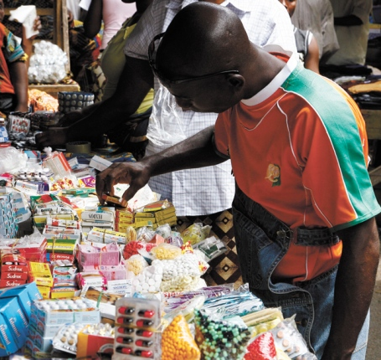
LMICs
Less dependable access to high quality antibiotics
No prescription is necessary in many LMICs
Because doctors are unavailable or too expensive, many buy cheap generic antibiotics from street vendors
These generics from China and India can make antibiotics locally abundant in cities
However, antibiotic use is largely unsupervised and underregulated
Counterfeit and adultered antibiotics are also a problem
Notes:
https://www.who.int/antimicrobial-resistance/interagency-coordination-group/IACG_final_report_EN.pdf?ua=1 ‘Paper tiger’ initiatives to address AMR which are not enforced, such as bans on over-the-counter sales

Slide 33
Another reason for greater resistance in LMICs is the increasing use of broad-spectrum antibiotics
These target a wide number of bacteria and therefore set the stage for resistance genes to emerge
Notes:
http://dx.doi.org/10.1126/science.aau4679

Slide 34
Another reason: LMIC have more unique interfaces at which bacteria and their resistance-encoding elements can be exchanged between humans and food animals
These would include farms, at markets, and along food value chains that are minimized or non-existent in high-income settings.
Bacteria resistance genes (CTXs) flow freely among human and animal-origin E coli in the leaky Cambodian market ecosystem but are largely isolated to specific hosts in the less leaky UK market ecosystem
Notes:
Nadimpalli, M. L., Stegger, M., Viau, R., Yith, V., de Lauzanne, A., Sem, N., ... & Price, L. B. (2023). Plugging the leaks: antibiotic resistance at human–animal interfaces in low‐resource settings. Frontiers in Ecology and the Environment. Resistance genes flow freely among human and animal-origin E coli in the leaky Cambodian ecosystem but are largely isolated to specific hosts in the less leaky UK ecosystem Implementing water, sanitation, and hygiene infrastructure in human communities and food animal production must be prioritized to address global antibiotic resistance

Slide 35
Notes:
Nadimpalli, M. L., Stegger, M., Viau, R., Yith, V., de Lauzanne, A., Sem, N., ... & Price, L. B. (2023). Plugging the leaks: antibiotic resistance at human–animal interfaces in low‐resource settings. Frontiers in Ecology and the Environment.

Slide 36
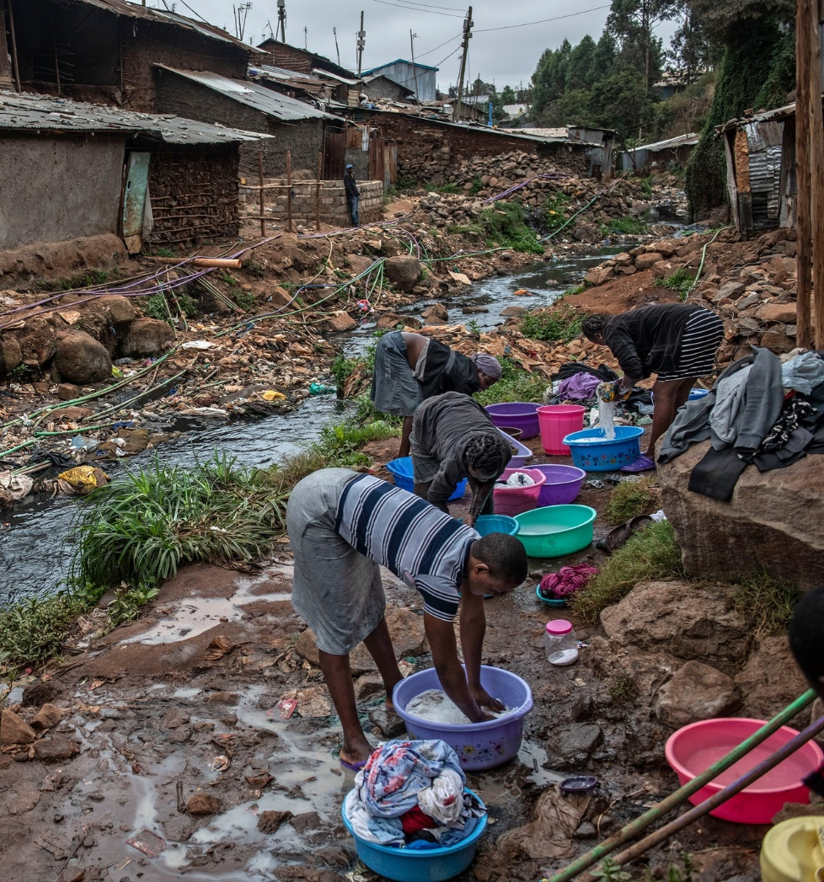
Low and middle-income countries:
Higher burden of disease
Access to effective antibiotics is uneven
Lower but growing per capita use of broad-spectrum antibiotics
Need to reduce resistance yet also expand access to effective antibiotics and to supervise their use
High income countries
Lower burden of disease
Greater per capita antibiotic use
Resistance correlates with the amount of use
Need to reduce use
Notes:
Women wash clothes just outside a river polluted with sewage and waste in the Kibera neighborhood of Nairobi, Kenya. The rate of drug-resistant infections in the community is high.
https://www.nytimes.com/2019/04/29/health/un-drug-resistance-antibiotics.html?rref=collection%2Fseriescollection%2Fdeadly-germs-lost-cures&action=click&contentCollection=health&region=stream&module=stream_unit&version=latest&contentPlacement=4&pgtype=collection

Slide 37
India’s antibiotic resistance problem: a poorly regulated antibiotic manufacturing hotspot
India makes many of the world’s antibiotics, a lucrative, highly competitive but also poorly regulated within India.
Many antibiotics, even newer ones, can be bought without a prescription in street pharmacies
State-based drug regulatory authorities can approve medications for marketing and use in their state even if the product has not been approved by the Central Drugs Standard Control Organization, India’s national drug regulatory organization
Public–private divide in health care that has created simultaneously both excessive use of antibiotics and limited access to them.
Notes:
Nogrady, B. (2023). The fight against antimicrobial resistance. Nature, 624(7991), S30-S32. https://www.nature.com/articles/d41586-023-03912-8

Slide 39
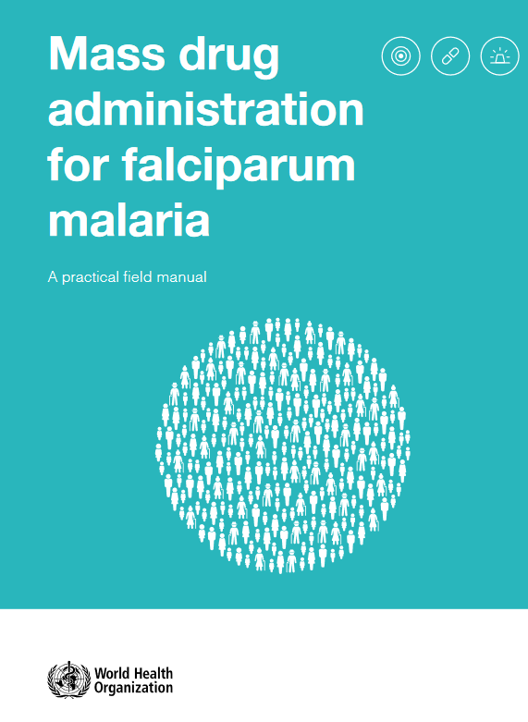
Mass antimicrobial administration
Fell out of favor in the late 1960s, after programs to prevent malaria through the large-scale distribution of a drug called chloroquine led to resistance in the malarial parasite
But opinions on mass drug administration seem to be changing.
Several African countries have reduced deaths from malaria by pre-emptively treating millions of children
Notes:
Resistance developed rapidly because thousands of people with insufficient levels of chloroquine in their systems became infected with malaria parasites. Strains that were susceptible to the drug died, but more-resilient ones multiplied. Eventually, chloroquine stopped working.
https://apps.who.int/iris/bitstream/handle/10665/259367/9789241513104-eng.pdf;jsessionid=08C1FFE11C7824F6488A535544E1A839?sequence=1

Slide 40
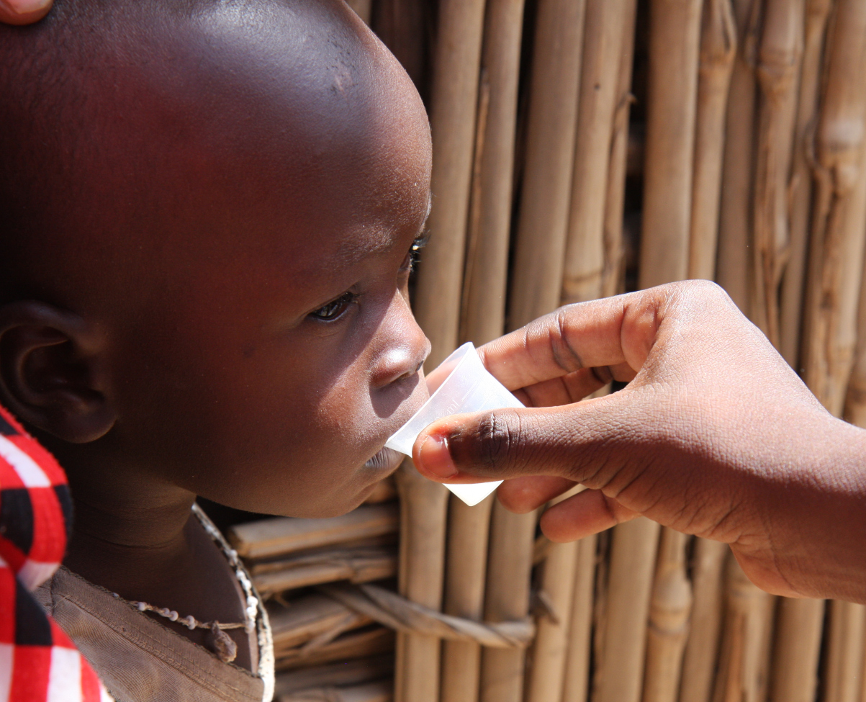
Mass drug administration of antibiotics in LMICs
A single twice-yearly dose of azithromycin given prophylactically within randomized villages to children less than 5 years of age in districts of Niger, Tanzania, and Malawi led to an 18% overall reduction in all-cause mortality in Niger compared to control villages
Mortality was reduced but resistance could develop
Notes:
Niger probably experienced the greatest benefit because it has the highest childhood mortality rate of the three countries. About 9% of children die before the age of 5 in Niger, compared with about 5% in Tanzania and Malawi. https://blog.cartercenter.org/2018/04/26/groundbreaking-study-could-revolutionize-public-health/

Slide 41
Notes:
https://www.science.org/content/article/remote-pacific-island-doctor-has-revived-60-year-quest-eradicate-disfiguring-disease

Slide 42
Addressing AMR
Command and control approaches aim to:
Limit overprescription and overuse among doctors and patients as is being done through antibiotic stewardship programs
Enforce tighter controls on the use of antibiotics in crop and livestock production
Realign cost-benefits such that individuals’ interests match those of the collective.
Incentivize drug companies to develop new antimicrobials by limiting the financial risks to do so
Flexible, adaptive management approaches
Antibiotic resistance should be expected because of evolutionary adaptation and the mobility of bacteria and resistance genes.
Solutions to resistance reside in ecological and evolutionary approaches, not just in tighter control of prescriptions and usage

