Slide 1
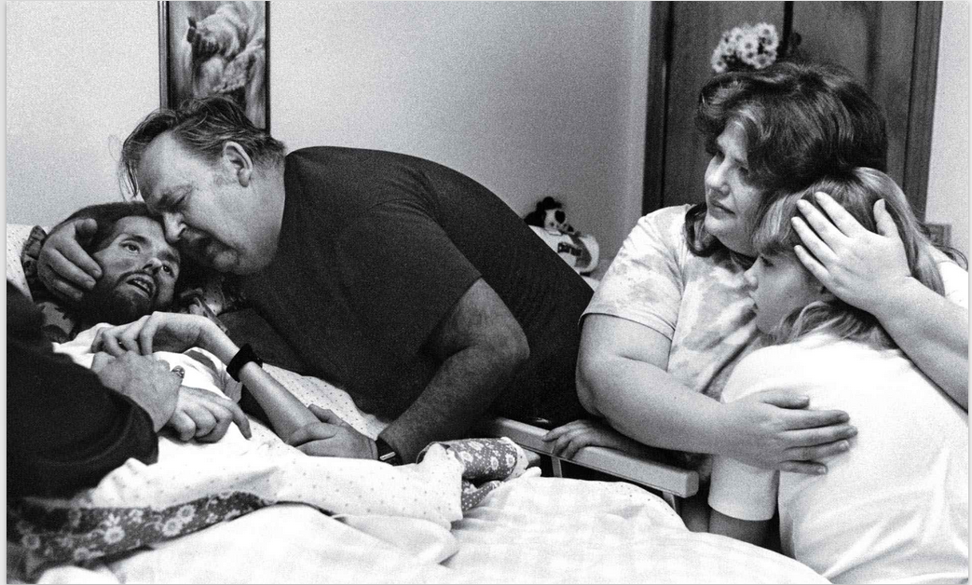
Notes:
David Kirby died surrounded by his family. But Therese Frare’s photograph of the 32-year-old man on his deathbed did more than just capture the heartbreaking moment. It humanized AIDS, the disease that killed Kirby, at a time when it was ravaging victims largely out of public view. Frare’s photograph, published in LIFE in 1990, showed how the widely misunderstood disease devastated more than just its victims. It would be another year before the red ribbon became a symbol of compassion and resilience, and three years before President Bill Clinton created a White House Office of National AIDS Policy.
https://www.life.com/history/behind-the-picture-the-photo-that-changed-the-face-of-aids/

Slide 2
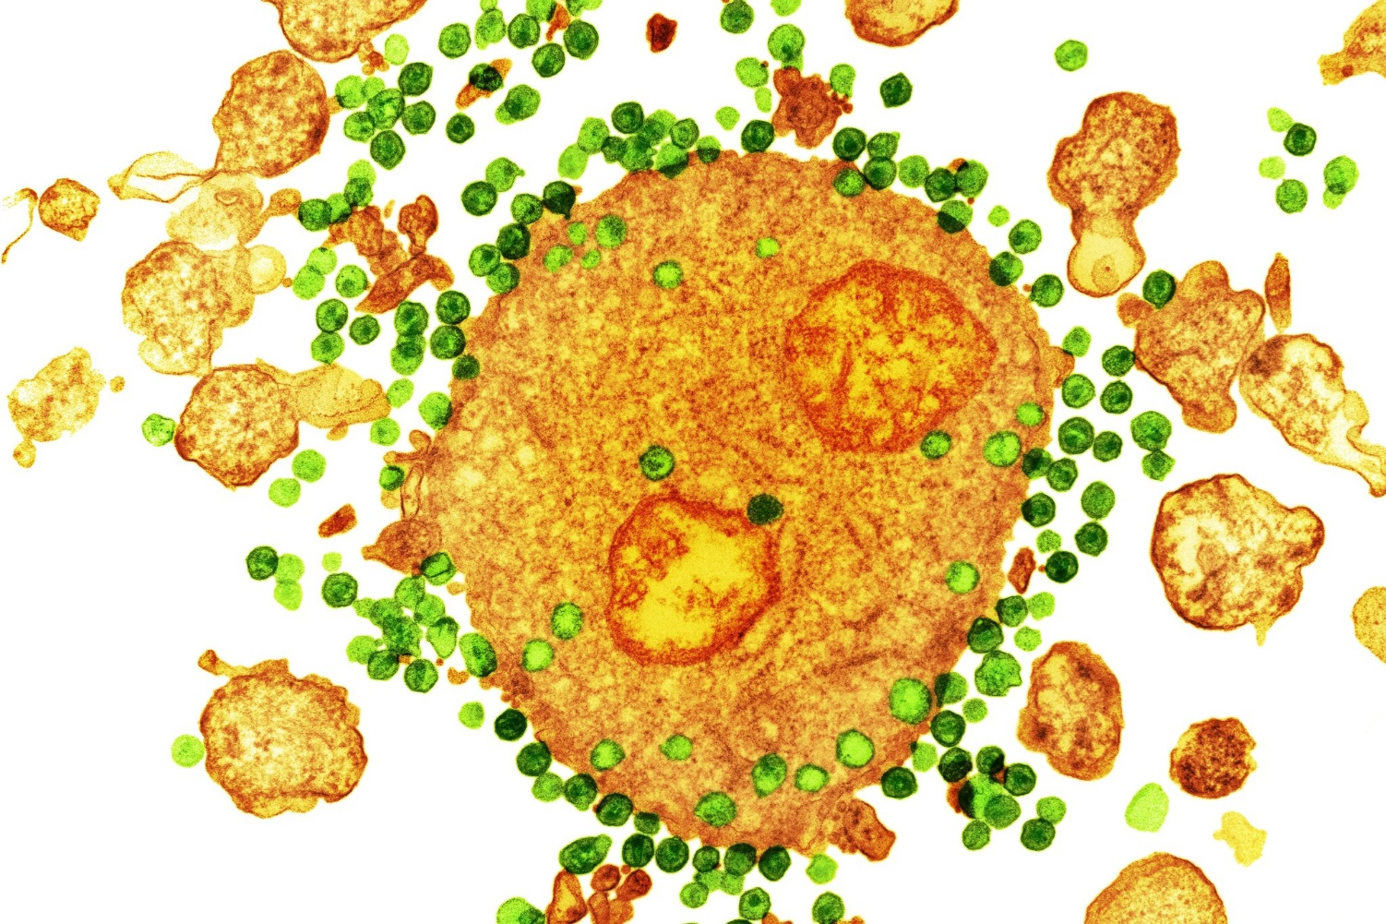
Notes:
A colored transmission electron micrograph of the H.I.V. virus, in green, attaching to a white blood cell, in orange. This is the type of white blood cell that HIV attacks, CD4 cells.
CD4 cells play an important role in the immune system. Your CD4 cell count gives you an indication of the health of your immune system – your body's natural defense system against pathogens, infections and illnesses. CD4 cells are sometimes also called T-cells, T-lymphocytes, or helper cells.

Slide 3
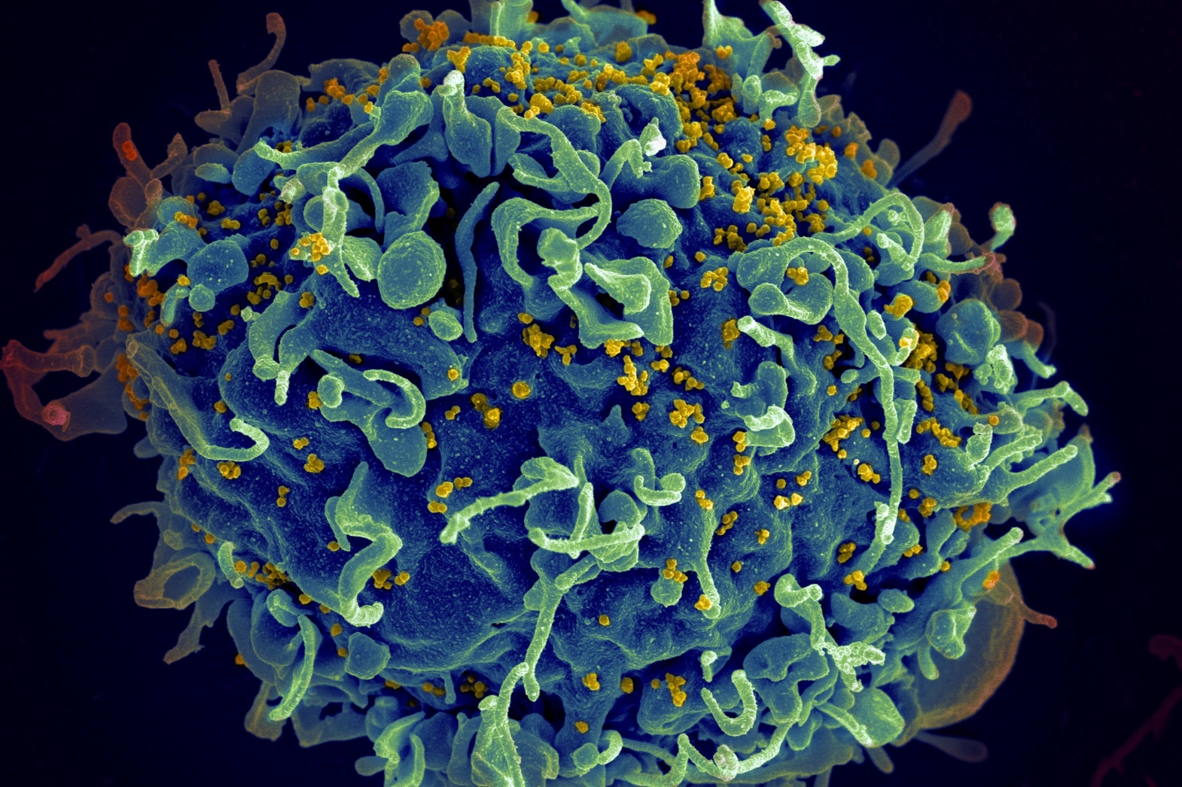
Human Immunodeficiency Virus and Acquired Immune Deficiency Syndrome (HIV-AIDS)
Global pandemic that emerged in the US in early 1980s.
  40 million people globally were living with HIV at the end of 2023.
  1.3 million people became newly infected with HIV in 2022.
  630 000 people died from AIDS-related illnesses in 2019.
  88 million people have become infected with HIV since the start of the epidemic.
  42.3 million people have died from AIDS-related illnesses since the start of the epidemic.
  AIDS-related deaths have been reduced by more than 69% since the peak in 1995.
Notes:
https://www.unaids.org/en/resources/fact-sheet
A human white blood cell, blue, under attack by H.I.V., in yellow.
https://www.nytimes.com/2019/03/05/health/hiv-aids-cure.html
The Spanish Influenza of 1918 killed between 20-50 million for comparison.
SARS-CoV-2 has killed 7 million people globally

Slide 4
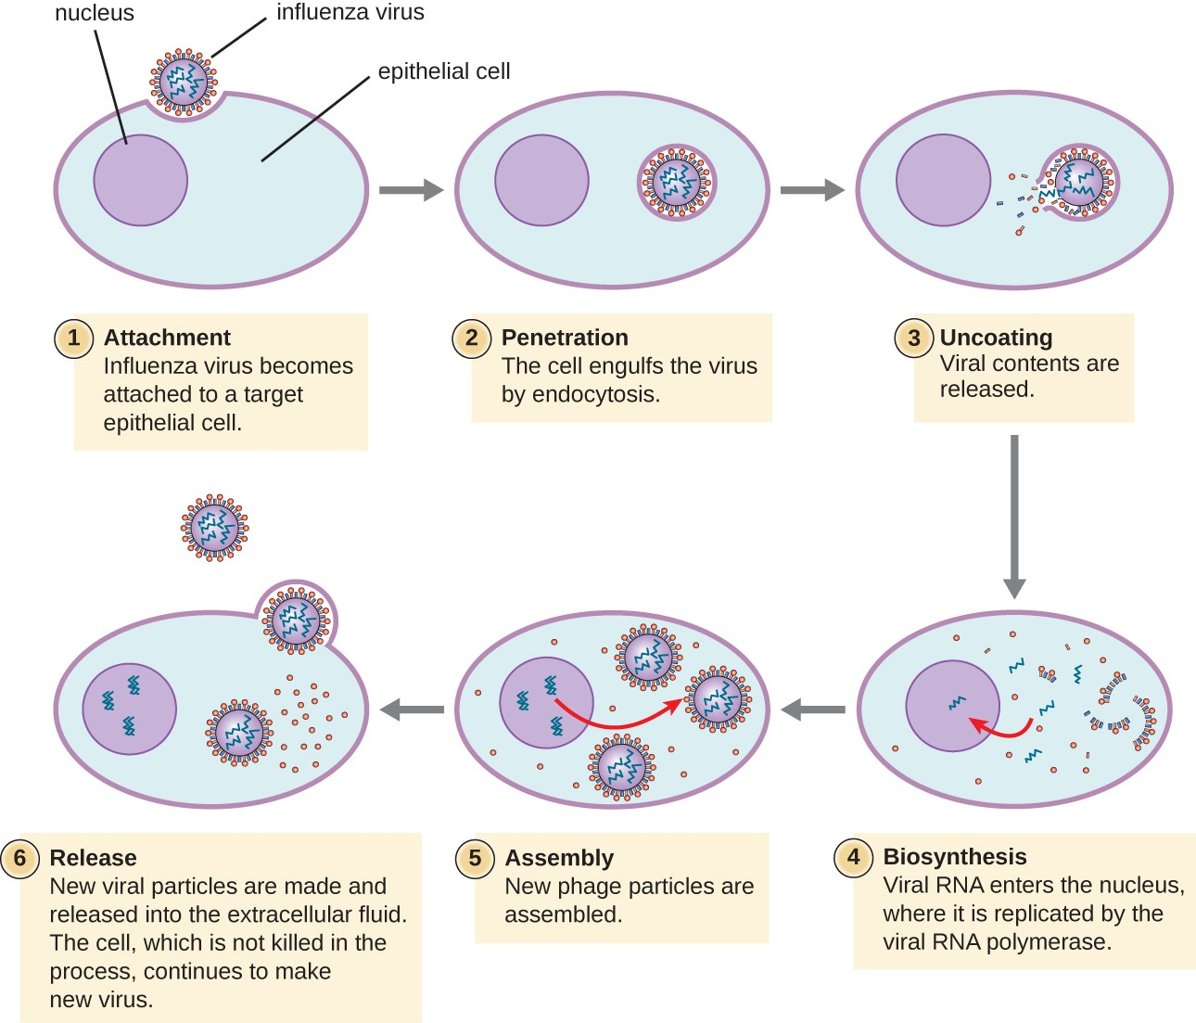
Virus replication
Note that the viral genetic information is not incorporated into the DNA of the host cell.
Information enters the nucleus, where the host’s cellular machinery is used to make new virus.
This is how viruses replicate.
There are also types of viruses called retroviruses. They replicate differently.
Notes:
Above, a virus and how it replicates. On the next page, a retrovirus and how it replicated.
Most viruses have either RNA or DNA as their genetic material. Influenza is an RNA virus. Genome refers to genetic material like RNA or DNA.
In this diagram of viral replication, virions, the virus particles that are infective, are released when someone with the flu, sneezes or coughs. When a person standing next to him/her breathes the air with virions in, they stick to the cells lining the nose and the throat and then inject their genetic material into the host cells. Once inside the host, the viral genome is turned into more viral proteins and viral genomes by the host's cell replication machinery, thus infecting more host cells, without being a part of the cells.
The key factor: a virus replicates without its genetic code being incorporated in the hosts DNA. Note that none of the viral genome does inside the nucleus of the host cell.
For all of our cells, DNA acts as a blueprint for producing proteins. Since the DNA is restricted to the nucleus of the cell, and proteins are made outside of the nucleus, copies of parts of this DNA blueprint are made by messenger RNA. This mRNA can leave the nucleus of the cell and be used to synthesize proteins

Slide 5
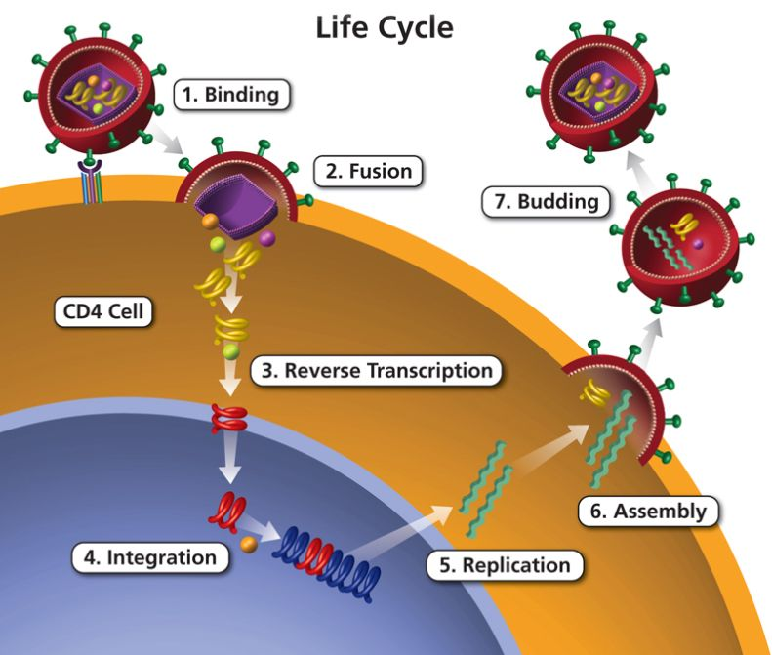
HIV is a retrovirus
A retrovirus is type of virus that uses RNA as its genetic material instead of DNA.
After infecting a cell, a retrovirus uses an enzyme called reverse transcriptase to convert its RNA into DNA.
This DNA enters the nucleus and is integrated into the DNA of the host cell
This DNA sequence is transcribed by the hosts to produce new viral RNA
HIV writes itself into the DNA of the host organism
Notes:
A retrovirus is different because it inserts its genome into the host’s genome, thus becoming a part of the host cells.
HIV is a retrovirus and integrates into human DNA shortly after infection, making it difficult for the immune system to detect and eliminate the virus
Retroviruses carry a unique protein called reverse transcriptase (made by the Pol gene in HIV) that is responsible for turning the RNA genome into DNA. This newly synthesized DNA is then cut and pasted into the host cell DNA, and the host cell gets tricked into making a large number of proteins for the virus. The most common retrovirus is the human immunodeficiency virus or HIV, which conveys an idea of how dangerous retroviruses are.

Slide 6
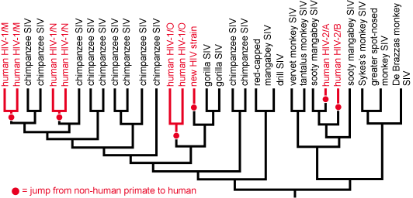
Retroviruses evolve rapidly
Reverse transcriptase enzyme makes around 10,000 times more errors than human polymerases, the chemicals that copy the human genome sequence when our cells divide
Every retrovirus that is produced has on average one modification more than the retrovirus from which it originates.
In a typical untreated HIV-1 patient with a virus load of billions of virus particles and a viral generation time of one to two days, evolution happens rapidly
Notes:
SIV – simian immune virus
HIV evolved from SIV not once but several times.
There are two forms of human AIDS virus, human immunodeficiency virus types 1 and 2 (HIV-1 and HIV-2).
Related simian immunodeficiency viruses (SIVs) are found in more than 30 species of primates in sub-Saharan Africa; each species has its own form of SIV. HIV-1 is classified into three groups, M, N, O. and P. HIV-1 strains are closely related to SIVcpz/s, from the chimpanzee subspecies Pan troglodytes SARS-CoV-2

Slide 7
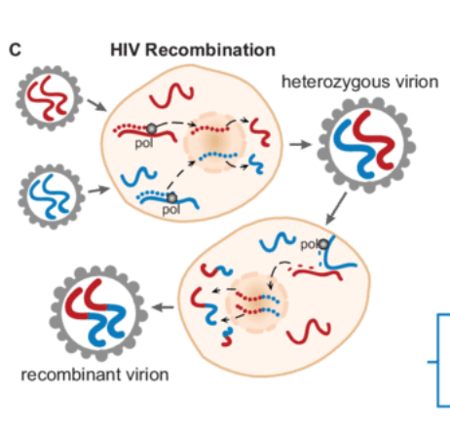
HIV can also recombine into novel forms
Genetic material can mix and fuse inside the nucleus of the host’s cells
Notes:
Pol is an HIV gene that makes enzymes that help transcribe the RNA of HIV into the DNA of the host cell. Pol also helps reassemble the HIV viruses made in the host

Slide 8
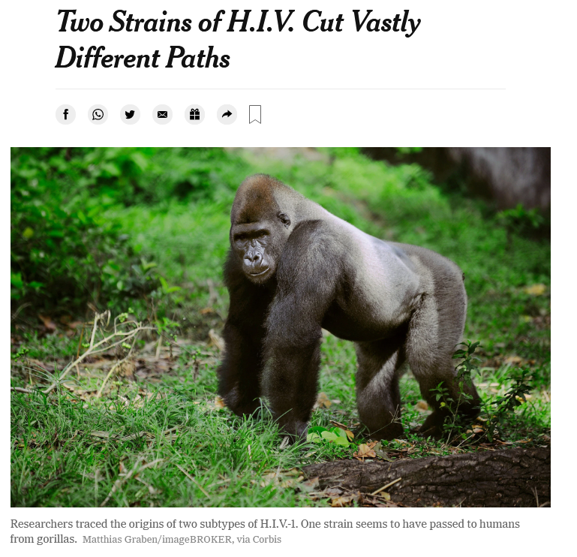
Reading/Questions 12

Slide 9
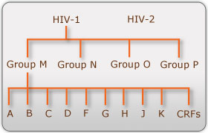
Notes:
https://www.hiv.lanl.gov/content/sequence/HelpDocs/subtypes-more.html
https://www.hiv.lanl.gov/content/sequence/HIV/CRFs/CRFs.html
HIV-1 is classified into three groups, M, N, O. and P.
Group M is the most common and originated from chimp SIV
Group N is rarer and derived from chimp SIV closely related to Group M.
Group O is derived from a spillover of gorilla SIV.
Group P is derived from a spillover of a chimp-gorilla SIV
HIV-2 is also classified into multiple groups. HIV-2 strains are closely related to SIVsmm, from sooty mangabey monkeys (Cercocebus atys).
Although both are transmitted through bodily fluids, HIV-2 is less pathogenic than HIV-1 and less widely spread.
There are four subtypes of HIV-1: the "major" group M, group O, group N, and group P. Within the major group are 9 clades (A, B, C…CRFs are circulating recombinant forms) that are genetically distinct from one another and tend to be associated with certain geographical regions.
Approximately 90% of HIV-1 infections belong to group M. It has been found that subtypes may have different infectivity levels and modes of transmission. Even though these subtypes are genetically distinct from one another, no change in effectiveness of antiretroviral drugs has been observed between subtypes

Slide 10
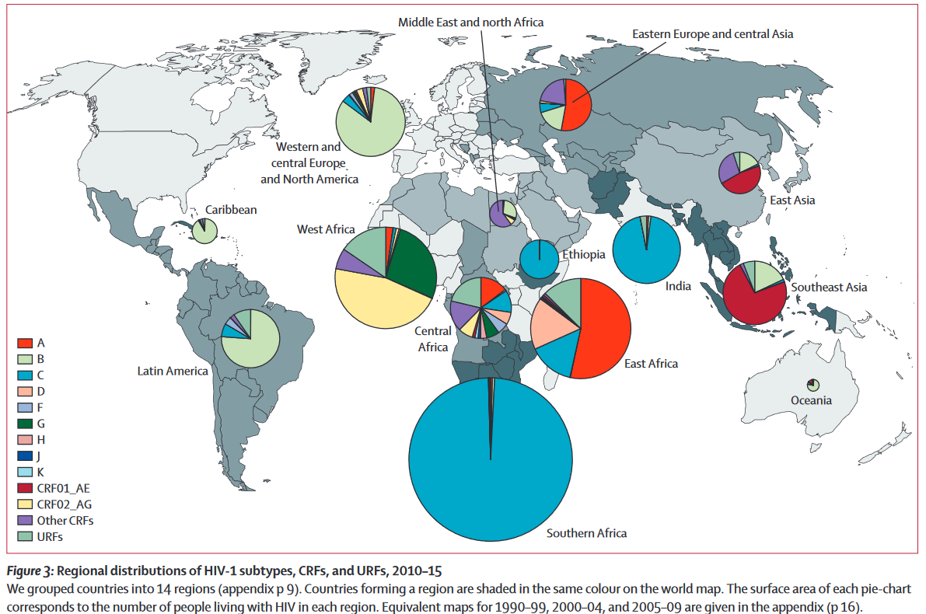
HIV-1 Group M subtype distribution
Notes:
Each of the major HIV 1 subtypes are present in Africa and Kinshasa, a Congo city considered an early focal point for the spread of HIV.
Subtype B, though relatively uncommon in Africa, came to dominate in North America, Europe, the Car
Hemelaar, J., Elangovan, R., Yun, J., Dickson-Tetteh, L., Fleminger, I., Kirtley, S., ... & Shao, Y. (2019). Global and regional molecular epidemiology of HIV-1, 1990–2015: a systematic review, global survey, and trend analysis. The Lancet infectious diseases, 19(2), 143-155.

Slide 11
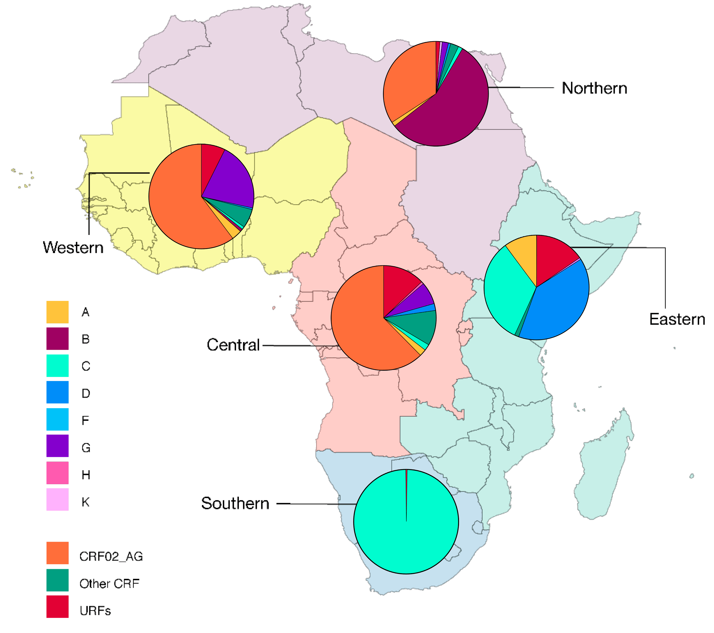
Notes:
Giovanetti M, Ciccozzi M, Parolin C, Borsetti A. Molecular Epidemiology of HIV-1 in African Countries: A Comprehensive Overview. Pathogens. 2020 Dec 21;9(12):1072. doi: 10.3390/pathogens9121072.
This figure show the HIV-1 Group M subtypes in Africa

Slide 12
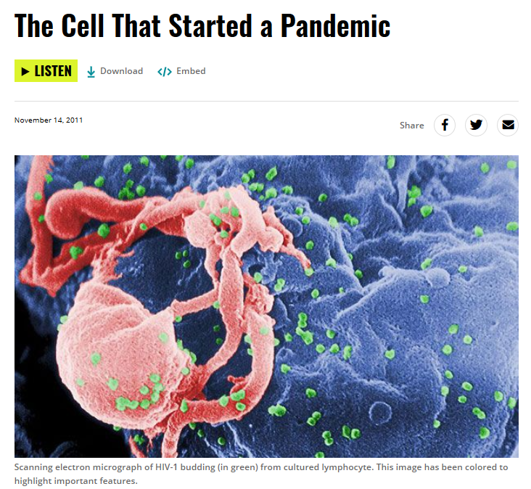
The spillover of HIV
Podcast/Questions 12
A chimpanzee consumes two or more different monkey each with their own version of SIV (simian immune virus)
Chimp SIV arose from the recombination of several different monkey SIV viruses
Chimpanzee SIV was also transmitted to gorillas

Slide 13
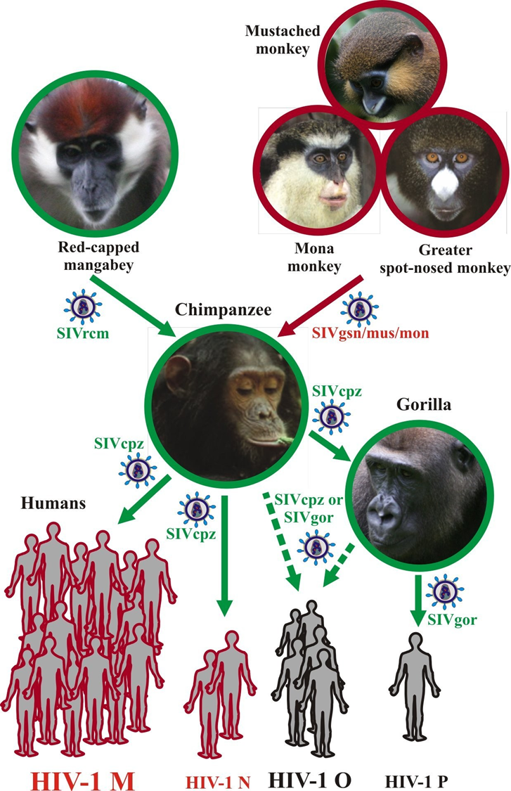
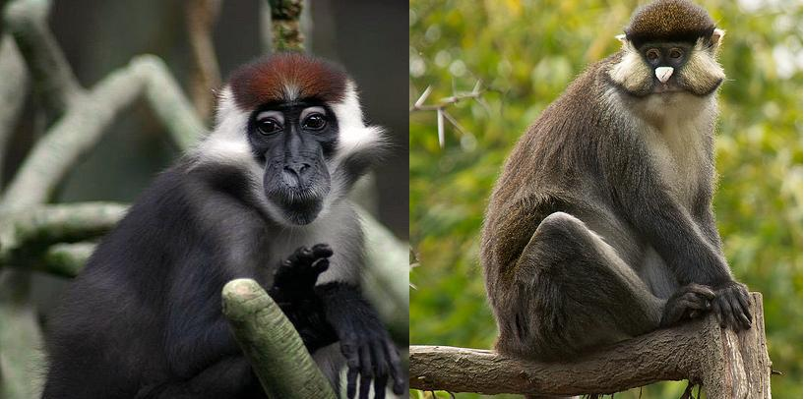
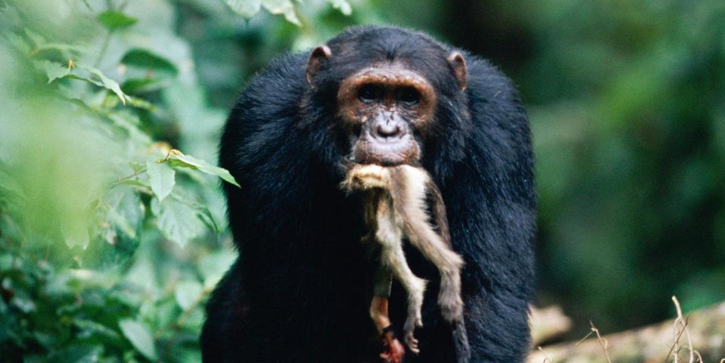
Notes:
Note that the four groups of humans at the bottom represent the four spillover events of SIV into humans that formed the Groups M, N, O and P of the HIV-1 virus.
Monkeys, not chimpanzees, a primate, are where HIV began. Red-capped mangabeys and greater spot-nosed monkeys were eaten by chimpanzees. Chimps acquired SIV, the simian immunodeficiency virus, from these monkeys. When humans hunted, cleaned and consumed chimpanzees, the virus jumped into the human population. But as the figure on the left communicates, it was far more complex than this and there were multiple jumps or spillovers occurred between chimps and humans and gorillas and humans.
https://www.nytimes.com/2015/03/02/science/two-strains-of-hiv-cut-vastly-different-paths.html

Slide 14
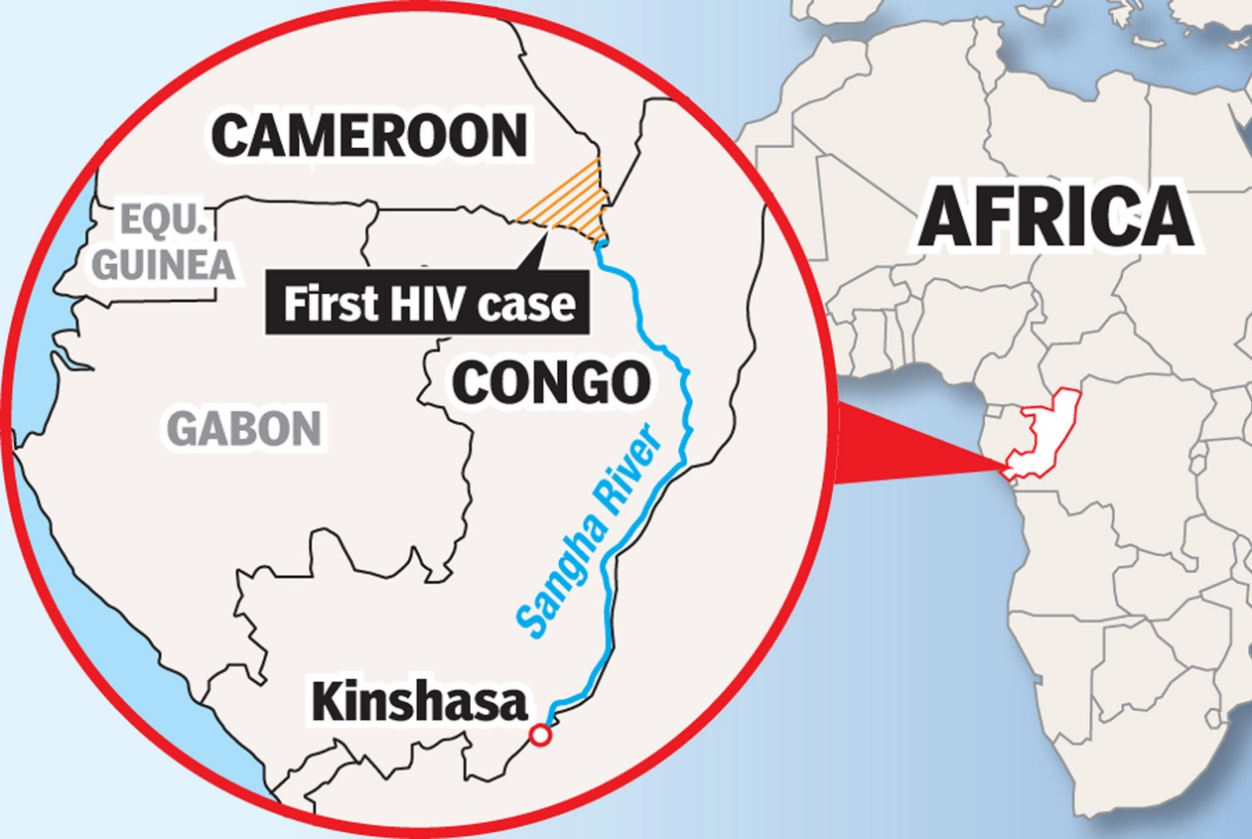
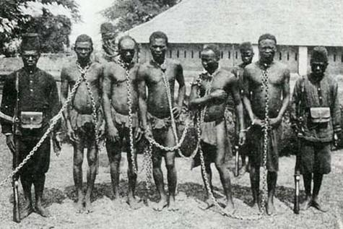
1885: Belgium begins colonizing central Africa and set up the Congo ‘Free’ State
In early 1900s: hunting or consumption of bushmeat leads to spillover of SIV to humans from chimpanzees, and from there humans take it to Kinshasa where it can spread
Under Belgian political and economic rule of the 1920s, young Congolese men were coerced to leave rural villages and work for Belgian companies. HIV travels with them.
Notes:
King Leopold II of Belgium sought to establish Belgium as an imperial power. He led the first European efforts to develop the Congo River basin, making possible the formation in 1885 of the Congo Free State, annexed in 1908 as the Belgian Congo and now the Democratic Republic of the Congo. Although he played a significant role in the development of the modern Belgian state, he was also responsible for widespread atrocities committed under his rule against his colonial subjects.

Slide 15
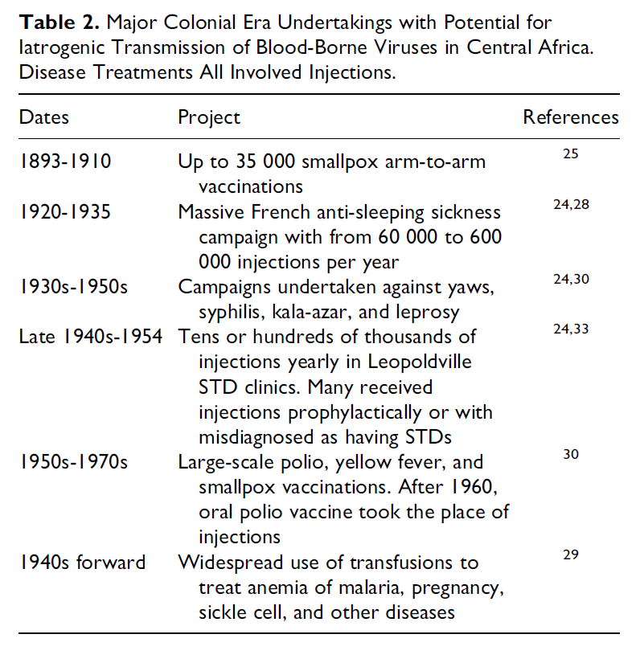
During late 1800s campaigns to immunize Africans began
Run by European colonial governments
Involved injections of large numbers of Africans often with the reuse of needles.
Continued through the middle 20th century although hypodermic needles had become cheaper and easier to produce
These practices, particularly in the early immunization campaigns, may have enhanced the evolution of HIV and its spread among Africans
Notes:
https://www.blackhistorymonth.org.uk/article/section/real-stories/the-history-of-aids-in-africa/
Vance, M. A. (2019). Conflicting Views in Narratives on HIV Transmission via Medical Care. Journal of the International Association of Providers of AIDS Care (JIAPAC), 18, 2325958218821961.
https://pmc.ncbi.nlm.nih.gov/articles/PMC6748459/

Slide 16
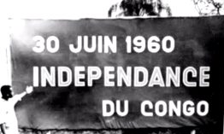
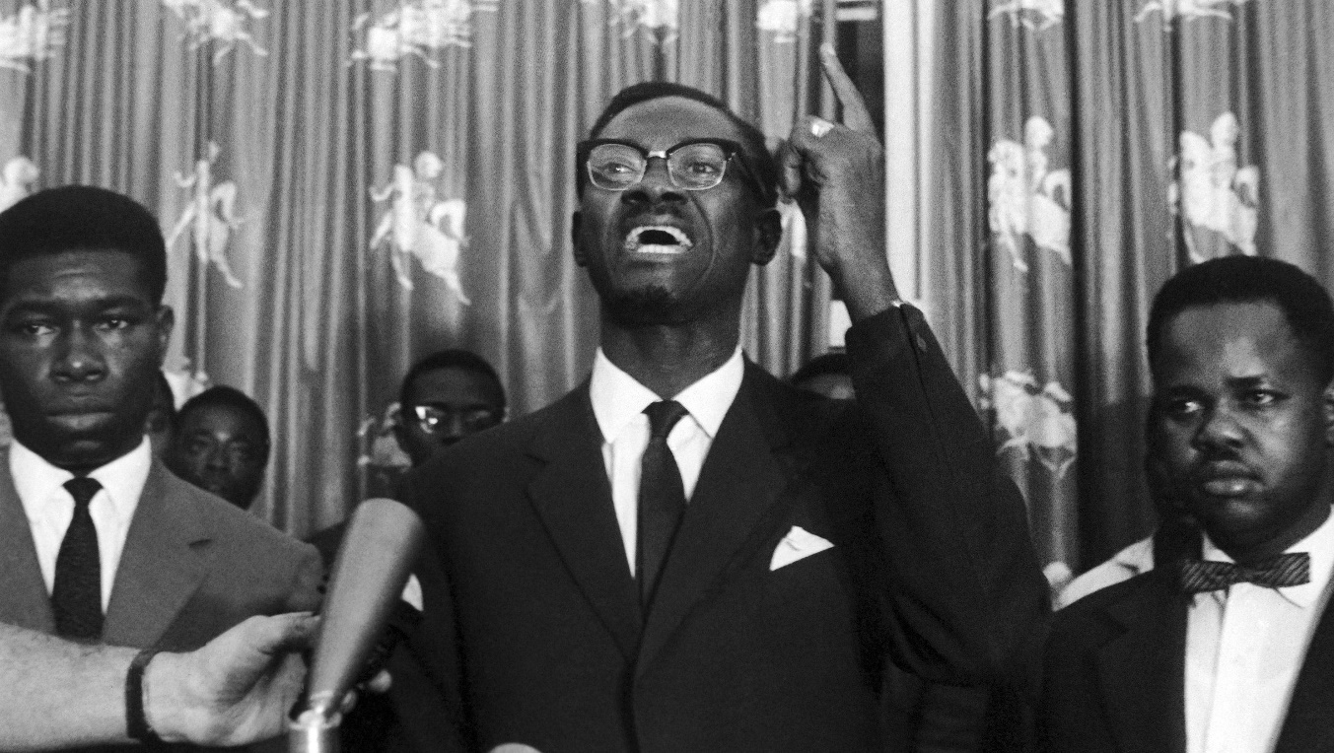
1950s -1960s: Emigration of Haitians to Congo to take jobs left vacant by departing Belgians, who have relinquished colonial rule of Congo.
International travel in general is starting to become more common.
1960s: Haitians return to Haiti due to political transition in Congo and take HIV with them.
Notes:
https://www.washingtonpost.com/national/health-science/colonialism-in-africa-helped-launch-the-hiv-epidemic-a-century-ago/2012/02/21/gIQAyJ9aeR_story.html
Haitians spoke French like the Belgians
Haitian workers went to work in the newly independent Congo in the 1960s. They went because the Belgians who had ruled over the Congo spoke French, and many Haitians spoke French. Haitian civil servants were recruited by the United Nations. They filled many of the jobs vacated by the Belgians when they left. Later, when Congo changed governments again, the Haitians were told to leave so that native Congolese could have their jobs. However, some of the Haitians had acquired HIV while in the Congo and took it back to Haiti.
This region has had many names bestowed upon it by colonial and well as African powers: From the Congo Free State to the Belgian Congo, then the then the Democratic Republic of Congo, Zaire, and back to the DRC. There is a small country that is called the republic of Congo to the west of the DRC

Slide 17
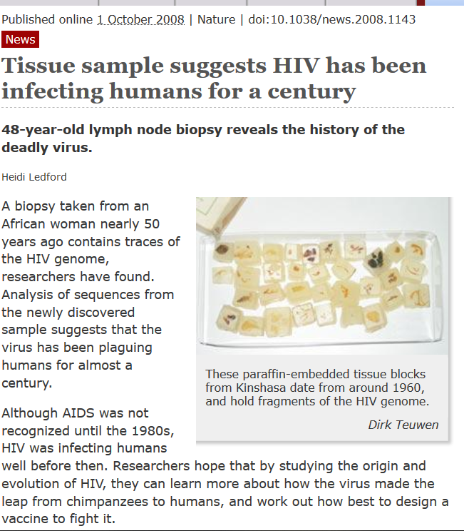
HIV detected in tissue samples from central Africa preserved from the years of 1959-1960. (see right)
In 1969, a 16-year old dies of what is now thought to be AIDS in US Midwest suggesting HIV may have been coming into the US well before the 1980s.
In 1976, a 29-year old Norwegian sailor and truck driver dies from what will later be determined to be HIV based on archived blood samples

Slide 18
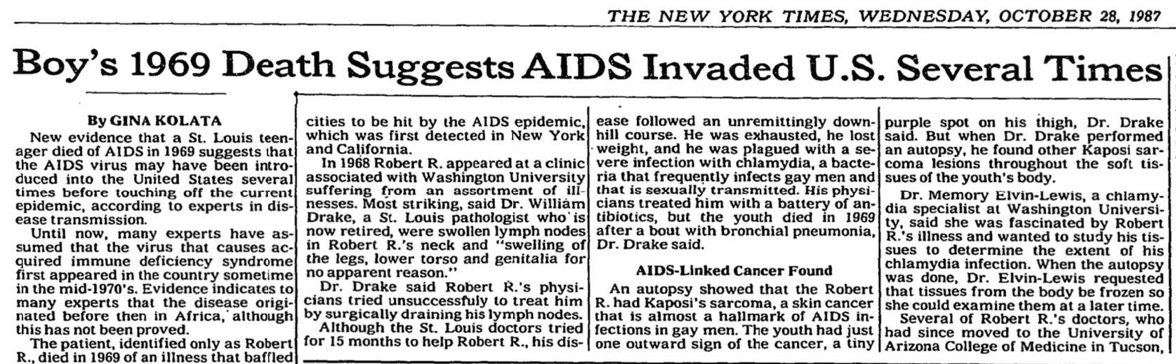
Notes:
https://timesmachine.nytimes.com/timesmachine/1987/10/28/issue.html
https://www.nytimes.com/1987/10/28/us/boy-s-1969-death-suggests-aids-invaded-us-several-times.html
https://www.stlmag.com/The-Pre-Pandemic-Puzzle/
Robert R.’s HIV was a rare, early strain—almost identical to the strain researchers first identified in Paris, but not the strain that became known in the late 1970s and continues to spread AIDS worldwide. Robert R.’s case teaches us something important about the history of the retrovirus. Rather than making a single blitzkrieg attack, HIV started with guerilla warfare. There may have been several different strains of the virus at low levels making incursions in different countries, At some point one of those strains got established, and that’s what spread the pandemic

Slide 19
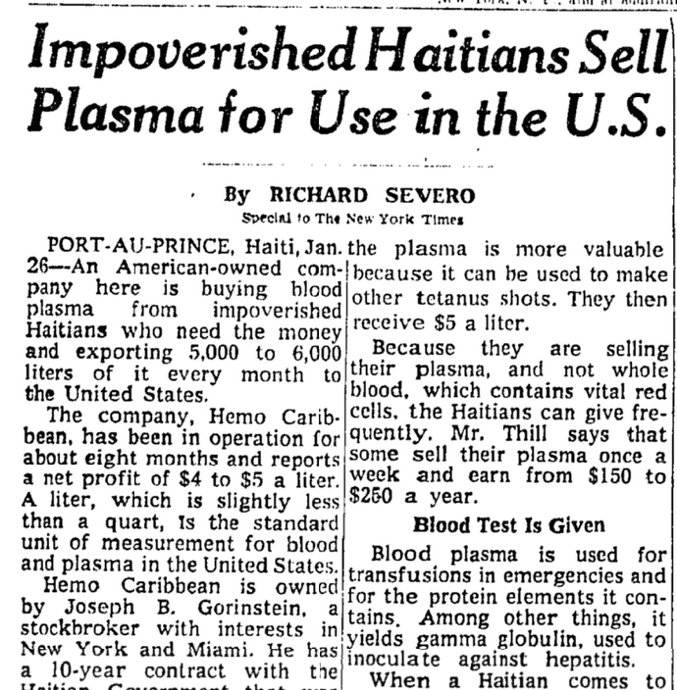
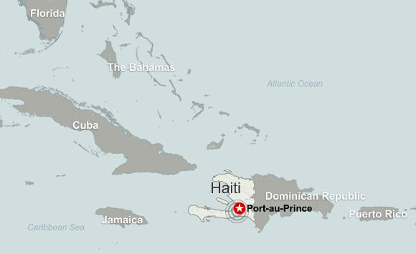
  1969: Blood plasma industry in Haiti set up by Miami company.
  Sterilization procedures not practiced. Plasma shipped to US and abroad.
  1970s: HIV is silently going global through international tourism in Caribbean and via contaminated plasma shipments
Notes:
In Haiti, HIV spread because a Miami-based plasma company operating there did not observe proper medical protocols. Like here in the US and in many countries, the poor often sell their plasma (the clear component of your blood) for money. HIV-infected poor in Haiti sold their plasma to a company called Hamo-Caribbean. HIV made its way to the US in plasma sent to doctors and hospitals. Some of the first people to get HIV were hemophiliacs, who depended upon plasma to lessen the impacts of their illness. Plasma is used to obtain clotting factor, a compound given to hemophiliacs, who lack clotting factor in their own blood. In the 1970s through the 1980s, HIV began appearing in four groups here in the US, among Haitians who had immigrated to Florida, hemophiliacs who had used contaminated plasma, gay men, and heroin users.
The operation paid inadequate attention to the safety of the donors and to screening of plasma for diseases and, combined with the deficiency in sterile supplies and techniques characteristic of health-care delivery in impoverished lands, that would create another “perfect storm” for HIV spread

Slide 20
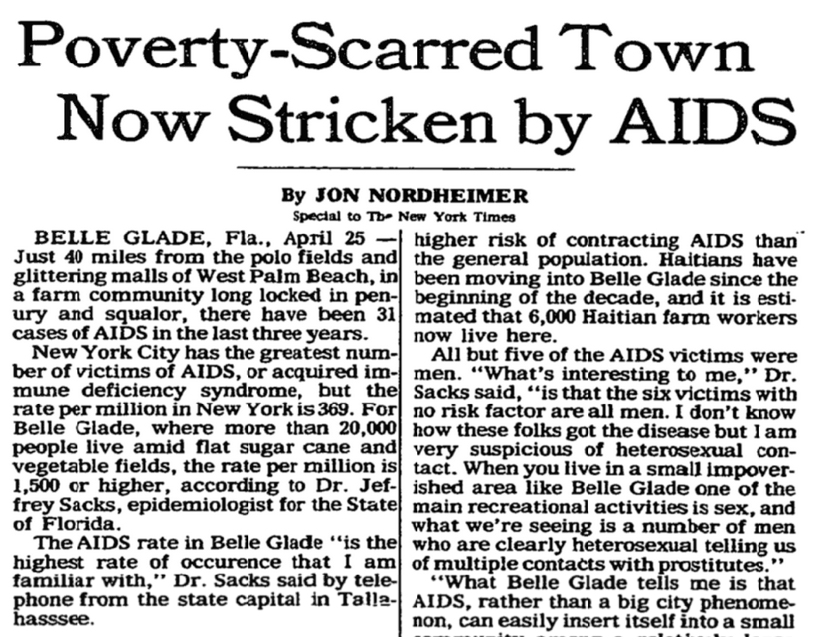
  In early 1980s, HIV appears in gay men and a town in southeast Florida with a large Haitian population
  By this time, HIV had already likely spread to five continents (North America, South America, Europe, Africa and Australia)
  AIDS was recognized as more common in certain populations: hemophiliacs, homosexuals, Haitians, and heroin users.
Notes:
https://www.sun-sentinel.com/news/fl-xpm-1985-04-21-8501150319-story.html
https://www.palmbeachpost.com/article/20101219/NEWS/812033220
https://www.youtube.com/watch?v=pKNh_7P4pwM
Start video at 1:35

Slide 21
HIV-AIDS arrival and spread in China
First detected in 1985 in foreign tourist, and shortly after in Chinese
HIV initially appeared in intravenous drug users because parts of China are near the Golden Triangle where poppy is cultivated
1990s saw spike in cases among individuals who donated blood
In rural areas of Henan, Anhui, and Shanxi provinces, blood collection stations operated with government oversight but little regulation
They used unsafe practices, such as pooling blood from multiple donors, extracting plasma, and reinfusing blood cells back into donors
Thousands of rural villagers became infected, creating a public health crisis that was initially covered up.

Slide 22
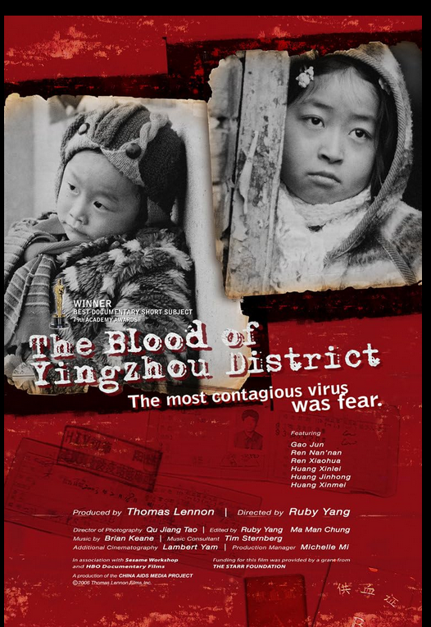
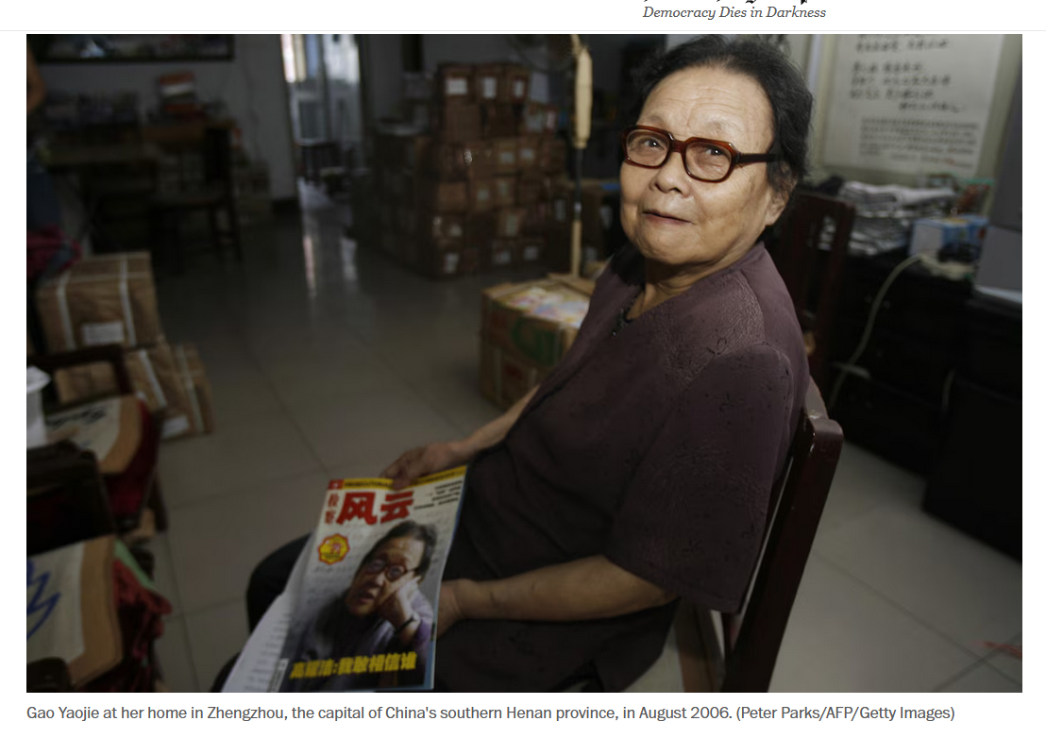
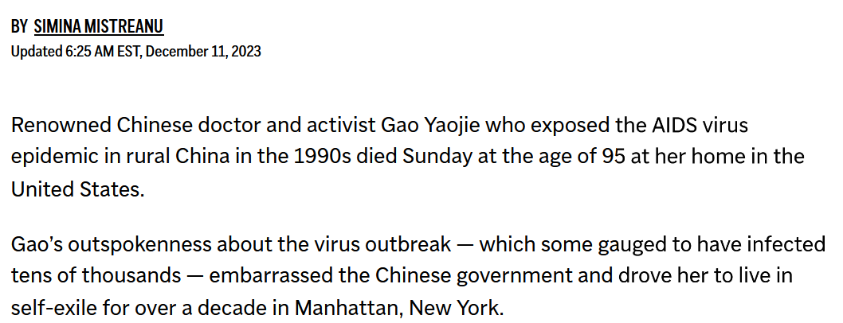
Notes:
https://www.youtube.com/watch?v=FwaWZMd75hg

Slide 23
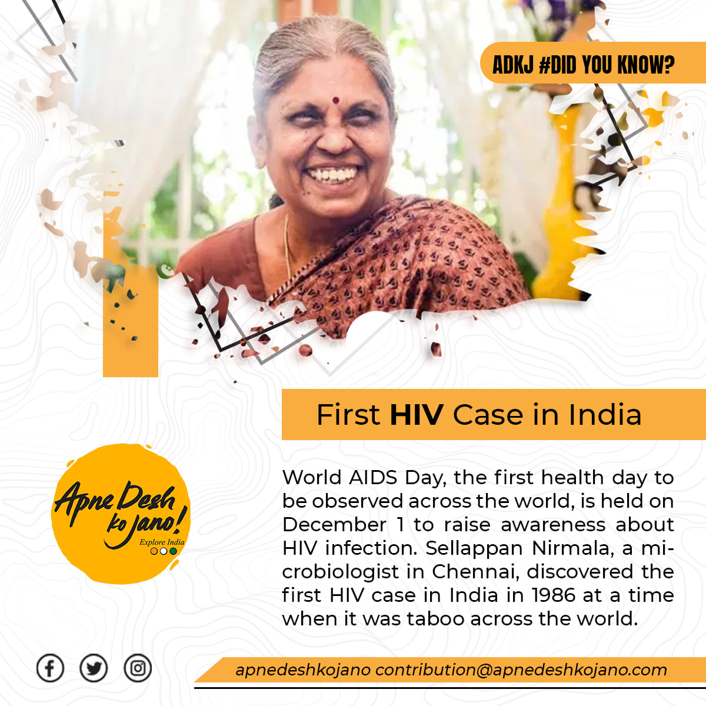
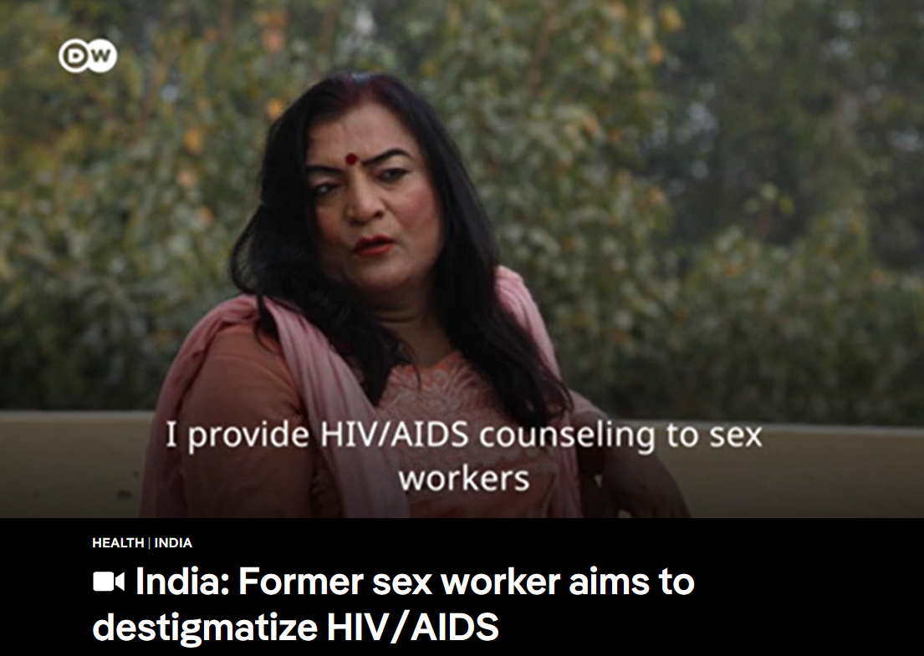
Notes:
This is the woman who identified the first cases in India
Thirty years ago, India discovered the dreaded HIV virus had reached its shores when blood samples from six sex workers tested positive. It was largely due to the efforts of one young scientist - but until now, her pioneering work has been all but forgotten. When it was first suggested she screen people for HIV/Aids, Sellappan Nirmala balked. It was at the end of 1985 and the 32-year-old microbiology student at the medical college in Chennai (Madras), was looking for a topic for her dissertation. The idea came from her professor and mentor, Suniti Solomon. Formal tracking of Aids cases had begun in the United States in 1982 and the medical authorities in India didn't want to be caught napping if the disease reached India. But at the time, the idea of that happening was widely considered "unthinkable", Nirmala recalls. The press at the time wrote that HIV was a disease of the "debauched West" where "free sex and homosexuality" were prevalent. Indians, on the other hand, were portrayed as heterosexual, monogamous and God-fearing.

Slide 24
HIV-AIDS arrival and spread in India
The first HIV cases in India were detected in 1986 in female sex workers in the city of Chennai.
Introduced through
  Commercial sex work, a major factor throughout Asia
  Prostitution operates in a legal grey area in India
  Intravenous drug use in the northeastern part of India also contributed
  Human mobility within India and internationally played a large role here than in China
Notes:
https://www.bbc.com/news/magazine-37183012
Indian press saw HIV as a disease of the "debauched West" where "free sex and homosexuality" were prevalent. Indians, on the other hand, were portrayed as heterosexual, monogamous and God-fearing.

Slide 25
Hysteria and discrimination at the start of the pandemic
Targeted people living with HIV–AIDS, particularly the four high-risk groups: homosexuals, heroin addicts, hemophiliacs, and Haitians.
Various politicians called for quarantining of anyone who tested positive for HIV,
There was an AIDS-quarantine ballot initiative in California, and various states threatened or passed conditional quarantine measures.
Some HIV-positive children were excluded from school; two such cases — those of the three Ray brothers in Arcadia, Florida, and of Ryan White in Kokomo, Indiana — received national attention

Slide 26

Video
Notes:
Ryan White, a teenager from Indiana, USA who acquired AIDS through contaminated blood products used to treat his hemophilia was banned from school. On 8 April 1990, Ryan White died of an AIDS-related illness aged 18.
Terrified Americans wanted someone to blame. Federal health officials said homosexuals, Haitians, hemophiliacs and heroin users were all victims — thus effectively calling them all carriers. Many individuals felt the sting of suspicion, including Ryan White, a 13-year-old hemophiliac bullied and barred from middle school after he contracted H.I.V. from a blood-clotting factor.

Slide 27
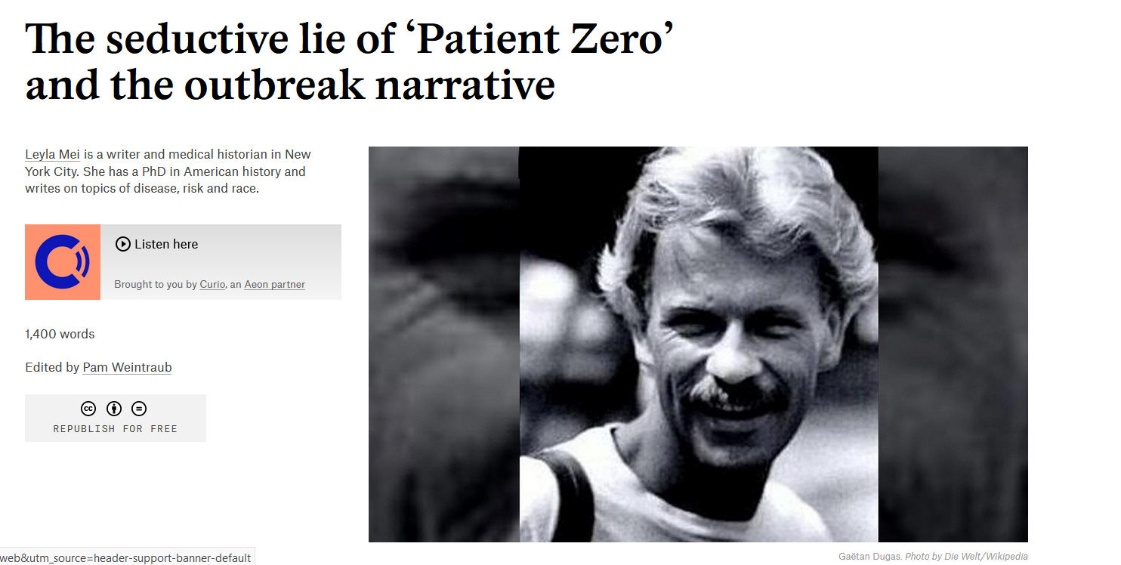
Notes:
https://aeon.co/ideas/the-seductive-lie-of-patient-zero-and-the-outbreak-narrative
Gaetan Dugas was not the first person to spread HIV in North America. In 2016, evolutionary biologists announced that the virus likely came to New York City in 1971 and was linked to viral isolates then circulating in Haiti and other Caribbean countries. Gaetan Dugas acquired the virus domestically, in the US, rather than bringing it to the US from the Caribbean.

Slide 28
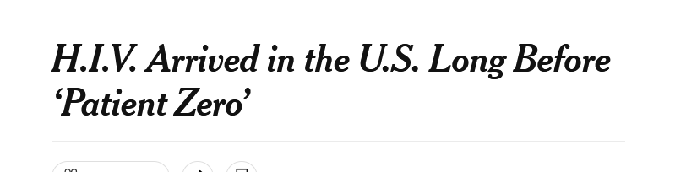
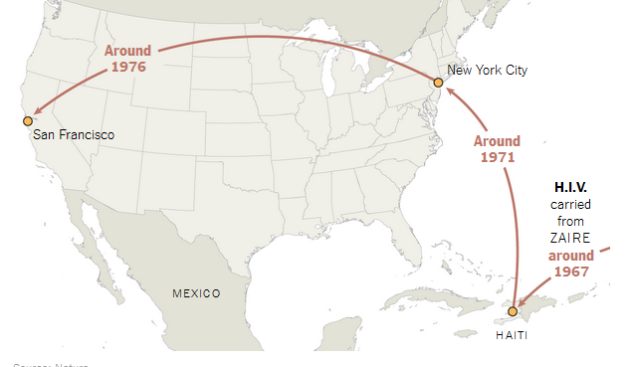
Reading/Questions 12
Notes:
https://www.nytimes.com/2016/10/27/health/hiv-patient-zero-genetic-analysis.html
In the tortuous mythology of the AIDS epidemic, one legend never seems to die: Patient Zero, a.k.a. Gaétan Dugas, a globe-trotting, sexually insatiable French Canadian flight attendant who supposedly picked up H.I.V. in Haiti or Africa and spread it to dozens, even hundreds, of men before his death in 1984. Mr. Dugas was once blamed for setting off the entire American AIDS epidemic, which traumatized the nation in the 1980s and has since killed more than 500,000 Americans.
But after a new genetic analysis of stored blood samples, bolstered by some intriguing historical detective work, scientists on Wednesday declared him innocent. The strain of H.I.V. responsible for almost all AIDS cases in the United States, which was carried from Zaire to Haiti around 1967, spread from there to New York City around 1971, researchers concluded in the journal Nature. From New York, it spread to San Francisco around 1976. The new analysis shows that Mr. Dugas’s blood, sampled in 1983, contained a viral strain already infecting men in New York before he began visiting gay bars in the city after being hired by Air Canada in 1974.

Slide 29
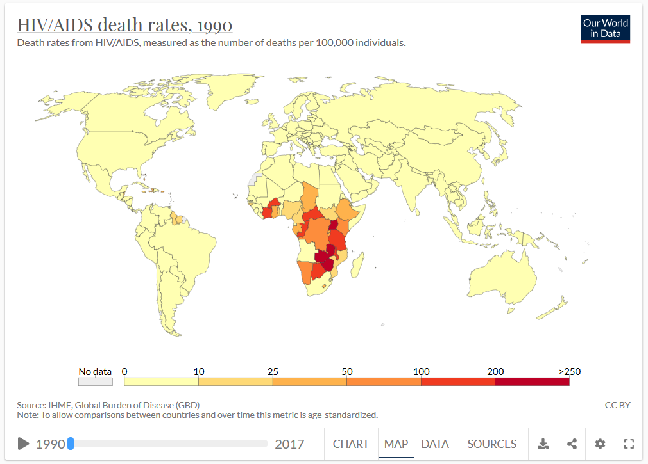
  1984: HIV identified as cause of AIDS
  By 1995, complications from AIDS was leading cause of death for adults 25 to 44 years old in US.
  However, recognition of HIV-AIDS and the development of drugs was delayed because federal government was slow to respond

Slide 30
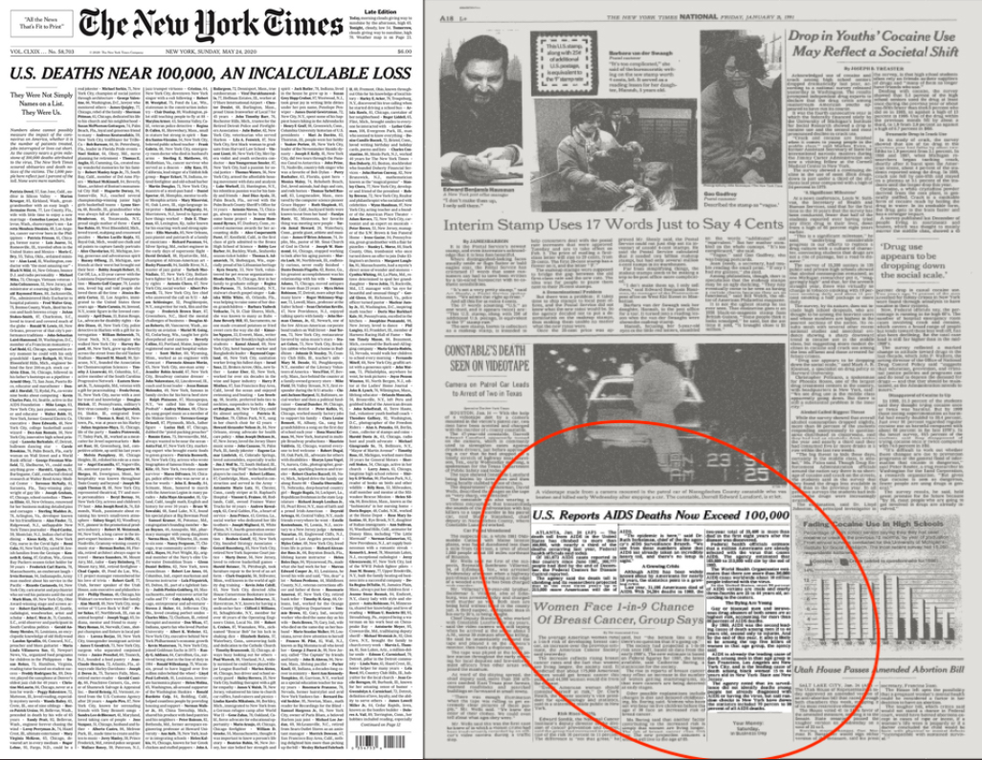

Slide 31

Timeline of HIV-AIDS

Slide 32
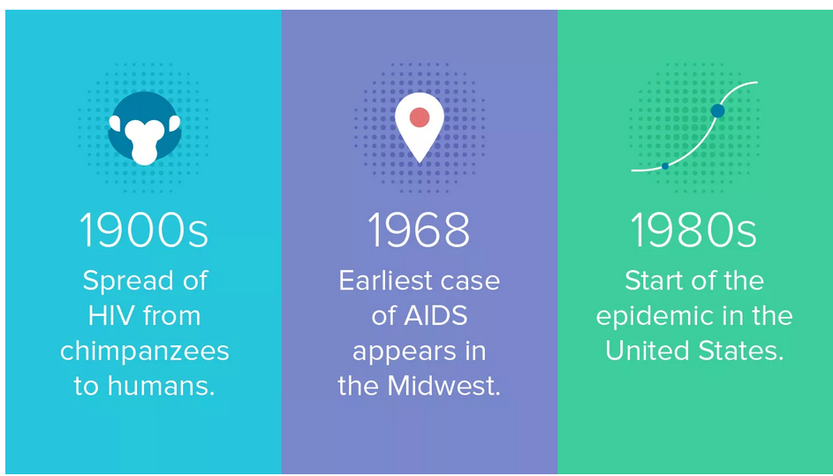
Why wasn’t AIDS detected earlier in central Africa?
Its capacity cause mortality may have not evolved yet
High background mortality rates from infectious disease
Many died outside of the few hospitals available
Weak to non-existent public health monitoring
Very little historical evidence available to document its early emergence
Not enough people had it, it was only by the 1960s that several thousand people in the Congo region were likely carrying HIV
Notes:
https://en.wikipedia.org/wiki/Grethe_Rask#Illness_and_death_(1975%E2%80%931977)

Slide 33
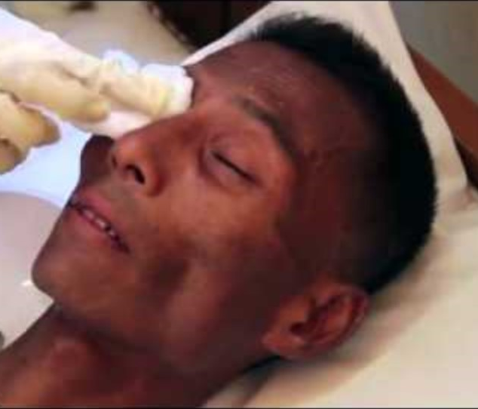
By 1970s, likely that there were surges in opportunistic infections in patients in large cities of the Democratic Republic of Congo.
Ordinarily these are treatable diseases but can become serious in the immunocompromised and lead to death.
Cryptosporidiosis - a diarrheal disease caused by a tiny parasite called Cryptosporidium.
Cytomegalovirus - can infect multiple parts of the body including the eye, where it can lead to blindness in immunosuppressed
Notes:
HIV positive person in Myammar receiving treatment for infection of the eye with cytomegalovirus

Slide 34
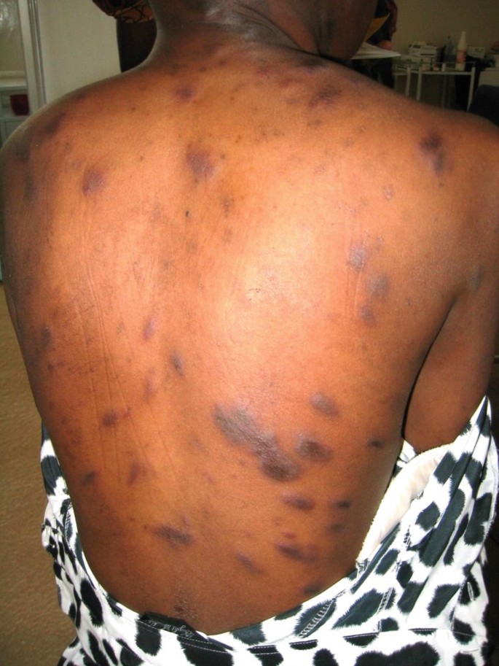
Kaposi’s sarcoma - type of cancer caused by a herpesvirus. Small blood vessels grow abnormally and form firm pink or purple raised spots on the skin. Life-threatening when it affects organs inside the body
Pneumocystis pneumonia (PCP) - PCP is a lung infection caused by a fungus
Notes:
https://www.cdc.gov/hiv/basics/livingwithhiv/opportunisticinfections.html

Slide 35

Factors shaping initial spread of HIV in Africa
Truck drivers, soldiers, and migrant laborers facilitated i movement of HIV-1 out of central Africa, as they engaged with sex workers and spread HIV along transport and trade routes.
In mid 1980s, estimated that 30% of Ugandan truck drivers and military personnel were HIV positive
HIV-AIDS in Africa was not predominantly a disease of gay men, heroin users, hemophiliacs and Haitians. It spread mainly through heterosexual sex.
Notes:
https://link.springer.com/article/10.1007/s11904-016-0318-8

Slide 36
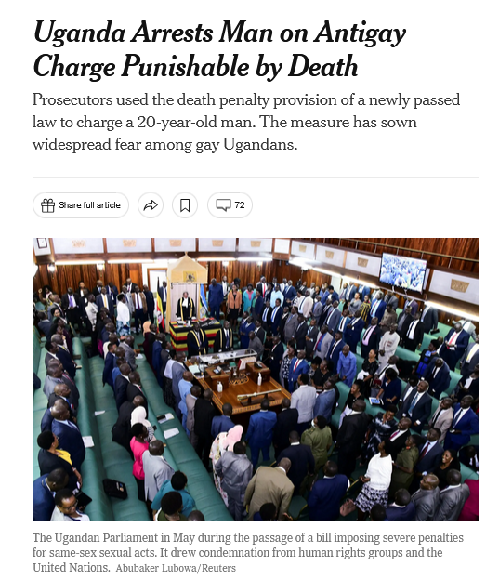
Many parts of Africa then and today not as open to gay lifestyles
Underuse of condoms, and how women were not empowered to resist unprotected relations enhanced spread
Children could acquire it from their mothers through the placenta or during birth. Most children would die in the first few years of life from opportunistic infections
Notes:
As of November 16, 2024, there have been no reported executions in Uganda under the Anti-Homosexuality Act, which was enacted in May 2023. This law includes provisions for the death penalty in cases of "aggravated homosexuality," but no such sentences have been carried out to date. However, the legislation has led to increased discrimination and violence against LGBTQ+ individuals in Uganda.
https://www.nytimes.com/2023/08/29/world/africa/uganda-anti-lgbtq-law-charges.html
https://www.nytimes.com/2024/01/19/health/uganda-lgbtq-hiv.html

Slide 37
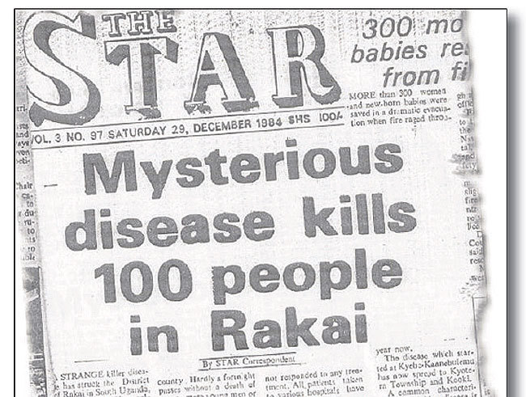
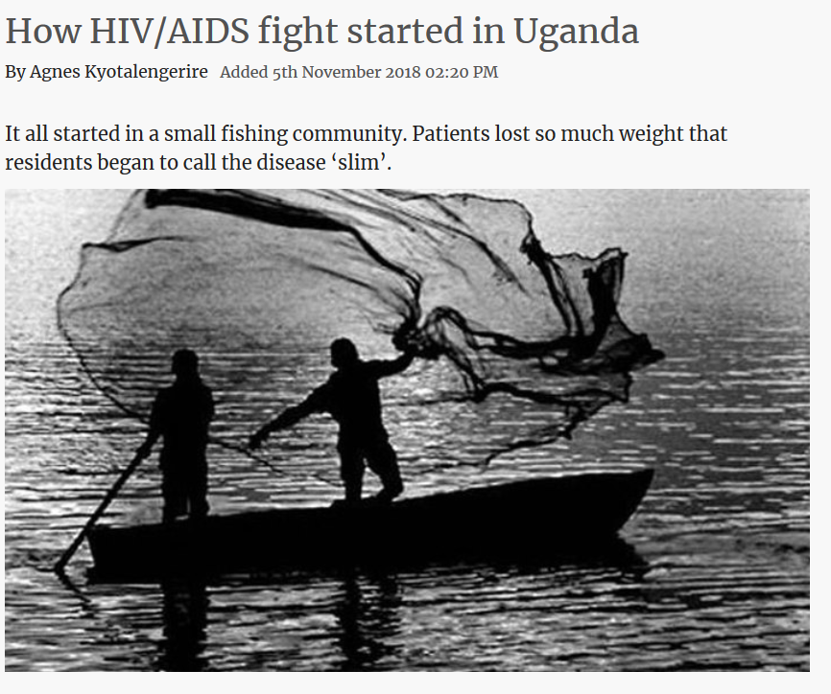
Notes:
Early 1980s, in Uganda, doctors reported cases of a new, fatal wasting disease locally known as 'slim’.
https://www.newvision.co.ug/new_vision/news/1488954/hiv-aids-fight-started-Uganda
http://endeavors.unc.edu/the_first_sparks_of_the_aids_epidemic

Slide 38
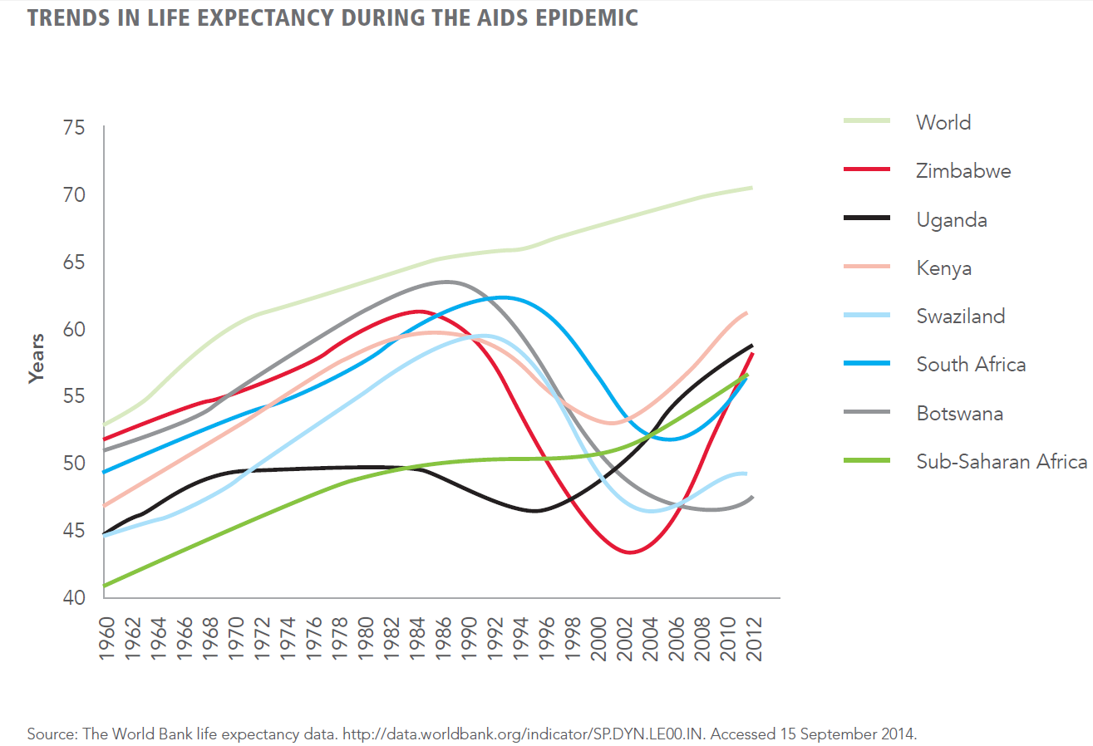
1980s
  Growing epidemic in central-west Africa spreads to eastern African nations.
  North to south transportation routes bring HIV to southern Africa.
1990s
  Epidemic explodes
  Worse in central-eastern and southern Africa than the central west African countries where it started.
  In parts of south Africa, 25% of sexually active people have HIV
Notes:
https://www.blackhistorymonth.org.uk/article/section/real-stories/the-history-of-aids-in-africa/
2014 UNAIDS 90-90-90

Slide 39
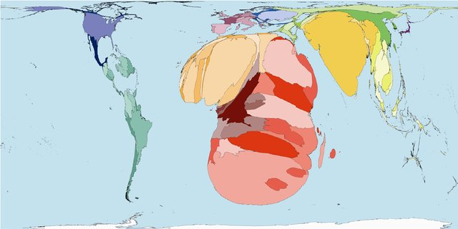
Notes:
HIV/AIDS Prevalence in Africa, 2004
https://www.researchgate.net/publication/6411307_Worldmapper_The_Human_Anatomy_of_a_Small_Planet

Slide 40
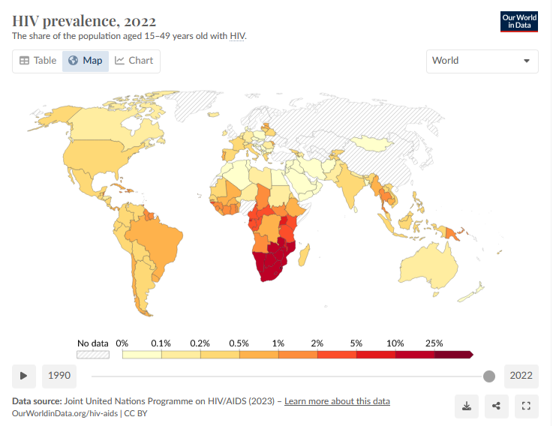
Notes:
https://ourworldindata.org/hiv-aids
https://www.healthdata.org/research-analysis/library/subnational-mapping-hiv-incidence-and-mortality-among-individuals-aged-15
Both maps show data from 2019

Slide 41
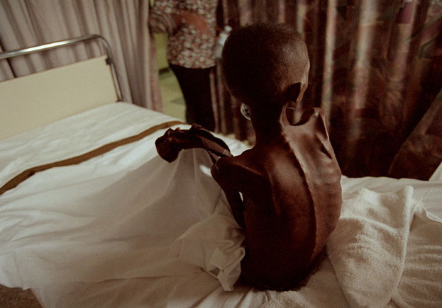
Notes:
https://www.blackhistorymonth.org.uk/article/section/real-stories/the-history-of-aids-in-africa/

Slide 42
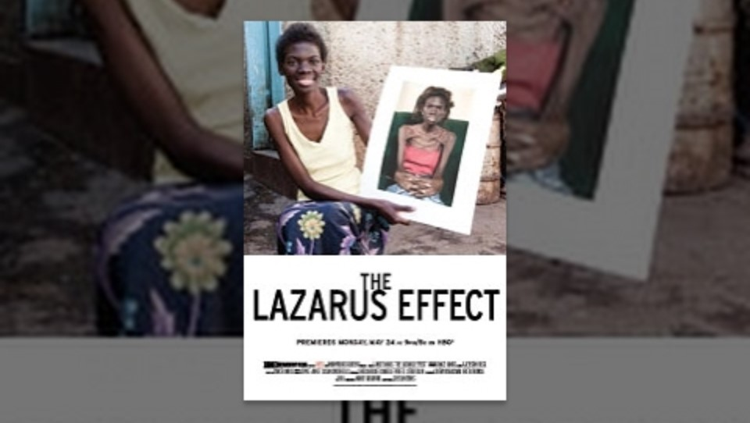
Notes:
This is the video The Lazarus Effect, from 2010. It conveys the dramatic impact pf the low-cost to free HIV drugs in Africa. How did we get to this point? From where HIV was a death sentence to one in which it could be a disease to be controlled?
Start at 4:30

Slide 43

How did HIV-AIDS become a controllable disease?
Social protest and activism initiated it
Education and awareness campaigns kept it going
Research into new drug treatments were speeded up
Availability of generic drugs made treatments inexpensive
Global funding initiatives distributed treatments
Notes:
HIV infections have dropped by 73 percent in the past 40 years in the US

Slide 44
ART and PrEP
In 1995, US FDA approved the first protease inhibitor
This began the era of highly active antiretroviral treatments (ART).
ARTs brought immediate decline of 60-80% in rates of AIDS-related deaths and hospitalizations
Viral loads in patients on ART can become low enough to be undetectable and untransmissible
In 2012, prep-exposure prophylactic (PrEP) drugs became available so that at risk people could prevent HIV infection
Notes:
Protease inhibitors prevent viral replication by selectively binding to viral proteases and blocking production of protein precursors that are necessary for the production of new viral particles.

Slide 45

ACT UP (AIDS Coalition to Unleash Power) and TAG (Treatment Action Group)
Expanded access to drugs still in the experimental stage
Made the drug approval process for life-saving medicines faster
Helped get highly effective HIV drugs (protease inhibitors) to the world
Made drug trials more inclusive of diverse populations
Created a model for health activism at local and global scales
Set the stage for ongoing initiatives to eliminate HIV
Notes:
This film documents the social protest and activism that sped up the process of testing and making available HIV drugs

Slide 46


Civil society organizations
ACT UP is an example of a civil society organization.
Civil organizations are well suited to deliver relevant HIV prevention services to key populations where and when governments be unable or choose not to.
Governments in low- and middle-income countries often cannot provide adequate funding and support to these civil society organizations
Notes:
CSOs are non-governmental organizations that operate independently from the government and for-profit businesses. CSOs include grassroots organizations, advocacy groups, charities, non-profits, community-based organizations, and think tanks

Slide 47
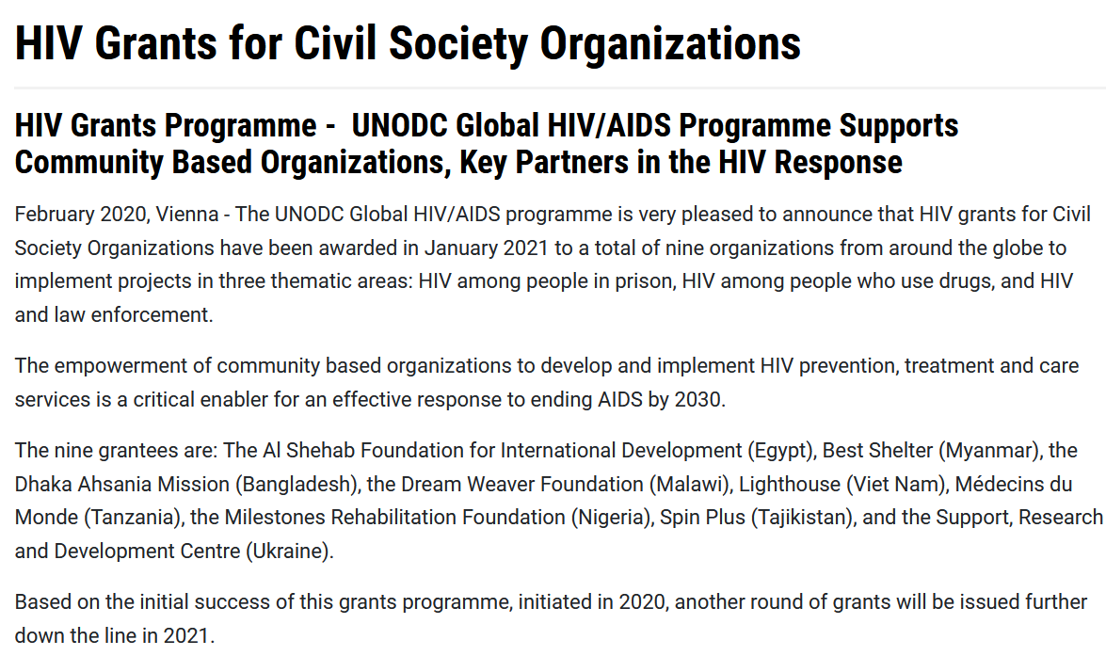

Slide 48
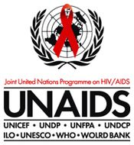
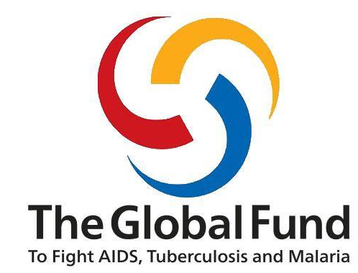
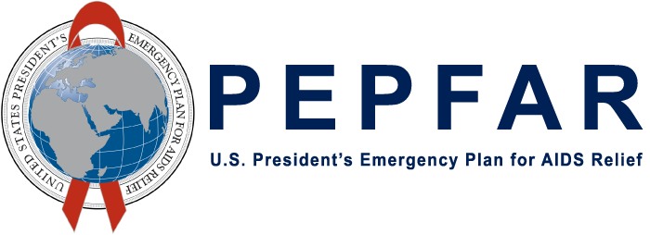
The three largest organizations implementing the global reduction in HIV
UNAIDS (Joint United Nations Program on HIV/AIDS) in 1996
The Global Fund to Fight AIDS, Tuberculosis, and Malaria in 2001)
PEPFAR (US Presidents Emergency Plan for AIDS Relief) in 2003

Slide 49

Notes:
https://www.youtube.com/watch?v=MZ42XmzAzJQ&t=76s&ab_channel=BillGates
https://www.nytimes.com/2022/08/05/world/asia/thailand-aids-overpopulation-mechai.html

Slide 50

Is PEPFAR neocolonialist?
Countries, international organizations and individuals providing financial and material aid for HIV-AID are seen by some as paternalistic and reflective of negative older colonial relationships
Criticism raised that not enough emphasis placed on addressing larger economic improvements in addition to providing lifesaving HIV treatments
Notes:
https://journalistsresource.org/economics/colonial-law-hiv-africa-women/

Slide 51


Slide 52

Cipla
ART was expensive and unavailable in low and middle income countries until the Indian drug company Cipla made inexpensive versions available in 2001
Notes:
https://www.livehistoryindia.com/story/eras/ciple-pharma
http://breakthrough.unglobalcompact.org/briefs/cipla-indias-robin-hood-of-drugs-yusuf-hamied/

Slide 53

Since 1972, India views patents as only applying to a product not the process. By making the same drug through a different process, they make drugs available at a lower price
Notes:
Since 1972, Indian Government policy has dictated that, in food and health, you cannot patent a product; you can only patent a process. Cipla and other drug companies reverse engineer medicines, they take a drug and figure out a way to make it through a different process. Then this drug can be sold as a generic without breaking patent laws. But it is not an entirely unproblematic enterprise politically economically.
https://www.livehistoryindia.com/story/eras/ciple-pharma
http://breakthrough.unglobalcompact.org/briefs/cipla-indias-robin-hood-of-drugs-yusuf-hamied/
How does India legally make drugs that have patents in other countries, and then offer them at very low cost to other countries in the world? The Indian pharmaceutical company Cipla did this was HIV drugs. How does this process of reverse engineering a patented drug work?
India has a legal framework in place that allows for the production and sale of generic versions of patented drugs. This framework is primarily governed by the Indian Patents Act, which has gone through several amendments, including one in 2005, to bring it into compliance with the Trade-Related Aspects of Intellectual Property Rights (TRIPS) agreement of the World Trade Organization (WTO). The TRIPS agreement sets global standards for intellectual property protection, including patents on pharmaceuticals.
Here's how the process of producing generic versions of patented drugs in India works:
Compulsory Licensing: The Indian Patents Act allows for the issuance of compulsory licenses under certain conditions. A compulsory license allows a third party to produce a patented drug without the consent of the patent holder. To obtain a compulsory license, the interested party must demonstrate to the Indian Patent Office that there is a public health need for the drug, and the patent holder has not made the drug available to the public at a reasonable and affordable price. This provision is in line with the flexibility provided by the TRIPS agreement for compulsory licensing in cases of public health emergencies.
Voluntary Licensing: In some cases, patent holders voluntarily license their patented drugs to Indian pharmaceutical companies. These licenses may involve a payment of royalties to the patent holder, and the Indian company can then produce and sell the drug as a generic version. This approach is used by some multinational pharmaceutical companies as a way to expand access to their drugs in developing countries while still maintaining some control over pricing and quality.
Research and Development: Indian pharmaceutical companies often invest in research and development to create their own versions of patented drugs, which are not exact copies but are therapeutically equivalent and satisfy regulatory requirements. This process, known as reverse engineering, involves analyzing the patented drug, understanding its chemical composition and manufacturing process, and then creating a generic version that is substantially the same in terms of safety and efficacy. These generic drugs go through their own regulatory approval process in India
Price Competition: Indian pharmaceutical companies are known for their ability to produce generic drugs at a lower cost due to factors like lower labor and production costs. This competition in the market can significantly reduce the price of medicines, making them more affordable and accessible not only in India but also for export to other countries. Cipla, for instance, played a crucial role in providing affordable generic versions of HIV/AIDS drugs, including antiretroviral medications, which helped make treatment more accessible to millions of people in India and other parts of the world.
It's important to note that this approach has received both praise for increasing access to essential medicines and criticism from some pharmaceutical companies who argue that it may discourage innovation. The balance between protecting intellectual property and ensuring access to life-saving drugs is a complex and ongoing global debate.

Slide 54

Global HIV-AIDS initiatives after Cipla
In 2002, the Global Fund to Fight AIDS, Tuberculosis and Malaria was established with $1.9 billion in pledges from the G8 nations, and charitable non-profit organizations
The G8, or the Group of 8 is made up of Canada, France, Germany, Italy, Japan, Russia, the USA and the UK.
Bill and Melinda Gates Foundation is a major supporter. Bill Gates was the inventor of Microsoft and the Windows operating system

Slide 55

In 2003, President George W. Bush announced creation of the President’s Emergency Plan for AIDS Relief (PEPFAR)
Began with a budget of $15 billion for 5 years and was intended to bolster treatment and prevention in the hardest-hit countries, particularly in sub-Saharan Africa
Pays for ART and efforts to prevent the spread of the virus

Slide 56


Reading/Questions 12
Notes:
https://www.nytimes.com/2023/03/14/health/pepfar-hiv.html

Slide 57
PEPFAR has saved 20 million lives
“That’s more than all the Jews killed in the Holocaust and all the people killed in the genocides of Armenians, Cambodians, Rwandans, Bosnians, Darfuris and Rohingya; all the confirmed deaths from Covid worldwide; all the deaths of American troops in all wars in the country’s history back to 1776; all the gun deaths in the United States in the last half-century; and all the auto deaths in the United States in the last half-century — combined”
Notes:
https://www.nytimes.com/2023/04/08/opinion/aids-pepfar-bush.html

Slide 58

PEPFAR received short-term reauthorization from Congress in March 2024.
Extends the program until March 2025, but it does not include the typical five-year renewal granted in previous cycles​
Negotiations for a longer-term reauthorization have been stalled due to disagreements in Congress revolving around party politics
PEPFAR continues to operate under the current funding, but its long-term future remains uncertain without a more stable reauthorization​

Slide 59


Slide 60

UNAIDS (1996), Global Fund (2022) and PEPFAR (2003)
Helped fund, advise, distribute, and monitor
  HIV testing
  ART
  Pre-exposure prophylaxis (PrEP)
  Treatments for opportunistic infections
  Education and outreach
Notes:
https://ourworldindata.org/hiv-aids

Slide 61

Pre-exposure prophylaxis (PrEP)
In 2012, FDA approved Truvada for HIV-negative people to prevent sexual transmission of HIV. Patent owned by the drug company Gilead Sciences.
Recommended for people at high risk of HIV infection.
The drugs in Truvada had been used to treat HIV infections.
PrEP can reduce risk of HIV infection 90% if used properly, but is far less effective if not taken as recommended
Can even be used for post-exposure if started within 72 hours

Slide 62


In 2018, less than 10% of the 1.2 million Americans who might benefit from PrEP could not afford it
US company Gilead Sciences maintained a monopoly on the drug
In other countries, a one-month supply of generic Truvada cost less than $6, but Gilead was charging Americans, on average, more than $1,600
PrEP use in US black and Hispanic populations was small fraction of that among whites
In US South, where a majority of HIV infections occur, use was half what it is in the Northeast.
Notes:
https://www.nytimes.com/2018/07/16/opinion/prep-hiv-aids-drug.html
American taxpayers and private charities — not Gilead — paid for almost all of the clinical research used to develop Truvada as PrEP.

Slide 63


Women were using PrEP at drastically lower rates than men
One million Americans were at risk for HIV infection should be taking the pills, but only about 270,000 are doing so.
Notes:
Patchwork of health insurance, Medicaid, assistance programs from Gilead can reduce the price, especially for Truvada since it is now a generic

Slide 64
Slow walking the next PrEP drug
Truvada’s patent expired in 2020. It is now a generic drug that costs less than $400 year
A newly patented and improved PrEP drug from Gilead, Descovy, went on the market in 2016. It initially had a price of $26,000 annually.
Truvada had harmful side effects from one of the two drugs in it, tenofovir
Gilead invented a version of tenofovir in 2014 that was less toxic, but did not put it into Truvada because it had several more years of patent protection and high profits
Gilead incorporated the improved tenofovir into the new patented and pricey version of PrEP, Descovy.

Slide 65


Reading/Questions 12
Notes:
https://www.nytimes.com/2023/07/22/business/gilead-hiv-drug-tenofovir.html

Slide 66
In 2023, US federal panel endorsed expanded coverage of HIV prevention strategies for Americans
This means that prescription to Truvada or Descovy, the two approved forms of PrEP, should now be totally free for almost all insured individuals.
A prescribing physician, however, must persuade an insurer that Descovy in particular is medically necessary for any specific patient to qualify for zero cost sharing for that drug’s use as HIV prevention.
This federal requirement is being challenged in some states and it is likely that PrEP availability will become a patchwork of coverage nationally
Notes:
https://www.nytimes.com/2023/08/22/health/hiv-prep-truvada-descovy.html

Slide 67

Missing the target: The 1996 United Nations Program on AIDS: 90-90-90 by 2020
Optimism about eliminating HIV-AIDS rose in response to the availability of ART
Scientists estimated that the HIV epidemic would peter out if 90% of infected people know their HIV status, 90% of that group receives antiretrovirals, 90% on treatment have undetectable viral levels.
However, as of 2024, only 19 countries have achieved the 90–90–90 HIV treatment targets. New target is now 95-95-95 in 2025
Notes:
https://www.unaids.org/en/resources/fact-sheet
Achieving the 90–90–90 target results in a minimum of 73% of people living with HIV having suppressed viral loads. At the end of 2019, 14 countries three regions had achieved the 73% target—Australia, Botswana, Cambodia, Eswatini, Ireland, Namibia, the Netherlands, Rwanda, Spain, Switzerland, Thailand, Uganda, Zambia and Zimbabwe.

Slide 68


Reading/Questions 12
Notes:
https://www.nytimes.com/2021/06/08/health/unaids-declaration-patents.html
Roberts, L. (2021). How COVID is derailing the fight against HIV, TB and malaria. Nature, 597(7876), 314-314
In 2020, across Africa and Asia HIV testing fell over 40% due to Covid disruptions

Slide 69

Reading/Questions 12
Notes:
https://www.nytimes.com/2021/06/08/opinion/hiv-aids-covid.html
The HIV-AIDS pandemic helped us respond better to SARS-CoV-2…

Slide 70

Notes:
..but HIV-AIDS is far from over
More than science is needed – the challenge is also social, political, and economic

Slide 71

Ongoing global strategies to reduce HIV
Preventing transmission from mothers
Addressing stigma
Closing the treatment and prevention gap
Targeting high-risk populations for HIV
Resurgence due to familiarity of HIV and availability of ART
Notes:
https://www.theglobalfund.org/en/hivaids/
https://thepath.unaids.org/

Slide 72

Reading/Questions 12
Notes:
https://www.nytimes.com/2023/01/17/health/child-hiv-kenya-africa.html

Slide 73

Stigmatization
People with HIV who perceived high levels of social stigma were 2.5 times as likely to delay entering care until very ill,
1 in 5 living with HIV avoided going to medical facilities because they feared discrimination
Stigma responsible for 35-50% of infant infections with HIV because it reduced mothers’ adherence to treatment
Notes:
https://science.sciencemag.org/content/369/6510/1419.abstract
The social processes of stigmatization can spur the spread of disease.
Stigmatization is compounded when the person or population is already marginalized.

Slide 74

Video
Notes:
Uganda

Slide 75

Notes:
Msomi, Nokukhanya, Richard Lessells, Koleka Mlisana, and Tulio de Oliveira. "Africa: tackle HIV and COVID-19 together." (2021): 33-36.

Slide 76

Targeting high-risk populations for HIV
Notes:
https://map.aidsvu.org/prev/county/rate/none/none/usa?geoContext=national

Slide 77

Notes:
https://www.nytimes.com/2017/06/06/magazine/americas-hidden-hiv-epidemic.html

Slide 78
HIV-AIDS in US rural versus urban locations:
Large urban areas that have dealt with similar health and substance crises in the past. They have networks of service providers and consumers in place
Small rural health jurisdictions often lack the infrastructure and have little history of dealing with comparable health issues
Lack of transportation and stigma are biggest barriers to testing and care in rural communities.
Those who live in large cities can get tested and treatments while feeling relatively anonymous in a clinic in ways rural dwellers cannot.
Rural areas are less likely to promote needle-exchange programs
Notes:
https://www.nytimes.com/2019/12/01/opinion/hiv-aids-rural-america.html

Slide 79


Austin, Indiana is a small city of about 4,000 people 80 miles south of Indianapolis.
In February 2015, the first 30 cases of HIV were reported. A year later there were 190 cases.
All were linked to opioid injections.
Notes:
After a hepatitis C and H.I.V. outbreak in Scott County, Ind., in 2014 and 2015 that was fueled by deindustrialization and opioids.
Hepatitis C is also epidemic and a more pervasive problem than HIV
https://www.indystar.com/story/news/2016/04/08/year-after-hiv-outbreak-austin-still-community-recovery/82133598/

Slide 80


Notes:
https://www.nytimes.com/2024/02/27/health/condoms-hiv-prevention.html

Slide 81

Notes:
https://www.cdc.gov/media/releases/2024/p1112-sti-slowing.html

Slide 82

Former USSR
HIV spread mainly by intravenous drug use and heterosexual sex
80-100 new cases of HIV infections among women a day, mostly 25-35 years age
Cold war politics and a conservative, nationalistic Russian culture contributed to slow, ineffective initial response to HIV.
Notes:
https://www.sciencemag.org/news/2018/06/ending-aids-these-three-places-show-epidemic-far-over
https://www.sciencemag.org/news/2018/06/russia-s-hivaids-epidemic-getting-worse-not-better
https://www.avert.org/professionals/hiv-around-world/eastern-europe-central-asia/russia
Few on ART so more AIDS deaths and new infections

Slide 83

Drug users, gay men, and HIV positive people stigmatized
Drug treatment programs and needle exchange program seen as ‘weak’ Western responses and are not common in Russia
Many high-risk populations rely on international NGOs (non-governmental organizations) and volunteer groups for HIV services
NGOs left country after President Putin in 2013 enacted law that forced many of them to register as “foreign agents.”
Notes:
HIV took off in Russia in the mid-1990s, later than in Western European countries
https://www.sciencemag.org/news/2018/06/russia-s-hivaids-epidemic-getting-worse-not-better
https://www.ncbi.nlm.nih.gov/pmc/articles/PMC9994792/
https://www.dw.com/en/russian-hiv-epidemic-at-a-tipping-point/a-36594412
Recent evidence suggests that HIV-AIDS has become a more generalized epidemic and less concentrated in high risk populations

Slide 84



Notes:
https://www.nytimes.com/2023/04/21/world/europe/russia-wagner-group-hiv-prisoners-ukraine.html

Slide 85
Nigeria
One of the world’s most populated countries
Nigeria has more HIV-infected babies than anywhere in the world.
Culture and stigma plays a large role, as having HIV implies a moral failure
Access to ART can also be difficult in some regions, as is making sure that they are continually taken
Making progress through programs like the Baby Shower program
Notes:
https://www.sciencemag.org/news/2018/06/ending-aids-these-three-places-show-epidemic-far-over

Slide 86


Slide 87

Florida
As of 2022, more infections than any other state, including California and New York
State’s population has doubled to nearly 22 million people: many are immigrants from Latin America or the Caribbean.
  HIV is more prevalent in several Caribbean islands than in the US
  Florida has a large black and Latino population: surge in HIV infections among men of these groups
Notes:
Compared with other U.S. states, Florida has a big problem. Georgia has the highest rates of new infection, but half the population of Florida. New York has a larger infected population, but has a lower death rate and fewer new infections.
Cohen, Jon. "The Sunshine State's dark cloud." (2018): Science 360(6394) 1176-1179.
DOI: 10.1126/science.360.6394.1176

Slide 88

15% of HIV infected Floridians did not know their HIV status
HIV infections progresses to AIDS here more than any other state largely because many infected people who start ART don’t continue.
Nearly 33% are, ‘lost to follow up’ for reasons such as transportation difficulties, stigma concerns, relocation, homelessness, lack of social support, substance abuse, and poverty.
In New York City, by contrast, 88% were retained in care.
Notes:
Cohen, Jon. "The Sunshine State's dark cloud." (2018): Science 360(6394) 1176-1179.
DOI: 10.1126/science.360.6394.1176
https://www.science.org/content/article/we-re-mess-why-florida-struggling-unusually-severe-hivaids-problem

Slide 89

Florida is also socially and politically diverse –like different countries when you compare, for example, rural Panhandle to neighborhoods of Miami
Any campaign to prompt testing and treatment in at-risk populations must be customized to appeal to different cultural backgrounds and levels of disenfranchisement
State lawmakers have turned away federal funding for HIV prevention and care, and limited sex education
Notes:
Florida has been slow to approve needle and syringe exchange programs compared to the other 45 states that have them

Slide 90


Slide 91
Why pursue a cure for HIV infections?
ART has to be taken for the rest of a HIV positive person’s life
Side effects develop with long-term use of antiviral drugs
Potential for resistance to develop
ART programs in many countries heavily reliant on international donor partners
Not all HIV positive people receive ART.
Effective cure might boost HIV control by encouraging disenfranchised individuals with HIV to proactively seek testing and treatment
Notes:
Ndung’u, T., McCune, J. M., & Deeks, S. G. (2019). Why and where an HIV cure is needed and how it might be achieved. Nature, 576(7787), 397-405.
https://doi.org/10.1038/s41586-019-1841-8

Slide 92


Notes:
https://www.who.int/publications/i/item/9789240038608
Adults who have taken ART in the past are more likely to have HIV that is resistant to the drugs

Slide 93

Twice yearly injection instead of daily oral ART
Gilead has developed long-acting injectable targeting treatment and prevention of HIV.
Administered biannually, lenacapavir (Sunlenca) is alternative to daily oral regimen, aiming to improve adherence and reduce new HIV infections.
In 2022, FDA approved Sunlencafor treatment, of adults with multi-drug resistant HIV-1 infection.
100% efficacy in recent a clinical trial for prevention
Notes:
Lenacapavir is a capsid inhibitor that disrupts multiple stages of the HIV lifecycle, including viral assembly, release, and capsid core formation. By targeting the viral capsid, it impedes the virus's ability to replicate and infect new cells.
https://www.nytimes.com/2024/10/02/health/lenacapavir-hiv-shot-prep.html
The drugmaker Gilead Sciences on Wednesday announced a plan to allow six generic pharmaceutical companies in Asia and North Africa to make and sell at a lower price its groundbreaking drug lenacapavir, a twice-yearly injection that provides near-total protection from infection with H.I.V. Those companies will be permitted to sell the drug in 120 countries, including all the countries with the highest rates of H.I.V., which are in sub-Saharan Africa. Gilead will not charge the generic drugmakers for the licenses. Gilead says the deal, made just weeks after clinical trial results showed how well the drug works, will provide rapid and broad access to a medication that has the potential to end the decades-long H.I.V. pandemic. But the deal leaves out most middle- and high-income countries — including Brazil, Colombia, Mexico, China and Russia — that together account for about 20 percent of new H.I.V. infections. Gilead will sell its version of the drug in those countries at higher prices. The omission reflects a widening gulf in health care access that is increasingly isolating the people in the middle.

Slide 94

There is no vaccine for HIV, yet.
Challenges to develop a vaccine
  HIV is a retrovirus and integrates into human DNA shortly after infection, making it difficult for the immune system to detect and eliminate the virus
  Incredible diversity of HIV strains circulating in the world.
  HIV viruses can mutate rapidly
Notes:
https://science.sciencemag.org/content/367/6478/611.summary
https://www.niaid.nih.gov/news-events/nih-and-partners-launch-hiv-vaccine-efficacy-study
https://www.hiv.gov/blog/final-hiv-research-highlights-aids-2020
https://www.nature.com/articles/d41586-024-02840-5
mRNA vaccines and traditional vaccines that stimulate the production of neutralizing antibodies are being tested

Slide 95


Notes:
https://lsa.umich.edu/history/history-at-work/reverbeffect/episode3/episode3_transcript.html

Slide 96

HIV-AIDS conspiracy theories
As early as 1990 a New York Times⁄CBS poll found that 10% of black New Yorkers believed HIV was ‘deliberately created in a laboratory in order to infect black people’
2009 survey of young adults in Cape Town South Africa found that 16% of black respondents agreed that ‘AIDS was invented to kill black people’ and that ‘AIDS was created by scientists in America’.

Slide 97

The ‘HIV as US bioweapon’ conspiracy theory
Began in 1983 when the Soviet Union planted fake news articles in Indian newspapers as part of Operation Infektion
The articles stated that the US Army had manufactured the AIDS virus.
Content was republished in newspapers in Zimbabwe, Kenya and Senegal.
In 1987 the theory was broadcast on the CBS evening news and disseminated throughout the world
Notes:
https://www.wilsoncenter.org/blog-post/operation-denver-kgb-and-stasi-disinformation-regarding-aids

Slide 98

The KGB wrote: ”We are conducting a series of [active] measures in connection with the appearance in recent years in the USA of a new and dangerous disease, “Acquired Immune Deficiency Syndrome – AIDS”…, and its subsequent, large-scale spread to other countries, including those in Western Europe. The goal of these measures is to create a favorable opinion for us abroad that this disease is the result of secret experiments with a new type of biological weapon by the secret services of the USA and the Pentagon that spun out of control.”
Notes:
https://www.wilsoncenter.org/blog-post/operation-denver-kgb-and-stasi-disinformation-regarding-aids
https://sites.ecu.edu/cwis/2023/03/

Slide 99

The ‘HIV as bioweapon’ conspiracy theory resonated with African-Americans and Africans
Notes:
Nattrass, N. (2013). Understanding the origins and prevalence of AIDS conspiracy beliefs in the United States and South Africa. Sociology of Health and Illness, 35(1), 113-129.

Slide 100

Notes:
Start 7:34 minutes in for segment on how the Russian KGB conducted a fake news campaign to malign the US and make it look like it was responsible for making and deploying the HIV virus as a biological weapon. Some African Americans as well as Africans expressed belief in this conspiracy theory, the idea that the US had made HIV in a lab to kill gays and people of color became viral in this pre-Internet time.

Slide 101

Notes:
https://www.nature.com/news/south-africa-ushers-in-a-new-era-for-hiv-1.20253
https://www.newsweek.com/thabo-mbeki-south-africa-hiv-aids-436012
Nattrass, N. (2013). Understanding the origins and prevalence of AIDS conspiracy beliefs in the United States and South Africa. Sociology of Health and Illness, 35(1), 113-129.

Slide 102
HIV policies in South Africa
HIV policies of former South African President Thabo Mbeki contributed to AIDS deaths between 1999 and 2008
More than 330,000 people died prematurely from HIV-AIDS between 2000 and 2005 due to the Mbeki government’s obstruction of life-saving treatment, and at least 35,000 babies were born with HIV infections that could have been prevented.
Mbeki delayed launching an ART drug program, charging that the drugs were toxic and an effort by the West to weaken his country. He also withdrew support from clinics to prevent mother-to-child transmission of HIV.
Notes:
https://www.hsph.harvard.edu/news/magazine/spr09aids/
The HIV as US bioweapon conspiracy theory had large impacts in South Africa, a highly segregated society until official apartheid policies were dismantled in 1994

