Slide 1
Reading/Questions 4
Notes:
A commercial center of Kampala, the capital of Uganda. https://www.nytimes.com/2023/06/26/business/economy/obesity-wealth-uganda.html

Slide 2
Reading/Questions 4
Notes:
https://www.nytimes.com/2024/08/12/opinion/beans-chickpeas-plant-based-food-meat.html

Slide 3
Notes:
https://www.weforum.org/agenda/2016/11/this-map-shows-the-rapid-increase-in-global-obesity/

Slide 5
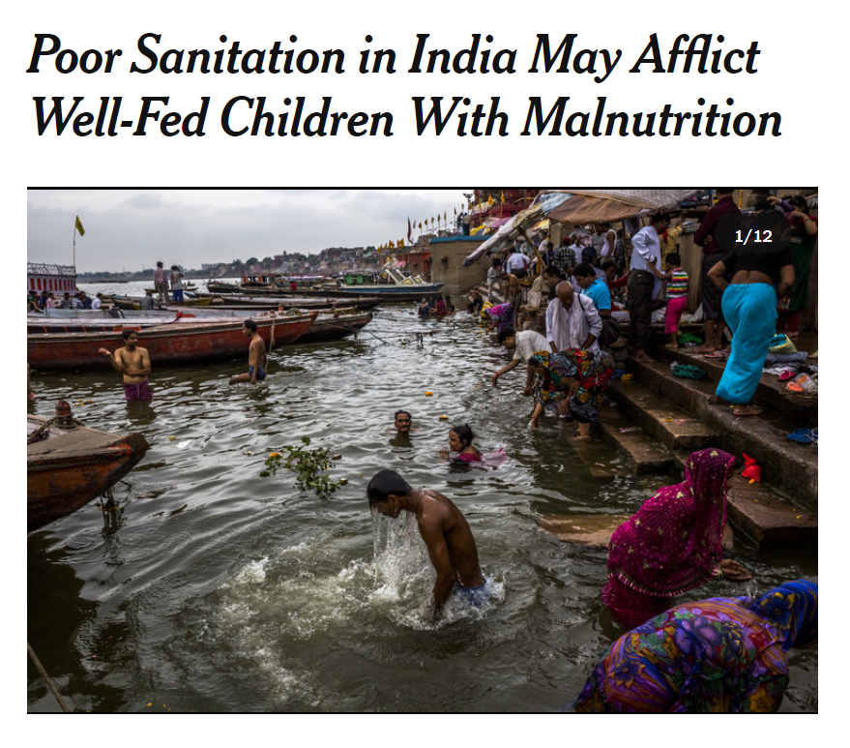
Notes:
https://www.nytimes.com/2014/07/15/world/asia/poor-sanitation-in-india-may-afflict-well-fed-children-with-malnutrition.html

Slide 6
Notes:
https://www.nytimes.com/2014/07/15/world/asia/poor-sanitation-in-india-may-afflict-well-fed-children-with-malnutrition.html

Slide 7
Notes:
The double burden can occur at the level of an individual, with the two extremes of malnutrition happening separately in a person’s lifespan
The double burden also occurs at the level of large populations, where there is a simultaneous increase in prevalence of both overweight and undernourished individuals.

Slide 8
Notes:
Tobacco companies, who were skilled at marketing cigarettes, used similar strategies to hook people on processed foods. A new study suggests that tobacco companies, who were skilled at marketing cigarettes, used similar strategies to hook people on processed foods
https://onlinelibrary.wiley.com/doi/epdf/10.1111/add.16332 Fazzino, T. L., Jun, D., Chollet‐Hinton, L., & Bjorlie, K. (2024). US tobacco companies selectively disseminated hyper‐palatable foods into the US food system: Empirical evidence and current implications. Addiction, 119(1), 62-71.
https://www.washingtonpost.com/wellness/2023/09/19/addiction-foods-hyperpalatable-tobacco/

Slide 9
Modernization as explanation of increase in NCDs
Holds that global increases in diseases of lifestyle like obesity, some forms of cancer, and type 2 diabetes driven by domestic processes involving:
Economic development and affluence: families with increasing incomes embrace the convenience and status offered by packaged foods and eating out
Urbanization: disruption of family and labor structures such that traditional family meals are replaced by convenience eating, including packaged food and dining out
Women’s empowerment: women in the workplace alter shopping and cooking routines and can result in more convenience eating
Levels of activity: we have more sedentary lifestyles with increasing affluence and globalization

Slide 10
Modernization as an explanation of increasing incidence of breast cancer in China
Women who breast feed, before their mid-thirties, and have more than one child are less likely to develop breast cancer
As women entered workforce over the past several decades, fewer women had children or waited longer to have children
Women less likely to breastfeed in China than previous generation
Video
Notes:
https://www.youtube.com/watch/MKOdtSIcs8U Research also shows that the women who have their first child at age 35 or younger tend to have a protective benefit from pregnancy. However, in China, many women have chosen to delay having a child as a result of work pressure and cultural change.
Women are also less likely to breastfeed than previous generations, which may be another contributing factor. Research has shown that both pregnancy and breastfeeding reduce a woman’s risk of developing cancer.
With the one-child policy in place since 1979 in China, most women – especially if they worked in the city – had to strictly follow the policy in order to avoid being fined. Although the one-child policy rule was replaced in 2015 with a two-child policy rule, the possible benefit on breast cancer incidence will probably take 15 to 20 years to show.
https://theconversation.com/whats-behind-the-huge-increase-in-breast-cancer-rates-in-china-84224

Slide 11
Reading/Questions 4
Notes:
https://www.nytimes.com/2024/08/08/opinion/climate-change-junk-food.html

Slide 12
Cancer in developing countries
Characterized by increases in cancers related to diet and lifestyle, like colon and breast cancer
Cancers here are diagnosed later with lower survival rates
Affluence provides more income for products that promote carcinogen exposures: meats, packaged and processed food, cigarettes
Newly globalizing economies lag in environmental protection laws and exposures to chemical carcinogens in the environment
Medical infrastructure may be geared toward earlier period in which infectious diseases were the dominant public health issue, and so many of the newer cancers that are treatable in developed countries, progress to terminal stages here
With rising affluence, less infectious disease and thus longer lifespans. However, the longer you live the more likely it is that you will get cancer.
Notes:
The 5-year breast cancer survival rate in SSA is <40% compared with >86% in the United States.

Slide 13
Challenges to cancer prevention and treatment in developing countries
Lower literacy rates
Cancer is often viewed with superstitions, myths, and misconceptions
Lack of early detection and screening programs
In many African countries, biospecimens have to be transported abroad for diagnostic pathology – infrastructure to detect as well as to treat cancer is less available.

Slide 14
Notes:
Rebbeck, T. R. (2020). Cancer in sub-Saharan Africa. Science, 367(6473), 27-28.
https://science.sciencemag.org/content/367/6473/27

Slide 15
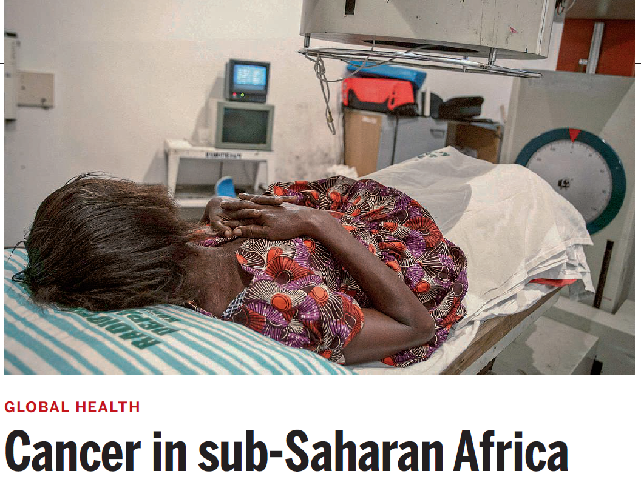
Oversimplification of the cancer crisis in Sub-Saharan Africa (SSA)
The cancer crisis is often oversimplified and portrayed as: the past in the developed world is the future of the developing world
Emerging evidence suggests that distinct tumor histopathology, tumor subtypes, and molecular signatures exist in SSA
Simply deploying treatment models developed in US or Europe will be insufficient
Cancer interventions in SSA require more than just transfer of knowledge and investment in infrastructure

Slide 16
Type 2 Diabetes
In many countries of Africa and Asia, rates of Type 2 diabetes are increasing
Medical infrastructure in these countries may be geared toward earlier period in which infectious diseases instead of NCDs were the dominant public health issue, resulting in:
Lack of testing and basic monitoring care for diabetes
Limited access to insulin
Greater likelihood of complications from diabetes like blindness, limb amputation, kidney failure (necessitating dialysis)
Notes:
https://www.nytimes.com/2014/04/26/opinion/sunday/the-global-diabetes-epidemic.html
In the United States, diabetes tends to be a disease that, while certainly not benign, is eminently manageable. Just this month, federal researchers reported that health risks for the approximately 25 million Americans with diabetes had fallen sharply over the last two decades. Elsewhere on the globe, however, diabetes plays out in a dramatically different fashion. Patients often lack access to care and can’t get insulin, blood pressure pills and other medicines that diminish the risk of complications. As more and more people develop the disease, hospitals may soon be overrun with patients experiencing all of its worst outcomes: blindness, limb amputation, kidney failure (necessitating dialysis), coma and death.

Slide 17
Reading/Questions 4
Notes:
https://www.nytimes.com/2017/12/26/health/india-diabetes-junk-food.html

Slide 18
Reasons for high Type 2 diabetes in India
Traditional diets replaced by SAD
Low literacy rates
80% of health care in India is dominated by the private sector which is out of the financial reach of the poor
The poor often seek out practitioners of Ayurveda, the traditional medical practices of India. These doctors may vary in their understanding of diabetes
Notes:
https://borgenproject.org/lifestyle-diseases-in-india/

Slide 19
Video
Notes:
https://www.youtube.com/watch?v=B3MfOFM5z0A&feature=emb_logo

Slide 20
Video

Slide 21
Notes:
https://www.science.org/doi/abs/10.1126/science.369.6509.1280

Slide 22
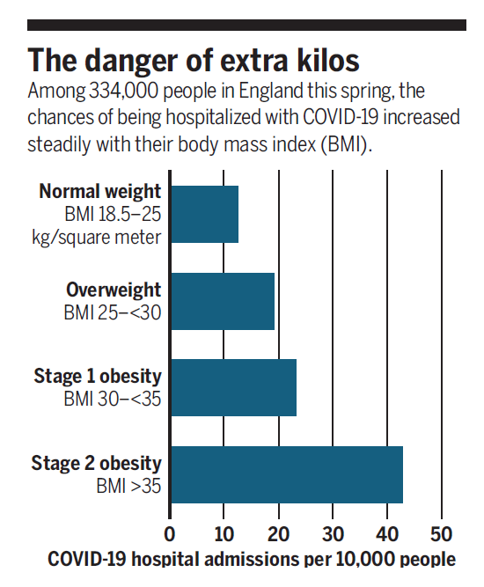
COVID and NCDs
Increases risk of serious complications from COVID:
Being older
Being male
Being poor
Being obese
Notes:
https://www.cdc.gov/obesity/data/obesity-and-covid-19.html
https://science.sciencemag.org/content/369/6509/1280.summary The overall COVID-19 case-fatality ratio is approximately 2.4 times higher among men than among women.

Slide 23
How obesity worsens Covid outcomes
Obesity impairs immunity
Fat cells infiltrate the organs where immune cells are produced and stored, such as the spleen, bone marrow, and thymus.
The obese lose immune tissue in exchange for adipose (fat) tissue, making the immune system less effective in either protecting the body from pathogens or responding to a vaccine.
Obesity is associated with chronic inflammation
In Covid patients, systemic inflammation caused by a runaway immune response (called a cytokine storm) can trigger organ failure and death
Obesity is associated with blood that is prone to clot
Covid can cause blood clots that can lead to strokes, heart attacks, pulmonary embolism, and sometimes limb amputations.
Notes:
https://wexnermedical.osu.edu/blog/blood-clots-covid Covid can trigger a runaway immune response called a cytokine storm that results in the failure of multiple organs, including the lungs, liver, kidney, and heart

Slide 24
Where NCDs and coronavirus collide in the US
Notes:
https://www.nytimes.com/interactive/2020/05/18/us/coronavirus-underlying-conditions.html

Slide 25
Reading/Questions 4
Reading/Questions 4
Notes:
https://www.nytimes.com/2024/07/28/opinion/food-climate-crisis-prices.html

Slide 26
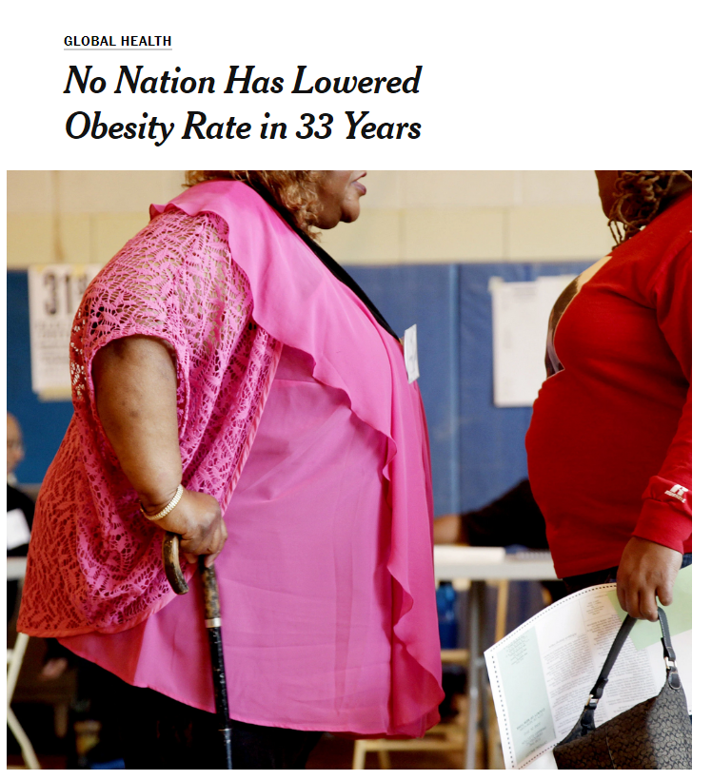
Interventions
Taxation of unhealthy, ultra-processed foods and beverages (Mexico, Norway and others)
Front-of package nutrition labels for foods with low nutritional or health value (Chile and others)
Banning the construction of new fast food drive thrus (parts of US)
Restricting junk-food marketing to kids (Canada, Ireland)
Taxation of local governments and companies if citizens and workers exceed health standards on weight and waist size (Japan)
Notes:
https://www.npr.org/sections/thesalt/2019/10/10/765789694/why-u-s-cities-are-banning-new-fast-food-drive-throughs https://www.nytimes.com/2014/06/03/health/no-nation-has-lowered-obesity-rate-in-33-years.html?ref=science
http://www.healthdata.org/research-article/global-regional-and-national-prevalence-overweight-and-obesity-children-and-adults
This study spanned 33 years, thus no nation lowered its rate and who might have, if ever, is unknown. Some states in the US have seen some reduction in obesity, like New York, Montana, Minnesota, and Ohio

Slide 27
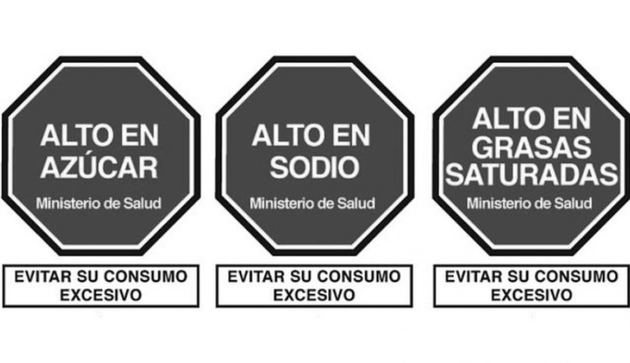
Notes:
The new regulation includes the mandatory use of front-of-package warning labels on packaged foods/beverages high in energy, sugars, and saturated fats

Slide 28
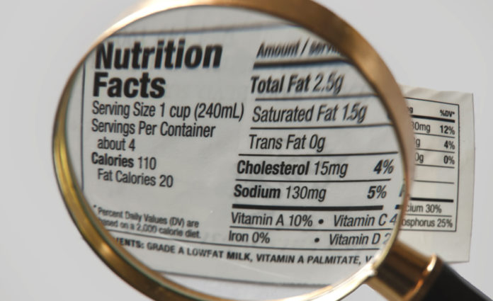
More than 40 countries have adopted easy-to-understand, front-of-package nutrition information
The US has not required front-of-package labeling, relying instead on the food industry’s voluntary efforts
Notes:
https://www.washingtonpost.com/opinions/2024/03/06/food-labels-nutrition-fda/

Slide 29
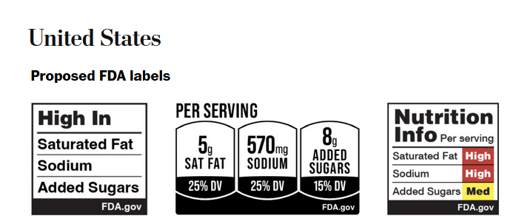
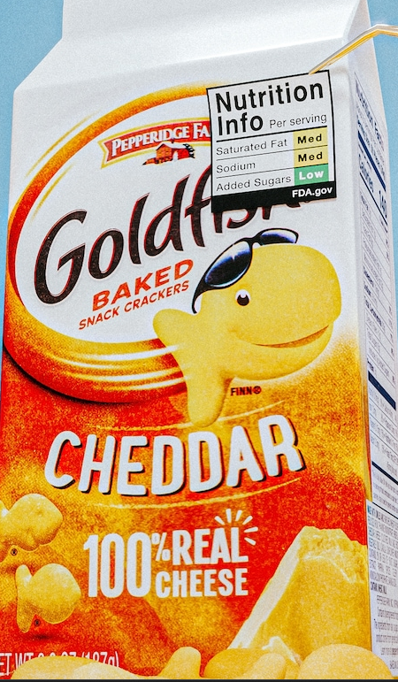
Clearer labelling has not been required in US because companies argue that this requirements infringe on their First Amendment rights
However, in response to international precedents, FDA is defending need for labeling and is proposing labels changes in 2024
Notes:
https://www.washingtonpost.com/opinions/2024/03/06/food-labels-nutrition-fda/ Clearer labelling has not been required in US because companies argue that this requirements infringe on their First Amendment rights by forcing them to convey messages they may not agree with or that could negatively affect their brand. However, in response to international precedents, US is defending need for labeling on the basis that it serves an important public interest by promoting public health and ensuring consumers are well-informed.
The Food and Drug Administration plans to propose labeling this fall for the front of food and drink packages to help Americans make healthier choices to address exploding obesity rates, years after other countries took similar action. https://www.washingtonpost.com/health/interactive/2024/food-warning-labels-fda-healthy-choices/

Slide 30
Notes:
https://www.nytimes.com/2024/01/16/dining/food-marketing-ozempic-era.html

Slide 31
Ozempic and Wegovy are the two largest selling weight loss drugs
These drugs are glucagon-like peptide-1 (GLP-1) receptor agonists
They slow down the rate at which food leaves the stomach and enters the small intestine, a process known as delayed gastric emptying.
Delayed gastric emptying leads to a prolonged sense of fullness and satiety, further reducing food intake.
Notes:
https://www.washingtonpost.com/opinions/2024/08/14/medicare-obesity-drugs-black-americans/

Slide 32
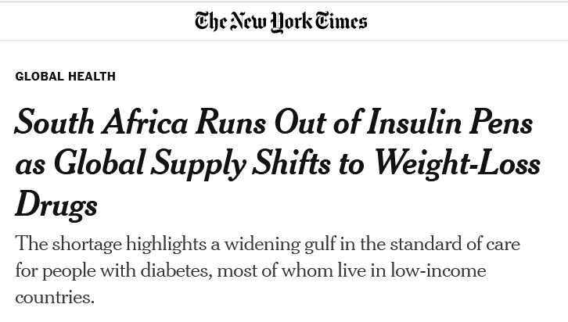
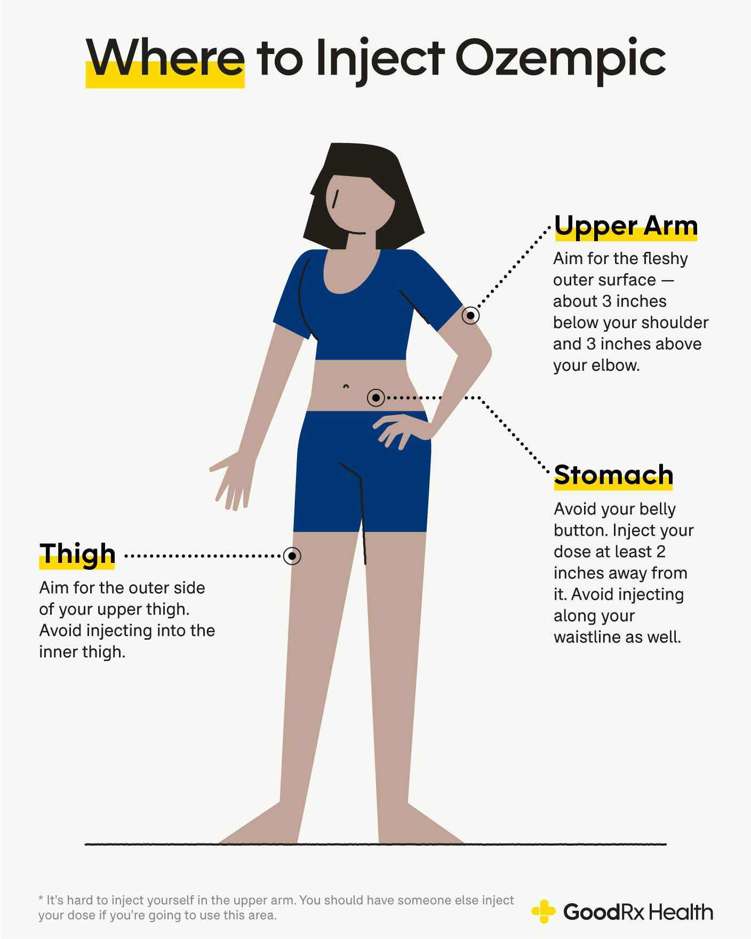
Reading/Questions 4
Notes:
https://www.goodrx.com/ozempic/where-to-inject-ozempic

Slide 33
New obesity drug treatments and health equity
Medicaid is designed to assist low-income individuals with healthcare costs.
Costs of treating the chronic diseases arising from obesity is enormous
In 2023, Black adults received only 12% of prescriptions for one of the popular new anti-obesity drugs
At present, Medicaid coverage for these drugs and how you get approved to take them varies widely from state-to-state
Full coverage for new obesity drugs could save Medicare an estimated $175 billion in the first 10 years alone.
Notes:
https://www.washingtonpost.com/opinions/2024/08/14/medicare-obesity-drugs-black-americans/ In other words, it costs more to not make these drugs more widely and easily available.

Slide 34
Notes:
https://www.youtube.com/watch/qRJogSKK-3U
https://www.youtube.com/watch/6n0AHU5w75I

Slide 35
Video
Notes:
https://vimeo.com/73234721 This video conveys the sheer economic magnitude of our globalized and industrialized food system. It is heavily capitalized. In this way, it is difficulty just to step out of the globalized food system. Some can, some cannot and have many of their choices circumscribed by this system. At the same time, local cultures can make it easier to step out of the globalized food system or reinforce it. The take home point is that being obese is far more than just not having willpower or the capacity to chose what is healthier to eat. There are larger structural factors, local cultural factors, including the idea of obesogenic environments that contribute to obesity. Fat shaming reflects a lack of intelligence about the causes of obesity, from those discussed above, to those of human biology and how there are many different natural body forms and shapes that are human and healthy. One can say that the globalized food system can create structural violence. But it should not be solely viewed through that lens. There are some foods that economies of scale can produce abundantly, cheaply and more efficiently.

