Slide 1
Reading/Questions 2
Notes:
https://www.nytimes.com/2022/07/08/opinion/environment/air-pollution-deaths-climate-change.html The brutality of air pollution – if it causes so many deaths, why do we tolerate it? Why do we allow it to be so normalized? For one, it is difficult to assign direct causality to death from air pollution. Most often, people die from heart and lung diseases like COPD (chronic obstructive pulmonary disease, which includes emphysema), cancers most specifically for lung and upper digestive tract, asthma, and heart attack and stroke. Air pollution can produce a once-unimaginable toll when extrapolated across a large number of people – that’s another reason we downplay it. Billions are constantly exposed to air pollution daily. It renders the horizon of daily life, which you may reflexively regard as a neutral sort of landscape, as instead something of a field of contamination, but one that can seem daunting to escape or rectify because of its sheer pervasiveness
Those who dismiss air pollution invoke these misleading and erroneous statements: “It only hurts those who are already sick” “We don’t know enough about the science of how PM 2.5 impacts health”
These discourses reflect an ignorance of the widespread scientific agreement on how particulate matter can impact health.

Slide 2
The world’s worst global health problem?
Air quality index (AQI) — a measure of particulate matter pollution (PM) as well as ozone, carbon monoxide, sulfur dioxide and nitrogen dioxide pollutant concentrations. The US AQI scale runs from 0 to 500, and values more than 300 are considered hazardous
Notes:
https://waqi.info/ https://epic.uchicago.edu/news/most-of-the-world-breathes-unsafe-air-taking-more-than-2-years-off-global-life-expectancy/ South Asia is the world’s most polluted region. PM 2.5 penetrates every cell of our bodies, from the cells in our skin to the cells deep in our lung, and even in our brain. Air pollution is considered to be the greatest environmental threat to human health

Slide 3
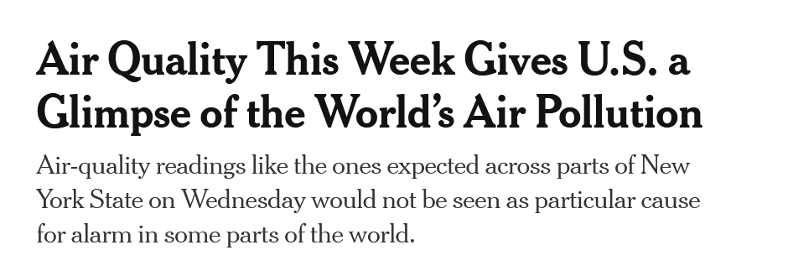
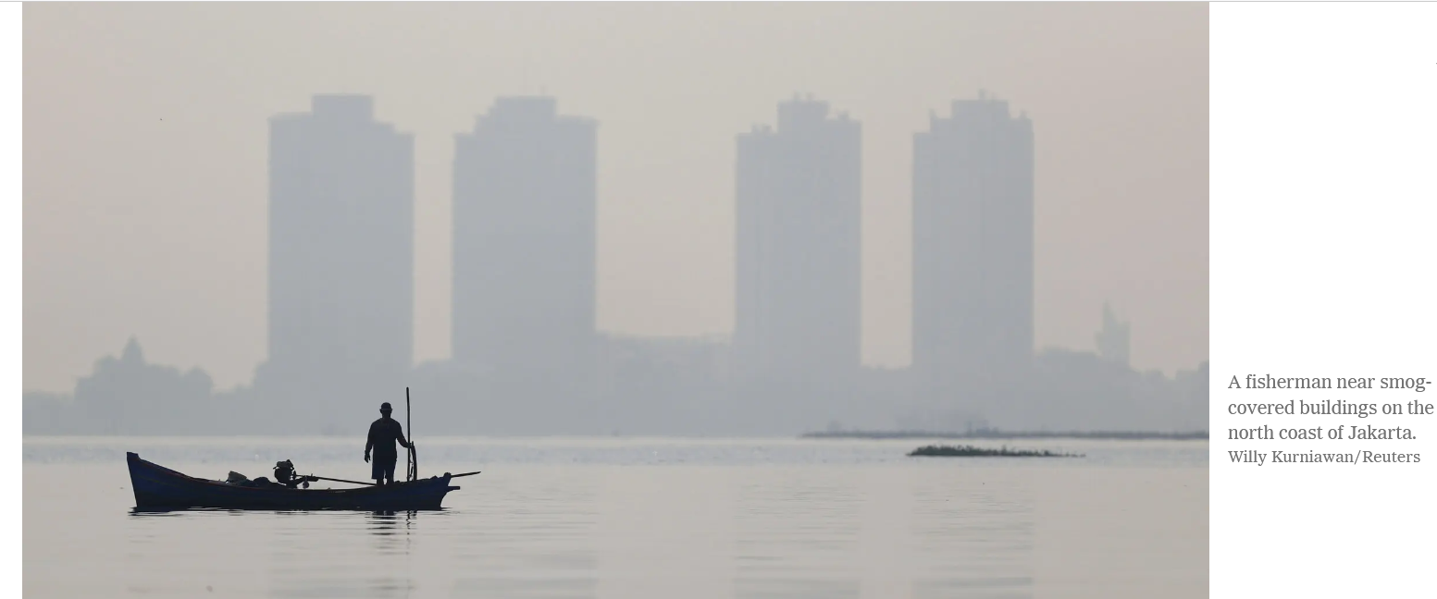
Notes:
https://www.nytimes.com/2023/06/07/us/air-quality-pollution-worldwide.html

Slide 4
Air Quality Index
Notes:
The AQI was developed by the EPA. It is now used all over the world. It measures several different pollutants to derive a single numerical score. Particulate matter (PM) is positively correlated with the AQI: as AQI goes up, so does the concentration of particulate matter. Aerosols is another word that typically refers to particulate matter

Slide 5
Air pollution is an under-recognized and insufficiently addressed global health issue
Deaths from all pollution-linked diseases are three times higher than deaths from AIDS, tuberculosis and malaria combined
10 million deaths globally each year due to air pollution, with most deaths attributable to the particulate matter (PM) component of air pollution.
Most air pollution-related deaths happen in low- and middle-income countries.
The average human on earth would live 2-3 years longer if air contained no particulate matter. This can range up to a decade for some cities in India today
Particulate matter has long been linked to heart and lung disease. But it may also be linked to increased childhood mortality, degenerative brain diseases such as Alzheimer’s, stillbirth and reduce birth weight, and reduced intelligence and cognitive performance.
Notes:
https://www.thelancet.com/commissions/pollution-and-health
https://epic.uchicago.edu/news/most-of-the-world-breathes-unsafe-air-taking-more-than-2-years-off-global-life-expectancy/
https://www.ssph-journal.org/articles/10.3389/ijph.2021.1604465/full
By comparison, smoking cigarettes cuts life expectancy by about 1.9 years, while drinking alcohol reduces it by eight months. Unsafe water and sanitation lead to a seven-month reduction in life expectancy. Conflict and terrorism shave off just nine days. Ten million premature deaths every 12 months is 100 million a decade. It would be a global emergency if Martians came to Earth and sprayed a substance that caused the average person on the planet to lose more than 2-3 years of life expectancy. This is similar to the situation that prevails in many parts of the world except we are spraying the substance, not some invaders from outer space

Slide 6
Potential change in life expectancy if PM was reduced to standards set by the WHO
Notes:
https://aqli.epic.uchicago.edu/the-index/ In large parts of South America, central Africa northern Asia, and Indonesia, clearing and burning of forest for agriculture is responsible for high levels of particulate matter

Slide 7
Why are the health impacts of air pollution downplayed?
It is difficult to assign direct causality to death from air pollution. Most often, people die from COPD (chronic obstructive pulmonary disease, which includes emphysema), cancers of the lung and upper digestive tract, asthma, and heart attack and stroke.
Air pollution can produce immense toll because billions of people are exposed each day and we tend to downplay the risks when the problem is so pervasive – the normalization of risk.
Those who dismiss air pollution invoke these misleading and erroneous statements like “It only hurts those who are already sick” or “We don’t know enough about the science of how it impacts health”.

Slide 8
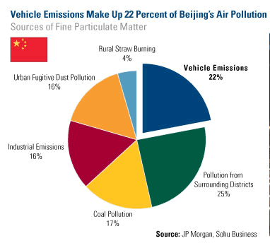
Particulate matter (PM)
Particulate matter is the air pollutant most responsible for shortening lives
These are the particles that occur in the air due to fuel combustion, fires, and natural sources of dust
Fossil fuel combustion and factories is the major source of PM in higher-income countries
Agricultural fires and the burning of biomass to cook or heat homes increases in importance in lower-income countries.

Slide 9
PM standards
U.S. Environmental Protection Agency (EPA) standard:
9 micrograms per cubic meter (μg/m3)
World Health Organization standard
5 μg/m3
In 2023, only Australia, Estonia, Finland, Grenada, Iceland, Mauritius, New Zealand, French Polynesia, Bermuda, Puerto Rico within WHO guidelines for annual average PM 2.5
In 2023, Bangladesh, Pakistan and India had the highest annual averages followed by Tajikistan, Burkina Faso, Iraq, the United Arab Emirates, Nepal, Egypt and the Democratic Republic of Congo
Notes:
Ground-level PM 2.5 is not tracked in large portions of Africa, the Middle East and South America

Slide 10
Video
Notes:
Pollution deaths rarely if ever show up in coroner’s reports, since, as with many deaths, the etiology is multicausal. In fact, though 40,000 are estimated to die each year from it in the United Kingdom., it was only in 2020 that air pollution was listed for the first time on a death certificate, that of the 9-year-old Ella Adoo-Kissi-Debrah, who has since inspired a landmark bill, called Ella’s Law, to guarantee a British right to clean air

Slide 11
Sources of PM
Animation
Reading/Questions 2
Notes:
https://www.nytimes.com/interactive/2019/12/02/climate/air-pollution-compare-ar-ul.html?smid=nytcore-ios-share View this animation to identify the natural and human sources of particulate matter.

Slide 12
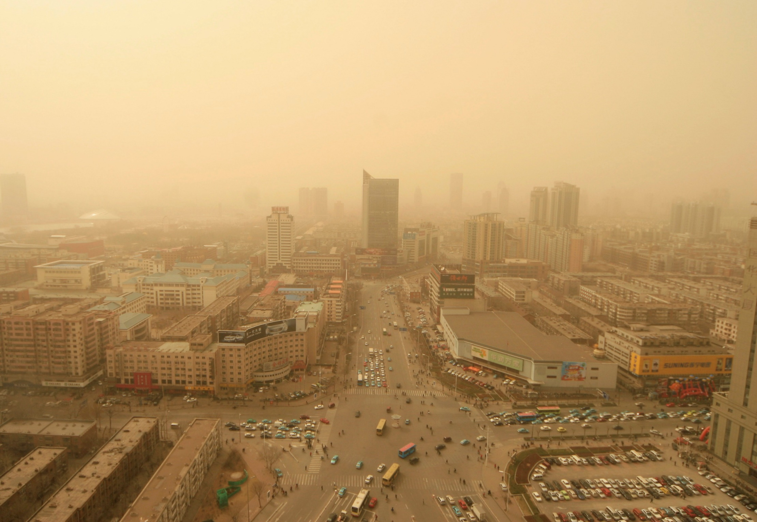
Notes:
Dust storm in Tianjin, China, a city near Beijing. This is an example of naturally produced particulate matter, although human development and agriculture can also contribute to these dust storms. These yellow dust storms originate in the interior of China, which is much more arid. than the rest of the country The Yellow River gets its name because of this yellow windborne clay dust (also know by geologists as loess) that is blown across the north of China from the steppes of Central Asia. Although natural in origin, this particulate matter is also associated with higher numbers of emergency room visits for asthma, chronic obstructive pulmonary disease and respiratory infections
https://www.taiwannews.com.tw/en/news/893441

Slide 13
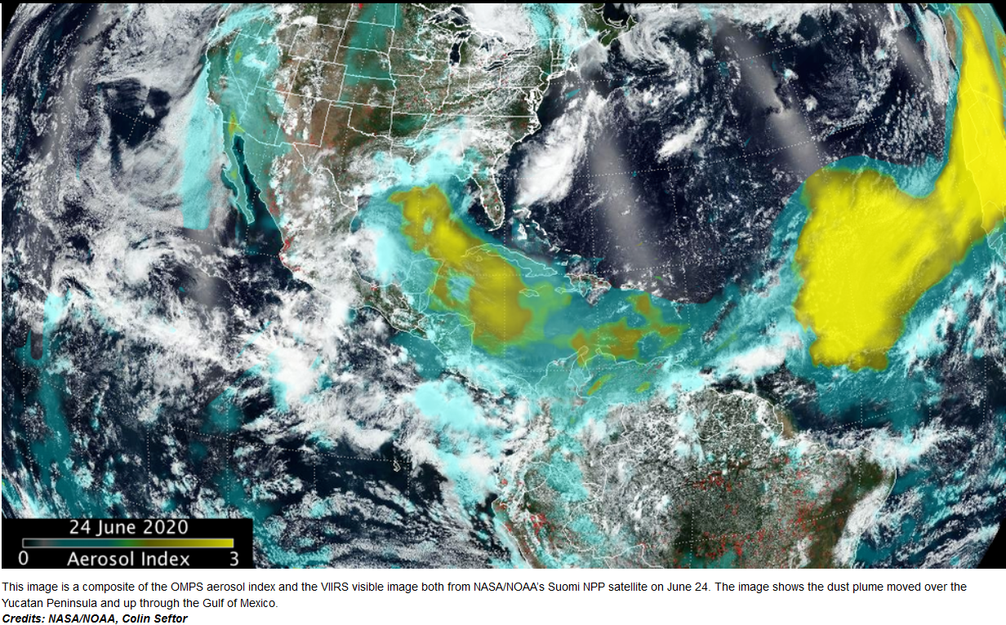
Notes:
Sahara Dust plume reaching the southeastern US. These are frequent occurrences in the summer months. Because of ongoing circulation of dust, sea salt and organic matter produced by vegetation, even entirely eliminating all human-caused pollution would still leave half of the world’s population exposed to particulate levels judged unsafe by the W.H.O.

Slide 14
Sahara air layer events
Notes:
The southeastern US experienced a hazardous particulate matter event this summer. Particulate matter levels were unhealthy to hazardous in many areas for a week-long period due to a plume of Sahara dust that made its way across the Atlantic Ocean.

Slide 15
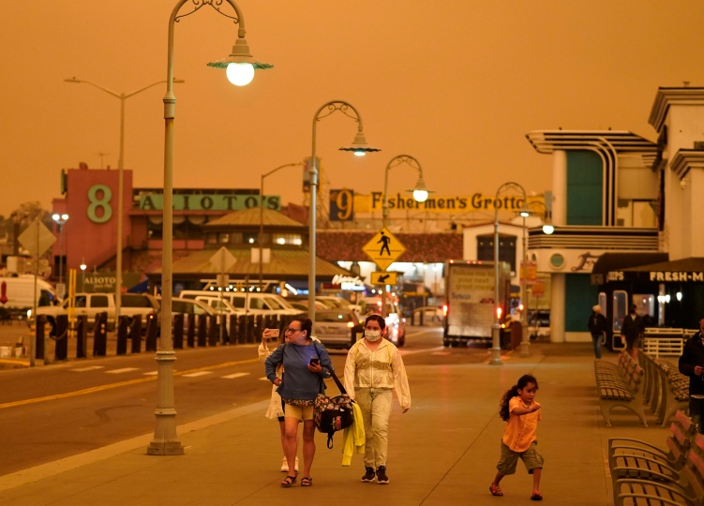
Wildfires as source of PM
Wildfires are increasing in frequency, size and intensity around the world, and smoke seasons are getting longer,
Can create very high PM concentrations
During recent fire seasons (summer and fall), air in Northern California, Oregon and Washington was among the most polluted in the world.
PM levels there exceeded those in cities in India that regularly rank among the worst in the world.
Notes:
https://www.nytimes.com/interactive/2020/11/26/climate/california-smoke-children-health.html
https://www.nytimes.com/2018/11/16/us/air-quality-california.html Under darkened skies from wildfire smoke, people walk at Fisherman's Wharf Wednesday, Sept. 9, 2020, in San Francisco. (AP Photo/Eric Risberg)

Slide 16
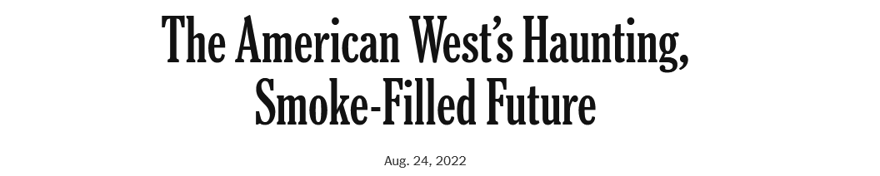
Readings/Questions 2
Notes:
https://www.nytimes.com/interactive/2020/11/26/climate/california-smoke-children-health.html Fresno, California

Slide 17
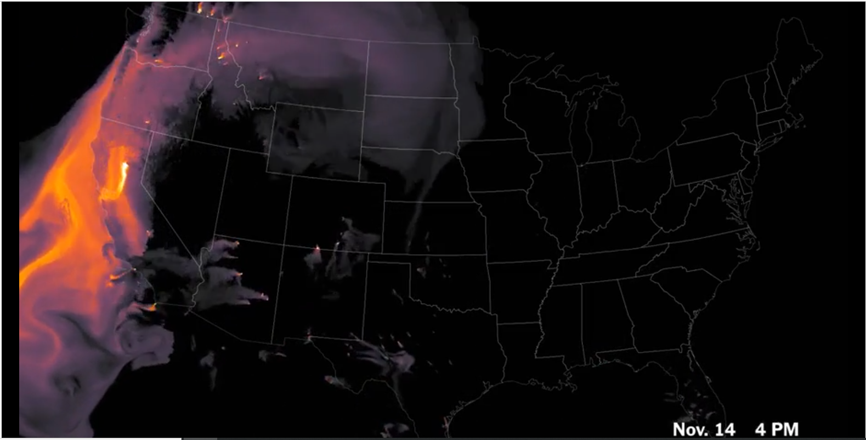
Video
Notes:
Scroll down on NY Times page to find video.
Estimates of surface-level wildfire smoke from a National Oceanic and Atmospheric Administration computer model from the 2018 fire season. Many smaller fires can be seen all across the nation over this time interval. https://www.nytimes.com/interactive/2018/11/16/upshot/california-smoke-map.html

Slide 18
Video
Notes:
2021 fire season – note that wildfire smoke goes all the way across the US

Slide 20
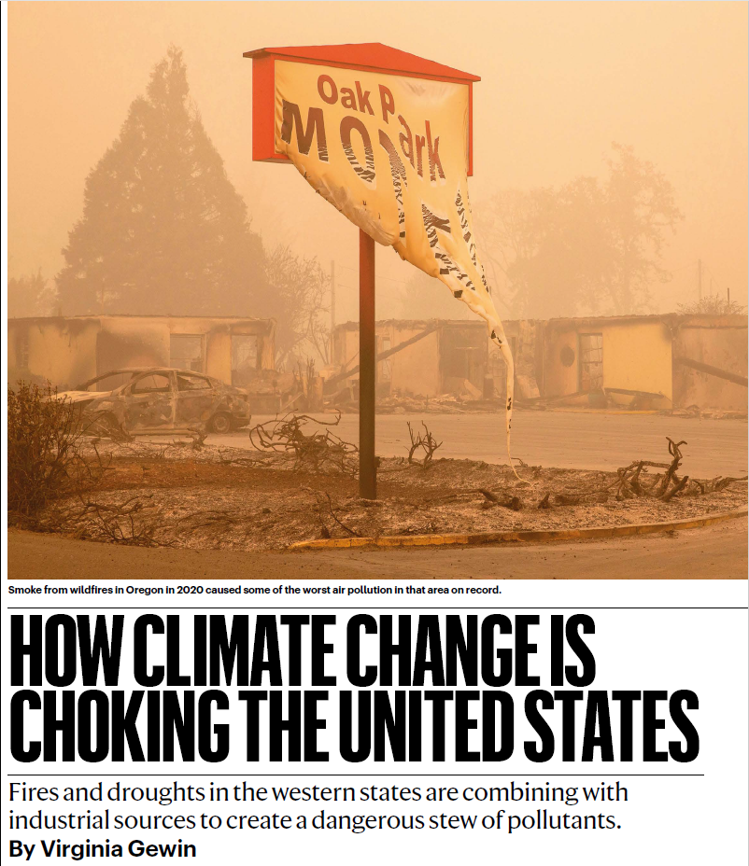
History of wildfire policy and health in US
For past 150 years, govt policies emphasized suppressing all forest fires, which led to a large build-up of dead wood and flammable vegetation in forests.
In the past few decades, forest managers have tried to reduce that fuel load by conducting prescribed burns when there is less chance of fires burning out of control.
But now this is harder to do because of climate change - windows of opportunity to do prescribed fire safely have shrunk
Several recent megafires started as prescribed fires that got out of control
Notes:
https://www.nature.com/articles/d41586-022-04333-9

Slide 21
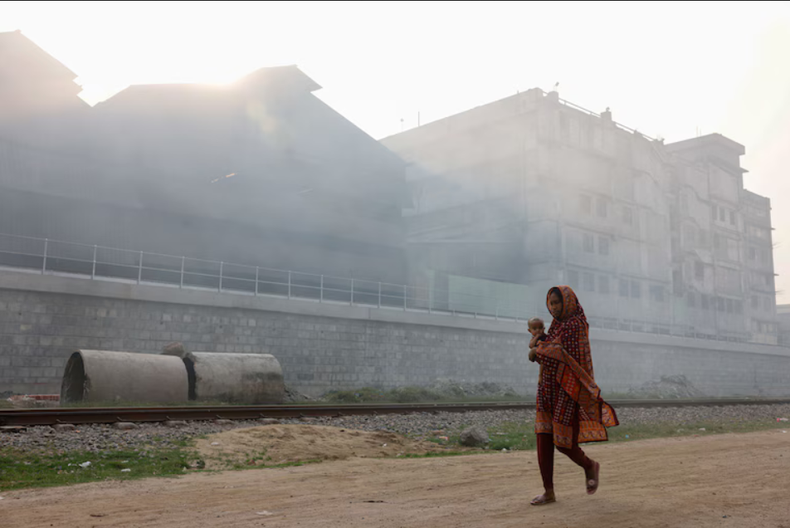
However, burning of fossil fuels in large cities is major source of PM
Deaths caused by air pollution have risen more than 66 percent since 2000.
Urbanization associated with globalization is the major cause of PM exposures and mortality
Notes:
A woman carrying a child walks past factories in the Shyampur area of Dhaka, Bangladesh, on March 16. Bangladesh had the highest annual averages for PM 2.5 pollution last year out of 134 countries measured in a new report. (Mohammad Ponir Hossain/Reuters) Bangladesh’s PM 2.5 levels averaging more than 15 times higher in 2023 than the WHO’s recommended threshold.
https://www.washingtonpost.com/climate-environment/2024/03/20/iqair-air-quality-report-who/

Slide 22
Video

Slide 23
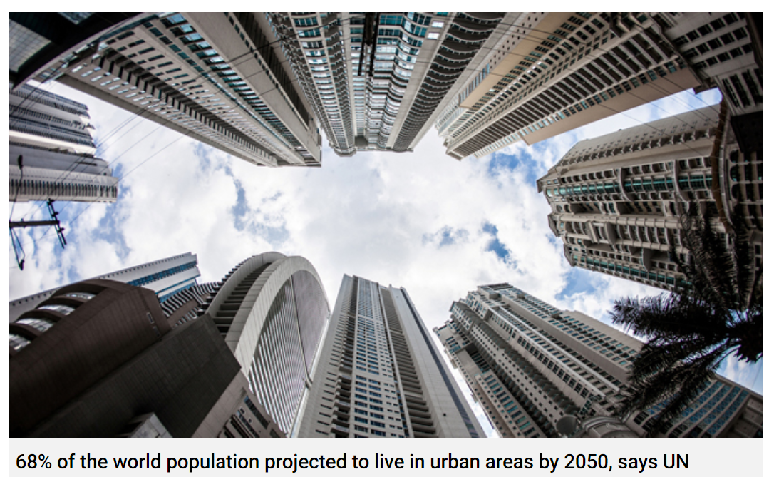
PM is world’s worst health problem because of
The mobilities of globalization
Coincidence of large numbers of people living in emerging megacities with manufacturing economies
Notes:
Globalization has fueled economic growth and the emergence of large urban areas that attract people to them with their opportunities for employment.
More people, larger cities, more pollution, more health impacts. The number of urban residents is expected to continue to increase New York City has 9 million – actually now a rather small megacity.
New Delhi has 29 million people Beijing has close to 20 million inhabitants.
https://www.un.org/development/desa/en/news/population/2018-revision-of-world-urbanization-prospects.html

Slide 24
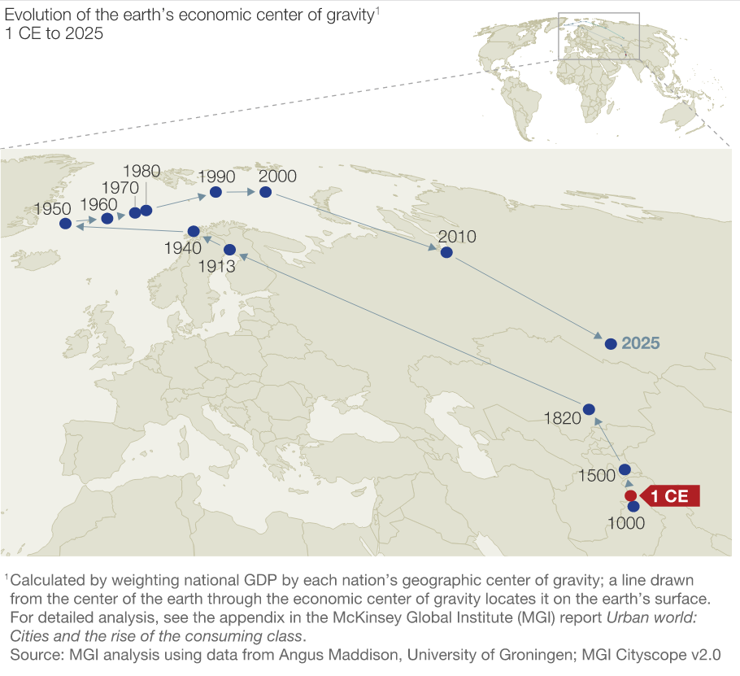
The economic center of gravity shifted back toward Asia over the last few decades.
It initiated in Asia (1000), moved to Europe (1913), toward North America (1950), and then back toward Asia
Notes:
https://www.mckinsey.com/featured-insights/urbanization/urban-world-cities-and-the-rise-of-the-consuming-class
Although the math behind this map is simplified and leaves out many aspects of what defines an economy, it conveys how the economic center of gravity for the globe has shifted over time.

Slide 25
Growing concerns over air pollution in US led to increasing regulation of air pollution (US CAA) in the 1970s
This coincided with the cultural and economic opening up of China beginning in the 1970’s
Many North American polluting industries began outsourcing labor and production to China and other parts of Asia
Notes:
Note where air quality has increased and where it has decreased in the map above. As manufacturing all over the world moved to China and India, their air quality has on average gone down. North America’s air improved in part from this outsourcing of polluting industries to places in the world where pollution control laws were less strict and labor was cheaper. Laws and regulations like the Clean Air Act helped clean up North American air, but we have far fewer of the factories and manufacturing base we had at one time.
Cleaner air in the US over the past few decades is in part a consequence of this shift in manufacturing to China and India. Think of your laptops and phones – none of them are made here. Automobiles may be assembled here, but the parts are made elsewhere.

Slide 26
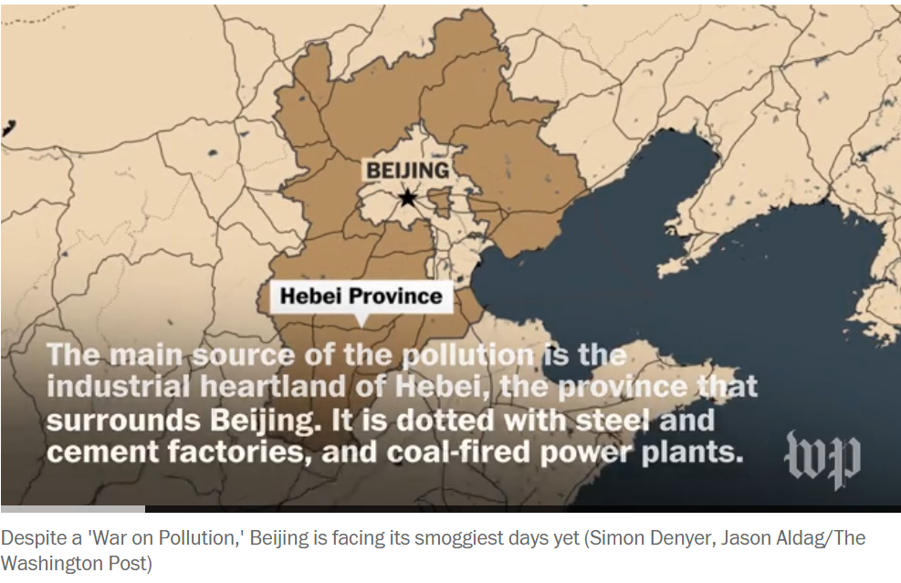
This growth was often too rapid for cities in Asia to develop the infrastructure and policies to absorb environmental impacts
Megacities increased PM and number of people exposed to PM, magnifying the health impact
In sum, cleaner air in the US over the past few decades is in part a consequence of this shift in manufacturing to China and India
Notes:
https://www.washingtonpost.com/news/worldviews/wp/2017/01/05/a-day-in-the-life-of-beijings-apocalyptic-smog/

Slide 27
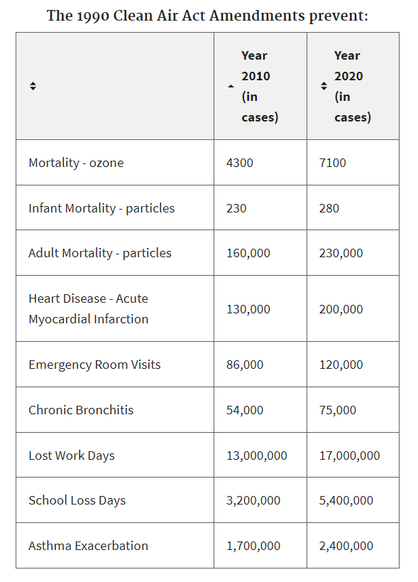
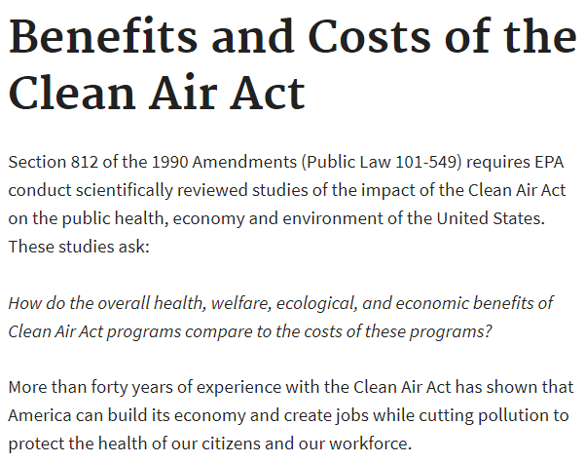
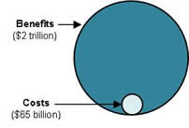
Notes:
These numbers represent the estimates of the number of cases of disease prevented due to the Clean Air Act. The EPA is required to conduct cost-benefit analyses for all environmental policies they enforce.
The benefits of the US have consistently outweighed the costs over time.
https://www.epa.gov/clean-air-act-overview/benefits-and-costs-clean-air-act
https://www.epa.gov/clean-air-act-overview/benefits-and-costs-clean-air-act-1990-2020-second-prospective-study
…but you have to remember, what was also a reaction to this increased regulation of industries and manufacturing? Yes, there were improvements in technology to lessen air pollution, but there was also a shift to China to take advantage of lower wages and the absences of strict environmental regulations

Slide 28
The US Clean Air Act resulted in a net decline in PM and shifts in where exposures are high and low
Notes:
If rank declined, pollution decreased. If rank increased, pollution increased. Kentucky is one of the places in the country that has benefited from the Clean Air Act. Many of the regions that have worse air are some of the poorer regions of the country. https://www.nytimes.com/interactive/2019/06/19/climate/us-air-pollution-trump.html
Ma, Lala. "Mapping the clean air haves and have-nots." Science 369, no. 6503 (2020): 503-504.

Slide 29
Notes:
By assessing the darkness and particulate matter on the feathers of approximately 1,300 bird specimens drawn from natural history collections, relative ambient concentrations of atmospheric black carbon were tracked between 1880 and 2015 within the US Midwest manufacturing belt, a region historically reliant on coal and dense with industry. The precipitous drop in atmospheric black carbon at midcentury reflects policies that sought to switch from less polluting forms of fuel and heating. The basis of what would become the Clean Air Act began in 1955 with the Air Pollution Control Act. Note that more coal is consumed to produce energy after 1960 but with far less particulate matter pollution.
https://www.pnas.org/content/114/43/11321 US Manufacturing Belt: Area spanning Chicago, Buffalo, Detroit, Milwaukee, Cincinnati, Toledo, Cleveland, St. Louis, and Pittsburgh

Slide 30
The 2008 Beijing Summer Olympics
To improve air quality, the Chinese government enacted reg­u­la­tions between No­v 2007 and Sept 2008. The Olympics were July to Sep­t 2008.
All coal plants were re­quired to in­stall de­vices to de­crease emis­sions.
Some chem­i­cal plants in Bei­jing were shut down
The gov­ern­ment in­creased the price of gaso­line to dis­cour­age the use of cars.
Dur­ing the Games, ve­hi­cles with odd num­bered plates could only cir­cu­late on odd days, while even num­bered plates were only al­lowed to cir­cu­late on even days.
All ce­ment and con­crete plants were closed
Air quality and health statistics improved dramatically, although once the Olympics were over, air pollution increased again
Notes:
https://chicagopolicyreview.org/2016/02/12/the-2008-beijing-olympic-games-spillover-effects-on-air-quality-and-health/

Slide 31
Photos
Notes:
https://www.theguardian.com/cities/gallery/2015/dec/08/beijing-air-pollution-red-alert-smog-before-after-pictures These photos show the difference between a high smog and a low smog day in Beijing in 2015.

Slide 32
Video
Notes:
https://www.bbc.com/news/world-asia-india-41925067
https://www.youtube.com/watch?v=iksEqOi_1bk

Slide 33
New Delhi in India has air that is on average more than twice as polluted as Beijing’s, according to the World Health Organization.
The “pollution season” in greater Delhi, home to 29 million people, begins in October and persists through December
The city has recently enacted pollution lockdowns – closing schools and limiting polluting activities like construction and crop burning
Notes:
https://www.washingtonpost.com/news/energy-environment/wp/2016/05/11/air-pollution-in-india-is-so-bad-that-it-kills-half-a-million-people-every-year/
https://www.nytimes.com/2014/05/09/world/asia/cities-in-india-among-the-most-polluted-who-says.html https://www.washingtonpost.com/world/2021/11/15/india-delhi-pollution-lockdown/

Slide 34
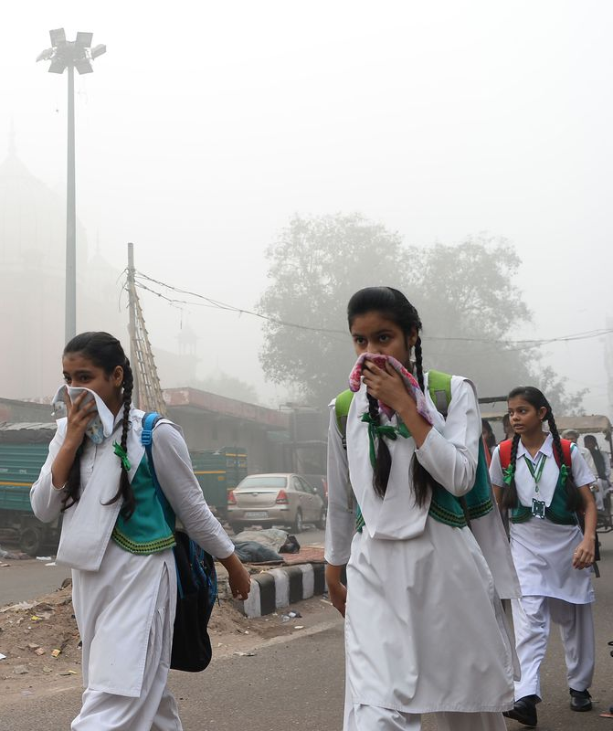
PM sources in Northern India
Like Beijing, fossil fuel combustion from transportation and coal-fired power plants are a major source of PM.
However, New Delhi and northern India has more PM originating from
Small-scale industries that are poorly regulated instead of big state run industries
More open flame cook stoves
Trash burning
More burning of crop stubble
Notes:
Crop burning has increased with globalization and the growth of New Delhi. Rice residue burning makes a substantial contribution to air pollution. Shyamsundar, P., Springer, N. P., Tallis, H., Polasky, S., Jat, M. L., Sidhu, H. S., ... & Cummins, J. (2019). Fields on fire: Alternatives to crop residue burning in India. Science, 365(6453), 536-538.
https://vimeo.com/278655350

Slide 35
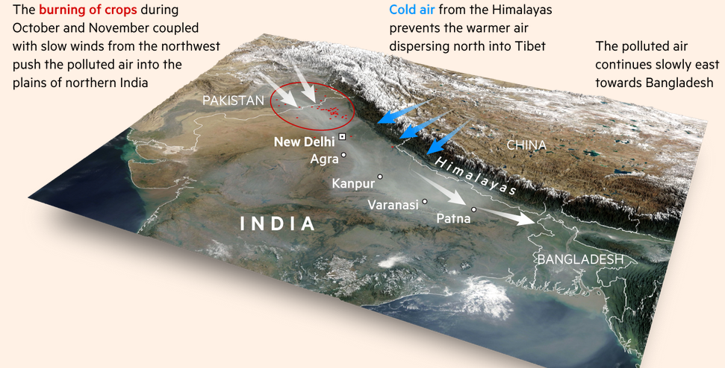
Notes:
Northern India has a topography that makes human-caused pollution worse. Air pollution flows from west to east and gets trapped up against the Himalayan Mountains. Cool air from the Himalayas forms a cap over the warm lowland air, creating a temperature inversion. The warm air is held down by the cold air above, trapping the pollutants that would otherwise disperse and become less concentrated.

Slide 36
Video
Notes:
https://www.bbc.com/news/world-asia-india-41925067
https://www.youtube.com/watch?v=iksEqOi_1bk

Slide 37
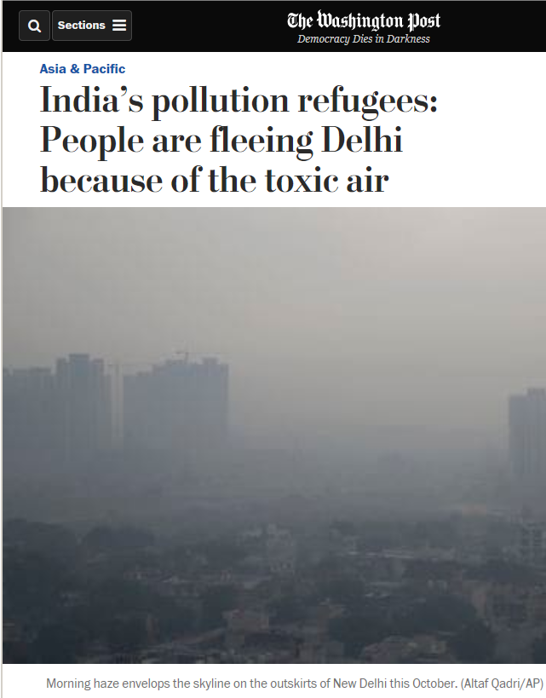
PM disproportionately impacts the poor in India
Those with more wealth have access to cleaner neighborhoods and indoor environments
They may also have the means to leave during the pollution season.
The poor, the homeless and those whose livelihoods require outside work have fewer options to avoid exposure.
Reduction policies may worsen inequalities when burden of reducing air pollution are unfairly distributed to disadvantaged groups, who may have to sacrifice their jobs for pollution reduction.
Notes:
Access to clean air is an environmental justice issue and a human right

Slide 38
Notes:
Cookstove types from around the world (or how many people of the world cook their meals)
Gordon, S. B., Bruce, N. G., Grigg, J., Hibberd, P. L., Kurmi, O. P., Lam, K. B. H., ... & Bar-Zeev, N. (2014). Respiratory risks from household air pollution in low and middle income countries. The Lancet Respiratory Medicine, 2(10), 823-860.

Slide 39
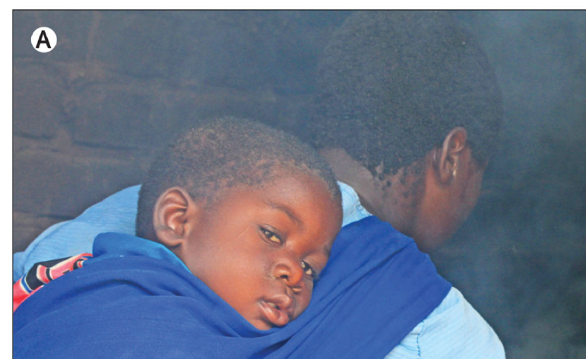
Household air pollution (HAP)
A third of the world (around three billion people) use biomass (wood, dung, crop stubble) and other raw to slightly processed cooking fuels (e.g., charcoal, coal, kerosene) worldwide.
Most often used for cooking in developing countries.
PM from HAP is associated with approximately 3.5 million deaths annually – it rivals ambient (outdoor) PM
The health burden is unevenly distributed as women and children are more often exposed to cooking fires
However, exposures to HAP are declining
Notes:
Natural gas (like in your home) is a mixture of several gases, including propane. Gordon, S. B., Bruce, N. G., Grigg, J., Hibberd, P. L., Kurmi, O. P., Lam, K. B. H., ... & Bar-Zeev, N. (2014). Respiratory risks from household air pollution in low and middle income countries. The Lancet Respiratory Medicine, 2(10), 823-860.
In most cultures, women have a leading role in domestic cooking, with men cooking when at work or away from home. In the typical domestic context, therefore, women have several periods of intense cooking smoke exposure per day. Young children and infants, typically carried on the back or placed near their mother to sleep, are also exposed to these short, very high level, exposures to smoke (figure 1). There is particular concern when young children are exposed to smoke because data suggest that smoke exposure during the window of developmental susceptibility in early life is particularly detrimental

Slide 40
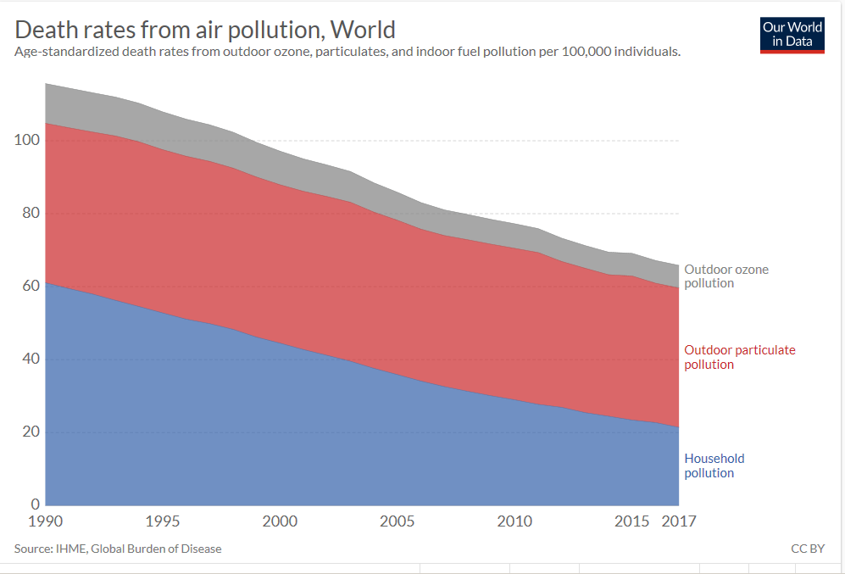
Notes:
https://ourworldindata.org/air-pollution
Note that the death rates from HAP have declined more than rates for outdoor (ambient) particulate matter pollution. Innovations in cookstoves, more education about the hazards of indoor pollution, and development that leads to the availability of cleaner energy sources are all part of this improvement in the hazards of household air pollution.

Slide 41
The energy ladder
At the bottom of the energy ladder are cheaper forms of fuel (charcoal, wood, dung, crop residues).
These are polluting fuels with both poor combustibility and toxic emissions.
Simple homes built with mud, thatch, and animal skins rarely have a chimney and, when present, the chimney is usually a simple vent with no air-drawing flue
Electricity, propane, and natural gas are considered clean cooking fuels and promoted by the WHO.
Notes:
Gordon, S. B., Bruce, N. G., Grigg, J., Hibberd, P. L., Kurmi, O. P., Lam, K. B. H., ... & Bar-Zeev, N. (2014). Respiratory risks from household air pollution in low and middle income countries. The Lancet Respiratory Medicine, 2(10), 823-860.

Slide 42
The cooking fuel transition
A progression up the energy ladder: households move away from biomass (firewood, dung) to transitional fuels (coal, kerosene) and then to modern fuels (propane, natural gas, and electricity). Factors that shape this transition
Income, fuel prices and infrastructure to provide fuel
Gender and family roles: head of households in developing countries are often male and tend to base energy and appliance purchase decisions on their preferences and needs.
Advanced energy sources may not facilitate preparation of foods that are part of the traditional diet.
Notes:
DOI: 10.1111/gec3.12469

Slide 43
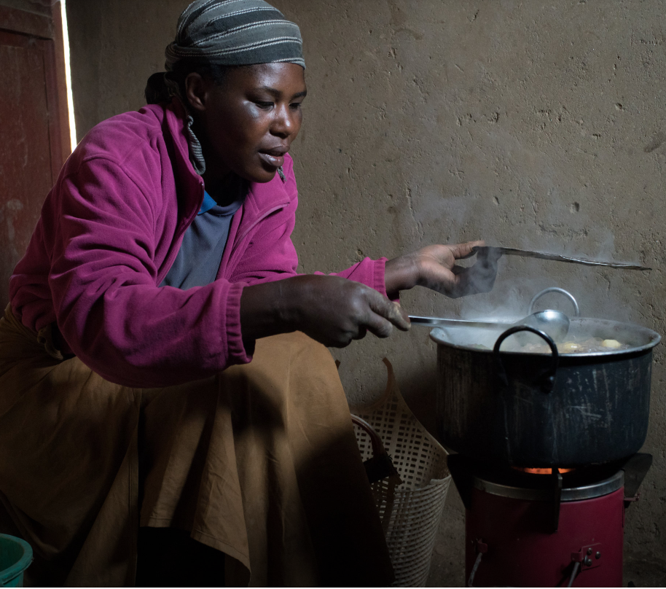
Fuel choice is also a matter of climate. In colder climates preferences may remain with firewood and firewood stoves, rather than propane or electivity, as wood can be used to cook and provide heat at the same time
However, innovations in cooking stoves can make as much difference as switching fuels.
Notes:
Schunder, T., & Bagchi‐Sen, S. (2019). Understanding the household cooking fuel transition. Geography Compass, 13(11), e12469. DOI: 10.1111/gec3.12469
https://www.nytimes.com/2018/12/06/business/rwanda-charcoal-pellet-stoves-.html

Slide 44
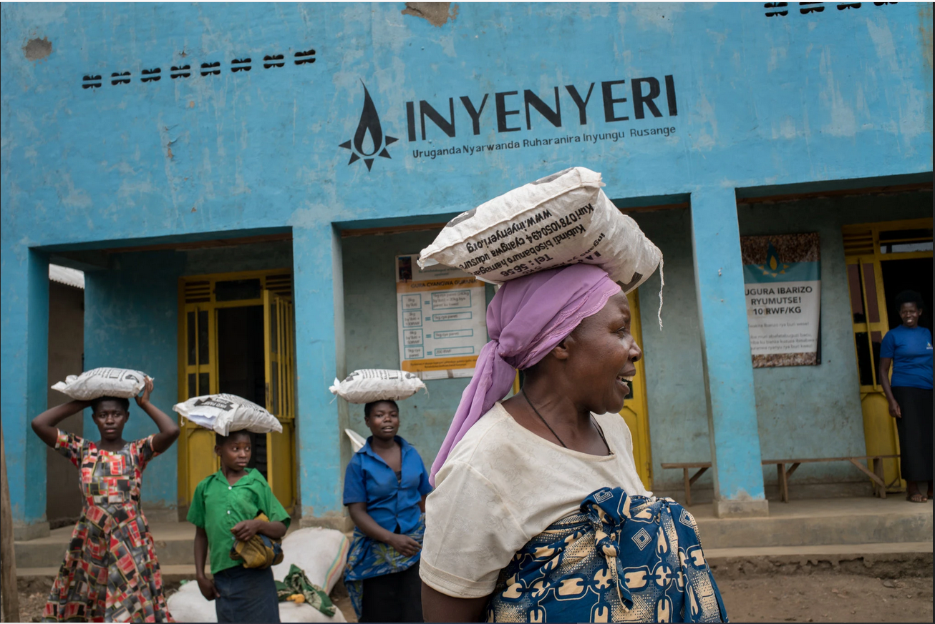
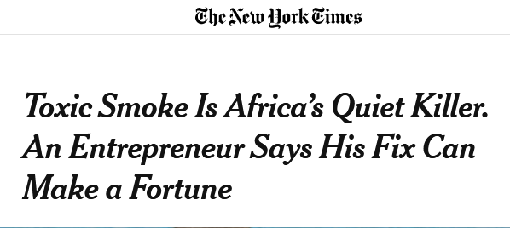
Readings/Questions 2
Notes:
https://www.nytimes.com/2018/12/06/business/rwanda-charcoal-pellet-stoves-.html

Slide 45
HAP in developed countries
Buildings often have poor ventilation and buildup of CO2, particulate matter, and volatile organic compounds (VOCs)
Many VOCs are human-made chemicals that can be emitted by a wide array of products numbering in the thousands, including paints and glues in furniture and flooring, building materials, cleaning supplies, cosmetics, copiers and printers and different types of plastic.
Exposure to VOC emissions in a household setting can lead to respiratory problems. With greater concentrations and exposures, VOCs can lead to lung damage, headaches, loss of coordination and nausea, increased risks of cancers of the upper respiratory tract
Notes:
https://science.sciencemag.org/content/373/6555/612.summary
In one study, well-ventilated conditions (which lowered the levels of CO2 and VOCs), workers in an experimental study scored 61% higher than when they worked in typical office building conditions. When they worked in the cleanest conditions, with even lower CO2 levels and higher ventilation rates, their scores climbed 101%.
A tiny sacrifice in energy efficiency through improved ventilation could increase a business’s bottom line by as much as 10% by decreasing absenteeism and boosting worker productivity.

Slide 46
HAP in developed countries
Notes:
Cooking fuels are not the issue in developed countries
The push to make homes more energy efficient had the initial effect of holding in more pollutants and increasing CO2 levels. Green certified homes often now include a ventilation plan to address this.

Slide 47
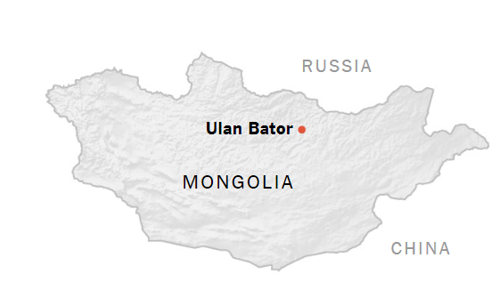
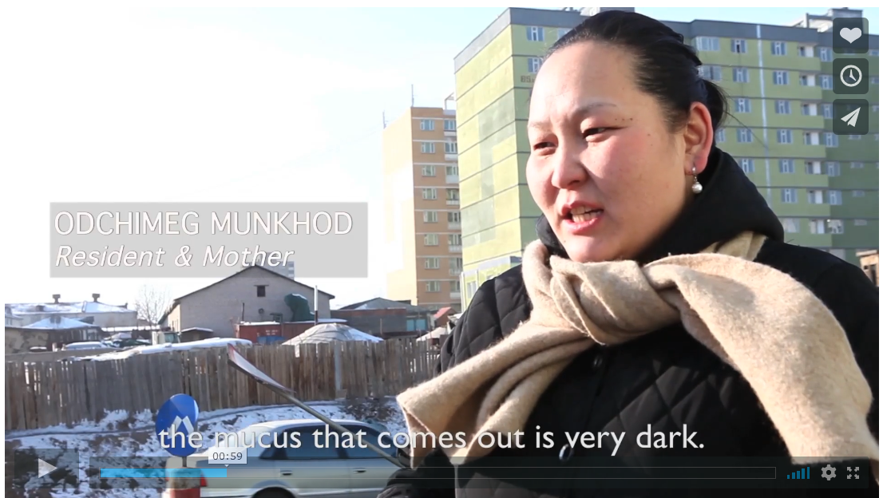
Ulan Bator, Mongolia
Higher PM level than New Delhi
Outdoor (ambient) and HAP are both exceedingly high.
Rural migration into Ulan Bator has created informal yurt settlements outside cities that are dependent upon coal for heat and cooking in the cold climate.
Migrants cannot afford other kinds of housing
Video
Video
Notes:
But there is one place where particulate matter pollution can exceed New Delhi and Beijing: Ulaanbaatar, Mongolia. Outdoor (ambient) and HAP are both exceedingly high. But it is a far smaller city than New Delhi, 1.5 million residents in Ulaanbaatar compared to 22 million in New Delhi https://www.pri.org/stories/2013-03-08/location-video-mongolia-cleaning-one-worlds-most-polluted-cities https://www.youtube.com/watch?v=4Etvek2ZQHQ

Slide 48
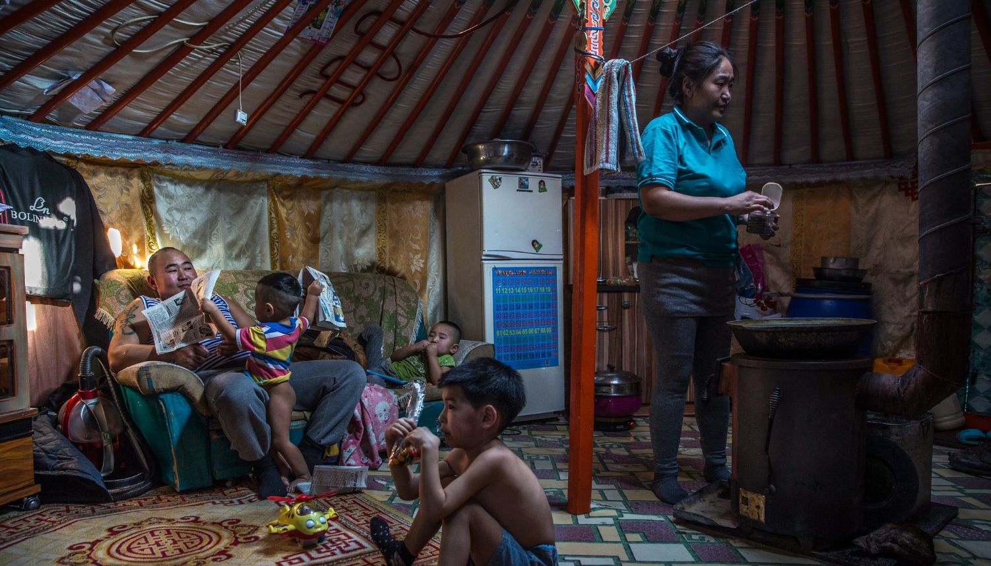
Readings/Questions 2
Notes:
https://www.nytimes.com/interactive/2018/03/15/world/asia/mongolia-ulan-bator-coal.html

Slide 49
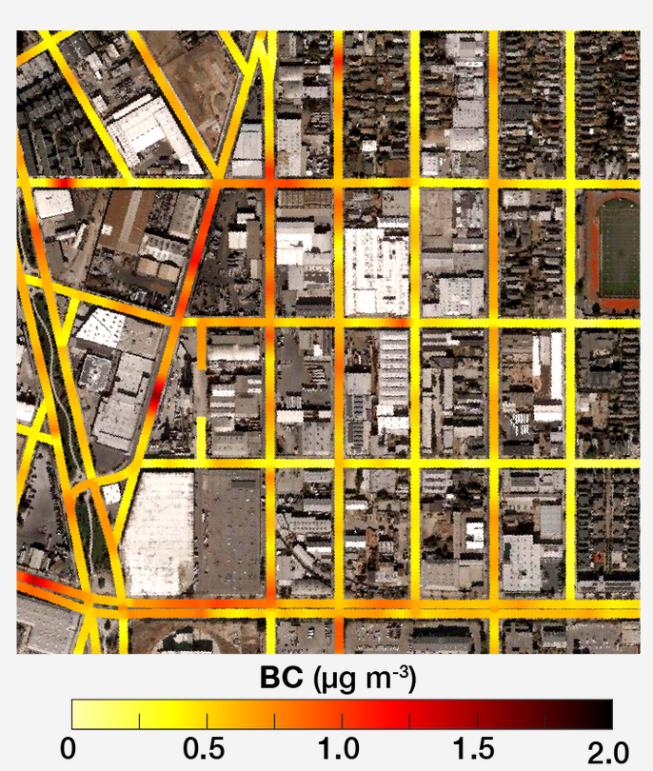
Clean air is an environmental justice issue
PM can very enormously over short intervals of time and over small distances
Typical air quality maps online may miss this local detail.
Even if an area is shown as healthy at the scale of a county, PM can vary enormously at block and neighborhood scales due to local wind patterns, road traffic, proximity to polluting industries.
These local high levels create inequities in exposures
Notes:
BC – black carbon in micrograms per cubic meter. Note how some neighborhoods are near zero while others are not
https://journals.plos.org/plosone/article?id=10.1371/journal.pone.0094431
https://www.washingtonpost.com/news/wonk/wp/2014/04/15/pollution-is-substantially-worse-in-minority-neighborhoods-across-the-u-s/
https://www.edf.org/airqualitymaps/oakland/air-pollution-and-health-east-Oakland http://apte.caee.utexas.edu/google-air-mapping/
Pollution measured at this scale was worse than pollution measured and aggregated to county, state, and national levels. Even within a city block, pollution could vary by 5-8 times. This in turn translates to health impacts at the level of individual homes and neighborhoods that larger trends in air pollution monitoring may miss.

Slide 50
Racial-ethnic disparity in PM2.5 exposure
Notes:
Source contributions to racial-ethnic disparity in PM2.5 exposure Racial-ethnic minorities in the United States are exposed to disproportionately high levels of ambient fine particulate air pollution (PM2.5), the largest environmental cause of human mortality. However, it is unknown which emission sources drive this disparity and whether differences exist by emission sector, geography, or demographics. Quantifying the PM2.5 exposure caused by each emitter type, we show that nearly all major emission categories—consistently across states, urban and rural areas, income levels, and exposure levels—contribute to the systemic PM2.5 exposure disparity experienced by people of color. We identify the most inequitable emission source types by state and city, thereby highlighting potential opportunities for addressing this persistent environmental inequity. Tessum, C. W., Paolella, D. A., Chambliss, S. E., Apte, J. S., Hill, J. D., & Marshall, J. D. (2021). PM2. 5 polluters disproportionately and systemically affect people of color in the United States. Science Advances, 7(18), eabf4491.
https://www.nytimes.com/2021/04/28/climate/air-pollution-minorities.html

Slide 51
Legacies of redlining: greater pollutant exposures
Notes:
https://www.nytimes.com/2022/03/09/climate/redlining-racism-air-pollution.html

Slide 52
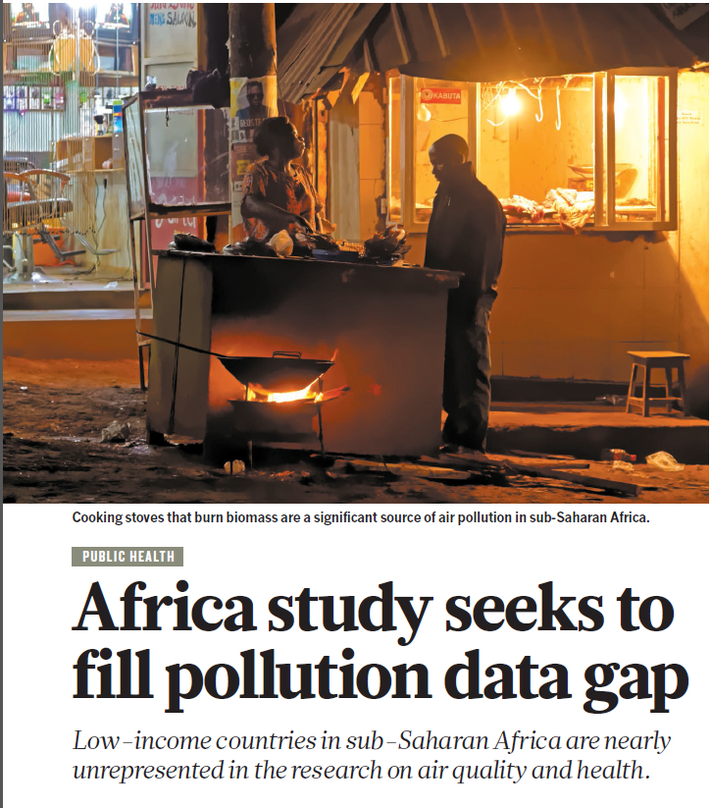
Clean air is an environmental justice issue
Historic redlining and other practices of racial and class segregation expose some people to more air pollution than others.
Some national governments have tended to downplay or even dismiss responsibility for high particulate matter levels
China referred to it for a while as ‘fog’
Pakistan blames India rather than addressing its own sources of PM
Some poorer countries lack a basic air quality monitoring program
Some governments dismiss worries over PM because they view it as the price of progress
Notes:
https://www.npr.org/sections/goatsandsoda/2020/01/06/792693712/scary-moms-are-part-of-the-citizen-war-against-pollution-in-Pakistan
https://www.nature.com/articles/d41586-018-04330-x

Slide 53
Access to clean air is an environmental justice issue and a human right
Readings/Questions 2
Notes:
Access to clean air is an environmental justice issue and a human right https://www.nytimes.com/interactive/2020/12/17/world/asia/india-pollution-inequality.html

Slide 54
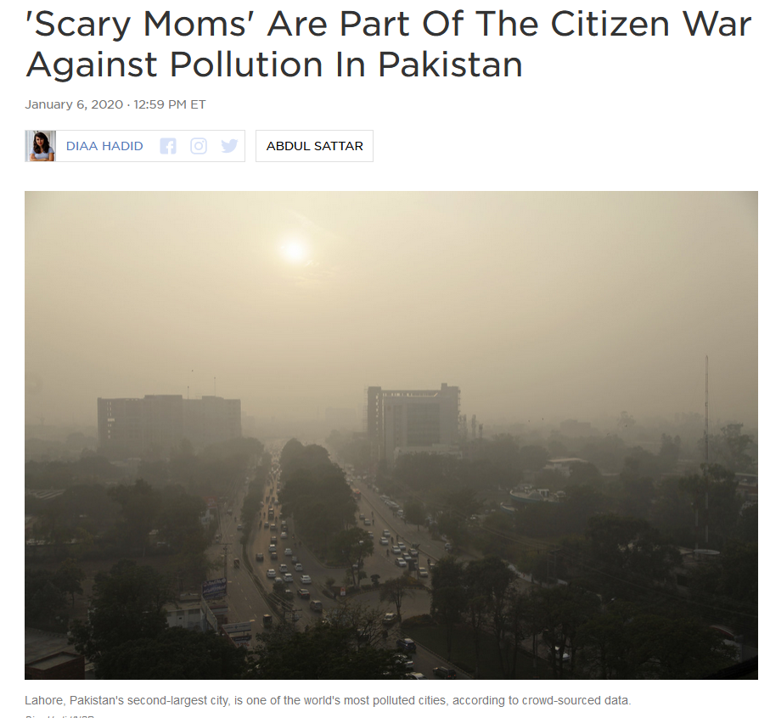
Local bottom-up responses to air quality
Citizen-based activism
‘Scary Moms’ in Pakistan is a citizen group that holds public officials accountable for providing up-to-date PM monitoring and enacting pollution reduction measures
Notes:
https://www.npr.org/sections/goatsandsoda/2020/01/06/792693712/scary-moms-are-part-of-the-citizen-war-against-pollution-in-Pakistan

Slide 55
Top-down responses to air quality

Slide 56
PM is the “New Tobacco”
When smoke enters airways, the immune system begins to ramp up.
Lining of the lungs becomes inflamed, making it difficult to breathe. This can aggravate pre-existing heart and lung problems
With chronic exposure to PM2.5
Shortened lifespan
COPD: chronic obstructive pulmonary disease, which includes emphysema
Increased risk of mortality for lung cancer and cancers of the upper digestive tract,
Increased prevalence of asthma, more frequent and severe asthma attacks
Increased risk of heart attack and stroke
Increased risk of lower birth weight and infant mortality
Notes:
Wong, C. M., Tsang, H., Lai, H. K., Thomas, G. N., Lam, K. B., Chan, K. P., ... & Thach, T. Q. (2016). Cancer mortality risks from long-term exposure to ambient fine particle. Cancer Epidemiology and Prevention Biomarkers, 25(5), 839-845. The Global Burden of Disease Study (GBDS) found a positive relationships between increasing PM2.5 and relative risk of infant mortality due to respiratory infections globally. COPD and emphysema are marked by shortness of breath, coughing, debilitating fatigue
https://www.theguardian.com/environment/2018/oct/27/air-pollution-is-the-new-tobacco-warns-who-head

Slide 57
Neurodegenerative impacts of PM:
Alzheimer’s-like brain pathologies observed in apparently healthy children living in Mexico City, compared with a group of similar children in less polluted city.
Above normal levels of the amyloid and tau proteins (markers for Alzheimer’s) in more than 99% of autopsies conducted on 203 city residents in highly polluted citites
In Ontario, Canada, living farther away from a major road lowered risk of developing dementia
In US, living in locations where ambient PM exceeded EPA recommendations nearly doubled women’s risk of developing dementia.
Notes:
Peeples, Lynne. "How air pollution threatens brain health." Proceedings of the National Academy of Sciences (2020).
https://doi.org/10.1073/pnas.2008940117

Slide 58
PM 2.5 could be responsible for ∼15% of dementia deaths
Notes:
Top 15 world countries with the highest (d) attributable incidence (a function of the number of people) of dementia due to PM2.5 and (e) attributable incidence rate (standardizes population sizes). due to PM2.5. Bands show uncertainty range of 95% confidence intervals. Ru, M., Brauer, M., Lamarque, J. F., & Shindell, D. Exploration of the global burden of dementia attributable to PM2.5: what do we know based on current evidence?. GeoHealth, e2020GH000356.
Ambient PM2.5 pollution could be a major risk factor for dementia, responsible for ∼15% of dementia deaths. This burden was estimated to lead to $26 billion (USD in 2010) in costs in 2015 globally. As such, reducing PM2.5 exposure may be an important measure to reduce the global burden and the high costs associated with dementia. Accounting for the impact of PM2.5 on dementia may substantially increase the benefits associated with clean air or climate change mitigation policies.

Slide 59
Ambient black carbon PM can cross the placenta to impact fetus
Represents a potential mechanism explaining the detrimental health effects of pollution in early life
Dirty air may spur brain disease at far younger ages than previously suspected
Notes:
BC – black carbon
Green dots are clean air, red is polluted with PM https://doi.org/10.1038/s41467-019-11654-3
Bové, H., Bongaerts, E., Slenders, E., Bijnens, E. M., Saenen, N. D., Gyselaers, W., ... & Nawrot, T. S. (2019). Ambient black carbon particles reach the fetal side of human placenta. Nature Communications, 10(1), 1-7.

Slide 60
In utero and early-childhood exposure to PM impairs cognitive development
Children born in Texas when PM was atypically low (due to decreases in industrial production during a brief economic recession) went on to have higher high school test scores
Children born in Santiago, Chile, with higher exposure to fetal pollution, such as carbon monoxide and PM, went on to perform worse on high-stakes national exams that determine access to secondary schools
Higher PM levels in the year of birth lead to lower labor force participation and lower earnings in adulthood
A study of nearly 3,000 Barcelona schoolchildren, those attending schools with more traffic pollution had slower cognitive development
Notes:
Zivin, J. G., & Neidell, M. (2018). Air pollution's hidden impacts. Science, 359(6371), 39-40.
Peeples, Lynne. "How air pollution threatens brain health." Proceedings of the National Academy of Sciences (2020).
https://doi.org/10.1073/pnas.2008940117

Slide 61
The environmental Kuznet’s curve
Notes:
As countries grow wealthier, first they become more polluted, and then, once rich, less so, as they can afford the technologies and investments associated with pollution control. And the growth of the service economy means that manufacturing has likely been outsources to other locations. The environmental Kuznet’s curve is a simplification of how the world changes, but it offers a starting point for thinking about these complex relationships around economic development, standards of living, pollution, and globalization https://www.nytimes.com/2022/07/08/opinion/environment/air-pollution-deaths-climate-change.html

Slide 62
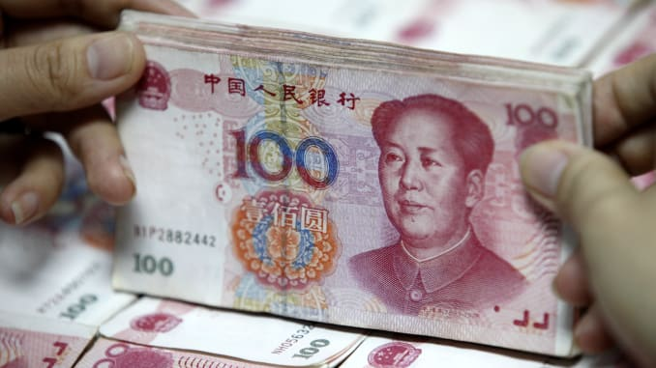
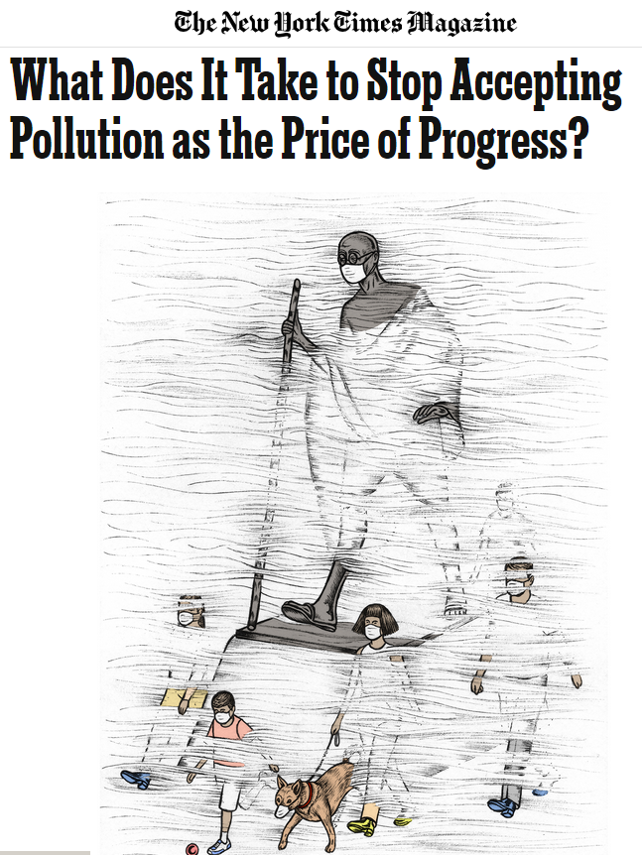
“Is pollution the price of progress?”
Readings/Questions 2
Notes:
https://www.nytimes.com/2018/01/23/magazine/what-does-it-take-to-stop-accepting-pollution-as-the-price-of-progress.html
“It’s the price of progress” – this can be a very oversimplistic discourse invoked to thwart implementing pollution control. Yes, pollution may increase when a country industrializes. But this does not mean that pollution in inevitable and has to be tolerated. Do countries that industrialize first and develop pollution control policies have an obligation to extent their technological advancements to developing countries? Or do the developing countries have the right to develop as fast as they can and not use pollution controls that could slow down development?

Slide 63
There may be no clear safe level with particulate matter
In 2021, the World Health Organization lowered its global air quality standard from 10 micrograms of particulate matter per cubic meter to five
Before the WHO update, about 8% of the US was judged to be breathing dirty air; after, the figure was 93%. Across Europe, the revision pushed the numbers from 47% to 95.5 percent.
Notes:
https://www.nytimes.com/interactive/2019/06/19/climate/us-air-pollution-trump.html
https://www.nejm.org/doi/full/10.1056/NEJMoa1702747#t=abstract
https://onlinelibrary.wiley.com/doi/full/10.1111/1753-6405.12264
Di, Q., Dai, L., Wang, Y., Zanobetti, A., Choirat, C., Schwartz, J. D., & Dominici, F. (2017). Association of short-term exposure to air pollution with mortality in older adults. Jama, 318(24), 2446-2456.
https://www.who.int/airpollution/en/
Are we only seeing the tip of the iceberg with the health effects of particulate matter. And the number of unexposed humans or other primates in long-term studies is dwindling, making research all the more pressing

Slide 64
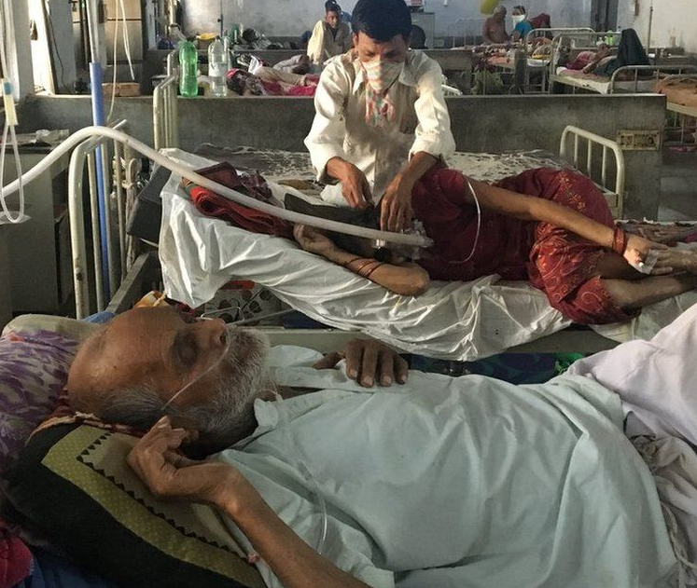
PM as strategy
Immediacy of health effects from PM can facilitate responses to climate change
Health effects of PM generate a feeling of “clear and present danger”
Notes:
https://www.nytimes.com/2022/07/08/opinion/environment/air-pollution-deaths-climate-change.html https://www.bbc.com/news/world-asia-india-48102417

Slide 65
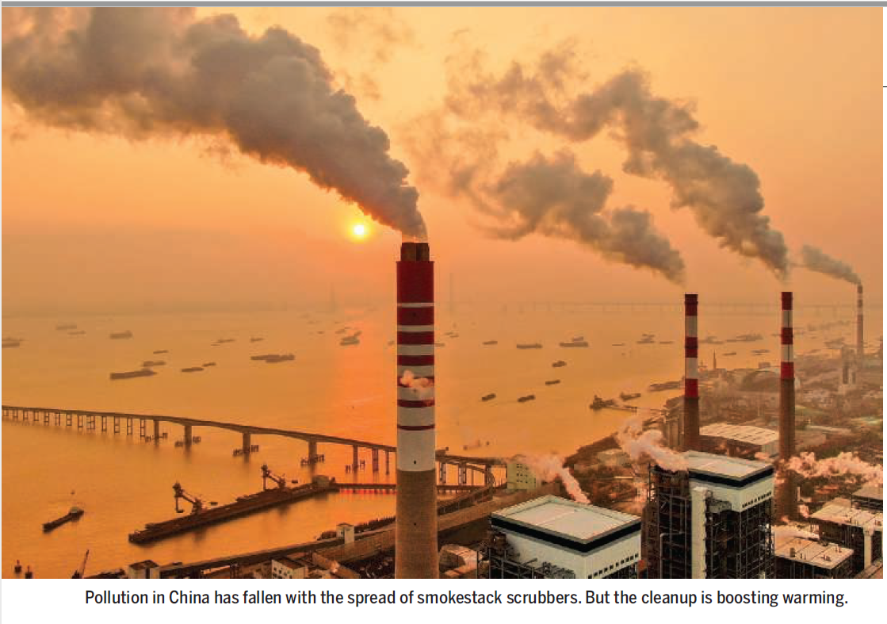
Burning fossil fuels releases the greenhouse gases that cause warming
Burning also produces PM that reflects sunlight and cools the atmosphere, offsetting a fraction of the warming.
Reducing PM without reducing fossil fuels use will accelerate warming
Warming has been buffered by atmospheric cooling caused by PM
Readings/Questions 2
Notes:
Voosen, P. (2022). Cleaner air is adding to global warming. Science (New York, NY), 377(6604), 353-354.

Slide 66
Notes:
https://www.pnas.org/doi/abs/10.1073/pnas.2313797121 Here we can see how China has reduced its PM while it has increased in India. The lowered PM over China has resulted in more warming of the regional atmosphere and ocean there. This warmer water and atmosphere propagates across the Pacific along prevailing winds and ocean currents. This results in warmer temperatures along the northern Pacific coast of North America. These warmer temperatures tend to lead to forest drying, enhancing the frequency of fires in British Columbia of Canada, Washington and Oregon. These wildfires produce smoke that can blow across the United States and impact air quality in the central and eastern United States. This is an example of a teleconnection, how changes in a system in one location can propagate over large distances to change conditions elsewhere. You can say that increased premature mortality in the eastern US due to PM is a consequence of China’s war on pollution and reductions in PM.

Slide 67
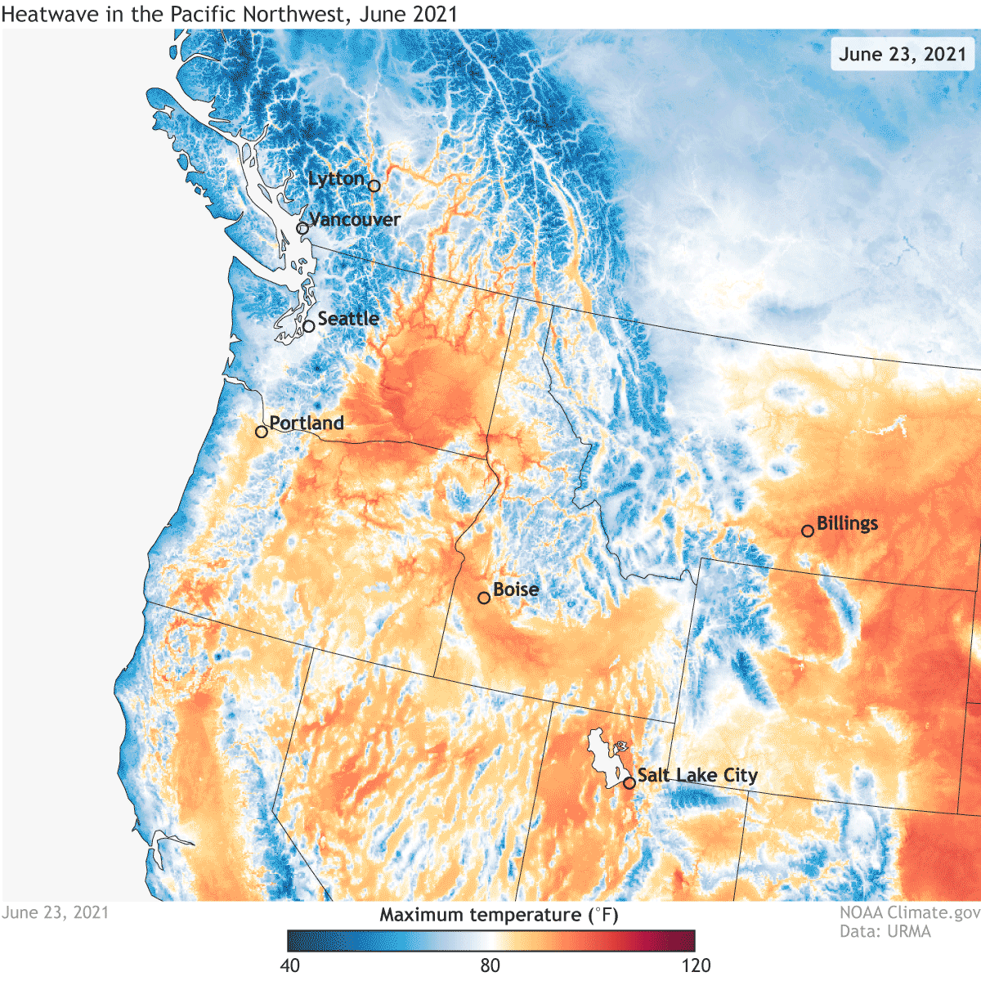
Teleconnections between PM reductions and wildfire
Policy-driven PM reductions in China
Warmer atmosphere and ocean as air becomes cleaner
Warmer air and water move from west to east in Pacific along prevailing circulation patterns
Warmer air temperatures along western North America
More wildfires
Greater exposure to PM in North America
Notes:
This effect of PM reductions in China is superimposed upon the climate change and warming occurring from enhanced carbon dioxide concentrations in the atmosphere due to fossil fuel combustion. PM reductions are not the major driver, but they contribute to the Pacific heat events off the coast of North America. https://www.pnas.org/doi/abs/10.1073/pnas.2313797121 Wang, H., Zheng, X. T., Cai, W., Han, Z. W., Xie, S. P., Kang, S. M., ... & Zhou, L. (2024). Atmosphere teleconnections from abatement of China aerosol emissions exacerbate Northeast Pacific warm blob events. Proceedings of the National Academy of Sciences, 121(21), e2313797121.

