Slide 1
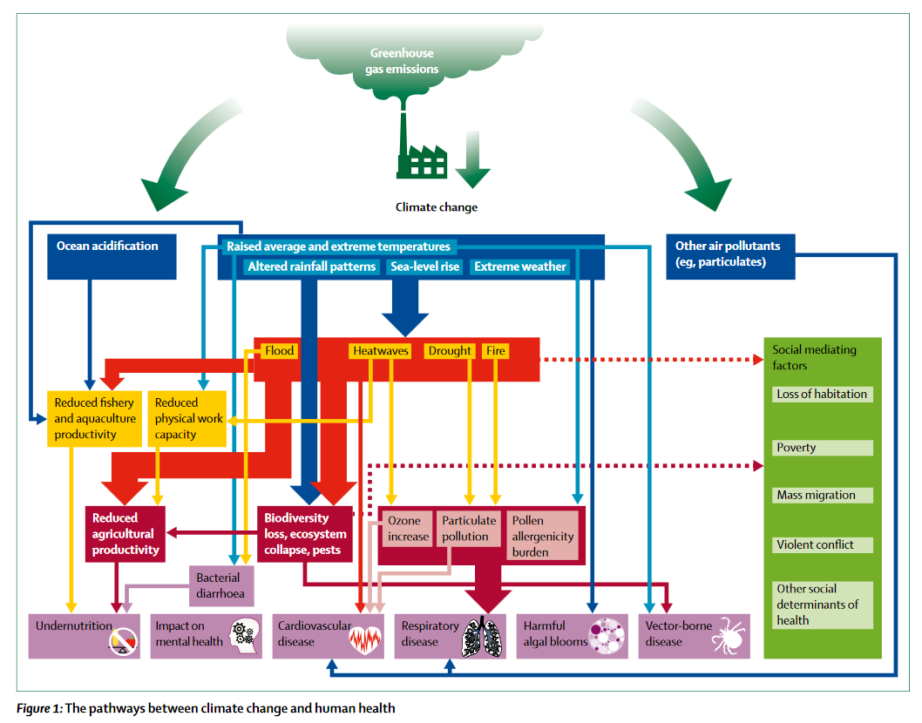
Notes:
The pathways among climate change and human health are numerous and complex – we would need an entire semester to go over how climate change is impacting global health. That’s why we are focusing on only one – extreme heat.

Slide 2
“There is no part of global health that climate change isn’t reshaping”
Extreme heat is the leading cause of mortality caused by weather and climate events
In addition, climate change has aggravated 218, or 58%, of the 375 infectious diseases listed in US Centers for Disease Control and Prevention’s National Notifiable Diseases Surveillance System.
Climate change has exacerbated dozens of non-communicable diseases
Changing environmental conditions are also harming health care access and food security
Notes:
https://doi.org/10.1038/d41586-022-02167-z Prillaman, M. (2022). Climate change is making hundreds of diseases much worse. Nature. Heat for example, may increase respiratory disease, as well as heat-related illness and kidney disease

Slide 5
Chronic Kidney Disease of unknown causes
Notes:
https://youtu.be/h4w19rFnoYY?si=cHdJg74JFLv7prlL

Slide 6
Readings/Questions 3
Notes:
https://www.nytimes.com/2024/07/08/health/sri-lanka-kidney-disease.html

Slide 7
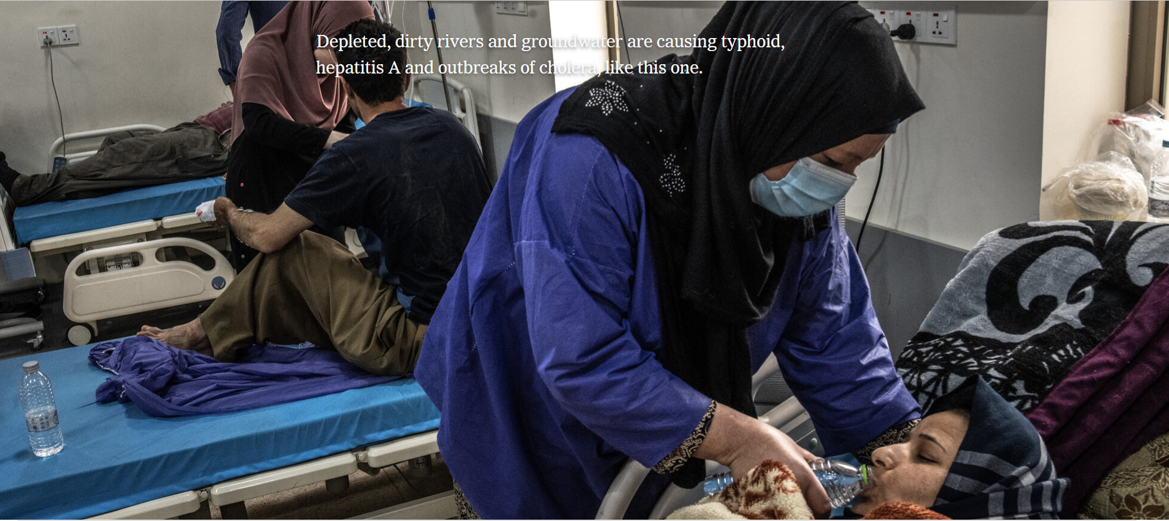
Reading/Questions 3
Notes:
https://www.nytimes.com/2023/07/29/world/middleeast/iraq-water-crisis-desertification.html

Slide 8
Readings/Questions 3
Notes:
https://www.nytimes.com/2022/06/14/world/asia/india-south-asia-climate-change.html

Slide 9
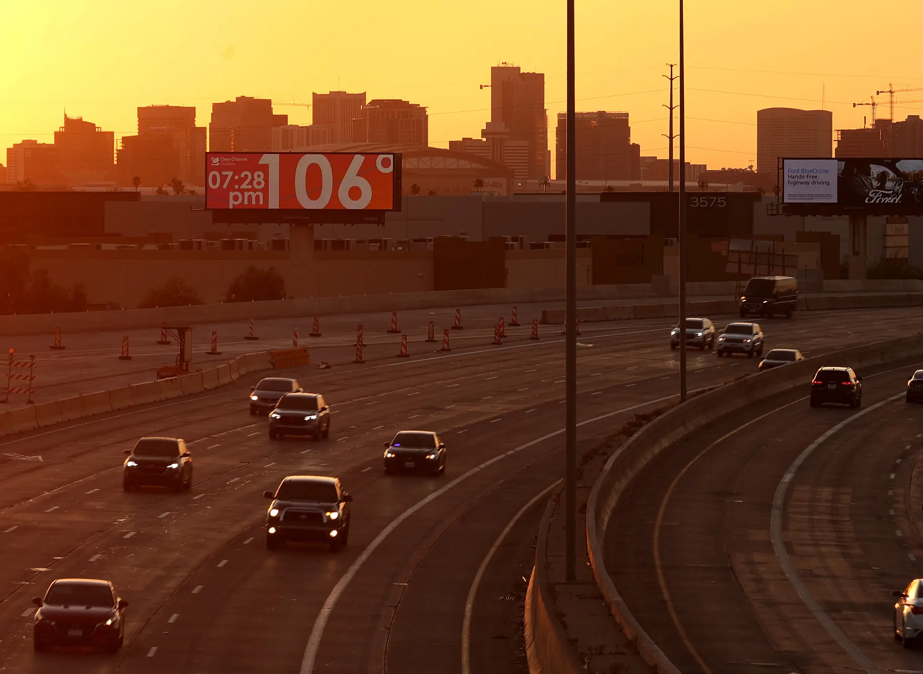
Readings/Questions 3
Notes:
https://www.nytimes.com/2024/08/23/us/extreme-heat-deaths.html Phoenix AZ

Slide 10
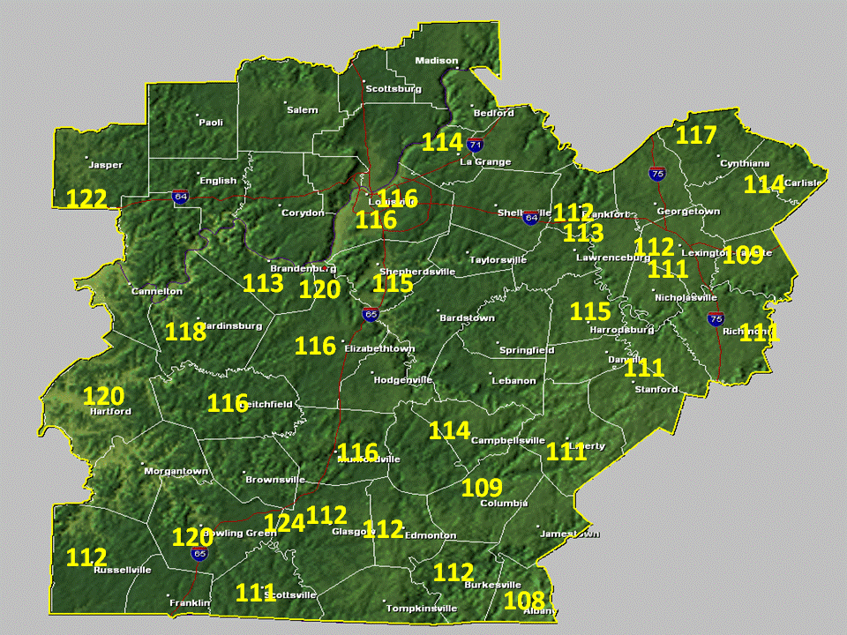
Direct physiological response to extreme heat
When humidity is high, humans cannot effectively evaporatively cool their bodies
Temp physiologically experienced by humans is higher than air temp.
This is known as the heat index.
High heat indices risk of heat exhaustion and heat stroke
Notes:
The heat index is a measure of how hot it feels when relative humidity is factored in with the actual air temperature. Humidity is an important factor in how hot it feels because when humidity is high, water doesn’t evaporate as easily, so it’s harder for your body to cool off by sweating. The numbers show in yellow or the heat index, the temperature your body would feel given the conditions of humidity and air temperature

Slide 11
Notes:
Sweating is a healthy response to heat – you want to sweat otherwise your body will not be able to cool itself.

Slide 12
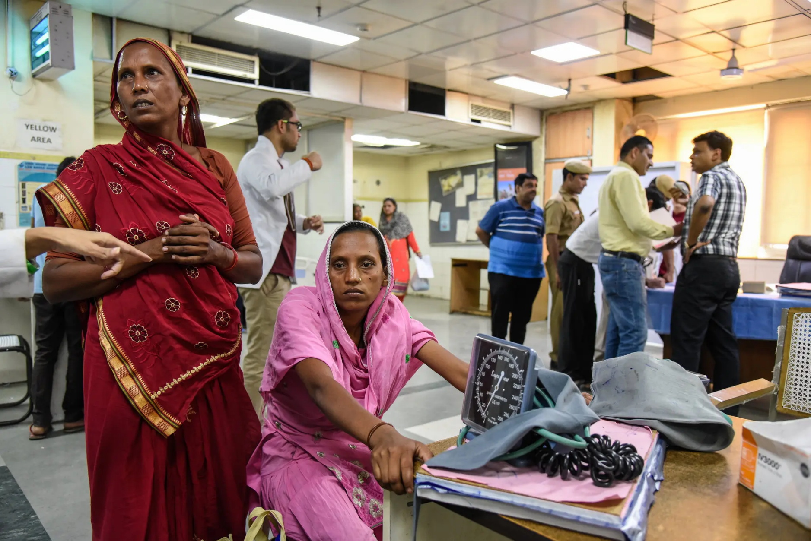
Reading/Questions 3
Notes:
https://www.nytimes.com/2018/07/17/climate/india-heat-wave-summer.html

Slide 13
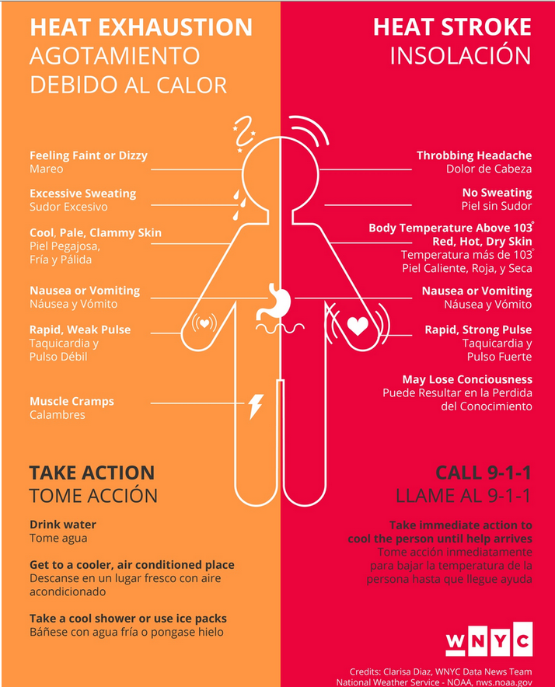
Notes:
Fainting due to dilation of blood vessels may also occur during heat exhaustion, (also called heat stress or heat cramps). Urine may be dark in color as an indication of dehydration. Heat stroke (hyperthermia): occurs when the body can no longer regulate its temperature, and its temperature rises rapidly—up to 106°F or higher. Heat stroke usually occurs as a progression from heat exhaustion It can result in death without immediate medical attention, as well as brain damage and organ failure. Dehydration will lead to low blood pressure and decreased kidney function. A severe decrease in kidney function can lead to a buildup of toxins and impurities in the blood. This can cause people to feel tired, weak and can make it hard to concentrate. When hot, your heart has to beat faster and work harder to pump blood to the surface of your skin to assist with sweating to cool your body. This can put a strain on the heart.
If you have COPD, you are using additional energy to breathe. When you are in extreme heat your body uses more energy while working hard to keep your normal body temperature. If it gets too hot, this can affect a person's breathing, and make the symptoms of COPD worsen. Certain diabetes complications, such as damage to blood vessels and nerves, can affect your sweat glands so your body can't cool as effectively. That can lead to heat exhaustion and heat stroke more quickly. People with diabetes get dehydrated more quickly.

Slide 14
Two types of heat stroke
Classic heatstroke
Caused by passive heating from the external environment, such as during heat waves. It typically affects children and older adults who are less able to regulate their body temperature.
In young children, sweat glands may not be fully developed And with age, we begin to lose our ability to sense thirst and thermoregulate
Exertional heatstroke
Occurs when we physically exert ourselves with strenuous activity in hot weather. Our heats up our body from the inside in addition to the ambient heat of the environment.
Exertional heatstroke can affect anyone doing physical activity,

Slide 15
How heatstroke can damage the brain
Heat stroke can have impacts to the brain analogous to a concussion.
10-30% of patients who survive heatstroke sustain long-term cognitive or neurological damage
Fatality rates for former heatstroke patients climb in the years immediately following heat stroke, suggesting that surviving a heat stroke leads to increased risk of cardiovascular disease
Notes:
https://www.washingtonpost.com/wellness/2023/07/06/heatstroke-exercise-brain-hot-weather/ https://www.wsj.com/articles/to-treat-extreme-heat-ice-packed-body-bags-and-wet-gowns-7c35c5c9

Slide 16
Heat thresholds for humans have been poorly defined
At present, thresholds based on mathematical prediction model from a study in 2010
Models predicted a web bulb temp of 35 °C as the limit of human survival.
The model treated the human body as unclothed object that doesn’t sweat or move, making the result less applicable to the real world.
Despite this, countless public-health bodies adopted it — even the Intergovernmental Panel on Climate Change — reducing the motivation to obtain a more relevant number,
New estimate is around 31 °C based on calculations made by actually measuring people in controlled setting.

Slide 17
Who is more vulnerable to heat extremes?
Those with existing health conditions
Urban residents
Residents of developing countries
Those who work outdoors, particularly those in jobs with little power to change the conditions of their labor
The poor, the homeless and migrant populations
The very old, particularly those who live alone (‘fatal aloneness’)
The very young who are unable to modify their thermal environment
People who have to live in homes that worsen heat exposures
The incarcerated
Large crowds that can overwhelm infrastructure to keep people cool
Notes:
https://www.washingtonpost.com/outlook/2019/07/26/europes-killer-heat-waves-are-new-norm-death-rates-shouldnt-be/
Heat illness is a disease of vulnerability. Those who can protect themselves, do. And those who can’t, don’t. Like so much else about climate change, the toll of extreme heat is fundamentally unequal. It’s not just that wealthy people can more readily afford air conditioning, or that they are more likely to live in cooler neighborhoods with lush vegetation, less vehicle traffic and fewer factories. It’s that low-income countries are expected to experience far more dangerous conditions as the planet continues to warm.

Slide 18
Notes:
https://www.nytimes.com/2023/07/20/world/europe/heat-elderly.html Donata Grillo, 75, cooled herself with a damp sponge on Wednesday in Rome, where she lives alone without air conditioning or a functioning refrigerator The elderly are susceptible to ‘fatal aloneness’ during heatwaves if no one is around to check them or to assist them in moving to a cooler place. It was all she had to keep cool this week as temperatures topped nearly 106 degrees Fahrenheit, or 41 Celsius, in her native Rome. She does not own any air conditioning or fans, or even a functioning refrigerator, in her two-bedroom apartment in a public housing complex on the city’s periphery, next to a hospital and highway. About 24 percent of Italians are over 65, making it the oldest country in Europe, and over 4 million of them live alone. After the heat wave of 2003, in which 70,000 people across Europe died of heat-related causes, Italy became one of the first countries in Europe to put in place a national plan to mitigate the impact of extreme heat, based on the guidelines from the World Health Organization.

Slide 19
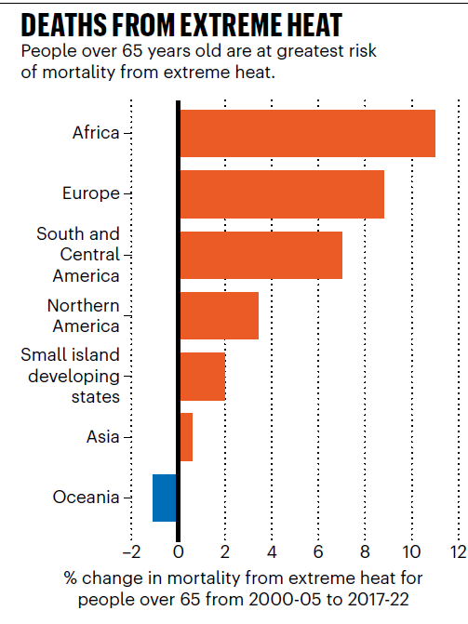
Elderly
Among those most vulnerable to extreme heat are people over the age of 65.
Older people struggle to cool themselves down because their sweat glands are less sensitive to chemical signals from the brain.
They are also more likely to have cardiovascular diseases.
Notes:
From Lancet study

Slide 20
Fatal aloneness
Notes:
https://www.nytimes.com/2023/07/20/world/europe/heat-elderly.html For older people, heat is the new Covid.

Slide 21
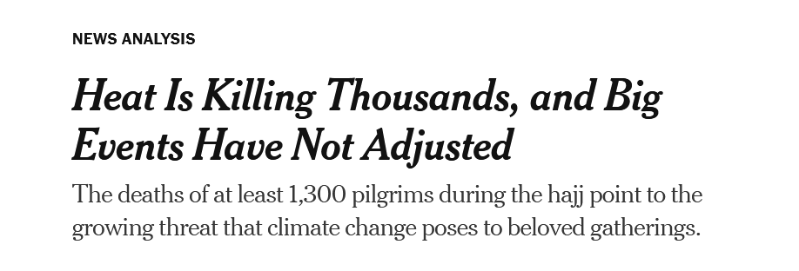
Reading/Questions 3
Notes:
https://www.nytimes.com/2024/06/25/world/australia/record-heat-deaths-events.html

Slide 22
Notes:
https://www.nytimes.com/2024/06/27/world/middleeast/gulf-states-heat-climate-change.html
At this year’s hajj, the Islamic pilgrimage in Saudi Arabia, at least 1300 people died as temperatures surpassed 100 degrees Fahrenheit. And in many ways, that heavy toll was just the latest sign that crowd control and heat waves fueled by climate change are on a dangerous collision course.

Slide 23
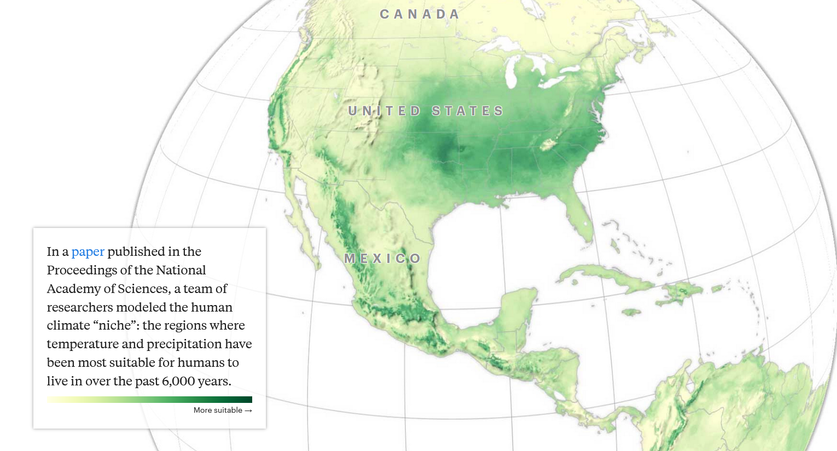
Climigration
Notes:
https://projects.propublica.org/climate-migration/

Slide 24
Notes:
https://projects.propublica.org/climate-migration/

Slide 25
Notes:
https://projects.propublica.org/climate-migration/

Slide 26
Notes:
https://projects.propublica.org/climate-migration/

Slide 27
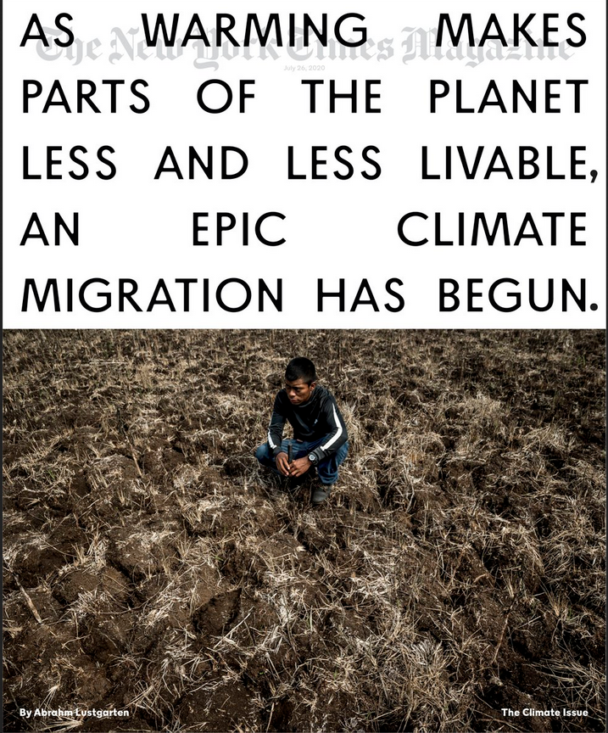
Every day 37,000 people leave their homes and join the 258 million migrants who live in a different country from where they were born.
For many, climate migration is well underway
This will have impacts on the countries from which they originate as well as their destinations
Urgent need exists to create migration policies that balance the human rights of migrants with the concerns of host populations.

Slide 28
Heat adaptation plans (HAPs)
Strategic frameworks designed to help communities, organizations, and individuals cope with and reduce the negative impacts of extreme heat events
Notes:
https://www.nytimes.com/2024/05/21/climate/india-extreme-heat.html https://ieefa.org/articles/surge-indias-renewables-tendering-set-keep-coals-share-below-50-total-installed-capacity https://www.fastcompany.com/90793483/meet-the-7-chief-heat-officers-who-are-making-their-cities-more-resilient

Slide 29
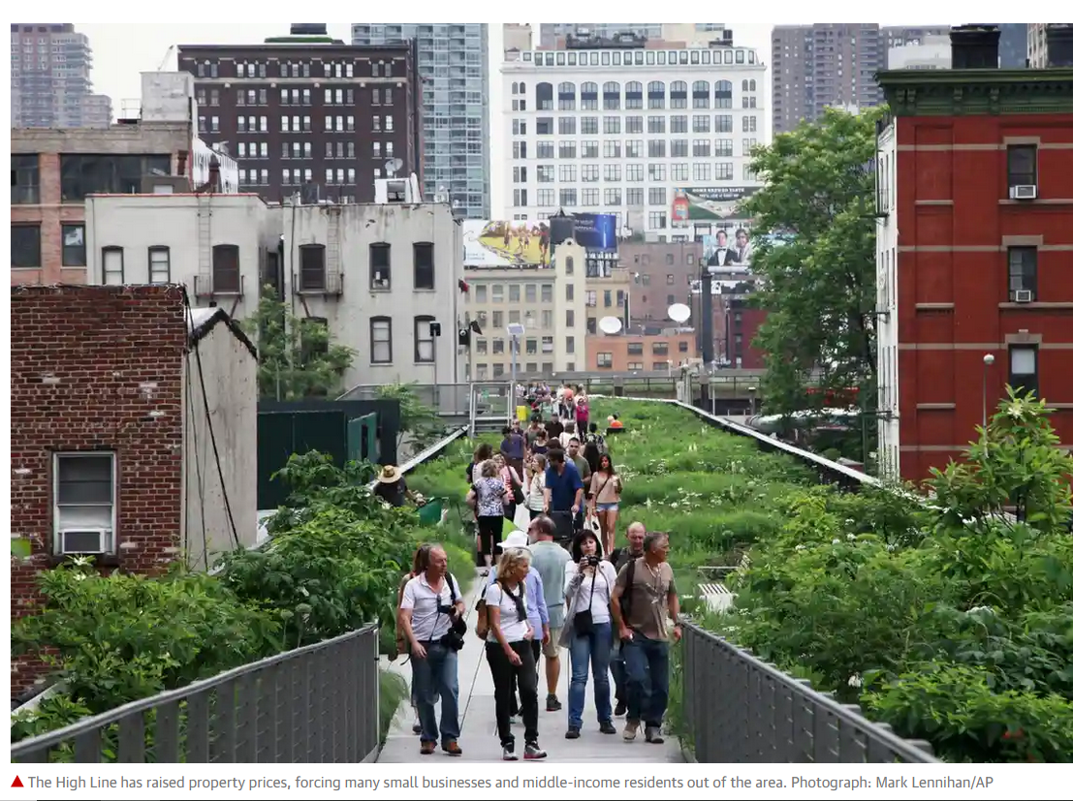
Rain gardens, green roofs, tree plantings, conversion of roads to walkways and bicycle paths are being used to reduce local warming
However, these projects run the risk of displacing the poor – in this case they can become a form of green gentrification
New amenities may alter pre-existing neighborhoods and displace residents through rising housing costs and tax rates.
Notes:
https://www.theguardian.com/cities/2015/may/06/dangers-ecogentrification-best-way-make-city-greener Other expressions of this include the planting of forests for carbon credits where the land could be used to support food crops for local populations. Caution: do not take a binary good versus bad view of green gentrification and the aforementioned carbon forest injustices. In some cases, these actions can help address the wicked commons problem of climate change. They are not inherently wrong or bad. Instead, it is their contexts and the human element in these projects that determines their degree of fairness. Tradeoffs and compromise have to be something we all share in as it is impossible to revert the current and future human moment back to some earlier balanced and pristine state.

Slide 30
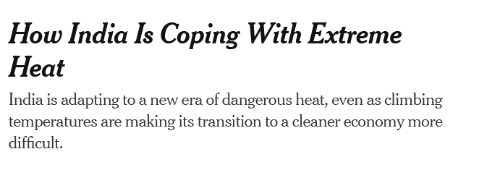
Readings/Questions 3
Notes:
Construction in Ahmedabad, India, where temperatures have exceeded 100 degrees Fahrenheit, or about 37 Celsius, for much of the month of May 2024

Slide 31
India’s heat action plans (HAP)
India was the first country in South Asia to create a heat action plan in the city of Ahmedabad in the state of Gujarat
The plan involved establishing a system to warn residents when dangerous temperatures are expected, educating health care workers to recognize heat-related illnesses and opening cooling centers.
Research estimates these programs save more than 1,000 lives a year.
Since 2010, India’s national government has worked with over 20 states and more than 130 cities to establish their own heat action plans.
The results of state and city plans are mixed. Many plans fail to reach vulnerable populations or lack the resources to implement solutions.
Notes:
https://cprindia.org/briefsreports/how-is-india-adapting-to-heatwaves-an-assessment-of-heat-action-plans-with-insights-for-transformative-climate-action/ India is also the fastest growing economy in the world and its dependence on coal to produce electricity is a major source of concern in the struggle to curb climate change. However, renewable energy capacity has been growing fast In the first quarter of 2024, 72% of the new power capacity added in India came from renewable energy Coal accounted for less than half of India’s total capacity for the first time since the 1960s

Slide 33
Heat waves in the last few years have not produced as much mortality as anticipated in India and Pakistan
Possible explanations:
Local adaptation and responses through HAPs have been successful
Problems with data, including intentional underreporting
Heat thresholds are poorly defined
Notes:
https://www.nytimes.com/2022/07/14/opinion/environment/heat-waves-india-pakistan-climate-change.html

