Slide 1
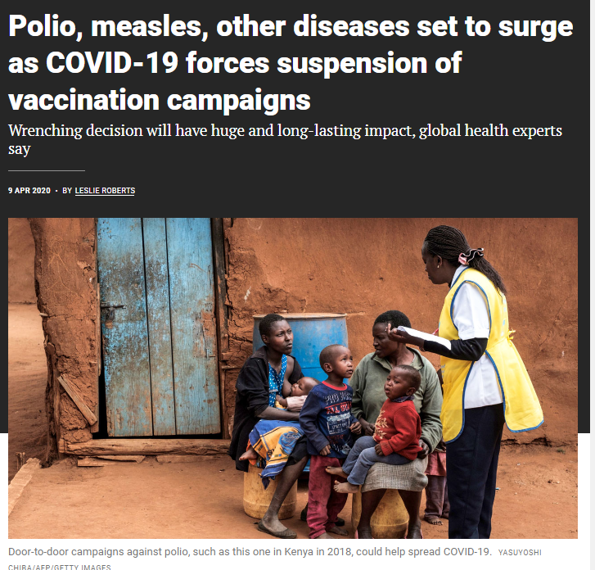
Covid-19 and polio
At the beginning of the COVID-19 pandemic, many countries in the world experienced declines in immunization rates for children
The Global Polio Eradication Initiative paused its immunization and monitoring activities for a few months
cVDPV2 found to be circulating in a couple of developed countries
Notes:
https://www.science.org/content/article/polio-measles-other-diseases-set-surge-covid-19-forces-suspension-vaccination-campaigns However, the infrastructure and routines established by immunization programs were also used to kickstart vaccination programs for Covid.

Slide 2
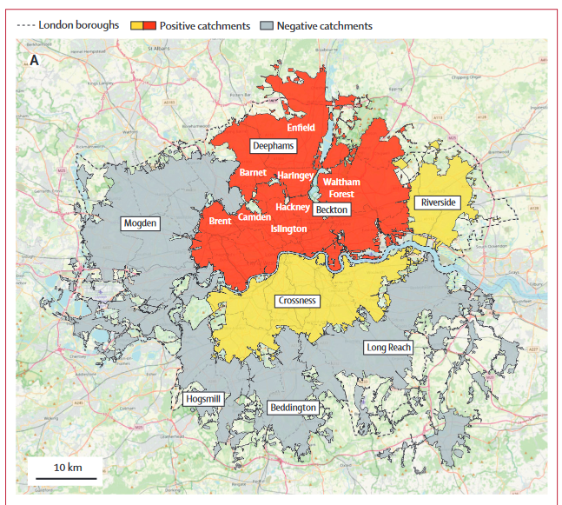
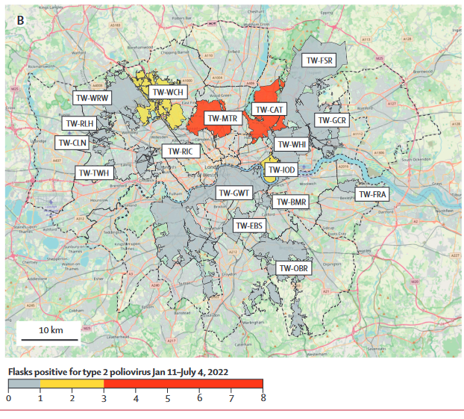
Notes:
https://www.thelancet.com/action/showPdf?pii=S0140-6736%2822%2901804-9 Klapsa, D., Wilton, T., Zealand, A., Bujaki, E., Saxentoff, E., Troman, C., ... & Martin, J. (2022). Sustained detection of type 2 poliovirus in London sewage between February and July, 2022, by enhanced environmental surveillance. The Lancet, 400(10362), 1531-1538.

Slide 3
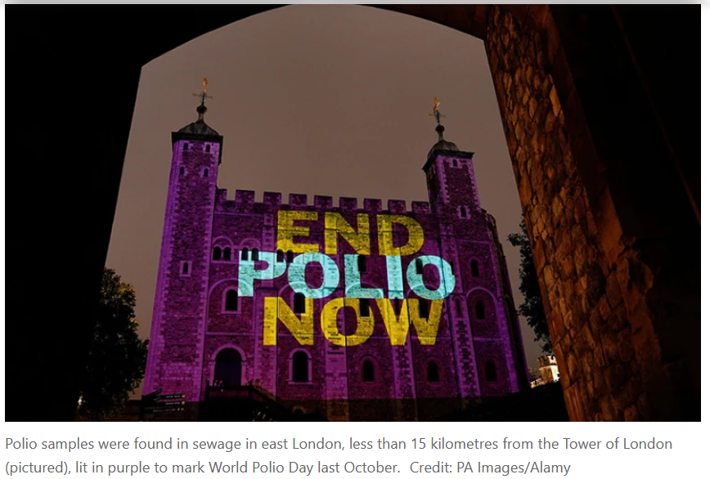
cVDPV2 detected in London wastewater (2022)
Source was people vaccinated with OPV in other countries who returned to London where they shed the attenuated virus
Detected viruses were related and contained mutations suggesting the virus was spreading person to person
Attributed to drop in vaccination in last few decades and made worse by COVID-19
In parts of west London, only 35% of teenagers had received their IPV polio booster in 2020–21.
Notes:
No people with symptoms of polio — including paralysis — have been reported so far, but health authorities are asking doctors to look out for, and report, any symptoms of the disease.
The last case of wild polio contracted in the United Kingdom was in 1984, and the country was declared polio-free in 2003
86% of people in London vaccinated against polio, rates of vaccination are generally high but fell during the Covid-19 pandemic.
https://doi.org/10.1038/d41586-022-01802-z

Slide 4
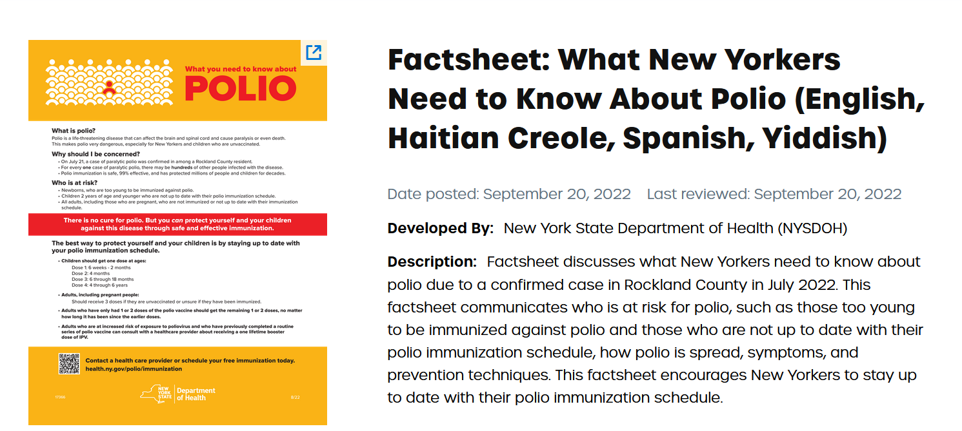
Notes:
https://vaccineresourcehub.org/resource/factsheet-what-new-yorkers-need-know-about-polio-english-haitian-creole-spanish-yiddish

Slide 5
cVDPV2 polio case discovered in New York State (Rockland County, 2022)
Detected in wastewater for multicounty region of New York City, July 2022
Virus detected in a person was related to virus identified in London sewage. Patient never traveled outside of the U.S.
Someone received the OPV outside of the US and brought it here
60% of Rockland County’s 2-year-olds have received all three doses of the polio vaccine (80% for the rest of the state).
cVDPV appeared again in March 2023 in wastewater but has not been detected since
Notes:
The last case of polio in the United States was in 2013, in someone who brought the disease in from abroad. There has not been a case originating in the United States since 1979
OPV has not been administered in the United States since 2000.
Three scenarios US patient acquired cVDPV2 from the environment
US patient acquired CVDPV2 from a person who acquired it from the environment
cVDPV2 transmitted person-to-person from visitor from London
https://www.nytimes.com/2022/07/21/nyregion/polio-case-new-york.html?referringSource=articleShare

Slide 6
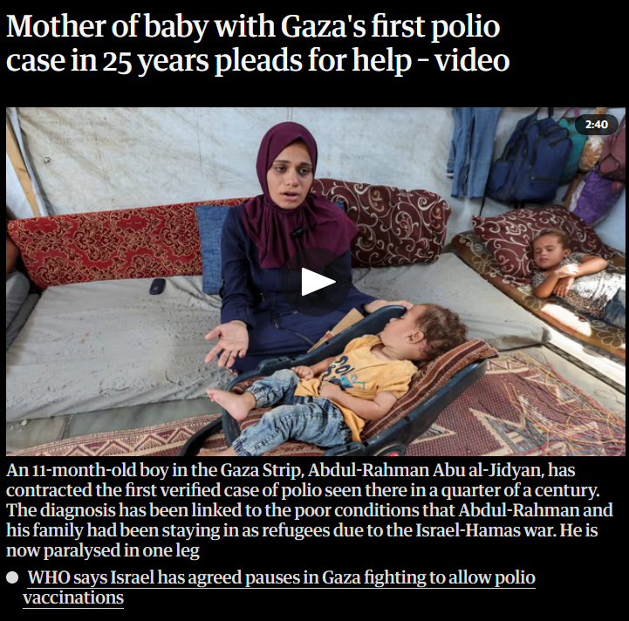
Paralytic polio in Gaza (cVDPV2)
First confirmed case polio in Gaza in 25 years
One year old living with his family in a tent in was unable to get routine vaccinations because family was constantly forced to move
Gazan health officials have reported multiple children with symptoms consistent with polio
Israel and Hamas have agreed to brief pauses in fighting so that humanitarian workers can begin an inoculation campaign
Notes:
https://www.nytimes.com/2024/09/01/world/middleeast/gaza-polio-crisis.html About two months ago, he stopped crawling and was feverish. His family took him to a hospital, which sent a sample to a lab in Jordan. A test confirmed health officials’ fears: He had polio.

Slide 7
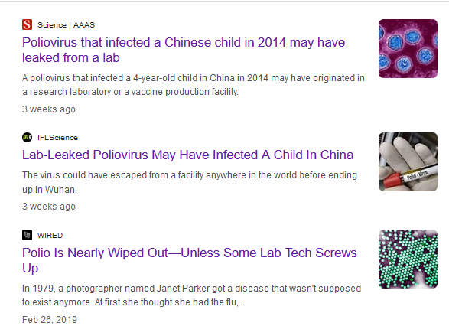
Leaks of polio virus from labs and vaccine production facilities
Vaccine manufacturers use attenuated strains of the polio virus to make their vaccines
Researchers and universities have samples of the virus
Since 2000, there have been 21 reported incidents of poliovirus release from labs and vaccine-production facilities in 8 countries, with 16 cases of polio as a result,
WHO has documented 74 facilities that hold polio, in 22 countries.
Notes:
https://www.nature.com/articles/d41586-023-03602-5 Kupferschmidt, K. (2024). Old poliovirus sample hints at recent lab leak. Science (New York, NY), 385(6714), 1152.

Slide 8
Immunocompromised people may shed virus
Unforeseen 35 years ago when eradication efforts began.
In most people who receive OPV, the immune system generates antibodies that protect them against the virus.
But in a small number of people born with specific immune deficiency disorders, the immune system allows the attenuated virus from the vaccine to live on, evolving as time goes by and emerging in their stools.
This may have been what contributed to a polio outbreak in the Philippines in 2019–21.
Notes:
https://www.nature.com/articles/d41586-023-03602-5 One person with the condition lives in the United Kingdom and was vaccinated with OPV as a child. For more than 20 years, he asymptomatically carried — and shed —the attenuated virus, which evolved to its disease-causing form. His gut was “essentially a culture vessel” That’s why scientists were surprised to learn that the person’s infection had gone. It disappeared after he received the antiviral drug remdesivir for severe COVID-19 in August 2021. This could be coincidence, but it bolsters the case that antivirals could be used to treat polio infection (two such drugs are being explored as polio treatments).

Slide 9
Eradication? Or just control?
90% of children have to be immunized to eradicate polio
Polio can be certified as eradicated when no case observed for three years, and when there is no sign of it in wastewater.
A year after that, OPV must be withdrawn to prevent cVDPV. Without high rates of immunity, cVDPV will emerge.
Continued surveillance needed as added protection
Can the challenges to eradicate polio be met? At what cost? Is ongoing control a viable strategy?

