Slide 1
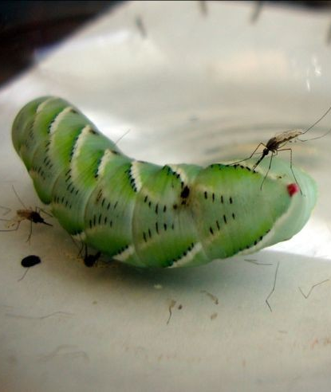
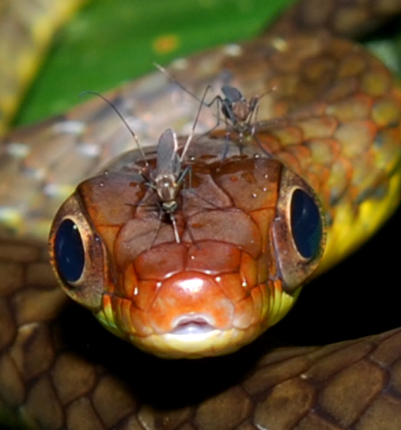
Notes:
Mosquitoes feed on a wide variety of animals, not just mammals, even some arthropods (caterpillar, left) and reptiles (snake, right). These in the photo are all different species from those that bite us. This reflects the diverse evolutionary histories and ecological roles of mosquitoes.
These images are meant to convey that they are highly successful organisms from an evolutionary and ecological point of view.

Slide 2
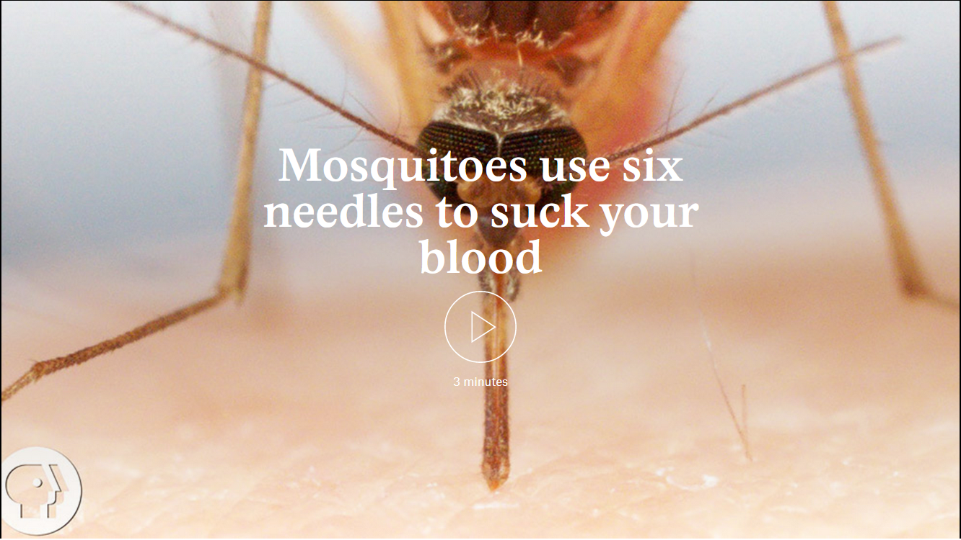
Notes:
https://aeon.co/videos/what-makes-mosquitoes-so-good-at-getting-under-our-skin

Slide 3
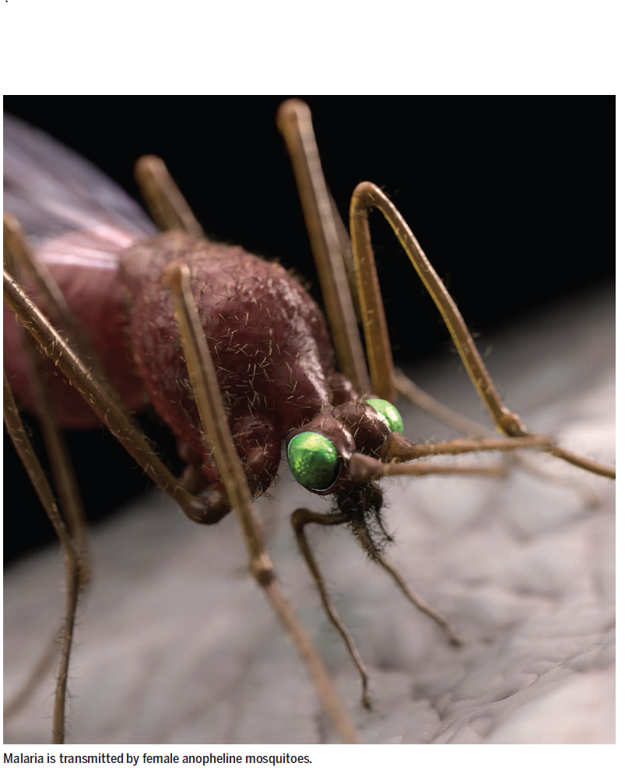
The global mosquito
Of the millions of insect species, only a tiny fraction of them, less than 1%, are pests.
A vast majority are beneficial to humans
3000 species of mosquito – most feed on nectar of plants
100 mosquito species transmit diseases to humans and sicken millions annually
Half of the global population is at risk of mosquito-born disease
Notes:
http://www.nytimes.com/2014/08/24/opinion/sunday/bug-love.html

Slide 4
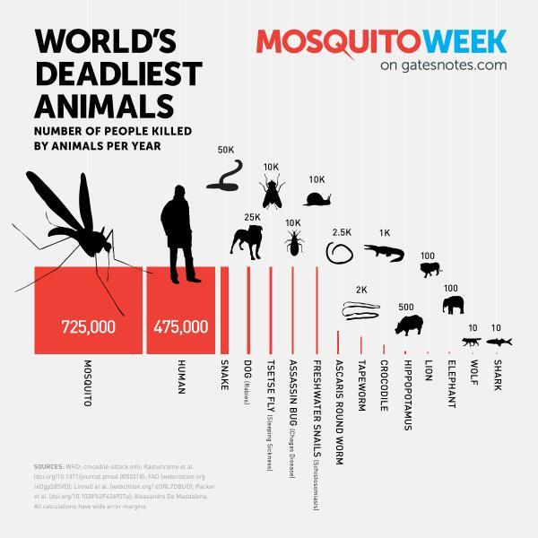
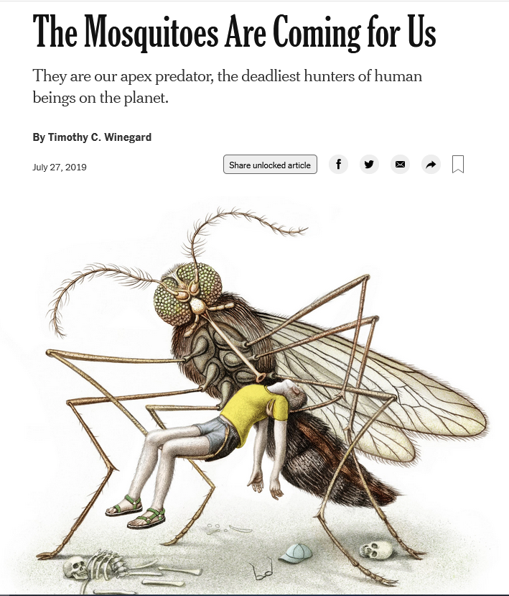
Notes:
https://twitter.com/gatesfoundation/status/461853846458089473
https://www.nytimes.com/2019/07/27/opinion/sunday/mosquitoes-malaria-zika-history.html

Slide 5
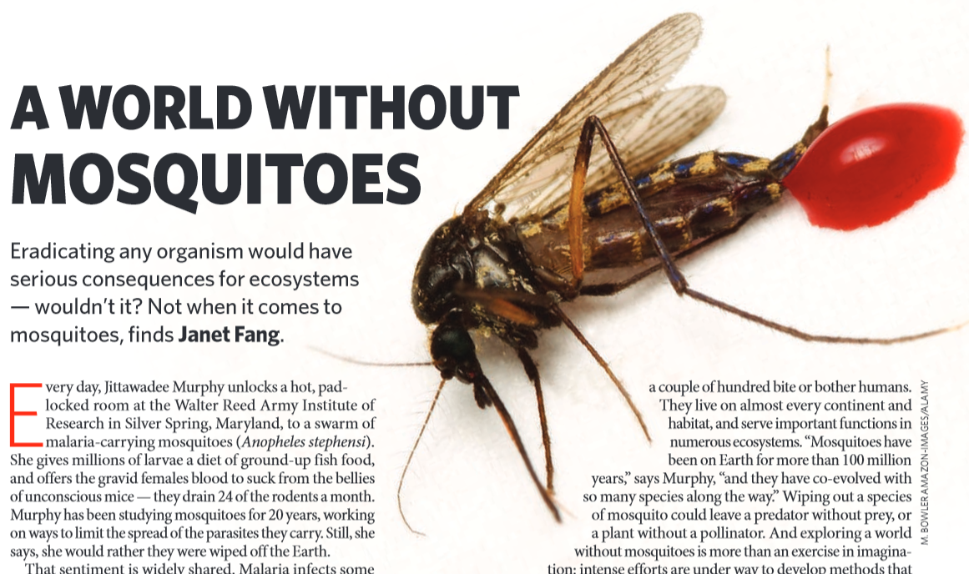
Arboviruses transmitted by mosquitoes
Dengue virus
Yellow fever virus
West Nile virus
La Crosse virus
St. Louis virus
Chikungunya virus
Zika virus
Oropouche virus – transmitted mainly by midges (gnats)
Notes:
Fang, J. (2010). Ecology: a world without mosquitoes. Nature News, 466(7305), 432-434.
Arboviruses are transmitted by insects

Slide 6
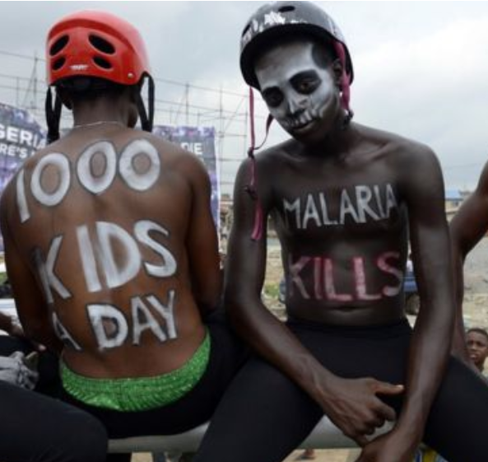
Malaria
Malaria
Caused by parasitic protist Plasmodium transmitted by the Anopheles mosquito
Globally, 249 million malaria cases in 2022, 608,000 malaria deaths
Nearly half of the world's population at risk for infection.
In many of the countries affected by malaria, it is the leading cause of death
Notes:
Malaria is a mosquito-borne disease caused by parasites of the genus Plasmodium (P. falciparum, P. vivax, P. ovale, P. malariae, and P. knowlesi) and acquired through the bites of infected Anopheles mosquitos. With an incubation period of 10 to 15 days after the infective mosquito bite, the disease manifests with fever, chills, headaches, vomiting and tiredness. Although the disease is preventable and treatable, untreated malaria is typically associated with anemia and splenomegaly (enlarged spleen). In particular, P. falciparum cases commonly progress to life-threatening conditions including “cerebral malaria”, organ dysfunction and death.
https://www.who.int/teams/global-malaria-programme/reports/world-malaria-report-2021

Slide 7
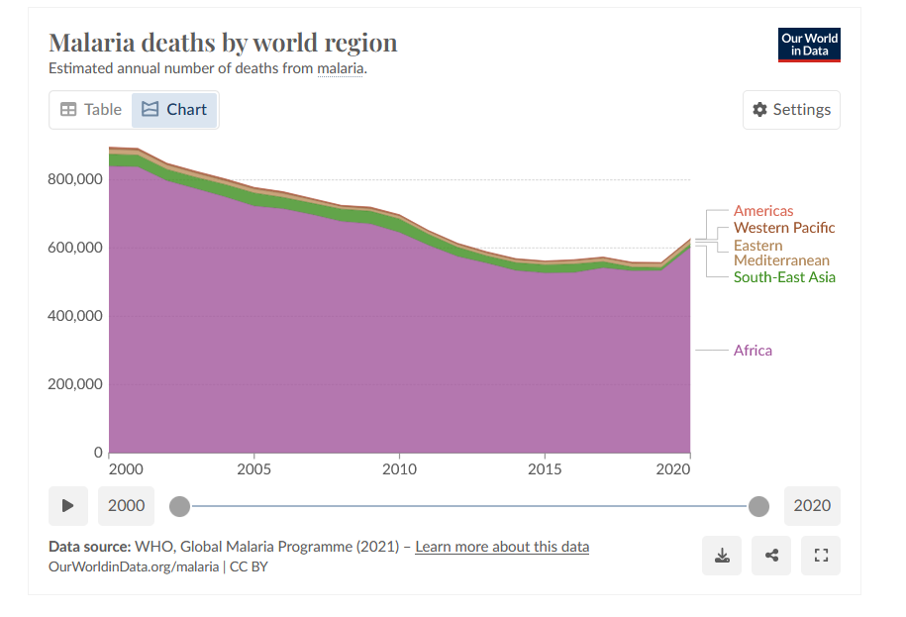
Most deaths are among young children in sub-Saharan Africa.
Expansion of interventions and development of new malaria prevention technologies have saved millions of lives globally and cut malaria mortality by 36% from 2010 to 2020
However, the last few years have seen a plateau in progress
Notes:
https://www.who.int/teams/global-malaria-programme/reports/world-malaria-report-2021

Slide 8
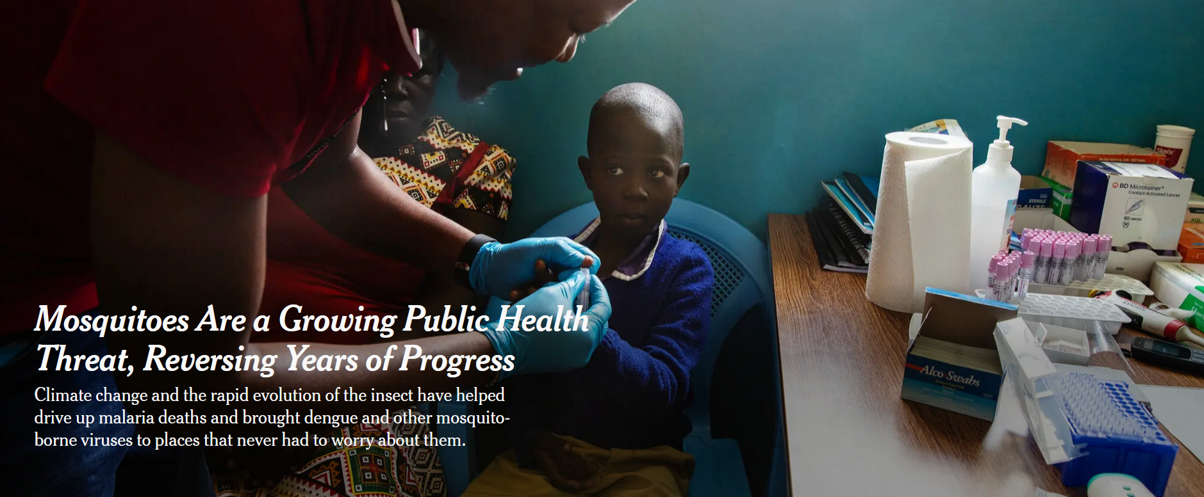
Readings/Questions 13
Notes:
https://www.nytimes.com/2023/09/29/health/mosquitoes-malaria-disease-climate-change.html

Slide 9
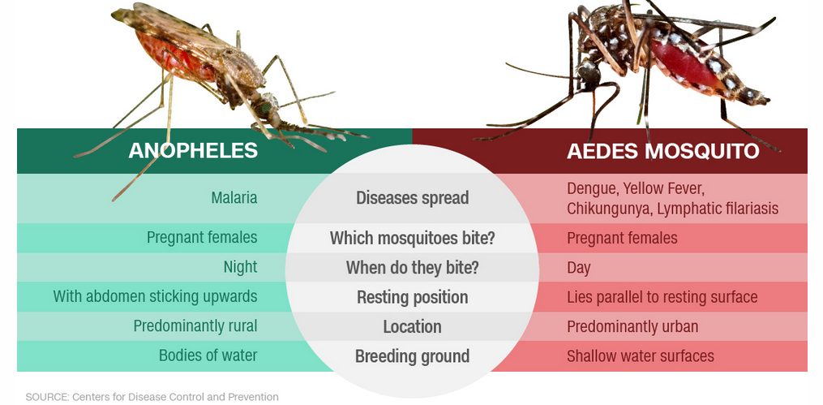

Slide 10
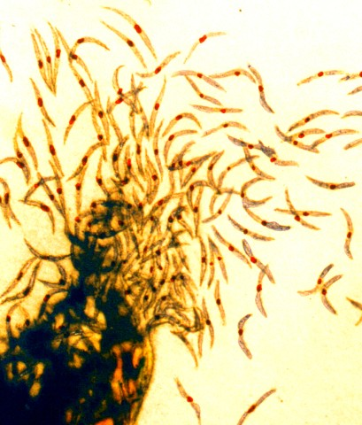
The genus Plasmodium
Includes more than 200 different species that parasitize various hosts such as reptiles, birds, amphibians, and mammals
53 species parasitize mammals, of which 30 species parasitize primates.
To date, six Plasmodium species have been identified as human pathogens
A human can be infected with one or more different species of Plasmodium at the same time, or in sequence.
Notes:
https://doi.org/10.1002/bies.201900138
Gitta, B., & Kilian, N. (2020). Diagnosis of Malaria Parasites Plasmodium spp. in Endemic Areas: Current Strategies for an Ancient Disease. BioEssays, 42(1), 1900138.
Sporozoites, one of several different forms of the parasite, from a mosquito (right)

Slide 11
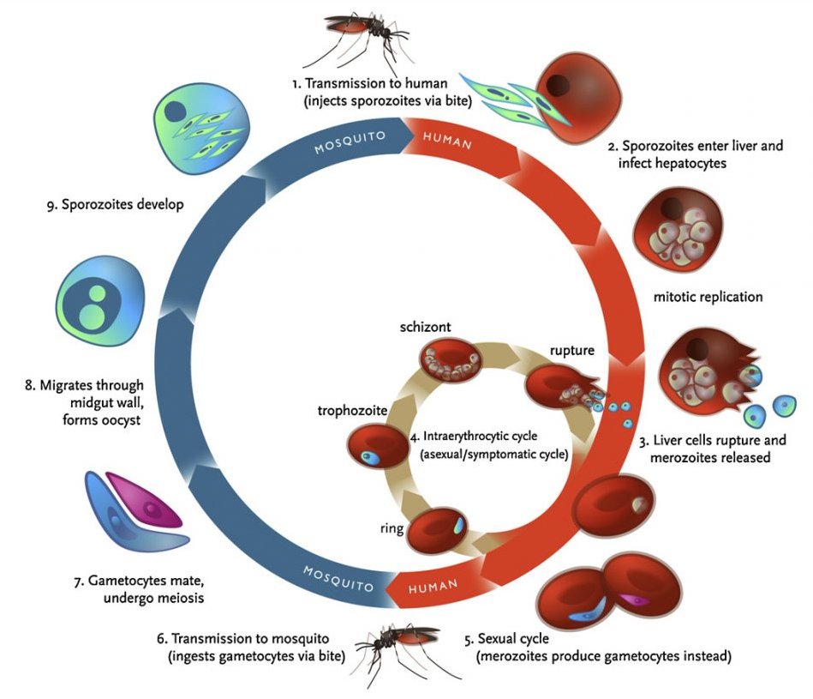
Complex life cycle of malaria makes it hard to eradicate
Two stages of the life cycle, one inside the mosquito and one inside the human
Some Plasmodium species can even regulate its abundance in the human body so that it remains low until the rainy season comes
Notes:
The malaria parasite’s complex life cycle and shifting surface proteins have challenged vaccine developers. But an alternative question is, why do some people live in conditions of poverty in which malaria is so rampant, while others do not and live in relative wealth and absence of malaria.

Slide 12
Malaria: the epidemic of the poor
Malaria is constrained by climate, but it also has political, social and economic factors that dictate its prevalence
The impact of malaria takes its toll on the poorest, those least able to afford preventative measures and medical treatment.
Malaria contributes to poverty through lost productivity or income associated with illness or death.
The countries affected by malaria are often unable to assume the economic burden it imposes, which may in some parts of the world be a legacy of colonialism
.

Slide 13

Mobility of people challenges malaria control
Endemic malaria: malaria is established and being transmitted person-to-person
Imported or non-local malaria: travelers bring it back but the parasite does not get transmitted by mosquito
Local malaria: malaria is transmitted via mosquito from a traveler to someone living in the country that did not travel
Notes:
https://www.nytimes.com/2017/04/24/health/fatal-malaria-united-states.html
How malaria deaths occur in the US, as based on the above NY Times article:
Although the study was based on hospital data rather than interviews with patients, the authors suspect that many of the victims grew up in malarial areas, developed immunity in childhood from repeated infections, and then did not realize that their childhood immunity had disappeared after years in the United States. “They just think they’re going home, so they don’t have to prepare for anything,” Dr. Khuu said. The fact that malaria immunity wanes after a few years away from repeated exposure is well-known to malaria experts, but not common knowledge, so immigrants may not get prescriptions for anti-malaria drugs before traveling or sleep under mosquito nets in a malarial area.

Slide 14
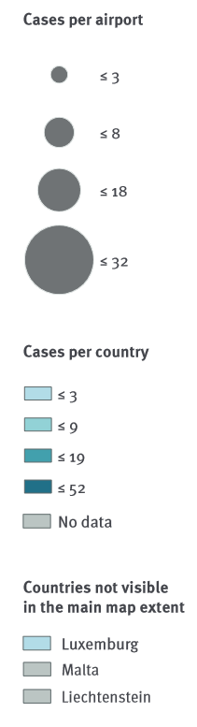
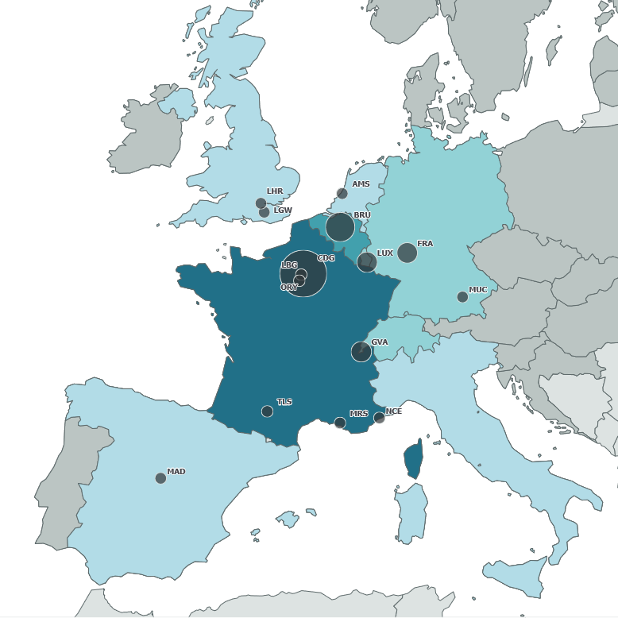
Airport and luggage malaria
Infrequent, but does occur
Mosquitoes transported in airplane cabins or in luggage
Location of local malaria cases tend to cluster around international airports in Europe
Notes:
Amsterdam airport Schiphol (AMS, n = 3), Brussels airport (BRU, n = 18), Charles de Gaulle airport (CDG, n = 32), Frankfurt airport (FRA, n = 8), Geneva airport (GVA, n = 5), Paris–Le Bourget airport (LBG, n = 3), London Gatwick airport (LGW, n = 2), London Heathrow airport (LHR, n= 2), Luxembourg airport (LUX, n = 5), Madrid–Barajas airport (MAD, n = 1), Marseille Provence airport (MRS, n = 2), Munich airport (MUC, n = 1), Nice Côte d’Azur airport (NCE, n = 1), Paris-Orly airport (ORY, n = 3), Toulouse Blagnac airport (TLS, n = 2).
Hallmaier-Wacker, Luisa K., Merel D. van Eick, Olivier Briët, Hugues Delamare, Gerhard Falkenhorst, Sandrine Houzé, Harold Noël, Javiera Rebolledo, Wim Van Bortel, and Céline M. Gossner. "Airport and luggage (Odyssean) malaria in Europe: a systematic review." Eurosurveillance 29, no. 41 (2024): 2400237.

Slide 15
Sri Lanka eliminated endemic malaria in 2012 and certified as malaria free in 2016
Imported malaria cases are regularly reported, but no local transmission until 2018
In 2018, laborer from India traveled to Sri Lanka to work at a construction site. A month after arrival he became ill with malaria. The stage of his malarial infection indicated he was already infected when he arrived in Sri Lanka (non-local malaria).
A Sri Lankan salesman visited the same construction site few weeks after the laborer. Twelve days after his return to the capital city Colombo, he developed malaria, which was initially misdiagnosed.
100% genetic identity in the parasite in both patients, strongly suggesting that both patients were infected with the same Plasmodium strain carried by a mosquito at the construction site
Transmission stopped with the salesman because of timely public health response. There is still no endemic malaria in Sri Lanka, but imported, non-local cases still occur.
Notes:
This slide illustrates the constant threat of malarial reintroduction either through endemic transmission or in this case through imported malaria.
Karunasena, V. M., Marasinghe, M., Koo, C., Amarasinghe, S., Senaratne, A. S., Hasantha, R., ... & Mendis, K. N. (2019). The first introduced malaria case reported from Sri Lanka after elimination: implications for preventing the re-introduction of malaria in recently eliminated countries. Malaria Journal, 18(1), 210.
https://doi.org/10.1186/s12936-019-2843-6

Slide 16
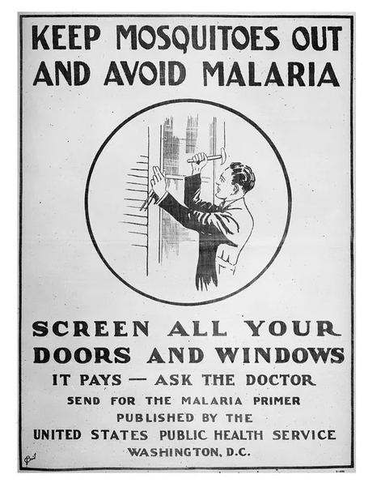
Imported malaria in the US
Malaria officially eradicated from US in 1951
Non-local malaria arrives in US regularly via travelers infected abroad in malaria-endemic area
A few cases since 1951 saw malaria become locally-acquired, when a mosquito in the US bit a traveler with malaria and then bit someone who had not left the US and gave them malaria

Slide 17
Locally acquired malaria in the USA in 2023
Florida: Seven cases of Plasmodium vivax malaria
Texas: One case of Plasmodium vivax malaria
Maryland: One case of Plasmodium falciparum
Arkansas: One case of Plasmodium vivax malaria
The last case of locally acquired malaria in the United States before the 2023 cases occurred in 2003
Despite these occurrences, the overall risk of locally acquired malaria in the United States remains very low.

Slide 18
Mobility of mosquitoes also challenges control and eradication
These dispersals can be natural or they can be through movement of mosquitoes through shipping and transportation
As many as 17 nonnative mosquito species are established in the state. 11 of 17 nonnative species first reported in the past two decades, and six of these 17 detected in only the past five years
Many have the potential to transmit arboviruses – but no introduced mosquito can transmit malaria, only three native Anopheles mosquitos can
Notes:
https://pulitzercenter.org/stories/new-mosquito-bringing-disease-north-America
https://blogs.ifas.ufl.edu/news/2023/03/22/uf-ifas-study-new-mosquito-species-reported-in-florida/

Slide 19
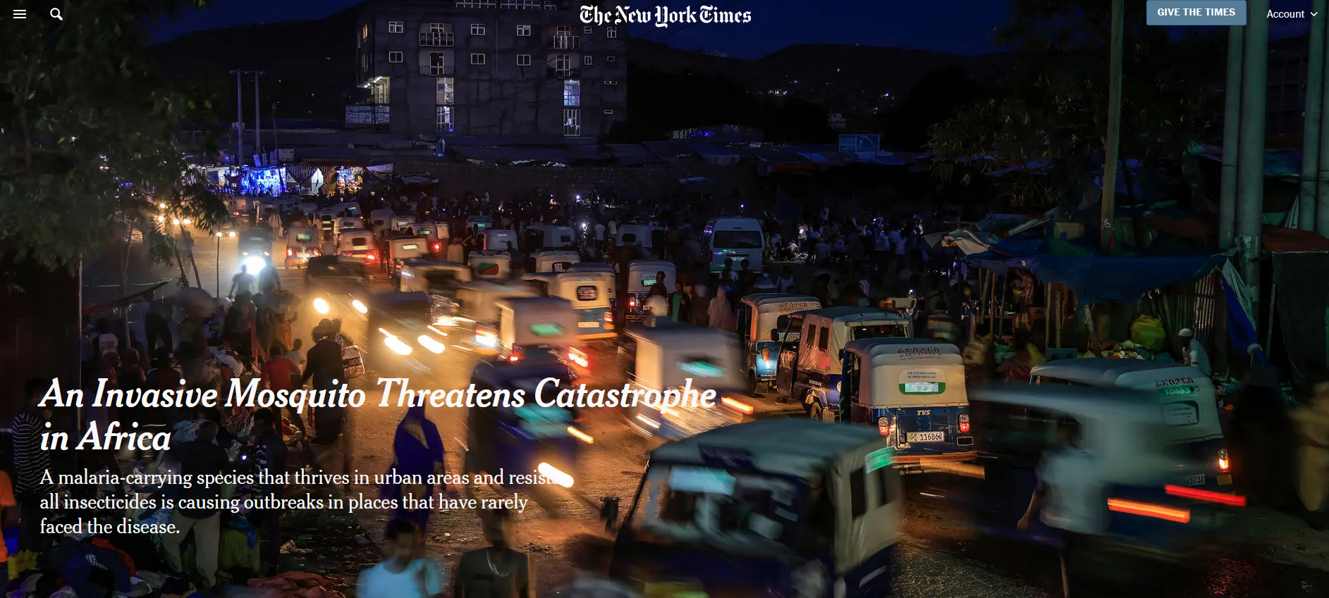
Readings/Questions 13
Notes:
https://www.nytimes.com/2023/09/29/health/mosquitoes-stephensi-malaria-africa.html
Anopheles stephensi

Slide 20
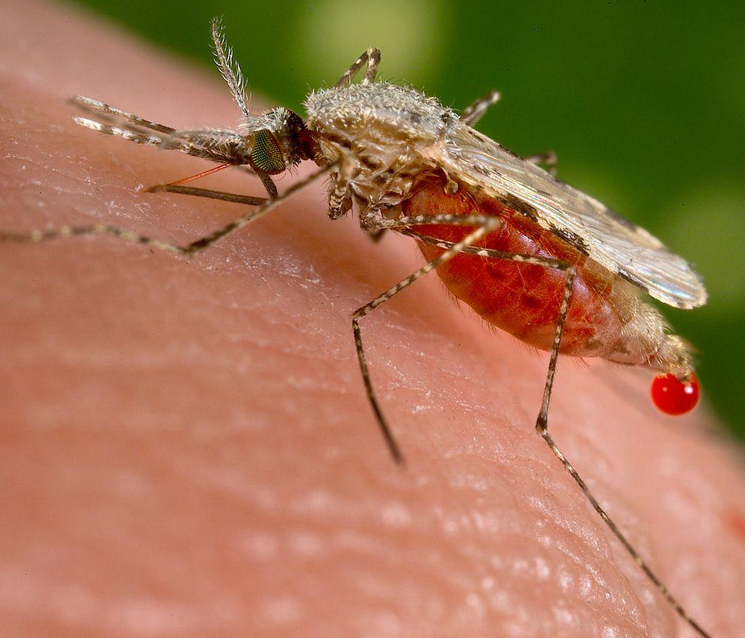
Anopheles stephensi prefers to feed on non-human animals (zoophilic) but also is flexible in its feeding behaviors and will bite humans if no other prey available
Also prefers to nest in poorly constructed buildings or animal sheds, structures characteristic of unplanned urban sites found around and within many rapidly expanding cities in Africa.
It has also evolved to bite during the day
Anopheles stephensi is likely to colonize rapidly urbanizing cities across Africa
126 million people living in African cities could be at risk of malaria if A. stephensi continues to spread across the continent.
Notes:
Range expansion of mosquitos and plastic behavior also make malarial control difficult, as exemplified by A. stephensi, shown in photo.
Surendran, S. N., Sivabalakrishnan, K., Sivasingham, A., Jayadas, T. T., Karvannan, K., Santhirasegaram, S., ... & Ramasamy, R. (2019). Anthropogenic factors driving recent range expansion of the malaria vector Anopheles stephensi. Frontiers in Public Health, 7, 53.
Sinka, M. E., Pironon, S., Massey, N. C., Longbottom, J., Hemingway, J., Moyes, C. L., & Willis, K. J. (2020). A new malaria vector in Africa: Predicting the expansion range of Anopheles stephensi and identifying the urban populations at risk. Proceedings of the National Academy of Sciences, 117(40), 24900-24908.

Slide 21
Malaria is surging in Ethiopia and reversing a decade of progress
Armed conflict:
  Humanitarian agencies have been unable to distribute bed nets, medications or diagnostic tests.
  People are displaced, homeless and exposed to mosquitoes
  Malaria travels out of these regions with refugees
Climate change: highland areas that were too cool for mosquito or the parasite they carry are becoming warmer and wetter
Increasing resistance to current drugs and insecticides
The invasive Asian mosquito species Anopheles stephensi is becoming established

Slide 22
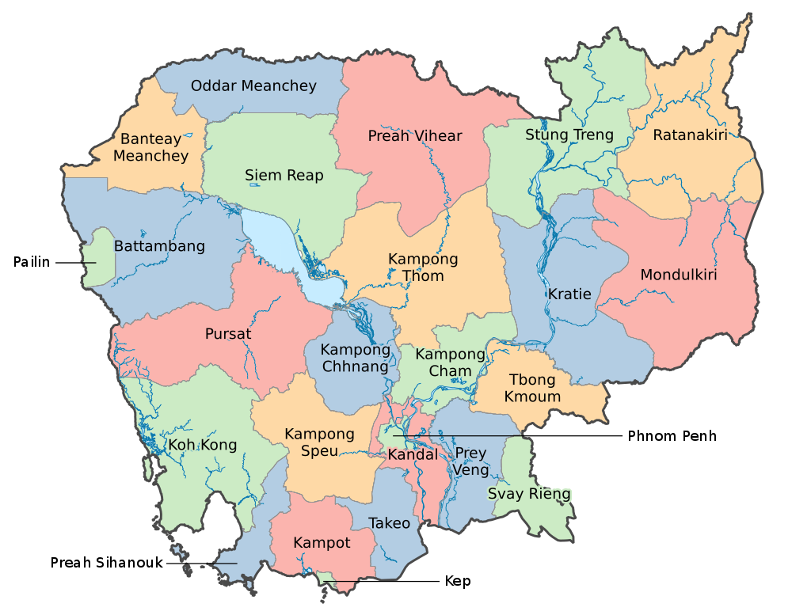
Mosquitoes are abundant and diverse
Adult mosquitoes were collected at 24 primary schools during the rainy and dry seasons of 2017 and 2018 in Kampong Cham and Tboung Khmum provinces in Cambodia

Slide 23
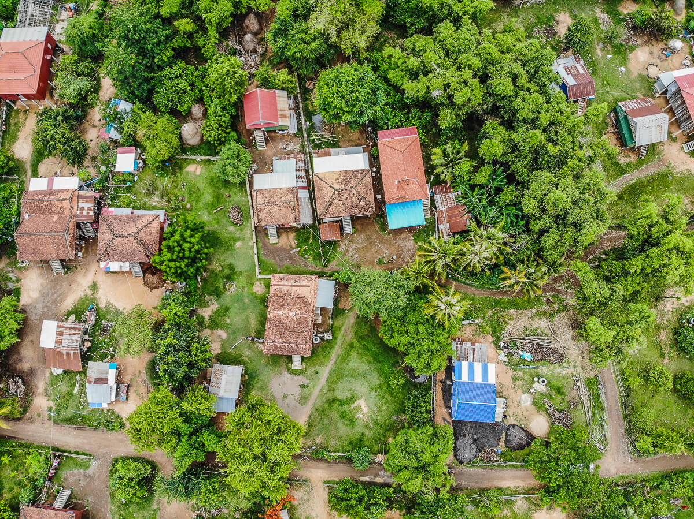
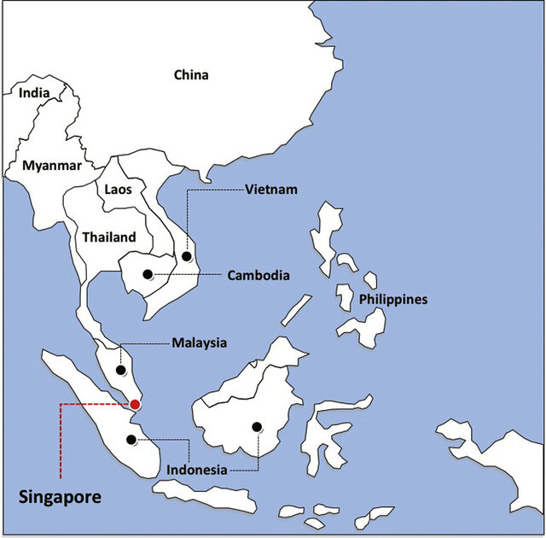

Slide 24
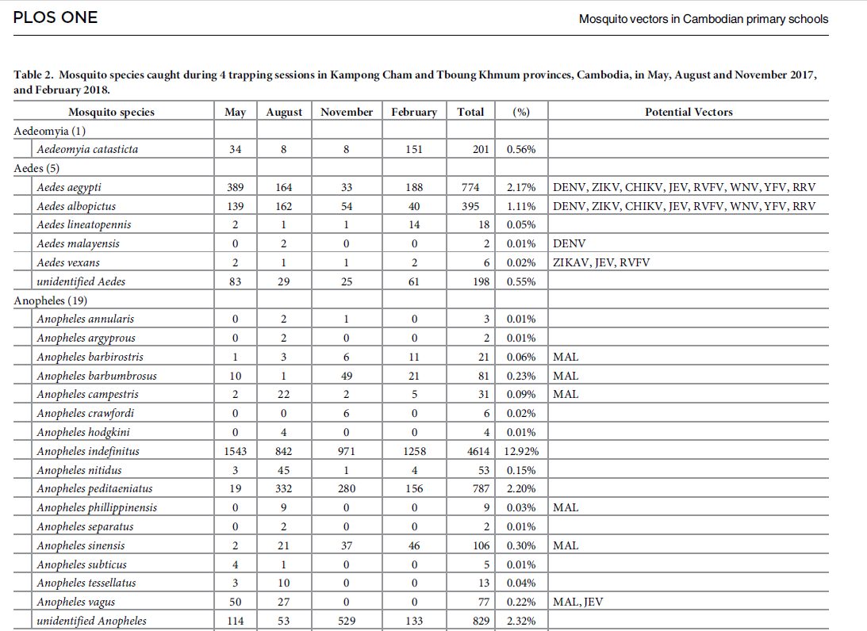
Notes:
Boyer, S., Marcombe, S., Yean, S., & Fontenille, D. (2020). High diversity of mosquito vectors in Cambodian primary schools and consequences for arbovirus transmission. PLoS One, 15(6), e0233669.

Slide 25
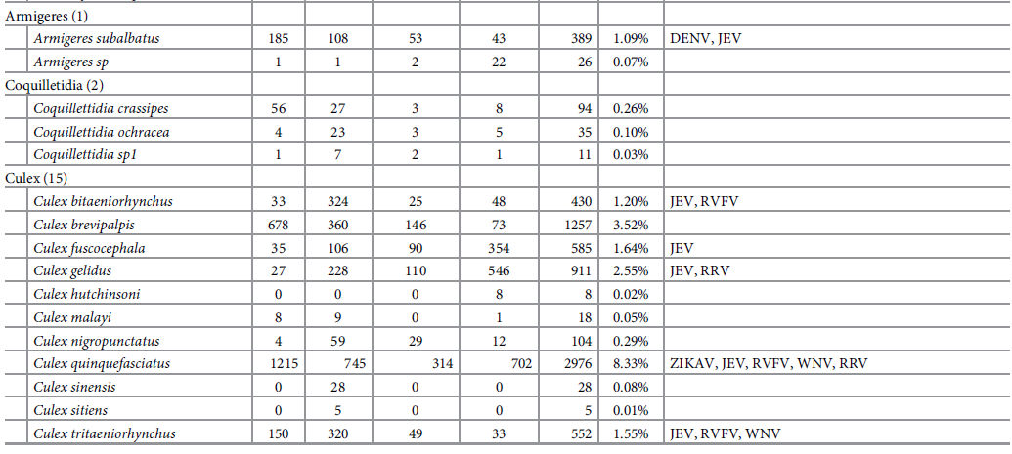
Notes:
Boyer, S., Marcombe, S., Yean, S., & Fontenille, D. (2020). High diversity of mosquito vectors in Cambodian primary schools and consequences for arbovirus transmission. PLoS One, 15(6), e0233669.

Slide 26
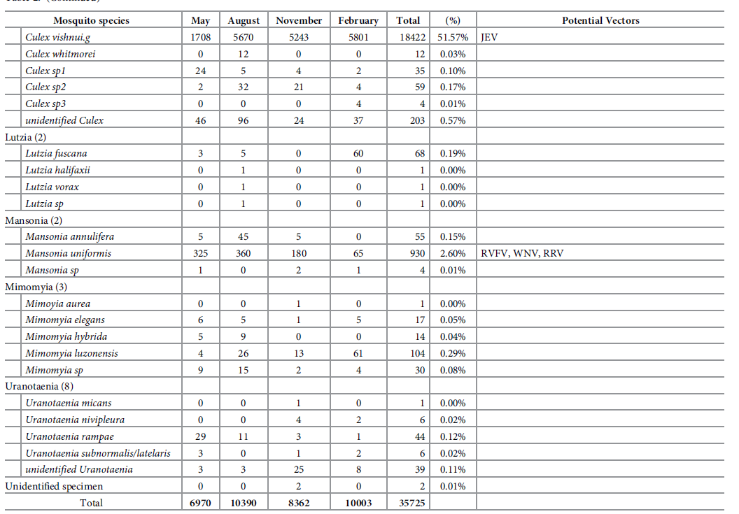
Notes:
Boyer, S., Marcombe, S., Yean, S., & Fontenille, D. (2020). High diversity of mosquito vectors in Cambodian primary schools and consequences for arbovirus transmission. PLoS One, 15(6), e0233669.

Slide 27
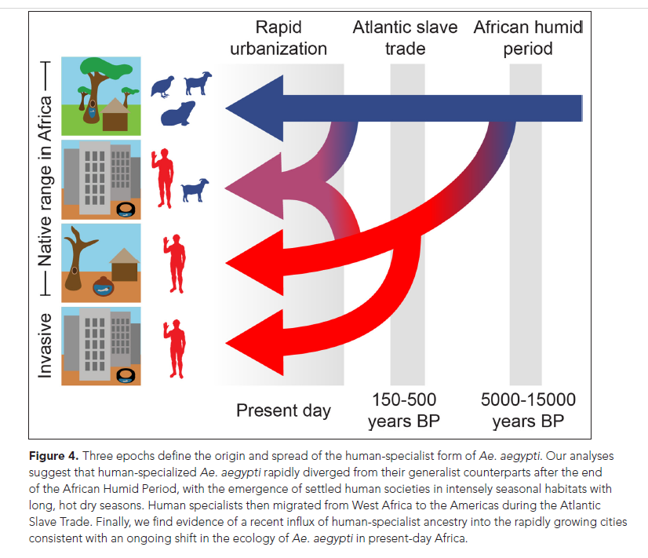
Human influence on mosquito evolution
Aedes aegypti was long ago a species of mosquito that did not feed on humans
Began feeding on humans approximately 5000 years ago, at the end of the African Humid Period, when the Sahara dried and water stored by humans became a uniquely stable, aquatic niche for them
The Atlantic slave trade took human-specialist mosquitoes to North America
Rapid urbanization in Africa has also selected for huma specialization, as well as urban habitat preferences and daytime biting
Notes:
Rose, N. H., Badolo, A., Sylla, M., Akorli, J., Otoo, S., Gloria-Soria, A., ... & McBride, C. S. (2023). Dating the origin and spread of specialization on human hosts in Aedes aegypti mosquitoes. Elife, 12, e83524.
This mosquito can bite people without being noticed because it approaches from behind and bites on the ankles and elbows.

Slide 28
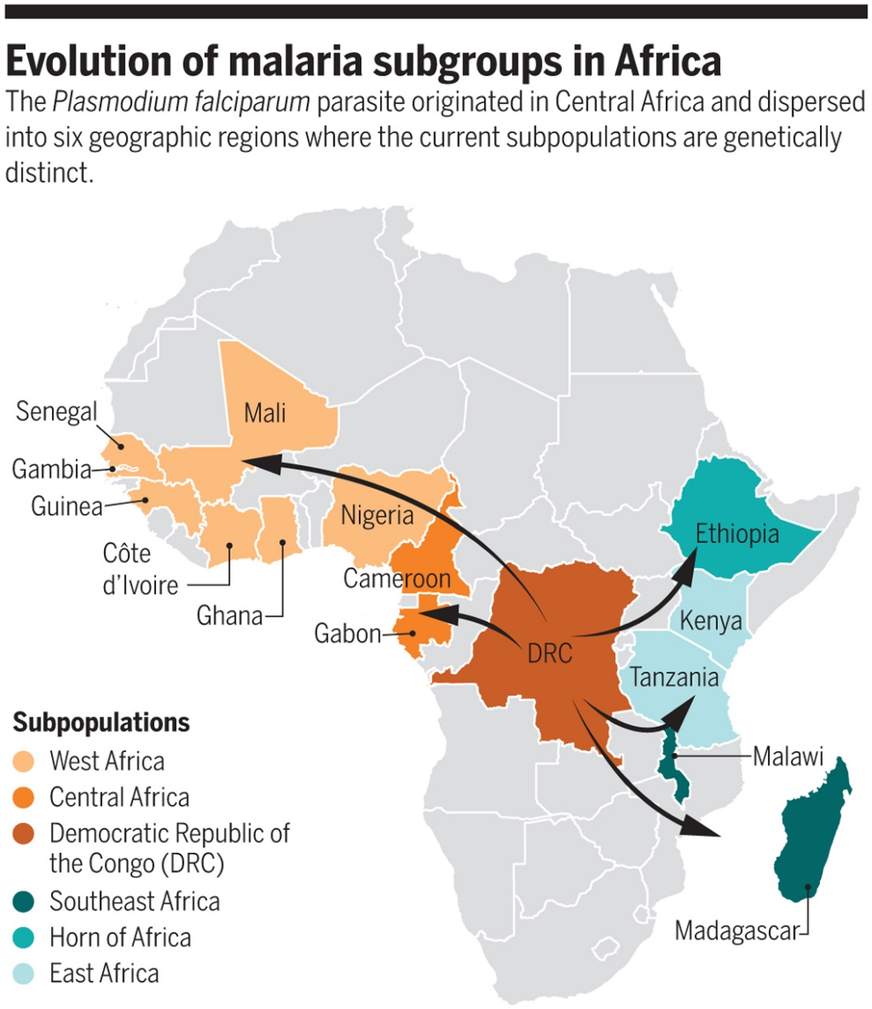
Plasmodium is highly successful evolutionarily and ecologically
Different Plasmodium species have jumped from animal reservoirs into humans in the past
New spillovers can be expected
Even with a single species of Plasmodium, there are different subgroups reflecting different evolutionary histories and subsequent differences in how malaria may respond to treatments
Notes:
https://www.science.org/doi/10.1126/science.aay0988

Slide 29
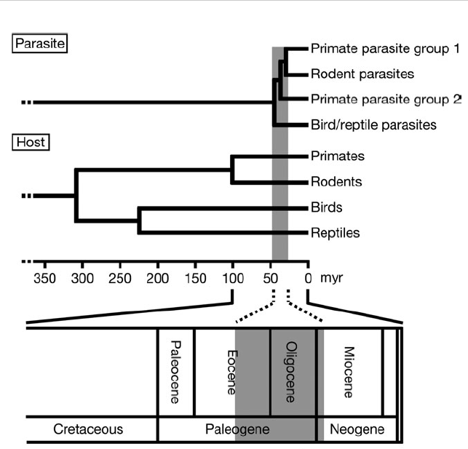
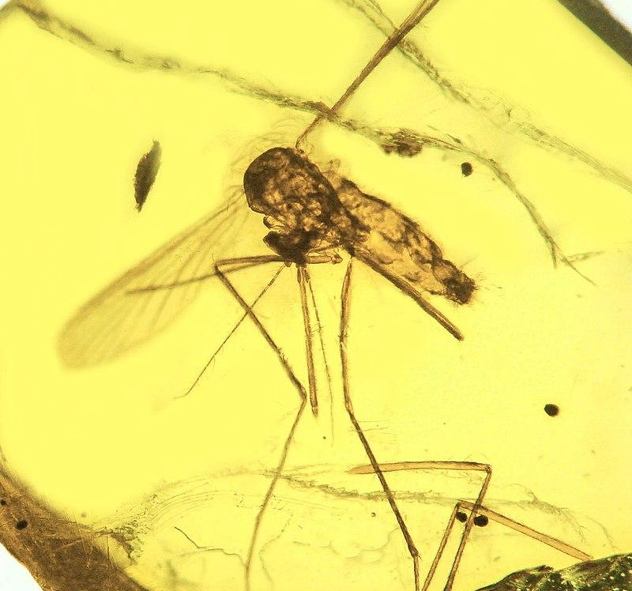
Primate parasites including P. vivax
Primate parasites including P. falciparum
Notes:
Plasmodium appeared in mammals millions of years ago. A chance genetic mutation arose in Plasmodium falciparum around 50,000 years ago that enabled the parasite to switch from gorillas to humans as hosts. Plasmodium evolution and diversification make tracking and understanding the parasite all the more challenging.
https://journals.plos.org/plosbiology/article?id=10.1371/journal.pbio.3000490
Hayakawa, T., Culleton, R., Otani, H., Horii, T., & Tanabe, K. (2008). Big bang in the evolution of extant malaria parasites. Molecular Biology and Evolution, 25(10), 2233-2239.
Oldest mosquito fossil with Plasmodium malariae, 15-20 million year old, in amber
https://www.flickr.com/photos/oregonstateuniversity/25762256070/

Slide 30
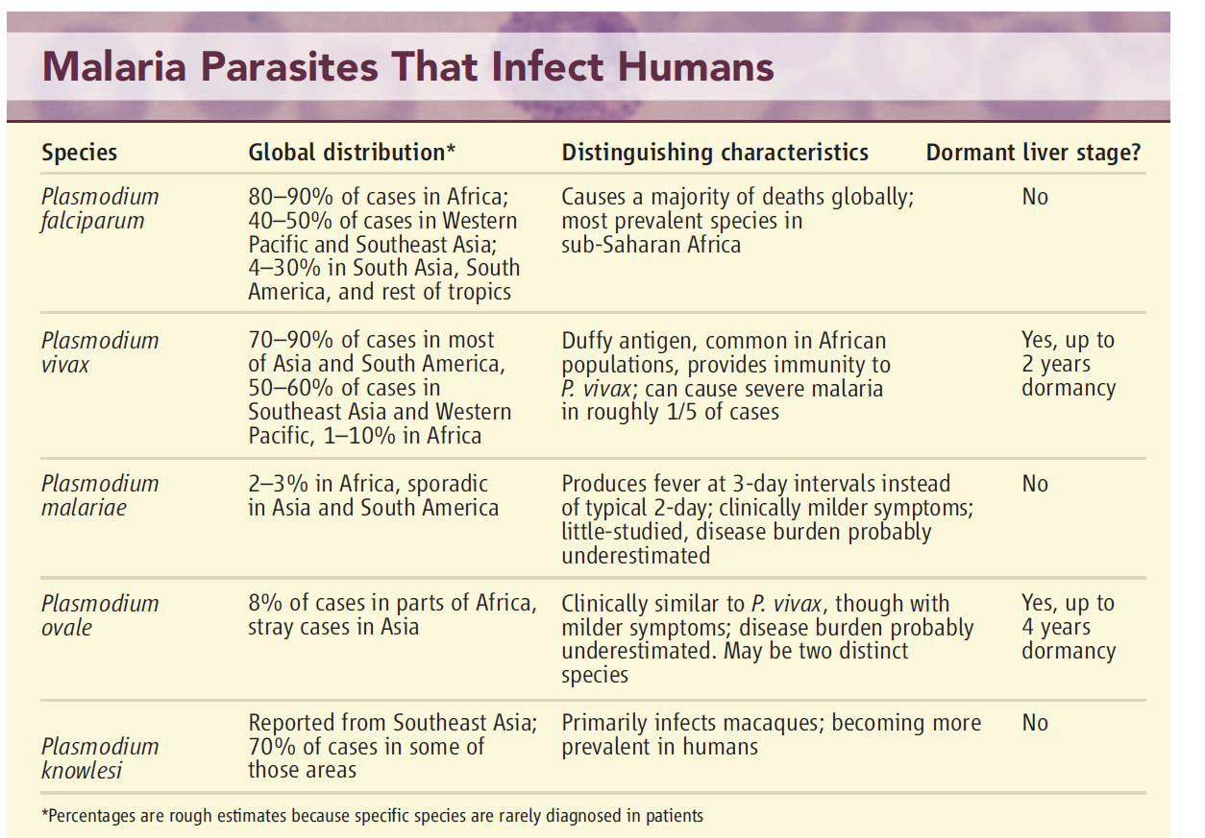
Notes:
There are five types of Plasmodium which cause human malaria, each causing a different severity of symptoms and responding to different treatments. Six types if you consider the two types of Plasmodium ovale.
P. knowlesi is known as zoonotic malaria since the parasite still resides in macaques.
P. vivax and P. falciparum are responsible for the majority of clinical cases and deaths worldwide.

Slide 31

Plasmodium parasites emerging in humans
Plasmodium knowlesi primarily infect macaques but has recently made jump to humans and can now spread from human to humans
Plasmodium gaboni identified in chimpanzees and bonobos but has not yet jumped to humans
New species of Plasmodium are likely to evolve and emerge

Slide 32
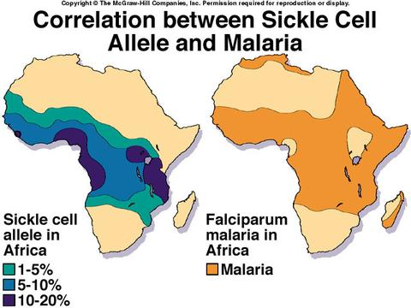
Evolutionary interactions between humans and malaria evidenced through adaptations to:
  Plasmodium falciparum
    Sickle cell
    Dantu blood group
  Plasmodium vivax
    Duffy antigen
Notes:
People who are heterozygous for the sickle cell allele (HbAS) have one normal hemoglobin gene (HbA) and one sickle hemoglobin gene (HbS). These individuals usually do not develop severe sickle cell disease but carry red blood cells that are less hospitable to P. falciparum infection. This provides a survival advantage in malaria-endemic regions.
Homozygous Individuals: Those who inherit two sickle cell alleles (HbSS) develop sickle cell disease, which can be life-threatening without proper medical care. In areas without malaria, this genetic mutation does not confer an advantage and is generally detrimental.

Slide 33
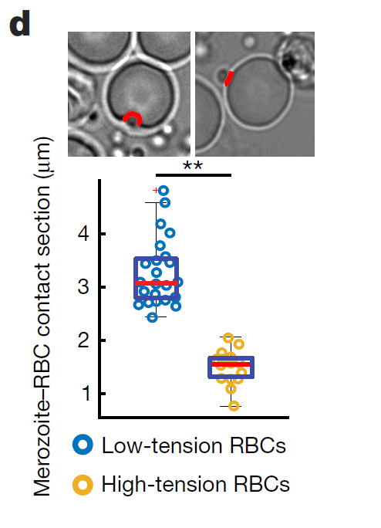
Dantu blood group
The Dantu human blood group found in coastal east Africa has a novel protein is expressed on the surface of red blood cells
This increases the surface tension of the RBCs, making it difficult for Plasmodium to enter it
In Kilifi, a town on the Kenyan coast, 10% of the population have one copy of the Dantu gene, which confers up to 40% protection against malaria.
One per cent of the population have two copies, conferring up to 70% protection
Notes:
The RBC surface is ‘pulled tighter’ in the Dantu blood group.

Slide 34
Plasmodium falciparum – the malaria of sub-Saharan Africa
Most malarial death is caused by P. falciparum in Africa, mostly in Nigeria, Democratic Republic of Congo, Mozambique, and Uganda.
In most other malarial regions, P. vivax predominates.
The clinical symptoms of P. falciparum and other malarial parasites (fever, chills, headaches) are caused by the destruction of red blood cells.
Alteration of the surface properties of red blood cells by P. falciparum causes them to adhere to blood vessel walls, potentially leading to obstructed circulation, organ failure, and cerebral malaria.
Notes:
Plasmodium falciparum is also associated with the development of blood cancer (Burkitt's lymphoma) and is classified as a carcinogen.
Plasmodium falciparum is lethal – the malaria that most often causes death.

Slide 35
Plasmodium vivax – the once global malaria
A century ago, Plasmodium vivax endemic in every country of the world, including regions north of the Arctic Circle
The parasite is carried by at least 71 mosquito species, many which live in temperate climates—as far north as Finland
More than 100 countries have eliminated malaria in the past century, all of them overcame Plasmodium vivax.
Eradications closely linked to economic development and mosquito control (insecticide spraying, eliminating mosquito habitat)

Slide 36
Plasmodium vivax
Unlike falciparum, vivax parasites form hypnozoites (“sleeping parasites”) that hide inside liver cells
Remain there for weeks, months, or even years
Allow parasite to survive in more temperate zones and wait out the winter for warm-season mosquitoes to begin biting
Hypnozoites not detected by blood tests
A single infectious bite can trigger six or more relapses a year, as the dormant parasites in the liver activate and cause a new bout of disease.
Recurrent vivax episodes leave people chronically anemic
Fighting off those episodes can leave people more vulnerable to other diseases—and to poverty and malnutrition, because they can’t work while ill.
Notes:
Plasmodium ovale, can also form hypnozoites, but it is much rarer than P. vivax
https://malariajournal.biomedcentral.com/articles/10.1186/1475-2875-7-S1-S9
Plasmodium falciparum kills you quickly, Plasmodium vivax more slowly.

Slide 37
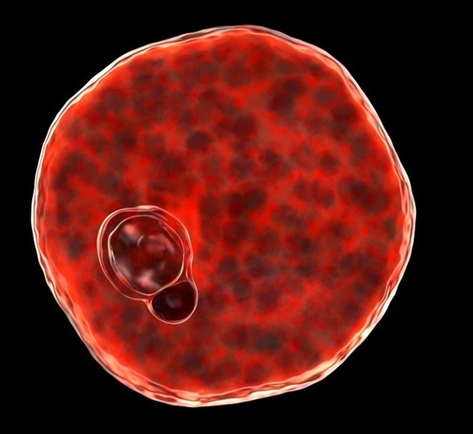
Duffy negative
P. vivax is much of less of a problem than P. falciparum in sub-Saharan Africa
In sub-Saharan Africa, most of the population lacks the Duffy antigen, a protein on the surface of red blood cells
P. vivax uses this protein to invade RBCs: no Duffy antigen, greatly reduced susceptibility to P. vivax.
The parasite can’t spread effectively in populations in which most people are Duffy-negative.
Notes:
Howes, R. E., Patil, A. P., Piel, F. B., Nyangiri, O. A., Kabaria, C. W., Gething, P. W., ... & Ménard, D. (2011). The global distribution of the Duffy blood group. Nature Communications, 2, 266.
Plasmodium vivax inside red blood cell.

Slide 38
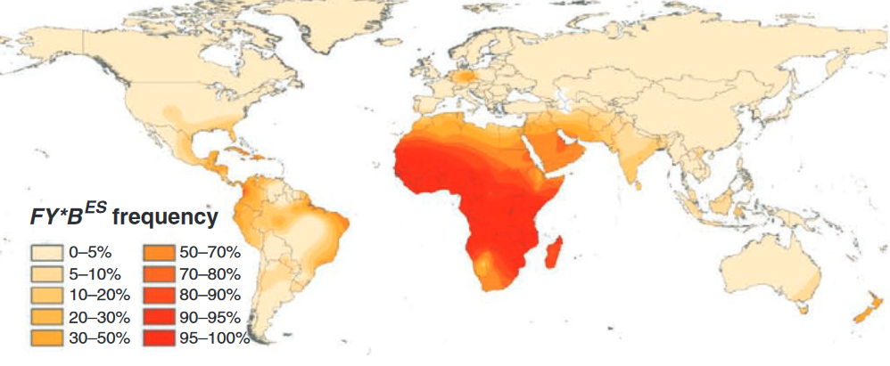
Duffy negative
phenotype frequency
Notes:
Howes, R. E., Patil, A. P., Piel, F. B., Nyangiri, O. A., Kabaria, C. W., Gething, P. W., ... & Ménard, D. (2011). The global distribution of the Duffy blood group. Nature communications, 2, 266.

Slide 39
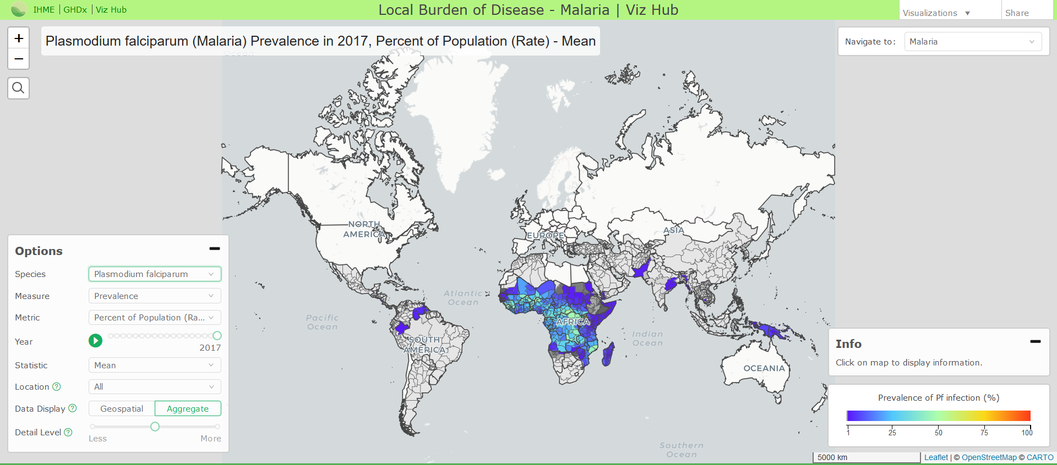
Notes:
https://vizhub.healthdata.org/lbd/malaria#

Slide 40
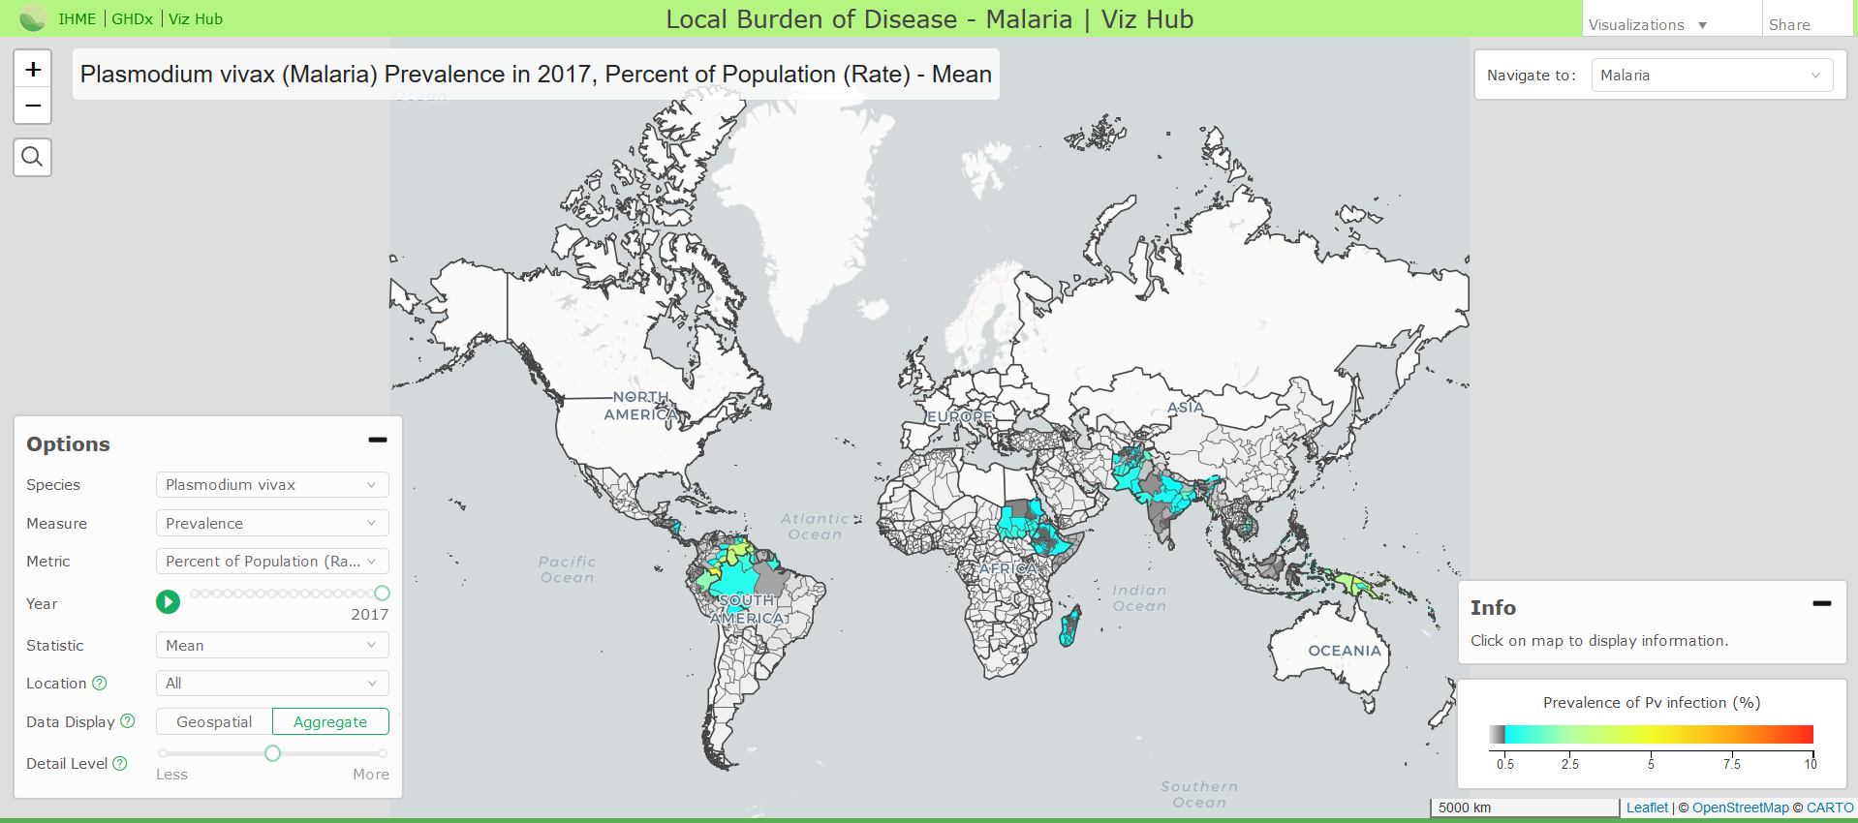
Notes:
https://vizhub.healthdata.org/lbd/malaria#

Slide 41
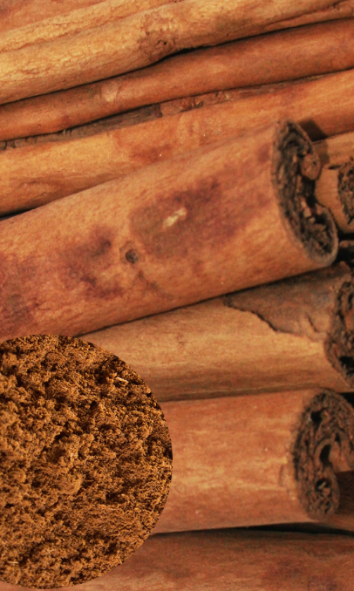
Controlling malaria: the colonial-global history of quinine
In 17th century, Spanish discovered that indigenous peoples in Peru used a bark to remedy fevers
Bark from cinchona tree quickly became favored treatment for fevers in Europe.
Eventually discovered that it could also prevent malaria. The bark—and its active ingredient, quinine, became an important commodity in Europe and eventually became critical to the health of the British empire in India
Notes:
Quinine remained the antimalarial drug of choice until after World War II, when other drugs, such as chloroquine, that have fewer side effects largely replaced it.

Slide 42
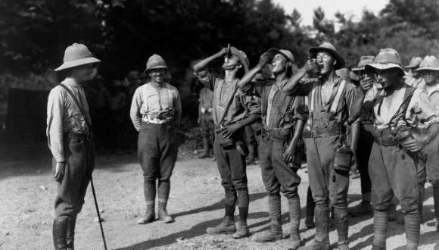
By the 1840s British citizens and soldiers in India were using 140,000 pounds of cinchona bark annually.
By the 1930s Dutch plantations in Java were producing 22 million pounds of cinchona bark, or 97% of the world's quinine production
Quinine was bitter, so British in India and other tropical posts mixed the powder with soda and sugar to make tonic water
Daily dose of protective this quinine tonic was mixed with gin to become gin and tonic

Slide 43
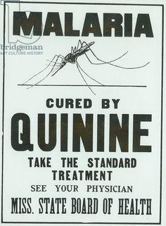
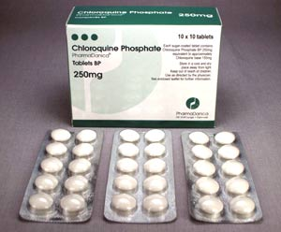
Notes:
Quinine was first isolated in 1820 from the bark of a cinchona tree. Bark extracts have been used to treat malaria since at least 1632.
Can be used as a prophylactic, a preventative, or as a way to treat malaria once contracted

Slide 44
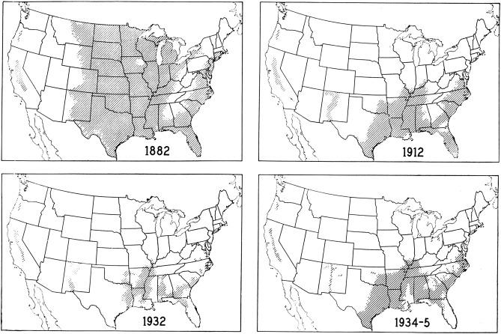
Notes:
https://www.cdc.gov/malaria/about/history/elimination_us.html
1947 - The National Malaria Eradication Program began in the United States. The disease caused widespread illness among soldiers training in the southern U.S. during World War Two. Homes were sprayed with DDT insecticide and mosquito breeding sites were drained.
1951 - Malaria was eliminated in the United States.

Slide 45
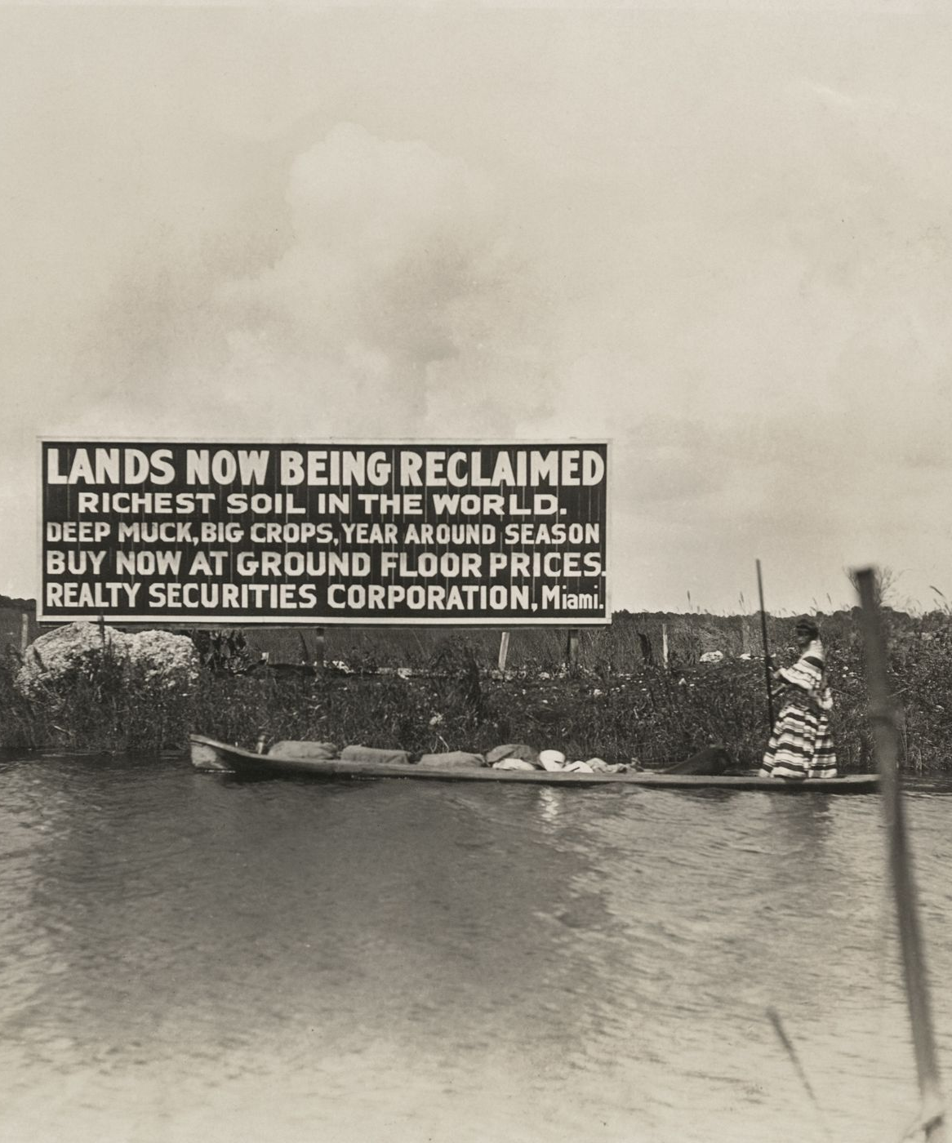
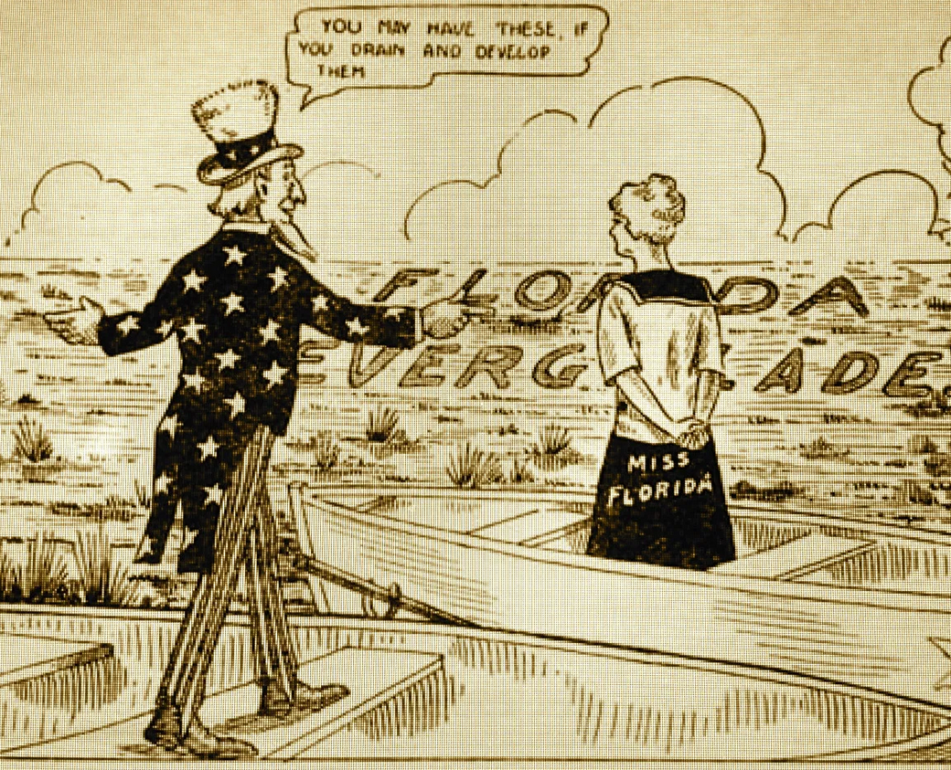
Notes:
While malaria was reduced by draining wetlands, this also marked the loss of large tracts of biodiverse habitats and ecosystems that provided other ecosystem benefits
https://archive.curbed.com/2019/1/16/18185454/real-estate-south-florida-everglades-the-swamp
Cartoon Everglades Drainage, 1916 Swamp Land Act of 1850 transferred swamp federal lands to the states.

Slide 46
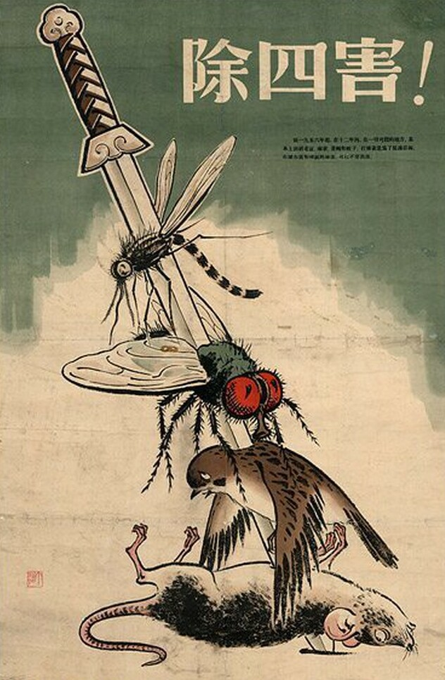
Four Pests Campaign
Took place in China from 1958 to 1962 as part of the Great Leap Forward of communist China
Hygiene campaign aimed to eradicate the pests responsible for the transmission of pestilence and disease as part of the Great Leap Forward
Targeted the mosquitoes responsible for malaria with spraying
Reduced malaria burden in some regions

Slide 47
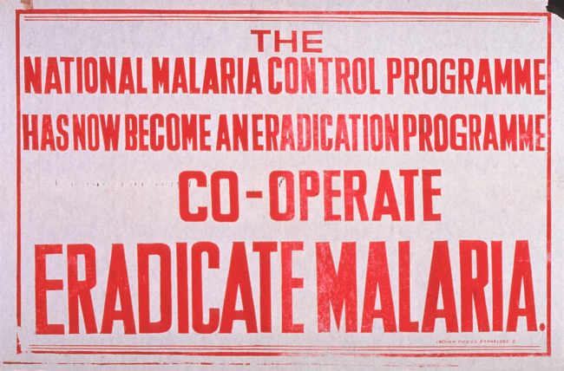
1955 – 1969: the first global malaria eradication campaign (World Health Organization)
  Malaria (mostly P. vivax) was eliminated from much of Europe, North America, Caribbean and parts of Asia, South-Central America
  Malaria persisted in sub-Saharan Africa
  Mosquitoes increasingly resistant to DDT and Plasmodium became resistant to quinine-based drugs
  Financial support of this international effort collapsed and campaign failed
Notes:
https://www.reuters.com/article/us-africa-malaria-events-timeline/timeline-the-long-road-to-malaria-eradication-idUSKCN0YU0ER
https://circulatingnow.nlm.nih.gov/2016/04/25/setting-our-sights-on-a-world-without-malaria/

Slide 48
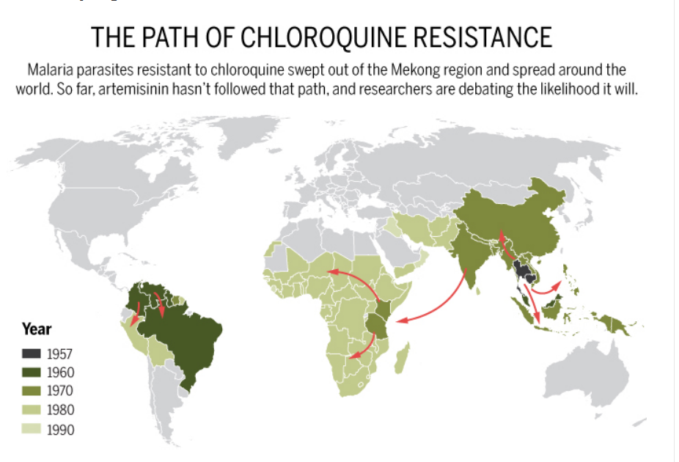
Notes:
Southeast Asia has served as a launch pad for drug-resistant malaria multiple times, with disastrous consequences. In the 1950s, Cambodian authorities reported that chloroquine, the main cure for malaria at the time, had stopped clearing some infections. Within three decades, chloroquine-resistant strains had spread to Africa, where 90% of the world’s malaria cases occur, and the death toll started to climb. By 2000, malaria was killing about one million people a year globally.
Quinine has been used an anti-malarial drug for centuries. Chloroquine became a major anti-malarial drug treatment after its invention in the 1930s.

Slide 49
Resistance first observed in malaria-causing Plasmodium falciparum parasites in Southeast Asia
Chloroquine resistance arrived in East Africa in late 1970s, spread through Central Africa and reached the west African seaboard in late 1980s
Consequences were devastating. Malaria mortality in children between 1980 and 2004 more than tripled from 493,000 to 1,613,000
The continued use of chloroquine killed millions who could have been saved if a more effective treatment available.
By 2004, chloroquine treatment was ineffective in up to 80% of patients who received it

Slide 50

2000: Second global campaign to eliminate malaria begins
World Health Organization, Global Fund to Fight AIDS, Tuberculosis and Malaria, Bill Gates Foundation
Targeted sub-Saharan Africa and P. falciparum
Large reductions in the prevalence of malaria achieved in the last two decades
Areas exist where endemic transmission of malaria has been stopped

Slide 51
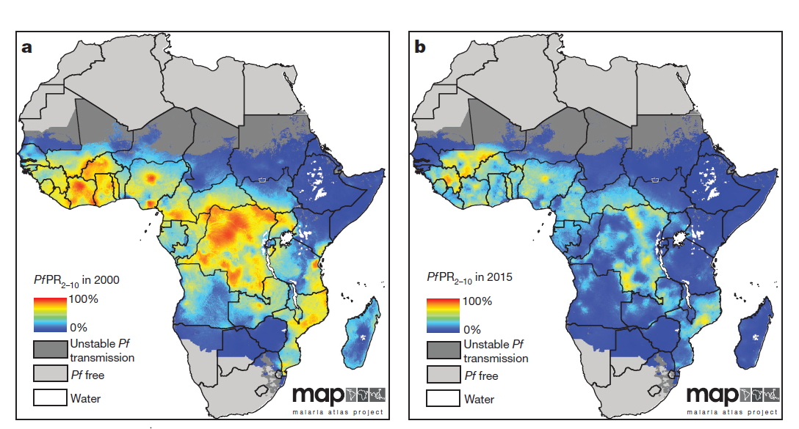
Plasmodium falciparum rates of transmission 2000-20015
Notes:
Colors simply indicate abundance of malaria

Slide 52
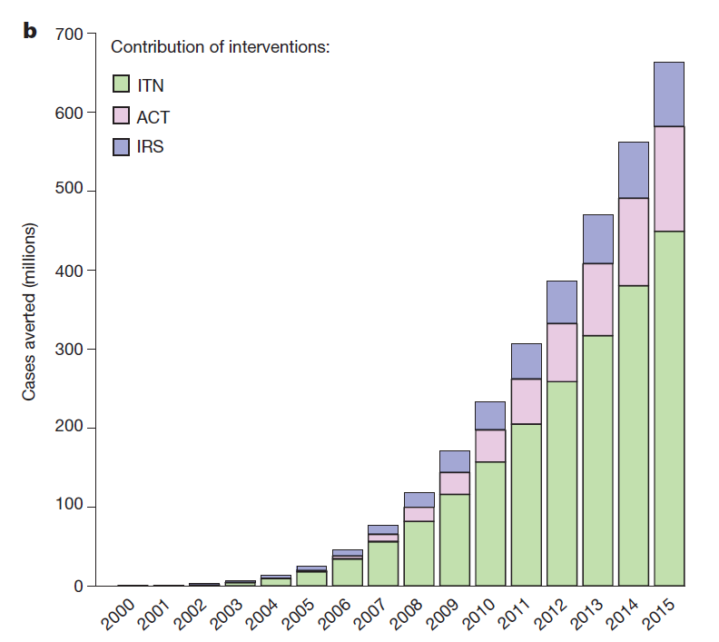
Interventions in second eradication campaign
Indoor residual spraying (IRS) followed by efforts to improve water drainage, sanitation, and house design
Treatment of clinical malaria with artemisinin-based combination drug therapy (ACT)
Insecticide-treated bed nets (ITNs)
However, overreliance on one intervention exclusively will lead to greater resistance of mosquitoes and the Plasmodium parasite
Notes:
Last 15 years have seen international financing for malaria control increase approximately twentyfold – the distribution of free bed nets has been a large part of this reduction
Nets have been responsible for approximately 68% of the estimated reduction in malarial transmission since 2000.

Slide 53
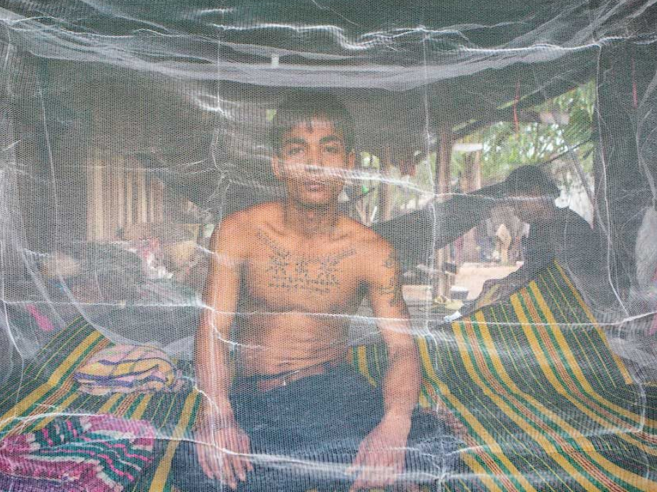
Insecticide treated nets
In 2005, George W Bush’s Malaria Initiative provided free bed nets to protect sleeping children
Bed nets impregnated with long-lasting insecticides called pyrethroids
Pyrethroids are inexpensive and considered safe around people (but are toxic to aquatic insects and fish)
Notes:
The distribution of mosquito nets or bednets impregnated with insecticides such as permethrin or deltamethrin has been shown to be an extremely effective method of malaria prevention. ITNs protect people sleeping under them and simultaneously kill mosquitoes that contact the nets.

Slide 54
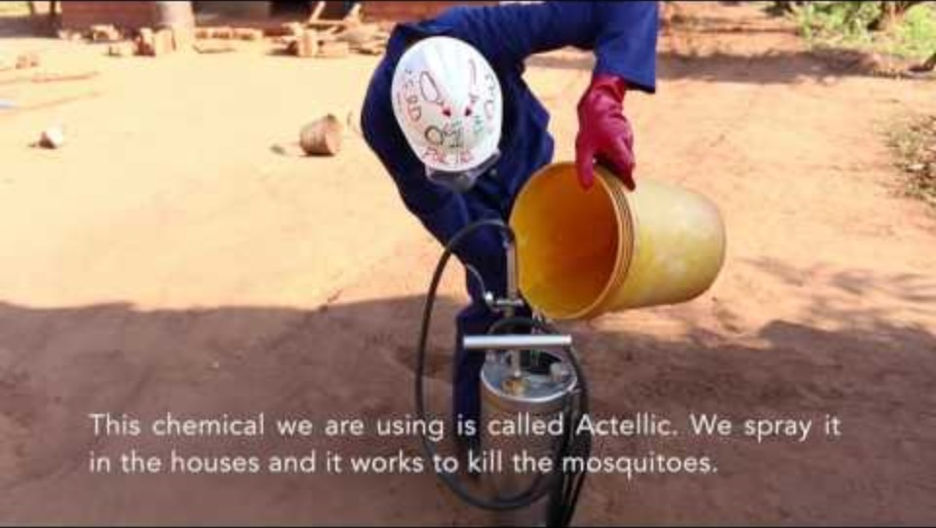
Video
Malarial mosquitoes are often "endophilic"; that is, the mosquito rest inside houses after taking a blood meal.
This make them particularly susceptible to control through indoor residual spraying.
First generation insecticides to kill mosquitoes like DDT replaced with new ones, the pyrethroids
Notes:
https://www.usaid.gov/news-information/videos/protecting-ghanaians-malaria-through-indoor-residual-spraying
DDT is still used to control malaria in some countries, although it is banned in the US. There are some people who argue that the ban on DDT resulted in malarial deaths that could have been avoided. Pyrethroid are also used for spraying. These are a later generation insecticide than DDT, which was first put into widespread commercial use in the 1940s. Pyrethroids were discovered in the 1960s. However, pyrethroids are beginning to loose their effectiveness as the mosquitoes acquire resistance.

Slide 55
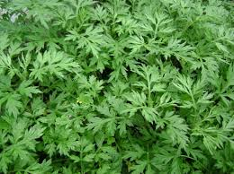

The second eradication campaign had artemisinin to treat and prevent malaria
Youyou Tu
Artemisinin is derived from a Chinese herb that has been used in the treatment of fevers for over 1,000 years, thus predating the use of quinine in the western world. Artemisinin began to be used since quinine-based drugs were increasingly ineffective.
Notes:
Artemisinin is derived a Chinese herb (qinghaosu) that has been used in the treatment of fevers for over 1,000 years, thus predating the use of quinine in the western world
http://www.who.int/malaria/media/artemisinin_resistance_qa/en/
2015 Nobel Prize awarded to Youyou Tu of the China Academy of Traditional Chinese Medicine in Beijing for isolating the compound in sweet wormwood
Artemisinin began to be used since quinine-based drugs were increasingly ineffective

Slide 56

North Vietnamese troops were suffering due to Plasmodium’s resistance to quinine and chloroquine
Chairman Mao of China had secret program to find new medicine and recruited scientists to examine herbs used in traditional Chinese medicine (TCM)
Sweet wormwood, (Artemisia annua) identified and used in TCM to treat fevers.
Youyou Tu isolated the active ingredient and introduced the world’s next anti-malarial drug
Viet Cong soldiers of North Vietnam. China was backing North Vietnamese in their war with US and South Vietnam
Notes:
Viet Cong soldiers of North Vietnam. China was backing North Vietnamese in their war with US and South Vietnam

Slide 57

In late 1980s and 1990s, China shared knowledge with Western countries as their country opened up economically
Photo at right shows early meeting between Chinese and French officials about bringing artemisinin to the world in early 2000s
Notes:
https://www.ncbi.nlm.nih.gov/pmc/articles/PMC3671478/

Slide 58

Artemisinin combination therapy (ACT)
Quinine-based antimalarials lost their effectiveness because Plasmodium became resistant - artemisinin has filled the gap
ACTs pair the drug artemisinin or a derivative with one of five partner drugs.
Different combinations are used in different parts of the world.
Artemisinin hits hard and fast, wiping out malaria parasites in hours, while partner anti-parasite drug works over a longer period
Notes:
Companion drugs include lumefantrine, mefloquine, amodiaquine, sulfadoxine/pyrimethamine, piperaquine and chlorproguanil/dapsone.
And as you would suspect, available without a prescription in some countries, like this one from Pakistan. But in countries where going to a doctor is prohibitively expensive for many, is it wrong to consider this an entirely negative circumstance?

Slide 59

Leveling off of the successes of second global campaign
Resurgence of malaria due to:
  Difficulty of preventing introduced transmission
  Resistance of mosquitoes to insecticides
  Plasmodium is now becoming resistant to artemisinin in southeast Asia
  Weakening of malaria control programs due to political instability
  Complacency after initial successes
Notes:
https://www.theglobalfund.org/en/blog/2019-04-25-malaria-resurgence-is-a-very-real-risk/

Slide 60

Notes:
Overall use of nets has increased but rates of availability and adoption variable from country to country. Period is for 2000-2013. Black line indicates percent of households with at least one ITN. Red line indicates percent of households with at least one ITN for every two people.

Slide 61

Notes:
https://www.newvision.co.ug/new_vision/news/1492183/imported-mosquito-nets-derailing-war-malaria
Also counterfeit nets that have no insecticide or are poorly made

Slide 62


Video

Slide 63

Notes:
Malaria cases have been increasing in some parts of the Americas, South-East Asia, Western Pacific and Africa,
A severe shortage of first-line antimalarial drugs, scarce investment in vector control measures, loss of equipment and infrastructure, and a collapsed health system as a result of the ongoing political and economic crisis (annual inflation rate of 1,000,000%), are major determinants of the malaria resurgence in Venezuela. Malaria cases in Venezuela have spilled over to other neighboring countries in the region, overloading local health care services in Brazil and Colombia. The large-scale migration of Venezuelan nationals, aggravated in the last six months, is a reasonable concern that the growing malaria epidemic in Venezuela could spread to the entire region.
https://www.ncbi.nlm.nih.gov/pmc/articles/PMC6471461/

Slide 64

Mosquitoes continue to evolve resistance to insecticides
First generation insecticide: DDT
Second generation insecticide: pyrethroids
Third generation pesticides: neonicotinoids
Notes:
Makoni, Munyaradzi. "Malaria fighters' latest chemical weapon may not last long." (2020) Science: 1153-1153.
DOI: 10.1126/science.369.6508.1153

Slide 65

Notes:
https://www.nature.com/immersive/d41586-018-05772-z/index.html

Slide 66

Emergence of artemisinin resistance (ART-R) in southeast Asia during second global campaign
First detected in 2005 in the same region where resistance to chloroquine drugs emerged during first global malaria eradication campaign.
Notes:
Artemisinin rapidly wipes out the majority of parasites, and a longer-acting partner drug in the combo mops up the rest. When ACTs are working as they should, the number of parasites detectable in a finger-prick of blood drops by half within three hours of taking the medicine. But in 2008, researchers in western Cambodia reported that parasite numbers in some patients were not falling as quickly as they ought to.
Roberts, L. (2016). Drug resistance triggers war to wipe out malaria in the Mekong region. Science, 10.

Slide 67
Reasons ART-R developed in southeast Asia
Health systems here have been historically underdeveloped and inconsistent in health delivery because of war and political turmoil, particularly in rural areas.
High use rates of anti-malarial drugs in larger cities of southeast Asia contributes to resistance
Anti-malarial drug quality has been sporadic and unpredictable, which can lead to resistance
Many species and subspecies of the Anopheles mosquito in southeast Asia. Small isolated mosquito populations can rapidly pass on genes for resistance

Slide 68

Role of political instability in a consistent control and treatment plan
  Japanese occupation in 1940-1945
  Region designated French Indochina until 1954
  Vietnam War (1955-1975)
  Cambodian Civil War (1967-1975)
  Hostilities among communist factions in Cambodia, Laos, and Vietnam through early 1990s
Notes:
Artemisinin resistance has emerged in southeast Asia - the very same region as where chloroquine resistance emerged. Why?
https://www.nature.com/immersive/d41586-018-05772-z/pdf/d41586-018-05772-z.pdf?origin=ppub

Slide 69

Counterfeit anti-malarial drugs remain a problem in south Asia as well as sub-Saharan Africa
Globally, some 200,000 preventable deaths occur each year due to anti-malarial drugs that do not work.
One-third of anti-malarial medicines distributed in southeast Asia and sub-Saharan Africa are of poor quality.
This illegal activity is most common in places with little government oversight and limited access to safe, affordable and high-quality medicines.
Notes:
https://theconversation.com/fake-drugs-are-one-reason-malaria-still-kills-so-many-92712
The double burden of counterfeit drugs: Patients who unwittingly purchase ineffective anti-malarial drugs are out of pocket for medicines that do nothing. Then, they pay for additional treatments when the first course of medicine fails. Patients pay twice – for the ineffective drugs and for the additional drugs when the first treatment fails
Drug quality and use has been sporadic and unpredictable, which can lead to resistance to malarial drugs and the persistence of malaria

Slide 70

Drugs may be deliberately and fraudulently mislabeled with respect to identity, source or pharmaceutical content. Some contain no active ingredients at all or contain them in incorrect amounts.
They may be short on artemisinin, and some anti-malarial drugs found in poor countries have either expired by the time they reach consumers or been damaged by exposure to extreme heat.
These practices can lead the malarial parasite to develop drug resistance
Notes:
https://theconversation.com/fake-drugs-are-one-reason-malaria-still-kills-so-many-92712

Slide 71

High diversity of Anopheles in SE Asia
Small isolated Anopheles mosquito populations in southeast Asia
In small populations, Plasmodium is able to pass on mutations that confer resistance easier and these can then spread to other populations
Notes:
https://www.intechopen.com/books/anopheles-mosquitoes-new-insights-into-malaria-vectors/understanding-anopheles-diversity-in-southeast-asia-and-its-applications-for-malaria-control
Sinka, M. E., Bangs, M. J., Manguin, S., Rubio-Palis, Y., Chareonviriyaphap, T., Coetzee, M., ... & Hay, S. I. (2012). A global map of dominant malaria vectors. Parasites and Vectors, 5, 1-11.

Slide 72

Slowing of ART-R in southeast Asia achieved through the Regional Artemisinin-resistance Initiative (RAI)
The Global Fund to Fight AIDS, Tuberculosis and Malaria and governments of Cambodia, Lao PDR, Myanmar, Thailand, and Vietnam formed RAI
Transmission of malaria interrupted so that resistance genes would not spread
Key to success was support given to networks of village malaria workers to improve access to malaria diagnosis and treatment in hard-to-reach areas.
Falciparum malaria declined markedly in Cambodia, Lao PDR, Thailand, and Vietnam
Notes:
Dhorda, M., Kaneko, A., Komatsu, R., Kc, A., Mshamu, S., Gesase, S., ... & von Seidlein, L. (2024). Artemisinin-resistant malaria in Africa demands urgent action. Science, 385(6706), 252-254.

Slide 73



Notes:
Of great concern is that the mutations that cause resistance to artemisinin begin to occur in Africa
The same mutations in Plasmodium that have contribute to artemisinin resistance in southeast Asia are now popping up in parts of Africa. They were not imported from Asia through transport of people or mosquitoes with the resistance parasite.
https://www.science.org/content/article/drug-resistant-malaria-gaining-foothold-africa
Public health authorities have long worried that the emergence in Africa of malaria resistant to artemisinin was only a matter of time. Parasites that can thwart this key component of front-line treatments appeared in Southeast Asia in the early 2000s and eventually led to clinical failures. The stakes are higher for Africa, which in 2019 saw 94% of both malaria cases and deaths worldwide—estimated at 229 million and 409,000, respectively. Two recent papers provide evidence that the dreaded resistance now has a foothold on the continent. The findings are “a game changer,” says malaria researcher Philip Rosenthal of the University of California, San Francisco. For now, there’s no evidence that current treatments are failing outright; patients with the resistant parasites simply take longer to clear them. “I don’t think this is a reason to panic,” Rosenthal says, “but we should be very concerned that things may be changing, and we definitely need new drugs.”

Slide 74

2020: start of the third eradication campaign
New insecticides and antimalarial drugs under development
Better tests to detect the Plasmodium parasite in human blood samples
Vaccines will likely play a greater role

Slide 75
Improvements in tests to detect malaria
Malaria is a curable disease if you know you are infected.
If eradication is the goal, people with low levels of the parasite and who are asymptomatic, will have to be identified
The microscopic examination of stained blood films still remains the gold-standard in Plasmodium detection today, but it is hard to detect low levels of infection
Need is for alternative diagnostic methods that are simple, fast, highly sensitive, and ideally do not rely on blood-drawing and can potentially be conducted by the patients themselves

Slide 76

Reading/Questions 13
Notes:
https://www.nytimes.com/interactive/2023/09/29/health/mosquitoes-new-solutions.html

Slide 77

Readings/Questions 13
Notes:
https://www.nytimes.com/2022/10/04/health/malaria-vaccines.html

Slide 78
Malaria vaccines: RTS,S/AS01(Mosquirix) and R21/Matrix-M
Two safe and protective malaria vaccines, RTS,S/AS01 and R21/Matrix-M, have been registered and licensed in several African countries over the past 2 years.
These vaccines target children under 5 years who bear the main burden of malaria.
Both vaccines target Plasmodium falciparum, the most common and most lethal of four malaria parasite species
RTS,S/AS01: Efficacy of approximately 56%, approved for use in 2021
R21/Matrix-M: Efficacy of about 78% and lower costs to produce, approved for use in 2023. The WHO has said that R21 will be available across Africa as early as mid-2024

Slide 79
RTS,S/AS01 (Mosquirix) versus Ozempic
37 years to bring to market
  1987: The project to develop RTS,S is initiated by GlaxoSmithKline
  1998: The first Phase 1 clinical trials begin in adults in the United States.
  2021 RTS,S recommended for use by WHO
  2024: RTS,S is now being integrated into routine childhood immunization programs in several African countries,
16 years to bring to market
  2002: Research and development of semaglutide begins at Novo Nordisk
  2012: Phase 1 clinical trials start
  2018: Ozempic is launched
Notes:
More than 18 million people, most of them young children, have died of malaria in the quarter-century since the vaccine’s 1998 trials.

Slide 80

This benefits vaccinated children, but the unvaccinated population will continue to transmit malaria.
New vaccination strategies will need to include all age groups are be deployed in or around areas reporting parasites with artemisinin resistance genes like the K13 mutation
Dual benefits of reducing malaria transmission while also reducing propensity for artemisinin resistance to spread
Notes:
DOI:10.1101/2024.08.28.24312699

Slide 81

Do vaccines take a lot of money away from simpler solutions?
Readings/Questions 13
Notes:
https://www.nytimes.com/2023/09/29/health/mosquitoes-malaria-strategies-house.html

Slide 82

How will climate change impact the distribution of malaria?
Warmer = more mosquitoes = more malaria is reasonable assumption, but there are more factors to consider.
Climate change is not just a change in temperature patterns, but also changes in rainfall and how patterns in each coincide spatially and temporally
Warmer temps without adequate rainfall may not promote more malaria
This complexity intersects with life cycle of the mosquito and the thermal ecology of the Plasmodium parasite
Notes:
Remember, mosquitoes require water to lay their eggs and for the larval stage of the mosquito to develop.
At temperatures below 68°F, the parasite Plasmodium falciparum can not complete its growth cycle in the mosquitoes so it can not be transmitted. However, Plasmodium vivax, which can complete its life cycle in lower temperatures.

Slide 83

Temps may be too warm in some locations for malaria – malaria may decrease in some parts of Africa
Dengue may increase more in response to warmer temps than malaria
Notes:
https://doi.org/10.1126/science.adl0412
The baseline assumption is that warmer climate will make vector-borne disease worse because people observe that most [such] diseases occur in the tropics, and in more temperate places they occur in the summer. However, the effect of rising temperatures can go either way. For many years the temperature optimum for malaria was pegged at about 31°C. Recent studies indicate that the temperature optimum is likely dramatically lower: just 25°C. Above 28°C, transmission decreases rapidly. Parts of sub-Saharan Africa may undergo reductions in malaria. However, in the highlands of South America and southern Africa, warming temperatures increasingly favor malaria transmission. And in once-malarial regions of Europe and North America that have controlled the disease, keeping it in check may become more challenging.

Slide 84

Deforestation and urbanization trends will also shape mosquito disease potential
Notes:
Economic change and instability can push people into remaining forests to make a living, bring them in contact with mosquitoes and the Plasmodium parasite
https://e360.yale.edu/features/turning-the-tide-on-the-relentless-destruction-of-cambodias-forests

Slide 85

Notes:
Economic change and instability can push people into remaining forests to make a living, bring them in contact with mosquitoes and the Plasmodium parasite
https://e360.yale.edu/features/turning-the-tide-on-the-relentless-destruction-of-cambodias-forests

Slide 86

Notes:
Kibera, Kenya
Some of the fastest growing cities in the world are in Africa. Urban habitats can also support mosquitoes and spread of malaria depending upon vegetation cover and availability of water, type of buildings, and human population density. However, malaria is far less of a problem in cities than another mosquito-borne disease, dengue

Slide 87

Notes:
Overflow from dengue ward in Telangana state, southern India

Slide 88

Dengue
Endemic to more than 100 countries
Fast growing infectious global disease – by 2080, two-thirds of the planet’s population will be susceptible to exposure to dengue
Dengue, like malaria, is an arboviruses, a term used to refer to a group of viruses that are transmitted by arthropod vectors (arthropod-borne virus).
While malaria is a disease of rural poverty, dengue transcends class more readily and is often an urban problem
While many get dengue and few die, it creates economic disruption for individuals, families and societies
Notes:
Dengue ward in hospital in the Philippines
At present, half the world is susceptible to exposure to dengue

Slide 89

Notes:
The estimated force of infection (FOI) for dengue, which is the per capita rate at which susceptible individuals become infected

Slide 90



Slide 91
More places are seeing local transmission of dengue for the first time
Cases are appearing outside of tropics, including the US because of
  Increased international travel
  Importation of virus into areas where it doesn’t occur
  Spread of mosquitoes that carry dengue
  Climate change
  Since 50-90% of people are asymptomatic, dengue can travel undetected or goes undiagnosed
Notes:
https://www.washingtonpost.com/world/2024/03/10/dengue-fever-brazil-outbreak-epidemic/
https://www.nytimes.com/2023/10/24/health/what-is-dengue-fever.html

Slide 92

Local transmission of dengue in the US
Limited local transmission of dengue has been reported in Florida, California, Hawaii, Texas, and Arizona in 2023-2024.
Most cases are from travelers returning from dengue-endemic areas
Notes:
https://www.cdc.gov/dengue/data-research/facts-stats/current-data.html

Slide 94

Spread by Aedes aegypti and Aedes albopictus. They also transmit yellow fever, chikungunya and Zika viruses
Dengue causes fever, severe joint pain, muscle aches. Also known as breakbone fever. Less common is a hemorrhagic fever that can potentially lead to death.
Notes:
Aedes aegypti (left) is also known as the yellow fever mosquito. Aedes albopictus (right) is known as the Asian tiger mosquito.
Dengue ward in hospital in the Philippines

Slide 95

Aedes aegypti is from tropical Africa and most likely spread throughout the world via slave and trading ships during 17th to 19th centuries
Feeds mostly at dusk and dawn and in shady places
Two subspecies of Aedes aegypti: Aedes aegypti formosus in sub-Saharan Africa and Aedes aegypti Formosus
Aedes aegypti aegypti is the mosquito that has spread around the tropical and subtropical world outside Africa.
Notes:
Known as the Yellow fever mosquito, but it also transmits dengue, Zika, and chikungunya

Slide 96

Notes:
Note the more northern distribution of Aedes albopictus

Slide 97

Aedes albopictus
Native to Southeast Asia
Also known as the Asian tiger mosquito
Prior to 1979, found only in Asia and Western Pacific
Spotted in Houston in 1985
Hypothesized to have arrived via shipment of tires from Japan
Remains active and bites all day
Prefers human habitats over wetlands more than Aedes aegypti and will lay eggs in water-filled artificial containers
Notes:
https://source.wustl.edu/2014/10/hot-on-the-trail-of-the-asian-tiger-mosquito/
Eritja, Roger, John RB Palmer, David Roiz, Isis Sanpera-Calbet, and Frederic Bartumeus. "Direct evidence of adult Aedes albopictus dispersal by car." Scientific Reports 7, no. 1 (2017): 14399.
This mosquito has become a significant pest in many communities because it closely associates with humans (rather than living in wetlands), and typically flies and feeds in the daytime in addition to at dusk and dawn

Slide 98

Range of A. albopictus stretches farther north than that of A. aegypti, and its eggs are somewhat resistant to subfreezing temperatures, raising the possibility that A. albopictus could mediate a re-emergence of dengue in the United States
Notes:
Range of Aedes albopictus in brown

Slide 99

Notes:
Singapore
https://www.todayonline.com/big-read/big-read-warming-temperatures-and-increased-urbanisation-fight-against-dengue-will-only
https://www.dw.com/en/singapores-mosquito-police/av-41991007

Slide 100

Urbanization and dengue
Expansion of dengue associated with rapid urbanization and population growth in tropical cities
Rapid development can lead to unplanned infrastructure problems involving control of stormwater that can breed mosquitoes
Seasonal dengue outbreaks endemic to many large tropical cities
Dengue is hyper-endemic in some countries, like the Philippines, where by age 9, 90% of Filipinos have been exposed to the virus

Slide 101

Notes:
https://www.hindustantimes.com/gurgaon/dengue-cases-at-27-likely-to-rise-further-say-gurgaon-doctors/story-HVBxrCOxlavg2ItkKcGxyI.html

Slide 102

Notes:
From Brazil

Slide 103


Slide 104

Four distinct dengue viral serotypes
Initial infection with any of the four confers lifelong immunity to that serotype.
After dengue infection, the immune system protects against a second infection with any serotype for one to two years
But after that period, people are protected only from the serotype to which they were first exposed,
They are then at increased risk of antibody dependent enhancement (ADE) .
When infected with other serotypes. ADE can lead to dengue hemorrhagic fever, which can cause massive fluid loss, organ failure, and death.
ADE involves cytokine storms, a runaway immune system response
Notes:
Protective antibodies can turn double agent, teaming up with the dengue virus to make an infection more severe, even life-threatening.
http://scim.ag/dengue_antibodies
The ADE hypothesis builds on the fact that an antibody to the first dengue serotype can bind to the virus, but not strongly enough to “neutralize” it. This binding antibody/virus complex more easily enters host cells, allowing the virus to copy itself at even higher levels. The intensified infection leads the immune system to storm the body with chemical messengers called cytokines, ultimately increasing the likelihood of blood vessels leaking, causing hemorrhage and shock.
Rothman, A. L. (2011). Immunity to dengue virus: a tale of original antigenic sin and tropical cytokine storms. Nature Reviews Immunology, 11(8), 532.
https://www.ncbi.nlm.nih.gov/pmc/articles/PMC7439999/

Slide 105

Origins of dengue and the Aedes mosquito
The four dengue viruses originated in monkeys and independently jumped to humans in Africa or Southeast Asia 100 - 800 years ago and spread slowly around the world
Remained a relatively minor, geographically restricted disease until the global slave trade brought dengue to the South America
Isolated outbreaks of dengue occurred in cities of southeast U.S. from 1820 to 1945
Dengue exploded after 1950, due to World War 2 and the coincidental transport of Aedes mosquitoes with the dengue virus around the world
Notes:
http://link.springer.com.ezproxy.uky.edu/article/10.1007/s40475-013-0008-1
Troop ship bringing Americans home after WW 2, along with dengue virus and mosquitoes carrying it

Slide 106

Aedes aegypti females of the African subspecies Aedes aegypti formosus (left) and the globally distributed subspecies Aedes aegypti aegypti (right). Ae. aegypti aegypti (abbreviated Aaa) prefers human blood-meals and is adapted to breed in human habitats. The ancestral form of Aaa in sub-Saharan Africa, Ae. aegypti formosus (Aaf, left), breeds in nonhuman-disturbed habitats such as forests and vegetated ecotones and prefers non-human blood meals.
Notes:
A. aegypti formosus (Aaf) is evolving and is now beginning to be found in urban areas in Africa, whereas before it was primarily a species that would lay eggs in natural water bodies.

Slide 107

In east Africa, where the mosquito is native, Aedes aegypti formosus (Aaf), prefer to suck blood from other animals, such as monkeys and rodents.
However, they are evolving to feed more on humans and thereby are increasing the likelihood of more dengue in Africa
Drier climate, particularly in areas that experience a wet-dry season, along with proximity of dense human populations in urban areas are leading to the evolution of Aaf that feed on humans
Notes:
Rose, N. H., Sylla, M., Badolo, A., Lutomiah, J., Ayala, D., Aribodor, O. B., ... & Kriete, A. L. (2020). Climate and urbanization drive mosquito preference for humans. bioRxiv.
https://doi.org/10.1101/2020.02.12.939041
The image shows that in west Africa, Aaf is evolving to prefer more human blood meals. This highlights again one of the same points raised about malaria. Natural selection and adaptation are part of the global problem of mosquito-borne disease. Arboviruses that cause disease in humans are hard to control because the mosquitoes that carry them are dynamic in space and time.

Slide 108

Dengvaxia vaccine for dengue
Dengvaxia consists of an attenuated yellow fever virus that expresses genes of each of the four types of dengue virus
Dengvaxia requires three doses and is can only be given to people aged 9–16 who have had dengue
Approved for public use in 2015; created by the French pharmaceutical company Sanofi Pastuer
Prior to its use, warnings were expressed that Dengvaxia might still be given to children who never had dengue, thereby increasing the risk of ADE and hemorrhagic fever

Slide 109

Dengvaxia in the Philippines
Philippines approved Dengvaxia for use but did not screen for prior exposure because they thought benefits outweighed risks of ADE
A massive national vaccination campaign began, while other countries like Brazil proceeded cautiously
Filipino children who had not been exposed to dengue were vaccinated, and when they developed complications, 800,000 children had been vaccinated
Twenty children in Philippines died as a result
Notes:
https://www.sciencenews.org/article/measles-global-spread-vaccination
They also didn’t screen because they thought that most children would have been exposed to dengue early in their life, as dengue is hyper-endemic in the Philippines

Slide 110

Protests erupted across the country.
Philippine government immediately ended all dengue vaccinations and suspended license for Dengvaxia to be used in the Philippines
The deaths led to a upsurge in anti-vaxxer attitudes, and vaccinations for all diseases declined, including routine childhood vaccinations
Notes:
https://www.sciencenews.org/article/measles-global-spread-vaccination

Slide 111

The Philippines subsequently had a severe dengue epidemic as well as a resurgence of measles
Polio also re-emerged
Dengvaxia is in limited use today
Company that makes Dengvaxia is discontinuing it in the third quarter of 2026 due to low global demand
Notes:
https://www.dw.com/en/dengue-vaccine-controversy-sparks-panic-in-philippines/a-42711828
https://doi.org/10.1080/21645515.2018.1522468
https://www.nytimes.com/2019/08/06/world/asia/philippines-dengue.html
https://www.cdc.gov/vaccines/acip/recs/grade/CYD-TDV-dengue-vaccine.html
https://www.pharmaceutical-technology.com/features/dangvaxia-philippines/?cf-view

Slide 112

Qdenga
Much more widely used than Dengvaxia
Developed by the Japanese pharmaceutical company Takeda
Requires two doses and is for people aged 4-60 regardless of prior history of infection
80% efficacy
Notes:
https://www.nature.com/articles/d41586-023-03115-1

Slide 113


Butantan-DV
Single-dose and 80-90% effective
Made by Brazilian researchers
Vaccine targets all four dengue virus serotypes.
Safe for people with or without a prior dengue infection
Not yet been approved for public use

Slide 114


Slide 115

Readings/Questions 13
Notes:
https://www.nytimes.com/2024/02/10/health/dengue-brazil-americas.html
Dengue is hyperendemic in Brazil, its high prevalence remains constant from one year to the next. The start of 2024 saw a large increase in dengue, so large that it became a public health emergency that overwhelmed hospitals.

Slide 116

Millions of Brazilians live in densely populated, irregular communities called favelas
Because of their rapid growth and spontaneous character, favelas are often beyond the reach of government services and basic utilities.
Inadequate stormwater and sanitation infrastructure

Slide 117

With unreliable water service, people often resort to storing water outside, creating countless mosquito breeding sites.
Uncollected rubbish becomes a breeding ground for the insects
If water sits for one week, the mosquito life cycle can be completed
Notes:
One of the favelas or shantytowns of São Paulo, Brazil's largest city, where local residents have turned a stream into an open-air garbage dump and a source of frequent flooding due to lack of sewage and garbage collection. Nor do favelas in Brazil’s cities have piped water.

Slide 118
Other causes for Brazil’s current dengue crisis:
Warming climate particularly in areas of southern Brazil where climate has historically been cooler
Limited availability of Qdenga
Limited hospital capacity for large number of dengue cases
After several years during which only two of the viral subtypes of dengue predominated in Brazil, the other two have recently returned. Many Brazilians are vulnerable to these subtypes, so they are more likely to become infected.
Notes:
https://www.nature.com/articles/d41586-024-00626-3
https://www.washingtonpost.com/world/2024/03/10/dengue-fever-brazil-outbreak-epidemic/

Slide 119


Slide 120

Dengue is the most likely mosquito-transmitted disease to become established in the US because of climate change
Aedes aegypti is here, just need the virus to expand out of where local transmission has taken place
Notes:
Model projections of dengue risk
https://www.nature.com/articles/d41586-024-00626-3

Slide 121

Targeted methods of mosquito control
Older strategies of control worked but could be inefficient and have negative side effects
More recent approaches
  Precision public health
  Biocontrol of mosquito populations
    Sterile mosquito treatments
    Wolbachia biocontrols
    Gene drives

Slide 122

Precision public health
Notes:
When domestic transmission of Zika virus was confirmed in the United States in July 2016, the entire country was not declared at risk — nor even the entire state of Florida. Instead, precise surveillance defined two at-risk areas of Miami-Dade County, neighborhoods measuring just 2.6 and 3.9 square kilometers. Travel advisories and mosquito control focused on those regions. Six weeks later, ongoing surveillance convinced officials to lift restrictions in one area and expand the other.
By contrast, a campaign against yellow fever launched this year in sub-Saharan Africa defines risk at the level of entire nations, often hundreds of thousands of square kilometers. More granular assessments have been deemed too complex. Precision public health focuses on specific areas where disease outbreaks are more likely or where their effects impact a large number of people. This is a more cost effective refinement to the idea of complete global surveillance.

Slide 123

Sterile insect treatments
Notes:
Beebe, N. W., Pagendam, D., Trewin, B. J., Boomer, A., Bradford, M., Ford, A., ... & Ritchie, S. A. (2021). Releasing incompatible males drives strong suppression across populations of wild and Wolbachia-carrying Aedes aegypti in Australia. Proceedings of the National Academy of Sciences, 118(41).

Slide 124
Male mosquitoes have been genetically modified to carry a gene that is lethal to female offspring.
Male mosquitoes have to be raised and released to initiate the control
When released into the environment, the engineered males will mate with wild females, and their female offspring will die before they can reproduce.
Male offspring will carry the gene and pass it on to half of their progeny.
As each generation mates, more females will die, and mosquito populations dwindle

Slide 125

Notes:
https://www.oxitec.com/en/our-technology#how-it-works

Slide 126


Wolbachia biocontrol
Wolbachia is a genus of bacteria that live inside many different insects.
Although it is not typically found in disease-carrying mosquitoes, it can be artificially introduced Into them.
Wolbachia have been shown to stop the malarial parasite’s capacity to infect mosquitoes and is considered an effective biocontrol agent
Readings/Questions 13
Notes:
https://www.nytimes.com/interactive/2023/09/29/health/mosquitoes-wolbachia-disease-viruses.html
Microscope image is of Wolbachia bacteria inside an insect cell
Beebe, N. W., Pagendam, D., Trewin, B. J., Boomer, A., Bradford, M., Ford, A., ... & Ritchie, S. A. (2021). Releasing incompatible males drives strong suppression across populations of wild and Wolbachia-carrying Aedes aegypti in Australia. Proceedings of the National Academy of Sciences, 118(41).

Slide 127


Slide 128

Notes:
https://int.nyt.com/data/videotape/finished/2023/05/1684848644/900-900w.mp4
https://www.nytimes.com/interactive/2023/09/29/health/mosquitoes-wolbachia-disease-viruses.html

Slide 129

Notes:
https://www.youtube.com/watch?v=gzT96OxPa9U&t=139s

Slide 130

Notes:
This image shows the impact of the release of Wolbachia-infected mosquitos on the incidence of dengue fever in the city of Medellin, Columbia

Slide 131

Gene drives
Readings/Questions 13
Notes:
https://www.nytimes.com/2023/09/29/health/mosquitoes-genetic-engineering.html

Slide 132

The unique and useful attribute of gene drives is that the genetic change they induce in a population of organisms spreads on its own very efficiently.

