Slide 1
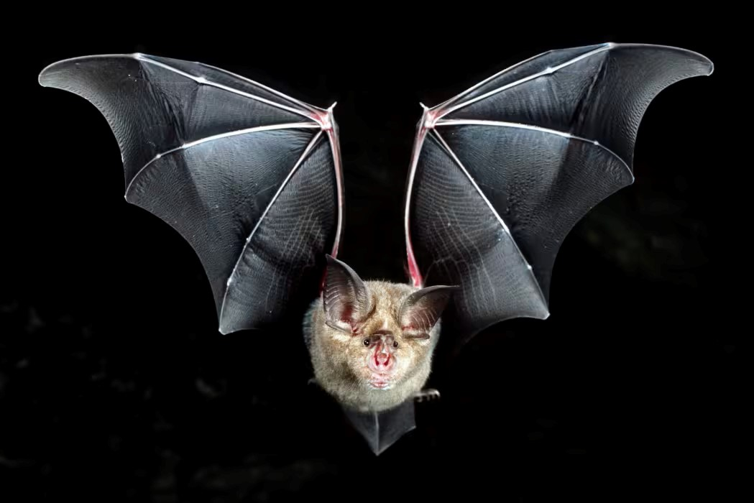
Notes:
Covid-19, the SARS-CoV-2 virus, a zoonotic disease

Slide 2
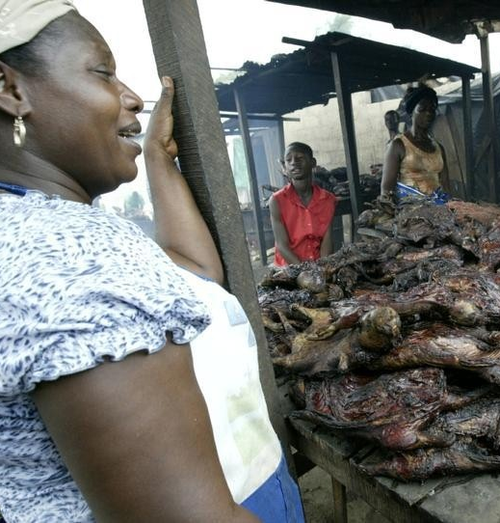
Notes:
Another recent outbreak of zoonotic disease, Ebola virus The Ebola outbreak in several west African countries in 2014 – 2015 caused 12,000 fatalities. It was the largest outbreak of Ebola observed to date and 2 out of every 5 people who contracted it died. At that time, there was no vaccine for this strain of Ebola, only treatments to alleviate symptoms, which require close monitoring and hospitalization to survive for many of the infected Bats are a reservoir for Ebola, although the virus also resides in primate species.
https://www.theatlantic.com/photo/2014/08/liberia-battles-ebola-epidemic/100795/ The two most common types of Ebola virus are Zaire ebolavirus and Sudan ebolavirus. The 2014-2015 outbreak was Zaire ebolavirus, for which there is now an effective vaccine.

Slide 3
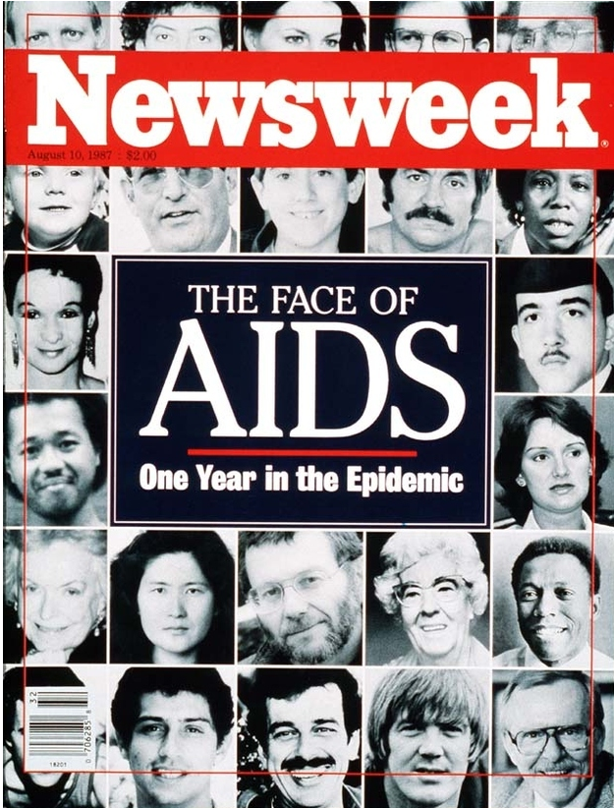
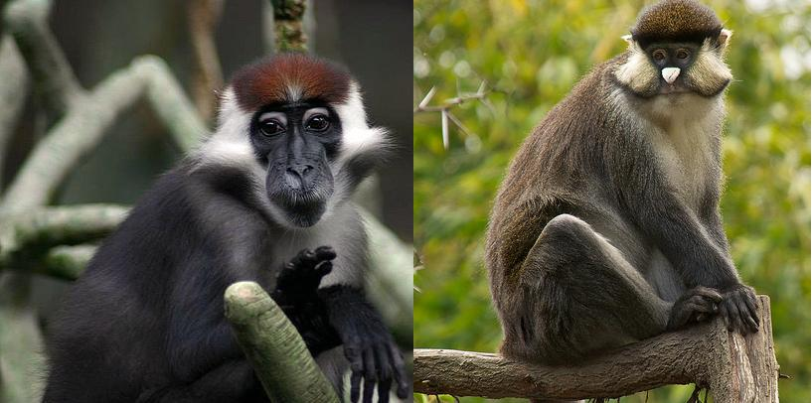
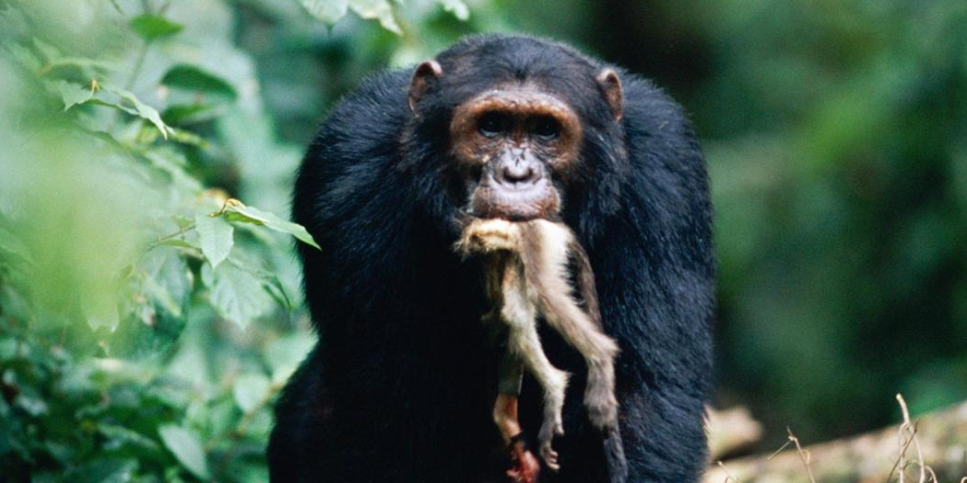
Notes:
A zoonotic disease that killed many people over decades. It is no longer a terminal disease due to antiviral drugs which can prevent infection and arrest the replication of the virus in the human body. Since the beginning of the AIDS pandemic, nearly 78 million people have contracted HIV and close to 39 million have died of AIDS-related causes.
Monkeys, not chimpanzees, a primate, are the origin of HIV. Red-capped mangabeys and greater spot-nosed monkeys were eaten by chimpanzees. Chimps acquired SIV (simian immunodeficiency virus) from these monkeys. When humans hunted, cleaned and consumed chimpanzees, SIV spilled over into the human population and became SIV.

Slide 4
Notes:
The upsurge in zoonotic diseases in the last few decades is shown in these graphs. Keusch, G. T., Amuasi, J. H., Anderson, D. E., Daszak, P., Eckerle, I., Field, H., ... & Saif, L. (2022). Pandemic origins and a One Health approach to preparedness and prevention: Solutions based on SARS-CoV-2 and other RNA viruses. Proceedings of the National Academy of Sciences, 119(42), e2202871119.

Slide 5
Notes:
Keusch, G. T., Amuasi, J. H., Anderson, D. E., Daszak, P., Eckerle, I., Field, H., ... & Saif, L. (2022). Pandemic origins and a One Health approach to preparedness and prevention: Solutions based on SARS-CoV-2 and other RNA viruses. Proceedings of the National Academy of Sciences, 119(42), e2202871119.

Slide 6
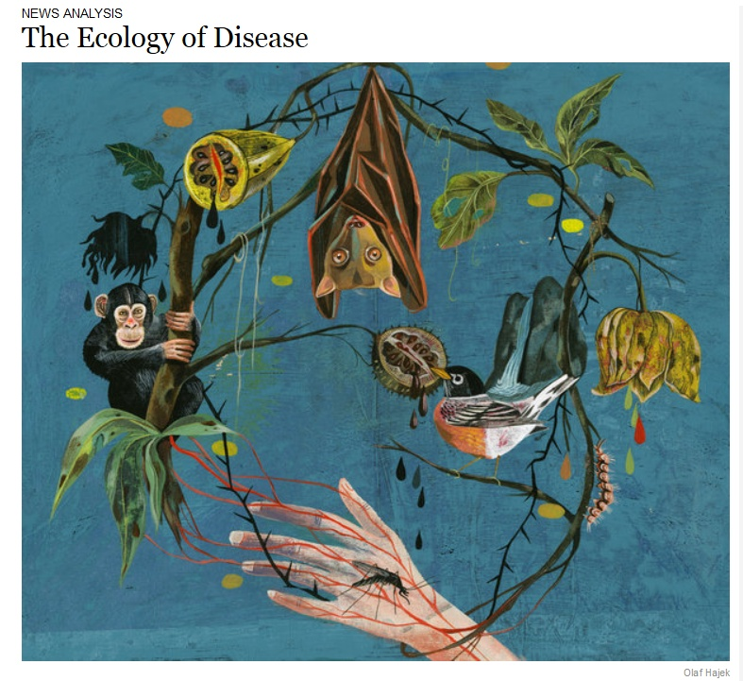
SARS-CoV-2, Ebola, HIV-AIDS are all zoonotic diseases, or zoonoses. They involve spillover of pathogens that exists in animals but can infect humans.
Human modification of ecosystems are often a driver of encounters between humans, animals, and pathogens
They comprise 60-75% of all human infectious diseases
Zoonotic diseases can differ in the timing of spillover.
They have crossed between us and other organisms sometime in the past and now reside entirely in humans
They may jump repeatedly back and forth between humans and animals
Notes:
Polio is not a zoonotic disease.

Slide 7
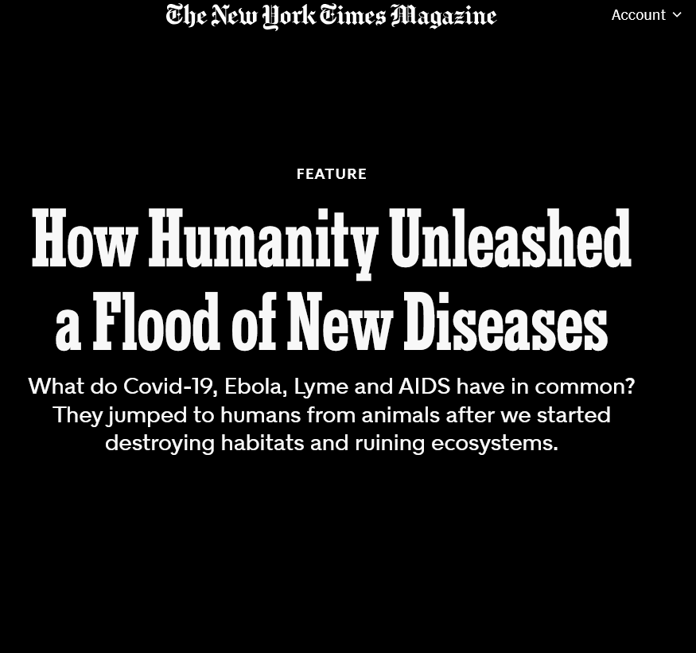
Readings/Questions 10
Notes:
https://www.nytimes.com/2020/06/17/magazine/animal-disease-covid.html

Slide 8
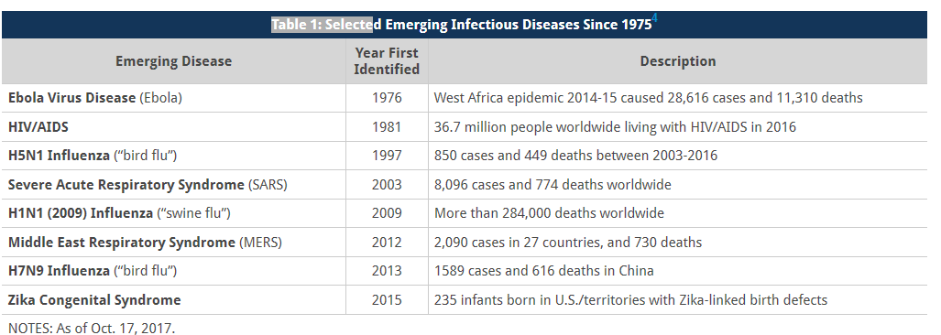
After optimism of 1960-70s about conquering infectious diseases, global concern has grown about the increasing frequency of spillovers of zoonotic disease in the last two decades
Notes:
This list was made in 2015
You can add SARS-CoV2 to this list There has also been a global pandemic of monkeypox, near the end of our recent SARS-CoV2 pandemic While not every newly identified infectious disease has major public health implications, some result in significant epidemics or global pandemics. Such outbreaks can lead to significant economic costs and interruptions in trade and travel. For example, SARS created an estimated $30 billion in economic losses in 2003, primarily from reduced commerce, travel and trade. Zika cost six U.S. states an estimated $0.5 to $2 billion. Costs for our recent SARS-CoV2 pandemic in the US is estimated to be 14 million by then end of 2023.

Slide 9
Zoonoses and PHEICs
Zoonotic disease has been responsible for seven of the eight World Health Organization’s declarations of Public Health Emergencies of International Concern (PHEIC) – all declared since 2003.
2003: SARS-CoV-1
2009-2010: H1N1 influenza pandemic
2014: Polio resurgence
2014-2016: Ebola in Guinea, Sierra Leone, Liberia (west Africa)
2015-2016: Zika virus
2018-2020: Ebola in Democratic Republic of Congo (central Africa)
2020-2023 SARS-CoV-2 pandemic
2022: Mpox
Notes:
Polio is not zoonotic. The virus can reside in the soil, although it may be likely that some microbial processes may be part of its capacity to survive outside of the human body Criteria used by WHO and member states when considering whether to declare or report a Public Health
Emergency of International Concern:
Is the public health impact of the event serious?
Is the event unusual or unexpected?
Is there a substantial risk for international spread?
Is there a substantial risk for international travel or trade restrictions? Criticisms have been raised that PHEICs are too binary, either there is or there is not a global pandemic. Calls are being made for a new, objective epidemic scale that better communicates the potential severity of an epidemic
to member states and the public, and the necessity of activating proportional responses Fan, Victoria Y., Richard Cash, Stefano Bertozzi, and Muhammed Pate. "The when is less important than the what: an epidemic scale as an alternative to the WHO's Public Health Emergency of International Concern." The Lancet Global Health (2023).

Slide 10
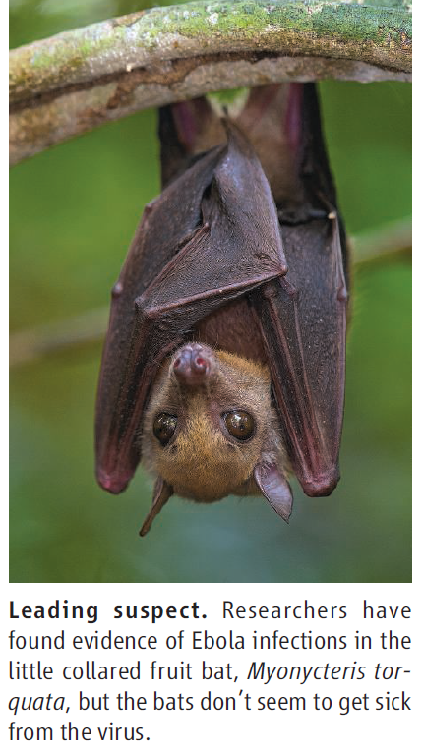
Chains of infection characterize zoonotic disease
Zoonotic disease can have multiple non-human animal reservoirs where pathogens can reside.
There are also vector species and amplifier species

Slide 11
Gorillas are an amplifier species for Ebola virus. The Ebola virus builds up in their tissues and results in mortality.
Bats are a reservoir of the Ebola virus but are asymptomatic.
Bats or gorillas can pass Ebola to humans

Slide 12
Notes:
Conceptualizations of spillover versus reality Because most pathogens that jump to humans have multiple nonhuman hosts it is time for the scientific community to at last put to rest the myth of there being
“a reservoir” for most pathogens Keesing, F., & Ostfeld, R. S. (2021). Impacts of biodiversity and biodiversity loss on zoonotic diseases. Proceedings of the National Academy of Sciences, 118(17).

Slide 13
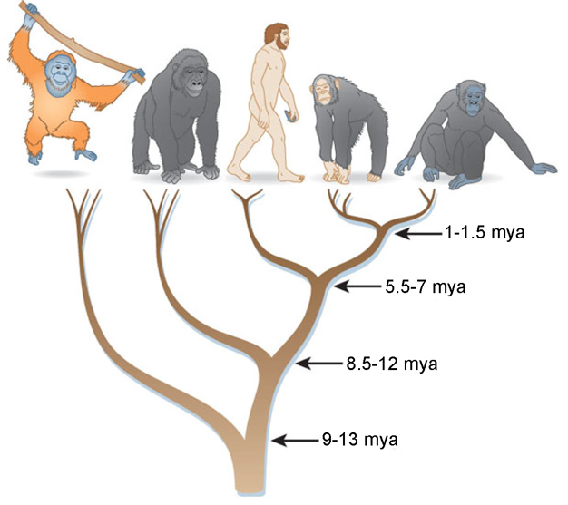
Human culture and ways of living today make us more vulnerable to viral zoonotic disease
Humans have more viral zoonotic pathogens, but fewer helminths (parasitic worms) and protozoa (single-celled organisms) pathogens than expected based on analyses of parasitism in other primates.
This is because our built environments and infrastructure create conditions unfavorable for helminths and protozoa and more favorable for viral spillovers and spread
Notes:
Amoroso, C. R., & Nunn, C. L. (2021). Epidemiological transitions in human evolution and the richness of viruses, helminths, and protozoa. Evolution, medicine, and public health, 9(1), 139-148.

Slide 14
Endemic zoonotic disease
A pathogen may spillover into a human population and then disappear.
However, the pathogen may become endemic to a human population in two ways.
The pathogen persists in local animal populations and routinely spills over from animal into human populations (river blindness).
The pathogen becomes established in the human population to the extent that in no longer requires an animal reservoir (measles or influenza B)
Notes:
One would say that river blindness was endemic in Uganda

Slide 15
Reverse zoonoses and secondary spillover
During the SARS-CoV-2 pandemic there were concerns about transmission of pathogens from humans to novel animal reserviors, in what are called “reverse zoonoses”
This can set the stage for a secondary spillover back into humans
Approximately 30 animal species have been identified as becoming infected by SARS-CoV2 transmitted by humans.
Notes:
Fagre, A., Cohen, L. E., Eskew, E. A., Farrell, M., Glennon, E., Joseph, M. B., ... & Albery, G. (2021). Spillback in the Anthropocene: the risk of human-to-wildlife pathogen transmission for conservation and public health.
Sparrer, M. N., Hodges, N. F., Sherman, T., VandeWoude, S., Bosco-Lauth, A. M., & Mayo, C. E. (2023). Role of Spillover and Spillback in SARS-CoV-2 Transmission and the Importance of One Health in Understanding the Dynamics of the COVID-19 Pandemic. Journal of Clinical Microbiology, e01610-22.
There are at least 31 animal species that are known to be susceptible to SARS-CoV-2, including mink (Neovison vison), white-tailed deer (Odocoileus virginianus), domestic cats (Felis catus domesticus), domestic dogs (Canis lupus familiaris), nondomestic felid species (genus Panthera), and golden hamsters (Mesocricetus auratus). These species have become infected via reverse zoonosis on multiple occasions, and all but domestic dogs seem to be capable of spreading SARS-CoV-2 between each other or potentially to humans (5). There is concern that viral mutations may accumulate within these species, in particular, mink and white-tailed deer, which have been shown to spread SARS-CoV-2 rapidly within populations.The virus could potentially spread back into humans from these species, bringing with it new mutations that affect viral pathogenicity, virulence, and existing immunity in humans

Slide 16
Readings/Questions 10
Notes:
https://www.nytimes.com/2022/01/19/magazine/spillback-animal-disease.html

Slide 17
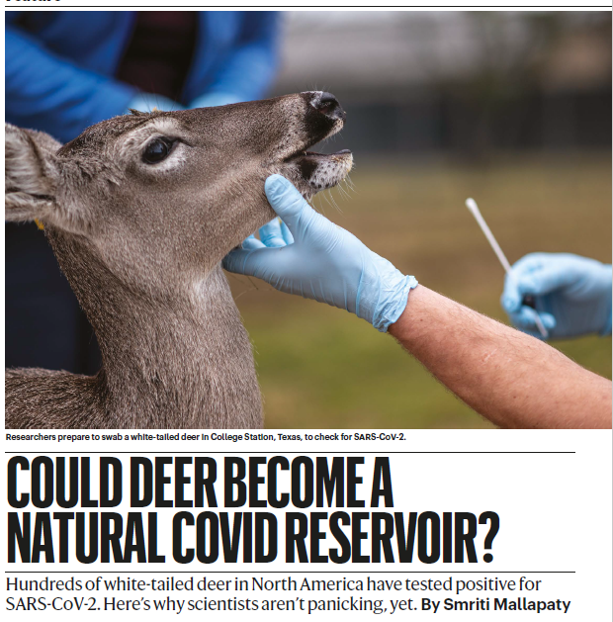
Notes:
https://www.nature.com/articles/d41586-022-01112-4

Slide 18
Zoonoses become difficult to control as number of reservoir species and their interactions increase
Zoonotic disease becomes more difficult to control or eradicate as the number of host species and their interactions increase
Video
Notes:
The guinea worm offers a good example of this difficulty of addressing zoonotic disease when it is embedded in ecosystems and animals

Slide 19
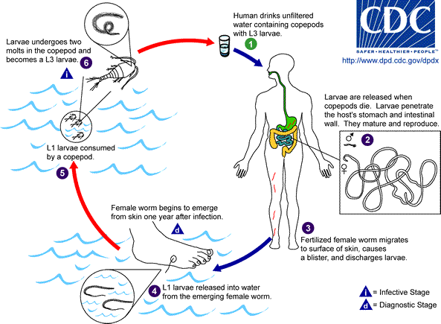
Ecological interactions associated with Guinea-worm disease (Dracunculiasis)
Reservoirs are copepods
Caused by drinking water with larvae of the parasitic worm living in copepods
Symptoms develop one year after infestation: fever, swelling and pain at worm site
90% of worms come out in legs and feet.
Removing worm can take several days to weeks and is very painful, slow, and debilitating.
Secondary bacterial infections often develop as a result of open wounds.
No drug, no vaccine to prevent re-infection
Notes:
Dracunculiasis, or “affliction with little dragons”
The pain drives the victim to dunk the leg in water, and the worm releases millions of larvae, starting the cycle anew.
Because most worms emerge in July, the middle of the growing season, crops can’t be tended. Besides the pain, the community will not be productive and will be faced with hunger. To get water or prepare a meal is a nightmare.”

Slide 20
Downward trend in infection over time due to eradication efforts
Could be the first parasitic disease to be eradicated
The eradication strategy involves:
Establishing community-based surveillance systems
Implementing effective case containment measures
Filtering of drinking water
Health education and community mobilization
Insecticides
Notes:
https://www.cartercenter.org/health/guinea_worm/
"I'd like for the last Guinea worm to die before I do," President Carter told reporters in 2015 When The Carter Center assumed leadership of the Guinea Worm Eradication Program in 1986, there were an estimated 3.5 million human cases annually in 21 countries in Africa and Asia. https://ourworldindata.org/grapher/number-of-reported-guinea-worm-dracunculiasis-cases?time=earliest..2023

Slide 21
in 1986, there were an estimated 3.5 million human cases annually in 21 countries in Africa and Asia.
Came close to eradication in 2010’s until a resurgence occurred in 2017-2019 when the guinea worm began infecting dogs
That has been brought under control and in 2023 there were only 14 cases, although this number may be higher because of the challenges of documenting all infections
Notes:
https://www.cartercenter.org/news/pr/guinea-worm-worldwide-cases-jan2019.html
https://www.nytimes.com/2018/03/22/health/south-sudan-guinea-worms.html

Slide 22
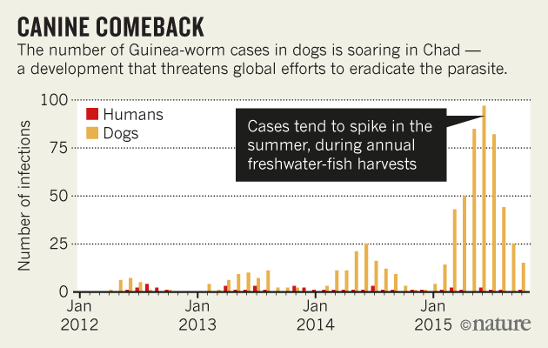
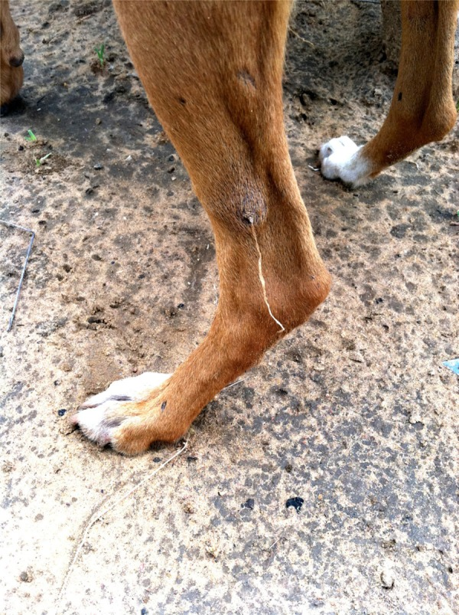
Most of Chad’s cases have occurred among fishing communities along the Chari River where dogs are eating the entrails of gutted, copepod-eating fish. Dogs then reintroduce the worms to humans by reintroducing the larvae into water.
Notes:
http://www.npr.org/sections/goatsandsoda/2016/08/09/489330803/why-the-world-isn-t-close-to-eradicating-guinea-worm

Slide 23
Readings/Questions 10
Notes:
https://www.nytimes.com/2018/06/18/health/guinea-worms-dogs-chad.html
Unlike the deer that were able to host the SARS-CoV-2 (Covid-19) virus, dogs provided a means for the parasite to reinfect humans. Deer-to-human transmissions of Covid did not take place, at least not within our modes of disease surveillance.

Slide 24
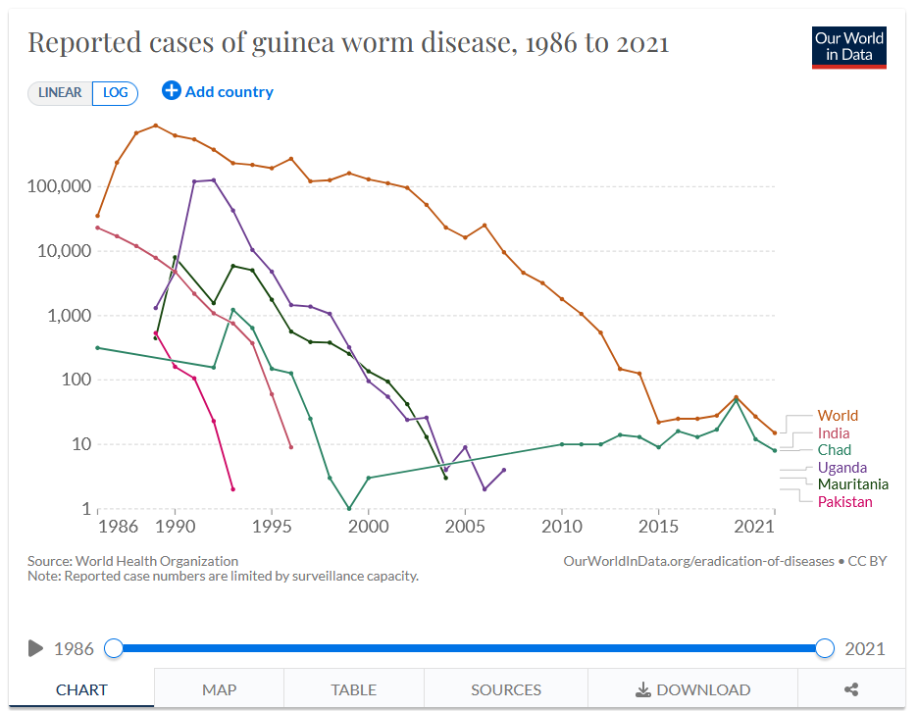
Notes:
In 2021, there were only 15 cases in the world. Spread in dogs was controlled.
https://ourworldindata.org/guinea-worm-path-eradication

Slide 25
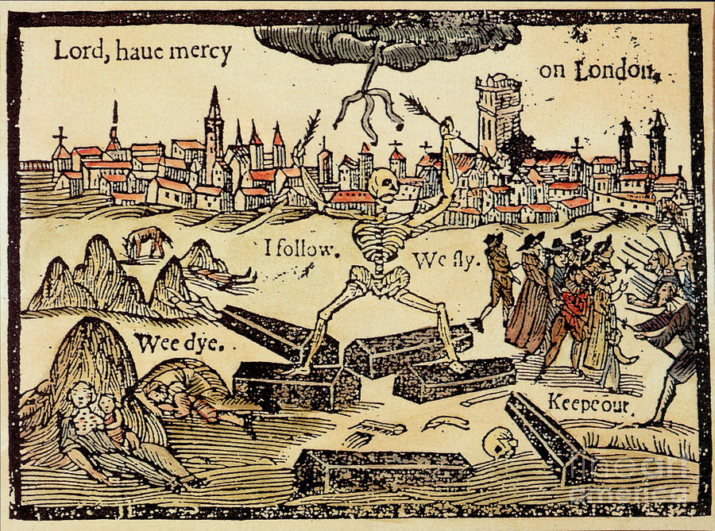
Plague
Notes:
The Black Death was one of the most devastating pandemics in human history, peaking in Europe in the years 1346–53. The Black Death spread throughout Europe, the Middle East and northern Africa and wiped out up to 30% to 50% of the population. The plague occurred in waves.
The Black Death killed 75 to 200 million people.
The aftermath of the plague created a series of religious, social, and economic upheavals, which had profound effects on the course of European history.

Slide 26
Notes:
https://www.nytimes.com/2020/07/15/sunday-review/coronavirus-history-pandemics.html

Slide 27
Notes:
Roosen, J., & Curtis, D. R. (2018). Dangers of noncritical use of historical plague data. Emerging Infectious Diseases, 24(1), 103.

Slide 28
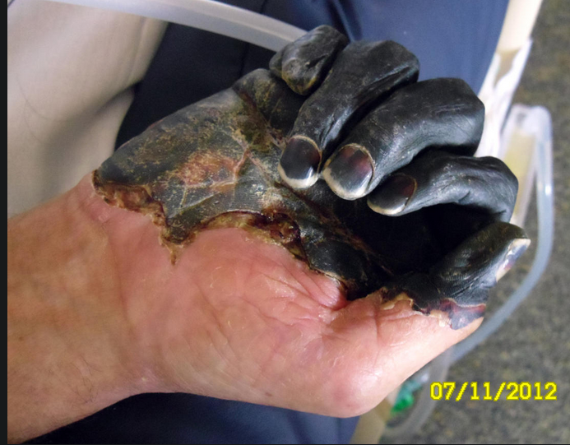
Notes:
Climate records taken from tree rings and incidents of plague suggest that a more dry-adapted rodent like the wild gerbil instead of rats were responsible for the plague
Wet springs and warm summers in Central Asia were correlated with European plague outbreaks.. A couple of years after a wet spring and warm summer in Central Asia an outbreak of plague would occur in Europe. Gerbil populations are a reservoir of plague bacteria (as are many small rodents), and when their numbers increased during these favorable wet springs and warm summers, fleas would increase too and spread to rats. The plague-bearing fleas and rats would disperse along the Silk Road, a major source of trade between Europe and Central Asia during the time period of the Black Death
The microbial pathogen responsible was the Yersinia pestis, a bacterium. It still results in several hundred deaths per year. Untreated pneumonic plague has a mortality of nearly 100%. The hand in the image has the bubonic form in which the bacteria infects the lymphatic system and sometimes blood.
http://www.nytimes.com/2015/02/25/science/rats-may-be-exonerated-in-european-plague-say-scientists-with-a-gerbil-theory.html?ref=science&_r=0
https://www.cbsnews.com/pictures/ore-man-survives-black-death-plague-graphic-images
https://www.bbc.com/news/science-environment-31588671
/

Slide 29
Notes:
Schmid, B. V., Büntgen, U., Easterday, W. R., Ginzler, C., Walløe, L., Bramanti, B., & Stenseth, N. C. (2015). Climate-driven introduction of the Black Death and successive plague reintroductions into Europe. Proceedings of the National Academy of Sciences, 112(10), 3020-3025.

Slide 30
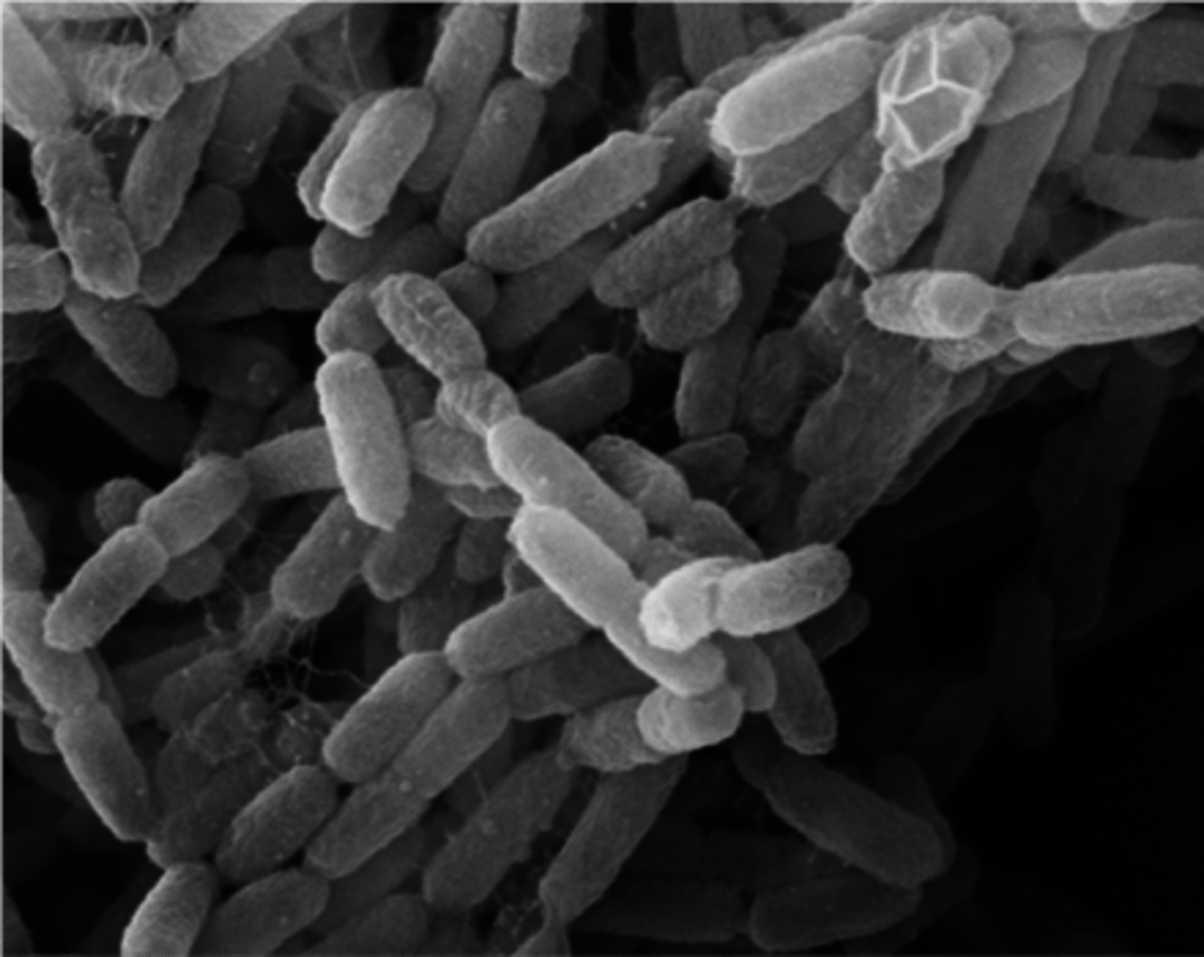
Yersinia pestis, the bacterial agent of the plague
Notes:
http://www.who.int/csr/don/27-november-2017-plague-madagascar/en/ https://youtu.be/WT2XgejsXpY?si=sl5ntf0O5DL3KCCm 202 deaths as of Nov 2017 in Madagascar during recent plague
The pneumonic form of the plague was mainly responsible for this outbreak in Madagascar, a form that can be spread through exhaled aerosols

Slide 31
How housing and burial practices link to plague
Madagascar is one of the last places where outbreaks of human bubonic plague still happen regularly.
Fleas carrying the plague bacterium Yersinia pestis can spread the disease through their bites. And while a species commonly known as “the rat flea” has been fingered as the main culprit in plague outbreaks, a species known as “the human flea” plays a secondary role.
In Madagascar where plague outbreaks have occurred, huge variability in the number of fleas in different households in the same village
Notes:
https://news.emory.edu/stories/2024/04/esc_identifying_flea_infestation_30-04-2024/story.html

Slide 32
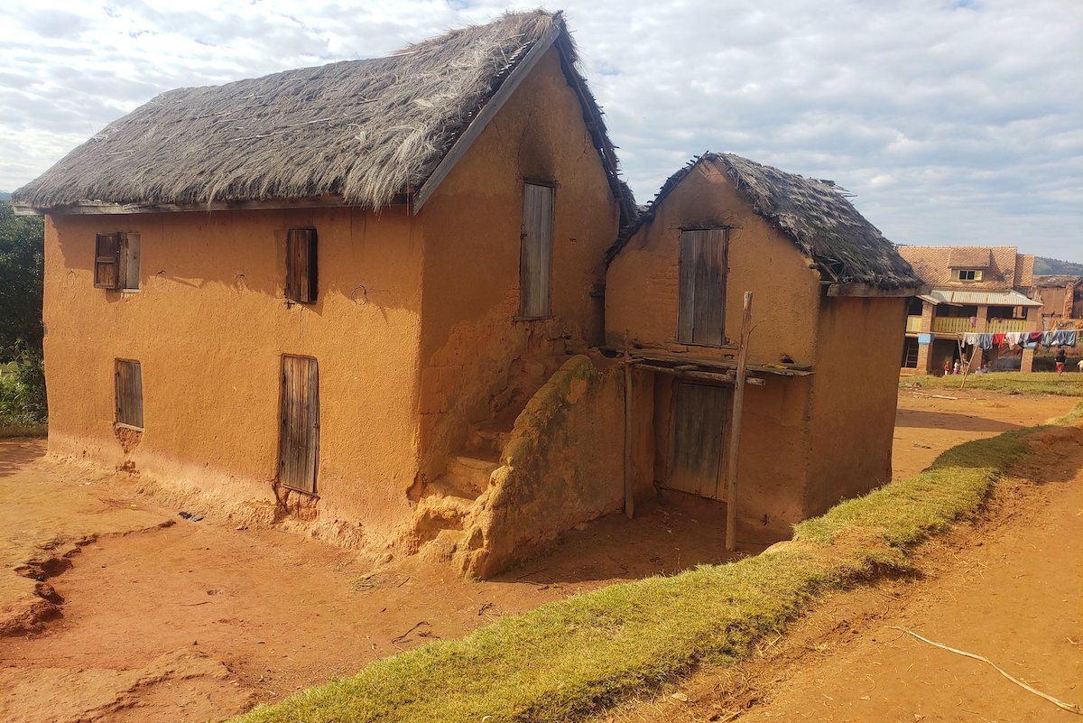
Households that have a traditional dirt floor covered by a plant-fiber mat, as opposed to households with cement or board floors increase the number of fleas
Flea larvae need humidity and the dirt covered by the plant-fiber mat holds an ideal amount of moisture for them to thrive
A secondary risk factor was keeping animals in the house at night.

Slide 33
Notes:
The custom of “famadihana” in Madagascar increases the potential for the spread of plague https://youtu.be/S4dVWOhoiPY?si=ej6m3wbB2nbjzgo0 https://sg.news.yahoo.com/plague-alert-over-madagascars-dance-dead-030315553.html In Madagascar, ceremonies in which families exhume the remains of dead relatives, rewrap them in fresh cloth and dance with the corpses are a sacred ritual. But an outbreak of plague sweeping the Indian Ocean island nation has prompted warnings that the macabre spectacle, known as the turning of the bones or body turning, presents a serious risk of contamination.

Slide 34
Notes:
https://www.nature.com/articles/d41586-022-03160-2

Slide 35
Natural selection during the Black Death and its impact on human health today
An immune system that was very responsive to the plague bacterium increased the odds of survival
Genes for this immune system function were passed on
The genetic variations that were adaptive for surviving the plague are associated today with certain autoimmune disorders, such as Crohn’s disease, rheumatoid arthritis and lupus.
In these diseases, the immune system that defends the body against disease and infection attacks the body’s own healthy tissues.
What was once an adaptation that enhanced survival is now a cause of autoimmune disease
Notes:
Such rapid and strong selection is highly unlikely to occur for human traits other than immune defense. No other set of traits is under such strong evolutionary pressure. https://www.nature.com/articles/d41586-022-03160-2

Slide 36
Commonalities among zoonotic diseases: environmental change and human vulnerabilities
Zoonotic diseases are associated with environmental change and the modification of ecosystems
Ebola, malaria, SARS-CoV-2, HIV, plague – all involve human modification of or interaction with the environment and the organisms in them.
The presence of vulnerable human populations are also often involved with zoonotic disease
Notes:
http://www.nytimes.com/2016/02/02/health/zika-virus-world-health-organization.html

Slide 37
Notes:
The Zika virus pandemic will have long lasting social and economic effects for an entire generation of mothers and children. Poorer families in which a woman contracted Zika and had a baby with microcephaly are not as able to meet their needs and those of the child.

Slide 38
Notes:
https://www.nytimes.com/2016/04/06/world/africa/uganda-zika-forest-mosquitoes.html In 1947, Uganda’s population was about 4.5 million; today, it is nearly 40 million.

Slide 39
Notes:
5 million people in Uganda to 40 million today – and with it has come altered ecosystems, land use change, and a more mobile human population

Slide 40
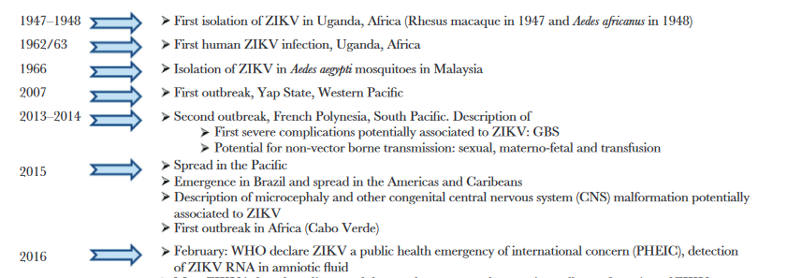
Zika virus (ZIKV)
Virus was initially isolated in monkeys, in the Zika forest of Uganda in 1947,
ZIKV was first detected in humans in Uganda in 1962-63
During the first 60 years of its known existence, epidemic ZIKV was never reported. It caused a mild flu-like illness.
However, in 2007, outbreaks of Zika occurred in the Micronesian Yap Islands.
In 2013, ZIKV outbreak in French Polynesia, where 30,000 suspected cases affected 50–66% of the population. Growing indication of more serious impacts on health.
The largest ZIKV outbreak to date began in Brazil at the end of 2014 and beginning of 2015
2016: ZIKV declared a PHEIC by WHO
Notes:
Gubler, D. J., Vasilakis, N., & Musso, D. (2017). History and emergence of Zika virus. The Journal of Infectious Diseases, 216; S860-S867. https://academic.oup.com/jid/article/216/suppl_10/S860/4753677 https://www.who.int/emergencies/zika-virus/timeline/en/

Slide 41
Notes:
https://directorsblog.nih.gov/2018/05/29/tracing-spread-of-zika-virus-in-the-americas/

Slide 42
Notes:
Brazil versus Tahiti The soccer game that may have brought Zika back to Brazil from Tahiti, part of French Polynesia. Brazilians travelled there in large numbers for this tournament and then went home to Brazil

Slide 43
From the Zika Forest to the rest of the world
The species of mosquito linked to the virus in Uganda, Aedes africanus, has preference for monkeys rather than humans and tended to remain in forests – this kept ZIKV from infecting a lot of humans.
As the area around the Zika forest was cleared and developed, human populations increased
Mosquitoes changed host preferences and started biting humans, thereby facilitating the spillover of ZIKV into human populations. Yet then it only caused a benign infection in humans, with only a mild fever
Globalization and air travel made it possible for ZIKV to travel around the world via humans
ZIKV then found its way into the mosquito Aedes aegypti, which is distributed globally and aggressively preys on humans and does not remain in forests
Viral evolution occurred in ZIKV that made it more transmissible and capable of crossing the placental barrier

Slide 44
Brazil and ZIKV
Brazil had experienced a relatively long interval of stable growth and increasing numbers of people moving into the middle class
The ZIKV pandemic in 2015-2016 arrived at the same time as one of the worst economic downturns in 25 years in Brazil
Video

Slide 45
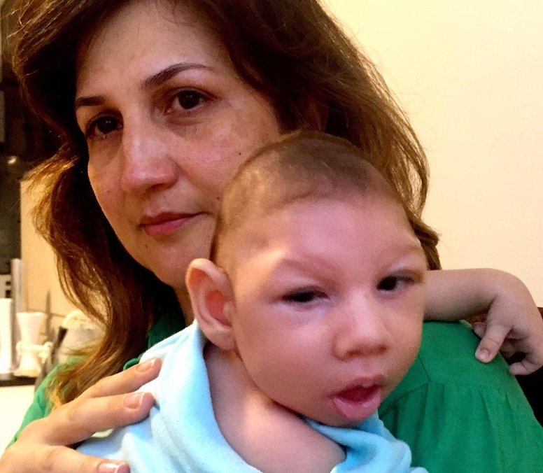
In communities at the heart of the epidemic in northeast Brazil, more than 60% of the exposed population was infected with
A sudden rise in cases of microcephaly were detected throughout Brazil and the Americas
Notes:
Genetic changes in the virus likely resulted in emergence of a virus strain with increased transmissibility leading to greater epidemic potential and perhaps virulence
Aedes aegypti, the yellow fever mosquito, is a mosquito that can spread dengue fever, chikungunya, Zika fever, and yellow fever.
Scientists have established that a mutation in Zika allowed it to cross the barrier of the placenta in the womb — a first for a mosquito-borne virus — but they don’t know why the babies of some pregnant women who caught Zika escaped unscathed. Between 7 percent and 14 percent of babies born to mothers who caught Zika while pregnant have congenital Zika syndrome, the spectrum of symptoms observed in infants exposed to the Zika virus in utero. In about 3 percent, the effects include microcephaly. Researchers say new cases of congenital Zika syndrome are occurring and that the virus is still circulating in Brazil and beyond (2022)

Slide 46
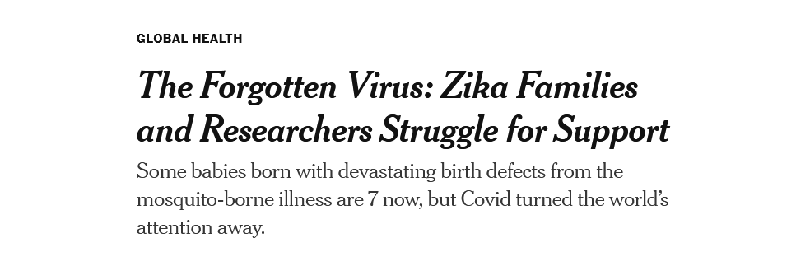
Zika infections dropped dramatically through a combination of herd immunity, household-level mosquito elimination efforts, and broader mosquito control programs
New cases of congenital Zika syndrome still occur but the virus is circulating at very low levels
However, there is a lasting impact on those families who are raising children impacted by Zika
In sum, Zika was a consequence of globalization, ecosystem change, and also the presence of a vulnerable human population

Slide 47
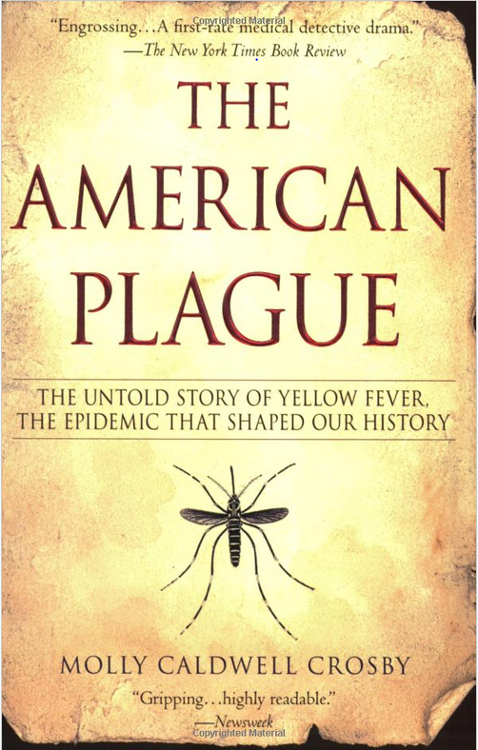
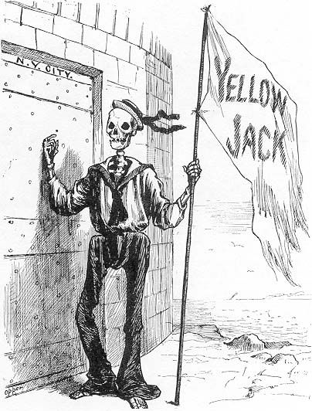
Notes:
https://www.who.int/csr/don/11-february-2019-yellow-fever-brazil/en/

Slide 48
Yellow fever
In 1878, an epidemic in Memphis, Tennessee, killed 5,000.
Yellow fever hasn’t spread in the US for 100 years
However, yellow fever virus is estimated to cause 200,000 cases of disease and 30,000 deaths each year, with 90% occurring in Africa.
Symptoms from infection with virus are mild and flu-like
But 15% of patients experience severe hemorrhagic fever, and up to half of these will die.
After plaguing humanity for centuries, a vaccine was developed in 1937
Notes:
Norrby, E. (2007). Yellow fever and Max Theiler: the only Nobel Prize for a virus vaccine. Journal of Experimental Medicine, 204(12), 2779-2784.
The first confirmed outbreaks of yellow fever in the American colonies occurred in Charleston, Virginia, and Philadelphia, Pennsylvania, in 1699. A Quaker diarist in Philadelphia wrote that there were “few houses, if any, free of the sickness.” A 1793 outbreak in Philadelphia killed about 10% of the city’s population. Eventually the colonists would discover that yellow fever was somehow being imported by ships from the West Indies and implement quarantine policies, but it was not until 1900 that U.S. Army researchers pinpointed mosquitoes as the transmission vector for the disease.
https://www.historyofvaccines.org/index.php/content/articles/yellow-fever
Only through mosquito control measures has the disease been eliminated in the southeastern US.

Slide 49
There are two types of yellow fever cycles
Sylvatic (jungle)
Urban
Different species of mosquitoes and mammals are involved with each cycle
A human in a sylvatic cycle may introduce it into an urban cycle, where monkeys are no longer required for an outbreak to continue
Conversely, if monkeys occur close to cities, spillover of the YFV from the sylvatic to the urban cycle can occur
Some mosquito species, like Aedes albopictus, can be involved in both cycles

Slide 50
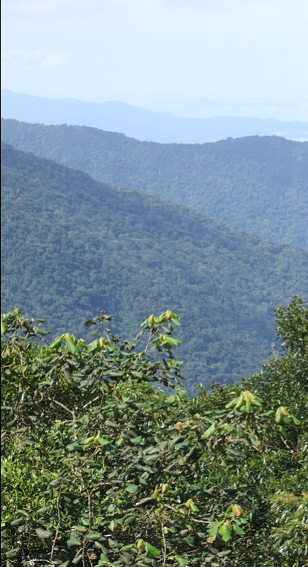
Yellow fever resurgence in Brazil
Notes:
https://www.who.int/csr/don/11-february-2019-yellow-fever-brazil/en/
6.32 million people in Rio de Janiero (above) 12 million people in Sao Paulo

Slide 51
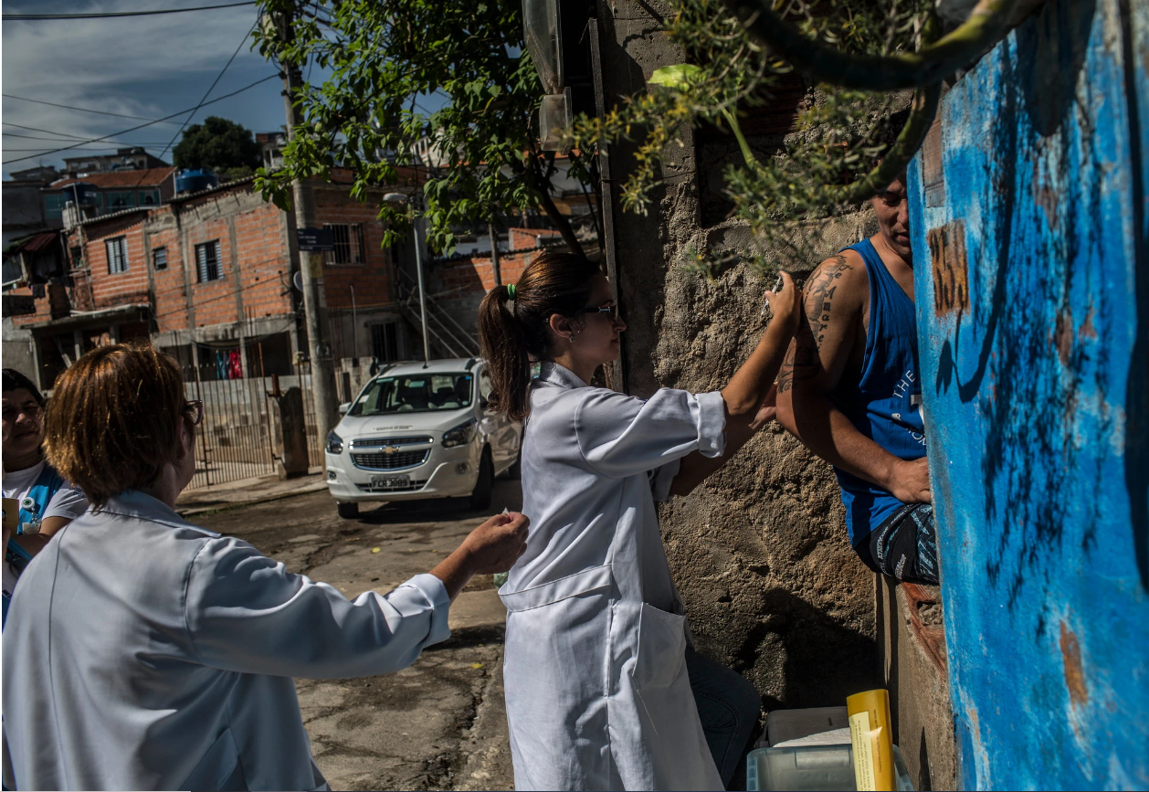
Still no urban cycle of YF reported in Central or South America since the end of Aedes eradication program in late 1950s
However, increasing numbers of non-vaccinated humans visit forests in South American jungles where sylvatic cycle of YF is transmitted by mosquitoes
They return to Aedes-infested urban areas, which increases the risk of resurgence of the urban cycle of YF in the Americas
Video
Readings/Questions 10
https://www.aljazeera.com/videos/2018/1/29/brazil-millions-vaccinated-after-yellow-fever-outbreak
Notes:
https://www.who.int/csr/don/11-february-2019-yellow-fever-brazil/en/
The last documented outbreak of urban yellow fever in Brazil was recorded in 1942. Large cities in eastern Brazil, where immunization rates can be low, would be very susceptible to an urban-cycle epidemic of yellow fever, and large numbers of deaths would be likely. Covid-19 has also lowered vaccination rates for yellow fever
https://www.aljazeera.com/news/2018/01/brazil-millions-vaccinated-yellow-fever-outbreak-180129184934186.html
https://www.npr.org/sections/goatsandsoda/2018/04/12/601871150/yellow-fever-encroaches-megacities-straining-global-vaccine-supply

Slide 52
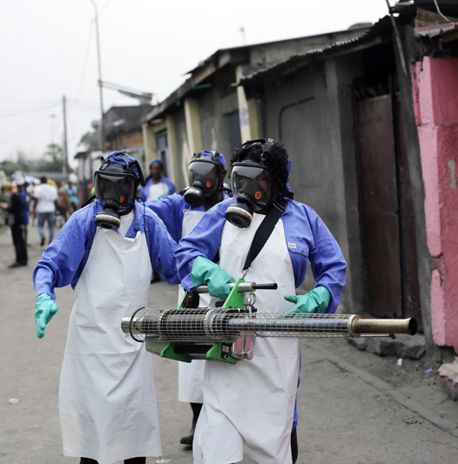
Yellow fever resurgence in sub-Saharan Africa
In 2016, Angola and Democratic Republic of Congo experienced urban cycle epidemics in which mosquitoes transmitted YFV from person to person via a mosquito rather than thru intermediary monkey hosts
Air travel to China resulted in detection of yellow fever there but only in travelers. YFV did not become established
Video
Notes:
In this photo teams from MSF carry out fumigation efforts in the Yolo Sud neighborhood of Kinshasa, Democratic Republic of Congo, in a bid to kill the mosquitos that transmit yellow fever. Photo: AP

Slide 53
Notes:
Wasserman, S., Tambyah, P. A., & Lim, P. L. (2016). Yellow fever cases in Asia: primed for an epidemic. International Journal of Infectious Diseases, 48, 98-103. Yellow fever travelled to China but did not become established.
Despite the success of YF vaccination in controlling outbreaks and protecting persons living in or traveling to YF-endemic areas, large numbers of Chinese workers appear to travel to yellow fever endemic areas of Africa without a pre-travel yellow fever vaccination
Map showing the distribution of Aedes aegypti across Africa and the Asia-Pacific region (areas shaded pink). The red outline delineates yellow fever-endemic regions. Yellow dots represent the location of yellow fever cases related to the Angolan outbreak (source: HealthMap). Commercial flight routes with direct connections between Luanda and Beijing and indirect connections from Luanda to South and Southeast Asia via Dubai (source: FLIRT) are also represented. (This map appears in Wasserman et al: International Journal of Infectious Diseases)
https://www.elsevier.com/connect/yellow-fever-epidemic-threatens-to-spread-from-angola-to-china

Slide 54
Climate conditions and the distribution of Aedes aegypti make it possible for yellow fever to return to the US.
A traveler from another country could also reintroduce YVF to the US and create a local outbreak.
However, current surveillance, monitoring, vaccination of travelers, and mosquito control are likely to keep the possibility of a wider outbreak low – if funding for this public health service is maintained
Notes:
https://www.latimes.com/science/sciencenow/la-sci-sn-yellow-fever-americas-20170308-story.html

Slide 55
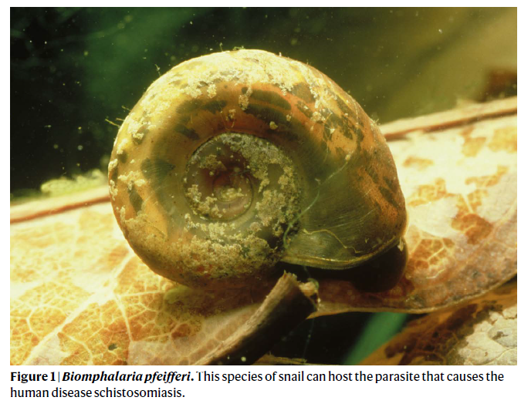
Schistosomiasis
World’s second most common parasitic human disease after malaria with more than
Over 200 million people are infected by it globally and the vast majority of these people live in sub-Saharan Africa.
Caused by snail-transmitted flatworms (Schistosoma species) that penetrate human skin
New cases of the disease often surge following the construction of dams.
Addressing the disease involves making changes to the ecosystems and the environment
Notes:
Schistosomiasis reinforces poverty, adversely affects the health of children and adults, and defies control efforts, because even when infections are treated with drugs, people can quickly get re-infected when they return to snail-infested waterbodies.
Although schistosomiasis only kills a relatively small proportion of the people who are infected, and then usually only after many years, the disease causes a great deal of disability and reduces the educational and work performance of infected individuals. It is thus known as a ‘disease of poverty’, both resulting from and contributing to lower socioeconomic conditions in the areas where it is endemic
Over the past two decades, global campaigns using antiparasitic medication have been carried out to combat the scourge of the disease. In 2022, the World Health Organization released guidelines to further expand the scale of these mass-treatment campaigns, with the goal of eliminating schistosomiasis as a public health problem by 2030. Although this strategy has yielded clear public-health benefits, the following key question remains: what solutions can be devised to further combat schistosomiasis and forge a sustainable future?
The parasitic worm’s life cycle includes an intermediate stage in a freshwater snail host of the genus Biomphalaria or Bulinus. Human infection, caused by worms of the genus Schistosoma, occurs with freshwater exposure (such as in a lake), when skin-burrowing juvenile parasites enter and migrate through the human body. The worms produce eggs that are excreted from the body in urine or stools. If these eggs reach areas of fresh water, hatch and find a snail, and then infect a human host, their complex life cycle is completed. Because of the parasite’s requirement for snails as part of its life cycle, there is a long history of public-health interventions aimed at reducing the snail population. Such approaches have focused on chemically treating freshwater bodies. These interventions have shown public-health benefits, but their adoption rates have been low, partly because of ecological concerns about the use of chemicals.

Slide 56
Notes:
After the Diama Dam was completed in 1986, the people living around the dam experienced the world’s largest recorded outbreak of intestinal schistosomiasis. Even decades later, in some villages upstream of the dam, almost all of the kids may be infected. The eggs produced by the flatworms end up dispersed throughout the body. The immune system then encapsulates the eggs in non-functioning, bony tissue. Bladder function diminishes, they suffer from chronic abdominal pain and distension of the abdomen, and it can ultimately culminate in bladder cancer.
Dams are associated with restricted movement and altered abundances of fish and other aquatic animals. Crayfish are a natural predator of snails and with the construction of dams, they may decline because of restricted mobility and alteration of the natural flood regime of the former rivers. This leads to the increase in snails and schstosomiasis. Dams are often accompanied by a substantial increase in fertilizer use since the main reason for building dams is often to make water available for irrigation. Fertilizer use can lead to nutrient enrichment of local waters and increased growth of aquatic vegetation that hosts the snail that hosts the flatworm that causes schistosomiasis

Slide 57
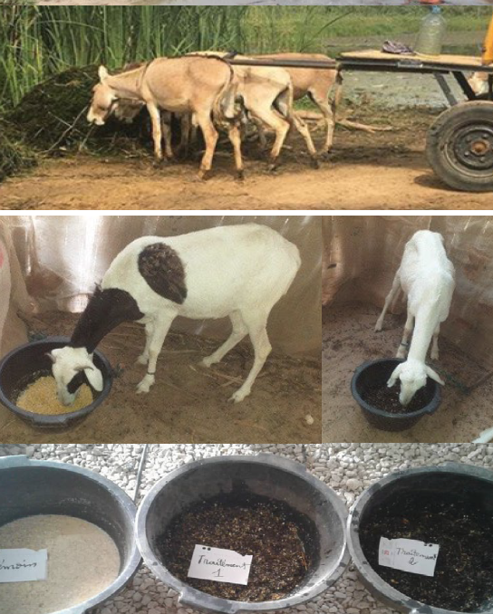
Integrated strategies to address schistosomiasis
Agricultural development and fertilizer use in West Africa fueled growth of submerged aquatic vegetation that serves as habitat for freshwater snails that transmit Schistosoma parasites
When submerged vegetation removed, Schistosoma infection rates in schoolchildren declined
Removed vegetation was effective traditional livestock feed and could also be used crop fertilizer
Notes:
Disease, food and water challenges intersect in many ways, such as through widespread poverty–disease traps, whereby disease exacerbates malnutrition, stunts physical and cognitive development and reduces educational attainment, labor supply and incomes, all of which impede economic growth that can improve sanitation and access to energy, water, education and healthcare.. Despite their interdependence, disease, food and water challenges are typically addressed independently by governmental and non-governmental organizations, practitioners and researchers.

Slide 58
Notes:
https://www.youtube.com/watch?v=uoWQDA1Syok

Slide 59
Crayfish can be farmed and released into the river as an additional way to control the abundance of snails that cause schistosomiasis
In sum, addressing zoonotic disease may also require the modification of the environment and altering aspects of livelihoods to diminish disease prevalence
Human modification of the environment is a globally ubiquitous process and so are zoonotic diseases.
However, the different ways the environment is modified in different parts of the world yield different kinds of zoonotic disease.
For the developed world, the absence of these encounters with zoonotic pathogens can indirectly lead to other diseases

Slide 60
Notes:
https://www.youtube.com/watch?v=NcV5vRO0K1U

Slide 62
Notes:
Bosch, T. C., Wigley, M., Colomina, B., Bohannan, B., Meggers, F., Amato, K. R., ... & Melby, M. K. (2024). The potential importance of the built-environment microbiome and its impact on human health. Proceedings of the National Academy of Sciences, 121(20), e2313971121.
Architectural design often reduces natural elements such as soil and trees, and there is a reduction of environmental microbes from nature entering the building. It is estimated that 90% of contemporary human life in “developed” economies is now spent “indoors”

Slide 63
Readings/Questions 10
Notes:
https://www.nytimes.com/2021/07/19/health/human-microbiome-hadza-rewilding.html

Slide 64
Germ theory: Koch’s postulates
The microbe must be found in all individuals suffering from the disease, but not in healthy individuals.
The microbe must be isolated from a diseased individual and grown into a pure culture.
The cultured microbe should cause disease when introduced into a healthy experimental host.
The microbe must be reisolated from the experimental host and shown to be the same as the original.
Notes:
The germ theory of disease was developed in the mid/late 19th century and is arguably the most important paradigm in the history of medicine. It states that microbial pathogens are responsible for causing infectious diseases, Carlsson, F., & Råberg, L. (2024). The germ theory revisited: A noncentric view on infection outcome. Proceedings of the National Academy of Sciences, 121(17), e2319605121. Photo: Mycobacterium tuberculosis, the bacterial causative agent of tuberculosis was identified and described for the first time in 1882 by Robert Koch,

Slide 65
Notes:
Typhoid Mary did not suffer the effects of typhoid even though she was capable of passing it on – an example of how Koch’s postulates are not always true

Slide 66
Host theory
Germ theory does not explain why different individuals infected by the same pathogen may experience very different disease severity or even no symptoms at all (asymptomatic carriership).
In host theory, the microbe is equated to an environmental trigger that merely reveals underlying and preexisting immunodeficiencies of the host
Infectious diseases are caused exclusively by inherited (“inborn errors of immunity”) or acquired immunodeficiencies of the host
Notes:
The people in the photos were not susceptible to HIV. Their immune systems controlled it. This control has not been linked to past environmental conditions: they had unique immune systems as a result of distinctive gene expressions in the cells of their immune systems. Only 1% of people are estimated to have these kinds of immune systems. Carlsson, F., & Råberg, L. (2024). The germ theory revisited: A noncentric view on infection outcome. Proceedings of the National Academy of Sciences, 121(17), e2319605121.
https://www.scientificamerican.com/article/genetic-clues-hiv-elite-controllers-better-vaccines-cancer-treatments/

Slide 67
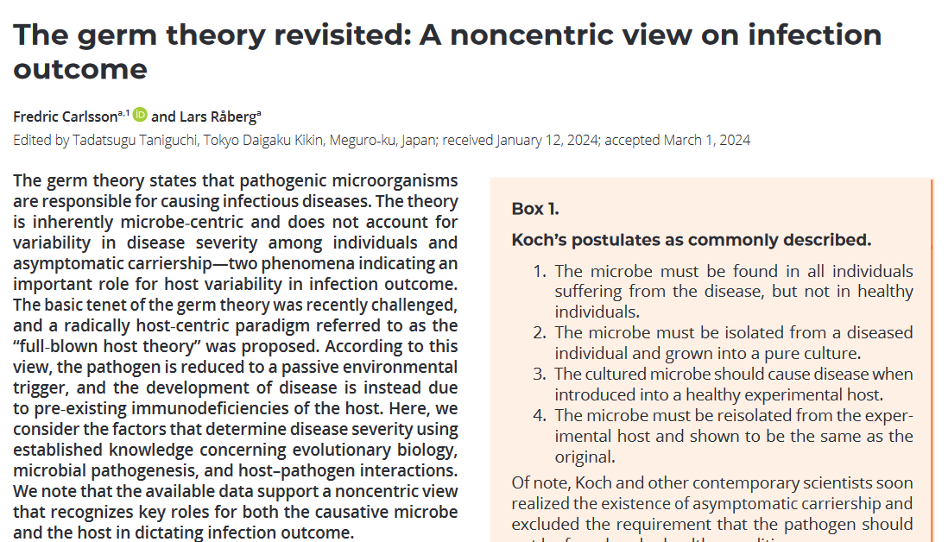
Notes:
The non-centric view recognizes key roles for both the microbe as in germ theory but also includes the role of the host’s immune system in dictating infection outcome. As we explain in the next slides, host theory accounts for how in one part of the world, intestinal parasites cause disease that can be debilitating, but in other part of the world, having intestinal parasites, can improve aspects of one’s health. The woman on the right is intentionally ingesting intestinal parasites.

Slide 68
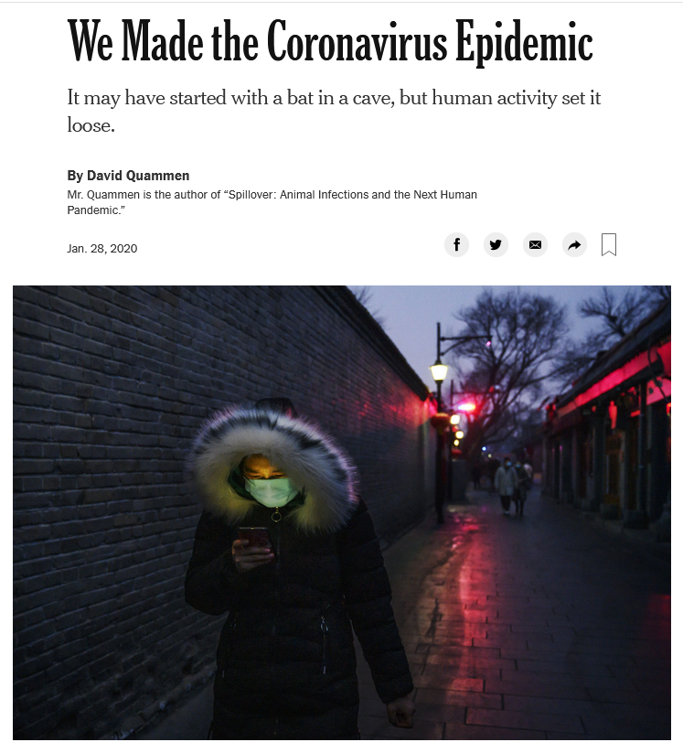
Readings/Questions 10
Notes:
We build airports and transportation systems that move humans millions of humans daily. We build huge cities with millions of people who are in close contact with each other. We have crowded into the natural environments where the animals that harbor coronaviruses live. In some parts of the world, we eat animals that carry coronavirus, and although this may be for cultural or ceremonial systems, sometimes wildlife consumption is a backup system for when our food systems falter. These animal products can also be shipped around the world, Our recent coronavirus pandemic was not our first. It was the worst though.

Slide 69
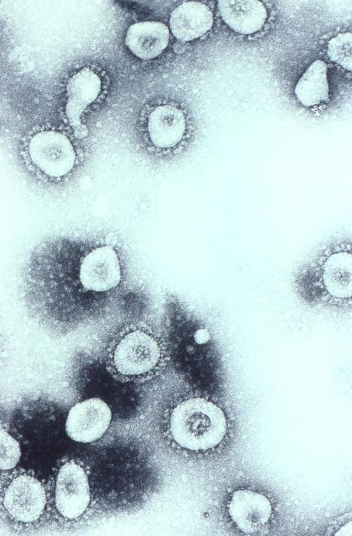
Seven presently known coronaviruses infect humans
Four cause common colds, two (OC43 and HKU1) came from rodents, and the other two (229E and NL63) from bats.
There are three well-documented large coronavirus outbreaks in humans that caused severe respiratory disease in
Severe Acute Respiratory Syndrome, or SARS-CoV-1 (2003)
SARS-CoV-2, the current pandemic virus (2019-2022).
Middle East Respiratory Syndrome, or MERS-CoV (2012)
Notes:
Cyranoski, D. (2020). Profile of a killer: the complex biology powering the coronavirus pandemic. Nature, 581(7806), 22-26.
OC43 shown on the right. Bats are a major reservoir for coronaviruses, although they may not be the animal responsible directly for the virus spillover into humans. Intermediary hosts often carry these viruses into humans: With SARS-CoV-1, the intermediary was civet cats, which are sold in live-animal markets in China. With MERS, the intermediary are camels With SARS-CoV-2, the intermediary was likely a pangolin, another animal in the live-animal trade.
MERS had a case fatality rate of 33% but this may be an overestimate because there may have been milder cases that remain undocumented. SARS-1 has mortality rates around 10%, with the rate for people older than 64 years being as high as 50%. SARS-2, aka Covid-19 is close to 2%. https://www.cidrap.umn.edu/news-perspective/2003/05/estimates-sars-death-rates-revised-upward

Slide 70
Notes:
Information in the graph is for mammals on Earth. Note that bats are the most numerous individuals. Humans and livestock are not included on this graph Greenspoon, L., Krieger, E., Sender, R., Rosenberg, Y., Bar-On, Y. M., Moran, U., ... & Milo, R. (2023). The global biomass of wild mammals. Proceedings of the National Academy of Sciences, 120(10), e2204892120.

Slide 71
The bat immune system
Bat immune system is ‘tuned’ not to overrespond to viruses because of its high metabolism
The energy demands of bat flight are very high
Cells in the body break down and release bits of DNA during activity
Mammalian immune systems interpret these metabolic byproducts as pathogens
However, the sensitivity of the immune system of bats has evolved to not overrespond to these byproducts, which would cause inflammation that could damage their body
This weakened response allows them to maintain a higher viral load as well
Instead of spending huge amounts of energy through an immune response to eliminate the virus completely, bats seem to tolerate low levels of their presence
Notes:
https://doi.org/10.1016/j.chom.2018.01.006 https://www.nature.com/articles/d41586-023-00791-x
Byproducts of oxidative metabolism and stress are known to cause DNA damage, resulting in the escape of self-DNA from the nucleus, mitochondria, or lysosomes into the cytoplasm
When pathogens do intrude, bats typically don’t overreact with an outsized inflammatory response, which is often responsible for much of the damage caused from an infection. Bats have several ways to tame the inflammatory response. Instead of spending huge amounts of energy getting rid of a virus completely, they seem to tolerate low levels of its presence in a kind of ‘peace treaty’ between bats and the pathogens they host

Slide 72
Notes:
The global dimensions of bats as a source of zoonotic disease on Earth. Streicker, D. G., & Gilbert, A. T. (2020). Contextualizing bats as viral reservoirs. Science, 370(6513), 172-173.

Slide 73
Barrier to rabies control
Post exposure prophylaxis (PEP) can be expensive for poor who are bitten by rabid animals
PEP more available and accessible in cities than in rural areas
Attitudes toward animals and whether dogs and cats have status as pets and are deserving of care
Notes:
Other factors: Livestock are more prized, so dogs receive less attention
Dogs are valued as pets in some cultures and places, in others they are not
Legal requirements regarding the registration and vaccination

Slide 74
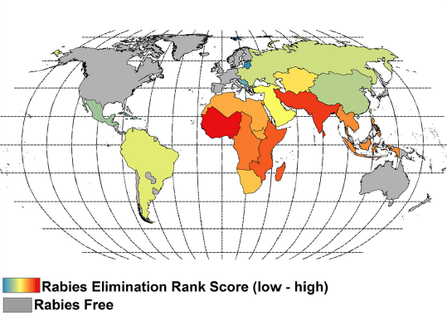
However, high public health costs for animal control. In US $300 million annually spent for animal control.
Dog vaccination and sterilization programs have only begun in the last few decades in other parts of the world
WHO goal is to eliminate dog-transmitted rabies in humans by 2030
Notes:
A low rank score represents a theoretically quicker pathway toward elimination. Note that many of the regions where rabies has a high elimination score, there are some countries experiencing war or political instability

Slide 75
WHO goal is to eliminate dog-transmitted rabies in humans by 2030
Notes:
A low rank score represents a theoretically quicker pathway toward elimination. Note that many of the regions where rabies has a high elimination score, there are some countries experiencing war or political instability

Slide 76
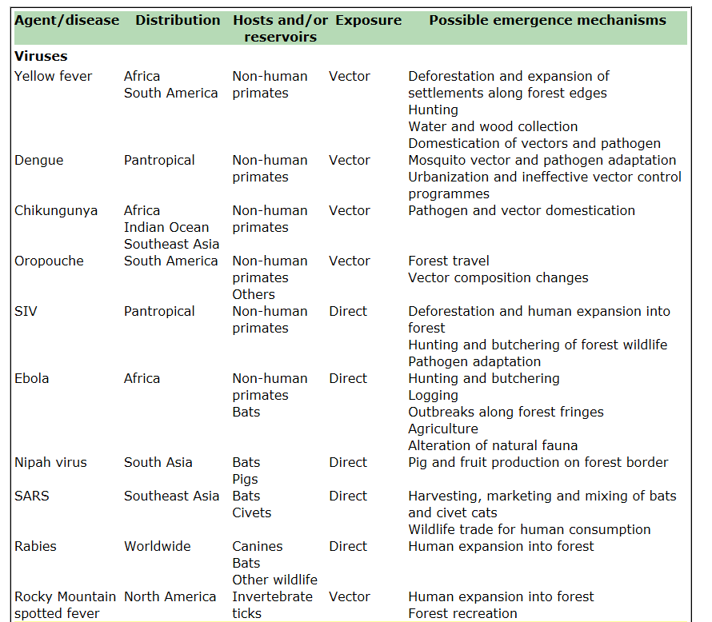
Having intact habitats is a public health service
Until recently, health community viewed natural world as only a source of disease – nature is ‘dirty’, unclean
Now recognized natural systems provide services to support human health.
Deforestation, hunting, expansion of settlements, urbanization, agriculture: all of these can lead to spillover of zoonotic pathogens into human populations

Slide 77
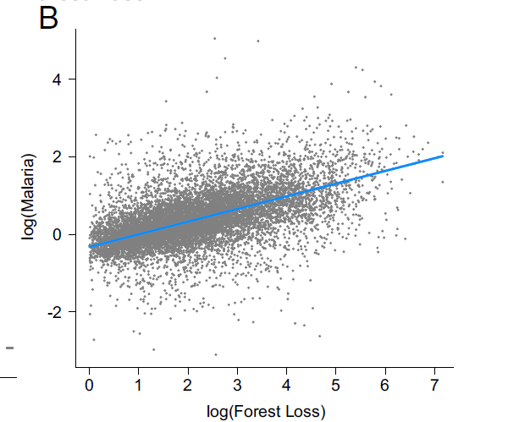
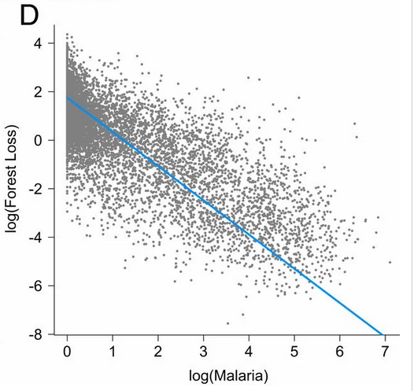
Amazon deforestation and malaria transmission
First forest effect: as forest loss increases in a formerly intact forest, malaria incidence increases
Sick logger feedback: as malaria incidence continues to increase, forest loss slows down
.
Notes:
MacDonald, A. J., & Mordecai, E. A. (2019). Amazon deforestation drives malaria transmission, and malaria burden reduces forest clearing: a retrospective study. The Lancet Planetary Health, 3, S13.
https://doi.org/10.1016/S2542-5196(19)30156-1
The effects of deforestation on malaria are largest in the early stages of deforestation in the interior of the Amazon as forest edge habitat increases, promoting mosquito vector breeding habitat, survival, and human biting rate, but the effects attenuate as forest loss progresses, forest edge area declines, and human settlements become larger and further removed from forest. The key implication is that forest clearing has a direct impact on human health
Socioecological feedbacks develop in which high malaria incidence simultaneously reduces forest clearing. Malaria reduces economic activity. In other words, elevated malaria burden may also reduce rates of deforestation. https://doi.org/10.1073/pnas.2409583121 There is likely more heterogeneity in the relationship between malaria and deforestation from state to state in Brazil, and within states and localities. Arisco, N. J., Peterka, C., Diniz, C., Singer, B. H., & Castro, M. C. (2024). Ecological change increases malaria risk in the Brazilian Amazon. Proceedings of the National Academy of Sciences, 121(44), e2409583121.

Slide 78
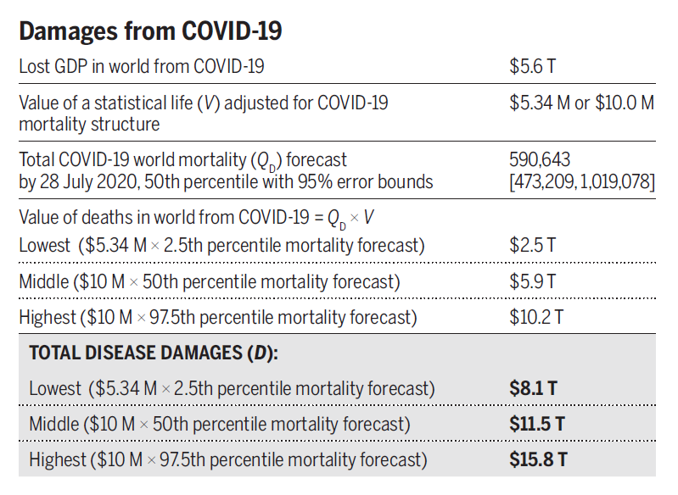
Choose your investment strategy:
Notes:
What is less costly? Investing in conservation-oriented approaches to prevent zoonoses from becoming pandemics, or just paying the costs that accrue with pandemics? Investments to prevent tropical deforestation and to limit wildlife trade will protect against future zoonosis outbreaks and in the long run cost less than the pandemics
Dobson, A. P., Pimm, S. L., Hannah, L., Kaufman, L., Ahumada, J. A., Ando, A. W. & Kinnaird, M. F. (2020). Ecology and economics for pandemic prevention. Science, 369(6502), 379-381.

Slide 79
Pathogen “chatter” and the inevitability of another global pandemic of zoonotic disease
Chatter refers to the periodic reporting from disease surveillance networks of new pathogens as well as localized ‘pop up’ cases of familiar pathogens in sometimes unexpected places.
These all indicate the potential for another pandemic to occur
SARS-CoV-1, SARS-CoV-2, MERS were not surprises – it is only a matter of time before another pandemic occurs
Notes:
https://harpers.org/archive/2020/06/findings-june-2020/

Slide 80
‘Missing’ zoonoses
Notes:
Numbers in color legend indicate predicted number of ‘missing zoonoses. Despite having a large number of bat species, there are missing bat zoonoses in South America. Viruses in bats don’t jump around as much in South America as in Africa, suggesting that evolutionary history, as well as biological and ecological interactions may be keeping these viruses from spilling over into other animals and potentially humans.
Olival, K. J., Hosseini, P. R., Zambrana-Torrelio, C., Ross, N., Bogich, T. L., & Daszak, P. (2017). Host and viral traits predict zoonotic spillover from mammals. Nature, 546(7660), 646.
Warmer colors highlight areas predicted to be of greatest value for discovering novel zoonotic viruses. c, Even-toed ungulates (order Cetartiodactyla, n = 70). d, Bats (order Chiroptera, n = 157). e, Primates (order Primates, n = 73). f, Rodents (order Rodentia, n = 183).

Slide 81
The rate of emergence of novel diseases is increasing and that their economic impacts are also increasing.
Postponing a global strategy to reduce pandemic risk would lead to continued soaring costs.
The situation with pandemics is akin to terrorism. Both terrorist attacks and disease outbreaks seem inevitable. To get a jump on them, intelligence is vital.
Notes:
https://www.nytimes.com/2022/09/29/health/pandemic-preparedness-covid-monkeypox.html

Slide 82
Zoonotic disease will continue to shape global history

Slide 83
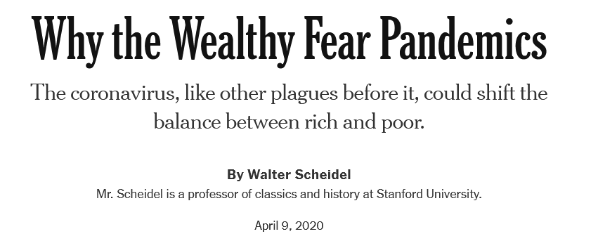
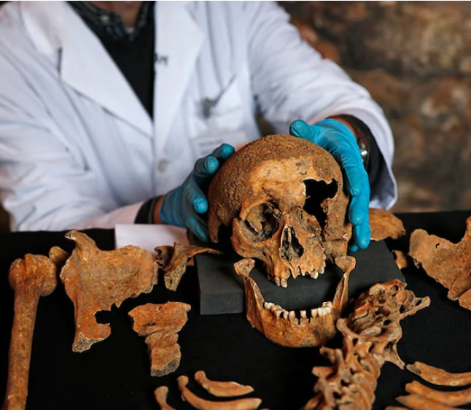
The Black Death
Malnutrition made the Black Death (bubonic plague) worse for the poor.
Wealthy had more options to avoid plague
However, economic inequality diminished in much of Europe during and after the Black Death
So many workers died of plague that labor was in demand, driving up wages for those who survived
The power of the wealthy declined
Large societal changes were set in motion that altered economic conditions and health for generations at global scales
Readings/Questions 10
Notes:
Evidence was taken from analysis of chemical composition of skeletal bones that can determine factors about the health of the person when they were alive https://www.nytimes.com/2020/04/09/opinion/sunday/coronavirus-economy-history.html

Slide 84
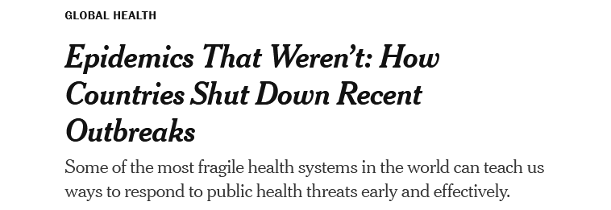
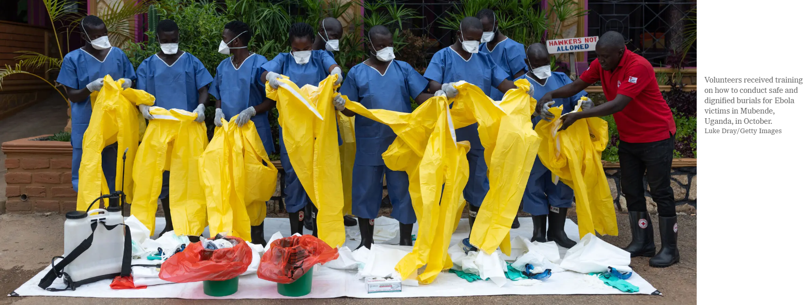
Readings/Questions 10
Notes:
https://www.nytimes.com/2022/12/27/health/pandemic-prevention-preparedness.html

