Slide 1
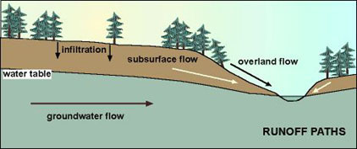
Subsurface, groundwater, overland flow feed channel flow

Slide 2
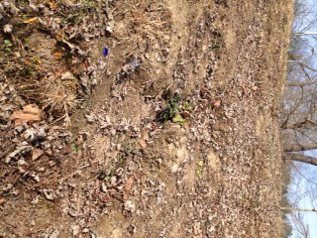
Notes:
Rills represented by lines superimposed on this photo
Whenever they build a subdivision or new road, the engineers have to study how it will change overland flow. They will often have to build a drainage channel or sculpt the contours of the land so as to make rainfall runoff in a preferred direction and avoid erosional issues.

Slide 3
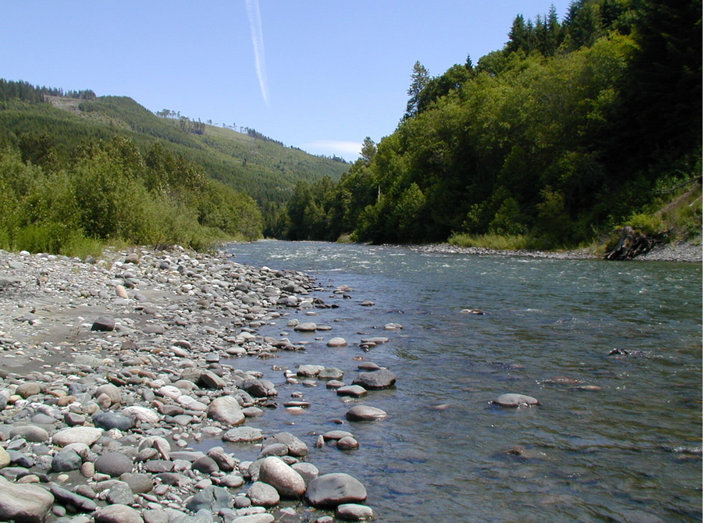
River channel types based on dominant lithology
Alluvial channel river
Bedrock channel rivers
Notes:
Alluvial channel river shown in photo

Slide 4
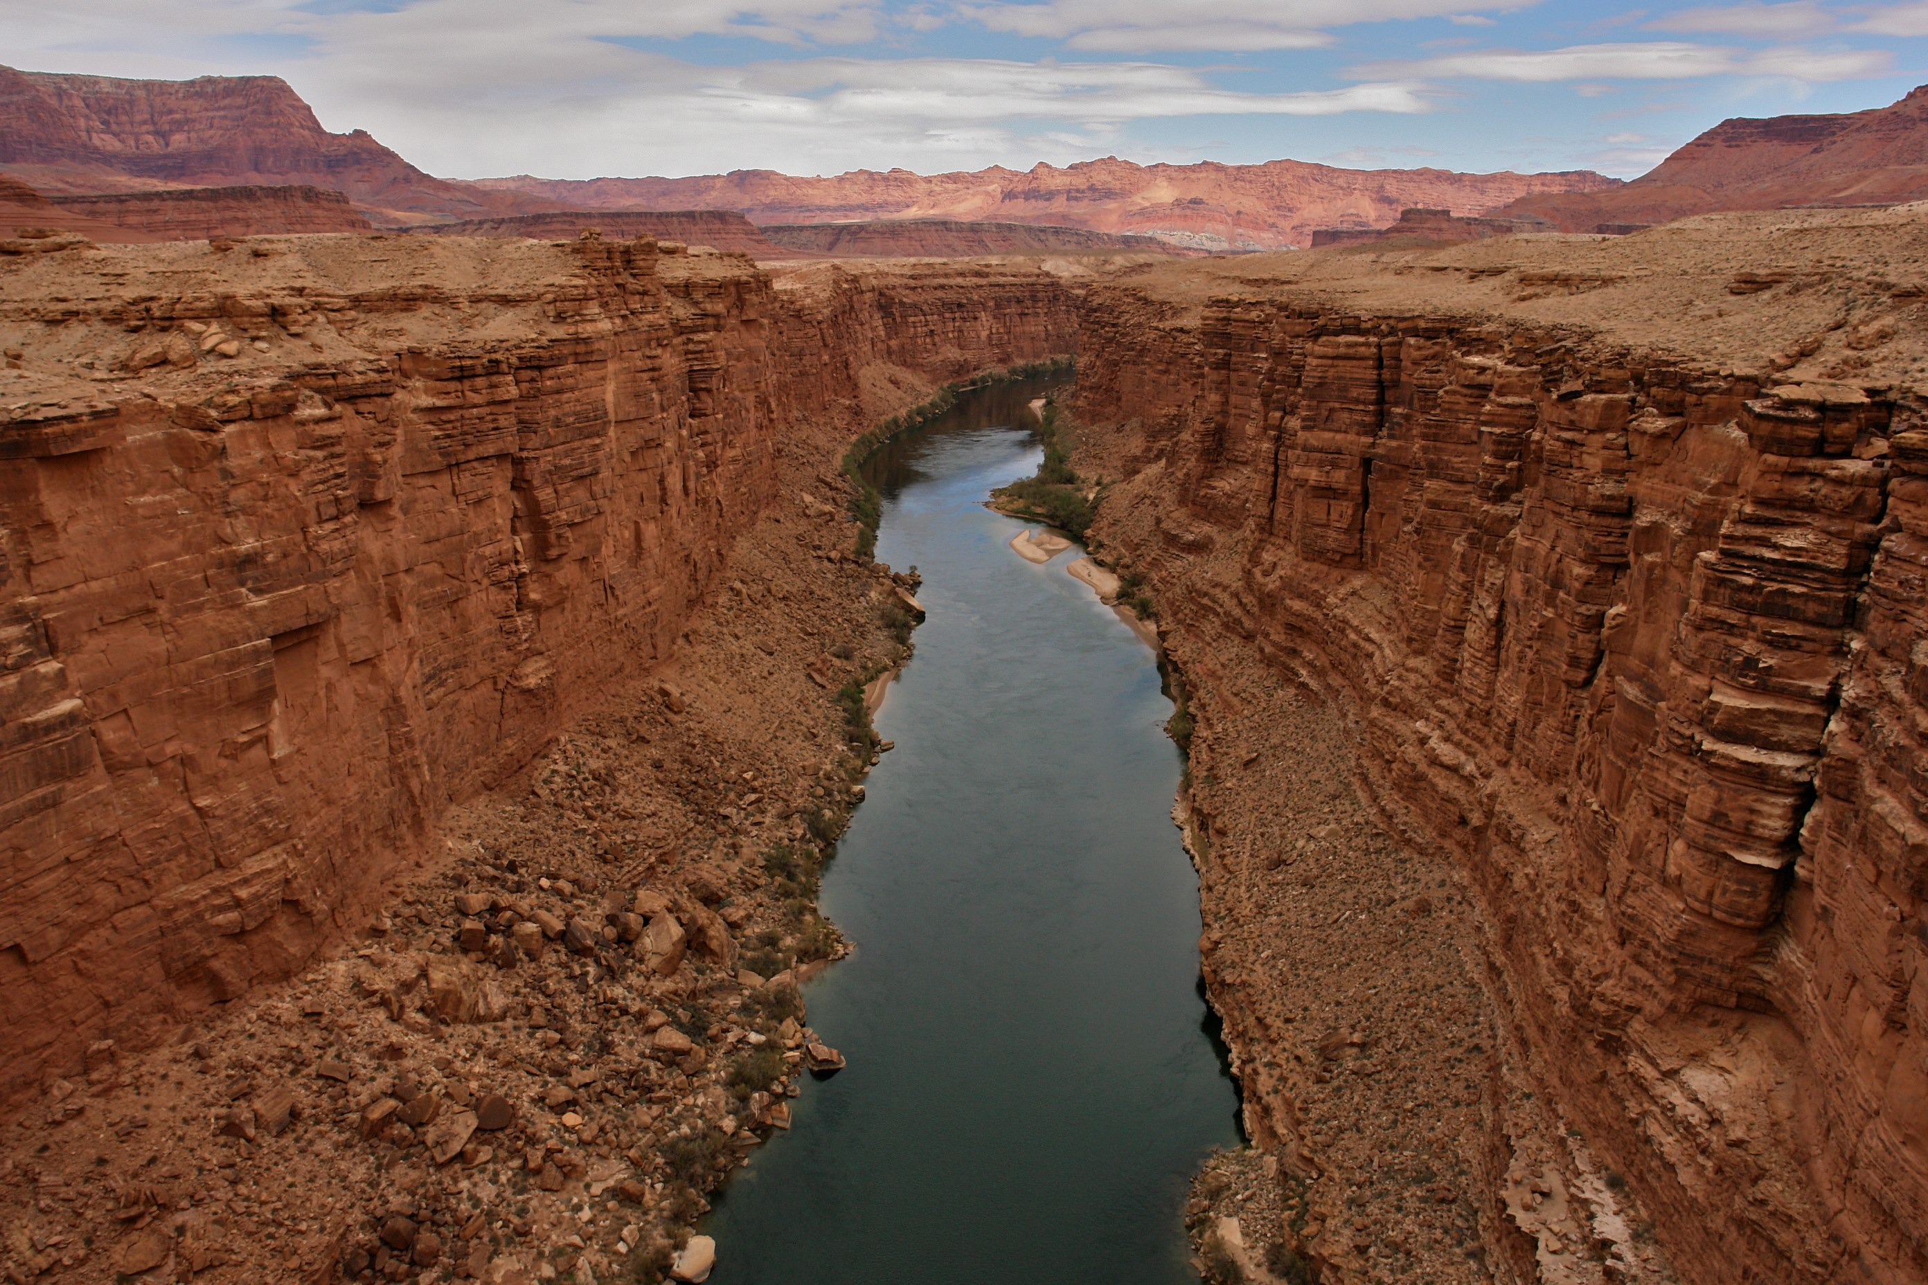
Notes:
Bedrock channel river

Slide 5
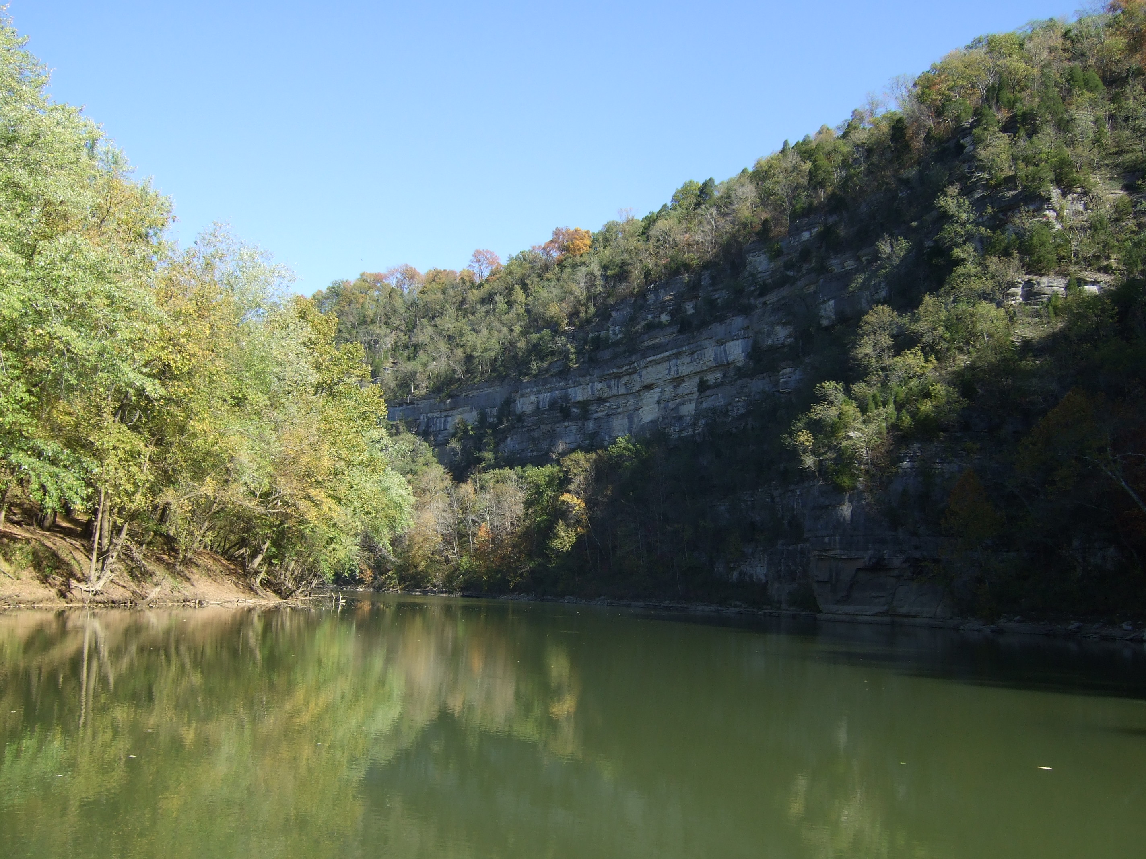
Notes:
Kentucky River is a mixture of alluvial and bedrock channel river

Slide 6
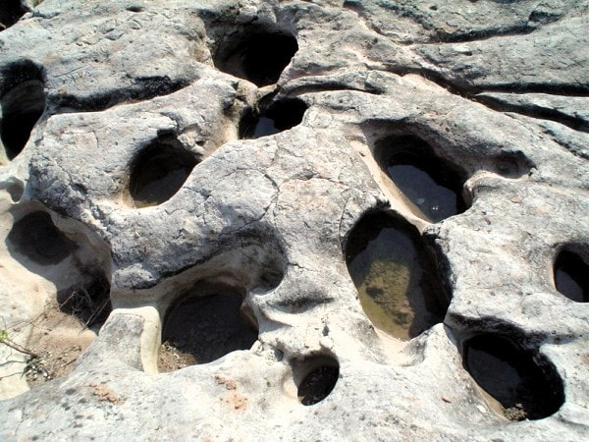
Within channel fluvial erosion
Hydraulic action-plucking of rock material by water
Abrasion-scouring of channel by sediment grains
Corrosion-rocks and minerals dissolved into water

Slide 7
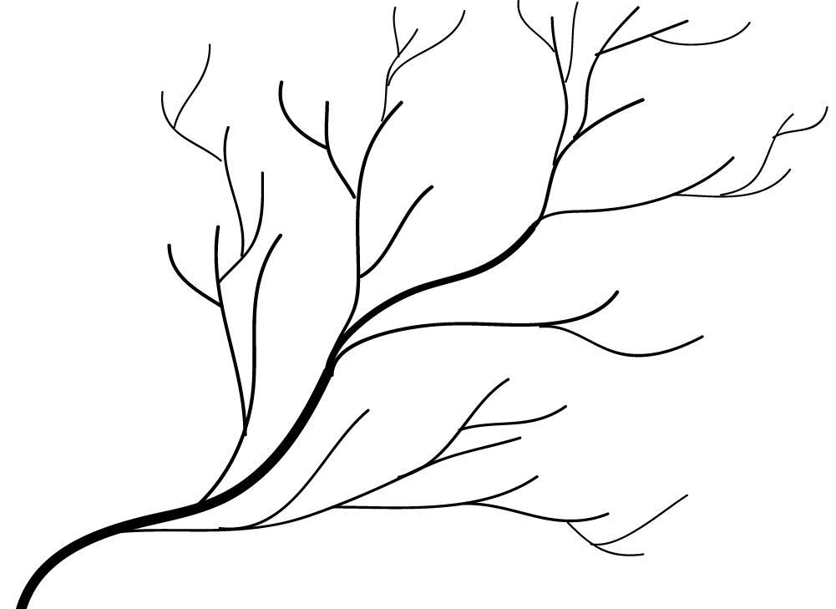
Drainage basin patterns
Fluvial erosion creates different types of drainage patterns
  Dendritic: occur in uniformly sloping horizontal rocks
  Trellis: found in rocks of alternating degrees of hardness and two slope orientations
  Radial: develops on mountains
  Humanized: drainage patterns reflect human impacts and engineering

Slide 8
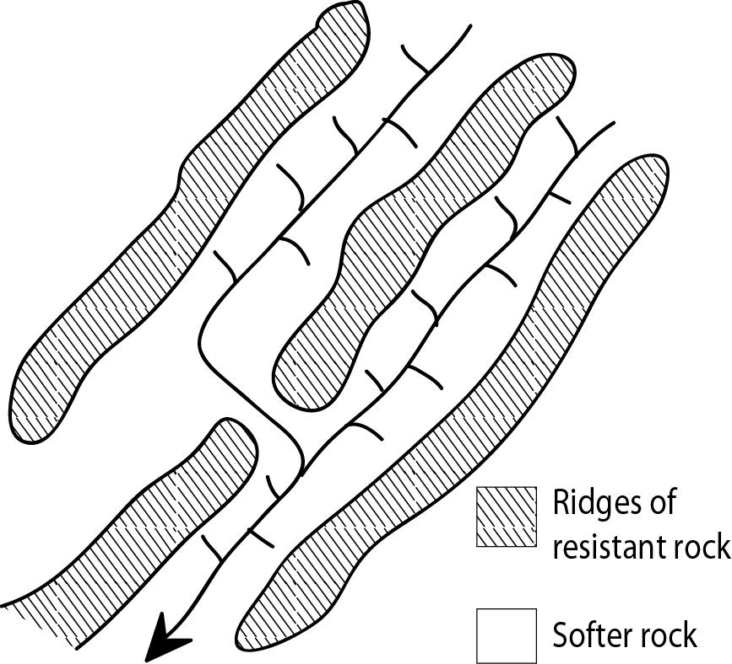
Notes:
Trellis (right)

Slide 9
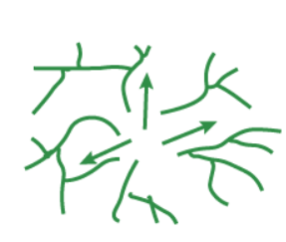
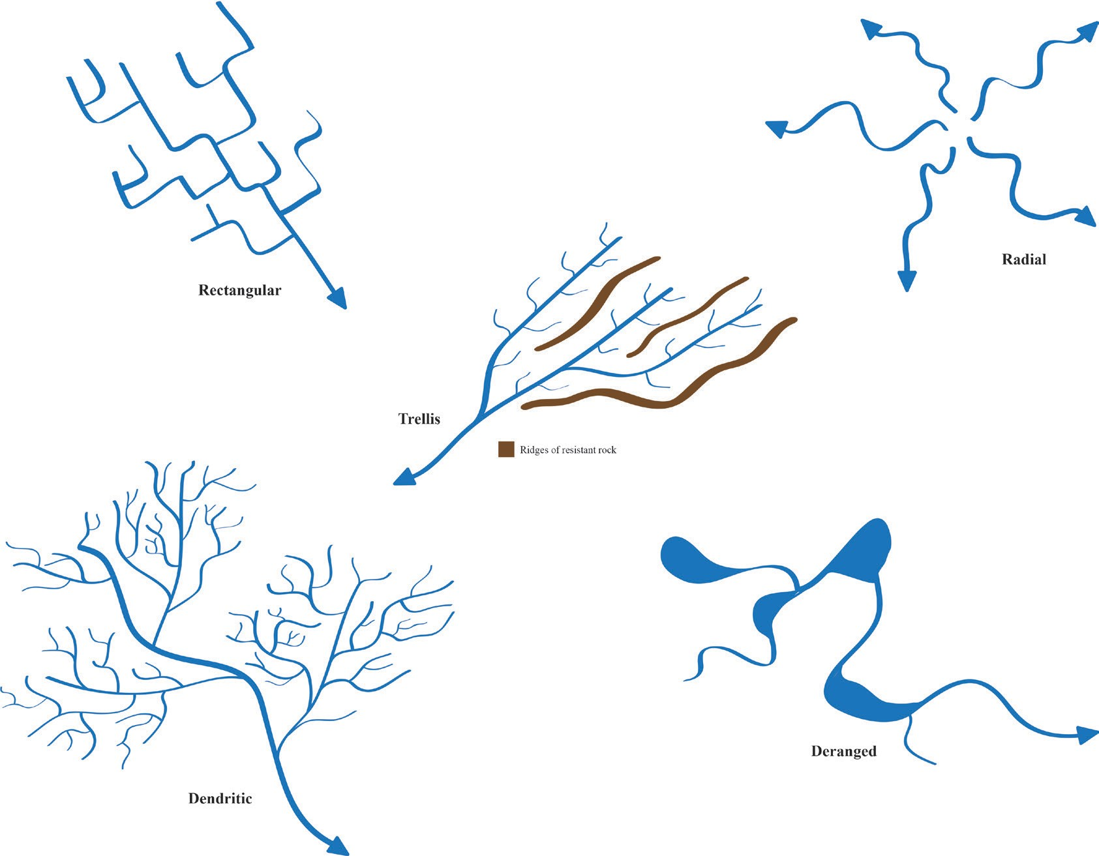
Notes:
Radial (left) and a humanized drainage patterns (right), which can be quite variable depending upon the type of human impacts such as channel straightening, construction of levees or artificial reservoirs and dams

Slide 10
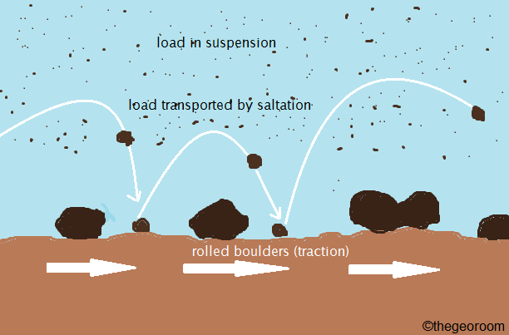
Fluvial transportation
Sediments are moved in these ways
  Bedload
    Traction (larger particles)
    Saltation
  Suspended load
    Suspension
    Solution (smaller particles)

Slide 11
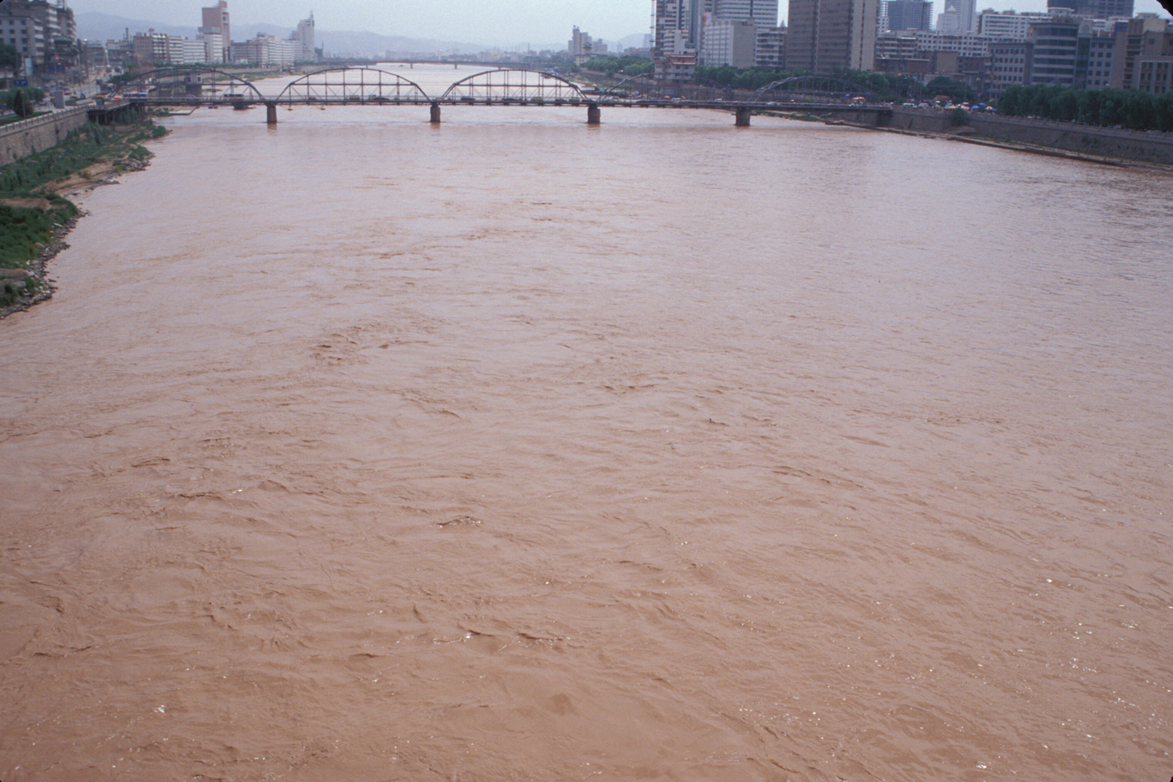
Notes:
The Yellow River at Lanzhou, China.

Slide 12
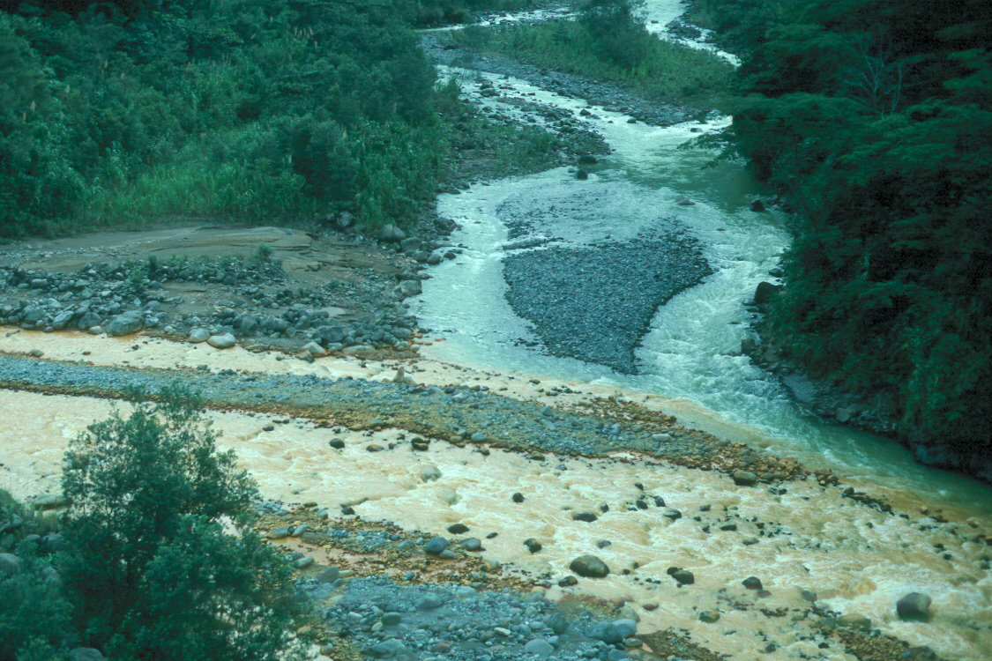
Notes:
Suspended load (lower channel) and bedload (clear upper channel) confluence, Costa Rica.

Slide 13
Stream capacity, the total potential sediment load a stream can carry
Stream capacity varies with
  Gradient
    Steeper gradient has greater capacity.
  Velocity of water
    Higher velocities during high discharge events increase capacity.
  Channel size and shape
    Greater area to wetted perimeter ratio reduces friction and increases stream capacity.

Slide 14
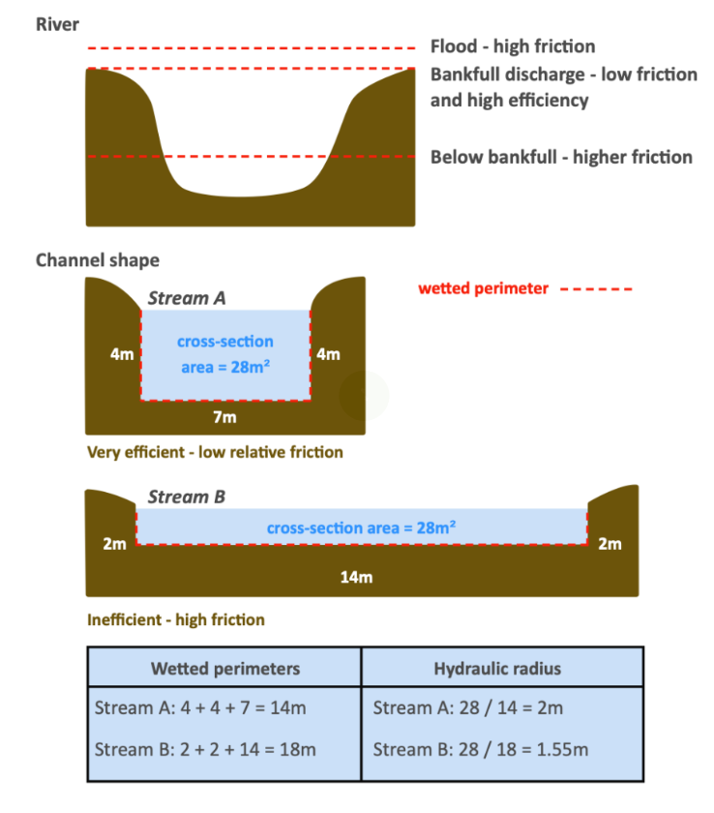

Slide 15
The relationship between capacity and load determines whether deposition of erosion occurs
Deposition
  Stream capacity < load
Erosion
  Stream capacity > load
Streams switch from depositional to erosional agents depending on how the relationship between stream capacity and load varies along a stream or river

Slide 16
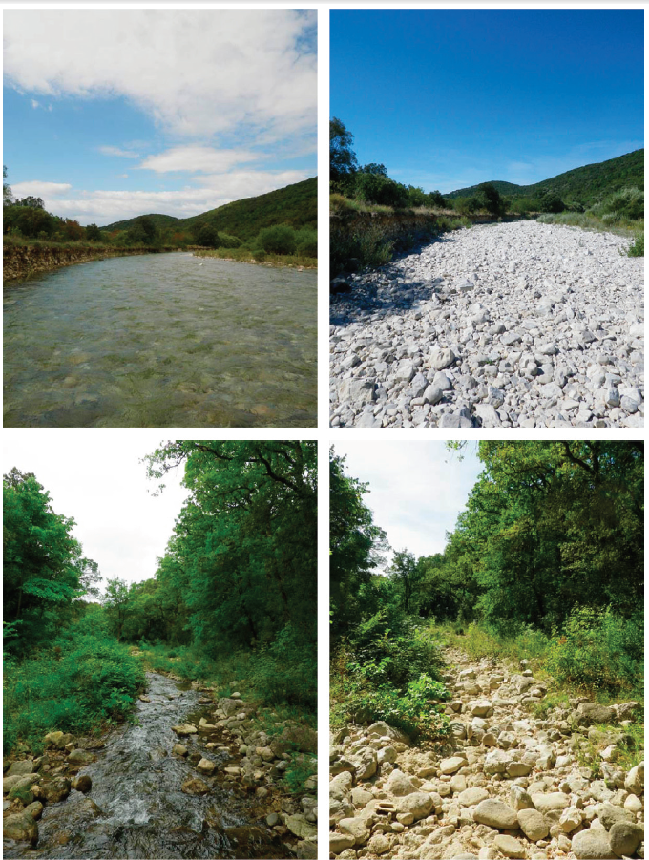
River channel types based on arrangement, shape, or timing of flow
Meandering
Braided
Anastomosing
Intermittent (at right)

Slide 17
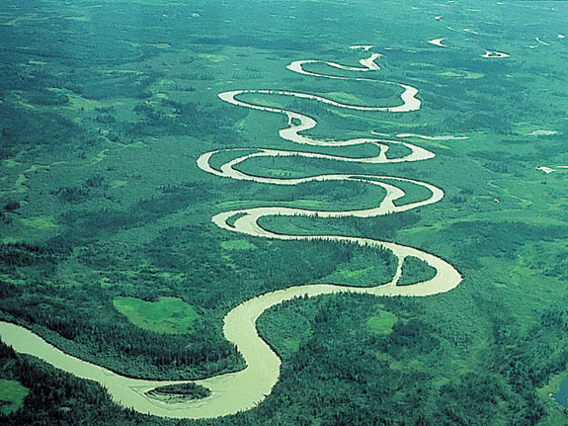
Meandering channel forms
Notes:
Meandering river

Slide 18
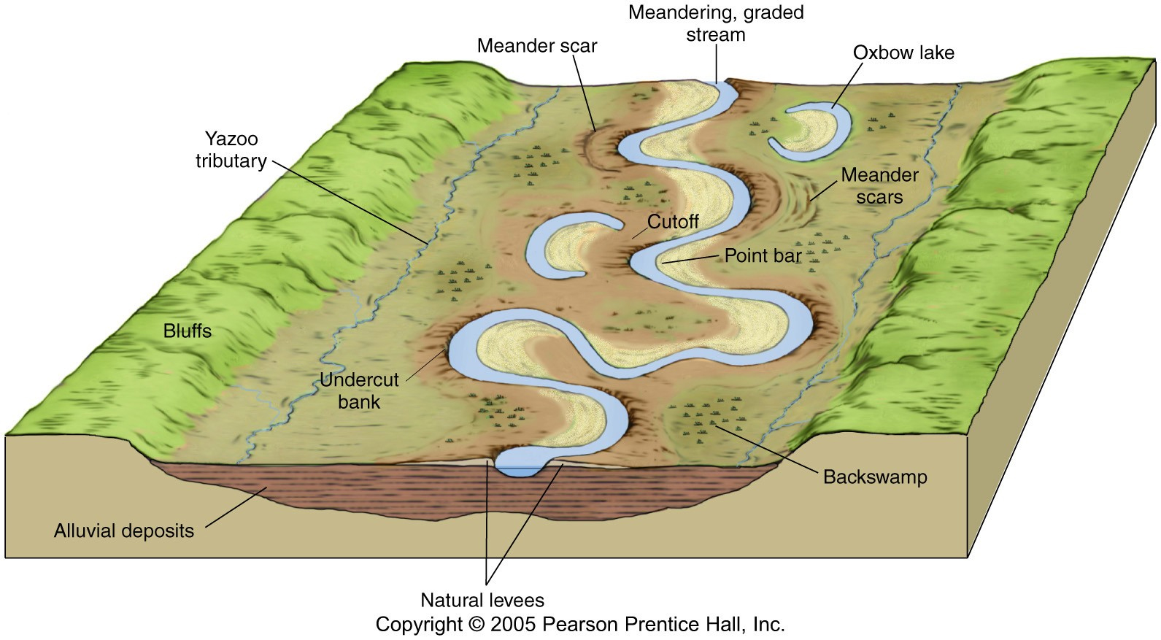

Slide 19
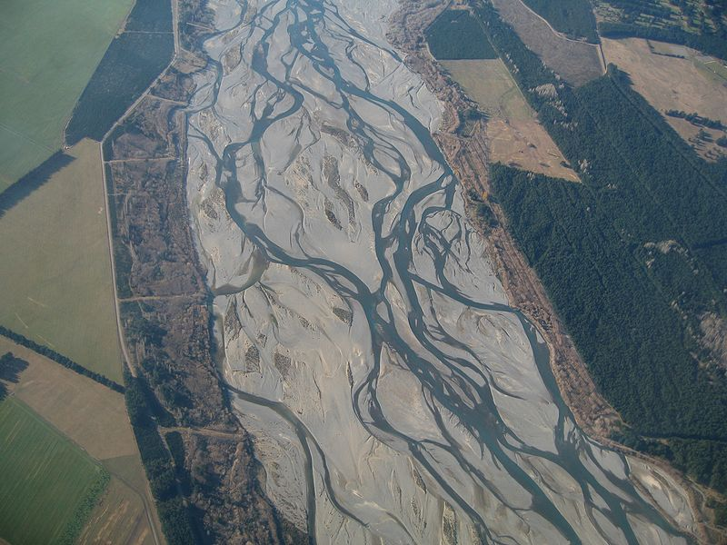
Braided river
Notes:
Where bed load is much greater than suspended load, the channel form is often braided, with lots of small channels running down the coarse stream bed.
The Waimakariri River in the South Island of New Zealand

Slide 20
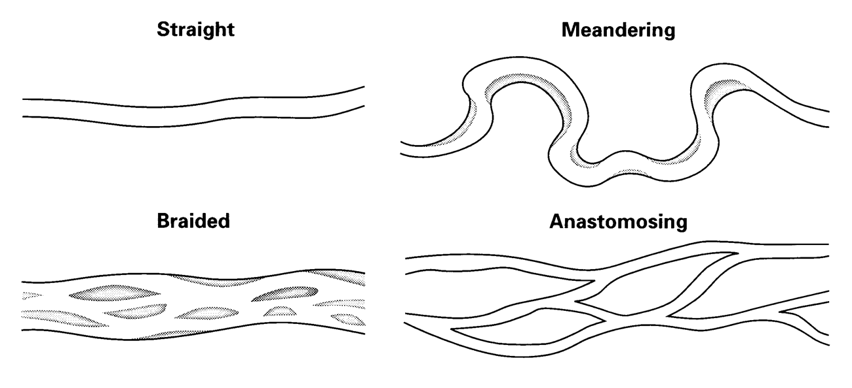
Anastomosing channel forms

Slide 21
Processes and landforms in meandering channel
Straight channels: zone of highest velocity near surface and middle of the stream
Bends: highest velocity toward outer bank and below surface
Water in channel also has complex rotating motion

Slide 22
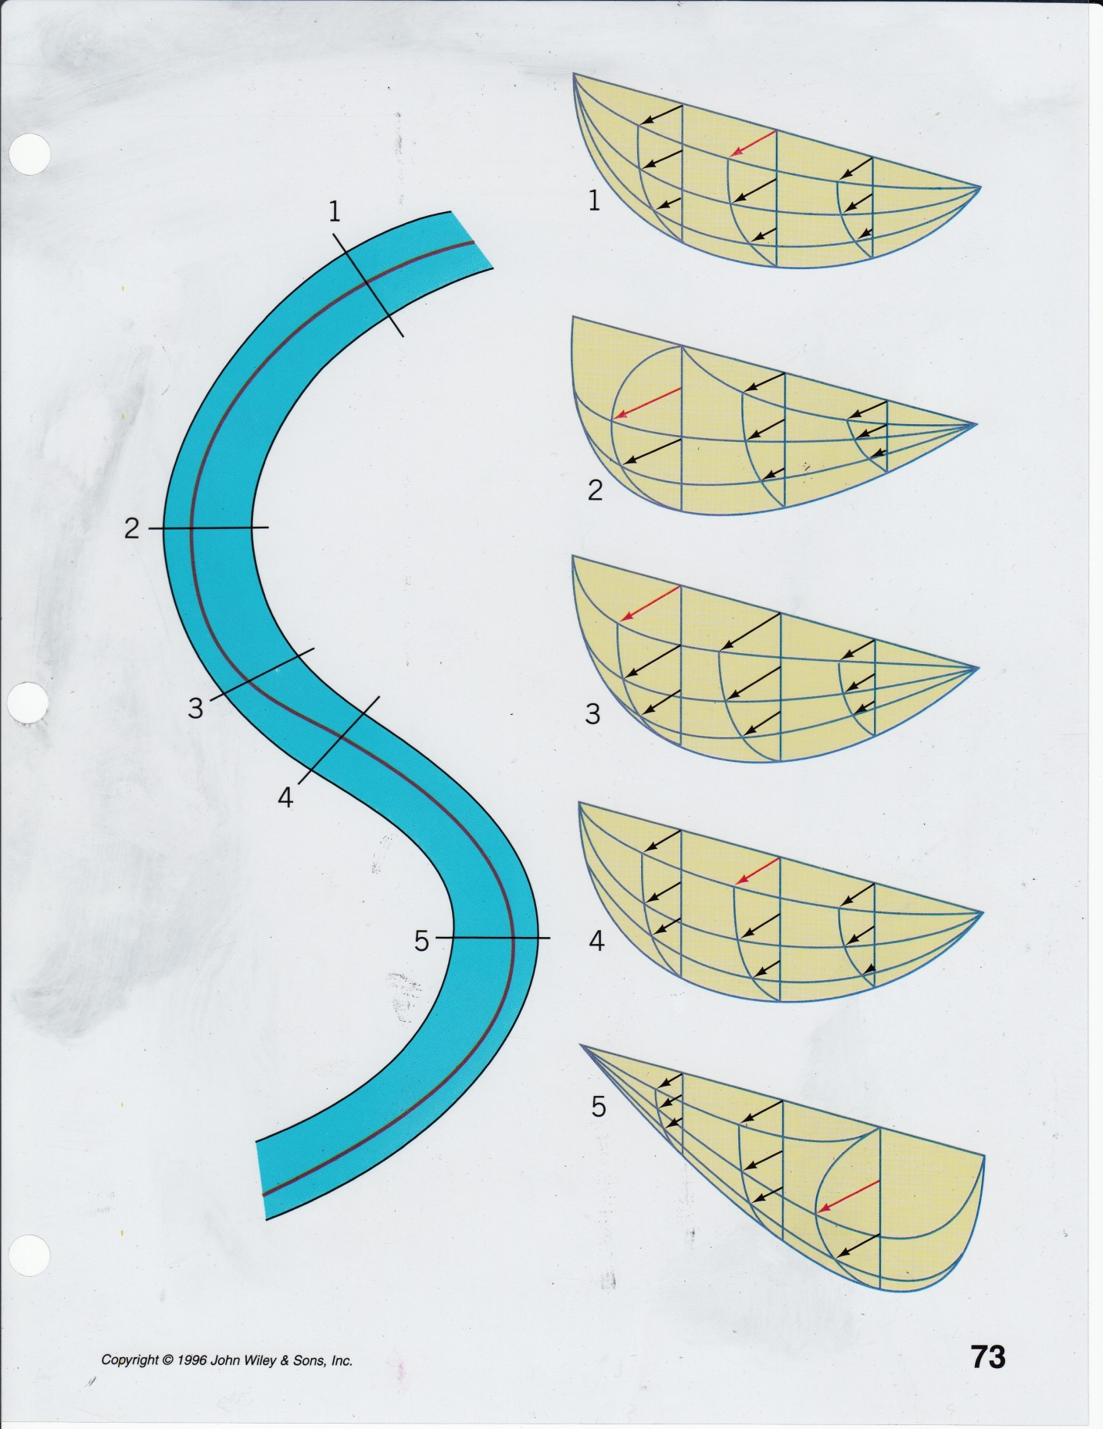
Notes:
Line in stream denotes thalweg – the fastest current in the channel

Slide 23
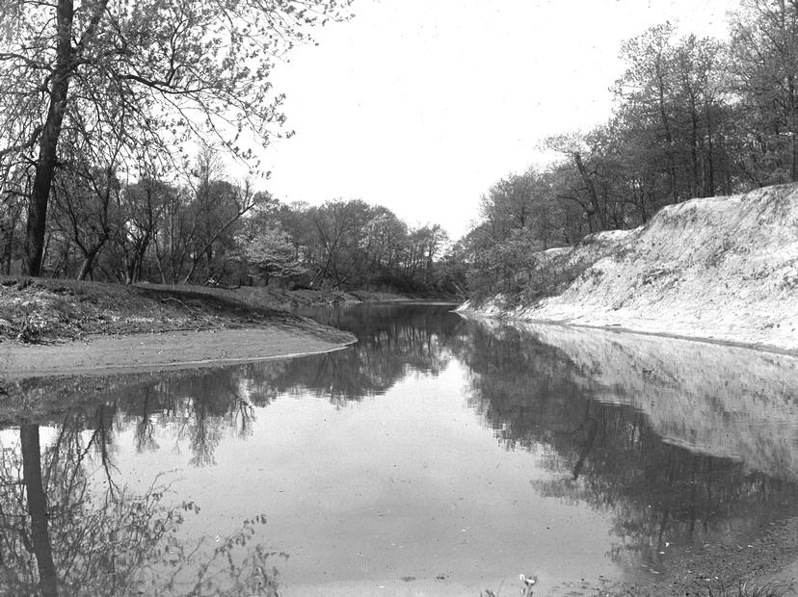
Meandering stream or river
Erosion on cut banks (capacity greater than load)
Transport of this sediment downstream
Deposition on point bars (load greater than capacity)

Slide 24
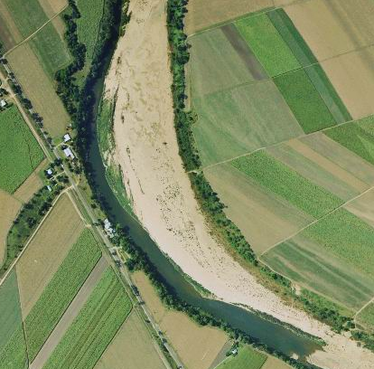
Notes:
24
Point bar on the Herbert River, Queensland.

Slide 25
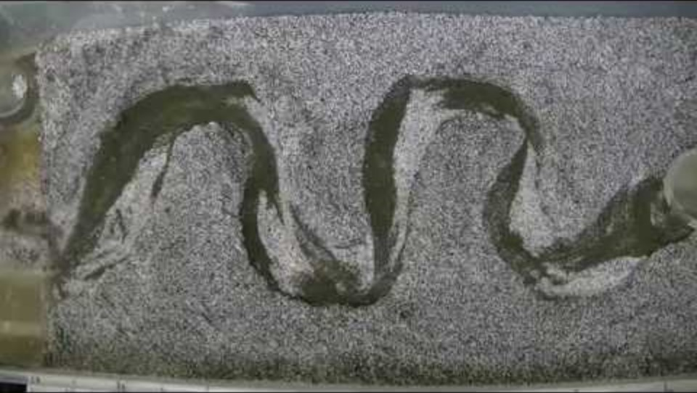

Slide 26
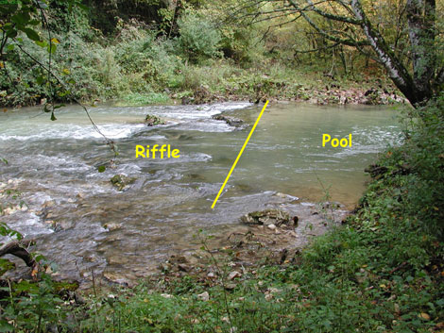

Slide 27
Fluvial depositional landforms
Floodplains
  Flat low-lying ground on either side of the channel
  Inundated during periods of flooding
  Alluvium deposited on floodplain
  Flow of water can also reduce topographic contrasts
Levee
  Elevated area adjacent to channel
  Represents topographic high formed from downcutting of river and the deposition of coarse grained materials when the river floods.
Notes:
27

Slide 28
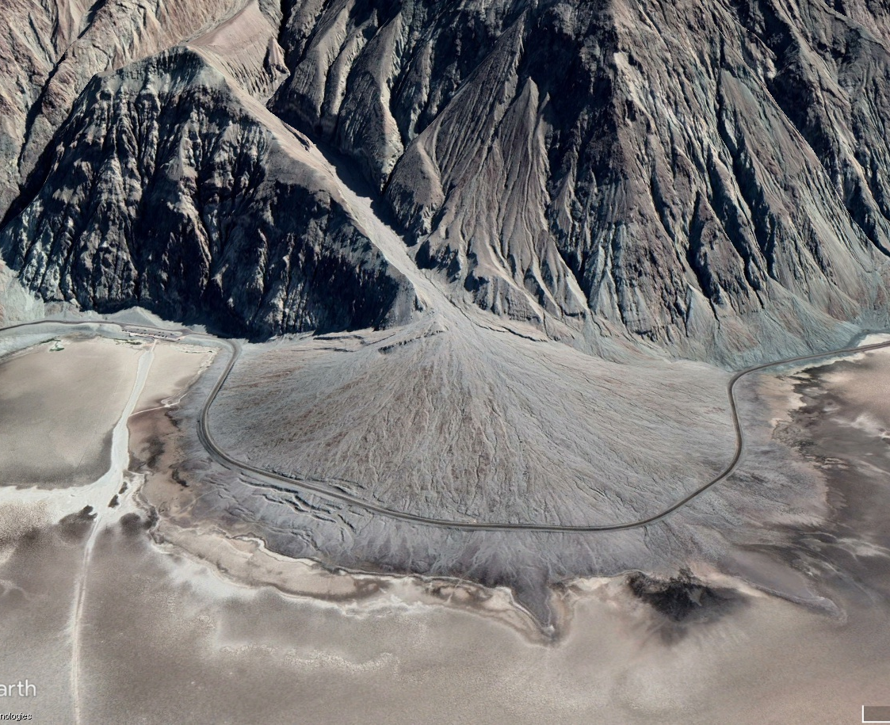
Fluvial depositional landforms
Alluvial fans
  These occur in arid climates where intermittent streams carry sediments off surrounding uplands
Notes:
Gorilla Creek fan and Tasman River, South Island, New Zealand.

Slide 29
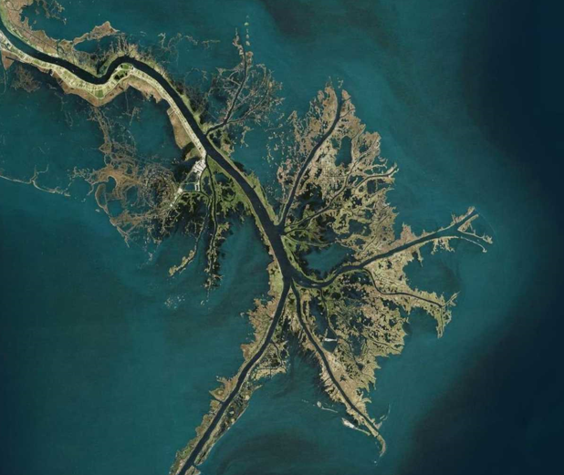
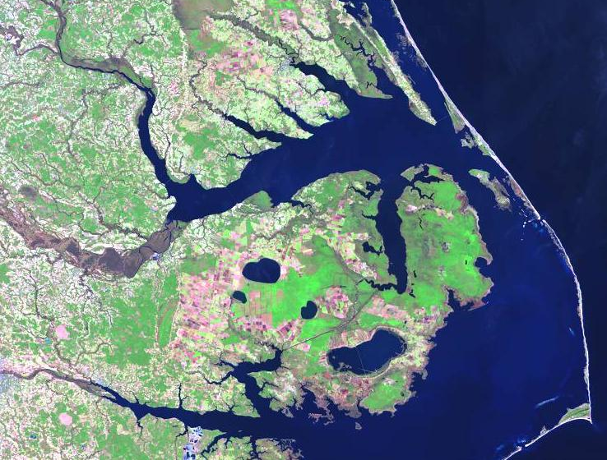
Coastal landforms derived from deposition of fluvial sediments
Deltas and barrier islands

Slide 30
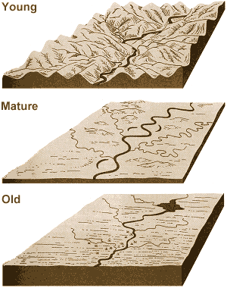
William Morris Davis and the three stages in the Cycle of Erosion (1909)
Conceptual theory developed showing how riverine landscape change through time
Youthful stage
  High relief
  V-shaped valleys
  Straight channels
  High stream gradient (steeply sloping streams)
Rivers are far from absolute base level, the level (near sea level) below which a stream cannot erode its channel and stops flowing

Slide 31
Mature stage
  Decreasing relief
  U-shaped valley
  Widening floodplain
  Meandering increasing
  Getting closer to absolute base level

Slide 32
Old age
  Surface eroded to peneplain
  Wide meander belt
  Rivers are near absolute base level; low gradient
However this developmental scenario – from youthful to mature to old age – does not unfold so immutably
Notes:
Immutably means predictably. This sequence of landscape evolution does occur, but then land can be uplifted again, or it can subside. Sea level fluctuates. The organismal metaphor for landscapes is true but simplistic.

Slide 33
The “work” of the river
The absolute base level is typically sea level, the lowest point to which a river can erode. Absolute base level acts as a "goal" for the river, since it cannot erode its bed lower than the base level.

Slide 34
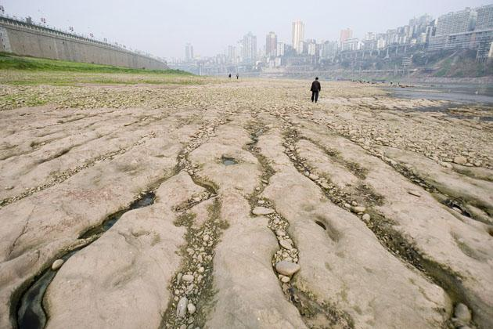
Controls of absolute base levels
Multiple factors constrain whether a river can erode down to absolute base level
Is this stream going to do any more erosional work in the landscape?
Notes:
Jialing River drained dry by human use

Slide 35
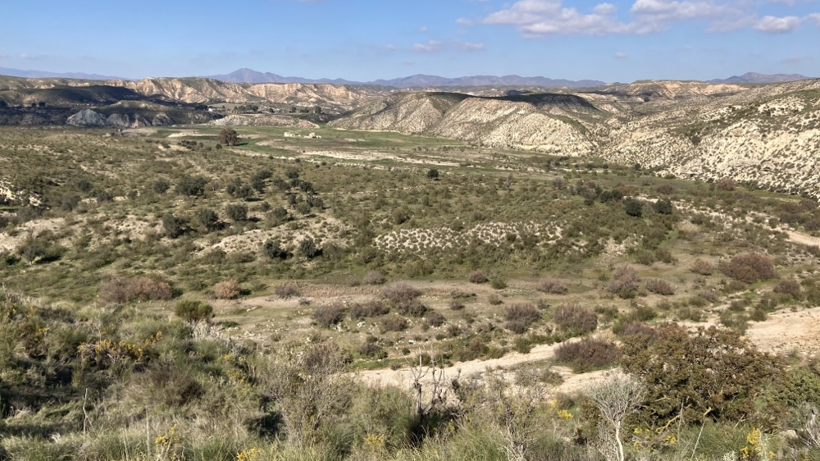
Factors controlling absolute base level
Changes in river levels
  Climate change
  Human water utilization
Change in sea level
Renewed tectonic uplift or subsidence of land
Notes:
Local geological factors like rock type also shape erosion rate and the ‘work’ to get to base level
Rio Aguas in southern Spain comprises a river system that has been greatly reduced by drier, warmer climate

Slide 36
“Adding and taking away work of the river”
Reducing flow volumes, rise in sea level or tectonic subsistence (“taking away work”)
  River is moved closer to absolute base level
  Less downcutting
Increasing flow volumes, fall in sea level or tectonic uplift (“adding work”)
  River is moved further from base level
  Rejuvenation of downcutting

Slide 37
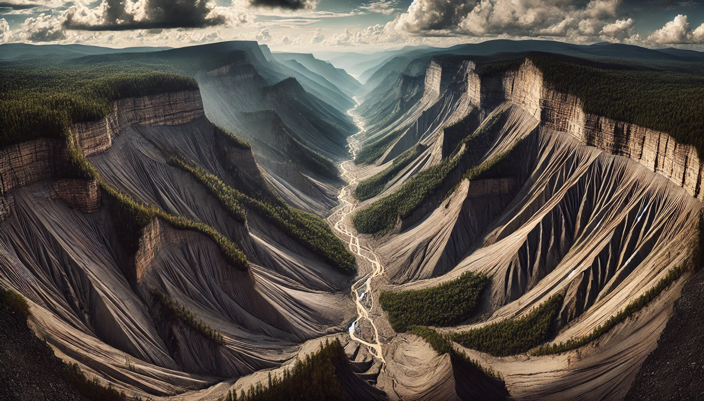
Notes:
ChatGPT rendering of the Appalachians under a scenario of onset of uplift

Slide 38
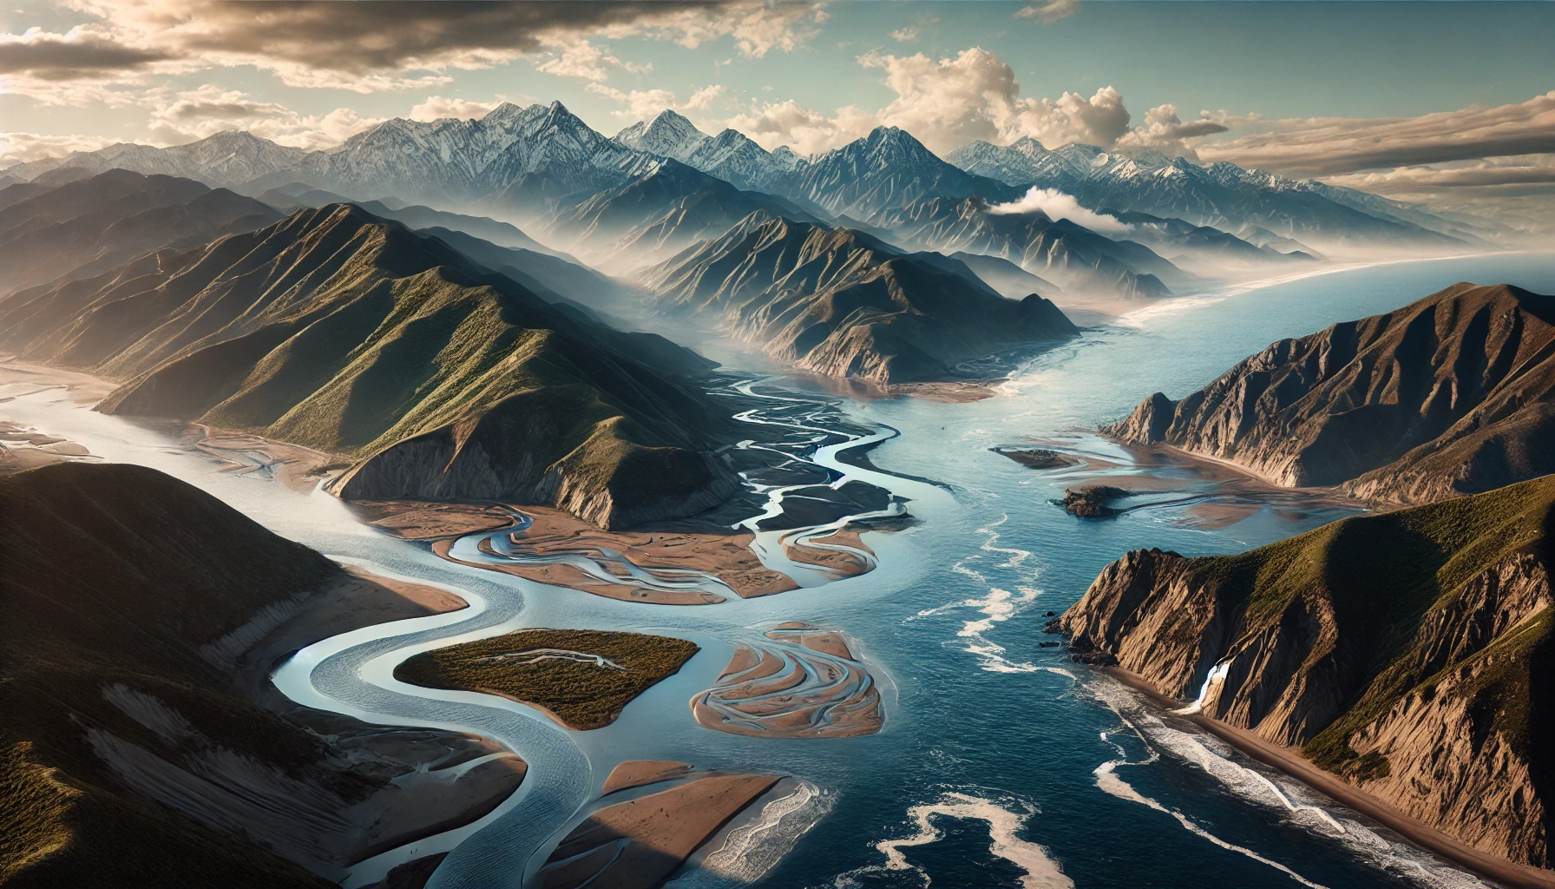
Notes:
ChatGPT rendering of the California coastal mountains with sea level rise and subsidence.

Slide 39
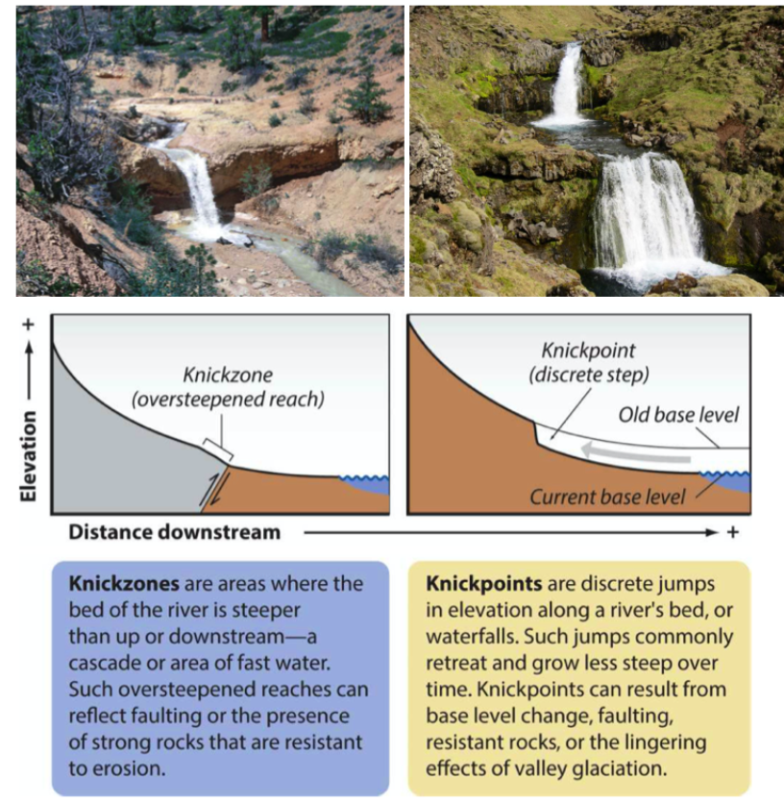
A graded stream is in equilibrium whereby its profile efficiently transports sediment down to absolute base level with no major erosion or deposition occurring along its course
Idealized state – most streams do not achieve this
Knickzones and knickpoints are indicators of non-equilibrium states

Slide 40
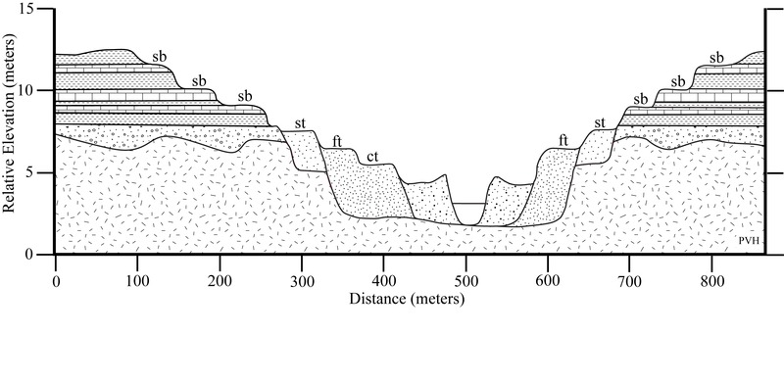
Fluvial terraces
Notes:
Fluvial terraces are the remnants of earlier floodplains that existed at a time when either a stream or river was flowing at a higher elevation before its channel downcut to create a new floodplain at a lower elevation

Slide 41
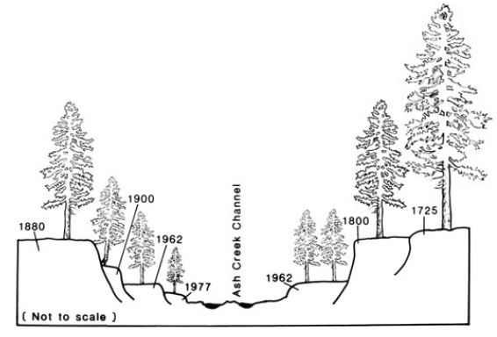

Slide 42
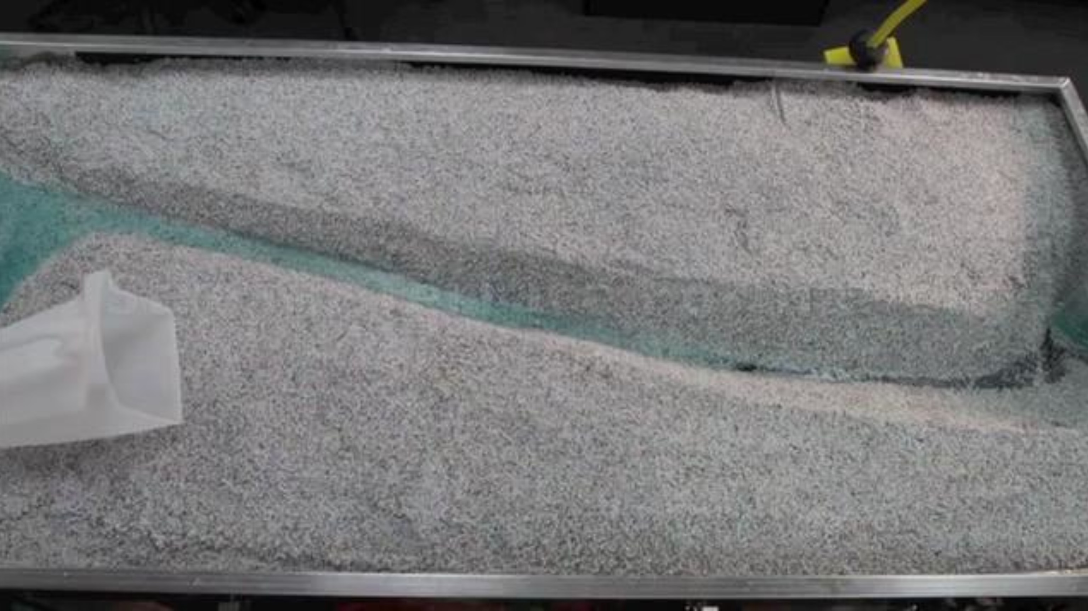
Notes:
https://vimeo.com/31464905

Slide 43
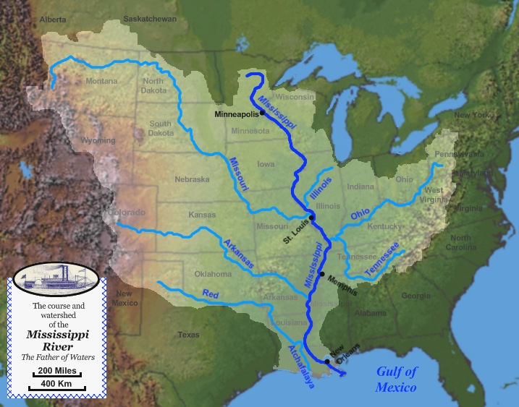
Drainage basins
Also known as a watershed
Region drained by a river or group of rivers
Appropriate level to study, monitor, and regulate water pollution
Drainage basins are separated by topographic barriers called divides
Notes:
https://river-runner.samlearner.com/?fbclid=IwAR2r5jY9nnqFtFtWXSrZBIjKndV4nr506-yrdd1faEn91Ue1ByrnJmPArWc

Slide 44
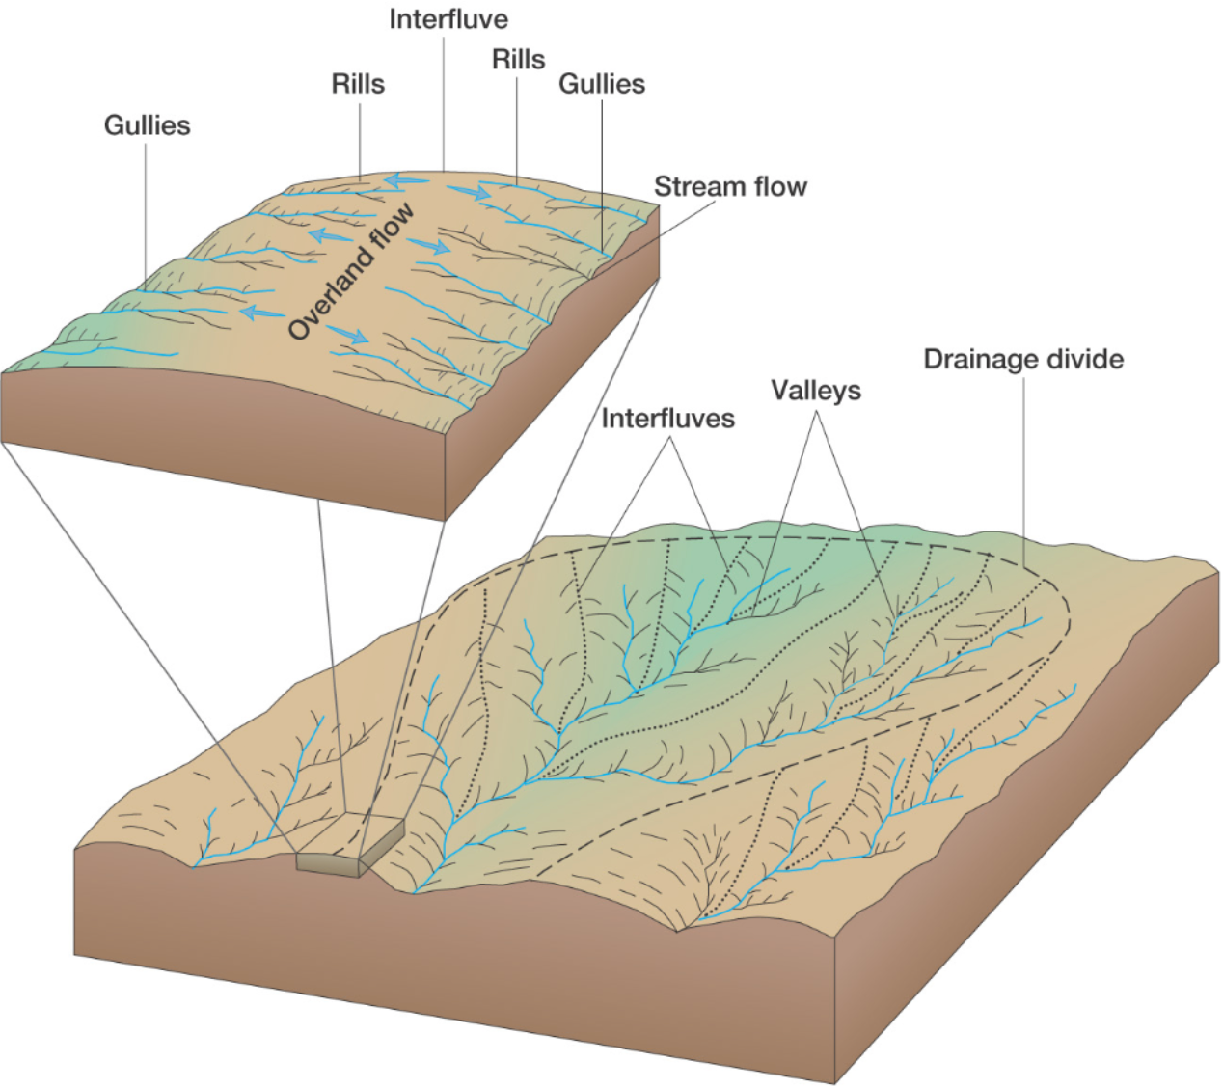

Slide 45
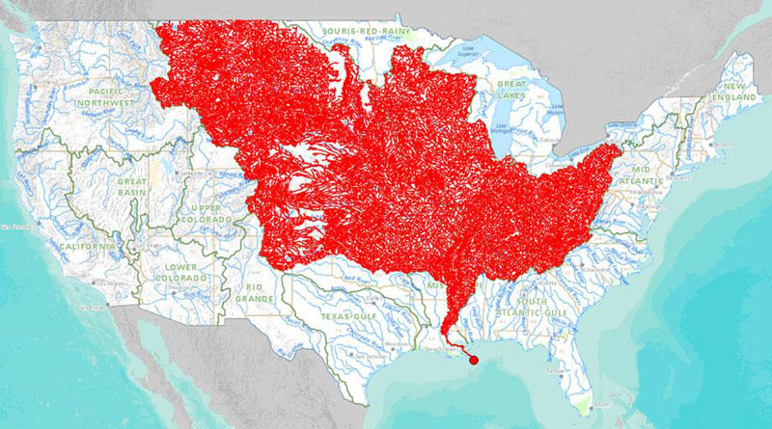

Slide 46
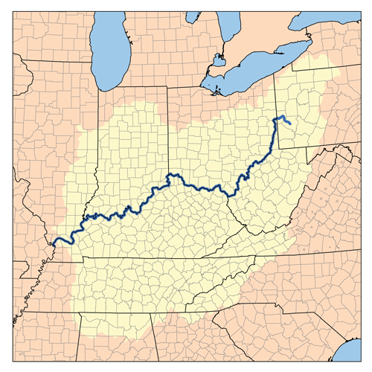


Slide 47
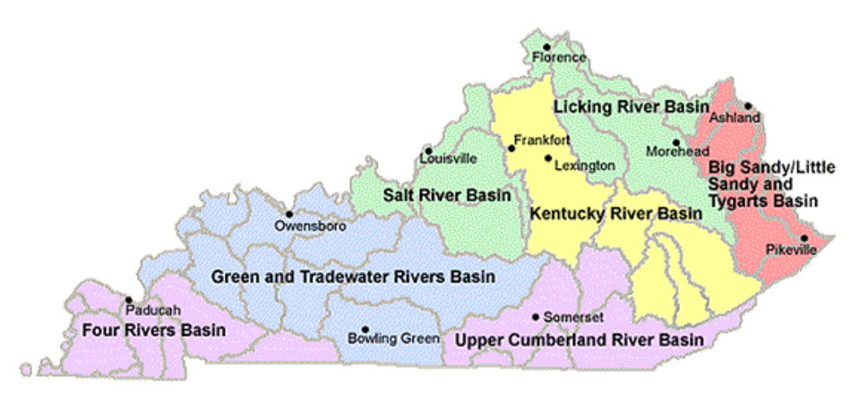

Slide 48
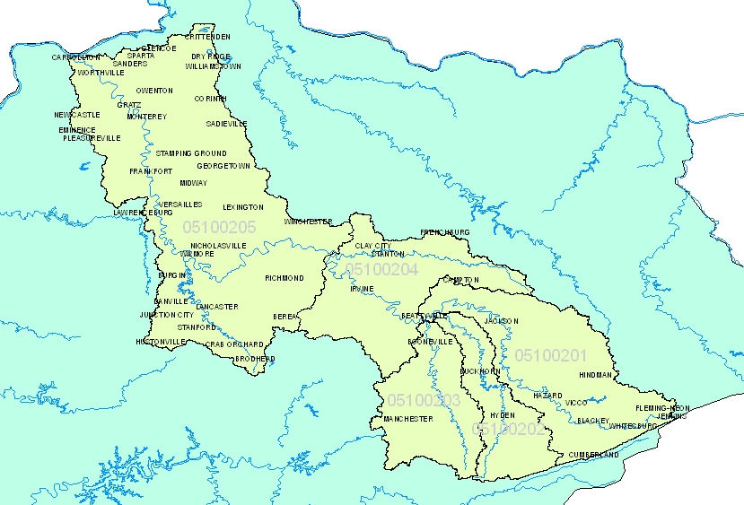

Slide 49
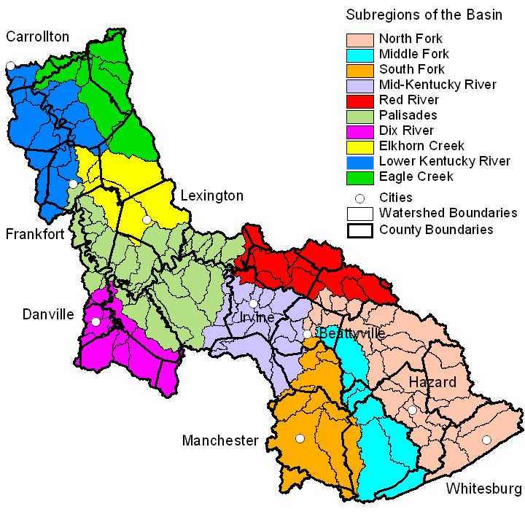

Slide 50
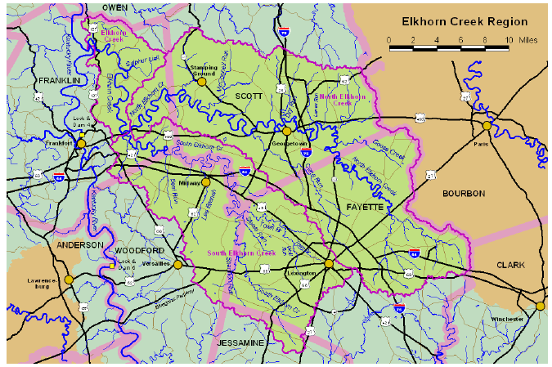

Slide 51
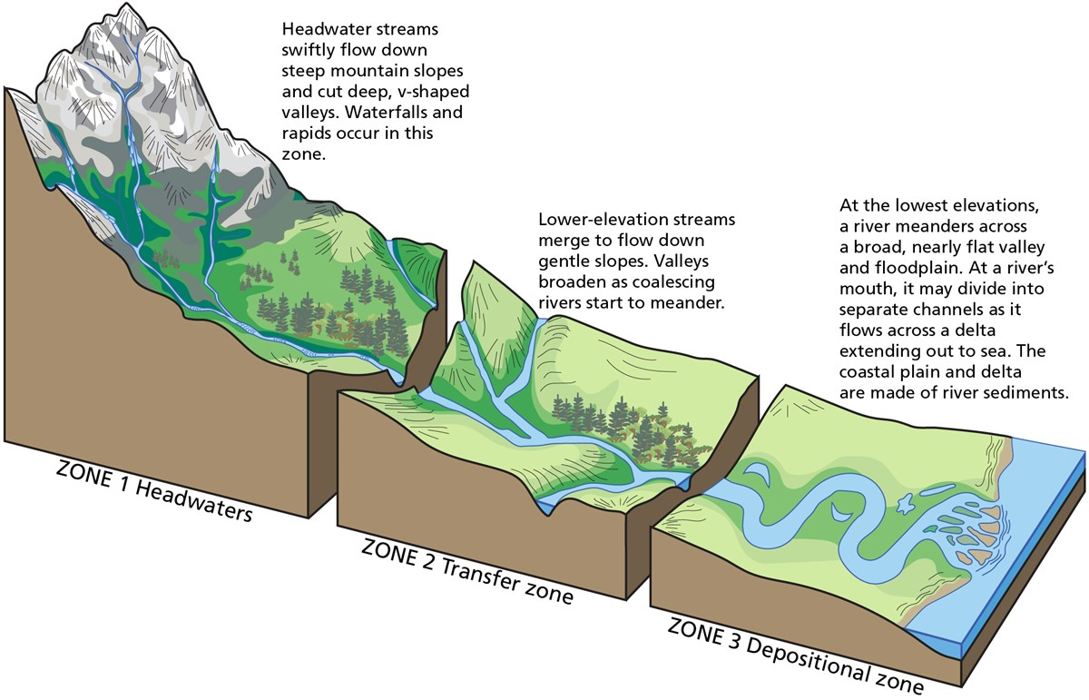
Stream order

Slide 52
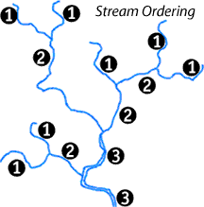
Stream order and drainage basin order
Each stream segment can be classified by stream order
Highest order stream is drainage basin order
Higher order stream
  Higher peak flood discharge (3, 4…)
  Flood peak is delayed longer from rainfall event
  Flood peak lasts longer before subsiding
Lower order stream (1, 2…)
  Floods at lower peak discharge
  Flashier streams
    Shorter delay in discharge peak
    Shorter duration of flooding.

Slide 53
Drainage basin properties
Stream number
  More 1’s than 2's, more 2's than 3's…
Mean stream length
  As a stream order increases, the average stream length increases
Stream slope
  As stream order increases, stream slope decreases
Basin areas
  As basin order increases, the area of the drainage basin increases

Slide 54
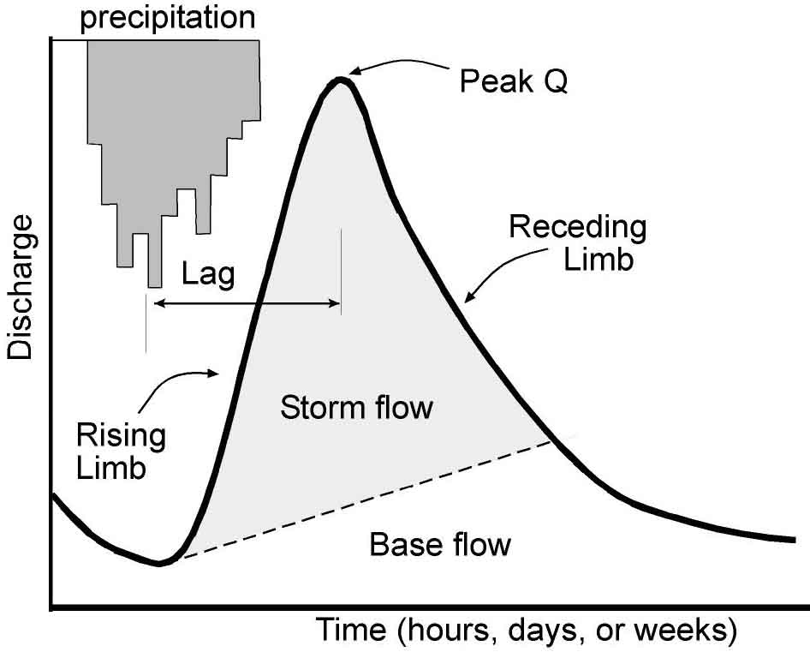
Hydrographs
Discharge – volume of water that moves through a stream channel in a given time interval
Hydrograph – plot of discharge through time
Flood stage – height of river in which damage to human structures occurs
Notes:
Q (discharge)

Slide 55
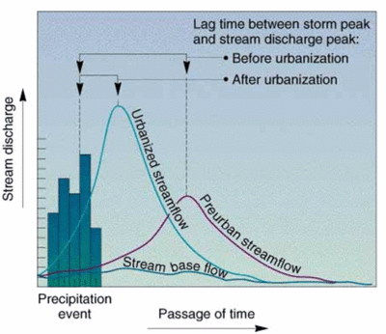
Hydrographs
Given the same amount of rainfall, shape of hydrograph can vary according to:
  Stream order
  Land use surrounding the river
  Degree of river
  impoundment from dams or locks

Slide 56
Bankfull discharge
Bankfull stage associated with flow that just fills channel to top of banks and water begins to overflow onto floodplain
Reflects morphologic response of the river to the existing climate regime
May have some element of predictability and occur at repeated intervals
Return interval can vary from river to river, but may be expected every 1-2 years up to 25 years in others.
Notes:
Q (discharge) = volume per unit time
Q (discharge) = velocity per unit area

Slide 57
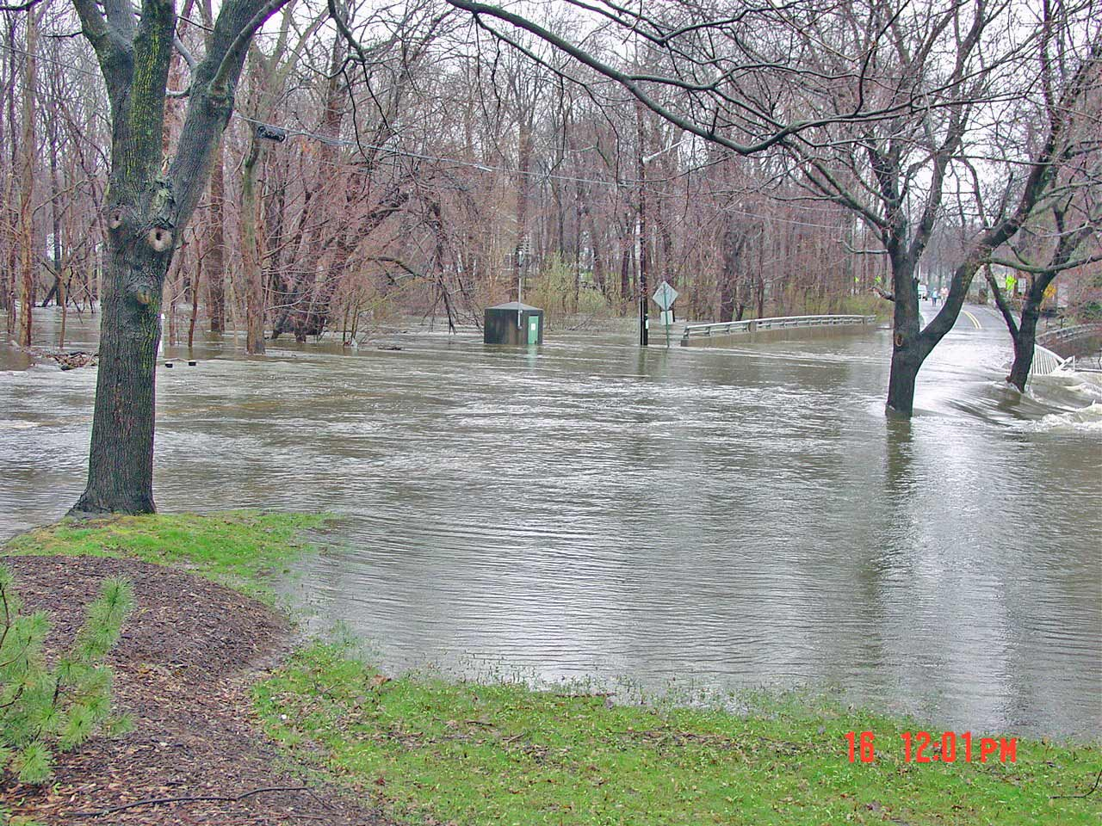

Slide 58
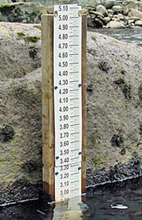

Rating curves usually have a break point, which is around the stage at which the river spreads out of its banks.
Stage is not water depth, but height of the water relative to a fixed gage datum

Slide 59


