Slide 1
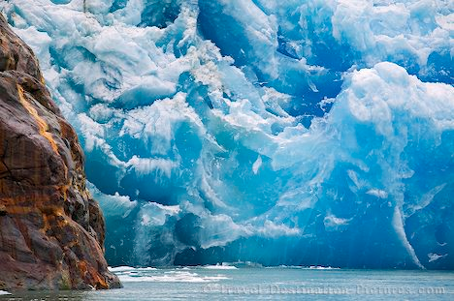
Glacial landforms and processes

Slide 2
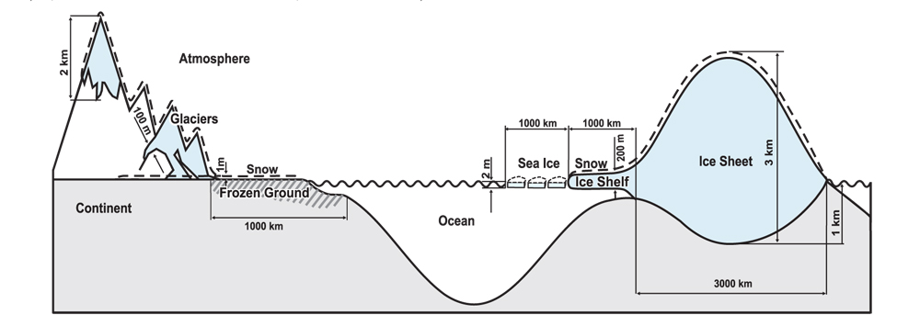
Components of the cryosphere

Slide 3
Ice sheets and glaciers
Continental ice sheet (Antarctica and Greenland). These often are composed of one or more ice domes with multiple glaciers
Alpine or valley glaciers
Piedmont glaciers – form at base of mountain and spread out over lowlands
Outlet glaciers – flow outward from an ice sheet
Cirque glaciers – forms in the head of a valley
Tidal glaciers – glaciers that end in the sea
Notes:
Ice caps are smaller versions of ice sheets

Slide 4
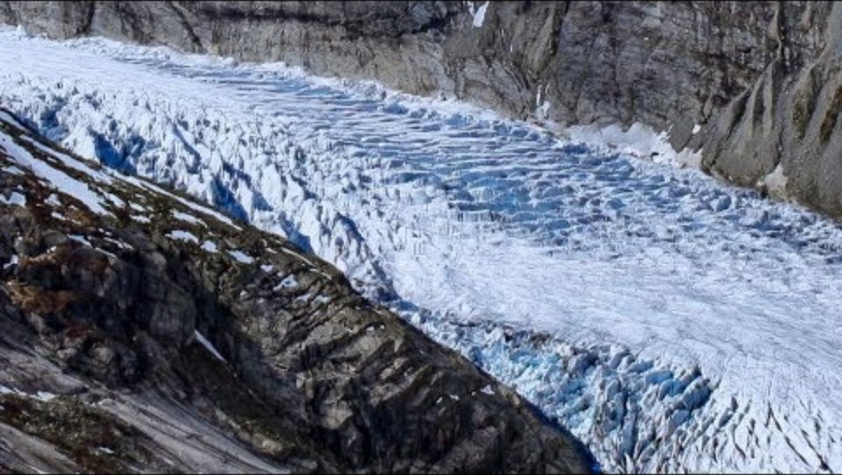
Glaciers
A large mass of perennial ice resting on land or floating
Occur in high-latitude polar environments and high-altitude mountain environments (alpine)
Formed under the accumulation and recrystallization of snow
Flows slowly under the pressure of its own weight and the pull of gravity

Slide 5
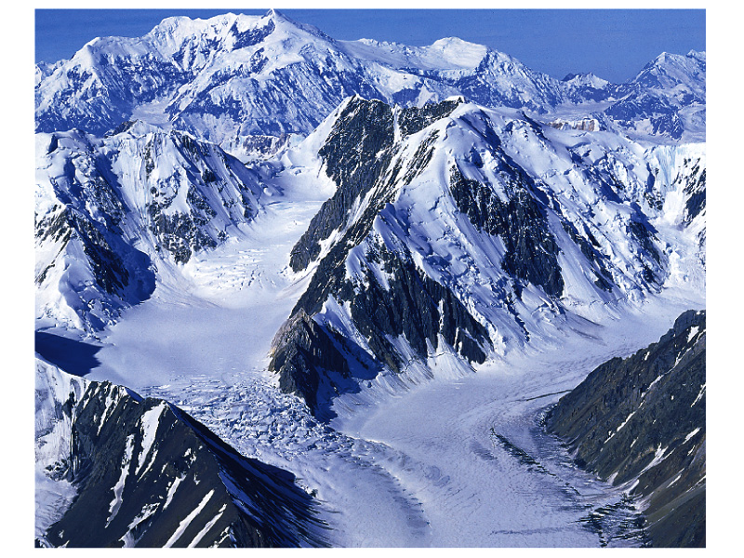
Notes:
Alpine or valley glacier

Slide 6
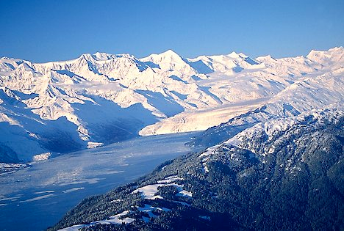
Notes:
Tidal glacier

Slide 7
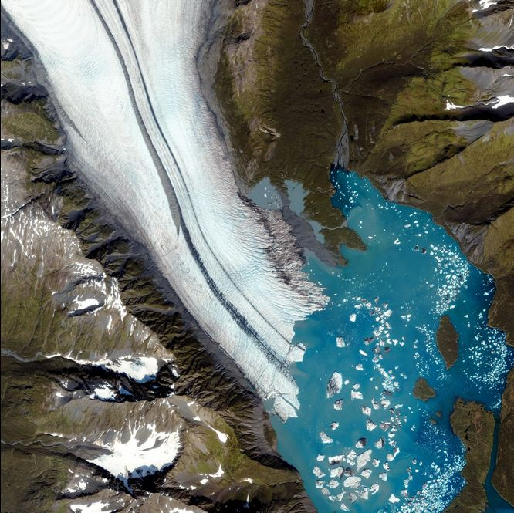
Notes:
Kenai Fjords, another tidal glacier

Slide 8
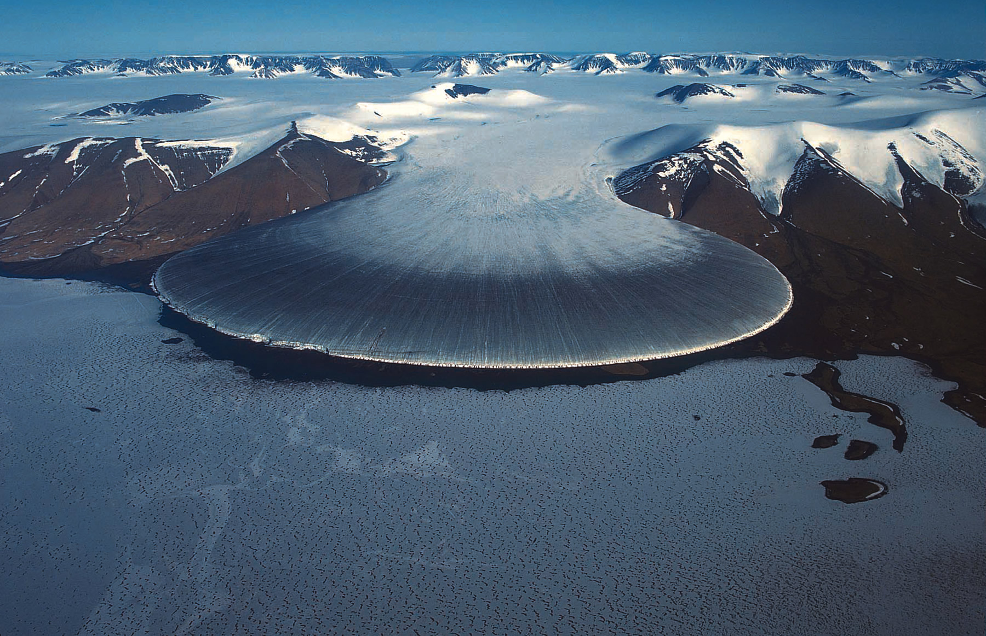
Notes:
Piedmont glaciers are formed where valley glaciers flow out from mountainous terrain and coalesce into a singe large glacier, spreading
over the lowland topography.

Slide 9
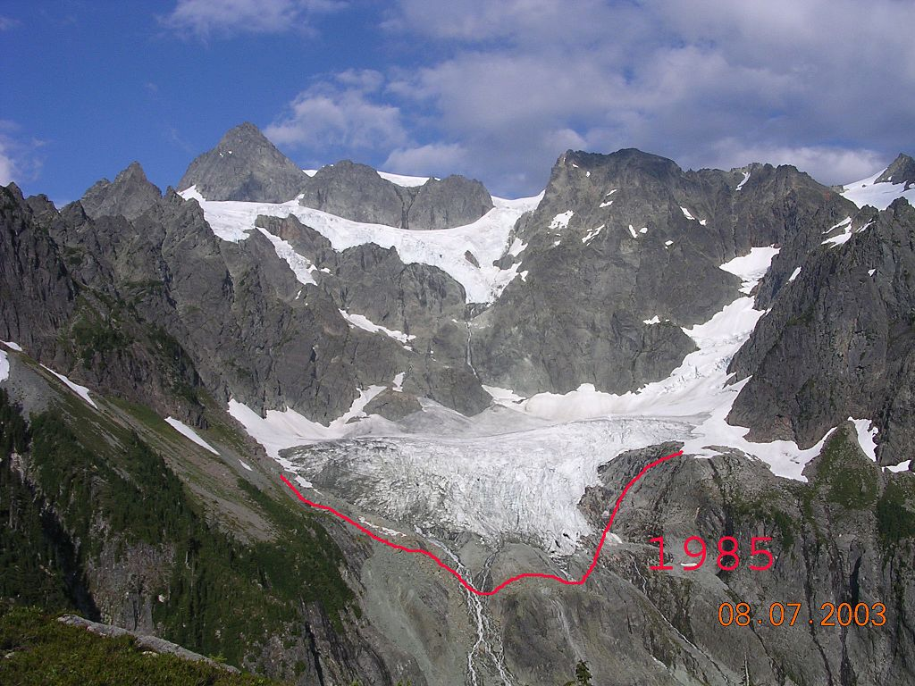
Notes:
Cirque glacier

Slide 10
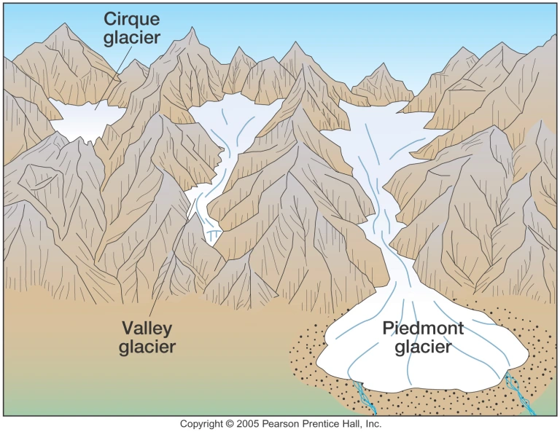

Slide 11
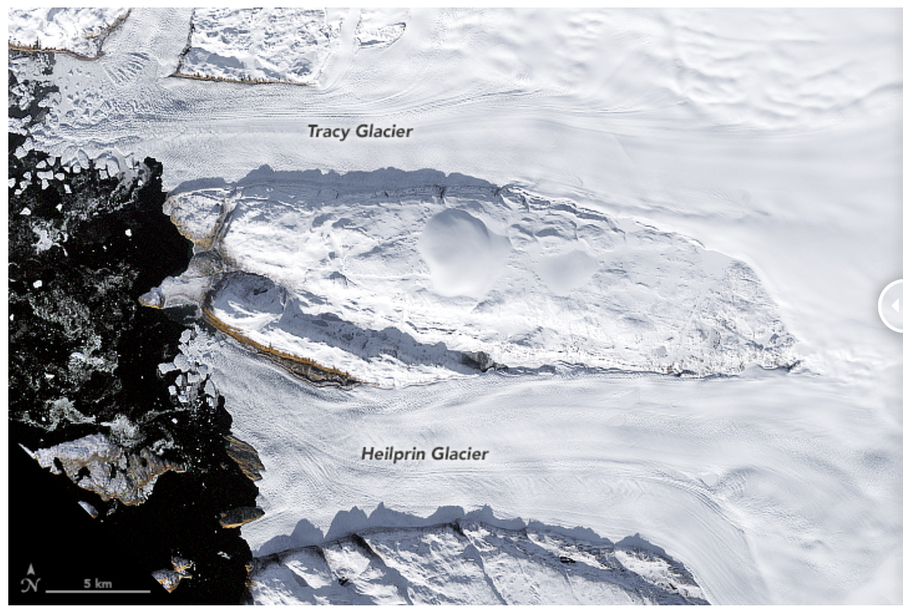
Notes:
An outlet glacier is a valley glacier that carries ice from an ice sheet or ice cap into the ocean by flowing through a gap in the surrounding mountains

Slide 12
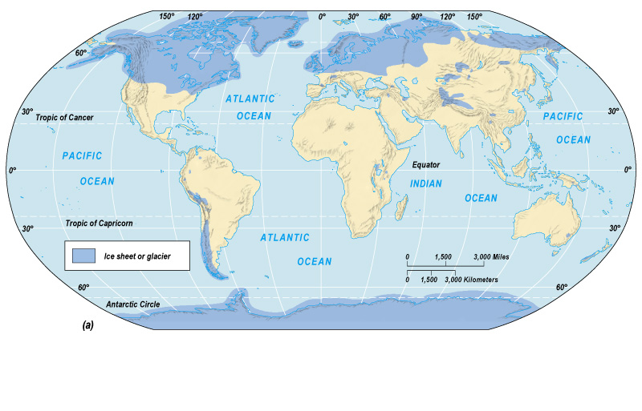
Notes:
Maximum extent of Pleistocene glaciation
Most recent glacial maximum peaked 18,000 years ago and is considered to have ended 10,000 before present

Slide 13
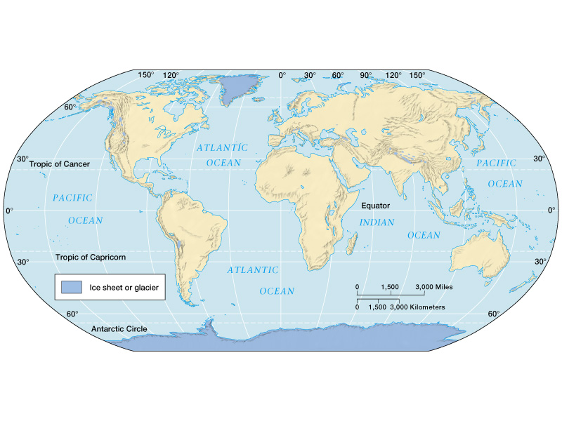
Notes:
Current extent of glaciation is about 10% of land surface

Slide 14
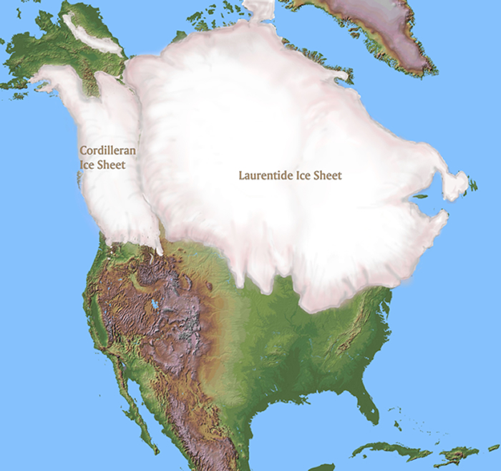

Slide 15
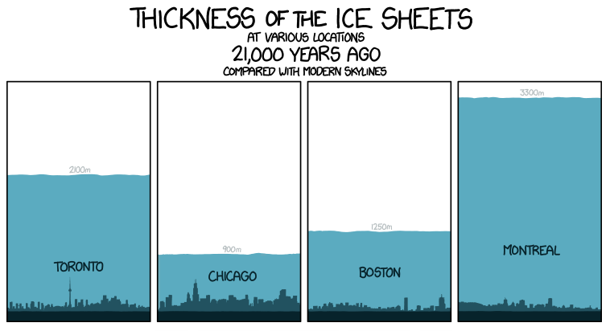
Notes:
The Greenland ice sheet once extended down into North America. It reached its last southernmost extension roughly 20,000 years ago. The maximum thickness of the present-day Greenland ice sheet ranges from approximately 1-2 miles (2000-3000 meters)

Slide 16
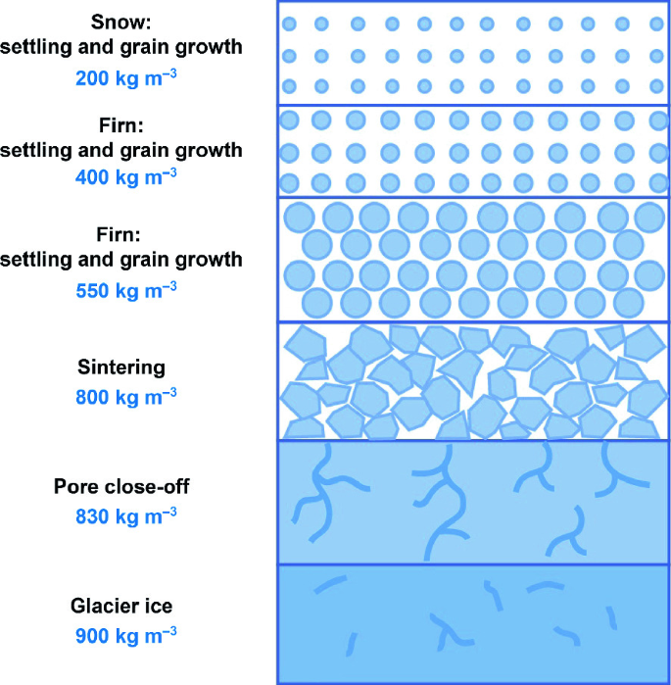
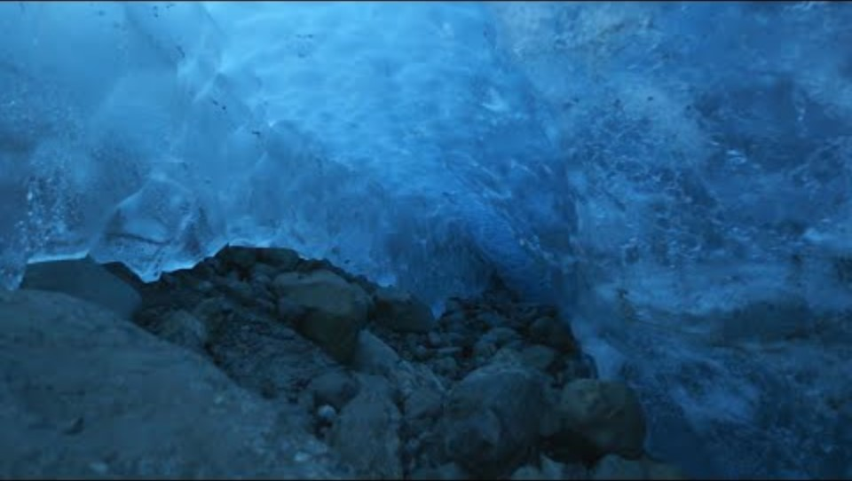
Glacial ice
Glacial ice formed by pressure and recrystallization of snow
Firn is intermediate between snow and glacial ice

Slide 17
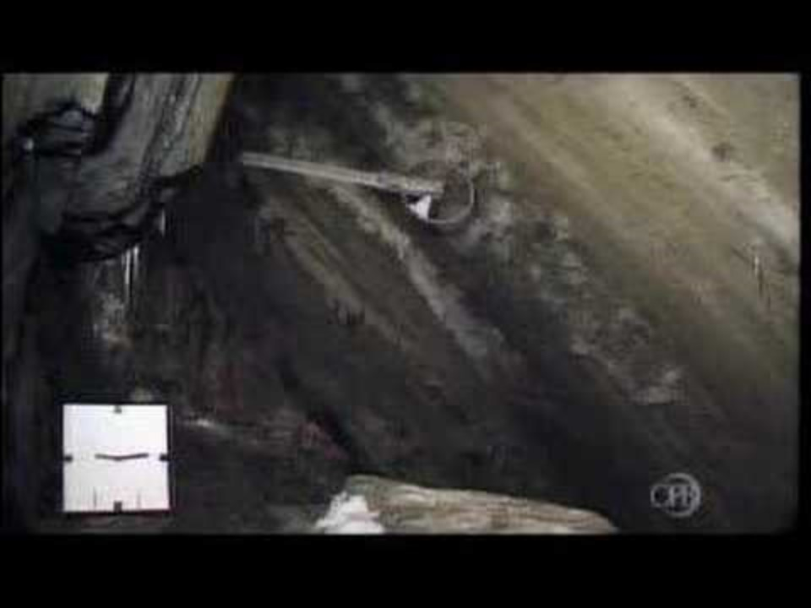
Glacial movement
Glacial ice has a plastic (pliable) manner and flows in response to pressure, slope, and gravity
Not always a smooth flow as surges or slips may occur irregularly
Fastest flow is in the center of the glacier where friction with surrounding rock is less

Slide 18
Glacial mass balance
Refers to the difference between the accumulation and ablation (loss) of ice and snow on a glacier over a specific period, typically a year. It is a key measure of a glacier's health and determines whether a glacier is growing, shrinking, or remaining stable.
  Zone of ablation
  Zone of accumulation
  Equilibrium line

Slide 19
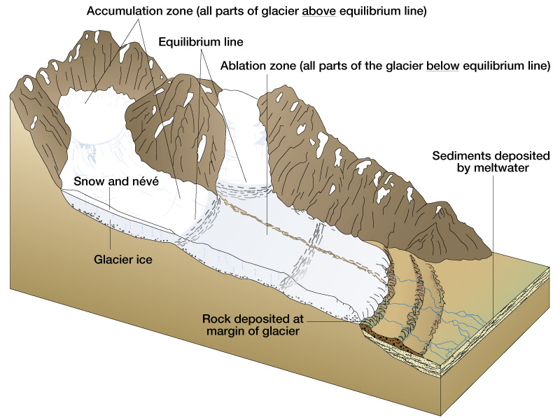
Notes:
Accumulation zone receives input of snow. Ablation zone has outputs of ice, melt water, and water vapor. The

Slide 20
Warm-based glaciers
Pressure exerted by overlying ice causes bottom of glacier to be close to melting point
Liquid water can form which can repeatedly melt and refreeze with entrains debris into the ice
Presence of water reduces friction and encourages basal sliding and rapid ice velocities
Large amount of sediment eroded to form moraines
More common in temperate climates and alpine glaciers
Notes:
This decrease in the melting point under pressure is the principle behind phenomena such as the ability to ice skate, where the high pressure under the blade causes a thin layer of ice to melt, creating a slippery surface.

Slide 21
Cold-based glaciers
Pressure melting point is not reached and the glacier remains frozen to its bed.
There is little movement, debris entrainment or deposition, and landforms are typically subdued
More common in high latitude ice sheets
Notes:
This decrease in the melting point under pressure is the principle behind phenomena such as the ability to ice skate, where the high pressure under the blade causes a thin layer of ice to melt, creating a slippery surface.

Slide 22
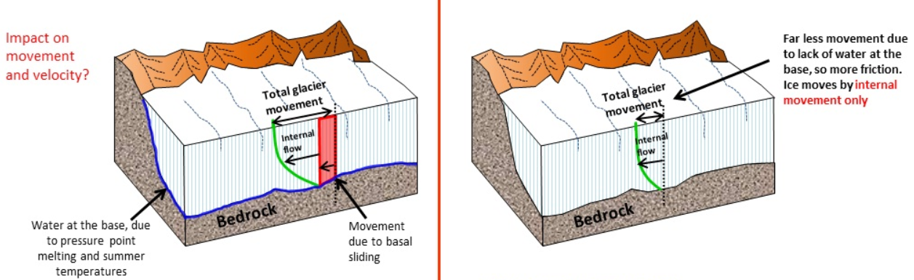
Warm-based
Cold-based

Slide 23
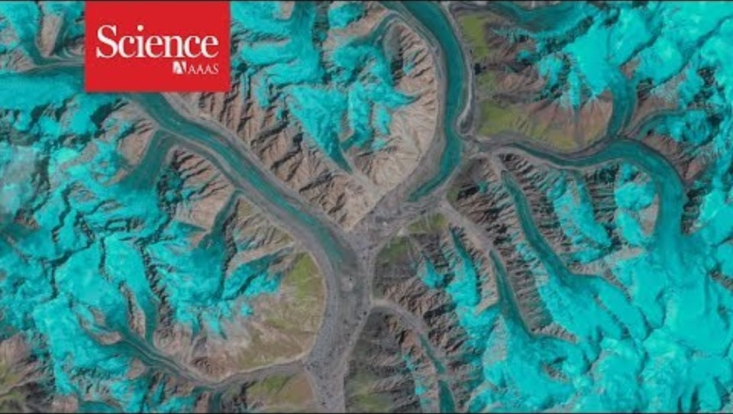
Glacial surge

Slide 24
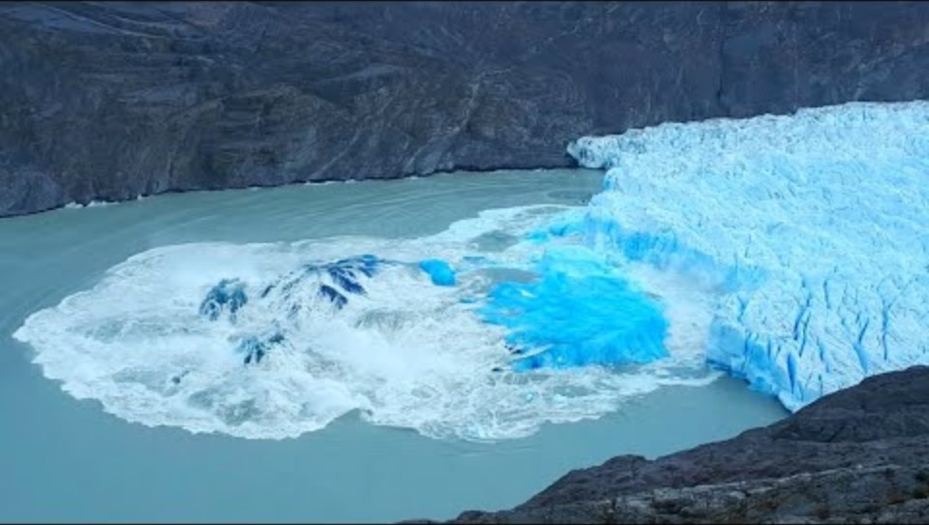
Glacial calving

Slide 25
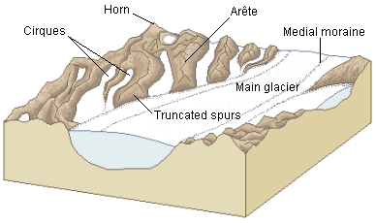
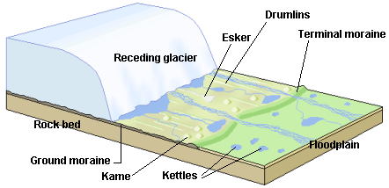
Glaciers create a combination of constructive (depositional) and destructive (erosional) landforms

Slide 26
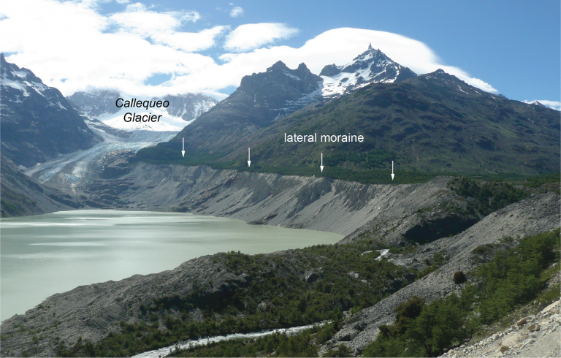
Amount of glacial erosion shaped by:
Ice thickness
Steepness of slope
Glacial downward velocity
Sediment or rock type underlying ice
Duration of glaciation
Supraglacial and subglacial cyro-hydrological drainage

Slide 27
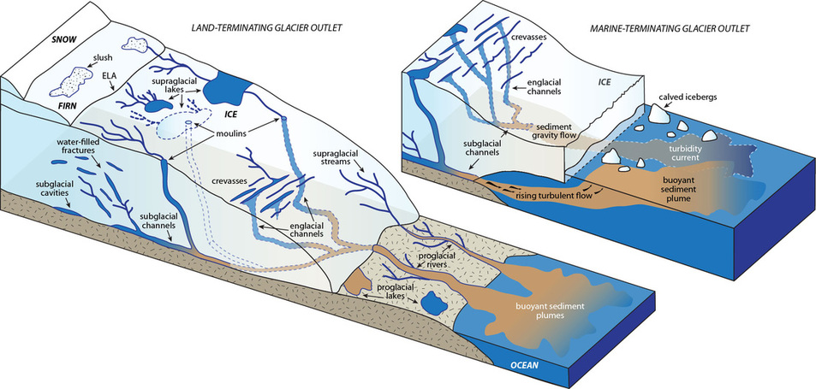
Supraglacial and subglacial cryo-hydrologic drainage
Notes:
http://www.venachu.com/research.html

Slide 28
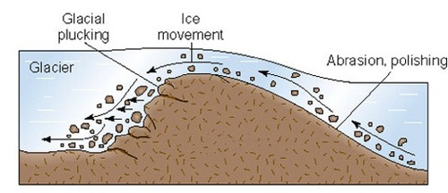
Processes of glacial erosion
Abrasion – grinding action on bedrock at the bottom of the glacier
Plucking – rocks are ripped out of the ground by glacier movement and carried along by the glacier for some time before deposition

Slide 29
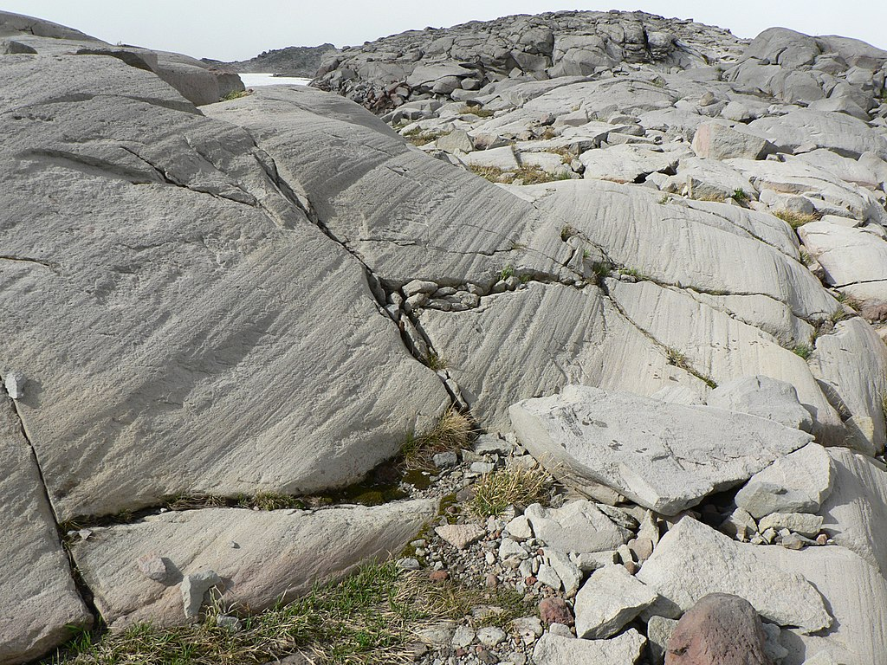
Glacial polishing and striations
Notes:
Striations and polishing

Slide 30
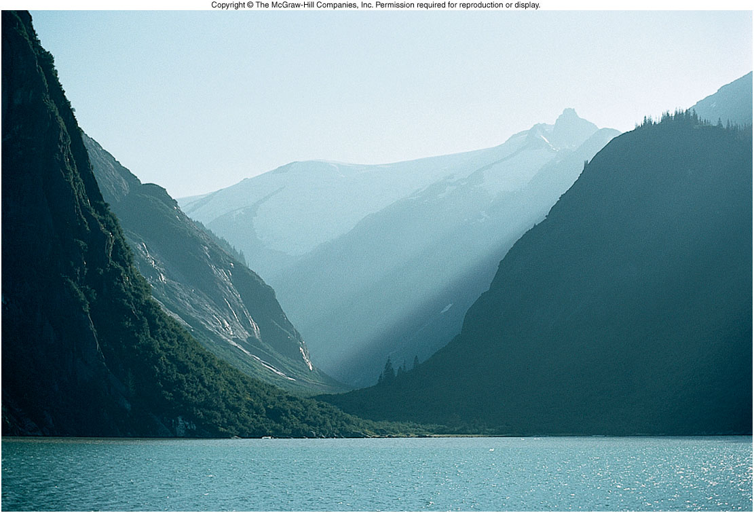
U-shaped glacial valley
Notes:
Flowing water often makes a V-shaped valley formation. As a glacier moves through a V-shaped valley it erodes and scrubs out the valley leaving it U-shaped once it retreats

Slide 31
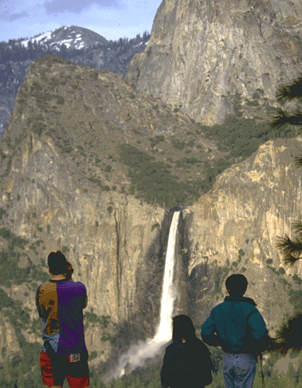
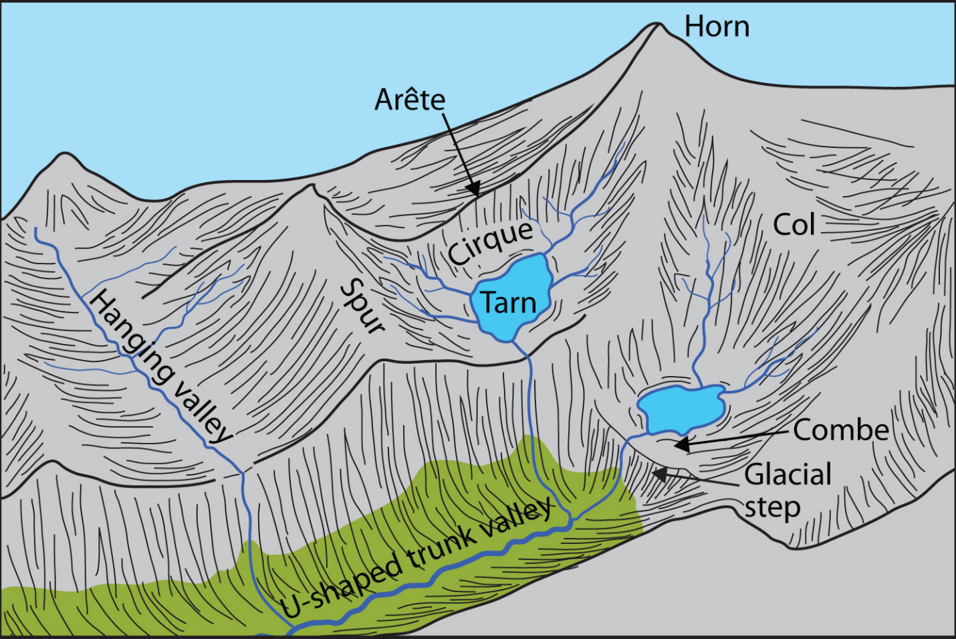
Hanging valleys
Notes:
Created when glacially valleys intersect the ocean and are partially flooded.

Slide 32
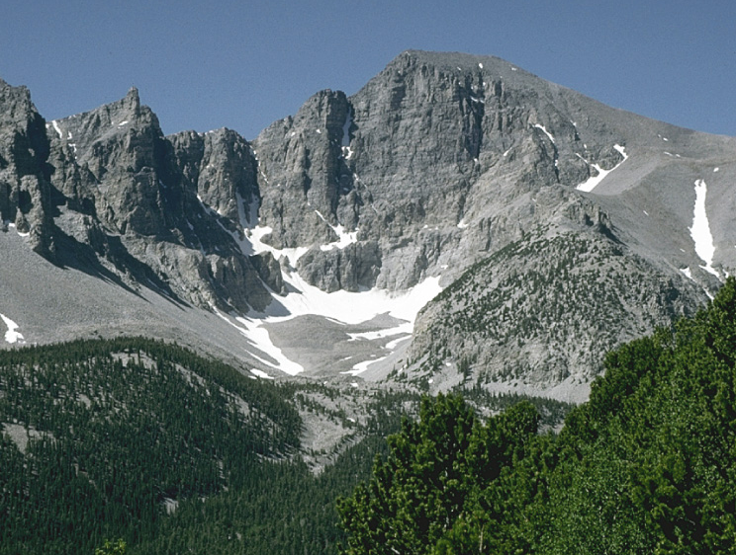
Cirques
Notes:
Cirques are bowl-shaped eroded, depressions near-mountain top ridges where snow accumulates and forms the head of an alpine glacier. When glaciers retreat, the cirque is often the last part to melt.

Slide 33
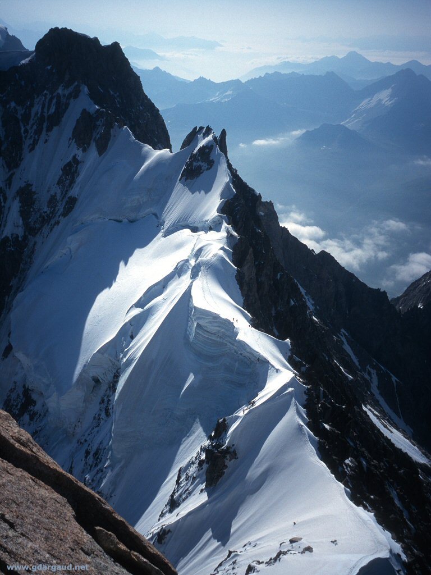
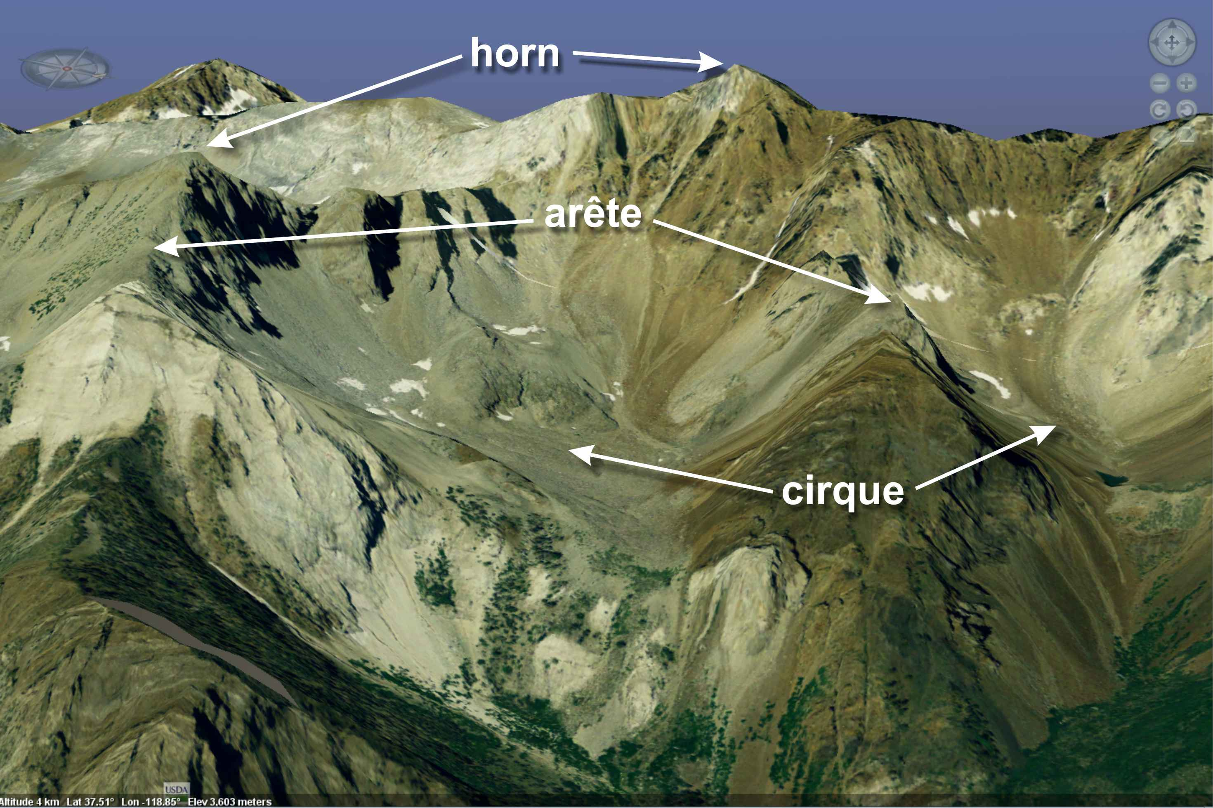
Aretes

Slide 34
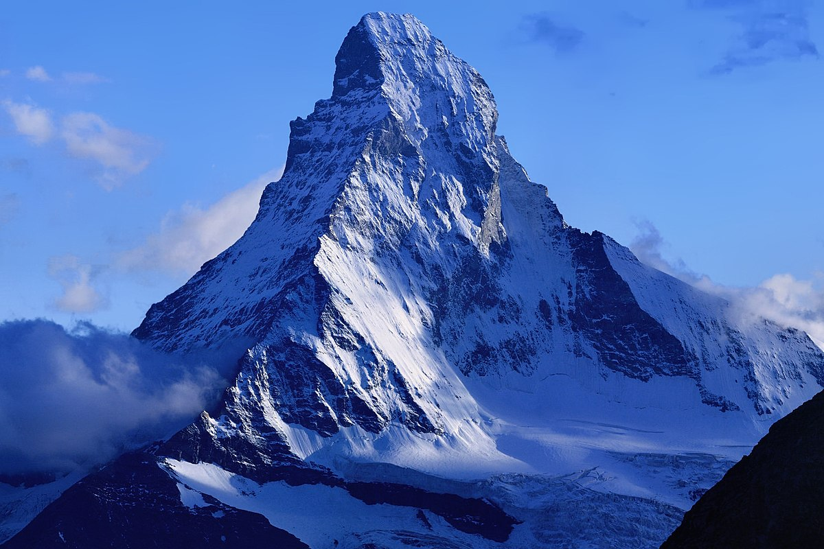
Horns

Slide 35
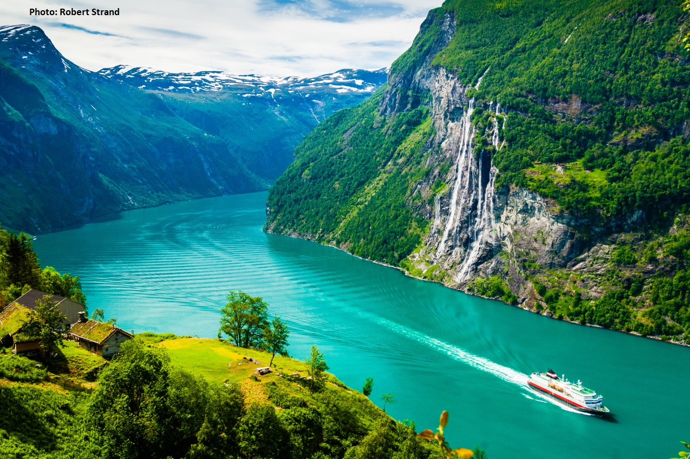
Fjords
Notes:
Created when glacially valleys intersect the ocean and are partially flooded.

Slide 36
Glacial depositional landforms
Till is sediment deposited directly by a glacier, usually unsorted
Glacial outwash are sediments deposited by melt water streams emanating from a glacier
Glacial flour is the fine sediment transported by streams draining glaciers
Loess is the windblown component of these fine sediments eroded by glaciers

Slide 37
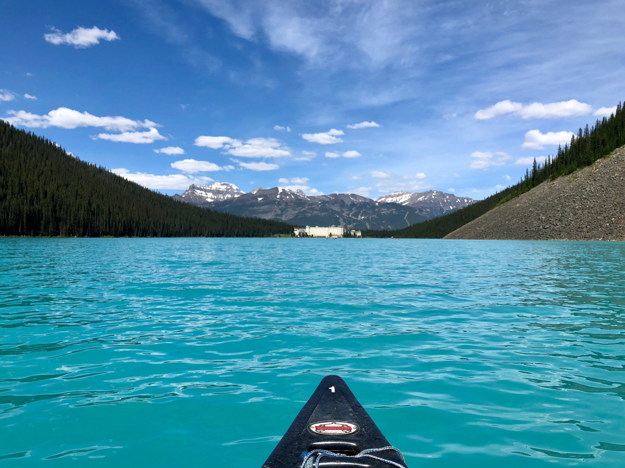
Notes:
Color is due to fine sediments of glacial ‘flour’ which absorb the reds of the spectrum and blues and greens are reflected back to our eyes.
Lake Louise in the Canadian Rockies

Slide 38
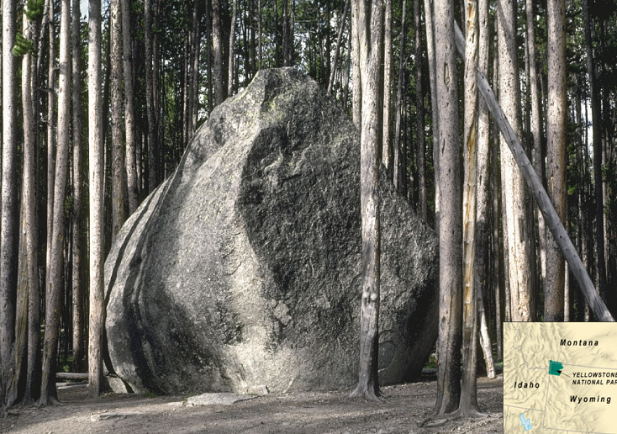
Glacial erratics
Notes:
Glacial erratics are enormous boulders transported and deposited by glaciers, often far from their source region.

Slide 39
Moraines
Moraines are formed by deposition of glacial till as glacier melts.
Lateral moraines
  Long linear ridges of glacial till deposited along the side of the glacier parallel to its direction of movement.
Medial moraines:
  Long linear ridges that form along the contact where tributary glaciers with lateral moraines merge to join larger valley glaciers.

Slide 40
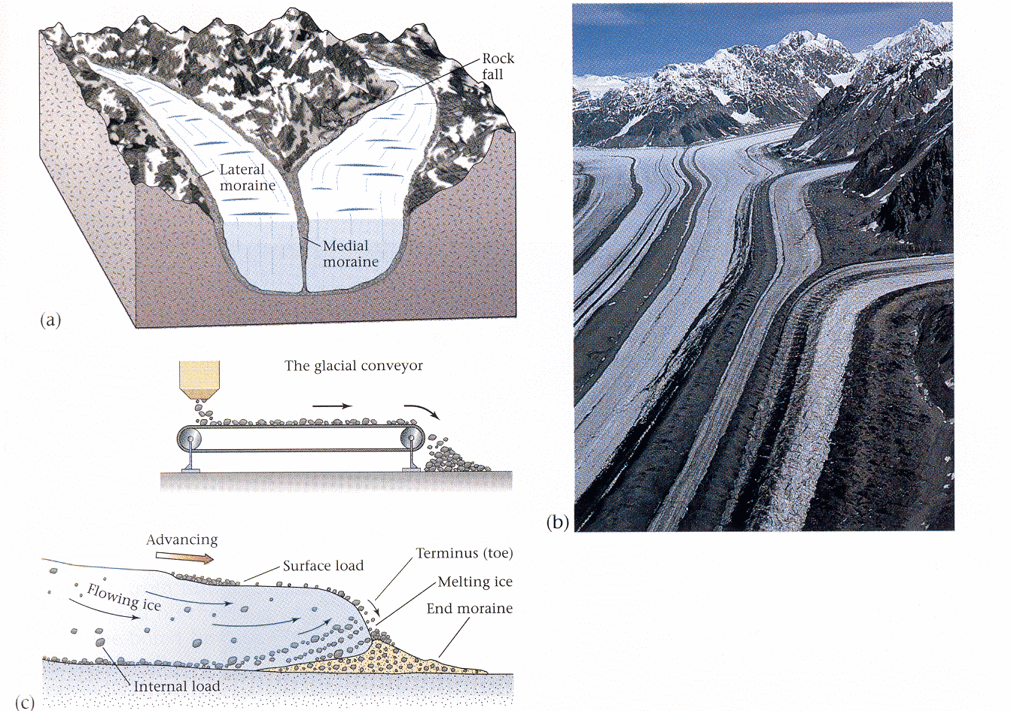
Notes:
Moraines (end/lateral/medial) are linear features deposited at bottom or along sides of glaciers.

Slide 41
Terminal moraines
  Linear, arc-shaped depositional ridges that form at the terminus of a glacier. These till deposits mark the limit of glacial movement.
Recessional moraines
  Linear, arc-shaped ridges deposited by the melting glacier as it retreats
  Smaller than terminal moraines
  They mark the gradual retreat of the glacial ice after it has already deposited its terminal moraine.

Slide 42
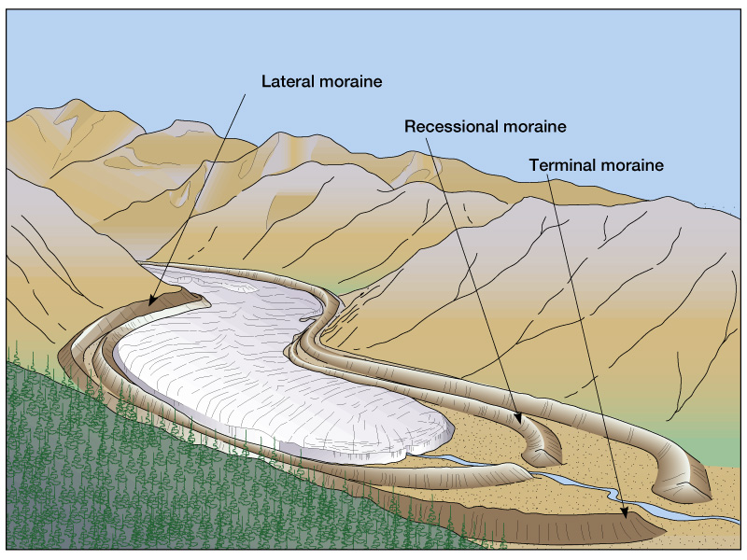
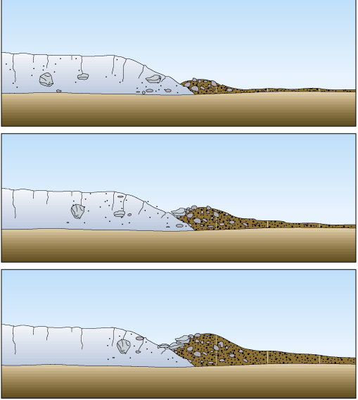
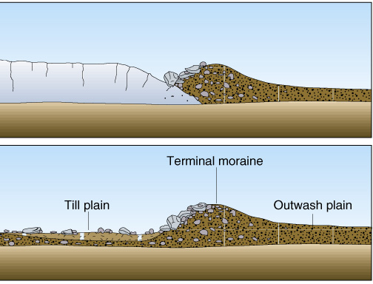
Notes:
Moraines (end/lateral/medial) are linear features deposited at bottom or along sides of glaciers.

Slide 43
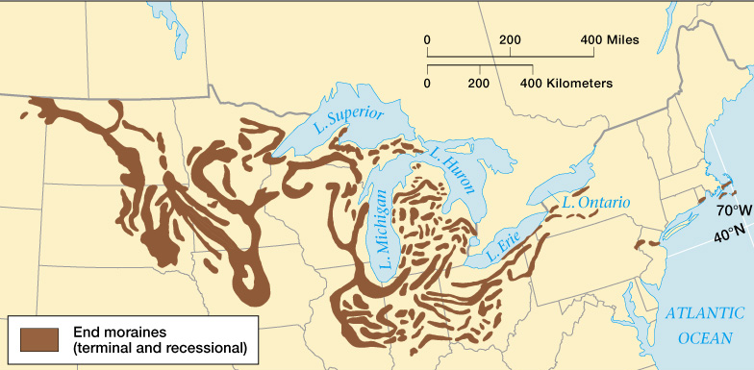
Finger Lakes Region, New York

Slide 44
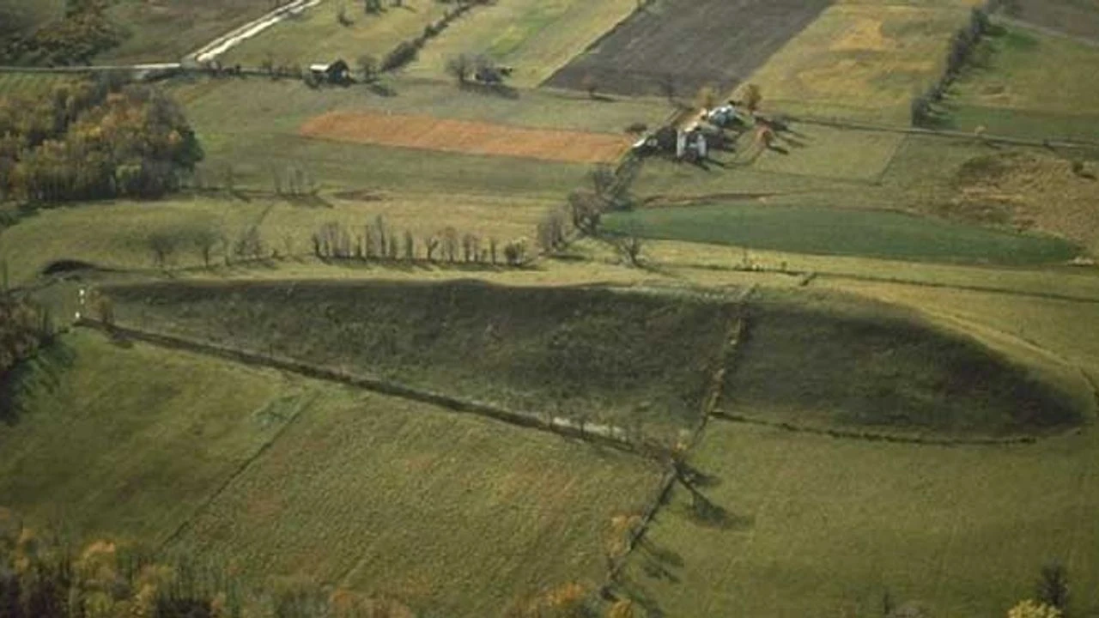
Drumlins
Drumlins

Slide 45
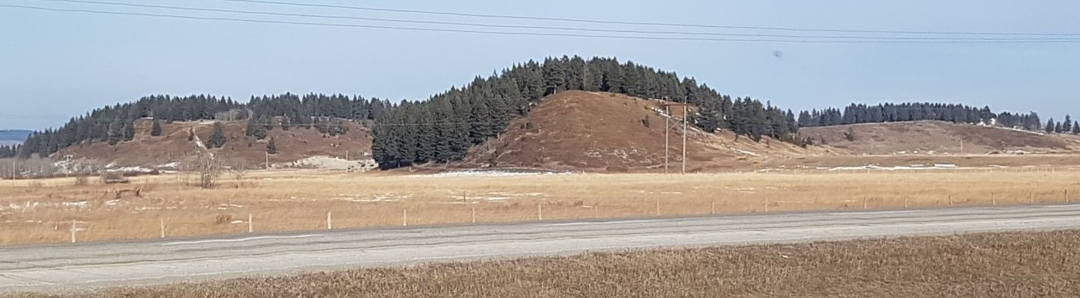

Slide 46
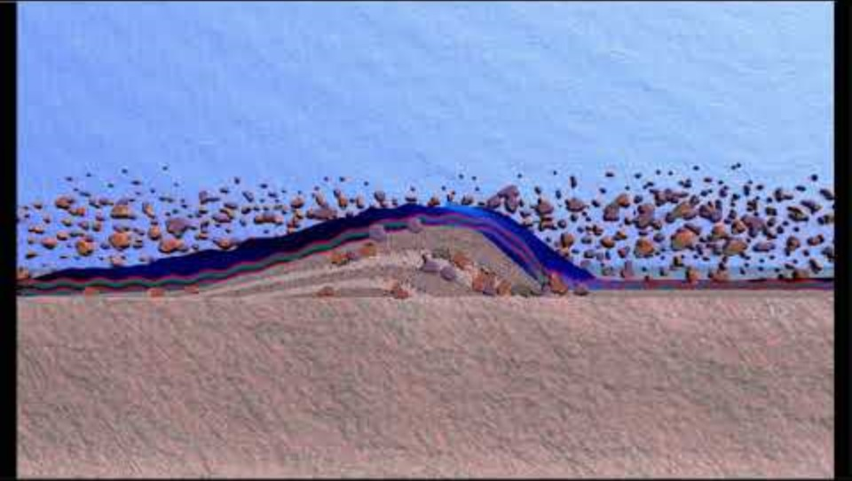
Notes:
Drumlins are often found in groups, called drumlin fields or swarms, and are a key feature of glaciated landscapes.

Slide 47
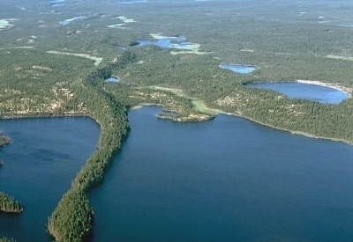
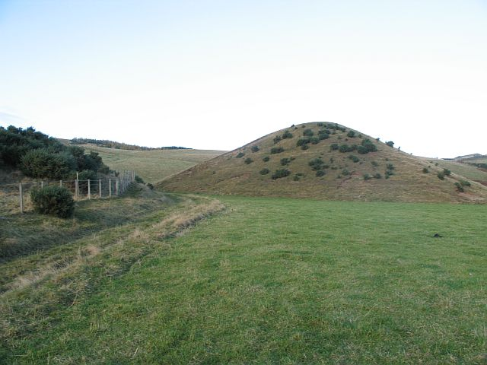
Eskers and kames
Notes:
Eskers form when glacial meltwater carries sediment through tunnels or channels in the ice, and deposits it as the water slows down. The sediment builds up in piles that take the shape of the channels
Kames are created when meltwater from a glacier deposits sand and gravel in holes or fissures in the glacier. When the glacier retreats/melts these piles of sediment are left behind

Slide 48
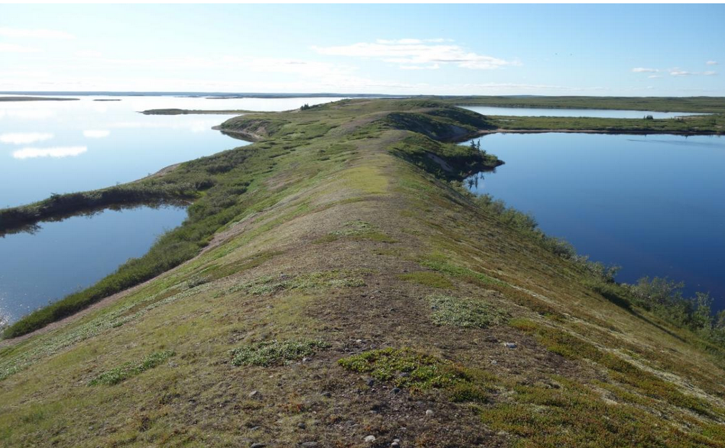

Slide 49
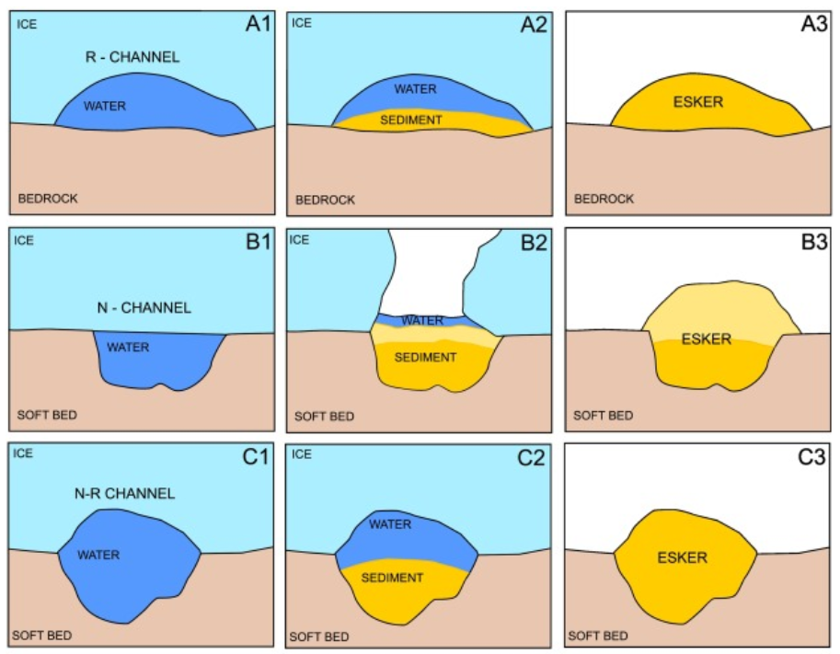
Notes:
https://www.sciencedirect.com/science/article/pii/S0169555X22003117

Slide 50
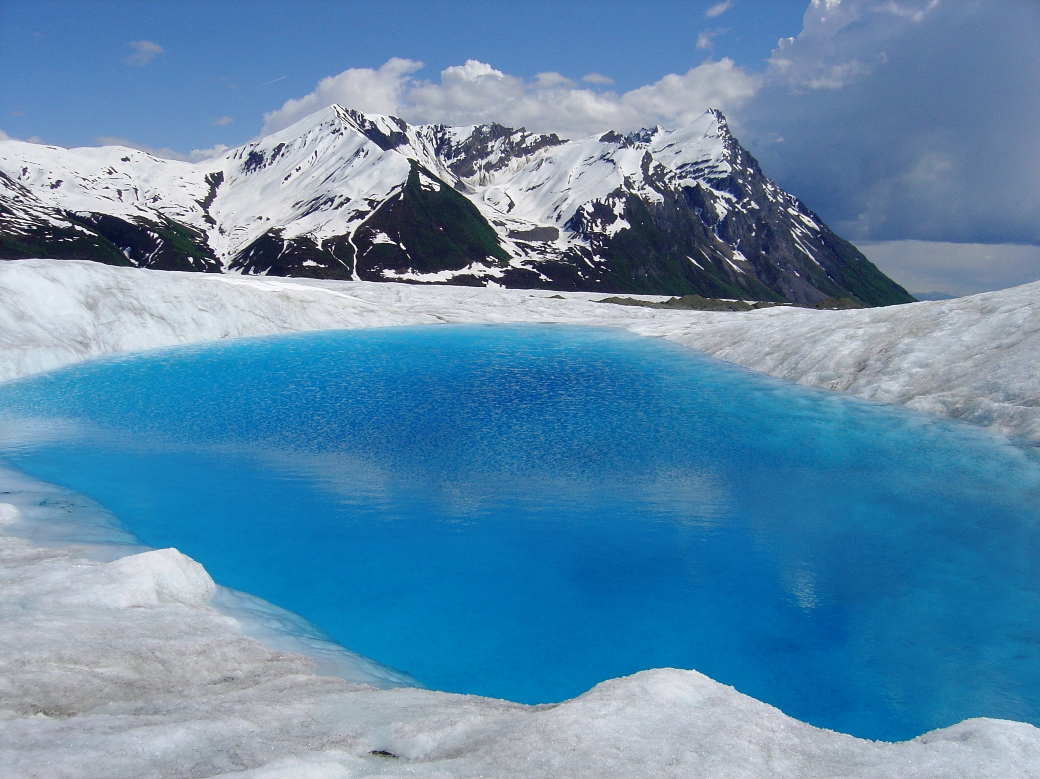
Supraglacial lake

Slide 51

Tarns (corrie lakes)
Notes:
Tarns are small lakes that forms in a glacial cirque

Slide 52


Slide 53


Slide 54

Kettle lakes and prairie potholes

Slide 55

Prairie pothole region of the US and Canada
As glaciers retreated, they left behind uneven terrain with depressions caused by chunks of ice that had broken off and become buried in sediment.
These large blocks of ice, eventually melted, creating depressions or "potholes" in the landscape.

Slide 56



Notes:
Prairie potholes

Slide 57

Glacial lake outburst flood
Occurs when a large volume of water is suddenly released from a glacial lake.
These lakes typically form when meltwater accumulates in depressions at the front of glaciers behind moraines or within ice-dammed areas.

Slide 58

Triggered by
  Landslides or avalanches can displace water over/weaken the moraine or break apart the ice dam
  Seismic activity
  Melting of ice dams, including volcanic and geothermal activity

Slide 59


Slide 60


Slide 61

The Great Lakes
Formed from erosional action of the Laurentide Ice Sheet that repeatedly advanced and retreated over the region
When the glaciers began to retreat around 10,000 years ago, the basins they carved filled with meltwater
Notes:
These lakes—Superior, Michigan, Huron, Erie, and Ontario—are the largest group of freshwater lakes by surface area in the world, holding about 21% of the Earth's surface fresh water.
Dubbed “the nation’s fourth seacoast,” the U.S. Great Lakes shoreline alone totals more than 4,500 miles — longer than the U.S. East and Gulf coasts combined. The North American Great Lakes are unique among the world’s large lakes in that their basins are linked together and form one continuous drainage basin.
https://www.seagrant.wisc.edu/resources/the-formation-of-the-great-lakes/how-they-were-made/

Slide 62


Slide 63


Slide 64

Notes:
North American Midcontinent Rift

Slide 65

Notes:
Dubbed “the nation’s fourth seacoast,” the U.S. Great Lakes shoreline alone totals more than 4,500 miles — longer than the U.S. East and Gulf coasts combined. The North American Great Lakes are unique among the world’s large lakes in that their basins are linked together and form one continuous drainage basin.
https://www.seagrant.wisc.edu/resources/the-formation-of-the-great-lakes/how-they-were-made/

Slide 66

Notes:
Flow is generally from west to east out the St. Lawrence Seaway
These lakes—Superior, Michigan, Huron, Erie, and Ontario—are the largest group of freshwater lakes by surface area in the world, holding about 21% of the Earth's surface fresh water.

Slide 67

Notes:
https://www.sciencedirect.com/science/article/pii/B9780444536433001357

Slide 68

Notes:
Antarctica is the highest continent on Earth: average elevation is 8,200ft (2500m).

Slide 69

East Antarctic ice sheet
West Antarctic ice sheet
Transantarctic Mountains
Ross ice shelf
Ronne ice shelf
Notes:
Ice thicknesses show in contours (in units of meters)

Slide 70


Ice domes
Ice domes
Ice sheets are composed of individual ice domes

Slide 71


Ice shelves
Antarctic Ice shelves range from 100 – 1000 meters (300 – 3000 ft).
Fed by glaciers, these massive slabs of ice float on the surface of the ocean. Their elevation rises and falls with the tides.

Slide 72


Outlet glaciers
Notes:
Transantarctic Mountains.
The West Antarctic ice sheet lies below sea level, meaning that the WAIS would be seabed if the ice sheet was not there.

Slide 73

Alpine glacier
Alpine glacier
Notes:
When the climate warms, ice shelves may melt as water temperatures increase, reducing the restraining contact with the bedrock, accelerating ice flow from land and enhancing mass loss through ice calving.

Slide 74

Outlet glacier movement shaped by water temperatures underneath ice shelf and the grounding ridge of the glacier on the sea floor
Notes:
Over the past 40 years, water has warmed at all longitudes around Antarctica.

Slide 75


Antarctic sea ice

Slide 76

Notes:
Greenland continental ice sheet

Slide 77


Notes:
Greenland ice sheet showing piedmont glacier flowing from the interior ice cap out onto lowlands

Slide 78


Notes:
Piedmont glacier

Slide 79


Notes:
Tidal glacier, Greenland

Slide 80

Crevasses

Slide 81


Slide 82


Supraglacial lakes
Moulins
Notes:
http://www.youtube.com/watch?v=kYKKgn0GaY0&feature=related

Slide 83


Slide 84


Notes:
The question is not whether Greenland is melting. It is melting. The question is what are the dynamics of the melting – and how fast or slow water and ice move into the ocean
Formation of supraglacial lakes and moulins may lead to enhanced basal lubrication and acceleration of movement of glaciers toward the ocean over time.

Slide 85

Notes:
However, some of the basal water will form channels in the underlying sediments and thereby limit the lubrication of the overlying ice. Overall rhythm of melting is very dependent upon local conditions

Slide 86

Notes:
Meltwater on the surface of the ice shelves can also enhance breakup and calving of glaciers. If the ice shelves retreat past the grounding line, then they can accelerate seaward.

Slide 87

Notes:
However, the steepness of the glacier and its ice shelf determines how much of it will break up. If the slope is shallow (a), there is greater likelihood of breakup. Water will percolate down if the slope is less steep. If slope is steeper (b) then more of the water will simply flow of the glacier and the calving of ice will be slower.
These factors suggest that as the Greenland Ice sheet melts, the rate and volume of melting will be variable from place to place.

Slide 88
Arctic sea ice
Notes:
Arctic sea ice comprising the ice cap in the Northern Hemisphere.

Slide 89

Perennial and seasonal Arctic sea ice
Notes:
Is the ice in your ice maker bin all one age or multiple ages?
Perennial (older) ice and seasonal (younger) ice.
Perennial sea ice (older ice) persists over several years. Seasonal sea ice is what froze the prior winter and will melt the following summer. It is younger ice.

Slide 90


