Slide 1
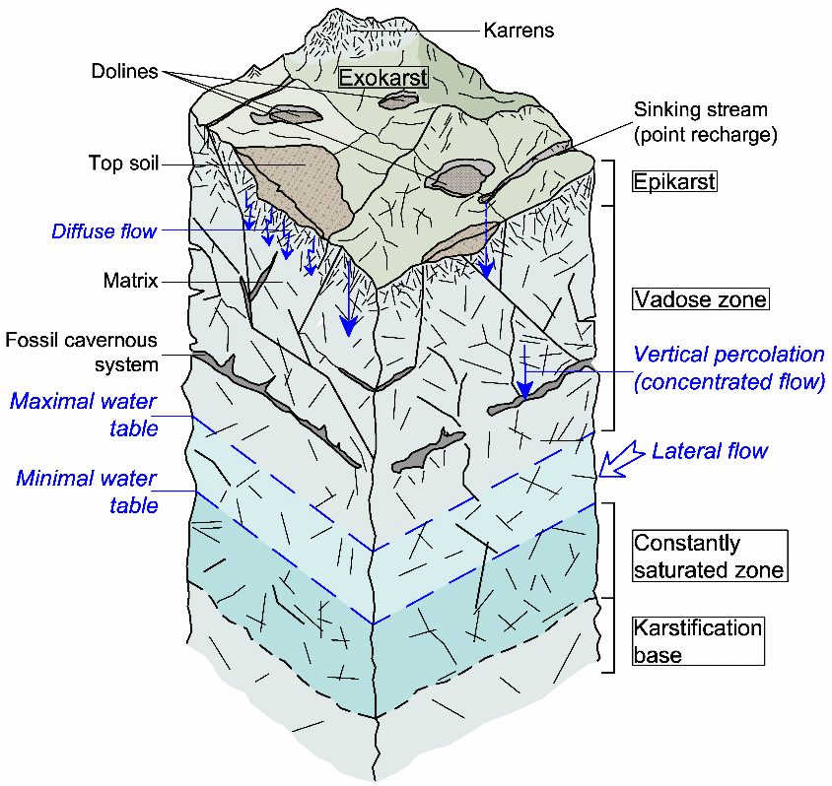
What is Karst?
A landscape underlain by limestone and chemically similar rocks, where surface topography and subsurface is shaped by carbonation, a chemical weathering process
Characterized by sinkholes, disappearing streams, subterranean drainage, and caves.
Karst can also refer to the landforms that are formed through karstic processes
Notes:
Karst can also form through acidic water that percolates up from underground sources rather than through surface waters
Epikarst refers to the near-surface layer of a karst landscape, typically characterized by enhanced dissolution and increased permeability due to the concentration of weathering processes. It acts as a transition zone between the surface and deeper karst systems.
Exokarst refers to the visible, surface features of a karst landscape formed by the dissolution of rock at or near the surface. It includes a wide range of landforms that are often dramatic and visually distinctive.

Slide 2
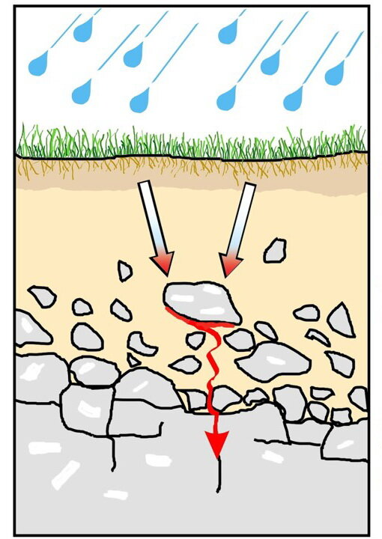
Carbonation begins when carbon dioxide dissolves in water within surface soils to form carbonic acid
When this slightly acidic water comes into contact with carbonate rocks, they are slowly dissolved and over time can weather large volumes of rock and create many different type of landforms.
Karst landforms best develop where there are carbonate rocks, warm climates, and ample precipitation
Notes:
Karst can also form through acidic water that percolates up from underground sources rather than through surface waters

Slide 3
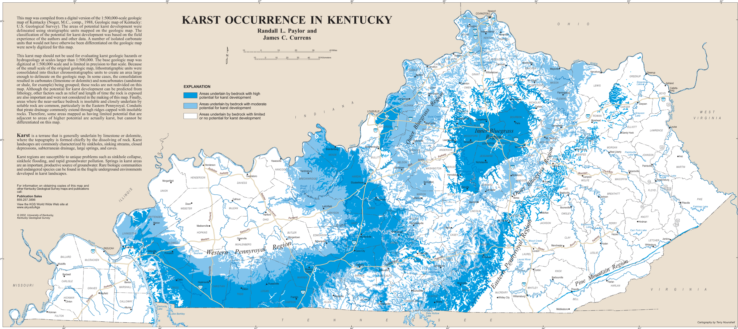

Slide 4
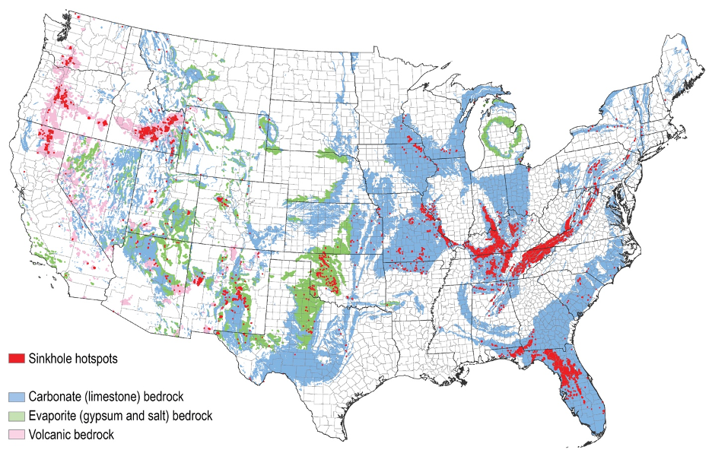
Notes:
Karst terrains in the US

Slide 5
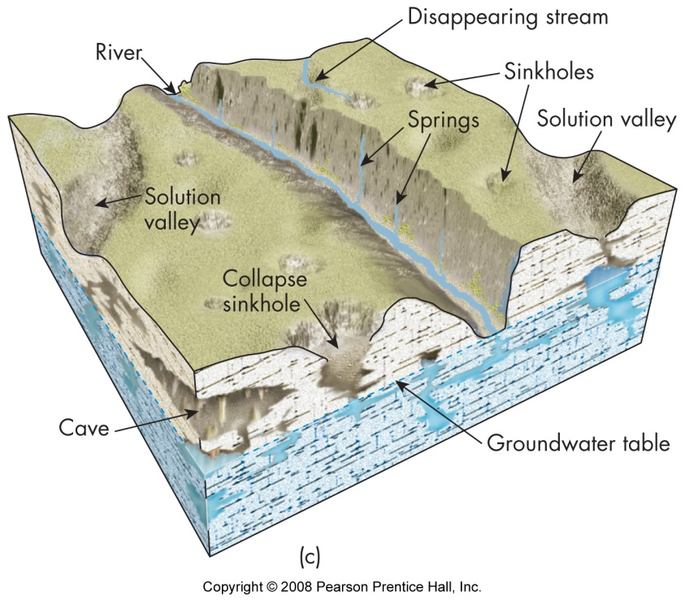

Slide 6
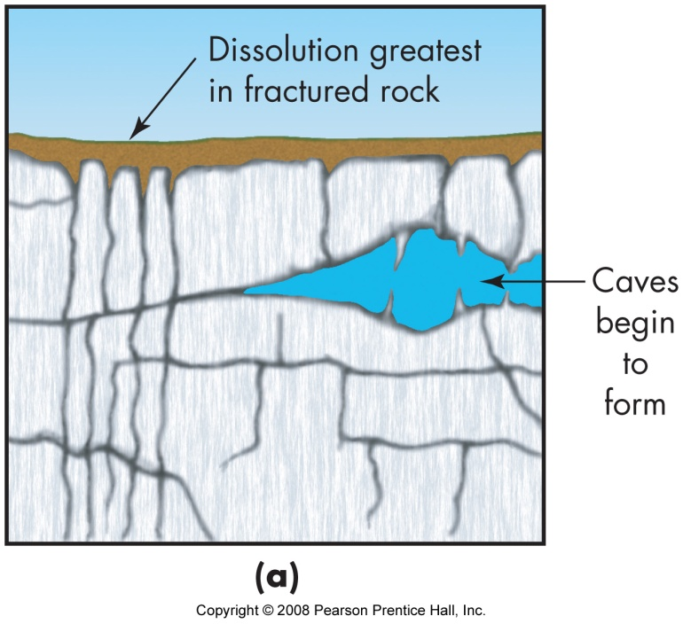
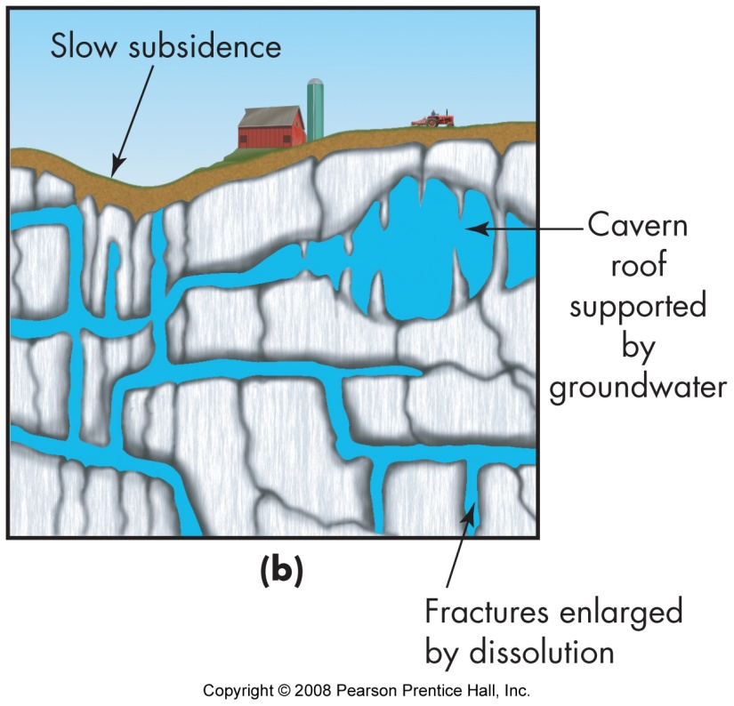
Sinkholes
Various names depending upon language and culture, can also be known as dolines (parts of Europe or cenotes (Mexico).
Formation: groundwater dissolves soluble rock, creating fractures and caves.
Dissolving continues to form larger caves and fractures
Different types of sinkholes and landforms due:
  Extent of weathering and erosion of limestone
  Amount of overlying soil
  Surrounding rock types and orientation

Slide 7
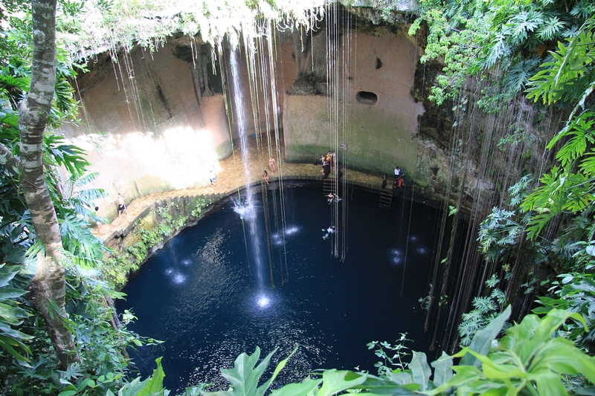
Notes:
Cenotes (Yucatan state, Mexico)

Slide 8
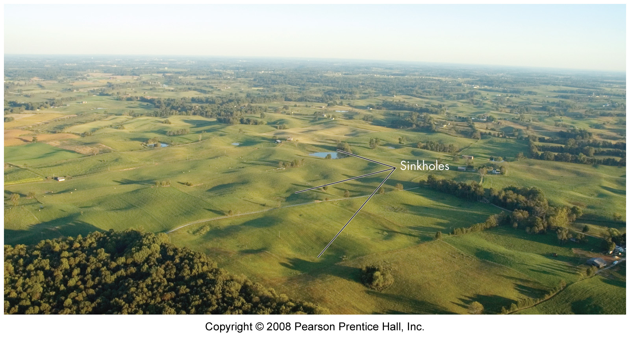
Notes:
Karst plain, Central Kentucky

Slide 9
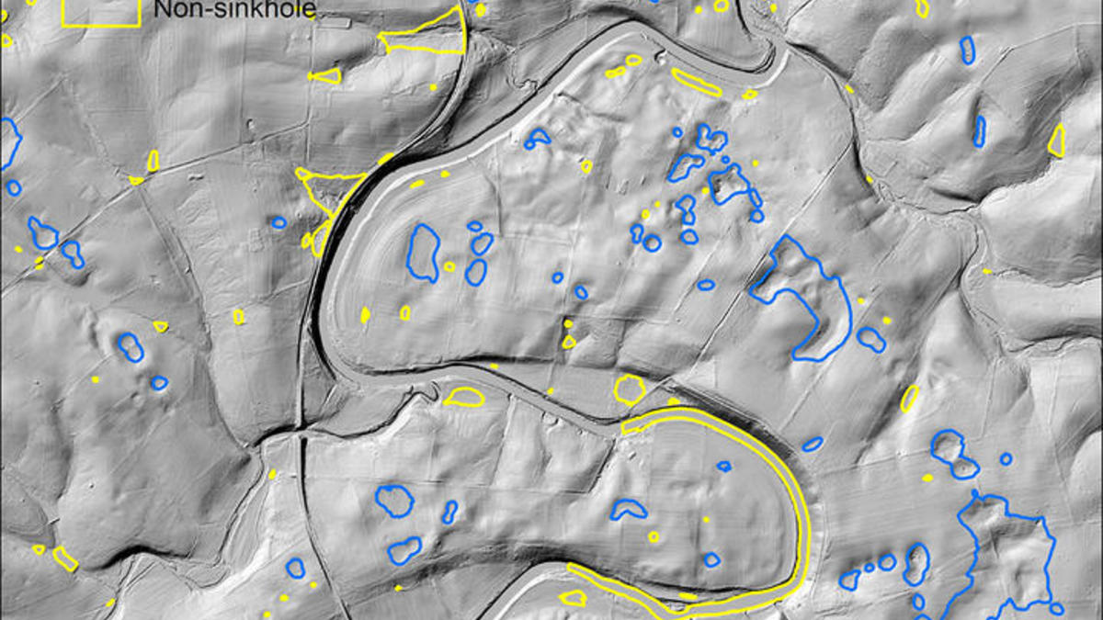
Notes:
https://www.engr.uky.edu/news/2019/03/kgs-jacobs-collaborate-sinkhole-machine-learning-research
Sinkholes in blue. There are lots of sinkholes in Kentucky because it has all the ingredients necessary for a karst landscape to form.

Slide 10
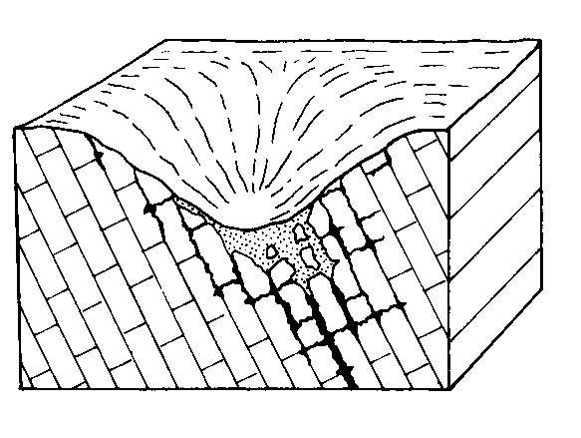
Notes:
Solution sinkhole
Note how the bedding and arrangement of the structure of the limestone enhances dissolution of limestone

Slide 11
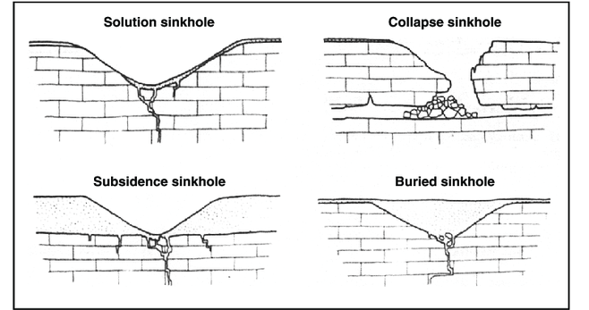

Slide 12
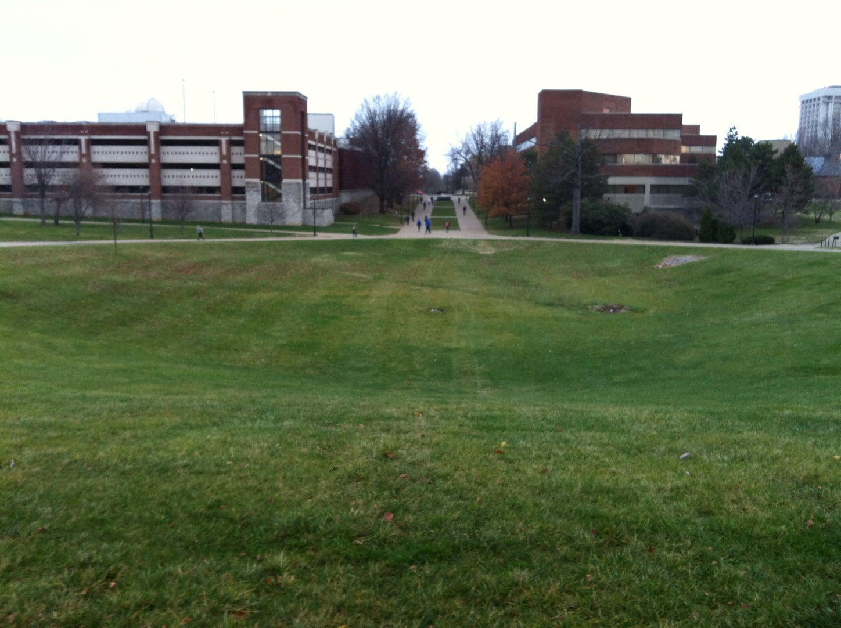

Slide 13
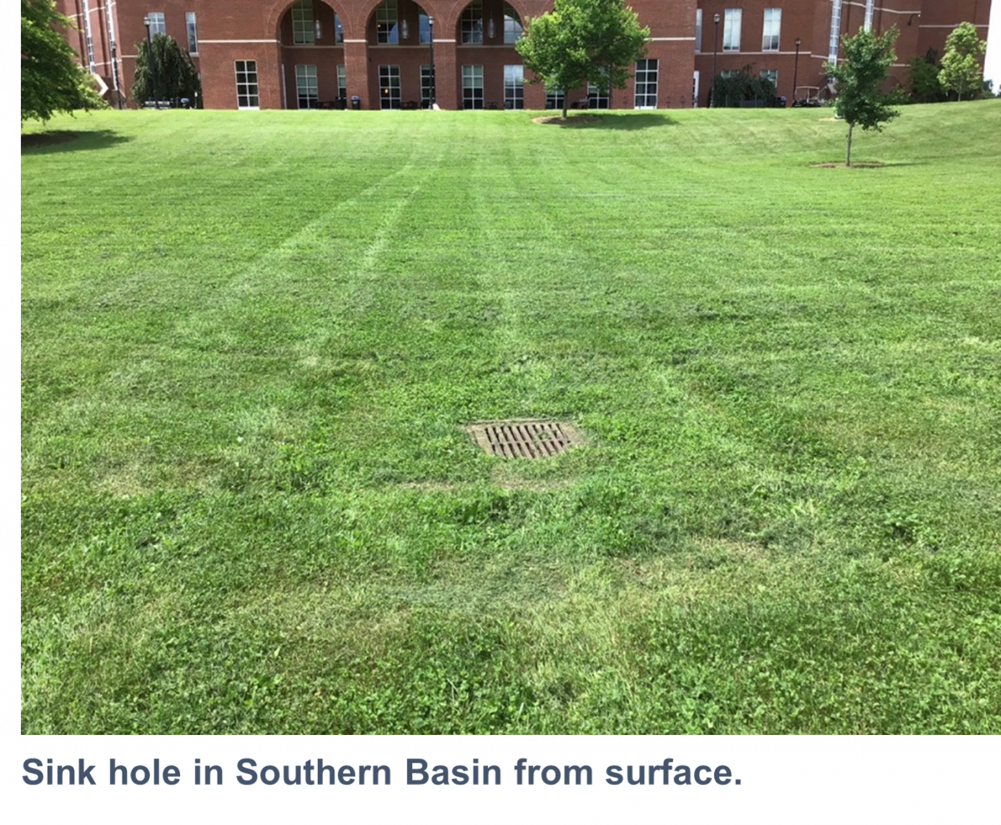
Notes:
Located in the heart of campus, W.T. Young serves as the central library in the university library system. Stormwater from this approximately 20 acre site primarily discharges via the University storm sewer system and travels to a larger LFUCG culvert that discharges to Town Branch. In the event that flows exceed the capacity of the lines leading to the LFUCG culvert, this system has been designed with two large detention basins (North and South) with a sink hole located at the base of each basin. As flow begins to back up into the detention basins, it diverts to the sink holes as a secondary point of discharge. Most rainfall events will bypass the sink holes and discharge to Town Branch via the LFUCG system.
https://www.uky.edu/env/groundwater/class-v-injection-wells
An injection well is a well that is used to place water and fluids underground into porous geologic formations. Regulated by the Safe Drinking Water Act, these wells are subject to federal requirements in order to protect public health and prevent contamination of underground sources of drinking water. The EPA regulates injection wells. Injection wells are grouped into six categories or classes based on use. Class V wells are used for the injection of Non-Hazardous fluids into or above underground sources of drinking water. At the University, Class V wells are used to discharge stormwater from portions of campus into existing modified sinkholes.

Slide 14
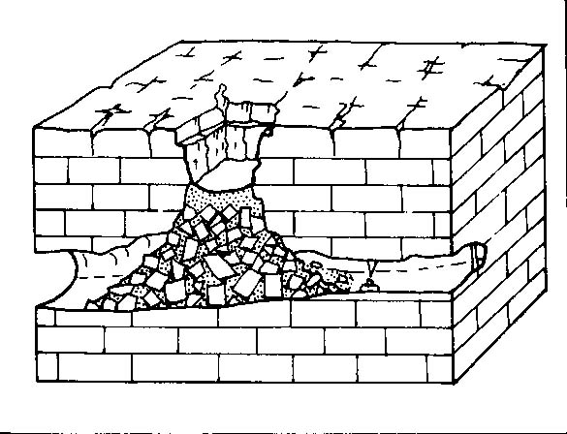
Notes:
Collapse sinkhole

Slide 15
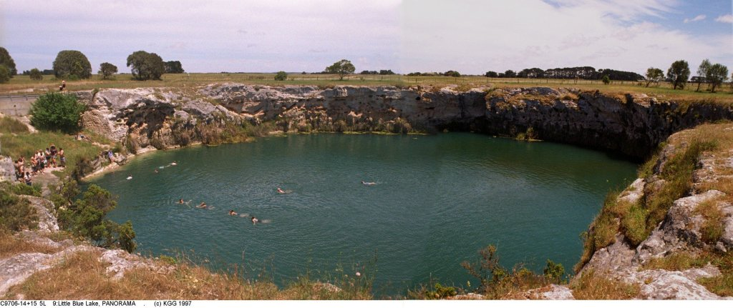
Notes:
Collapse doline with water-table lake in Gambier Karst, South Australia

Slide 16
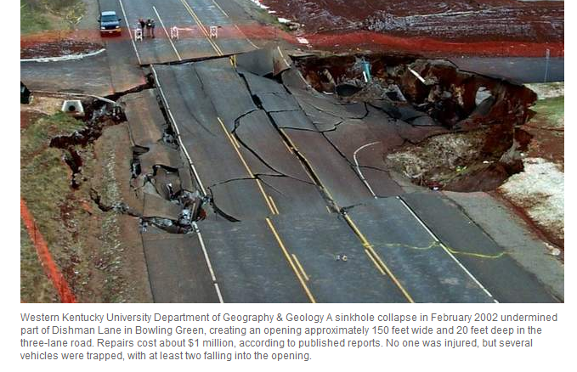

Slide 17


Slide 18
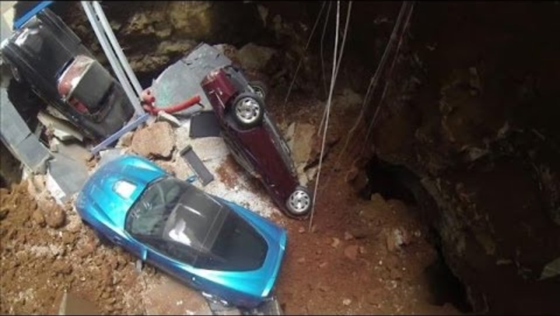

Slide 19
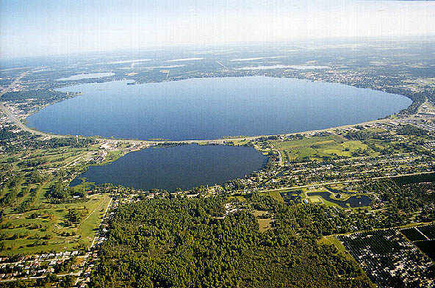
Notes:
Lake Jackson, near Tallahassee, Florida
This is an example of a karstic lake

Slide 20
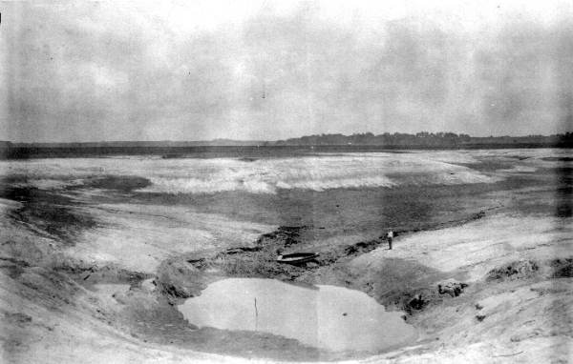
Notes:
This photo of Lime Sink was taken on 20 July 1932, over a week after the drawdown, which occurred over the night of 9-10 July.

Slide 21
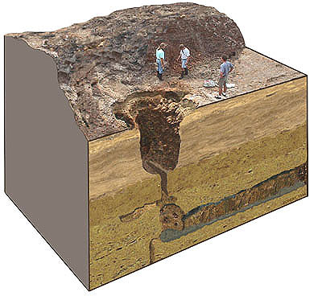
Notes:
When Lake Jackson’s sinks rupture and the lake water drains out, the process is referred to as a dry down. It has occurred many times during the last century.

Slide 22
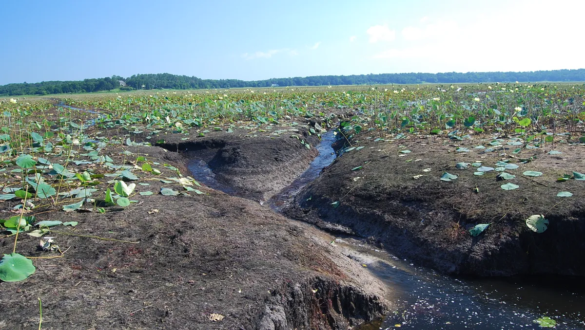
Lake Jackson emptied

Slide 23
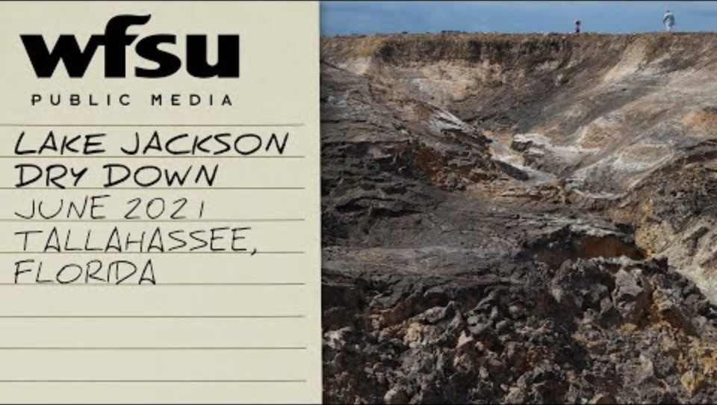

Slide 24
Notes:
Karst plain, central KY

Slide 25
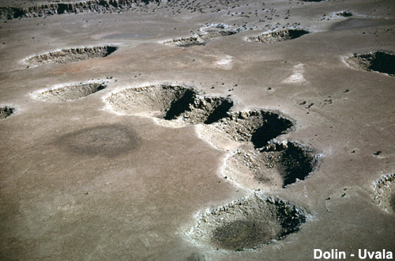
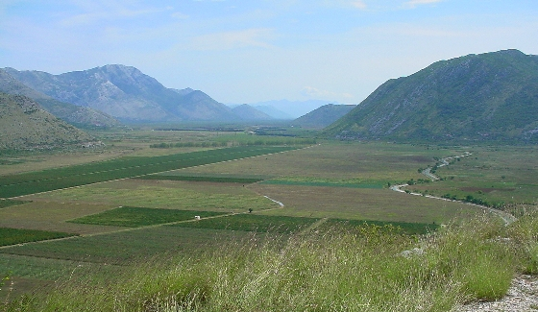
Uvalas and poljes
Uvalas (top)
  Compound sinkholes, coalescence of many smaller sinkholes
Poljes (bottom)
  Broad flat alluvial floor formed from coalescence of uvalas

Slide 26
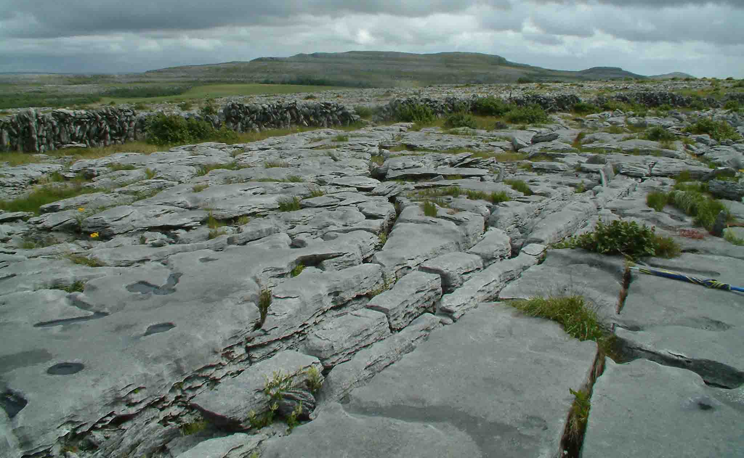
Notes:
Clints and grikes
Corrosive drainage along joints and cracks in the limestone can produce slabs called "clints" isolated by deep fissures called "grikes". (County Clare, northwest Ireland)

Slide 27
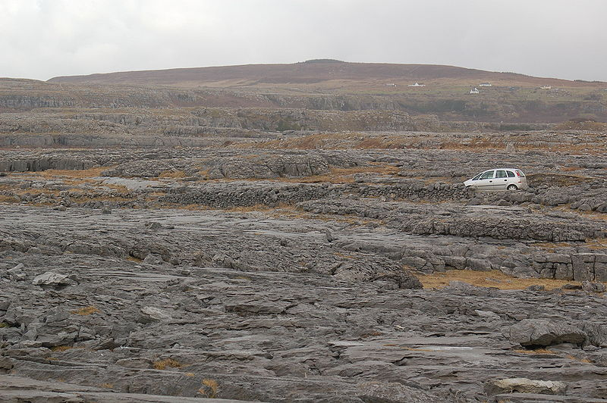
Notes:
Karren landscape composed of clint and grike features in limestone (County Clare, northwestern Ireland, the Barrens).

Slide 28
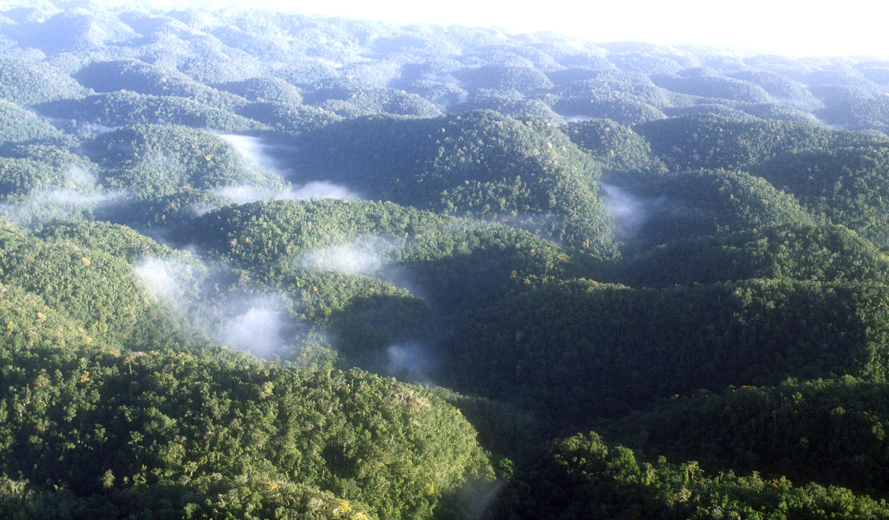
Notes:
Cockpit karst, Jamaica

Slide 29
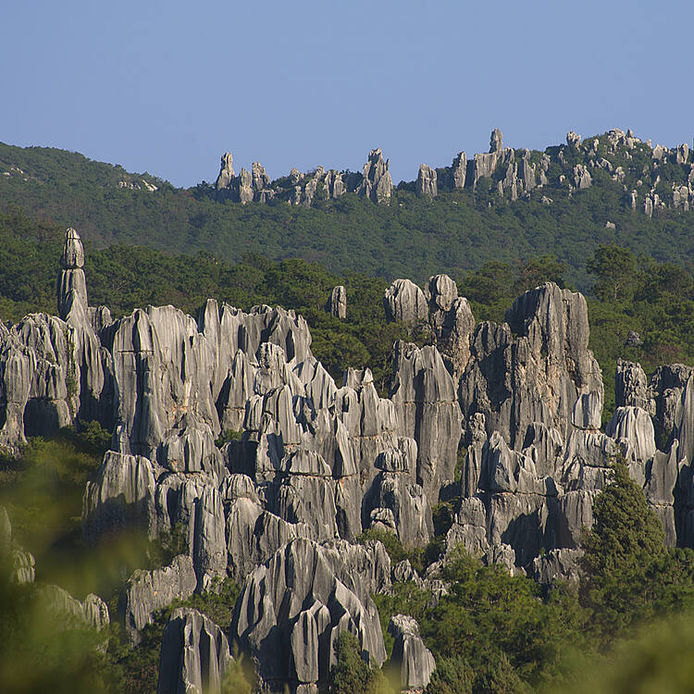
Karst towers, China
Notes:
Tower karst, Guangxi province of southern China
https://whc.unesco.org/en/list/1248/

Slide 30
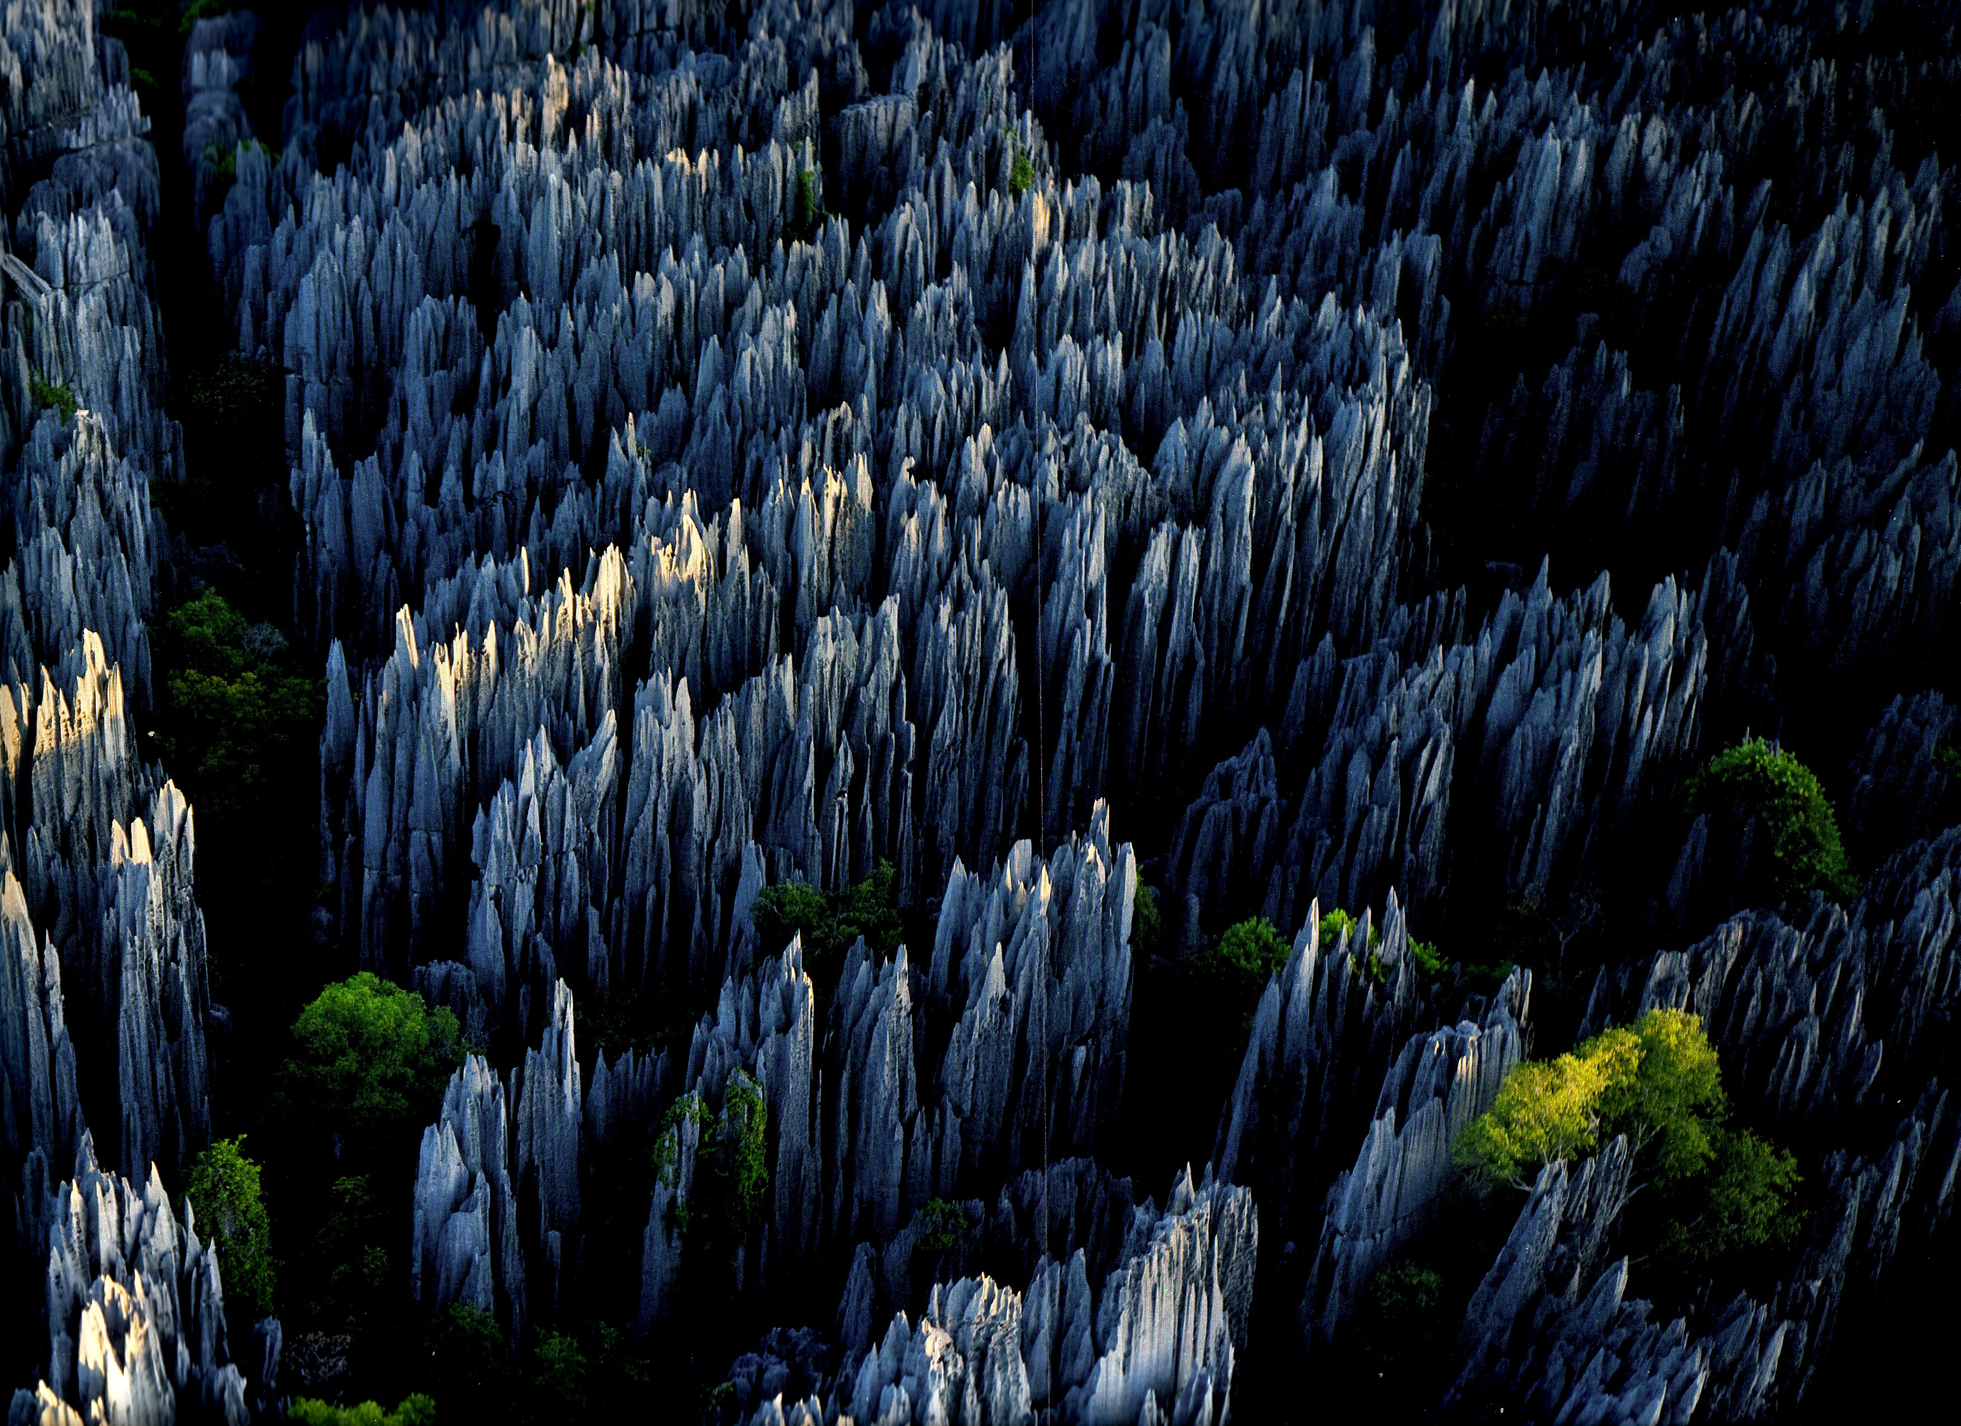
Notes:
Tower karst, Madagascar

Slide 31
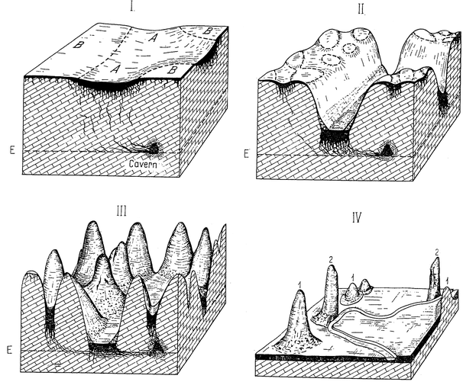

Slide 32
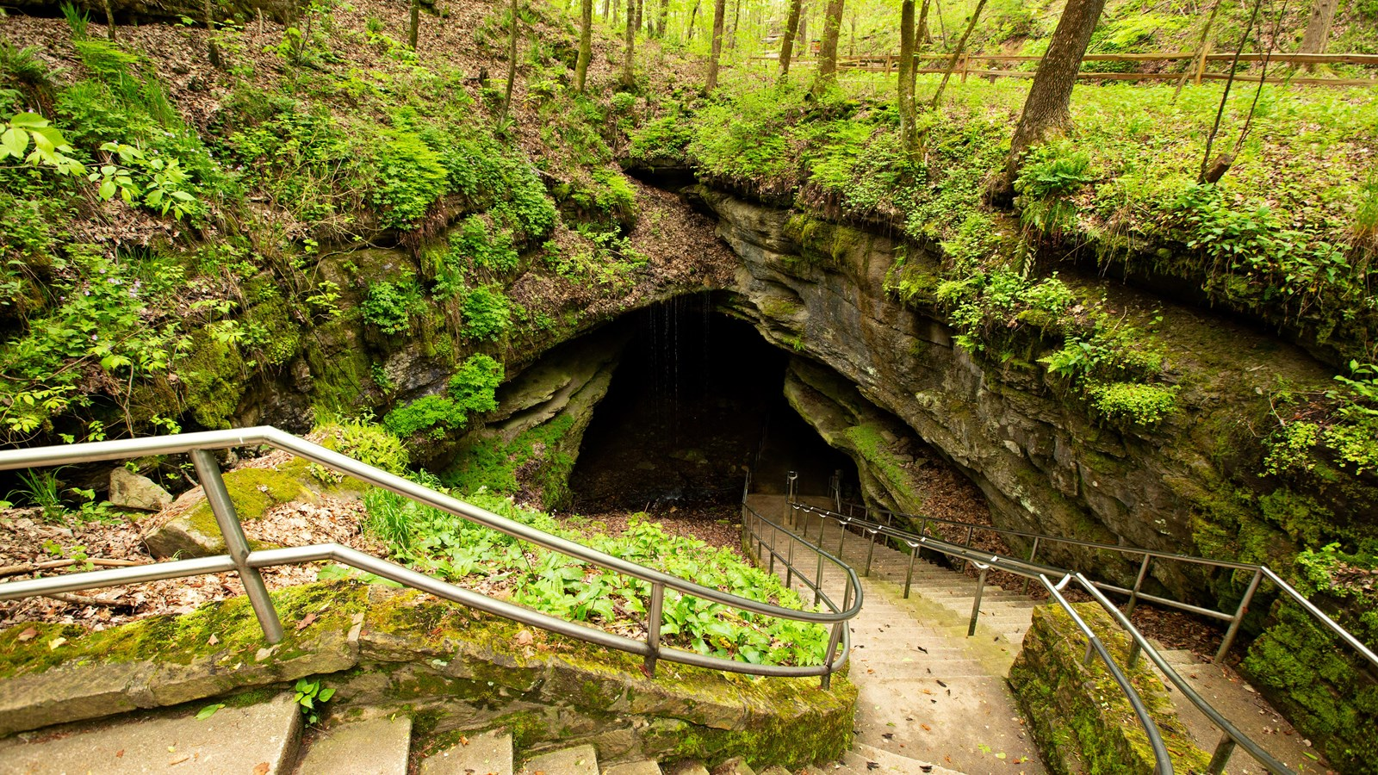
Notes:
Mammoth Cave National Park

Slide 33
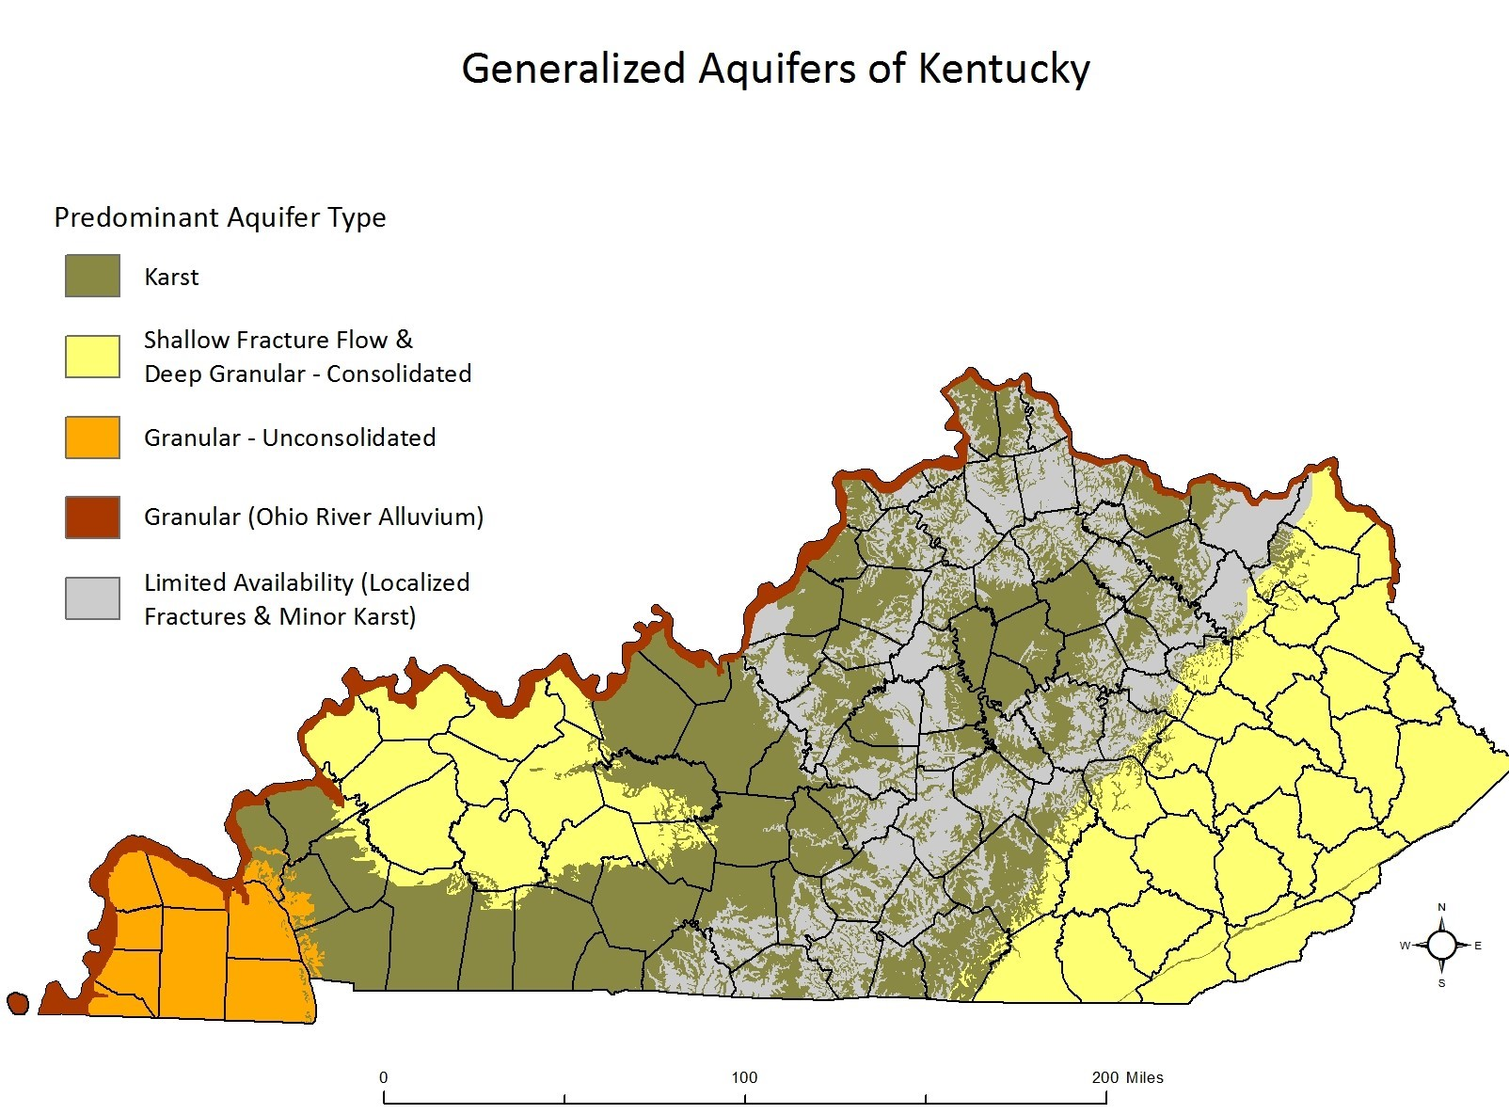
Notes:
Karst aquifers are composed of limestone
https://www.uky.edu/KGS/geoky/index.htm

Slide 34
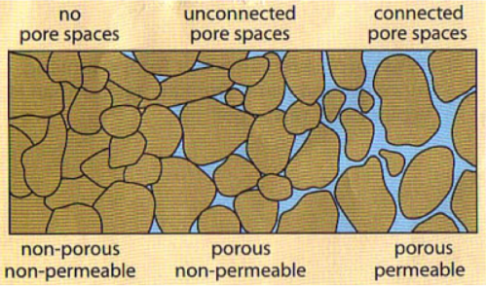
Aquifers
Large body of porous, permeable rock or sediments capable of holding groundwater
Porous – measure of the open space withing rock or sediments
Permeable – measure of how much water can travel thru these spaces
Karstic dissolution of carbonates creates porosity and permeability
Notes:
Porosity is a measure of how much of a rock is open space. This space can be between grains or within cracks or cavities of the rock.
Permeability is a measure of the ease with which a fluid (water in this case) can move through a porous rock.
Loosely cemented sand and gravel can also form aquifers

Slide 35
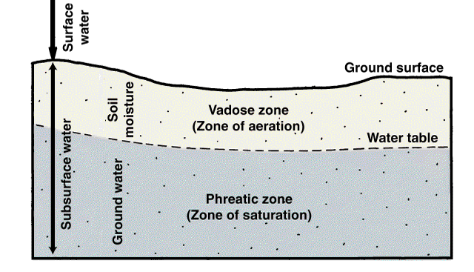
Notes:
Surface and subsurface water

Slide 36
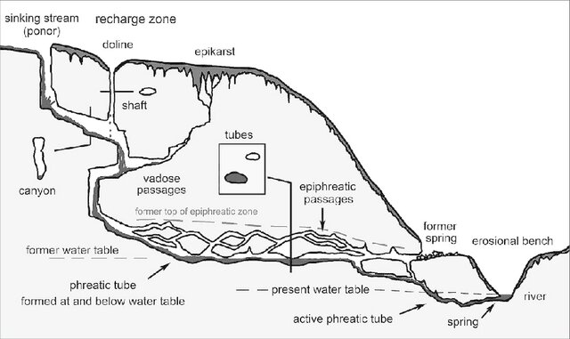
Notes:
vadose passages – formed via surface water
epiphreatic passages – formed in phreatic zone but because of water table lowering are now air-filled
phreatic tube – contains flowing water
Water tables fluctuate through time, so it is possible to have a passage that has been wet and then dry and then wet again, depending upon the local geology and position of the cave relative to the water table

Slide 37
Types of cave passages
Vadose passages form above the water table in the vadose zone, where water flows mainly vertically due to gravity, through cracks and fissures. Dominated by downward percolation of water.
Epiphreatic passages form at or near the water table in the epiphreatic zone, where water flow shifts between the vadose and phreatic zones. These passages are periodically filled with water, often during floods or high-flow conditions, but not permanently submerged. May evolve into vadose passages if the water table drops over time.
"Keyhole passages" form when a phreatic tube is later incised by vadose flow.
Phreatic passages form entirely below the water table in the phreatic zone, where water flow is primarily horizontal and under pressure. Circular or elliptical cross-sections, often forming tunnels. Water dissolves the rock evenly in all directions, creating smooth passage walls.

Slide 38
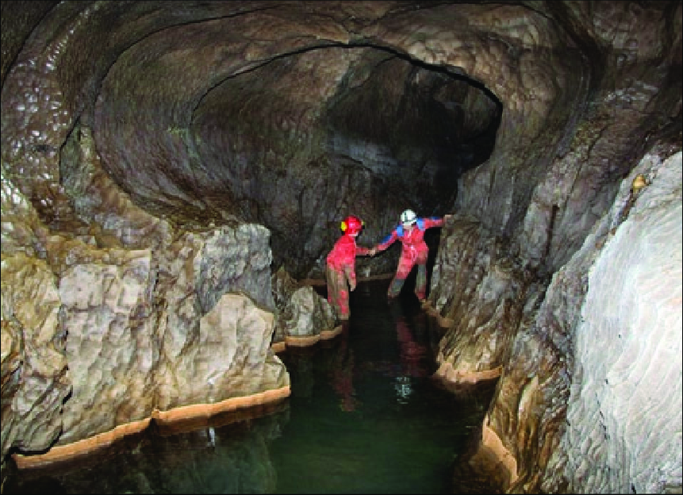
Notes:
In the epiphreatic zone, the typical shape of passages is most often a combination of an oval (phreatic) shape and a canyon (vadose)

Slide 39
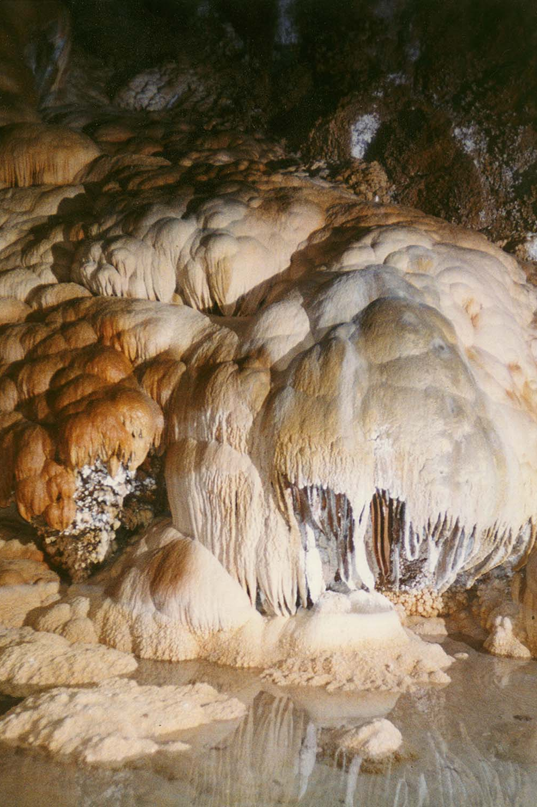
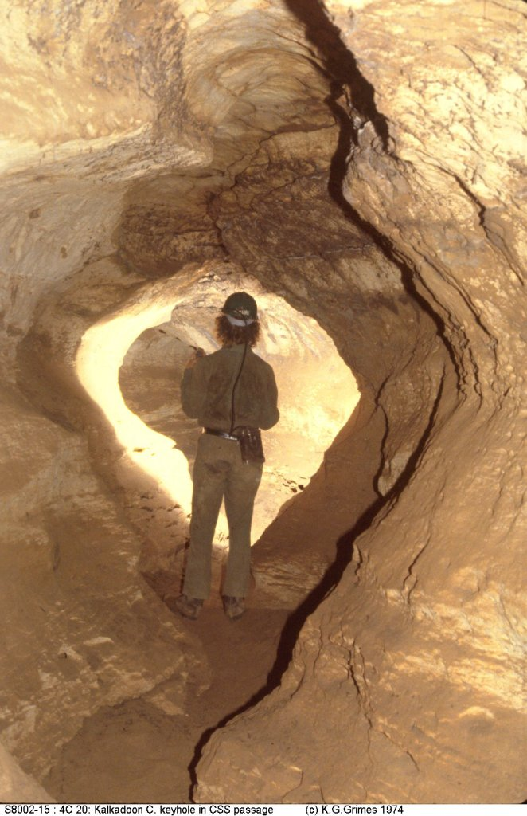
Notes:
Speleothems is the name given to stalactites and stalagmites. Speleothems form from the precipitation of minerals out of solution when caves are dry. They will not form underwater. This cave could have been never been underwater and formed from surface waters (a vadose passage). Or it could have been a phreatic cave, and when the water table fell, speleothems begin to develop when it was located in the vadose zone
Right, this passage formed as a phreatic cave and is now above the water table in the vadose zone.
A phreatic passage forms below the water table. In the zone water will create rounded passages. These caves typically do not have speleothems because mineral formations develop only when air exposure and dripping water allow minerals to precipitate.

Slide 40
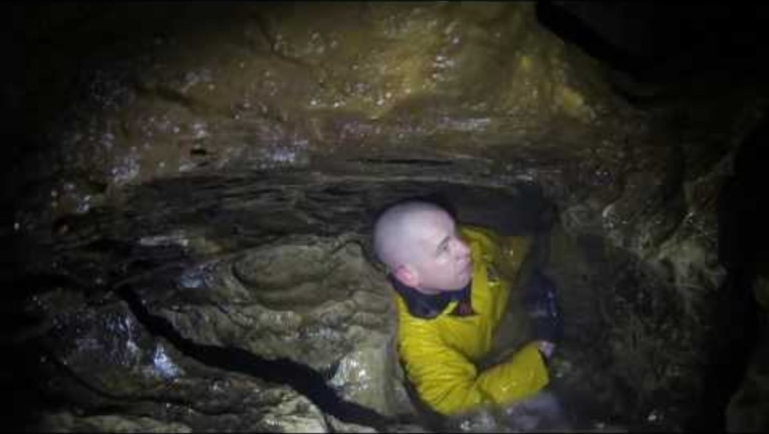
Notes:
Vadose passage

Slide 41
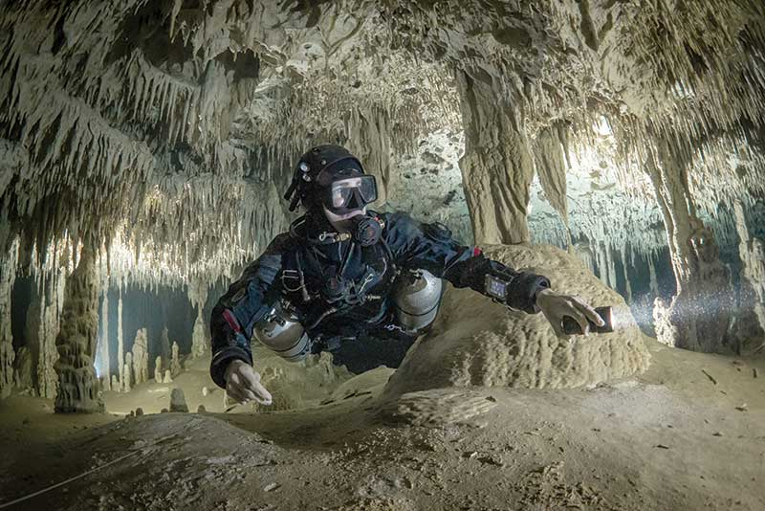
Notes:
This passage had to be exposed to air for a period of time for the speleothems to form. Then the water table rose and refilled the cave. Fluctuations in water table position give caves and their passages their defining shape and features.

Slide 42
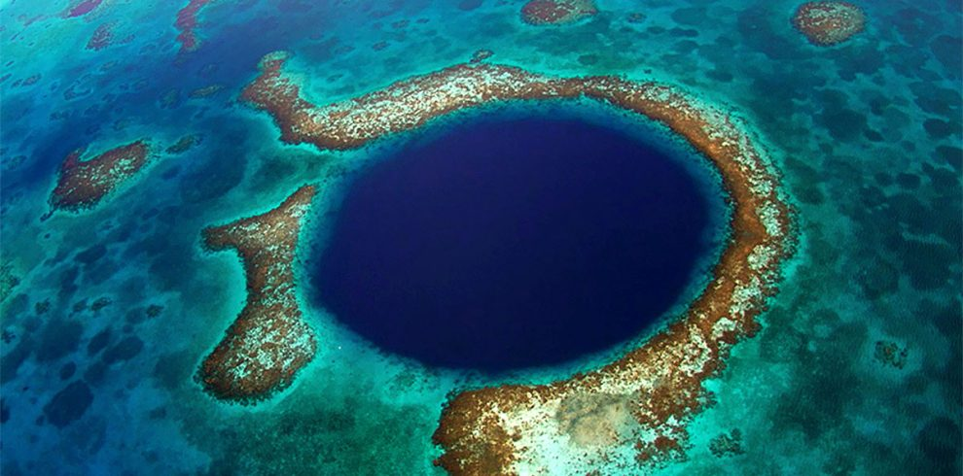

Slide 43
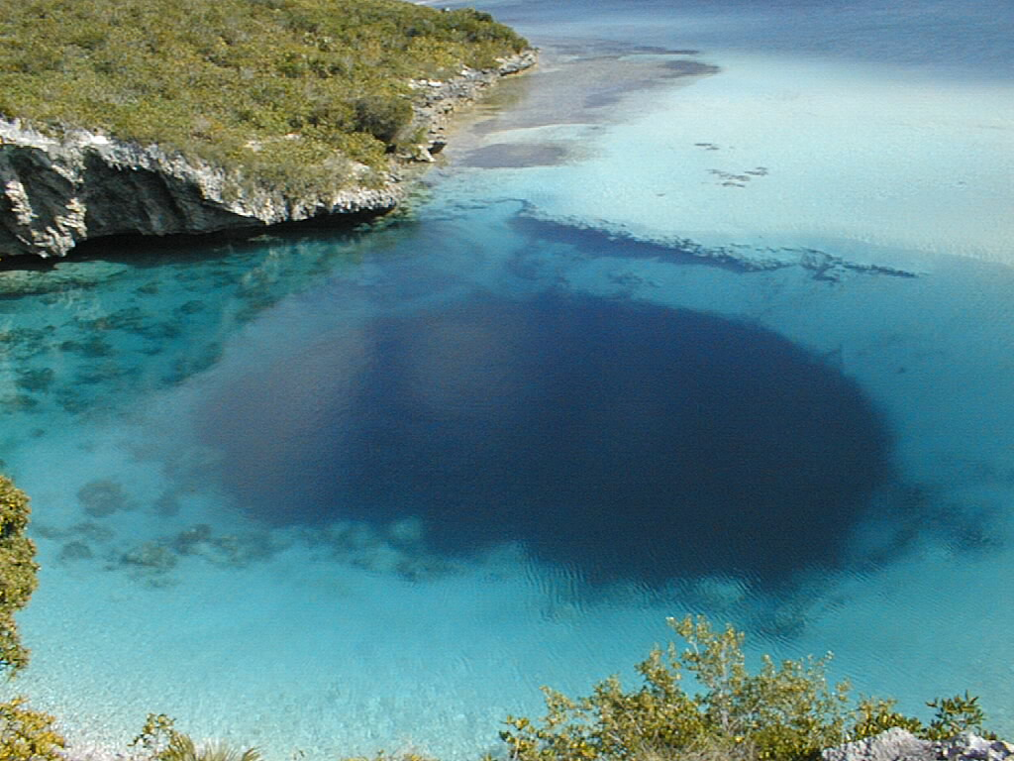
Notes:
Blue hole, Bahamas

Slide 44
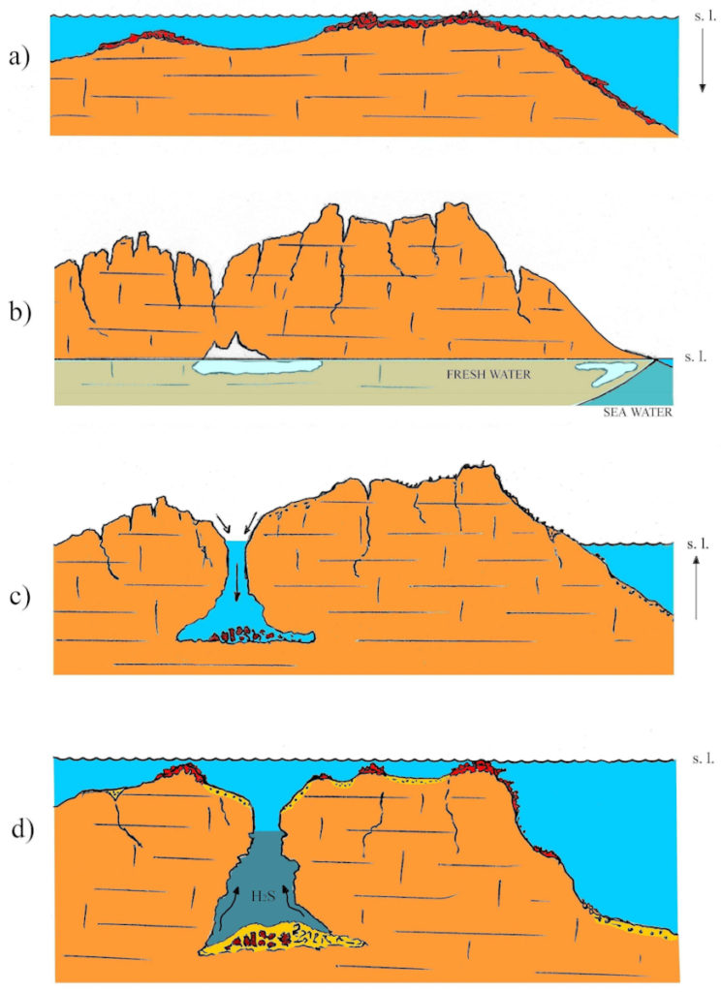

Slide 45


Slide 46
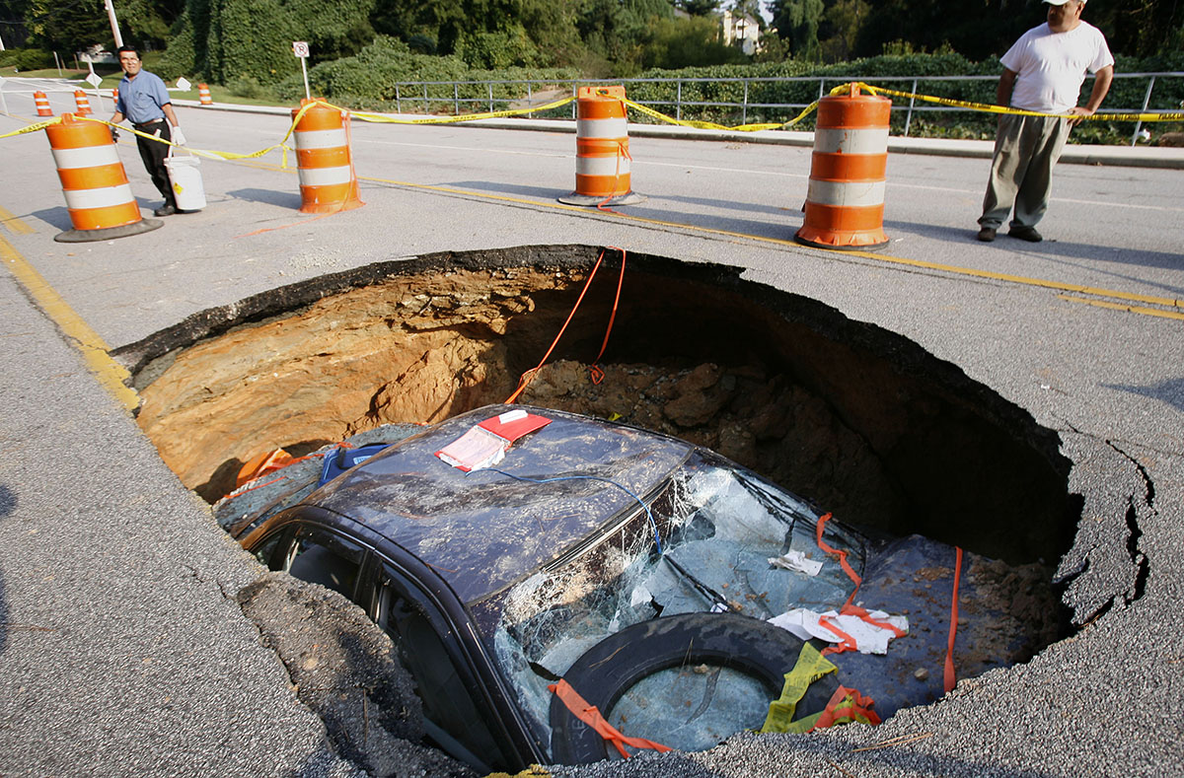
Notes:
https://www.ajc.com/news/photos-few-metro-atlanta-biggest-sinkholes/BQo0BCR60jFobPgCvJ7zyI/

Slide 47
Pseudokarst
Landforms that look like they were formed from karstic processes but aren’t
  Thermokarst can form when permafrost melts and create landforms and topography that resemble karstic sinkholes and lakes
  Lava tubes can be mistaken for epiphreatic tubes
  Evaporite rocks can weather in ways that leave behind landforms that resemble karstic landforms
  Sinkholes and ground subsidence are not always associated with karst and karstic processes. Groundwater and oil extraction, as well as aging pipes and water infrastructure can also cause sinkholes
  Springs can also form in different contexts and not just karstic processes associated with limestone

Slide 48
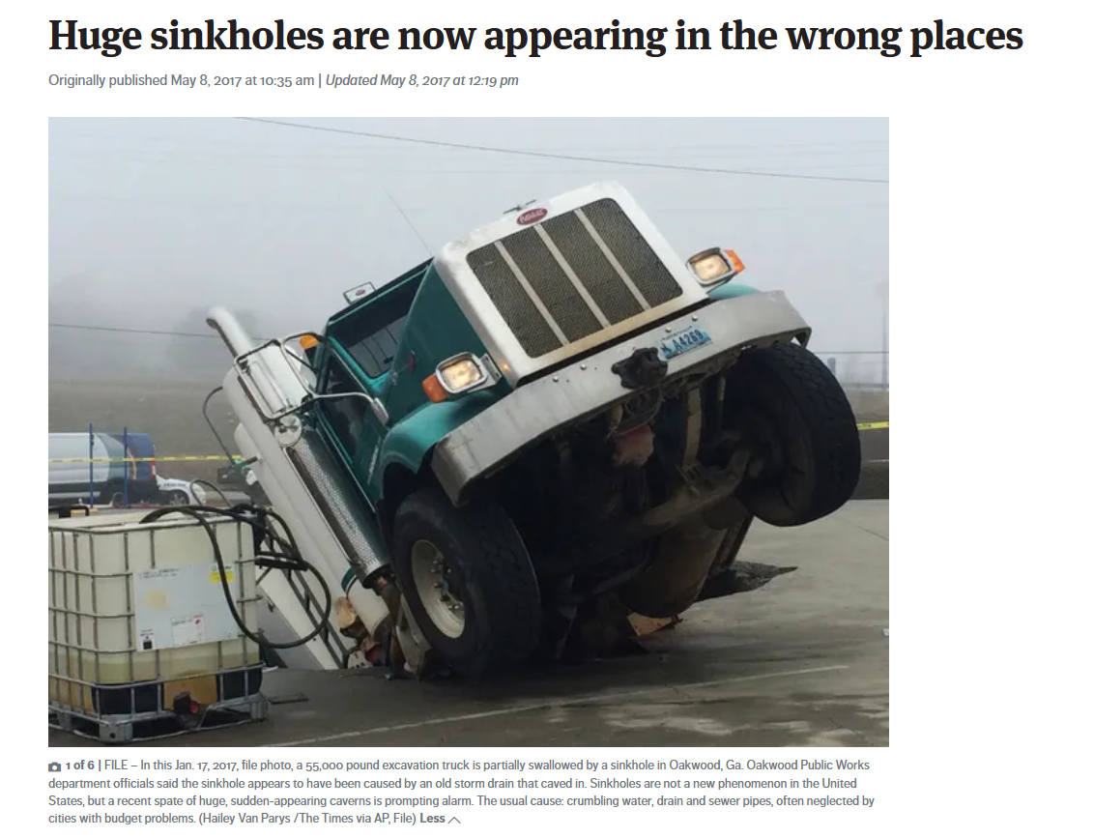
Notes:
https://www.seattletimes.com/nation-world/huge-sinkholes-are-now-appearing-in-the-wrong-places/

Slide 49
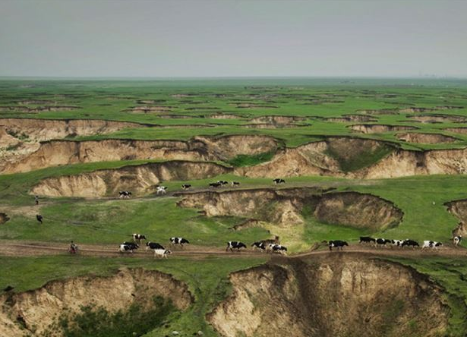
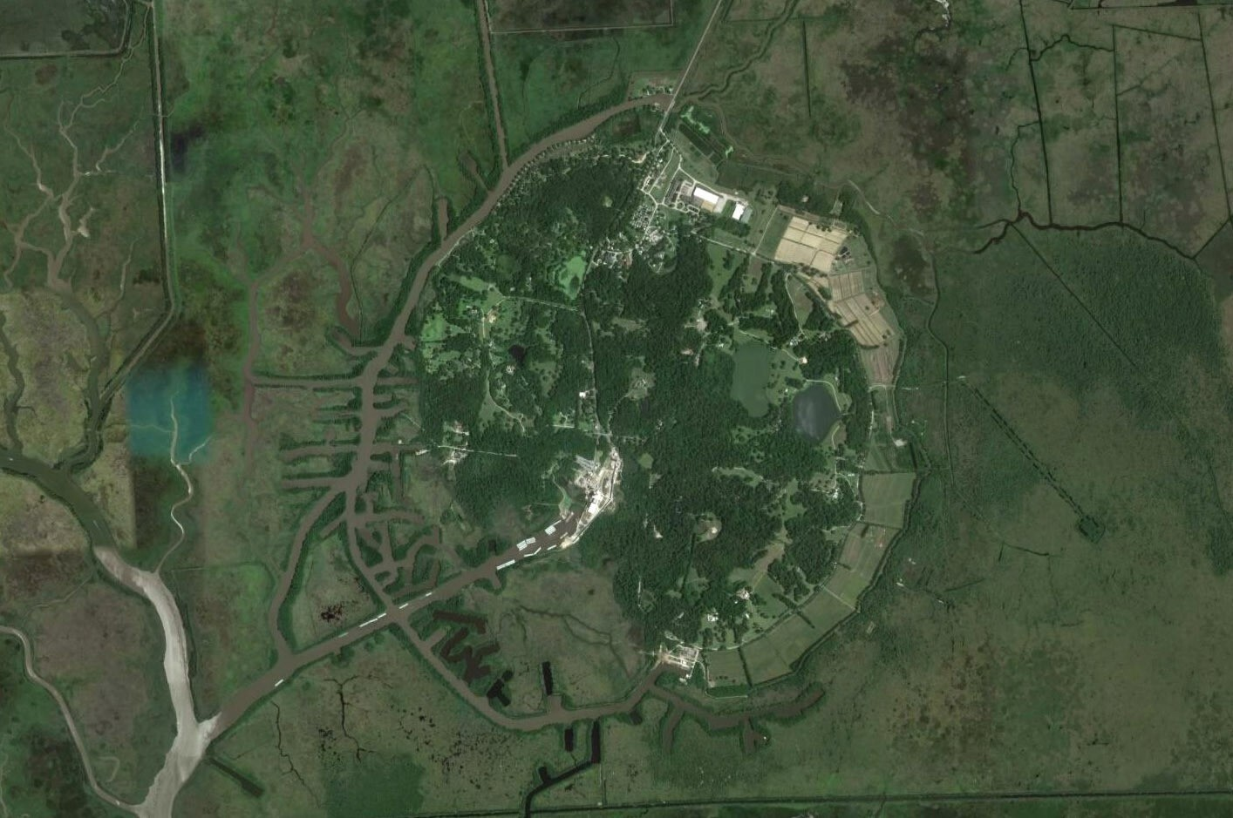

Slide 50
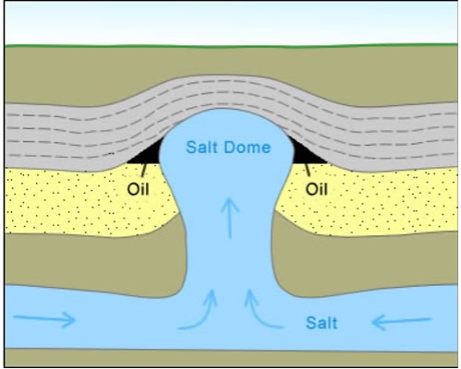
Notes:
Salt dome

Slide 51
Notes:
https://clui.org/projects/salt-domes-gulf-coast/salt-domes/avery-island-salt-dome
Avery Island Salt Dome

Slide 52
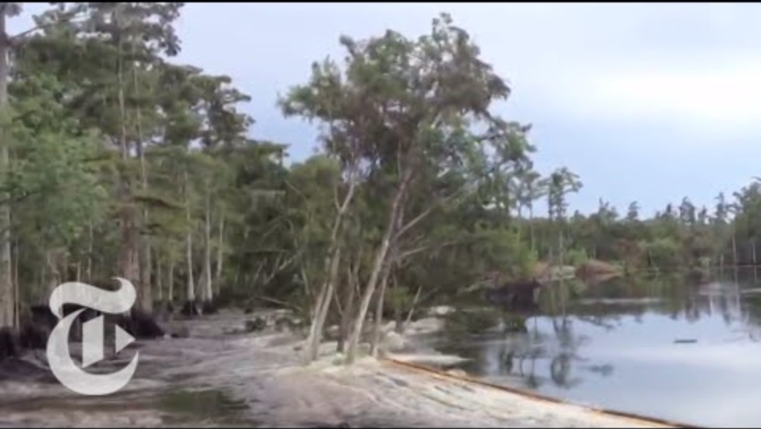
Notes:
The Bayou Corne Sinkhole was created from a collapsed underground salt dome cavern operated by Texas Brine Company and owned by Occidental Petroleum. The sinkhole, located in northern Assumption Parish, Louisiana, was discovered on August 3, 2012, and 350 nearby residents were advised to evacuate.

Slide 53
Types of springs
Karst spring occur in karst landscapes where soluble rocks like limestone have been eroded to form underground channels and caves. Water flows through these channels and emerges as a spring, often with high flow rates, especially after rain.
Gravity springs occur where groundwater flows naturally to the surface due to gravity, typically where the water table intersects the ground on slopes or valleys.
Artesian spring are found in confined aquifers when groundwater is under pressure and flows to the surface through cracks or faults without the need for pumping
Fracture springs are formed by water that flows through fractures, faults, or cracks in rock layers. They are common in bedrock formations where geological structures direct water to the surface.

Slide 54

Notes:
Gravity spring

Slide 55

Notes:
Artesian well or spring if it is not drilled

Slide 56

Notes:
Fracture and fault springs

Slide 57

Notes:
Karst spring

Slide 58

Notes:
Karst springs. Wakulla Springs Florida, Edward Ball State Park
Wakulla is one of the largest springs in the world

Slide 59

Notes:
Boil Spring at McConnell Springs

Slide 60

Fluviokarst landscapes and landforms
Shaped by both fluvial processes and karst processes.
  Disappearing streams return to vadose passages
  Blind valleys develop where a river abruptly disappears underground, usually into a sinkhole, rather than flowing to a visible downstream location.

