Slide 1
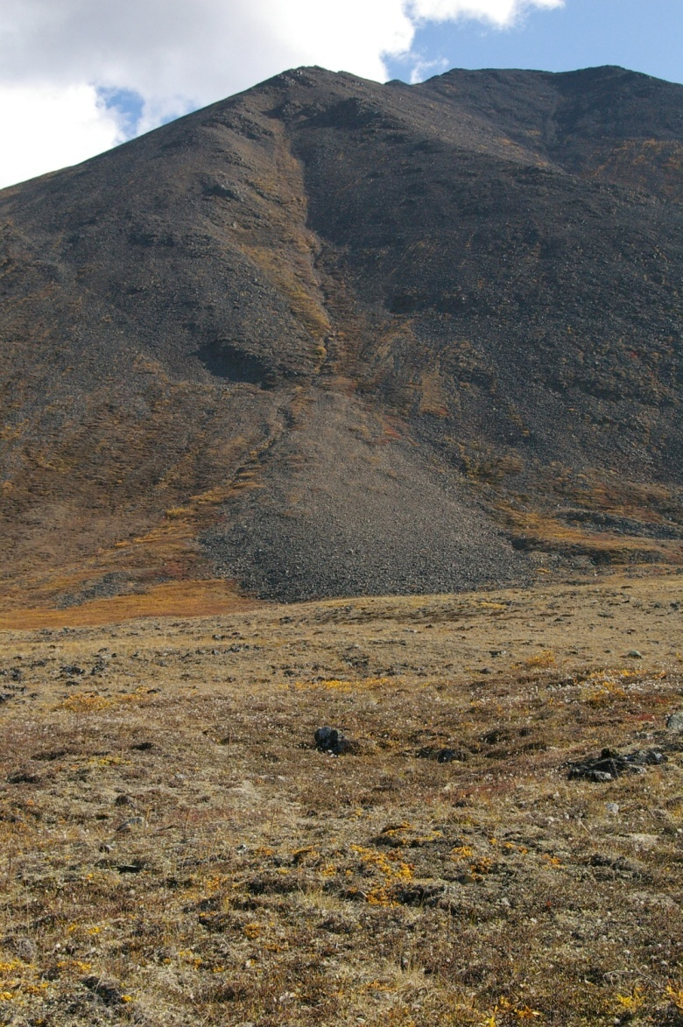
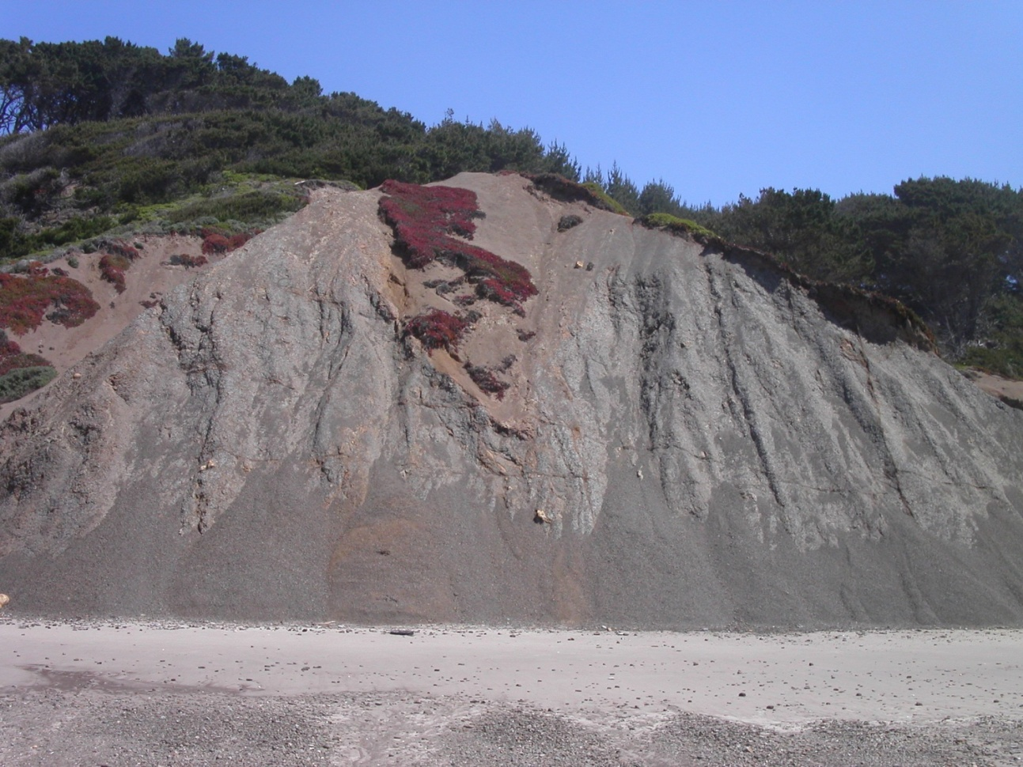
Mass movements
Downhill movement of surface materials under the influence of gravity

Slide 2
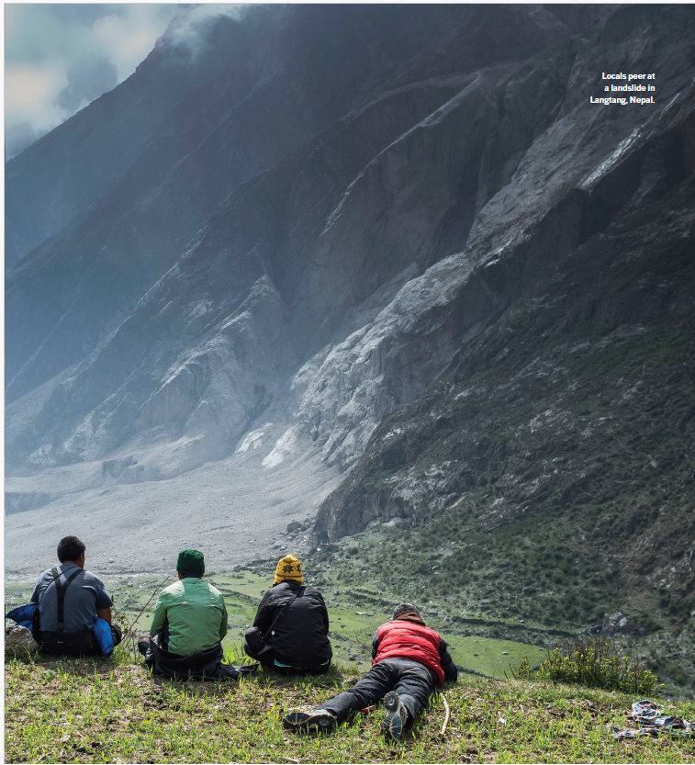

Slide 3
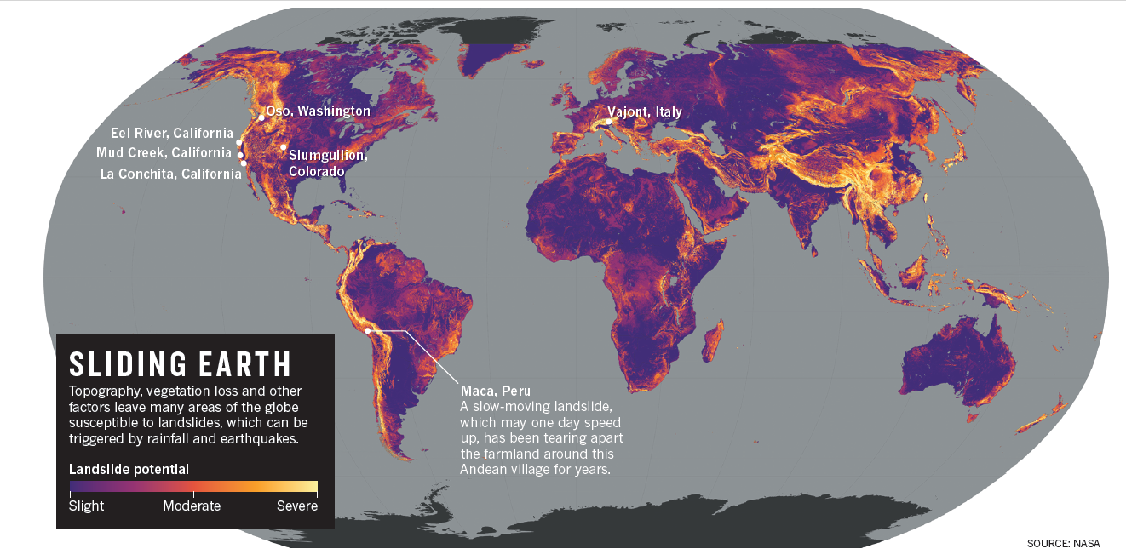
Notes:
It’s almost certain that every fast landslide started as a slow one, says William Schulz of the Landslides Hazards Program at the United States Geological Survey (USGS) in Golden, Colorado. “Just no one noticed.”
Now, geologists are noticing. They have, in recent years, begun to take advantage of improved sensor technology — as well as advances in radar imaging and laser ranging — to study these slow-motion natural disasters. And

Slide 4
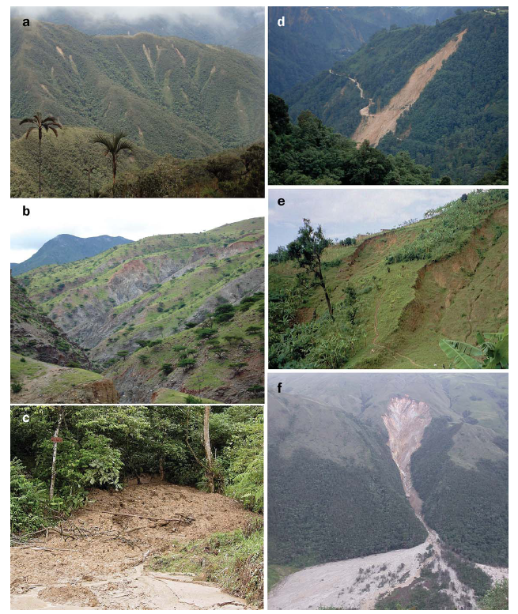

Slide 5
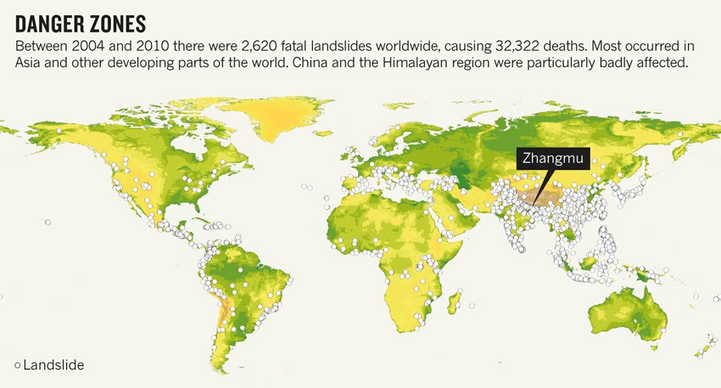

Slide 6
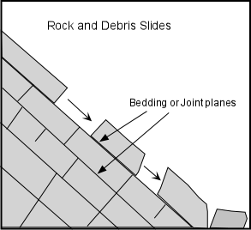
Three broad factors determine if mass movements occur:
Angle of repose
Frictional forces that resist downslope motion. These arise from
  Vegetation
  Rock structure like bedding and jointing
Frictional forces that exert an influence on downslope motion
  Gravity
  Moisture

Slide 7
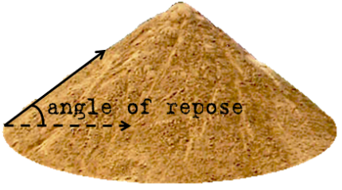
The maximum slope gradient at which a mass of unconsolidated material will resist movement
Usually ranges from 25-40 degrees
If gravity > friction, mass movement occurs
If gravity < friction, material remains in place

Slide 8
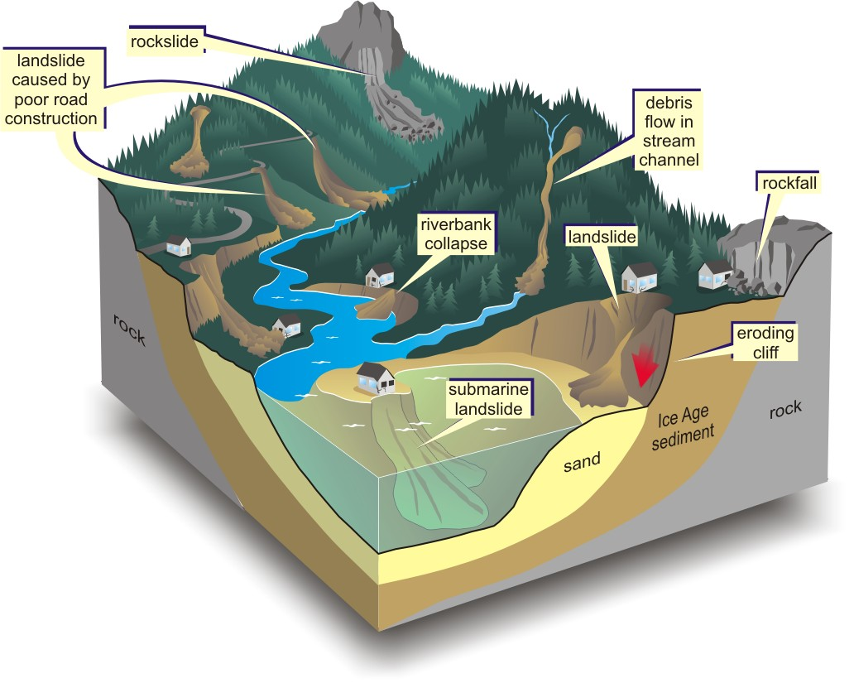
Classifying mass movements: falls, slides, flows, slumps and creep
Classification based on:
  Presence or absence of water
  Downhill speed of movement
  Material
  Angle

Slide 9
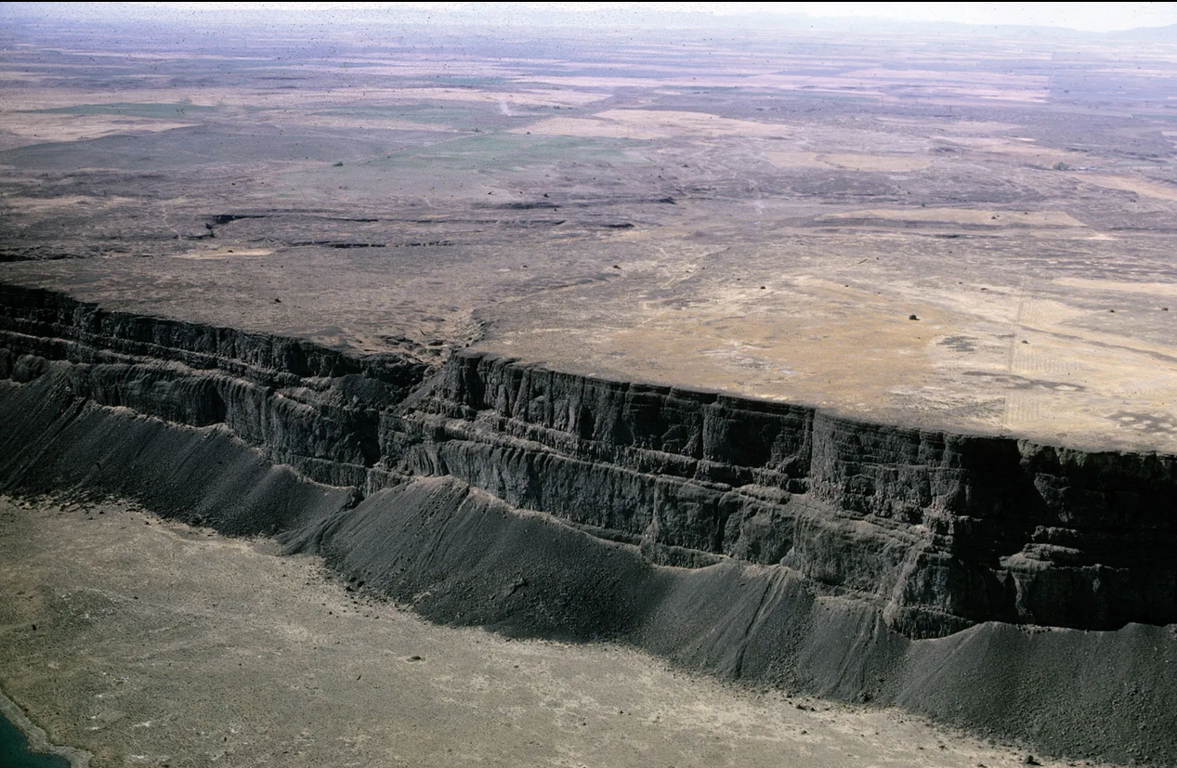
Notes:
Columbia Plateau

Slide 10
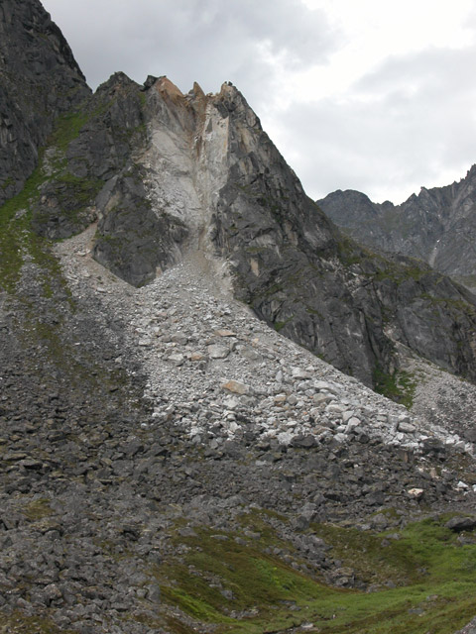
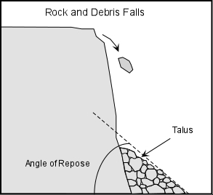
Falls: debris falls at or near vertical angles
Rock fall, soil fall.
Rockfall and talus slopes

Slide 11
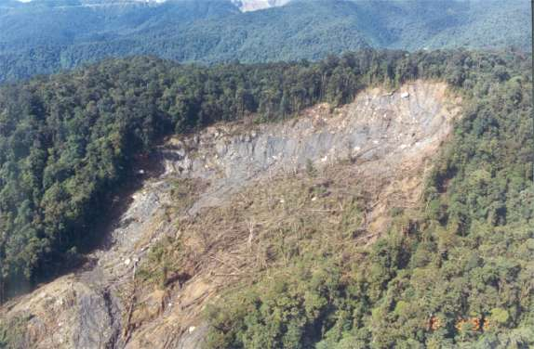
Slide: non-vertical movement along hillslope with low water content
There is a detectable planar surface upon which the slide took place.
Examples are rock glide, landslide, mud slide.

Slide 12
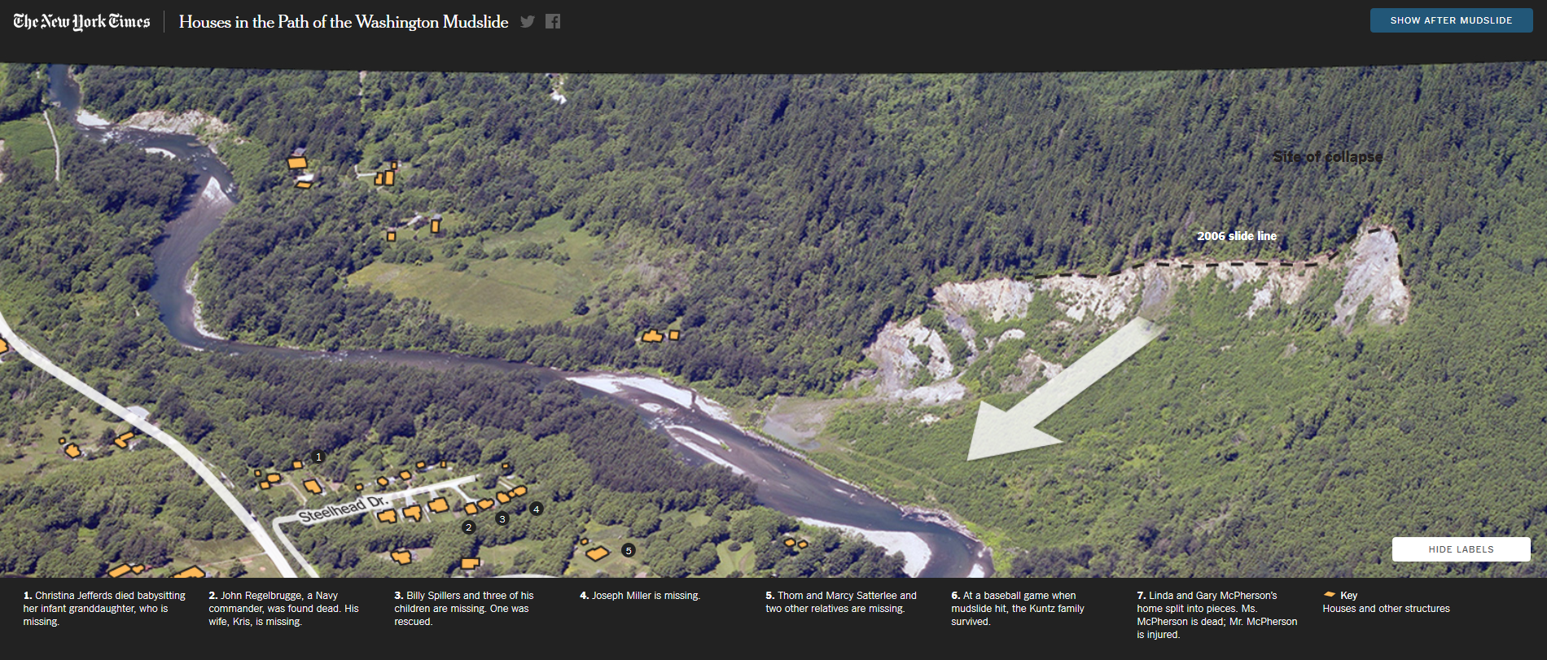
Notes:
Mudslide

Slide 13
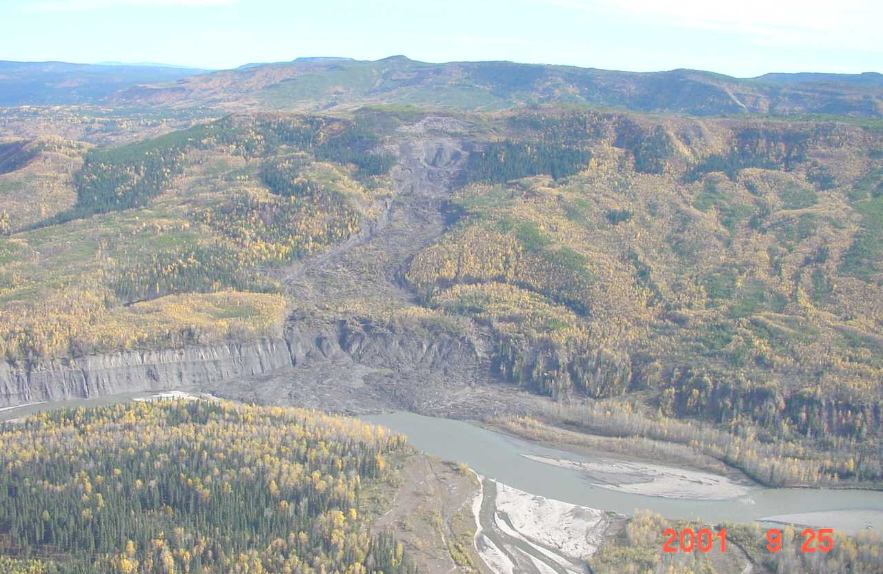
Flow: contains more water and is classified according to material mixed into it: mudflow, earthflow, debris flow
Earthflow at confluence of rivers, northern British Columbia.

Slide 14
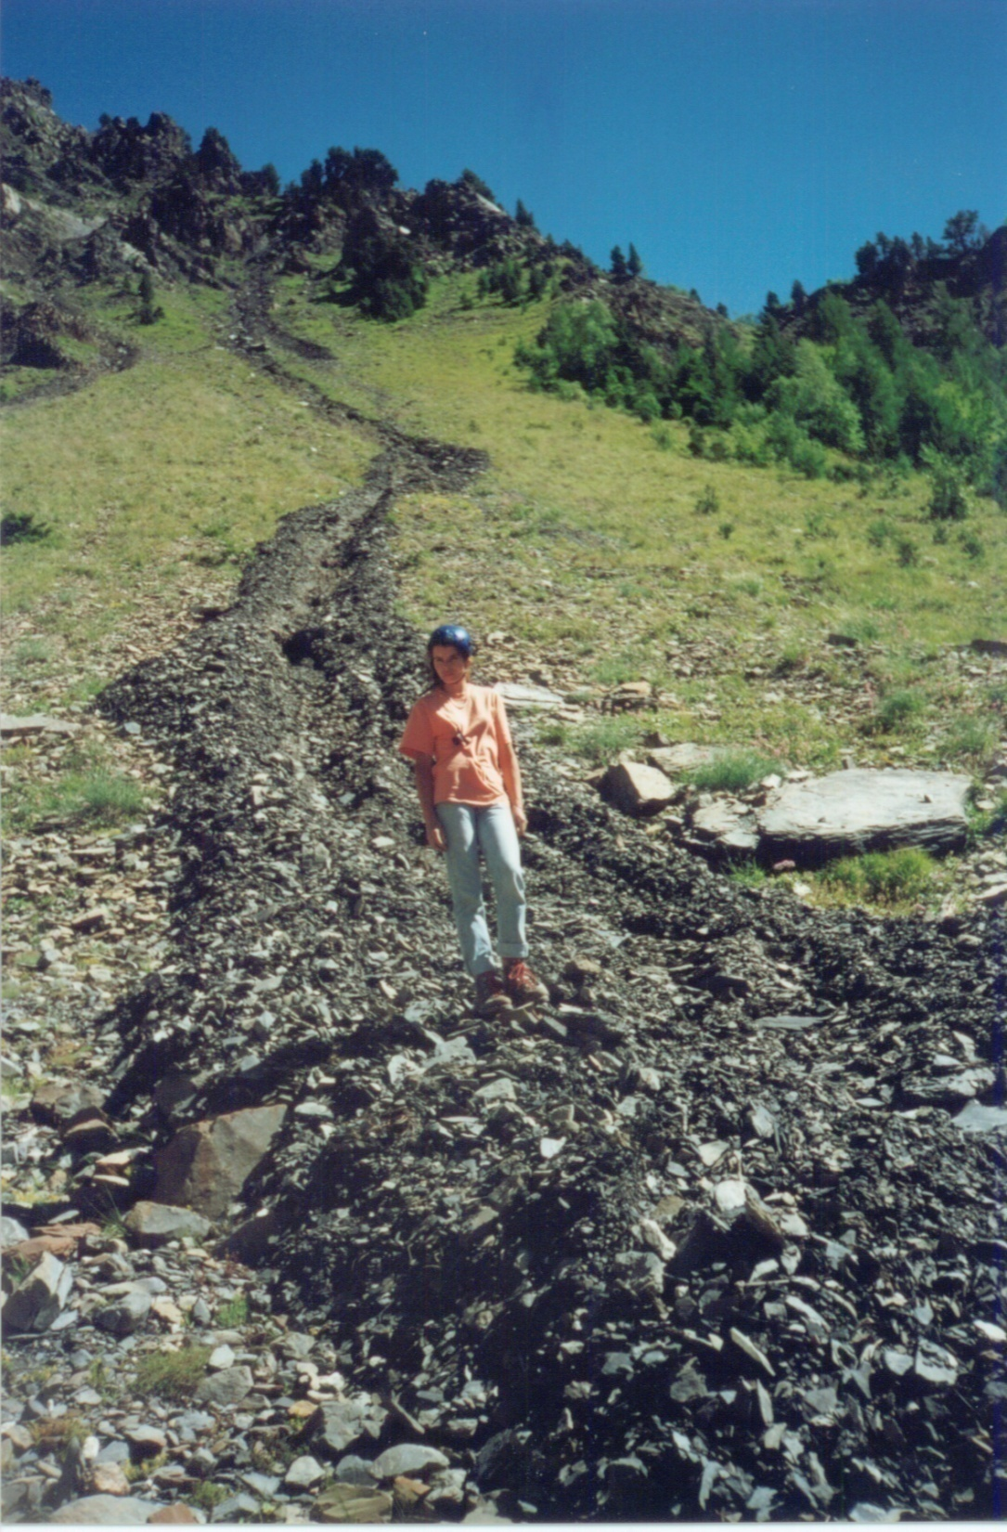
Debris flows located in French North Alps.

Slide 15
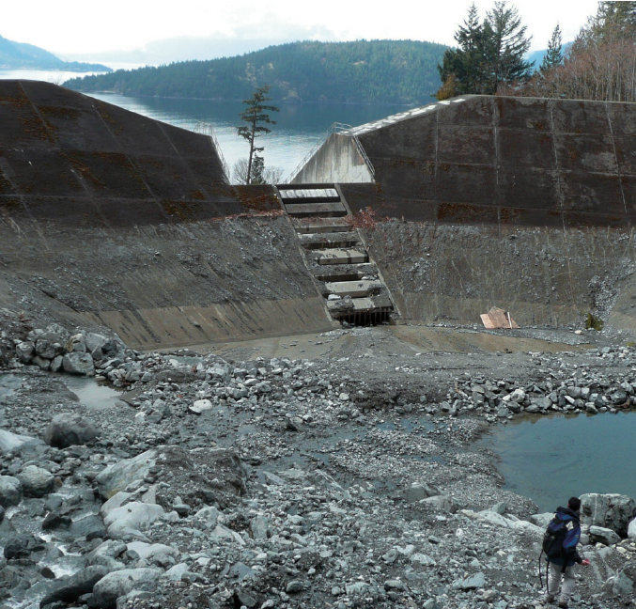

Slide 16
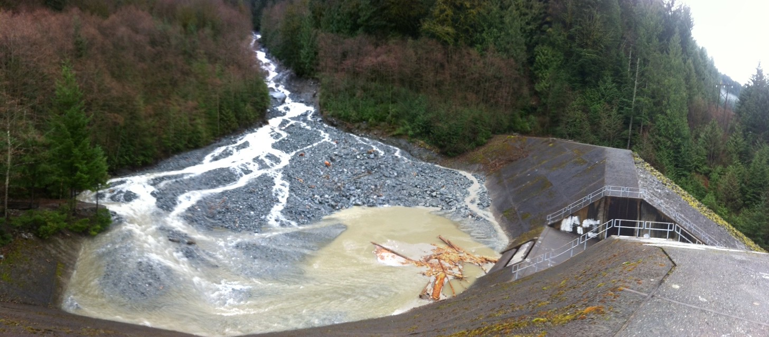

Slide 17
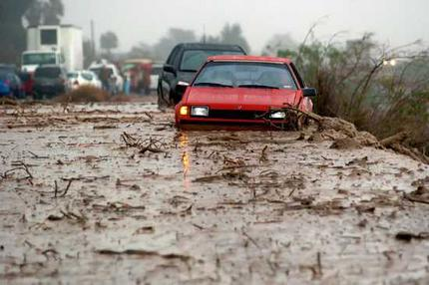
Mudflow
Notes:
Mudflow

Slide 18
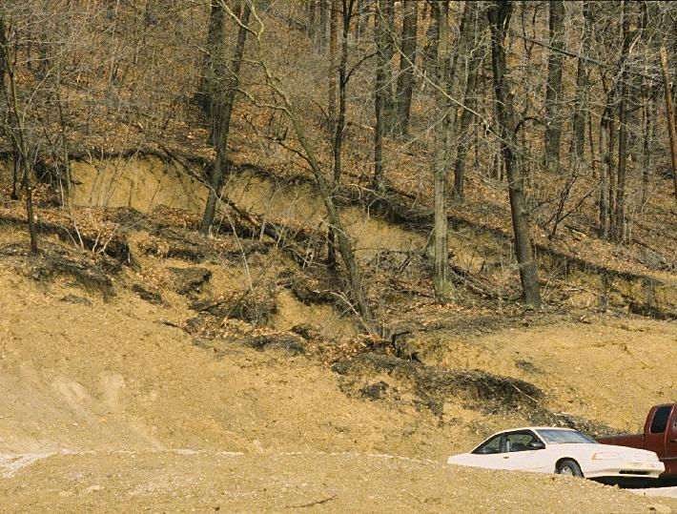
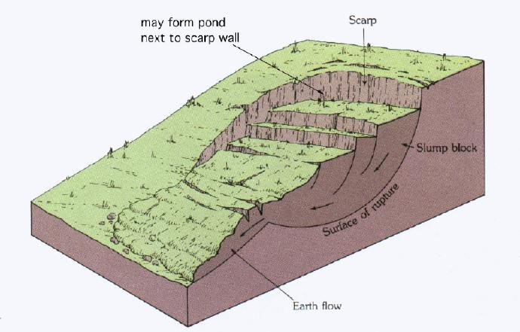
Slumps have rotational movement.
Movement is a rotation of an entire block more than as an undifferentiated mass in a slide.
Examples are rock slump, soil slump.
Slump blocks north of Pittsburgh, PA.

Slide 19
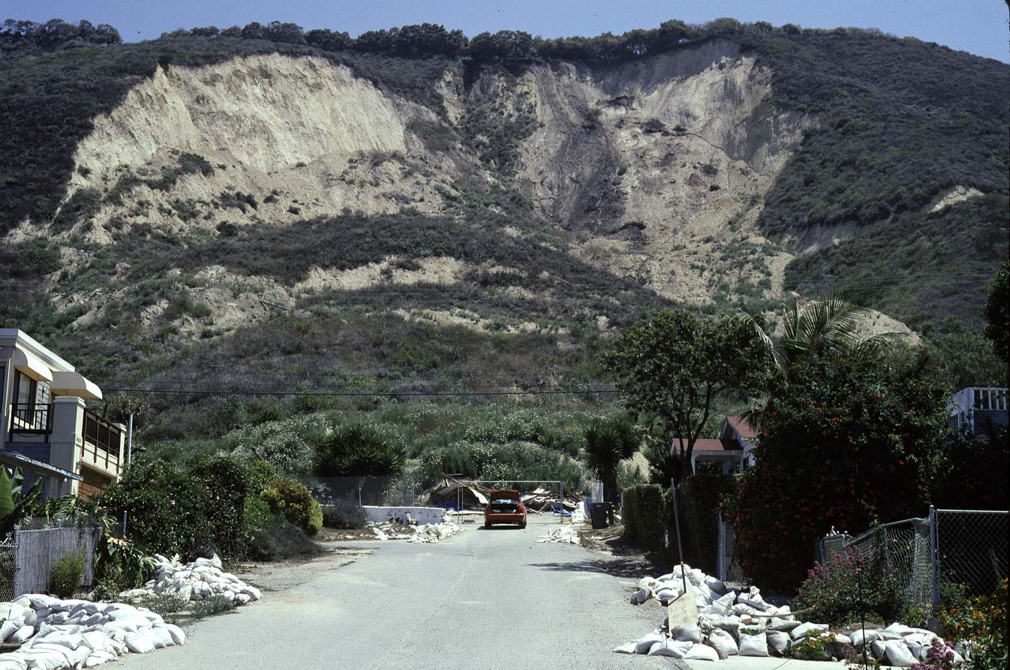
Slump, California
Notes:
La Conchita slump. September 1995.

Slide 20
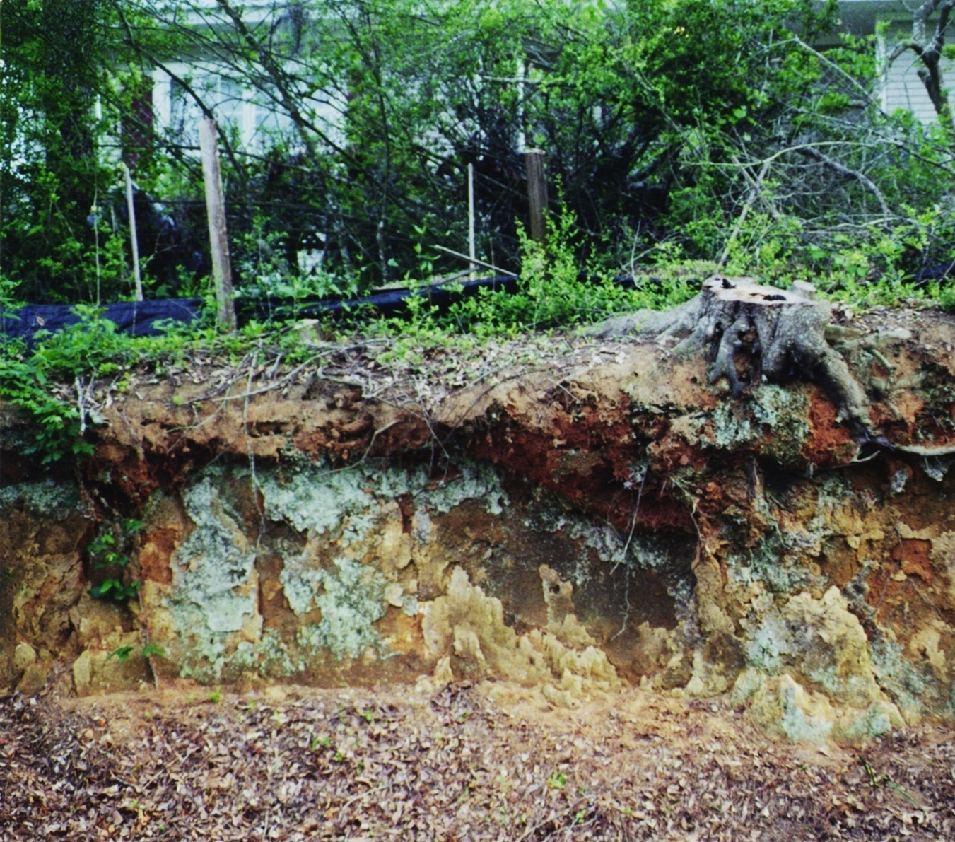
Creep: very slow movement, typically of soil under influence of gravity
Notes:
Soil creep

Slide 21
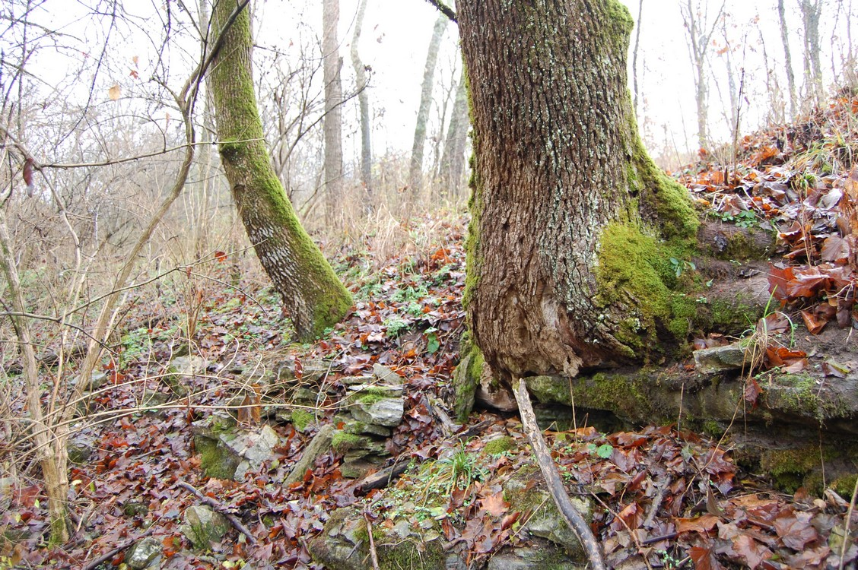
Notes:
This effect, to varying degrees, can be found rather commonly in hilly Kentucky, such as here in the Shaker Village of Pleasant Hill near Harrodsburg where the tree on the left can be seen to have a distinct curve in its trunk.

Slide 22
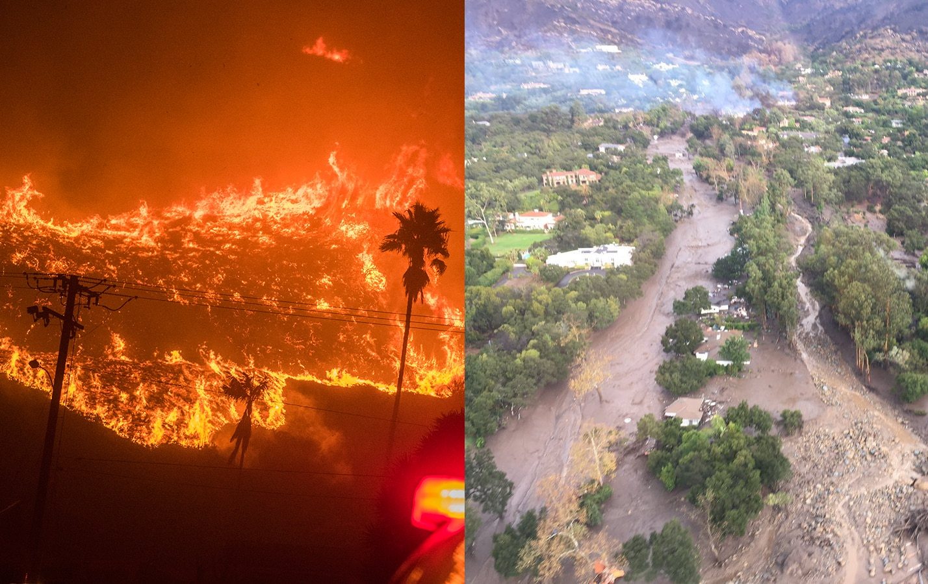

Slide 23
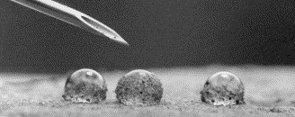
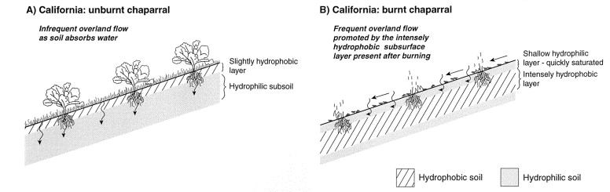
Debris flows and wildfire
During wildfires, water-repellant oils translocate to subsurface of soil
This layer acts like wax-paper; water will not infiltrate soil
Decrease in friction and influence of gravity induces mass movement
Mudflows more extensive in El Nino years that follow an active wildfire season.
Notes:
https://www.washingtonpost.com/news/capital-weather-gang/wp/2018/01/10/how-the-harrowing-thomas-fire-planted-the-seed-for-californias-deadly-mudslides/
https://www.californiachaparral.org/chaparral/myths/

