Slide 1
Periglacial landscapes
Consist of near-glacial landforms and processes in the sense of either location or conditions:
Perennially frozen ground (permafrost)
Seasonally-thawed ground (active layer)
Incomplete vegetation cover of herbaceous plants and dwarf trees
Ground is snow free for part of the year
Frequent fluctuations of air temperature across freezing point

Slide 2
Permafrost
Ground with a temperature perennially below freezing
Ice can be contained in pore spaces and cement the soil matrix together
Ice can form as freezing plane and descend into the ground without displacing soil
Ice can be bodies pure ice (lenses, veins, wedges) that form as liquid water.
Land cover of permafrost
Continuous
Discontinuous
Sporadic
Permafrost also occurs in submerged sea bottoms
Permafrost soils are called gelisols
Notes:
Water vapor can deposit onto ice bodies in the ground due to lower vapor pressure along surface of ice

Slide 3
Arctic tundra
Notes:
Most tundra is in the Northern Hemisphere. Most permafrost is in the Northern Hemisphere. This is simply because there is a landmass at the latitudes where these features and conditions can develop. Permafrost is present in Antarctica. It exists mainly in the continent's ice-free areas, particularly in the coastal regions and in the dry valleys of East Antarctica, such as the McMurdo Dry Valleys. These valleys, located in Victoria Land, are one of the largest ice-free regions on the continent, and they contain extensive permafrost.
Unlike the Arctic, where permafrost is more widespread and associated with tundra ecosystems, Antarctica's permafrost is found in isolated, ice-free areas surrounded by glaciers and permanent ice sheets. The permafrost in Antarctica is generally older and colder than that in the Northern Hemisphere, with some areas believed to have remained frozen for millions of years. However, in recent decades, even Antarctic permafrost has shown signs of change, particularly in response to warming temperatures.

Slide 4
Alpine tundra
Notes:
Found only in some of the highest coldest mountain ranges like those of the Tibetan Plateau. Above is Colorado. Very little permafrost is found in the Southern Rocky Mountains. Discontinuous permafrost can develop in the Middle and Northern Rockies.

Slide 5
Notes:
DOI: 10.1029/2019WR024969 Tibetan Plateau has extensive permafrost

Slide 6
Notes:
https://microsite.geo.uzh.ch/cryodata/PF_map_explanation.html A few scattered locations where permafrost occurs in the Alps

Slide 7
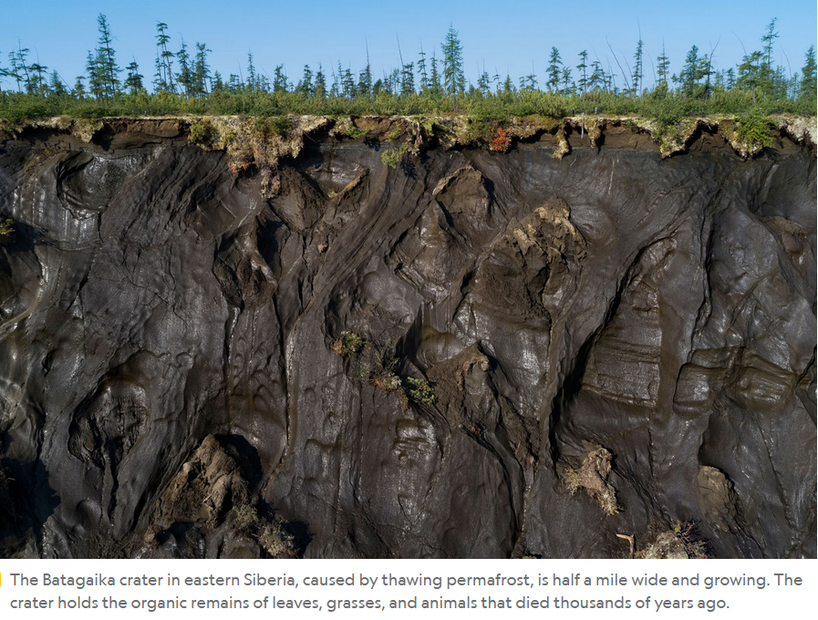

Slide 10
Notes:
A block of thawing permafrost that fell into the ocean on Alaska’s Arctic Coast. Credit: U.S. Geological Survey

Slide 11
Drunken forest
Notes:
Drunken trees in melting permafrost near Fairbanks, Alaska. Drunken forests develop due to permafrost thaw.

Slide 12
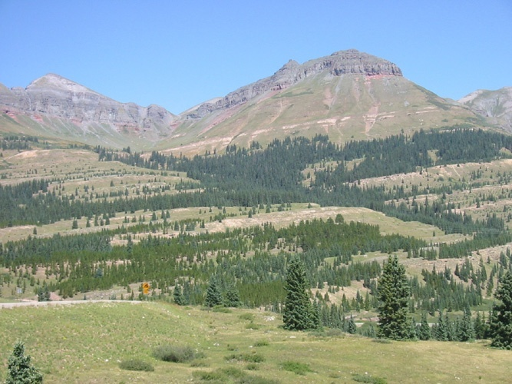
Notes:
Solifluction does not have to occur in areas with permafrost. Solifluction is a type of mass wasting, or slow downhill movement of saturated soil and regolith, commonly found in areas with freeze-thaw cycles. While it is often associated with permafrost regions, where the active layer above the permafrost thaws seasonally, it can also occur in non-permafrost environments where there are similar freeze-thaw dynamics. In such cases, water-saturated soils on slopes can still flow slowly due to gravity during thawing periods, leading to solifluction without the presence of underlying permafrost.

Slide 13
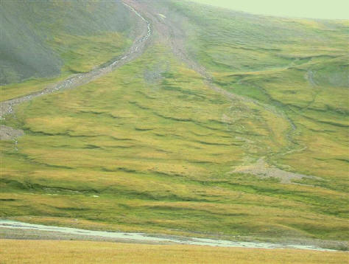
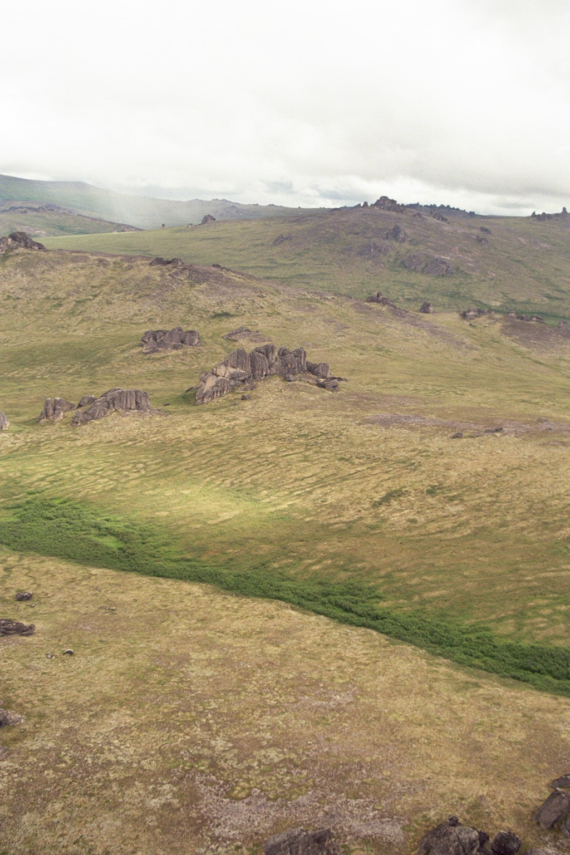
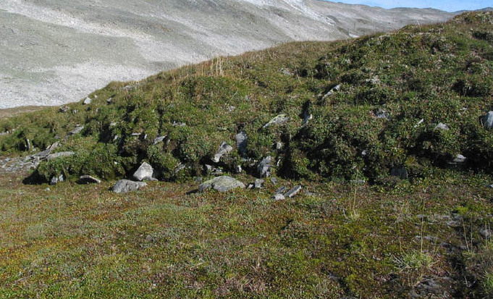
Notes:
Solifluction is a type of earth flow common in periglacial environments underlain by permafrost. It can also occur where there is not permafrost but the soils freeze and thaw each year. During the summer the surface layer of permafrost melts creating a water-saturated layer that becomes mobile. The underlying frozen ground acts as a sliding plane along which the mass of soil can slowly move down slope over.

Slide 14
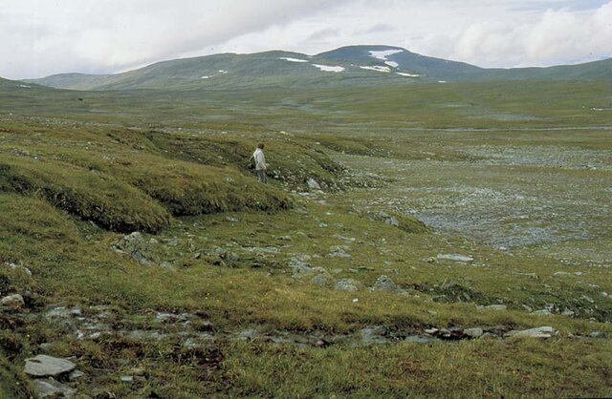
Solifluction terraces
Notes:
https://www.geologinenseura.fi/sites/geologinenseura.fi/files/hirvasetal.pdf

Slide 15
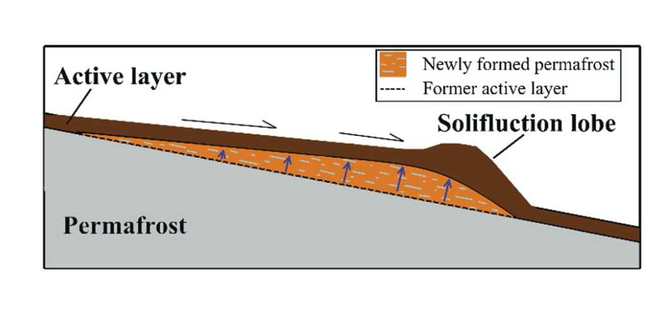
Notes:
Simplified conceptual model of solifluction lobe (terrace) displacement (black half-arrows) and permafrost aggradation over several years. Displacement of the lobe and accumulation of material draw the permafrost table upwards (blue arrows) and cause the formation of ground ice in the newly formed permafrost (light blue) https://cdnsciencepub.com/doi/10.1139/as-2016-0018

Slide 16
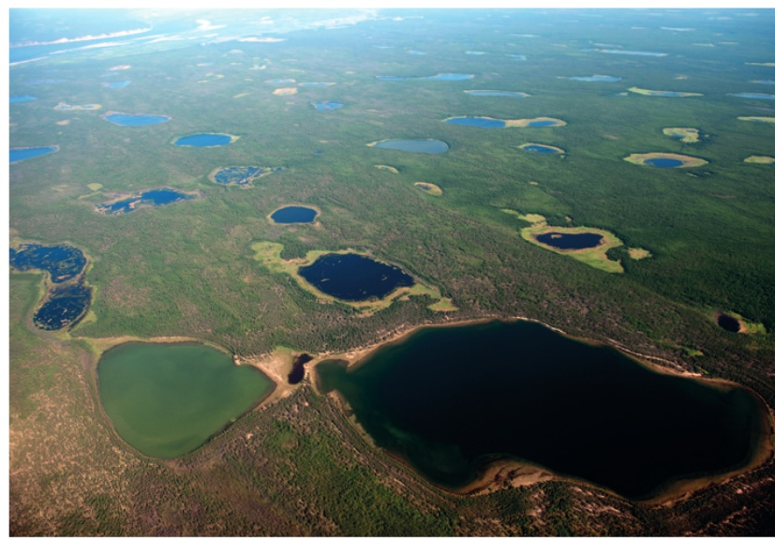
Thermokarst and thermokarst lakes
Thermokarst forms when permafrost thaws. Soil loses internal structure and can subside unevenly under its own mass.
Meltwater lakes from in lower elevations – these are known as thermokarst lakes

Slide 17
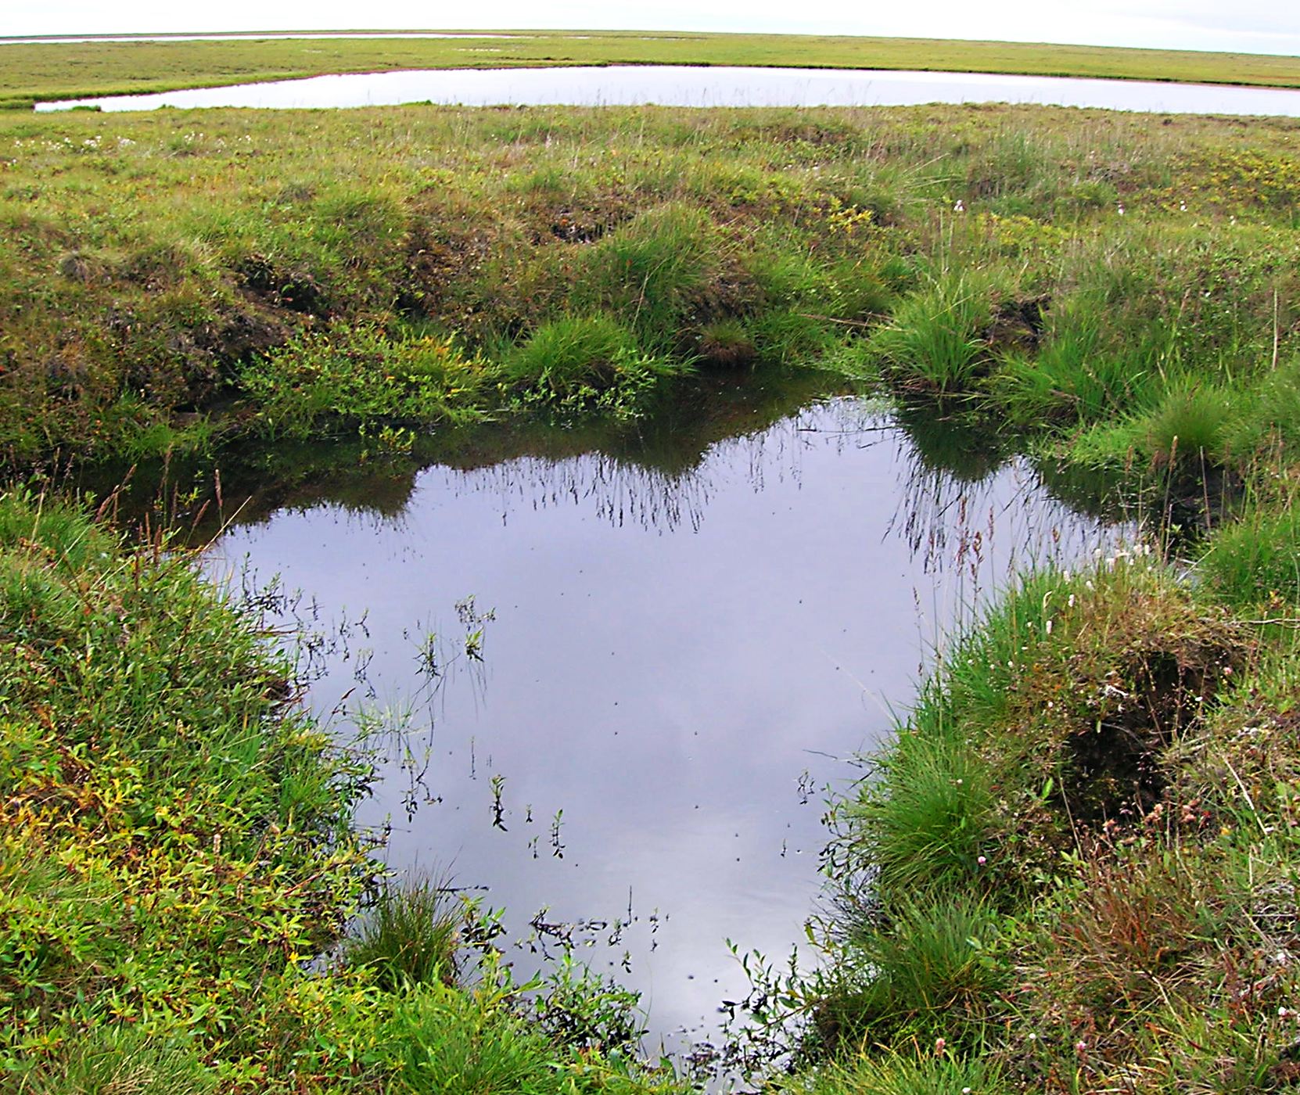
Positive and negative climate feedbacks in thermokarst
Thawing initiates decomposition of organic matter in permafrost. This releases carbon dioxide and methane, which are greenhouse gases (positive feedback).
These can become deep enough to store organic matter in sediments at their bottom in anoxic conditions that prevent their decomposition (negative feedback)
Notes:
https://doi.org/10.1038/nature13560

Slide 18
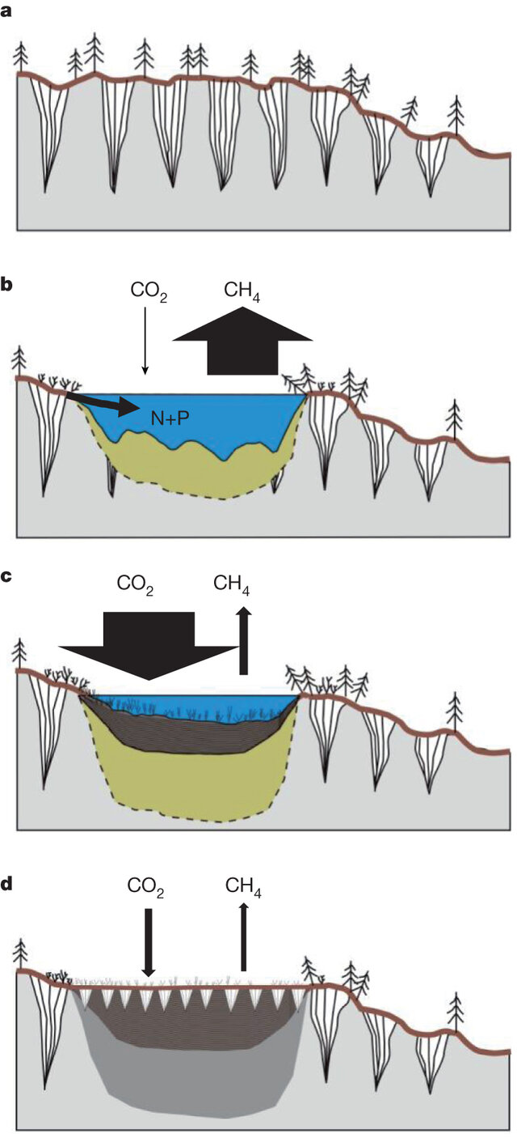

Slide 20
Nivation hollows
Notes:
Nivation hollows form through a combination of processes associated with snow patches that persist in certain areas for extended periods. The snow patches insulate the ground beneath them, causing repeated freeze-thaw cycles at the edges and base of the snow patch. Water from melting snow seeps into cracks in the bedrock or soil, where it freezes and expands during colder periods, breaking apart the rock or soil particles. This process is known as frost shattering or frost wedging, and it weakens the rock or soil The snow patch itself contributes to nivation, the process of weathering and erosion under or near a persistent snow patch. As snow melts, water can enhance chemical weathering, and the flowing meltwater helps carry away loosened sediment. The meltwater generated from snowmelt, combined with the freeze-thaw action, transports the weathered material downslope. Over time, this removal of material enlarges the hollow.

Slide 21
Cryoturbation (frost heave) and formation of patterned ground
Notes:
Boulders come to the surface in permafrost areas due to a process known as frost heave. This occurs when the ground freezes and thaws in cycles, causing water within the soil to freeze and expand. Since frozen water (ice) occupies more volume than liquid water, this expansion exerts upward pressure on the soil and rocks within it. Boulders, which are denser and heavier than the surrounding soil, tend to be pushed upwards over time because of the combined effects of frost heave and soil movement. As the water in the soil freezes and thaws, fine soil particles are more easily shifted and compacted, while larger, heavier objects like boulders resist downward movement, and the surrounding soil shifts beneath them. This process, often referred to as cryoturbation, is responsible for the gradual upward movement of boulders to the surface, particularly in areas with permafrost or in environments with freeze-thaw cycles. https://upload.wikimedia.org/wikipedia/commons/3/31/Mud_boils.JPG

Slide 23
Notes:
https://www.dvidshub.net/video/552378/frost-action-soils Start around the 7 minute mark

Slide 24
Notes:
Arctic Island of West Spitsbergen https://royalsocietypublishing.org/doi/10.1098/rsta.1999.0500

Slide 25
Ice wedges
Notes:
Ice wedge are the result of repeat frost cracking and ice-vein growth occurring over hundreds to thousands of years. The process of ice wedging happens exclusively in the upper horizons of permafrost. Firstly, water held within surface cracks freezes in the winter to form an ice vein. In doing so the crack expands. Then in the following spring, these veins thaw, before refreezing the following winter. Over time, this cycle of freeze and thaw expands the cracks significantly to form ice-wedges.

Slide 26
Formation of irregular ice wedge polygons from ice-wedge melting
Notes:
https://www.woodwellclimate.org/ice-wedges-climate-change/

Slide 27
Notes:
Ice-wedge polygons

Slide 28
Pingos

Slide 29
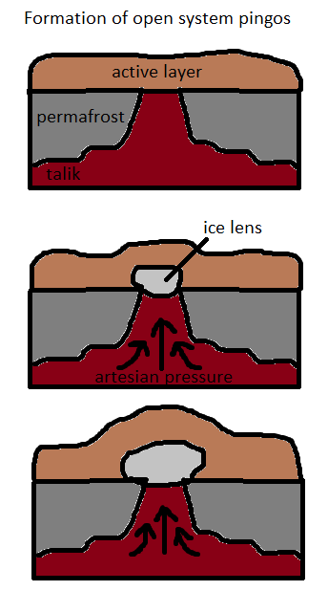
Notes:
Left: how closed system (hydrostatic) pingos are formed Right: how open hydraulic pingos are formed

