Slide 1
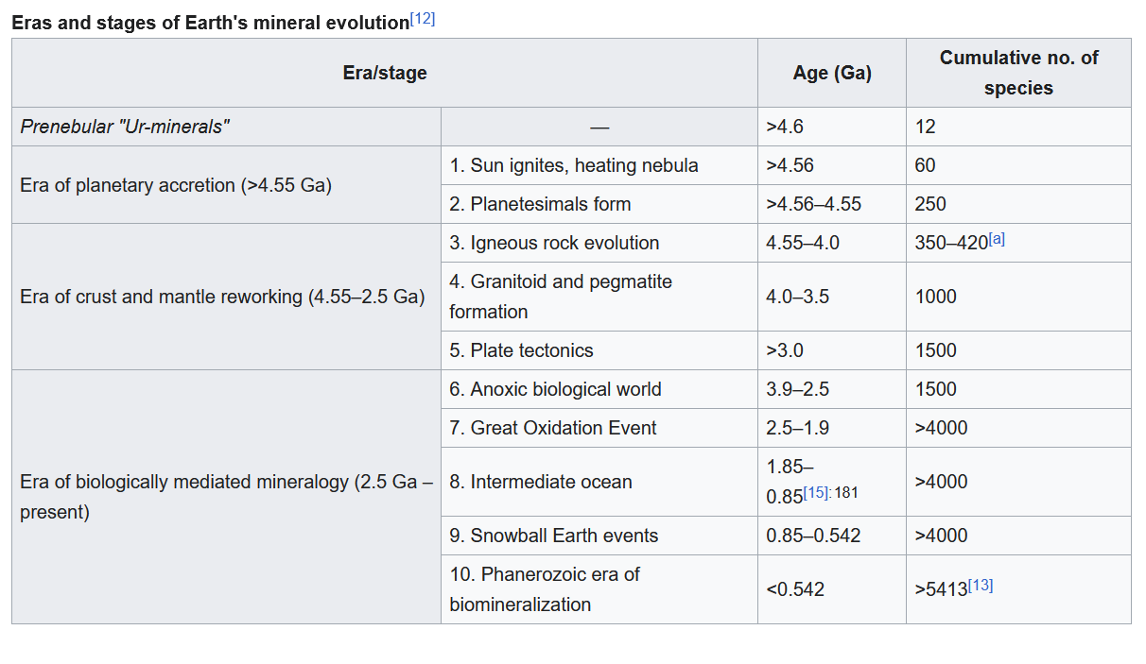
Notes:
This unit is unique because it focuses on how some organisms can biomineralize and in turn shape landforms.

Slide 2
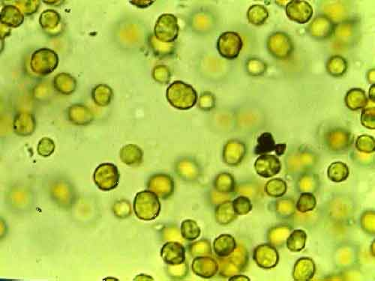
Notes:
Zooxanthellae are unicellular yellow-brown dinoflagellate algae that are endosymbiotic with corals. They live in the gastrodermis of coral polyps
For coral, these algae provides color, oxygen, carbohydrates, and their presence helps speed up secretion and calcification of coral minerals
For algae, the coral animal produces carbon dioxide and nitrogen (in the form of ammonia), a plant nutrient

Slide 3
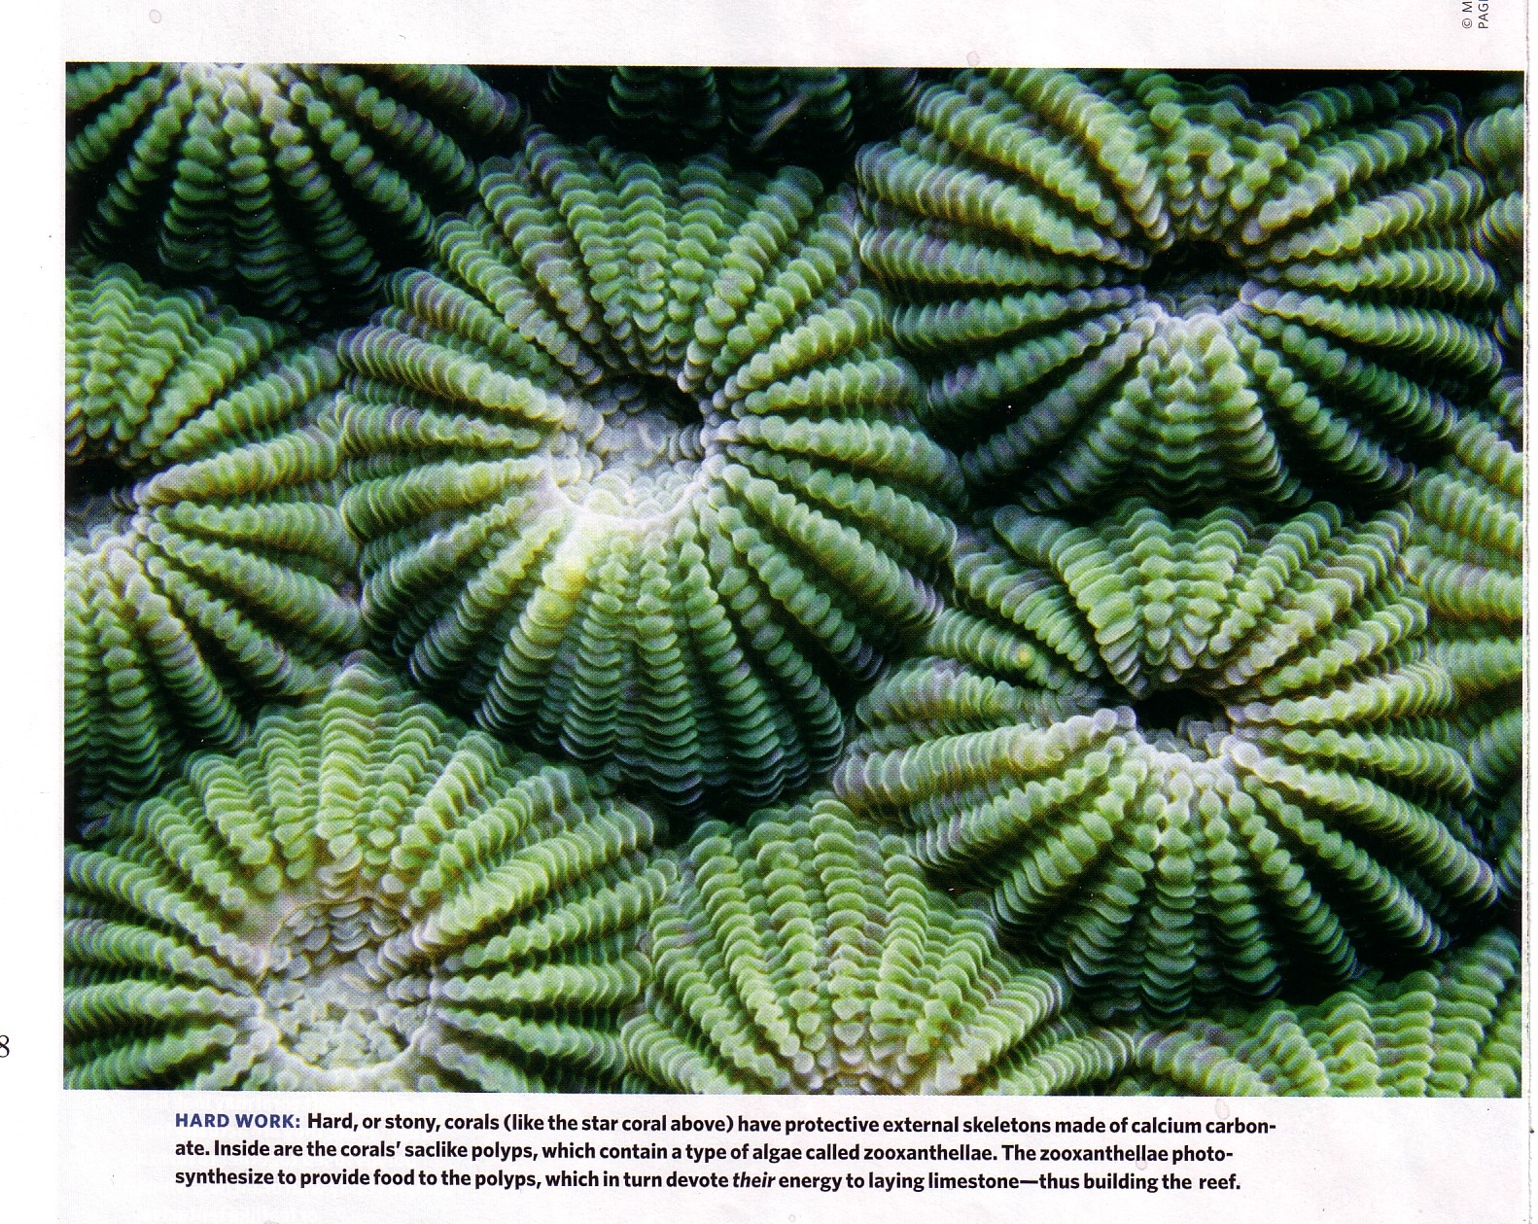

Slide 4
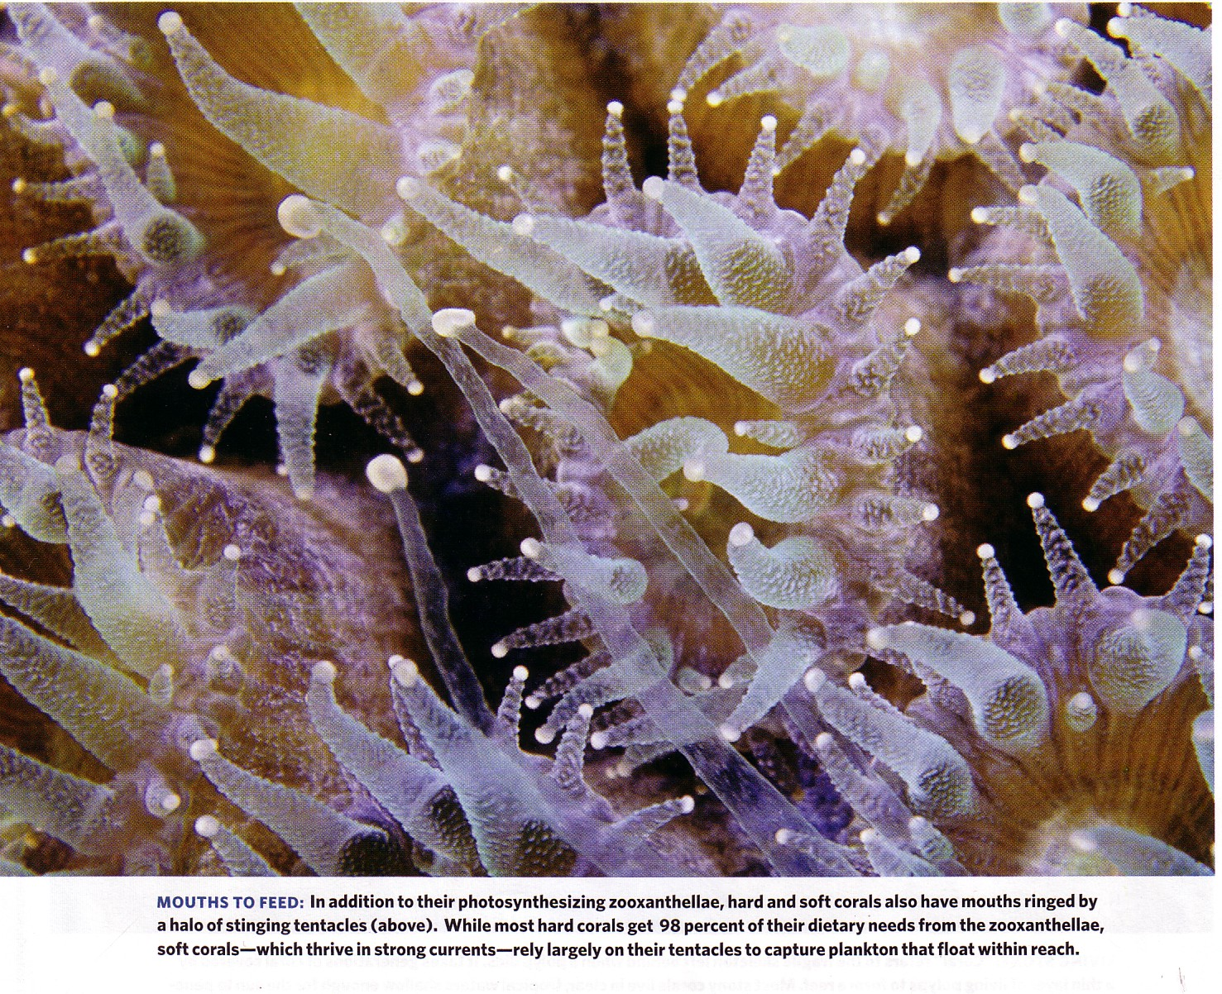

Slide 5
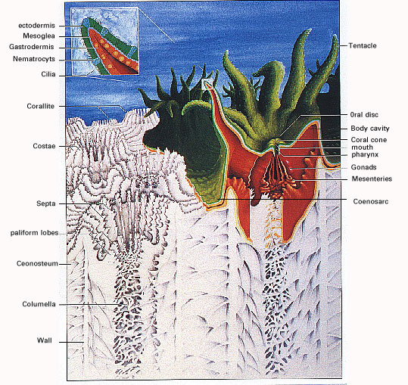

Slide 6
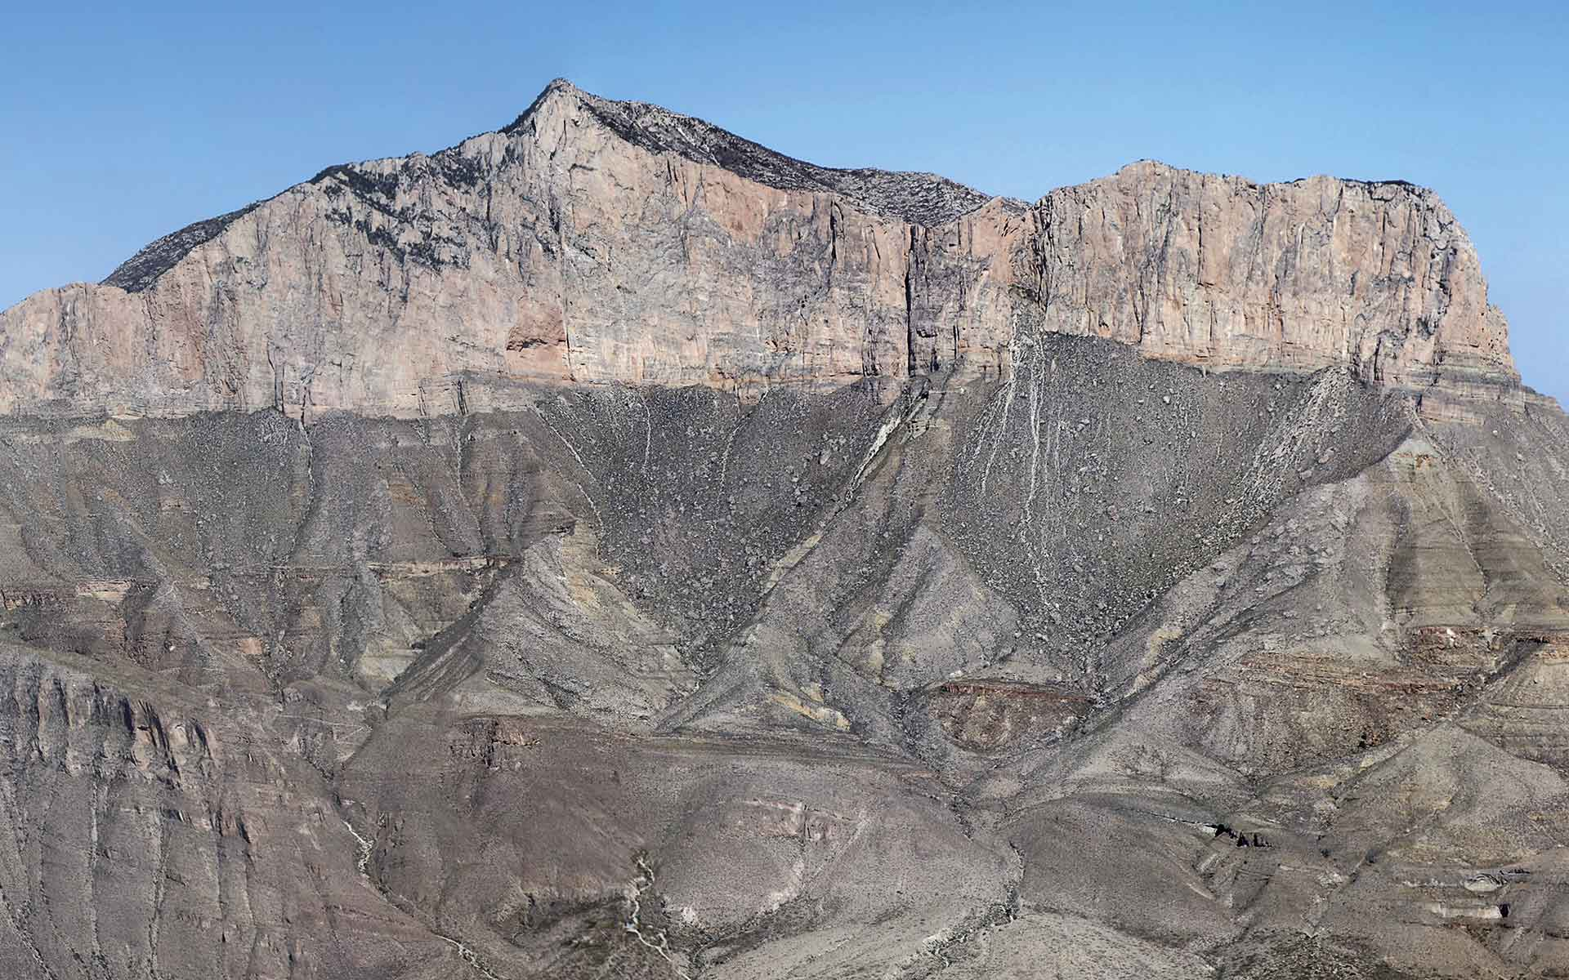
Notes:
Capitan Reef of the Guadalupe Mountains, TX and NM
Trails here can span a sea floor profile extending from a 700 m deep basin floor to the top of the shallow water shelf, crossing an extensive transect of the well-documented Capitan Reef.
https://iugs-geoheritage.org/geoheritage_sites/permian-reef-complex-of-the-guadalupe-mountains/

Slide 7
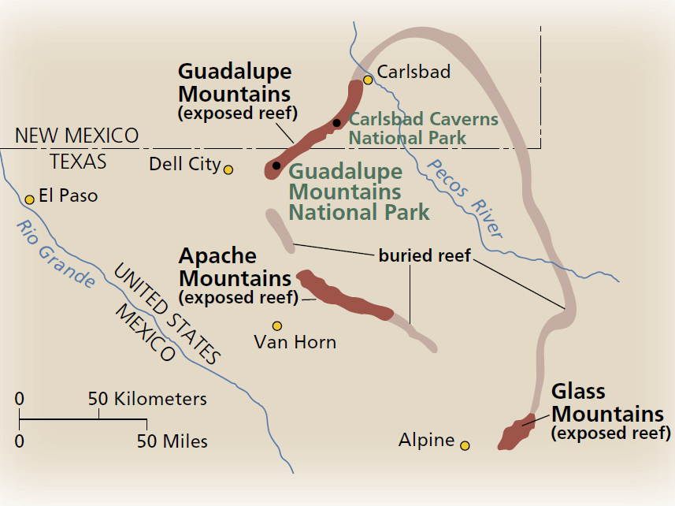

Slide 8
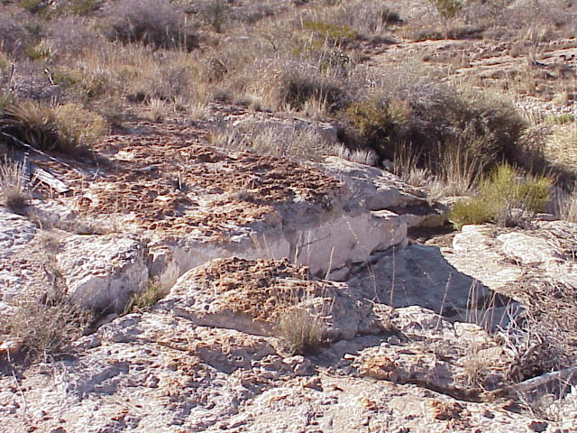
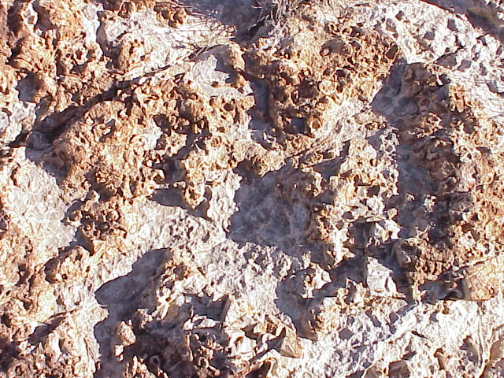

Slide 9
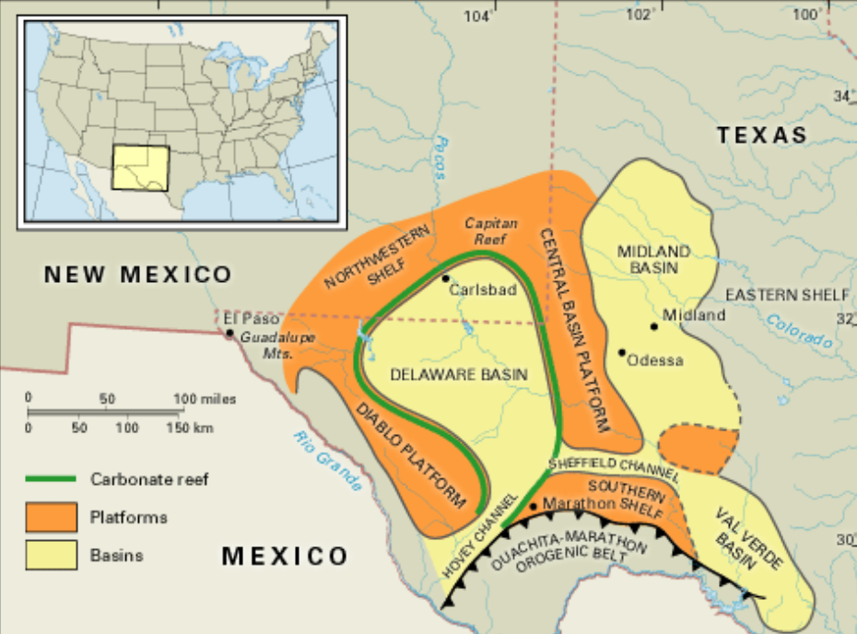

Slide 10
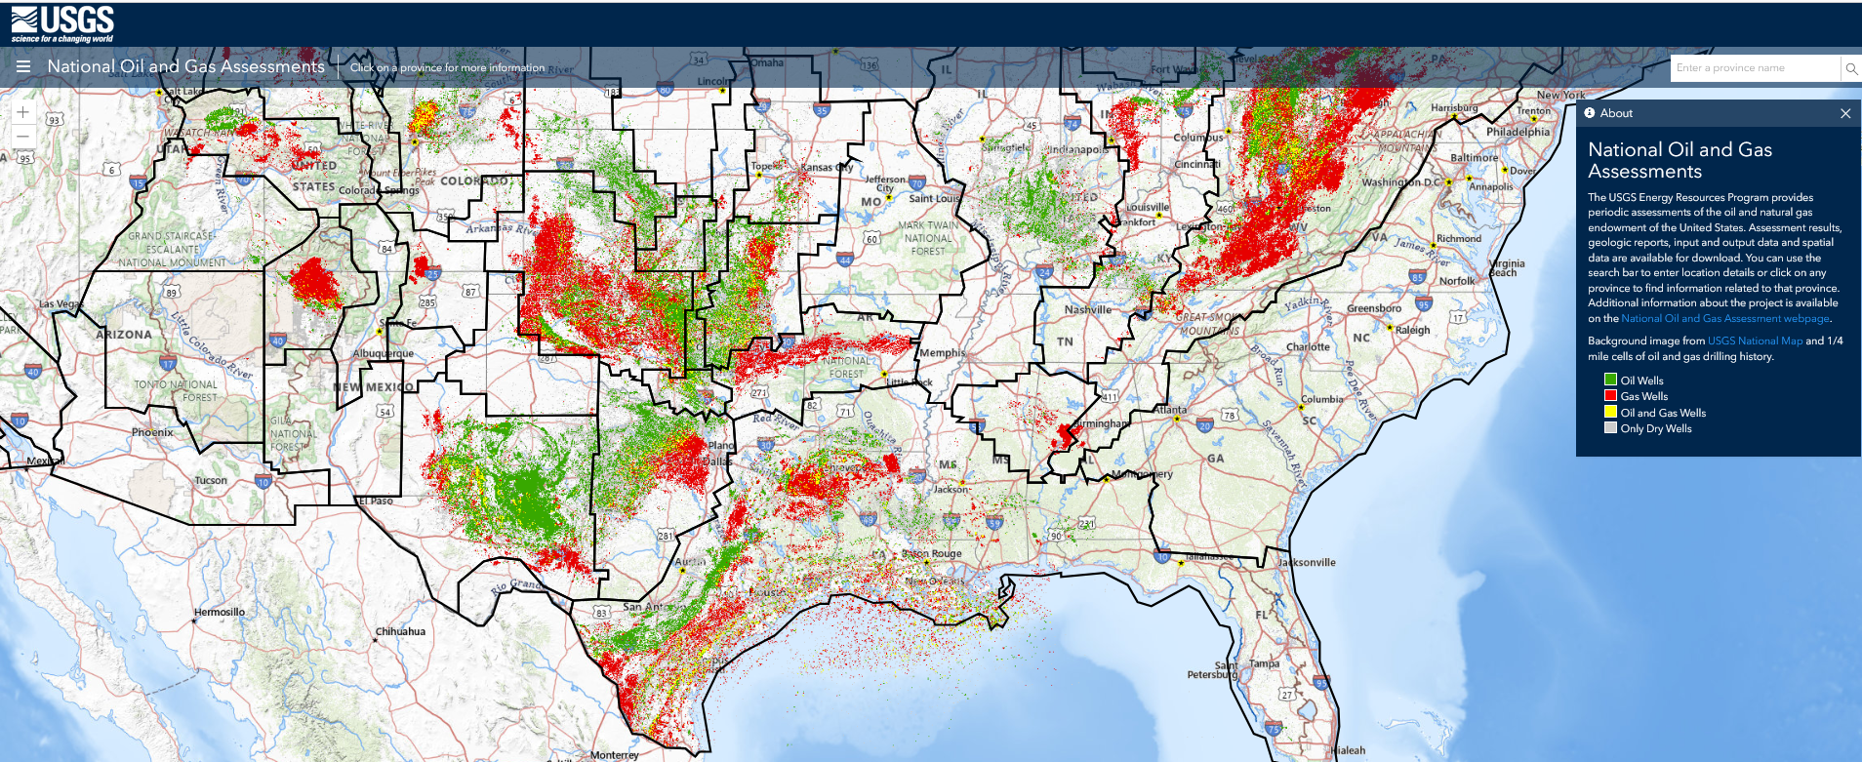
Notes:
The coral reefs in the Permian Basin hold oil because the ancient reef structures acted as natural traps for organic matter that decomposed and transformed into oil over millions of years, with the porous nature of the reef providing a reservoir for the trapped hydrocarbons, while the surrounding rock layers acted as a barrier preventing the oil from migrating further; essentially, the reef provided a perfect geological structure for oil accumulation.
https://www.usgs.gov/media/images/map-united-states-oil-and-gas-wells-2017
Green indicates areas of active oil production
Red indicates areas of active natural gas production

Slide 11
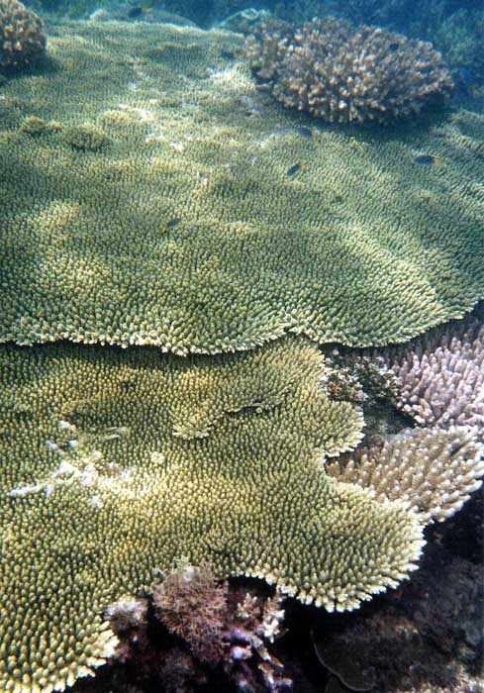
Phylum Cnidaria
Class Anthozoa
Subclass Hexacorallia
Order Scleractinia
  Dominant reef-building ‘hard’ coral
  First appeared in the Middle Triassic
  Filled the ecological niche once held by tabulate and rugose corals.

Slide 12
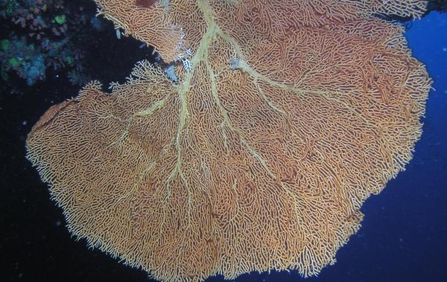
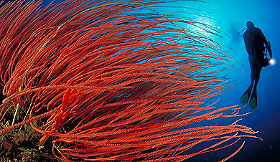
Subclass Octocorallia
Soft corals lack the rigid calcium carbonate skeleton of hard corals.
They have a flexible, fibrous structure made of protein and tiny skeletal elements called spicules.
Soft corals do not contribute significantly to reef building
Notes:
Soft corals can form reef-like structures at deeper depths because some species do not have zooxanthellae, thus no need for ample sunlight for them to photosynthesize. Soft corals can dominate in areas where water quality or temperature are unsuitable for hard corals.
Soft corals are distributed worldwide (in polar, temperate and tropical waters)

Slide 13
Other biomineralizing organisms
May build reef as individuals in the absence of hard corals (stromatolites) or contribute to hard reef structure
  Stromatolites
  Sponges
  Bivalves
  Benthic foraminifera
  Bryozoans
  Calcareous algae

Slide 14
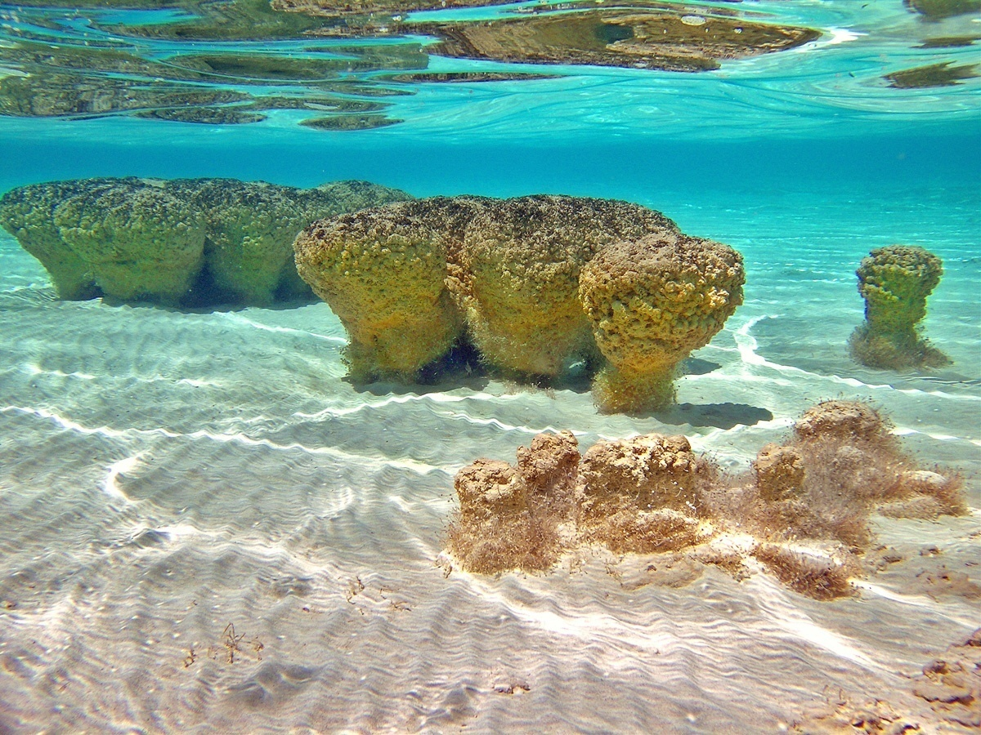
Notes:
Stromatolites are mounds of prokaryotic algae and cyanobacteria. Modern stromatolites occur today along the Australian coast.

Slide 15
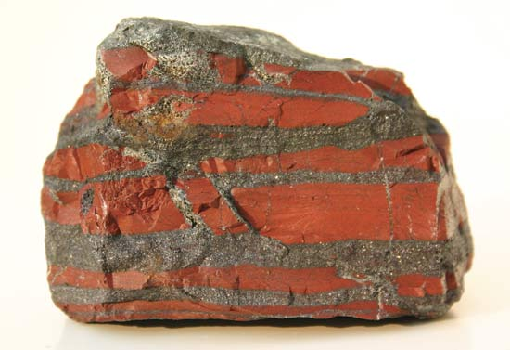
Notes:
Banded iron formations. This is not a fossil stromatolite, but an iron-containing sedimentary rock that has oxidized due to the presence of oxygen. Stromatolite reef created the first oxygen in the atmosphere, making conditions less oxidizing and more hospitable for non-photosynthesizing organisms.
When cyanobacteria evolved and started photosynthesizing, they began oxygenizing the atmosphere. In the presence of oxygen, surface veneers (oxides) form on the surface of many metallic elements (for example, rust forms on iron in the presence of oxygen). Banded iron formations are the fossil evidence for the emergence of oxygen on planet Earth through the metabolism of cyanobacteria in stromatolites.

Slide 16
Stromatolites
Mounds of prokaryotic (single-celled) organisms: algae and cyanobacteria.
Modern stromatolites occur today along the western Australian coast.
Comprised the first reefs in geologic history
Have been found on Earth for 2 billion years
Do not typically occur with coral reef
Notes:
Stromatolites encode the role that ancient microorganisms played in the evolution of life on earth and in shaping earth's environments. The fossil record of stromatolites is astonishingly extensive, spanning 4 billion years of geological history with the forming organisms possibly having occupied every conceivable environment that ever existed. Today, stromatolites are nearly extinct in marine environments, living a precarious existence in only a few localities worldwide. Modern stromatolites were first discovered in Shark Bay, Australia in 1956, and through out western Australia in both marine and non-marine environments. New stromatolite localities have continued to be discovered in various places such as the Bahamas, the Indian Ocean and Yellowstone National Park, to name but a few localities. Stromatolites are most often described as biogenically-produced structures formed by colonies of photosynthesizing cyanobacteria.

Slide 17
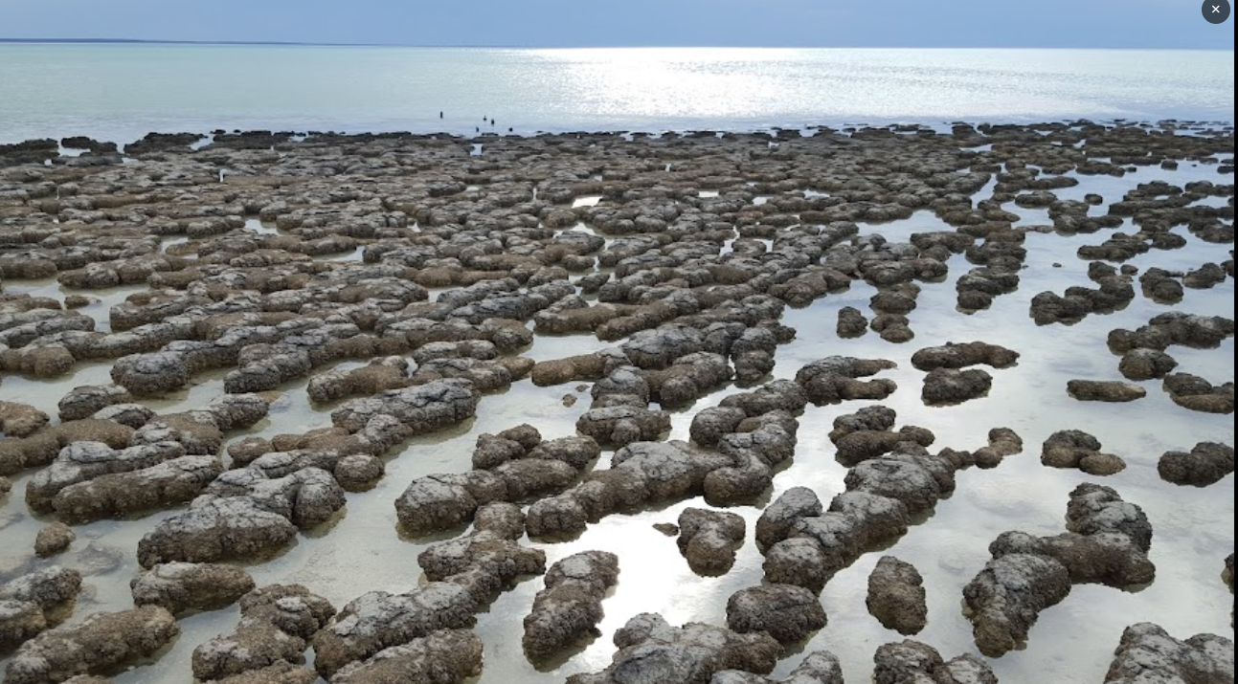
Notes:
Stromatolite reef, Hamelin Pool Marine Reserve near the boardwalk, Western Australia

Slide 18
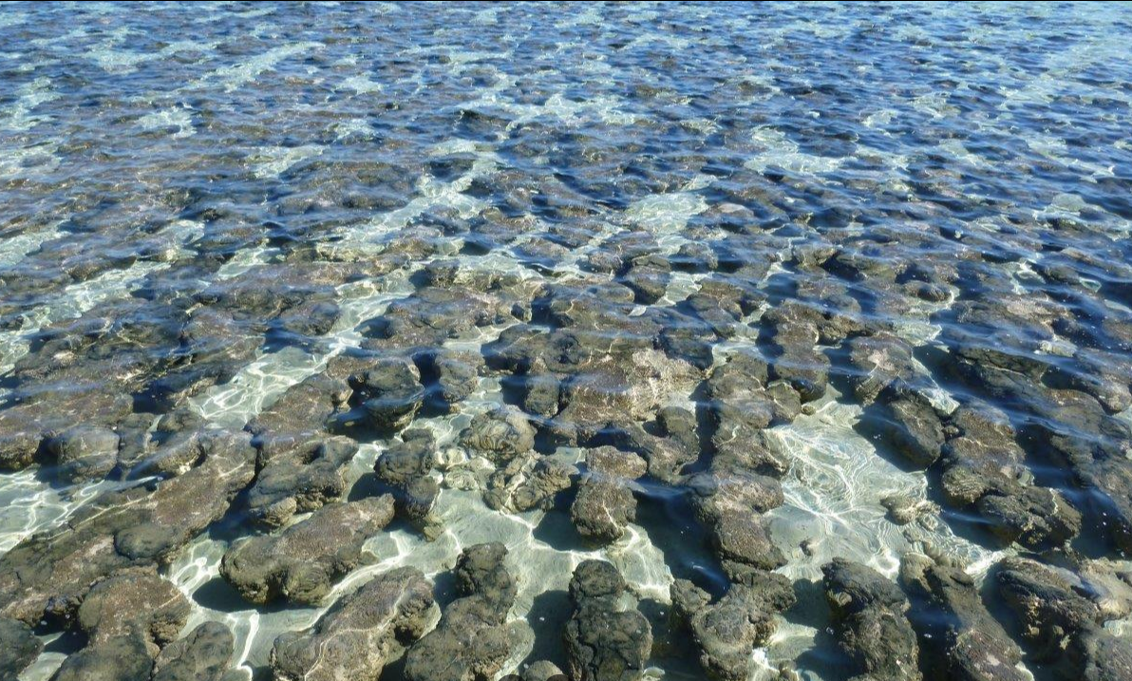
Notes:
Stromatolites are mounds of prokaryotic algae and cyanobacteria. Modern stromatolites occur today along the western Australian coast. This is a stromatolite reef

Slide 19
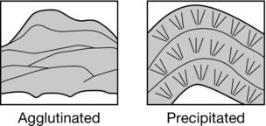
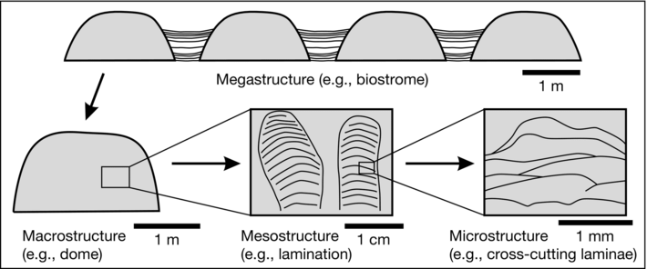
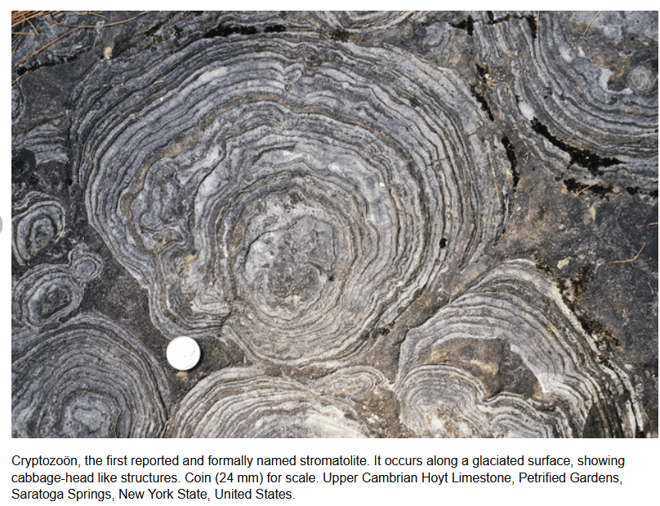

Slide 20
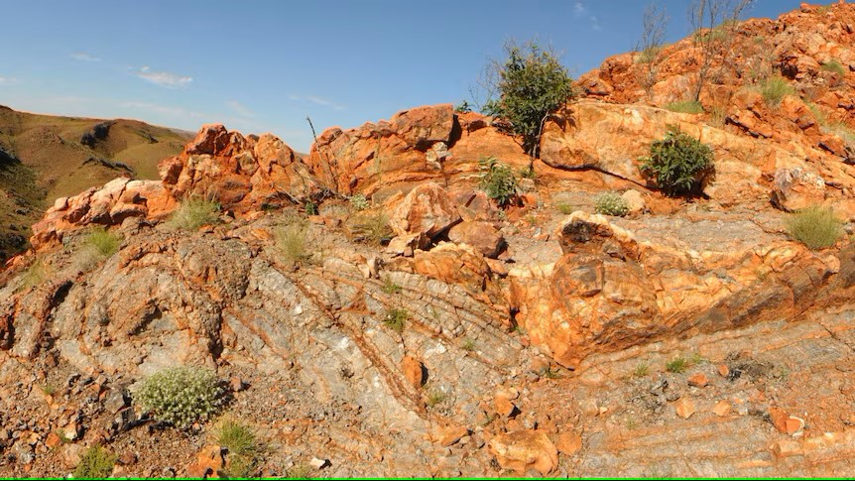
Notes:
https://www.abc.net.au/news/science/2017-05-10/early-life-on-land-in-3.5bn-year-old-hot-spring-in-pilbara/8497594
Western Australia

Slide 21
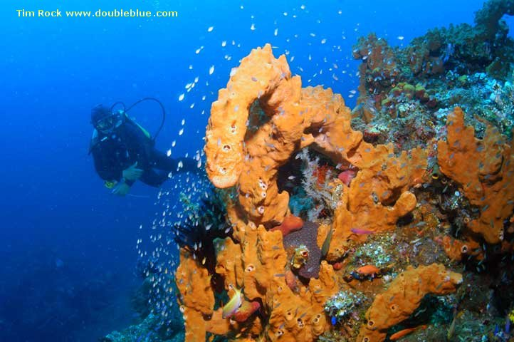
Sponges (Phylum Porifera)
Notes:
Sponges can form reefs on their own, and contribute to coral reef by their detritus, notably the spicules that give rigid form to their bodies. Spicules can be made of silica or calcium carbonate.
Sponges have a water-based circulation system. Sponges can enhance coral growth by filter feeding and keeping water clear. Large sponges can filter thousands of liters of seawater per day via the motion of cilia lining its internal anatomy.
Sponges may also be symbiotic with algae.
Evolved in the Devonian (450 million ya)

Slide 22
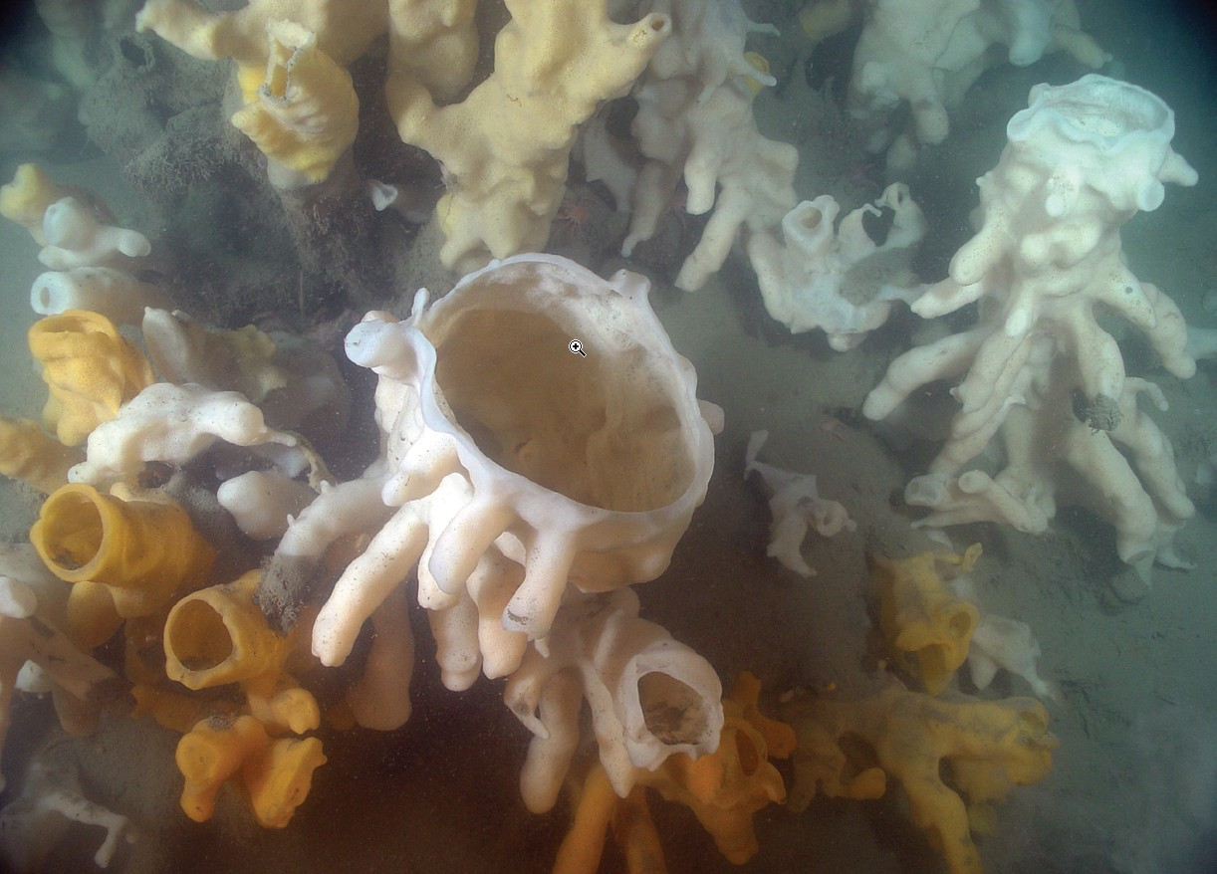
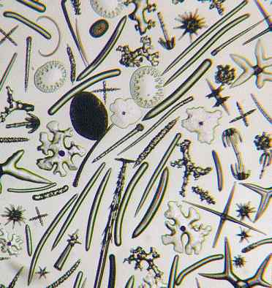

Slide 23
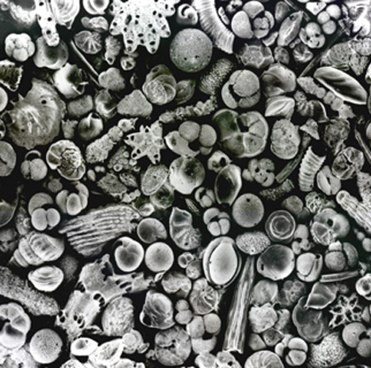
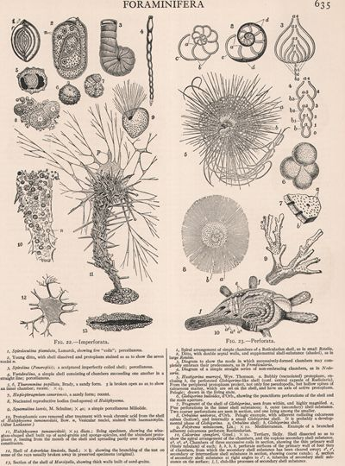
Notes:
Foraminifera

Slide 24
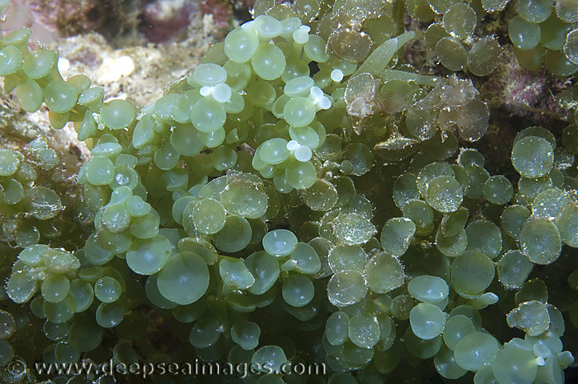
Notes:
A colony of forams (Marginopora vertebralis) growing on a coral reef on the Wheeler Reef system in the Great Barrier Reef off the coast of Townsville in Queensland, Australia.
The shells from these forams are believed to be the source of over 50% of the calcareous sedimentary rock formed on the sea bottoms. Forams do not build large reef as much as they contribute to the calcareous sediments in and around reef.
Many forams have calcareous shells, which, upon their death, contribute to sediment production. These sediments accumulate and can cement over time to form limestone and reef-like structures. Large benthic forams, like Homotrema and Archaias angulatus, are often found in reef environments, where their skeletons contribute to the reef's overall calcium carbonate budget. In regions like the Bahamas and the Indo-Pacific, foram-derived sands can dominate beaches and lagoon areas, indirectly supporting reef development. While modern forams don't form true reefs, they contribute to carbonate production and support reef resilience by recycling nutrients and providing a food source for reef organisms.

Slide 25
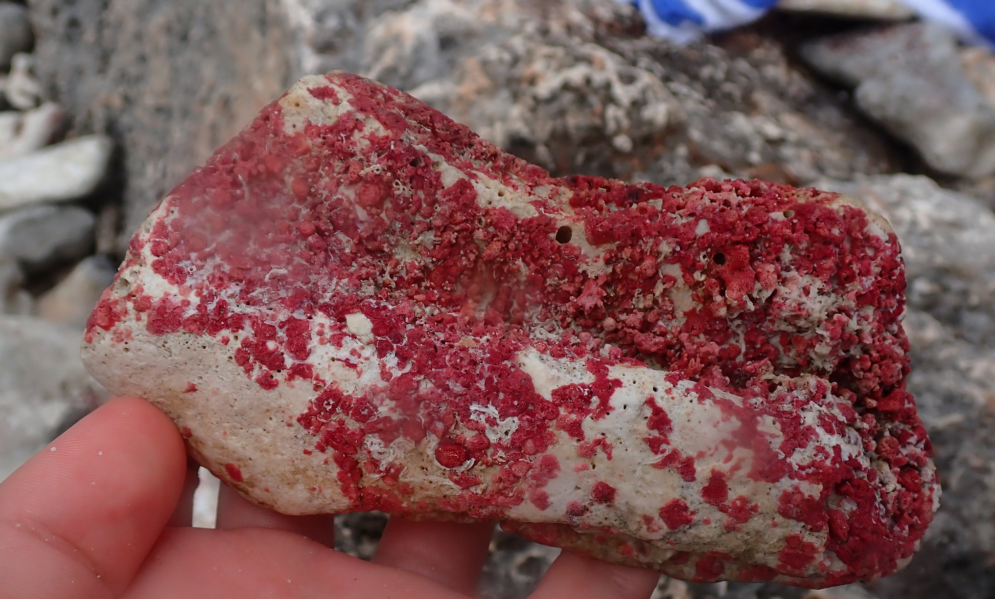
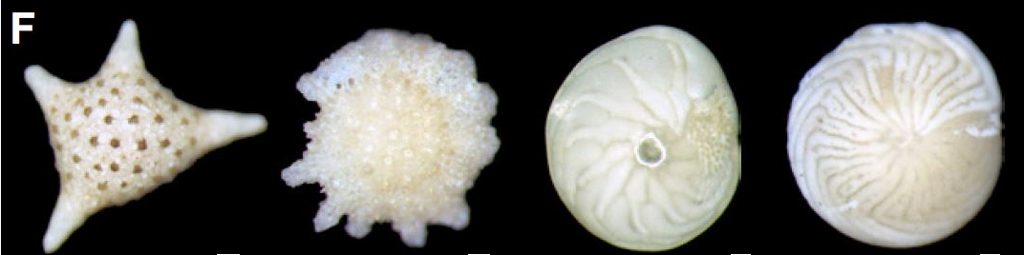
Notes:
Homotrema rubrum

Slide 26
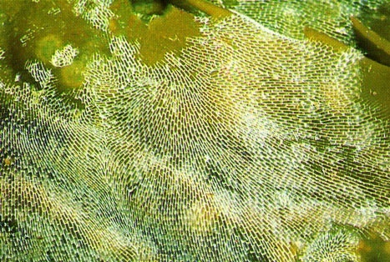
Notes:
Bryozoans may be found on all types of hard substrates
Bryozoans are also colony-forming animals. Many millions of individuals can form one colony. The colonies range from millimeters to meters in size, but the individuals that make up the colonies are tiny, usually less than a millimeter long. In each colony, different individuals assume different functions.

Slide 27
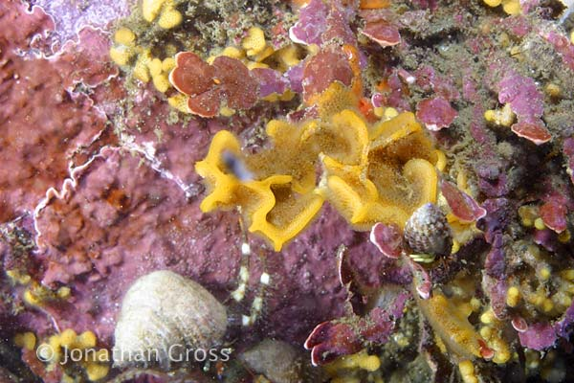
Notes:
.
Bryozoans

Slide 28
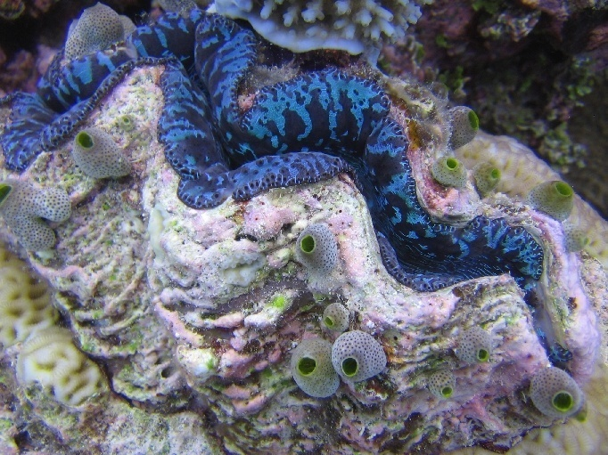
Notes:
Bivalves in the Phylum Mollusca

Slide 29
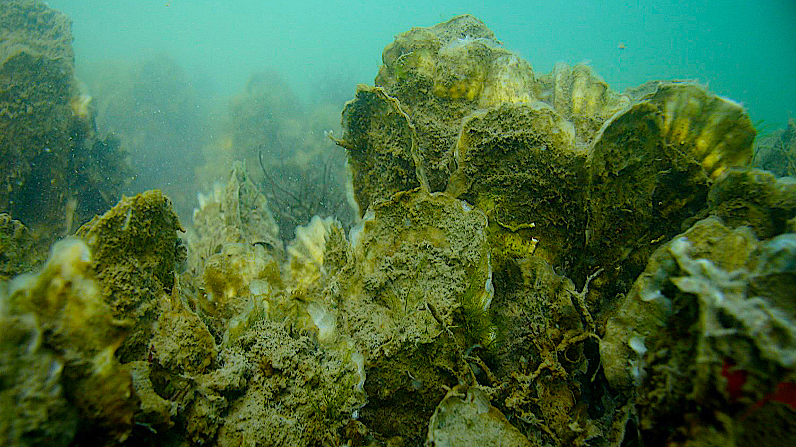
Notes:
Bivalves in the Phylum Mollusca
https://ncseagrant.ncsu.edu/hooklinescience/how-have-oyster-reefs-changed-over-the-last-six-decades/
Gastropods also biomineralize like bivalves, but they do not tend to form large aggregations like this oyster reef above

Slide 30
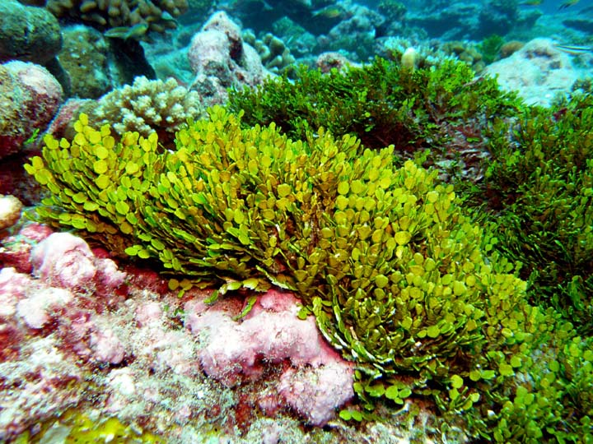
Notes:
Calcareous algae (Halimeda sp.)

Slide 31
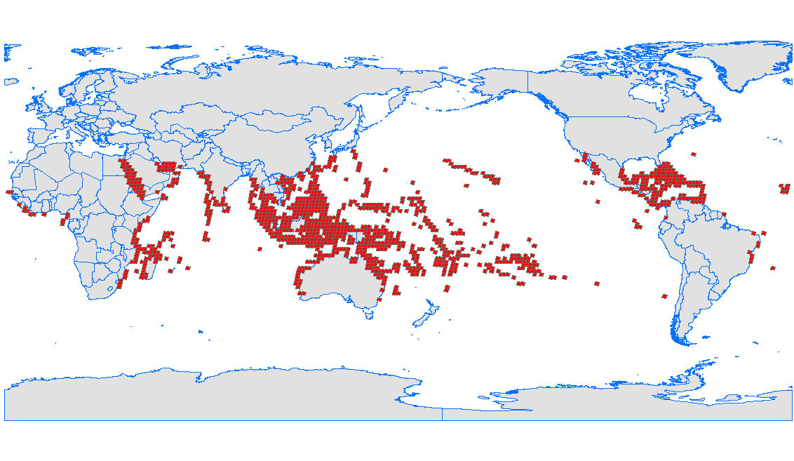
Notes:
Coral reef

Slide 32
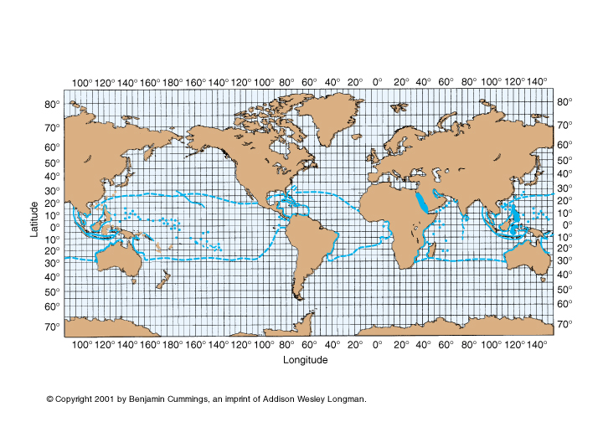
Notes:
Optimal temp. 85 F

Slide 33
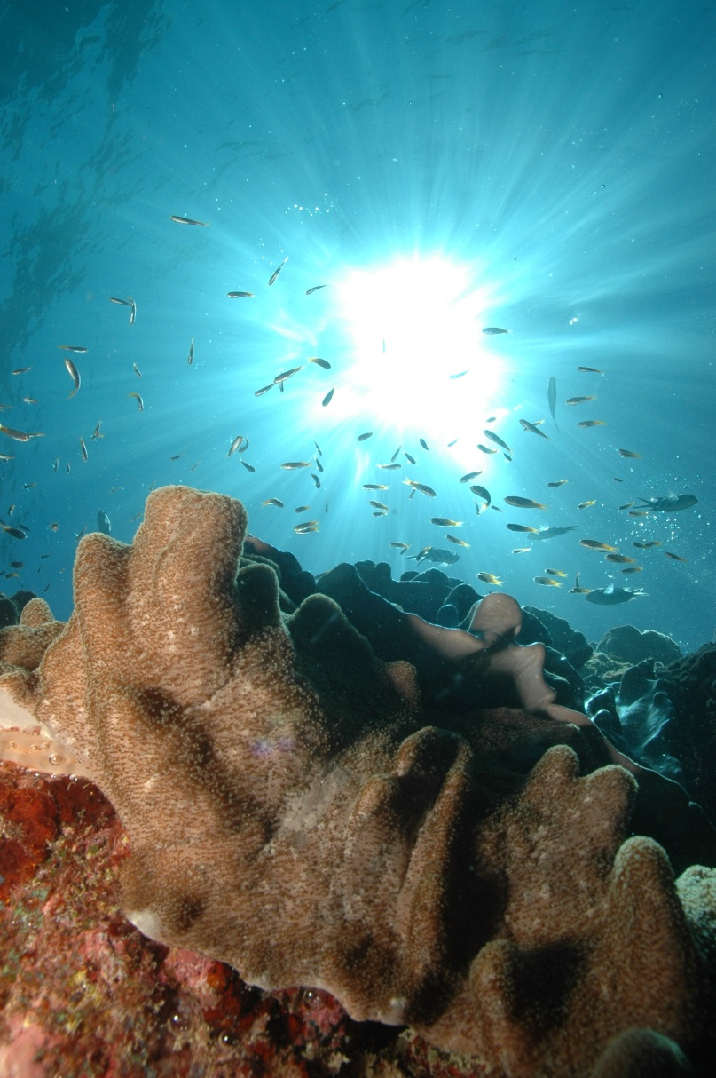
Notes:
High light, clear and shallow warm water levels promote photosynthesis.
Hard reef building corals limited to upper 30 meters due to light attenuation with depth.

Slide 34
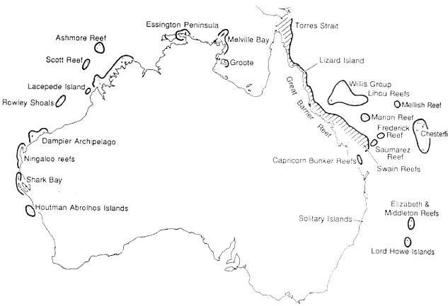

Slide 35
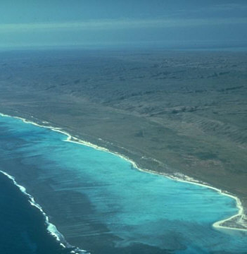
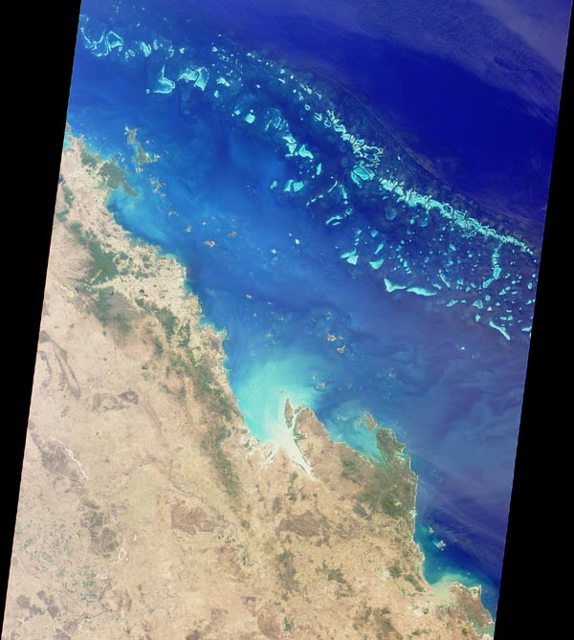

Slide 36
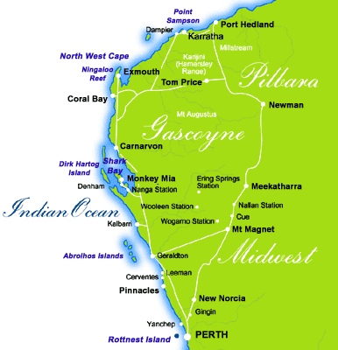
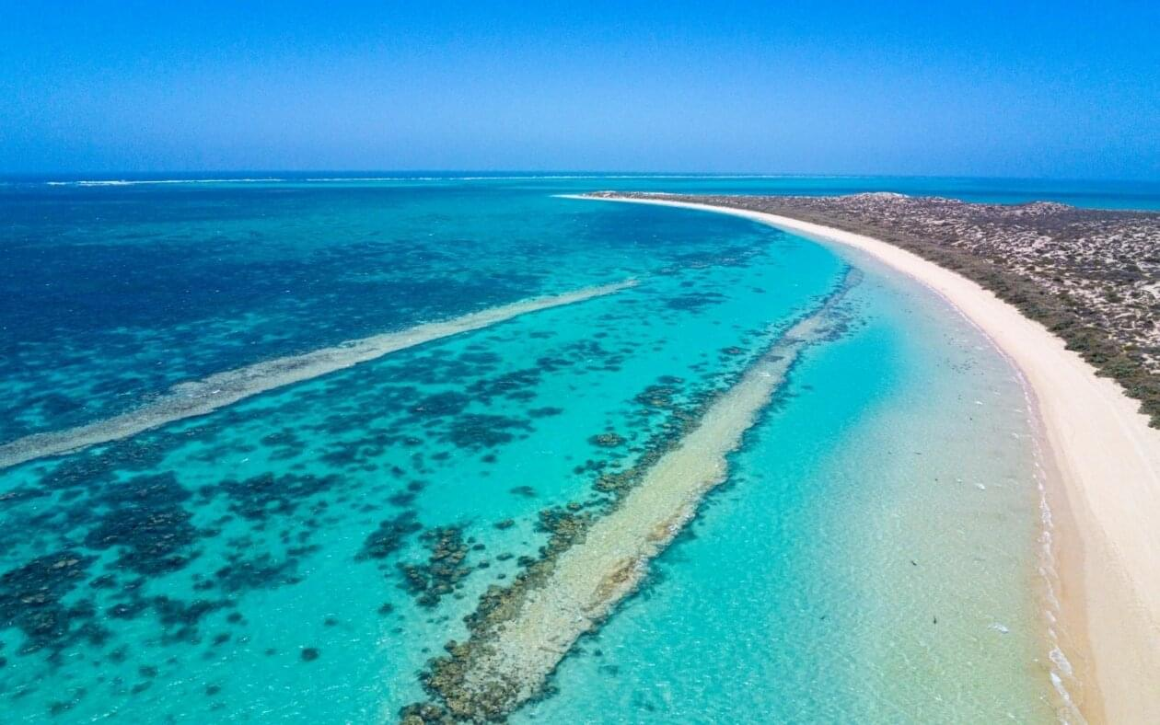
Notes:
High salinities: corals have low tolerance for brackish water
Why are fringing reefs better developed on the west coast of Australia (Ningaloo Reef and Coral Bay) than along the east coast?

Slide 37
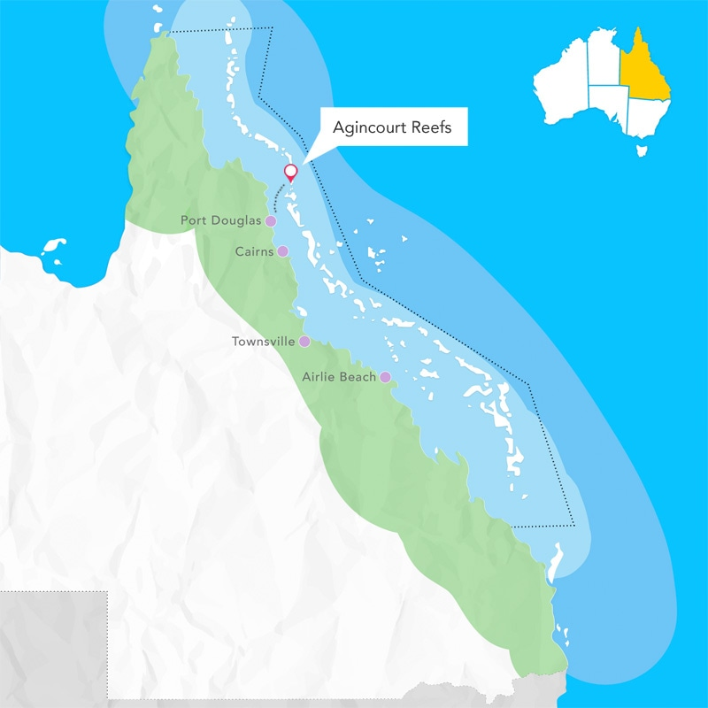
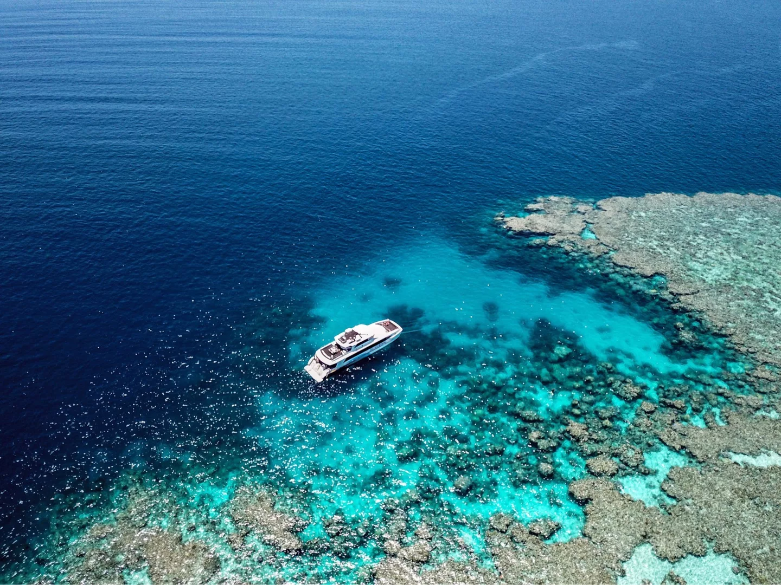

Slide 38
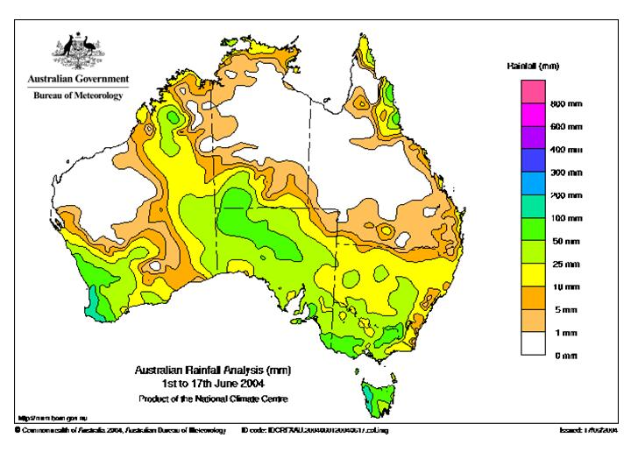
Notes:
Cairns
Tully
Barron

Slide 39
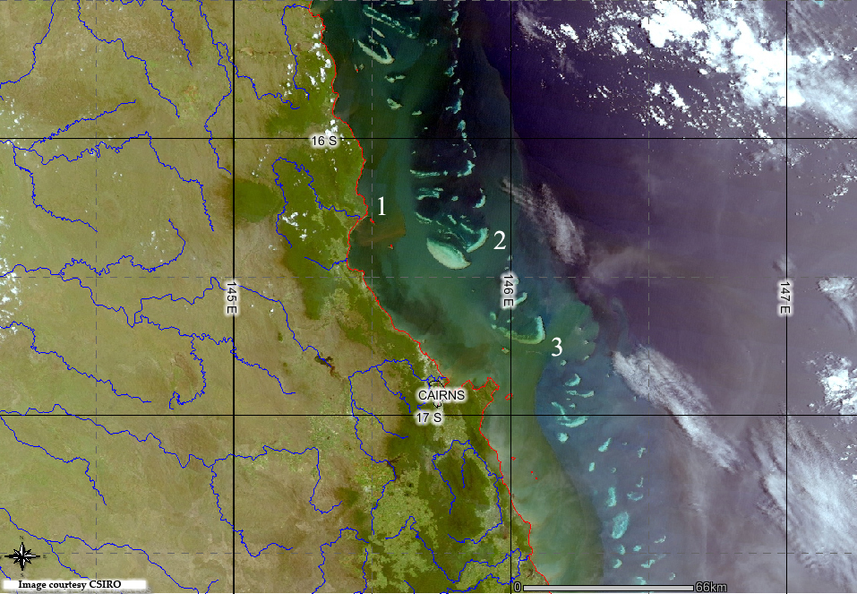
Notes:
Low suspended sediment conditions better. Sedimentation can smother corals; reduce light penetration in water; require some wave action to lessen sedimentation

Slide 40
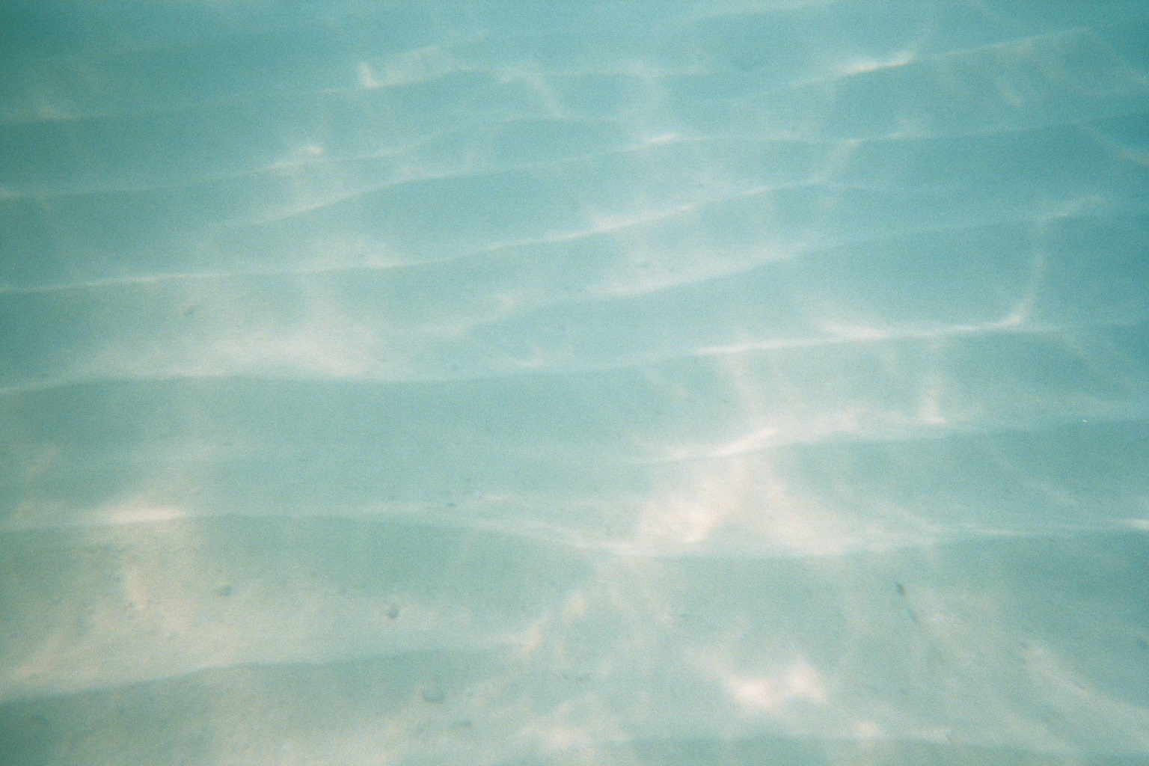
Notes:
Corals require immobile substrates for the coral organism to attach and begin growing

Slide 41
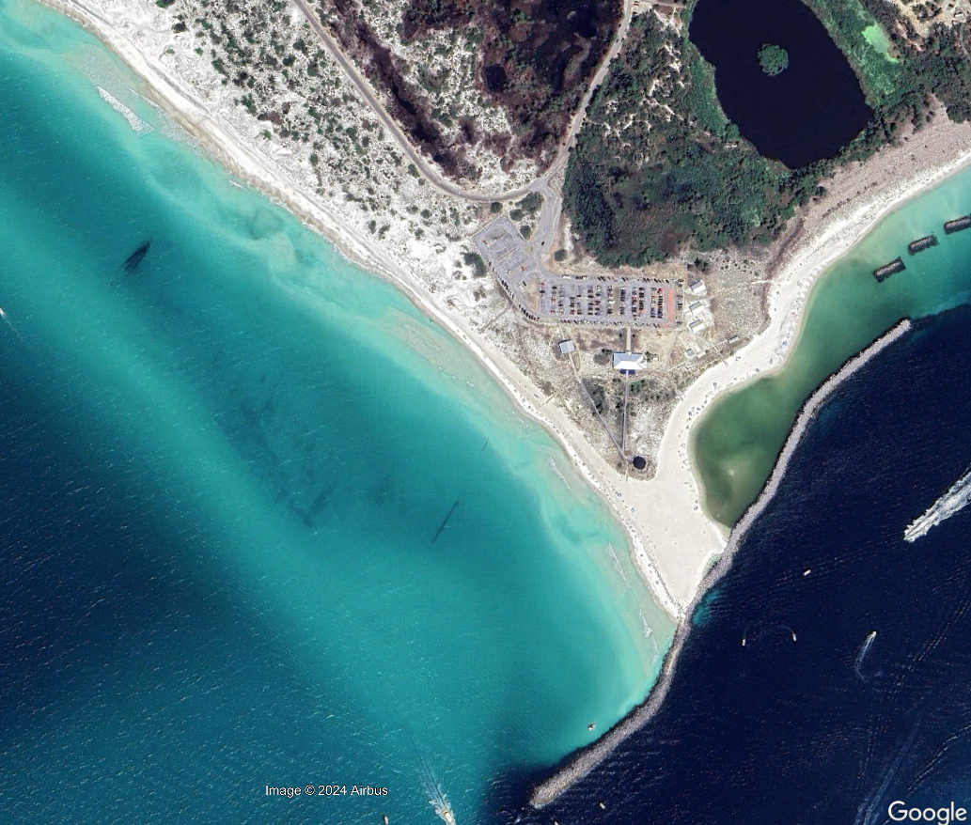

Slide 42
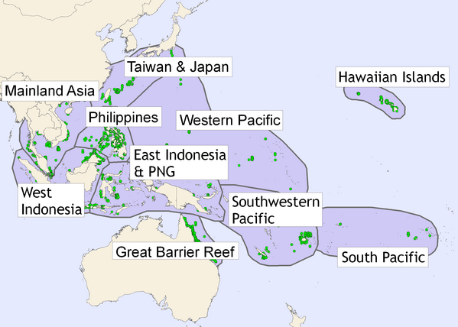
Notes:
Locations where these conditions ideally met include the Indo-Pacific Coral Triangle

Slide 43

Notes:
Mesoamerican Barrier Reef, the second largest barrier reef in the world

Slide 44
Coral reef and related landforms
Fringing reefs
Barrier reefs
Patch reefs
Atolls
Carbonate platforms
Coral cays and beaches
Carbonate cays and beaches

Slide 45





Slide 46

Far North Queensland, Australia
Notes:
Fringing reef, Far North Queensland, Australia
The only place where two World Heritage Areas meet. Cape Tribulation and GBR

Slide 47

.
Notes:
Fringing reef off the coast of Israel

Slide 48

Notes:
http://environment.newscientist.com/article/dn11603

Slide 49



Slide 50


Notes:
This is a ribbon reef on the GBR

Slide 51

Notes:
Patch reef

Slide 52

Notes:
Patch reef
Platform reefs may become coral cay if sand and vegetation stabilize substrate.

Slide 53

Notes:
Patch reef (bommies) Agincourt Reef, Great Barrier Reef

Slide 54

Notes:
Patch reef grow on antecedent topographic highs

Slide 55

Notes:
Antecedent topography (topography in the past, in this case, when sea levels were lower) shapes the distribution of reef types and shapes today

Slide 56


Notes:
Carved by currents and erosion in front of reef
Buttress and canyon structures, also called spur (rock) and groove (sand)
Spur and groove in reef off the coast of Tobago (right)
Prony Bay, New Caledonia (left)

Slide 57


Slide 58

Coral growth versus reef growth

Slide 59

Notes:
Growth of individual coral (a few mm to 10 -15 cm per year) should not be equated with growth of reef. To construct a reef, more has to occur than just coral growth.

Slide 60


Slide 61


Slide 62

Notes:
El Nino brings coral bleaching to central-eastern Pacific and Caribbean.
La Nina brings bleaching events to Australia and the western Pacific

Slide 63

Reef growth involves biologic and geomorphologic processes
Primary framework: living coral “skin” and the coral skeleton underneath it.

Slide 64

Secondary framework: coralline algaes, encrusting corals, bivalves, foraminifera, sponges, soft corals.
This secondary framework binds the primary framework into “reef rock”

Slide 65


Tertiary framework: bioerosion and weathering and erosion of reef materials (waves, storms) generates coral fragments, sand, and silt that veneer the reef and spaces between it

Slide 66


Notes:
Effects of 2004 Tsunami, Thailand

Slide 67


Notes:
Bioeroders

Slide 68




Slide 69


Slide 70

  Final stage is lithification
  Coral fragments and sediments become welded to primary and secondary framework to form final reef fabric.
  Reef growth is the balance between these aggradational and degradational processes

Slide 71

Notes:
Pacific Island nations: Tuvalu. It is a lower income country, with limited natural resources and a small economy.

Slide 72

Notes:
Tuvalu

Slide 73


Notes:
Tuvalu is a coral atoll
https://youtu.be/Ey8Uhis0T20?si=yZUXYbrkPHXSETFr

Slide 74

Notes:
Simon Kofe, Tuvalu’s foreign minister, has filmed a speech to climate summit COP26 knee-deep in the ocean.
https://www.benarnews.org/english/news/pacific/tuvalu-climate-change-spokesman-simon-kofe-resigns-07302023232405.html

Slide 75

Notes:
On some atolls, elevation is maintained by coral debris that is pushed up on the islands by waves and storms. In some cases, this may slow inundation for sea level rise so long as coral reefs remain healthy. This runs counter to the discourse that all island nations are disappearing from sea level rise.
One one study that analyzed thirty Pacific and Indian Ocean atolls—comprising 709 islands in total—revealed that 89 per cent of islands were either stable or had grown in land area, while only 11 per cent had decreased in size. In Tuvalu, a small Pacific nation often singled out by the media as one of the first nations likely to disappear entirely due to sea level rise in the future, a recent study found that between 1971 and 2014, eight of Tuvalu’s nine atolls and almost three-quarters of the 101 reef islands had grown in size. This increased Tuvalu’s total land area by 3 per cent, even though in Tuvalu sea levels rose at twice the global average.
Duvat, V. K. (2019). A global assessment of atoll island planform changes over the past decades. Wiley Interdisciplinary Reviews: Climate Change, 10(1), e557.

Slide 76

Notes:
Bahama Banks, a carbonate platform
A carbonate platform is a large, shallow, submarine area that primarily accumulates carbonate sediments, typically composed of limestone or dolomite due to the activity of marine organisms like corals, algae, and mollusks. These platforms are usually found in warm, tropical marine settings, where clear, warm, and shallow waters allow for high rates of biological carbonate production. Some platforms are rimmed by coral reef or carbonate sand shoals that act as barriers, protecting the inner platform and creating lagoon-like conditions.
In supersaturated waters, calcium carbonate can precipitate directly from the water, forming ooids and micrite. Warm, shallow waters often favor such precipitation.

Slide 77


Slide 78
Modern carbonate platforms
A large, shallow, sedimentary structure primarily composed of carbonate sediments, such as limestone and dolostone, deposited in marine settings.
Sediments derived from:
  Biogenic processes: the marine organisms that make carbonates
  Abiotic processes: calcium carbonate precipitates directly out of sea water,
Some platforms are rimmed by coral reef that act as barriers, protecting the inner platform and creating lagoon-like conditions
Notes:
Carbonate platforms can also be large sedimentary structures of lithified carbonates. Sediments deposited long ago have been transformed into solid rock.

Slide 79

Florida Carbonate Platform
Notes:
Its development is tied to the accumulation of carbonate sediments produced by marine organisms in warm, shallow seas, as well as tectonic stability and subsidence that allowed for sustained sedimentation. Some of this sedimentation can also be abiotic and derived through the precipitation of carbonate directly out of sea water.
Parts of the platform are very old, millions of years, and in places it is covered by a veneer of new carbonate sediments, particularly in the Bahamas. The Bahamas is basically one large carbonate platform that is still producing carbonate sediments. The Bahamas are a modern analogue of the environments in the past that have produced large thicknesses of carbonates.

Slide 80


Slide 81


Slide 82

Notes:
DOI:10.1016/S0025-3227(03)00161-0
Florida Carbonate Platform and the Bahamas Platform

Slide 83
Carbonate platforms vs coral reef
As with coral reef, many organisms contribute to sediment production on a platform (calcareous algae, mollusks, and foraminifera).
Coral is not a direct and dominant contributor on a platform
Ooids are unique to carbonate platforms. They are tiny spherical grains of calcium carbonate chemically precipitated out of sea water – an abiotic process.
Nearby coral reef can contribute sediments indirectly to a platform in the form of eroded and weathered coral and live rock

Slide 84


Ooids and oolitic limestone
Small, spherical carbonate grains that form from abiotic processes on carbonate platforms
Their carbonate minerals are precipitated directly out of ocean water
Wave motion creates their round form
Once buried they can become lithified into an oolitic limestone
Notes:
Oolitic sand grains from Joulter Cays, Bahamas
https://commons.wikimedia.org/wiki/File:Ooids,_Joulter_Cays,_Bahamas.jpg

Slide 85


Slide 86

Notes:
Reef is best developed online on the northern and eastern sides of the Bahama Islands.

Slide 87

Carbonate platforms vs coral reef
Are often associated with each other but have different environmental controls
Coral reefs are sensitive to narrow range of temperature, salinity, light, and water clarity. They thrive in clear nutrient-poor tropical waters.
Carbonate platforms can develop in more varied conditions, including areas with higher nutrient levels, fluctuating salinity, or broader temperature ranges
Notes:
Microbialite is a benthic sedimentary deposit made of carbonate mud (particle diameter less than 5 μm) that is formed with the mediation of microbes. Photo is of microbialite carbonates in Lake Salda (Turkey) rocks

Slide 88

Notes:
This is a cay, a body of sediment derived from erosion and redeposition of sediments and larger sized particles to form an island that can sometimes be colonized by vegetation. This is a coral cay (with a coral beach) in the Great Barrier Reef.

Slide 89
Carbonate vs coral cays and beaches
The cays of the Bahamas are generally classified as carbonate cays and are distinct from classic coral cays.
While coral cays form directly on coral reef systems, the Bahamian cays occur on a carbonate platform (the Bahama Banks)
It is possible for a cay or beach to be a mixture of both carbonate platform sediment and sediment derived from coral reef organisms

Slide 90

Notes:
Bahamas carbonate cay and beach

Slide 91

Notes:
Coral cay and beach, Great Barrier Reef

Slide 92

Notes:
Atoll, fringing reef, barrier reef, and carbonate platform – islands in the Maldives can be all of these

Slide 93

Notes:
Maldives
Atolls
Fringing reef
Carbonate platform

Slide 94




Slide 95

Notes:
DOI:10.1007/s00338-003-0366-6

Slide 96


