Slide 1
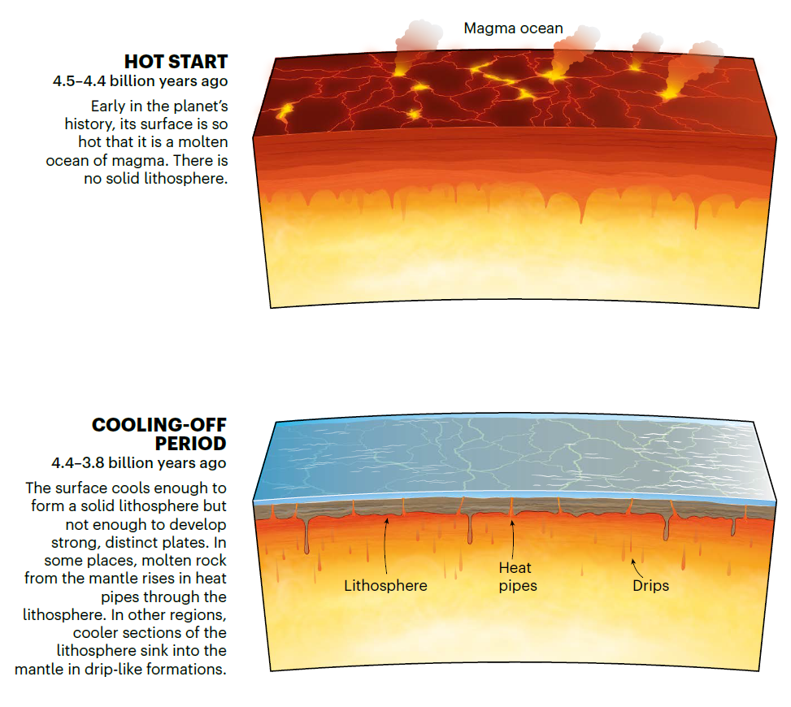
Notes:
https://www.nature.com/articles/d41586-024-02602-3

Slide 2
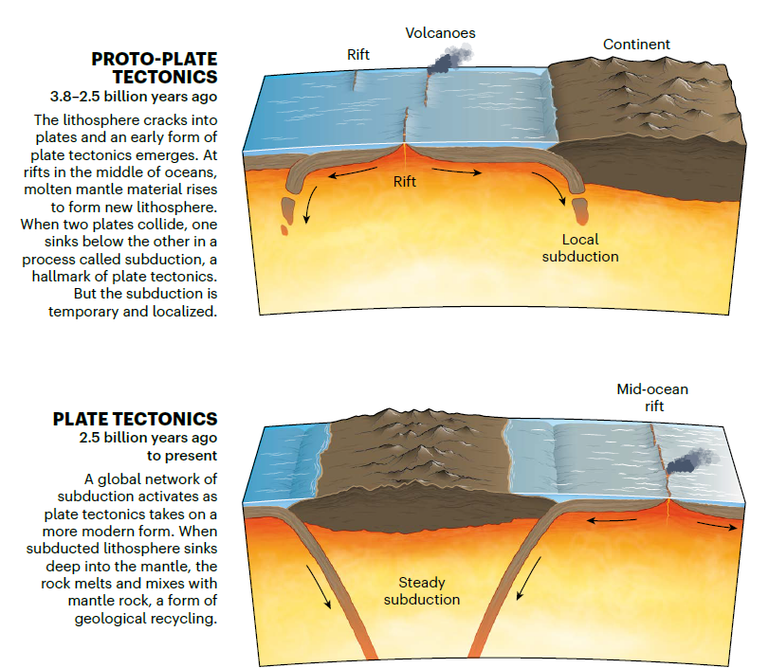
Notes:
https://www.nature.com/articles/d41586-024-02602-3

Slide 3
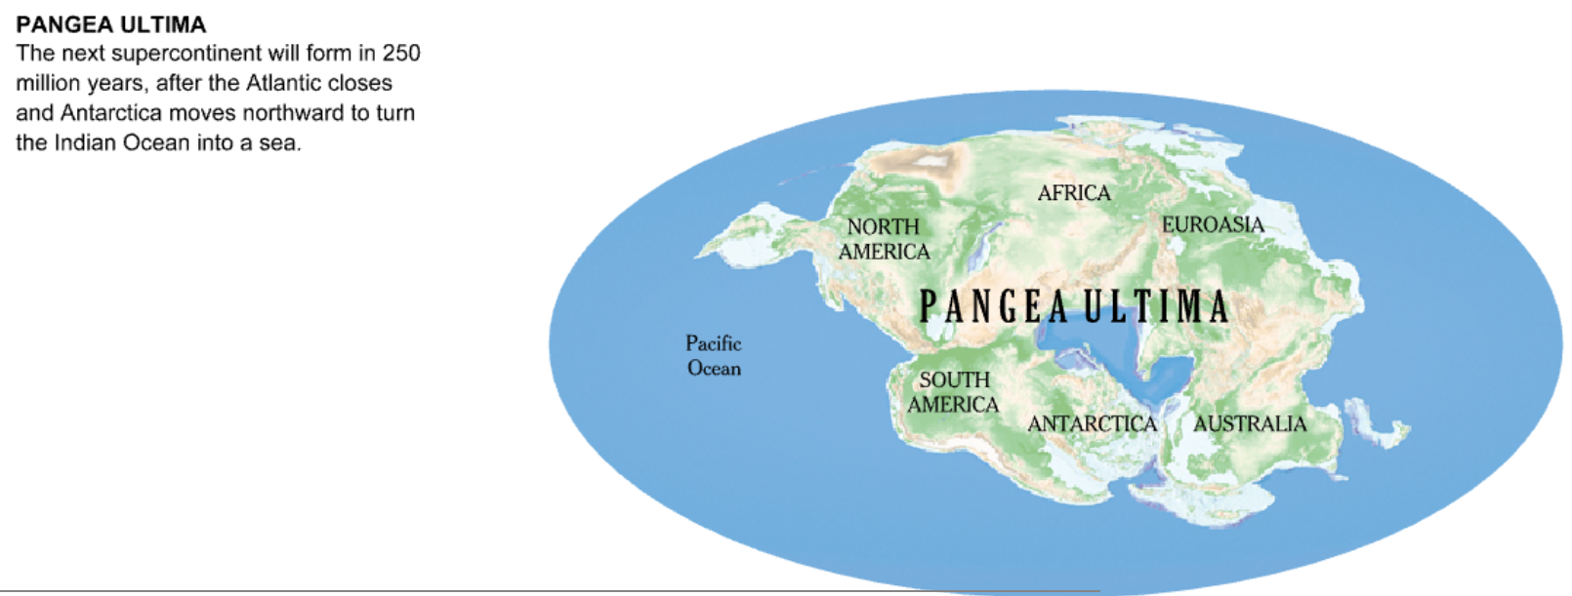

Slide 4
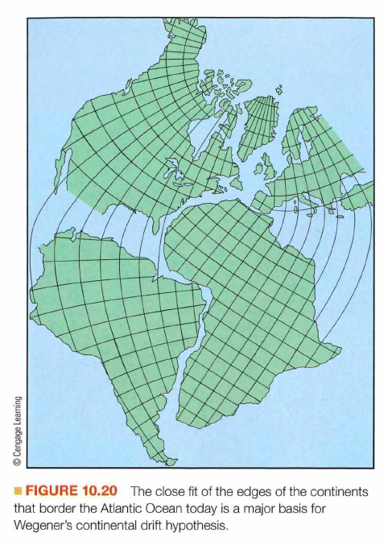
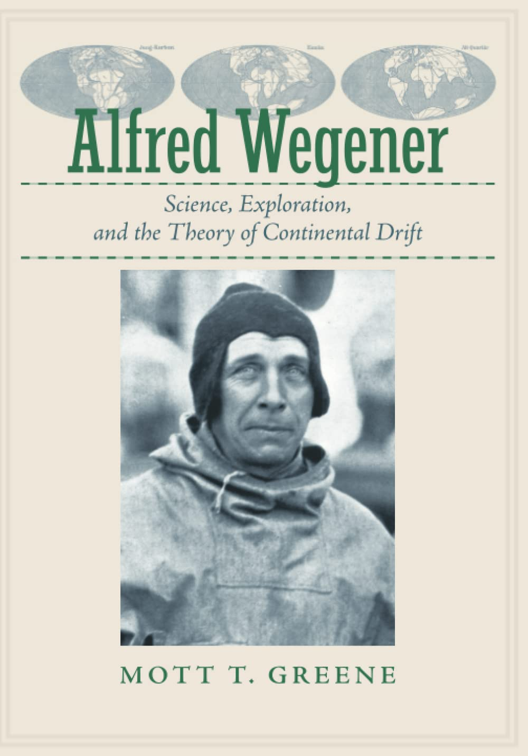

Slide 5
Continental drift
In 1915, Alfred Wegener published his ideas that the continents moved, or drifted, through time based on:
  Fit of continental shorelines: coastlines of South America and Africa match
  Mountains that were geologically similar on different continents
  Identical plant and animal fossils found on widely separated continents
He postulated the existence of earlier configurations of continents including:
  The supercontinent Pangaea and its two smaller landmasses Laurasia (North America, Asia, Greenland, Europe) and Gondwana (South America, Africa, Australia, India, Antarctica)
Notes:
Wegener was a German meteorologist, geophysicist and polar researcher. In 1915 he published 'The Origin of Continents and Oceans', which outlined his theory of Continental Drift.

Slide 6
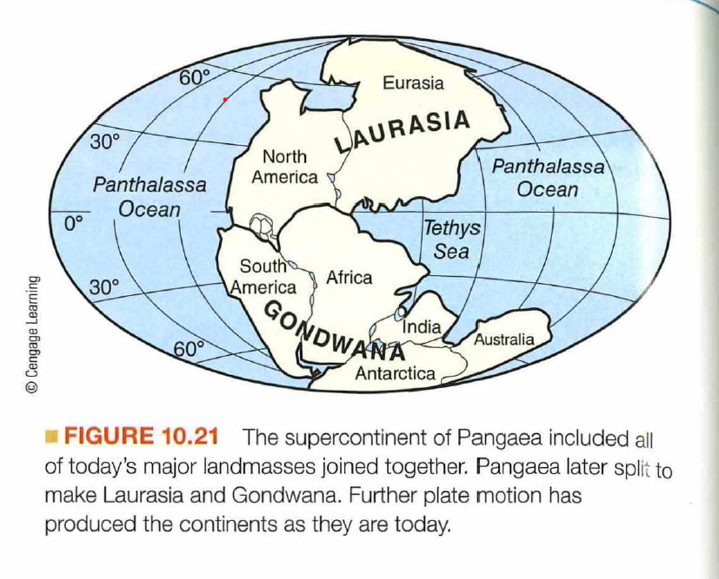

Slide 7
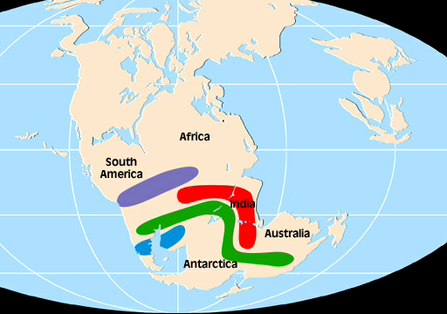
Notes:
Colors indicate distribution of an extinct plant or animal taas inferred from the fossil record

Slide 8
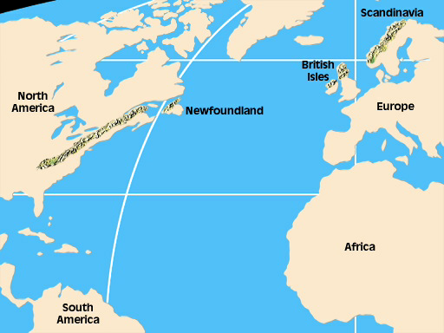

Slide 9
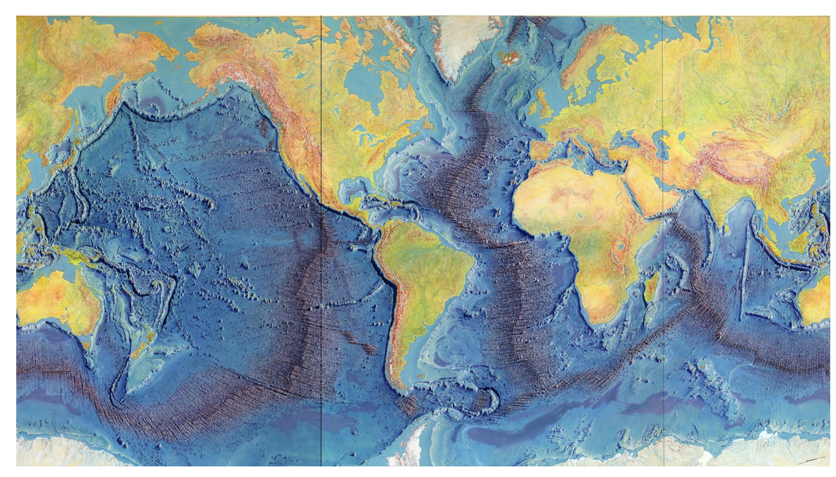

Slide 10
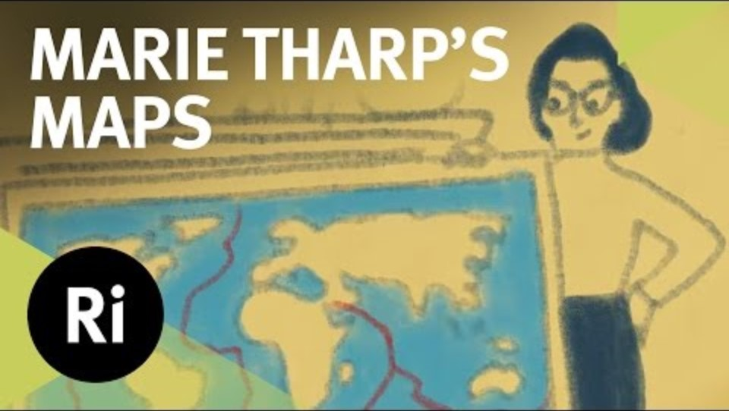

Slide 11
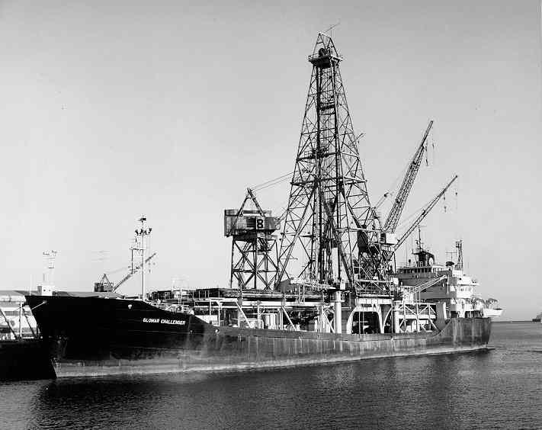
The emergence of plate tectonics theory
Continental drift theory was ignored because there was no mechanism to explain motion.
Mechanisms proposed as ‘plate tectonics’ in 1960s based on:
  Mapping of the sea floor and discovery of mid-ocean ridges, sea floor spreading, and deep trenches
  Better understanding of the geologic structure of the Earth’s interior
  Paleomagnetism in iron-containing basaltic sea floor rocks could be used to reconstruct movement of continents through time

Slide 12
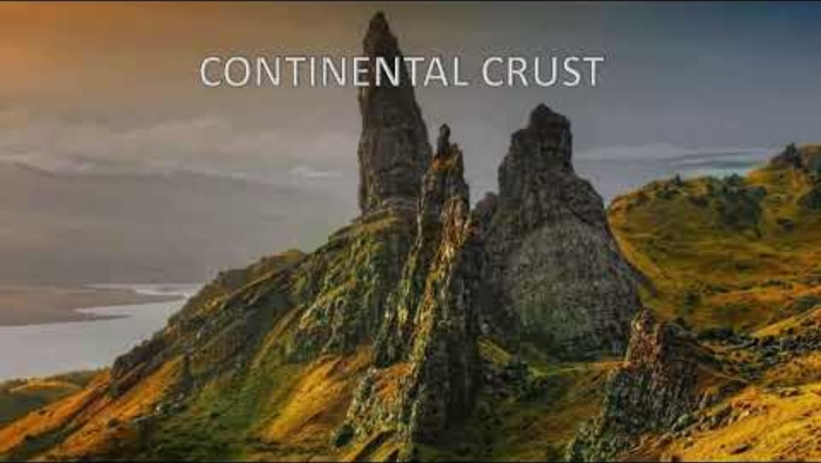
Two kinds of crust
Oceanic
  Thin and dense
  Dominant rock is basaltic in character
Continental
  Thick and less dense
  Dominant rock is granitic in character

Slide 13
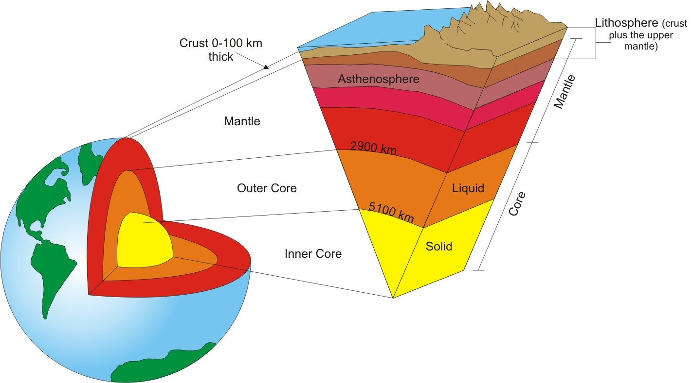
Mantle
  Top of upper mantle is solid (dark brown) but lower part (purple) is molten and is called the asthenosphere
  Mantle becomes progressively more molten with depth
Lithosphere
  The crust (light brown) and the upper mantle form the lithosphere
  The lithosphere is broken up into tectonic plates

Slide 14
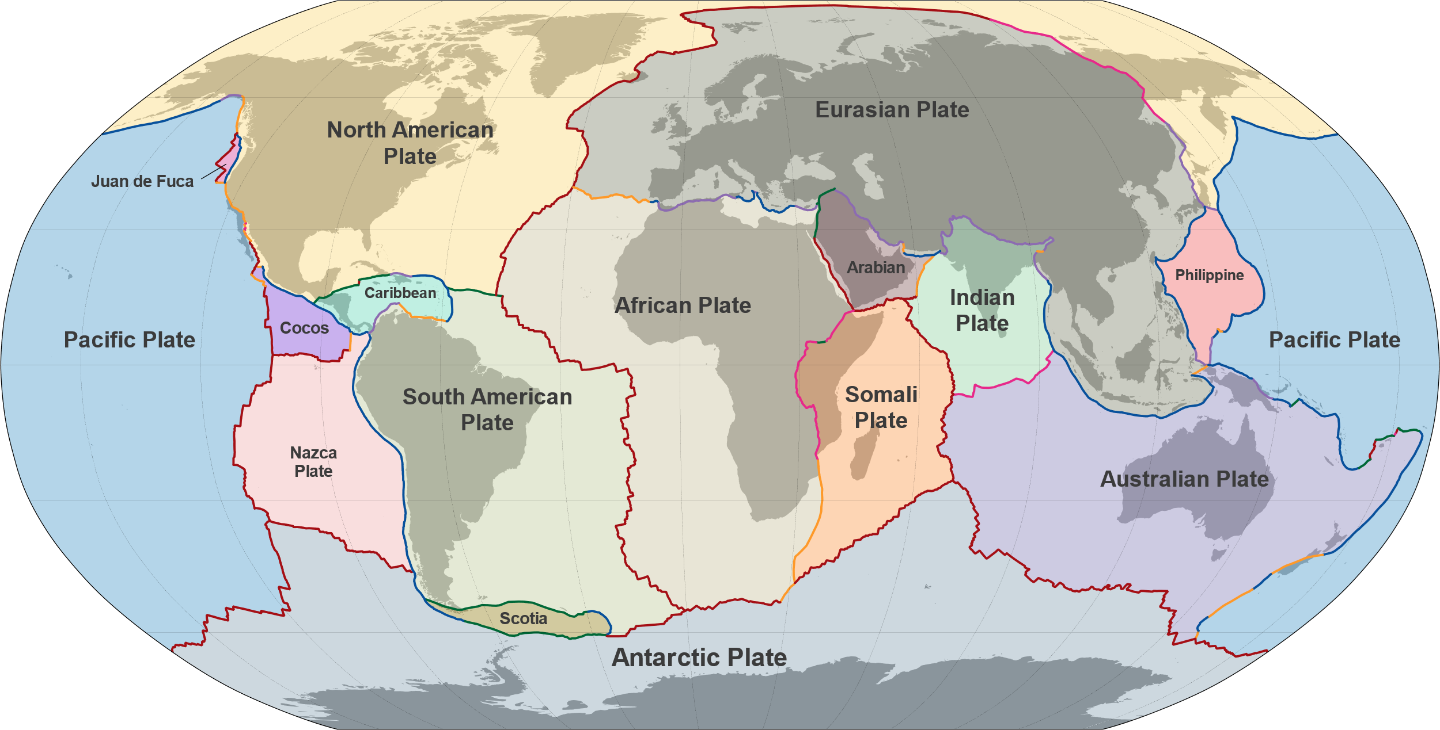
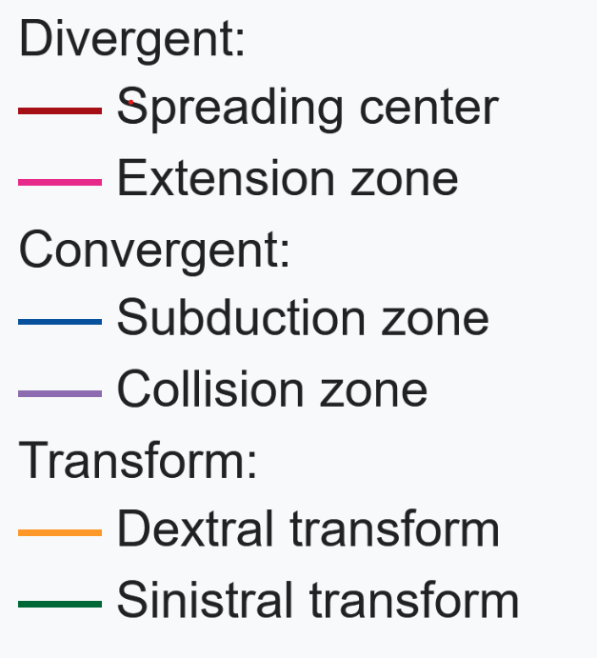
Notes:
Can a plate be composed of both continental and oceanic crust? Yes.

Slide 15
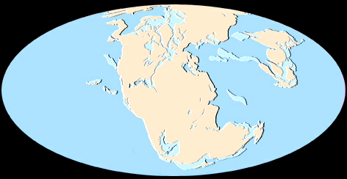

Slide 16
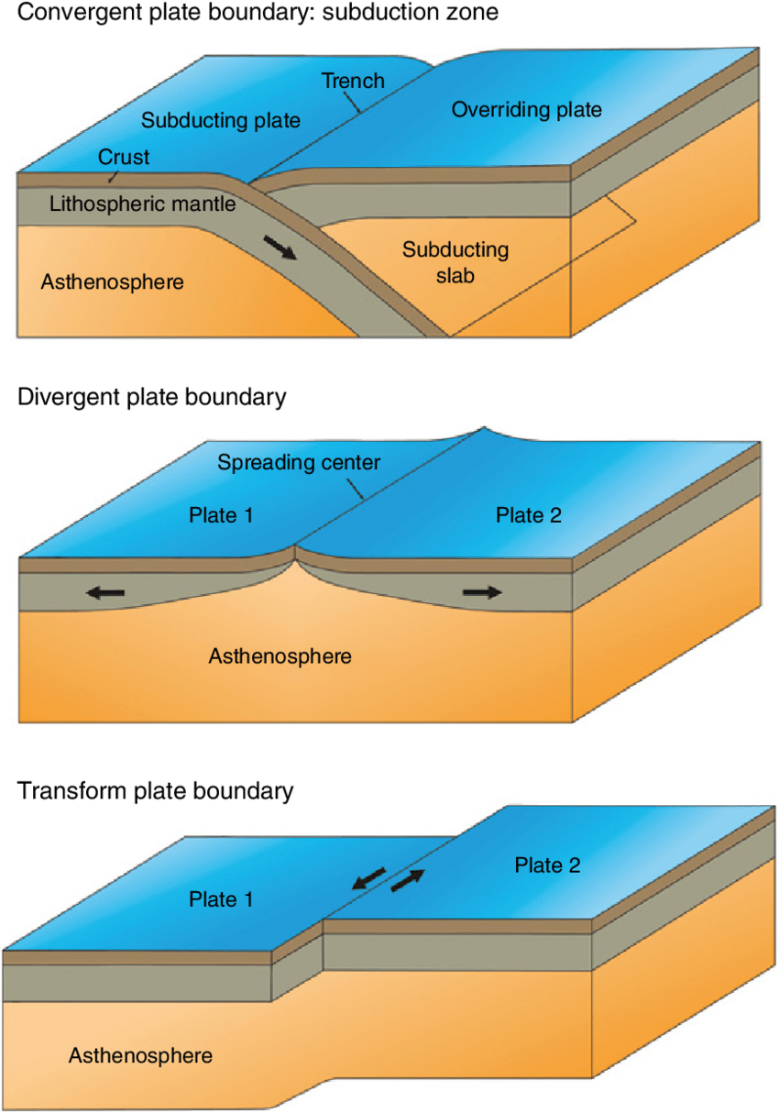
Three general categories of plate boundaries
  Divergent – plates spreading apart, new crust created
  Convergent – plates colliding, crust may potentially be melted through subduction at trench
  Transform – plates rub against each other side to side

Slide 17
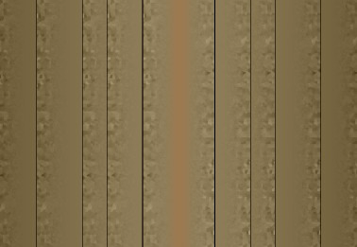
Divergent plate boundary types
All have divergent spreading motion from newly created crust
Mid-ocean ridge (occurs in ocean crust)
Rift valley (occurs in continental crust)
On land, rift valleys can be dry, form large lakes, and if they become big enough they can become seas and eventually oceans

Slide 18
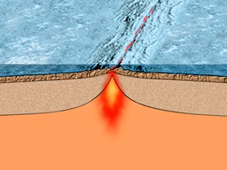
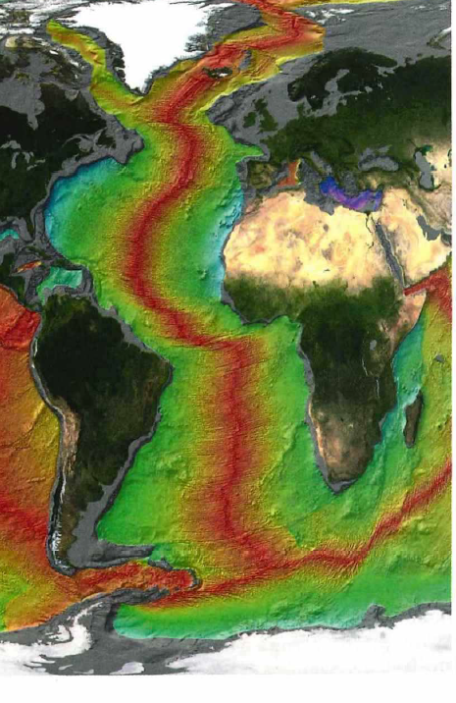
Notes:
Divergent plate boundary, a spreading center at a mid-ocean ridge. New crust is being created along the ridge. The ridge is higher because the rock is hotter and less dense. Rocks shown in red are younger as they have been recently made along spreading center

Slide 19
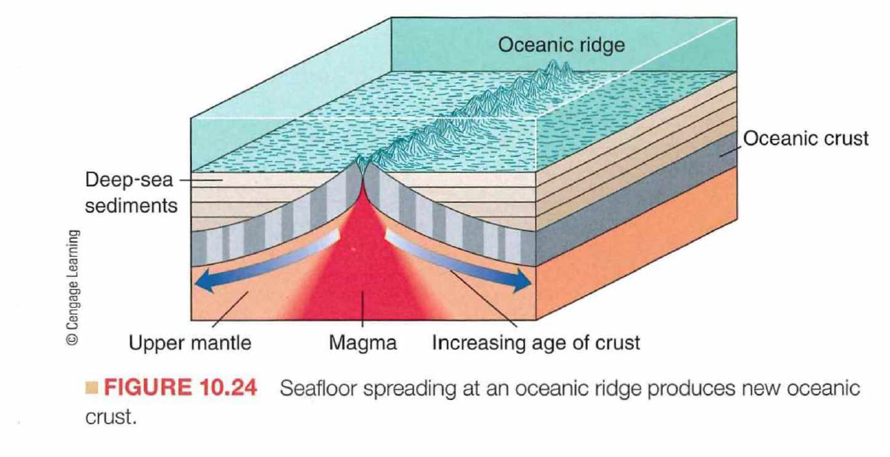

Slide 20
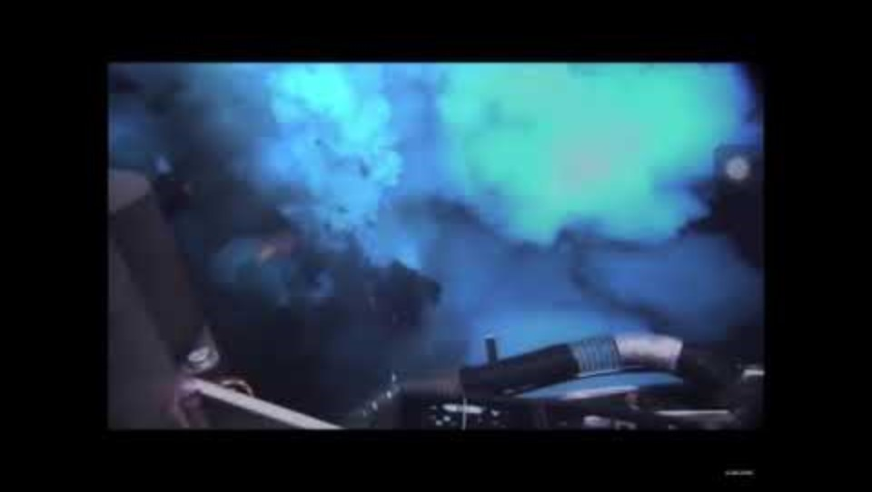
Notes:
Eruption along mid-Atlantic ridge spreading center

Slide 21
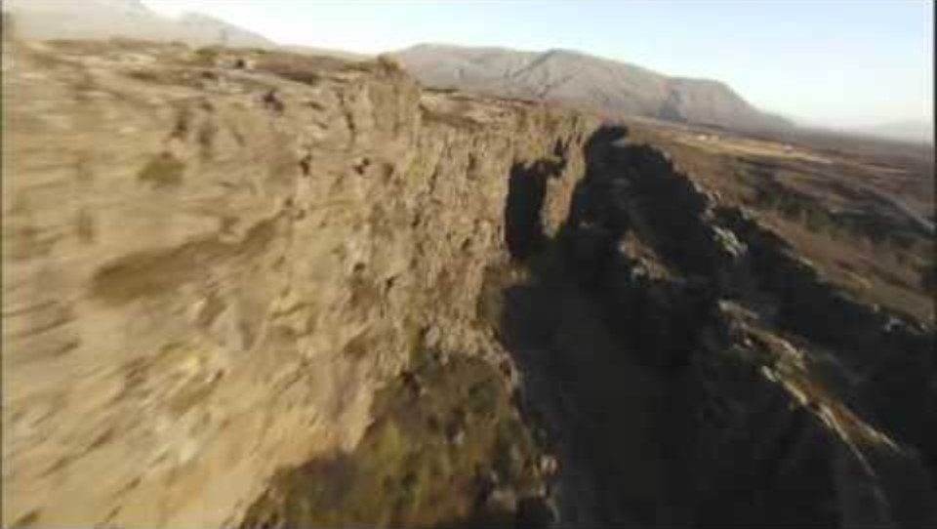
Notes:
Mid-ocean ridge volcanism

Slide 22
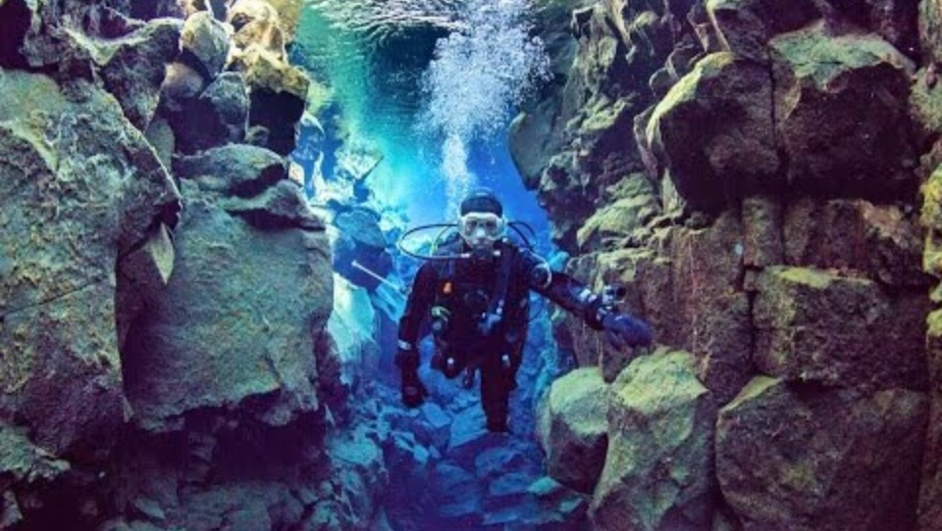

Slide 23
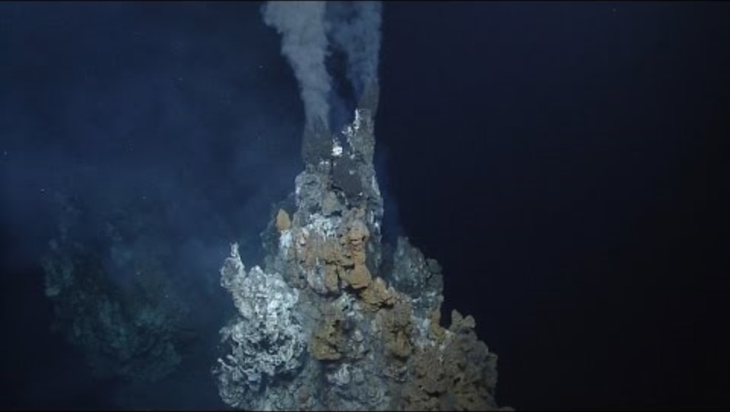
Notes:
https://youtu.be/KtFFmDGIsa4?si=F7LskjdGp5Bei_rW
Black smoker, a hydrothermal vent found near mid-ocean ridges

Slide 24
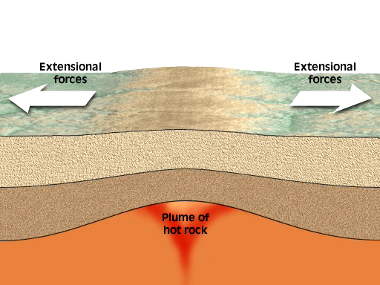
Notes:
Rift valley

Slide 25
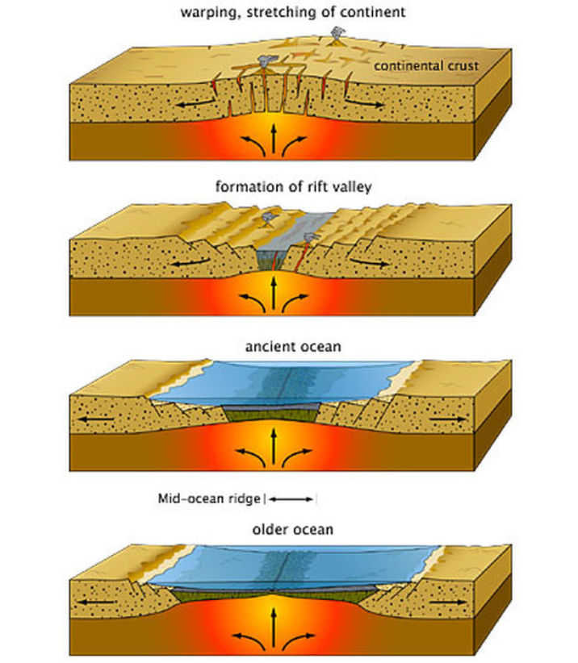

Slide 26
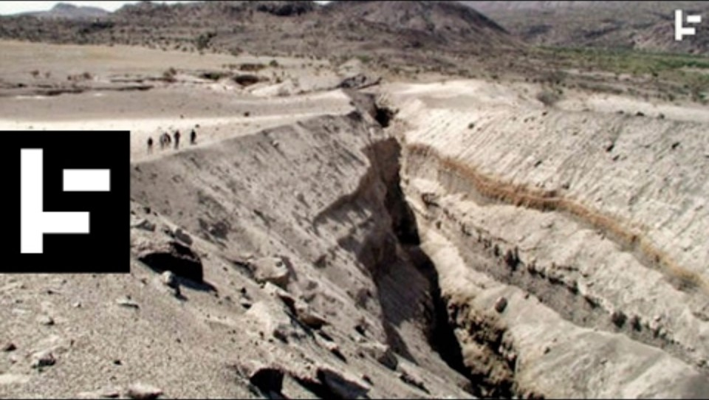
Notes:
East Africa Rift Valley
https://youtu.be/b9FY57z2cXI?si=iZV_ZEzxHvY14go4

Slide 27
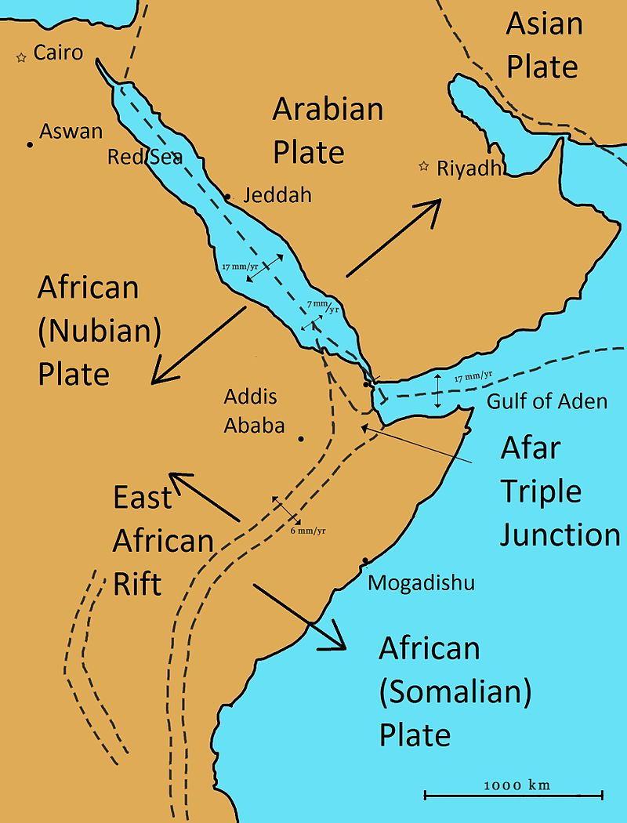
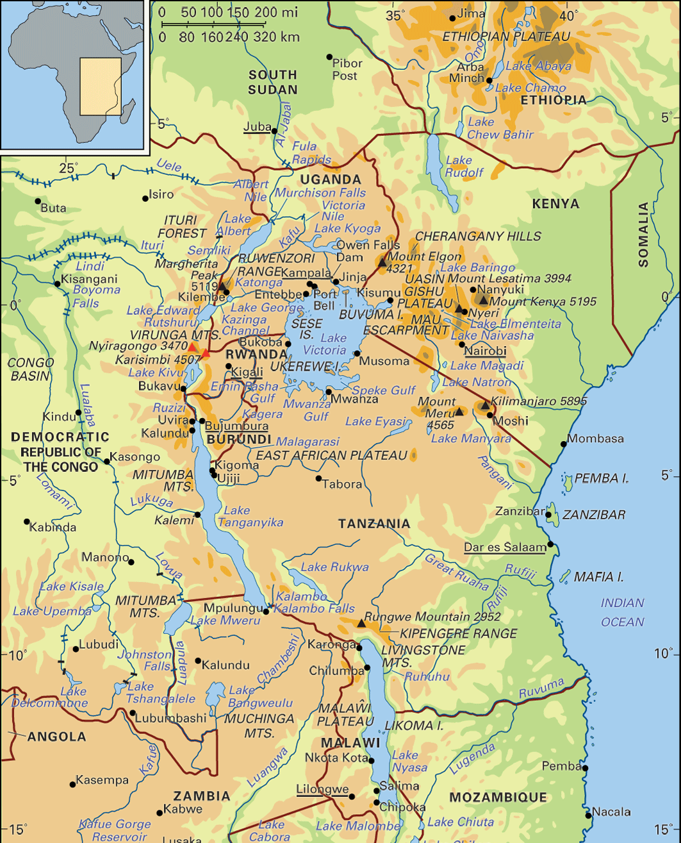
Notes:
Red Sea

Slide 28
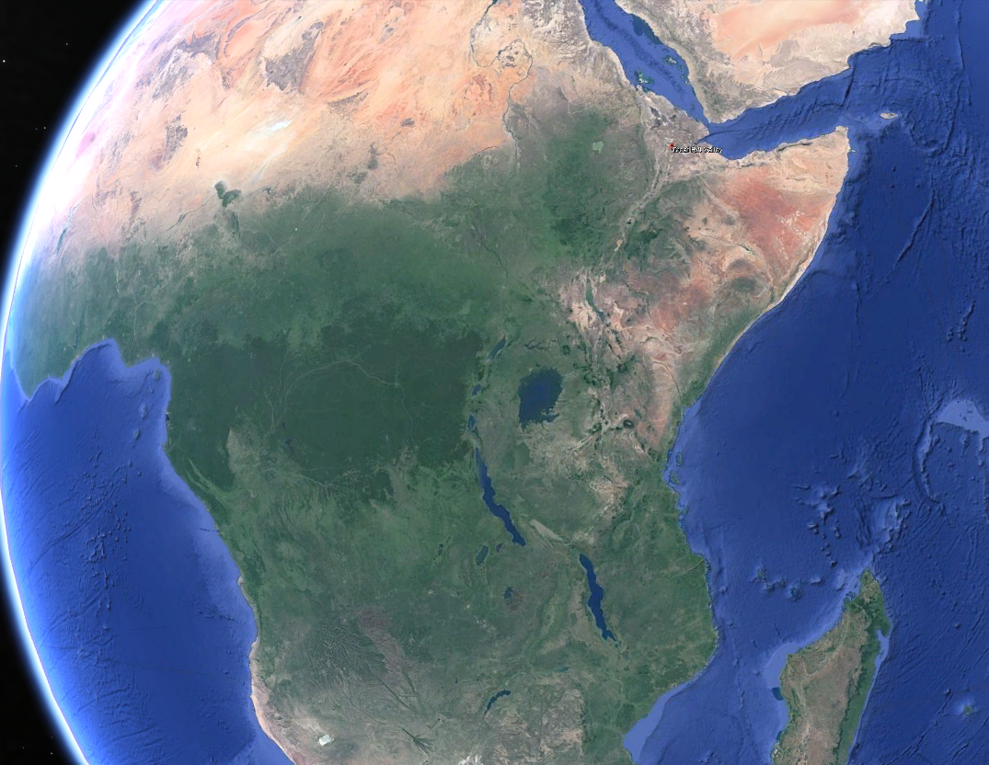
Notes:
The Great Rift Valley of Africa
Lake Victoria: The largest lake in Africa and the second-largest freshwater lake in the world by surface area. It is shared by Tanzania, Uganda, and Kenya.
Lake Tanganyika: The second deepest and second-largest freshwater lake by volume in the world. It lies between Tanzania, the Democratic Republic of Congo (DRC), Burundi, and Zambia.
Lake Malawi: The third-largest lake in Africa and the ninth-largest in the world by area. It is located between Malawi, Mozambique, and Tanzania.

Slide 29
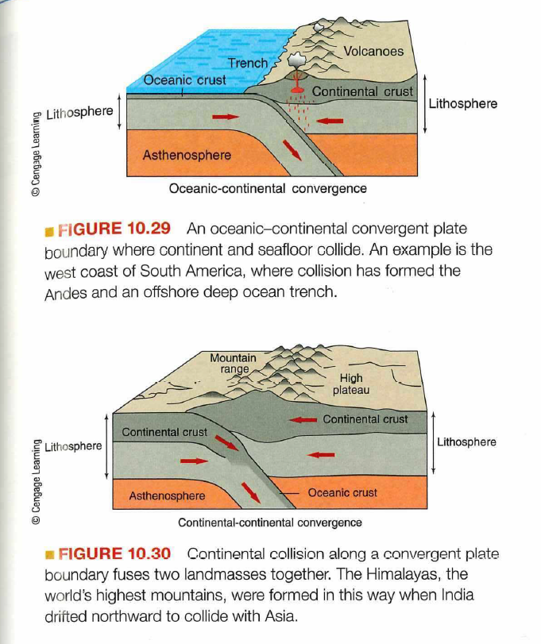
Convergent plate boundary types
Ocean-continent
  Oceanic crust is subducted under continental crust to form volcanic arcs (Cascade Mts, Andes Mts)
Ocean-ocean
  Oceanic crust is subducted under continental crust to form island arcs (Aleutian Islands, Japanese Archipelago)
Continent-continent
  Continental crust collides with continental crust
  Form collisional mountain ranges like Himalayas
  Little subduction: lighter density granitic continental crust not readily subducted
  Little volcanic activity

Slide 30
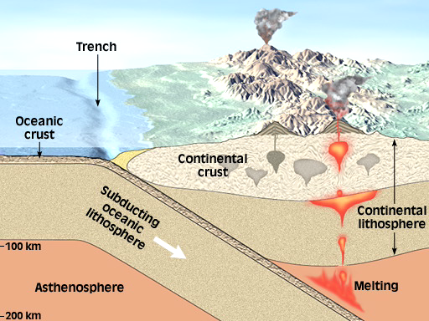
Ocean-continent convergent boundary and the formation of a volcanic arc
Notes:
Convergent plate boundary: oceanic crust colliding with continental crust. Ocean crust is denser and sinks underneath the continental crust, where heat and pressure will melt it. The magma can rise to the surface and form a continental volcanic arc.. The Cascade Mountains of the Pacific Northwest are a good example of this kind of a mountain chain
This volcanism adds material to the continent to offset that lost by erosion.

Slide 31
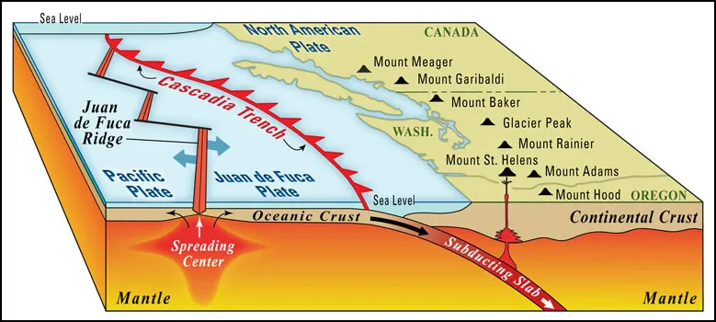
Ocean-continent convergent boundary and the formation of a volcanic arc
Notes:
The Cascades and the Andes are volcanic arcs that form at continental-ocean crust convergent plate boundaries
Above (Cascade Mountains)

Slide 32
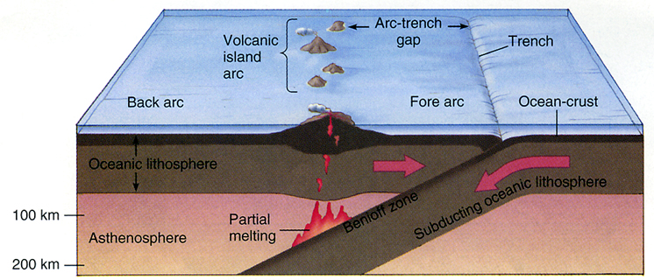
Ocean-ocean convergent boundary and the formation of
an island arc
Notes:
Ocean-ocean crust convergent boundary. Oceanic crust is subducted underneath oceanic crust

Slide 33
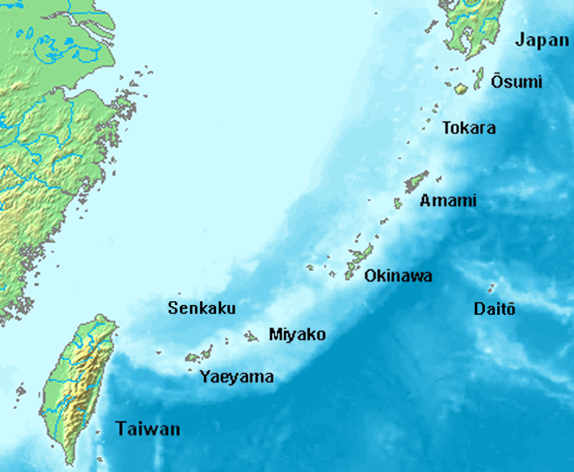
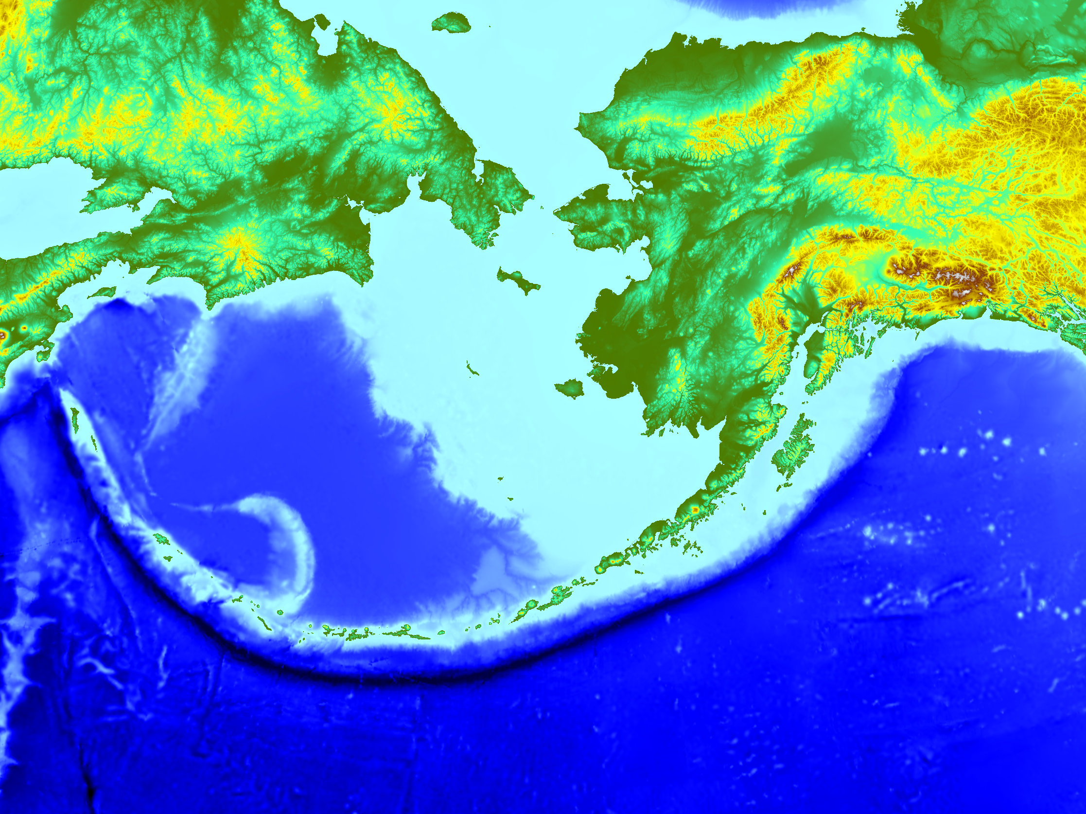
Ocean-ocean convergent boundary and the formation of
an island arc
Notes:
Japan arc and the Aleutian arc are island arcs formed from a convergent plate boundary where oceanic crust is subducted under oceanic crust.

Slide 34
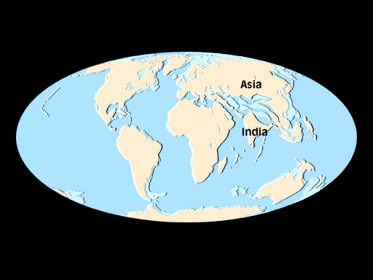

Slide 35
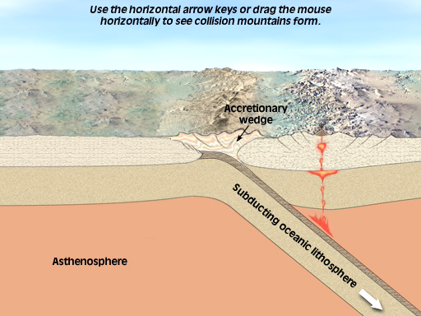
Continent-continent convergent boundary and the formation of
a collisional mountain range
Notes:
Convergent plate boundary: continental crust colliding with continental crust
The Himalayas are a good example of this type of plate boundary and collision type. We can this type of mountain range a collisional mountain range
Little to no subduction and volcanic activity with collisional mountain ranges. Much more sedimentary rock that has been piled and pushed up form the mountains. Volcanic arcs and island arcs will have far more igneous rock material and may even still be volcanically active

Slide 36
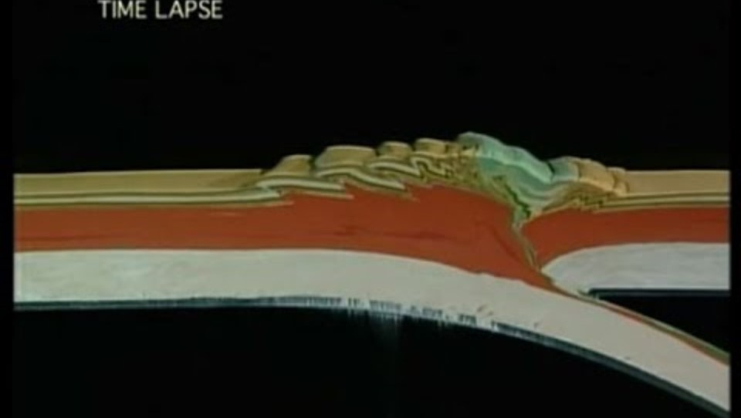
Continent-continent convergent boundary and the formation of
a collisional mountain range
Notes:
https://youtu.be/d9bKXY0OMxc?si=jYV56CS0CeoOA67z
Start at 0:53

Slide 37
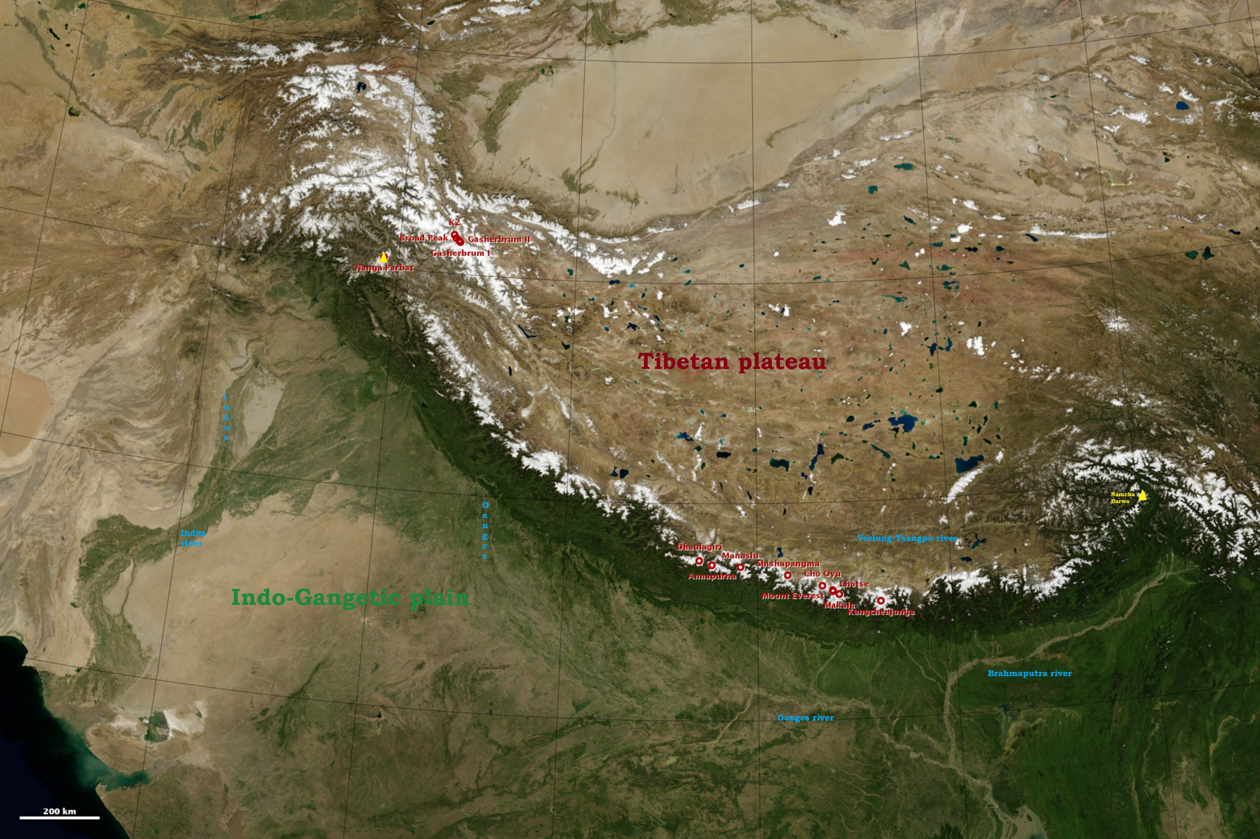
Continent-continent convergent boundary and the formation of
a collisional mountain range
Notes:
Himalayans, a collisional mountain range

Slide 38
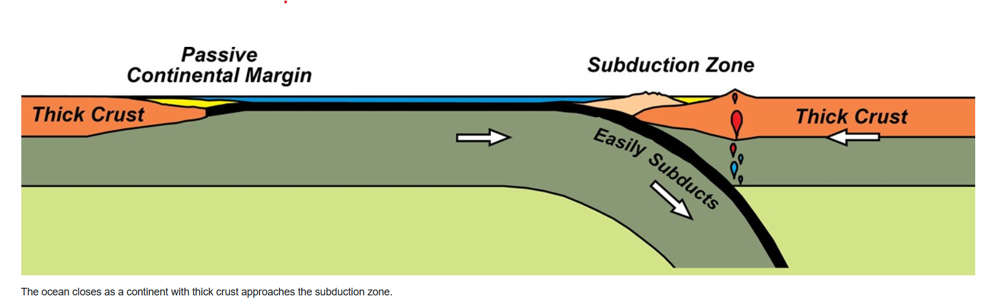
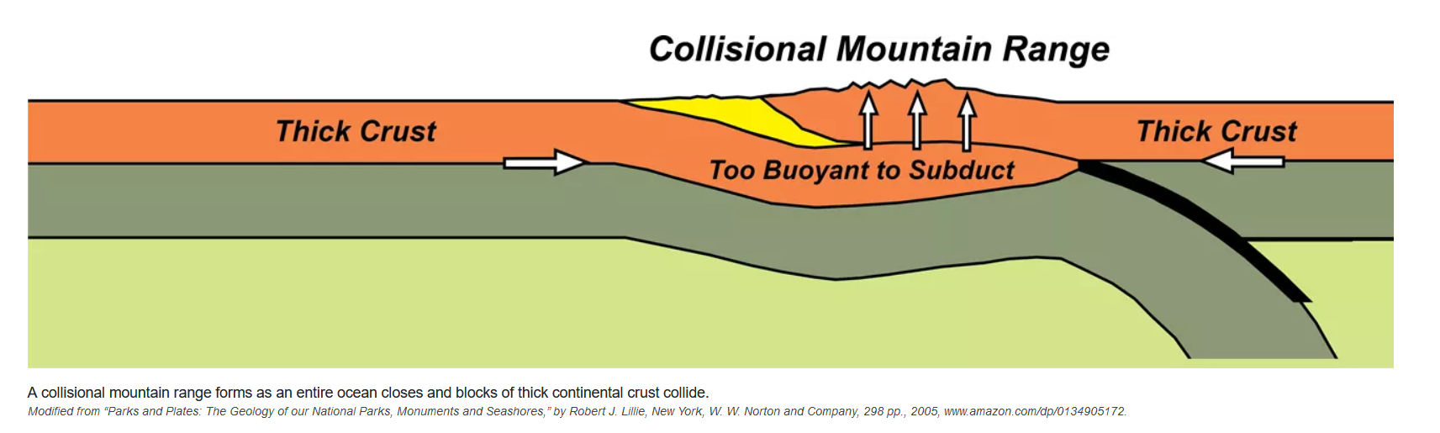
Notes:
Continent-continent convergent boundary and the formation of a collisional mountain range

Slide 39
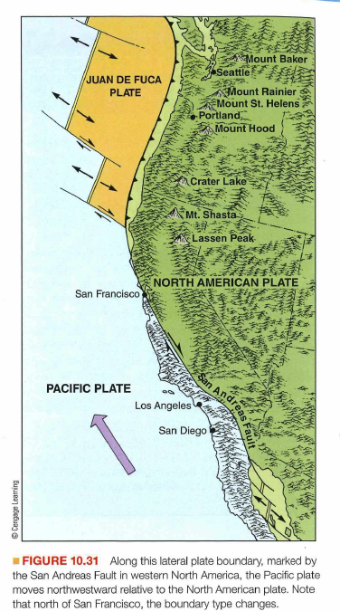
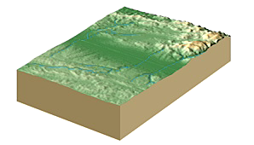
Transform plate boundaries

Slide 40
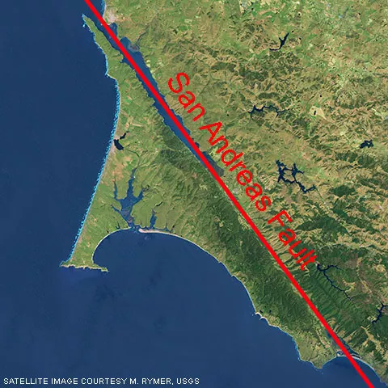
Notes:
San Andreas fault

Slide 41
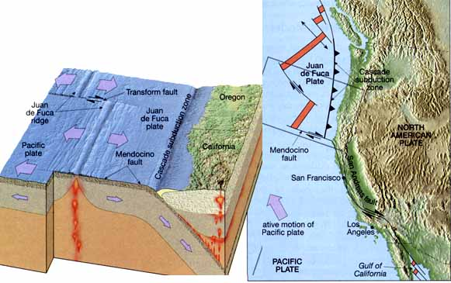
Pacific coast of North America
Convergent plate motion and subduction is active along the coasts of northern California, Oregon and Washington
Sierra Nevada Mts, to the south, have strike-slip motion and no present day subduction

Slide 42
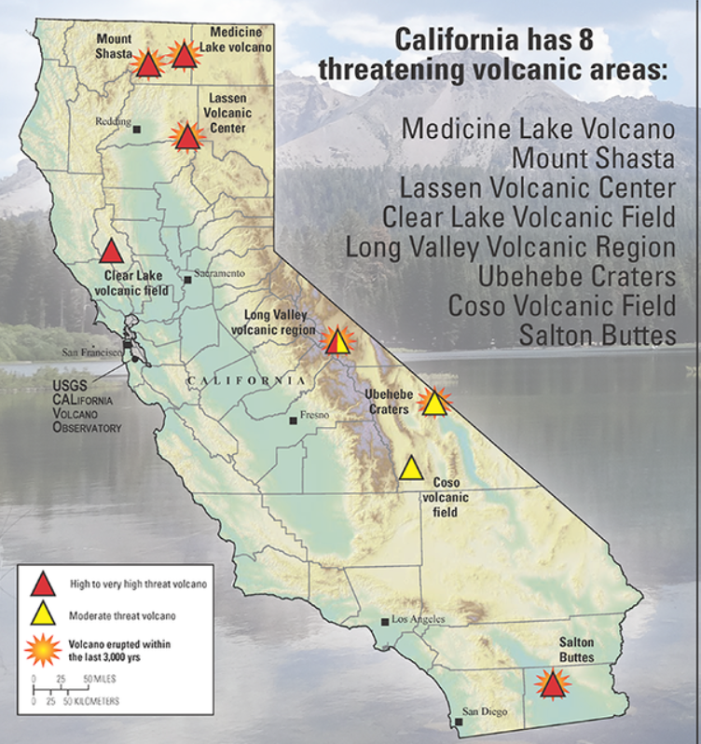
A volcanic eruption in Los Angeles?
You will not have volcanic eruptions in Los Angeles because there is no longer active subduction
However there are areas outside of Los Angeles that still have volcanic features that occasionally vent but would not destroy Los Angeles
Notes:
https://www.usgs.gov/news/new-report-details-whats-harms-way-near-californias-volcanoes
Salton Buttes volcanic activity is formed from divergent plate motion associated with spreading center along Gulf of California
https://www.nasa.gov/image-article/salton-trough/

Slide 43
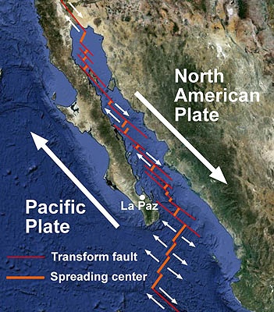
Notes:
Parts of the San Andreas Fault system have a divergent motion due to underlying volcanic activity. This is what leads to the volcanism and Salton Butte.
https://www.mbari.org/news/the-geologic-setting-of-the-gulf-of-california/

Slide 44
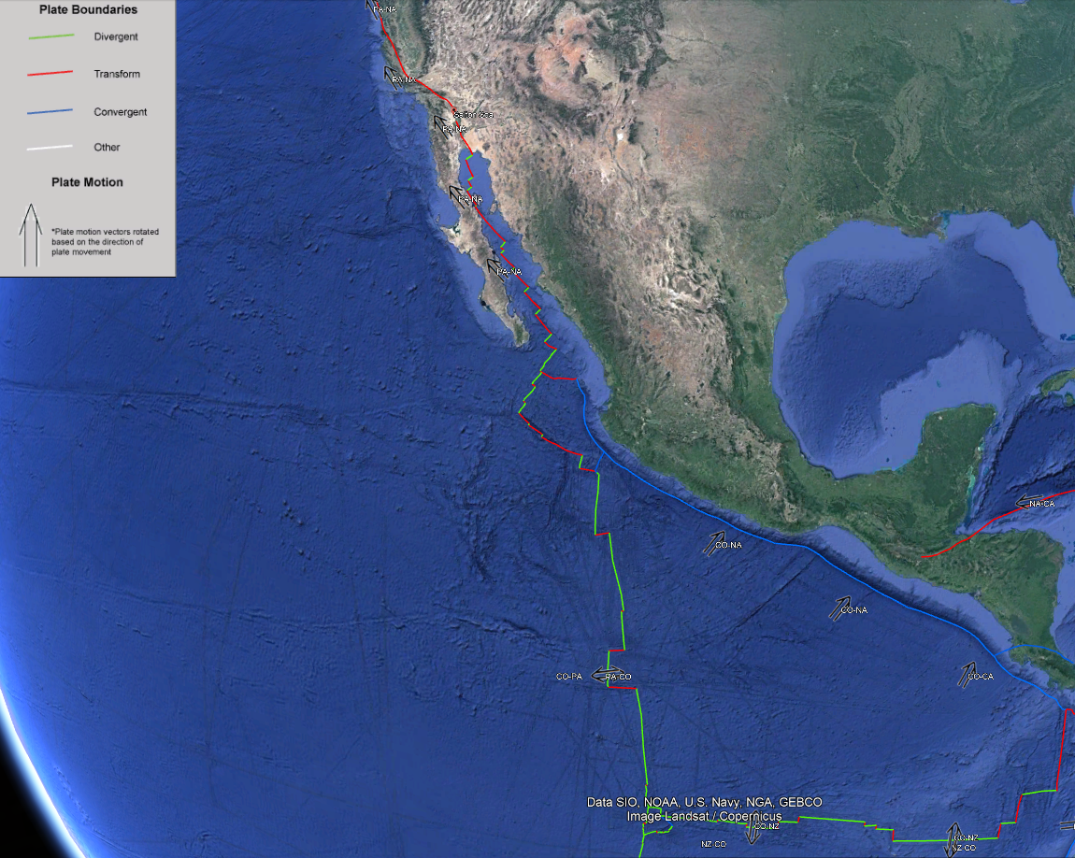
Notes:
The Salton Sea and the Salton Buttes are located within a unique tectonic transition zone between the divergent tectonics of parts of the Cocos Plate and the transform tectonics along the San Andreas fault system of the Pacific Plate

Slide 45
Pacific coast of North America
Has all three plate boundary types in close proximity
  Spreading centers (divergent boundary)
  Subduction zone (convergent boundary)
  Oceanic transform faults (transform boundary)
  Spreading centers vary in their rate of spread
  This creates transform faults between different parts of the newly created sea floor
  Continental transform faults (transform boundary) as exemplified by the San Andrea fault

Slide 46

Mechanisms of plate motion
Energy released from radioactive decay and high pressures melts rock to form convective currents in molten interior of Earth
  Mantle drag-convection currents drag plates along
  Slab pull-weight of subducted plate pulls rest of plate along
  Ridge push-creation of new crust pushes older crust

Slide 47


Slide 48


Slide 49
Hot spots
Plumes of magma that rise up through the middle of oceanic or continental crust
Not located near a divergent plate boundary and a spreading center
Plates move over a mantle plume, the source of the magma
Motion of plate creates an island chain in the ocean, as seen in the Hawaiian Islands
Hotspots can form under continental crust too, as exemplified in Yellowstone National Park

Slide 50


Slide 51

Notes:
Iceland is a hotspot and is also located along a spreading mid-ocean ridge.
Iceland sits on a volcanic hotspot known as the Iceland Plume. This hotspot is a mantle plume, which is an upwelling of abnormally hot rock within the Earth's mantle. As the plume rises towards the surface, it causes extensive volcanic activity, leading to the formation of Iceland itself. The hotspot is responsible for the high volcanic activity seen in Iceland, with numerous active volcanoes.
Iceland is also located at the boundary between the North American and Eurasian tectonic plates, which are diverging. The Mid-Atlantic Ridge, a divergent boundary, runs through Iceland, where the plates are pulling apart. This spreading causes the seafloor to spread and creates new crust as magma rises to the surface, forming new oceanic crust. In Iceland, the ridge is above sea level, making it one of the few places in the world where you can observe this geological process on land. The Þingvellir National Park is a famous location where the rift between these tectonic plates is visible.
The combination of the volcanic hotspot and the divergent plate boundary makes Iceland one of the most geologically active places on Earth.

