Slide 1
Climate
Climate is the statistical summary of atmospheric variables over an extended period of time, typically several decades.
Precipitation, temperature are the most commonly used variables

Slide 2
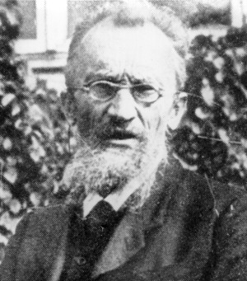
Köppen climate classification system
There are many different climate classification systems.
They are often named after their inventor and modified by others.
We are learning the Köppen classification system.

Slide 3
Notes:
Note: climate systems and the maps made from them are models, idealized representations of reality.
Are climate boundaries sharp? No, not as sharply shown in the map
Ecotones are gradual transition zone between biomes. This is more characteristic of the boundaries between climate types.
Are there locations in Cfa that are more like a D? Yes, high in the Appalachian Mountains.

Slide 5
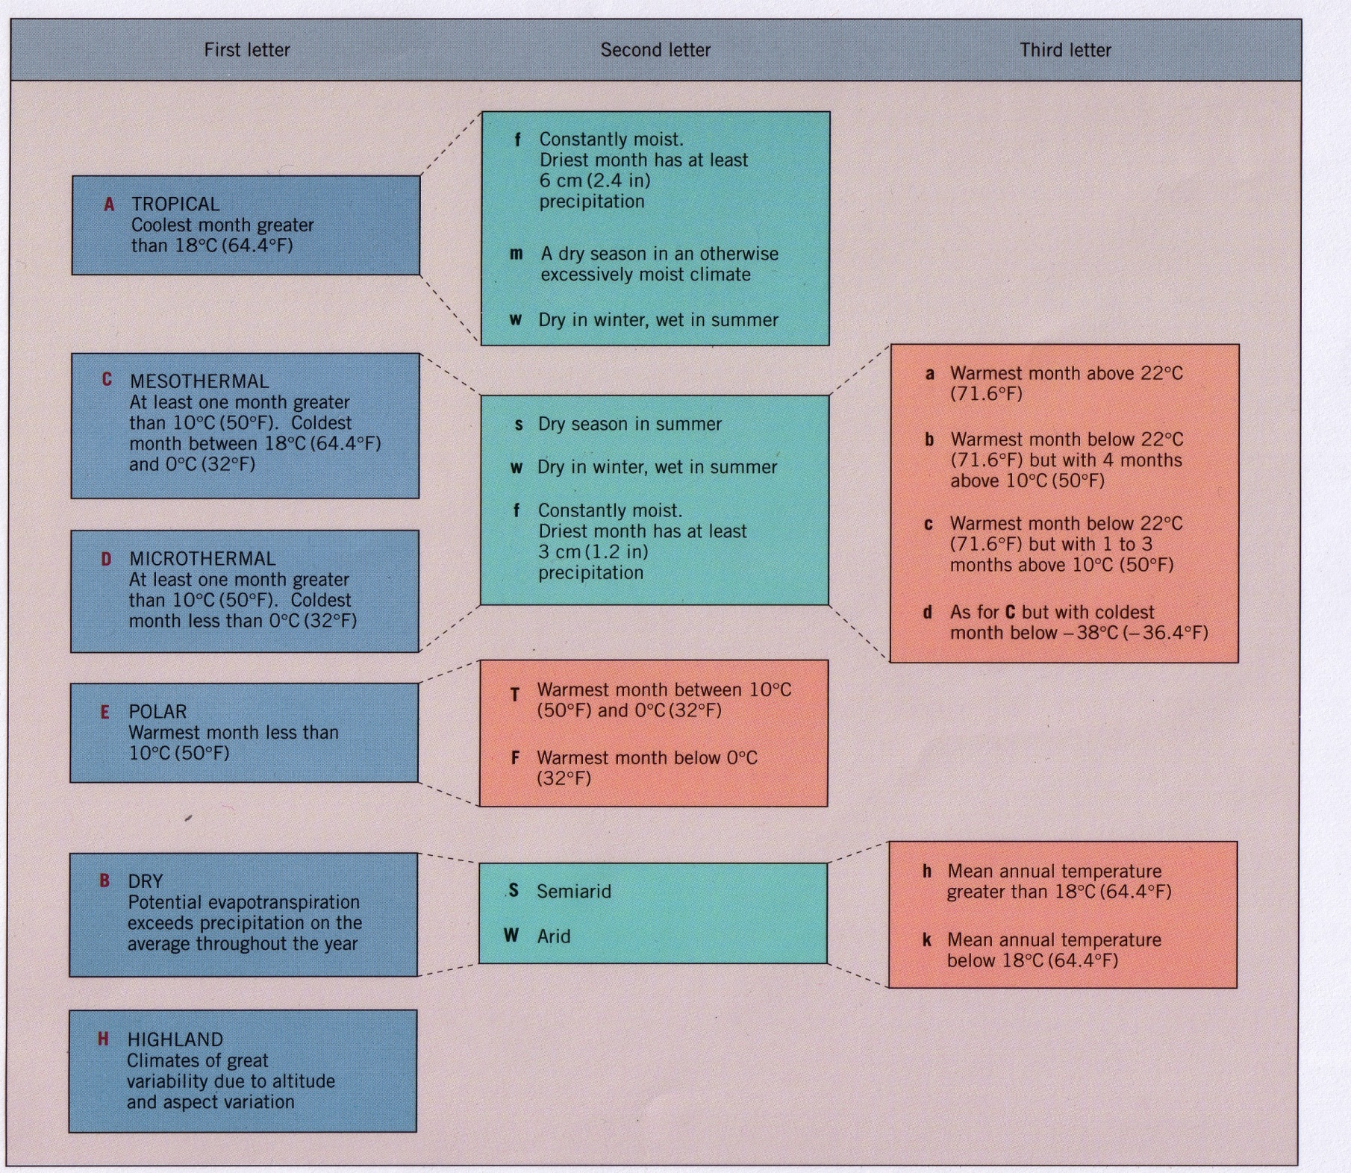
Notes:
And you don’t have to learn them quantitatively – just qualitatively.

Slide 6
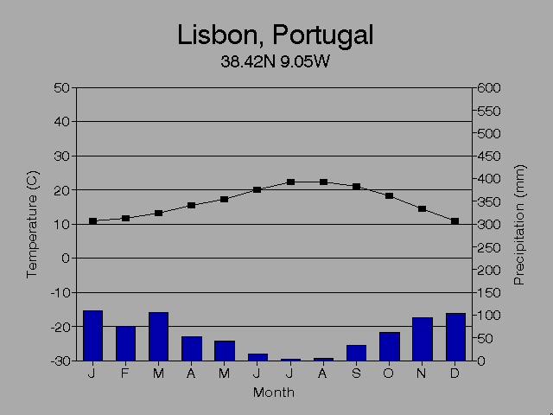
Climographs
Show averaged monthly values of temperature and precipitation
Temp is a continuous property. Precip is discrete and totaled by month.
Notes:
Continuous means that the property measured is always there. There is always temperature. Thus we use a line to represent temperature. However, precipitation is discrete. It is not always present. Thus we use bar charts to represent rainfall.

Slide 7
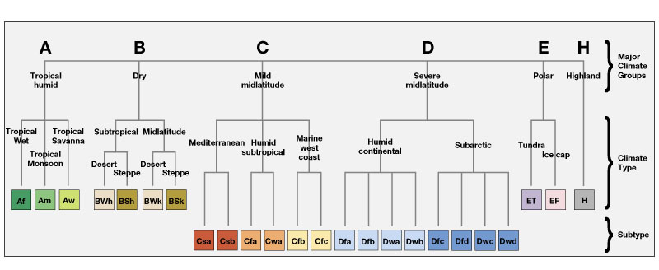
Tropical
humid
Dry
Midlatitude cool winter
or
Mesothermal
Midlatitude cold winter
or
Microthermal
Polar
Mt
For this lecture, you need to know only these Koppen climate types: Af, Am, Aw, BWh, BWk, BS, Cfa, Cs, Cfb, D, ET, EF, H

Slide 8
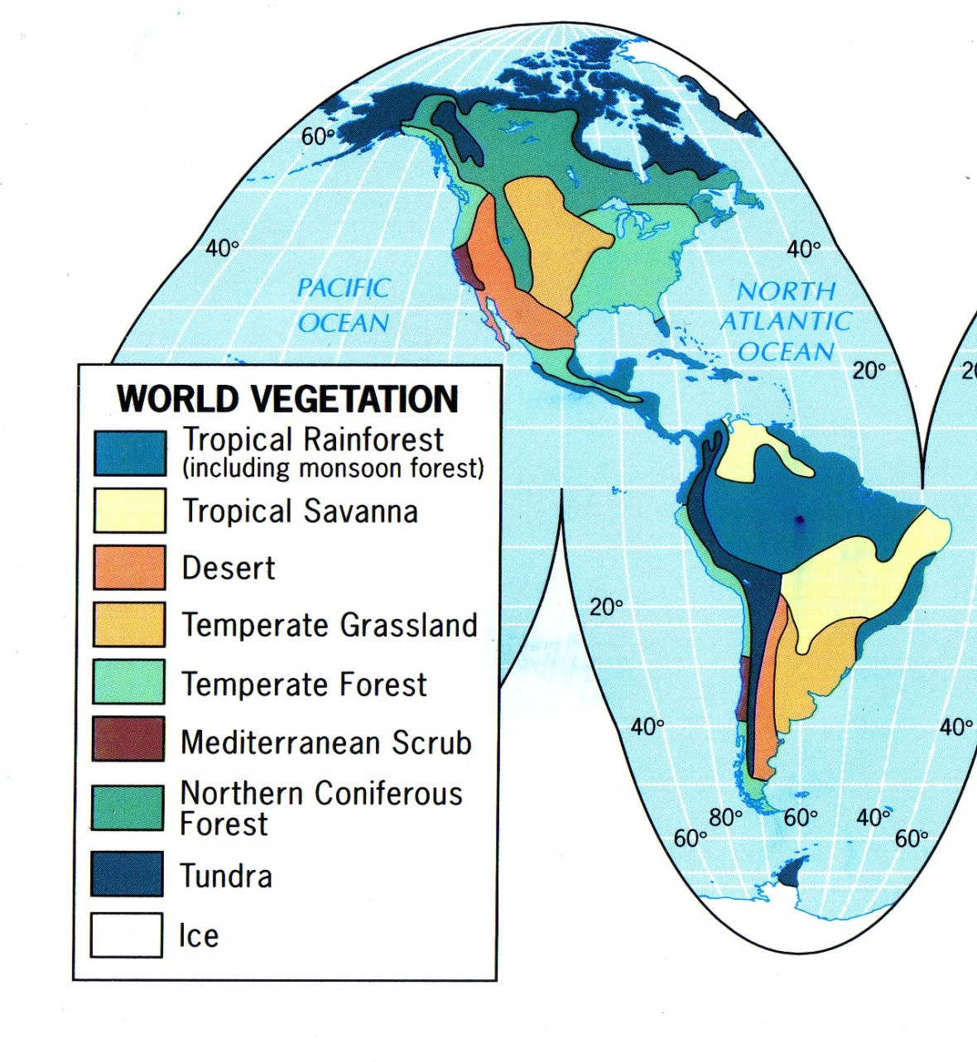
Biomes
Biomes-a distinctive assemblage of plants that forms a regional ecological unit in response to climate

Slide 9
Controls on climate and biomes
Latitude
Position relative to global pressure cells (chiefly, the ITCZ, STHP, midlatitude cyclones)
Location relative to large areas of land and bodies of water (known as continentality and the maritime effect)
Elevation
Rainshadow effect (dry and wet side of mountain ranges)
Ocean currents
Warm currents: east coast of continents: warm and more humid
Cold currents: west coasts of continents: milder and drier

Slide 10
Climate shapes vegetation by influencing:
Temperature and water availability
Rates of photosynthesis and respiration
Photosynthesis: production and storage of carbohydrates
CO₂ + H₂O + energy (from sunlight) yields C₆H₁₂O₆ + O₂
Respiration: breakdown of carbohydrates for energy
C₆H₁₂O₆ + 6 O₂ yields CO₂ + 6 H₂O + energy
Transpiration
Phenology
Leaf growth form

Slide 11
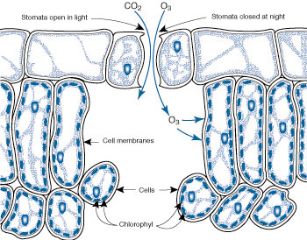
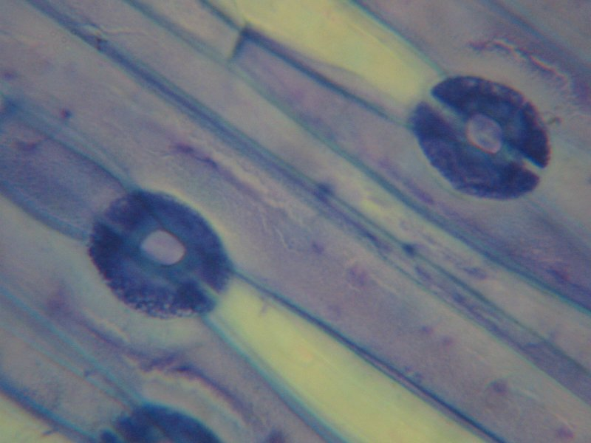
Transpiration
Stomates are openings into interior of leaves through which gas exchange and transpiration occur
Transpiration is the evaporative water loss from plants during gas exchange

Slide 12
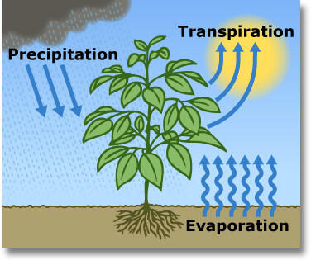
Transpiration
Transpiration helps draw up water into the plant through the roots
Transpiration serves as a cooling mechanism for plants when water evaporates
Water stress can result if too much water is lost through transpiration

Slide 13
Phenology
The timing of plant physiological changes with changes in temp, water availability. Follows the march of the seasons
Leaf abscission occurs in response to decreasing rates of photosynthesis as temperatures decline or when rainfall becomes scarce
Winter deciduous
Drought deciduous
Evergreen: leaf retention in response to conditions that make it advantageous to hold on to leaves and their nutrients

Slide 14
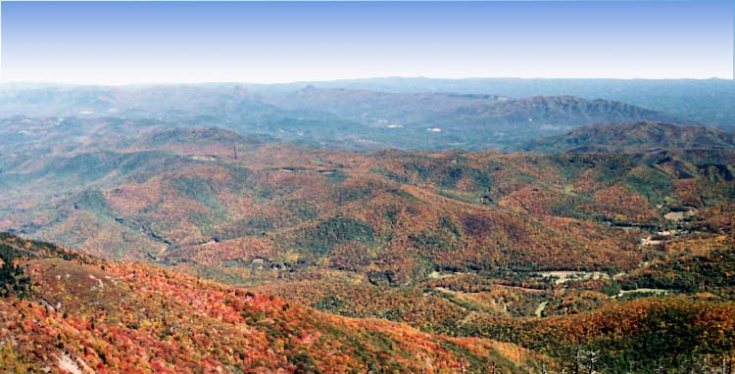
Winter deciduous

Slide 15
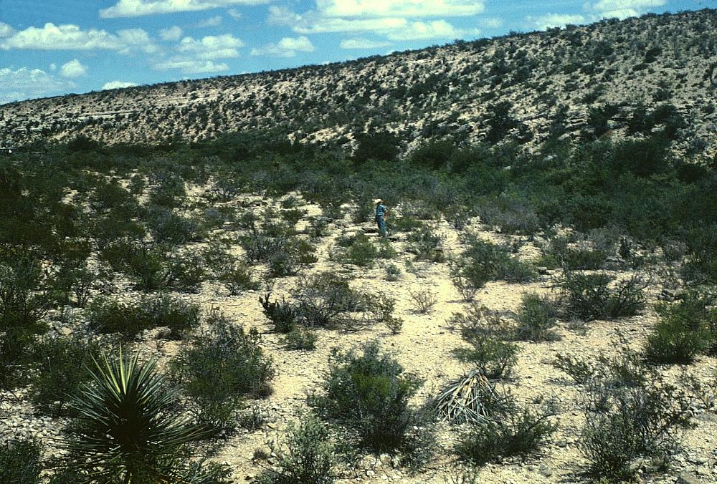
Drought deciduous
Notes:
Creosote bush in Chihuahua Desert

Slide 16
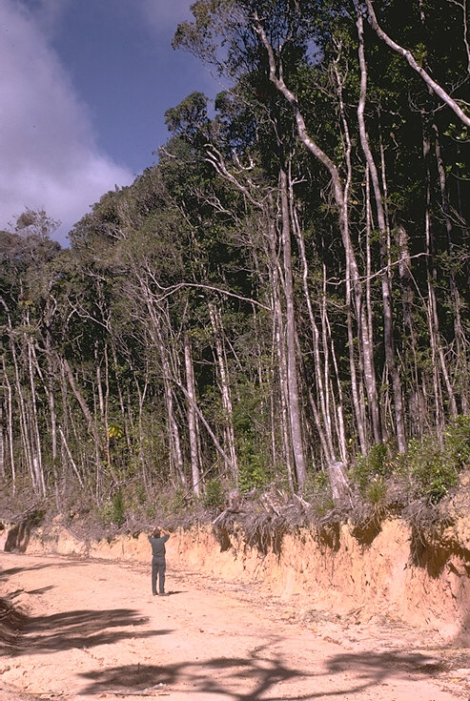
Evergreen vegetation
Adaptive where rainfalls are high and temperatures are warm
Tropics have low nutrient soils because they are highly weathered due to high rainfall and warm temps
Any available nutrients in the soil are rapidly taken up by plants
Evergreenness retains nutrients in living biomass as a mechanisms for avoiding competition among plants for these nutrients in the soil
Notes:
Proximity to volcanic soils determines fertility of many tropical soils

Slide 17
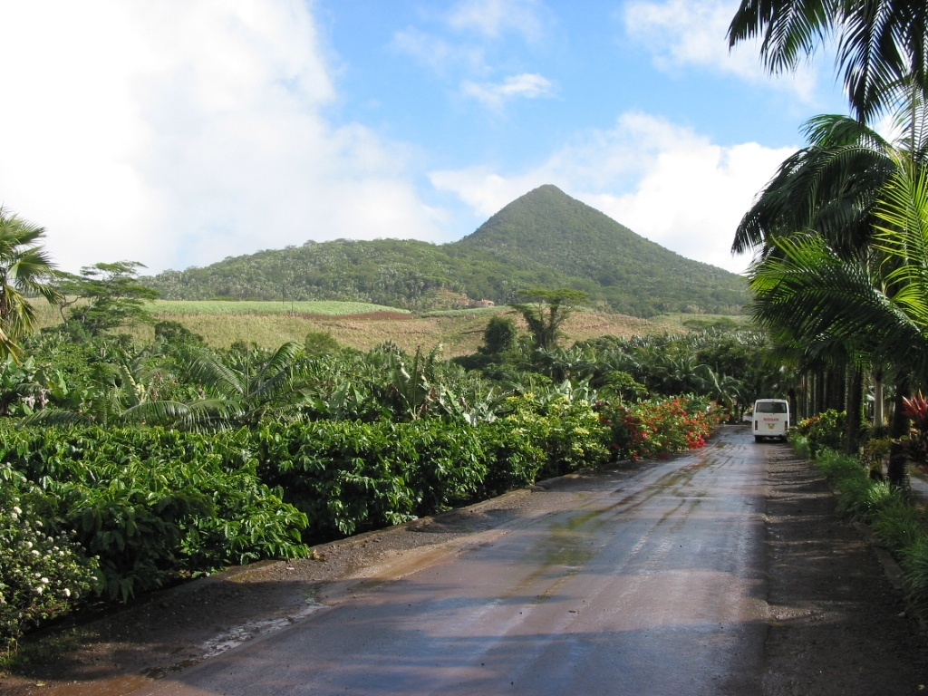
Notes:
Volcanoes in the tropics enhance the soil nutrient content in what would otherwise be nutrients poor soils. These soils in the tropics that are highly weathered and low in nutrients are called oxisols

Slide 18
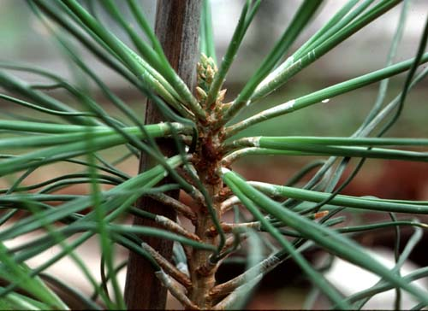
Needle leaf growth forms
Leaves have different growth forms depending upon the climate where they grow
Needle leaf growth forms maintain a low leaf surface area. This is an adaptive shape in dry climates as it prevents exposure of the leaf interior to dry conditions.
Pines are a good example of a needle leaf growth form

Slide 19
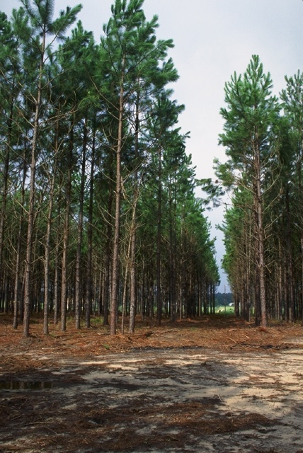
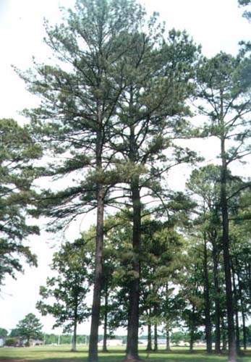
Notes:
Slash pine, left, loblolly pine right. Sandy soils of the Gulf Atlantic Coastal Plain drain rainwater off quickly, so even though there is a lot of rainfall in the southeastern US where these trees grow, dry soil conditions prevail except where soils become richer in clay.

Slide 20
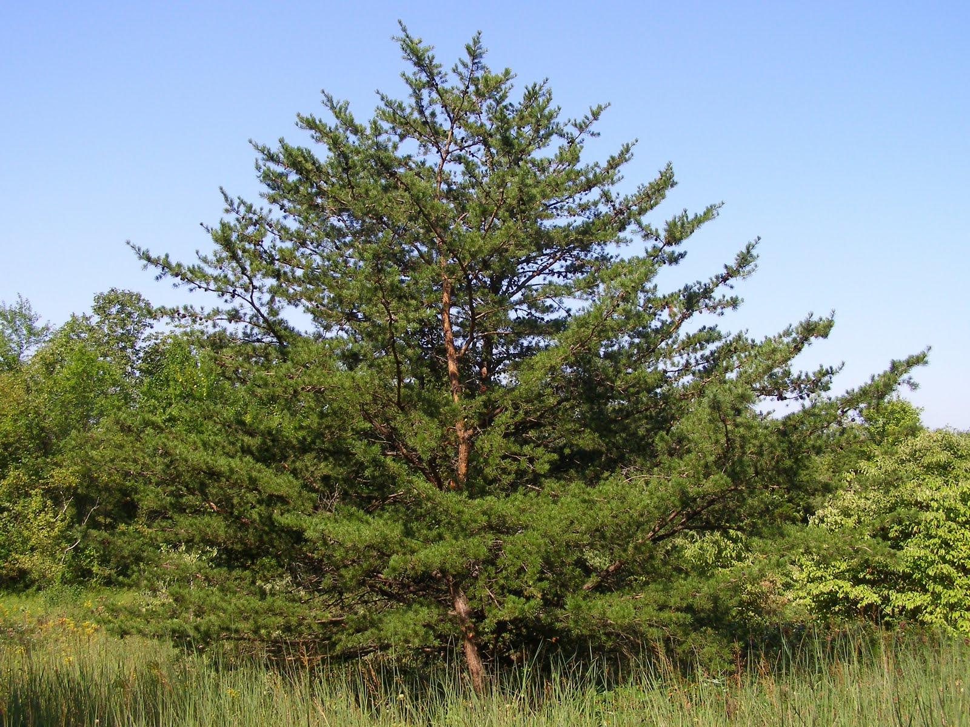
Notes:
Pinus virginiana, Virginia pine, found throughout the southern Appalachian region. It typically occurs on more sandy soils.

Slide 21
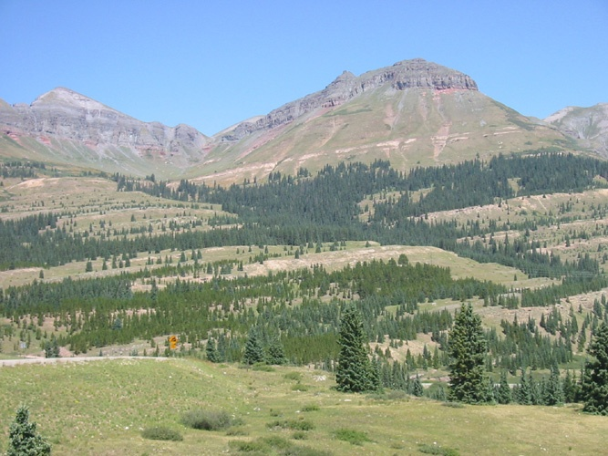
Notes:
Glacier National Park in Montana and fir and spruce needle-leaf trees. This growth form is well-adapted to the dry, windy conditions of the winters here in Montana. The western US is also far drier than the eastern US.

Slide 22
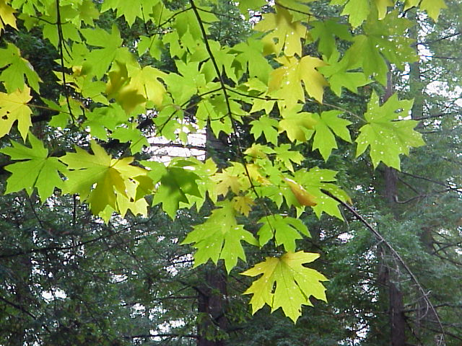
Broad leaf growth forms
Broad leaves are adaptive in environments were rainfall and moisture are abundant
Light (not water) becomes a limiting resource - leaves are large and flat for capturing light
Broad-leaved evergreens are found in the tropics
Broad-leaved deciduous trees include the oaks, maples, and hickories

Slide 23
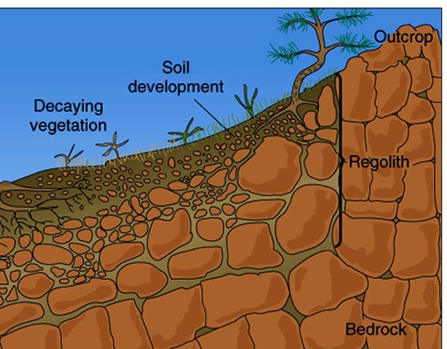
Soil formation
Bedrock undergoes weathering to become smaller pieces of rock called regolith.
Organic matter at surface decomposes through chemical and biological weathering
Invertebrates, burrowing animals, plant roots lead to bioturbation (mixing) and weathering of soil
Decomposed organic matter (humus) combines with regolith to form soil
Soil layers (horizons) form from chemical weathering through time.

Slide 24
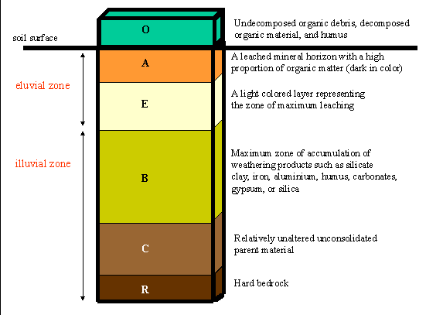
Notes:
O horizon
Organic matter: Litter layer of plant residues in relatively undecomposed form.
A horizon Surface soil: Layer of mineral soil with most organic matter accumulation and soil life.
E horizon
“E” being short for eluviated, this horizon that has been significantly leached of its mineral and/or organic content, leaving a pale layer largely composed of silicates. These are present only in older, well-developed soils, and generally occur between the A and B Horizons
B horizon
Subsoil: Layer of alteration below an "E" or "A" horizon. This layer accumulates iron, clay, aluminum and organic compounds, a process referred to as illuviation.
C horizon
Substratum: Layer of unconsolidated soil parent material. This layer may accumulate the more soluble compounds that bypass the "B" horizon.
R
Bedrock

Slide 25
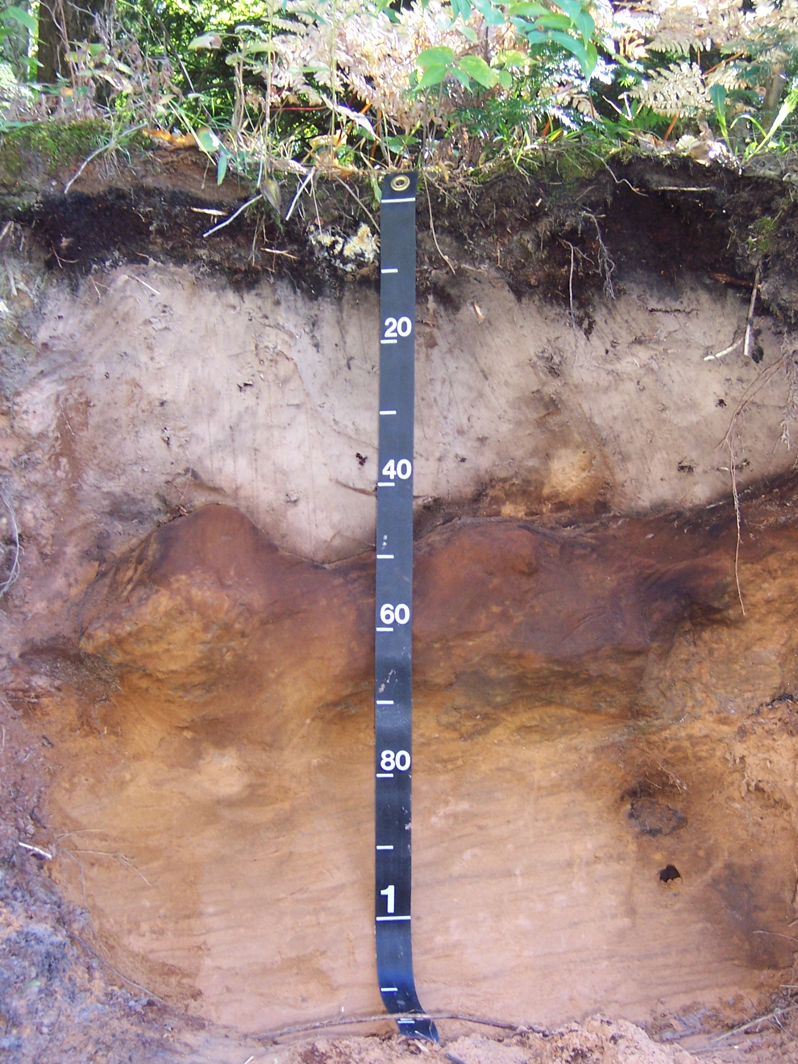
O
A
E
B
C

Slide 26
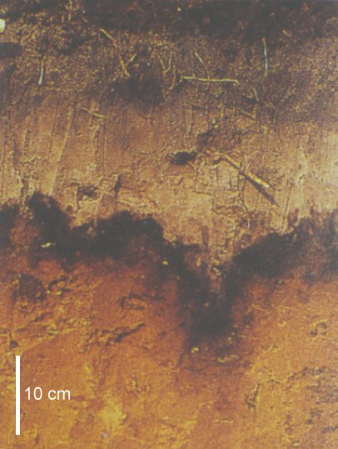
Eluviation and illuviation
Eluvation: zone that is leached, often lighter in color
Illuviation: zone that is enriched with leached materials, may be darker in color

Slide 27
Soil orders
Andisols –soils formed from volcanic ash
Aridisols – desert soils with low organic matter
Entisols – no horizon development, unmodified sand or sediment
Histosols – acidic, highly organic soils typically containing peat
Inceptisols – slightly more horizon development than Entisols
Mollisols – grassland soils; thick, organic A horizon
Oxisols – highly weathered low nutrient tropical soils with iron and aluminum oxides
Ultisols – highly weathered low nutrient soils with more clay than Oxisols

Slide 28
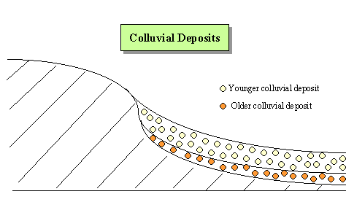
Colluvium
Colluvium is material in a soil profile that has been eroded elsewhere and transported in by gravity, water, or wind.

Slide 29
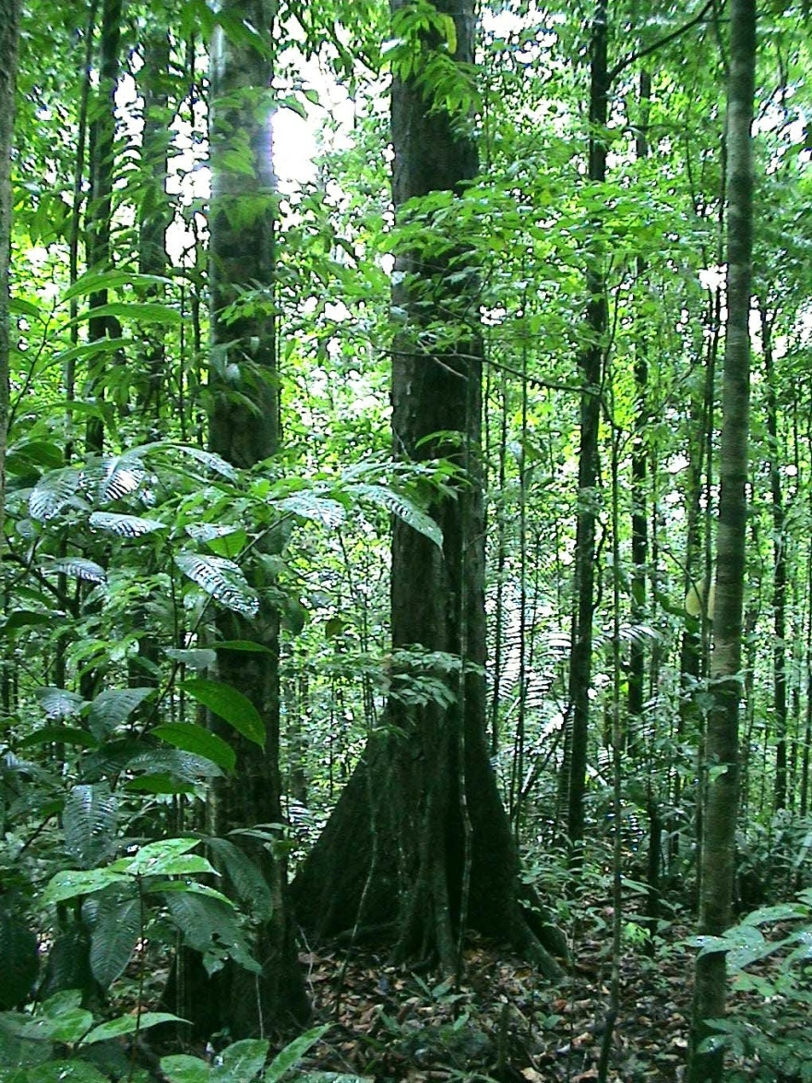
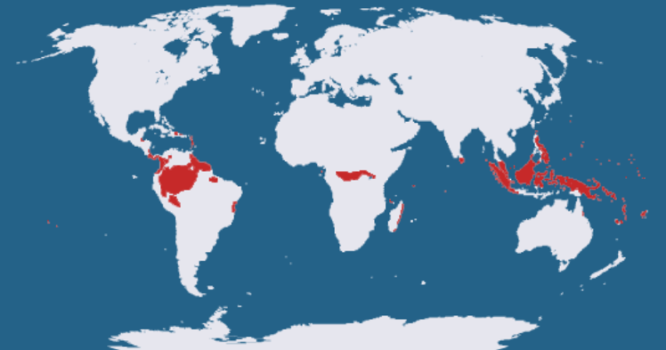
Köppen tropical (A) climates: Af Wet tropical
ITCZ dominant
Warm all year
High precipitation all year
No dry season Broadleaf evergreen rainforest biome
Oxisols
Amazon Basin, Congo Basin, Central American lowlands, Southeast Asia
Notes:
Lo

Slide 30
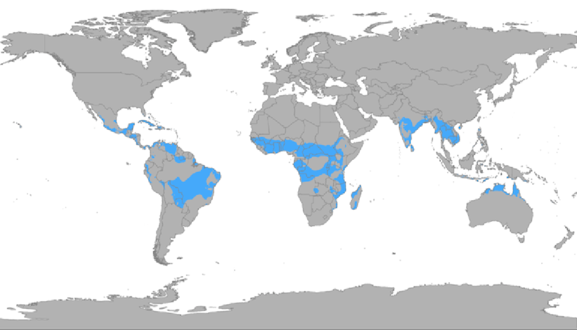
Köppen tropical (A) climates: Aw Tropical wet and dry
Alternating influence of ITCZ and STHP
Pronounced wet and dry seasons
Tropical savanna biome
Grasslands with widely spaced drought-deciduous trees
East Africa, northern Australia, India, South American pampas

Slide 31
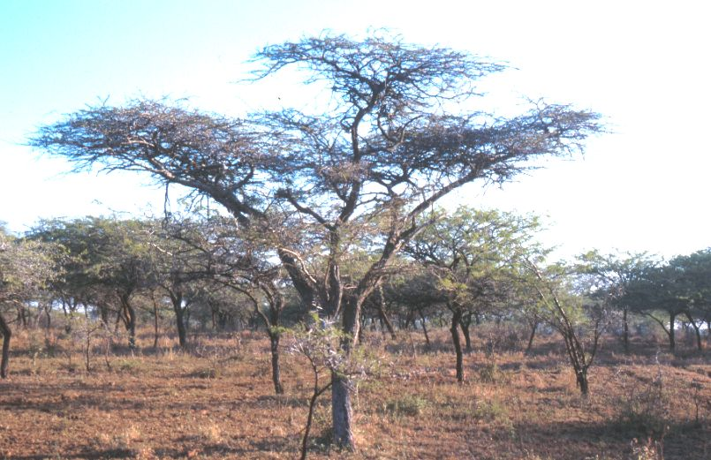

Slide 32
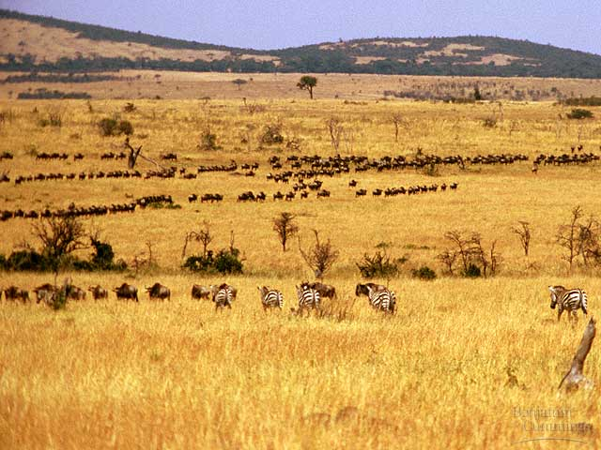

Slide 33
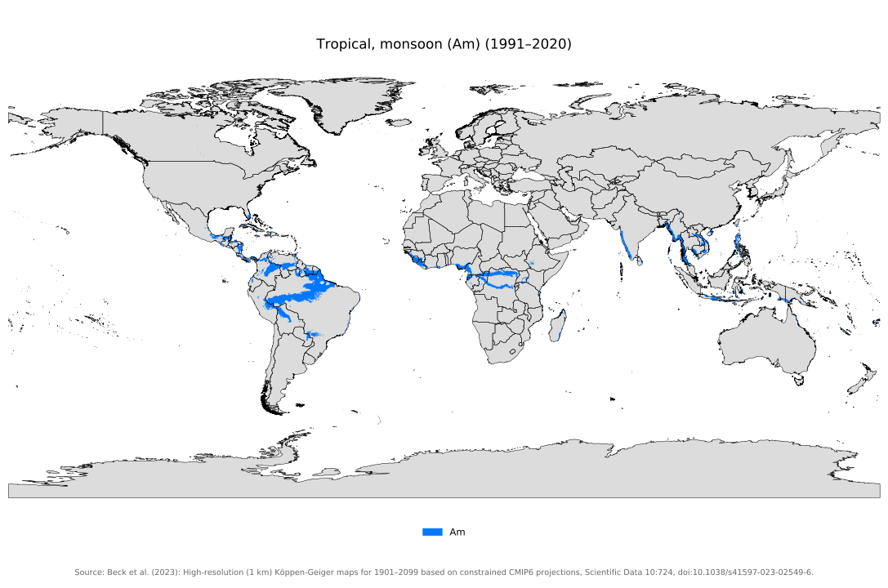
Köppen tropical (A) climates: Am Tropical monsoon
Monsoonal flow is dominant climatic influence
Extremely wet summer and extremely dry winter when compared to Aw
tropical deciduous forest biomess, characterized by a distinct dry season and abundant rainfall during the monsoon season
Coastal India, Southeast Asia, parts of South America and Africa

Slide 34
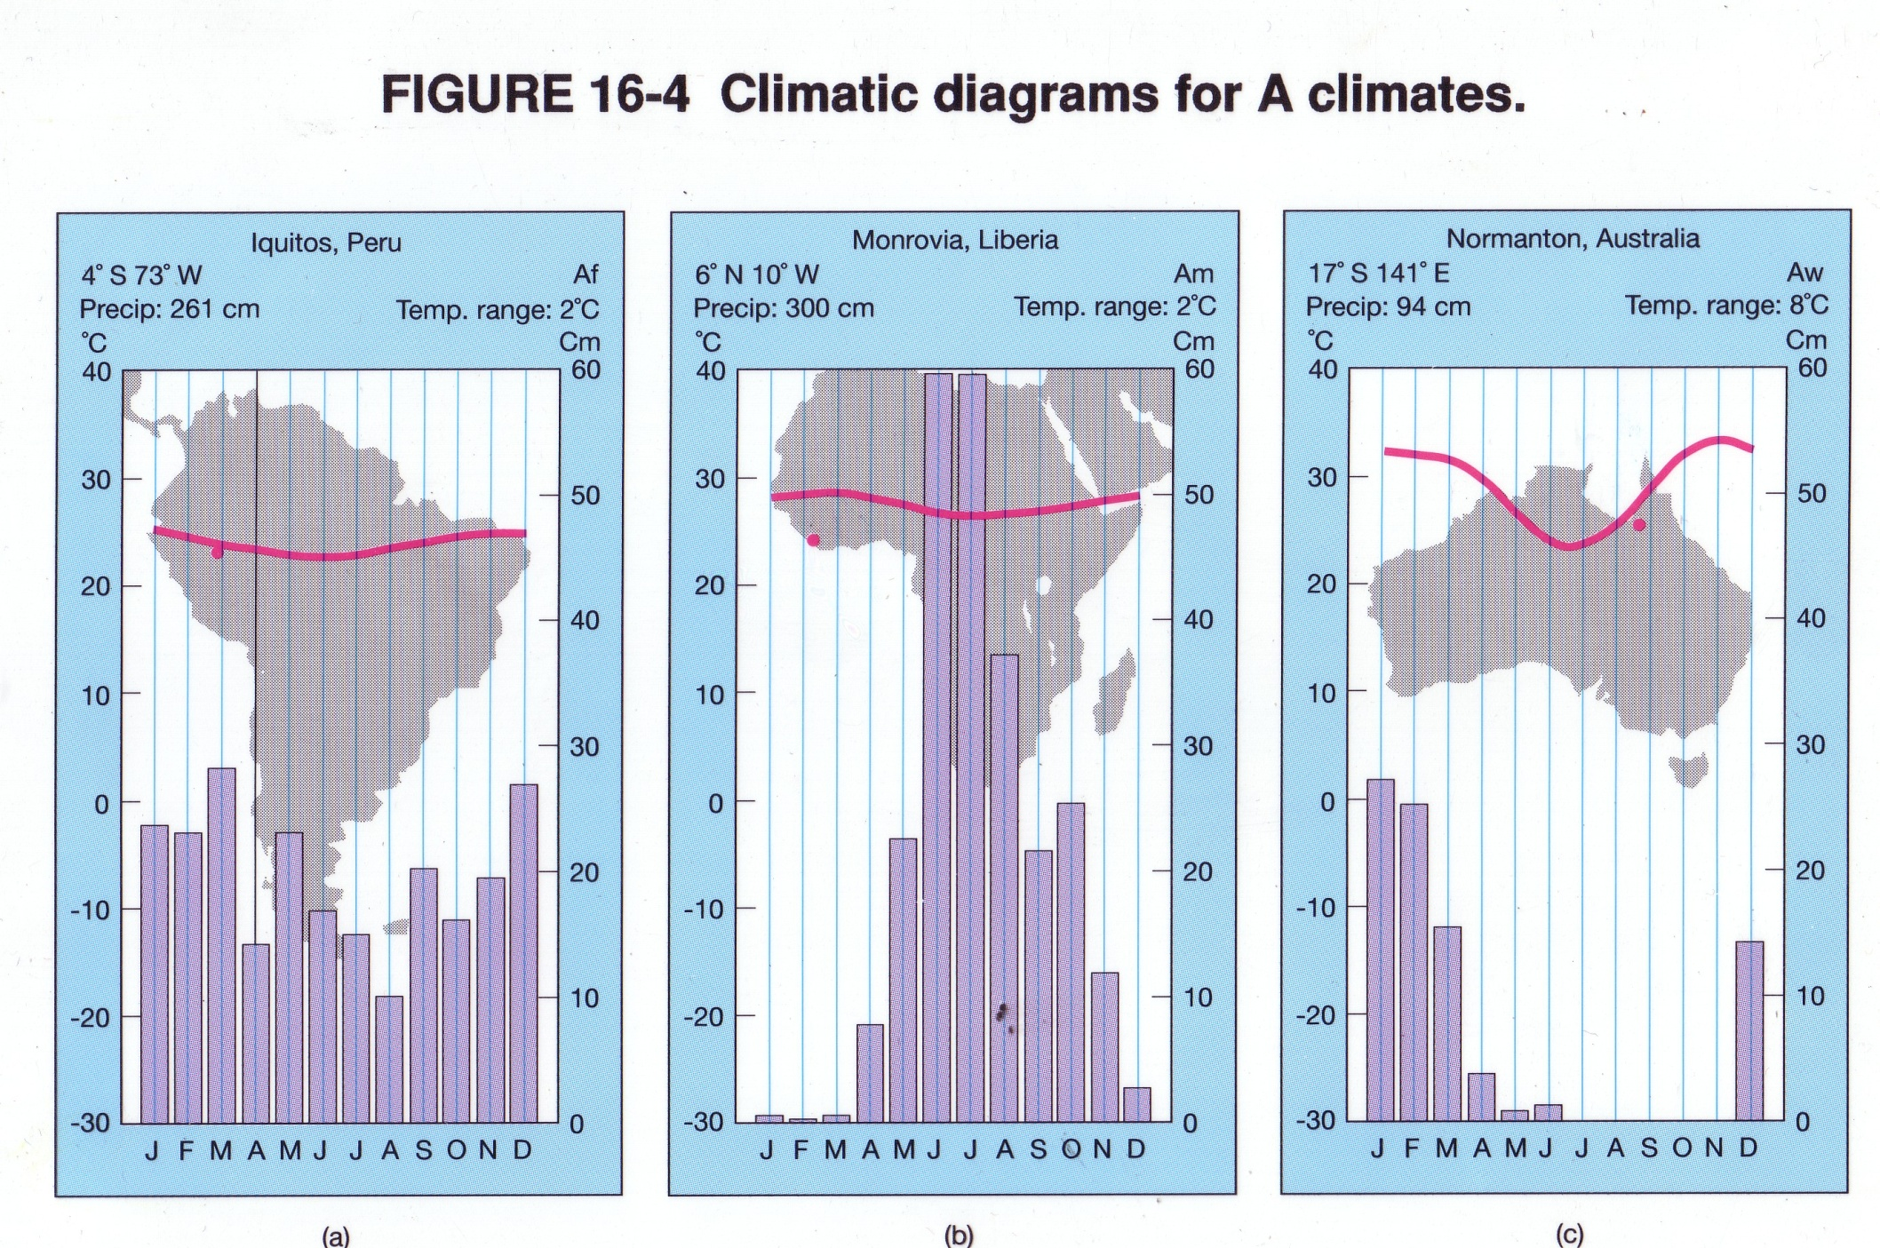
Notes:
Monsoonal climates (Am) as shown in the middle climograph, have precipitation highs and lows that are very extreme compared to the other A climates, Af and Aw.

Slide 35
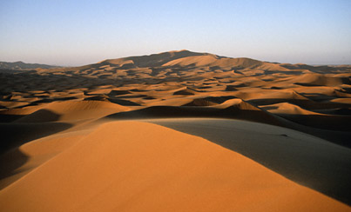
Köppen arid (B) climates: BWh Subtropical desert
Hot desert
Located poleward of A climates.
STHP dominant climate influence
Warm desert biome with sparse vegetation
Middle East, Sahara and Kalahari (Africa) Great Victoria (Australia), Chihuahuan (SW US and Mexico) deserts

Slide 36
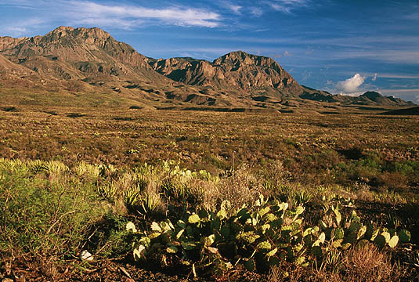
Chihuahuan Desert
(BWh)

Slide 37
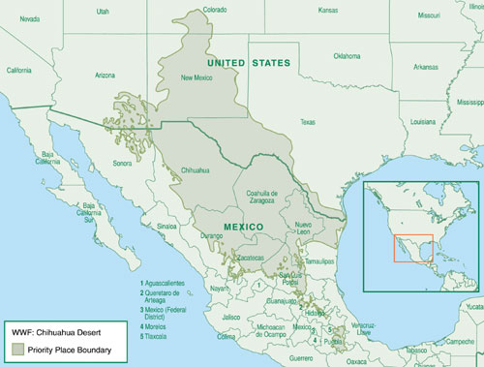
Chihuahuan Desert
(BWh)

Slide 38
Köppen arid (B) climates: BWk Mid-latitude desert
Cold desert: cooler temps than BWh, may even see temps below freezing in winter and snow
STHP dominant
Cool desert biome; potentially more vegetation that BWh. Plants often have succulence, as seen prominently in cacti with their fleshy thick tissues that limit water loss.
Gobi, Atacama, Patagonian, Mojave, Sonoran, Great Basin deserts.
North American BWk deserts also influenced by rainshadow effects
Notes:
Plant adaptations to low moisture: succulence (cacti); deep or spreading roots to maximize water collection, ephemeral reproduction (reproduce only in wet years)

Slide 39
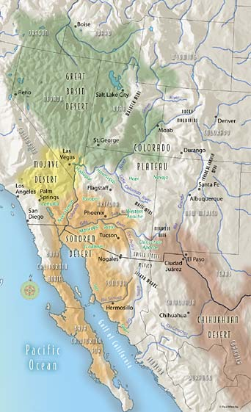
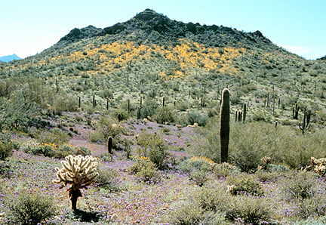
BWk
BWk
Sonoran Desert (BWk)
BWk
BWh
Chihuahuan Desert (BWh)
Notes:
Be able to name these four deserts and identify what kind of Koppen climate and biome they are

Slide 40
BWk is cooler and often at a higher latitude than BWh deserts

Slide 41
BWh climates are much drier than BWk

Slide 42
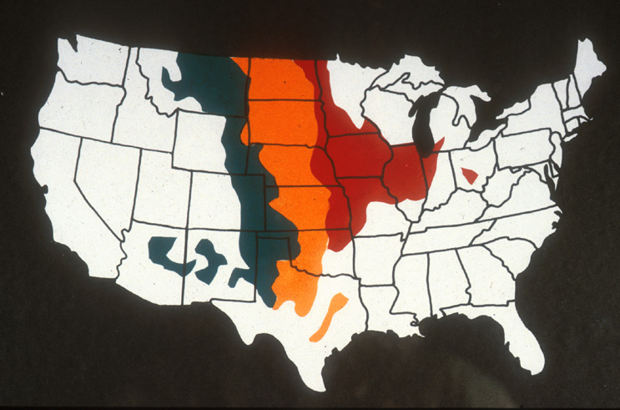
Köppen arid (B) climates: BS-Steppe climate
Semi-arid transitional climate between B and C climates
Temperate grassland biome
Mollisols
Prairies of the interior US, Asia (steppes is the name given to prairies in parts of Asia), Sahel region of Africa
/

Slide 43
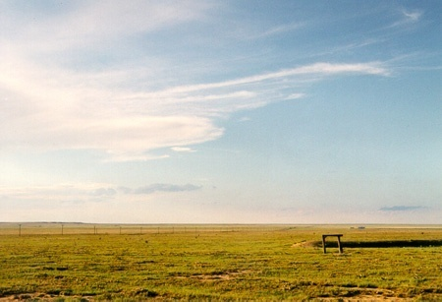
Notes:
Temperate grassland prairie biome: this is the short grass prairie of eastern Colorado

Slide 44
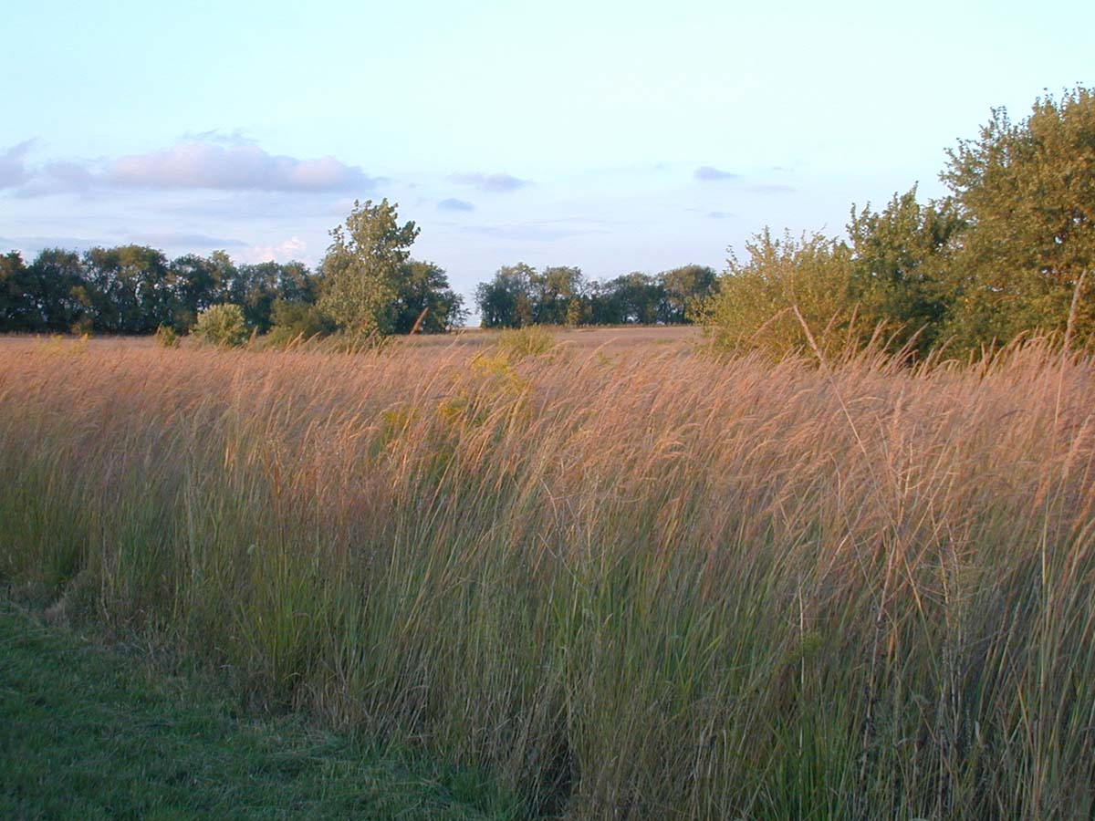
http://climate.konza.ksu.edu/
Notes:
Temperate grassland prairie biome: this is the long grass prairie of eastern Kansas. Eastern Kansas and the eastern Plains states receive more rainfall, so grasslands are typically made of grasses that can grow taller.

Slide 45
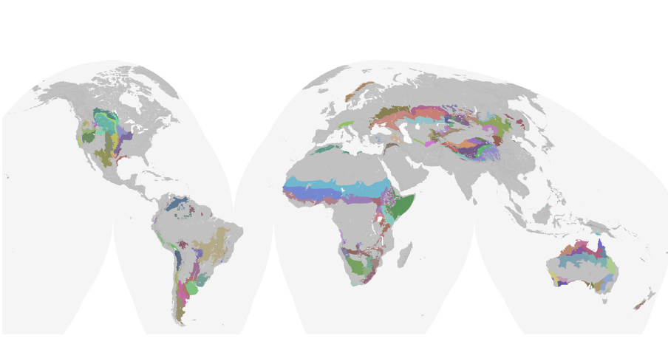
Grasslands of the B climates of the world

Slide 46
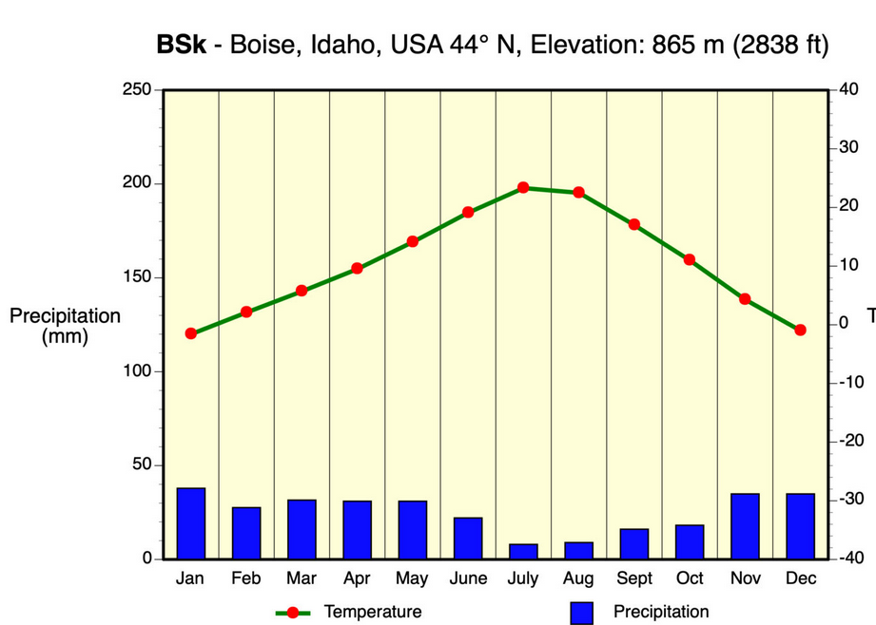
BS
BS

Slide 47
Köppen midlatitude cool winter (C) climates: Cfa-Humid subtropical
Typically found on eastern sides of continents near warm ocean currents)
No pronounced dry season
Winter precipitation from midlatitude cyclones
Summer precipitation from local rain and thunderstorms of
maritime tropical air masses and local surface heating
Deciduous forest biome: oaks, hickory, maple. Pines increase in abundance in areas with low nutrient sandy soils and high sunlight
Eastern US, South America, China, and Japan

Slide 48
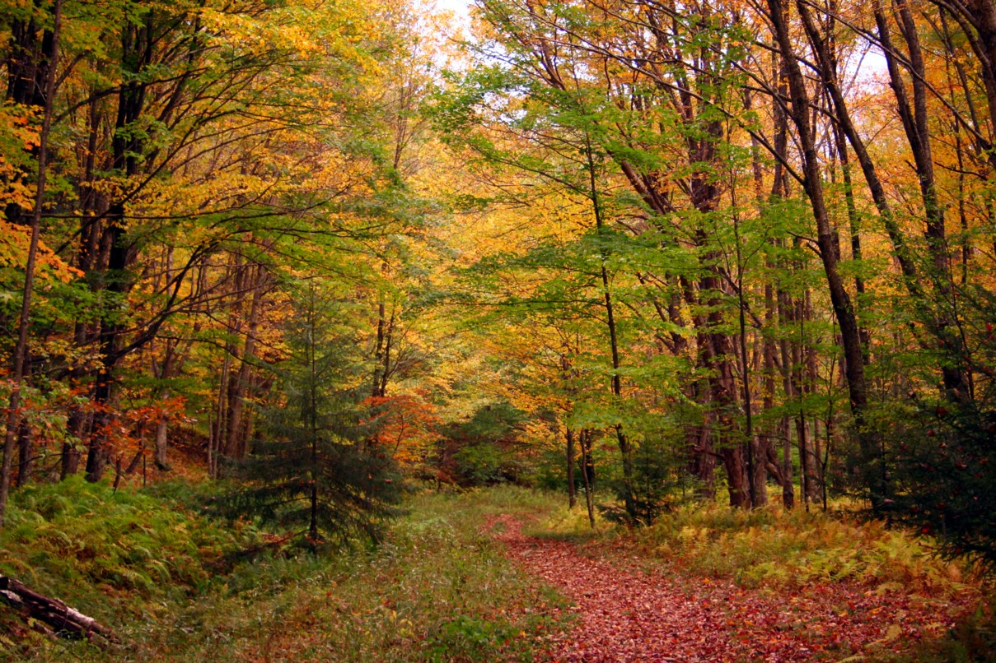
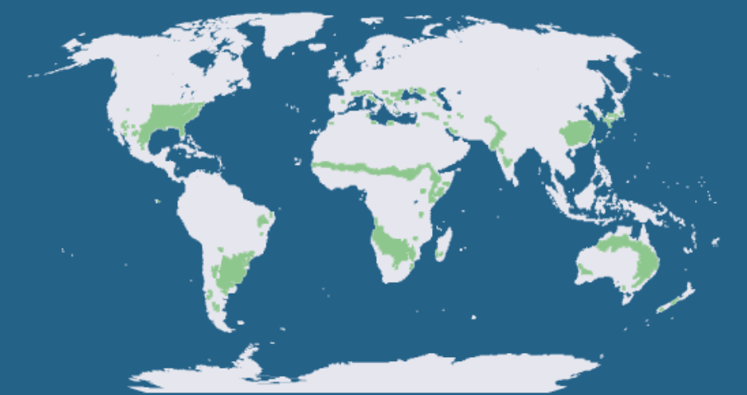
Notes:
Broadleaf deciduous forests (KY)

Slide 49
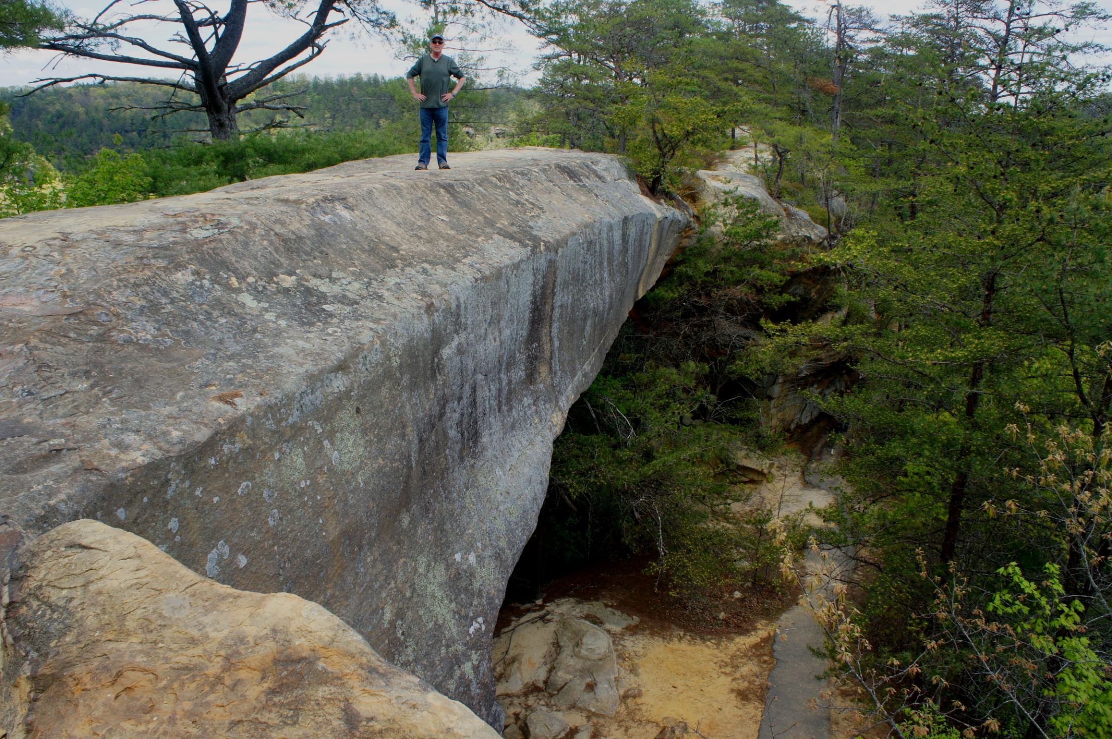
Notes:
Cfa climate, Broadleaf deciduous forest of Kentucky. Pines are abundant here in the Natural Bridge area of Kentucky because there is more sandstone and sandy soils. Pines are adapted to live on sandy soils. Sandy soils dry quickly after rains. Water passes through the sandy material into the water table faster than would occur in clay soils derived from weathered limestone. The needle leaved growth form of pines is adaptive for dry conditions.

Slide 50
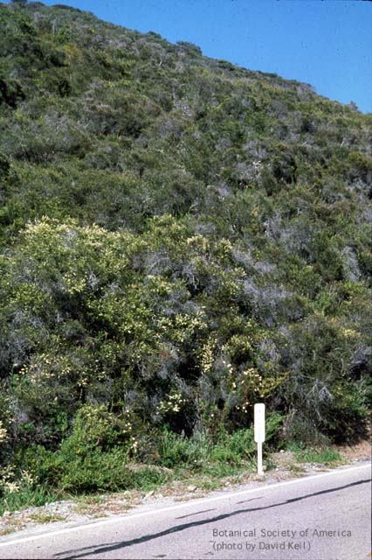
Köppen midlatitude C climates: Cs-Mediterranean
Found on west coasts of continents adjacent to cold currents
Dry summer because the STHP is dominant
Winter mildly wet from passing midlatitude cyclones
Mediterranean scrub biome comprised of chaparral and grasslands
West coast of continents: S. Europe, Chile, S. Africa, Australia
Notes:
Chaparral shown in photo, a form of the Mediterranean scrub biome of the Cs climates

Slide 51
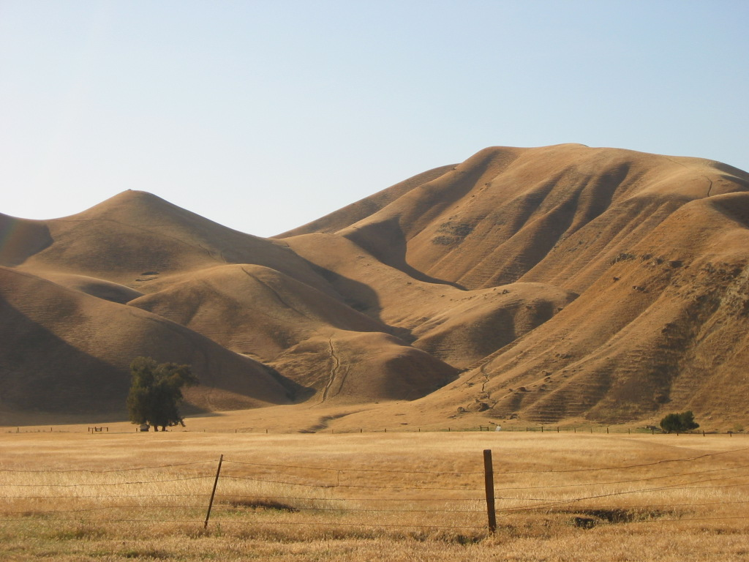
Notes:
Winter wet, summer dry in Cs climates of North America. California hills turn brown in the summer as the STHP reduces the likelihood of rainfall. Most of the rain in the Cs climate of North America occurs during the winter when midlatitude cyclones pass through.

Slide 53
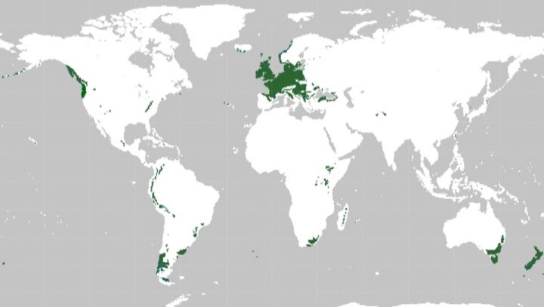
Köppen midlatitude (C) climates: Cfb-Marine west coast
Located north of Cs
More precipitation and milder temps than Cs
Midlatitude cyclone most active during winter
Marine coniferous forest biome
Coastal Washington, British Columbia, Alaska; Tierra del Fuego, western Europe, New Zealand

Slide 54
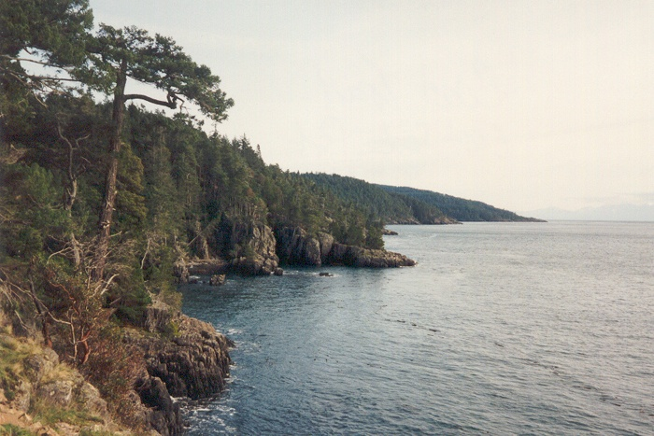
Notes:
British Columbia

Slide 55
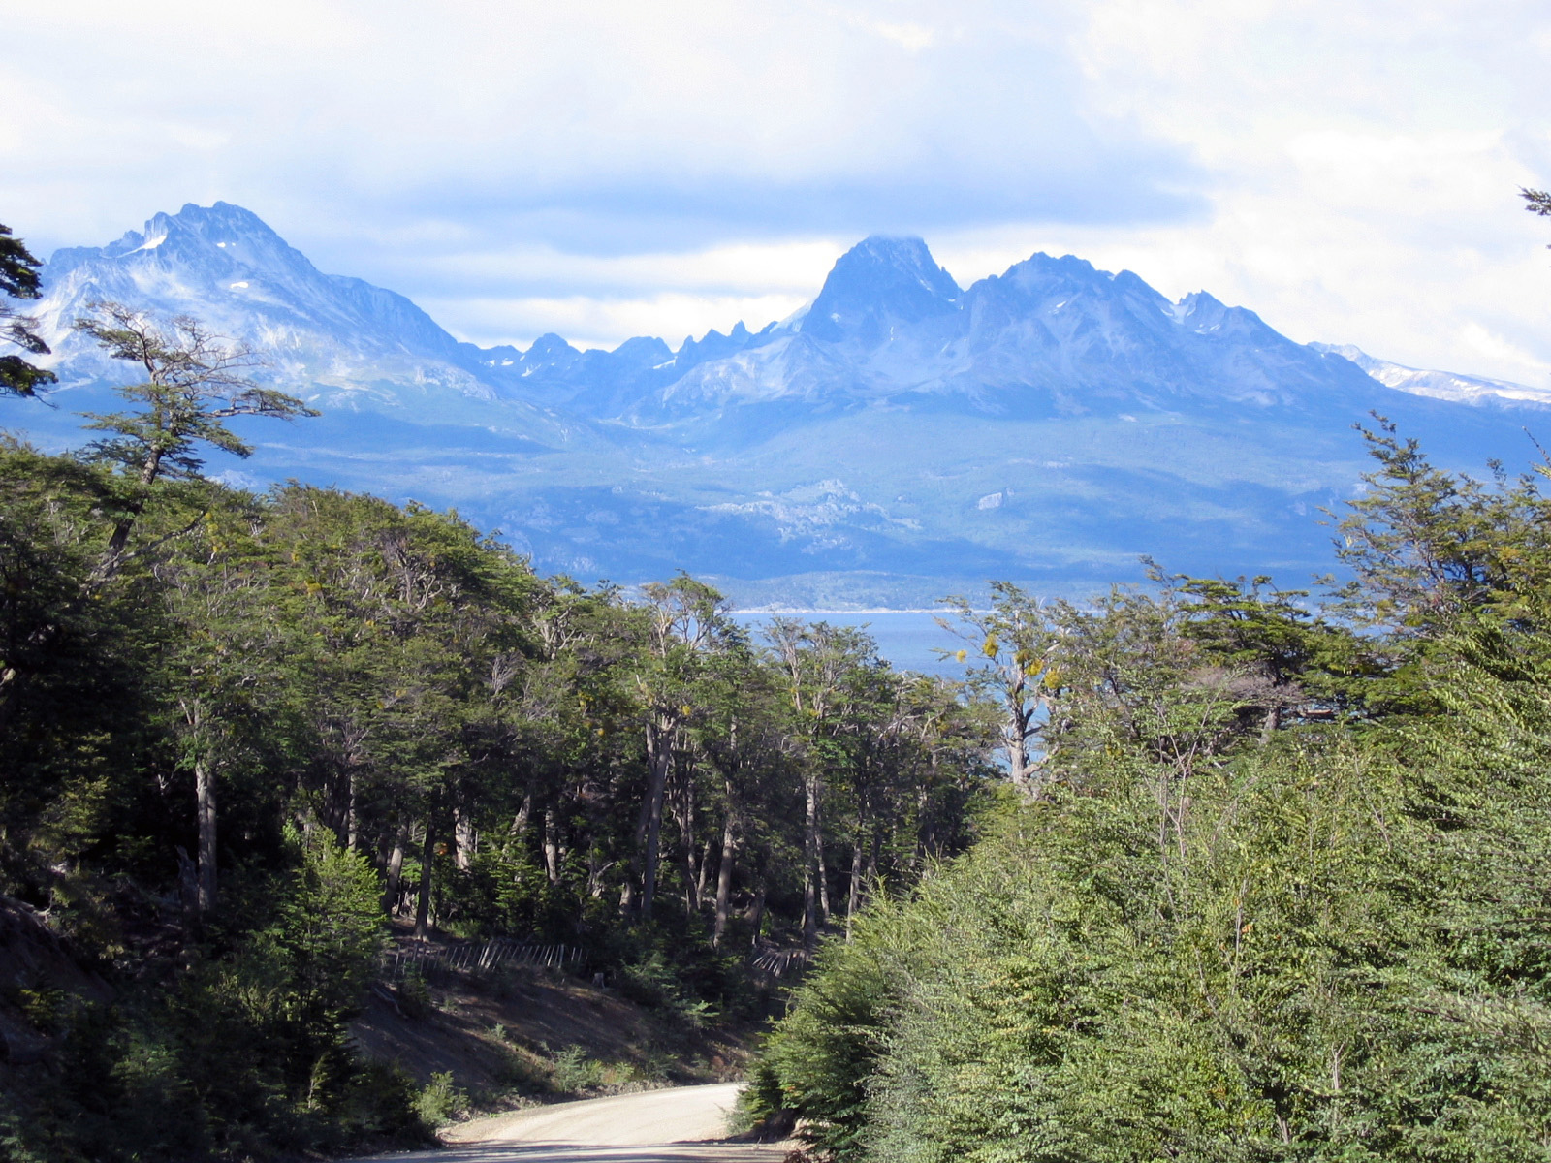
Notes:
Tierra del Fuego in South America

Slide 56
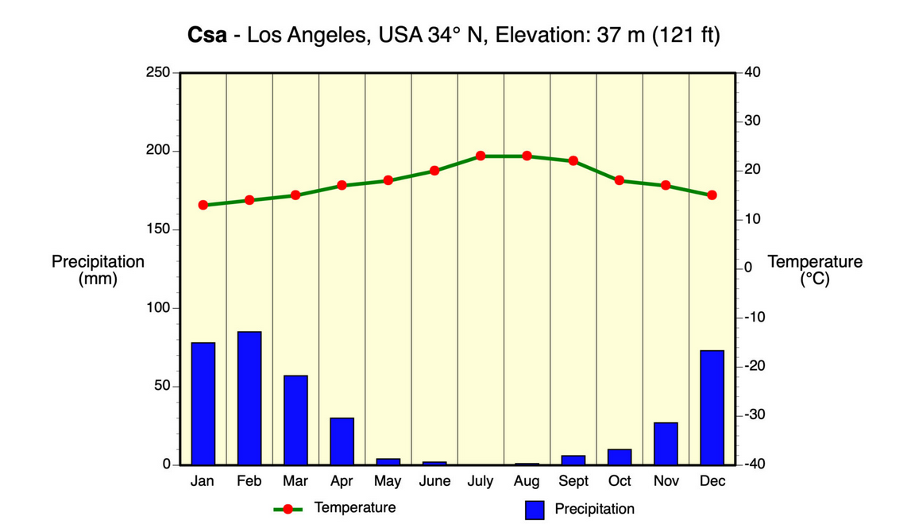
Cs

Slide 57
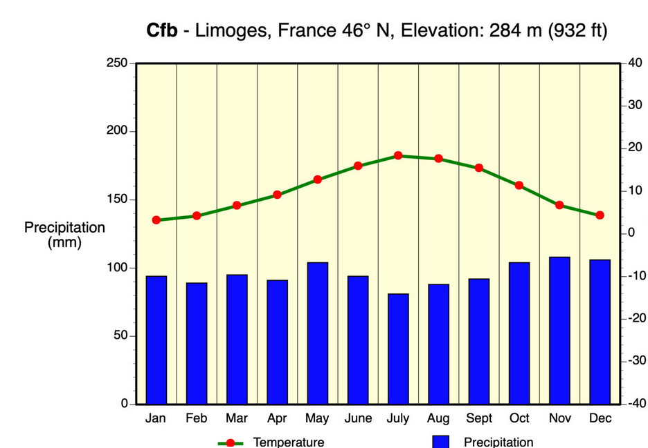
Cfb

Slide 58
Köppen midlatitude cold winter (D) climates
Higher in latitude than C climates
Winters very cold, summers can still be hot due to continentality
Large annual temperature range
Midlatitude cyclones bring winter precipitation, but with increasing influence of polar high, and the distance to moist marintime tropical air masses, precipitation totals are lower
Coniferous boreal forest biome of Canada, northern US interior and the taiga of Siberia

Slide 59
Notes:
Jack pine in boreal forest biome of D climates. Pines are adaptive here because the tropical air masses that produce rainfall do not routinely make it this far north. The polar high is a predominant weather influence, which keeps the region relatively drier than latitudes to the south.

Slide 60
Notes:
Interior D climates of Canada and the boreal forest

Slide 62
Köppen polar (E) climates
ET - Tundra
No high summer temps as with D climates
Polar desert: cold air with low moisture under influence of polar high
Unfrozen water infrequent; therefore water unavailable to plants
Permafrost (frozen soil)
Tundra biome
Treeless, low shrubs, mosses, lichens
Two types of tundra: Arctic tundra and alpine tundra
EF - Icecap
Antarctica, interior Greenland, Arctic icepacks
Dry, cold and sparse terrestrial life

Slide 63
Notes:
Arctic tundra in northern Canada

Slide 64
Notes:
Arctic tundra biome

Slide 65
Notes:
Alpine tundra biome in Rocky Mountains National Park, CO

Slide 66
Notes:
Extent of permafrost, a feature identified with ET climate.

Slide 68
Mountain (H) climates

Slide 71
Notes:
No continental-scale D climates in Southern Hemisphere (little land at this latitude)

