Slide 1
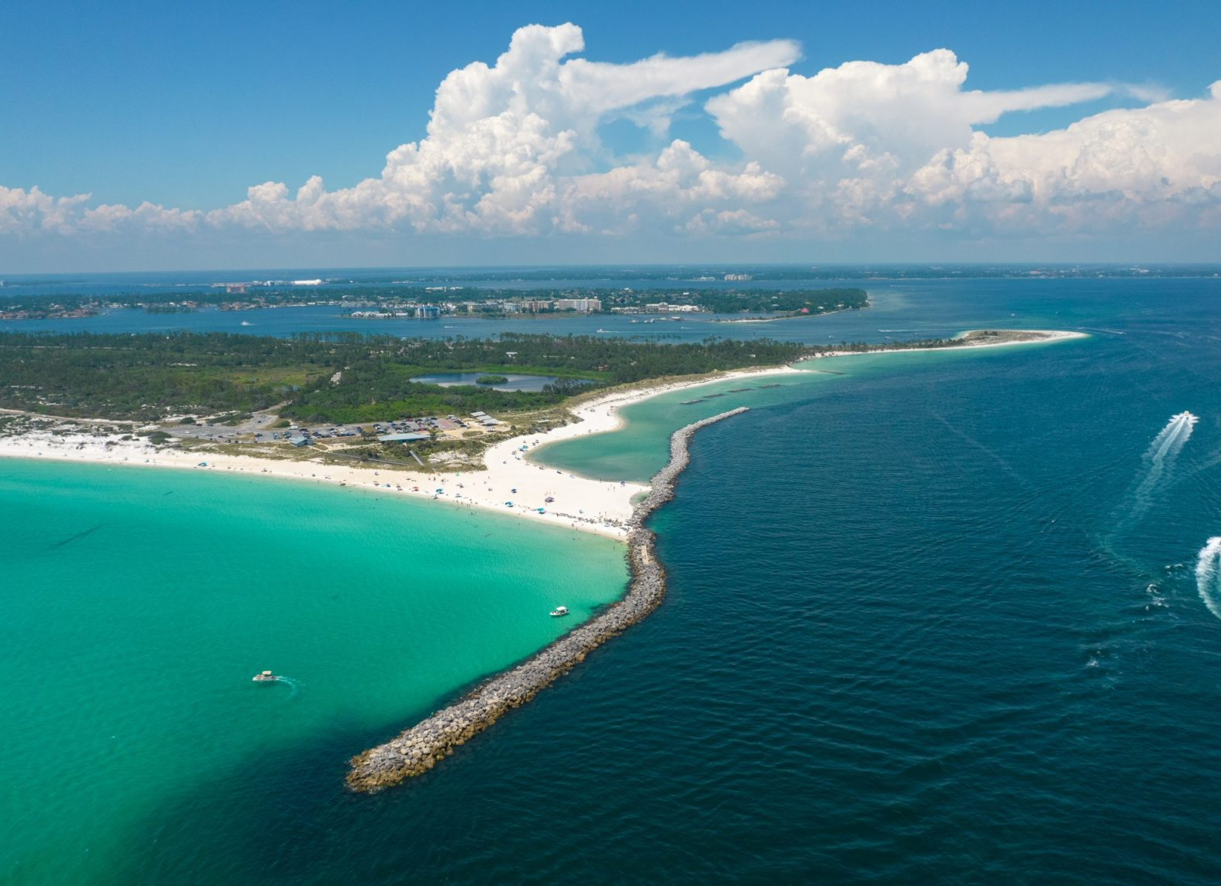
Coastal landforms and processes
Coast is contact zone between land, air, and sea.
Dynamic interaction of:
Tectonics and crustal motion
Energy supplied by ocean water: tides, waves, ocean currents.
Sediments and nutrients supplied by erosion from continents via fluvial transport

Slide 3
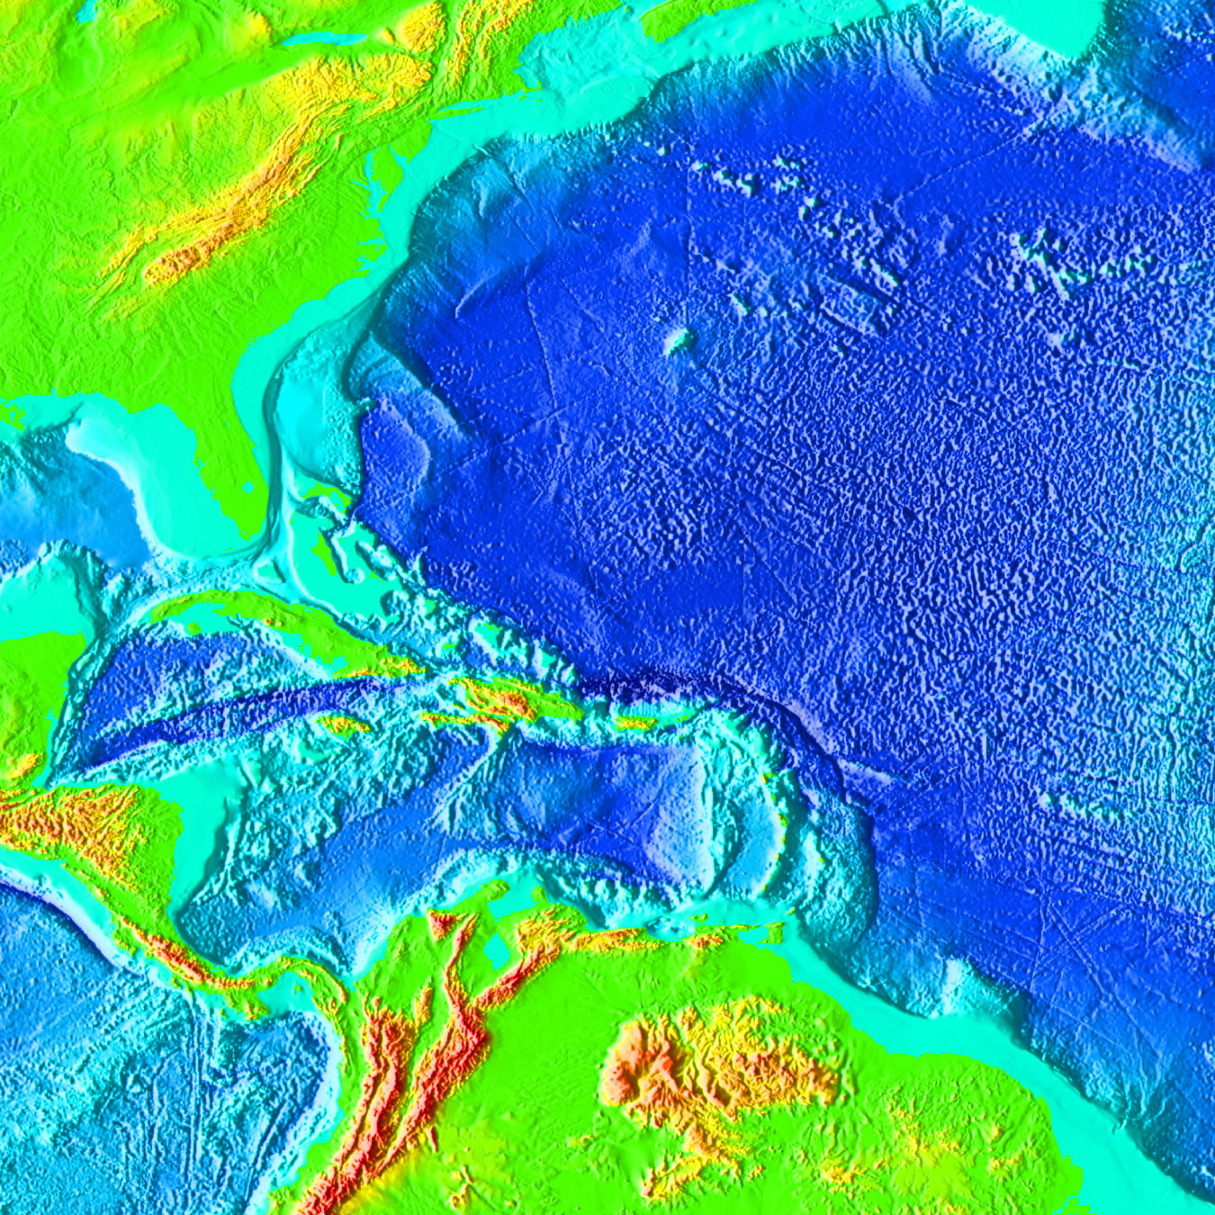
Identify: continental shelf, continental slope, abyssal plain
Notes:
Identify: Continental shelf Continental slope Abyssal plain

Slide 4
Wave refraction
Notes:
Wave refraction, Rincon, Santa Barbara. Surfers ride these ‘point breaks’ , that location where the wave starts to build as it contacts the shallow water. Surfers travel in the direction the wave is breaking, in this case, to the right it you were surfing or to the left of the image. The surfer tries to stay at that point where the wave has built up from shallower water but is also continuing to break because of the angle of the wave relative to the shoreline and water depth.

Slide 6
Longshore currents
Notes:
Longshore drift and sediment transport Swash and backwash are terms that describe the movement of water on a beach, influenced by waves approaching the shoreline.
This is the movement of water that rushes up the beach after a wave breaks. Swash travels at an angle determined by the wave's direction and energy, carrying sand, pebbles, and debris up the beach. It plays a role in building up the beach profile, especially during calmer weather when waves have lower energy, allowing sand and other materials to accumulate.
After the swash moves up the beach, gravity pulls the water back down toward the sea in a process called backwash. This movement flows perpendicular to the shoreline, regardless of the angle of the swash, and can carry some sand and sediment back down into the ocean. During high-energy conditions, like storms, backwash is often stronger, leading to erosion as it pulls sediment back into the sea.
Together, swash and backwash shape beaches by building them up or eroding them, depending on the balance between the two processes and wave conditions.

Slide 7
Notes:
Bald Head Island, NC. https://coastalreview.org/2024/07/measure-gives-bald-head-island-ok-to-study-adding-groin/

Slide 8
Headland-bay coast
Notes:
Headland-bay coast. Wave energy is focus on the headland, which erodes and then the sediment is transported Lenan Head and Dunaff Head, from the summit of Urris Hill on the Inishowen Peninsula, County Donegal in Ireland.

Slide 9
Notes:
Wave refraction

Slide 10
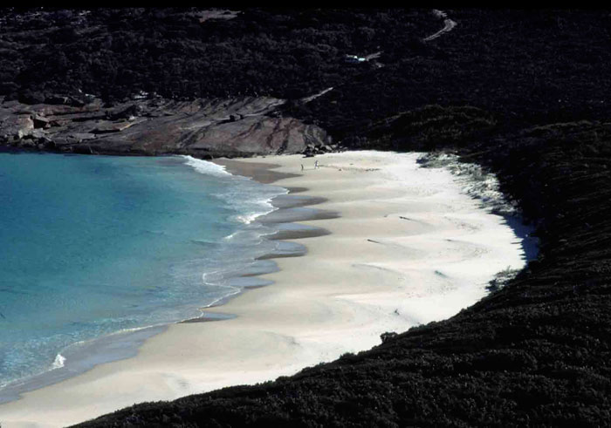
Reflective beach
Notes:
Reflective beach https://ozcoasts.org.au/conceptual-diagrams/science-models/beaches/wdb/

Slide 11
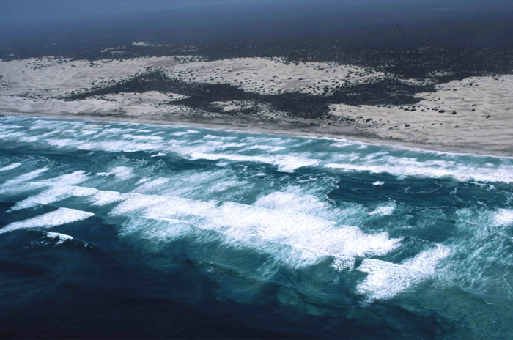
Dissipative beach
Notes:
Dissipative https://ozcoasts.org.au/conceptual-diagrams/science-models/beaches/wdb/

Slide 12
Notes:
Reflective and dissipative coasts Dissipative beaches are characterized as being high energy beaches with a wide surf zone (300-500 m) including two to three shore normal bars and troughs, and a low-sloping and wide beach face consisting of fine sand.
Reflective beaches are characterized by a relatively steep narrow beach face, composed of coarse sand, and a narrow surf zone. Waves break close to the shore on a reflective beach with little prior loss of energy. Deep water is close inshore.

Slide 13
Sneaker waves on a reflective beach
Notes:
Sneaker waves are more common on reflective coastlines because wave energy can propagate through deep water closer to shore.

Slide 14
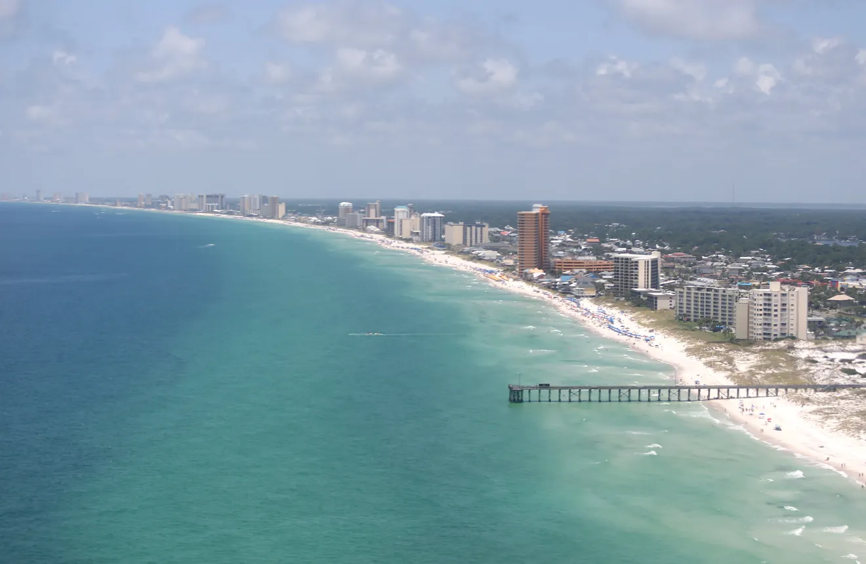
Sandbars along a dissipative beach
Notes:
Two sandbars with a trough between them in Panama City Beach. This is a dissipative beach https://www.newsherald.com/story/news/environment/2018/06/17/tale-of-two-sandbars-pcb-coastline-somewhat-unusual/11953252007/

Slide 15
Notes:
Panama City Beach from St Andrews St Park pier

Slide 17
Notes:
Rip currents

Slide 18
River delta types
Notes:
Delta types: river dominated, tide-dominated, wave dominated, and hybrid (mixtures of all of the other three types)

Slide 19
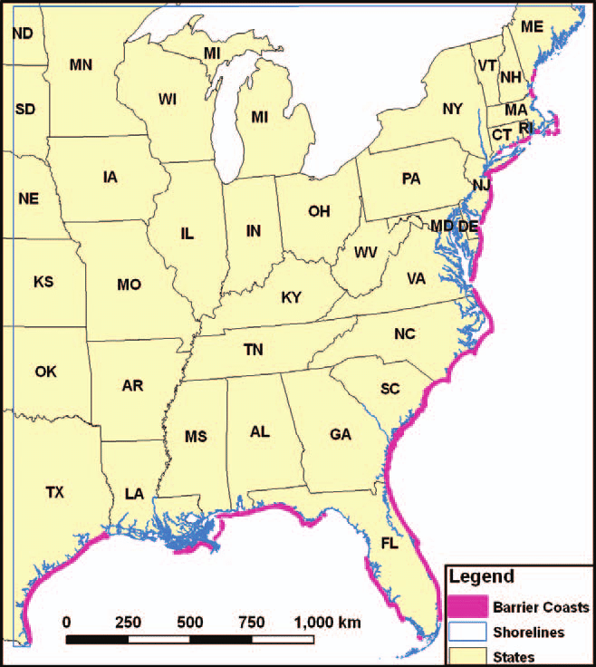
US barrier islands and beaches
Notes:
Barrier island coasts

Slide 20
Cross-section of a typical barrier island

Slide 21
Mixed energy barrier island
Low wave energy and high tidal range
Islands are wide and not very long
Separated by tidal inlets
Extensive estuaries and salt marshes behind barrier islands
Storm surges flow through large and numerous tidal inlets

Slide 22
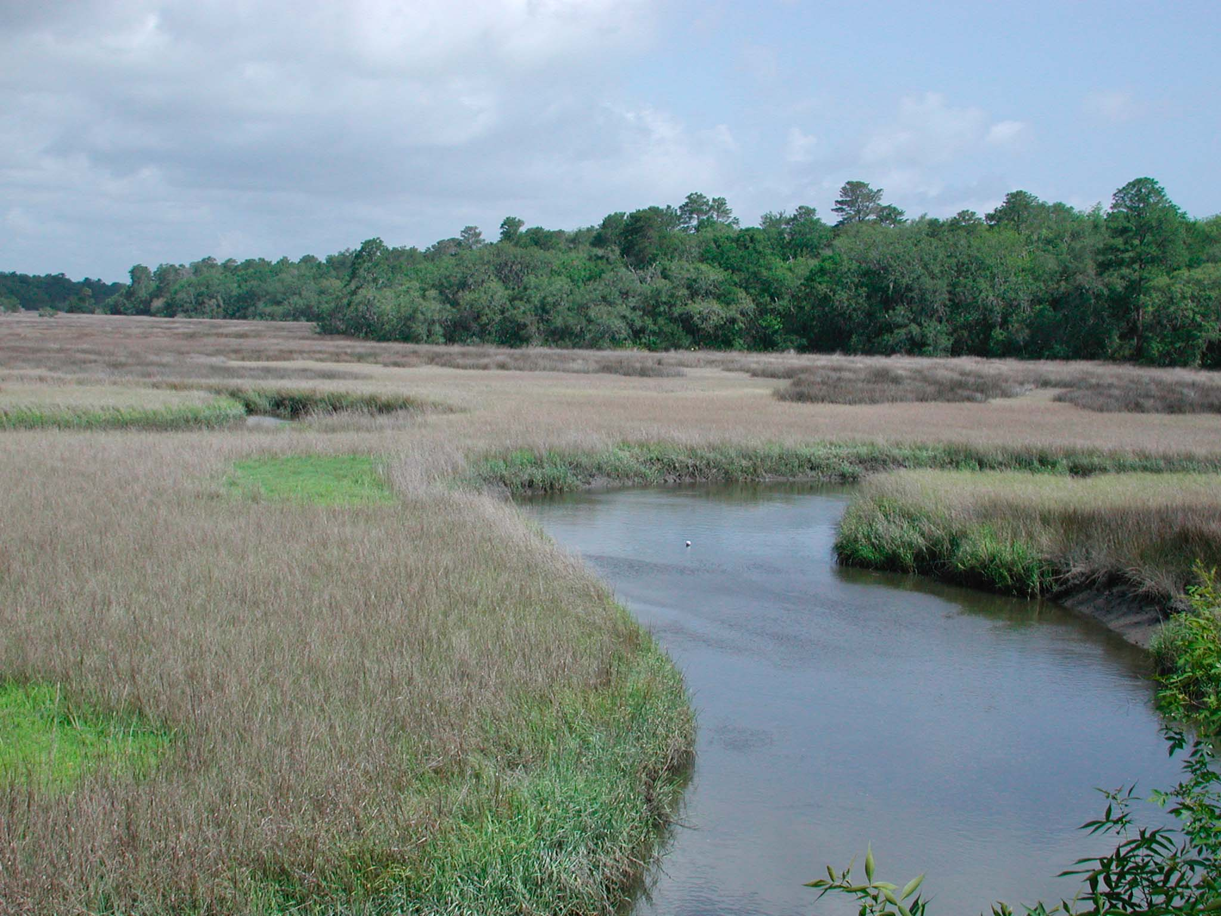
Estuarine salt marsh with tidal inlets
Notes:
Deltas can have well-developed estuarine habitat, salt marsh and tidal creek networks depending upon the delta type. Tidal deltas typically have the best developed estuarine systems with salt marsh and tidal creeks. Estuary, salt marsh, and tidal creeks network

Slide 23
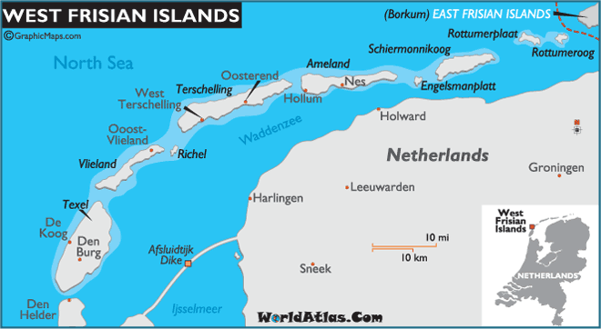
Notes:
Mixed energy barrier islands of the northern coast of the Netherlands (right) and the Georgia coast (left)

Slide 24
Wave-dominated barrier island
High wave energy and low tidal energy
Barrier islands are long and narrow
Often have large back-barrier lagoons
Storm surge and sediments flow over island in a processes know as overwash

Slide 25
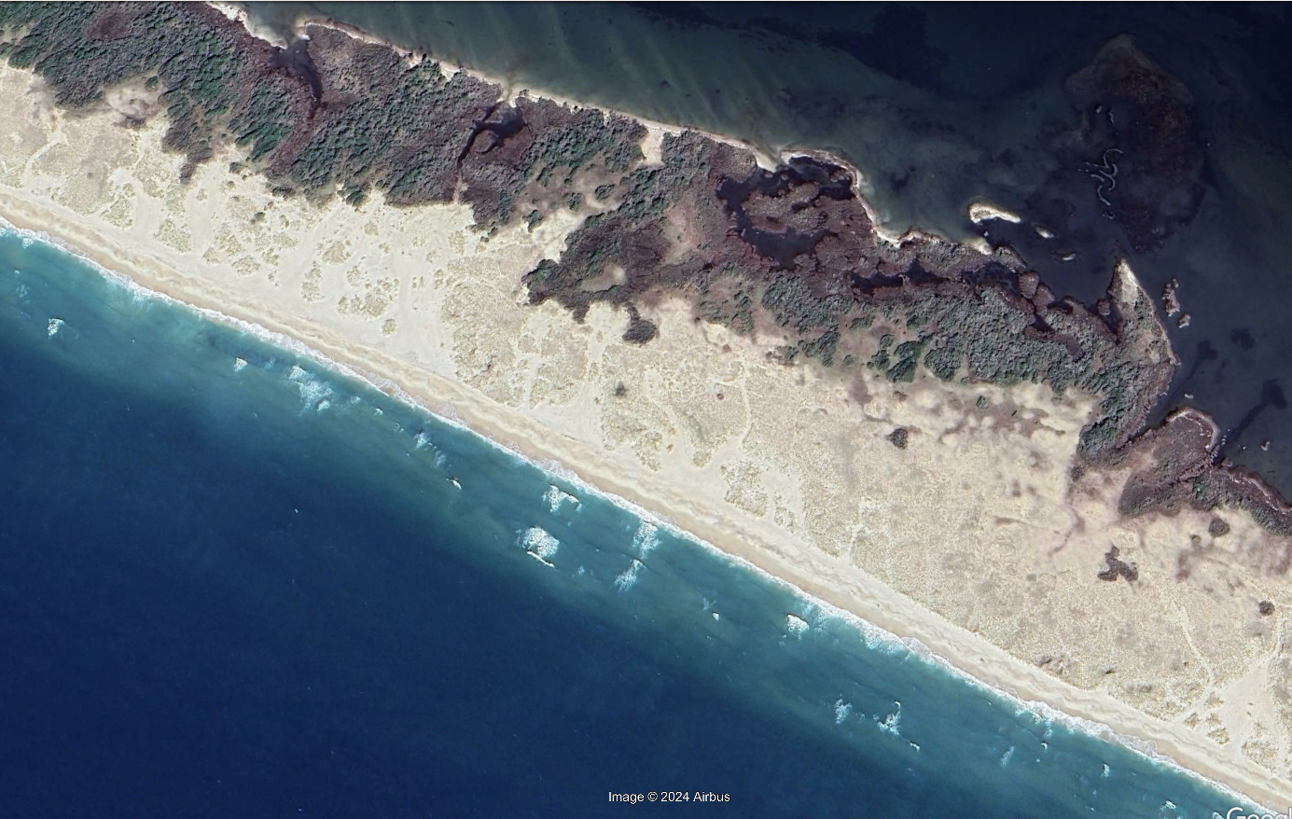
Notes:
Overwash on Shackelford Banks in the Outer Banks, a wave-dominated barrier island

