Slide 1
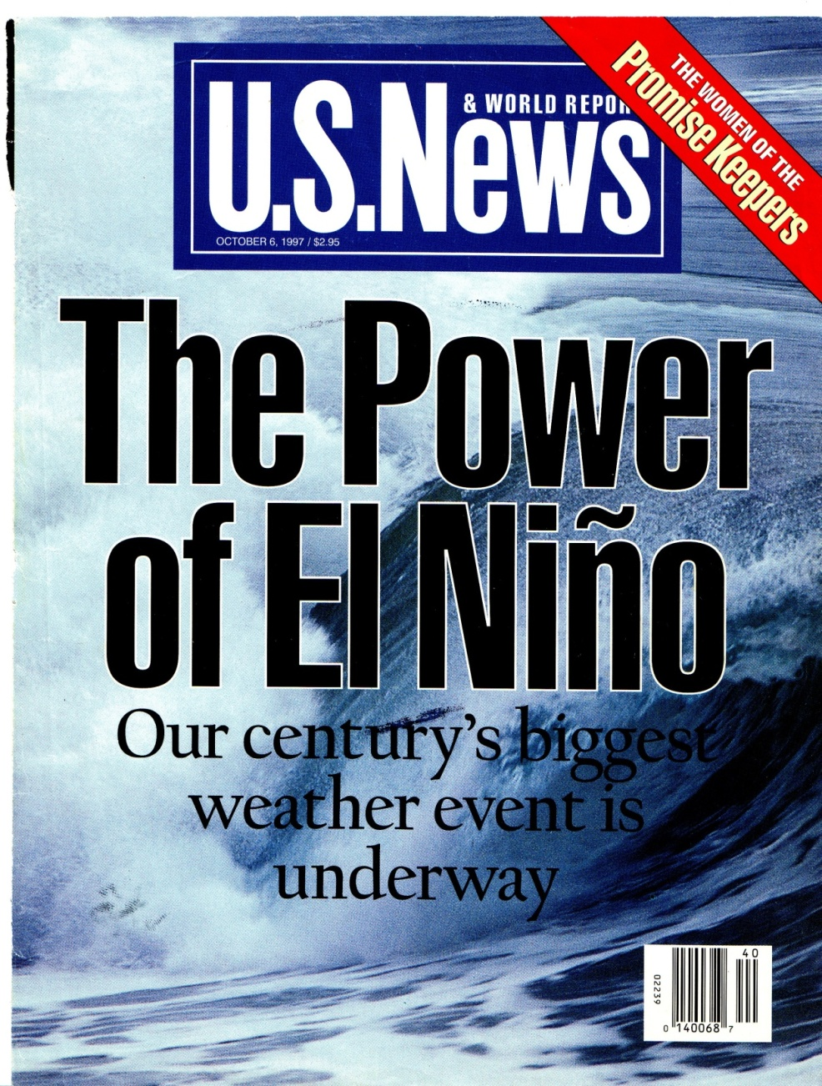
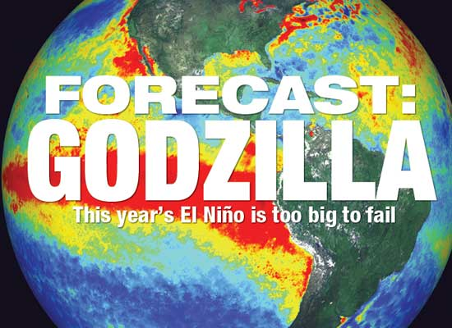
2015-2016
1992-1993

Slide 2
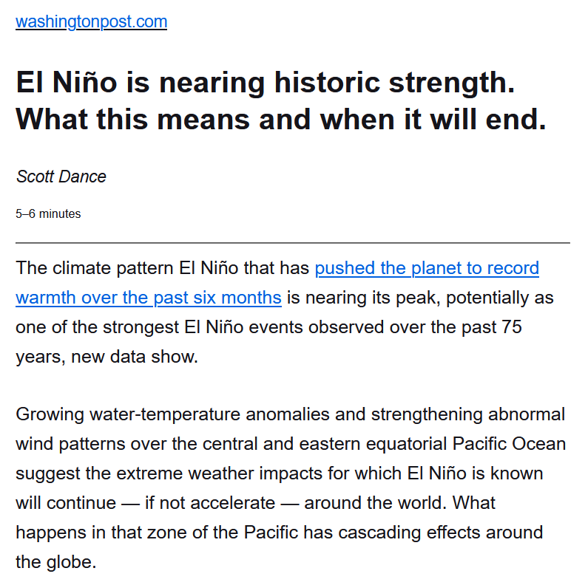
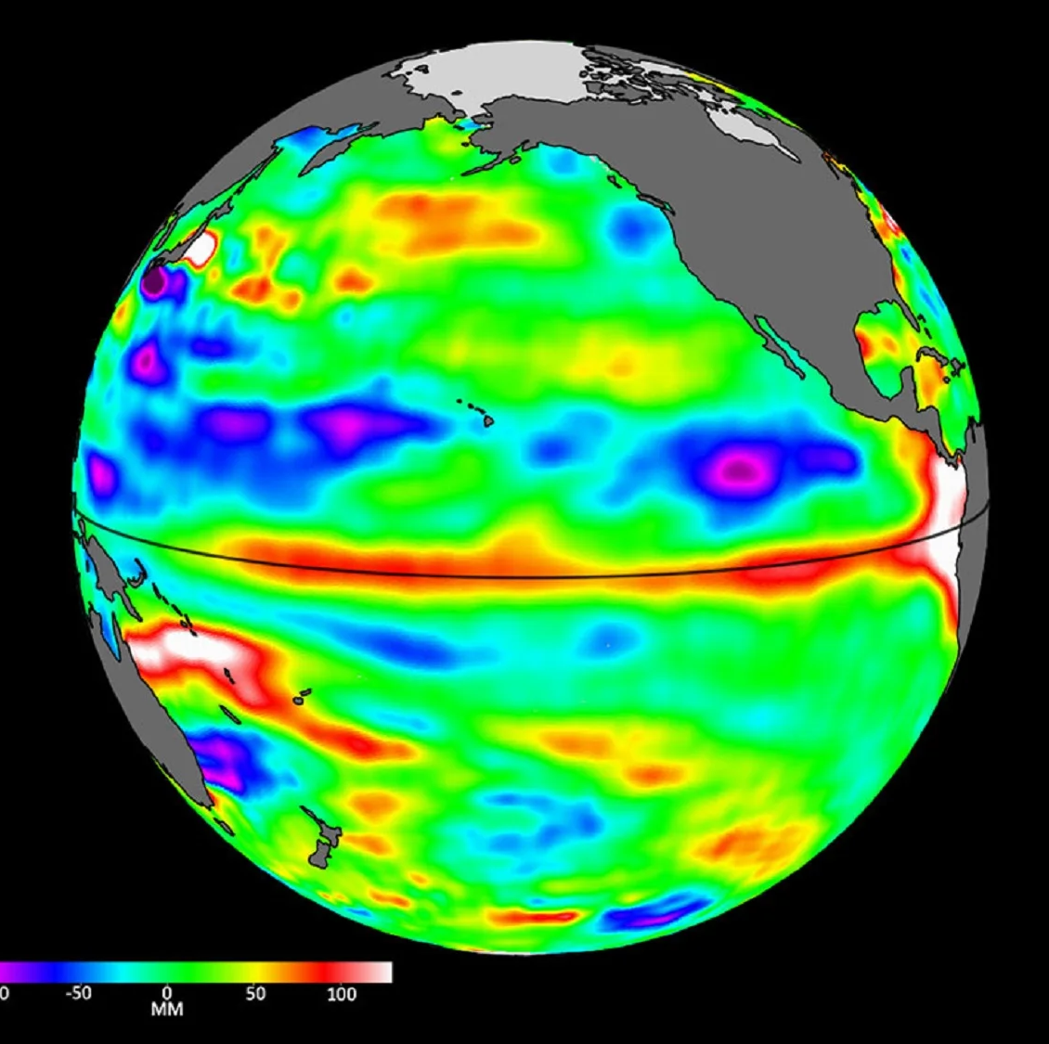
June 2023 - 2024
Notes:
https://www.washingtonpost.com/weather/2023/12/15/el-nino-peak-impacts-climate/
https://www.weather.gov/news/230706-ElNino

Slide 3
Southern Oscillation
Naturally occurring cyclical change in Pacific ocean and wind circulation patterns
Two endpoints of oscillation, La Nina and El Nino
  Cycles between endpoints every 2-7 years, a temporal scale larger than seasons
Natural event occurring for 50 million years ago
Global warming does not cause the Southern Oscillation, but growing evidence for their interaction
Also referred to as ENSO (El Nino – Southern Oscillation)
Has global teleconnections: strong El Nino and La Nina events shape weather around the globe

Slide 4
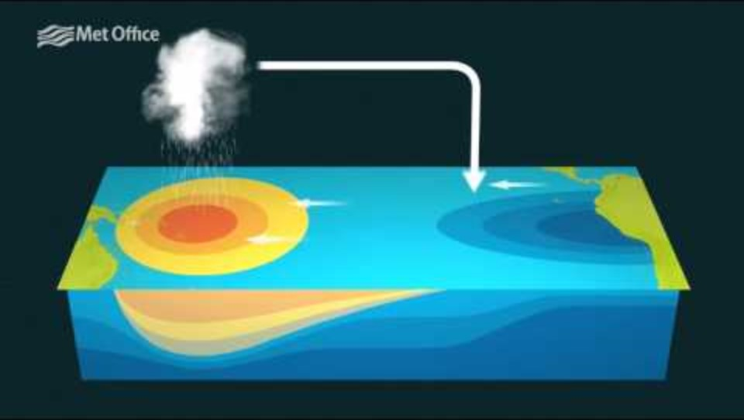
Notes:
https://youtu.be/WPA-KpldDVc?si=rFWTtSk2nfVGzJWg

Slide 5
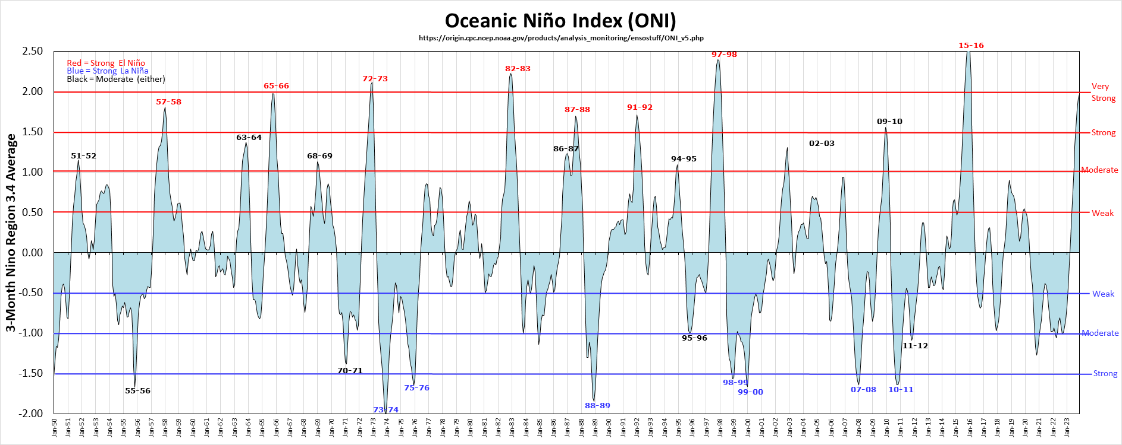
Notes:
https://ggweather.com/enso/oni.htm

Slide 6
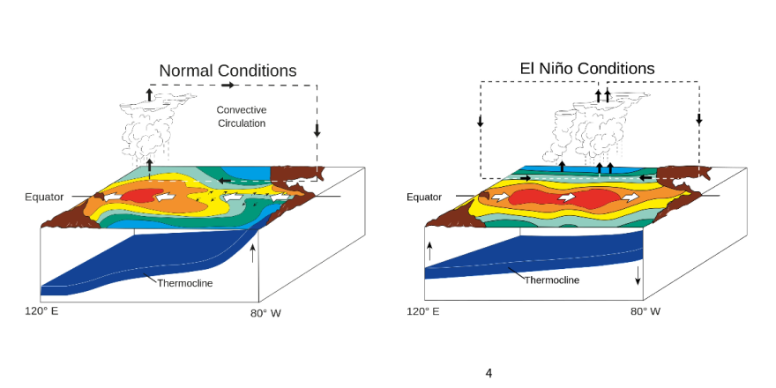
Normal conditions
West Pacific
  Warm ocean water
  Low pressure
  Unstable atmospheric conditions
East Pacific
  Cold water upwelling
  High pressure
  Stable atmospheric conditions
Notes:
Think of Walker circulation as in between a La Nina and an El Nino

Slide 7
El Nino
El Nino tends to produce greater global changes in weather and climate than La Nina
Across the Pacific, El Nino begins when tradewinds slow and reverse direction from neutral conditions – they shift from east to west to west to east.

Slide 8
El Nino
In the Eastern Pacific
  Upwelling ceases
  Warmer surface water
  STHP weakens
  Wet and unstable conditions develop
Western Pacific
  Cooler surface water
  Low pressure weakens
  Drier and stable conditions

Slide 9
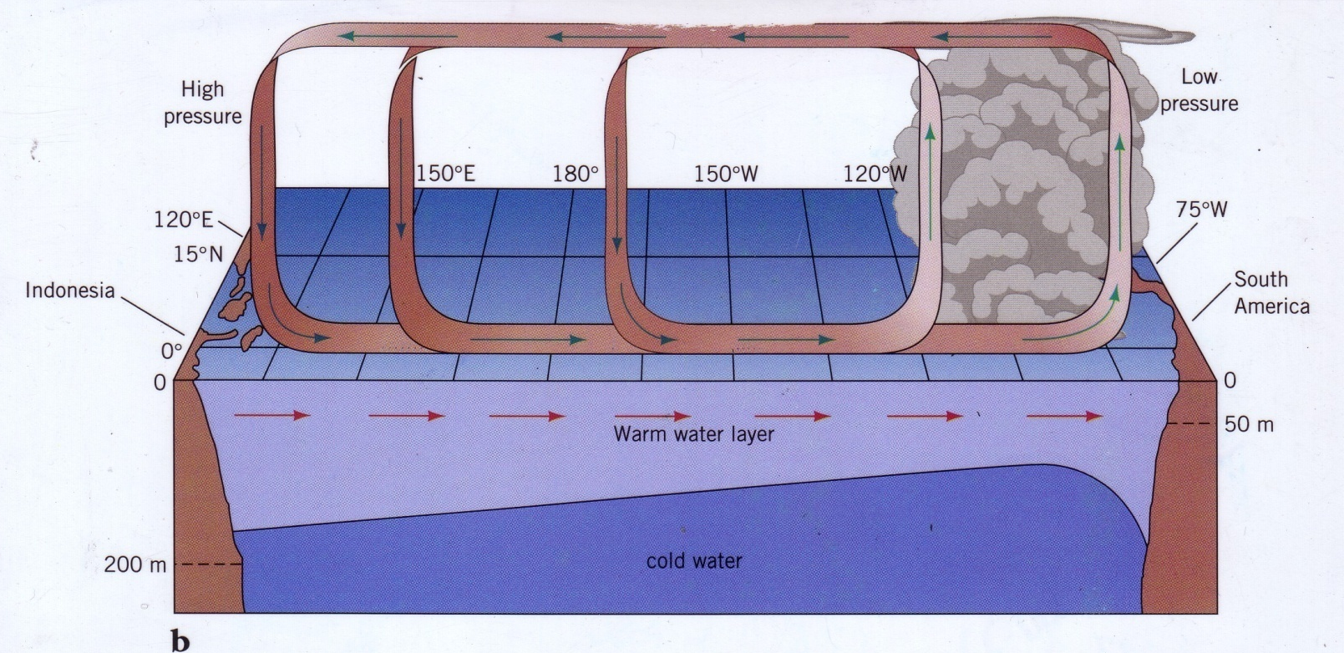
El Nino

Slide 10
La Nina
Amplification of normal circulation
  Easterly tradewinds grow stronger (E to W)
  More warm water piles up in western Pacific
  Lower pressure, more wet and unstable in western Pacific
  STHP in eastern Pacific grows stronger, cooler and drier conditions
  Greater upwelling in eastern Pacific
Drawing

Slide 11

La Nina

Slide 12
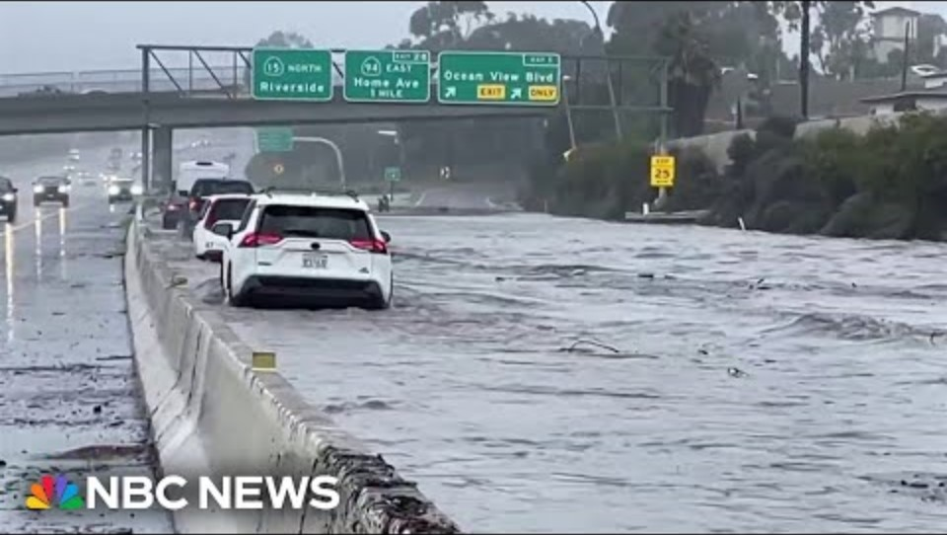
El Nino: High winds and waves, heavy rainfall, mudslides in California and South American coasts

Slide 13
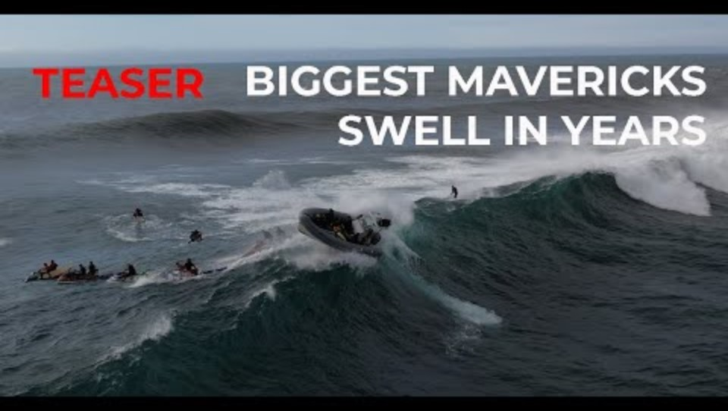
Notes:
Mavericks in Northern California, just 20 miles south of San Francisco, has local conditions that produce some of the biggest shore break for surfers in the world.

Slide 14
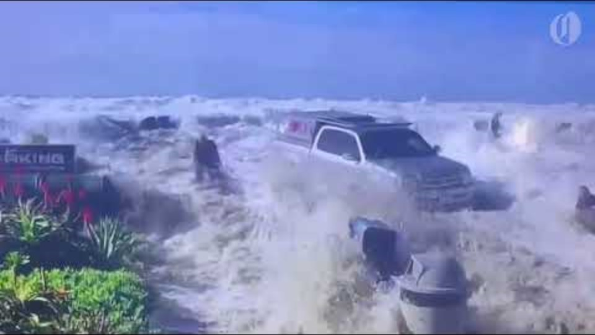
June 2023 - present
Notes:
https://www.washingtonpost.com/weather/2023/12/15/el-nino-peak-impacts-climate/
https://www.weather.gov/news/230706-ElNino

Slide 15
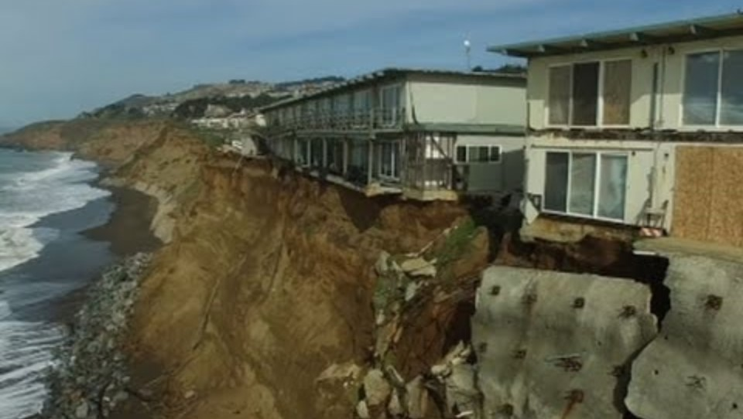
El Nino: Coastal erosion in California

Slide 16
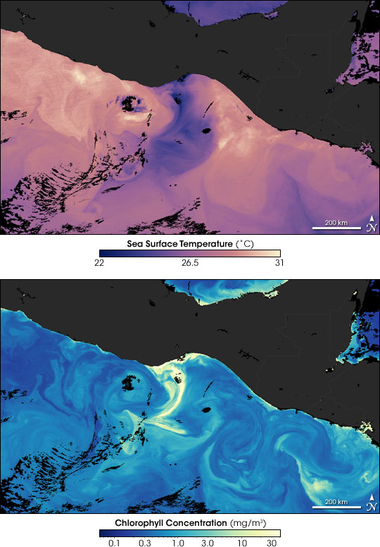
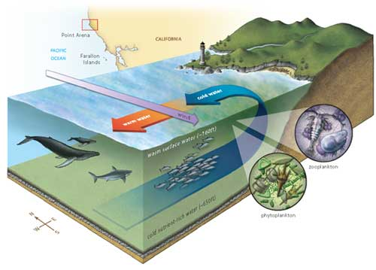
El Nino: Weak cold-water upwelling and alteration of marine food webs in Eastern Pacific
Notes:
Normal years (left) show cold water upwelling and the blooms of phytoplankton in response to nutrients brought up from the deep. The higher concentrations of chlorophyll in the bottom photo indicate the increased abundance of phytoplankton. They are photosynthetics organisms

Slide 17
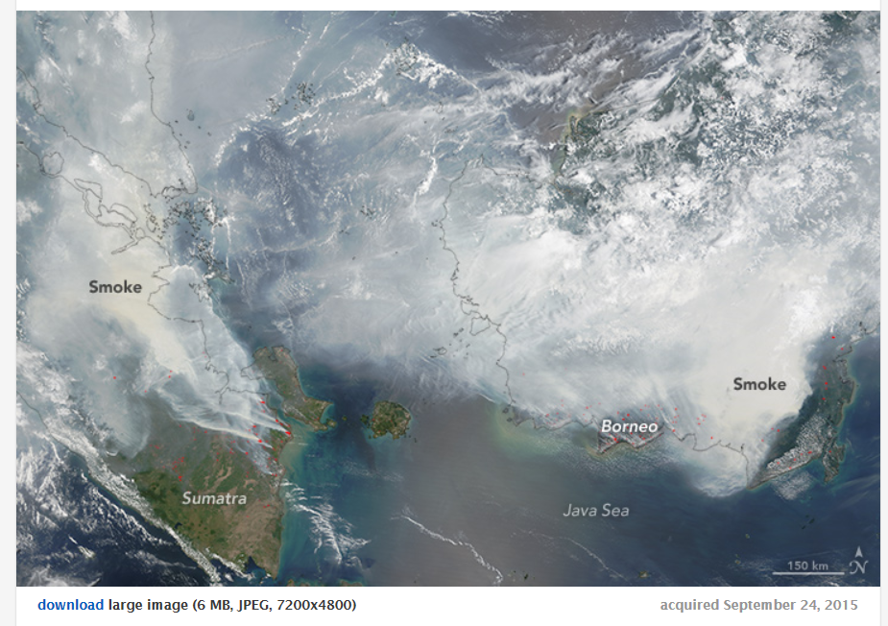
El Nino: Drought and forest fires in southeast Asia

Slide 18
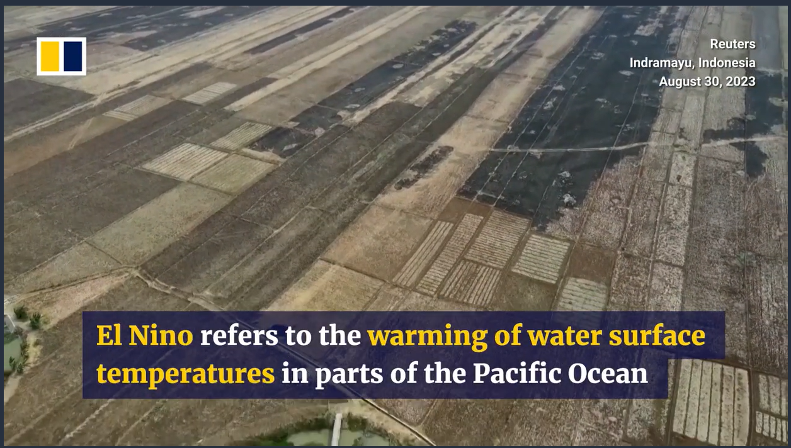
Notes:
https://www.scmp.com/video/asia/3234592/indonesia-battles-forest-fires-el-nino-expected-cause-severe-dry-season-country

Slide 19
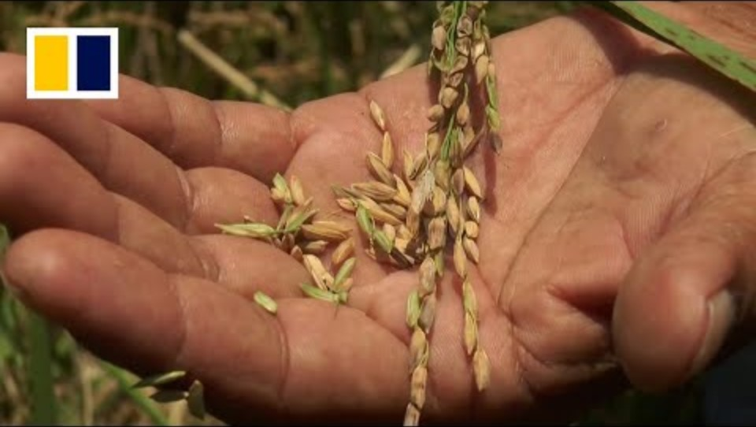

Slide 20
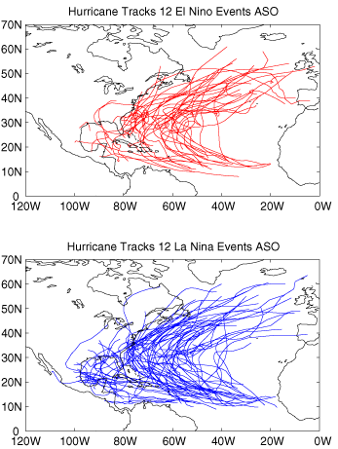
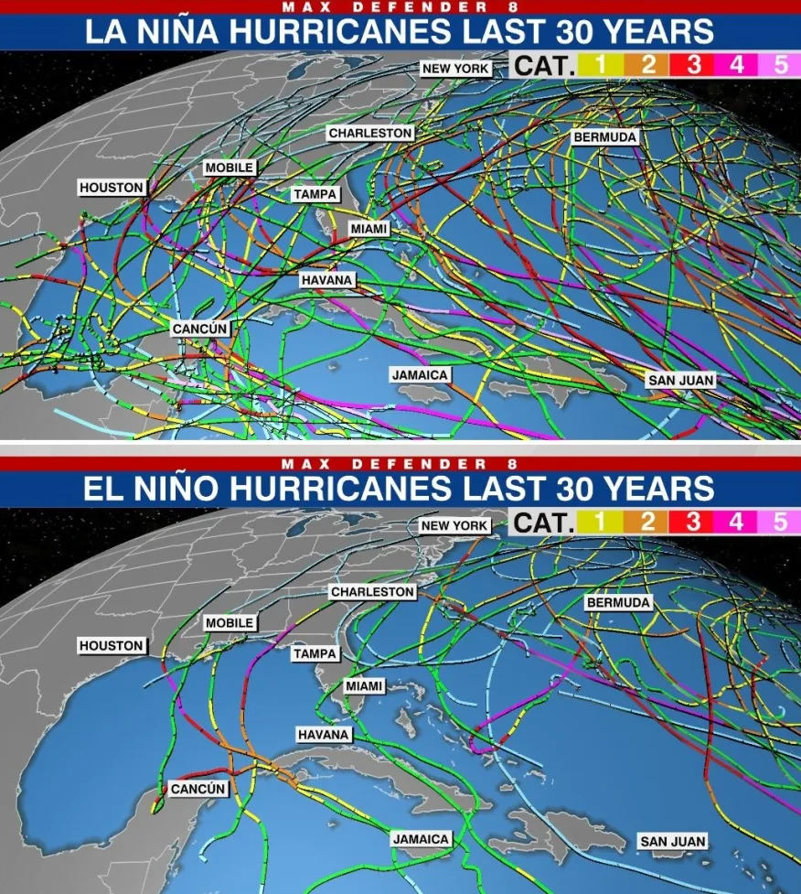
Notes:
Hurricane tracks for 12 La Nina events (top) and 12 El Nino events from 1950-2001 (left)
1992-2022 hurricane tracks for La Nina and El Nino events (right)

Slide 21
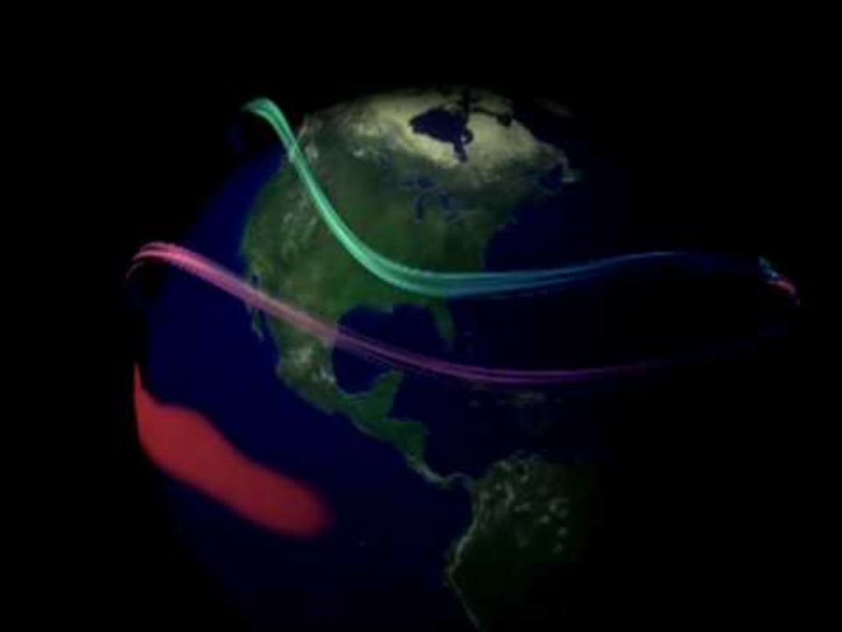

Slide 22
ENSO impacts on hurricane activity in U.S.
Fewer hurricanes and fewer landfalling hurricanes in Atlantic/Caribbean with El Nino
  Reversal of tradewinds and strong more southerly subtropical jet weaken hurricanes through increased wind shear
More hurricanes and more landfalling hurricanes in Atlantic/Caribbean with La Nina
  Tradewinds blowing from east to west favor hurricane development.
  Subtropical jet stream further north

Slide 23
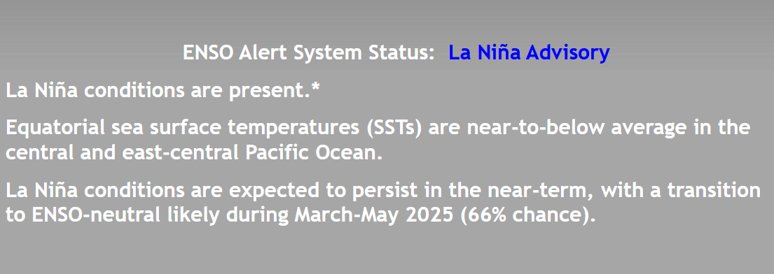
Current ENSO conditions
Notes:
https://www.cpc.ncep.noaa.gov/products/analysis_monitoring/lanina/enso_evolution-status-fcsts-web.pdf

Slide 24
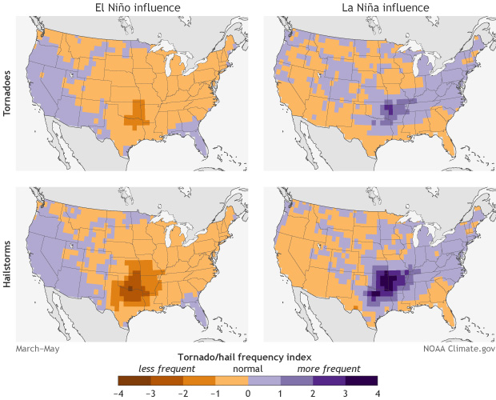
Impacts of ENSO in Kentucky
Effects from El Niño and La Niña tend to be small across the Ohio Valley.
Slight increase in spring severe thunderstorm activity under La Nina
Notes:
https://www.climate.gov/news-features/featured-images/el-ni%C3%B1o-and-la-ni%C3%B1a-affect-spring-tornadoes-and-hailstorms
https://www.weather.gov/lmk/enso_info

Slide 25
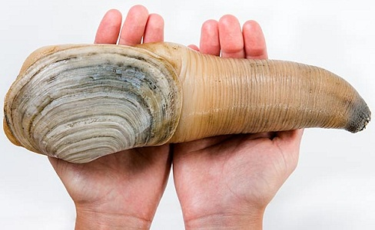
Does human-caused global warming cause El Nino?
Notes:
Geoducks of the Pacific Northwest coast can live for 140 years.

Slide 26
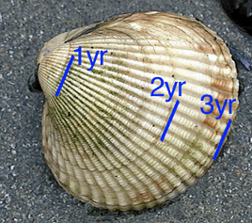
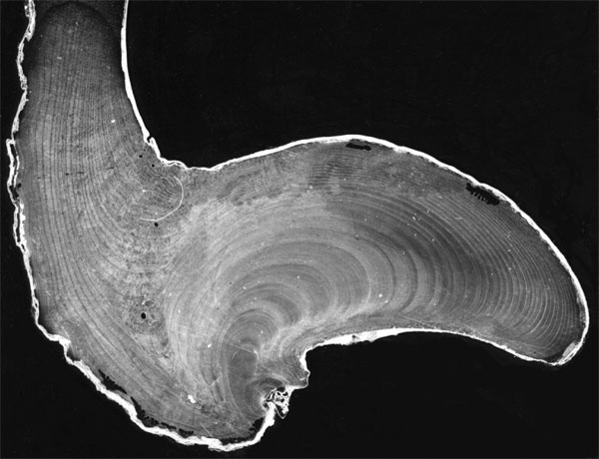
Notes:
X-ray showing yearly growth rings in a species of clams that have a lifespan of 20 years

Slide 27
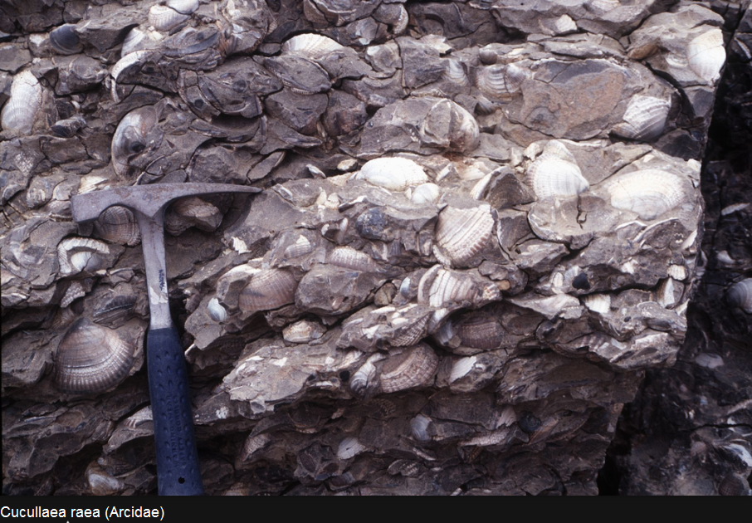
Notes:
ENSO fluctuations occurred 50 million years ago based on fossil record
The scholars who made this statement investigated shells of the bivalve species Cucullaea raea and Eurhomalea antarctica that are 50 million years old. Like trees, clams form growth rings. They measured their width and examined them for growth rhythms. Whether clams grow depends on the availability of food and heat. That means the change from "good" and "poor" environmental conditions at that time is reflected in the width of the growth rings. The clam shells showed the same three to six year rhythm associated with ENSO today

Slide 28
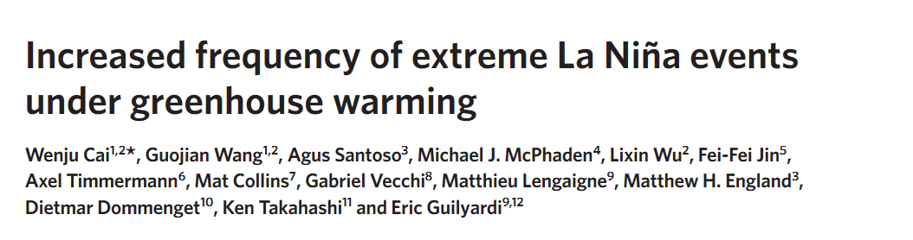
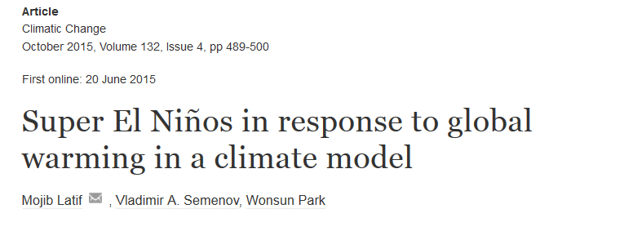
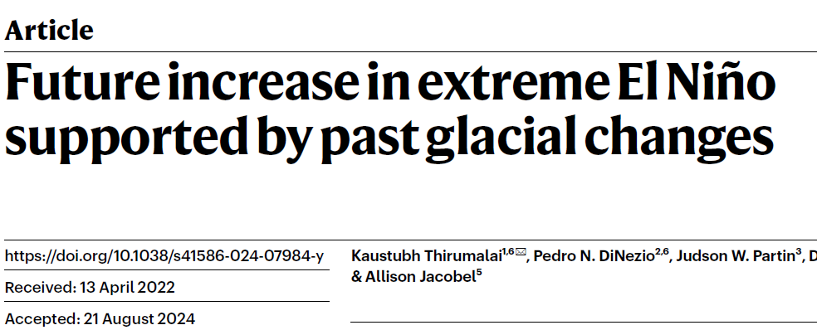
ENSO and global warming
ENSO is a natural cycle and is not caused by global warming
However, there are interactions between ENSO and greenhouse gas emissions
Impacts are still under study – but leaning toward more extreme El Ninos in the future

Slide 29
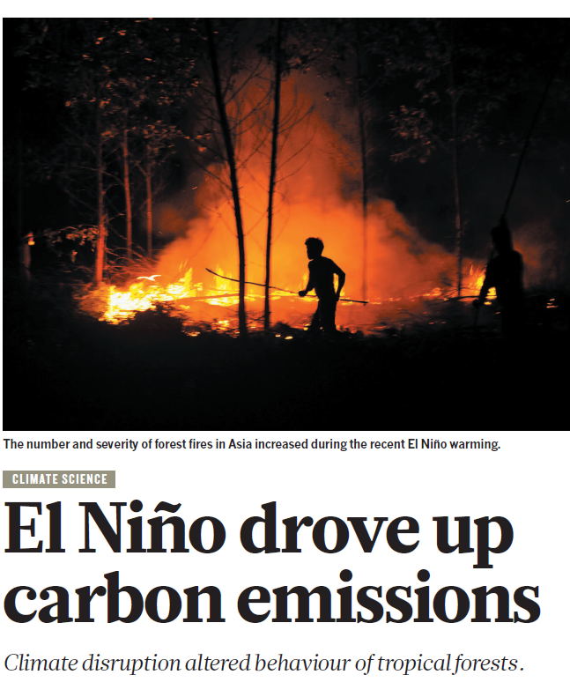
El Nino increases warming
2023-2024 El Nino saw the biggest annual increase in global CO2 concentrations on record
El Nino causes release of carbon dioxide from:
  Fires in Indonesia and southeast Asia
  Decreased plant growth and uptake of carbon dioxide where droughts occur

Slide 30
ENSO is one of several atmospheric oscillations
You don’t have to know what names and these oscillations or how they change weather and climate, just be aware that ENSO is just one of several.
  Madden-Julian Oscillation
  Pacific Decadal Oscillation
  North Atlantic Oscillation
  Arctic Oscillation
  Modokai El Nino

