Slide 1
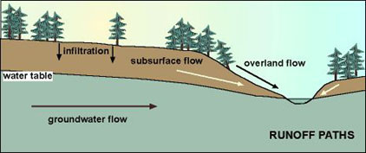
Subsurface, groundwater, overland flow feed channel flow

Slide 2
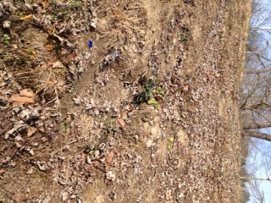
Notes:
Rills represented by lines superimposed on this photo.
This is overland flow
Whenever they build a subdivision or new road, the engineers have to study how it will change overland flow. They will often have to build a drainage channel or sculpt the contours of the land so as to make rainfall runoff in a preferred direction and avoid erosional issues.

Slide 3
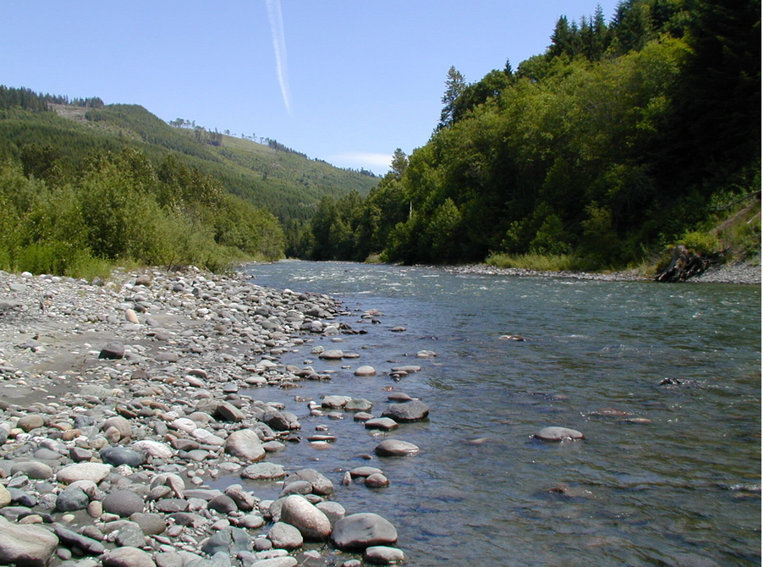
River channel types based on dominant lithology
Alluvial channel river
Bedrock channel rivers
Notes:
Alluvial channel river shown in photo

Slide 4
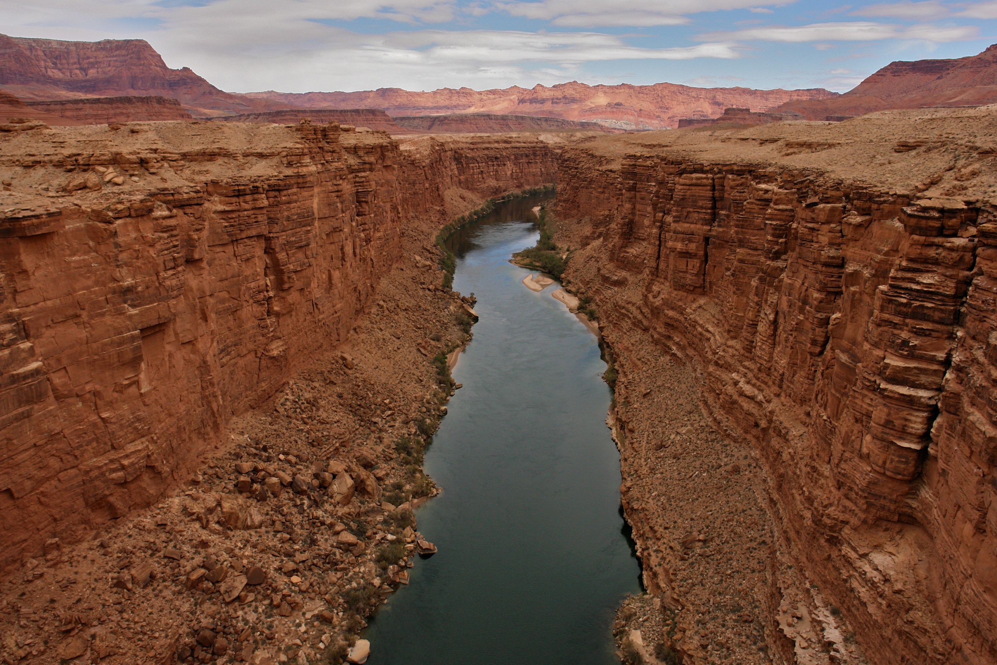
Notes:
Bedrock channel river

Slide 5
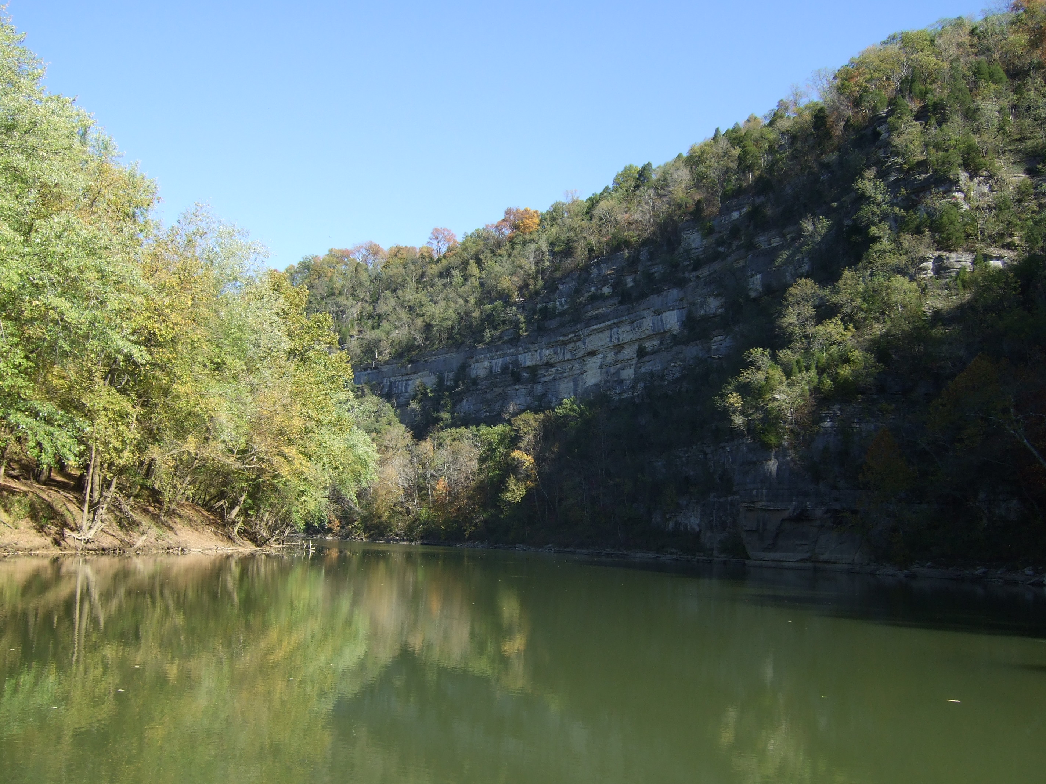
Notes:
Kentucky River is a mixture of alluvial and bedrock channel river

Slide 6
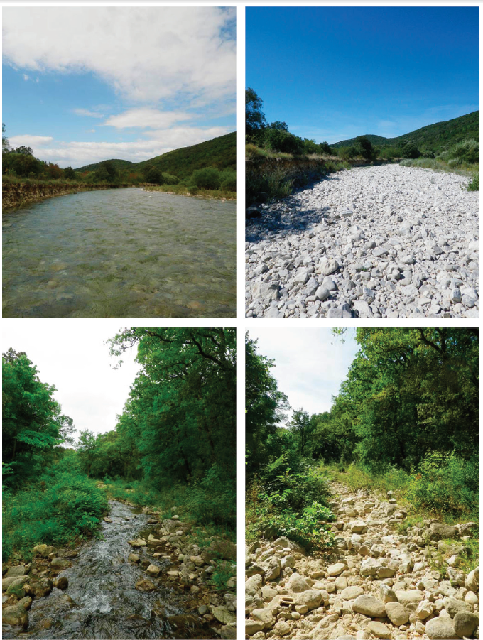
River channel types based on arrangement, shape, or timing of flow
Meandering
Braided
Anastomosing
Intermittent (at right)

Slide 7
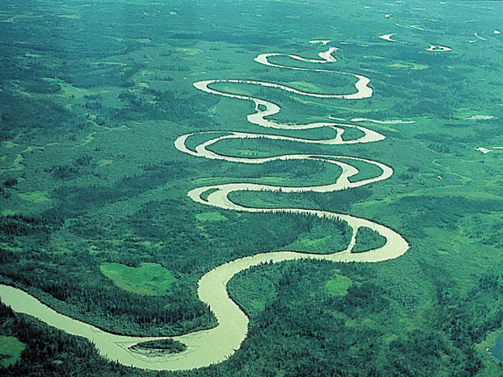
Meandering channel forms
Notes:
Meandering river

Slide 8
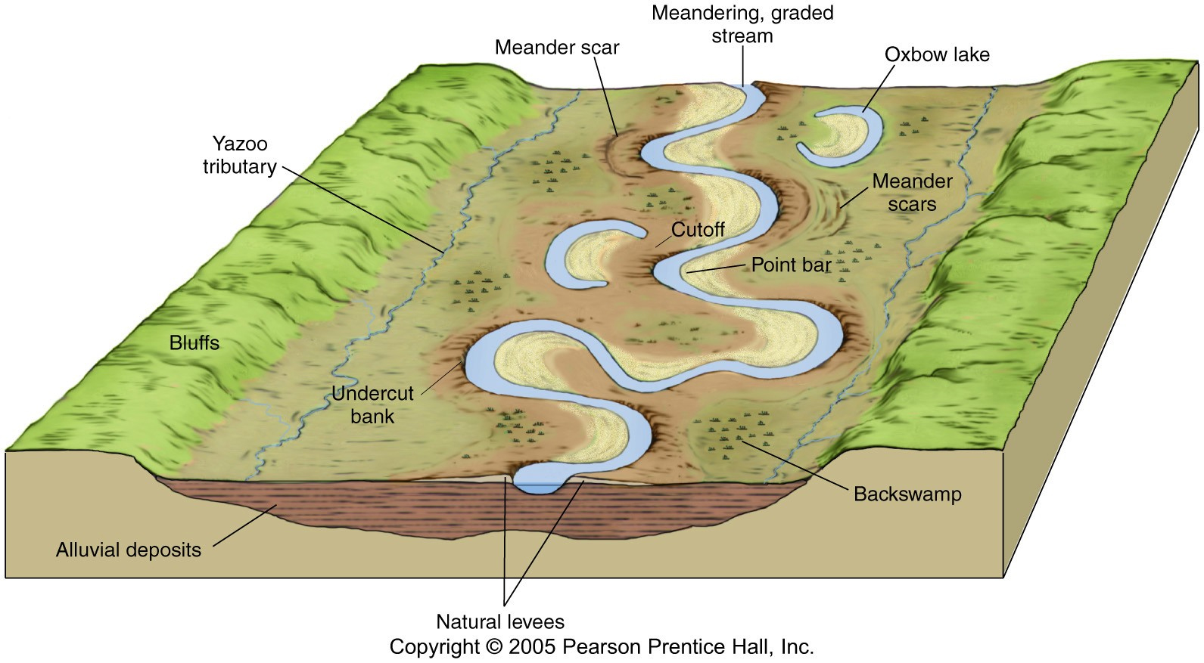

Slide 9
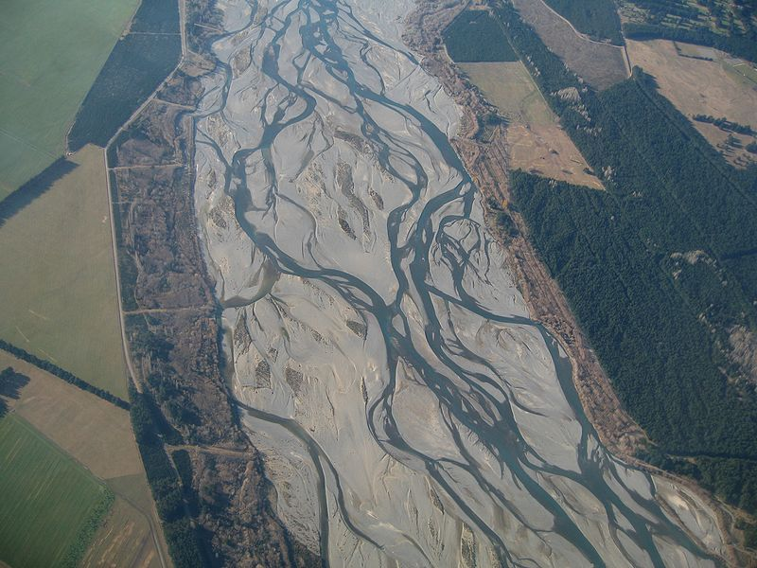
Braided river
Notes:
Where bed load is much greater than suspended load, the channel form is often braided, with lots of small channels running down the coarse stream bed.
The Waimakariri River in the South Island of New Zealand

Slide 10
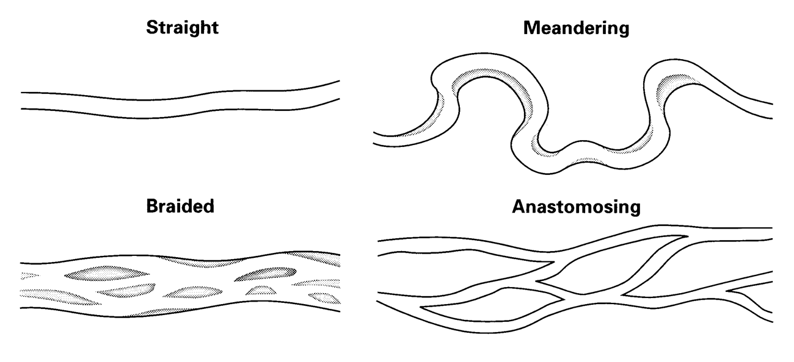
Anastomosing channel forms

Slide 11
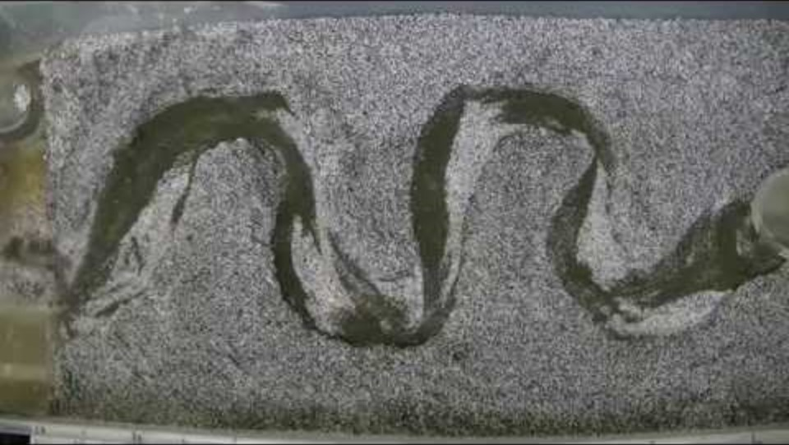

Slide 12
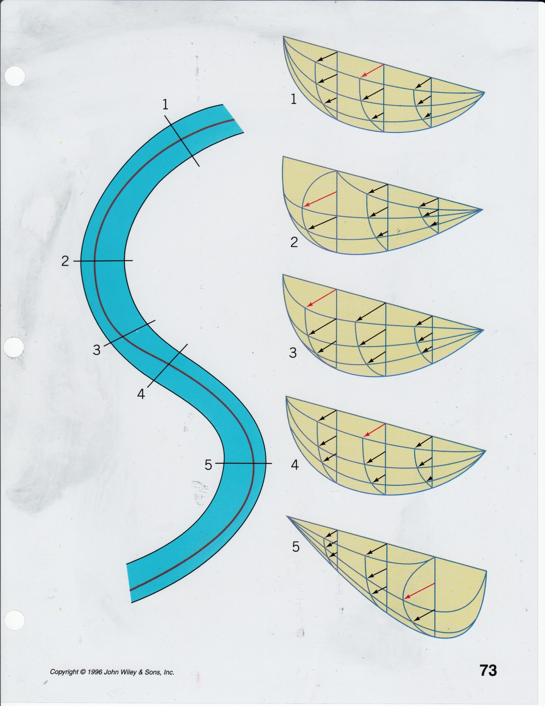
Notes:
Line in stream denotes thalweg – the fastest current in the channel

Slide 13
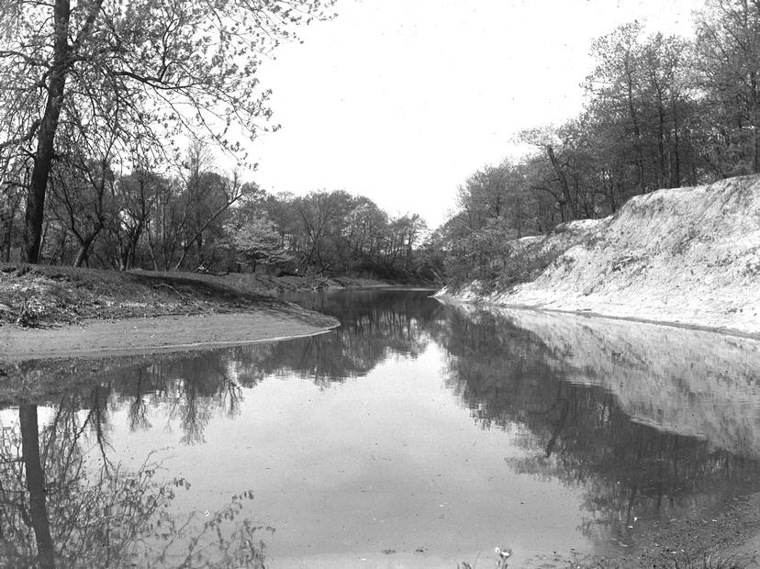
Meandering stream or river
Erosion on cut banks (capacity greater than load)
Transport of this sediment downstream
Deposition on point bars (load greater than capacity)

Slide 14
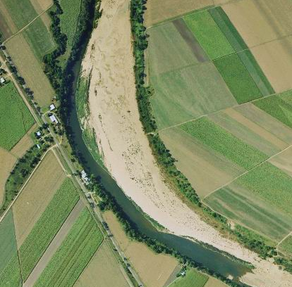
Notes:
14
Point bar on the Herbert River, Queensland.

Slide 15
Fluvial depositional landforms
Floodplains
  Flat low-lying ground on either side of the channel
  Inundated during periods of flooding
  Alluvium deposited on floodplain
  Flow of water can also reduce topographic contrasts
Levee
  Elevated area adjacent to channel
  Represents topographic high formed from downcutting of river and the deposition of coarse grained materials when the river floods.
Notes:
15

Slide 16
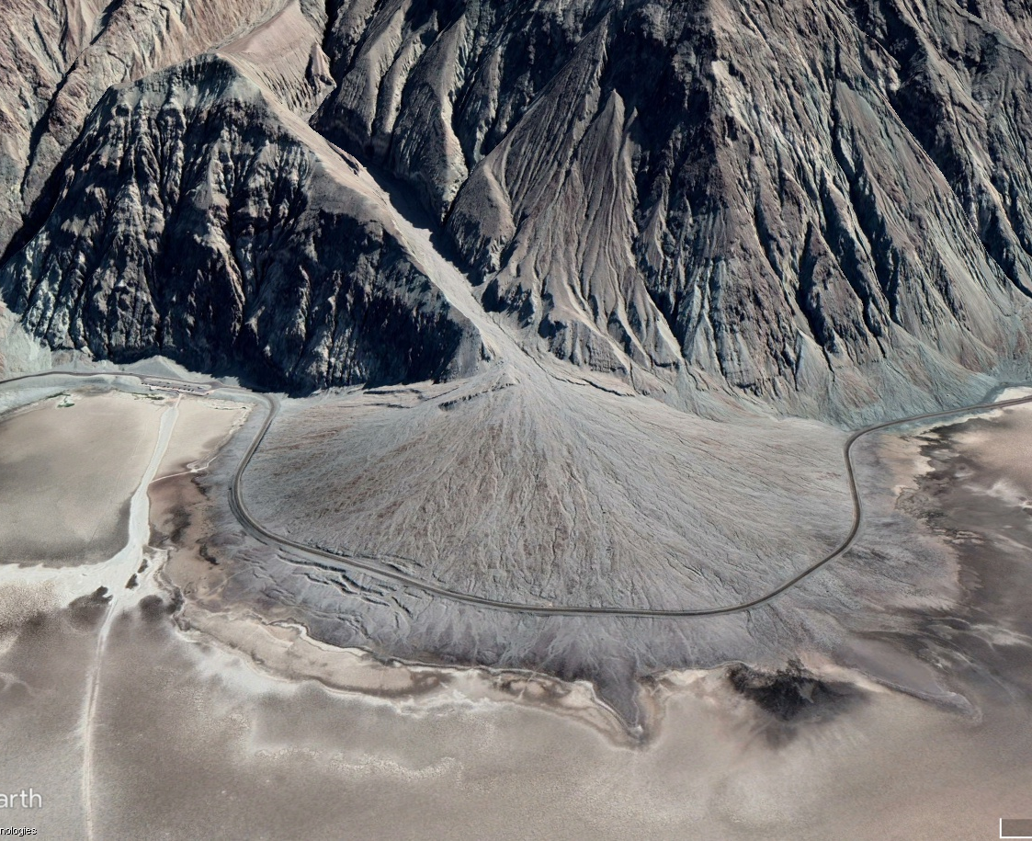
Fluvial depositional landforms
Alluvial fans
  These occur in arid climates where intermittent streams carry sediments off surrounding uplands
Notes:
Gorilla Creek fan and Tasman River, South Island, New Zealand.

Slide 17
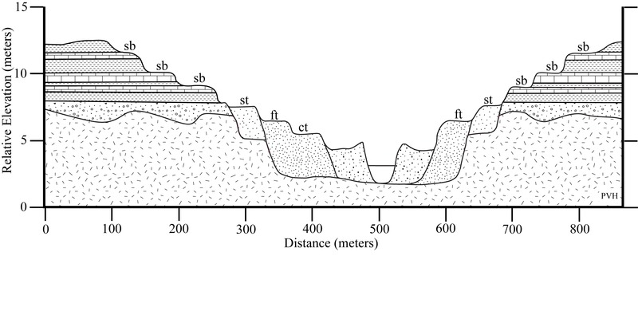
Fluvial terraces
Notes:
Fluvial terraces are the remnants of earlier floodplains that existed at a time when either a stream or river was flowing at a higher elevation before its channel downcut to create a new floodplain at a lower elevation

Slide 18
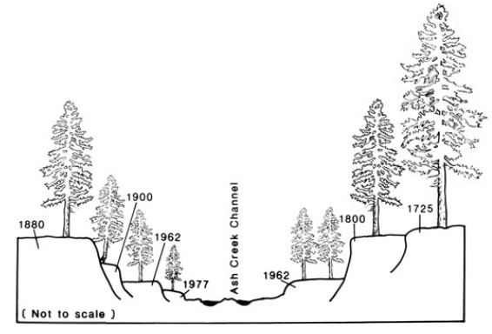

Slide 19
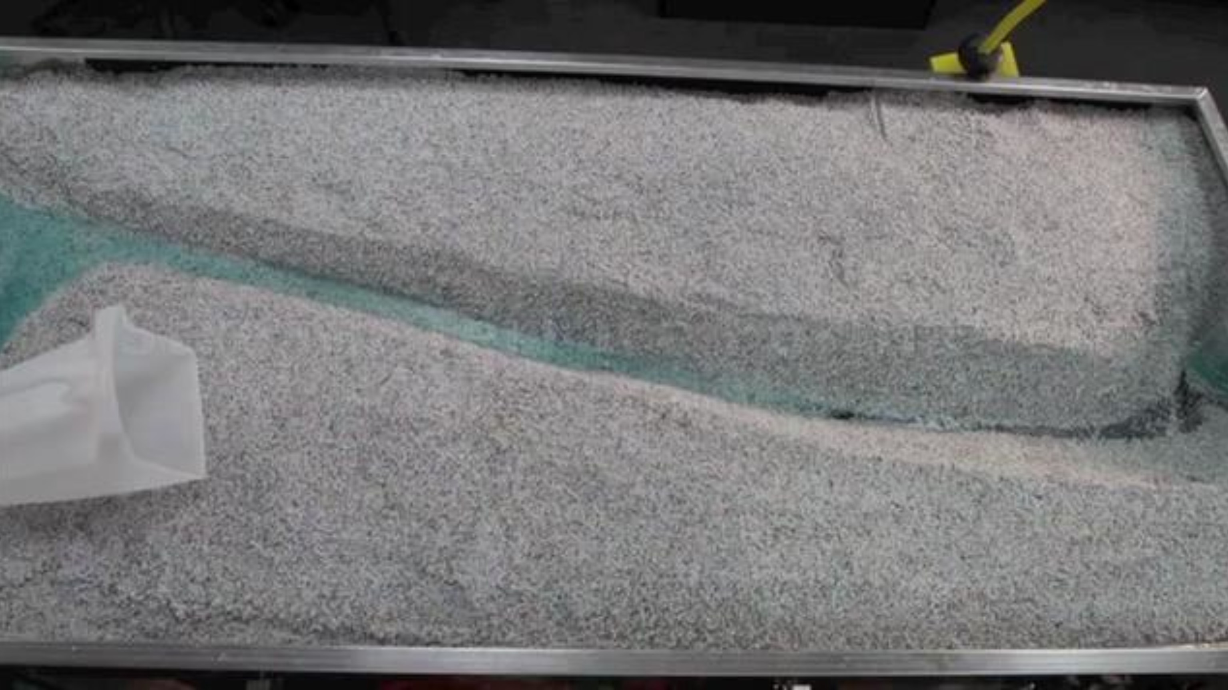
Notes:
https://vimeo.com/31464905

Slide 20
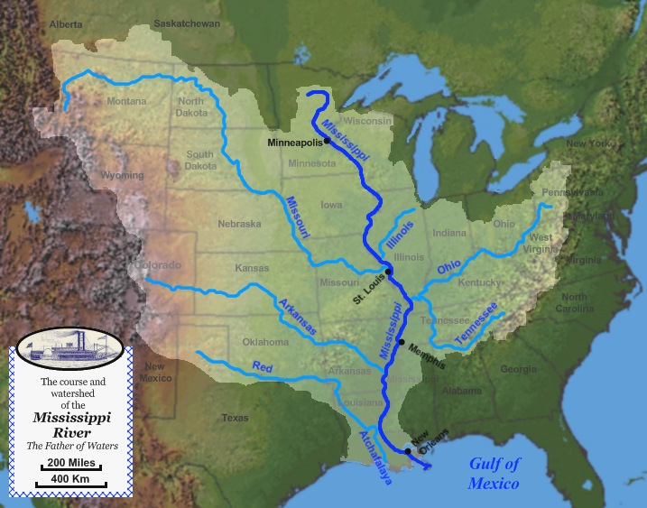
Drainage basins
Also known as a watershed
Region drained by a river or group of rivers
Appropriate level to study, monitor, and regulate water pollution
Drainage basins are separated by topographic barriers called divides
Watersheds are nested within each other
Notes:
https://river-runner.samlearner.com/?fbclid=IwAR2r5jY9nnqFtFtWXSrZBIjKndV4nr506-yrdd1faEn91Ue1ByrnJmPArWc

Slide 21
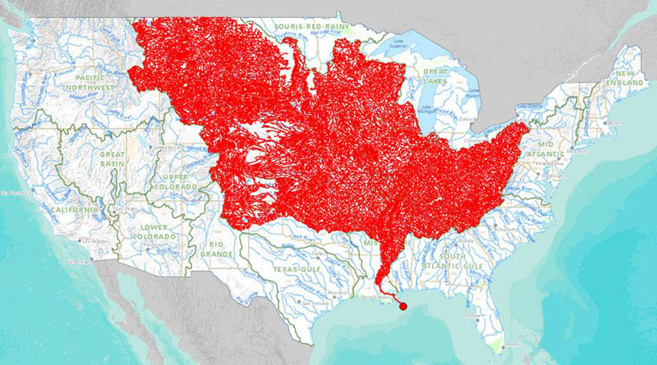

Slide 22
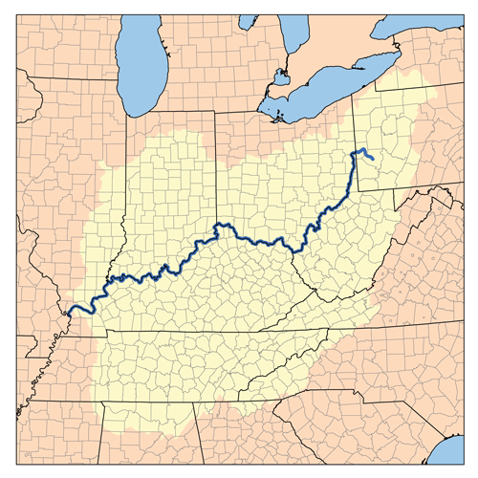


Slide 23
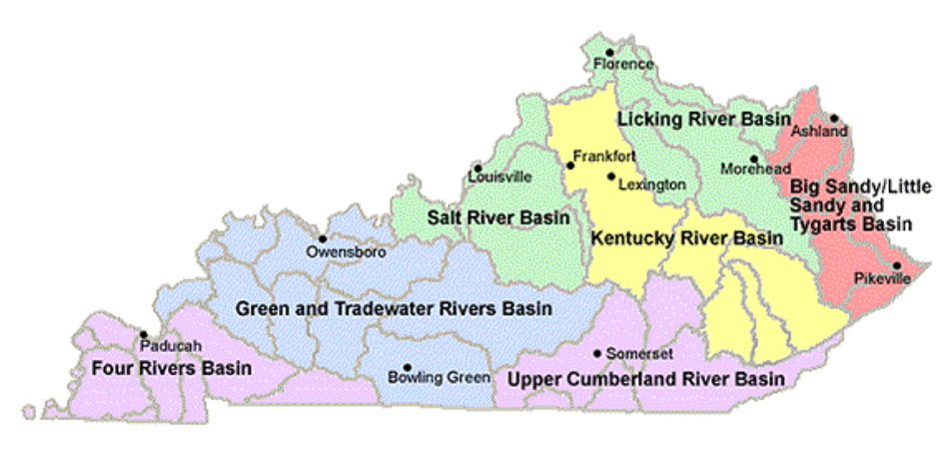

Slide 24
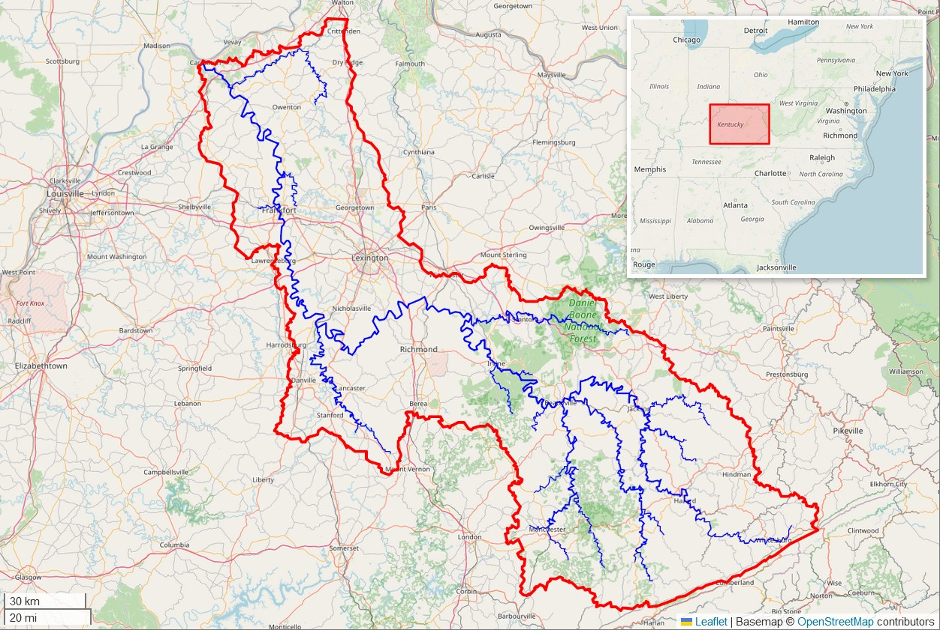

Slide 25
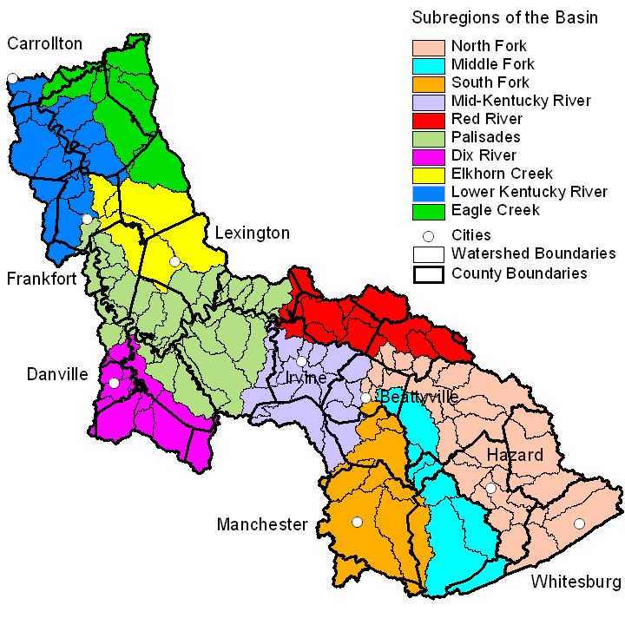

Slide 26
